Slide 1
PPU Ring and Beam Transport Systems Upgrades
AAC, February 16-18, 2016
by Mike Plum
Ring Area Manager &
Accelerator Physics Team Leader

Slide 2
PPU + STS Accelerator parameters
 | 1.4 MW | STS
 |  | First Target | Second Target
Energy / pulse (kJ) | 23.3 | 40 | 46.6
Beam Energy (GeV) | 0.94 | 1.3 | 1.3
Rep rate (Hz) | 60 | 50 | 10
Average current (mA) | 27 | 33 | 38
Power (MW) | 1.4 | 2.0** | 0.47
The SNS was designed with this upgrade in mind
Minimal changes are needed in the HEBT / Ring / RTBT areas for 1.3 GeV and a second target

Slide 3
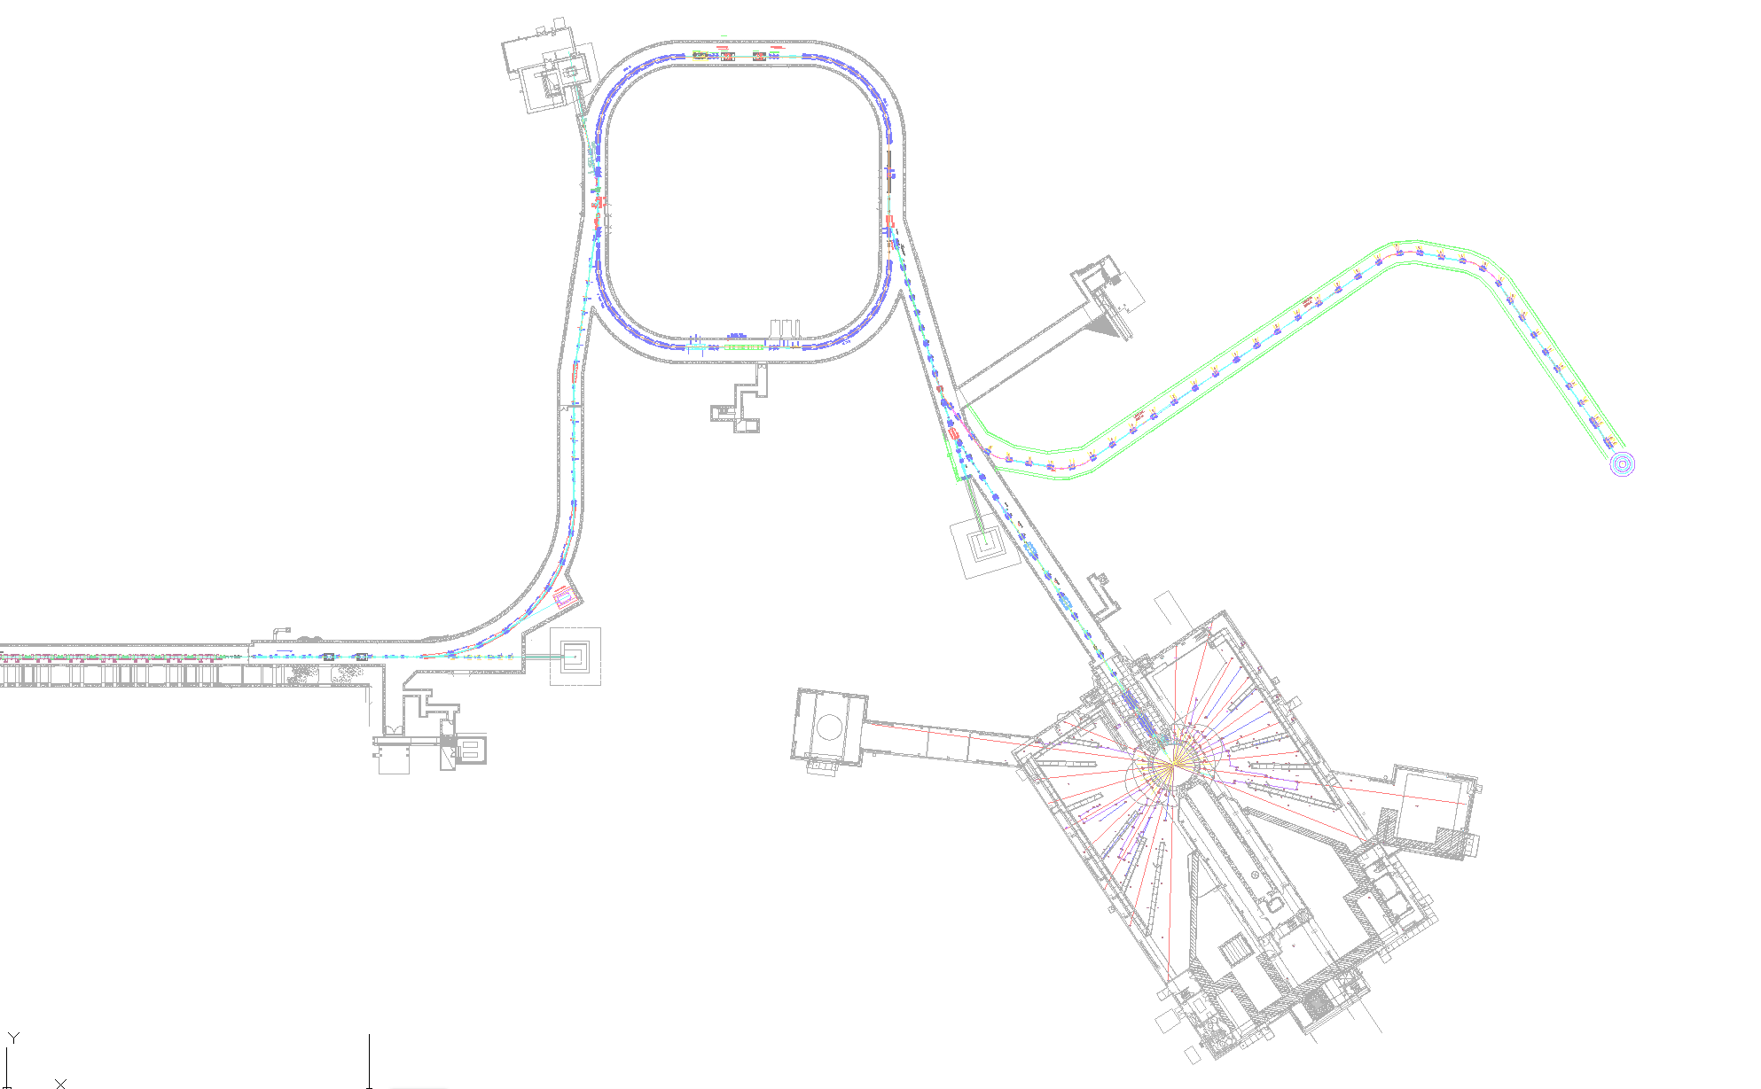
The PPU + STS Ring and transport scope
  Add two more extraction kicker magnets, PFNs, oil cooling systems, charging supplies, etc.
  Replace shims in extraction septum magnet
Replace two chicane magnets
Upgrade injection kicker power supplies
Replace injection dump septum magnet
Move chicane magnet #1 upstream ~32 cm
  New transport line to second target
  Additional water cooling system for the power supplies in the Ring service building
  Cooling fan kit for the main ring dipoles substation power transformers

Slide 4
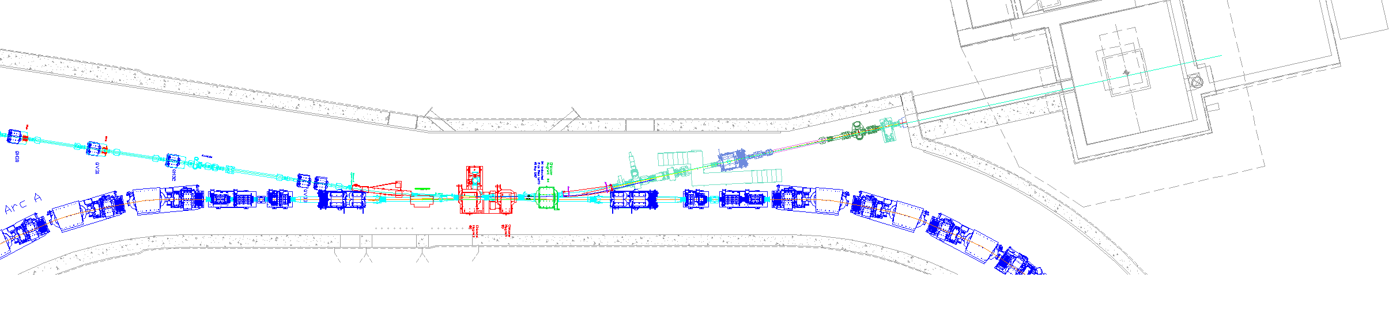
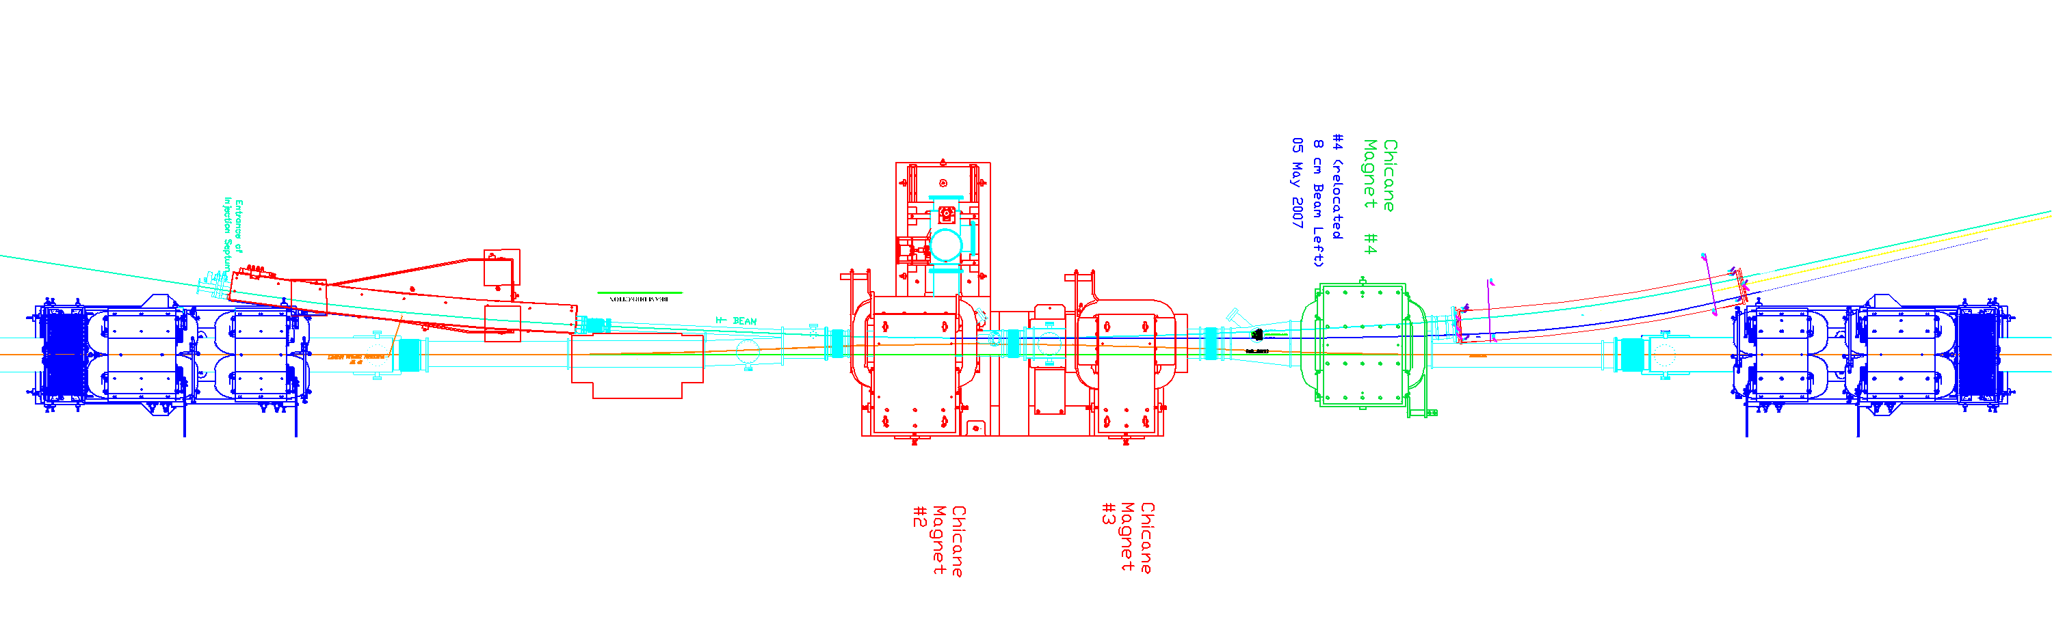
Ring injection scope detail
Upgrade injection kicker power supplies
Move chicane #1 ~32 cm upstream
New injection dump septum magnet
Two new chicane magnets

Slide 5
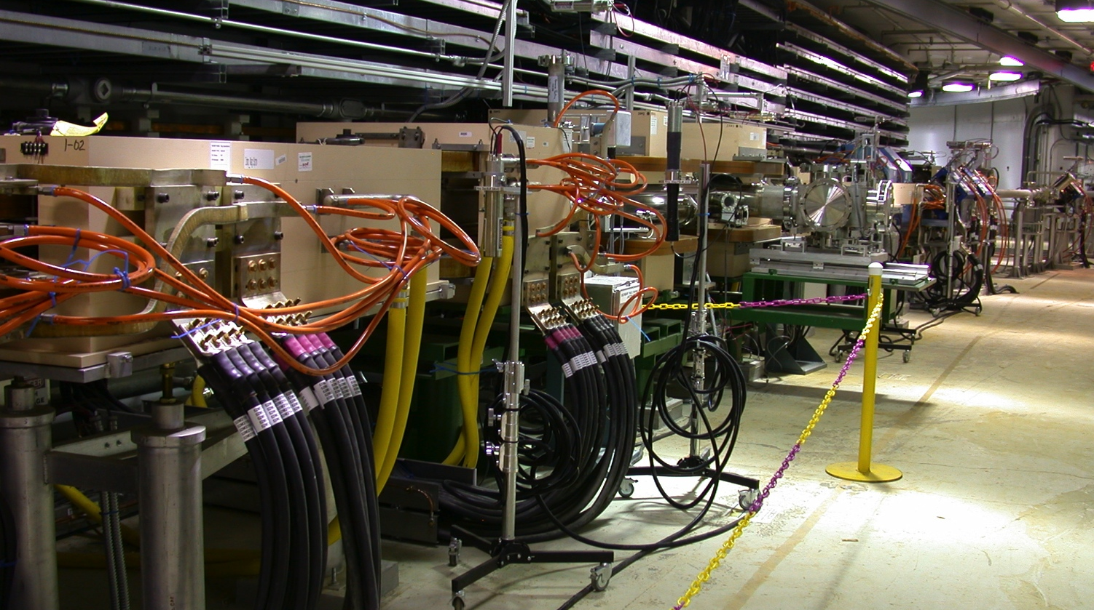
Ring injection
Inj. Dump Septum
(to be replaced)
Chicane #3
(to be replaced)
Chicane #2
(to be replaced)
Chicane #1
(to be moved)
(photo by M. Hechler)

Slide 6
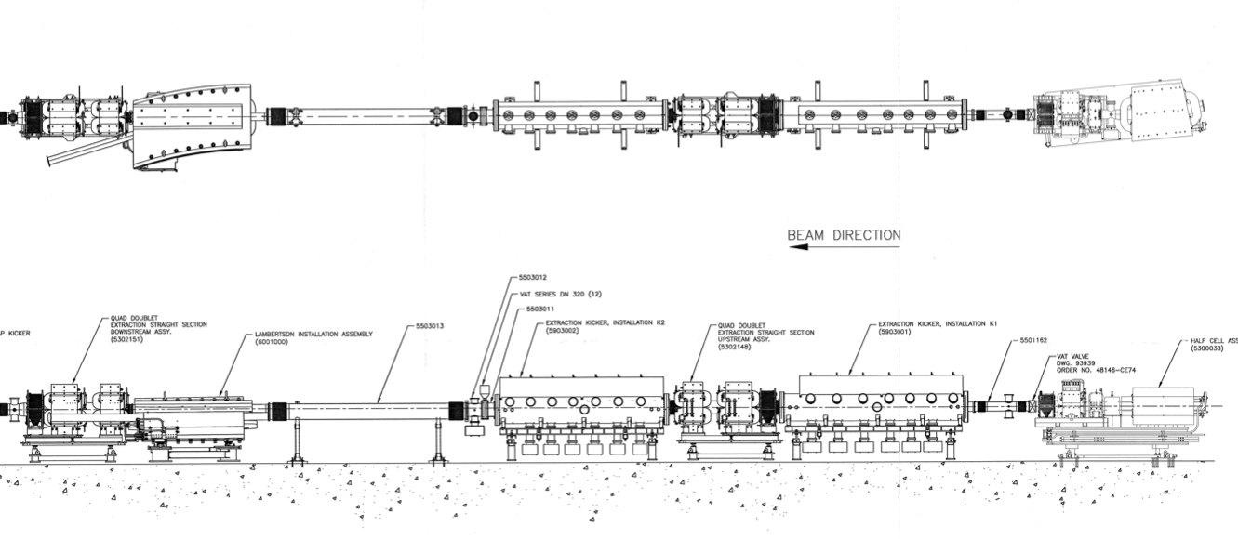
Ring extraction scope detail
beam
Top
view
Side
view
Replace shims in extr. septum magnet
Extend extraction kicker tanks, add one kicker magnet to each tank

Slide 7
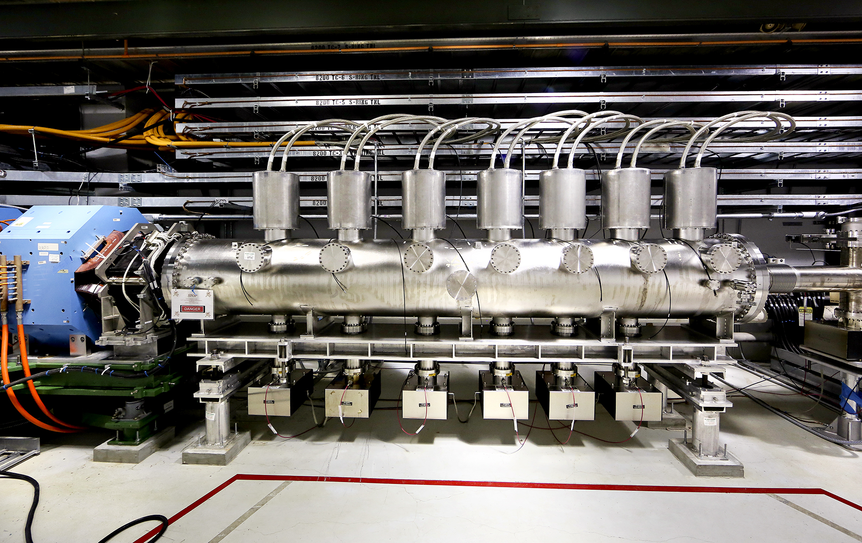
Ring extraction kickers
One extraction kicker will be added here (the other one will be added to the downstream end of tank 2)

Slide 8
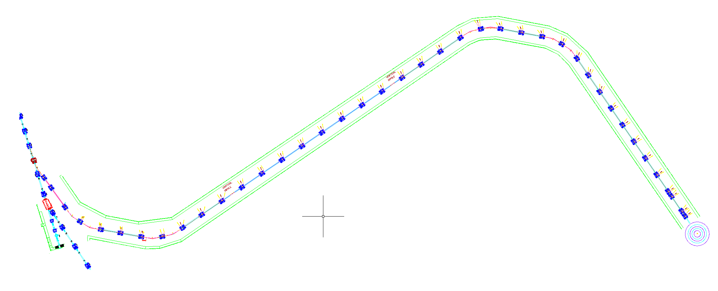
New transport line (R2T2) scope
from
Ring
Two kickers and septum to launch beam into R2T2
sloped beam line
Second target station
41 new quadrupole magnets
8 horizontal dipole magnets
2 vertical dipole magnets
to first target station

Slide 9
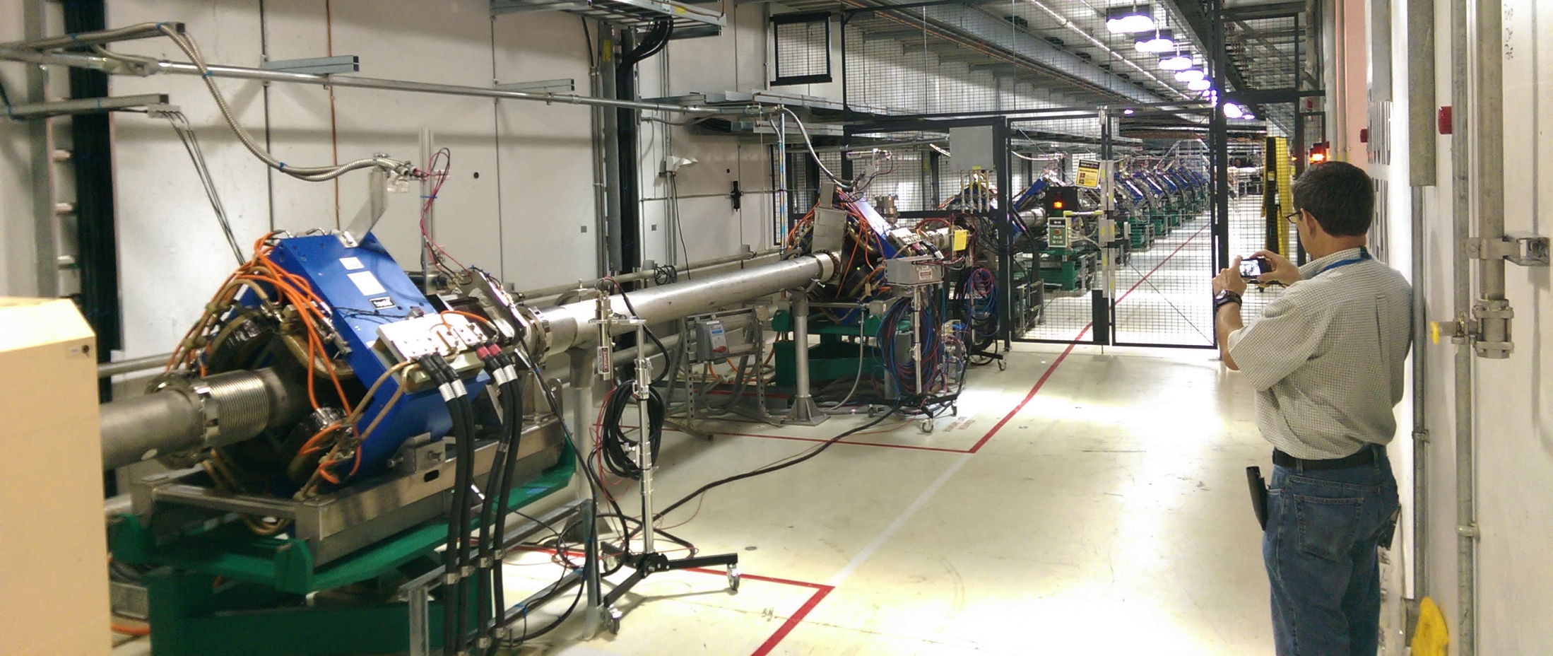
R2T2 additions to RTBT
Add septum
Add 2 kickers
DH13
QV13
QH12
QV11
QH10
Herb

Slide 10
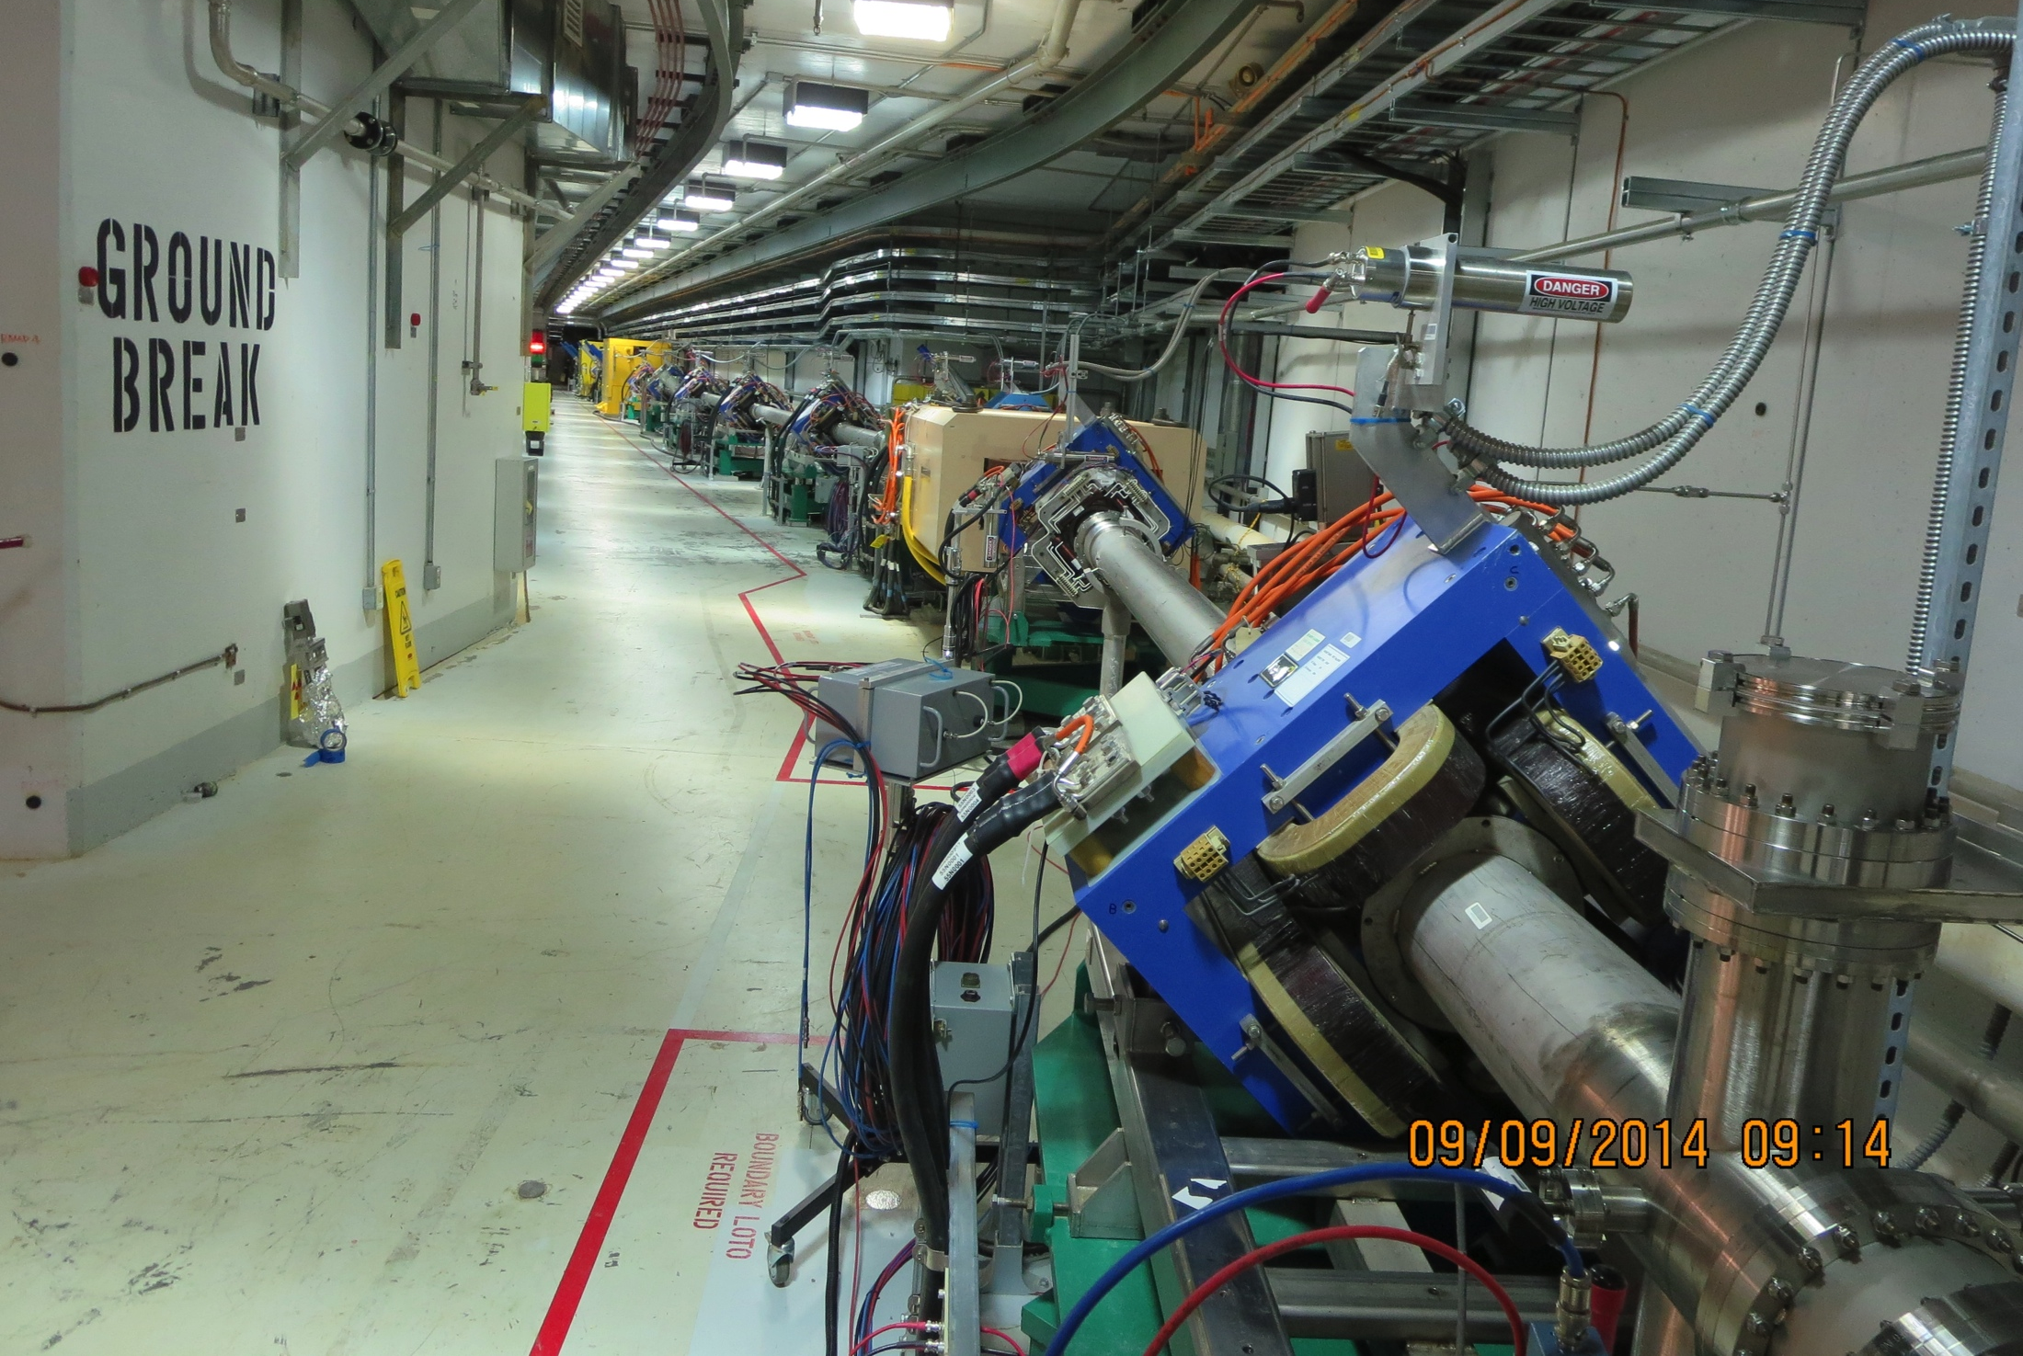
Path of R2T2
(photo courtesy H. Strong)

Slide 11
Strategy for new R2T2 transport line
Kick 10 Hz beam from RTBT to R2T2
Place kicker and septum upstream of DH13 so that can still lock out DH13 to prevent any beam from reaching TGT1
Keep existing RTBT quad magnet set points and locations (i.e. no perturbation to TGT1 beam when TGT2 magnets are turned off)
Simple FODO lattice from the new septum to TGT2, with final focus quads at the end (i.e. same strategy as TGT1 beam line)
Use clones of existing magnets when possible

Slide 12
Key challenges
Ring injection chicane
Stripper foil lifetime
Kickers and septum for launch into R2T2
Sloped beam transport line
R2T2 final focus

Slide 13
Ring injection challenges
  Complicated dynamics with five beams (H⁻, H⁰, H⁰*, H⁺, e)
  We plan to keep the existing strategy but correct deficiencies based on lessons learned (e.g. foil pos’n, 3D tracking)
Chicane #2:
Magnetic field must be lower to avoid magnetic stripping
Integrated field must be higher due to higher beam energy
Chicane #3:
Magnetic field must be lower to avoid stripping H⁰*
Integrated field must be higher due to higher beam energy

Slide 14
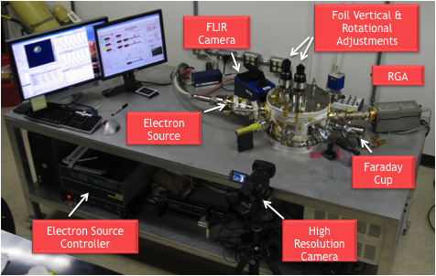
Stripper foil challenge
The stripper foil is already very hot at 1.4 MW beam power
It will become even hotter after the PPU and STS upgrades
Absolute temperature simulations are not accurate enough
We have started a project to measure the foil temperature. Not much progress to date…
We have a electron beam
foil test stand that we will use
to simulate the PPU and
STS heat loads
We are carefully monitoring
the performance of our foils
at 1.4 MW
Foil test stand

Slide 15
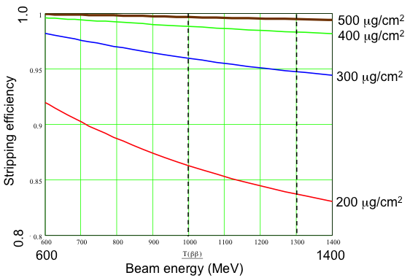
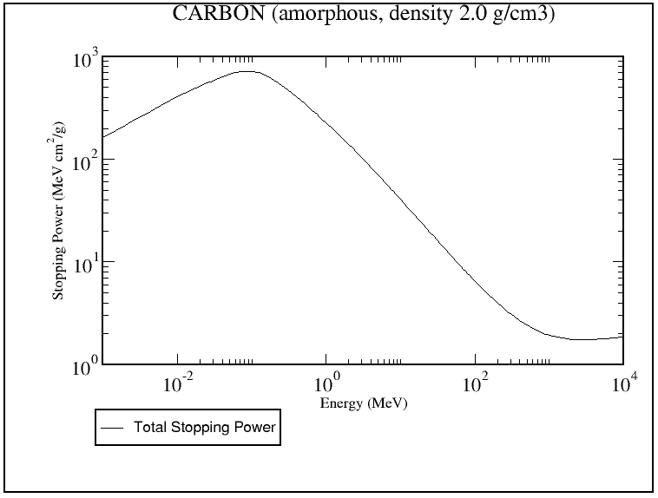
Stripper foils at 1.0 vs 1.3 GeV
Stripper foil must be ~8% thicker to get same stripping efficiency
(1.0 vs. 1.3 GeV)
Protons per pulse increases 53%, from 1.55x10¹⁴ to 2.37x10¹⁴
(1.4 MW at 940 MeV vs. 0.47 MW at 1.3 GeV, 10 Hz)
Proton stopping power decreases 5%
(1.0 vs. 1.3 GeV)

Slide 16
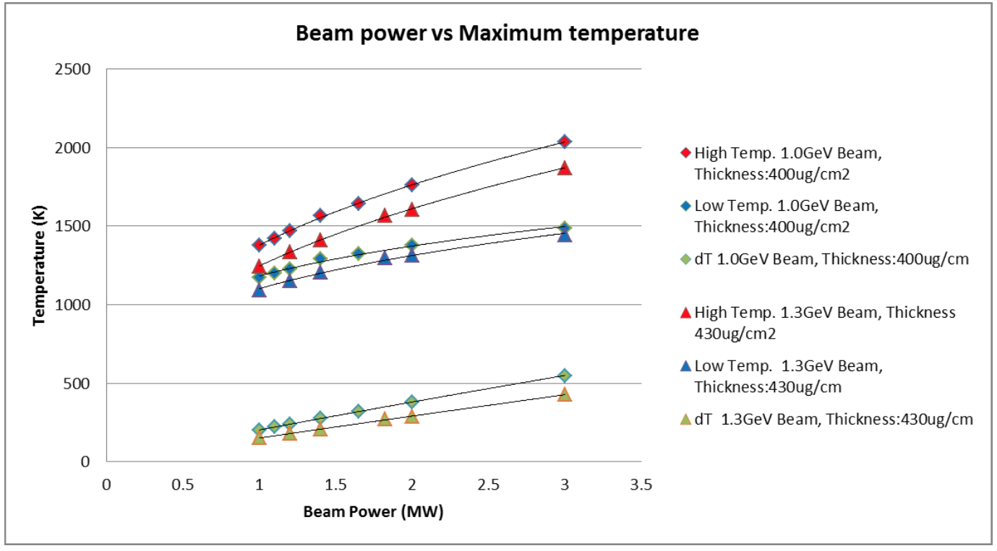
Stripper foil maximum temperature
ΔT = 304 ºK
1 GeV, 1.4 MW to
1.3 GeV, 3 MW
ANSYS simulation
Y. Takeda, April 11, 2013

Slide 17
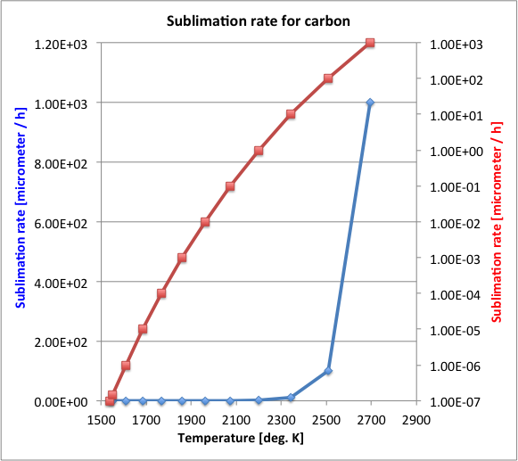
Stripper foil lifetime
Biggest risk to stripper foils is sublimation
A small temperature increase makes a big change in foil lifetime
Simulations predict a 10% decrease in foil thickness after 100 hours
Note: Big error bars here! Lots of assumptions.
1 GeV, 1.4 MW
1.3 GeV, 3.0 MW

Slide 18
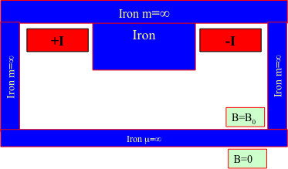
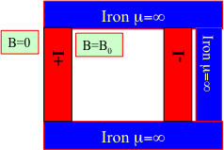
Launch into R2T2 transport line
Use two kicker magnets to keep each length to ~1 m (practical limit to ceramic vacuum chamber length according to FNAL experts). Also get limited position / angle control.
Two options here depending on type of septum magnet:
  QV11 – vertical kickers – QH12 – Lambertson septum – QV13
  QH10 – horizontal kicker – QV11 – horizontal septum – QH12
Lambertson septum
Normal septum
vs
Baseline design
Advice from the committee would be welcome!

Slide 19
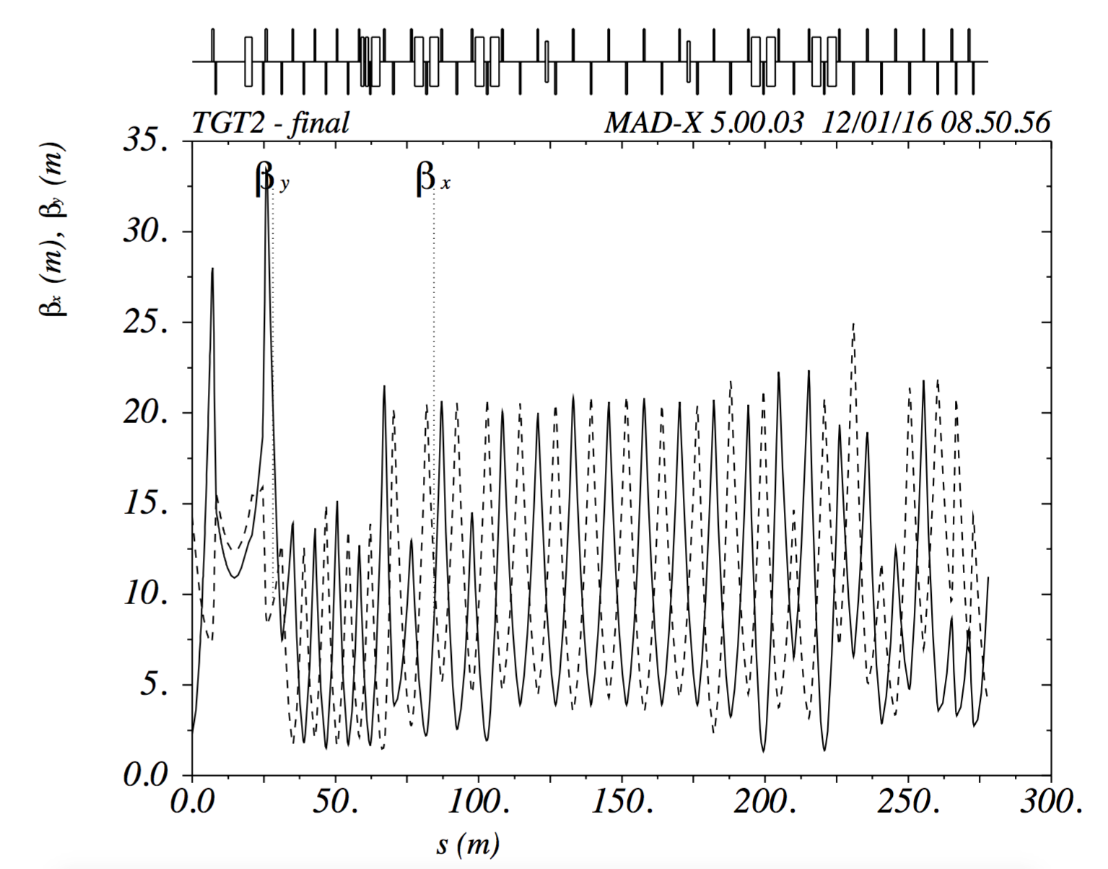
R2T2 beta functions (normal septum)

Slide 20
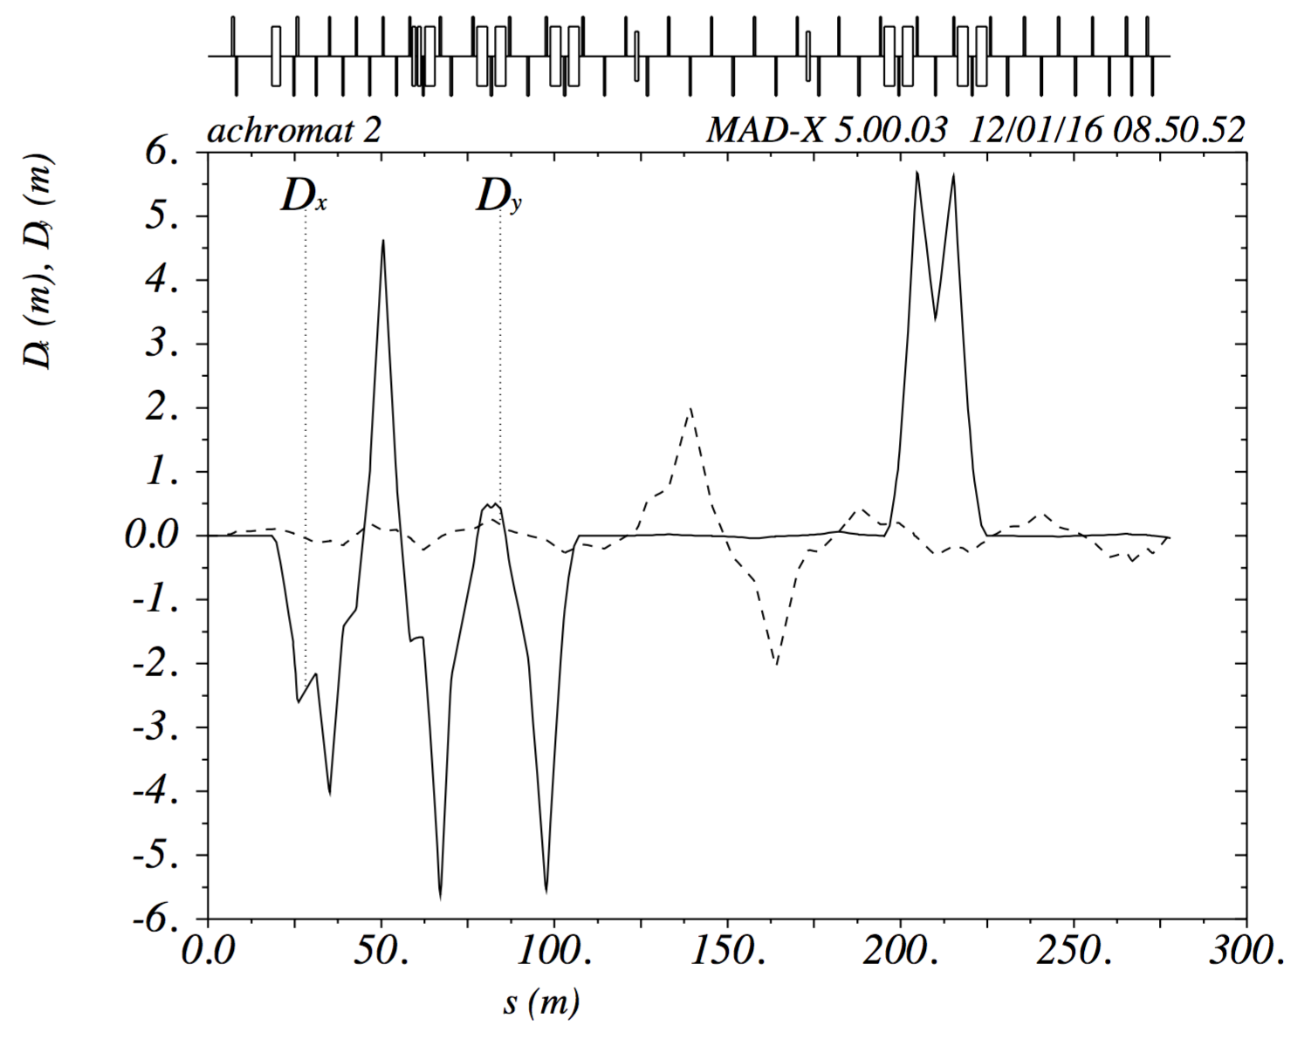
R2T2 dispersion functions (normal septum)
Vertical dispersion in sloped
part of beam line

Slide 21
What type of septum magnet to use?
Lamberton septum, e.g SNS ExSptm | Pros | Cons
 | Have some experience with ours | Have to undo the vertical kick somehow. The SNS ring extraction method (rolling the septum magnet and offsetting the downstream quad) is complicated.
 | The two beams can be closer together (less demand from upstream kicker) | Vertical kicks introduce vertical dispersion that needs to be compensated
 | Less demand on kickers (0.8 vs 1.4 deg., partly due to quad spacing) | The non-median plane symmetry introduces skew multipoles (e.g. we had a problem with skew quad components in our ExSptm)
 | Less beam offset in quad between kickers and septum, less likely to require a new quad
 | Magnet coil is not exposed to the beam
 | May be able to take advantage of vertical bend for elevation change in R2T2
 | Less bend angle from septum needed (due to quad spacing)
Normal septum, e.g. J-PARC RCS ExSptm | Pros | Cons
 | Simple horizontal kicker & septum, avoids cross plane coupling | Need bigger septum bend angle (due to quad spacing)
 | No vertical dispersion | Magnet coils exposed to beam
 |  | May need a series of septum magnets (like at J-PARC)
 |  | More demand on kickers (1.4 vs 0.8 deg., partly due to quad spacing)
 |  | Bigger beam offset in quad between kickers and septum, may need new quad

Slide 22
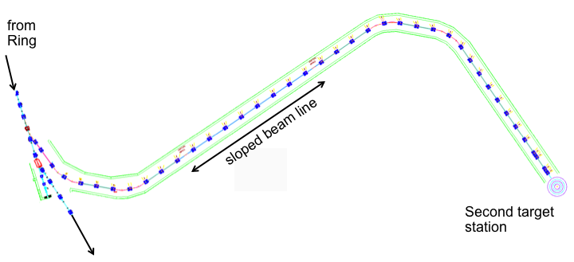
Sloped beam tunnel challenge
New target station is planned to be 5.2 m below the existing target. For the sloped section,
  2nπ phase advance between dipoles to get achromat
  π/2 phase advance per FODO cell to optimize aperture
  Clone existing quads and aperture clearance
  This sets the length of the elevation drop section to <49 m
What should tunnel look like?
  6 deg. slope for the 49 m option
  Smooth floor with no steps?
  Stepped floor?
  Some combination of the two?
Advice from the committee would be welcome!

Slide 23
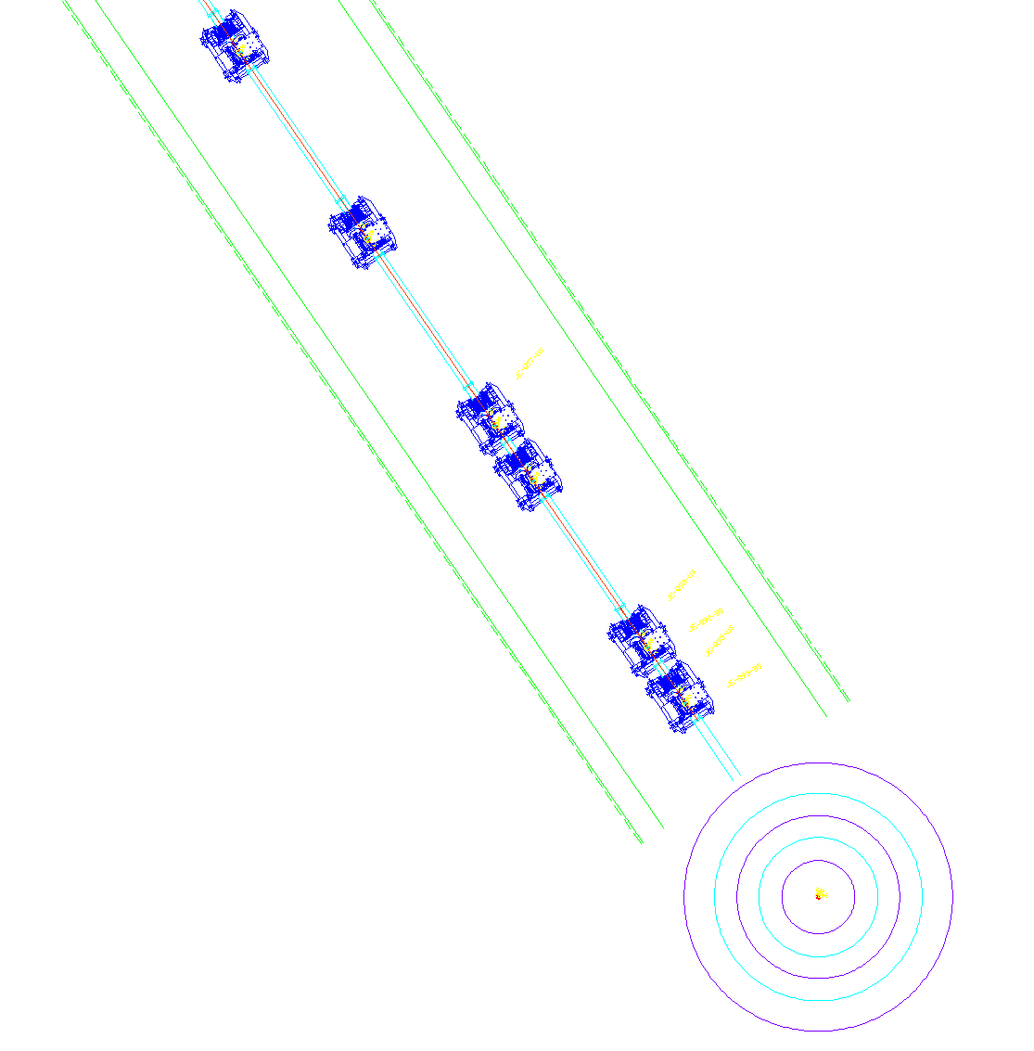
Final focus challenge
The final focus area is a challenge due to high radiation and limited space
May rely on a crane to install and maintain magnets
Last 6 quads
  Beam tunnel narrows in final focus region
  Access for installation and maintenance is difficult
  May need some quads to be larger (>21 cm) aperture
Second target center

Slide 24
Advice and charge
Charge:
  Provide advice on the accelerator systems components of the draft technical design report for the Second Target Station and provide guidance on the reasonability of the updated plan for the power upgrade in the SCL, with fewer new Cryo-modules than originally planned.
Please advise:
  Which septum magnet option is best?
    Lambertson or normal?
  What should the sloped part of the R2T2 tunnel look like?
    Flat floor, step, some combination?
    Is an overhead crane practical?

Slide 25
Summary
Most of the HEBT/Ring/RTBT is already capable of 1.3 GeV operations
Most modifications are in the ring injection and extraction areas
The new R2T2 beam transport line is very similar to the existing RTBT line, but has a 5.2 m elevation drop
Work planned this year includes electron beam tests of stripper foils and optimizing the launch into the new R2T2 beam transport line

Slide 26
Thank you for your attention!

Slide 27
Back up slides

Slide 28
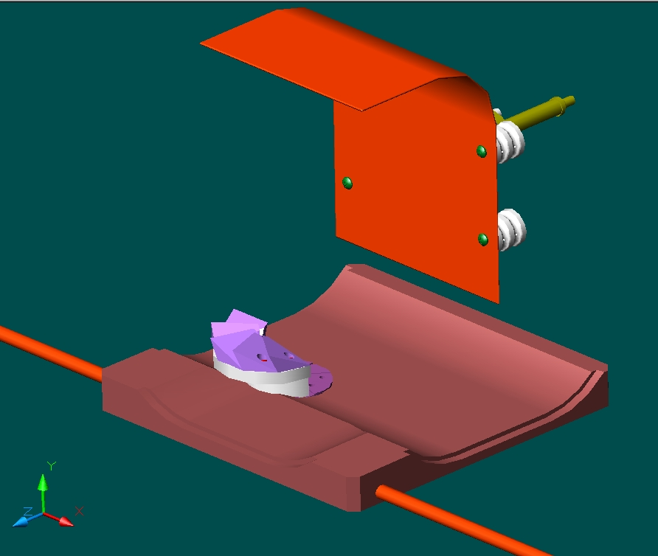
Electron Catcher Design
Field tilt of 200 mrad w.r.t injected beam sends electrons downward
Nominally, electrons should impact underside of electron catcher wedges
Convoy electrons from a 1 GeV H⁻ beam have 545 keV energy, gyroradius 12 mm, period 0.29 ns, pitch ~16 – 23 mm
Electron Catcher
Figure from L. Wang
Efficient electron catching requires that the catcher be in the right place w.r.t. the foil

Slide 29
SNS injection schematic
The SNS relies on Multi-Turn Charge-Exchange Injection to create a short pulse of protons in the Ring (250 m) from a long beam pulse delivered by the Linac (250 km in length).
Two electrons are removed by the stripping foil, injected protons are merged with previously accumulated beam.
The Secondary foil strips the H⁻ and H⁰ which survive
the first foil.

Slide 30
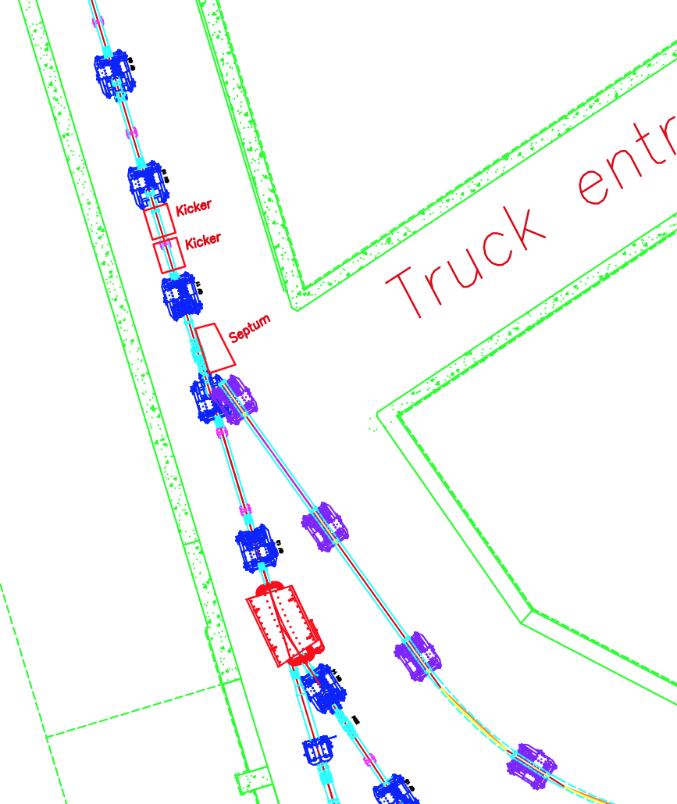
Initial deflection into R2T2
Ring
QV09
<< add two horizontal kicker magnets here
<< replace quad with larger aperture version (26Q40)
QH10
<< add normal septum magnet here
QV11
The new kicker and septum magnets will inserted between the existing RTBT magnets, so that when they are not powered the RTBT will have the original magnetic lattice
QH12
QV13
DH13
Extr.
Dump
R2T2
TGT1

