Slide 1
Controls and Protection Systems
Karen S. White
Controls Group Leader
2/16/16

Slide 2
Outline
Scope
Availability
Infrastructure
Process Controls
Controls Hardware
Controls Software
Protection Systems

Slide 3
Integrated Control System Overview
ICS Scope: Controls, Timing and Protection Systems
Accelerator Instruments (PPS, Vacuum, Tools)
Target Conventional Facilities
Cryogenics Test Facilities
Large, distributed system based on the Experimental Physics and Industrial Control Systems (EPICS) toolkit and Control System Studio (CSS)
EPICS provides a flexible, layered architecture and integrates a variety of front end platforms
Scalable, distributed architecture is extensible (PPU/STS)
new devices, capability, functionality can be added as needed
Emphasis on commercial, configurable, collaborative solutions

Slide 4
System Performance - Availability
PPS grounding error
PLC/firmware issues

Slide 5
Controls Infrastructure – Cyber Security
ORNL Office of Independent Oversight conducted an assessment of cyber security of industrial control systems (ICS) at HFIR and SNS to safely determine the vulnerabilities, risk and mitigations in place
Assessment team was directed to focus on:
The security posture of ICS implementations with respect to threats from the ORNL enterprise network and the ORNL supplied visitor network
The security posture of ICS implementations with respect to threats originating from remote access

Slide 6
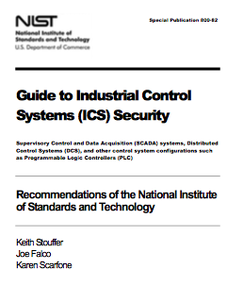
Controls Infrastructure – Cyber Security
Preparing for Assessment
Conducted self assessment using DHS ICS-CERT Cyber Security Evaluation Tool (CSET) based on NIST 800-82
Used the results of this analysis to make cyber improvements to our infrastructure
Completed conversion to more rigorous account management
Added Intrusion Detection System (IDS)
Audited all accounts and role authorizations including access to server rooms
Replaced aging, less capable firewalls
used to isolate the controls network

Slide 7
Controls Infrastructure
Audit concluded
“SNS is doing a good job of securing their systems and equipment”
“Decision to align controls with NIST Special Publication 800-82 (Guide to Industrial Control System Security) puts SNS on the right track to providing consistent, verifiable security”
OFIs
Until moving to a tool for maintaining the PLC logic files, extra care should be taken to verify any changes in the PLC logic before it is put into use
Move the logbook status entries behind the password system or restrict cyber sensitive information from being placed on the publicly readable logbook
The EPICS system should have a security assessment
Notes:
Use digital signatures to verify that an e-mail is legitimate for functions like authorizing Prox card access

Slide 8
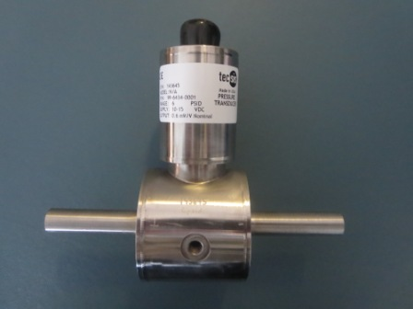
Process Controls Progress on Obsolescence
Instrumentation for High Radiation Areas
Worked with vendors to design and produce pressure and flow instruments for
High radiation area water loops
Ultra high radiation area mercury loops
First units installed in February 2016
Water Loop Flow
Mercury Loop Flow

Slide 9
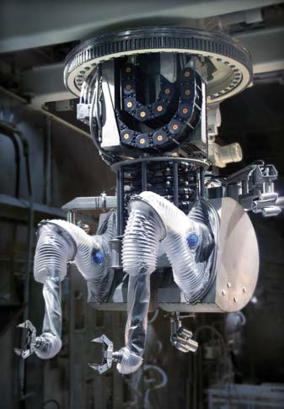
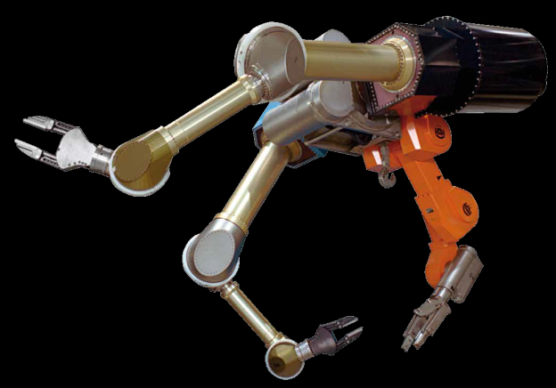
Process Controls Progress on Obsolescence
Remote Handling System
Identified a potential vendor for complete mechanical and controls replacement and obtained a budgetary cost estimate
Established working group to identify requirements
Camera controller upgraded to a modern matrix controller
Existing
Proposed

Slide 10
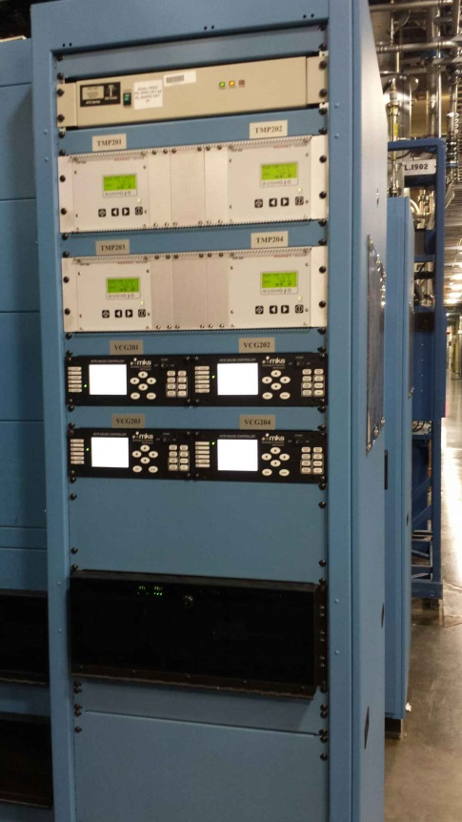
Process Controls Progress on Obsolescence
Chiller Controls
Working on replacement of Trane BACnet communication module
Vacuum (AIP-35)
Vacuum upgrade also replaces obsolete controls components: gauge controllers, ion pump controllers, PLCs
New controls installed for DTL1-6 July 2015
CCL 1-4 cables installed Jan 2016
CCL1-4 vacuum and controls installation scheduled for June 2016

Slide 11
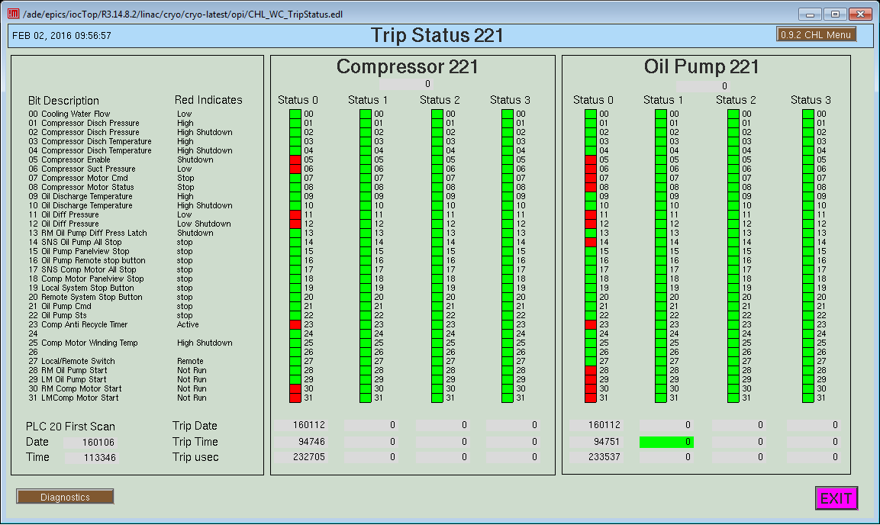
Process Controls Sustaining Control System Performance
Cryogenic controls
Installed automatic transfer switches for power to controls equipment
Systematically replacing cryomodule heater power supplies, 8 units each outage
Added PLC interlock to stop turbines 3 and 4 if a first stage compressor trips (4K Cold Box)
Replaced warm compressor gas management PLC and I/O modules
Upgraded PLC firmware
Added warm compressor skid trip data capture feature

Slide 12
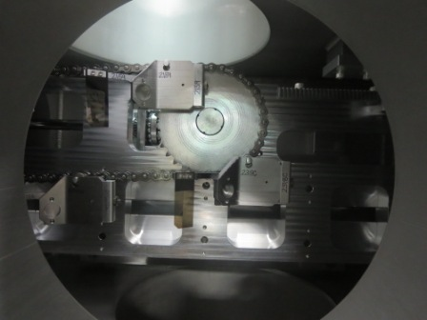
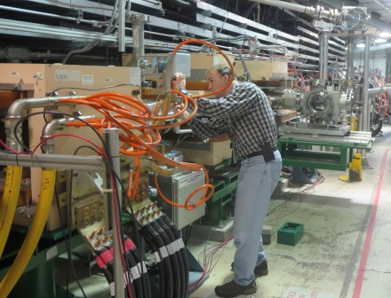
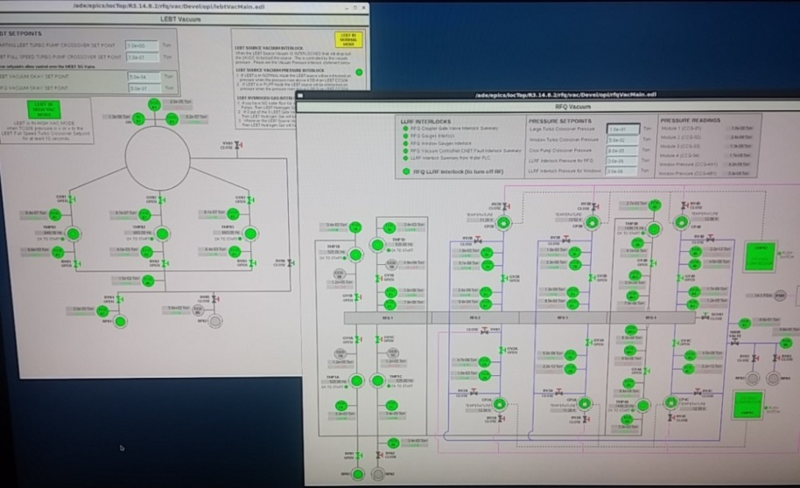
Process Controls Supporting Accelerator Development
Implemented motion controls for new primary stripper foil mechanism
ITS - Controls for LEBT, RFQ, MEBT water and vacuum

Slide 13
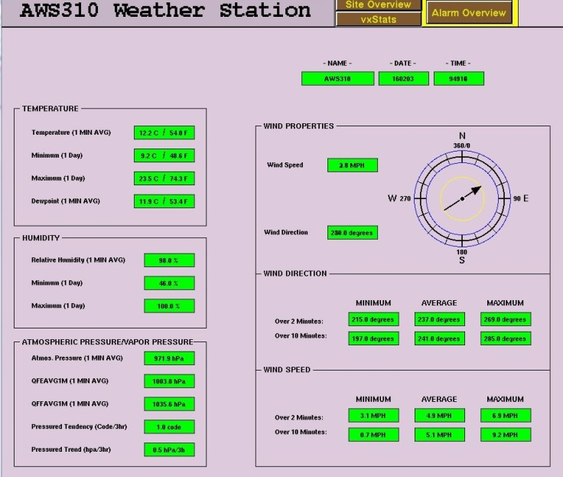
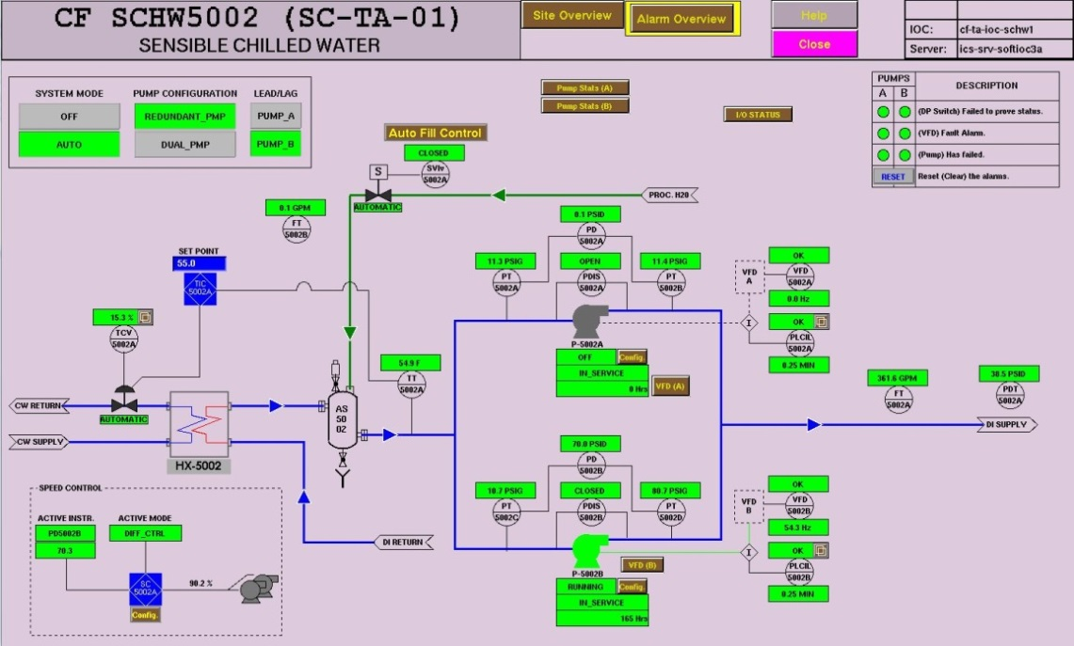
Process Controls Supporting CF Development
CUB CF Improvements
Integrated cooling tower water make-up system and weather station
Target CF Improvements
Sensible Chilled Water System controls upgraded to provide multiple pump modes

Slide 14
Process Controls Improving Development Process
Configuration Management of PLC Code
Previously, engineers informally managed PLC code versions on a shared SAMBA server
This method allow inconsistencies that could make it difficult to identify the correct version of code to load; lacked structure and documentation
Purchased commercial tool, “Factory Talk AssetCentre” to manage versioning of PLC code
Migration of PLC files to AssetCentre is nearly complete, only CHL files left to move
Protection Systems team will evaluate tool for their use
Tool availabile to other SNS groups

Slide 15
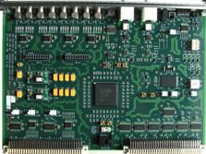
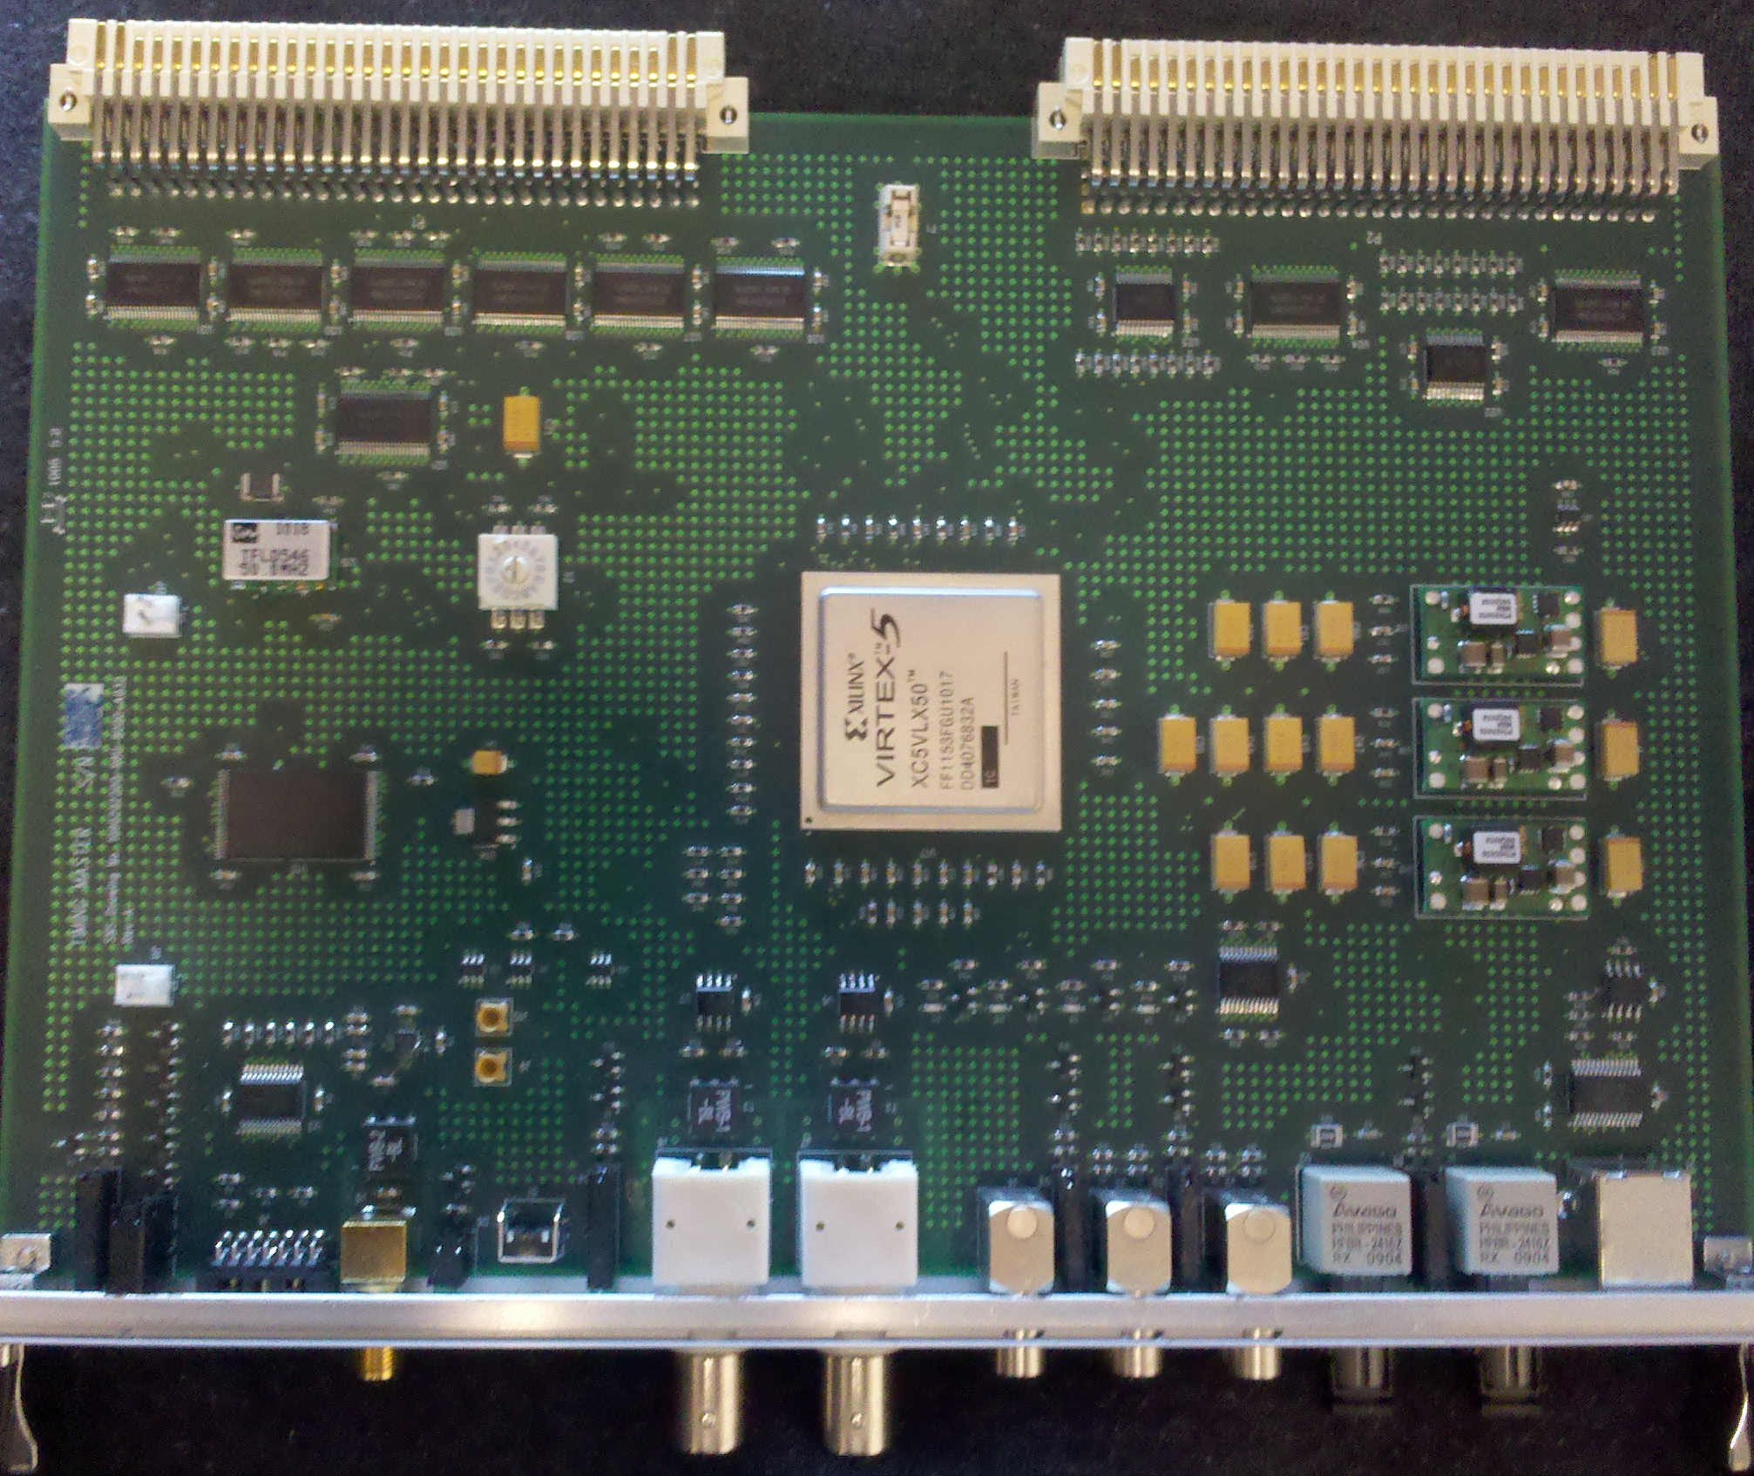
Controls Hardware Progress on Obsolescence
Timing System – continued deployment of new modules, recovering spares
Timing receiver - replaces old utility and trigger modules
Deployed in HPRF FY15 (15 units)
Deployed in LLRF FY16 (55 units)
66% timing receivers replaced
Timing fan-outs
100% Fiber-to-Fiber fan-outs replaced
68% Fiber-to-Copper fan-outs replaced
85% Timing infrastructure replaced
New Timing Master operating in the ITS

Slide 16
Controls Hardware Progress on Obsolescence
Machine Protection System
Difficult to support; many obsolete components
Limited ability to repair existing platforms
System is overly complex
Redesign in progress (AIP-39) to address obsolescence, simplify system and ensure expandability for PPU/STS
Power supply interface and controller cards (PSI/PSC)
Obsolete components limiting ability to make repairs or purchase replacement cards
Need to work with EE/PS to develop a plan to address
New power supplies free up some older modules to be used as spares

Slide 17
Controls Hardware Supporting Accelerator Development
New LEBT Chopper Controller
Ramp down functionality added, supports “sustaining 1.4MW” goal
Integrates DBCM fast MPS interface via rear transition card for better errant beam control; reduces MPS response time 7.6 μS
Includes control interface and replaces “black box” controller
Uses new timing receiver card with minimal modification

Slide 18
Controls Software Supporting Accelerator Development
Provided EPICS integration for many accelerator projects
Ion Source: spectrometer timing, new power supplies
E-kicker power supplies
New serial power supplies
New features and PanelView upgrade for RF transmitter
DTL vacuum upgrade (AIP-35)
CHL He inventory tool
MKS 937B vacuum gauge controller
TCP350 turbo pump
LEBT chopper controller

Slide 19
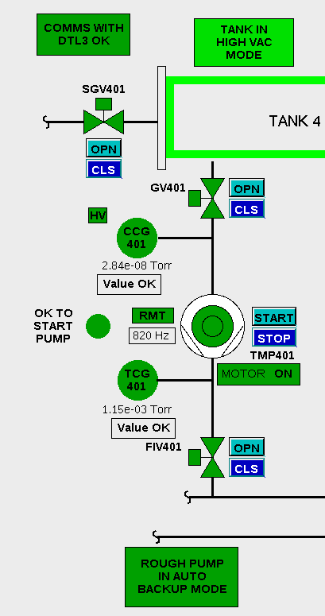
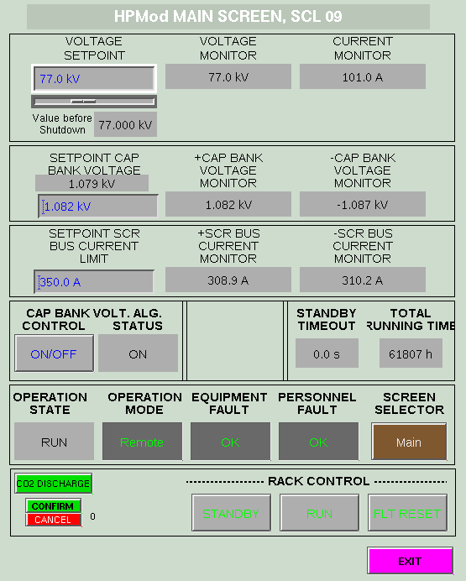
Controls Software Supporting Accelerator Development
EPICS integration for AIPs
New HVCM controller (NI) (AIP-34)
DTL vacuum upgrade (AIP-35)
ITS (AIP-30)
Power supplies, signal generators, RF, oscilloscopes
RFQ, LEBT, MEBT Vacuum

Slide 20
Controls Software Sustaining Control System Performance
Target alarms converted to CS-Studio alarm handler (BEAST)
Upgraded IOCs (MVME-5500): HPRF (15), Cryogenic Moderator (1)
Improved EPICS support for new timing master and developed device support for new timing receiver for LLRF IOCs
Device support for MPS, OMS-58, and Beckoff for new IOC (MVME-5500)
Improved cryogenic IOC directory structure and version management

Slide 21
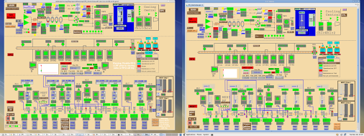
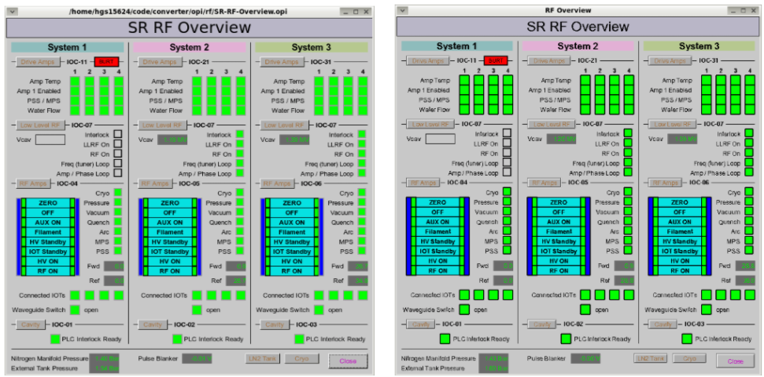
Controls Software Tools
Need to replace aging display manager (EDM)
CS-Studio BOY can render many EDM screens
EDM converter collaboration w/ Diamond Light Source
BOY used extensively on SNS beamlines
Performance will likely not scale for SNS accelerator
Analysis exposed internal limitations (burdens UI thread, tied to limiting technology)
EDM displays and auto-converted CS-Studio versions
Notes:
Graphical editing framework
Standard Widget toolkit

Slide 22
Controls Software Tools
Display Builder- “Looks like BOY”, but improved, modular design
Model: Widgets and their properties, file format
Representation: On-screen objects in JavaFX
Performance: Handles PVs and scripts in background threads
Started mid-2015, first release end-2016
Handles basic instrument displays, better performance
Currently implements ¹/₃ of BOY widgets with minimum features
BOY
Display Builder

Slide 23
Protection Systems Improvements Power Supply Grounding Isolation
Grounding issue discovered July 2013 in PPS CCR rack
Defect was corrected, grounding was evaluated system wide and improvement plan developed
July 2015 – Isolated CCR, replaced racks
January 2016 – Isolated klystron gallery cabinet
June 2016 - Isolate HEBT cabinet
January 2017 - Isolate Ring cabinet power, replace front end cabinets
July 2017 - Isolate RTBT cabinet power
January 2018 - Isolate Target PPS power

Slide 24
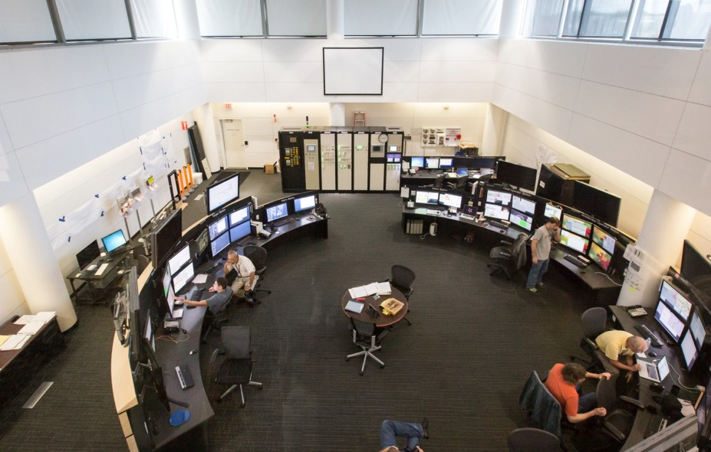
Protection Systems Improvements PPS CCR Rack Upgrade
Replaced 4 CCR Protection System racks with pre-assembled and pre-tested units
Demo and replacement took less than one day
Units ready for integration testing in three days
Although functionally equivalent, new design incorporates safety, maintainability, and human factor improvements
Notes:
Racks were replaced to eliminate error found in July 2013
Replacing racks in-toto minimized required SNS down time and maximized test and integration time
Some Improvements:
Replaced obsolete electronics
All 120VAC is confined to one rack. Access to all other racks has safe voltages
Re-arranged panel layout to better reflect SNS operating modes
Improved wiring methods, diagnostics, and modularity significantly improves repair time

Slide 25
Protection Systems Sustainability
Documentation
Generated : >250 new and >200 revised as-built drawings since January 2015
Continuing to validate protection systems’ configuration basis
Updating procedures
New radiation monitor calibration procedure takes ½ time
Analyzing failure modes and statistics
Plan to upgrade obsolete linac oxygen monitors
Use long-life sensors, eliminates annual sensor replacement (>$40k/year)
Reduces maintenance from ~40 hours to 4 hours per year

Slide 26
Protection Systems Sustainability Simplifying Infrastructure
Removed electrical safety interlock function from PPS
Eliminated interlocks for 464 of 468 power supplies, leaving only interlocks 4 used for beam containment
ORNL/SNS relies on LOTO for hazardous energy control
Eliminates requirement to manage power supplies as CECs
Reduces time needed for PPS certification by ~20%

Slide 27
Protection Systems Sustainability Simplifying Infrastructure
Consolidate PPS architectures and equipment
Lack of standardization on instrument PPS’ increases maintenance effort and spares cost
Instrument PPS prototype defined as the benchmark for evaluating existing beamlines and prioritizing upgrades
Collaborated with Electrical and IDAC groups to create standard secondary shutter motion control assembly/PPS interface for EPICS beamlines
Eliminated PPS interlocks for some sample robots and detector motion controls

Slide 28
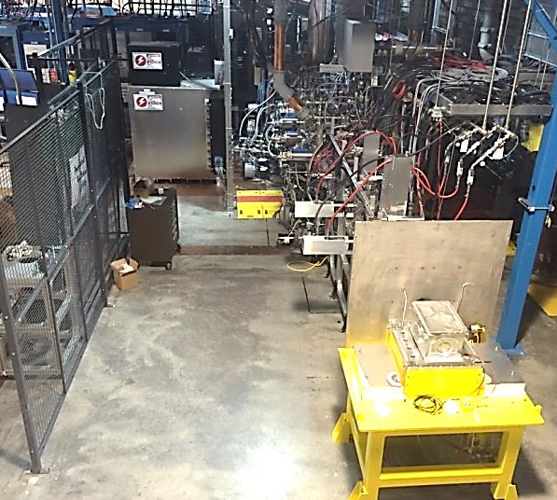
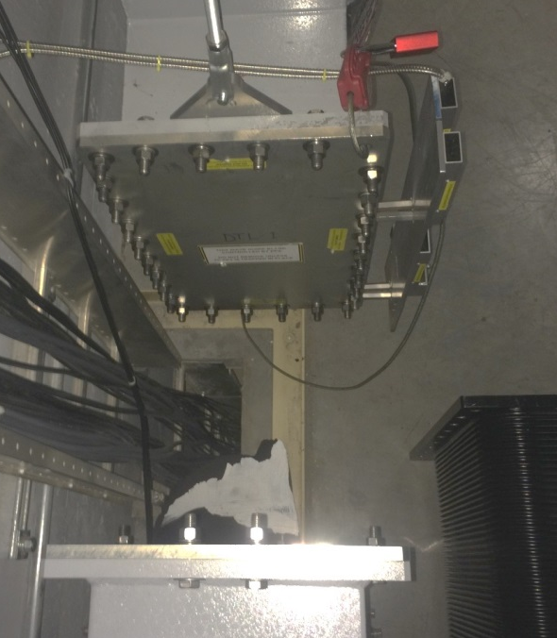
Protection Systems Supporting Accelerator Development
Developing PPS for ITS
Proposal to replace DTL ½ waveguide blanks with shutters
Reduces time to change operating mode of front end from ~8 hours to <20 min
Allows RFQ to remain on with personnel in tunnel
Reduces source restart time
Allows more time for source R&D during maintenance days

Slide 29
Summary
Controls is successfully
Managing the performance of our large, distributed EPICS based control system
Integrating a wide variety of device types
Supporting accelerator improvement and development projects
Improving design and development processes
Simplifying systems to reduce support requirements and maintain availability
Collaborating with IDAC to develop and test new software tools on the instrument beamlines before migration to the accelerator

