Slide 1
Software for Simulations and Operations
AAC 2016
Andrei Shishlo
SNS Warm Linac Manager

Slide 2
Outline
SNS Software Overview
History of Physics Software Development for Operations
  Software for Superconducting Linac
  Software for Warm Linac
SNS Linac Simulations tools
Recent Linac PIC Code Development
Using PyORBIT for SNS MEBT Optics Studies
Conclusions

Slide 3
Physics Software for SNS Linac
OpenXAL:
Open Source, Java + Script Languages
Online and Offline Usage based on Online Model (OM)
OM includes Envelope and One Particle Models
For Operations:
  Longitudinal Tuning and Control
  Orbit Correction
For Offline Analysis:
  Parameters for PIC Models
For
Operations and Simulations
Offline PIC Models:
Closed Source Codes (C++,Fortran)
  Parmila, Parmela
  Impact3D
  Track
  TraceWin
In-House Open Source - PyORBIT
  C++ and Script Shell (Python)
For
Simulations

Slide 4
Superconducting Linac RF Tuning
RF reference line
V₀
V
ΔZ
RF
BPM 1
BPM 2
SLACS (Superconducting Linac Automatic Cavity Setter) original XAL app. by J. Galambos
Used time of flight method with two calibrated BPMs
Provided SCL RF phases scaling in the case of changes (even when cavities switched off)
It took about 8 hours to tune the whole SCL
Could not study the stability and effects of different settings on SCL beam loss
After tuning we needed manual tweaking of the RF phases in SCL and warm linac to reduce beam loss

Slide 5
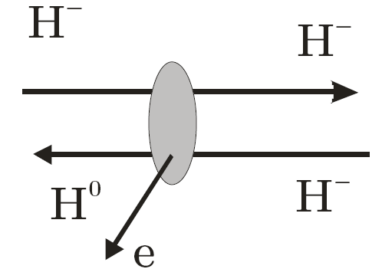
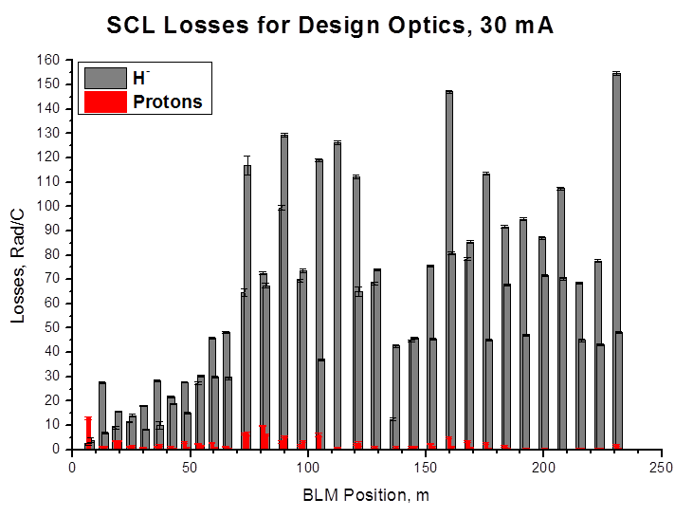
Intra-Beam Stripping Beam Loss
In 2012 IBSt was identified
Unexpected SCL beam loss was mitigated by making beam bigger (reducing SCL quad field gradients)
Empirical approach
There was no model
We wanted model based matching to increase beam sizes uniformly along SCL
First Observation of Intrabeam Stripping of Negative Hydrogen in a Superconducting Linear Accelerator
A.Shishlo, J. Galambos, A. Aleksandrov, V. Lebedev, and M. Plum
Phys. Rev. Lett. 108, 114801 – Published 12 March 2012

Slide 6
Transverse Beam Matching in SCL
SCL Med Beta
SCL High Beta
HEBT
LW 1-4
LW 12-15
LW 32
WS
9 Laser Wire Stations in SCL for transverse profiles measurements
Never could get LW data in agreement with the models including Impact code
Possible reasons: unknown RF settings and longitudinal Twiss at SCL
“Cannot get agreement between Impact model and LW data”
EXPERIENCE AND LESSONS WITH THE SNS SUPERCONDUCTING LINAC
Yan Zhang,
Proceedings of IPAC’10, Kyoto, Japan, pp 26-30

Slide 7
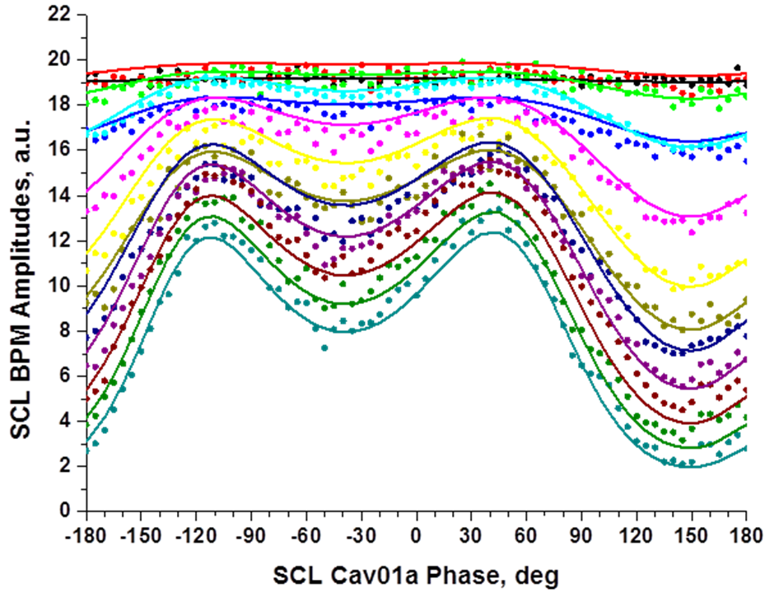
Longitudinal Twiss Analysis in SCL
CCL4
SCL
RF
BPM1
BPM2
…
BPM{n}
We use a controllable element (SCL RF) in the lattice and analyze BPM amplitudes vs cavity’s phase data.
Results (XAL units):
Alpha = 0.56 +- 0.02
Beta = 5.33 +- 0.13
Emitt = (0.928 +- 0.012)*10⁻⁶
A. Shishlo, A. Aleksandrov,
Phys. ST Accel. and Beams 16, 062801 (2013).
Over focusing
Defocusing

Slide 8
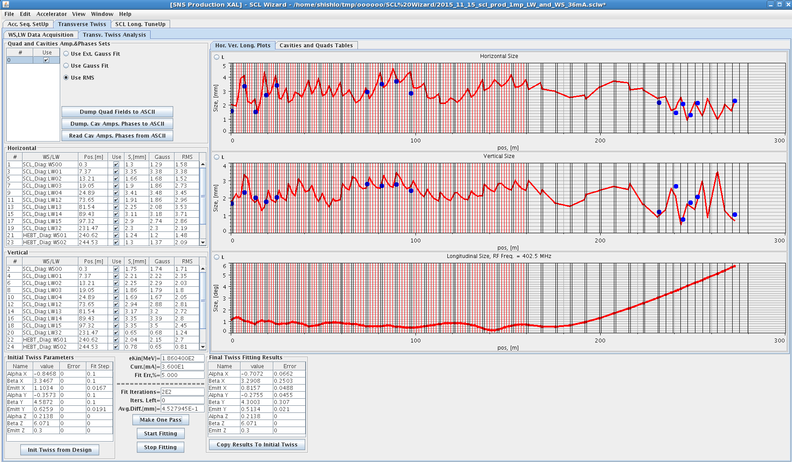
SCL Tuning Wizard
SLACS improved and automated, all BPMs’ included in analysis
Takes 40 minutes to tune SCL instead of 8 hours
Includes longitudinal Twiss calculation from scan data
Includes Laser Wire data analysis
Ready for SCL transverse matching studies
11.15.2015

Slide 9
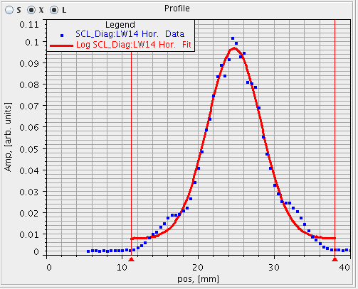
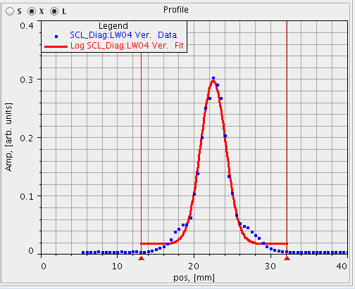
Problem Non Gaussian Profiles
Some LW profiles demonstrate big “shoulders”
We can try to do transverse matching, but results may be different from expectations
We need to check Warm linac settings and use multi-particle PIC code for optics planning

Slide 10
Warm Linac RF Tuning
RF Reference Line
BPM0
RF Phase
RF Offset 1
RF Offset 2
RF Cavity
BPM1
BPM2
Beam
L
Z₁
Z₂
PASTA – original XAL App. By J. Galambos (Phase and Amplitude Scans and Tuning Application) – based on BPM’s phases response signature algorithm developed at Fermilab
WARM LINAC TUNING WIZARD replaced PASTA in 2015 (OpenXAL App.)
  Addressed the initial region guess problem with inner BPMs
  Includes Delta-T, PASTA, and others algorithms
  Automated process – takes less than 1 h instead of 8 h
  Eliminates ambiguity of human interpretation
  Big help for operations during startup periods
  Gives us confidence that we tune warm linac according to the design

Slide 11
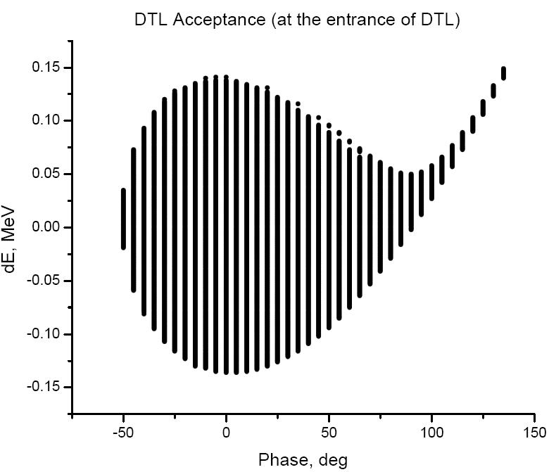
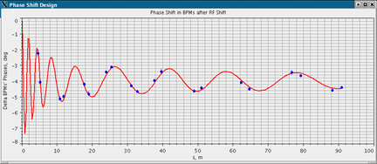
RF Shaker – Checking RF Setting
RF Shaker – OpenXAL Application for the model based fast check of the RF settings
It helps to find the start of the tune-design discrepancies
Δφ
DTL
Points are BPMs’ phase response
Red curve is the XAL Online Model
It shifts RF phases of chosen cavities by several degrees which is an equivalent of the offset injection into the acceptance region
RF Warm linac settings are according to the design, for transverse we need multi-particle code

Slide 12
Why We Need a New PIC Code (I)
PARMILA, IMPACT, TRACK – Benchmark I (HB-2010)
PARMILA – A. Shishlo, IMPACT – Yan Zhang, TRACK – Dong-O Jeon
Matched beam at the DTL entrance gives a good agreement between codes
NO SPACE CHARGE !

Slide 13
Why We Need a New PIC Code (II)
Unmatched beam at the entrance gives different predictions from codes.
Reason: beam too big, particles almost on the bore radius. Models for RF fields are not reliable.
Losses calculations: that is exactly the same particles that we are interested in.
We do not have the model for losses!

Slide 14
PyORBIT with Linac Model
PyORBIT is an open source project. It is a continuation of the original ORBIT code
PyORBIT started at ORNL, but now it is used at many facilities
Until recently was used mostly for rings
PyORBIT Linac Model Additions
New implementation of the abstract accelerator lattice package. The “sequences” and RF Cavities were added.
Two new 3D Space Charge classes
RF Gap Models
The linac structure parser for linac lattices
The linac lattice factory
Bunch generation from the emittance data
C++ and
Python
wrappers

Slide 15
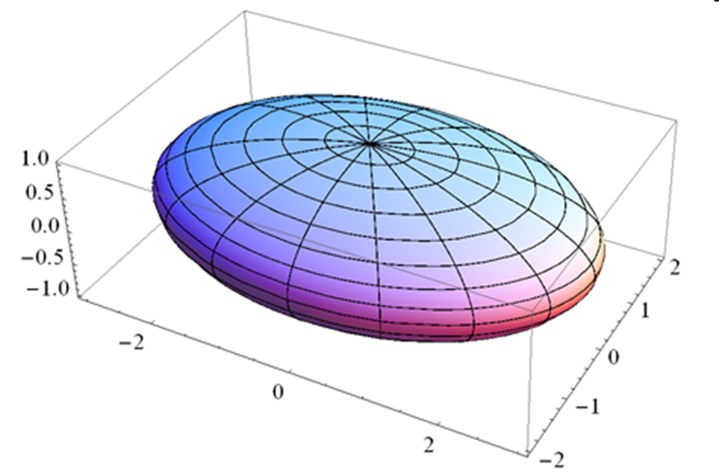
3D Space Charge Models for Linac
3D FFT Poisson Solver based on FFTW library
Classical 3D solver with open boundaries
Uniform Ellipsoid Approximation – XAL analog
Fast, needs low number of mini-particles
E_{r}
R₀
r
Allows to study space charge halo formation

Slide 16
PyORBIT RF Gap Models
Linear Simplified Model
Simplified with Radial Non-Linearity
“Parmila”-like
“Impact” – like
3D RF Fields Tracking by Runge-Kutta 4th order solver
Uses RF field on the Z-axis

Slide 17
PyORBIT–Parmila Benchmark
20,000 macro-particles
38 mA peak current
Water Bag 3D
Bunchers RF is on, 90⁰ phases
Timing:
Parmila SCHEFF – about 4 sec
PARMILA 3D PICNIC – 8 sec
pyORBIT 1 Ellipsoid – 1.6 sec

Slide 18
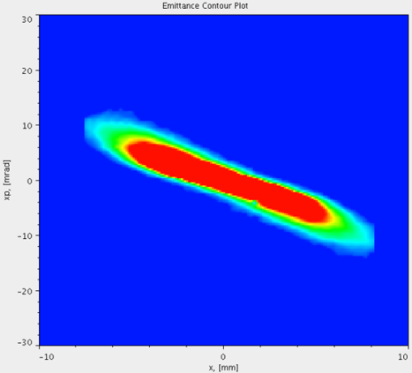
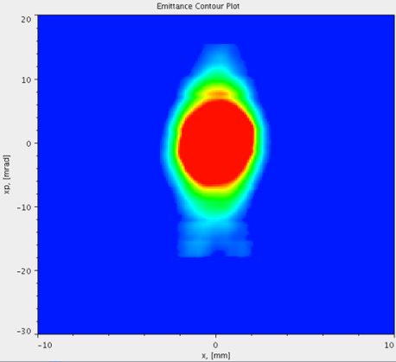
PyORBIT for MEBT Optics Studies
MEBT (3.6 m)
Chopper Trgt
QV11,QH12
QV13,QH14
Emitt.Dev.
Hor. Scrapers
Ver. Scrapers
WS 14
Horizontal
Vertical
Chopper target was removed
It was used as vertical scraper to reduce beam loss in LEDP (between CCL and SCL)
Existing vertical scrapers are not effective
We have to modify MEBT optics to provide effective vertical scraping
Or we could plan to add vertical scraping in a new place

Slide 19
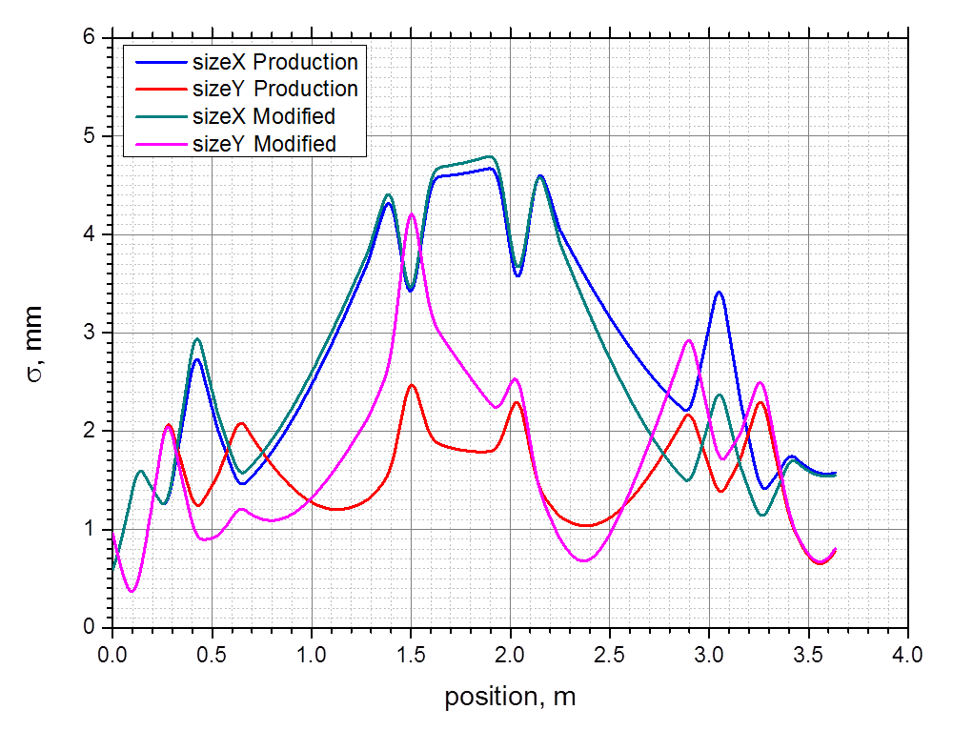
New MEBT Optics
Old
New
Old and New Transverse Beam Sizes in MEBT
The fitting of the Twiss parameters at the DTL entrance is included
Phase Space Distributions at Vertical Scrapers

Slide 20
Discrepancies in PyORBIT vs Data
WS 14 data and beam tracking with PyORBIT are not in agreement
We are still investigating this

Slide 21
Conclusions
Developing software for operations and beam physics studies is a successful ongoing process at SNS
Machine Operations got a lot of benefits from Accelerator Physics Team efforts
OpenXAL showed and proved its value for both operations and studies
PyORBIT linac addition is a relatively new tool that we will use for the operation improvements
The SNS linac is a good testbed for the PIC code benchmark

