Slide 1
Laser Stripping Experiment Status
Sarah Cousineau
AAC Review
February 17, 2016

Slide 2
Outline
Motivation
Reminder of concept
Project structure (funding, timing, etc)
Status of 10 μs stripping project
Status of power recycling cavity effort

Slide 3
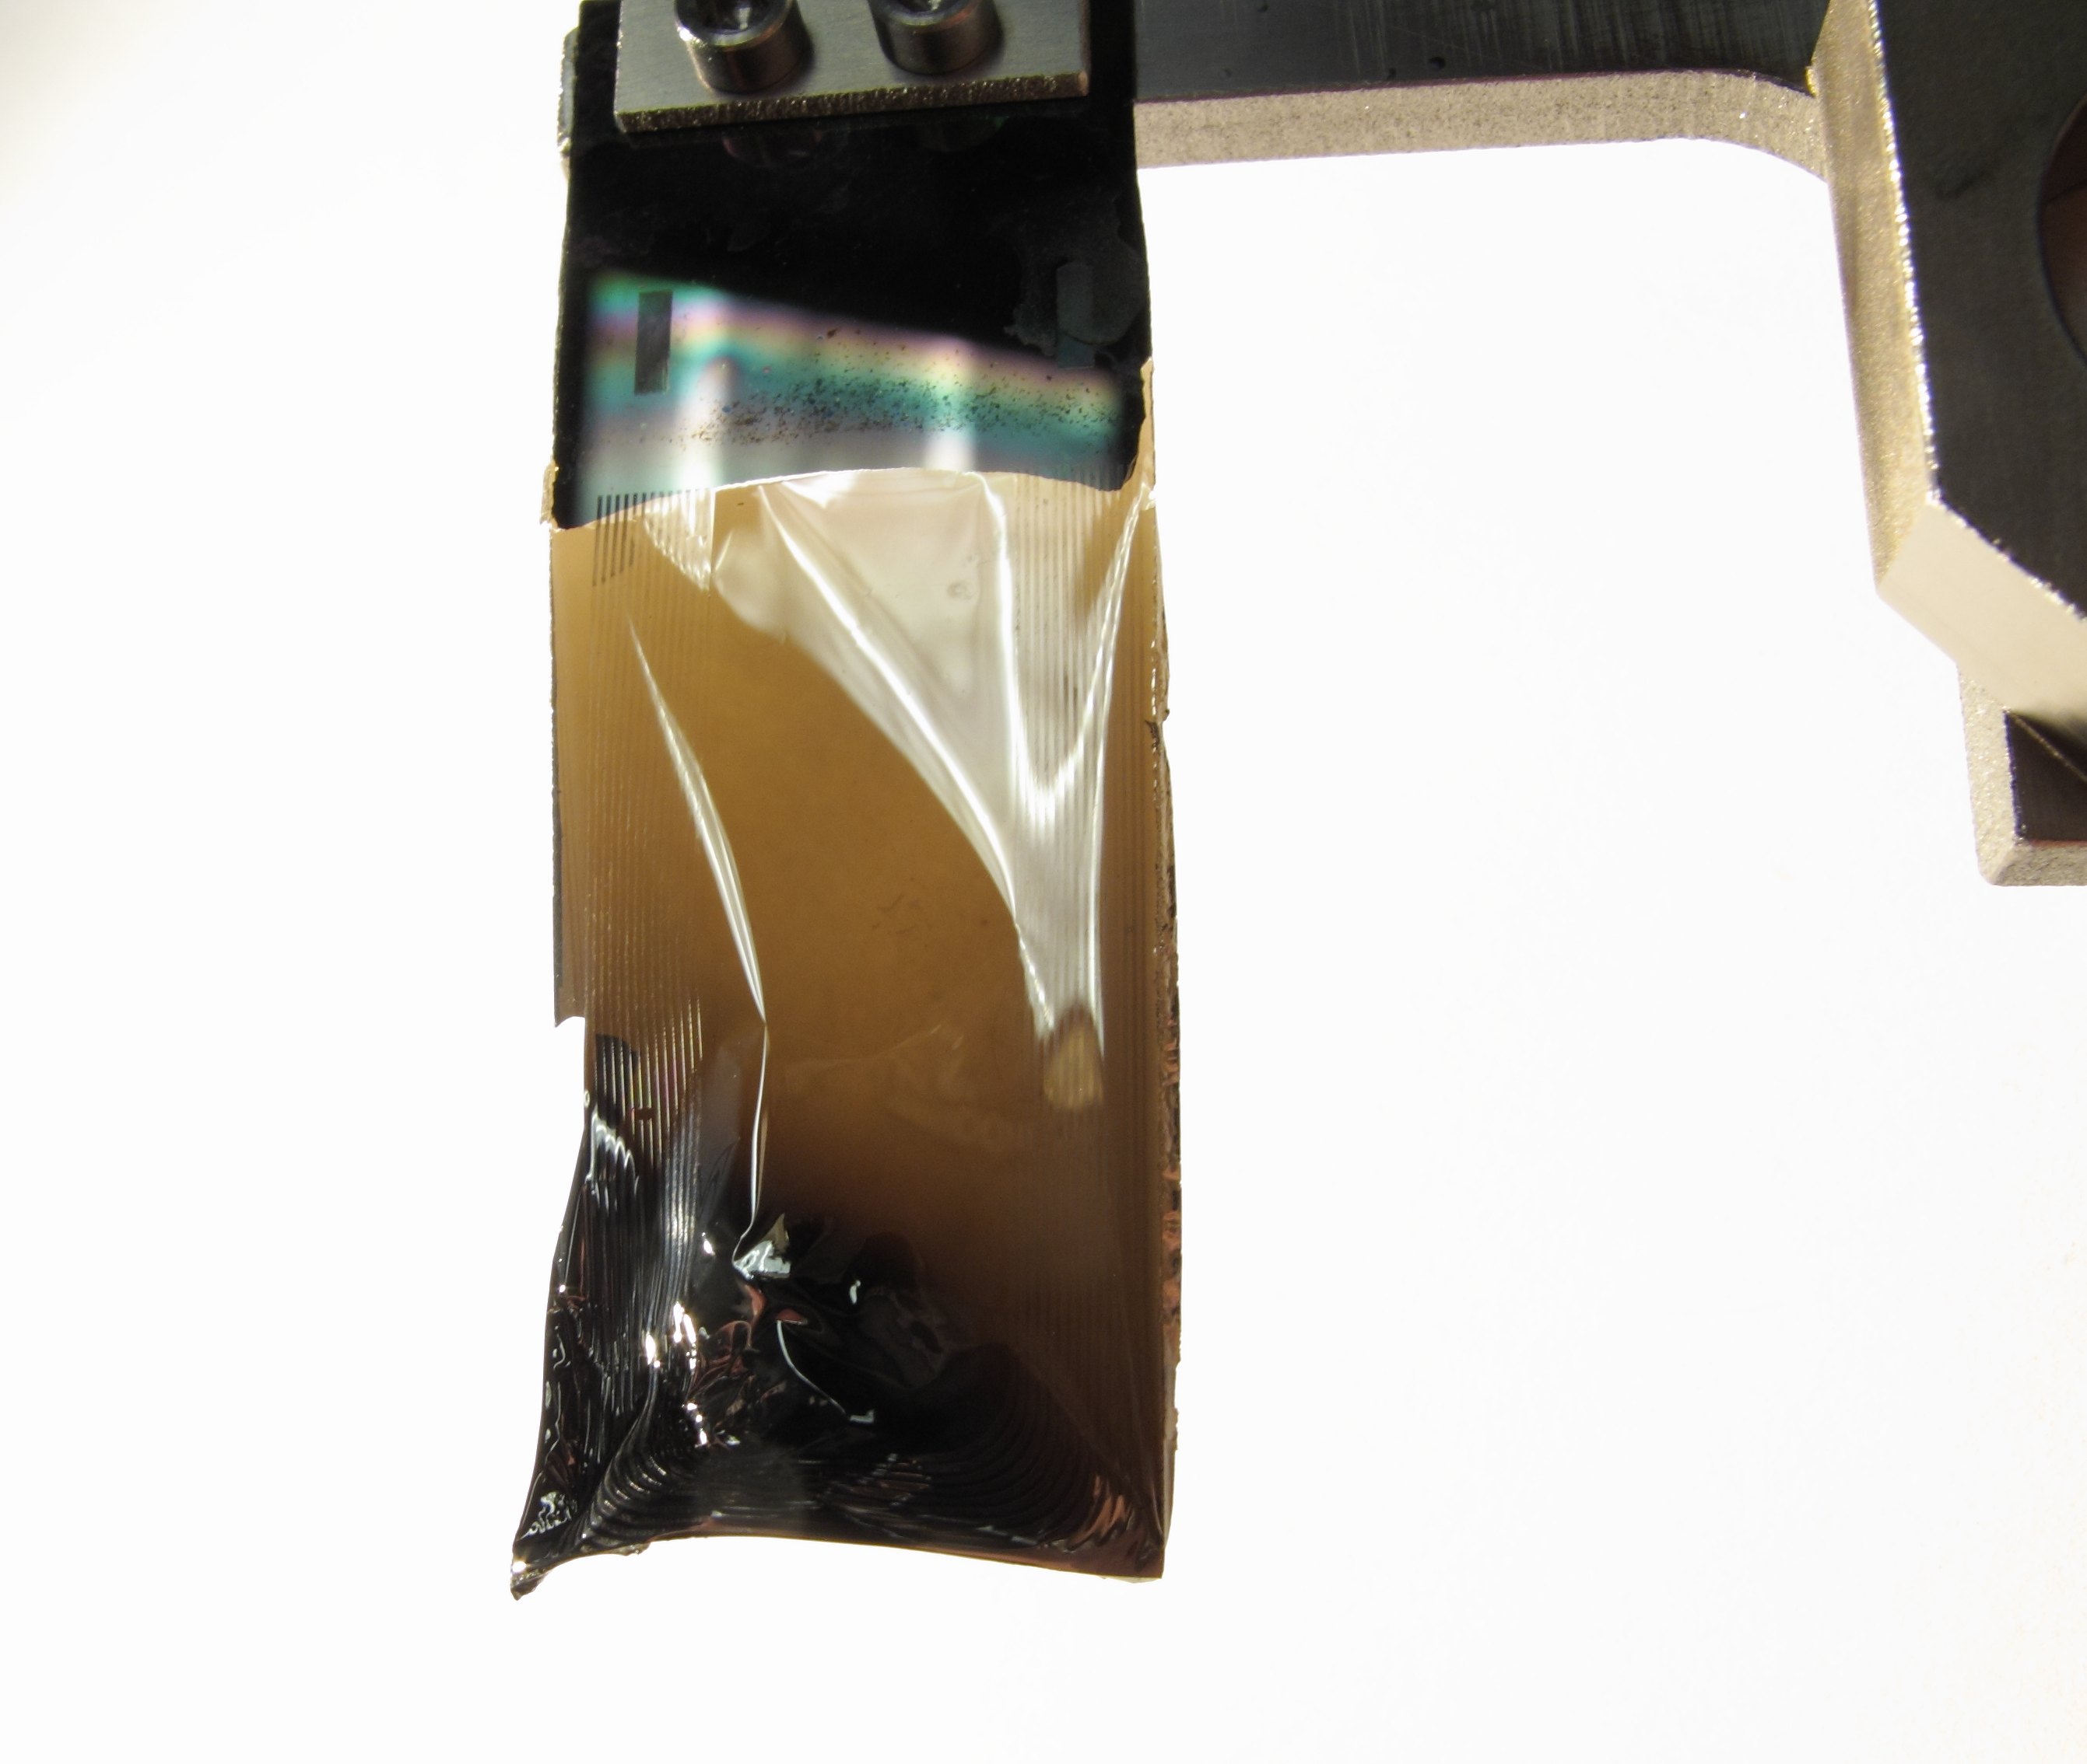
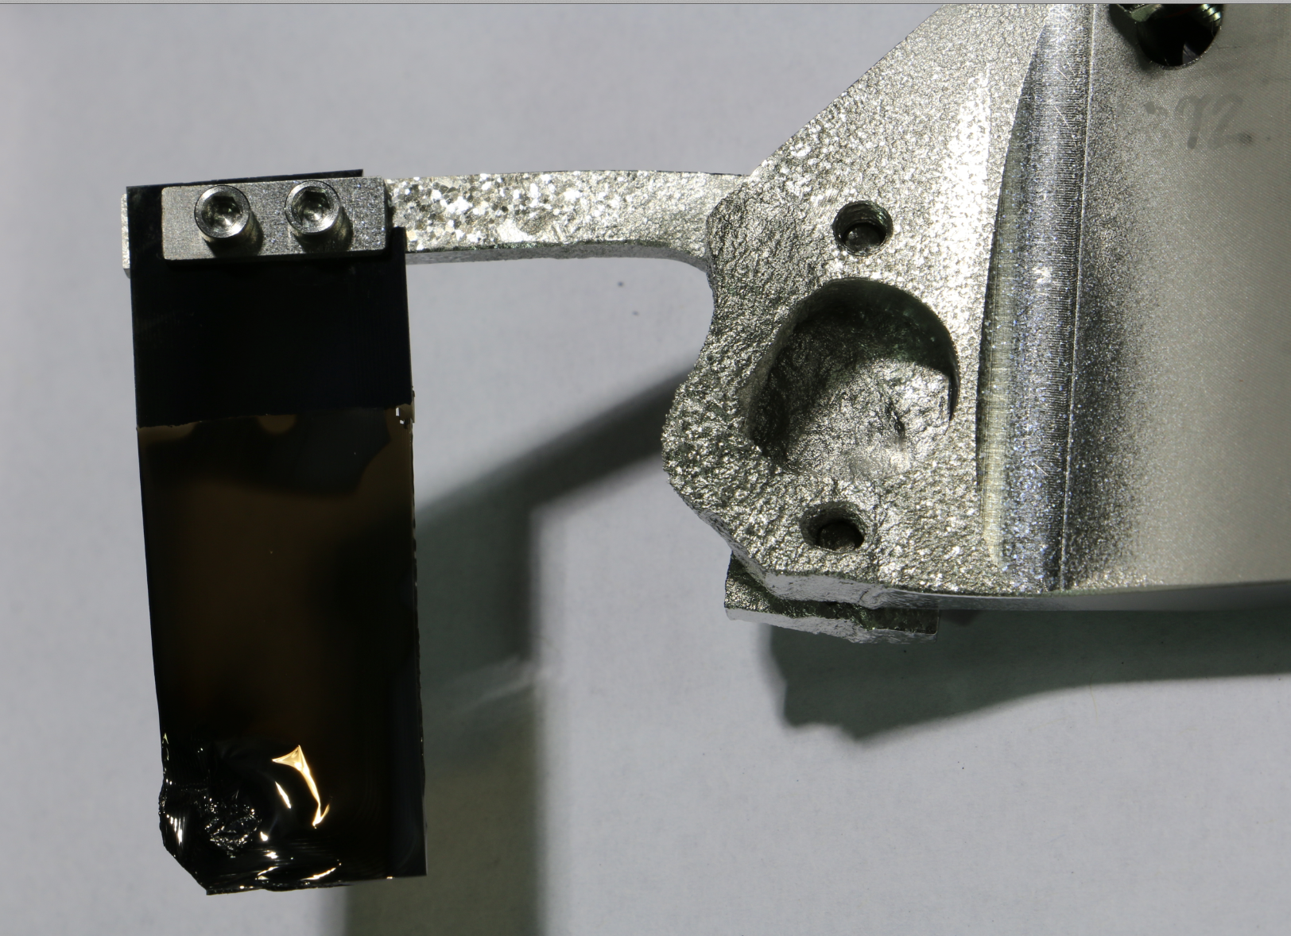
Foil Issues at SNS: Foil Damage, Radiation
Bracket damage from convoy electrons
New foil
Nanocrystalline diamond
Foil used for entire run cycle
#1073
#1872, up to 1.4 MW. 3 months
Typical Beam Loss Pattern SNS Ring, 1.3 MW
Highest loss point in accelerator – 800 mrem/hr @ 30 cm.
Requires dual plane injection painting to minimize loss.

Slide 4
The Price of Higher Beam Power Density (A Quick Experiment)
Injection radiation limit for experiment
Unexplored
Cutting the emittance by half increases injection beam loss by factor 10 - 30
Nominal case

Slide 5
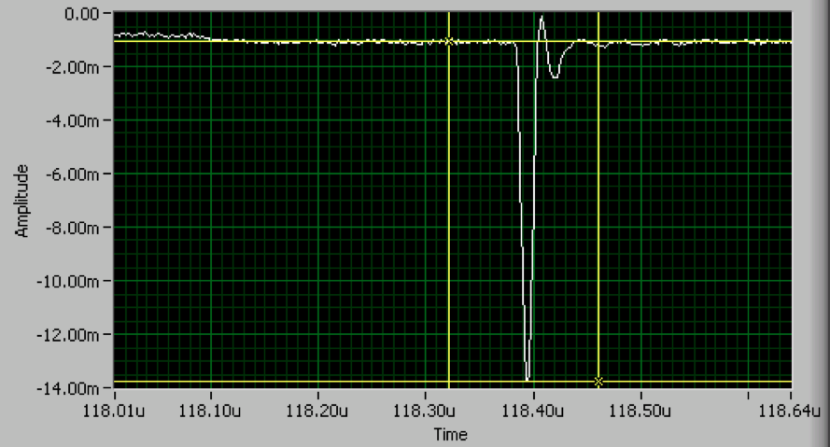
Laser Assisted Stripping Concept
?
2006 Proof of Principal Experiment
Laser field
Experiment conducted with
10 MW UV laser.
Diverging laser
Laser in tunnel
Straightforward scaling to 1 ms requires: ~600 kW average UV laser power (way too much!)
H⁻
H⁰
H^{0*}
p⁺
e
e
α
e
e
H-
6 ns
p
e
e
Step 1:
Lorentz Stripping
Step 2:
Laser Excitation
Step 3:
Lorentz Stripping
H⁻ → H⁰ + e⁻
H⁰ + γ → H^{0*}
H^{0*} → p + e⁻

Slide 6
The Laser Stripping Collaboration
BES and HEP share the injection foil problems.
There is common interest in developing laser stripping.
DOE HEP Grant:
“Laser-Assisted H⁻ Stripping for High Intensity Synchrotrons”
1st Grant
2nd Grant
Status: Almost Complete
Status: Just Awarded
$825K
3 Years: 04/2013 – 04/2016
Goals:
Demonstrate laser assisted stripping for 10 μs
Develop laser power amplification scheme with power recycling cavity.
$250K
2 Years: 04/2016 – 04/2018
Goals
Demonstrate laser stripping for 1 ms using power recycling cavity
Develop conceptual design of operation system

Slide 7
Progress on 10 μs Experiment This Year
Last year reported on successful demonstration ion and laser beam techniques aimed at required power.
This year’s focus was on finalization of the experimental configuration:
All equipment for 10μs experiment installed
Laser transported from remote to local station
Laser parameters at IP measured
Laser timed-in with beam
All necessary ion beam parameters verified at IP
WE ARE READY

Slide 8
Configuration of 10 μs Experiment
Experiment is in the transport line to the ring (HEBT)
Laser is located remotely in Ring Service Building (RSB)
Major concerns:
Laser power loss in transport
Pointing stability
Safety of laser in RSB
Complexity of installation
Laser
in Ring Service Building
~70 m
Interaction point

Slide 9
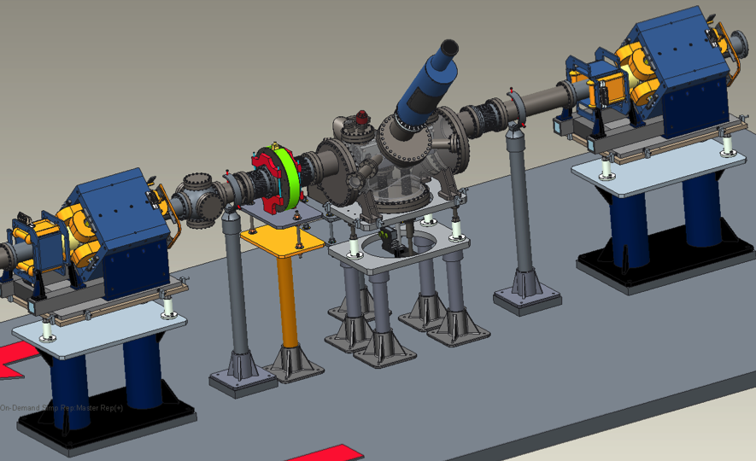
Engineering View of Experimental Vessel (you saw it last year)
Wire scanner
Current monitor
Movable Permanent Magnets
Interaction point
Courtesy Menshov

Slide 10
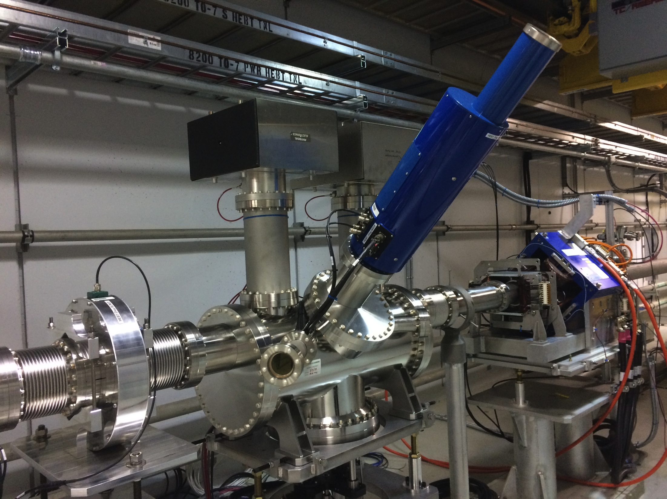
Installed Experimental Vessel
Demonstrated 100% conversion H⁻ to H⁰
No interference with high power operations

Slide 11
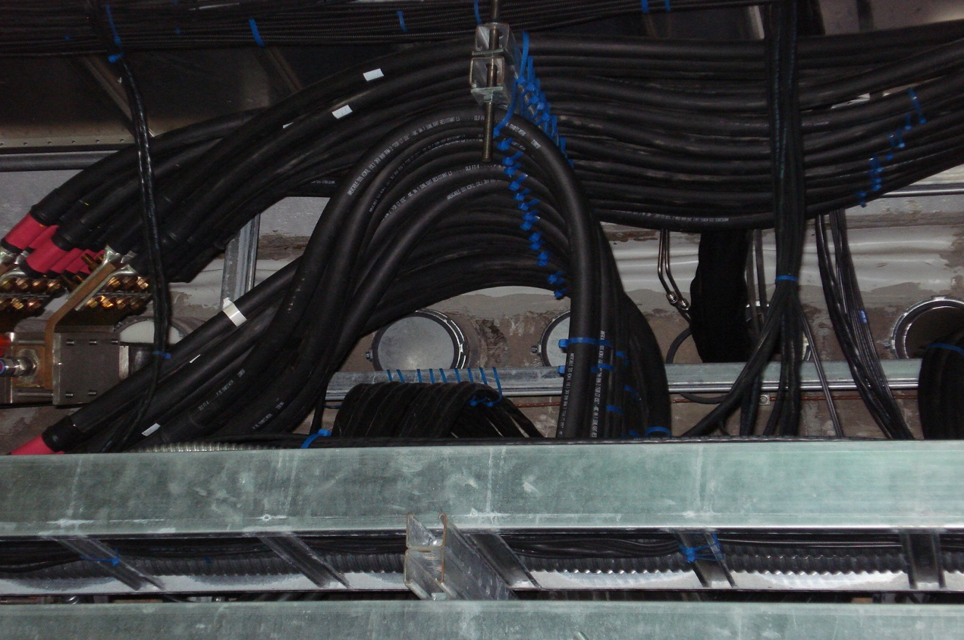
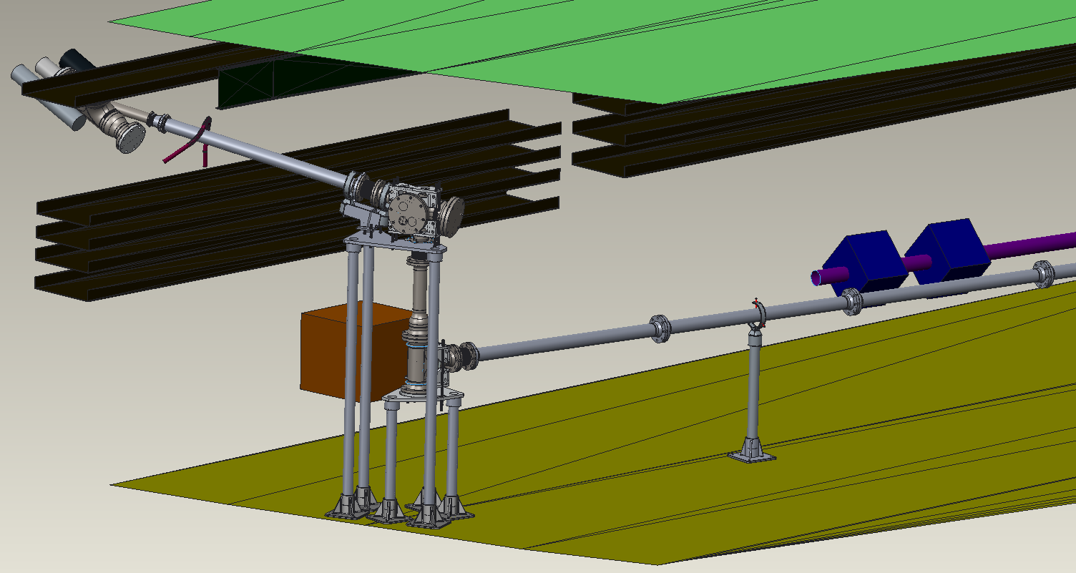
Laser Transport Line Design
Specs: 70 meters; 9 mirrors; 4 windows
Courtesy Menshov

Slide 12
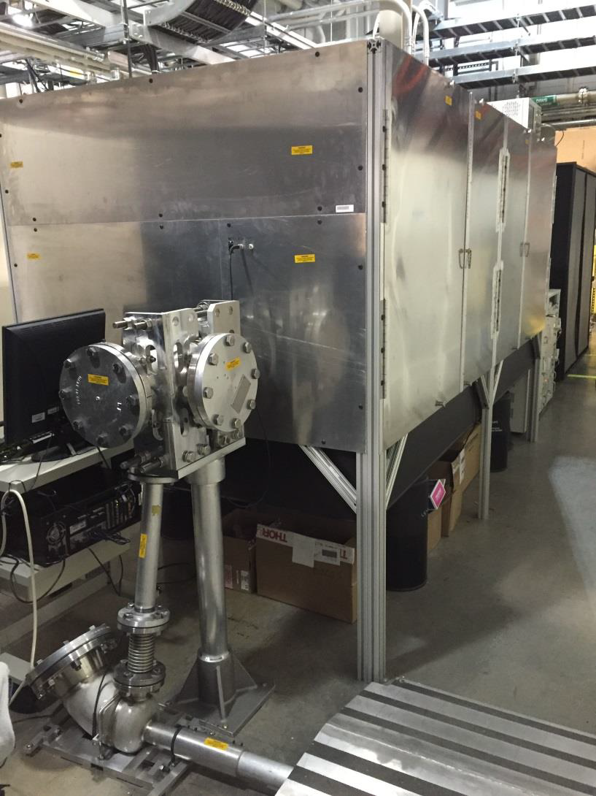
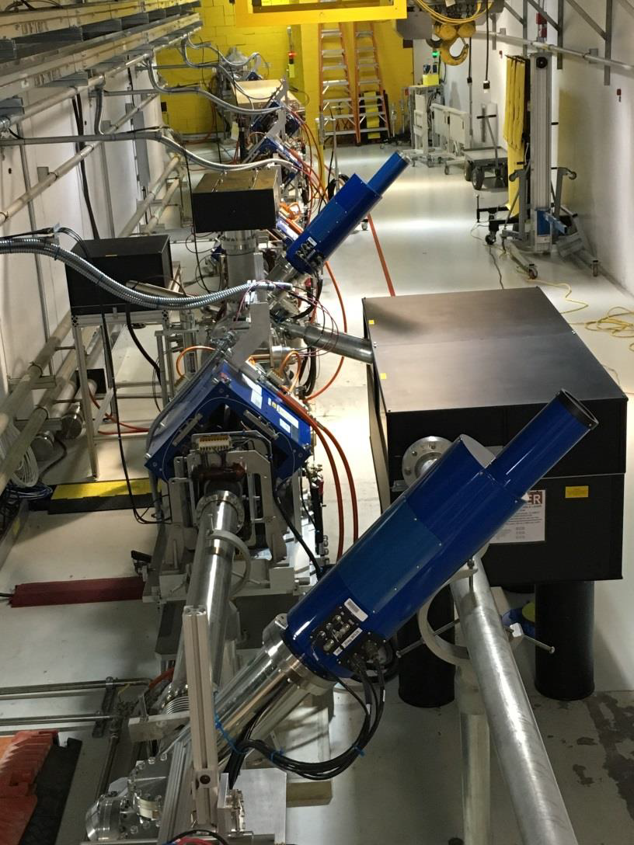
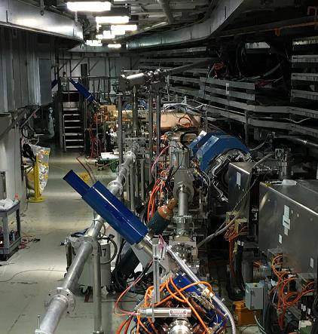
Laser Transport Line
Installed July 2015, January 2016
Final optics table
From RSB
Local optics table

Slide 13
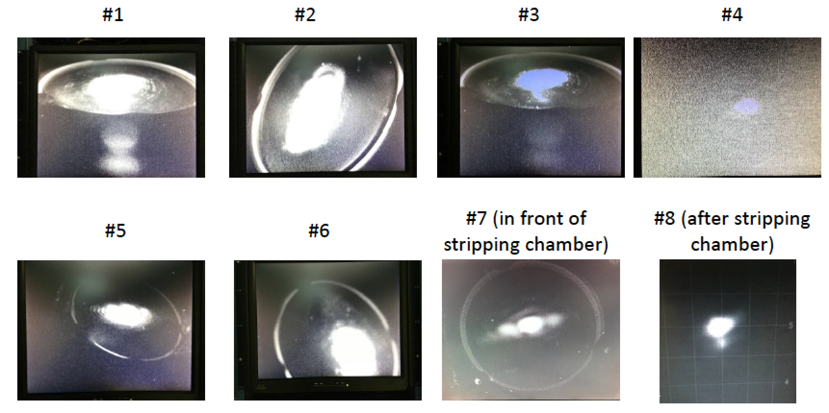
Laser Beam Spots on Monitors
Courtesy Liu, Rakhman

Slide 14
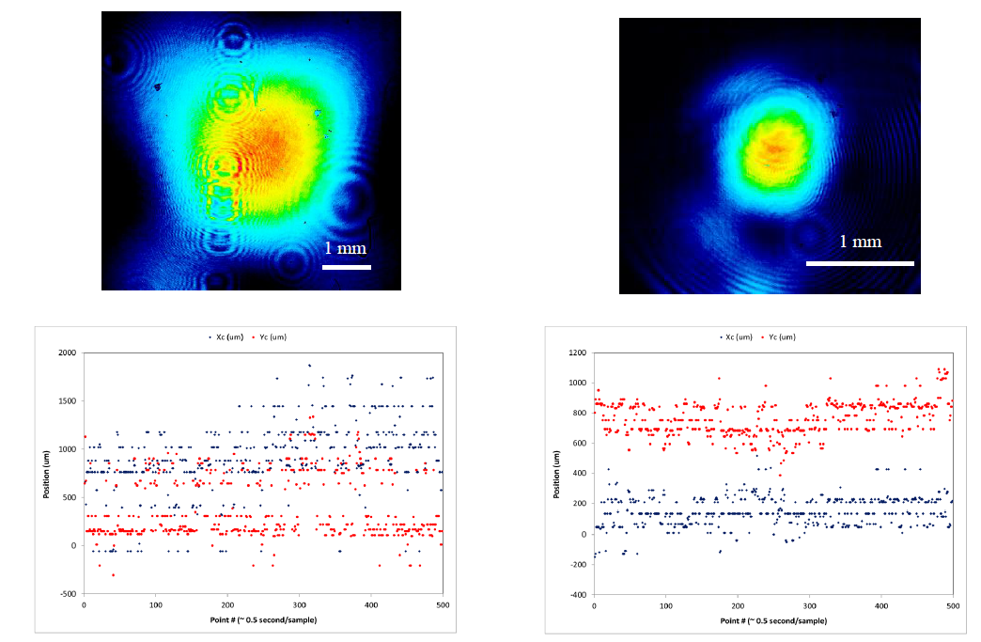
Laser Spot and Jitter at Local Station
At exit of laser transport line
At IP
Laser Spot
Laser Spot
Laser jitter
Laser jitter
Position (mm)
Position (mm)
Point # (~0.5 seconds/sample)
Point # (~0.5 seconds/sample)
Courtesy Liu, Rakhman

Slide 15
Final Measured Laser Parameters at IP
Parameter | Required (Design) | Delivered
Remote Station Laser Parameters
Macropulse length | 10 us | 10 us
Micropulse width | > 30 ps | 30 – 50 ps (adjustable)
Peak Power in RSB | 1.5 MW | 2.5 MW (at 35 ps)
In Tunnel Laser Parameters
Transmission Efficiency | 60% | 70%
Maximum Peak Power | 1 MW | 1.7 MW (limit to 1 MW for experiment)
Pointing stability at IP |  | ±0.10 mm (H) ×±0.11 mm (V)
Horizontal divergence at IP | 2 mrad | 2.6 mrad
Vertical size at IP | 0.8 mm | 1.1 mm

Slide 16
Experimental Plan and Risk Mitigation
Primary Risk: Window break / vacuum leak.
Mitigation Plan:
Windows have tested against baseline laser power.
Interlocks placed on laser size, divergence.
Experiments to be conducted only when recovery time available.
Will step laser power up slowly.
Model-Calculated Stripping Efficiency vs. Power
Tuning
Courtesy Gorlov

Slide 17
Next Step: Extending to 1 ms Stripping
Extending to 1 ms will require a laser power recycling cavity.
The concept is to start out with a 1 ms, low power laser pulse and amplify to ~1 MW peak in cavity power.
The experimental vessel was designed to accommodate a future cavity.
H⁻ beam

Slide 18
Laser Power Amplification Scheme
Courtesy Liu, Rakhman

Slide 19
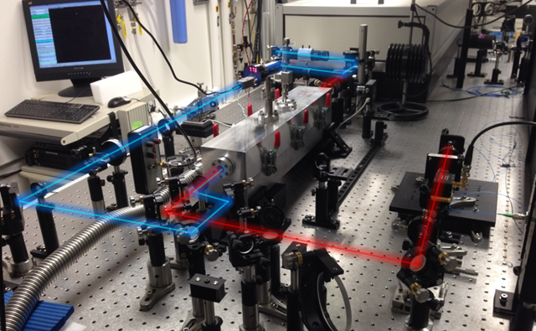
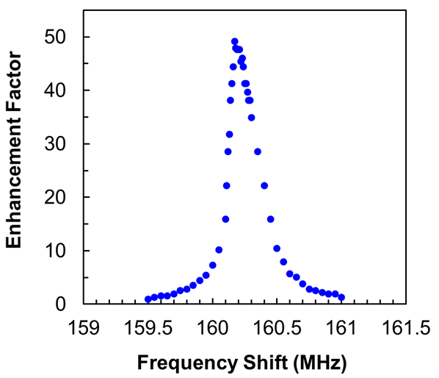
Recycling Cavity Status
Status:
Cavity lock achieved in May 2015.
Demonstrated 50 times power enhancement (goal was 30).
Challenge: Mirror damage threshold too low. Can’t run high power in cavity.
Plan forward centered on investigating high damage threshold mirrors using single wavelength.
Burst-mode UV beam
Cavity
Cavity locking beam
Courtesy Liu, Rakhman

Slide 20
Summary
We are ready to begin stripping experiments.
First experiments will commence in early March.
The laser power recycling cavity has achieved 50 times power amplification.
New grant will allow further development of power recycling cavity / amplification scheme for future 1ms stripping experiments.

