Slide 1
Beam Dynamics Studies at the ITS and Collaborative Accelerator R&D
Sarah Cousineau
AAC Review
February 16, 2016

Slide 2
Education, Outreach, Community Service
Community Service:
Review panels: ESS, Fermilab, CSNS, JParc, FRIB
PRSTAB Editorial Board, reviewers.
Conference Organization: IPAC, NAPAC, ICFA HB, ICAP.
Education Outreach:
Host 4-8 undergraduate interns per year
Host 3 graduate students, rolling
USPAS: 5 instructors, curriculum committee chair
University of Tennessee Collaboration
Supports education and research in accelerator physics.

Slide 3
University of Tennessee Collaboration
Partnership with University of Tennessee to provide Accelerator Science education.
Research funding:
  Laser Assisted H- Stripping (DOE HEP + SNS)
  6D Beam Dynamics at ITSF (NSF HEP + SNS)
UT program currently supporting:
  2 UT postdocs
  3 UT graduate students
  1-2 undergraduate interns per year
Rely on USPAS for coursework.

Slide 4
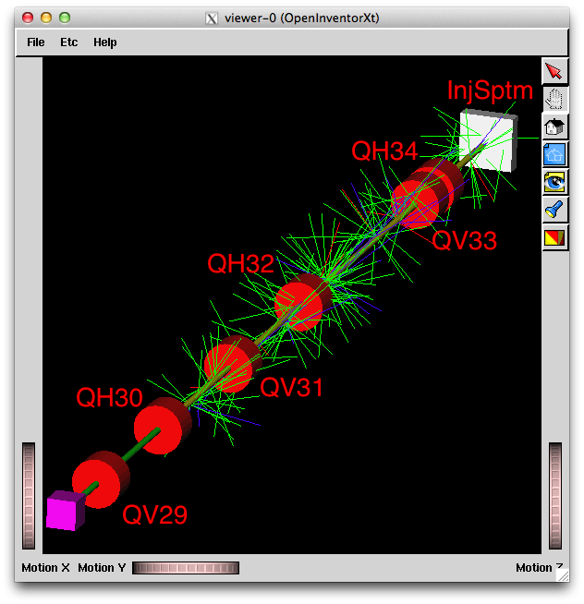
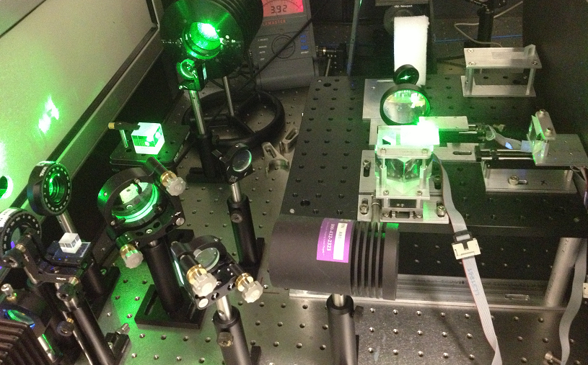
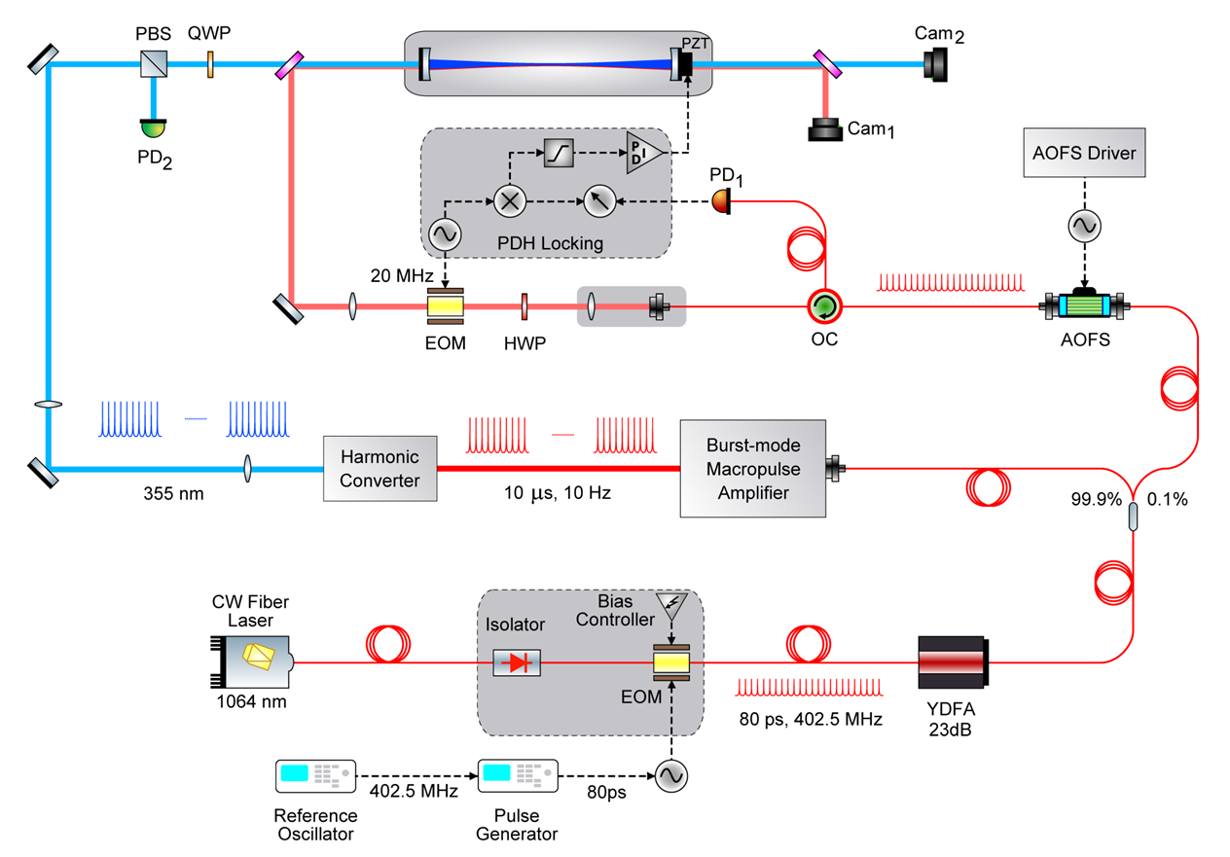
The Laser Stripping Project
DOE HEP Grant: “Laser-Assisted H⁻ Stripping for High Intensity Synchrotrons”
Postdoc/Student Projects
Technical details in break-out session tomorrow.
Terms of Initial Award
3 years: 05/2013 – 04/2016
$825K
Lutrell
Educational Support
4 undergraduate internships
1 graduate student
1 postdoc
Liu, Rakhman
Renewal Award
2 years: 04/2016 – 04/2018
$250K
Liu, Rakhman

Slide 5
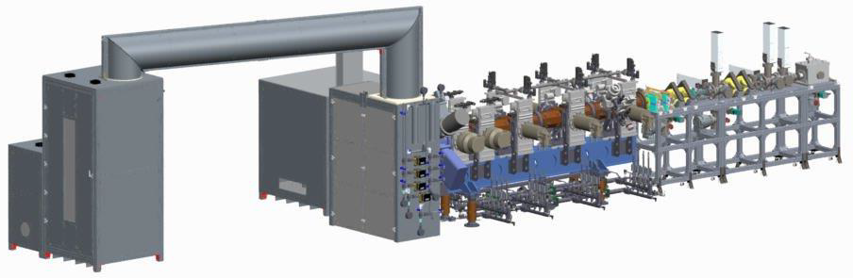
6D Beam Dynamics at the ITS
NSF Grant: “Six Dimensional Experimental Characterization of High Intensity Hadron Beams in Front End Systems”
Terms:
$600K
3 Years 09/2015 – 09/2018
Educational Support
1 postdoc (hired)
1 graduate student (in place)
1 undergraduate per year
Student/Postdoc Projects
Diagnostics design optimization
Design of lattice
Data acquisition software
Optimization of data processing
Simulations of beam halo

Slide 6
Motivation
A common conclusion: “Our code doesn’t reproduce the measured beam distribution because we don’t have an accurate initial distribution.”
Is it true? We want to find out.
The Goal:
Typically, measure
projections:
x’
y’
φ
x
y
z
Combine assuming no other relationships between variables

Slide 7
Motivation
But this is not a complete 6D distribution:
Assumes all cross-terms = 0
Includes cross-terms:
Possible sources of non-zero cross terms:
Solenoidal focusing in LEBT
Space charge forces
Non axially symmetric fields in ion source
Q: Are these terms significant enough to affect the beam dynamics?
A: We think so…

Slide 8
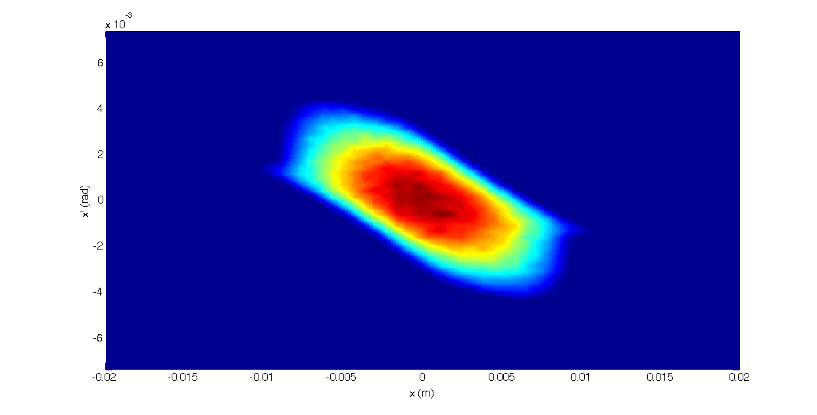
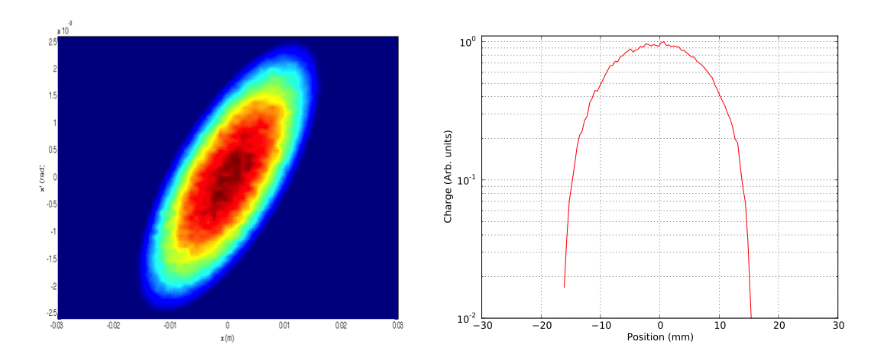
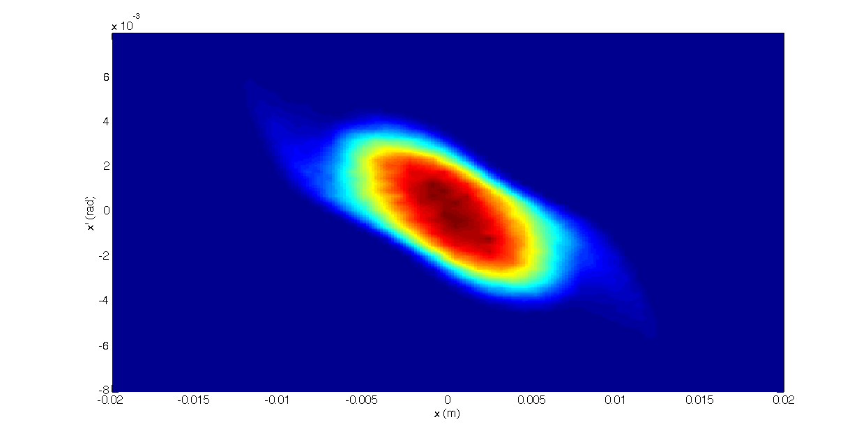
The Impact of Cross-Terms
Example: Start with 2 distributions whose typically measured properties look the same, but which differ in the underlying cross-terms.
Correlated in cross terms (KV)
FODO
Uncorrelated in cross terms
(all cross-terms = 0)
transport

Slide 9
The “Curse of Dimensionality”
Traditional diagnostics can be used to measure all projections.
The limiting problem is scan time.
For a course measurement:
Scan rate 1 step/sec: 10⁶ sec = 280 hrs
Scan rate 10 step/sec: 10⁵ sec = 28 hrs
1 2 …….. m
Problem compounded by need to average over multiple samples.
Times are not reasonable for operational accelerators.

Slide 10
6D Beam Dynamics Studies at the ITSF
Required Infrastructure:
Operational-style front end
High beam current (for space charge)
LOTS OF BEAM TIME (main limitation)
Integrated Test Stand
Full 6D diagnostics suite
A transport lattice with variable matching
Students, postdocs!
Upcoming additions
NSF HEP award
Goals of this project:
Complete the first direct 6D phase space measurement of beam exiting RFQ.
Measure and simulate beam halo formation.
Identify important phase space correlations.
  Finally, we have the critical ingredient!
  Does it help?
  Can we alter diagnostics in operational machines to provide this information?

Slide 11
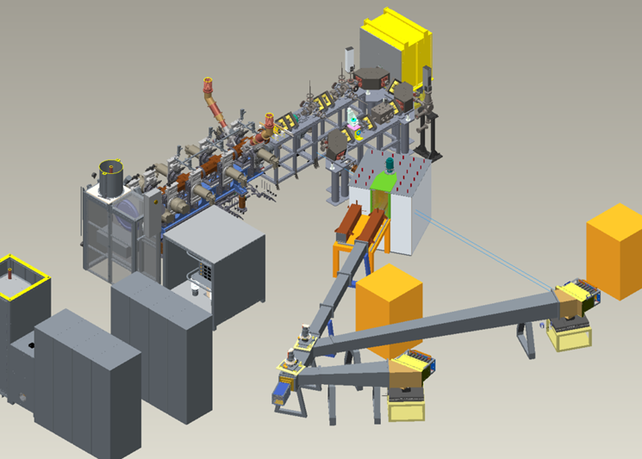
Integrated Test Stand Facility
Particles | H⁻
Energy | 2.5 MeV
Current | < 50 mA
Pulse width | < 1 ms
Rep rate | ≤ 60 Hz
Power | < 7.5 kW
MEBT
RFQ
Ion Source
Future Extension for Neutron Moderator Studies
Menshov

Slide 12
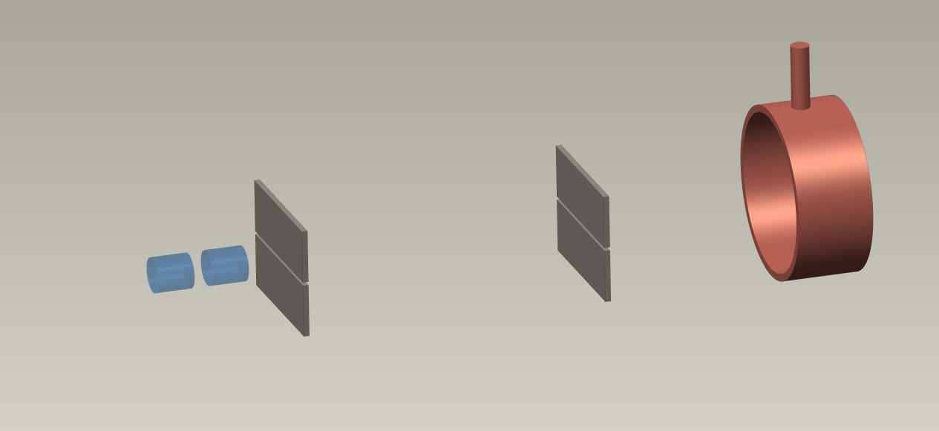
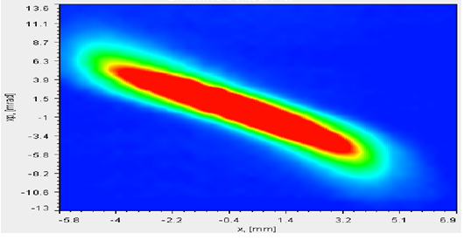
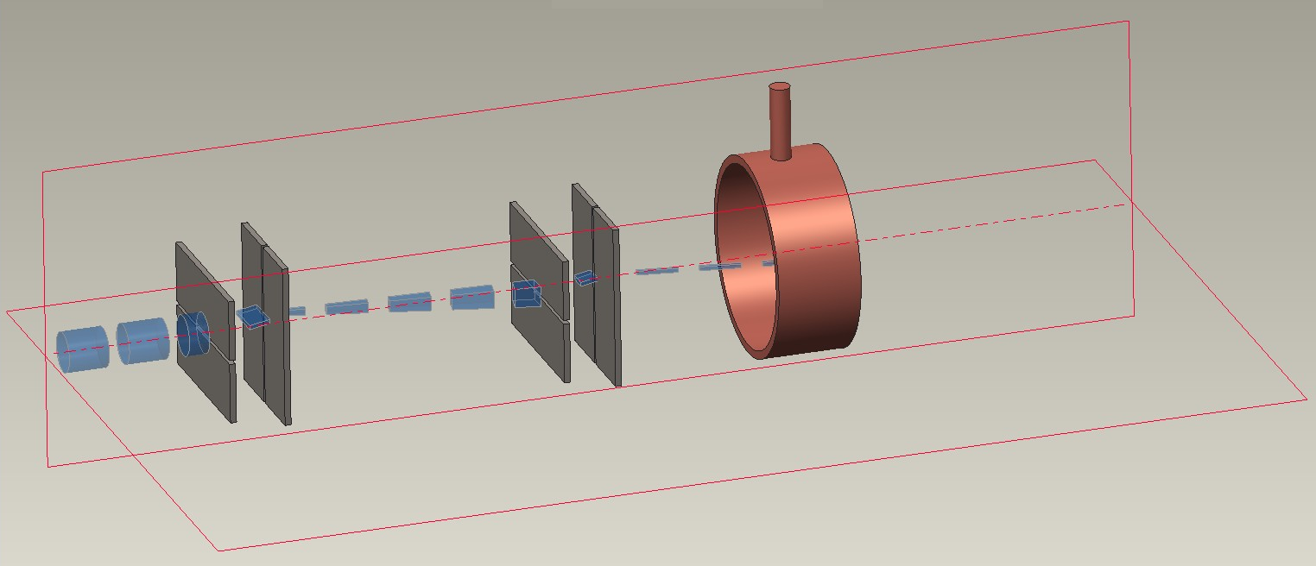
From 2D to 4D Transverse Measurements
BEAM
FARADAY CUP
4D system is part of original ITSF diagnostic suite
FARADAY CUP
BEAM
Menshov

Slide 13
Direct 6D Measurement Scheme
BENDING MAGNET
(Magnetic Spectrometer)
dx⋅dy⋅dx´⋅dy´
BEAMLET
dx⋅dy
BEAMLET
Energy Selection
RF DEFLECTOR
(BSM)
These are all well-established diagnostics techniques
Note the intensity is cut at each step. What is left at the Faraday Cup?
Phase Selection
FARADAY CUP
Menshov

Slide 14
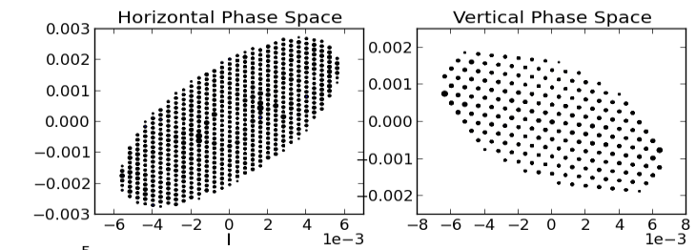
The Issue of Signal Strength
Equal sampling in all planes
Example:
B. Cathey
Beam Extent (r=n*σ) | N remaining
r = 1σ | 3.5×10⁶
r = 3σ | 2.9×10⁴
r = 5σ | 9.7
Faraday cup sufficient for at least 3σ

Slide 15
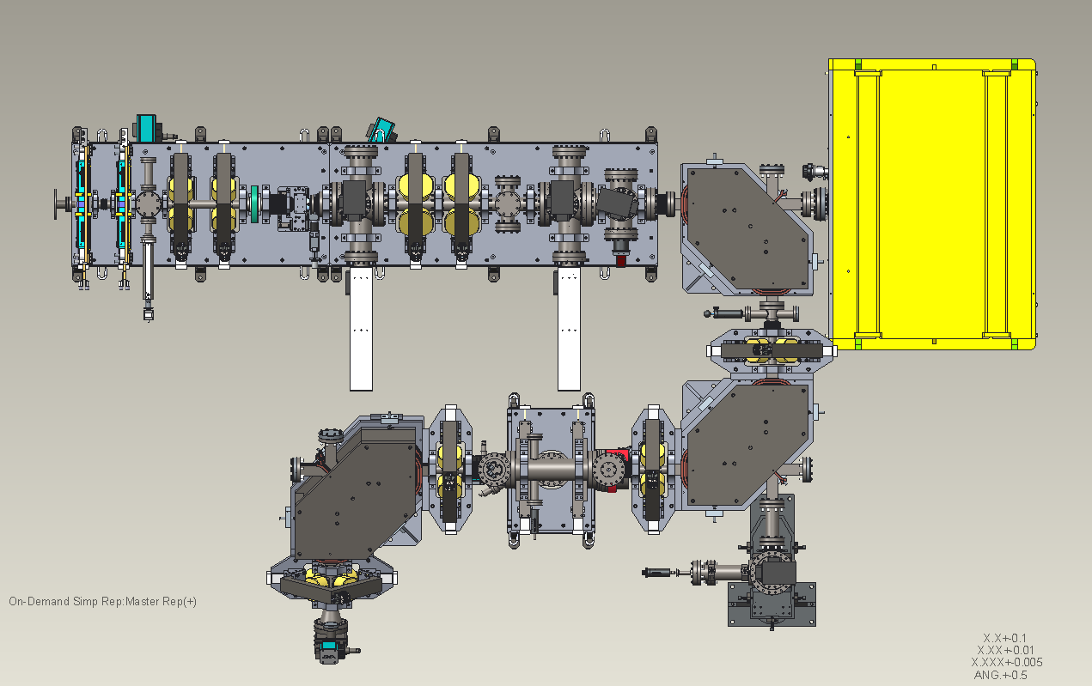
Layout of 6D Measurement Diagnostics
Slit Pair 1
Slit Pair 2
From RFQ
Slit Pair 3
BSM
Menshov

Slide 16
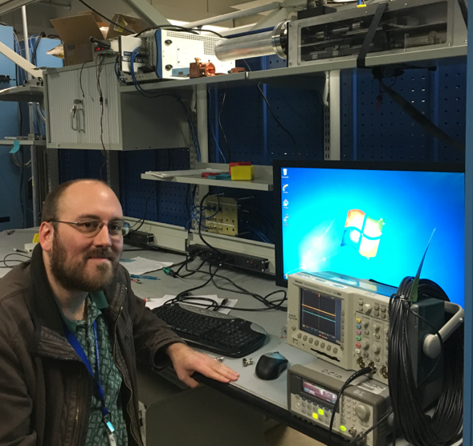
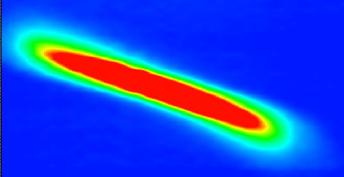
Reducing the z-φ Scan Time
Magnet
100 × faster
Magnet
  Advantage:
  Faster
  Disadvantage: Smaller dynamics range of charge to light conversion.
Energy selection slit
RF deflector
RF deflector
Time selection slit
View screen
Optimization is a graduate student project.
Faraday Cup or
other detector
Digital camera
φ
W

Slide 17
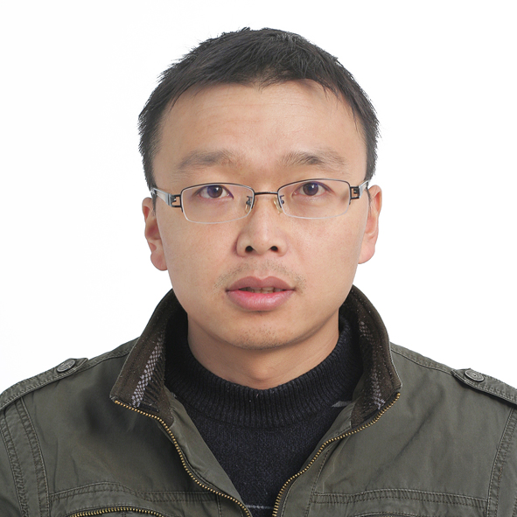
Lattice for Halo Studies
Option 2
Option 1
Menshov
Design of lattice is postdoc project.
New postdoc, Z. Zhang, arriving May, 2016.

Slide 18
Schedule
09/2015
-
09/2016
09/2016
-
09/2017
09/2017
-
09/2018
Hire graduate student, postdoc.
Optimize diagnostics.
Design lattice.
Develop data acquisition software.
Install diagnostics.
Fabricate and install lattice.
Perform 6D phase space measurement.
Perform beam dynamics experiments.
Simulate and benchmark halo with pyORBIT.
Evaluate cross correlations and diagnostics.

Slide 19
Summary
Accelerator physics, diagnostics, and ion source group very active in external community.
Strong accelerator physics education collaboration with UT, supported by DOE and NSF HEP grants that allow “hands-on” research for postdocs, students.
Beam dynamics at ITSF will attempt the first direct 6D measurement of beam in a front end.
Will use 6D distribution to study halo development and benchmark codes.
Schedule for 6D project is very aggressive.

