Slide 1
Target Systems Operations Experience and Remote Handling
Mike Baumgartner
Rick DeCosta
John Denison
Mike Dayton
Steve Parson
David McClintock
Bernie Riemer
Steve Trotter
Mark Wendel
Drew Winder

Slide 2
Outline
Major component replacement & spares status
Target systems availability
Actions to improve the predictability of the Neutron Science Program (Target Reliability Improvement Program support--TRIP)
Actions to improve Beam Line performance
Inner Reflector Plug (IRP) replacement
Heavy water conversion of the reflector water system
Other remote handling challenges
TN-RAM cask availability
Spent target storage
Servo-Manipulator obsolescence

Slide 3
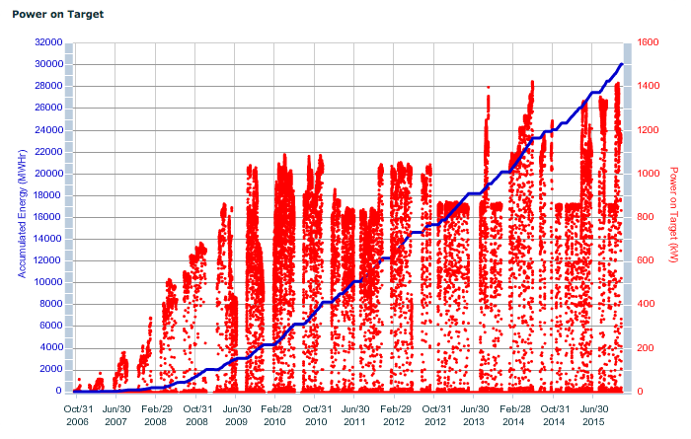
Installation of Major Components (Remotely)
T: Target Module
PBW: Proton Beam Window
IRP: Inner Reflector Plug
CVI: Core Vessel Insert
: Hg vessels that leaked
T10
PBW5
T9
T13
Tn
T6
PBW4
PBW3
BL16 CVI
BL9 CVI
T11
T12
T3
T5
T7
T2
PBW2
T4
T8
BL14 Shutter
CMS Stent Repair
BL1
Shutter
BL15
Shutter
T1
PBW1
IRP1

Slide 4
Component Delivery Status
Targets: 2 spares on site with 3 more coming this year
ORTE-003: Stored at SNS
MTX-008JF: Not before Jan 2017 (on-hold)
MTX-009: Installed
MTX-010: Stored at SNS
MTX-011JF: Aug 2016
MTX-012JF: Sep 2016
MTX-013: Jun 2016
Proton Beam Windows (PBWs): One spare on site with 1 more coming this year
KTC-005 (Aluminum): In High Bay
KTC-006 (Inconel): July 2016
Inner Reflector Plug (IRP): August 2016

Slide 5
Proton Beam Window Replacements
PBW | Serial Number | Date Installed | Date Removed | Accumulated Energy (MW-hrs) | RH Hours to Replace | Calendar Days to Replace
PBW1 | MTM-001 | 4/26/06 | 7/31/09 | 3055 | ? | ?
PBW2 | MTM-002 | 8/17/09 | 1/5/11 | 5206 | 36.5 | 9
PBW3 | KTC-001 | 1/5/11 | 7/30/12 | 6378 | 36 | 9
PBW4 | KTC-002 | 7/31/12 | 7/18/14 | 8674 | 34 | 8
PBW5 | KTC-003 | 7/21/14
PBW6 | KTC-004

Slide 6
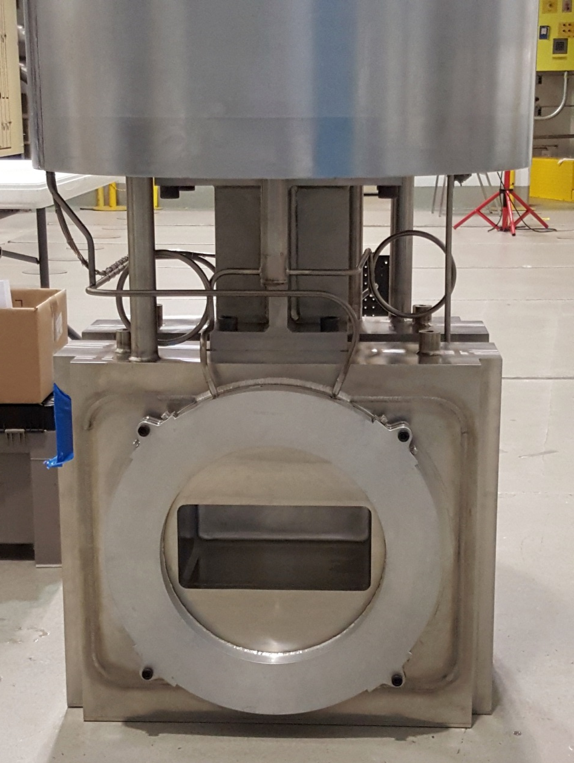
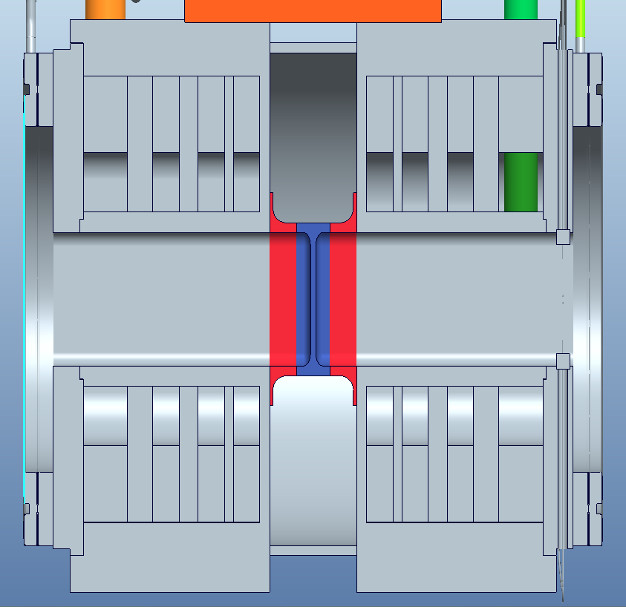
Aluminum PBW (PBW6) Is Next
Advantages of aluminum*
Increased PBW lifetime
3-5% increase neutron production
Decreased heating in PBW and shield blocks
Higher thermal conductivity and lower energy deposition cause less thermal stress
Proton Beam
RTBT Side
Core Vessel Side
*D.A. McClintock et al., Journal of Nuclear Materials 450 (2014) 163–175.

Slide 7
Target Replacements
Target | Serial Number | Date Installed | Date Removed | Accumulated Energy (MW-hrs) | Average Power (kW) | RH Hours to Replace | Calendar Days to Replace
T1 | MTX-001 | 4/26/06 | 7/15/09 | 3055 | 379 | 150¹ | 26¹
T2 | MTX-002 | 8/17/09 | 7/16/10 | 3145 | 771 | 96 | 17
T3 | MTX-005 | 7/29/10 | 4/9/11 | 2791 | 845 | 102² | 13
T4 | MTX-006 | 4/19/11 | 1/17/12 | 3252 | 782 | 69 | 23³
T5 | MTM-001 | 1/25/12 | 7/2/12 | 2362 | 938 | 159⁴ | 37⁴
T6 | MTX-004 | 8/2/12 | 9/26/12 | 617 | 916 | 63 | 11
T7 | MTX-003 | 10/3/12 | 10/26/12 | 98 | 943 | 71 | 35⁵
T8 | MTM-003 | 11/16/12 | 10/4/13 | 3750 | 851 | 76 | 12
T9 | ORTE-001 | 10/14/13 | 7/3/14 | 4195 | 1033 | 76 | 22⁶
T10 | MTX-007JF | 7/23/14 | 9/17/14 | 601 | 1052 | 54 | 11⁷
T11 | ORTE-002 | 9/22/14 | 11/12/14 | 167 | 1116 | 44 | 12⁸
T12 | MTM-002 | 11/18/14 | 10/2/15 | 4445 | 964 | 51 | 13⁹
T13 | MTX-009 | 10/8/15
Estimated. Mercury vent line leak identification and repair added duration.
Configuring Service Bay for target change and crane inspection added 2 days of effort.
Issue with 7.5T Service Bay crane resulted in a delay of ~7 days.
Upper knife edge seal leak on MTX-004 added ~8 calendar days; PBW4 installation added 6 days .
Investigation into T6 & T7 failures added ~22 days to T7 replacement.
Two crews. IRP Inspection added 1 day. PBW5 installation added ~11 days to complete T9 replacement.
Start of T10 replacement delayed 1.5 days due to Service Bay manipulator wiring damage.
T11 PIE activities added ~2 days to the replacement.
Secured the PBW sampling task and loaded T11 into a liner before target change.

Slide 8
Target System Availability
Target module mercury leaks dominate availability.
FY15 downtime hours
T11 leak: 557.5
T12 leak: 62.7
Shutter hydraulic water leak: 4.6
CMS hydrogen fills: 1.0
LWS #1 pump A failure: 0.1
FY16 downtime hours (year to date)
T12 leak: 181.2
Mercury leak detection fault: 3.9
The most significant gain in SNS Neutron Science Program predictability is improved reliability of mercury targets.
Improved reliability requires improved understanding, i.e., data to validate models and identify design improvements.
Running targets to failure as a “smoking gun” strategy to inform target design improvements is not an option due to Science Program predictability needs.

Slide 9
TRIP Support—Understanding and Mitigating Impact of High Cycle Fatigue
Target module high cycle fatigue, possibly combined with pre-existing flaws and/or lack of design margin, resulted in target leaks after ~1 week to ~1 month of beam delivery (T6, T7, & T11; may have been a factor with T10).
These lifetimes and impact to the science program is unsustainable. From an operations perspective, supporting efforts to address it is the highest priority.
Actions:
Installed mercury pressure vessel strain instrumentation beginning with T13 (MTX-009). Produced real time strain data to validate and/or refine models. [Wendel presentation]
Will implement a mercury loop helium gas injection system in parallel with installation of T15 (MTX-011JF or -012JF). [Riemer presentation]
Beginning with T10, implemented a capability to obtain mercury pressure vessel material samples at locations other than the target nose.

Slide 10
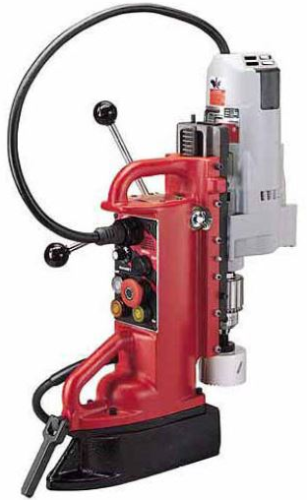
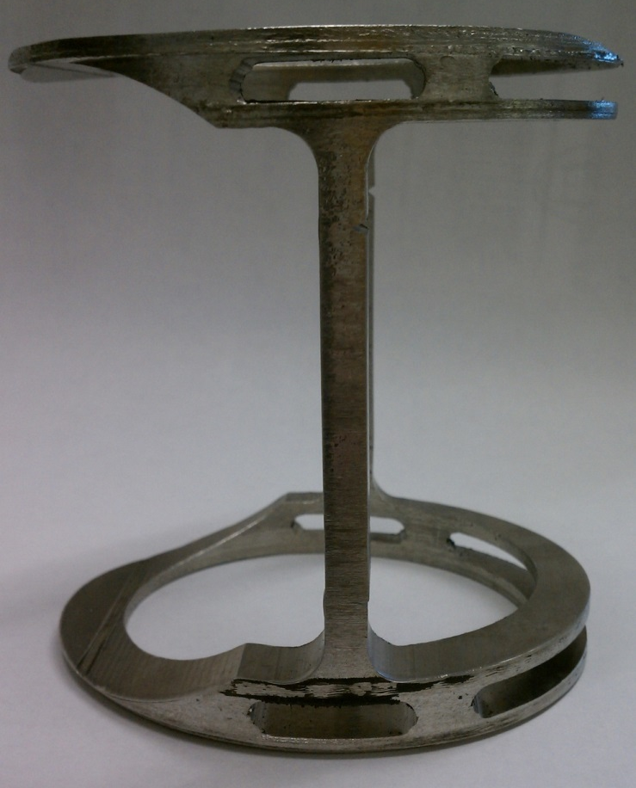
Status as of Last Year to Implement Capability to Sample Hg Pressure Vessel at Multiple Locations
Incorporate modifications to enable drill assembly to be handled remotely
Remove manual handle & incorporate a motor-driven feed and retract system
Remote out the electrical connections for:
Motor on/off
Motor feed/retract
Motor speed
Motor travel
Modify chuck to enable remote replacement of cutters
Mount drill assembly to base plate to enable clamping/alignment/etc.
Remove Magnet Base
T10 “Proof of Principle” Coring

Slide 11
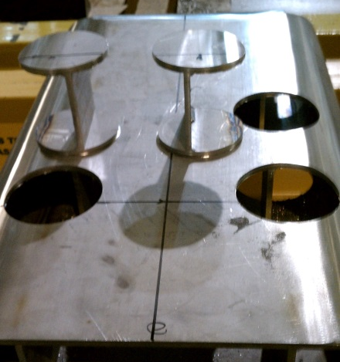
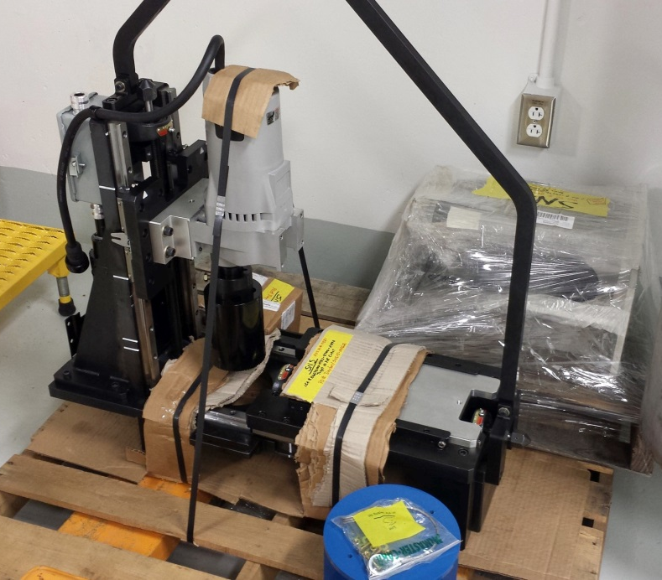
T10 Coring Tool
Completed coring tool modification & validated performance through mock-up tests.
Designed and built fixture to rotate target module to the horizontal when the nose boot & water shroud were removed.
Used the rotation fixture to remotely locate the tool over the leak location.
Alignment Pins

Slide 12
T10 Leak Location
T10 Leak Location

Slide 13
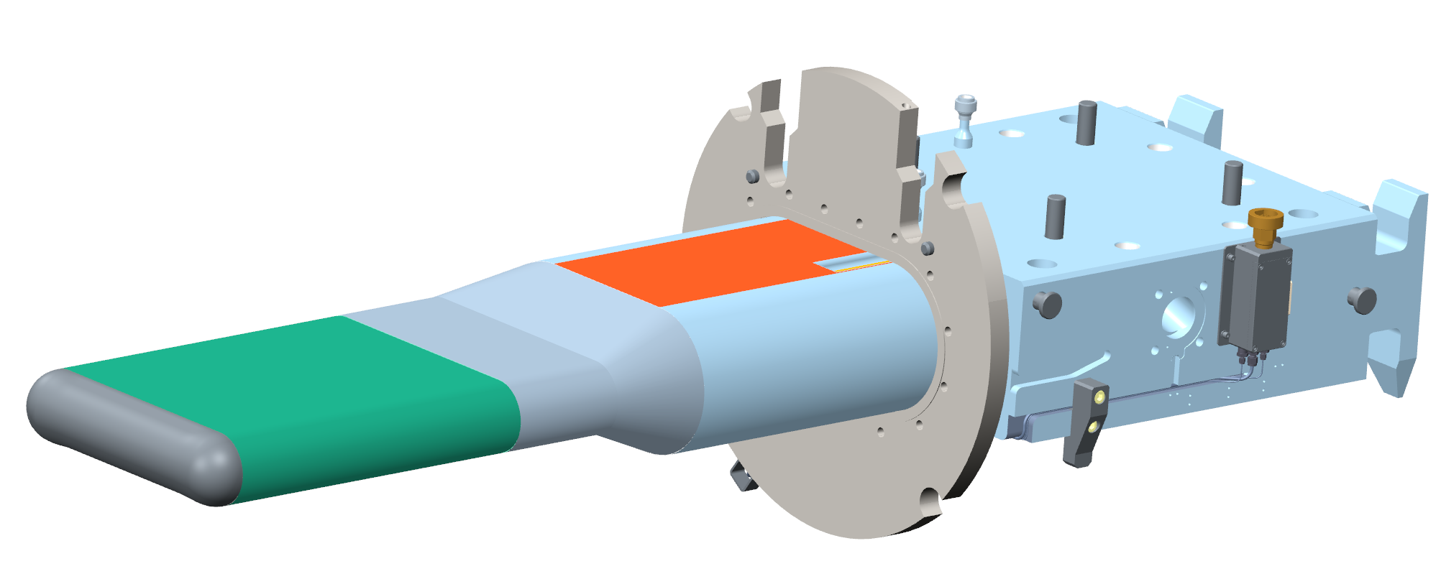
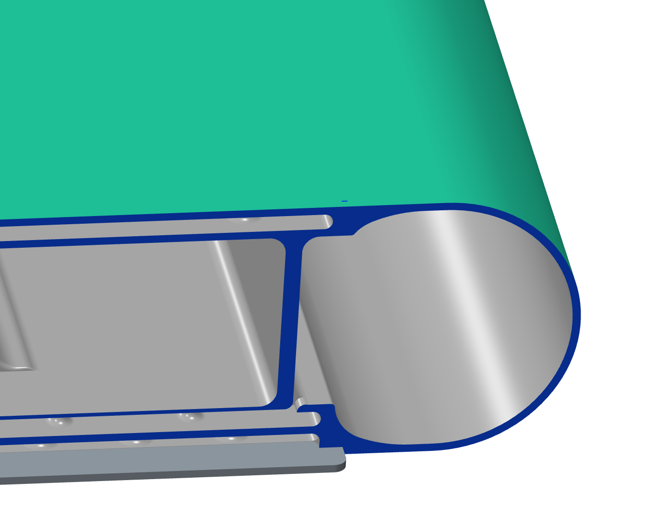
Leak Location
Weld
Transition
Front body
Analysis by Drew Winder
On the top of the target mercury vessel at or near the location where the front body is joined to the transition.
Crack appears to be on the bulk inlet side of the flow, centered in the partial weld penetration section between the window flow and the inlet.

Slide 14
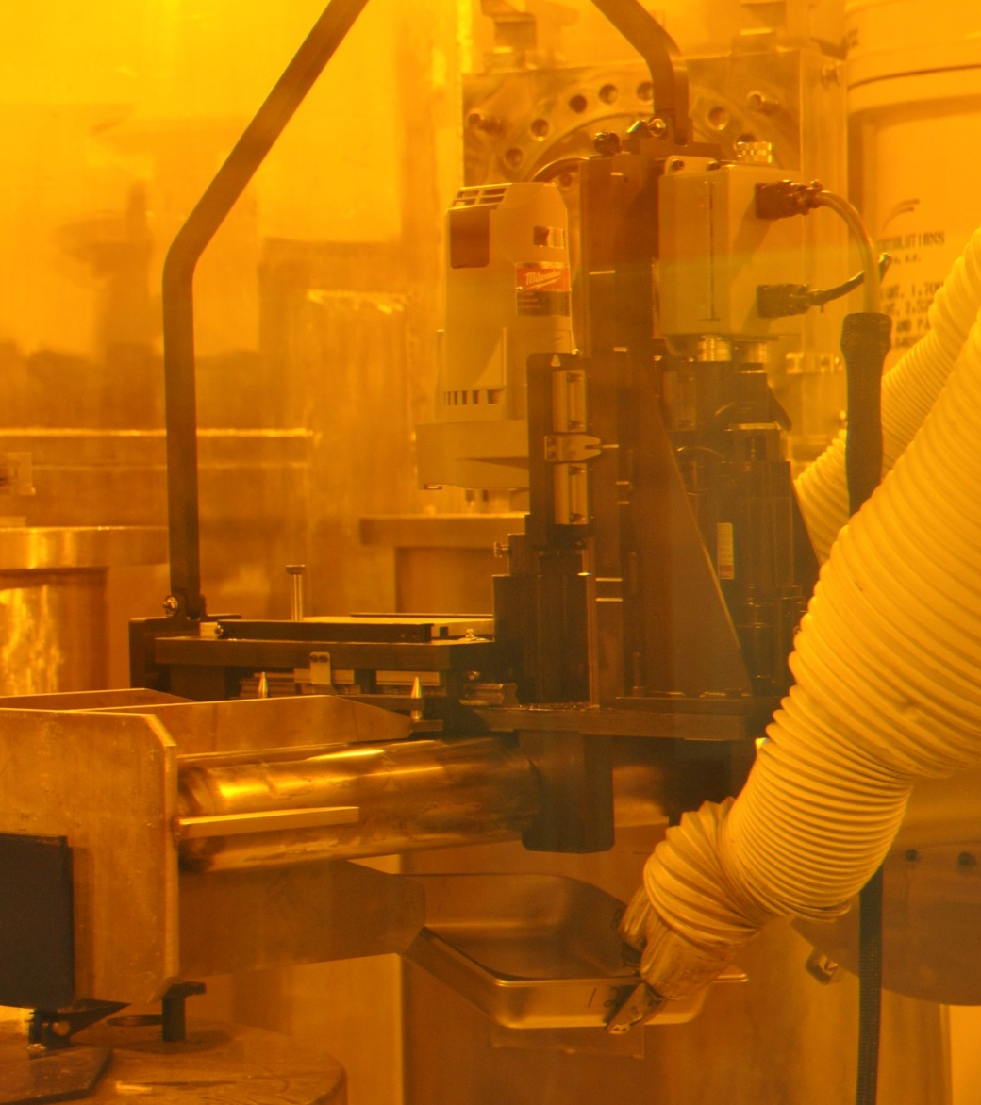
T10 Coring
Longitudinal Alignment Feature
Alignment Pins
Failed Weld Site Sampling
Opposite (Intact) Weld Site Sampling

Slide 15
T10 Coring

Slide 16
TRIP Support—Understanding and Mitigating Impact of Cavitation Damage
The impact of cavitation damage on target lifetime is not quantified.
If the T3 and T12 leaks were the result of cavitation damage, maybe combined with pre-existing flaws and/or lack of design margin, then target lifetimes are limited to several months at present power levels. [Riemer presentation]
Actions:
Maintain and improve capability to sample locations experiencing cavitation damage.
Implement a mercury loop helium gas injection system in parallel with the installation of T15 (MTX-011JF or -012JF). [Riemer presentation]

Slide 17
TRIP Support—Understanding and Mitigating Impact of Radiation Damage
SNS observes the following radiation damage limits:
Target module (316L SS): 12 dpa
PBW
Inconel 718 (SA): 15 dpa
Al 6061-T651: 2,000 appm He (3.6 dpa)
Radiation damage limits are predictable and do not impact the science program predictability.
However, a better understanding can extend component administrative lifetimes and reduce operating costs.
Actions:
Continued gathering material samples from every target module.
Implemented a capability to obtain PBW samples.

Slide 18
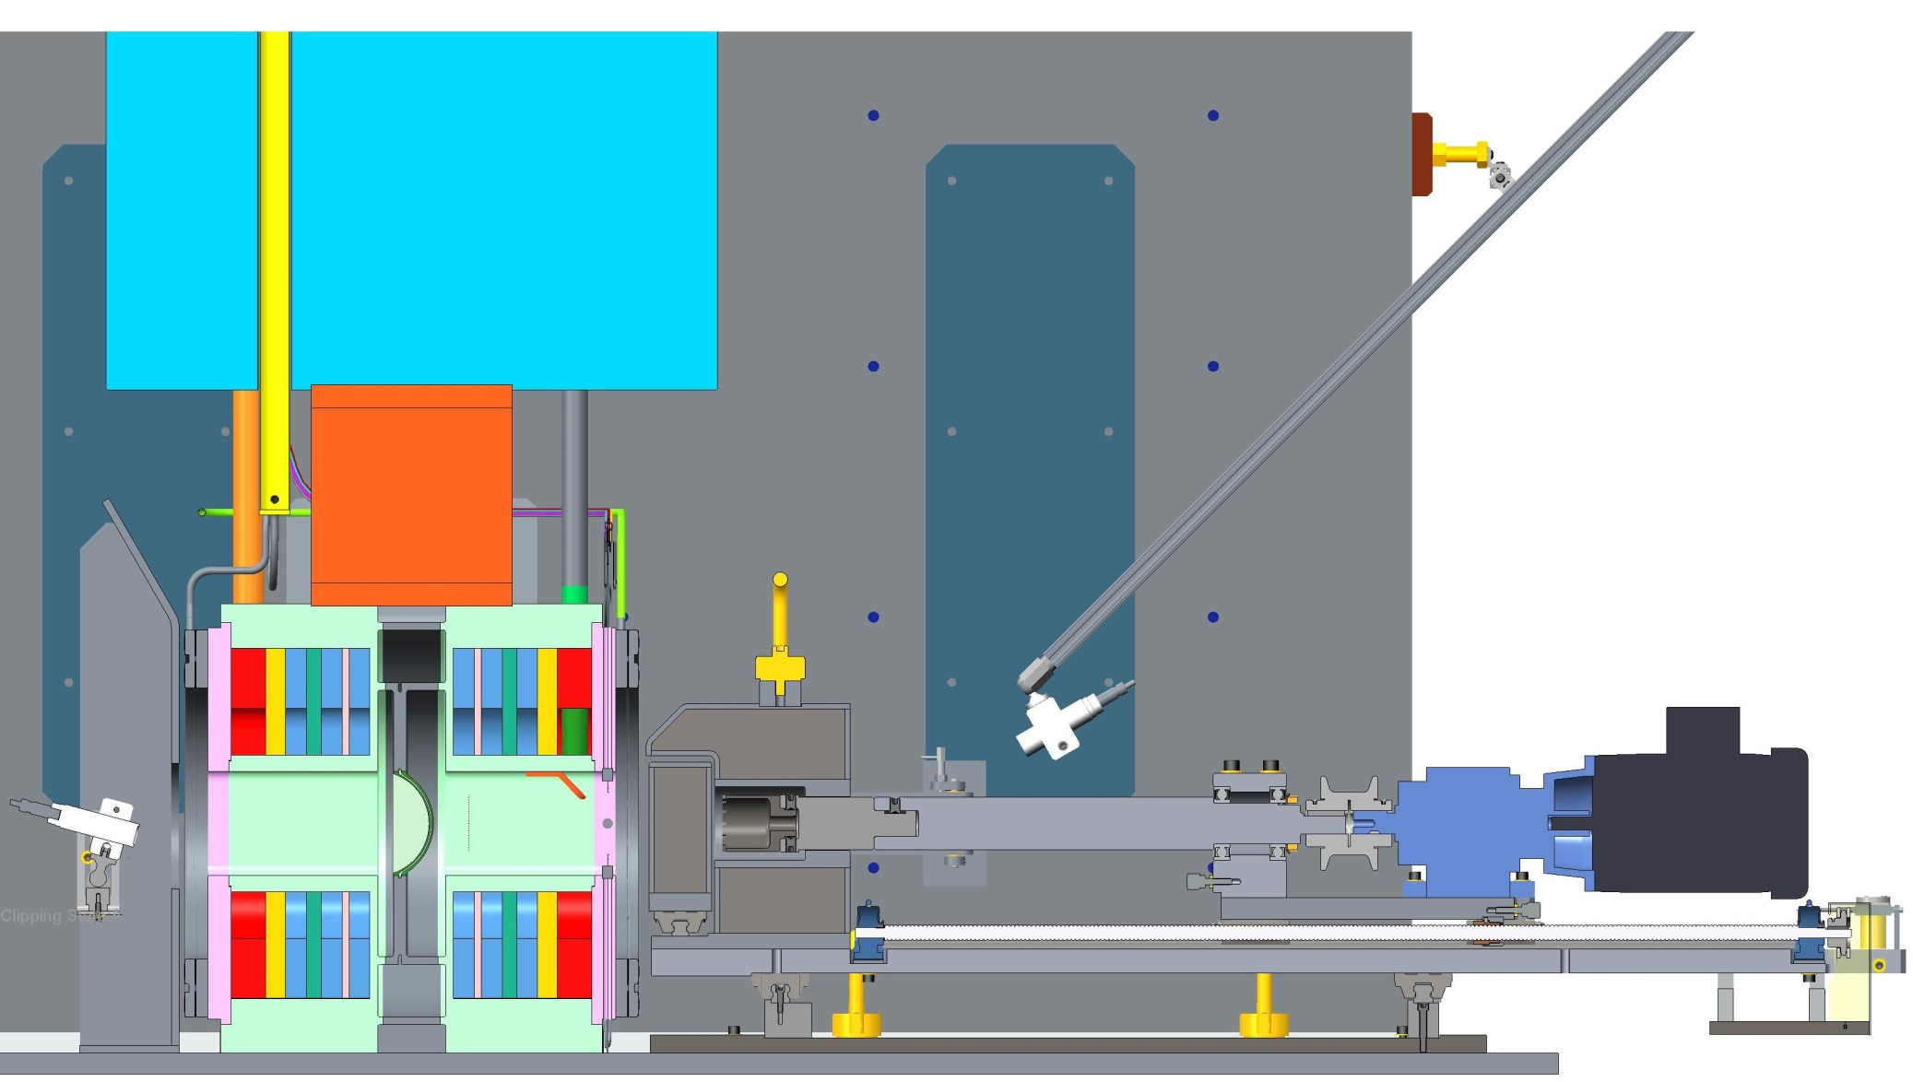
Last Year’s Status: Capability to Obtain an Irradiated PBW Sample Was at the Design Stage
Beam Window
Aft shielded door
Forward shielded door
Steel U-Block (shielding & PBW cask support)
Coring Bit
Cameras

Slide 19
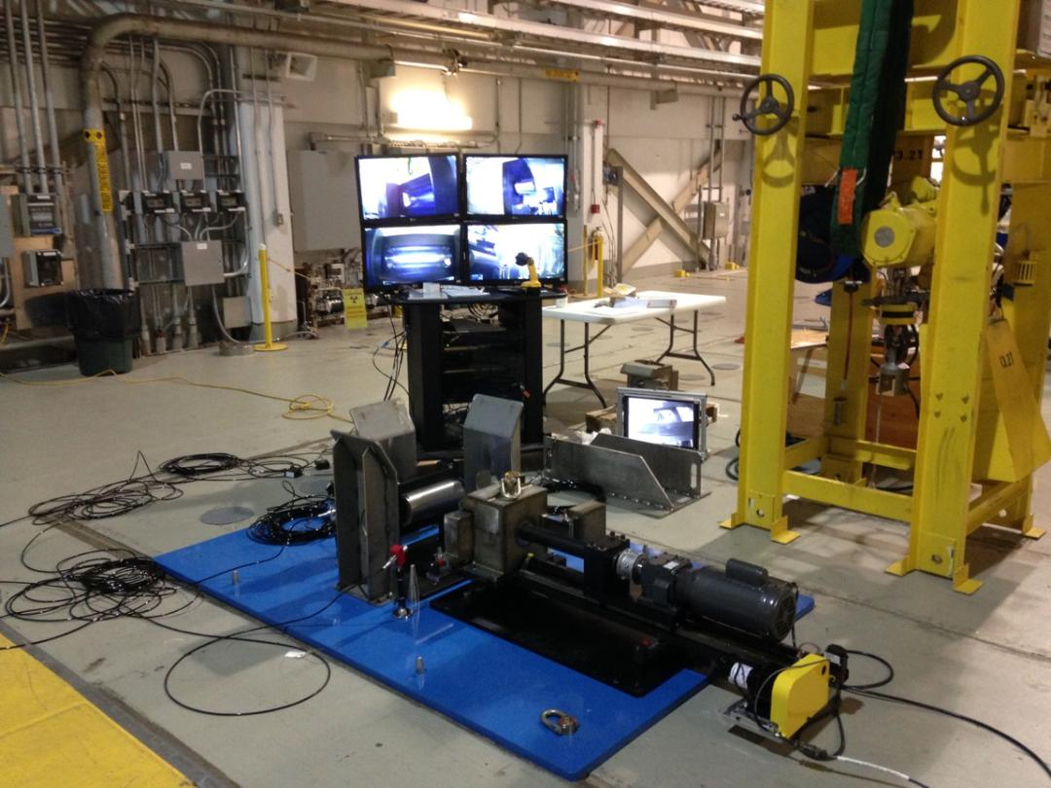
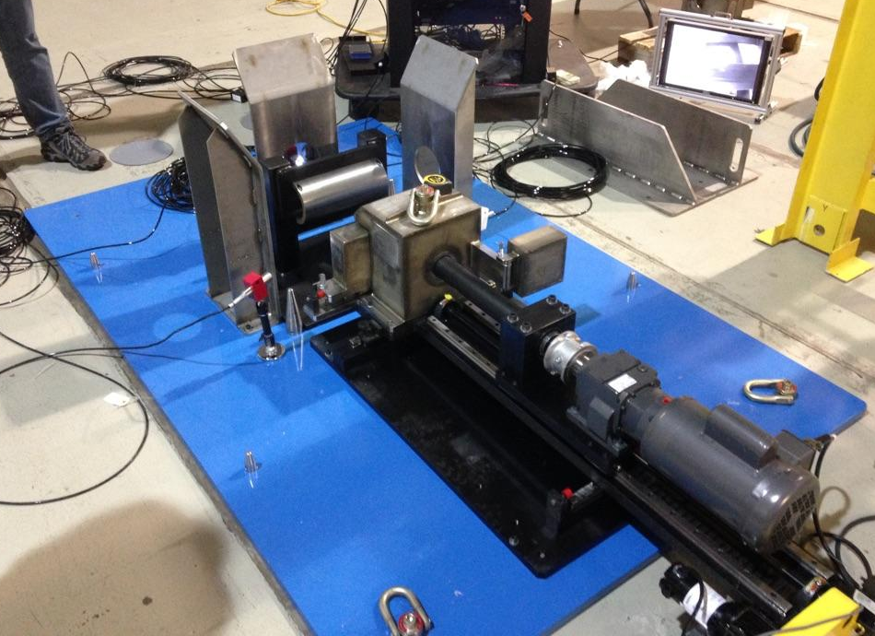
PBW Sampling Mock-up
Validated dry cutting would work & resulting temperatures would not anneal samples.
Determined acceptable cutter & tool speed.
Determined tool location throughout procedure.
Identified disk samples could fall out of the coring bit.
Identified cutter chips would be spread throughout the work area.
Identified over-heating issue with the control box.

Slide 20
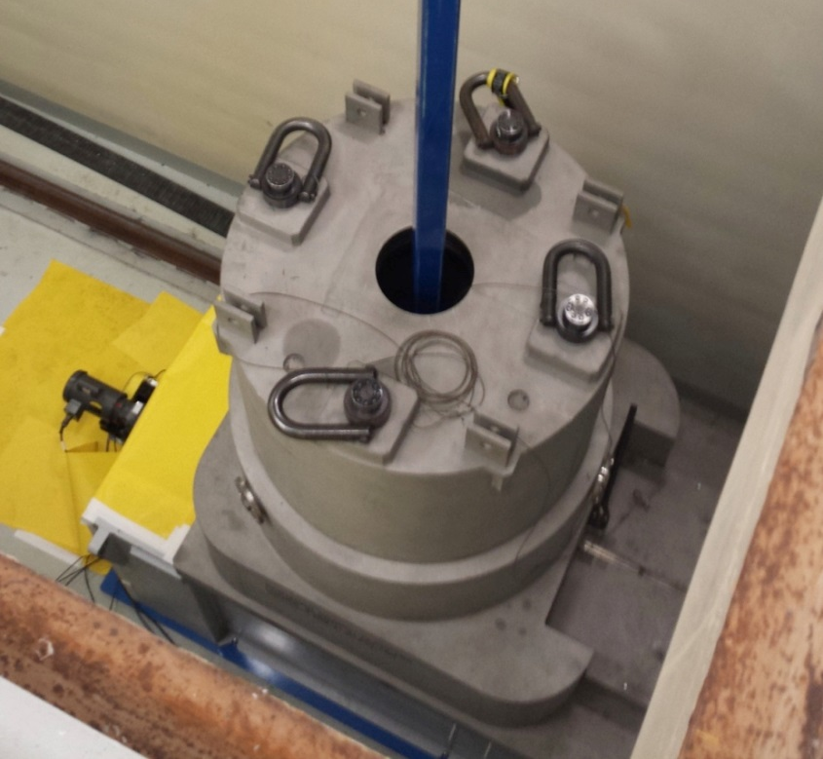
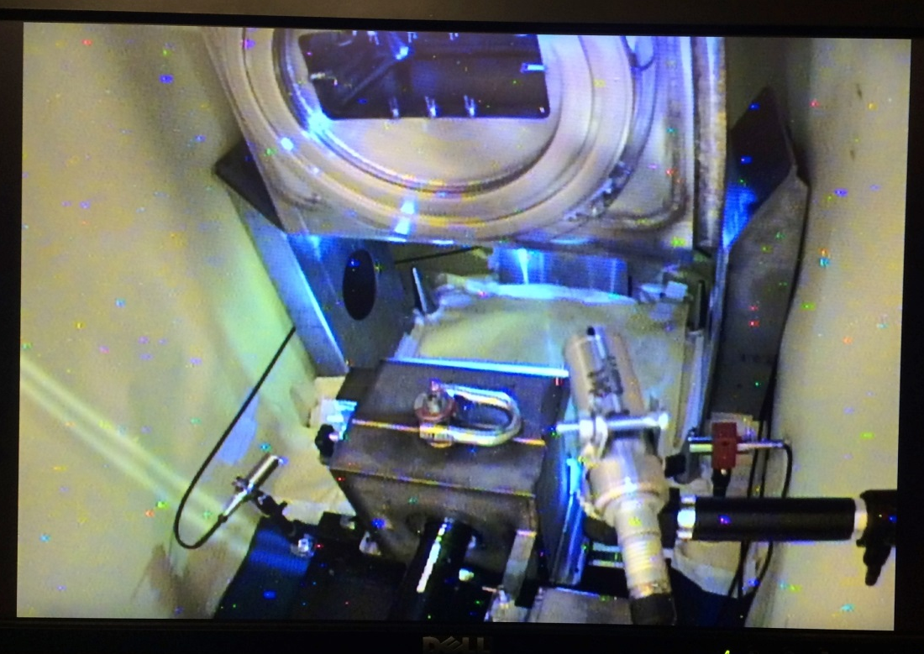
PBW Sampling Prep
Install cutter in Cask Cart Room & line the area with herculite; put the catch tray on the cutter.
Lower the PBW cask onto steel U-block.
Rig crane to the PBW and lower with upstream face toward cutter; install sample catch tray.
Raise PBW and rotate 180º; set it back down.

Slide 21
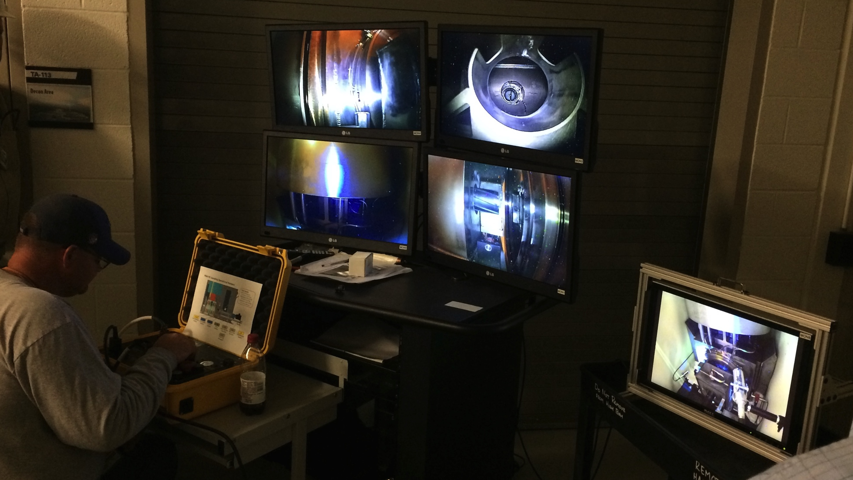
PBW Sampling—make a cut

Slide 22
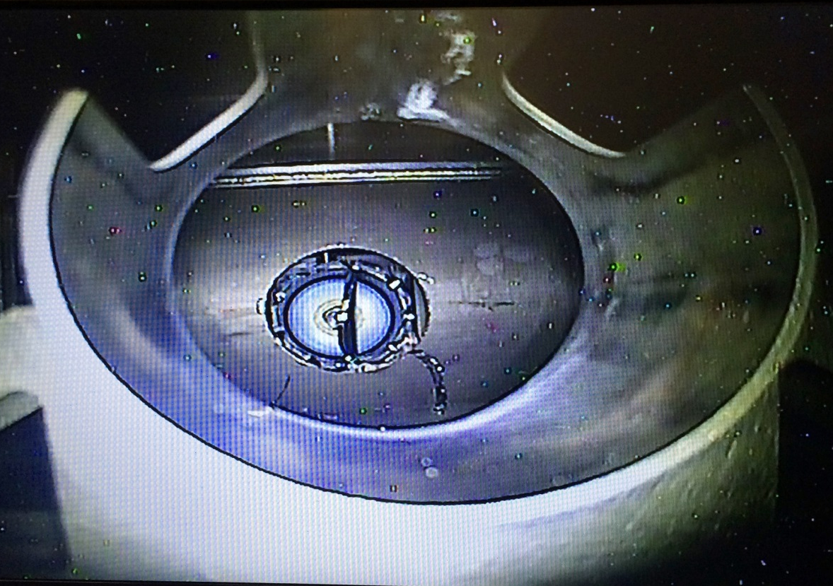
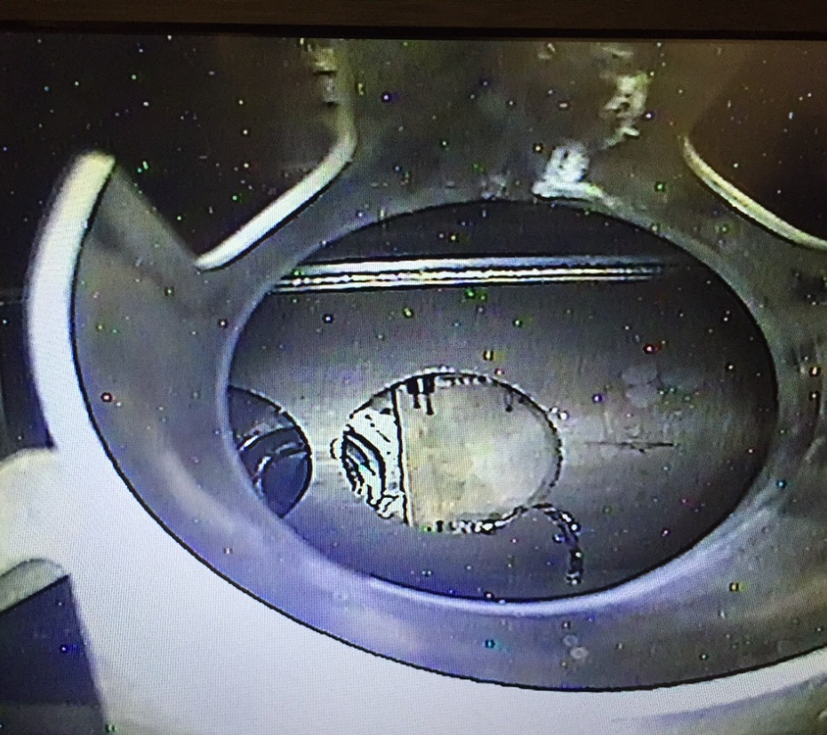
PBW Samples
Center cut was made first—one disk fell into the catch tray.
Survey results (1 rem = 0.01 Sv):
3.6 rem/h @ 2 m from U-block opening (PBW lowered)
Airborne activity while cutting: 3.0 x 10⁻⁴ μCi/ml (11.1 Bq/ml)
Sample cask: 3 rem/h @ contact, 1 rem/h @ 30 cm
Sample cask contamination: 400,000 dpm/100 cm²
Bag used to collect chips from area decontamination: 5R/h (contact)
The off center cut was made after changing sample casks.
Center Cut
Off Center Cut

Slide 23
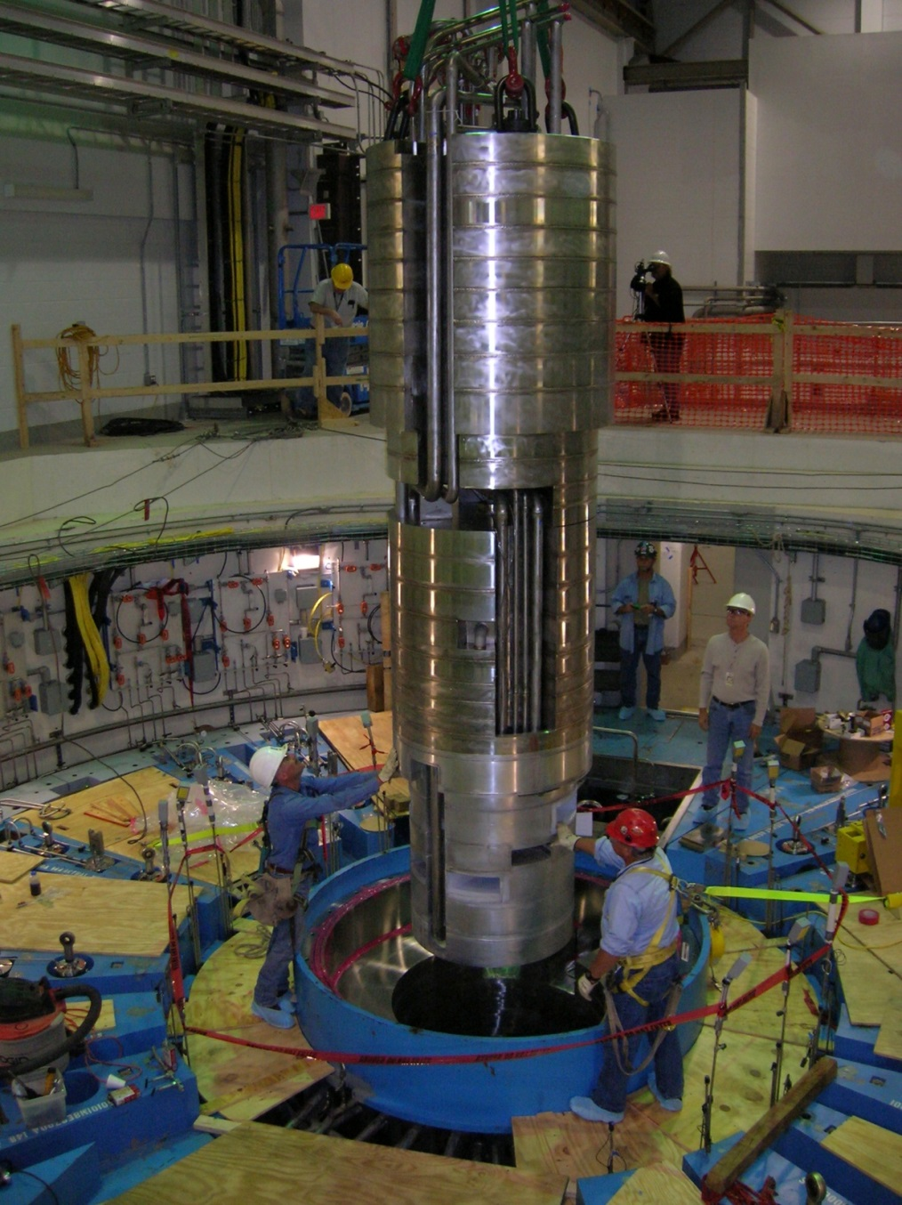
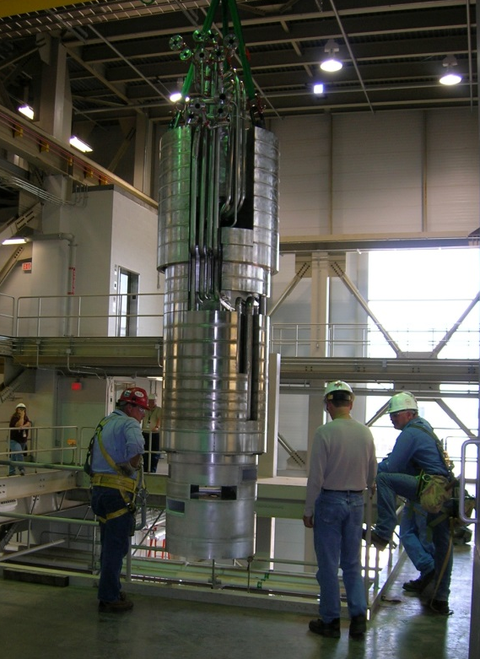
Improve Beam Line Performance with IRP Replacement
Restore poison (cadmium, gadolinium) performance for decoupled moderators.
Convert reflector water loop to heavy water---a 10-20% gain in neutron flux.
~200 mr/h at these locations (no scatter)
Several R/h with scatter off of a new IRP. [F. Gallmeier]
62,800 lbs., 15.5’ tall, ~4’ O.D.

Slide 24
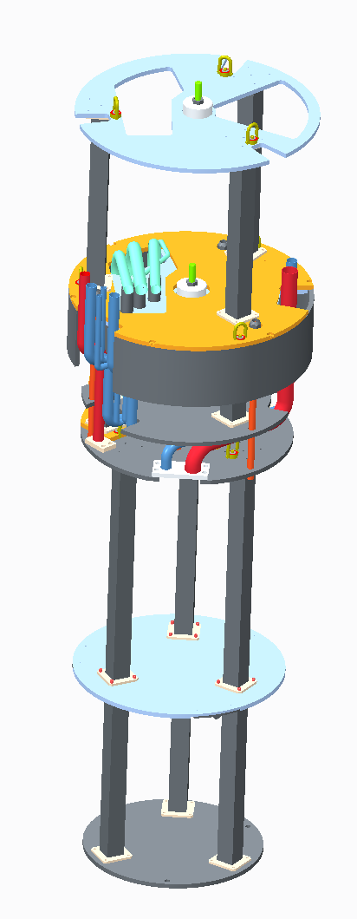
IRP Replacement
Developing an integrated plan that will:
Identify and plan all IRP installation activities from delivery through neutronic performance evaluation,
Deconflict Winter outage activities (e.g., floor space requirements, helium injection system installation, heavy water conversion),
Produce a schedule & identify resources.
Remote Handling
Mock-up IRP segments procured and on-site.
Remote Handling mock-ups to validate procedures and tooling is next.

Slide 25
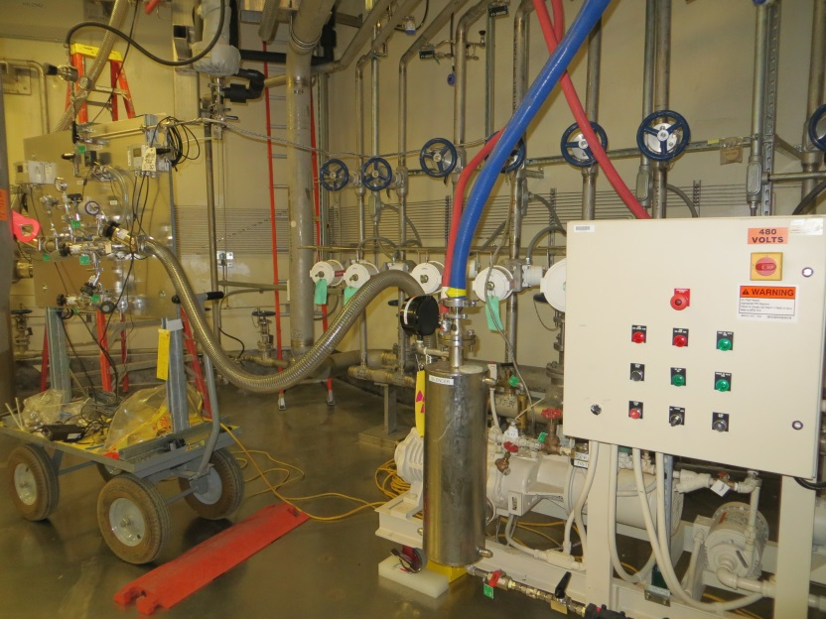
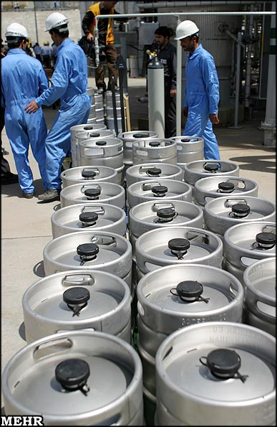
Reflector Water (HWS #4) Heavy Water Conversion
Heavy water procurement has been interesting.
Engaged Chemical Sciences Division to develop chemical analysis procedures and test the 120 containers needed for SNS.
Drying the loop before loading is important to maintain neutronic benefit.10% light water content would reduce neutron flux gain by 3%. [E. Iverson]
Initial reflector water drying test results indicate ~25 days might be required to remove 150 gallons.

Slide 26
Challenges – TN-RAM Cask Availability
One TN-RAM (Type B) cask is shared internationally.
SNS is designed to use TN-RAM cask for target and PBW disposal.
AREVA has built a second TN-RAM cask for SNS and FRIB use. Challenges with impact limiter approval.
Energy Solutions has fabricated a 3-60B cask to be deployed in 2016; it is compatible with SNS design.
Stayed flexible & took advantage of emergent opportunities—only one used target on-site & scheduled for March disposal.

Slide 27
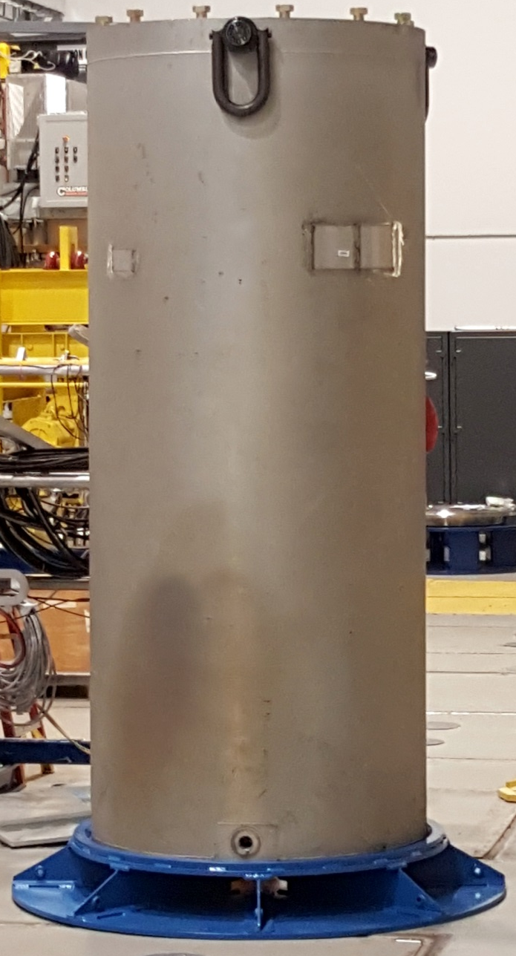
Developed Capability to Store Spent Targets On-site
It was critical to obtain material samples from all used targets, particularly at failure locations, in order to solve target design issues and refine models.
TN-RAM cask availability, Service Bay floor space limitations, and short target lifetimes drove target disposal before sampling.
Two Target Holding Containers (THCs) were available to store targets.
Dimensional differences between the TN-RAM and the THC required a spacer to ensure proper mating of the THC to the Bottom Loading Port.
Storage evaluation & approval was required.
Target Holding Container

Slide 28
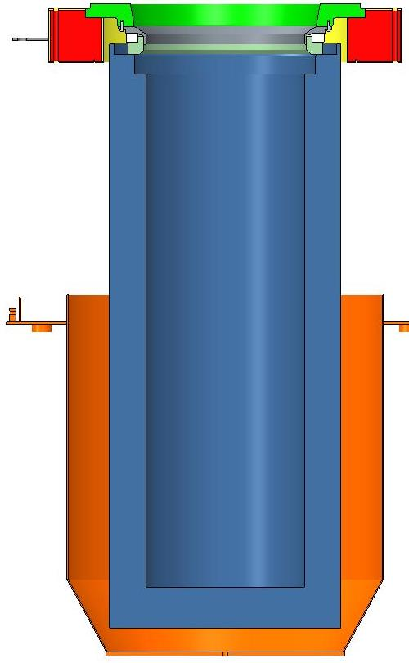
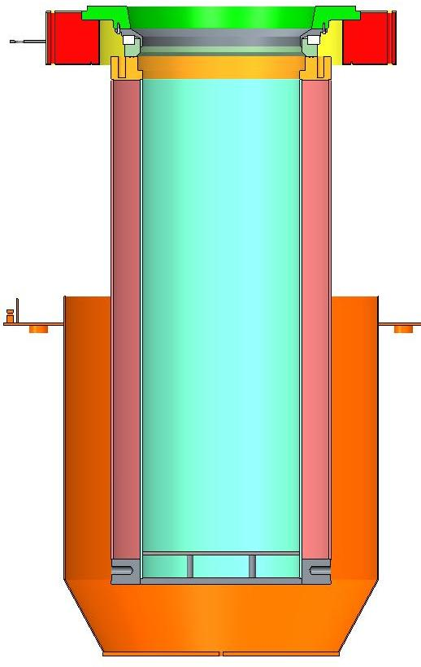
Target Holding Container (THC) Plan
The THC is designed to be used in the same manner as the TN-RAM cask
Approval of on-site target storage outside of the Service Bay in place, equipment in hand, awaiting dry run to validate tooling and procedures.
Bottom Loading
Port
TN-RAM in
nominal mated
position
THC in Cask Cart
Cask Cart
Bowl
5.25” is the
thickness of
the existing
spacer under the
TN-RAM…
5.25”
14.94”

Slide 29
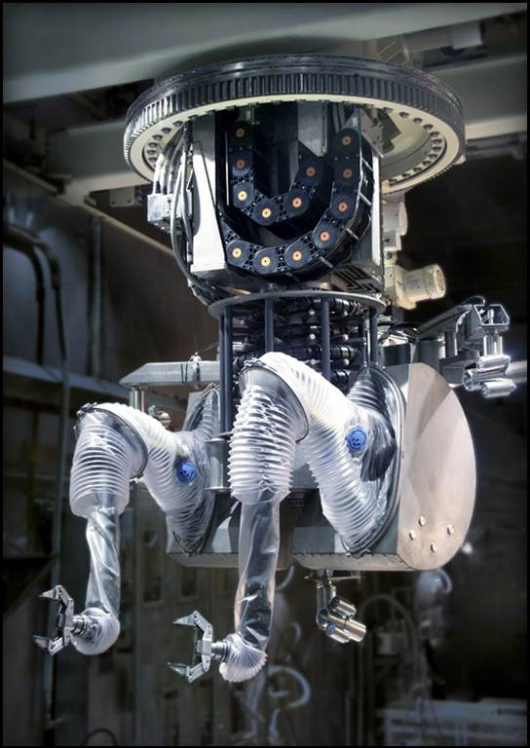
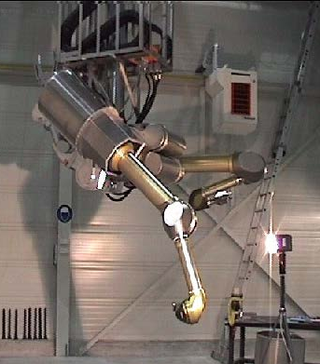
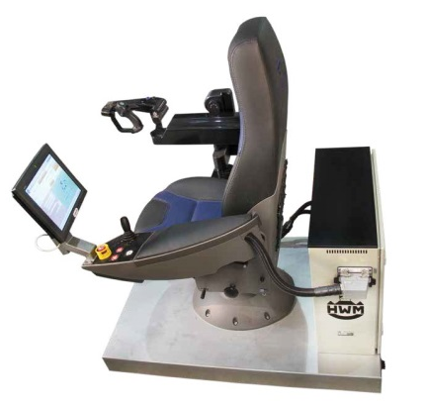
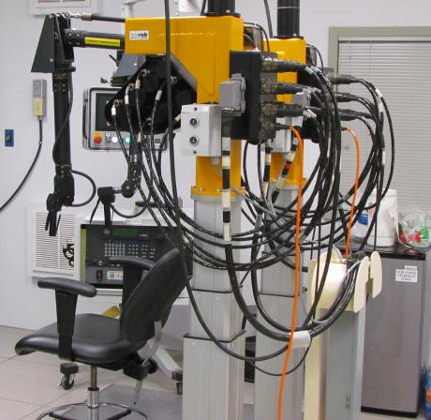
Servo-Manipulator Obsolescence Solution—AIP Funded Replacements
Wälischmiller Engineering GmbH TELBOT
Installed TeleRob GmbH Manipulator

Slide 30
Summary
Major component spares status is OK.
Improved target reliability is fundamental to improved target systems availability.
Efforts to validate models and identify design improvements are critical.
Helium gas injection is the biggest bang for the buck.
The IRP will be replaced and HWS #4 will be converted to heavy water to improve Beam Line performance.
Spent target & PBW storage & disposal is under control.
Servo-Manipulator replacement is necessary.

