Slide 1
The SNS Accelerator Improvement Program
George W. Dodson
Accelerator Advisory Committee
February 16 – 18, 2016

Slide 2
Requirements for an AIP Project
DOE provides AIP funds to SNS for additions, modifications, and improvements to the research accelerator and ancillary equipment facilities to maintain and improve the performance, reliability and efficiency of operations, and to provide new accelerator capabilities. This definition encompasses all systems involved with the production of neutrons for the individual SNS beamlines.
AIPs must result in a deliverable that can be identified and. The AIP deliverable must have an estimated cost greater than or equal to $500,000, less than $10,000,000 and a lifetime of at least 2 years. Fabrication of spares is not allowed in the AIP program (no spare Medium Beta Cryomodule).

Slide 3
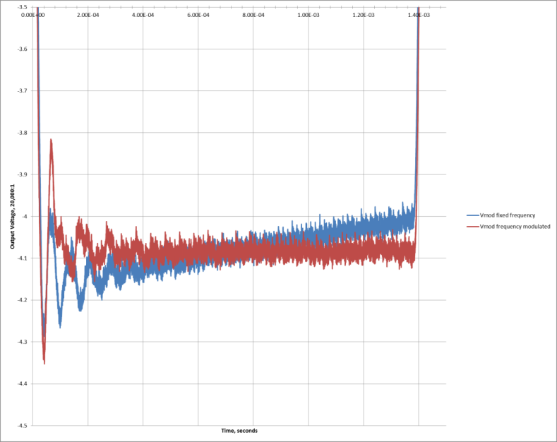
From FY 2013, the AIPs have been directed towards Reliable, Sustainable 1.4 MW Beam Operation
AIP 34 - HVCM Improvements (High Voltage Pulse Flattening and RF Control Margin)
Complete Snubber/Gate Driver Deployment – All production HVCMs have been upgraded with the new IGBT gate drives. All but 3 have snubbers installed. The rest will be completed on Maintenance Days.
Develop, Test and Deploy New Controller – 4 have been installed: SCL-Mod18 in summer, 2015 and DTL-Mod5, CCL-Mod4, and SCL-Mod14 in winter shutdown. Continue deployment. Operating accelerator with Pulse Flattening on DTL Mod5 and SCL Mod 18! Droop at end of pulse reduced by factor of 10. Gives RF control margin.

Slide 4
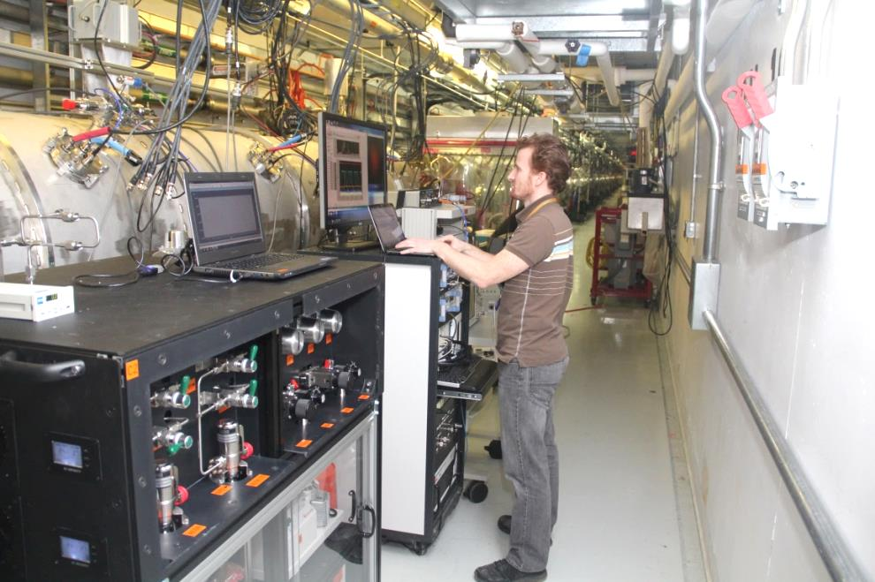
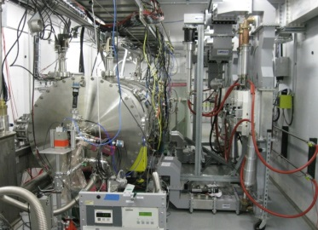
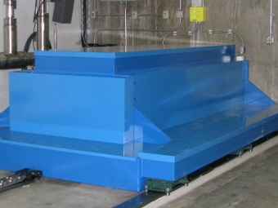
Reliable, Sustainable 1.4 MW Beam Operation
AIPs 13 and 25 - Develop SRF Infrastructure and R&D for Cavity Gradient Improvement using the Vertical Test Apparatus, Horizontal Test Apparatus (Beam Energy)
Cryogenic Test Facility (2K) with VTA and HTA in Test Cave – Completed in FY15
Although not an AIP, the plasma processing R&D relied on this infrastructure. This lead to the first in-situ Plasma Processing of an SNS cryomodule in the winter shutdown.
Test cave
First in-situ plasma processing of a cryomodule in the SNS linac tunnel.
VTA

Slide 5
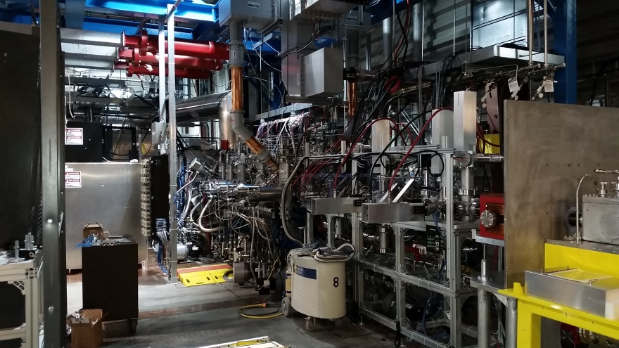
Reliable, Sustainable 1.4 MW Beam Operation
AIP-30 Integrated Test Stand Facility (Beam Current) – Installation Mostly Completed, Preparing for ARR
Test Stand for the acceptance testing with beam of the new RI RFQ
LEBT, Ion Source, Beam Instrumentation, Neutron Moderators development

Slide 6
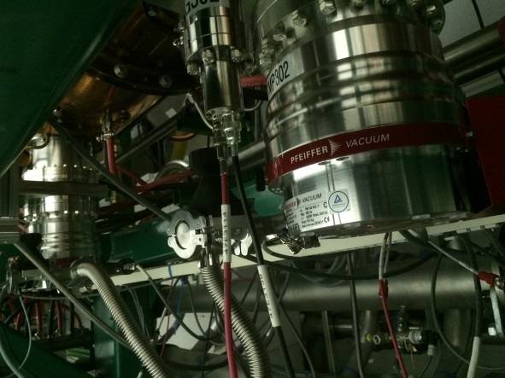
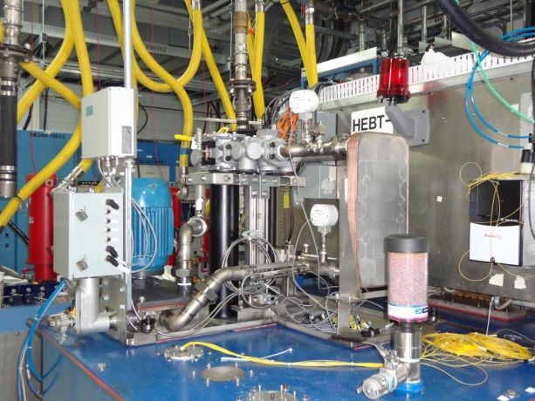
Reliable, Sustainable 1.4 MW Beam Operation
AIP-35 Warm Linac Vacuum Upgrade (Reliability) – DTL Complete, CCL, MEBT Underway
Replaces Ion Pumps with large Turbopumps more suited to large accelerating structures with many “O” Rings. Reduced RF Trips due to vacuum bursts. Reduced RF Processing time.
AIP-36 HVCM Cooling System Upgrade (Reliability) – Prototype Completed and Tested Funding Start in FY2016
Upgrade dramatically improves cooling to reduce component overheating damage. Will also reduce oil degradation and downtime due to improved oil flow, external pump, heat exchanger and oil filter(s).

Slide 7
Reliable, Sustainable 1.4 MW Beam Operation
AIP -39 Machine Protection System (MPS) Upgrade (Obsolescence Mitigation) – Start in FY2016
Replace obsolete, unavailable components and reduce system complexity. The current system is incapable of supporting PPU due to the unavailability of hardware components required to expand the system scope for these installations.
AIP 37 - Beam Instrumentation Infrastructure Upgrade (Obsolescence Mitigation) – Start in FY2016
Replace obsolescent custom components with COTS solution and improve system performance. An example:
Obsolete Custom IBM-PC XP-OS Motherboard dead-end system
replaced by
NI COTS PXIe and FlexRIO with a
RT-OS and an upgrade path

Slide 8
Future Improvements Planned Using AIP Funding
AIP 46 - Warm Linac Magnet Power Supply and Controller Upgrade – Future
Replace obsolescent components, standardize power supplies and controllers for MEBT, DTL and CCL
AIP 38 Design, Prototype, Fabricate and Test new DTL and CCL RF Coupler
New, improved DTL and CCL Couplers – Prototypes Completed – Future Funding
AIP 42 Warm Linac RCCS Upgrade
Will add redundant pumps, increased capacity, flexibility, instruments and controls for full current beam operation and the capacity to increase for the future PPU needs – Future Funding

Slide 9
AIP Funding and Spending FY 2007-2015

Slide 10
Planned and Budgeted FY 2015 AIPs
 |  | FY 15 |  |  | FY 16
AIP Number and Description | Total Project Cost | FY 15 Total Scheduled BA | Costed & Committed FY15 | FY 15 Carryover | Carryover from FY14 and New BES FWP | FY16 New BA Request | FY 16 Total Scheduled BA | Costed & Committed FY16
AIP-25 Cryogenic Test Stand Facility | $ 5,920,513 | $ 628,567 | $ (621,979) | $ - | $ - | $ - | $ -
AIP-30 Integrated Test Stand Facility | $ 2,516,000 | $ 820,742 | $ (697,512) | $ 53,760 | $ 241,102 | $ - | $ 187,342 | $ (31,115)
AIP-33 Small Scale Chemistry | $ 2,623,000 | $ - | $ - | $ - | $ - | $ - | $ -
AIP-34 New HVCM Controller | $ 2,000,000 | $ 903,979 | $ (444,608) | $ 288,205 | $ 288,205 | $ 364,632 | $ 652,837 | $ (60,548)
AIP-35 Warm Linac Vacuum | $ 5,315,142 | $ 3,455,590 | $ (3,024,017) | $ 420,416 | $ 737,721 | $ 1,000,000 | $ 1,737,721 | $ (507,501)
AIP-36 HVCM Cooling Upgrade | $ 1,189,000 | $ - | $ - | $ - | $ - | $ 285,368 | $ 285,368
AIP-37 Beam Instrumentation Improvements | $ 2,500,000 | $ - | $ - | $ - | $ - | $ 250,000 | $ 250,000
AIP-38 DTL-CCL Couplers | $ 1,030,000 | $ - | $ - | $ - | $ - | $ - | $ -
AIP 39 Machine Protection System Improvements | $ 3,360,000 | $ - | $ - | $ - | $ - | $ 100,000 | $ 100,000
AIP 42 Warm Linac Resonance Control System (RCCS) Upgrade | $ 590,000 | $ - | $ - | $ - | $ - | $ - | $ -
Subtotal Accelerator Improvement (AIP) |  | $ 5,808,878 | $ (4,788,116) | $ 762,381 | $ 1,267,028 | $ 2,000,000 | $ 3,213,268 | $ (599,164)
We costed/committed ~ $4.8 M in AIP funds in FY15 and had $0.76 M in carryover. With $2 M in FY 16 we will:
Complete AIP30, the ITSF
Complete AIP 34, the Warm Linac Vacuum except for CCL 1, 2
Complete AIP-35, the New HVCM Controller
Start AIP 36, the New HVCM Cooling Upgrade
Start AIP 37, the Beam Instrumentation Improvement Upgrade
Start AIP 39, the Machine Protection System Upgrade
In FY 17 we plan to start:
AIP 46, Warm Linac Magnet Power Supply and Controller Upgrade

Slide 11
Other Major Needs – Not AIPs
Spare Medium Beta Cryomodule $2M
CCL Klystron Second Vendor Startup $2M
Additional RF Circulators $1M
Replacement Remote Handling Robot $2M
All non-AIP costs are hardware-only

Slide 12
Summary
We control an active AIP Process.
AIPs have shifted over the years from addressing design problems with the original equipment base to what we need for sustainable operation.
This includes a recent emphasis on Obsolescence Mitigation.
With an installed equipment base of ~$700M, an AIP budget of $2.0 M/Year is not sustainable.

