Slide 1
Operational Performance and Development Projects for
Magnet Power Supplies, Kickers, and Choppers
Robert Saethre
Team Lead
February 17, 2016

Slide 2
Outline
Operational Status of Magnet Power Supplies, Kickers, and Choppers Team’s Responsibilities
Magnet Power Supplies
  New Standard for Linac Quadrupole Magnets
LEBT Choppers
  Development of faster switching to enable longer beam pulses in Ring
Injection and Extraction Kickers
  Development for better reliability and higher beam energies for the Proton Power Upgrade and Second Target Station

Slide 3
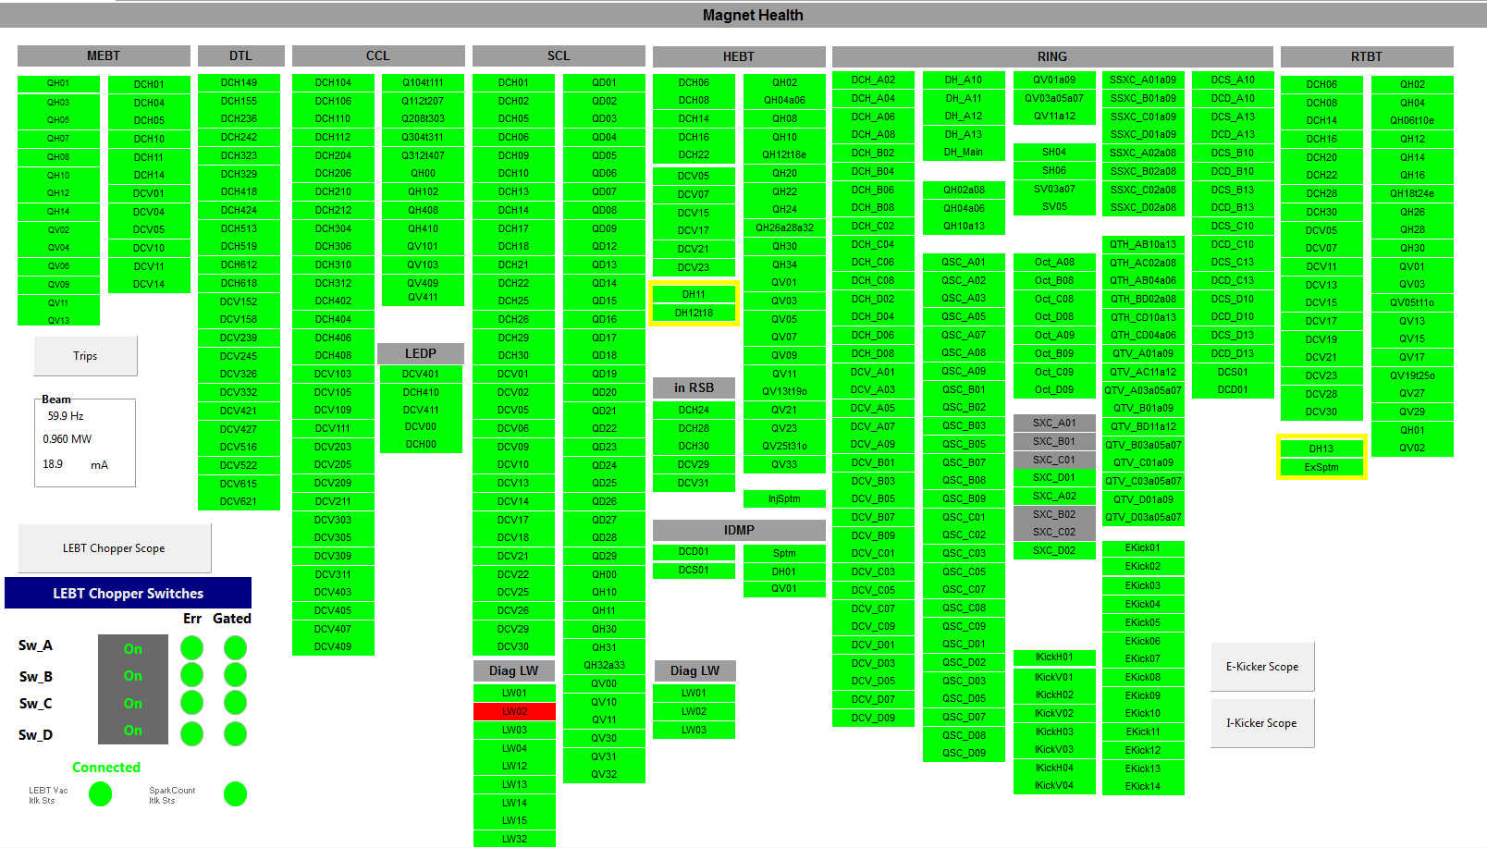
Magnet Power Supplies, Kickers, and Choppers Team Responsibilities
511 Power Supplies
14 Extraction Kickers
8 Injection Kickers
4 LEBT Choppers
8 Manufacturers
  Alpha, IE Power, Kepco, Magna, Ametek, ALE, DEI, TDK
26 Models
6 Control Interfaces
Team:
Vladimir Peplov, Ben Morris, Joey Weaver, Ken Fowkes

Slide 4
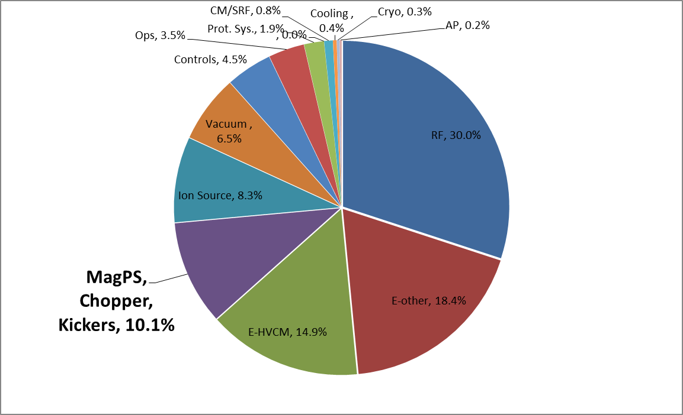
FY15-16 ytd Downtime by System

Slide 5
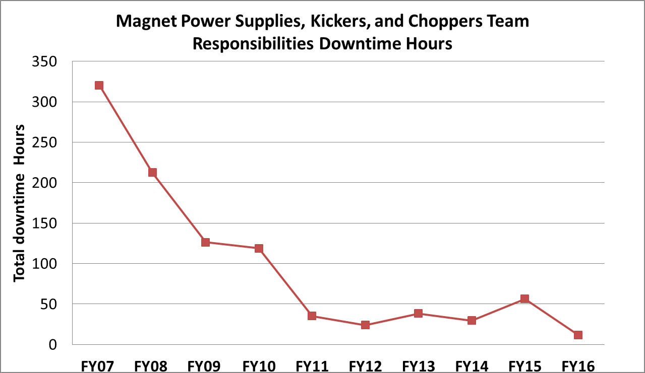
Hours of downtime for Magnet Power Supplies, Kickers, and Choppers are decreasing
FY15 increase due to SCL water leaks and MEBT Quad failures

Slide 6
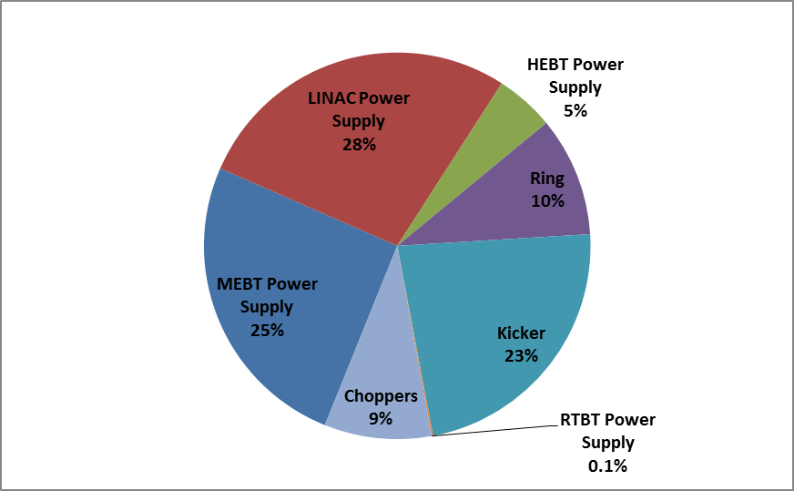
FY15-FY16 ytd Mag PS, Kickers and Chopper downtime by subsystem

Slide 7
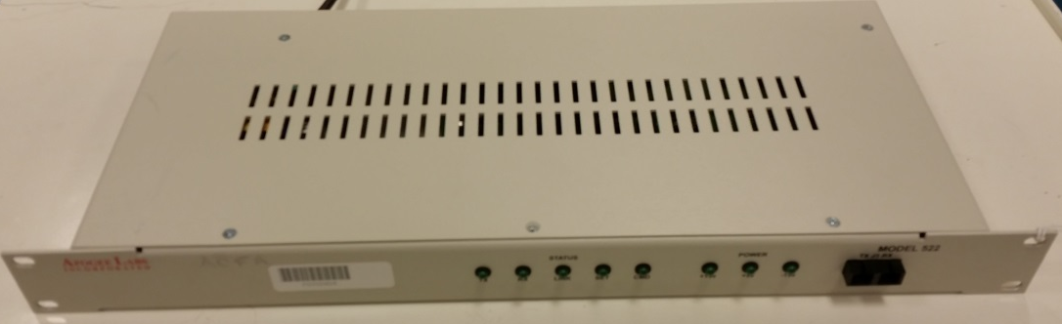
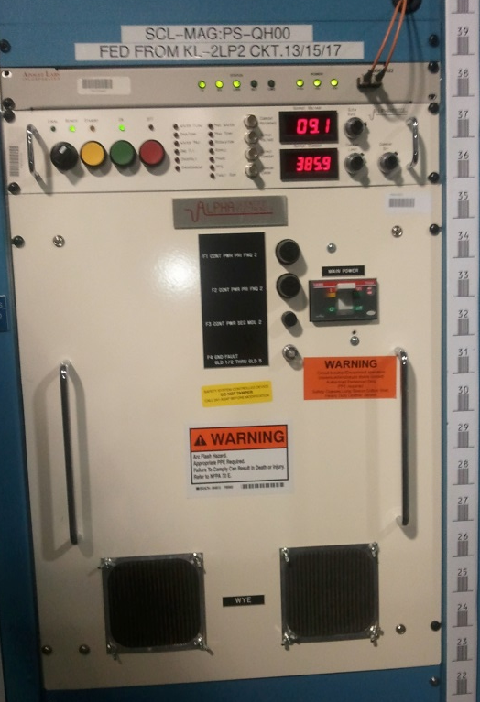
Magnet Power Supply Issues
Power Supply Interface (PSI)
  Obsolete parts
  Custom design from BNL
  Need to develop upgrade
  path
Linac Quadrupole Power Supplies
  Multiple Vendors and models
  Air/ Water cooling
  Low efficiency
  Large size 16U
HEBT, Ring, RTBT
  Custom Spares
  Many parts are becoming obsolete

Slide 8
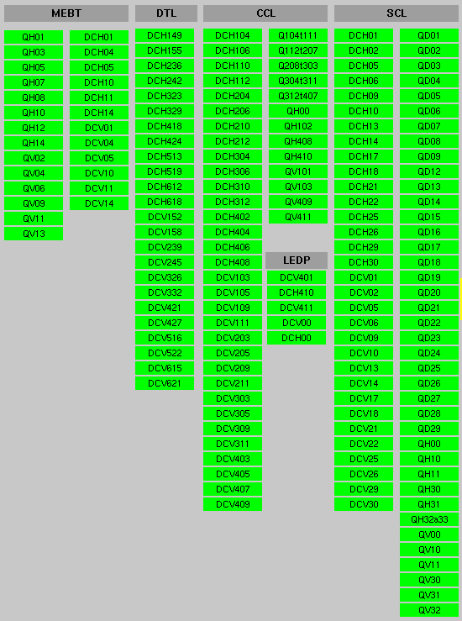
Propose a New Standard Linac Power Supply to replace 58 units in MEBT, CCL and SCL
Currently have
4 different
manufacturers and 6 different models
MEBT Quads:
14 Magnets
Low Current Correctors are not included
SCL Quads:
39 Magnets
CCL Quads:
8 Magnets
Funding under AIP46 is proposed

Slide 9
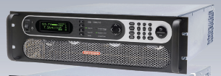
Proposed New Standard Linac Power Supply for Quadrupoles
Requirements
  Small 3U chassis
  10 kW, 20V, 500A
  1000 ppm Stability
  Remote Control
  Efficiency > 85%
  Air Cooling
    Front to back air flow
    Removes 47 Units from DI Water system
    Average 400 Watts of loss per power supply
      Measured heat to air for SCL Quads is >1600 Watts
  Plug and Cord AC input

Slide 10
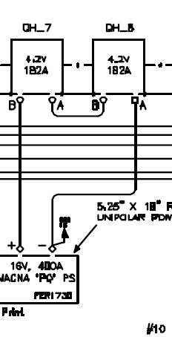
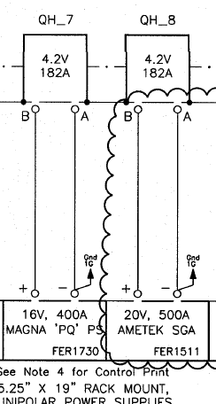
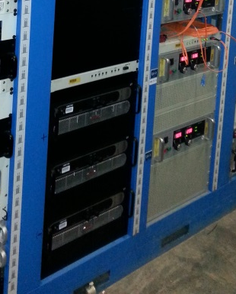
3 New MEBT Power Supplies demonstrate standardization concept
Installed 3 new supplies in front end rack 15 during this winter outage to separate QH5 from QH10, QH7 from QH8, QV6 from QH9

Slide 11
Plan for Magnet Power Supplies
Standardize Linac Quads power supply
  Propose to convert to standard in next 5 years
Develop plan to address PSI obsolescence
  Correctors, HEBT, Ring and RTBT power supplies are not easily replaced so a control scheme is required
  Utilize recovered PSI controllers from Linac for spares until long term PSI replacement available
Implement a test plan for spare power supplies and components in storage
  Test every two years
  Requires a test facility for larger systems

Slide 12
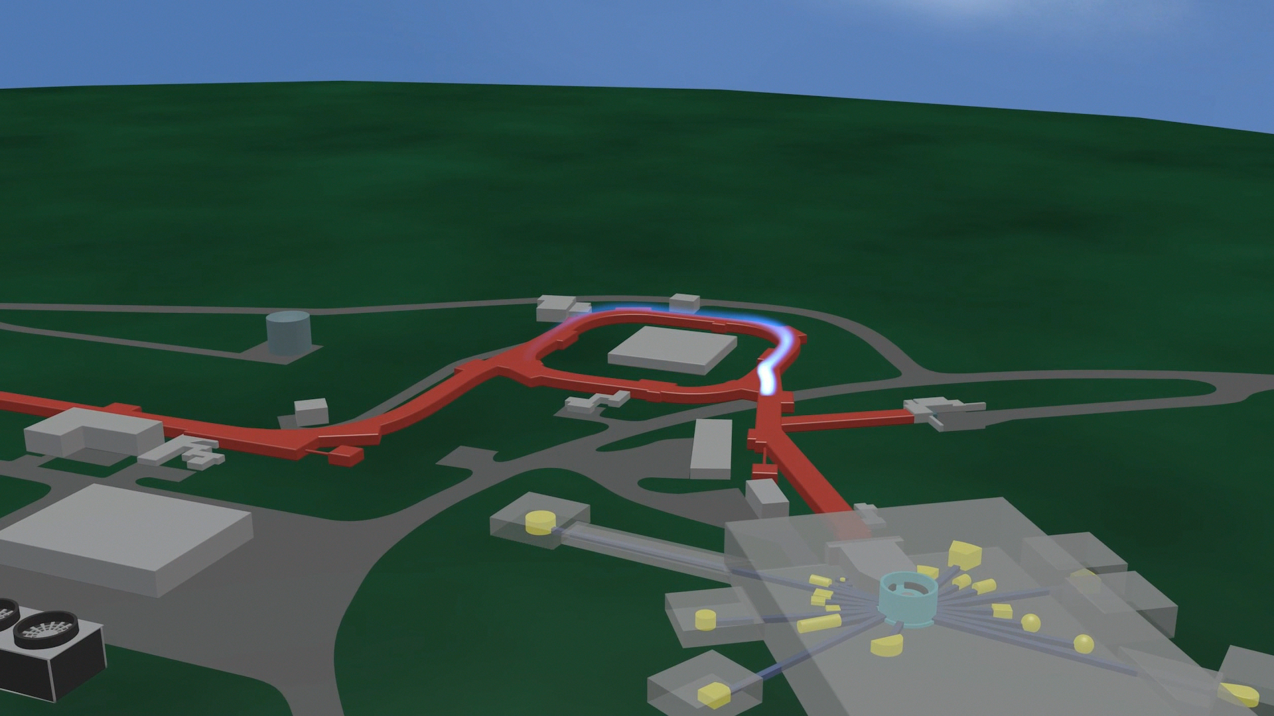
Overview of LEBT Chopper Pulser, Injection and Extraction Kicker Systems
LEBT Choppers in the Front End
  Create mini-pulses to provide a gap in beam for ring extraction
  Faster LEBT rise and fall times allow for smaller gaps → more beam in the accumulator ring
  Chopping fraction is the amount of beam fill to total ring length
Injection Kickers in the Ring
  Analog modulators create arbitrary current profiles
  Injection Beam painting in Ring is used to distribute beam space charge
Extraction Kickers in the Ring
  Fire during gap created by LEBT Chopper
  Deflects beam from Ring to Target
  Timing instabilities cause losses limiting minimum gap

Slide 13
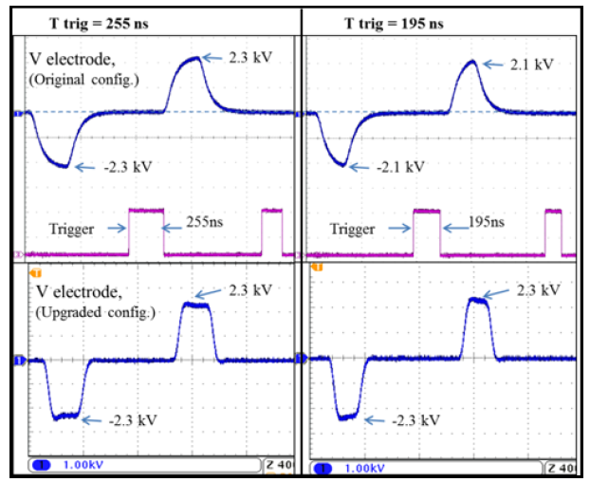
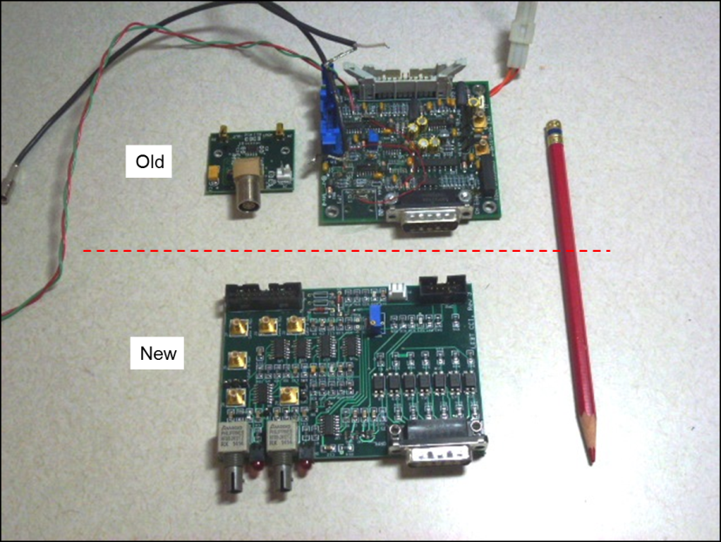
LEBT Chopper Pulser Issues and Development
Better reliability since FY12 due to improved Gate Drive design which limited failure caused by arcs in LEBT structure
Optical isolation of triggers eliminates recent hot swap failures of input trigger receiver
Reduced rise/fall times allowed minimum pulse widths to be reduced from 255 ns to 165 ns
Smaller gaps in the Ring equals higher chopping fraction
Pulse width reduction is limited to 195 ns by E-Kicker jitter causing losses during extraction

Slide 14
LEBT Chopper Ramp Down feature uses Ring RF to clean gap to allow for extraction kicker jitter
Ramp-down
New features
Flat-top
Ramp-up
Spin-cycle
  ~5-10% increase in “average un-chopped” fraction may be possible
  Ramp down feature implemented during this Winter’s outage

Slide 15
New development of Smart Chopping for even more beam in Ring
Smart chopping takes concept of RF beam gap clearing further by creating smaller gaps and adjustable patterns
Development of new LEBT chopper pulsers and stable extraction kickers are required
  Reduce the minimum LEBT chopper pulse widths to 120 ns for higher chopping fractions
  Update LEBT Chopper trigger controller to take advantage of the new operational modes
  Extraction kicker timing stability less than +/- 5 ns

Slide 16
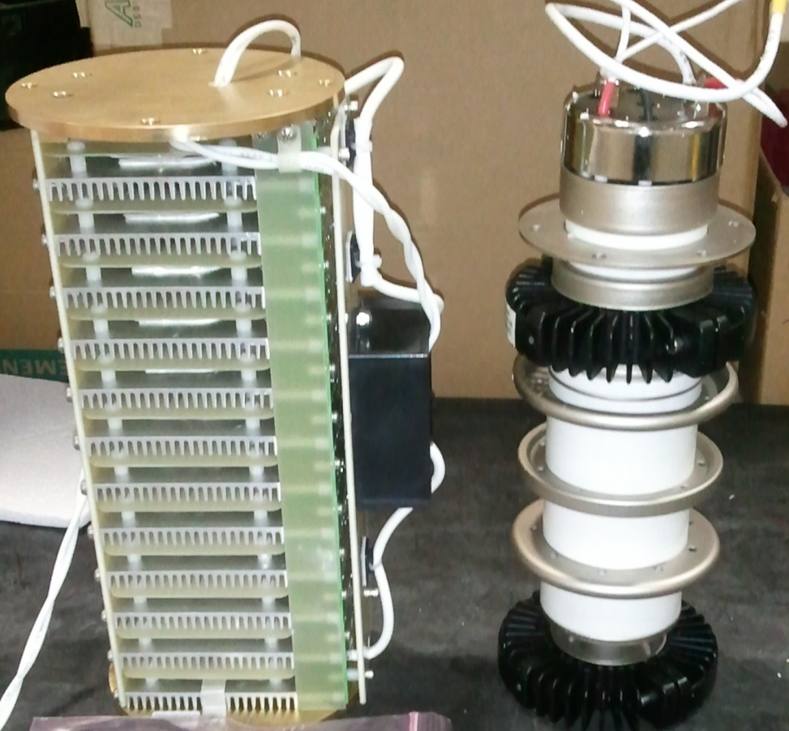
Extraction Kicker Issues and Development
Thyratron timing instability is greater than +/- 50 ns
Usable life of ~13,000 hours
Filament and Reservoir Heater power supply upgrades have improved thyratron stability
Solid State Switch under development
Solid State Switch Thyratron

Slide 17
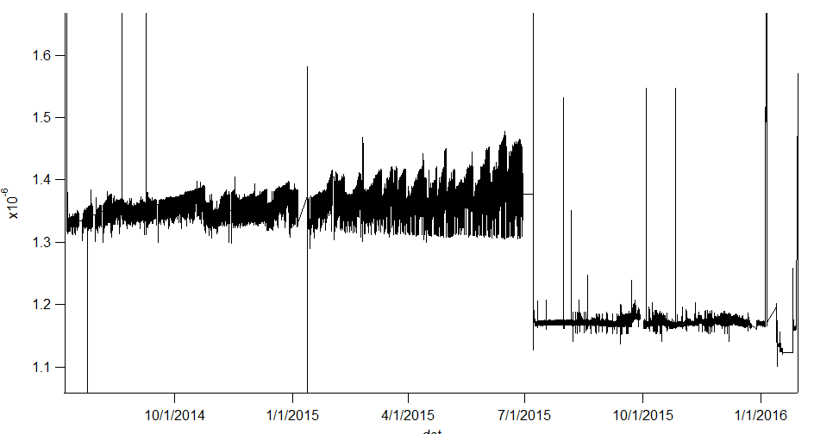
Solid State Switch performance
Stability very good +/- 3 ns
Rise time comparable to Thyratron
Tested on operational Kickers 8,13 and on the test stand
Minimum of 100 days of stable operation on each system
No signs of timing instability growth
Failures have occurred and we are working with the supplier to analyze
Thyratron
Solid State Switch

Slide 18
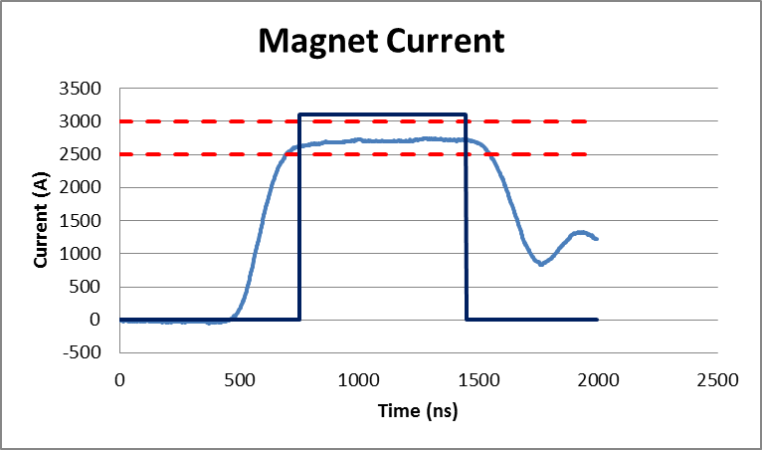
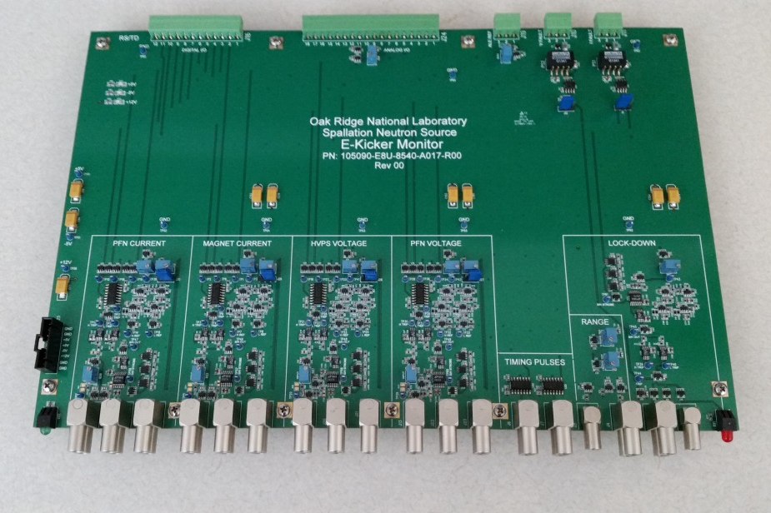
Extraction Kicker Development
Machine Protection System uses Windows XP Oscilloscopes for pulse to pulse monitoring
New Pulse Monitor for greater system reliability
  Monitors voltage and current waveforms
  Outputs pass/fail to MPS for every pulse
  Samples each pulses amplitude
  Automatically scales with set point
  Prototype has been tested with the test stand PFN
  Controls integration testing still to be performed

Slide 19
Extraction Kicker Development
SNS Proton Power Upgrade (PPU) and Second Target Station (STS) require higher fields to kick the beam due to higher beam energy
  Install 2 additional Kickers
    Magnets in tunnel
    PFNs
    Controls
  Faster charging supply to allow for a hot spare
    Currently 13 of 14 kickers used for beam kicking with the 14th running delayed by 5 us to be ready for quick turn over in the event of a failure
    PPU requires all 16 kickers or 1/16 higher individual currents in 15 kickers to allow a hot spare
    Existing power supply cannot charge PFN to higher voltages in 13 ms allotted between pulses

Slide 20
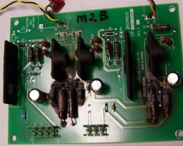
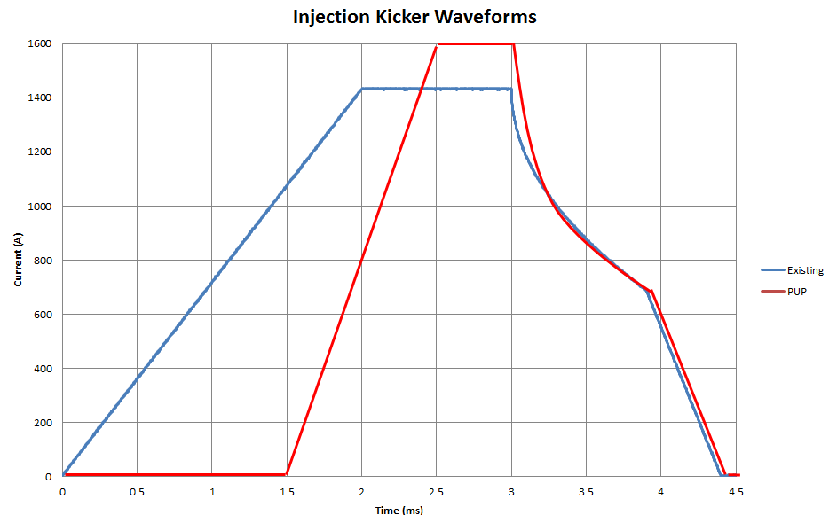
Injection Kickers Issues and Development
Gate Drive failures
  Fixed overheating of series resistor and zener diode
Higher currents required for Proton Power Upgrade and STS
  Upgrade injection kicker power supplies for higher currents 1400A → 1600A
  Upgrades have been designed by the manufacturer
  A change in the programmed waveform to reduce heating is also required

Slide 21
Summary
Addressing 3 major areas of downtime
  MEBT and Linac Magnet Power Supply reliability and spares
  Extraction Kicker thyratron life and timing stability
Addressing future requirements
  Proton Power Upgrade and STS
    Smart Chopping
    Higher beam energy

Slide 22
Backup

Slide 23
LEBT Chopper Development
Silver
Gold
Platinum
PW ≤52
Extended Macro
PW ≤52
MOSFET losses
Logic board
packaging
Gate Drive
PW ≤60
HV Switches
In house
Behlke
Other
Gate drive
Smart Chopping

Slide 24
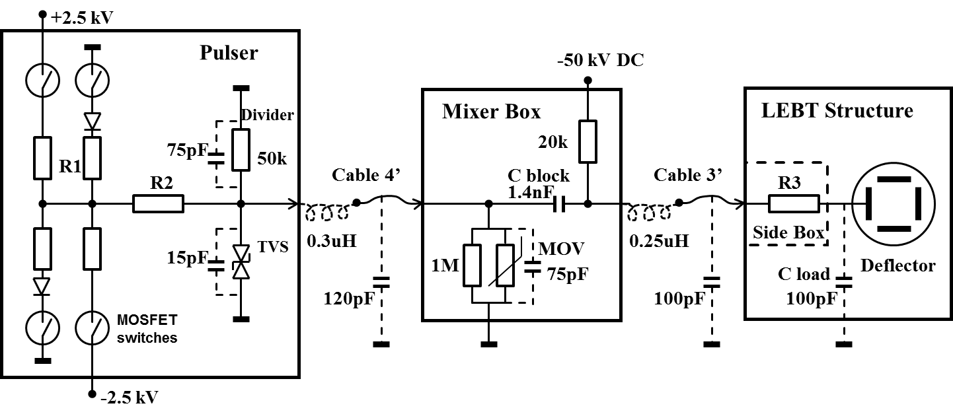
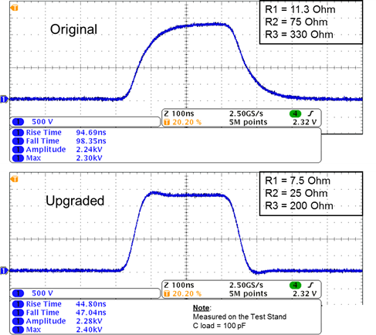
LEBT Chopper Rise/ Fall Time Reduced
Set by series resistance and capacitance
Pulse rise and fall time reduction
  50% reduction achieved
  Meets original specification
Pulse Width maximum raised
  Increased from 73.4% to 81.25%
  7.8% more beam in the mini-pulses
Simulated load

Slide 25
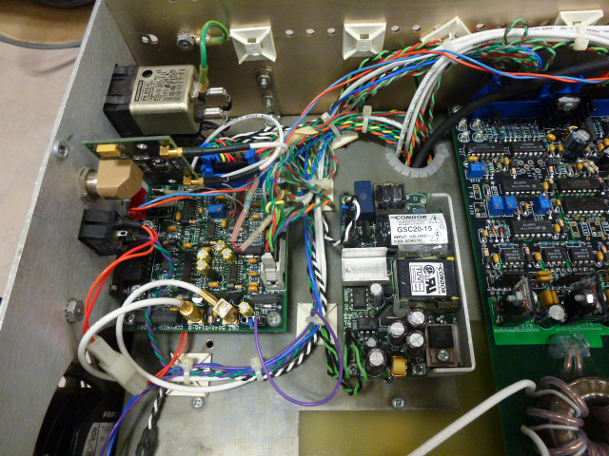
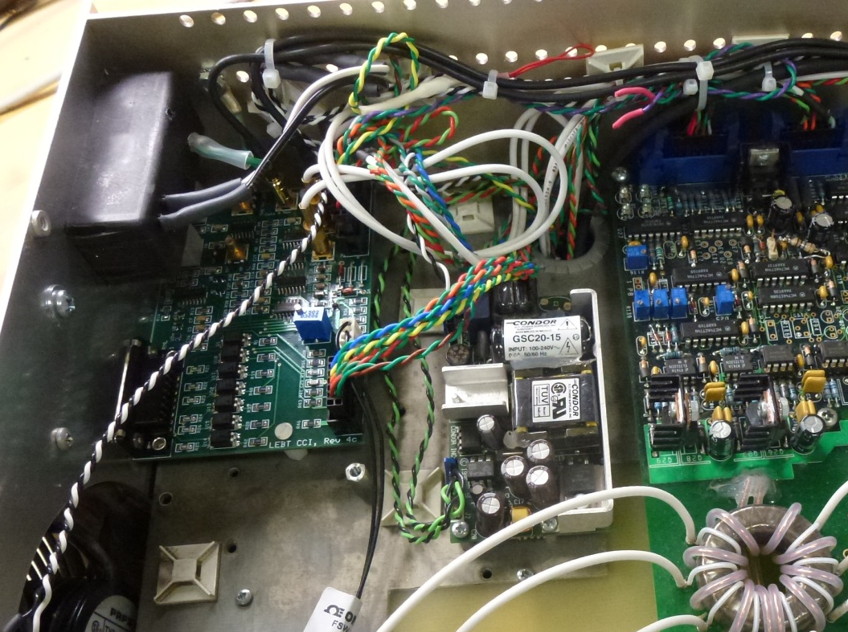
Receiver/Cross Conduct Inhibit Logic Boards
(installed inside the chassis)
Old
New

Slide 26
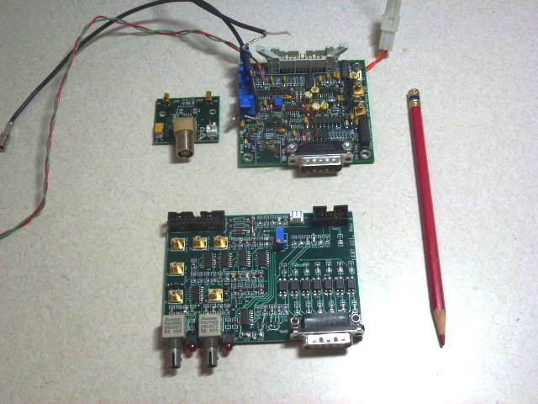
Old
New

Slide 27
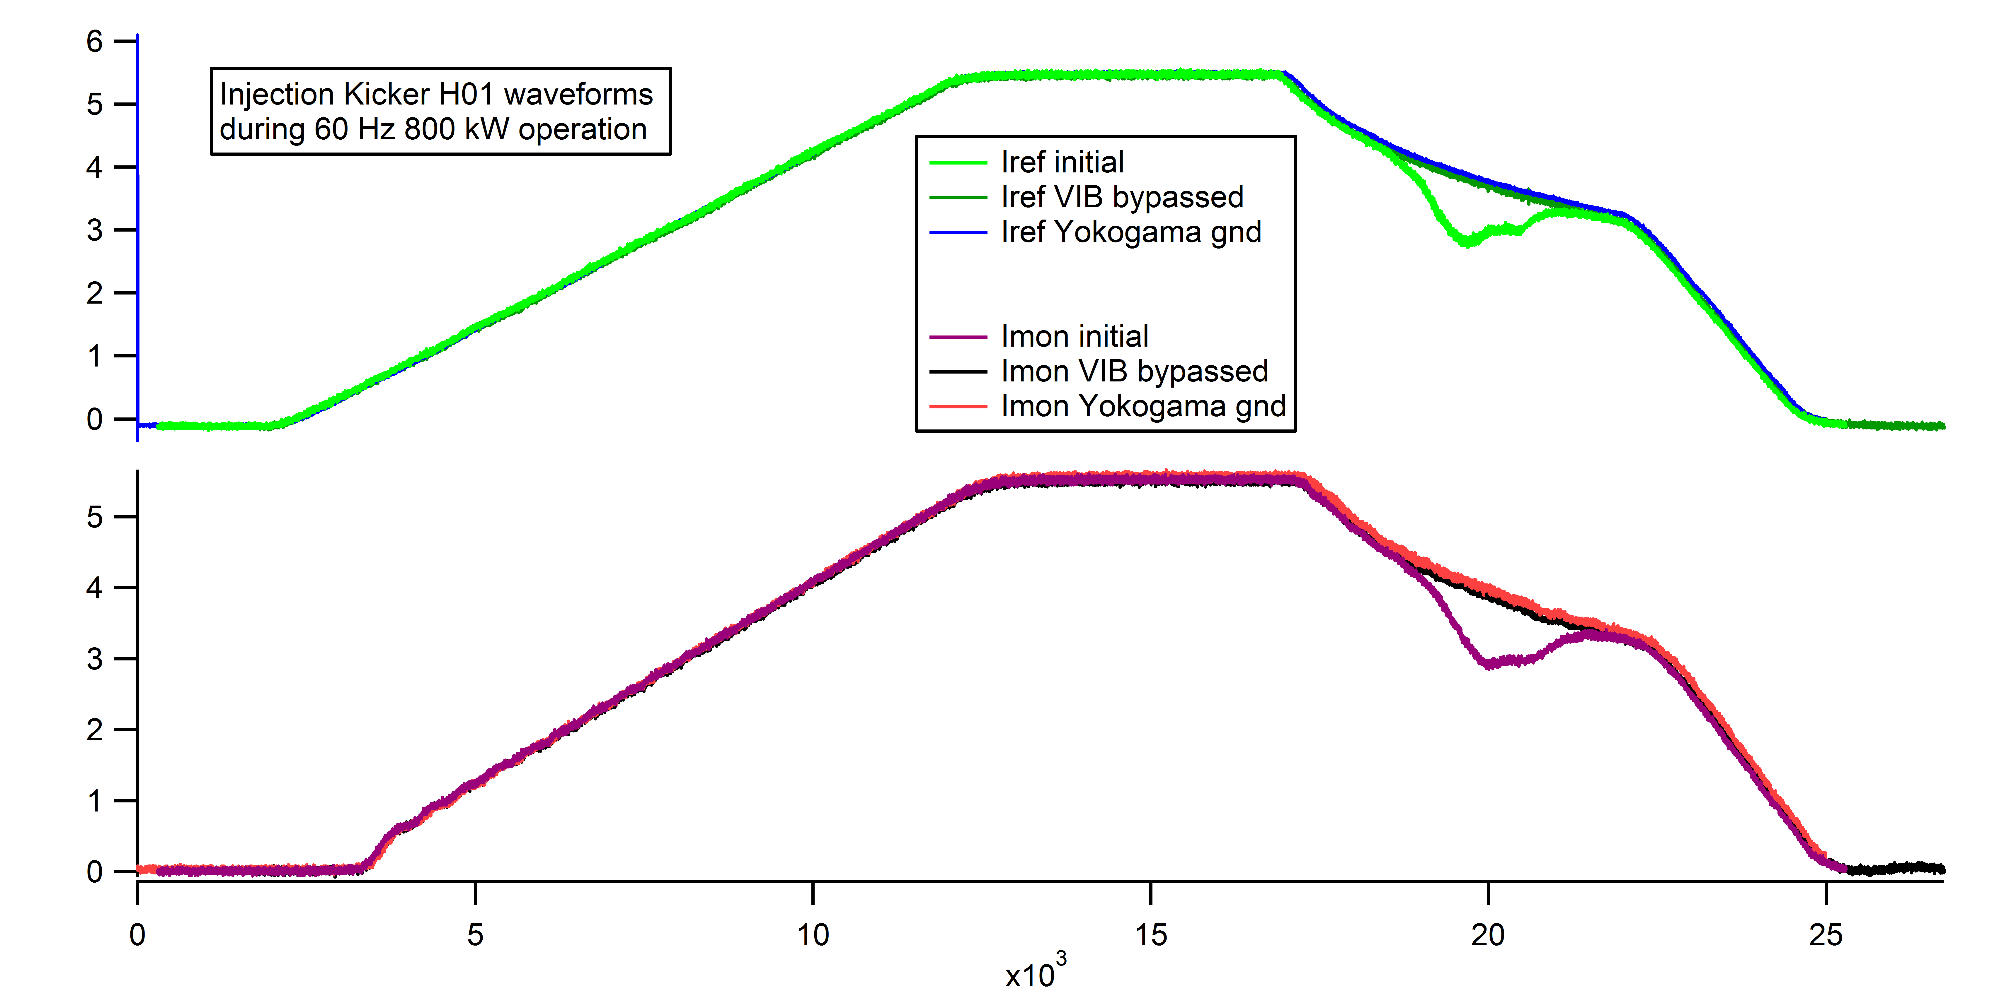
Injection Kicker Current Noise
Improper grounding of Arbitrary waveform generator cause distortion in current driving magnet

Slide 28
Injection Kicker Gate Driver Failure
December 20, 2011 Injection Kicker V03 failure
15V Zener used to step down 24V power supply overheated
Redesigned to change 24V to 15V directly eliminating Zener
Added LED indicators to monitor each IGBT drive power

Slide 29
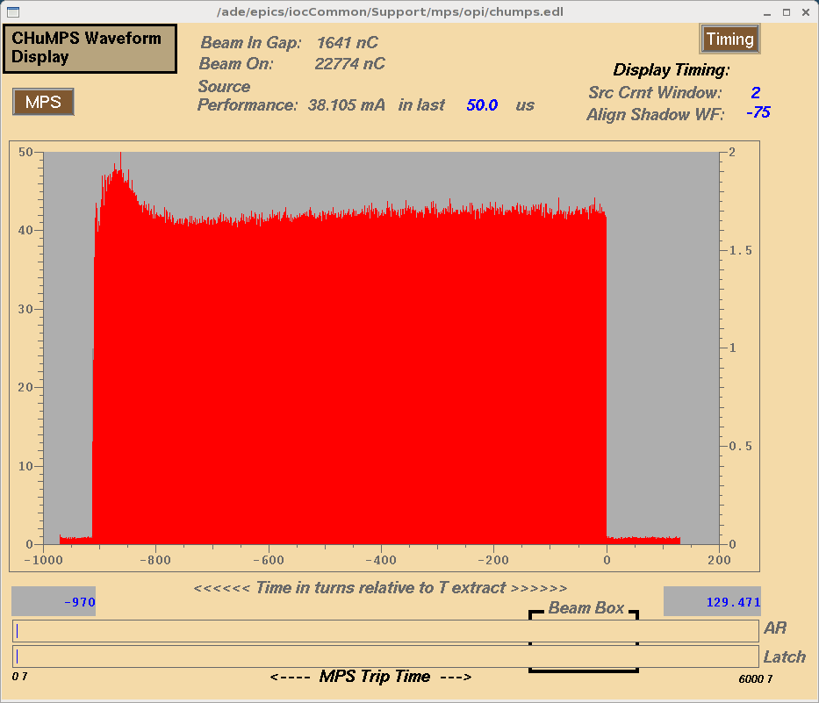
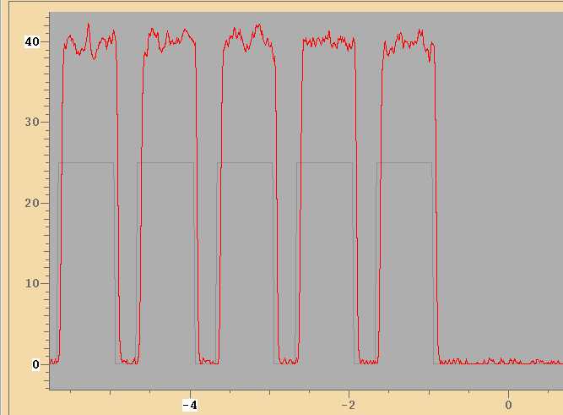
Beam Current: Better Chopping (courtesy J. Galambos)
Current (AU)
Ion source waveform
~20 % gap
< 100 ns rise time
1 ms
Time (us)
Chopping quality for 1.4 MW operation
  Smaller gaps than previously used
  High quality LEBT chopping

Slide 30
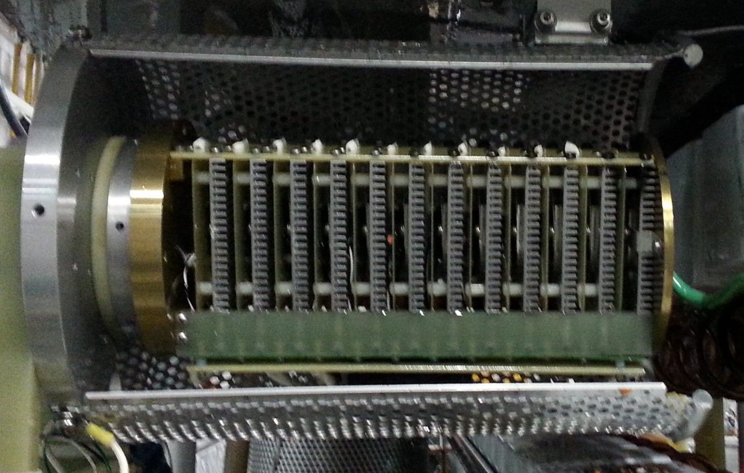
Solid State Switch to Replace Thyratron
Solid State Switch Thyratron
Solid State Switch Mounted in PFN

