Slide 1
Management Overview and Responses to 2015 AAC Recommendations
Presented to the
SNS Accelerator Advisory Committee
Kevin W. Jones
Research Accelerator Division Director
February 16, 2016

Slide 2
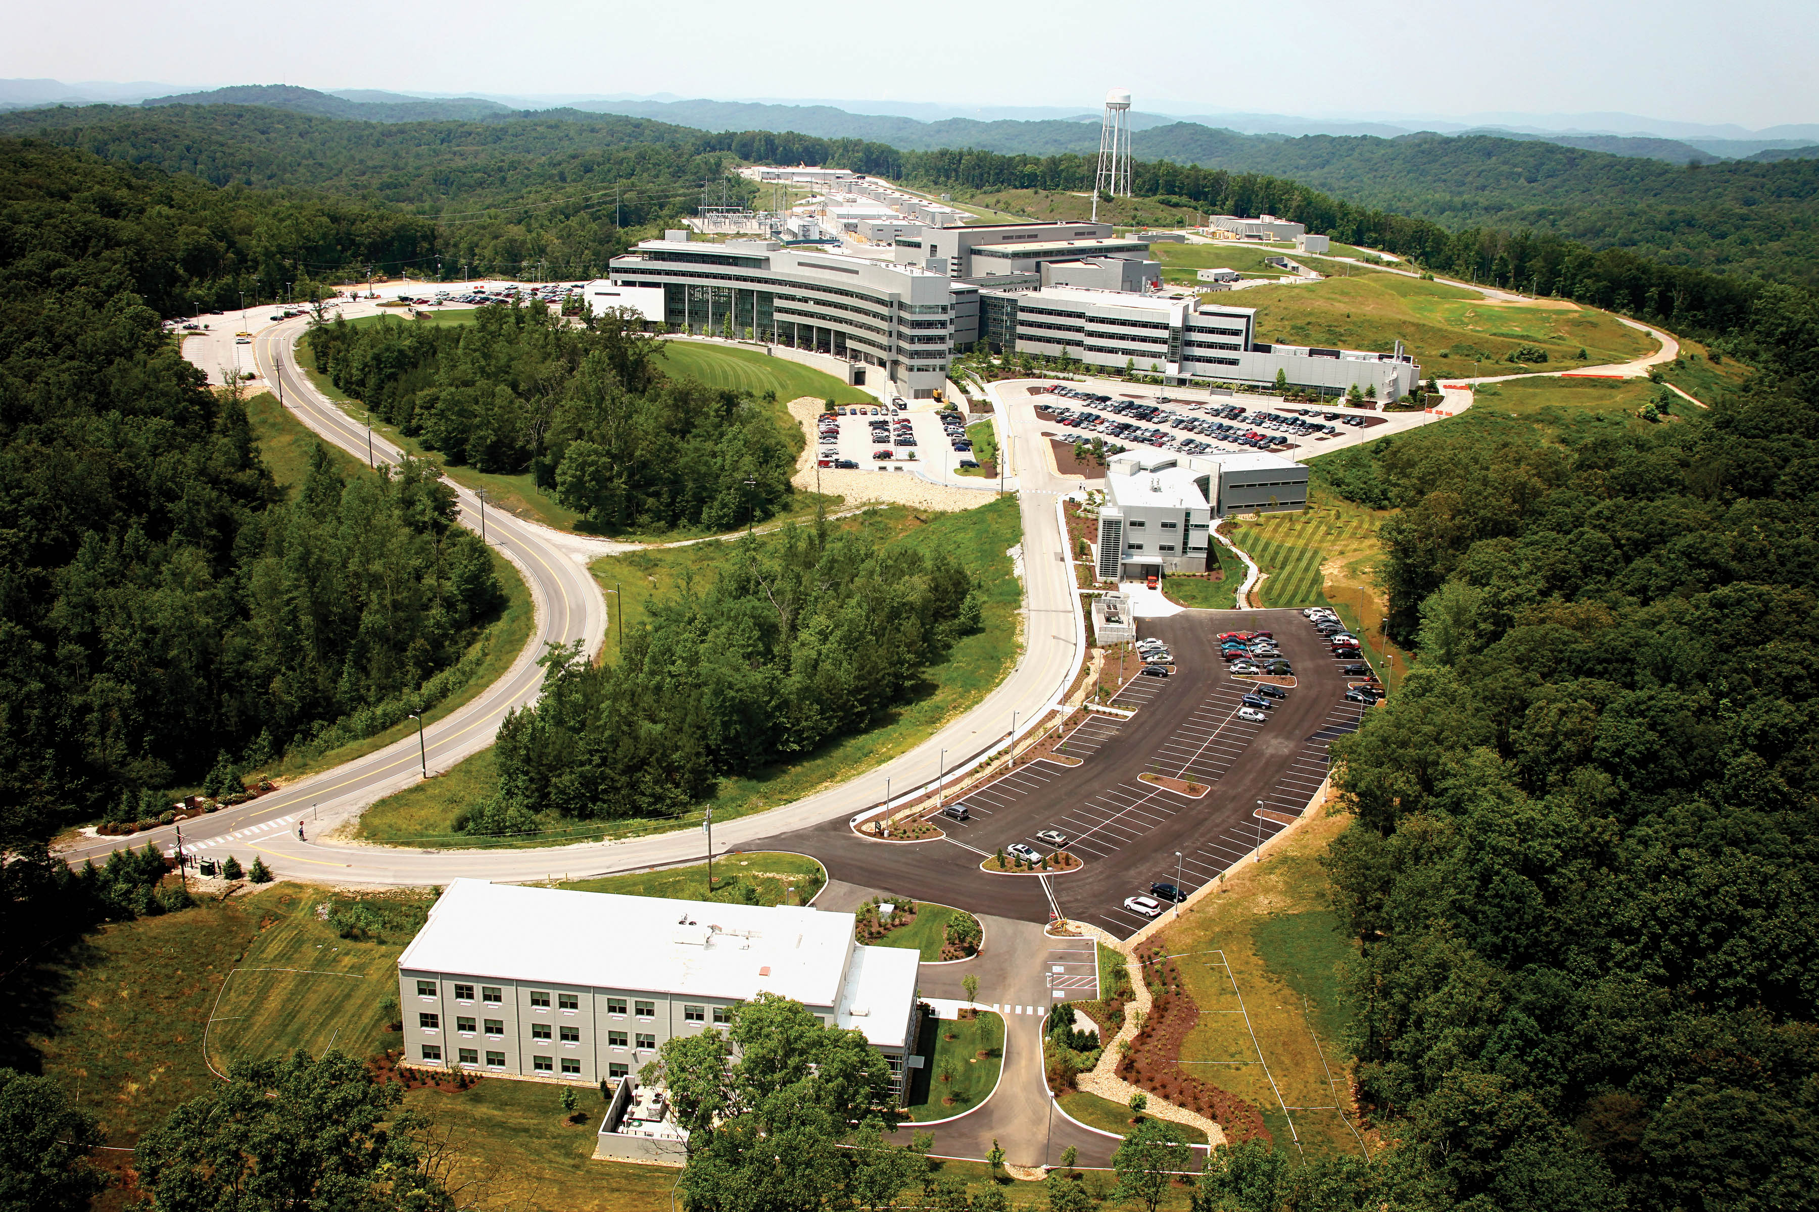

Slide 3
There have been additional changes in NScD since the last meeting of the AAC
Associate Laboratory Director
Paul Langan
Chief Scientist
Alan Tennant
Herb Mook, Senior Corporate Fellow Emeritus
Jeanine Evans, Executive Secretary
Joint Institute for
Neutron Sciences
Alan Tennant
Matrix Support
Bonnie Hébert, HR Manager
Lorie Hickey, Business Manager
Scientific and Program Services Office
Crystal Schrof
Directorate
Operations
Hans Vogel
Quantum
Condensed Matter
Stephen Nagler
Biology and
Soft Matter
Volker Urban (Acting)
Chemical and
Engineering Materials
Richard Ibberson
Neutron Data Analysis
and Visualization
Thomas Proffen
Research
Reactors
Tim Powers
Instrument
and Source
Don Abercrombie
Research
Accelerator
Kevin Jones
  Robert McQueeney departed, position of Deputy ALD eliminated
  Facility Maintenance, ESHQ, NRPD and Site Services transferred from RAD to Directorate Operations Office (DOO)
  Don Abercrombie appointed as permanent ISD Director
  Alan Tennant named as JINS Director

Slide 4
RAD is now focused on accelerator and target stewardship, control systems and data acquisition for the neutron scattering instruments
Research Accelerator Division
Kevin Jones, Director
George Dodson, Deputy Director
Maintenance Management and Information Systems
George Dodson
Instrument Data Acquisition and Controls
Steve Hartman
Accelerator Physics, Beam Instrumentation and Ion Source
Mike Plum (Acting)
Superconducting Linac Systems
Sang-ho Kim
Mechanical Systems
and Operations
Michael Baumgartner
Control Systems
Karen White
Accelerator Operations
Glen Johns
Electrical and RF Systems
Mark Champion
Eliminated the Department Head functions for Facility Maintenance, Data Operations, and Accelerator / Target Operations
Transferred to DOO:
  Facility Maintenance
  Site Services
  ESHQ
  Deployed NRPD Support

Slide 5
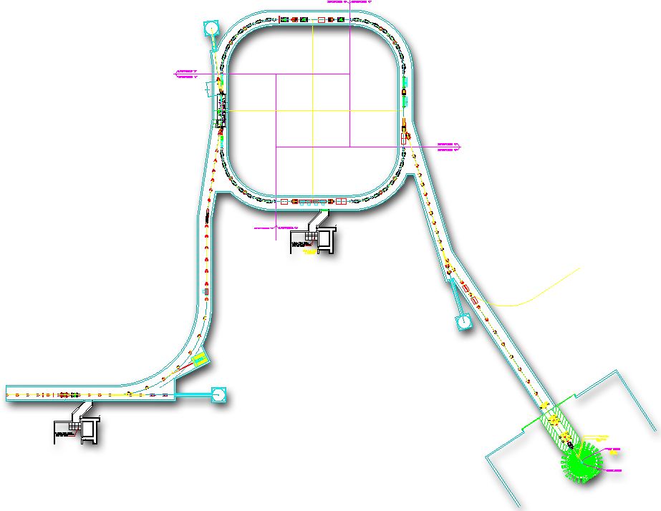


The SNS accelerator complex provides the world’s most intense pulsed neutron beams
The machine has over 100,000 control points and cycles ~5.2 million times a day
Power (and base neutron flux) is the product of:
Accumulator Ring: Compress ~1 msec pulse to 700 nsec
Collimators
  Beam Energy
  Peak Current
  Chopping Fraction
  Pulse Length
  Repetition Rate
Injection
Extraction
RF
~700 nsec
RTBT
2.5 MeV
186 MeV
~957 MeV
HEBT
Front-End
Warm Linac
Superconducting LINAC
Liquid Hg Target
LEBT chopper system makes gaps
945 ns
Contains RF mini-pulses
Current
Current
1 ms macropulse
1ms
~1 ms macropulse
The front end produces a 60 Hz, ~1 ms long chopped H- beam
1 ms

Slide 6
SNS performs well relative to design parameters
 | Design | Best Ever | Routine Operation
Kinetic Energy [GeV] | 1.0 | 1.07 | 0.957
Beam Power [MW] | 1.4 | 1.427 | 0.8-1.40
Linac Beam Duty Factor [%] | 6 | 6 | 5
Modulator/RF Duty Factor [%] | 8 | 8 | 7
Peak Linac Current [mA] | 38 | 42 | 36
Average Linac Current [mA] | 1.6 | 1.6 | 1.1-1.49
Linac pulse length [msec] | 1.0 | 0.98 | 0.975
Repetition Rate [Hz] | 60 | 60 | 60
SRF Cavities | 81 | 80 | 79-80
Ring Accumulation Turns | 1060 | 1020 | 1008
Peak Ring Current [A] | 25 | 26 | 14.5-25.8
Ring Bunch Intensity | 1.5x10¹⁴ | 1.55x10¹⁴ | 0.87-1.5x10¹⁴
Ring Space Charge Tune Spread | 0.15 | 0.14 | 0.09-0.16

Slide 7
The SNS neutron source is capable of sustained operation at power levels up to 1.4 MW
Since FY09 the SNS neutron source has exceeded all DOE PMM operational commitments for hours delivered and availability
DOE PMM Hours and Availability are not the same as scheduled hours and availability:
Annual DOE BES Facility Questionnaire submitted in October sets planned hours for that FY
Neutron Production Commitment is 90% of planned hours
Schedule has contingency and is published quarterly one month in advance
Additional hours are provided
Possible to meet DOE PMM of 90% while not meeting 90% against published schedule
BES recently expressed a strong preference for predictability and reliability over peak power – recent overall availability was a cause for sponsor concern in the outcome of the Triennial Review held in August 2015

Slide 8
Overall predictability and reliability against published schedule together with average power delivered must both improve
Sponsor has recently reduced emphasis on beam power and set a priority for predictable and reliable operation
No unplanned target failures
No interruptions of the planned user program

Slide 9
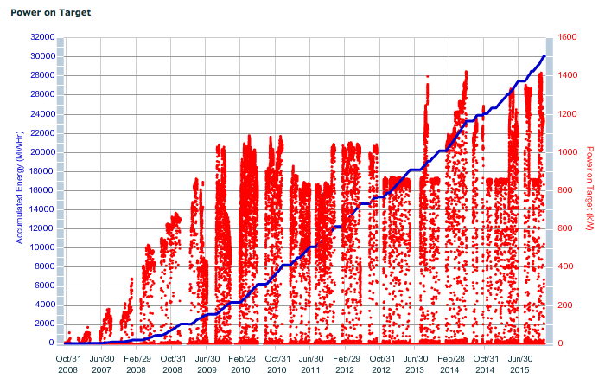
SNS has delivered over 30GW-Hrs since 2006 – the present limit on the in-service Inner Reflector Plug is ~39GW-Hrs

Slide 10
The replacement of the Inner Reflector Plug has been delayed to FY17 so the FY16 schedule has two standard outages
Target 12 reached end-of-life on September 25, 2015, achieving a new exposure record
Inner Reflector Plug (IRP) projected life extended to 39 GW-Hrs – currently at just over 30 GW-Hrs
Details in Target break-out session
Plan to change out RFQ in parallel with IRP in 2017 pending performance demonstration

Slide 11
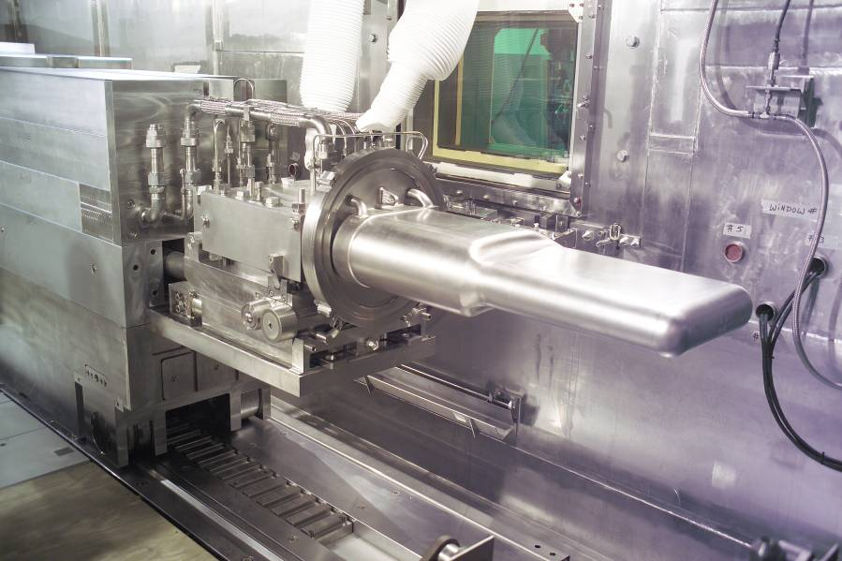
SNS only experienced one major unplanned outage since the last AAC
Utility Jumpers
On September 25, 2015 Target 12 indicated a mercury leak into the interstitial space that was confirmed using standard techniques
Again reduced to one spare target – entered target conservation mode with operation at 850 kW
Details to be presented in target break-out session
  Leak is in the single-wall bend on the beam-right side of the target, away from the beam impingement location
  Post-irradiation coupon removal is underway this week
CV Seal Flange
Shielded
Cart
Replaceable Target Module
SNS Target Module on Cart – Retracted Position
“Waves” propagating through residual mercury viewed through the bulk return channel – target nose down
Evidence of gas bubbles in the center of the supply channel beam right – target nose down

Slide 12
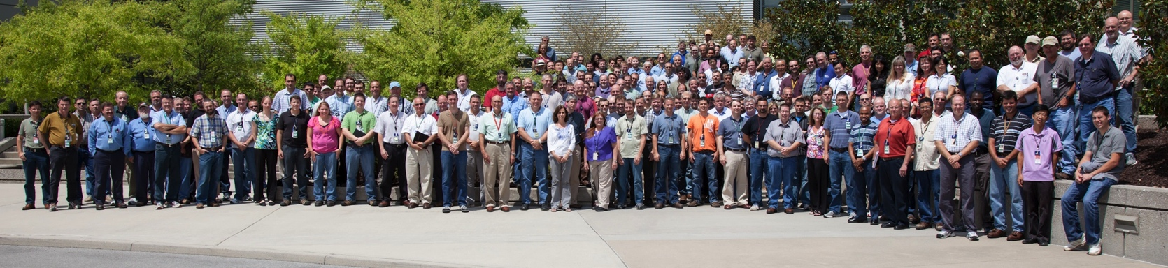
Summary
We can operate reproducibly with beam power ≥ 1.2 MW and availability ≥ 90% (excluding target / MEBT failures)
While we meet or exceed operating commitments we must adapt our operating strategy to meet sponsor reliability and predictability expectations
Our immediate focus is on sustaining availability and continuing operation at the highest possible power subject to operational and target lifetime constraints
Our medium term effort will achieve reliable 1.4MW operation by 2017, lay the foundation for 2.8MW capability and maintain the potential to carry out the Proton Power Upgrade and Second Target Station projects
Institutional commitment has been essential to our success
The hard work, dedication and talent of the SNS staff enable these achievements

Slide 13
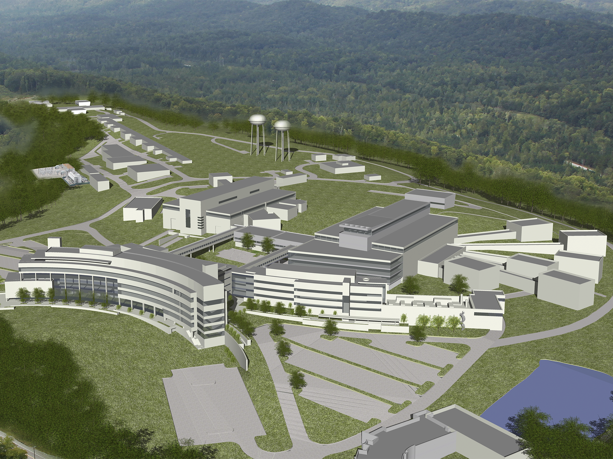
Discussion

Slide 14
AAC 2015 Action Items

Slide 15
Two Recommendations for Ion Source and Integrated Test Stand Facility:
1. After further testing continue plans to reinstall the LEBT valve to better protect the RFQ vacuum.
2. Beam Tests at the ITSF should be done ASAP. While seemingly not an option, early operation at low rep rate prior to installation of the PPS would allow timely measurements of transmission, energy and emittance.
Response: 1. LEBT Gate Valve - Redesign and installation of the LEBT Gate Valve is covered in the response to Charge Question 4, Recommendation 3 These actions will not be repeated under this issue.
Response 2. It was determined that an operational PPS system and an ARR is required for any beam operation in the ITSF. The ARR preparation has taken longer than expected, and beam is anticipated in the late Spring time frame.

Slide 16
Three Recommendations for the SCL and SRF:
1. Proceed with plans for on-site electro-polishing. The committee agrees with the plan to develop a small-scale facility as a first step. The committee supports the goal of exploring alternative methods with reduced safety hazards.
2. The committee accepts plans for spare medium-beta cryomodule. however, we encourage the inclusion of the procurement of the spare into the project prioritization process.
3. Proceed with plans for plasma processing. Consider additional plasma processing tests in a configuration where the Q can be measured. Plan the in-situ plasma processing carefully to minimize the risk of particulate contamination in the Linac.
Response: 1. Pending setting of priority and allocation of funding
Response: 2. Pending setting of priority and allocation of funding – fabrication of one medium beta cavity is in progress.
Response: 3. One plasma gas cart and one RF cart were developed for in-situ processing in the tunnel. The procedure for in-situ processing in the tunnel was developed and the first in-situ processing in the tunnel was successfully completed. The plan for the next shutdown period is under development.

Slide 17
Five Recommendations for High Power RF:
1. Complete replacement of the improved IGBT gate drives and snubber networks.
All production HVCMs have been upgraded with the new IGBT gate drives. Some systems had gate drives installed prior to the snubbers being ready and therefore have not had snubbers installed. Those 3 modulators will be completed during maintenance day outages after the winter outage is complete, based on availability of resources.
2. Implement the new controllers on a HVCM in the Linac to verify operation into beam loading cryogenic module.
Four controllers have been installed in the linac: SCL-Mod18 in summer 2015 and DTL-Mod5, CCL-Mod4, and SCL-Mod14 in winter 2015-2016. Initial attempts to pulse flatten on SCL-Mod18 resulted in excessive ripple on the modulator output waveform. This was caused by errors in the frequency-modulated timing pulses sent to the individual IGBT switches. The timing errors have been eliminated, and the test will be repeated at the end of the winter outage - schedule permitting. Pulse flattening on the other newly installed controllers will also be attempted at this time.
3. Replace all HVCM with new controller as soon as practical.
Three to four additional controllers will be installed during the summer 2016 outage, and the remainder of the controllers will be installed during the extended winter 2016-2017 outage

Slide 18
Five Recommendations for High Power RF: Continued
4. Complete evaluation of the alternate topology in the test stand at full power levels. The alternative topology could have a significant impact on the ongoing maintenance of the HVCM.
The alternate topology HVCM is presently undergoing high power testing at the HEBT test stand with output voltage and current of 70 kV and 100 A, respectively, repetition rate up to 60 Hz, and pulse width up to 1.35 mS. Pulse flattening has been demonstrated. Ripple and droop are controlled to less than 1 %. Thermal data are being collected, and initial results do not indicate any heating problems. An extended heat run at full voltage and duty factor is planned for spring 2016.
5. Monitor all klystron saturation characteristics and adjust heaters for minimum operating temperature and track heater adjustment trends to assist in indication of end of life.
Klystron cathode emission data is collected annually on every operational tube. Specifically, the emission data consists of the cathode current recorded at an associated heater current. The heater current is reduced in a step-wise fashion and cathode current is recorded at each step. The data is then plotted as the percent cathode current (Y) versus the heater current (X). The curves are compared to past data, with particular attention paid to the heater current level at the “knee” formed as cathode emission drops to determine if cathode emission is changing over time.
In addition to monitoring cathode emission, this data is used to determine if the heater settings may be reduced to help increase cathode lifetime. Specifically, the heater current set points are placed 1A above the heater current level at 98% cathode emission. This level ensures that the tube cathode is operating in the fully space charge limited region while running the filament at the lowest possible temperature .

Slide 19
Three Recommendations for Controls:
1. Consider augmenting Protection Systems and Process Controls teams with contractors. Restructure resources if necessary.
The Controls Group Protection Systems and Process Controls team are augmented with three full-time contractors. Two of the contractors are designers and one is a field engineer. Their services are available to all Controls Group teams and work is coordinated by Derrick Williams, Process Controls Team Leader. They have been in place since April 2014 and are budgeted to continue throughout FY16. The contract allows additional designers/engineers to be added as needed.

Slide 20
Three Recommendations for Controls: (continued)
2. Standardization of Protection Systems is essential to realize future efficiencies, reliability and safety. Continue this activity.
Standardization is an ongoing activity for our Protection Systems. In the last year, the following activities have been pursued:
Developed a mock prototype IPPS beamline standardizing on hardware, subsystems, and software (behavior) for benchmarking existing beamlines. Benchmark criteria will be used as part of the formal decision matrix when selecting and scheduling IPPS system upgrades.
Developed a plan to standardize secondary shutter motor controls. This collaborative effort between PPS, Instrument Support, and Instrument Data Acquisition and Controls (motor controls software) includes changeover from custom C code to EPICS for control. Implemented first article on BL- 14b. Second article scheduled on BL-4b January 2016
Standardized operator panels as part of the CCR rack upgrade
Established standardized wiring methods. Used for CCR rack upgrades, ITF and will be used for future upgrades.
Updated PPS EPICS database and screens to align with tag types and standardize graphics for operator panels. New build allows for better sustainability
Standardized on Allen Bradley Point I/O for upgrades and new designs.
Standardized on drawing layouts and methods. Over 400 drawings created or updated using the new standard so far.
Developing improved system and software requirements functional templates. Templates will allow software to be modeled and validated against requirements and system behavior to be standardized across all PPS systems.

Slide 21
Three Recommendations for Controls: (continued)
3. In the prioritization process of resources across the facility, consider the use of some obsolete systems as something that facilities can live with. Consider augmenting Protection Systems and Process Controls teams with contractors. Restructure resources if necessary.
In the prioritization process of resources across the facility, consider the use of some obsolete systems as something that facilities can live with.
We maintain an updated list of current and predicted obsolescence issues. These items are prioritized primarily by our estimate of when the issue will become a risk to control system availability and tackle one or two issues per year. The long range outlook provided by this list helps us plan for and purchase adequate spares to keep obsolete systems in service until resources allow for replacement. However, spares purchases can be limited by budget constraints. For large obsolescence projects (e.g. MPS) we work with the Deputy Division Director to fit the work into the long term AIP strategy.

Slide 22
Committee recommendation for H- stripping:
The committee supports the installation of the laser stripping experimental station in FY2015 as an important activity, and encourages its inclusion in the project prioritization process.
The installation of the equipment for the laser stripping experiment is proceeding on time, with an anticipated completion date of January 2016. The experimental vessel and the laser transport line through the ring service building (RSB) chase were installed in the summer 2016 outage. The stripping magnets have been operated and verified to provide 100% conversion from H⁻ to H⁰. The installation of the remainder of the transport line, as well as the finalization of the remote laser table in the RSB and the final optics table in the tunnel, will be completed and tested by the end of January. Stripping experiments will begin in late winter.

Slide 23
Two recommendations from charge question 1: Assess performance of the accelerator complex and neutron source since the last meeting:
1. Challenges exist in setting priorities for resources, including those between instruments and accelerator functions. The committee recommends development and use of a defensible project priority evaluation method, perhaps based on risks.
2. The committee encourages inclusion of an examination of the distribution of resources as part of the project prioritization process.
Some progress was made in this regard and further refinements are needed. The scientific organizations developed and implemented a process to set priorities for instrument upgrades. RAD staff that had ownership of elements of work scope associated with each of these projects were engaged in the scoping process to define needed resources and contribute to planned schedules. These projects were then included in the RAD prioritization process that was implemented to define high priority items to be performed during the recently-concluded winter 2015/2016 outage.

Slide 24
The RAD prioritization process included an initial prioritization performed by the group owning the equipment, to which a number of scoring criteria were applied. These included:
  Is the activity one of the top priority instrument improvement projects?
  Is the activity required to meet a regulatory requirement?
  Is the activity a response to an Advisory/Review Committee action or an event corrective action?
  Is the activity implementation of an AIP or new capability?
  Does the activity affect operability at high beam power?
  Does the activity address a reliability issue or offer a reliability improvement?
  Does the activity contribute to the system reliability budget?
Impact factors determined through this process were used to select 15 high priority activities for resource allocation during the outage to ensure completion, along with standard preventive/predictive maintenance work that could also be accommodated. A memorandum listing these activities and their priorities was distributed to all RAD staff 3 weeks before the start of the outage.
All but one of the activities were completed, the incomplete activity on BL-17 was deferred to the summer 2016 outage.

Slide 25
Two recommendations from Charge Question 2: Assess and provide advice on the plans for sustainable beam operation with availability >=90% level at ~1.4 MW beam power for 5000 operating hours per year in a constrained funding environment. Consider the lessons learned from the high power run in the first half of 2014 and current maintenance strategy.
1. Consider prioritization of "availability" above the importance of "1.4 MW" (rather than 1.35 for instance).
2. We encourage a rigorous approach to project prioritization, such as the use of risk analysis, and looking into best practice elsewhere. Looking forward at least 5 - 10 years is recommended, particularly in AIP: A sustainable, predictable funding level makes this possible. some sustainability issues can take 10 years to address - start now!
Operation at powers below 1.4 MW has become part of the strategy currently deployed to meet sponsor objectives. The sponsor has clearly stated now (Recommendation from BES Triennial Review, August 2015) that predictability and availability are key, along with managing targets to ensure there are no unplanned replacements. This has led to a strategy for FY2016 that seeks to demonstrate 2.5 months at 1.4 MW with the balance at lower powers to manage target lifetime. The need to operate at 1.4 MW is driven by certain low-count-rate inelastic neutron scattering experiments.
Recommendation 2 remains to be addressed.

Slide 26
Two recommendations for Charge Question 3: Assess the adequacy of our approach to sustaining and developing critical systems, including High Voltage Converter Modulators, Superconducting Cavities (plasma processing), Injection Stripping (Foils, lasers), Personnel Protection System and Controls (including high level applications) and the Integrated Front End Test Stand facility.
1. Ensure the overall SNS goals are set and well communicated to stakeholders. This would help in prioritization of resources and help to manage expectations.
2. Devise a prioritization process to align resource allocation with goals
The NScD ALD has clearly communicated overall high-priority goals for SNS to all stakeholders. The RAD Director has likewise communicated lower-level goals relevant to the organization that support meeting these high-priority goals. These goals are key to establishing funding priorities within the organization, that in turn translate into human and capital resources necessary for both operations and improvements.
The process to align resource allocation with goals requires additional refinement and quantification.

Slide 27
Charge Question 4: Is the SNS response to the observed RFQ issues adequate?
Recommendation 1: The committee supports the installation of the new RFQ as a very important activity for reliable operation at 1.4 MW, and encourages its inclusion in the project prioritization process.
Limited progress was made in this area.
  There was substantial pressure to complete necessary action items in response the the non-fail-safe failure of the PPS in FY2015, and this limited the resources available to design and implement a PPS system for the ITSF.
  There was a significant management failure in the preparation of necessary safety documentation to support the readiness review process. This is being addressed by the designation of a team of individuals to complete this work, under the direction of George Dodson as the task lead. Good progress has been made since this action was taken. Objective is to complete this work by the end of March 2016, and to complete the readiness review process by the end of May 2016 to permit 3-5 months of testing and operation prior to disassembly for relocation to the front-end.

Slide 28
Charge Question 4: Is the SNS response to the observed RFQ issues adequate?
Recommendation 2: immediately develop a detailed schedule for installation and commissioning. Identify and carry out ahead of time any work that can be done to prepare the location for the final installation.
A comprehensive and detailed plan for installing and testing the SNS RFQ in the front-end of the SNS Linac during the winter shutdown of 2016 is being developed.
A core team has been assembled
Scope has been defined and the project has been divided into seven distinct phases:
1. Document and design.
2. Advance preparation.
3. Dismantling of the SNS RFQ and staging in the FEB.
4. Dismantling of the LBNL RFQ and staging in the FEB.
5. Installing the SNS RFQ into the SNS accelerator.
6. Testing the SNS RFQ.
7. Transporting and installing the LBNL RFQ into the ITSF.

Slide 29
Document and design:
  a. Design for a LEBT transport stand has been completed.
  b. Design for the waveguide run to the SNS RFQ in the FEB is underway.
  c. Design for a LRBT/RFQ vacuum isolation valve is underway.
  d. Design for an expanded ion source cage is underway.
  e. Design for AC power distribution is underway.
  f. Design for cable distribution and routing is underway.
  g. Design of the equipment layout is underway.
  h. Design for FEB gas distribution system is underway.
  i. Design for improved routing of chilled water lines is underway.
2. Advance preparation:
  a. Demolished and removed unused HVAC conduit to the old MEBT amplifiers
  b. Removed the old MEBT amplifiers and cable raceway.
  c. Re-supported existing cable tray over the old MEBT amplifiers
  d. Demolished and removed insulated tower water lines to the old MEBT chopper loads.
  e. Demolished and removed unused sections of booster chilled water lines.
  f. The chiller room wall penetration has been extended to the floor.
  g. Patch panels for RFQ field probe cables have been installed.
  h. New cable tray will be installed in the FEB in during the Winter 2015 outage.
  i. AC power distribution will be installed in the FEB during the Winter 2015 outage.
  j. Gas handling and distribution system will be installed during the Winter 2015 outage.
  k. New chilled water lines will be installed during the Winter 2015 outage.

Slide 30
3. Dismantling of the SNS RFQ and staging in the FEB:
  a. No progress to date.
4. Dismantling of the LBNL RFQ and staging in the FEB:
  a. A detailed plan and schedule has been created.
5. Installing the SNS RFQ into the SNS accelerator.
  a. A detailed plan and schedule is currently being developed.
6. Testing the SNS RFQ.
  a. A detailed plan and schedule is currently being developed.
7. Transporting and installing the LBNL RFQ into the ITSF.
  a. No progress to date.

Slide 31
Charge Question 4: Is the SNS response to the observed RFQ issues adequate?
Recommendation 3: After further testing, install the LEBT valve to better protect the RFQ vacuum on the operating beamline as well as in the ITSF.
The LEBT/RFQ isolation valve is being re-designed for the new RFQ and will be backward compatible to the old RFQ. The new valve will be installed in the front end when the RFQ is replaced, and a similar valve will be installed on the test facility when the current production RFQ is installed there. Note that the old valve, even if refurbished, is not forward-compatible to the new RFQ.
Current operational practices will continue until the new valve is available.

Slide 32
Two recommendations from Charge Question 5: Does the AIP investment strategy align with the 1.4 MW reliable, sustainable operation and STS path?
1. Further articulate strategy and in concert, develop a transparent project prioritization system that can substantively inform decision making aligned with this strategy. Initially this could be limited to accelerator projects, but as we note in another recommendation, this must ultimately be done facility wide.
2. Based on the output of the above recommendation, it may be clear that increased funding for accelerator projects is the best investment for the SNS. If that is the case, consider doing so.
See discussion on earlier recommendation on project prioritization, scheduling, and funding

Slide 33
Recommendation from Charge Question 6: Provide advice on the accelerator systems components of the draft technical design report for the Second Target Station and provide guidance on the reasonability updated plan for the power upgrade in the SCL, with fewer new Cryomodules than originally planned.
Recommendation: In order to continue to refine the science driven requirements for the STS accelerator design, we encourage the laboratory to provide LDRD or program development support.
STS LDRD funds were forthcoming for STS, but not in the accelerator area. However, programmatic funds in the amount of $10M were included in the FY16 DOE-BES budget for the SNS Second Target Station Initiative.
LDRD funds are being expended for a low energy moderator demonstration facility on the Integrated Test Stand Facility.

