Slide 1
Neutron Sciences Directorate Overview
Presented to the SNS Accelerator Advisory Committee
Paul A. Langan Associate Laboratory Director for Neutron Sciences
February 16, 2016

Slide 2
SNS: World’s most intense beams of pulsed neutrons for research
Completed in 2006; achieved 1 MW capability in 2009
Schedules ≥4,500 hours/year of beam time for users
18 neutron scattering instruments; 1 fundamental physics beam line
Complementary to High Flux Isotope Reactor (HFIR)
Change from Be reflector plug coolant to D₂O, planned for early 2017, will increase flux from all moderators by 10–20%
Additional accelerator upgrades will enable reliable operation at ~1.4 MW

Slide 3
Neutron scattering is a demonstrated tool for discovery and innovation
Neutron penetration and sensitivity to Li and Na reveal ion mobility in new battery materials
Thompson et al., Adv. Energy Mater. 2015
Neutron sensitivity to hydrogen characterizes new benzene-derived diamond nanothreads created at 20 GPa
Fitzgibbons et al., Nature Mater. 2015
Neutron scattering contrast reveals relationship between heterogeneous microstructure and solar cell performance
Das et al., Nanoscale 2015
Neutron H/D contrast matching reveals hierarchical structure of cell wall synthesis machinery
Vandavasi et al., Plant Physiol. 2016
Co-location of SNS and HFIR with Oak Ridge Leadership Computing Facility and Center for Nanophase Materials Sciences catalyzes science impact
Notes:
Several examples of the science unique to neutrons…..

Slide 4
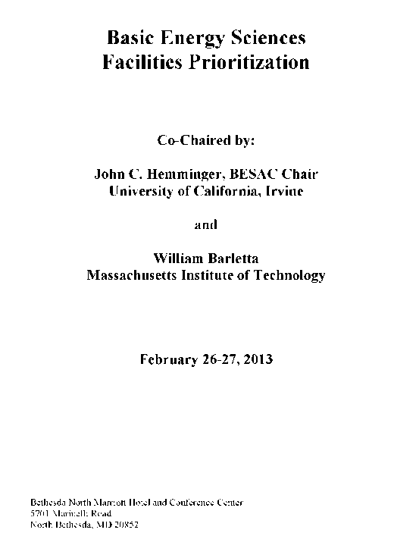
Community input, technical concept development, and operational experience used to finalize scope and performance of STS
Neutron Sciences Strategic Plan, 2014
Grand challenge workshops, 2014
Science case for STS, 2015
Technical Design Report for STS, 2015
A short-pulse, high-brightness cold source with broad dynamic range is needed to address emerging challenges in world-leading science
STS is absolutely central to US world-leading science
Significant scientific/technical issues must be resolved: Long- vs short-pulse source
Notes:
Add cover from BESAC 2013 report.
Statement – a long pulse.

Slide 5
Upgrading SNS to a world-leading fourth-generation neutron source
SNS-PPU
SNS-STS
Increases power capabilities of existing 60 Hz accelerator structure from 1.4 MW to 2.8 MW
Increases power delivered to first target station (FTS) to 2 MW
Increases neutron flux on available beam lines
Provides platform for construction of STS
Initial suite of 8 beam lines, with capacity to accommodate 22 beam lines
467 kW diverted to STS by additional accelerator systems
10 Hz repetition rate, enabling broad dynamic range
World’s highest brightness short-pulse source optimized for cold neutrons
380,000 ft² of new infrastructure
STS
Proton beam footprint
FTS

Slide 6
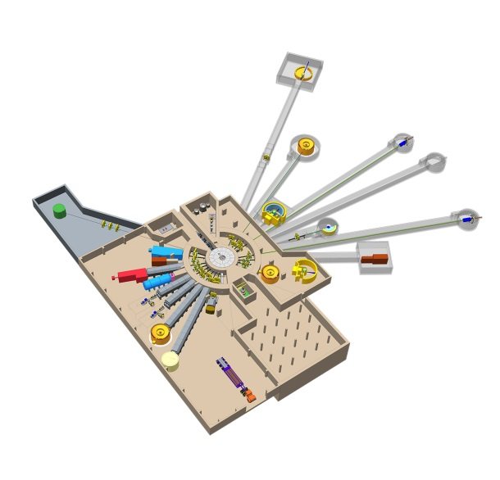
SNS-STS project comprises 4 major subsystems
Target station
Rotating solid tungsten target
3 moderators
Instruments
8 initial instruments
Science infrastructure (software, sample environment)
Accelerator systems
Proton beam transport
Shape proton beam profile to match compact source design
Conventional facilities
Utilities, site preparation
380,000 ft²
22 total beam lines

Slide 7
STS Project Office has been established
Core team in place
Advisory panels being formed
Dedicated staff
Director: John Galambos
Deputy Director, Science and Instruments: Ken Herwig
Project Controls: Barbara Thibadeau
WBS Level 2 leads for target, accelerator, and conventional facilities
Matrixed staff with operational and original project experience
Project Office
Accelerator and Target
Instrument Systems
Science Advisory Committee

Slide 8
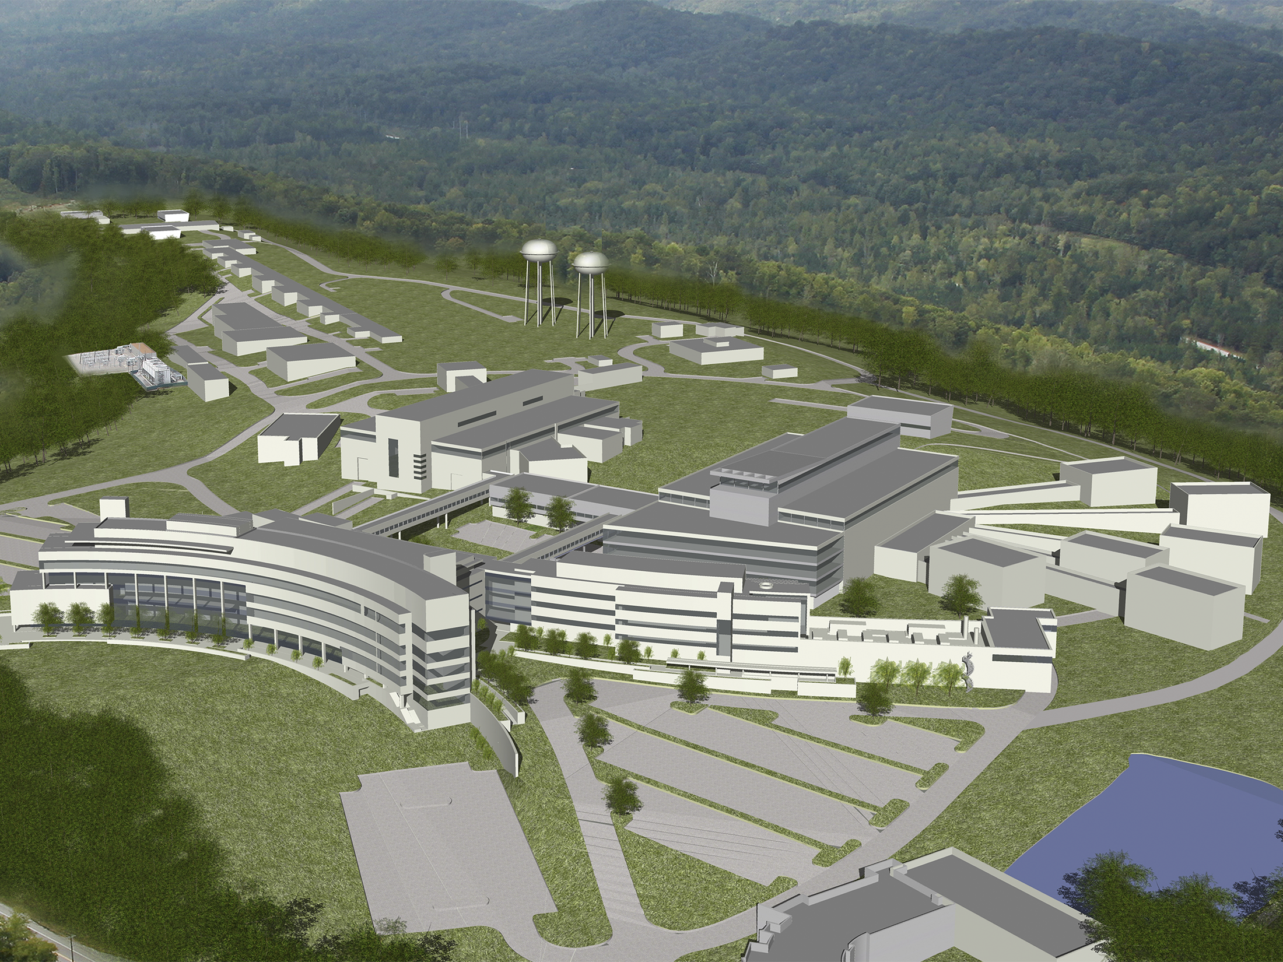
Discussion

