Slide 1
Planning Initiatives for the 2017 Long Outage
Presented to the
SNS Accelerator Advisory Committee
Kevin W. Jones
Research Accelerator Division Director
February 16, 2016

Slide 2
Comprehensive outage planning and management is essential to the ongoing success of SNS
Planning is underway for the Proton Power Upgrade and the Second Target Station
A key planning imperative for these projects is that the majority of the construction can be done with minimal impact to the continued operation of the User Program at the First Target Station (FTS)
This implies that modular elements of each project must be installed during regular planned maintenance outages to maintain a schedule that provides 5000 planned hours of neutron production for users
SNS needs to refine its abilities to:
  Plan, schedule and execute multiple parallel projects in a constrained resource environment while
  Maintaining operational excellence and be responsive to operational upsets
We need to be trusted stewards of the resources provided to us

Slide 3
Inner Reflector Plug (IRP) fabrication schedule and spare RFQ readiness do not support installation in FY2016
Modified the FY2016 operating schedule to reflect lifetime management for Target 13 by bringing summer outage forward one month; Target 14 will support operation at 1.4 MW from July through December 2016
Inner Reflector Plug (IRP) projected life extended to 39 GW-Hrs – current exposure is just over 30 GW-Hrs with forecasted accumulation of an additional 6-7 GW-Hrs in CY2016
Spare RFQ should be ready for beam tests in June 2016

Slide 4
The proposed FY2017 schedule incorporates the first long facility outage for major component replacement
One-week break for instruments in October 2016 - keep accelerator in operating condition based on lessons learned from similar break in the past – targeted maintenance interventions only
Go/No-Go decision September 2016: Does IRP arrive as expected in July and do we have confidence in remote handling procedures and mock-up/dry-run activities to agree to proceed?
Go/No-Go decision September 2016: Does spare RFQ demonstrate proper beam characteristics and is its performance sufficiently well understood to support removal and installation in the front-end?
Planning constraint: Facility can only sustain one long outage to maintain user engagement and confidence, so both activities must proceed in parallel

Slide 5
Progress toward more formal prioritization and planning was made for the Winter 2016 outage (1)
The scientific organizations developed and implemented a process to set priorities for instrument upgrades.
RAD staff that had ownership of elements of work scope associated with each of these projects were engaged in the scoping process to define needed resources and contribute to planned schedules.
These projects were then included in the RAD prioritization process that was implemented to define high priority items to be performed during the recently-concluded Winter 2016 outage.
The RAD prioritization process included an initial prioritization performed by the group owning the equipment, to which a number of scoring criteria were applied. These included:
  Is the activity one of the top priority instrument improvement projects?
  Is the activity required to meet a regulatory requirement?
  Is the activity a response to an Advisory/Review Committee action or an event corrective action?
  Is the activity implementation of an AIP or new capability?
  Does the activity affect operability at high beam power?
  Does the activity address a reliability issue or offer a reliability improvement?
  Does the activity contribute to the system reliability budget?

Slide 6
Progress toward more formal prioritization and planning was made for the Winter 2016 outage (1)
Impact factors determined through this process were used to select 15 high priority activities for resource allocation during the outage to ensure completion
Standard preventive/predictive maintenance work that could also be accommodated was included.
A memorandum describing the outage constraints and listing these activities and their priorities was distributed to all RAD staff 3 weeks before the start of the outage.
All but one of the activities were completed; further activities on BL-17 upgrade were deferred to the summer 2016 outage.
However, no integrated resource-loaded schedule was developed to support management of the outage

Slide 7
The Summer 2016 outage presents a considerable challenge for prioritization and planning
Continue planned and funded Instrument Upgrades (e.g. BL-17 vacuum upgrade)
Continue in-situ plasma processing to increase beam energy (construct duplicate RF/gas/vacuum systems to be able to process two cryomodules simultaneously)
Continue to deploy modulator upgrades (controllers and pulse-flattening technology)
Replace Target and Proton Beam Window (install new Aluminum PBW)
Initiate beam startup of Integrated Test Stand Facility and qualify the spare RFQ for beam operation
Routine maintenance and upgrades of all standard accelerator and beam transport systems
Development of an integrated schedule with key resource leveling will be essential to success – this is a key performance objective for the RAD Director and all Group Leaders for FY16

Slide 8
The Challenge:
Assignment of an Outage Manager to oversee integration and provide executive management for planning and execution
Commitment by project leads and equipment owners/team leads to provide well thought out plans for both projects and routine maintenance activities
Develop, agree to and implement “rules of the road” for schedule development: for example,
  What constitutes a project?
  What is the minimum unit of work that will be scheduled?
  How often will the schedule be statused?
  How will contingency be allocated?
  What tool will be used?
  Which individuals are responsible for providing input using what mechanisms?
  How are risks managed and mitigated?
Will require a restructuring of the management integration function given the (pending) departure of two key team members

Slide 9
Actions taken to mitigate risks for the two major projects planned for the long outage
An ITSF readiness team has been established under George Dodson’s leadership. Their assignment is to:
  By March 31, 2016 complete the document preparations necessary to support starting internal and external readiness reviews
  By May 31, 2016 complete the readiness review process, including resolution of any pre-start findings identified by the readiness review process
An RFQ relocation team has been established under the leadership of Mark Middendorf. Their assignment is to prepare complete detailed plans for the removal of the spare RFQ to the front end, and oversee the RFQ exchange and commissioning.
An IRP replacement team has been established under the leadership of Mike Baumgartner. Their assignment is to prepare complete detailed plans for and to execute all actions necessary to prepare the IRP, when received, for installation.

Slide 10
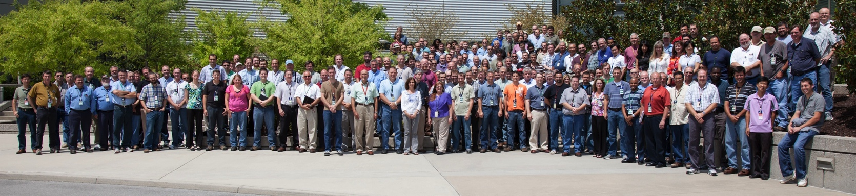
Summary
Management commitment and engagement is essential to success
This is a team effort – it requires coordination and cooperation from worker to Division Director
We have to demonstrate incremental improvement and long-term success to be able to effectively argue that we can execute PPU and STS as planned
I expect a significant step forward in rigor in planning and prioritization for the Summer outage and beyond
We will get it done!

Slide 11
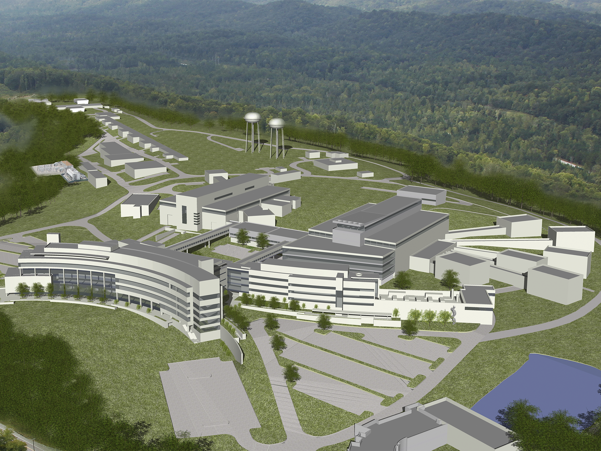
Discussion

