Slide 1
Progress in Ion Source Operation for Consistent High Current and Long Life Performance
Martin Stockli
Ion Source Team Lead
Accelerator Advisory Committee
Oak Ridge, TN37830
February 17, 2016

Slide 2
AAC 2015: Ion Source and Integrated Test Facility
Observations and Comments
As was true at the last review, the ion source reliability continues to be very good. Antenna failure rates are much reduced from in the past due to improved quality control; there has been only one antenna failure since the last review. There is an ongoing optimization of source parameters due to the influence of hydrogen gas coming from the ion source on RFQ performance, especially considering the close coupling between the source and RFQ. One tries to maintain low source gas flow for the RFQ, but if it is made too low, one has source plasma outages. Part of this optimization involves trying to better understand the rf ignition process of the source plasma.
The ion source test stand is operational again. (This was a recommendation in the 2013 review.) It was also very nice to see that external antenna development has resumed on the test stand, since ultimately this will most likely be the preferred configuration, compared to the internal antenna.
It was stated at the review that production sources 2 and 4 are preferred over source 3. The inferiority of source 3 is noticed in performance through the injector chain. The assumption is that the emittance is larger in source 3, but this would be good to verify with new measurements on the test stand. In addition, while one tries to make the sources nearly identical, it would be good to inspect the three sources carefully for mechanical differences, to see if any differences in emittance can be understood.

Slide 3
AAC 2015: Ion Source and Integrated Test Facility
The short electrostatic LEBT has been operating reliably. A routine change-out of LEBT is now done twice a year (insulator coating), which seems to be a good practice to facilitate this reliability. The LEBT gate valve, separating source vacuum and RFQ vacuum, had been removed in the past due to reliability issues. The need for the reinstallation of a valve in this location has been realized, partly due to recent accidental ventings of the RFQ. Improvements to the valve operation have been made, and it now seems reliable where it is being used on the ion source test stand. It should be reinstalled in LEBT so that in the future, one will be able to keep the RFQ under vacuum during source and LEBT maintenance, which should lead to better overall RFQ performance. Ultimately, one hopes that there will be little need to ever vent the RFQ vacuum, which is a good thing for the RFQ.
It was noted that there is no LEBT valve installed on the ITSF. A valve should be made similar to the one to be put back on the operating beamline, and installed here. The ITSF RFQ should be kept under vacuum as much as possible, and one should expect frequent source changes as the ITSF can be used to test source improvements, along with its other uses.
Recommendations
After further testing, continue plans to reinstall the LEBT valve to better protect the RFQ vacuum.

Slide 4
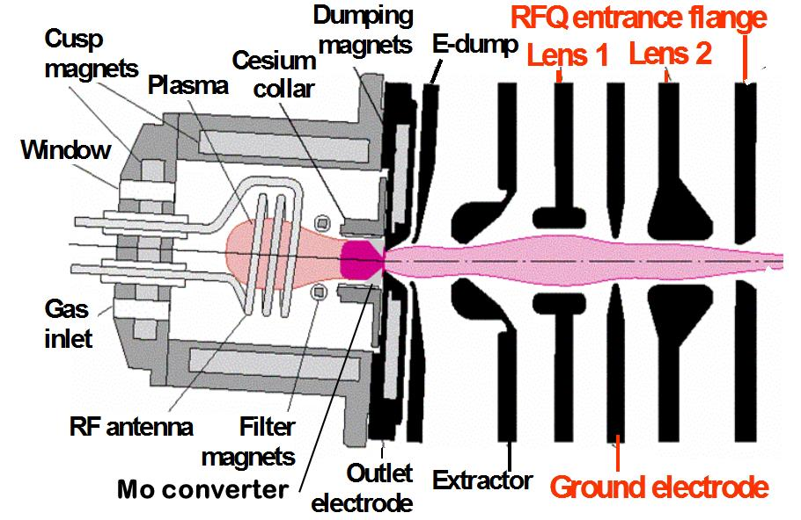
Content:
Introduction
Recent issues
  E-dump failures
  Recent performance
  RFQ transmission
  Plasma outages
  New 13 MHz tune
  Increasing the MEBT beam current
  The external antenna source
Conclusions
This talk is all about delivering
more H – ions for a longer time!

Slide 5
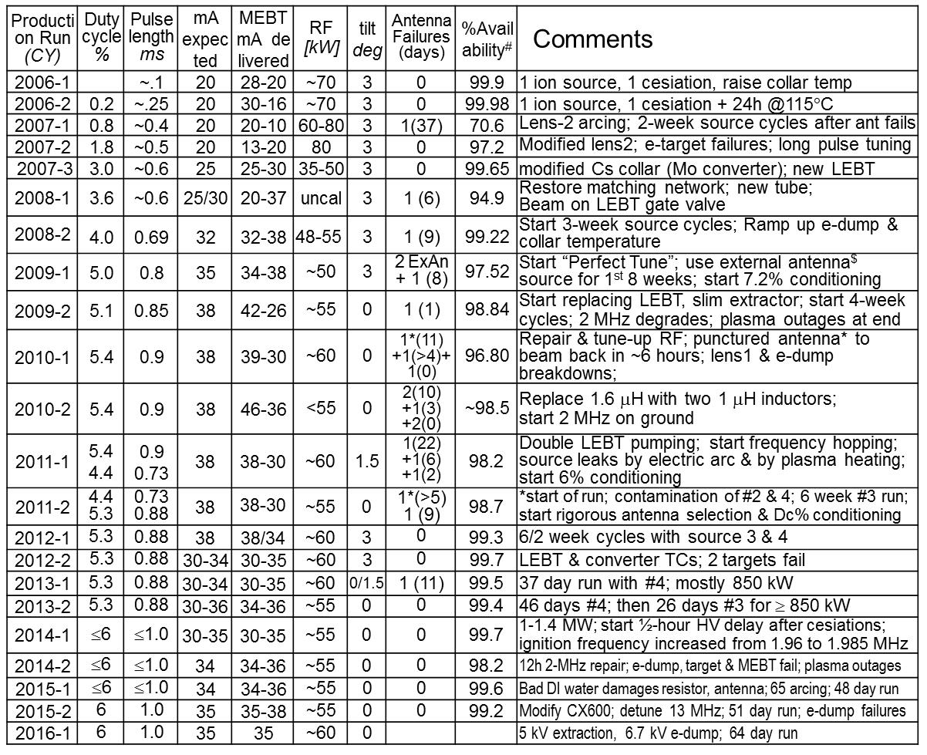
Ion Source & LEBT Performance
The ion source and LEBT availability remain high despite pushing their performance.

Slide 6
The SNS Baseline Ion Source and LEBT
LBNL developed the SNS H⁻ ion source, a cesium-enhanced, multicusp ion source.
Typically 300 W from a 600-W, 13-MHz supply generates a continuous low-power plasma.
The high current beam pulses are generated by superimposing 50-70 kW from a pulsed 80-kW, 2-MHz amplifier.
The two-lens, electro-static LEBT is 12-cm long. Lens-2 is split into four quadrants to steer, chop, and blank the beam.
The compactness of the LEBT constrains beam characterizations in front of the RFQ. The beam current is measured after emerging from the RFQ, which equals the LINAC beam current.
Measuring the chopped beam on the RFQ entrance flange shows >50 mA being injected into the RFQ under nominal conditions.
While there remain issues, this is a record-breaking Injector!

Slide 7
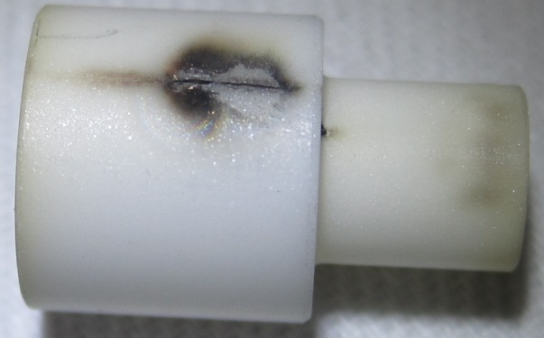
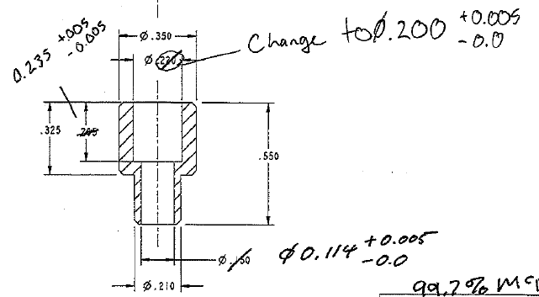
A precarious e-dump Position
The e-dump is controlled with an +8 kV supply on the source high voltage platform.
E-dump-to-extractor arcs raise the e-dump significantly over the operational ~8 kV limit.
Too many e-dump failures before 2008 resulted in keeping the e-dump near 2 kV.
Since 2008 design improvements allow for reliable operations till ~ 7kV, which is needed for high RFQ transmission!
+8 kV
-70 kV
+20 kV
-60 kV
-60 kV
Accepting a lower-cost manufacturer for the e-dump-to-source standoffs resulted in several e-dump failures in fall 2015.
However, this time we ran with lower e-dump voltages until the next maintenance day, minimizing downtimes.
All failures showed breakdowns of the shoulder, the smallest high-voltage gap.
from 0.065 to 0.075
Returning to the original manufacturer and robiustifying the design significantly improved the high voltage margin.
Failure risk reduced!
from 0.04 to 0.07

Slide 8
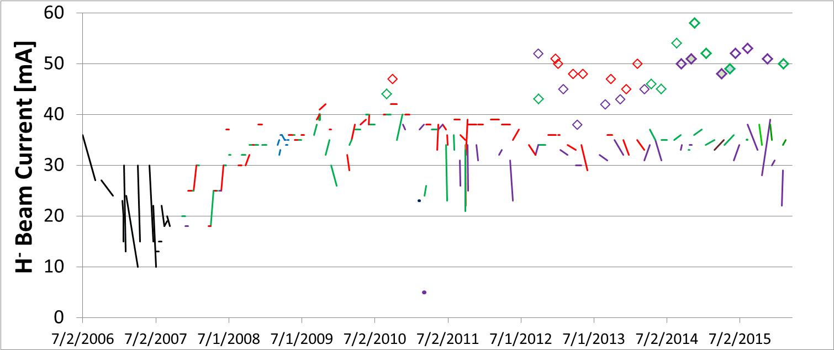
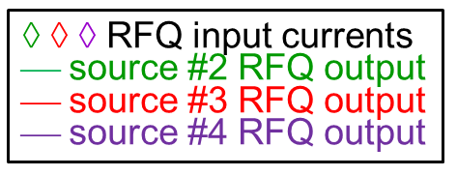
Ion Source and LEBT Performance History
Year of ~40 mA MEBT currents
Only source #3 makes ~38 mA
Decaying beams before developing proper conditioning
e-dump failures
Ramping up the beam with many improvements
Reduced RFQ transmission
source leaks & contamination
large leak
The 137th production source was started up February 4, 2016. This provided 137 opportunities to learn, improve and perfect the operation of our H⁻ source and reach record performances!
However, due to the nature of ion sources, especially H⁻ ion sources, many things are not fully understood and not exactly reproducible, and remain challenges!

Slide 9
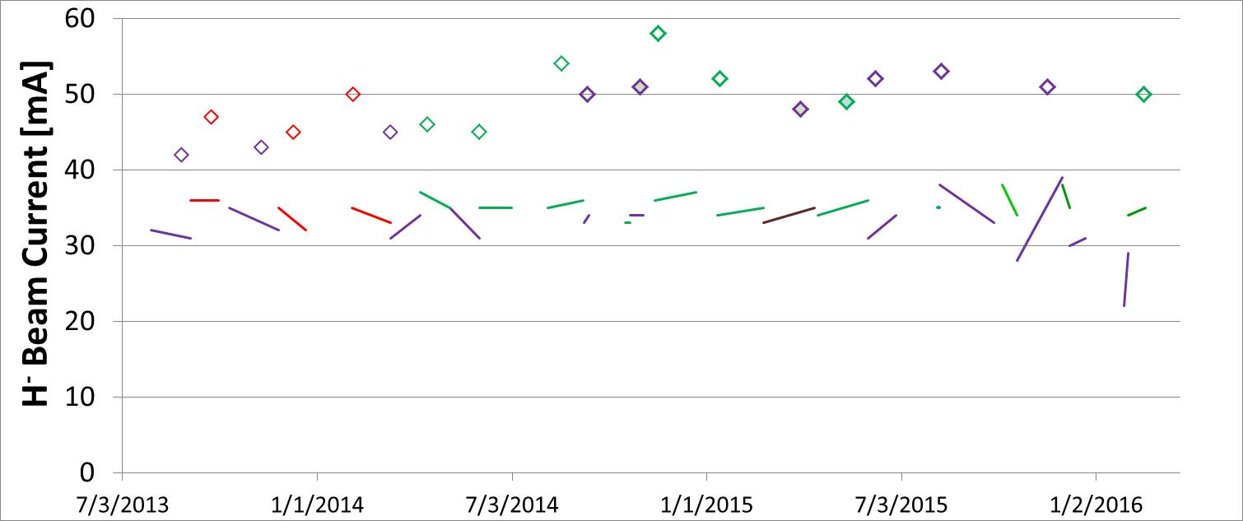
Recent Ion Source and LEBT Performance
1.4 MW
1.4 MW
AAC’15
#3 preferred due to higher performance
e-dump failure
#2 & #4 preferred for more stable RFQ
source leak suspected
e-dump failures
12 month Period | 7/13-6/14 | 7/14-6/15 | change
Average RFQ input | 45.4±2.4 | 51.8±1.2 | +14%
Average RFQ output (end of cycle) | 33.2±1.9 | 35.0±1.3 | +5%
◊ ◊ ◊ RFQ input currents
⎯ source #2 RFQ output
⎯ source #3 RFQ output
⎯ source #4 RFQ output
Source #2 & #4 continue as workhorses for neutron production.
Lowering the H₂ pressure enabled higher MEBT beam currents.
Proactive retuning has reduced the performance variations to a very few mA.
RFQ input- and output-currents are up, but the RFQ transmission remains compromised!

Slide 10
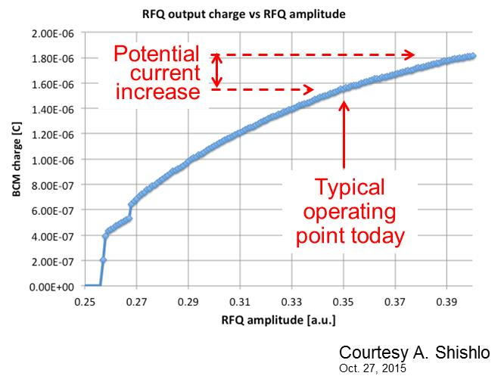
RFQ transmission vs. RFQ field
Adapted from M. Plum
Due to thermal
(resonance) instability
we cannot operate the
RFQ at the design field.
The instability appears to be enhanced by beam losses and high H₂ flows.
Measured transmission
is 12 – 30% less than
design.
This is the primary
limitation in 1.4 MW margin.
Absolute RF field measurements are difficult, and
there is uncertainty in the actual fields.
Last year we hoped that lowering the H₂ flow would enable higher RFQ powers, boosting the RFQ transmission.
However, only ~5% are typically achieved!

Slide 11
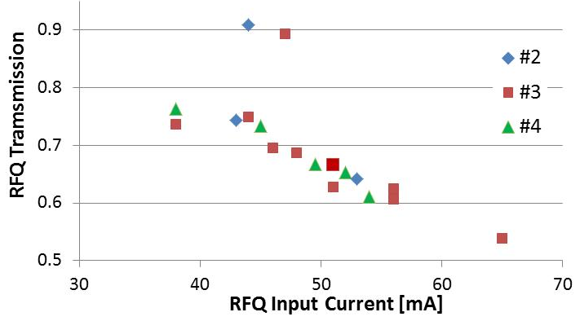
RFQ Transmission Measurements before retune
The transmission is decreasing with increasing RFQ input current, which could be a space charge issue!
2010
2012-2013
PARMTEQ predicts almost no space charge driven losses for beams <60 mA in the RFQ.
PARMTEQ
2010
Space charge driven emittance growth in the LEBT can explain the original downwards trend, but not the heavily compromised transmission!
2012-13

Slide 12
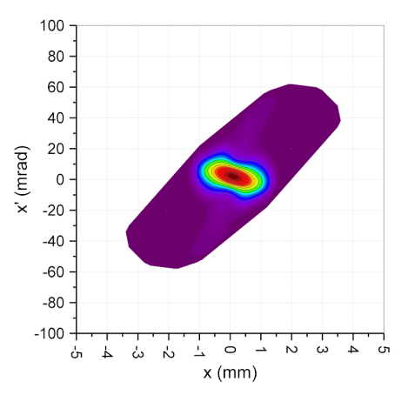
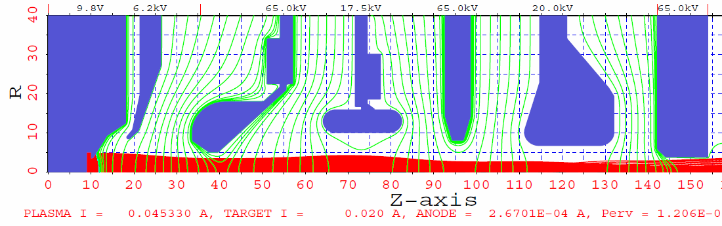
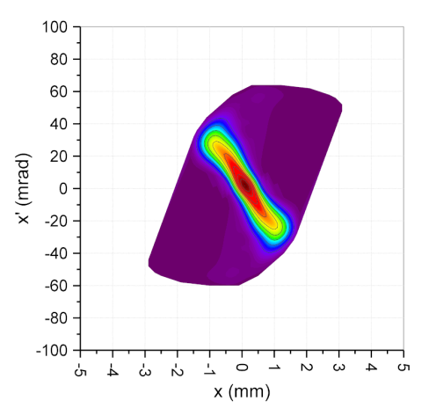
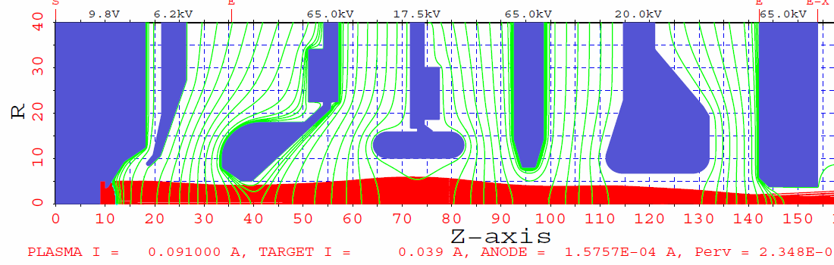
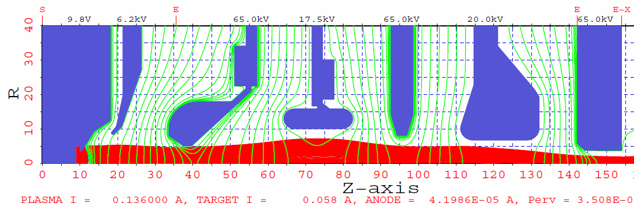
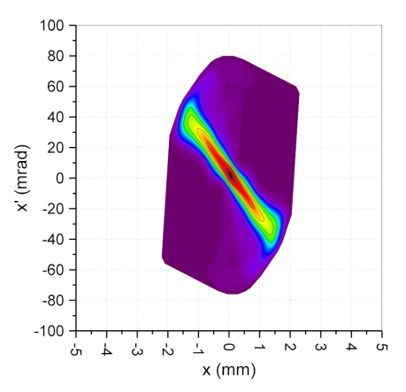
Space-Charge driven Emmitance growth in LEBT
20 mA
-65 -58.8 0 -47.5 0 -45.0 0
0.075 π mm⋅mrad
40 mA
-65 -58.8 0 -47.5 0 -45.0 0
0.119 π mm⋅mrad
60 mA
-65 -58.8 0 -47.5 0 -45.0 0
0.181 π mm⋅mrad
Beam current increases emittance ~linearly causing a linearly decreasing transmission!

Slide 13
Content:
Introduction
Recent issues
  E-dump failures
  Recent performance
  RFQ transmission
  Plasma outages
  New 13 MHz tune
  Increasing the MEBT beam current
  The external antenna source
Conclusions
This talk is all about delivering
more H – ions for a longer time!

Slide 14
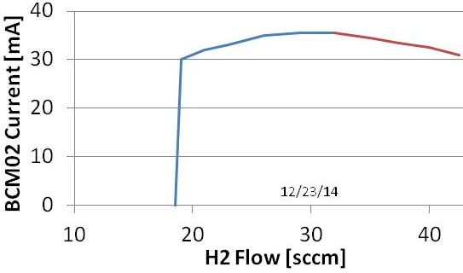
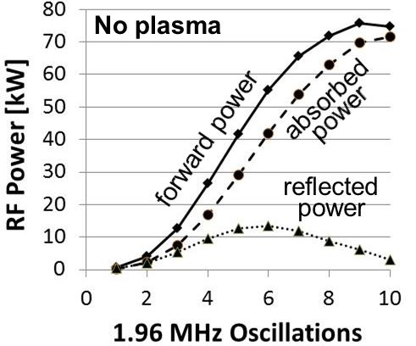
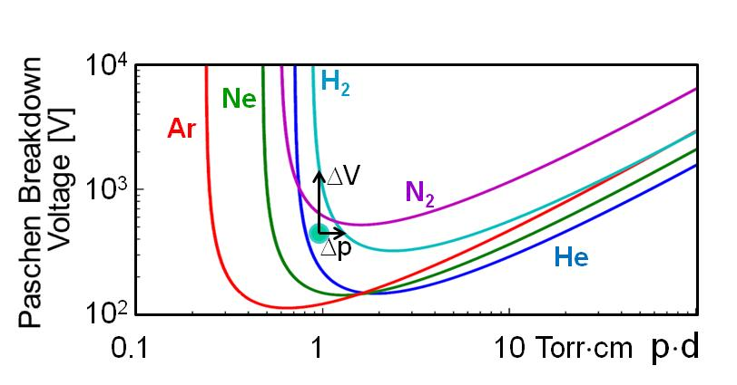
From AAC’15: the H₂ Flow
We maximize the H⁻ MEBT beam current: Increasing the H⁻ beam ⇒ denser plasma ⇒ higher electric fields ⇒ higher antenna current AND higher H₂ pressures.
But that increases the losses near source outlet.
There is an optimum H₂ flow that maximizes the H⁻ beam output, but outages need to be avoided!
76 kW of 2 MHz is not sufficient to breakdown the H₂ gas after prolonged operation.
However, a starter plasma can be amplified even with small RF powers. That is why SNS
Ignites continuous 13 MHz plasma with a pressure bump (PUFF).
Uses the 13 MHz plasma to absorb the 2 MHz plasma.
And, after a plasma outage goes back to 1).

Slide 15
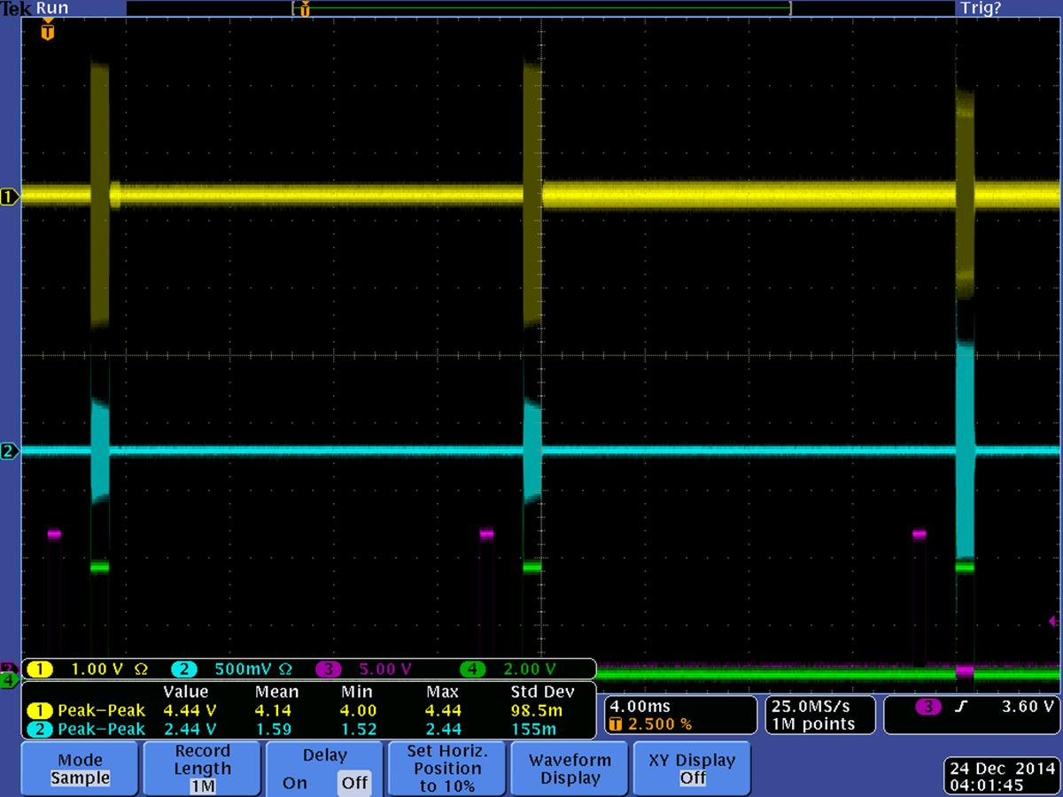
A Plasma Outage
2 MHz detuned
Seen by the 2 MHz directional coupler on ground
13 MHz
More 13 MHz
2 MHz forward
No plasma
Plasma
2 MHz reflected
Plasma outages start at the end of a 2 MHz pulse!

Slide 16
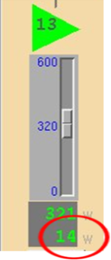
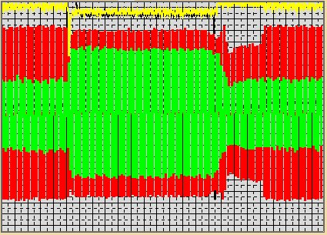
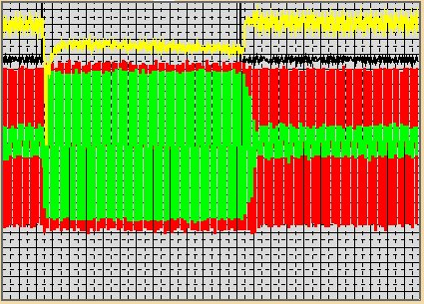
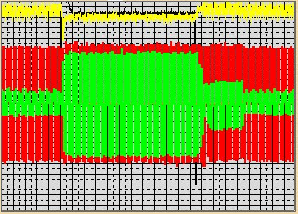
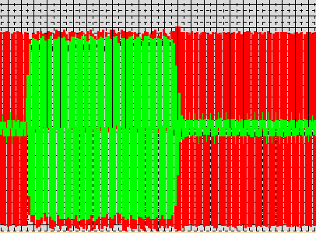
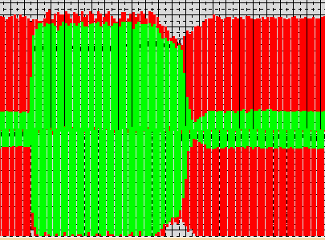
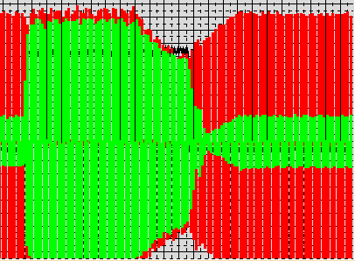
Time Resolved 13 MHz Measurements
In the past the average reflected power shown by the 13 MHz supply was used!
In 2014 FE scope#1 was used to display the forward & reflected 13 MHz RF.
Our tunes turned out to be inconsistent.
300W
400W
450W
The biggest surprise was that the 2 MHz plasma reflects practically all 13 MHz RF, which triggered foldbacks of the output power!
The 13-MHz supplier said averaging the reflected power is difficult!

Slide 17
The 13 MHz
R19 from 1.2k to 3.9k
⇒τ from 0.12 to 4 ms
C73 from 0.1 to 1
Reflected power comparator
The 13 MHz was modified to average the reflected power over 4 ms!

Slide 18
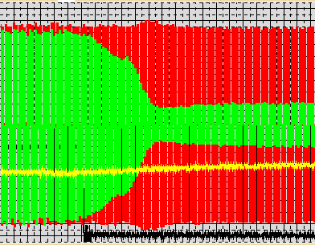
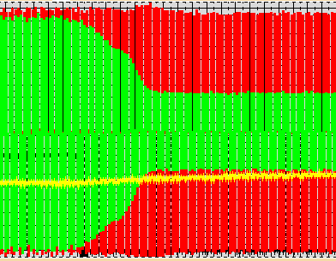
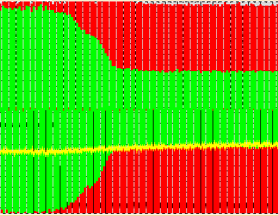
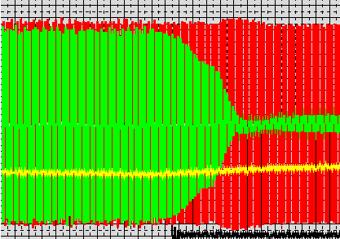
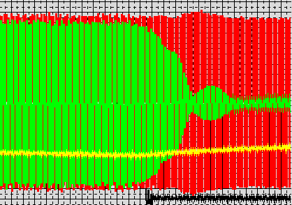

The 4-ms Filter works!
300 W; 25 sccm
400 W; 25 sccm
450 W; 25 sccm
1.0 1.1 ms
1.0 1.1 ms
1.0 1.1 ms
No more foldbacks of the output power!
300 W; 25 sccm
300 W; 20 sccm
300 W; 19.3 sccm
0.9 1.0 1.1
0.9 1.0 1.1
0.9 1.0 1.1 ms
Lower Hydrogen pressures are possible.
Plasma outages are preceded by a reflected power bump after the 13 MHz reflected power recovers!

Slide 19
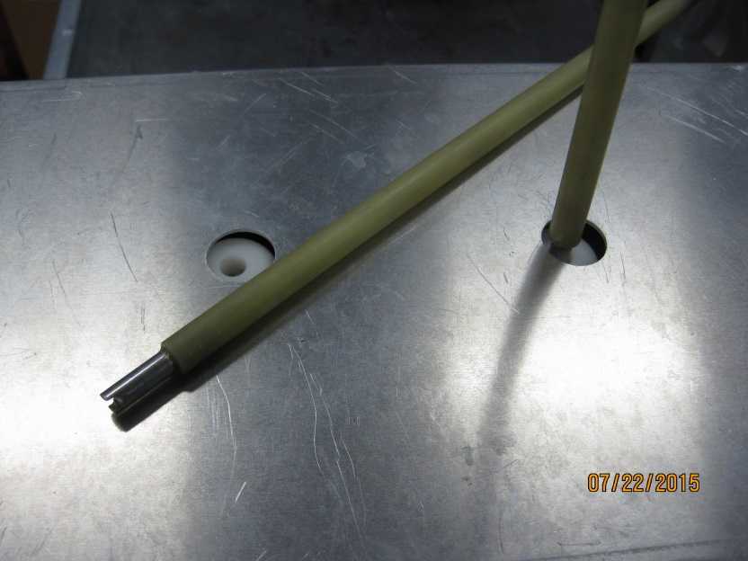
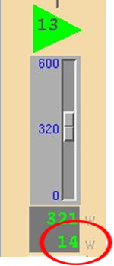
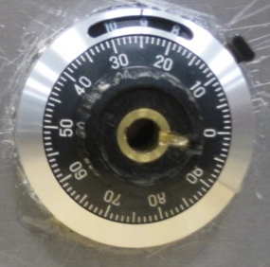

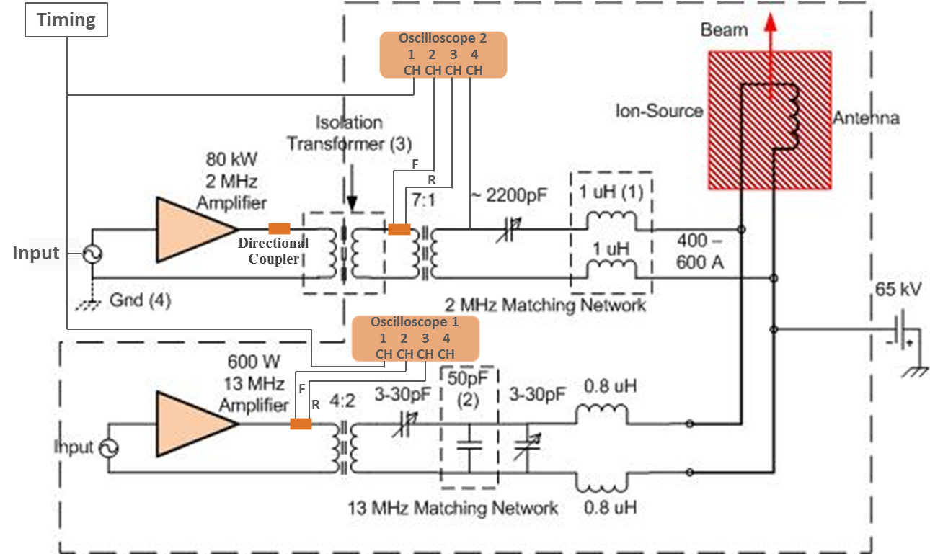
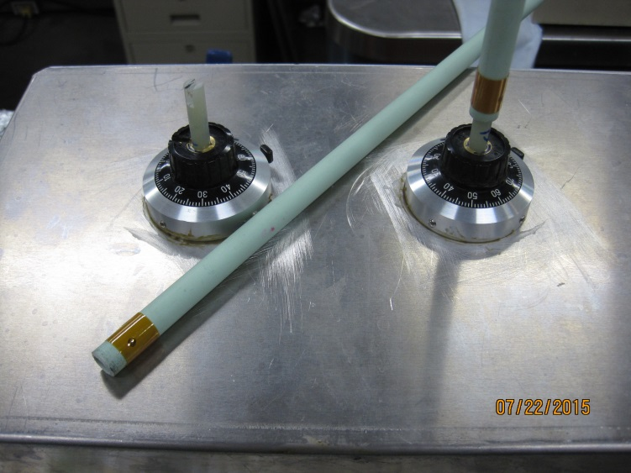
Tuning the 13 MHz Matcher
In the past the 13 MHz matcher was tuned with plastic slot drivers until the reflected power from the COMDEL CX600 indicated a minimum.
Adding 2 dials last spring enabled reproducible tunes!
Old matcher
+2 dials
= reproducible tunes!
2 MHz
13 MHz

Slide 20
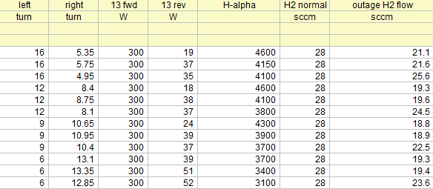
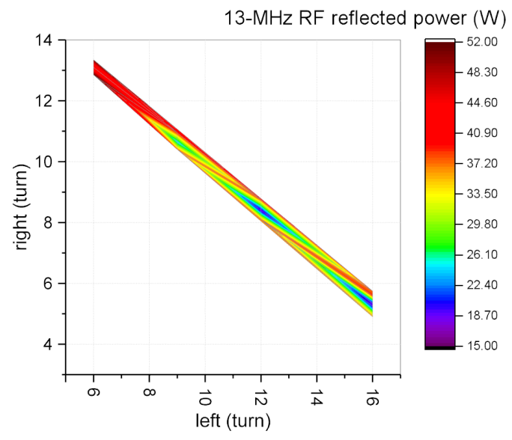
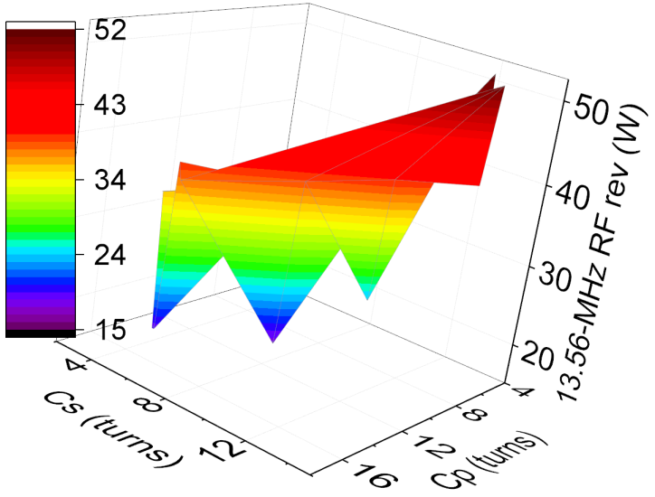
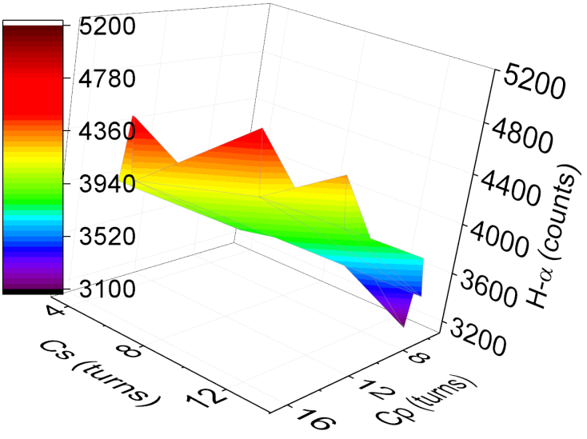
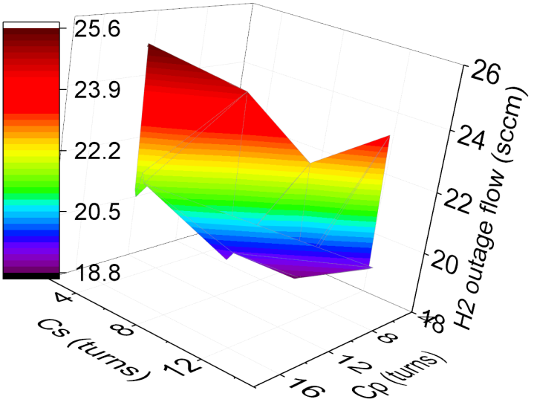
An outage resistant 13 MHz tune
The two 13-MHz tuning capacitors are strongly counter-correlated!
The resonance is less than 1 turn wide!
In the past we tuned minimizing the reflected power, yielding the brightest plasma.
Measuring the outage flow has shown that tunes with higher reflected power and less bright plasma allow for lower hydrogen flows.
That has enabled neutron production with ~10% less hydrogen which increased the beam current by 5% due to a higher transmission through the RFQ!

Slide 21
Content:
Introduction
Recent issues
  E-dump failures
  Recent performance
  RFQ transmission
  Plasma outages
  New 13 MHz tune
  Increasing the MEBT beam current
  The external antenna source
Conclusions
This talk is all about delivering
more H – ions for a longer time!

Slide 22
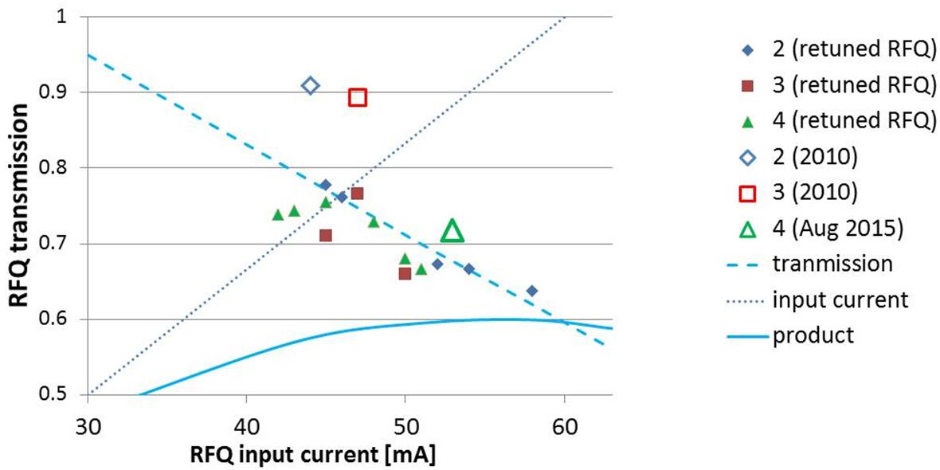
The Retuned RFQ and apparent Limits
In summer of 2013 the RFQ was retuned, which increased the transmission for 45 mA input current from 72% to 77%.
60
54
48
42
36
30
Transmission
RFQ Input Current
RFQ Input & Output Current
Transmission
RFQ input current Product = RFQ output current
RFQ Output Current
Multiplying the apparent transmission with the input current gives a parabola that peaks with 36 mA output for ~60 mA input current.
Are we doomed to MEBT currents ≤36 mA?
Maybe not, if we can learn new tricks!

Slide 23
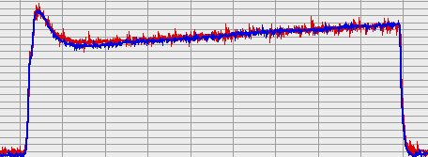
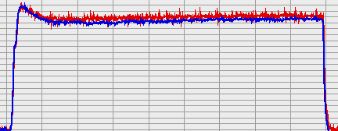
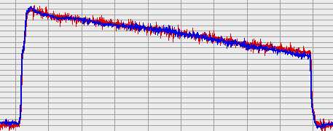
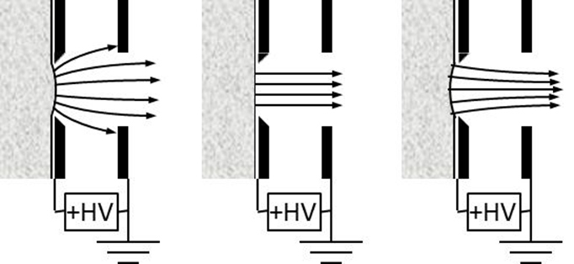
How to Make More H⁻ Beam with lesser Sources?
38 sccm
plasma grows
High-voltage discharges cause plasma outages which are avoided by increasing the H₂ flow.
We started to lower the H₂ flow after the high voltages conditioned. This increased the H⁻ beam as extraction-area losses are reduced.
28 sccm
plasma steady
After reaching the optimum H⁻ beam current near ~28 sccm, the beam current can decrease as the plasma is starved.
18 sccm
plasma starves
The MEBT H⁻ beam current is globally optimized during the final tuning using the
time-averaged charge, integrated over the full pulse-length. This is done during the power ramp-up to production.
This includes a LEBT retune to profit from reduced-divergence beams obtained with smaller pressures.
Short Answer: Very carefully!

Slide 24
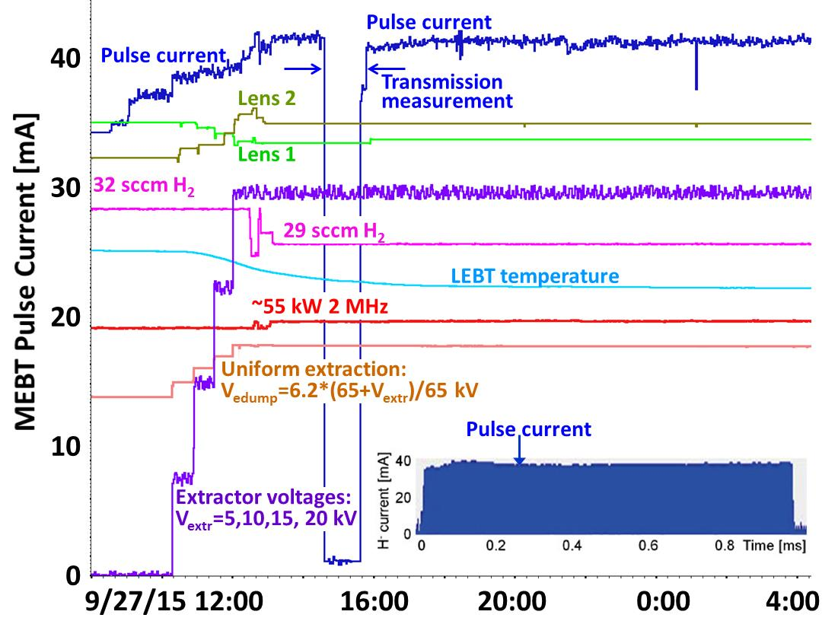
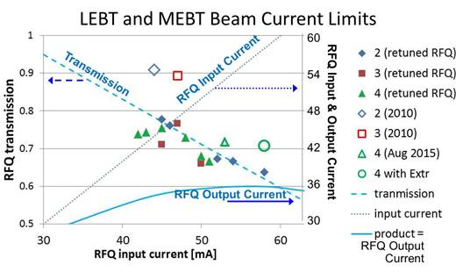

Lets push back the Meniscus!
The meniscus can be pushed back by lowering the pressure or by raising the extraction field.
Although our 0-20 kV extractor can increase the extraction voltage by up to 30%, no systematic beam enhancements were found in the past.
However, scaling the e-dump with the extractor, and retuning both lenses increased the beam current by ~3 mA.
26 sccm
20 kV
Beam current is up, the LEBT cooler, and the transmission is 71% a record for a 58 mA input current!
Rather than raising the 2 MHz power, we need to raise the transmission!

Slide 25
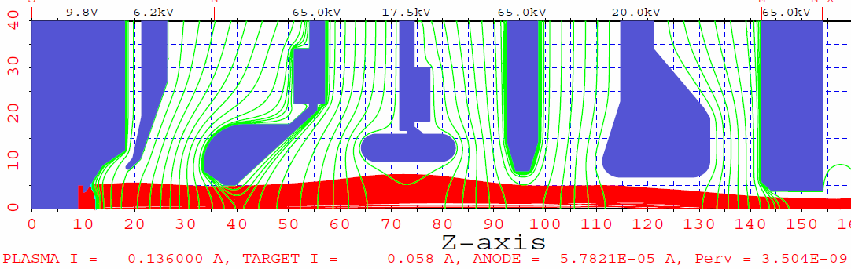
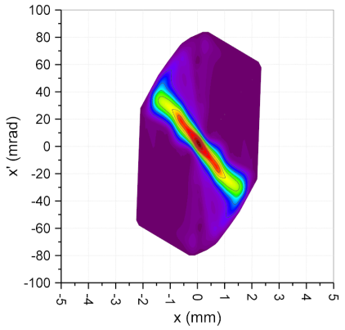




Extraction field modeling
58 mA extraction with grounded extractor and gradient matched e-dump:
-65 -58.8 0 -47.5 0 -45.0 0
0.199 π mm⋅mrad
Extraction field increased by 30%:
-65 -57.0 +20 -47.5 0 -45.0 0
0.155 π mm⋅mrad
Extraction field increased by 30% and retuned LEBT:
-65 -57.0 +20 -45. 0 0 -48.0 0
0.132 π mm⋅mrad
Pushing back the meniscus lowers the emittance, increasing the transmission!

Slide 26


51 Day Service Cycle of Source #4
Maint
C-discharge
Acc Phys
Target fails
1.3 MW power
1.3 MW power
41 mA
37 mA
38 mA
34 mA
32 sccm
26 sccm
chopper%
~55 kW
Cs 852
51 days of source #4 ~4 amp-hours of H- into RFQ
Having achieved persistent H⁻ beams, the service cycles of well performing sources is gradually extended until old age problems surface. Source #4 delivered ~4 amp-hours H⁻ over 51 days before being replaced after a target failure.
RF technology extends the life times of ion sources!

Slide 27



Source Replacements
Since late 2011, 6 and 6+ service weeks are customary for high performing sources to deliver more H⁻ ions when desired.
38 production sources were replaced in the past 4 years.
35 at the end of their service cycle.
2 prematurely after e-dump failed.
1 prematurely after antenna failed.
This is infant mortality!
Since recently the diameter of the most plasma exposed “tapered bend” of the antenna is carefully measured before and after service.
25 µm less coating was found after
51 days of use. If the sputter would be time-invariant, 75% of the 0.4 mm thick coating remains after ~1/2 year.
Plasma light and gas emission data suggest that most wear happens during conditioning!
Service cycles continue to be up to ~10 weeks for 5 A· h of H⁻!

Slide 28


SNS External antenna source
RF-driven (pulsed 2 MHz, 30-50 kW), Cs-enhanced, multicusp H⁻ sources delivering ~50 mA.
Similar to baseline source except for a water cooled AlN plasma chamber, antenna external to the vacuum and a plasma gun for ignition.
The auxiliary Bi-Cs dispenser was removed and several >50 mA runs were completed without beam decay!
Awaits ITF testing!
2015

Slide 29
Summary and Conclusions
SNS has operated for over a year with source #2 and #4 which yield a lower thermal load to the RFQ.
Paying more attention and spending more time tuning the source and LEBT have increased the linac H⁻ beam current and enabled 1.4 MW operations.
However, the compromised RFQ transmission reduces this gain to 1-2 mA in the MEBT.
Lowering the H₂ flow and increasing the extraction field push back the meniscus. Together with a LEBT retune, this increases the RFQ transmission. This is consistent with reduced emittances at the LEBT output.
This has enabled today’s 77% RFQ transmission resulting in a 35 mA linac beam current.
We continue our efforts to improve the consistency.
Thank you for your attention!

Slide 30




The Ion Source team supports operation, maintenance, improvement and development of the SNS ion sources and associated systems
Maintained Facilities: Frontend ion source and LEBT
Ion Source Test Stand
Small ion source test stand (used for Muons WFO)
ITF ion source and LEBT
Cleanroom for clean source assemblies
Equipment: 5 Source assemblies: 3 production, 2 test stand, 2 external
4 Electrostatic LEBTs
~ 40 high voltage supplies (8-11 per facility +~10 spares +~2 R&D)
-5 high power 2-MHz RF supplies ( 3 80-kW +2 120-kW solid state)
-6 13-MHz supplies (1 per facility plus 2 spares +1 R&D)
-7 matching networks (3 2 MHz plus 4 13 MHz)
4 hydrogen supply systems
3 vacuum systems with ~20 turbo pumps
11 scopes (~3 needed per facility)
3 ion source vacuum storage doilies
vacuum oven for LEBT storage
various workbenches, tools and tooling
Instrumentation: - 4 RGAs, - 3 optical spectrometers, 3 fast light detectors, 1 low-power emittance scanner
Scope:
Operational support Replace Frontend LEBT twice a year and refurbish to restore chopper voltage holding capability
Install, condition, start up, and tune up FE ion source to maximize MEBT beam current with a minimum of H₂
Replace, condition, start up, and tune up ion source as needed to maximize MEBT beam current with a minimum of H₂
Monitor ion source and LEBT performance and plan corrective maintenance when needed
Monitor RFQ transmission
Development: Modeling of low-energy beam transport
Improve operational performance and reduce variability
Improve characterization of plasma and low-energy beam
Test simpler and more robust solutions to areas of concern
Develop long-lived H⁻ sources
Test external antenna source
Outreach: Give >3 presentations at various institutions & meetings /year
Publish >3 papers in referred journals & referred proceedings /year
Co-organize workshops and conferences
Referee manuscripts
Collaborate with Muons and FNAL
Mentor interns
Ion Source
3 scientific staff
3 technician
6.0 FTE total
~2.0 FTE R&D & I&U

