Slide 1
STS Building Overview
Van Graves
STS Instrument Engineer
STS Fundamental Physics Workshop
July 26, 2019

Slide 2
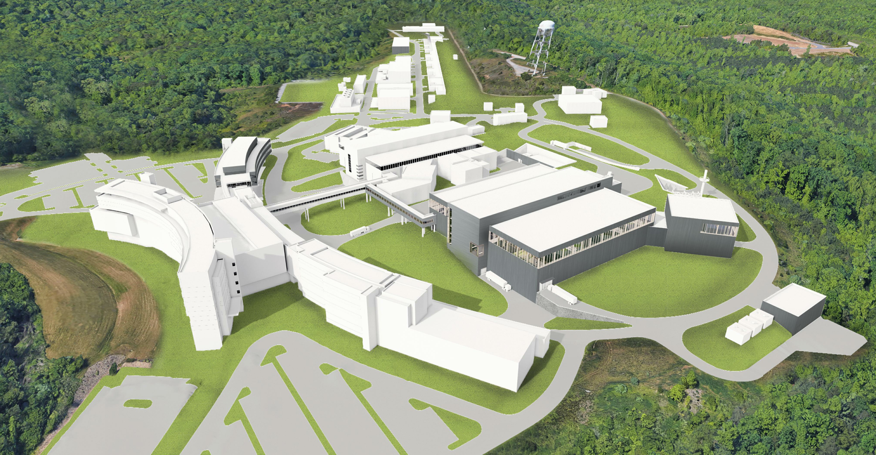
STS Render

Slide 3
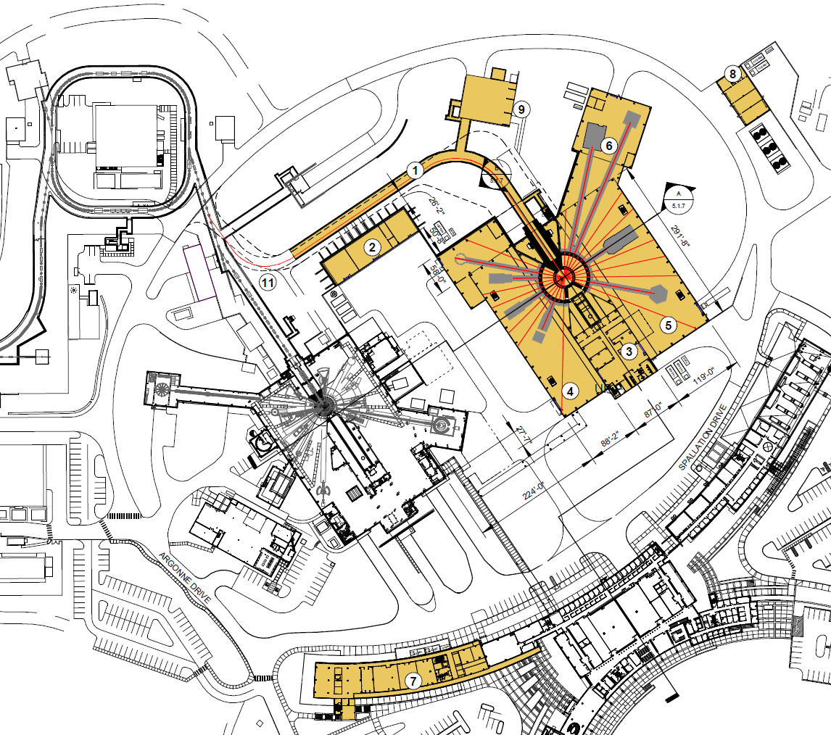
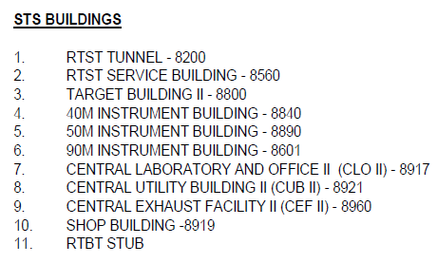
Site Plan

Slide 4
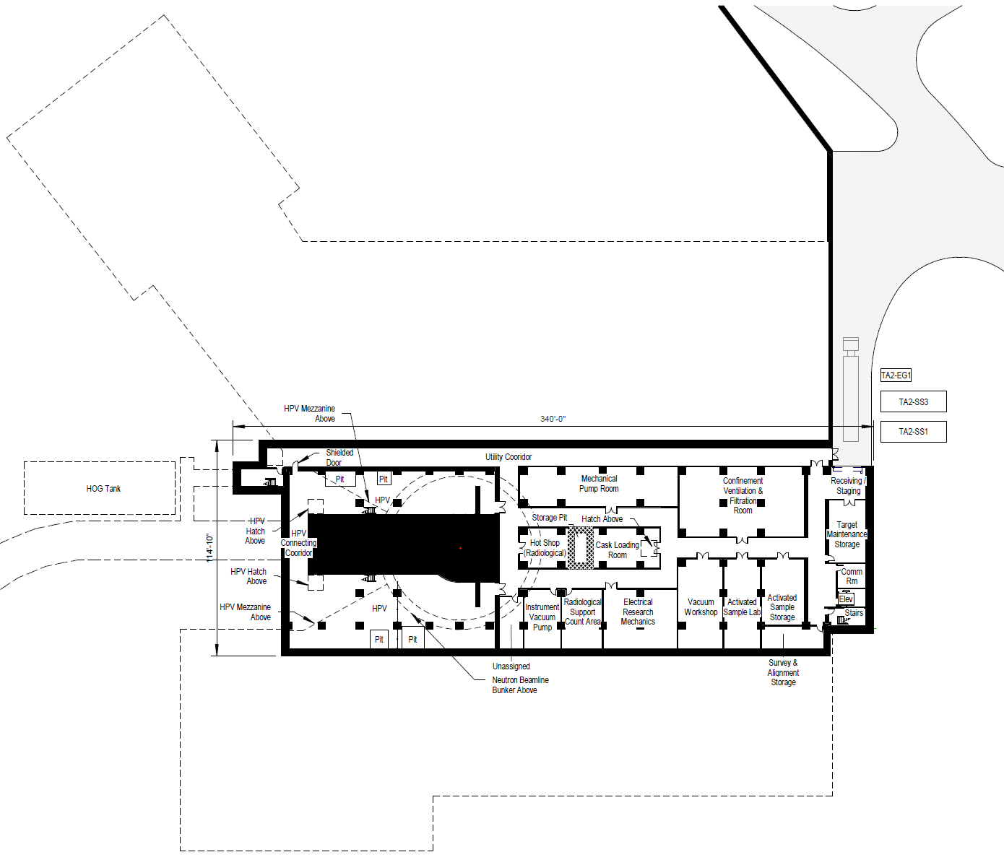
Basement

Slide 5
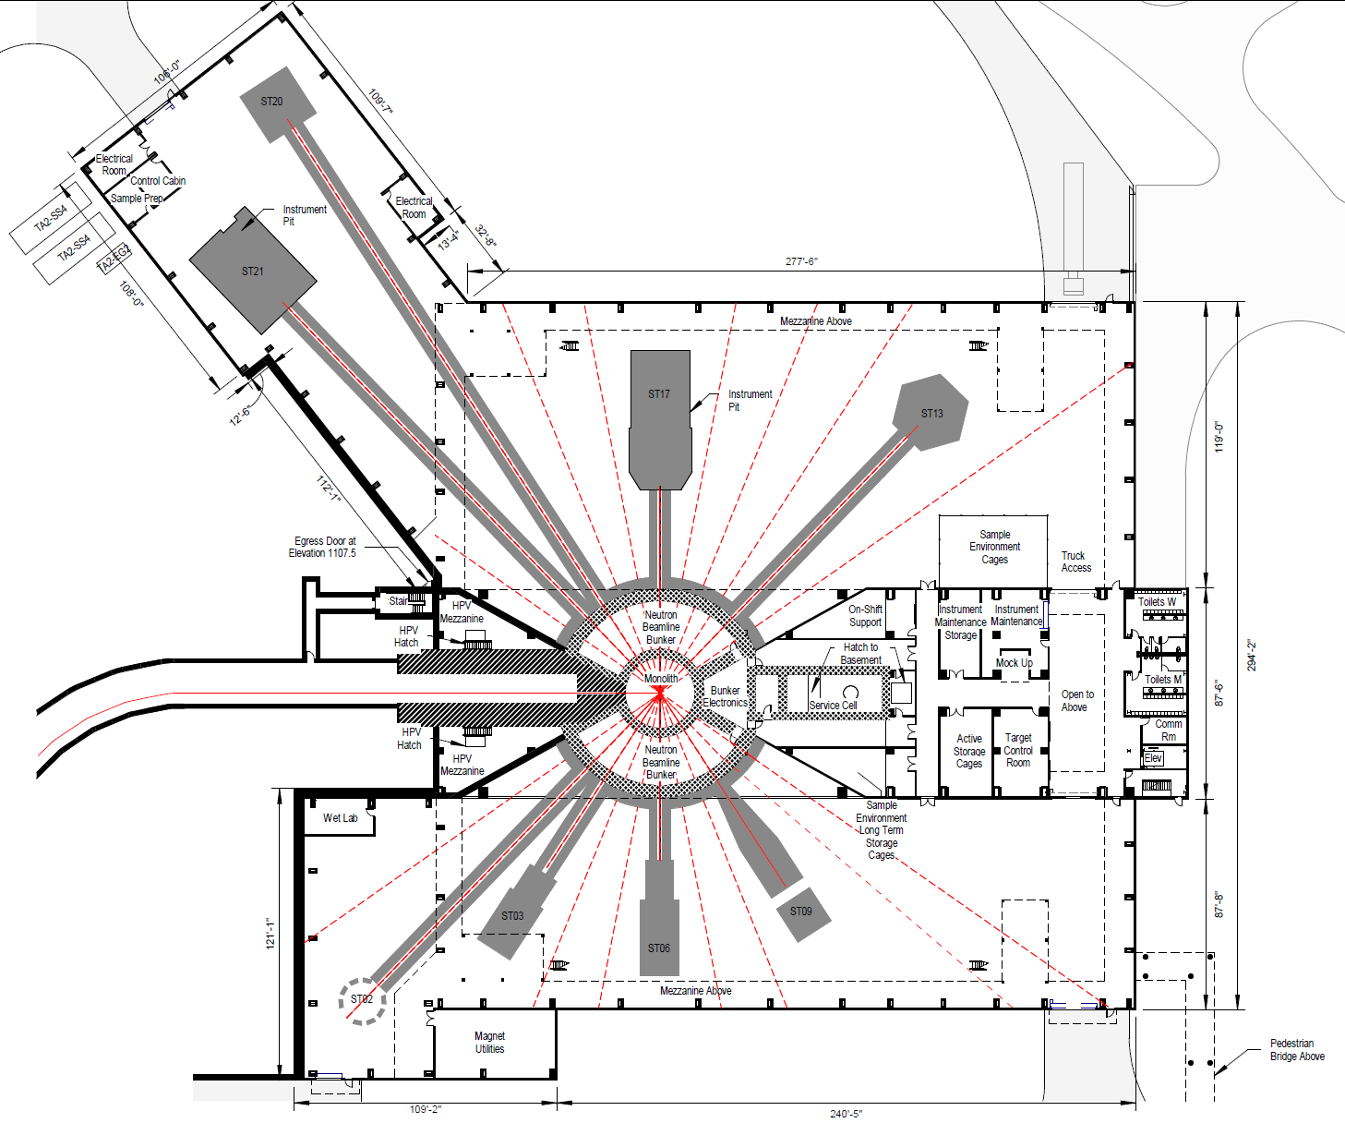
Instrument Floor

Slide 6
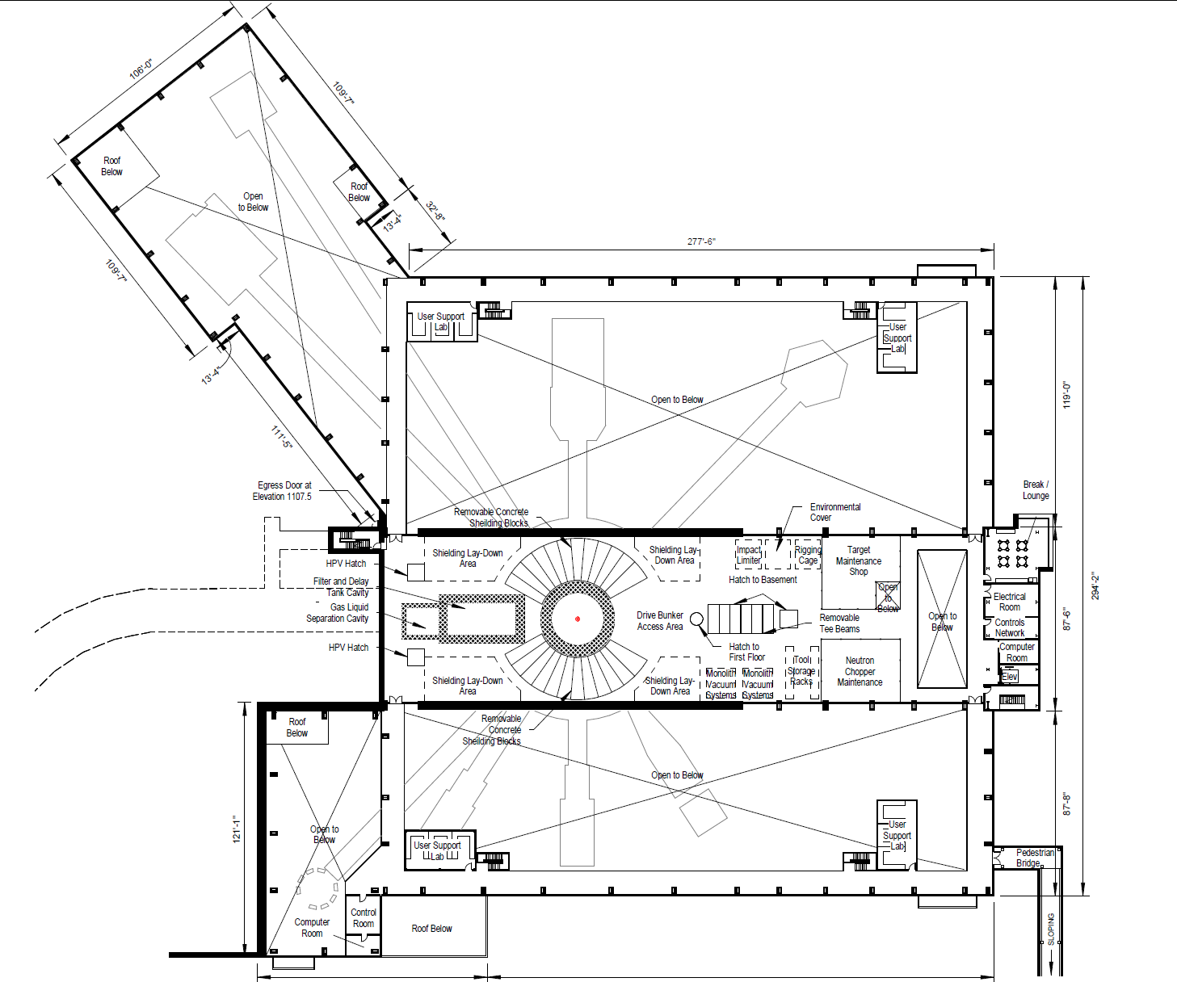
High Bay

Slide 7
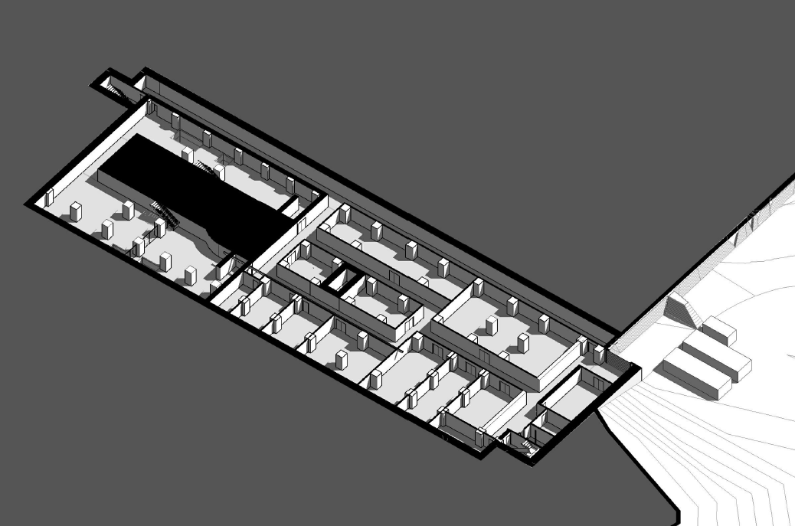
Basement Isometric Seciton

Slide 8
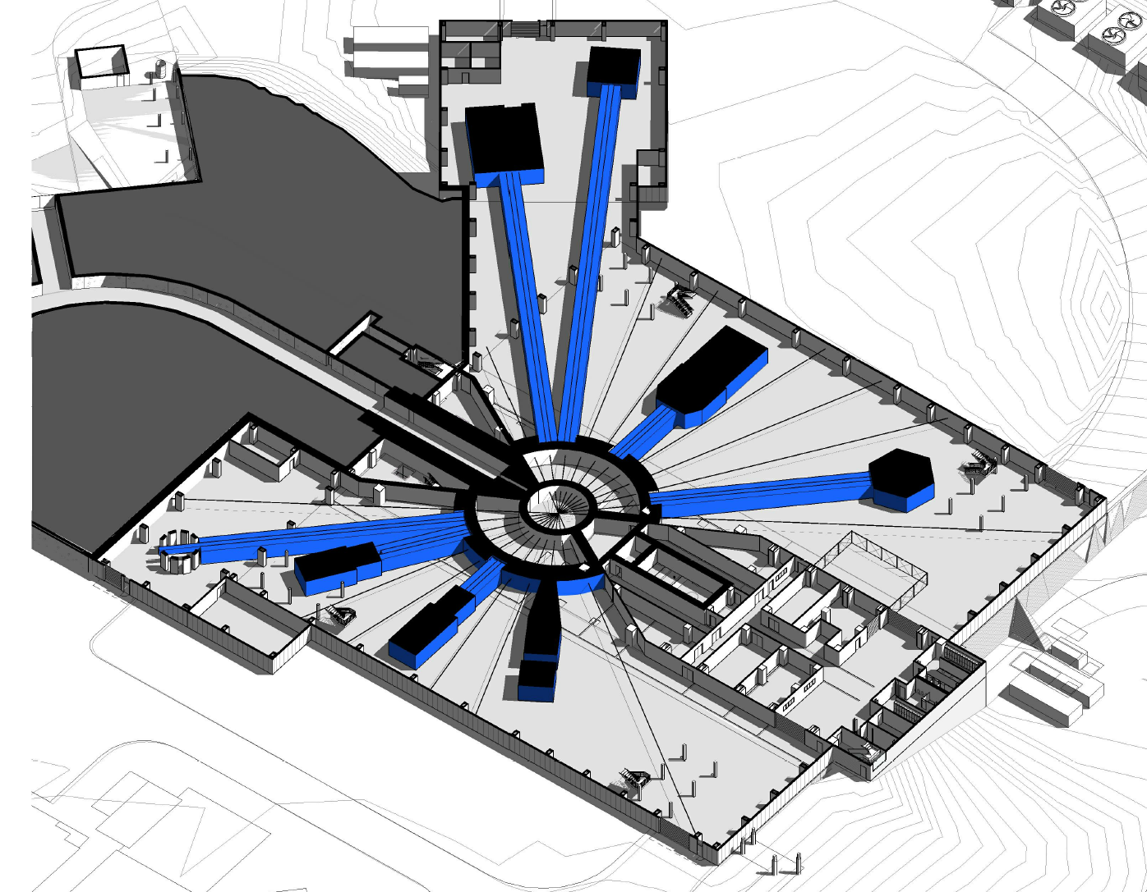
Instrument Floor Isometric Section

Slide 9
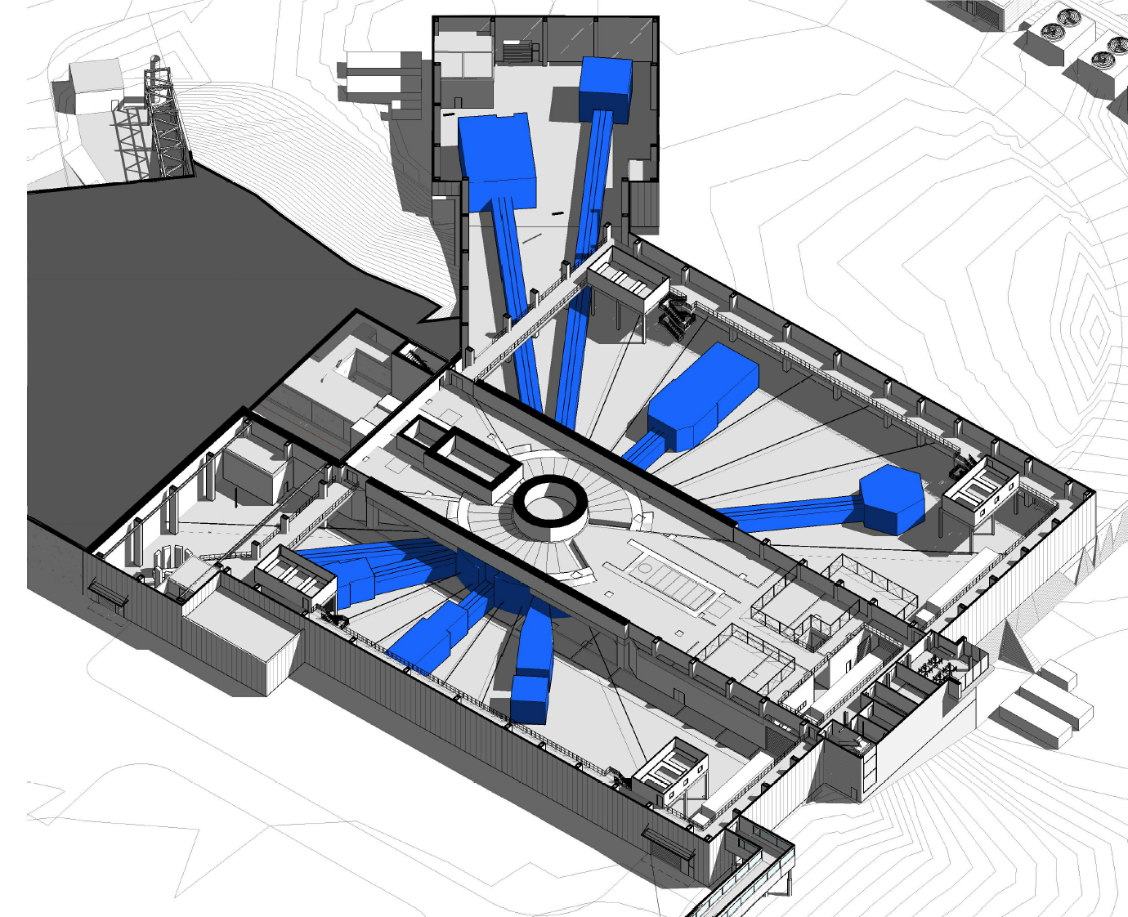
High Bay Isometric Section

Slide 10
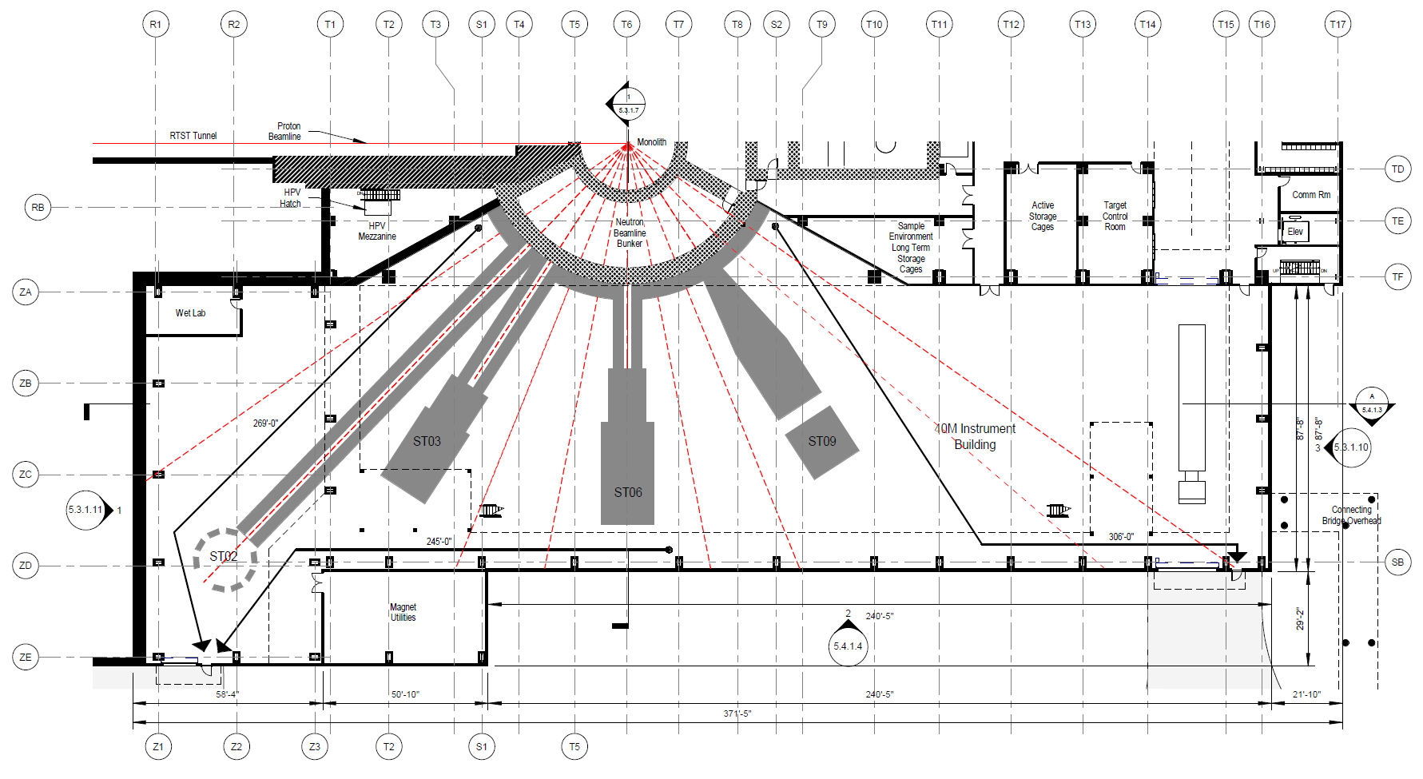
40M Instrument Floor

Slide 11
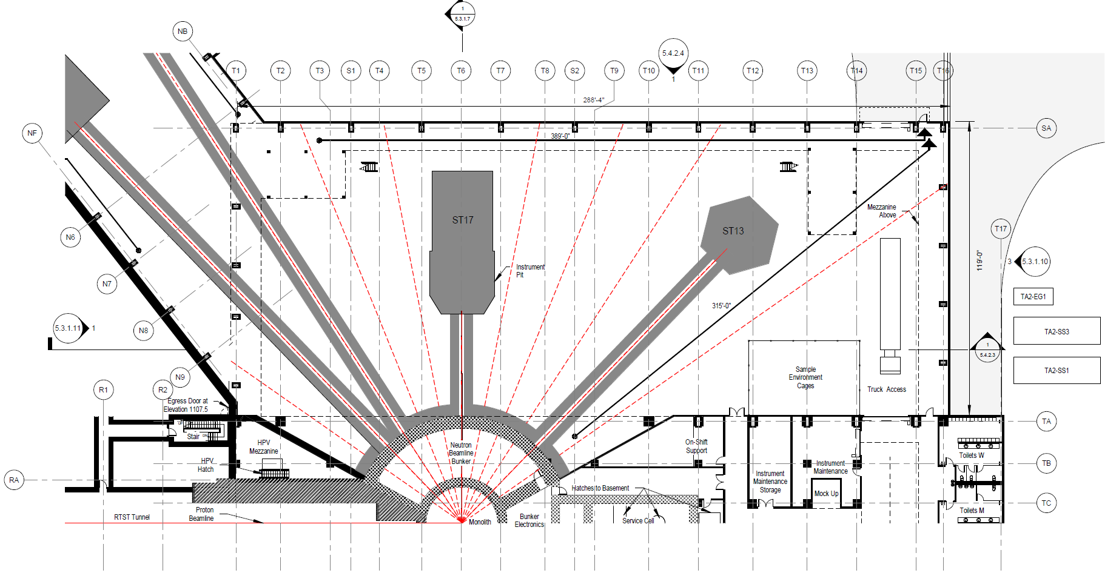
50M Instrument Floor

Slide 12
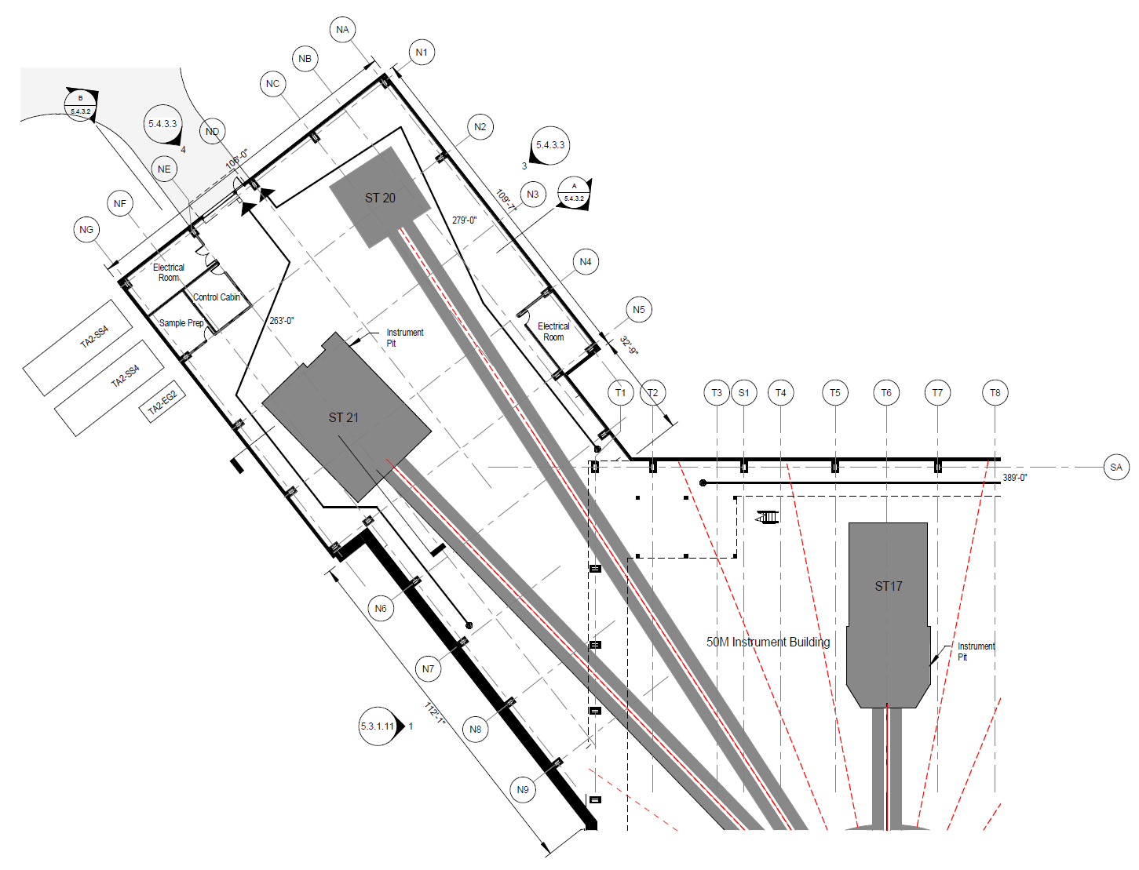
90M Instrument Floor

Slide 13
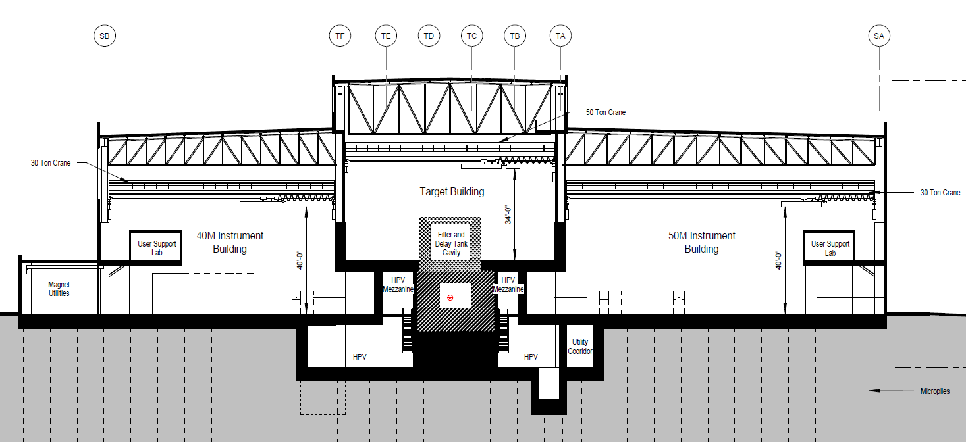
Section Along Proton Beam Upstream of Target

Slide 14
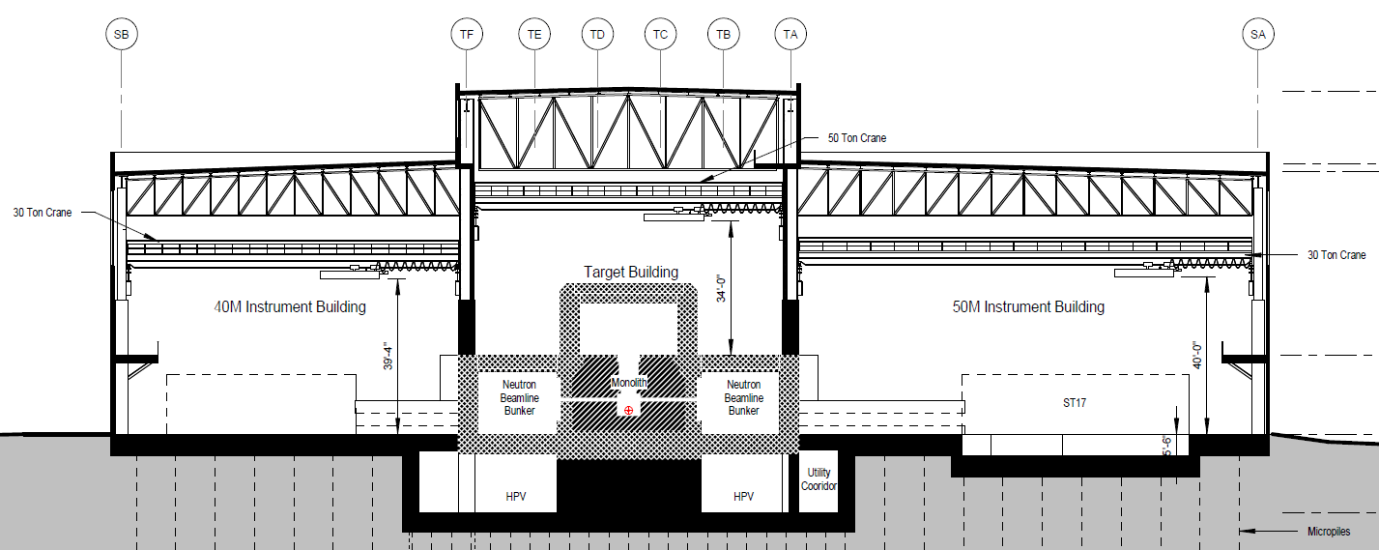
Section @ ST06-ST17

Slide 15
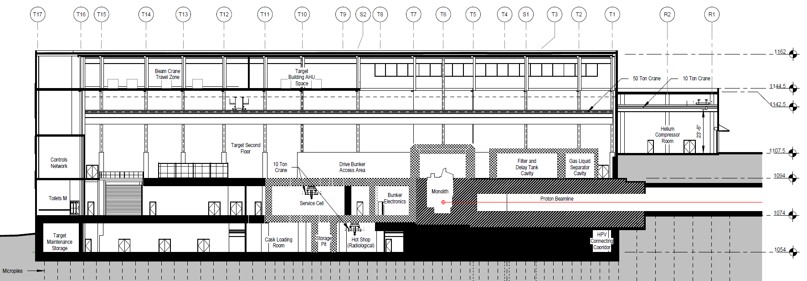
Section Along Proton Beam

Slide 16
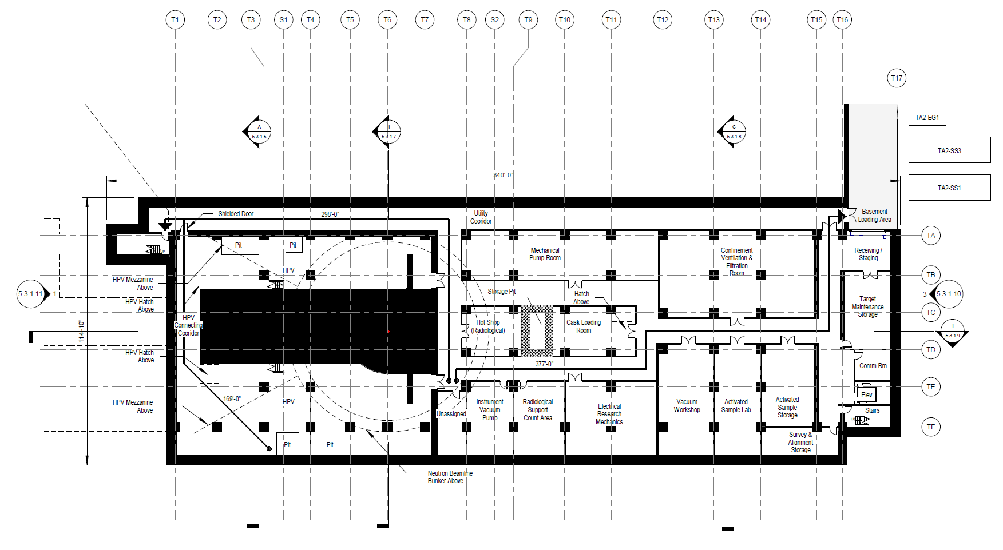
Target Building Basement
13.2m

Slide 17
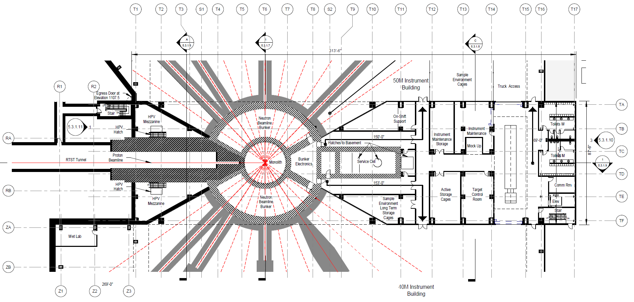
Target Building Instrument Floor

Slide 18
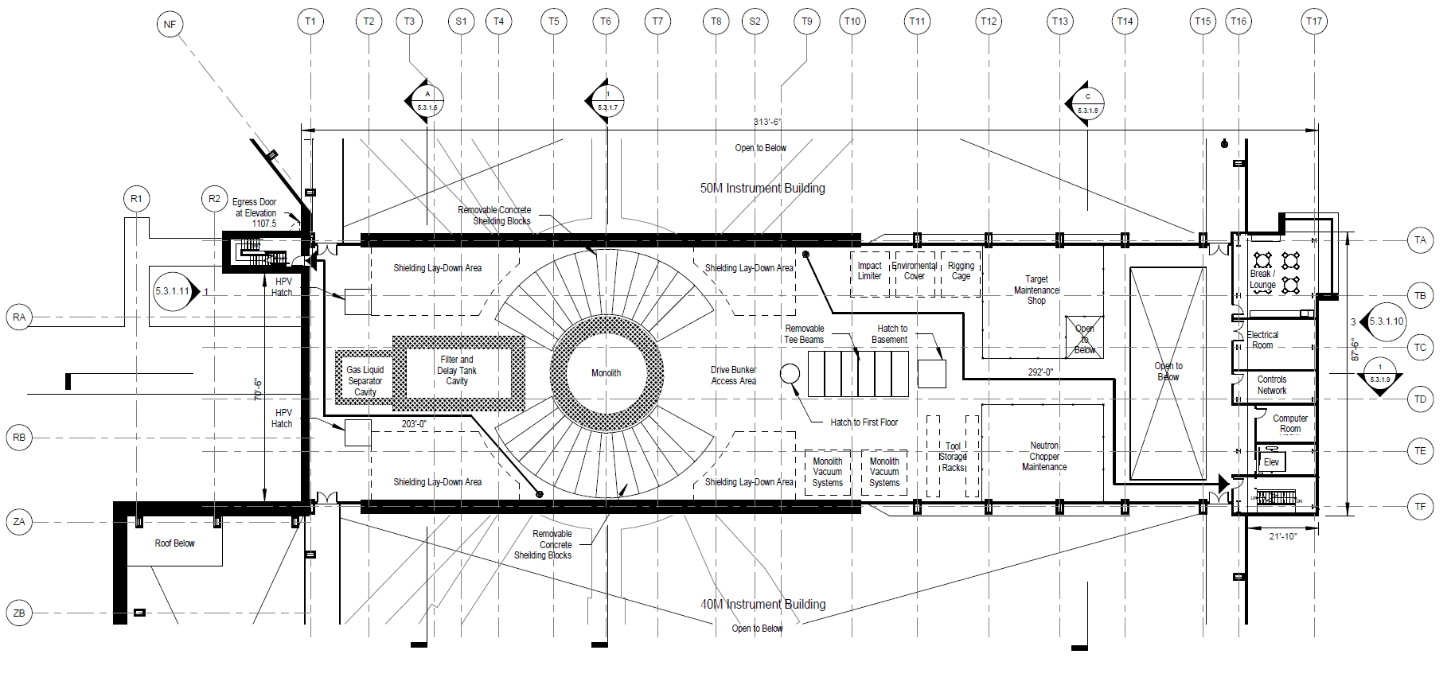
Target Building High Bay

Slide 19
Cooling Water System Locations in STS
Preliminary Layouts in Hot Process Vault (HPV) - Basement
Loop 2 Reflectors& Inner SS Shield (D2O)
Loop 3
Shielding, Core Vessel, Moderators, Monolith Inserts and (H2O)
Loop 1 Target & PBW (H2O)

Slide 20
Cooling Water System Locations in STS
Preliminary Layouts in Hot Process Vault (HPV) - Mezzanines
Loop 2 Reflector HOG Recombination System (D2O)
Loop 1 and Loop 3 HOG Condensers and LLLW Evaporation System

Slide 21
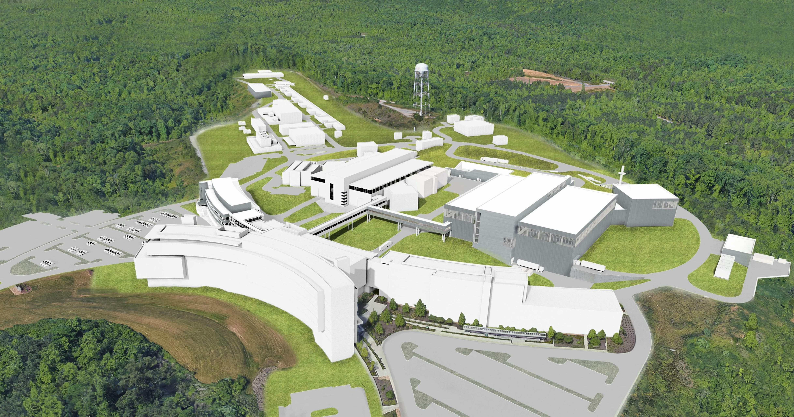

Slide 22
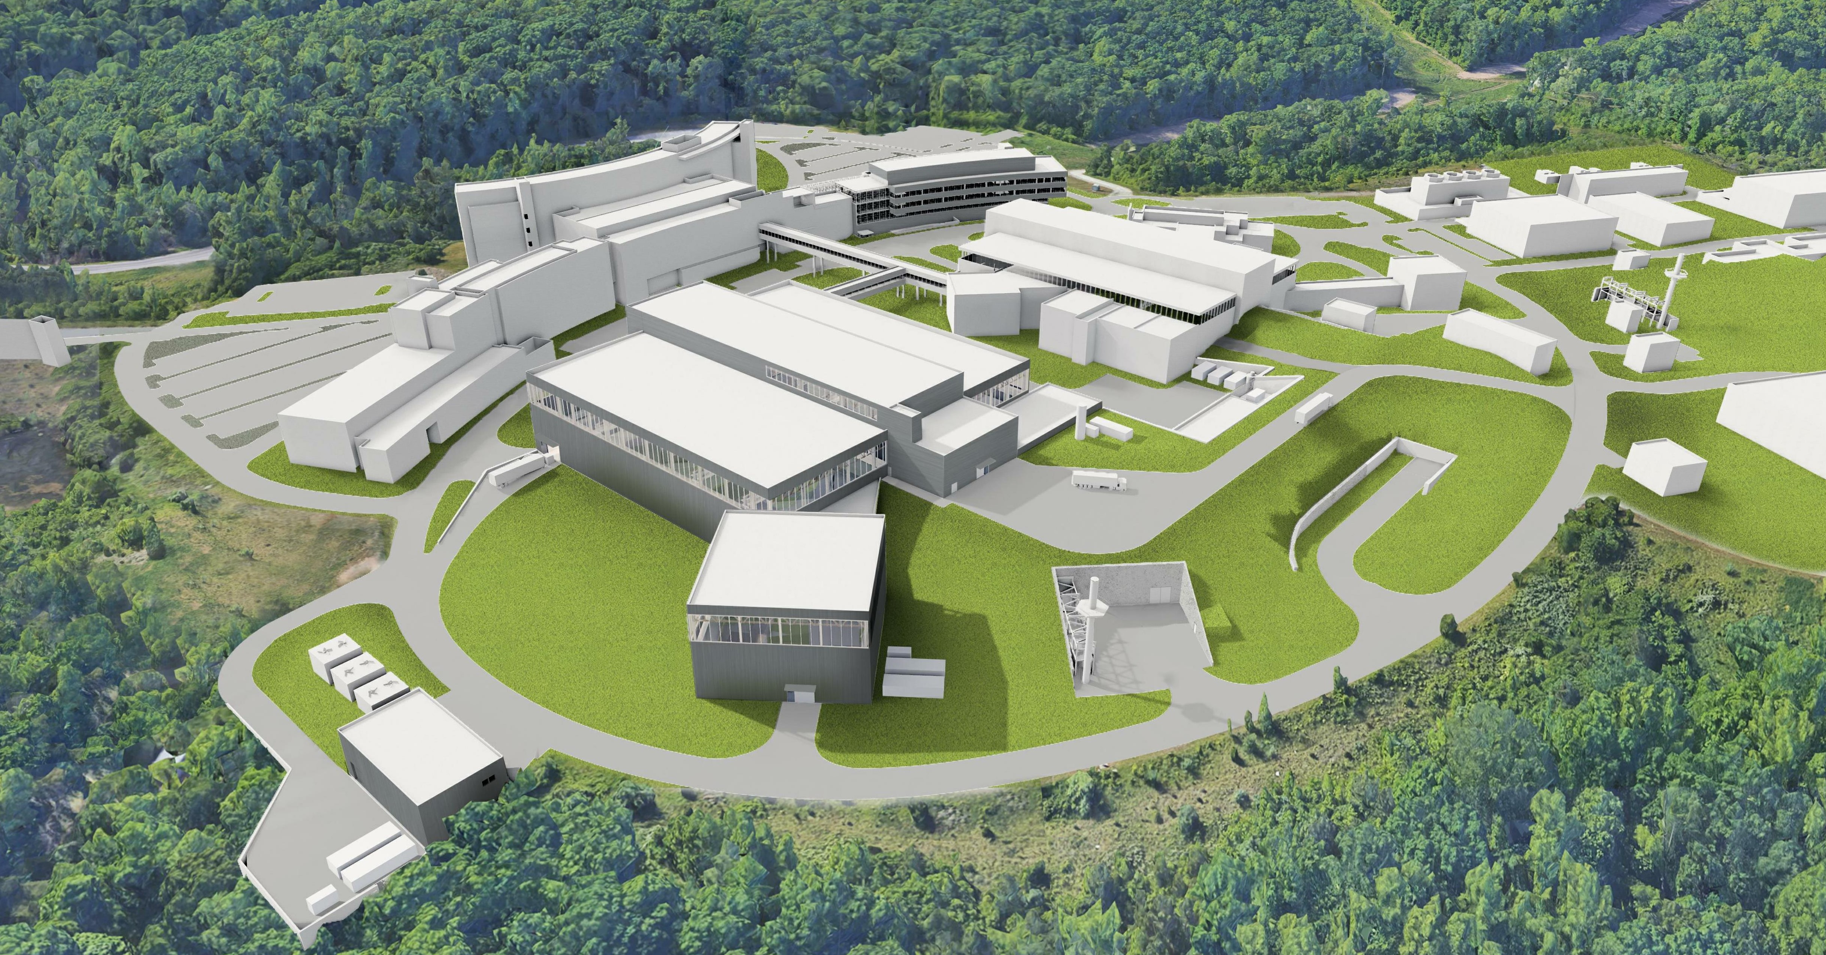

Slide 23
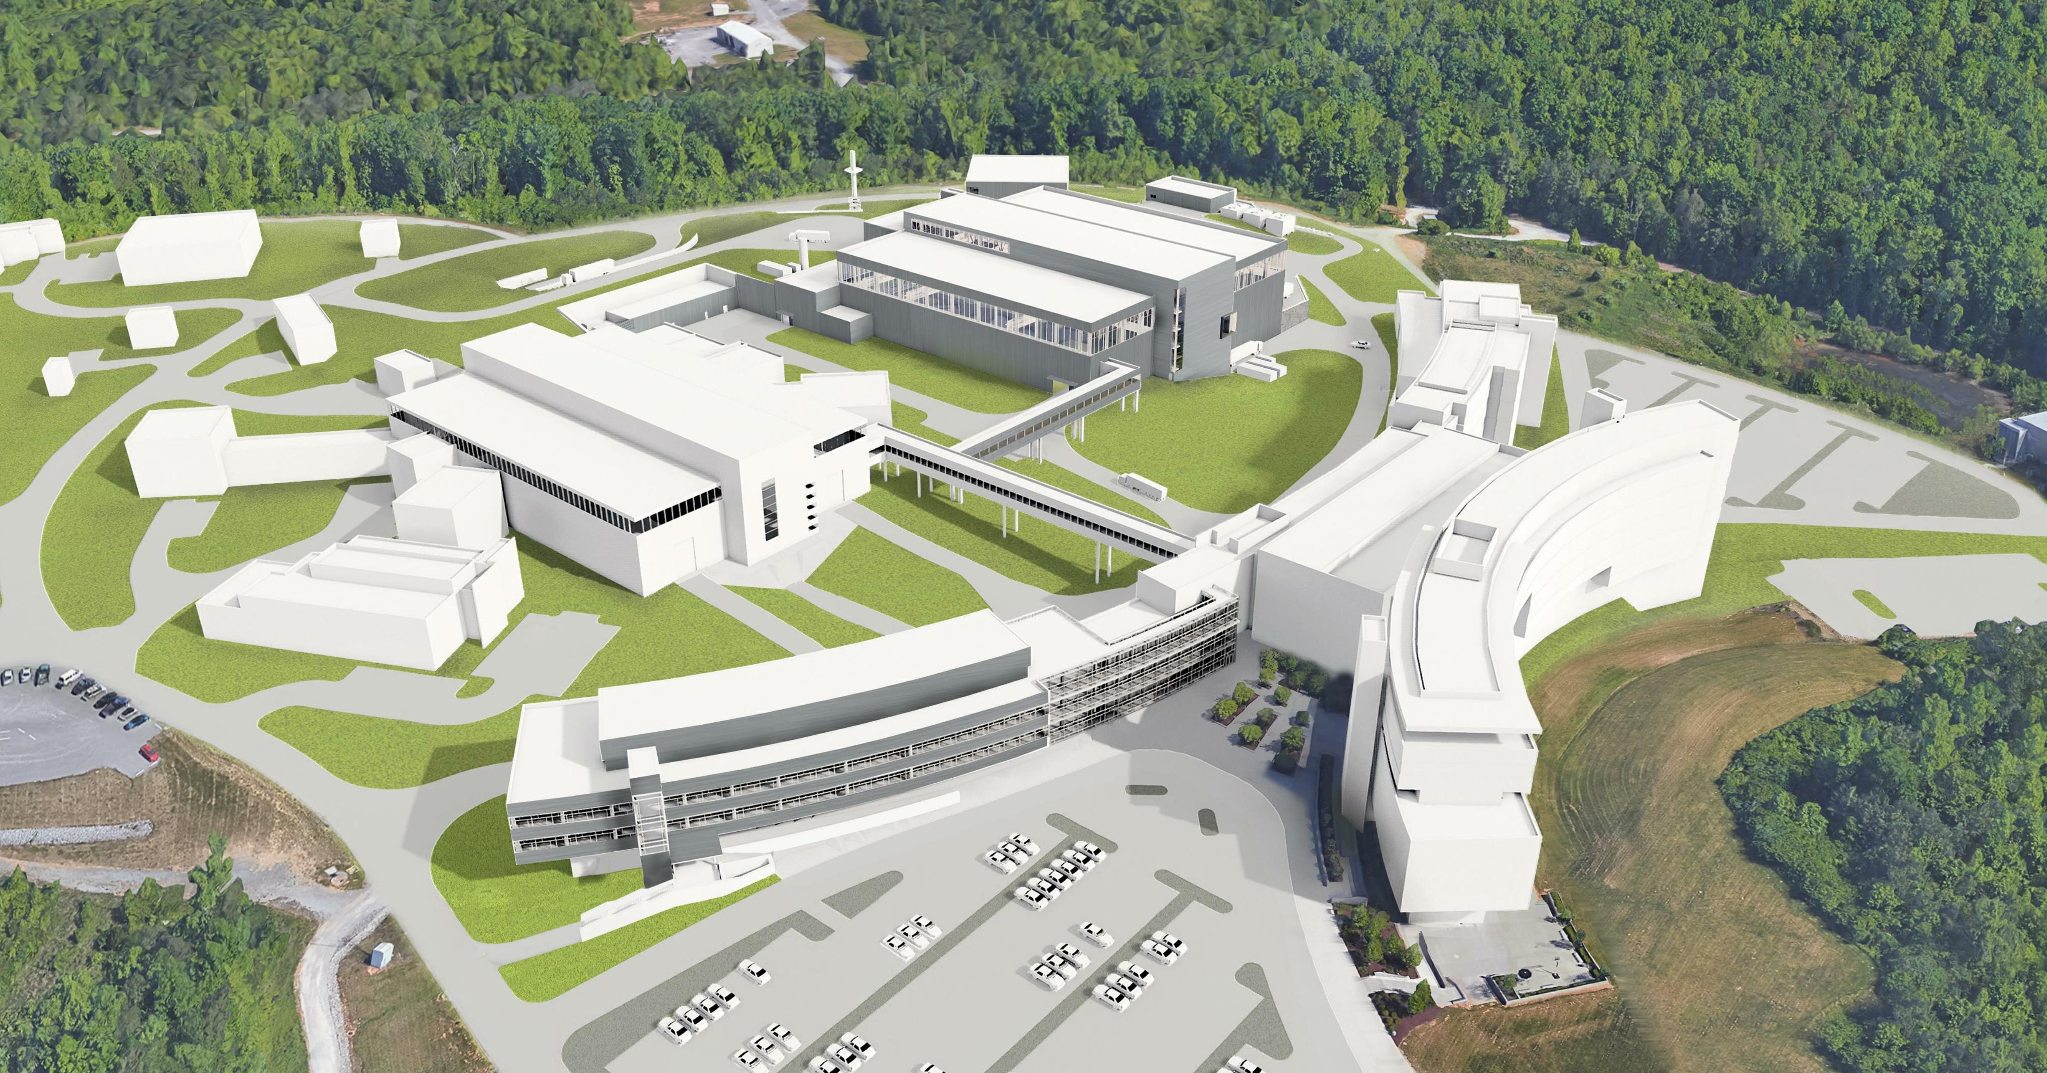

Slide 24
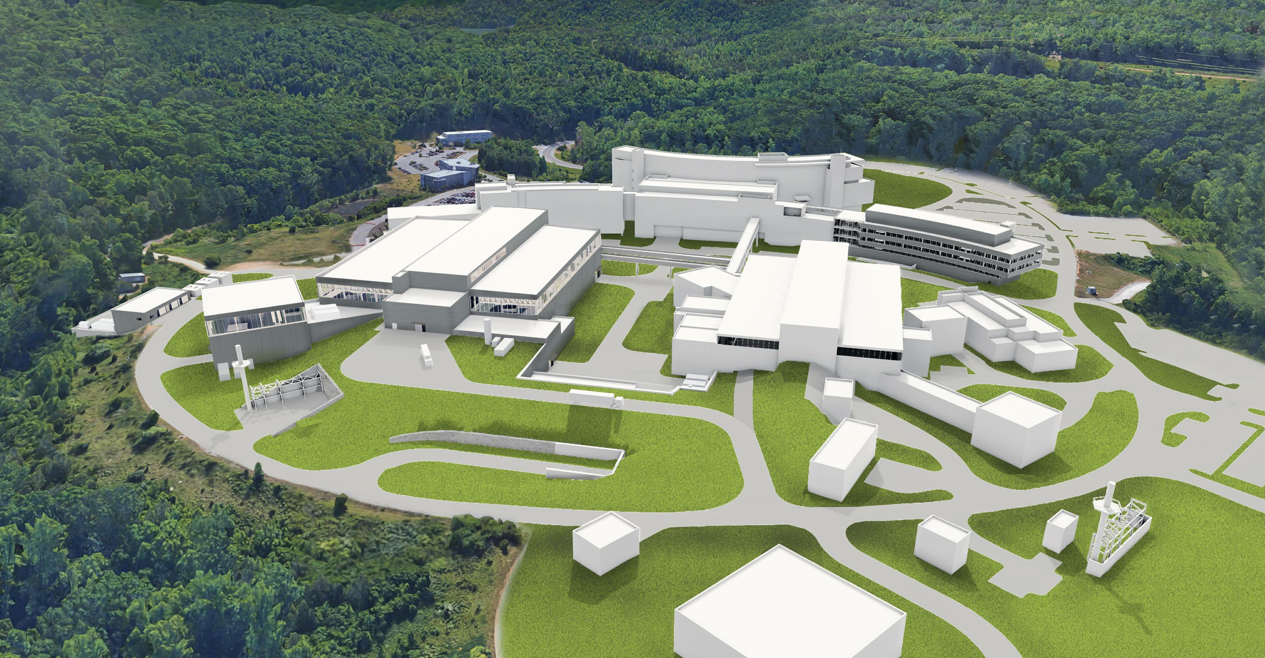

Slide 25
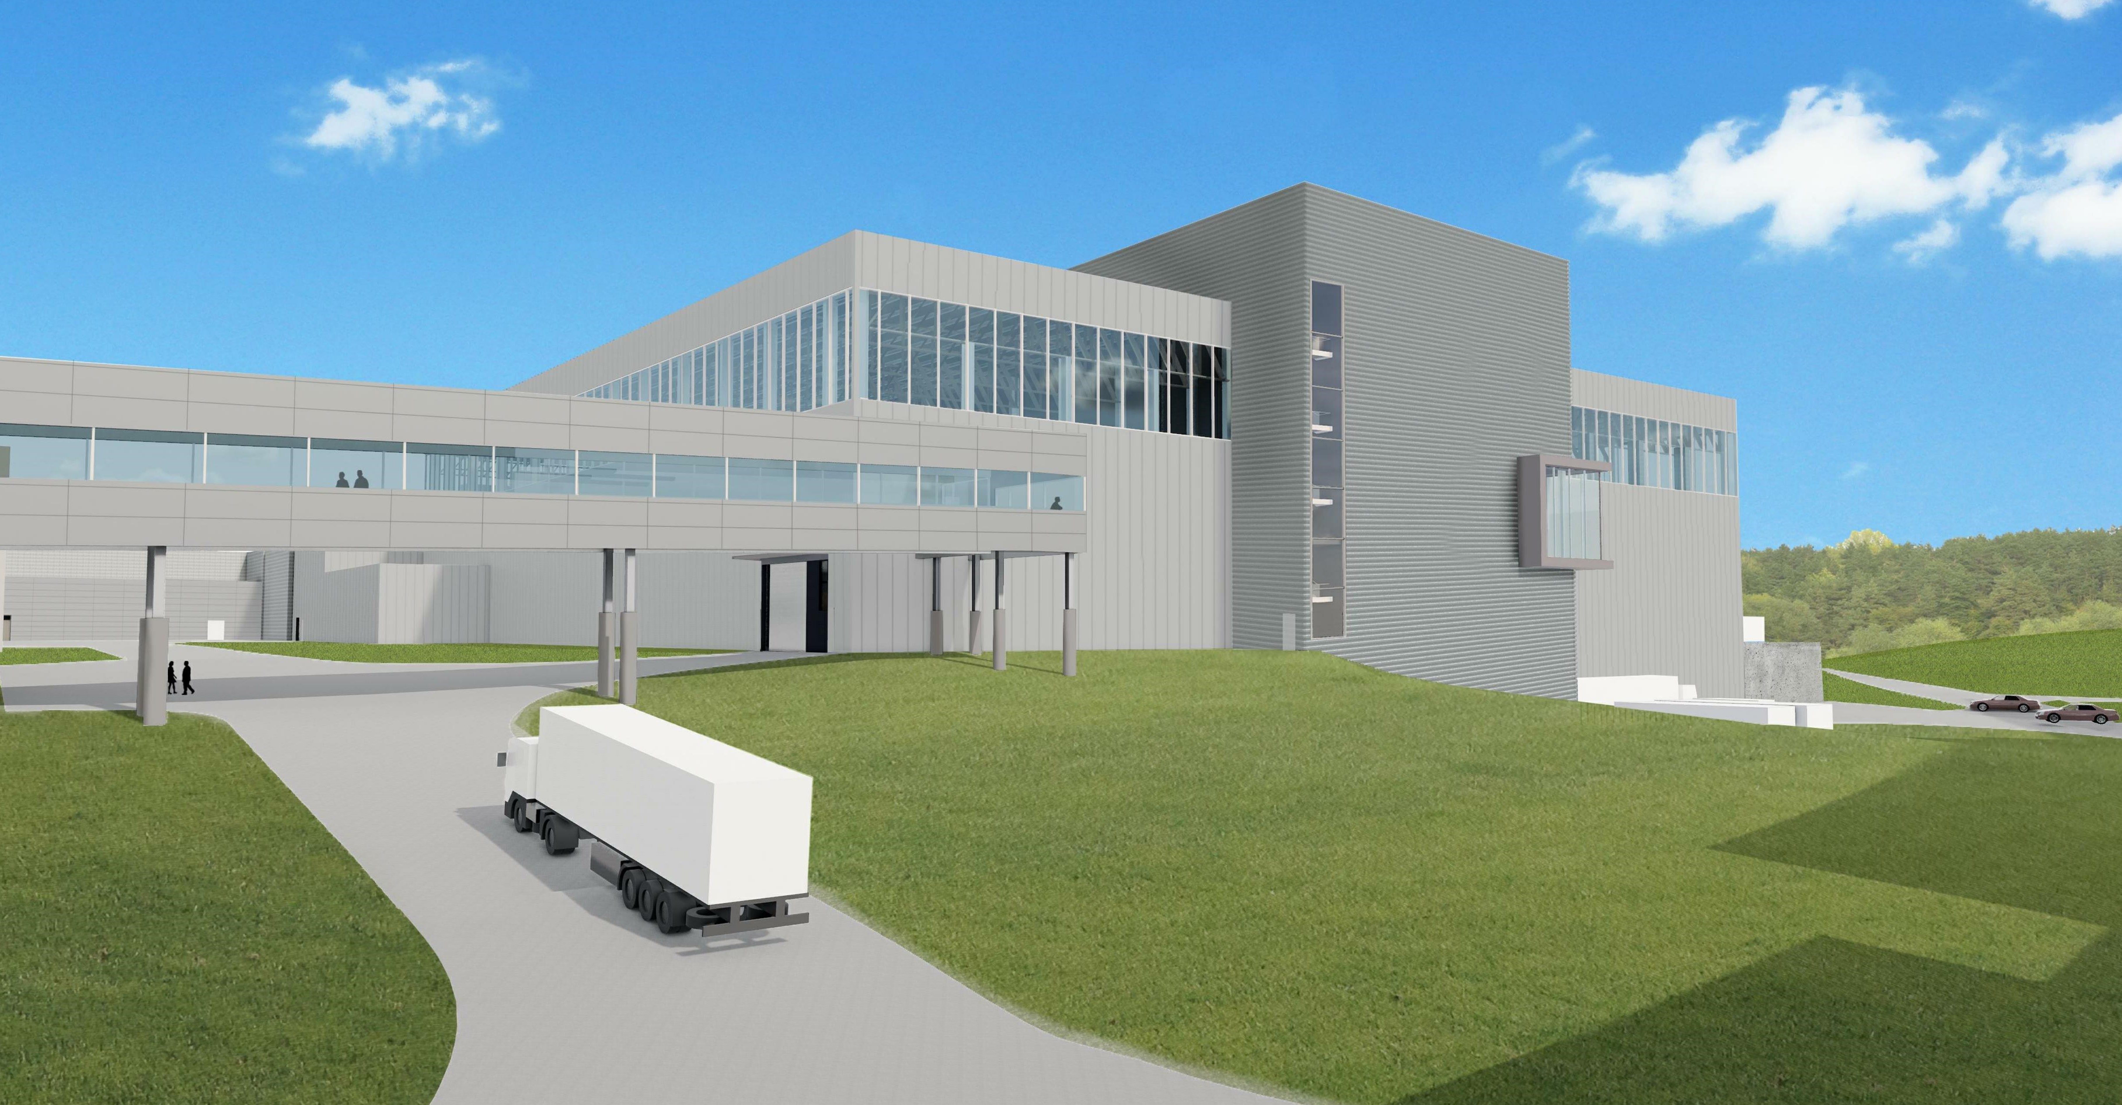

Slide 26
