Slide 1
STS Neutron Beamline Interfaces
Van Graves
STS Instrument Engineer
STS Fundamental Physics Workshop
July 26, 2019

Slide 2
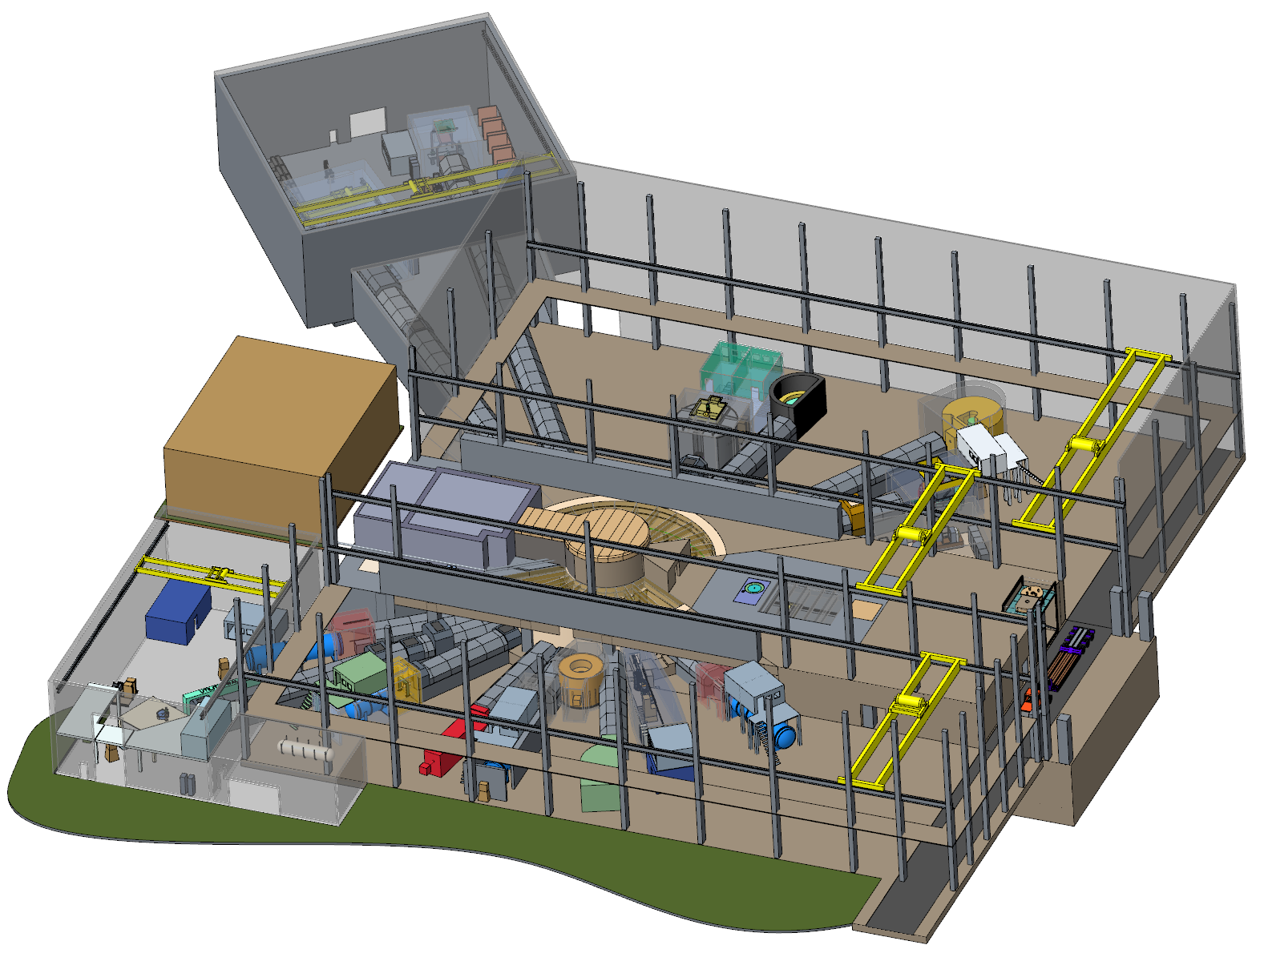
Outline
Facility layout
Neutron beamline bunkers
Monolith optics & alignment
Shutters
Instruments

Slide 3
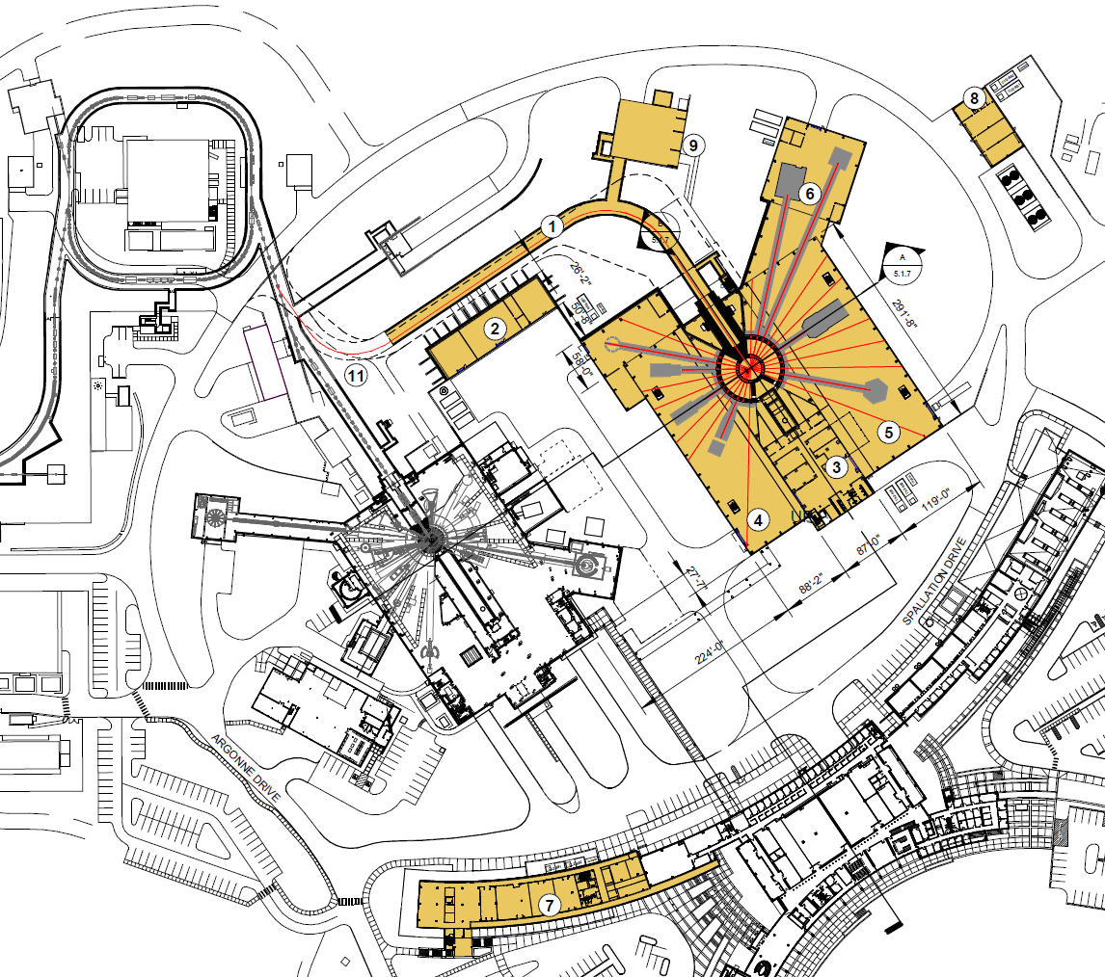
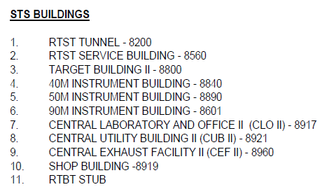
Site Plan

Slide 4
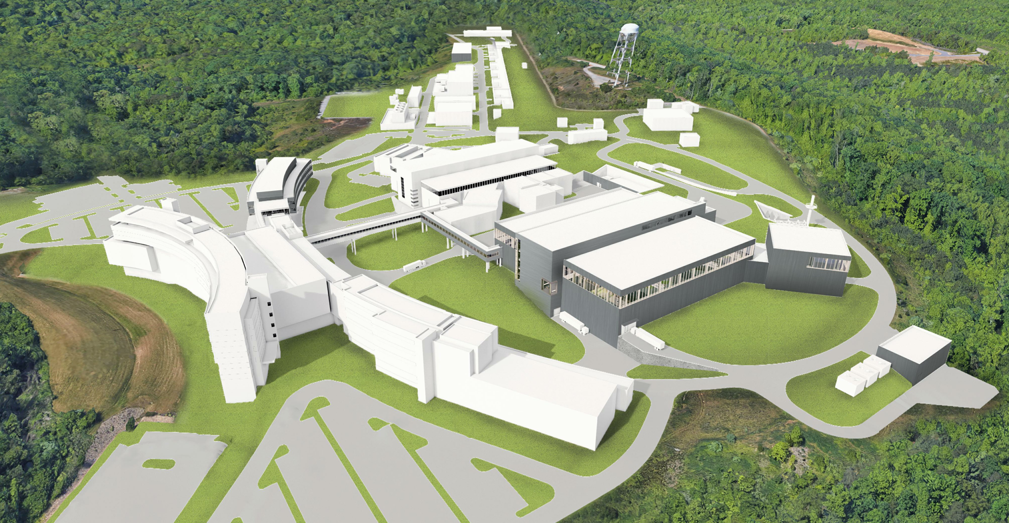

Slide 5
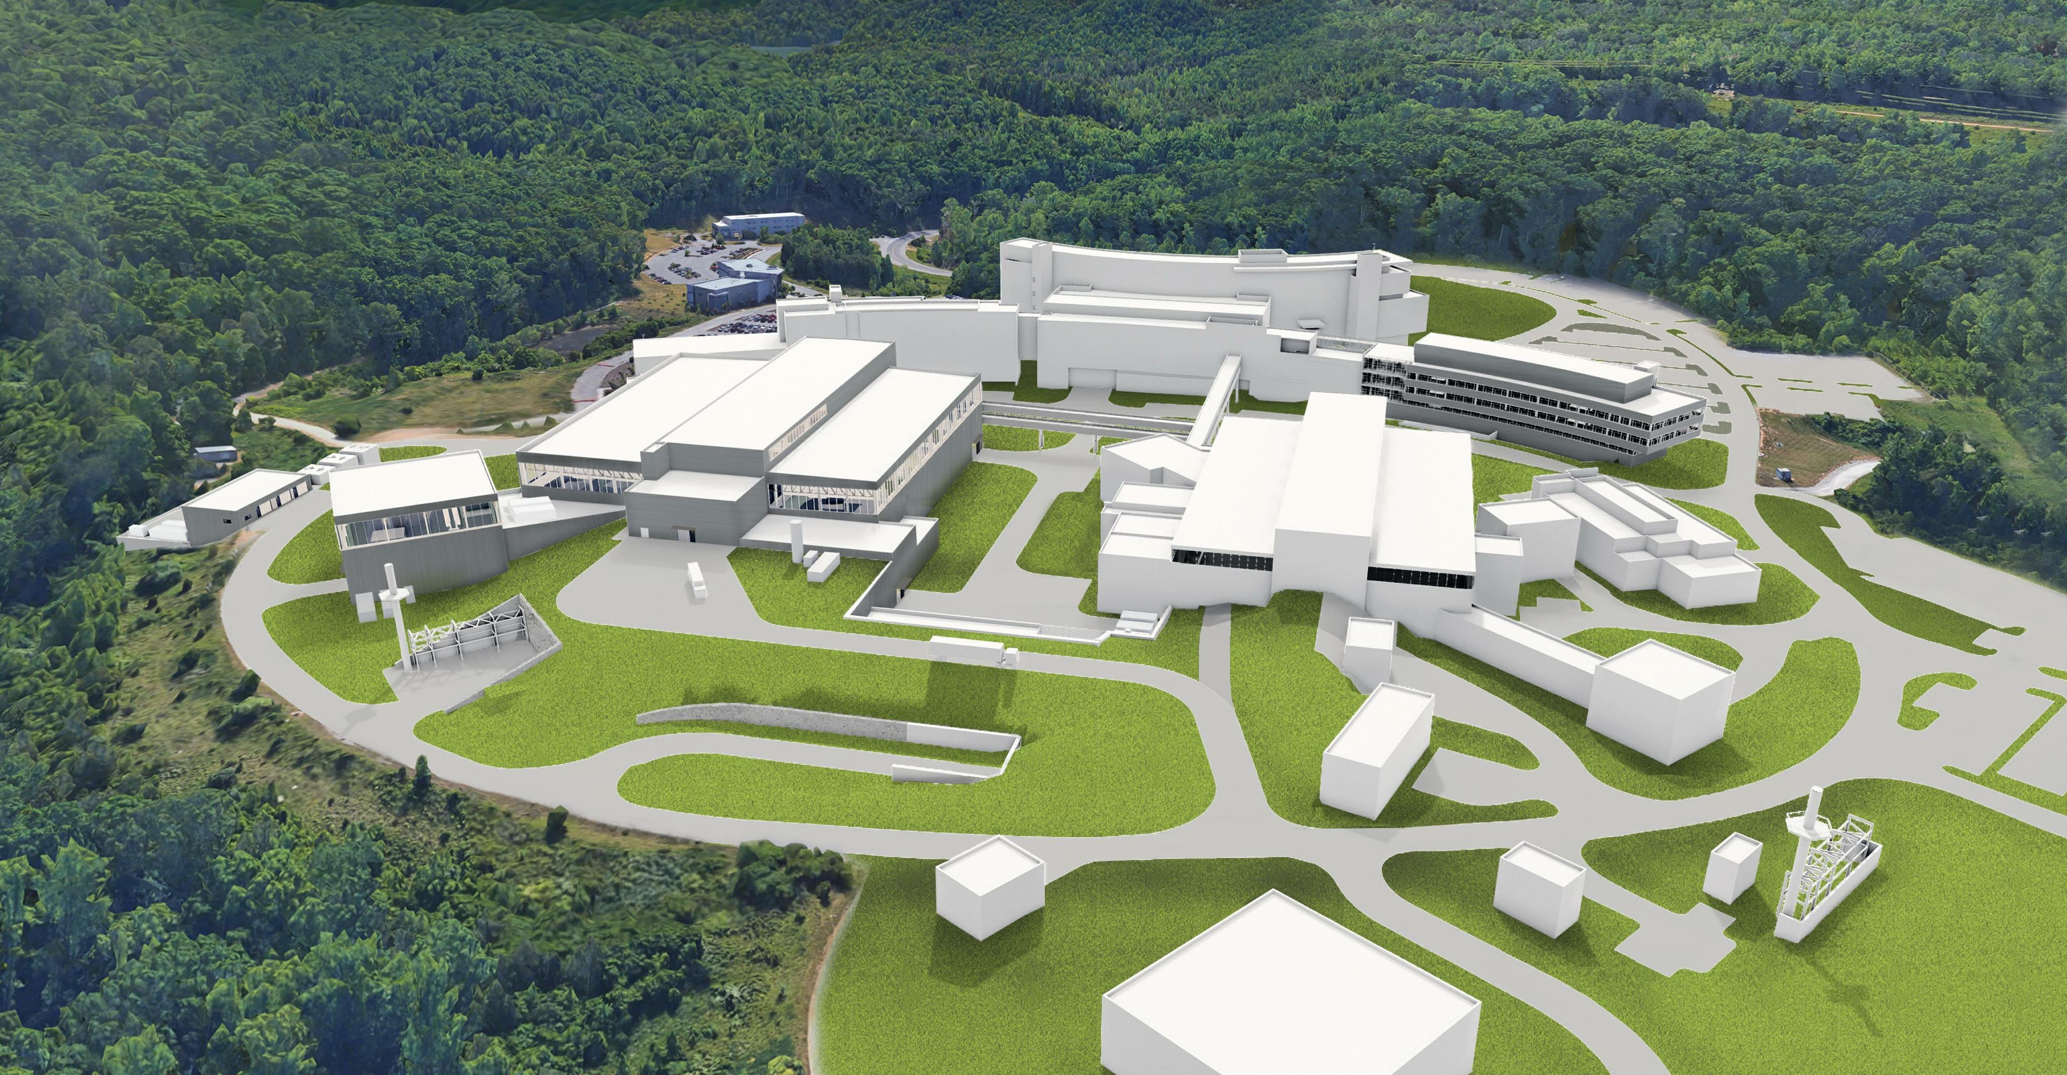

Slide 6
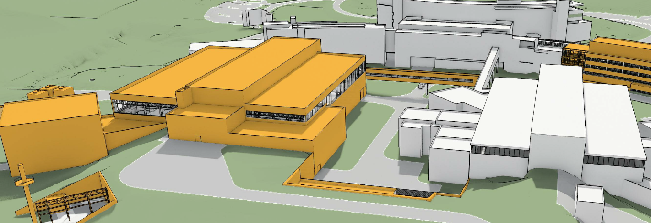
STS Facilities
STS divided into 4 joined buildings
Instrument buildings named by nominal instrument length from monolith center
Avg STS instrument length is 30% longer than avg FTS instrument length
90 m
90M Building
50 m
50M Building
Target Building
40M Building
40 m
STS
FTS

Slide 7
STS Initial Planning Instrument Suite
ST20
EWALD
ST19
TBD
ST18
TBD
ST17
CHESS
ST16
NESCRY
ST15
TBD
ST14
HERTZ
ST21
MENUS
STS will support 22 instruments
Currently all end stations fit within building envelopes
  Left two empty ports for additional long instruments, hope to limit building punch-throughs to these instruments
  STS site best supports long instruments in the ST18-ST22 quadrant
ST13
VERDI
ST12
NSE
ST22
IMAGING
ST01
SANS2
ST02
ZEEMANS
ST03
CYGNUS
ST04
TBD
ST05
VBPR
ST06
SANS1
ST07
BWAVES
ST08
WASABI
ST09
QIKR
ST10
TBD
ST11
SANS3

Slide 8
STS Day One Instruments
ST20
EWALD
ST17
CHESS
ST21
MENUS
ST13
VERDI
Eight initial instruments in current project scope have been developed to conceptual level
Final instrument suite and port locations will be selected post-CD1
ST02
ZEEMANS
ST03
CYGNUS
ST06
SANS1
ST09
QIKR

Slide 9
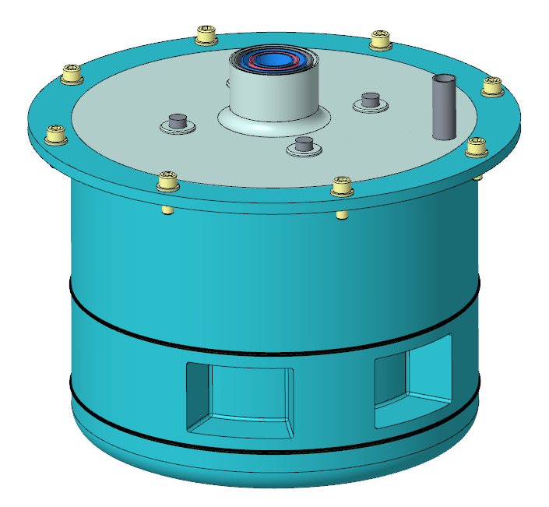
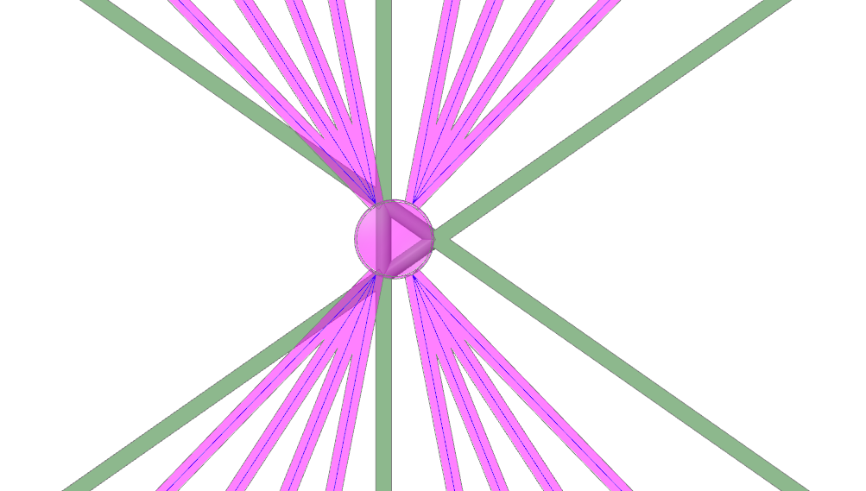
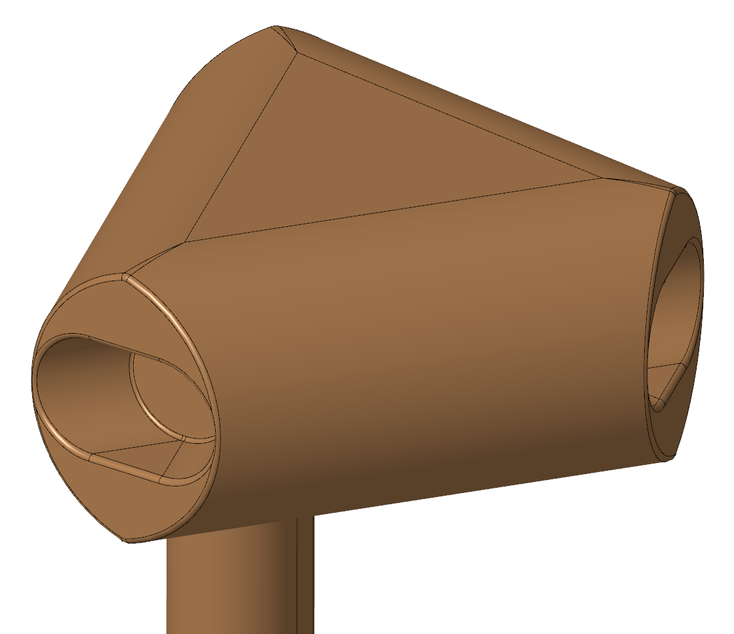
STS Beam Line Arrangement
Beam lines 12-22
Proton Beam
Top (Cylindrical) Moderator Beams
Bottom (Tube) Moderator Beams
Beam lines 1-11

Slide 10
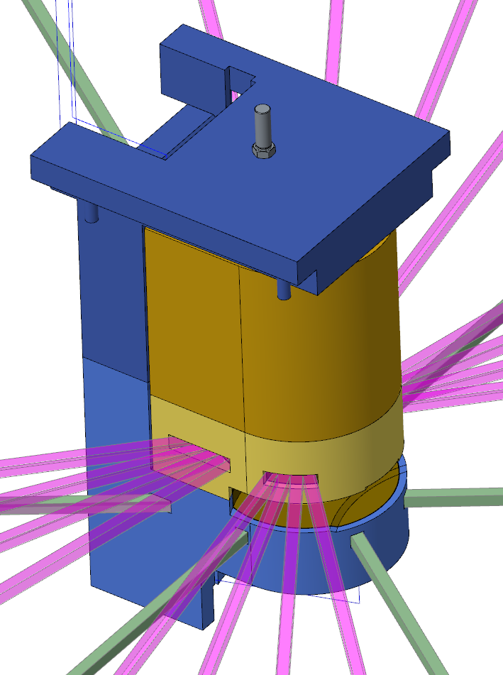
Instruments by Moderator
Tube moderator provides broader pulses than cylinder moderator at the same pulse peaks
2 of 6 tube moderator beam ports currently occupied by Day One instruments (SANS1 & CHESS)
ST20
EWALD
ST19
TBD
ST18
TBD
ST17
CHESS
ST16
NESCRY
ST15
TBD
ST14
HERTZ
ST21
MENUS
ST13
VERDI
ST12
NSE
ST22
IMAGING
Moderator/Reflector Assembly
ST01
SANS2
ST02
ZEEMANS
ST03
CYGNUS
ST04
TBD
ST05
VBPR
ST06
SANS1
ST07
BWAVES
ST08
WASABI
ST09
QIKR
ST10
TBD
ST11
SANS3

Slide 11
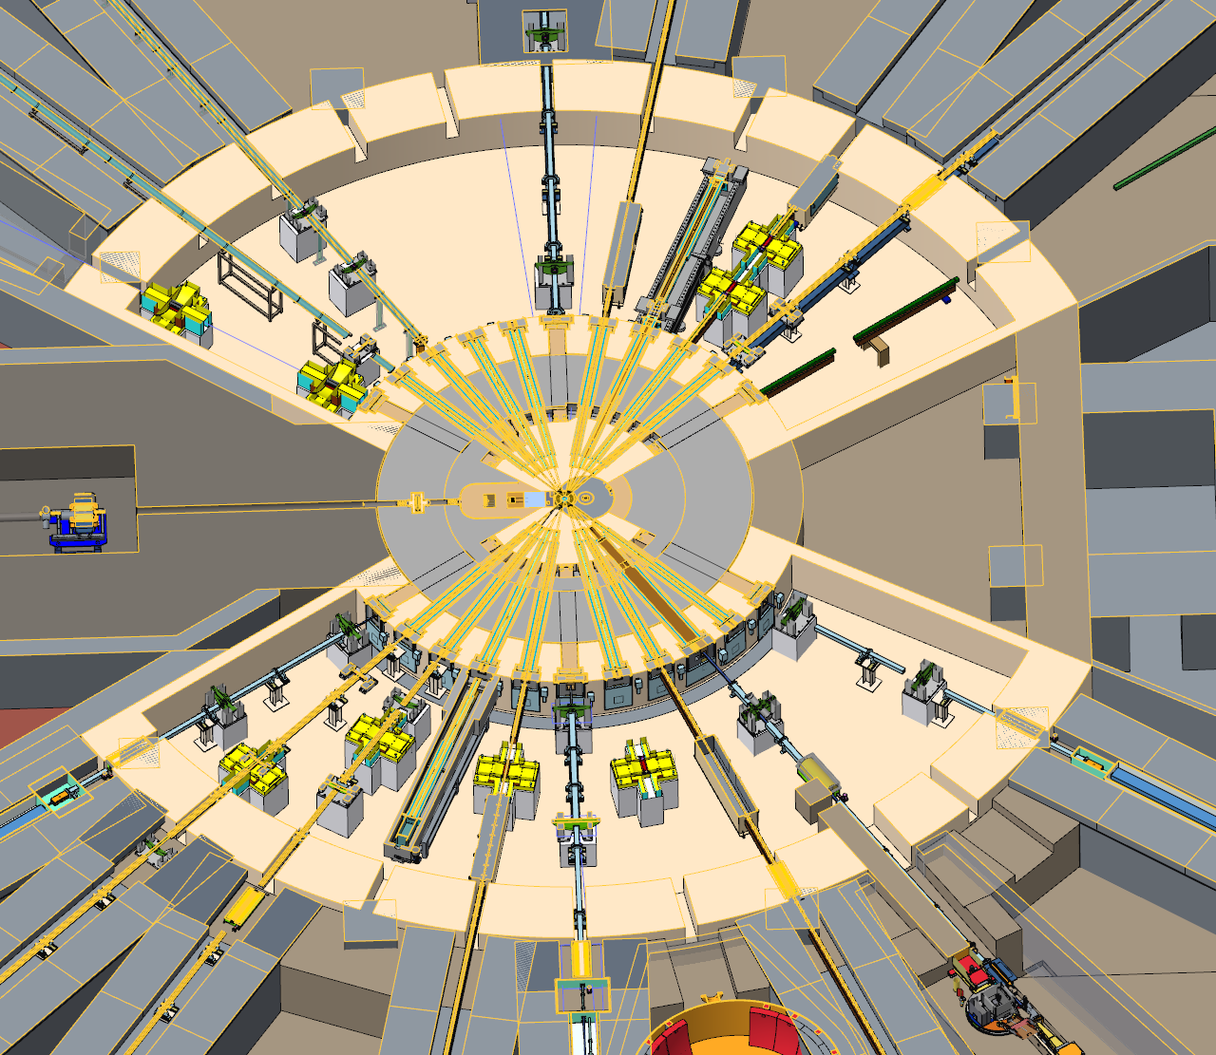
Outline
Facility layout
Neutron beamline bunkers
Monolith optics & alignment
Shutters
Instruments

Slide 12
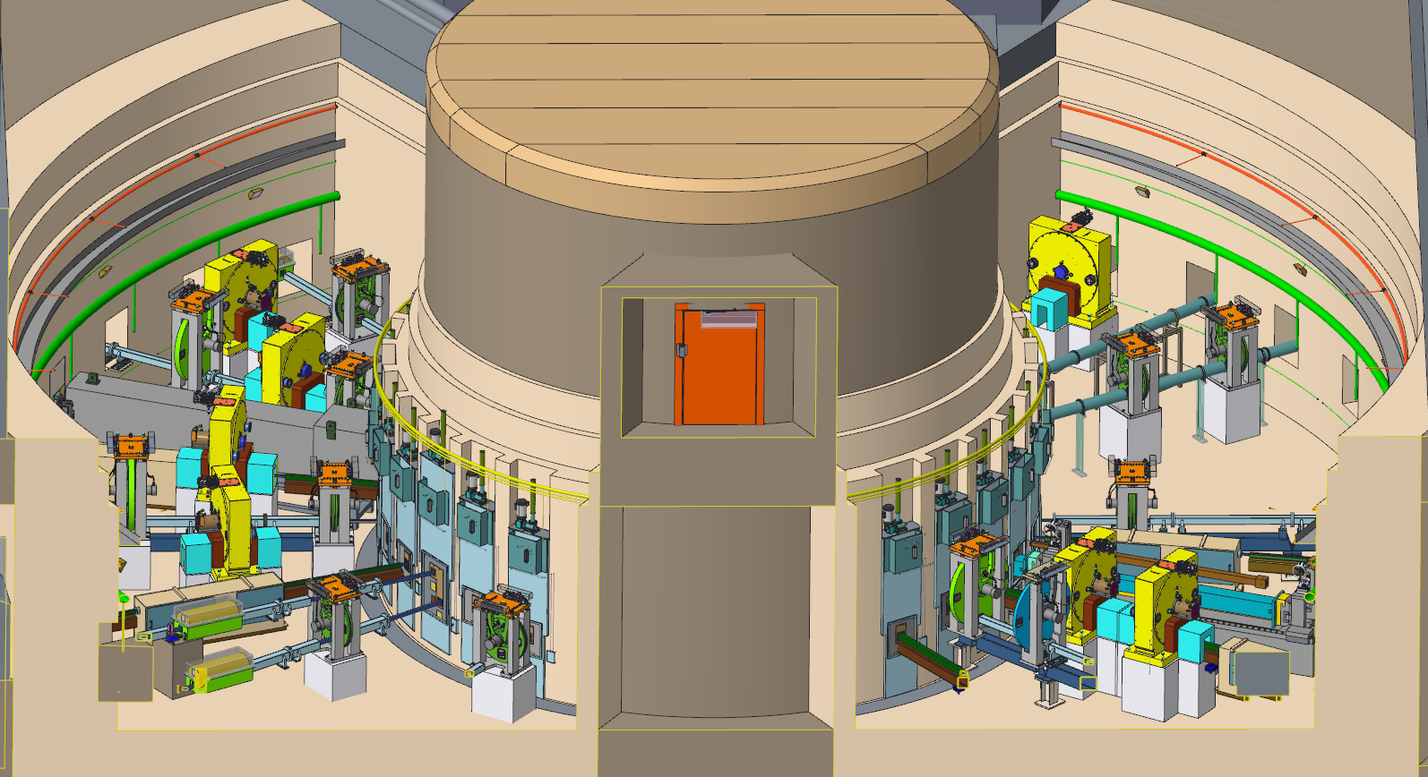
STS Incorporates Neutron Beamline Bunkers
Heavily shielded rooms near monolith where choppers and other beamline components are located
  Personnel-accessible during beam-off without unstacking significant amounts of shielding
Bunker implementation motivated by
  the desire to reduce background radiation by providing an integrated shielding design near the target monolith.
  the observation that the high brightness STS moderators are smaller than their FTS counterparts, requiring greater alignment precision of the in-monolith optics packages.
  the desire for straightforward and flexible installation of the near-monolith beamline components and required services (vacuum, cooling water, and electrical).
Bunkers require significant integration and interface definitions between Instrument Systems, Target Systems, and Conventional Facilities

Slide 13
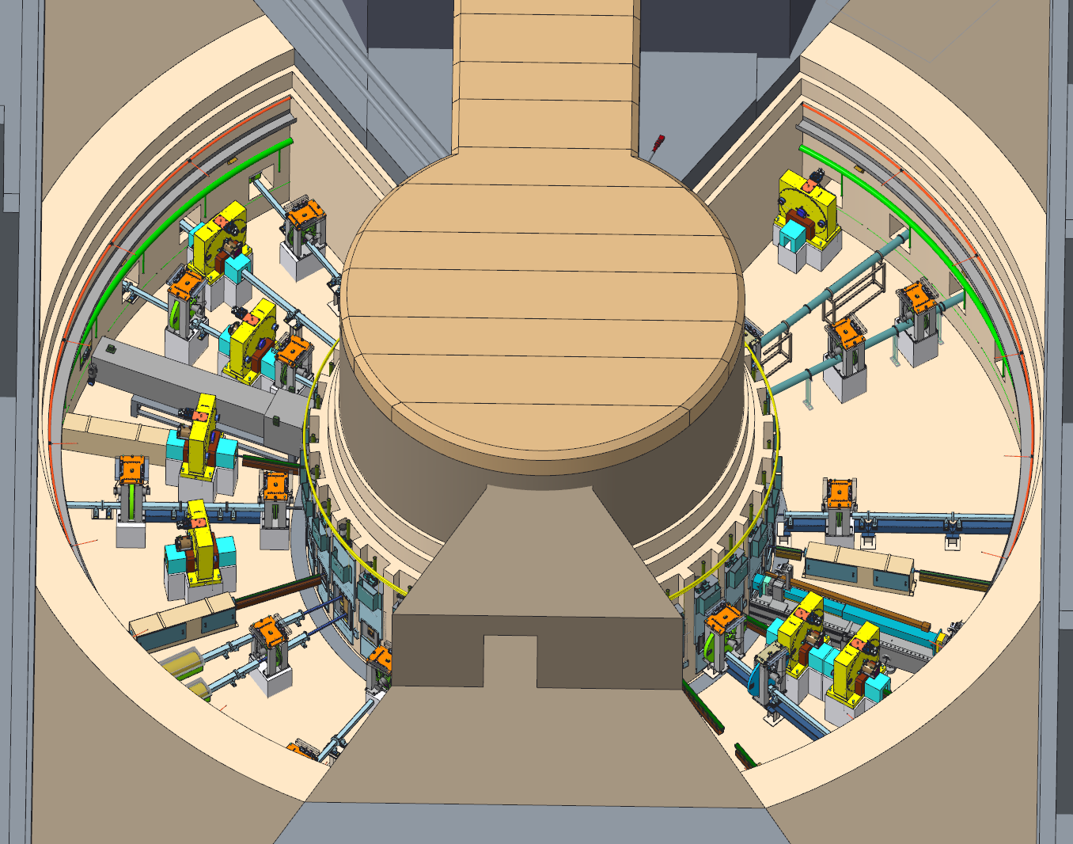
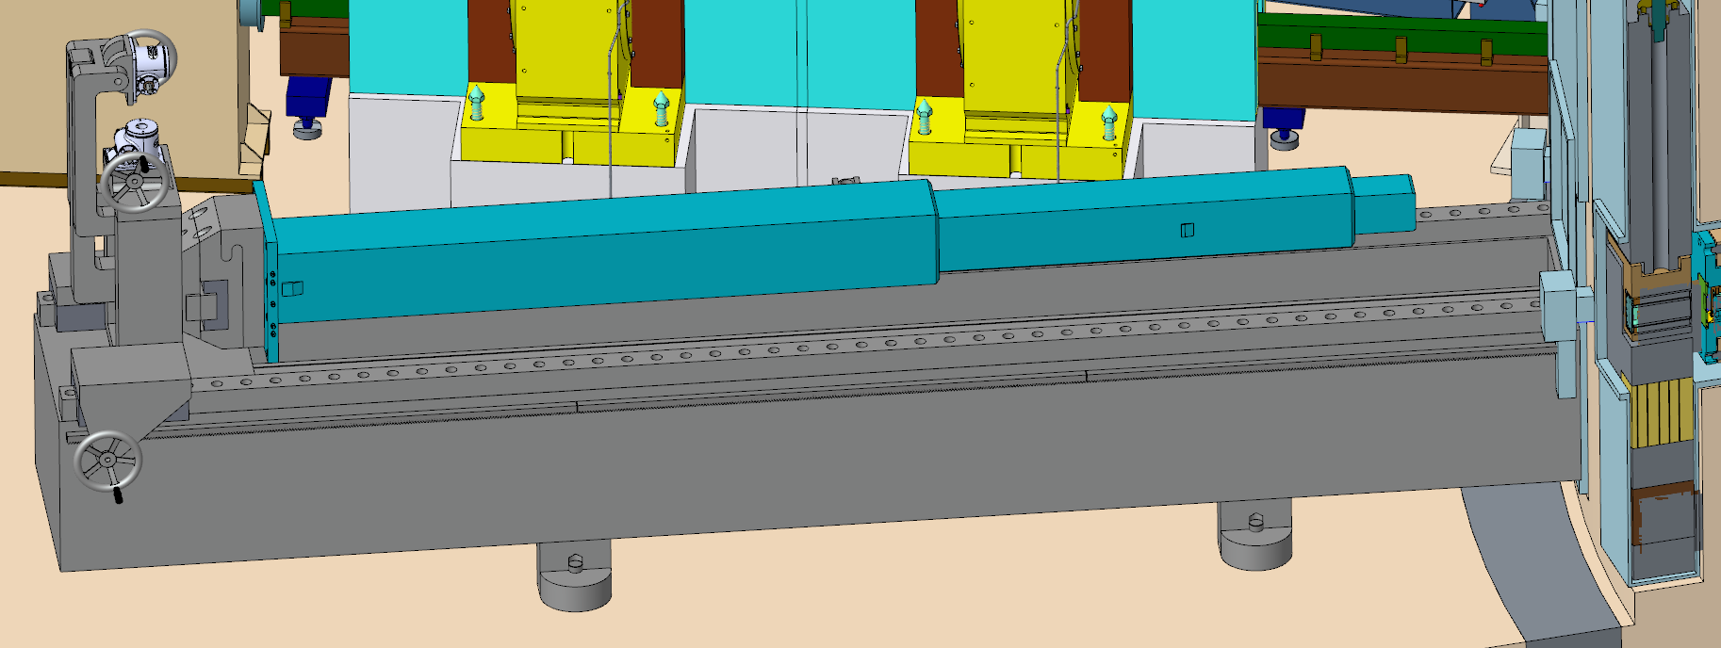
Neutron Beam Line Bunkers are Beam-off Accessible
Provide closest locations for hands-on accessible beam line optics & choppers
  Maintaining personnel accessibility during beam-off for life of facility is a fundamental design requirement and assumption
  This assumption is based on chopper activation experience at FTS & will be continually reviewed as neutronics analyses are completed
Houses facility Maintenance Shutters
Radial depth (~5.6 m) adequate for monolith insert handling equipment
Provides utilities for choppers, shutters, & monolith inserts
Removable shielding roof panels (~1.5m thick high-density concrete) & floor level access door
STS neutron bunkers will be more crowded than this!
Monolith Insert Remote Handling Device

Slide 14
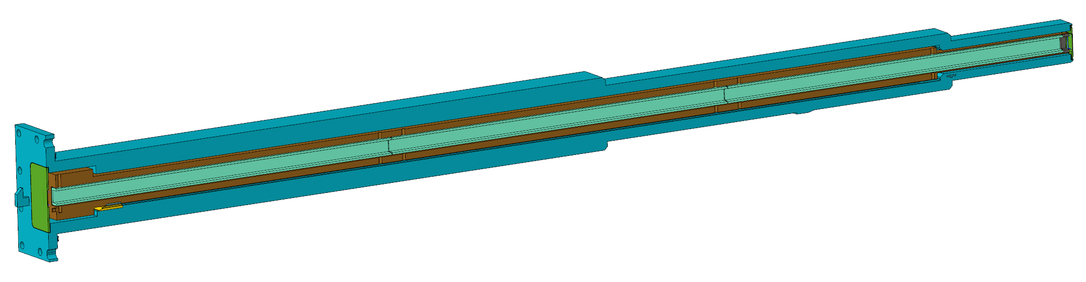
Outline
Facility layout
Neutron beamline bunkers
Monolith optics & alignment
Shutters
Instruments
Monolith insert with optical guide module
STS Neutron Factory & Monolith Inserts

Slide 15
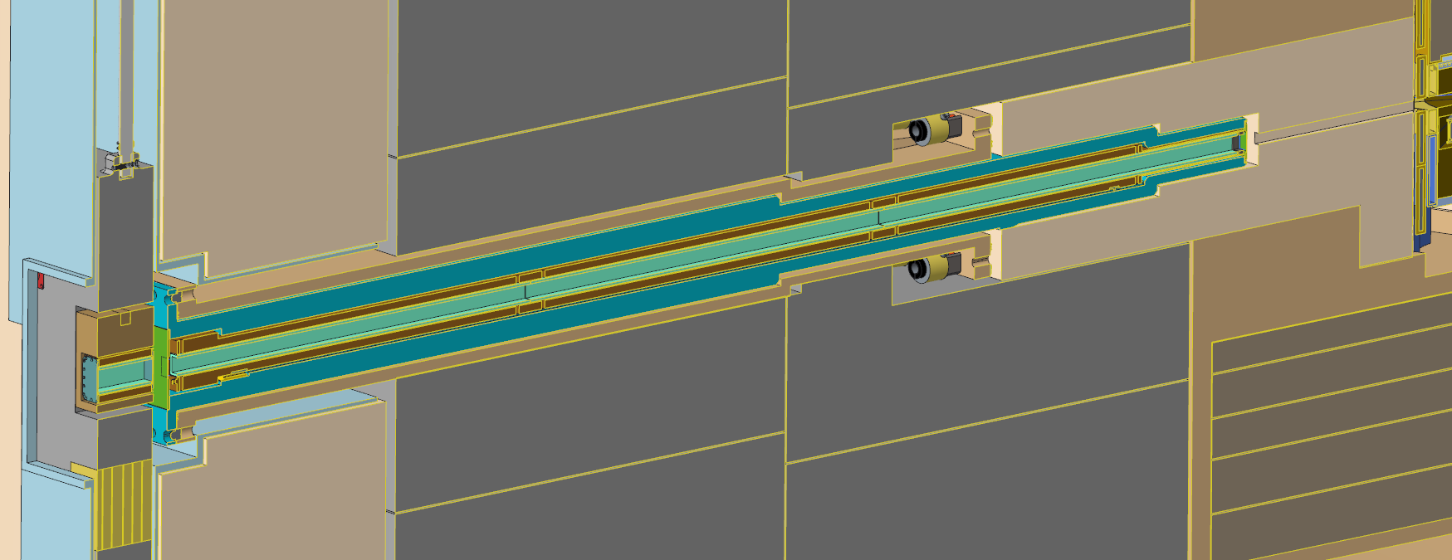
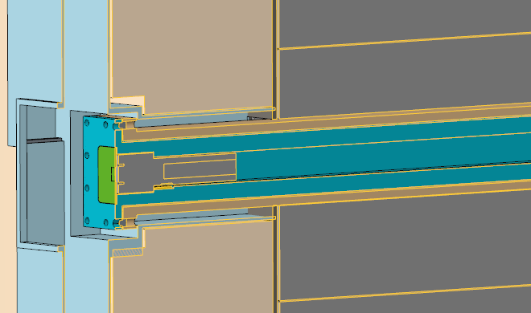
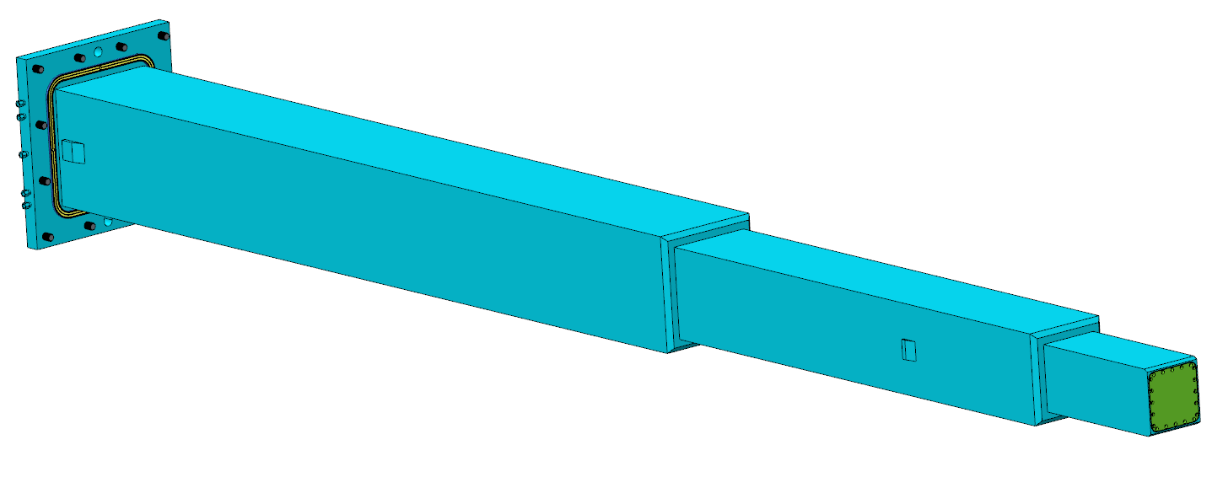
All 22 Monolith Inserts Installed During STS Construction
Reentrant, water-cooled, stainless housing which allows installation of neutron optics in close proximity to the moderators
  ~5 m long, ~2 tons
  Can also accommodate shield plugs
All Inserts installed during facility construction, assumed to be life-of-facility components (but can be replaced)
  Unpopulated beamlines will have shield plugs within Monolith Inserts
Seals against nozzle flange
Provides cooling environment for guide optics
Incorporates permanent upstream beam window
Exterior steps block neutron streaming paths and minimize upstream width
Maintenance Shutter
Nozzle Extension
Guide Module
Monolith Insert
Insert Seal Surface
Downstream Beam Window
Insert with shield plug
Insert Utility Connections
Upstream Beam Window

Slide 16
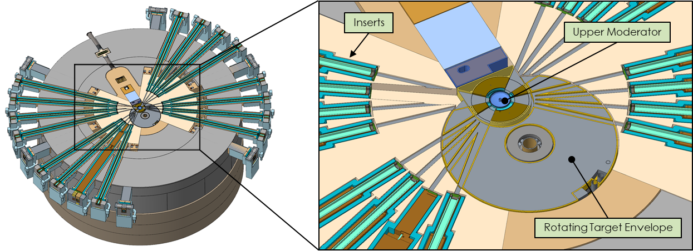
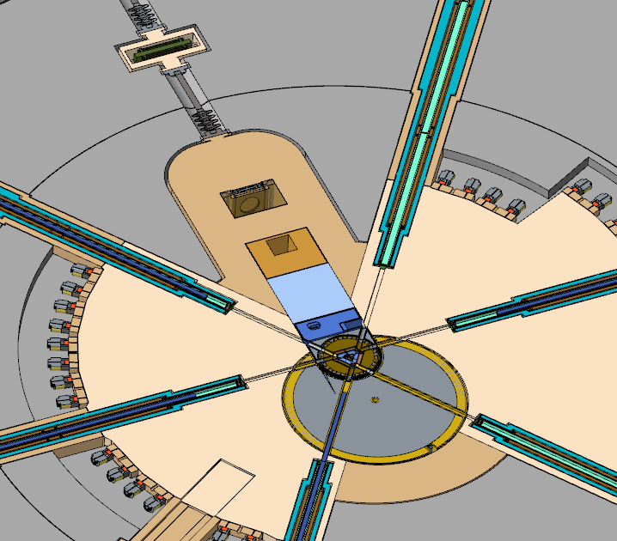
Moderator Approach Distance
Nozzles extend the vessel environment through the monolith shielding to the bunker
Nozzles will be matched to scientific and facility layout requirements (angles, sizes, slopes, etc.)
  Currently all except QIKR are standardized
Delivering the best science requires ability to place guide as close as possible to moderator
All moderator views are 3x3 cm, but Monolith Inserts are standardized with 5x5 cm openings to account for diverging optics
Approach distances determined by beam port location and moderator
  Tube moderator inserts don't have adjacent neighbors, can extend further into monolith
Horizontal section through upper moderator
Upper moderator approach distances
Beamline | Approach Distance (cm) | Beamline | Approach Distance (cm)
ST01 | 95 | ST22 | 95
ST02 | 98 | ST21 | 98
ST03 | 98 | ST20 | 98
ST04 | 98 | ST19 | 98
ST05 | 98 | ST18 | 98
ST06 | 78 | ST17 | 78
ST07 | 98 | ST16 | 98
ST08 | 98 | ST15 | 98
ST09 | 104 | ST14 | 98
ST10 | 98 | ST13 | 98
ST11 | 108 | ST12 | 108
Lower moderator approach distances

Slide 17
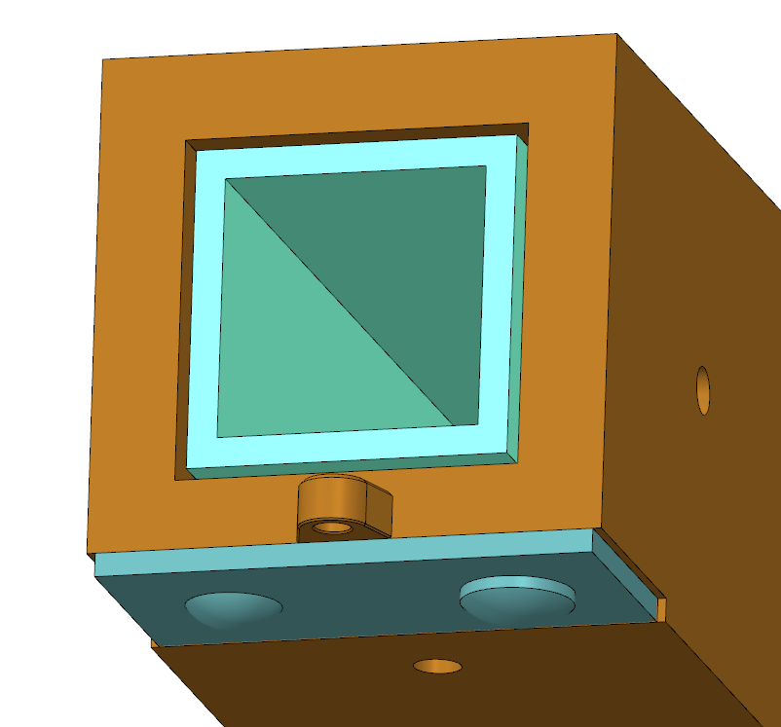
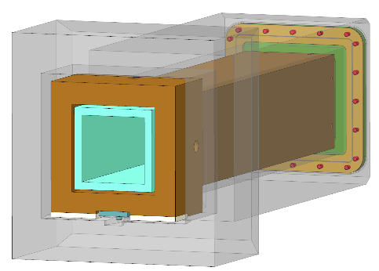
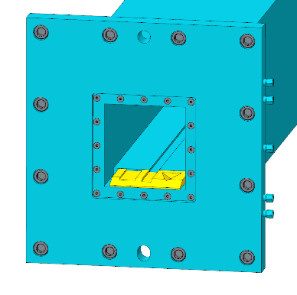
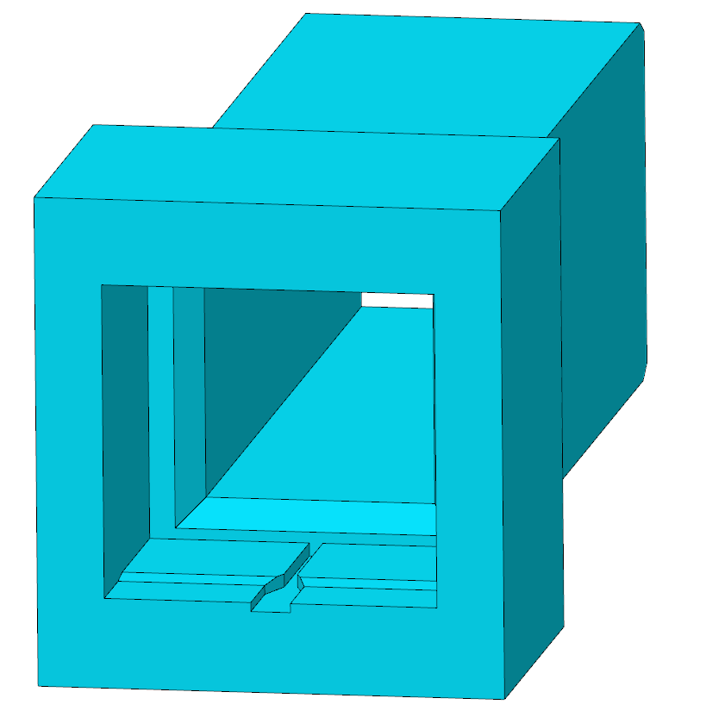
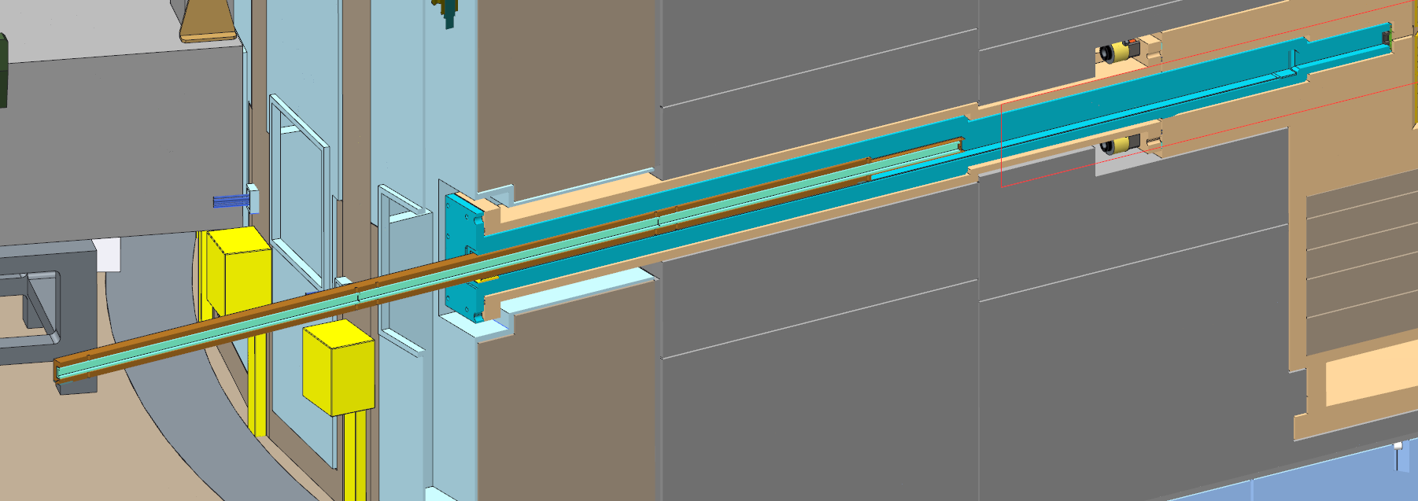
Guide Modules Aligned within Inserts
Most guide modules installations will be semi-remote because target will be in place
Guide alignment shims pre-configured based on mapped monolith insert geometry
Downstream beam window & shield plug removed prior to installation
Guide module pushed into kinematic locating features, gravity holds in place
Downstream window installed semi-remotely
Monolith Insert & Guide Module alignment mockup proposed
Downstream alignment features
Upstream alignment feature (insert & guide cut for visibility)
Guide Module
Monolith Insert

Slide 18
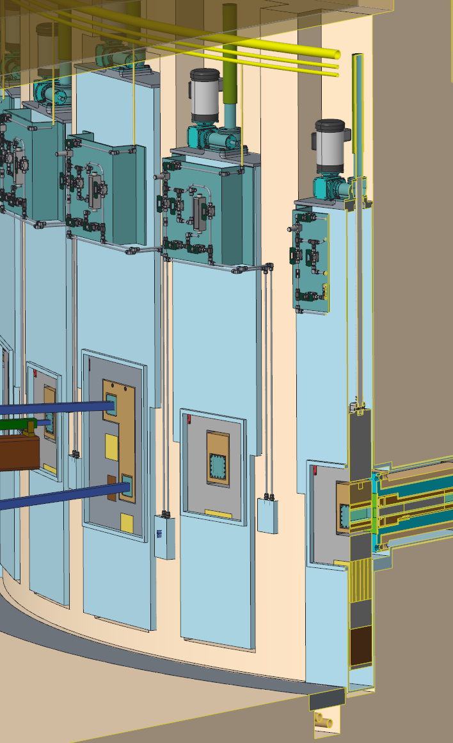
Outline
Facility layout
Neutron beamline bunkers
Monolith optics & alignment
Shutters
Instruments

Slide 19
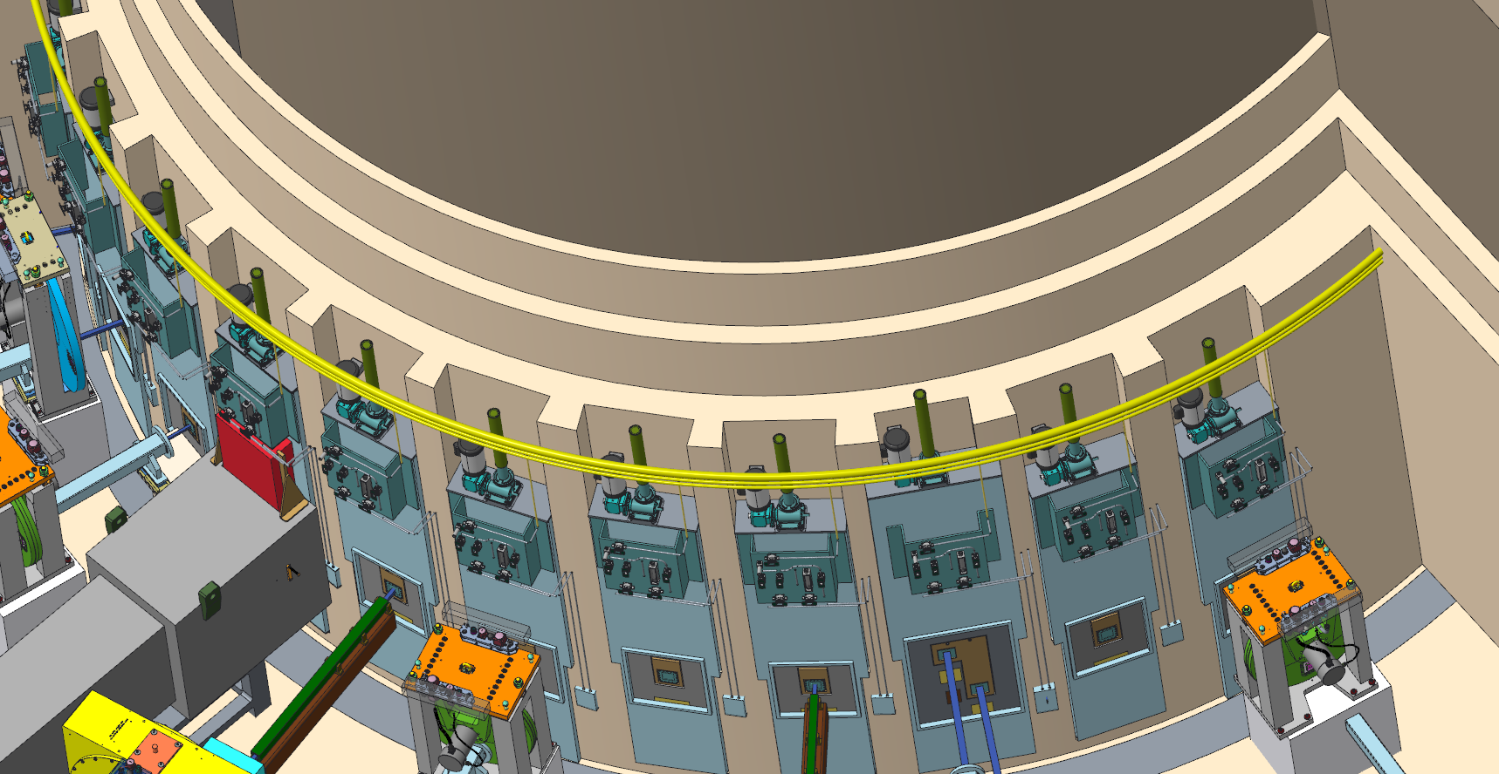
STS Shutter Philosophy
FTS Shutter use during beam-on ops Jan 21 – Apr 21, 2015 (~13 wks)
FTS uses large primary shutters for all beam lines
  Only a few beam lines use their primary shutter for experimental operations (some don’t have secondary shutters), most only used during weekly or run-cycle shutdowns
  Shutters are highly activated and heavily shielded
Since STS facility shutters are in personnel-accessible bunker, shutter activation can’t be allowed
STS approach is to provide Maintenance Shutters in bunkers, with each beam line responsible for their own Operations Shutter(s) downstream
FTS Beam Line | Primary Shutter Operations | Ops/Week
3 | 347 | 26.9
18 | 133 | 10.3
12 | 94 | 7.3
17 | 57 | 4.4
5 | 37 | 2.9
14 | 13 | 1.0
13 | 11 | 0.9
1 | 7 | 0.5
2 | 6 | 0.5
4 | 6 | 0.5
16 | 3 | 0.2
6 | 1 | 0.1
7 | 1 | 0.1
11 | 1 | 0.1
15 | 1 | 0.1
Maintenance Shutter

Slide 20
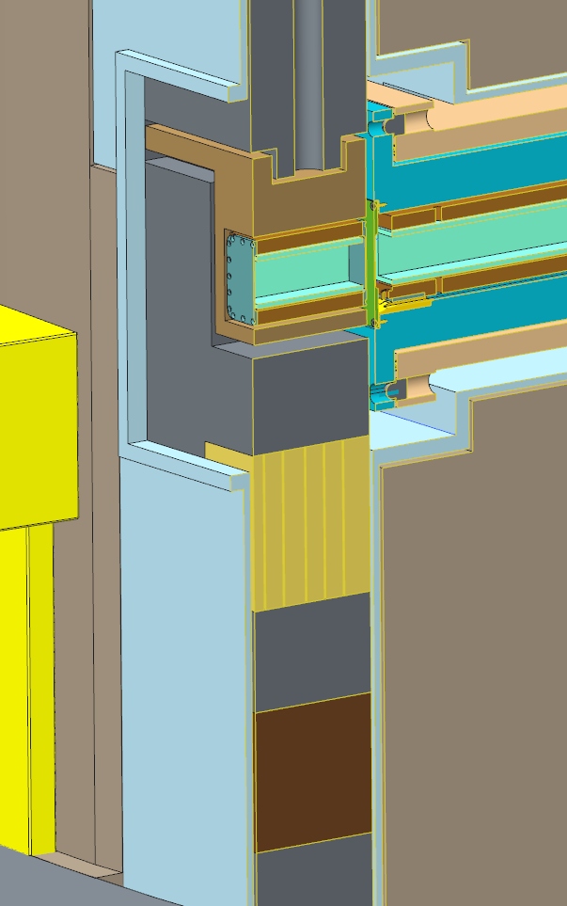
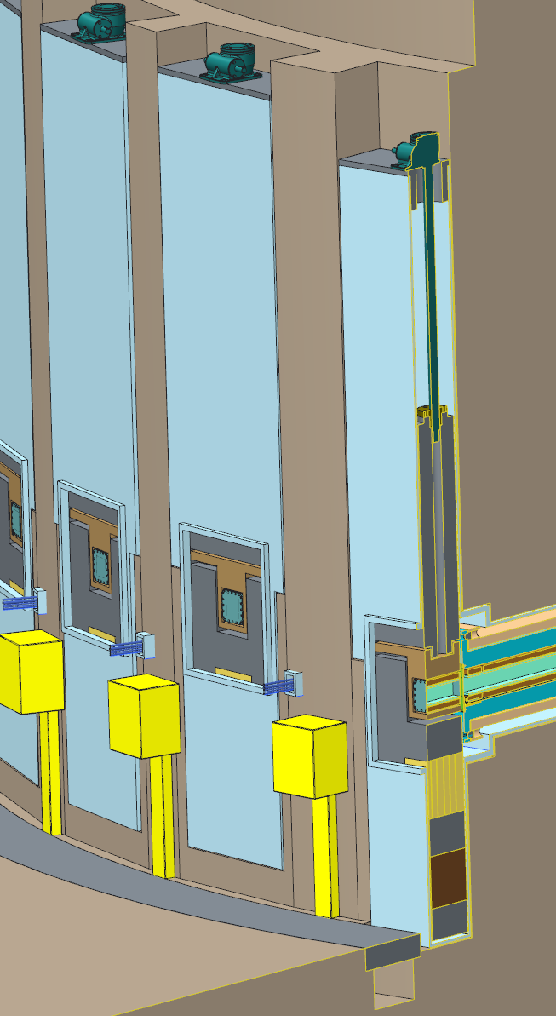
Maintenance Shutters have 3 Functional Positions – Open, Gamma Blocking, and Neutron Absorbing
Primarily used to block gamma radiation during maintenance outages
  Current concept: 20 cm tungsten
  Not used as neutron blockers due to activation limitations
Neutron absorber reduces activation of failed downstream components (choppers) during beam-on operations but does not allow their extraction from the beam line
  Constructed from material which does not activate strongly
  Will likely not block all neutrons, so components between Maintenance & Operations Shutters can only be accessed during facility shutdowns
Optical guides can be accommodated
Shutter cavity widths driven by requirement to extract monolith inserts
Shutter gates installed with beam lines
  Unused beam lines will have shield plugs within Monolith Inserts
Guide Carrier with kinematic alignment features
Neutron Absorber
Optional Guide
Gamma Blocker

Slide 21
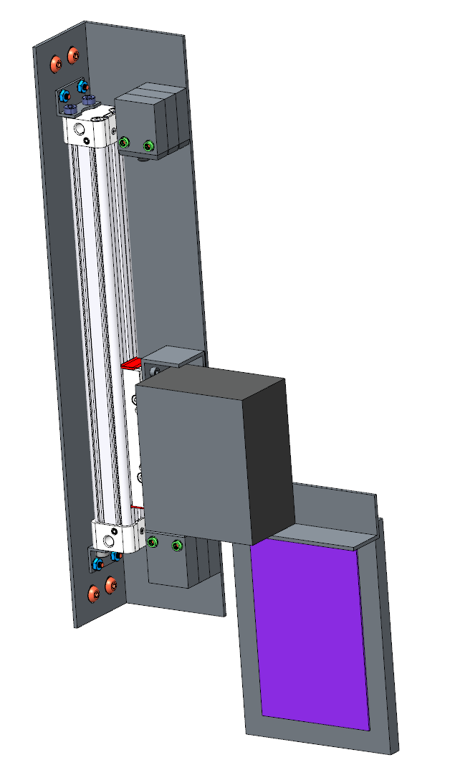
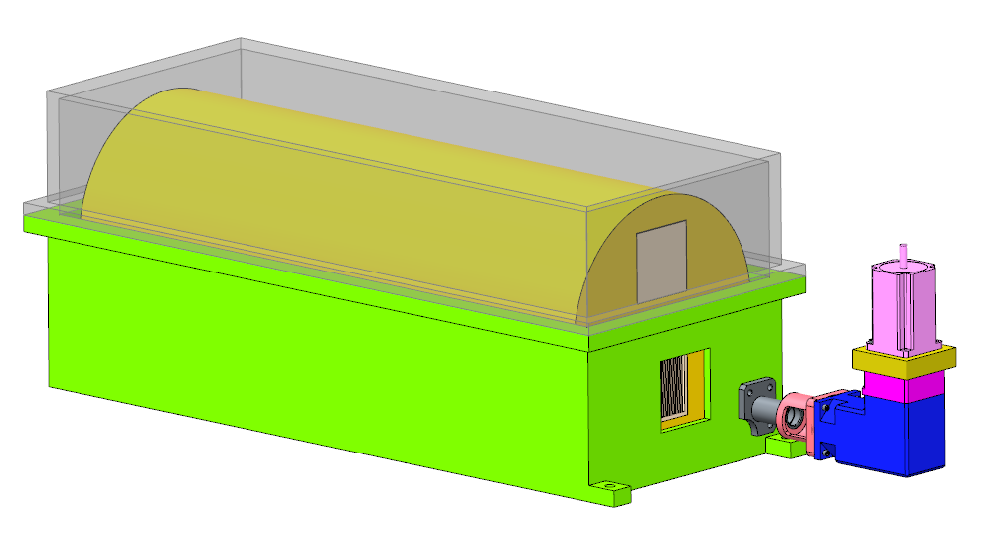
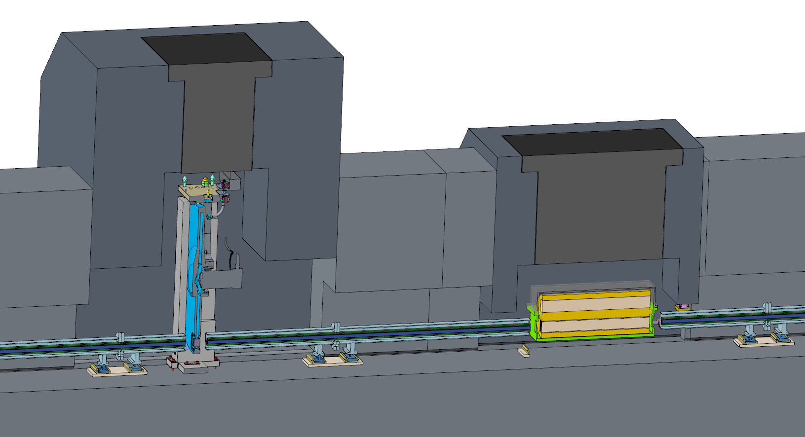
Neutron-Blocking Operations Shutters Required by all Beam Lines
Each beam line responsible for its own operations shutter(s) for daily experimental operations
  Curved lines may only require thin neutron absorbers
  Straight lines will require heavy tungsten shutter, early estimates suggest 1m tungsten
Plan to provide standard designs suitable for majority of beamlines, based on proven FTS secondary shutters
Operations shutters will allow personnel access for sample changes and failed downstream components
  Personnel can’t access beam line components upstream of operations shutters except during maintenance periods
Tungsten
Neutron absorber
1m
Guide
Operations shutter

Slide 22
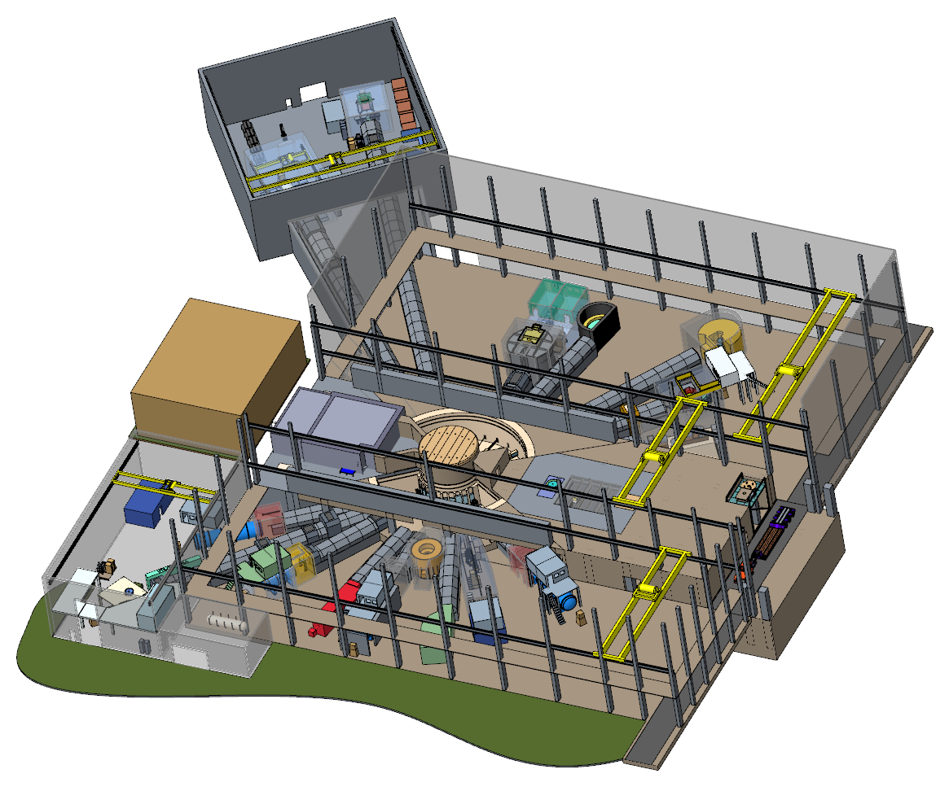
Outline
Facility layout
Neutron beamline bunkers
Monolith optics & alignment
Shutters
Instruments

Slide 23
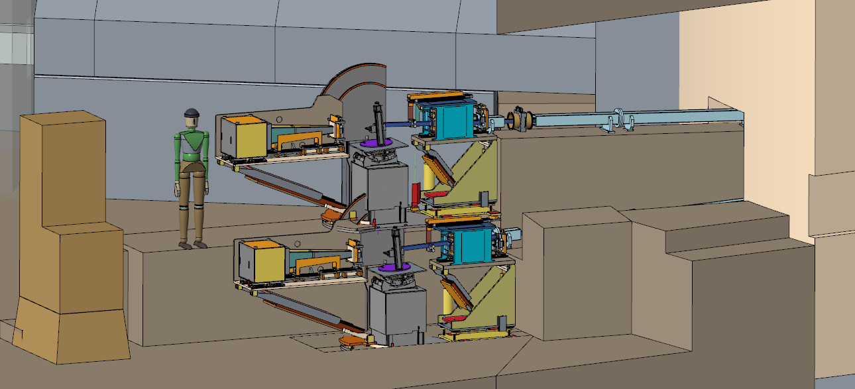
Day One Instruments
CHESS – Chopper Spectrometer for Small Samples
EWALD – Enhanced Wide-Angle Laue Diffractometer
VERDI – Versatile Diffractometer
MENUS – Materials Engineering by Neutron Scattering
QIKR – Quite Intense Kinetics Reflectometer
ZEEMANS – High Magnetic Field Instrument
CYGNUS - SWANS
SANS1

Slide 24
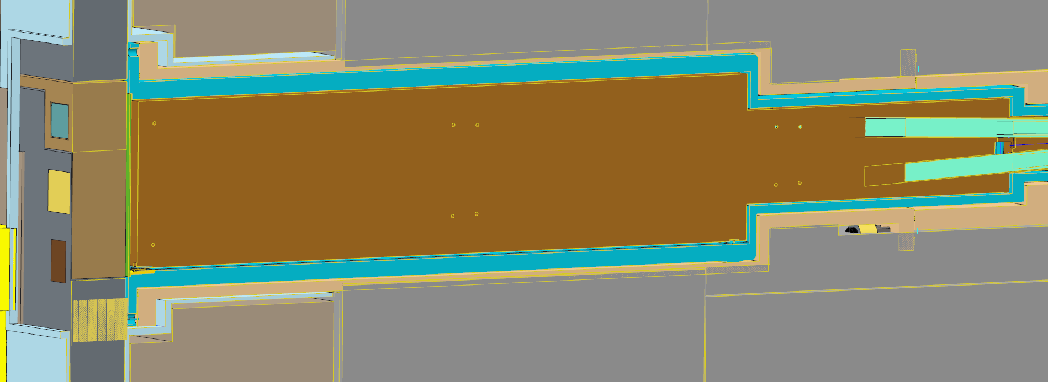
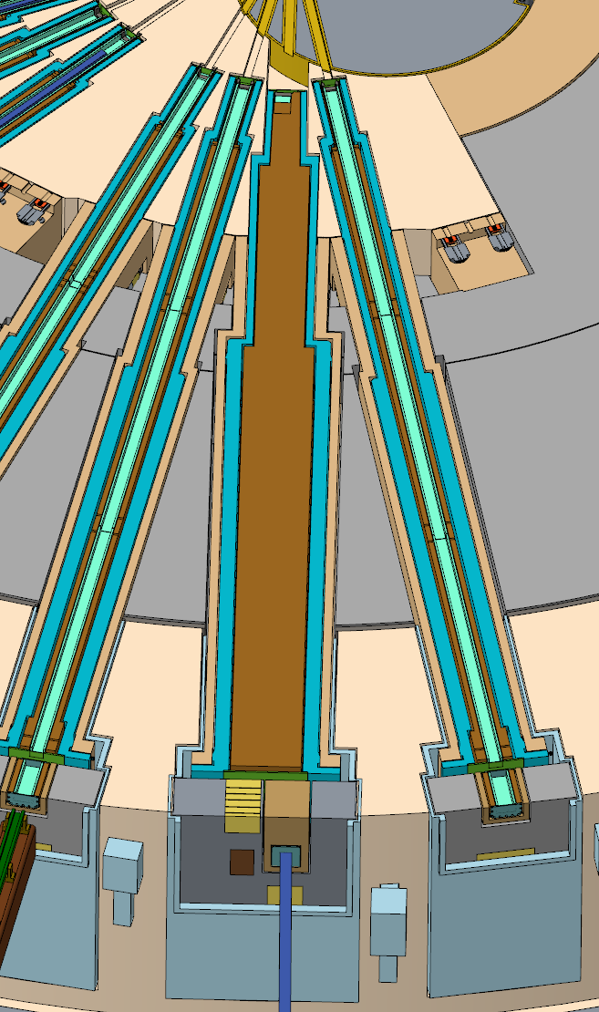
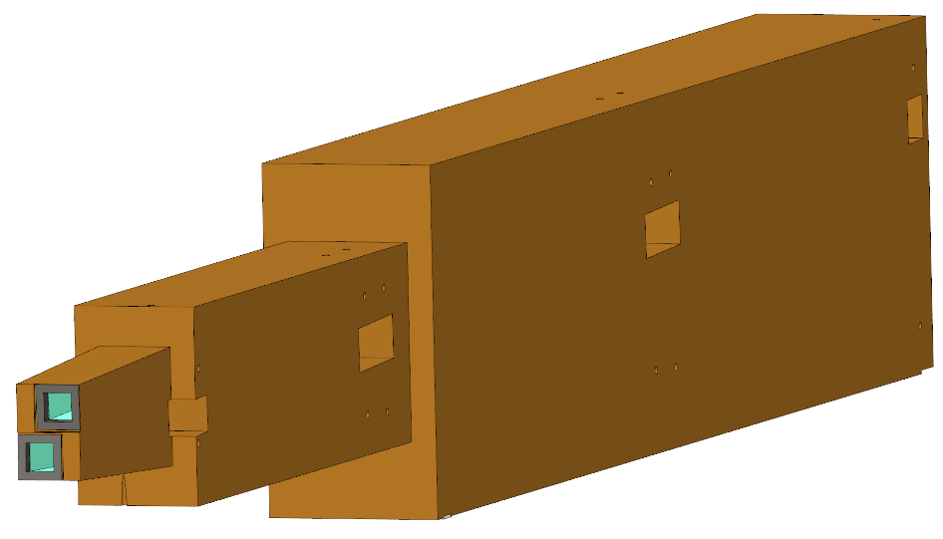
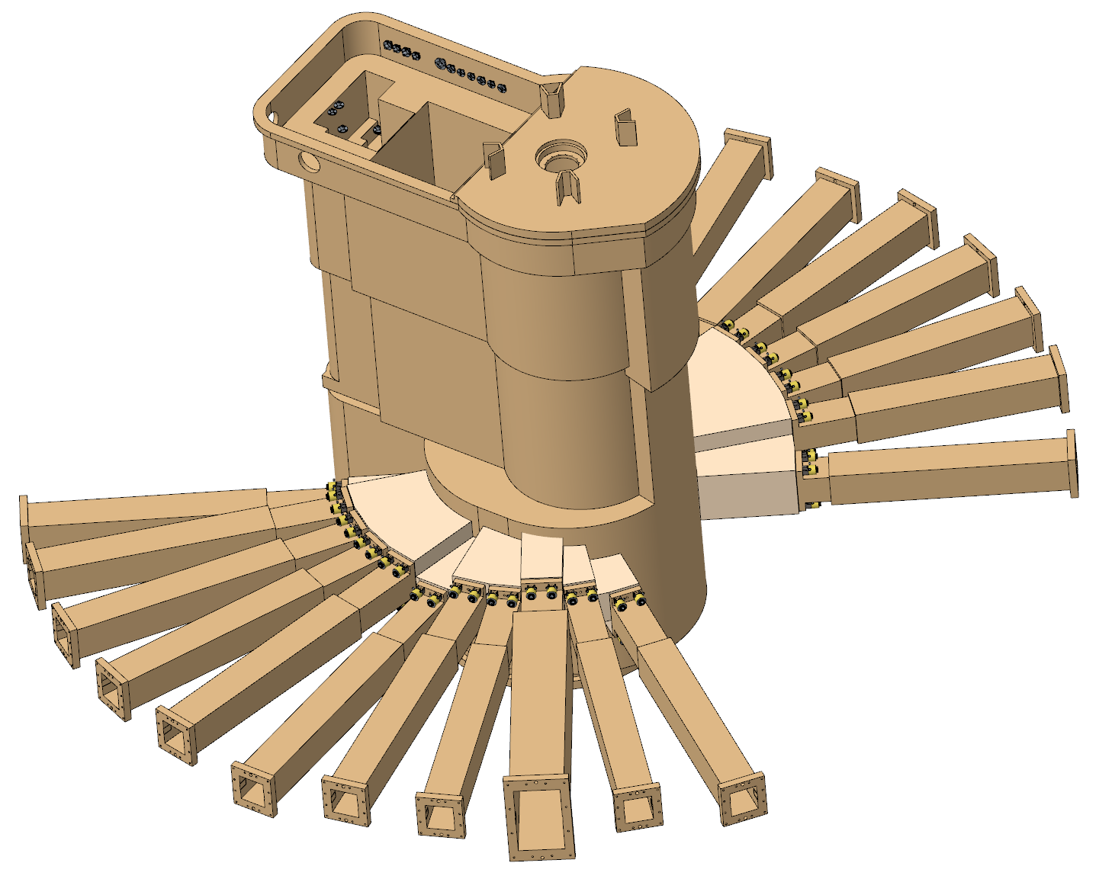
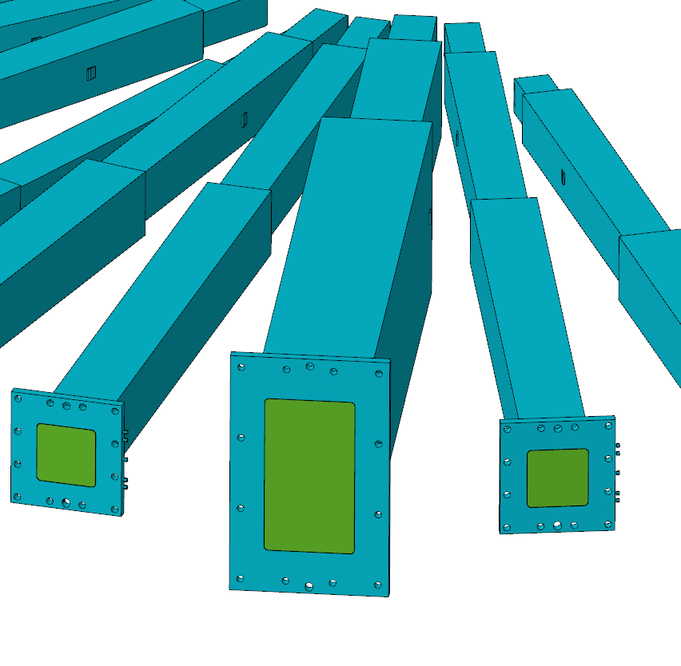
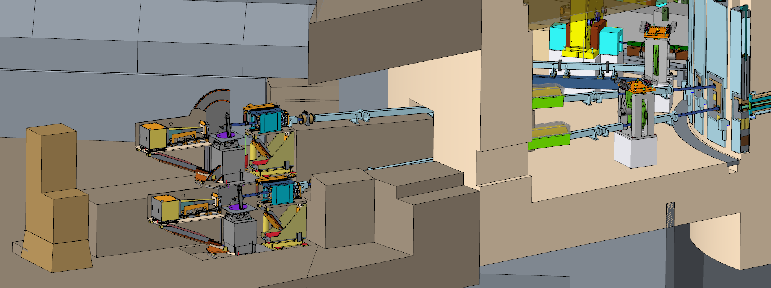
QIKR Requires Several Facility Customizations
Two independent views of same moderator to support liquid-liquid interfaces from both directions
  5° vertical separation, 2° horizontal separation between dual end stations
  Single chopper supports both beams
Diverging beams from moderator significantly complicate monolith optics
  Custom handling equipment needed
Custom Nozzle Extension and Maintenance Shutter required

Slide 25
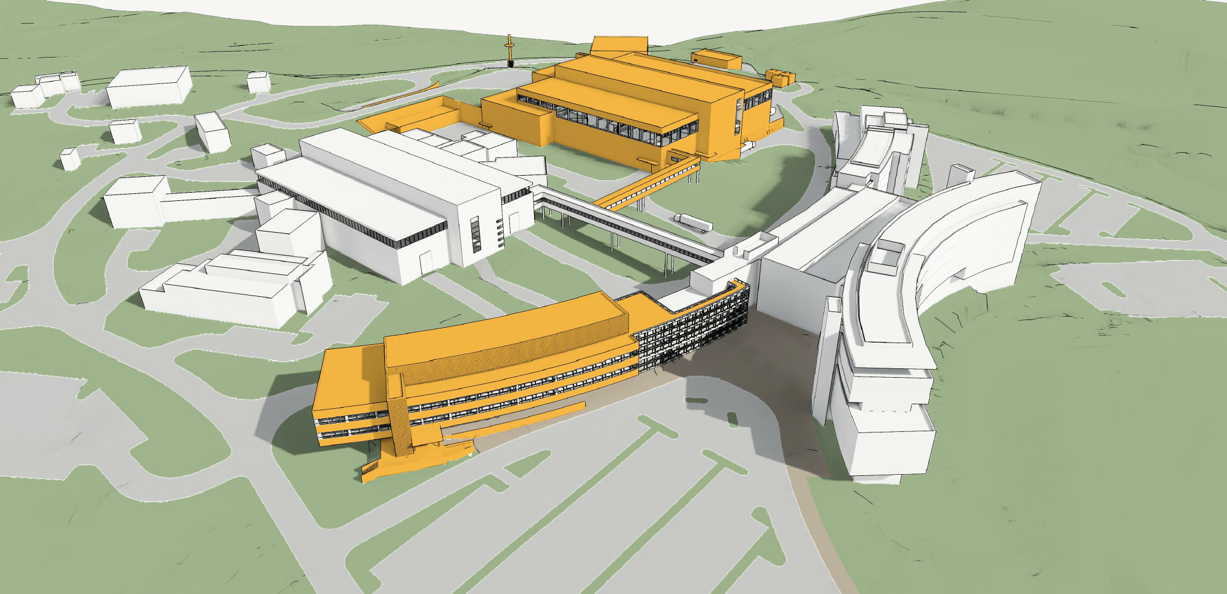
Summary
Neutron bunker operational philosophy drives the design of STS beamlines and interfaces with Target and Conventional Systems
Initial beamline concepts fit within current building boundaries, empty beam ports can accommodate two future long beamlines
FTS shutter experience led to adoption of maintenance / operations shutter scheme
Customizations to accommodate science requirements, within some limits, can occur for those needs which are known early in the design process

Slide 26
Questions?

Slide 27
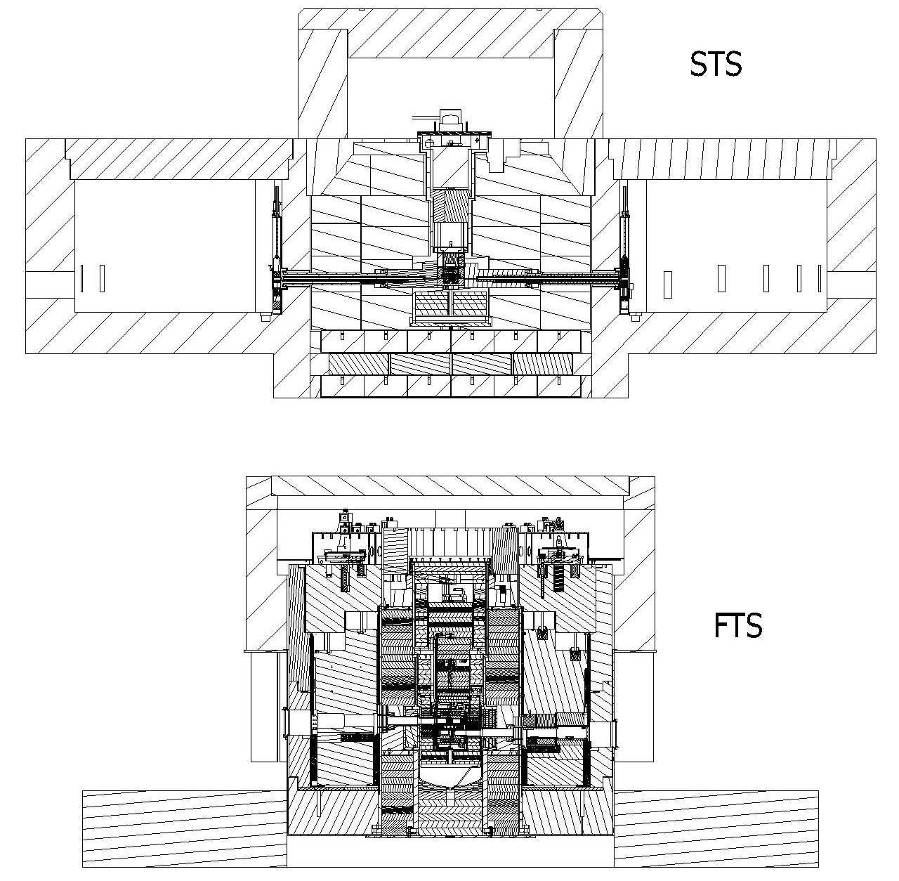
FTS/STS Comparison – Sections Perpendicular to Proton Beam
Core Vessel
Core Vessel Insert / Monolith Insert
Shutter Insert / Maintenance Shutter Insert
STS Core Vessel Environment extends further outward
STS monolith optics & shutters are much different than FTS
  STS Monolith Inserts combine FTS CV & Shutter Inserts
STS bunker diameter and Target Building width are linked
Primary Shutter / Maintenance Shutter
Core Vessel Environment
Target Building Boundary

Slide 28
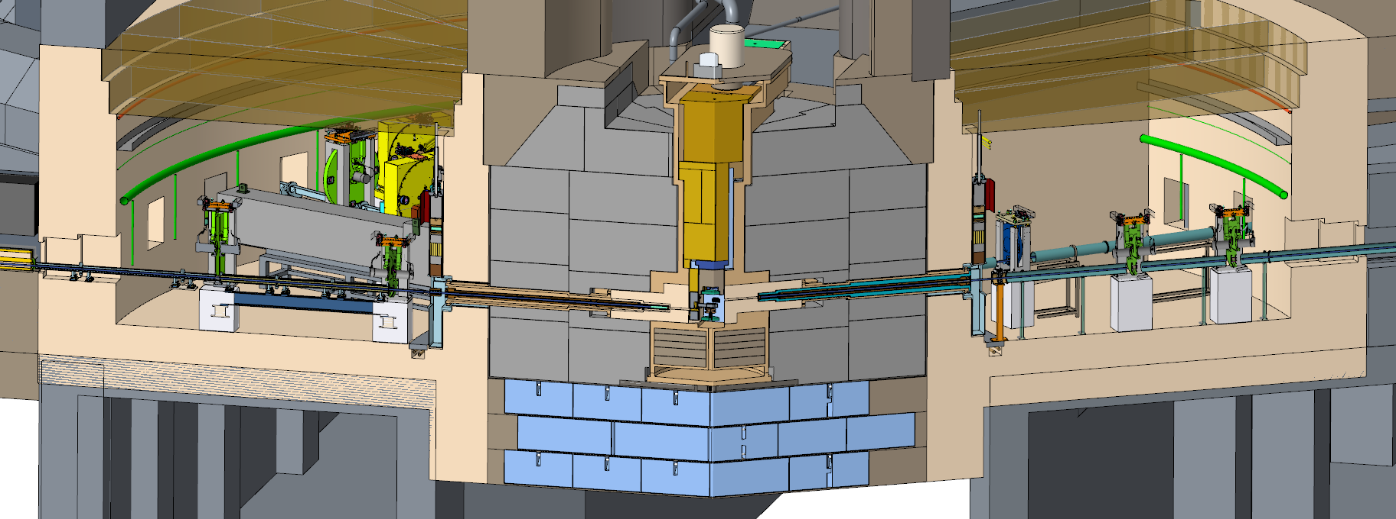
Bunker Interfaces & Scope
Conventional Facilities
  Permanent concrete
  Conventional utilities
Target Systems
  Core Vessel & Nozzle extensions
  Monolith shielding
  Monolith Insert utilities
Instrument Systems
  Bunker Roof Panels
  Monolith Inserts
  Maintenance Shutters
  Beamline technical equipment & shared utilities

Slide 29
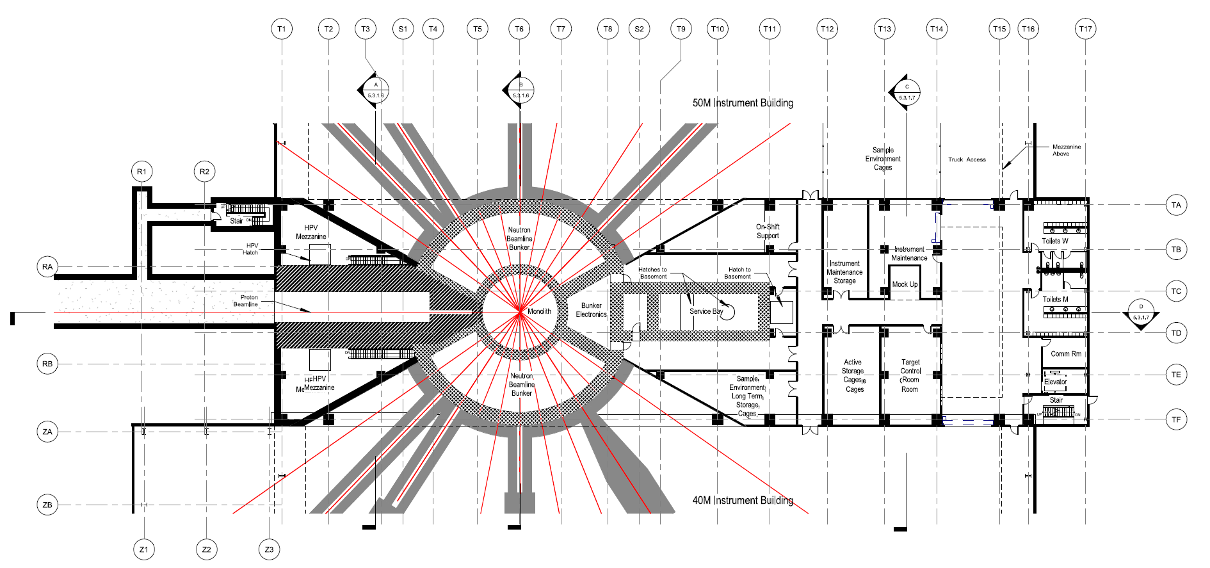
Conventional Facilities Must Support Compact Neutron Source Optics
Target and Instrument Building designs must provide stable platforms for both initial and future beamline installations
Requirement given to Conventional regarding monolith & instrument floor deflection
  1mm initial settlement + 1mm live load (temporary) deflection
  Preventing relative movement between monolith and instrument floors is critical
Initial structural design incorporates micro-pile spacing of 10ft
Small amount of basement space under 40M/50M Buildings, mostly slab-on-grade

Slide 30
Alignment – Neutron Beam Lines to Moderators
Core vessel nozzles attached on site
  Nozzle ends supported by monolith structure (not shown)
Vessel beam port face & nozzle flange fabrication and installation tolerances must be considered in adjustment range of inserts & guides
Large component fabricator indicates positional tolerances on pins ±0.1 mm and perpendicularity tolerance of ±0.02 mm (0.004° on the faces) plus ±0.2 mm installation tolerance
  Leads to a positional error of ±0.9 mm at the downstream end of the nozzles (~5 m)
  Remote installation of inserts & guides imposes a 6 mm gap around components, so fabrication error does not impact design
Nozzle installation must be well mapped for insert installation
  Monolith bulk shielding will be in place during survey, expect entire monolith to move as single entity
Core Vessel and Nozzle Extensions

Slide 31
Alignment – Neutron Beamlines to Moderators (cont'd)
Precisely defining beamline misalignment tolerances requires understanding of their impact on instrument performance
  Sensitivity analyses (neutron simulations) needed to fully define these tolerances
  Expect cylindrical moderator more forgiving than tube moderator with 1 beamline viewing each tube end
Preliminary study of tube moderator misalignment completed
  Initial conclusion is beamlines should be aligned within 0.5 degrees of tube axis
Brightness changes at neutron emission for off-axis angles for brightness of 3-cm-diameter tube moderator. The effect on the time-integrated brightness is shown on the left plot, and peak brightness is on the right plot.
"A Liquid Hydrogen Tube Moderator Arrangement for STS,” F.X. Gallmeier, STS document STS03-31-TR0005-R00, January 2018

Slide 32
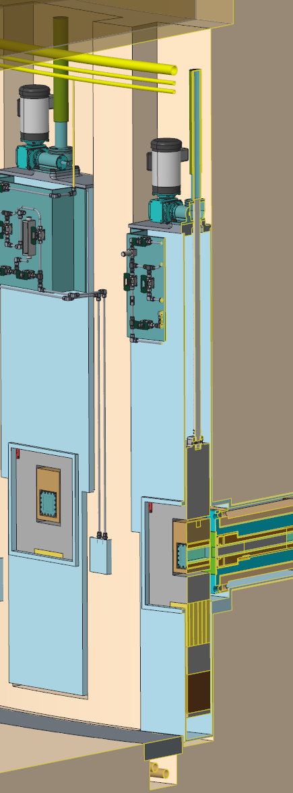
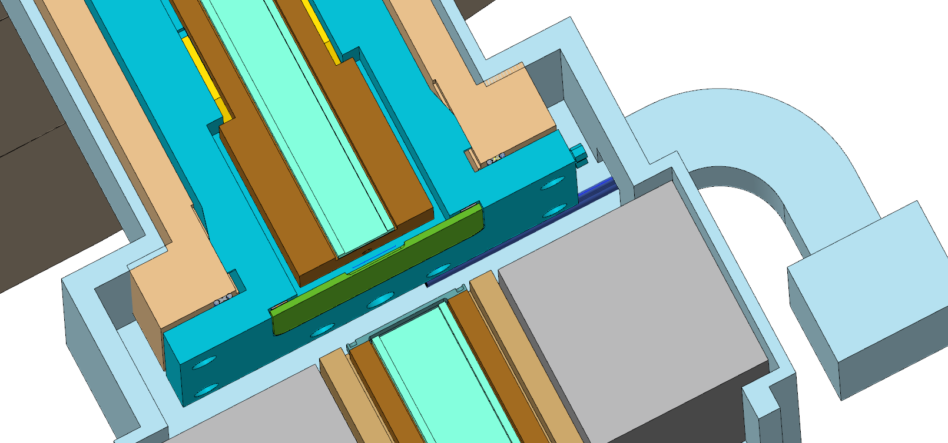
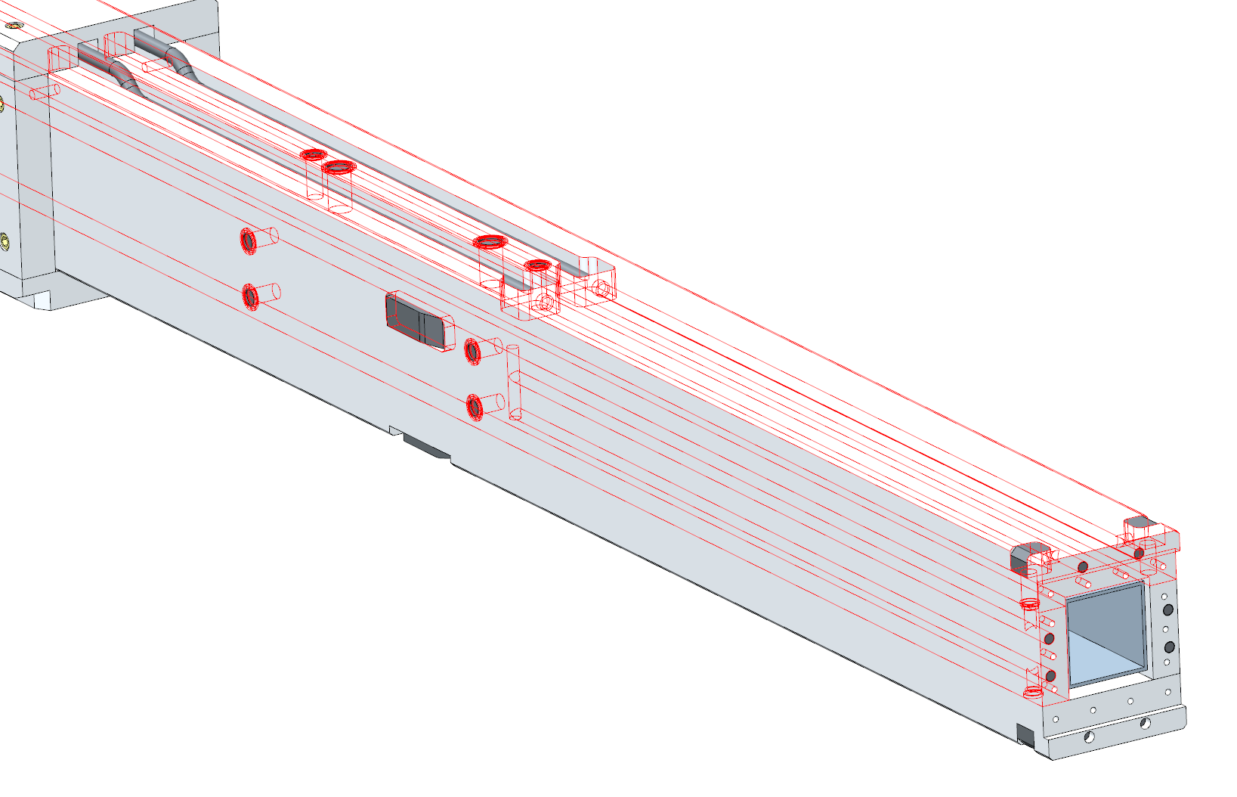
Monolith Insert Utilities
Hot off-gas
Helium supply &
insert seal vacuum check port
Cooling utilities provided by Target Systems as in FTS
  Helium supply / hot off-gas
  Seal vacuum port
  Water supply / return
Floor trench shields water pipes and provides drain location for monolith insert leaks
Gas valve panel
Insert utilties
Feedthrough box into monolith inserts
Insert cooling water supply & return
Insert internal water cooling paths

Slide 33
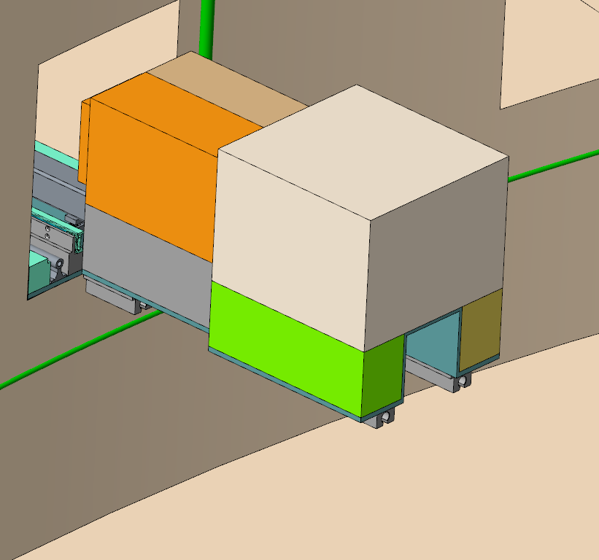
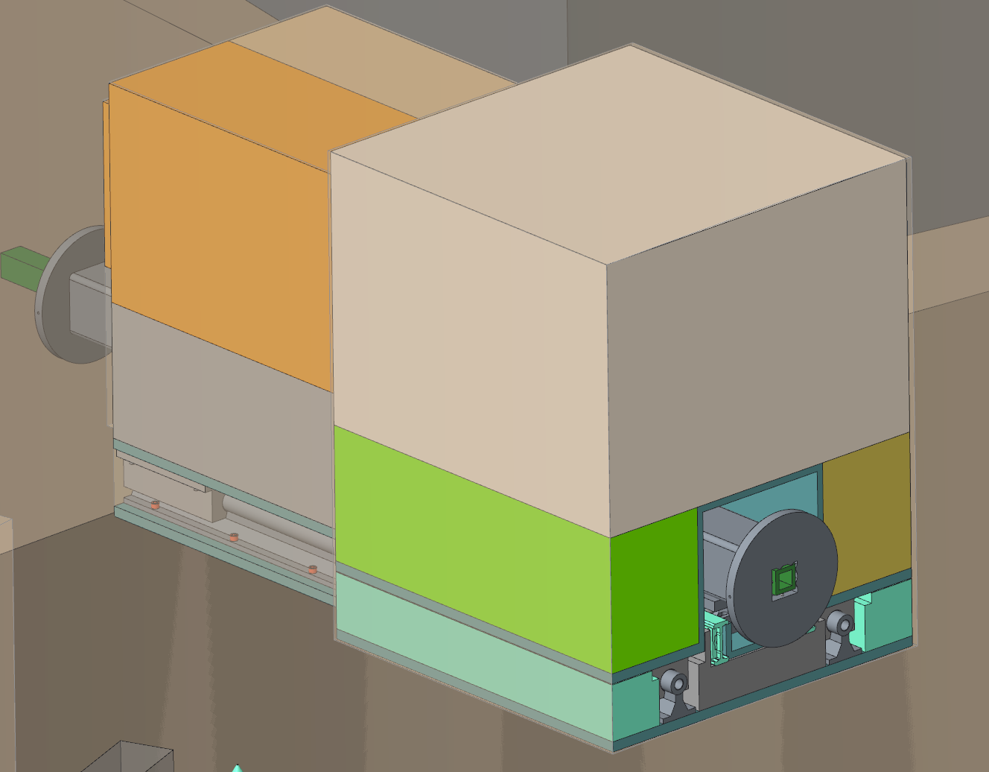
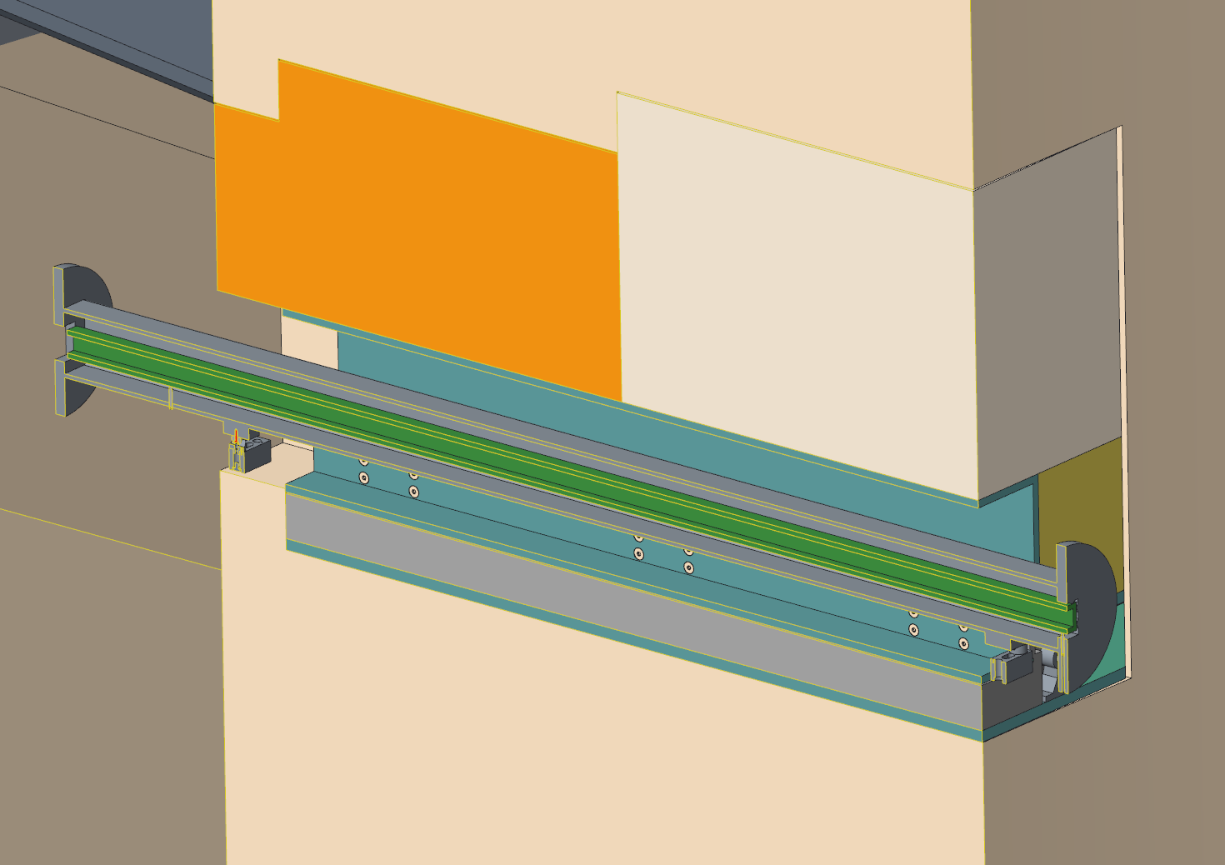
Initial Bunker Wall Penetration Shielding
Create ample penetrations in bunker wall to aid in beamline component installation and future needs
Must fill in openings with shielding (1.5m-thick bunker walls)
Considering a drawer-style concept to facilitate such installation
  Details are beamline-specific
Would require partial beamline disassembly and auxiliary support structure to pull drawers into bunker
  Prefer to put only passive optics in bunker wall, but this would not be a hard requirement
Inner bunker wall serves as SCE boundary, will require some sort of air barrier
Drawers extended into bunker

Slide 34

Outline
Facility layout
Neutron beamline bunkers
Monolith optics & alignment
Shutters
Choppers & beamline shielding
Instruments

Slide 35


Choppers Concepts Based on FTS Choppers
Basis for STS chopper concept: when chopper speed equals source frequency, the edges of STS neutron pulses exiting chopper have the same rise & fall time as the FTS exiting edges
  Chopper diameters increase from 0.58m (FTS/60Hz) to 1.25m (STS/15Hz)
  Smaller choppers (0.7m dia) are possible which require two disks to meet the STS Chopper Specification but function as a single disk chopper
  STS chopper library developed based on FTS designs for commonly used choppers
Large diameter choppers fit better in the bunker, but can be anywhere along the beamlines
Magnetic bearing T0 choppers are being strongly considered since they will impose no vibration on sensitive optics
STS 15Hz chopper library
Large diameter T0 choppers in bunker

Slide 36



Beam Line Shielding Estimates Completed
Preliminary beam line shielding estimates developed from McStas calculation for 15 Hz / 700 kW operation / multiple moderator sizes
  Constant cross section guides matching moderator view face sizes
  Straight & curved (2000m radius) beam lines
Results
  1m regular density concrete (RDC) around beam lines out to ~30m
  ~1.5m high density concrete (HDC) bunker roof panels & wall
Intend to implement consistent method for precast concrete shield blocks
  Fabrication tolerances from different techniques caused fit-up problems on FTS beam lines
As neutronics analyses are performed, streaming shield requirements along the beam lines will be developed
Bunker outer wall
Estimated 1.5m shielding around bunker
Estimated 1m shielding around choppers

