Slide 1
Looking for exotic short range forces with neutrons
Christopher C. Haddock
Postdoctoral Fellow
University of Maryland & NIST
Joint Quantum Institute
NIST Center for Neutron Research
Gaithersburg Campus, Gaithersburg MD USA
Christopher.haddock@nist.gov

Slide 2
The Standard Model is incomplete
General Theory of Relativity cannot be fully incorporated into the SM.
Observed experimental phenomena which cannot be accounted for by the SM include:
  Dark Matter
  Dark Energy
  Matter/Antimatter asymmetry in the universe
  Neutrino Oscillations
The SM has proven successful in its description of physical interactions as particle exchange processes.
Attempts to extend the standard model to include new interactions generally require the existence of a new exchange boson. In the case of a massive boson, the length scale is determined by the mass of the boson as m ~ 1/λ.
Of interest are interactions which could take place on the μm to mm length scale.
  The corresponding mass scale would then be eV to meV.
  Many such interactions are currently being investigated in attempt to discover dark matter candidates or provide evidence of non-Newtonian gravity at short distances, as suggested by theories containing compact extra dimensions.
ORNL Neutron Physics Workshop July 26-27 , 2019

Slide 3
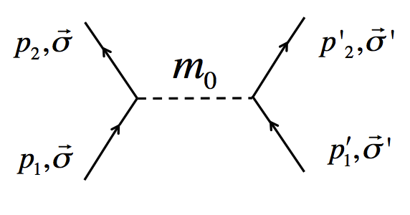
Where do we look?
Basic Theoretical Framework¹
Consider a generalized interaction between two fermions mediated by a single spin-1 boson of mass m₀:
We would like to know the form of all possible interactions derivable from this
diagram in the nonrelativstic limit.
In order to do so one must construct the nonrelativistic scattering amplitude from
scalar invariants formed from the spin and momenta of the fermions.
ORNL Neutron Physics Workshop July 26-27 , 2019

Slide 4

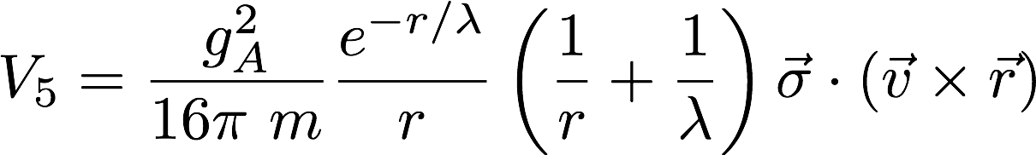
All possible linearly independent scalar invariants depending on the spins and or momenta of the fermions have been identified for this interaction. There are 16 in total
My research interests!
Deviation from Gravitational ISL, e. g. :
1 is spin-independent
6 involve the spin of one fermion
The remaining 9 rely on both fermion spins
10 of these 16 depend on the relative momenta of the fermions.
Exotic “Spin-orbit” - type coupling to matter, e.g. :
ORNL Neutron Physics Workshop July 26-27 , 2019

Slide 5
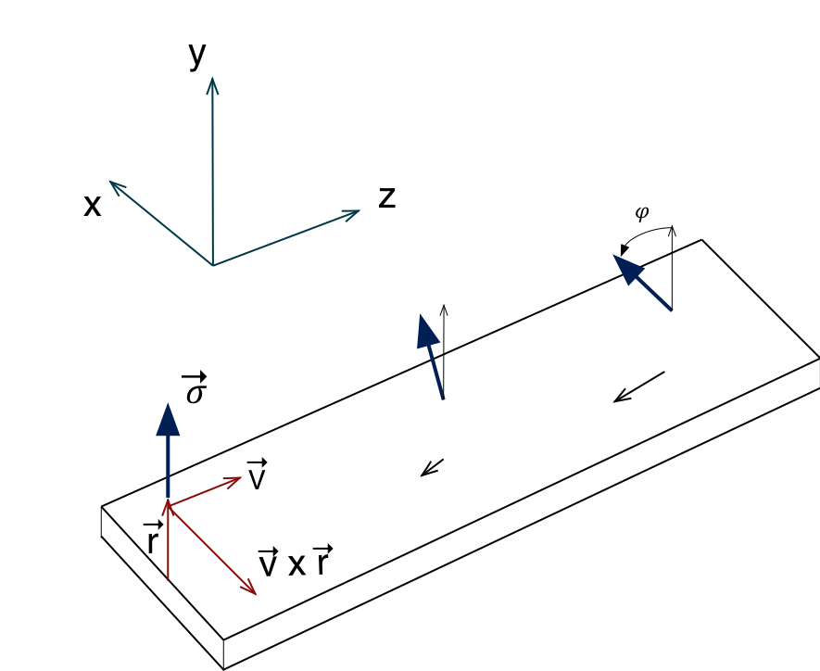
Spin-orbit type coupling
“Pseudomagnetic field”
Consider a beam of vertically polarized neutrons sent parallel to a flat slab of uniform, non-magnetic material:
Polarized neutron beam
(probe)
Neutron experiences coherent
potential from the bulk (source) material
ORNL Neutron Physics Workshop July 26-27 , 2019

Slide 6
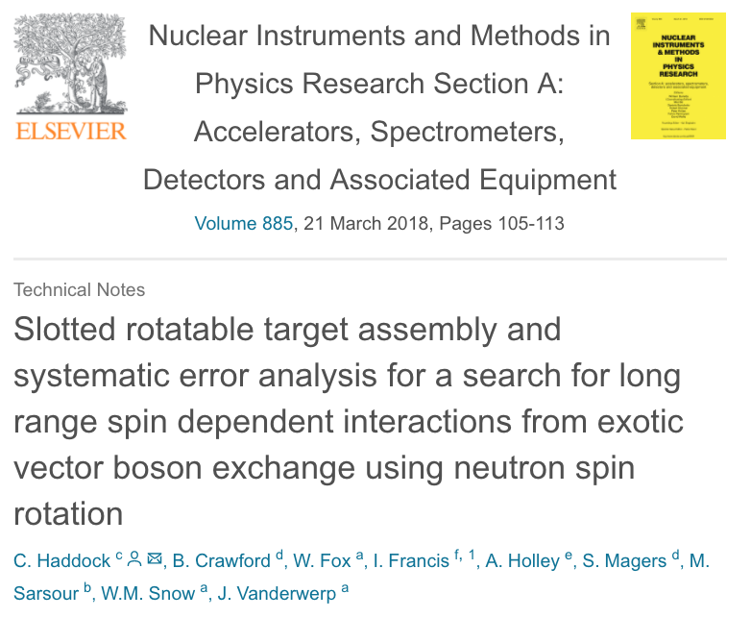
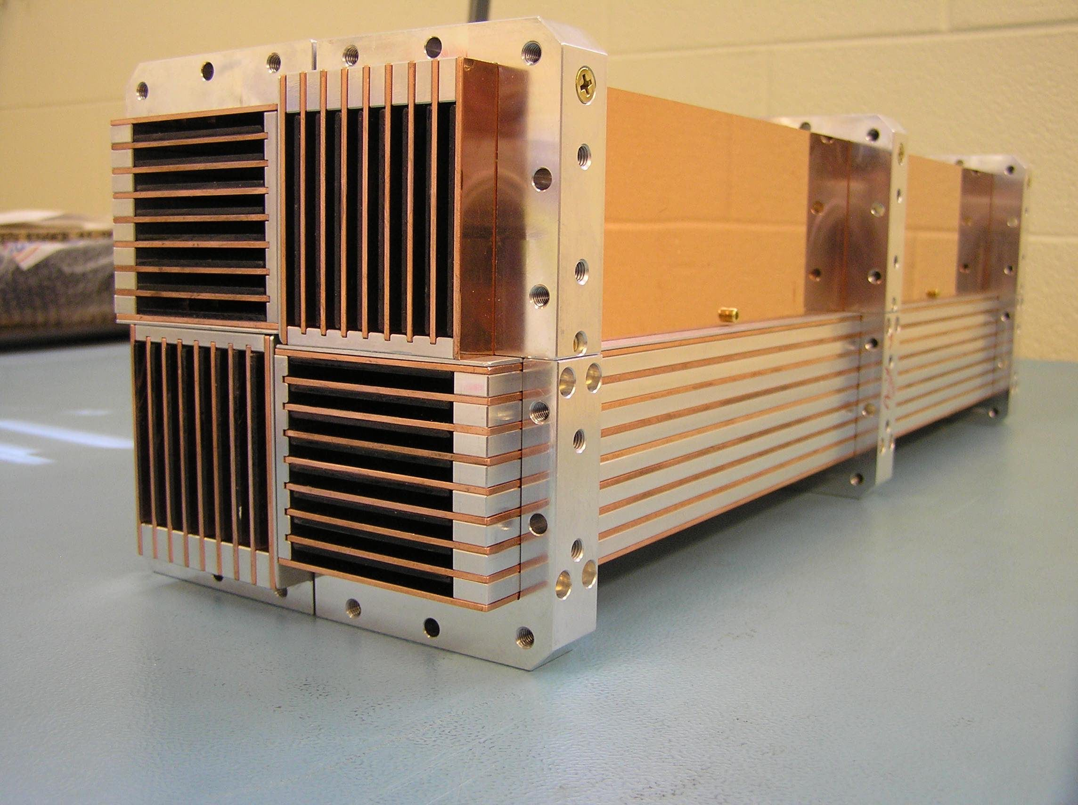
Novel Target Design
Neutron Beam
Small N
Large N
Side view of plates
ORNL Neutron Physics Workshop July 26-27 , 2019

Slide 7
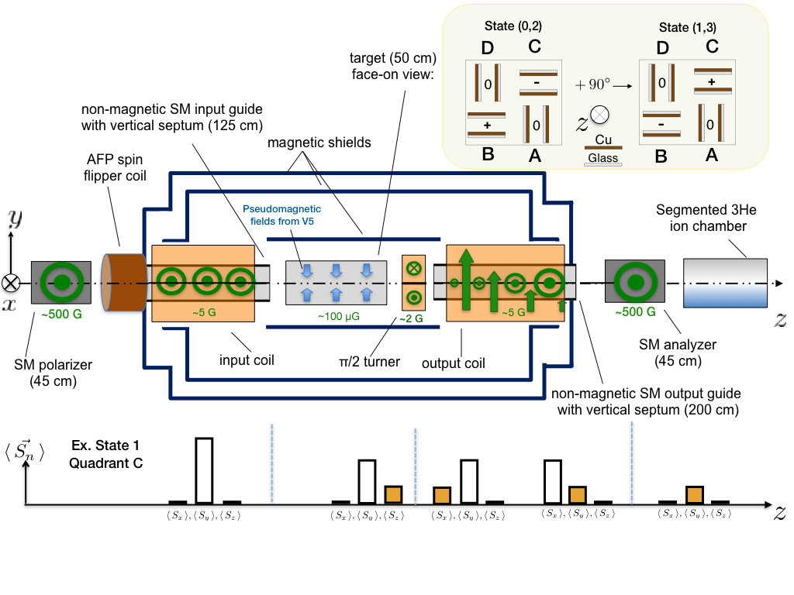
Our Neutron Polarimeter
Top -view
B-fields in green
x
y
Fifth force spin component
J-PARC PN Seminar 2018 May 21

Slide 8
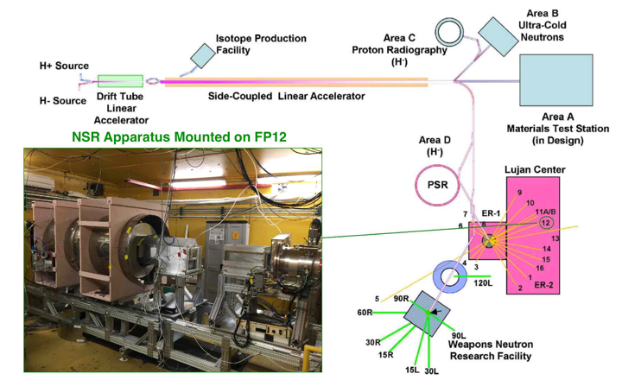
Our Neutron Polarimeter
ORNL Neutron Physics Workshop July 26-27 , 2019

Slide 9
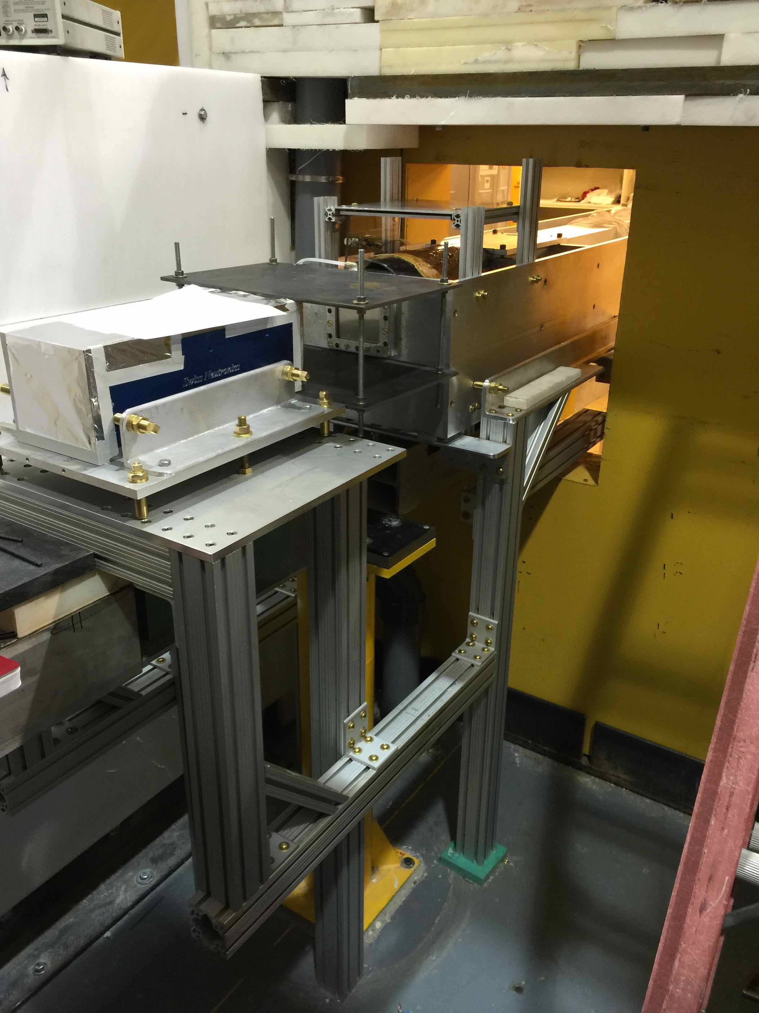
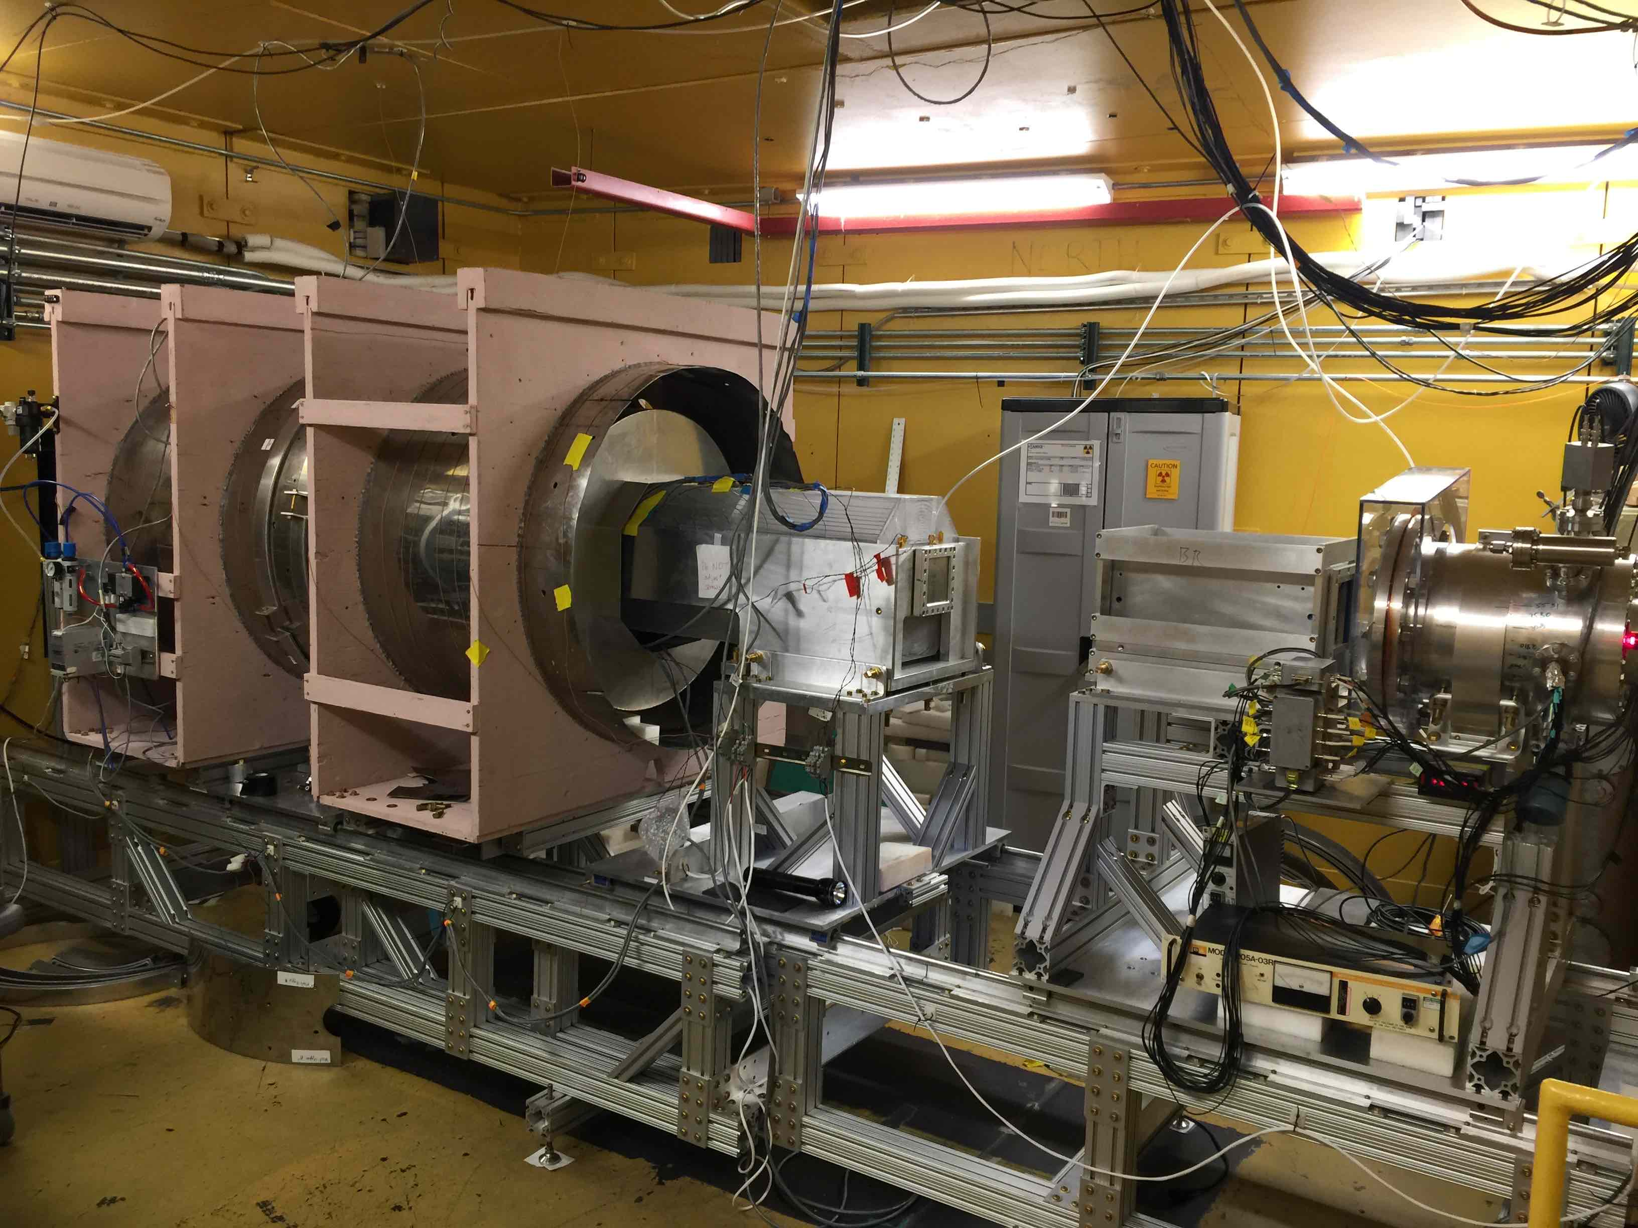
Our Neutron Polarimeter
FP 12 Cave (2016)
Neutron beam
Upstream view

Slide 10
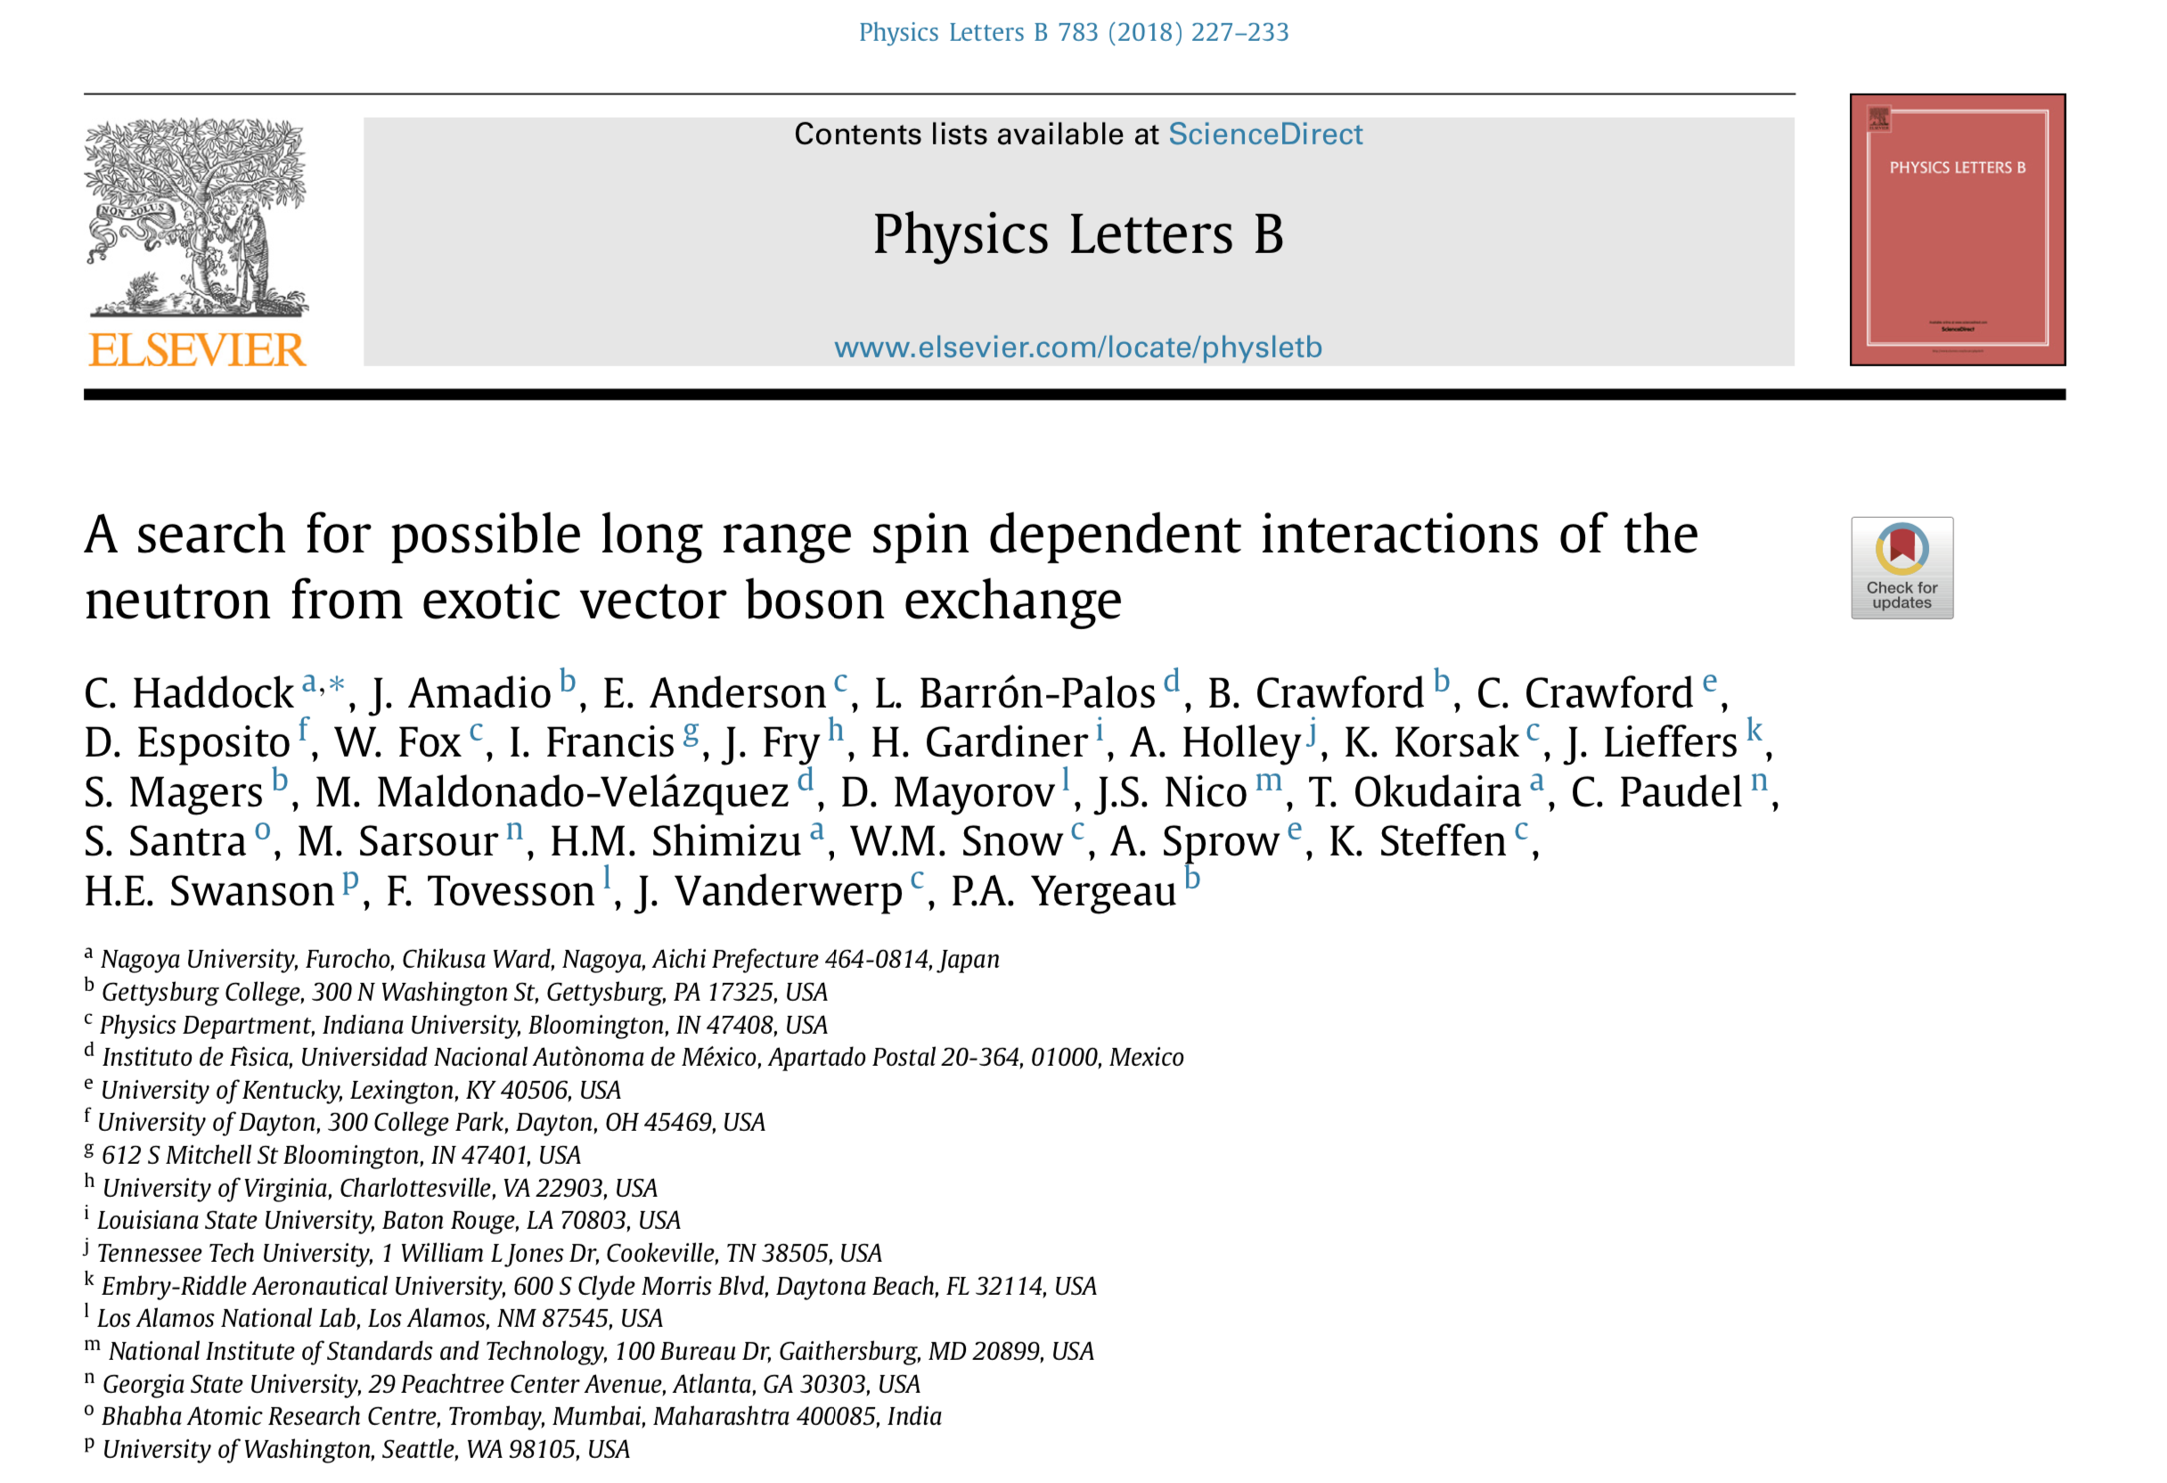
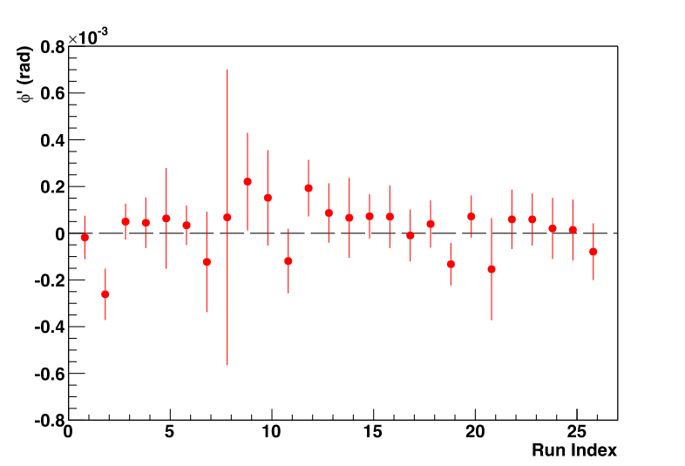
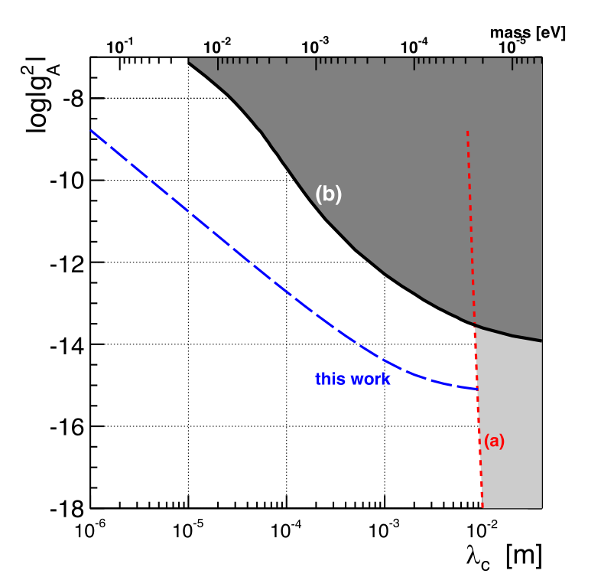
Results
Twenty six 32 minute run sequences
(spin rotation angle as a function of run number):
neutron measurement using Ramsey spectroscopy:
Florian M. Piegsa and Guillaume Pignol
Phys. Rev. Lett. 108, 181801 – Published 1 May 2012
(b) K–3He comagnetometry:
G. Vasilakis, J. M. Brown, T. W. Kornack, and M. V. Romalis
Phys. Rev. Lett. 103, 261801 – Published 29 December 2009

Slide 11
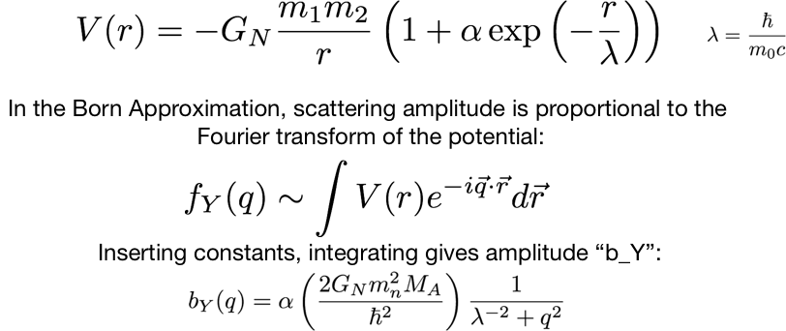
Possible Short Distance Modification of
Newtonian Gravity:
Consider the effect of Yukawa-like term in neutron scattering amplitude
ORNL Neutron Physics Workshop July 26-27 , 2019

Slide 12
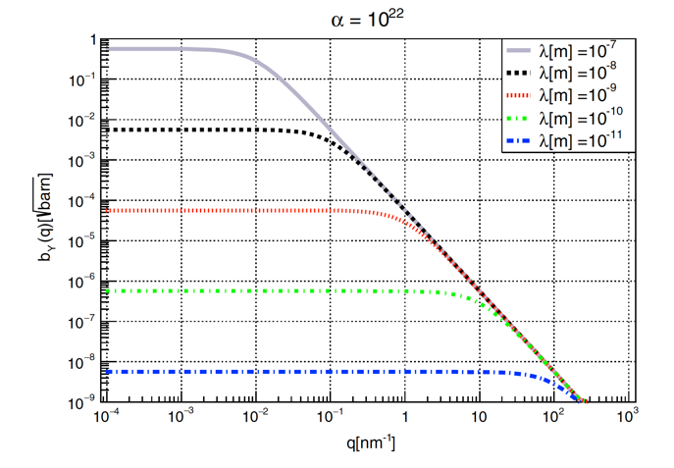
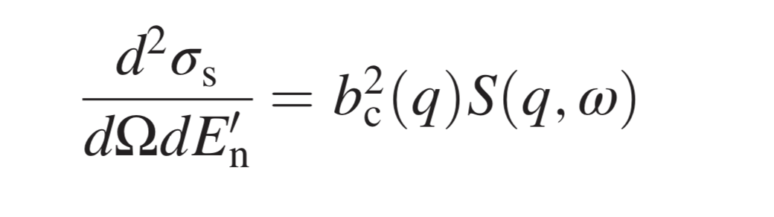
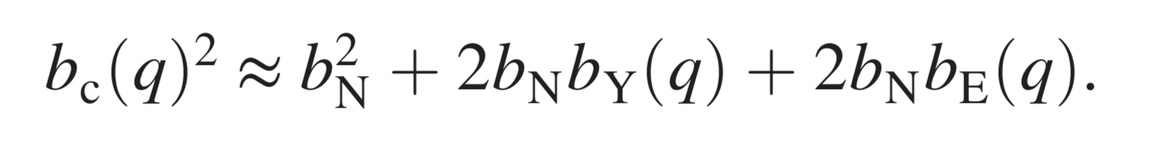
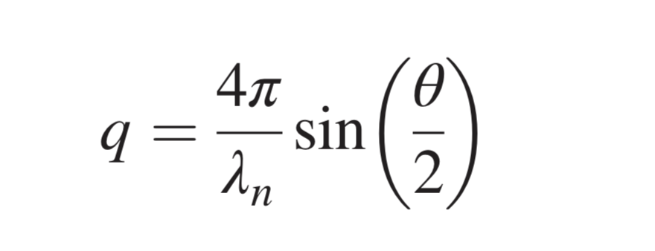
Neutron scattering experiments
Scattering probability as a function of momentum and energy transfer
Slow neutron scattering
Assume static approx. for sensitivity estimation (ω = 0)
N-electron interaction
JPARC/BL05 (2017)
Sensitivity to large λ
(Torsion balance, Casimir)
Sensitivity to small λ
(LHC)
ORNL Neutron Physics Workshop July 26-27 , 2019

Slide 13
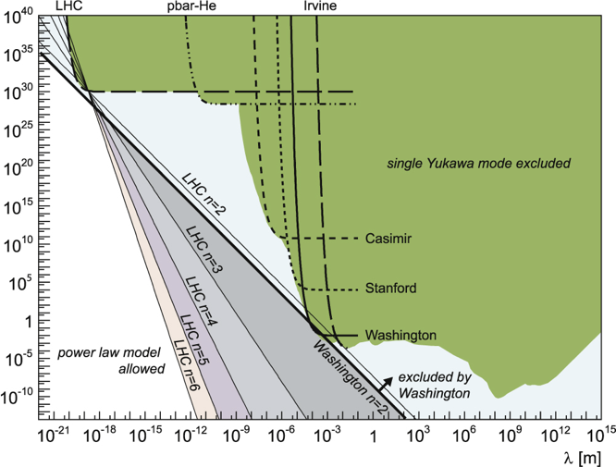

Consider the effect of Yukawa-like term in neutron scattering amplitude
α
Multiple Boson
Exchange Models
ORNL Neutron Physics Workshop July 26-27 , 2019

Slide 14
Our general strategy
Use pulsed neutron source at JPARC to measure neutron-Xe and neutron-He differential cross section.
Acquire data with high TOF resolution to study q-dependence
Improve existing limit on α by over the 0.1 nm to 10 nm length scale
ORNL Neutron Physics Workshop July 26-27 , 2019

Slide 15
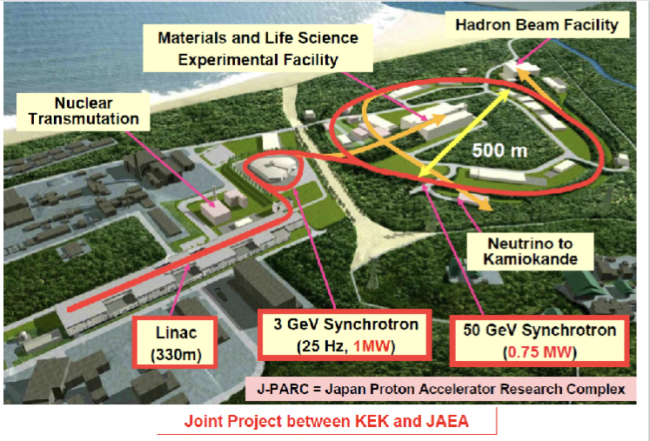
2016年11月~2017年2月
J-PARC/MLF/BL05の低発散ビームブランチで実験
ORNL Neutron Physics Workshop July 26-27 , 2019

Slide 16
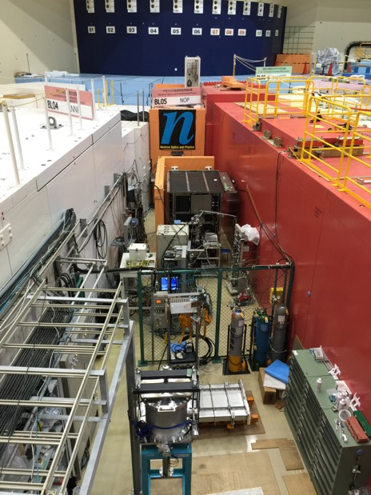
J-PARC BL05 Fundamental Physics
(beam lifetime TPC method mainly)

Slide 17
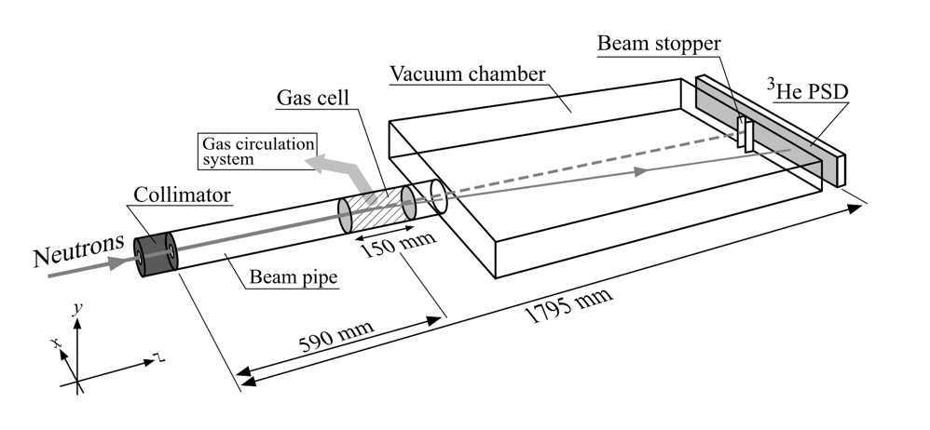
Experimental Layout
ORNL Neutron Physics Workshop July 26-27 , 2019

Slide 18
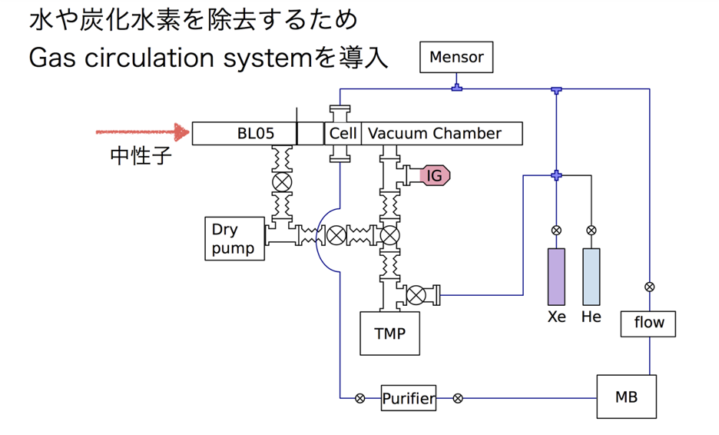
Gas handling and circulation system
Trapped H20 must be < 10 ppm to obtain
0.1% accuracy for q dependence
Neutron beam
ORNL Neutron Physics Workshop July 26-27 , 2019

Slide 19
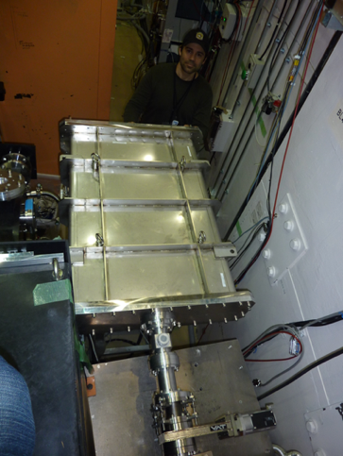
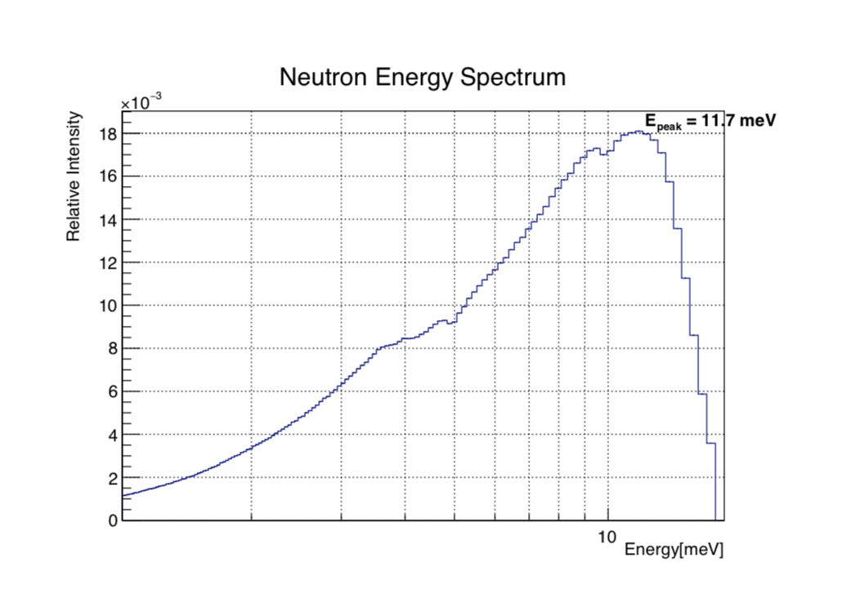
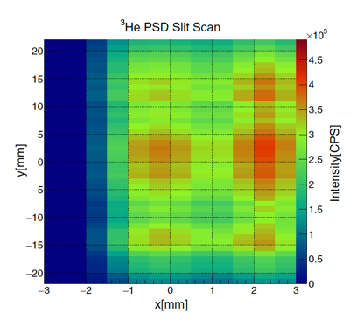
Setup / devices at BL05 JPARC MLF
2D profile during 150 kW run
I₀ = 1.1e+6 CPS
ORNL Neutron Physics Workshop July 26-27 , 2019

Slide 20
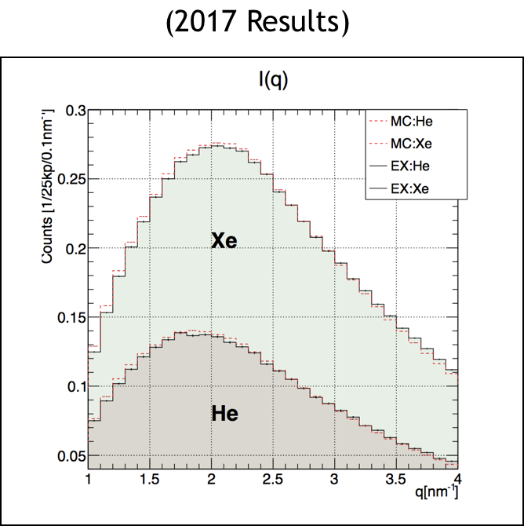
2017 Results
Scattering events
measured (2017)
q range -> [0.6,3] nm^-1 :
1e+7 n-Xe
2.5e+6 n-He
2.5e+6 n-Evacuated Cell

Slide 21
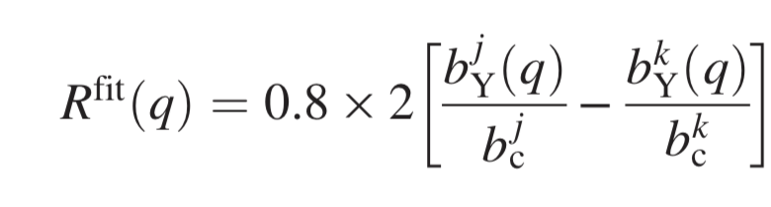
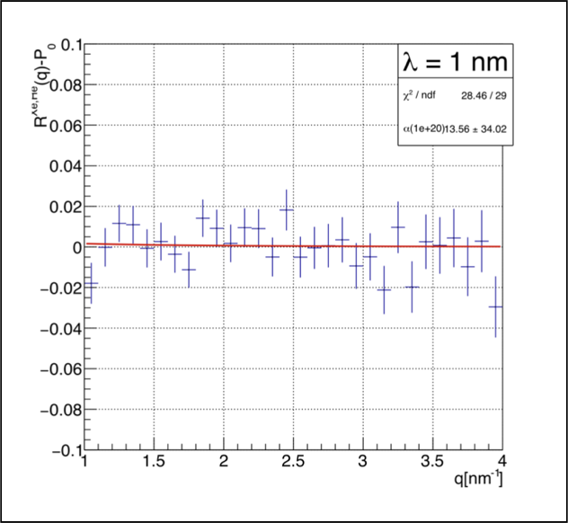
Residual Effect from Yukawa - like interaction
(Reduction method described in Phys. Rev. D 97, 062002)
Fit to residual effect to produce limit on α(λ)
ORNL Neutron Physics Workshop July 26-27 , 2019

Slide 22
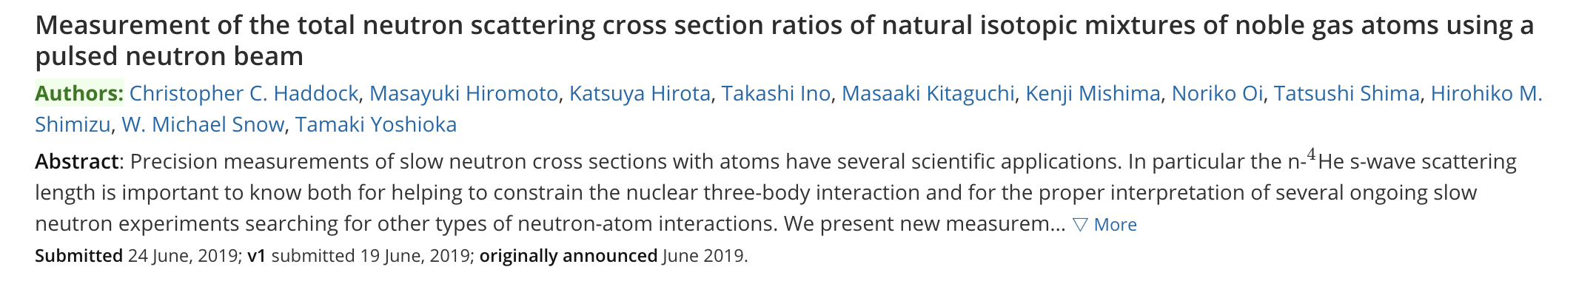
Other scattering studies
(a)
arXiv:1906.08223
Submitted to PRC, under review
(b)
Measurement of neutron-electron scattering length (ongoing studies at J-PARC BL21)
Took “first try” data Feb 2019
Applied for more beam time this Winter cycle
Can also improve limits on ISL deviation search
(c)
Nanoparticle scattering to search for deviations from ISL (create sample with Σbc = 0 )
Took some proof-of-principle data Jun 2019 using Nickel nanoparticles
Searching for optimal target
ORNL Neutron Physics Workshop July 26-27 , 2019

Slide 23
Summary
Neutrons are an effective tool to study a short range forces with high sensitivity
A parametrization of a general neutron - fermion interaction in the nonrelativstic limit provides a simple framework for a searching for possible interactions in the nm – mm length scale.
A spin polarimeter was constructed and used at LANSCE in late 2016 to place a new upper bound on the strength a new possible spin coupled interaction.
A neutron – noble gas scattering instrument was constructed and used to place a new upper bound on possible deviations from ISL at the ~ 0.1 nm length scale.
Additional experimental efforts are ongoing to make more precise measurements to reduce the available parameter space for new interaction coupling strengths.
ORNL Neutron Physics Workshop July 26-27 , 2019

Slide 24
Backup
4He scattering cross section
N-e scattering studies
ORNL Neutron Physics Workshop July 26-27 , 2019

Slide 25
N-4He Scattering Cross Section
During analysis of He & Xescattering data, noticed that 4He looked funny… contacted Mike Huber for help.
PRELIMINARY
BL05/MLF
2018
Image Credit:
Michael G. Huber (NIST)
Private communication
ORNL Neutron Physics Workshop July 26-27 , 2019

Slide 26

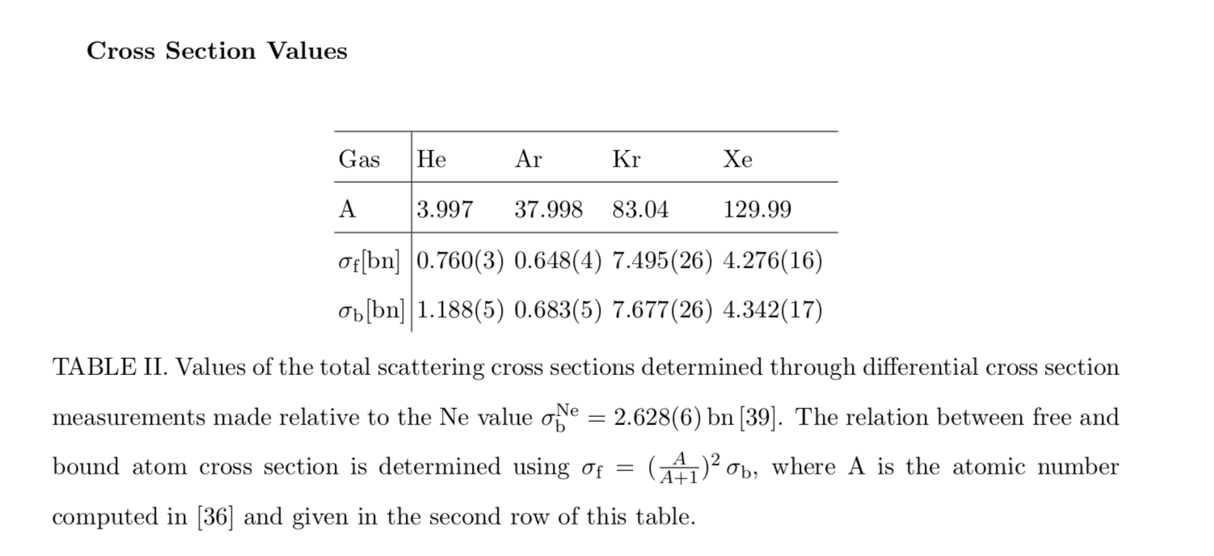
N-4He Scattering Cross Section
After publishing the results for n-Xe and n-He we measured the remaining noble gases (Ar and Kr and Ne):
arXiv:1906.08223

Slide 27
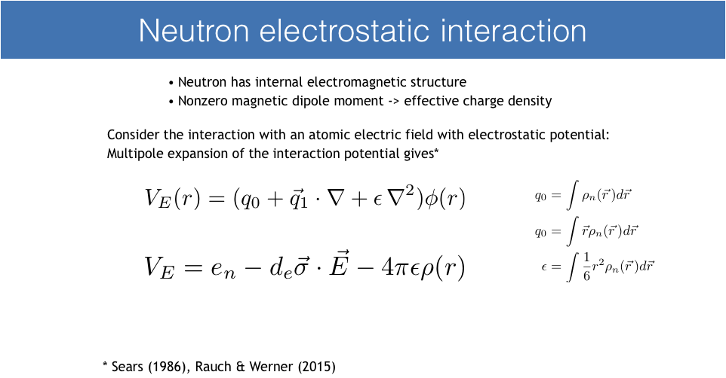
N-electron Scattering
ORNL Neutron Physics Workshop July 26-27 , 2019

Slide 28
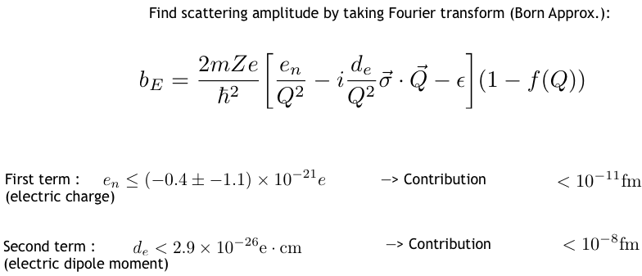
Neutron-electron Scattering
ORNL Neutron Physics Workshop July 26-27 , 2019

Slide 29

Neutron-electron Scattering Length
Recall:
x 10⁻³
Neutron charge radius
Can be computed from quark theories
(Carlitz et al.,Phys. Lett. Vol 68 B no.5 (1977))
Could potentially aid in proton radius puzzle?
ORNL Neutron Physics Workshop July 26-27 , 2019
Notes:
Add Mitsnya result?

Slide 30
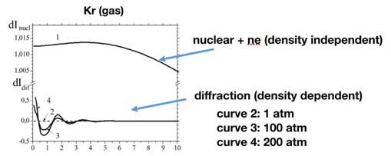
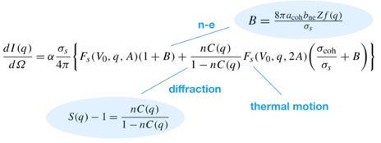
Recent re-analysis of gas diffraction data by Mitsnya et al. *
They analyzed existing data on Kr (gas & liquid) and 36 Ar
They suggest a comparative diffraction measurement for gases with very different b_{ne} contributions but similar nuclear properties e.g. Xe & Kr,
b_{ne} precision can reach 2% provided sufficient q resolution is met (~1e-3 relative values, achievable at NOVA)
* “Extraction of the neutron-electron scattering length from the neutron diffraction data measured on noble gases”, Nuclear Physics A 819 (2009) 1-10
L. Mitsnya, V.G. Nikolenko, S.S. Parzhitski, A.B. Popov, G.S. Samosvat
ORNL Neutron Physics Workshop July 26-27 , 2019
Notes:
Add averaged result from paper top right

Slide 31
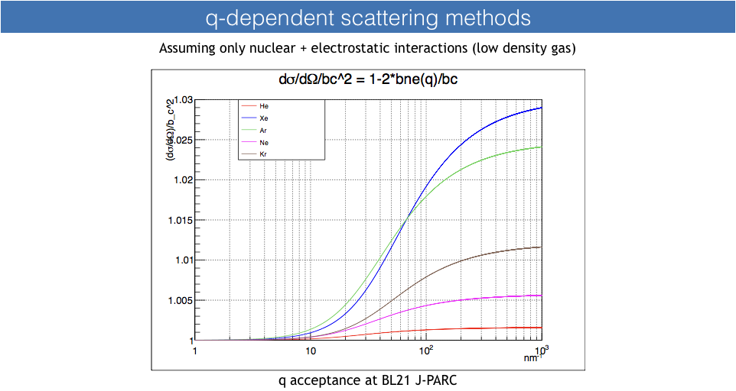
Contacted folks at J-PARC who look at scattering over larger range of q atBL21 (NOVA)
Estimated relative size of NE interaction for the noble gases:
ORNL Neutron Physics Workshop July 26-27 , 2019

Slide 32
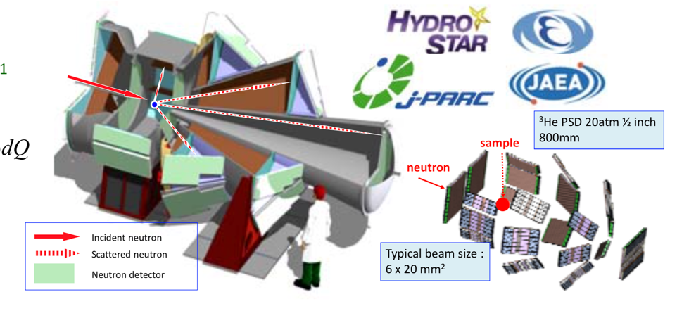
J-PARC MLF BL21 (NOVA)
ORNL Neutron Physics Workshop July 26-27 , 2019

Slide 33
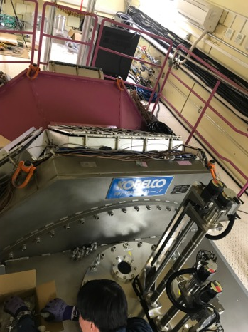
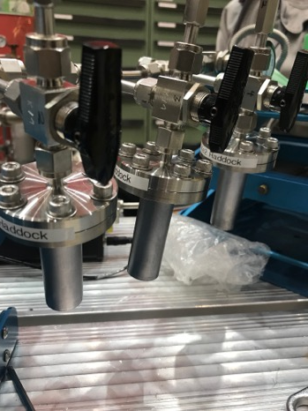
BL21Setup
Sample Changer
Vanadium Cells
Cell wall diameter = 20mm
thickness 0.1 mm

Slide 34
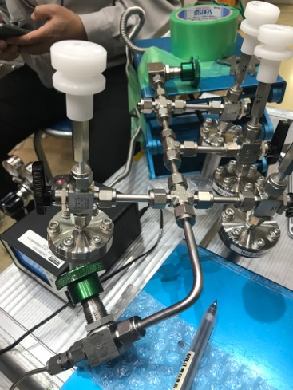
Overview of run
“Fill Station”
1st run was of 5 samples with 1-2 hrs per sample
Quick data analysis of incoming runs suggested that background scattering from cells may vary more than expected
Took 15 hours of one of the vac cells (cell #5)
Then, took same amount of data for Kr and Xe over the course of ~ 30 hours using the same cell.
Also took some He and Ne data using cells which we don’t have as much background data on
ORNL Neutron Physics Workshop July 26-27 , 2019

Slide 35
Preliminary Analysis
All scattering banks combined
ORNL Neutron Physics Workshop July 26-27 , 2019

Slide 36
Preliminary Analysis
ORNL Neutron Physics Workshop July 26-27 , 2019

Slide 37
Preliminary Analysis
ORNL Neutron Physics Workshop July 26-27 , 2019

Slide 38
Preliminary Analysis
ORNL Neutron Physics Workshop July 26-27 , 2019

Slide 39
Preliminary Analysis
ORNL Neutron Physics Workshop July 26-27 , 2019

Slide 40
Measured
Predicted
For Xe/Kr NE contribution, expect at most~ 1%
Measured w TOF cut (include only < 3eV)
ORNL Neutron Physics Workshop July 26-27 , 2019
->Rise is large, even after TOF cut

Slide 41
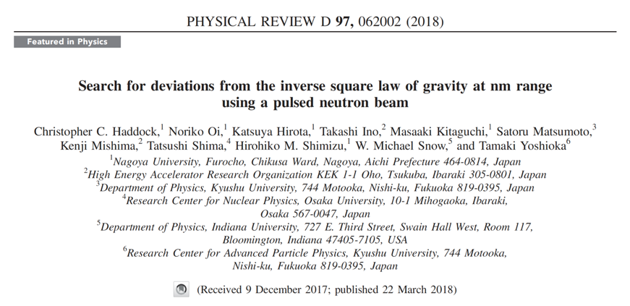
Gas Scattering Collaboration
ORNL Neutron Physics Workshop July 26-27 , 2019

