Slide 1
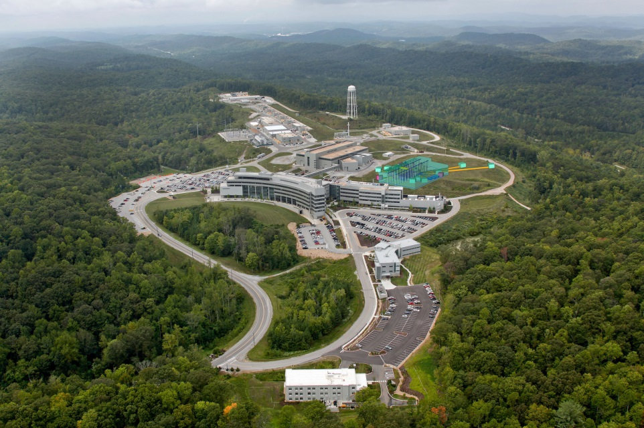



Nab and pNab at SNS
Stefan Baeβler
Inst. Nucl. Part. Phys.

Slide 2
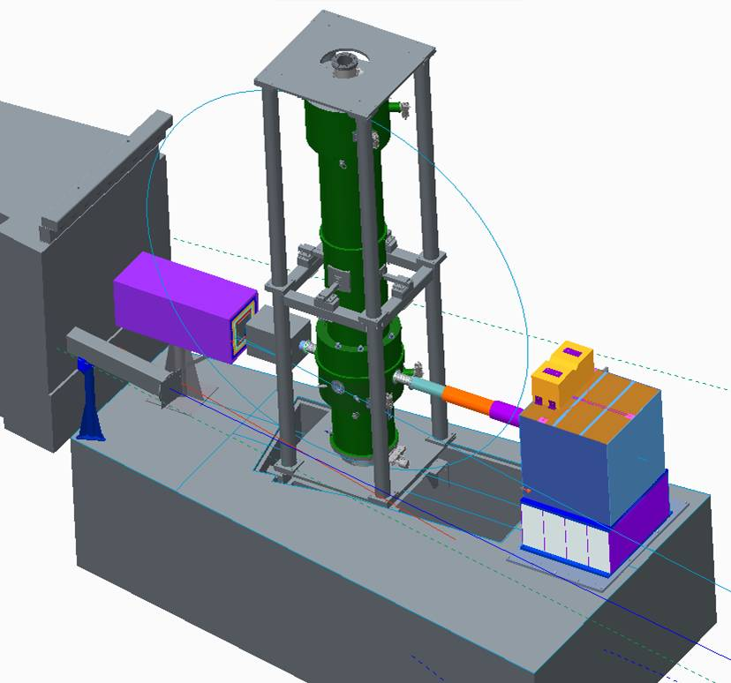
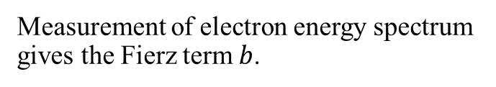
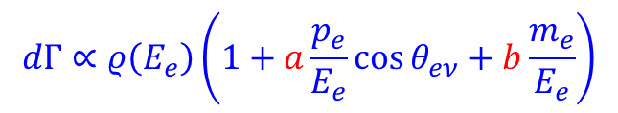
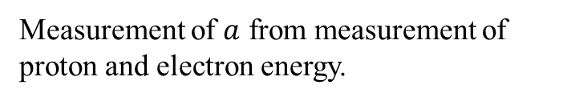


Idea of Nab experiment
n
e⁻
Nab @ Fundamental Neutron Physics Beamline (FNPB) @ Spallation Neutron Source (SNS)
p
$$θ_{eν}$$
$$\overline{ν_{e}}$$
Multipixel Si detectors for decay electrons and protons
$$dΓ∝ρ\left(E_{e}\right)\left(1+a\frac{p_{e}}{E_{e}}\cos{θ_{eν}}+b\frac{m_{e}}{E_{e}}\right)$$
8 meters
Measurement of electron energy spectrum gives the Fierz term $b$.
Measurement of $a$ from measurement of proton and electron energy.
Cold Neutron Beam from left
General Idea: J.D. Bowman, Journ. Res. NIST 110, 40 (2005)
Original configuration: D. Počanić et al., NIM A 611, 211 (2009)
Asymmetric configuration: S. Baeßler et al., J. Phys. G 41, 114003 (2014)

Slide 3

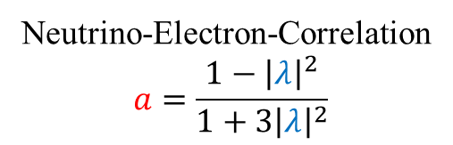
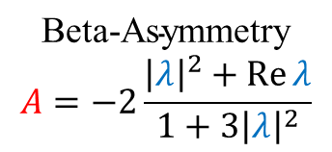

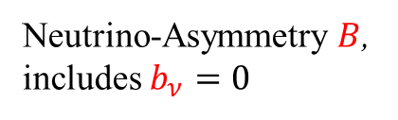

Correlation coefficients in neutron beta decay
$${\vec{σ}}_{n}$$
e⁻
Observables in neutron beta decay, as a function of generally possible coupling constants (assuming only Lorentz-Invariance):
C.F. v.Weizsäcker, Z. f. Phys. 102,572 (1936), M. Fierz, Z. f. Phys. 105, 553 (1937), J.D. Jackson et al., PR 106, 517 (1957)
p
n
$$\overline{ν_{e}}$$
$$dΓ∝ρ\left(E_{e}\right)⋅\left(1+3{\left|λ\right|}^{2}\right)⋅\left\{1+a\frac{{\vec{p}}_{e}⋅{\vec{p}}_{ν}}{E_{e}E_{ν}}+b\frac{m_{e}}{E_{e}}\right.+\left.{\vec{σ}}_{n}⋅\left(A\frac{{\vec{p}}_{e}}{E_{e}}+B\frac{{\vec{p}}_{ν}}{E_{ν}}+D\frac{{\vec{p}}_{e}×{\vec{p}}_{ν}}{E_{e}E_{ν}}\right)\right\}+{\vec{σ}}_{e}⋅…$$
Neutrino-Electron-Correlation
$$a=\frac{1−{\left|λ\right|}^{2}}{1+3{\left|λ\right|}^{2}}$$
Neutrino-Asymmetry $B$, includes $b_{ν}=0$
$$\text{Beta}\text{−}\text{Asymmetry}$$
$$A=−2\frac{{\left|λ\right|}^{2}+\operatorname{Re}{λ}}{1+3{\left|λ\right|}^{2}}$$
Fierz interference term $b=0$
Neutron lifetime $Γ=τ_{n}^{−1}=\frac{2π}{ℏ}G_{F}^{2}V_{ud}^{2}\left(1+3{\left|λ\right|}^{2}\right)∫ρ\left(E_{e}\right)dE_{e}$
(Expressions for correlation coefficients in SM, where $λ=g_{A}/g_{V}$ )
Notes:
3

Slide 4


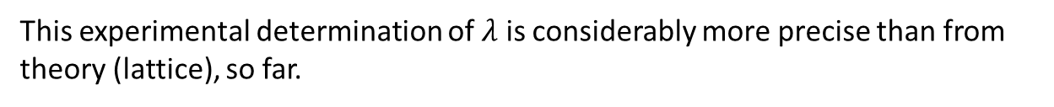
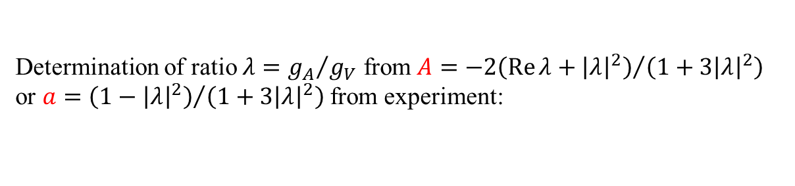



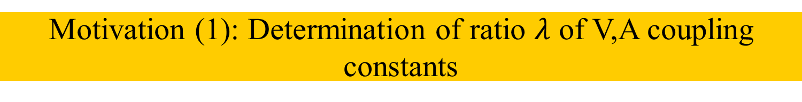

Motivation (1): Determination of ratio $λ$ of V,A coupling constants
Determination of ratio $λ={g_{A}}/{g_{V}}$ from $A={−2\left(\operatorname{Re}{λ}+{\left|λ\right|}^{2}\right)}/{\left(1+3{\left|λ\right|}^{2}\right)}$ or $a={\left(1−{\left|λ\right|}^{2}\right)}/{\left(1+3{\left|λ\right|}^{2}\right)}$ from experiment:
Ideogram of current experiments:
PERKEO III (2019)
$Δλ/λ = 0.03\%$
UCNA (2018)
(Nab goal)
aCORN (2017)
PERKEO II (2013)
$λ$ from $A$
UCNA (2013) ( )
UCNA (2010) ( )
$λ$ from $a$
Byrne (2002)
$λ$ from $A/B$
My current average:
$$λ=−1.2764(5)$$
( ) PERKEO II (2002)
Mostovoi (2001)
PERKEO II (1997) ( )
Yerozolimskii (1997)
Liaud (1997)
PERKEO I (1986)
Stratowa (1978)
-1.30
-1.28
-1.26
-1.24
$$λ = gA/gV$$
This experimental determination of $λ$ is considerably more precise than from theory (lattice), so far.

Slide 5



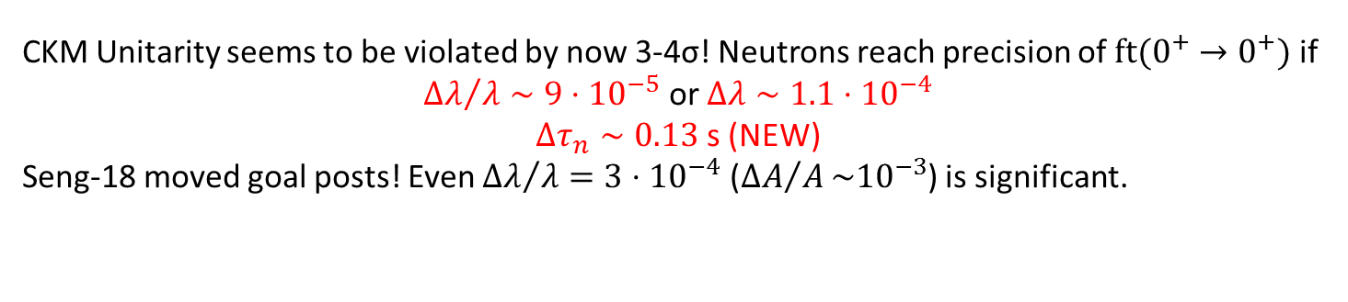



0.98
PIBETA [Pocanic04+S18]
0.975
Satula12+S18
PKO1
DD-ME2
CKM unitarity
PC-F1
PC-PK1
[PDG 2019]
0.97
[Li11+S18]
[Liang09+S18]
0.965
0.96
-1.29
-1.28
-1.27
-1.26
CKM Unitarity seems to be violated by now 3-4σ! Neutrons reach precision of $ft(0^{+}→0^{+})$ if
${Δλ}/λ∼{9⋅10}^{−5}$ or $Δλ∼1.1⋅{10}^{−4}$
$Δτ_{n}∼0.13$ s (NEW)
Seng-18 moved goal posts! Even ${Δλ}/λ=3⋅{10}^{−4}$ (${ΔA}/A\sim {10}^{−3}$) is significant.

Slide 6
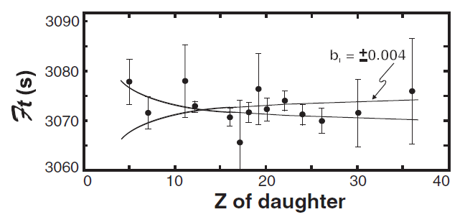
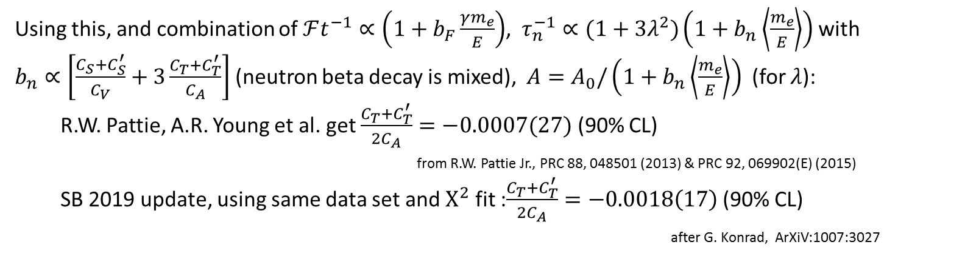
Motivation (3): Search for effective scalar (S) and tensor (T) interaction
Low-Energy search for scalar current: Determine Fierz term $b_{F}=−(C_{S}+C_{S}^{′})/C_{V}$ in superallowed Fermi decays: J. Hardy, I. Towner find $\frac{C_{S}+C_{S}^{′}}{2C_{V}}=0.0014\left(21\right)$ (90% CL)
(from J. Hardy, I. Towner, PRC 91, 025501 (2015))
Using this, and combination of $ℱt^{−1}∝\left(1+b_{F}\frac{γm_{e}}{E}\right)$, $τ_{n}^{−1}∝(1+3λ^{2})\left(1+b_{n}\left\langle \frac{m_{e}}{E}\right\rangle \right)$ with $b_{n}∝\left[\frac{C_{S}+C_{S}^{′}}{C_{V}}+3\frac{C_{T}+C_{T}^{′}}{C_{A}}\right]$ (neutron beta decay is mixed), $A=A_{0}/\left(1+b_{n}\left\langle \frac{m_{e}}{E}\right\rangle \right)$ (for $λ$):
  R.W. Pattie, A.R. Young et al. get $\frac{C_{T}+C_{T}^{′}}{2C_{A}}=−0.0007(27)$ (90% CL)
  from R.W. Pattie Jr., PRC 88, 048501 (2013) & PRC 92, 069902(E) (2015)
  SB 2019 update, using same data set and $Χ^{2}$ fit :$\frac{C_{T}+C_{T}^{′}}{2C_{A}}=−0.0018\left(17\right)$ (90% CL)
  after G. Konrad, ArXiV:1007:3027

Slide 7
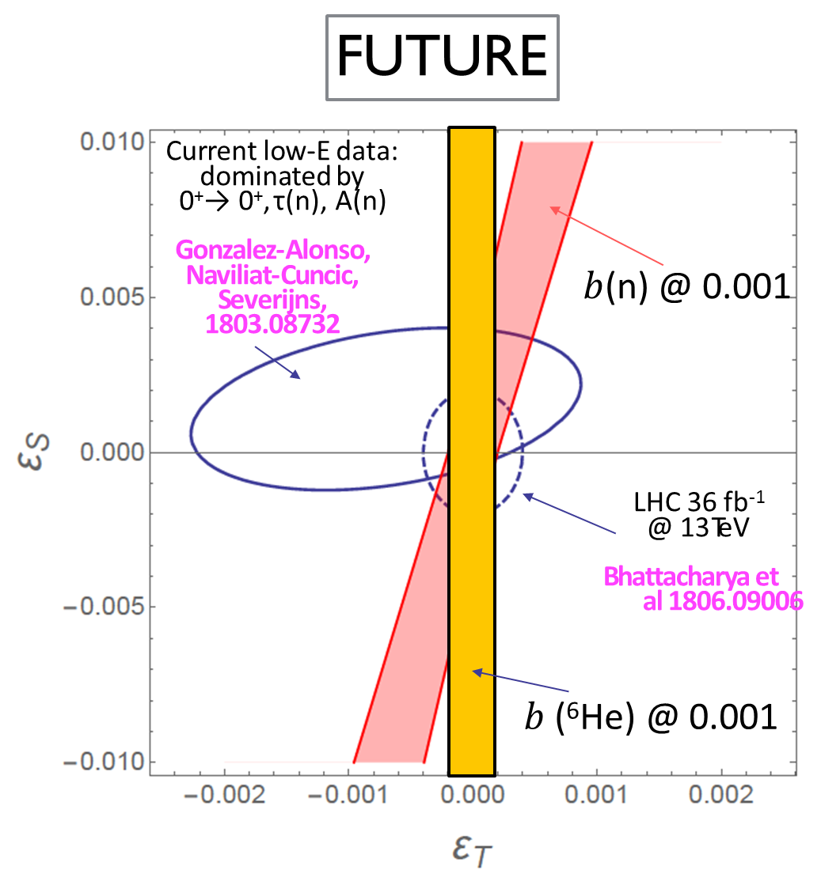
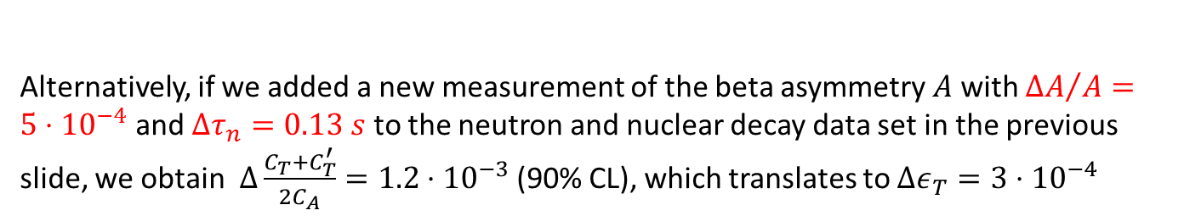
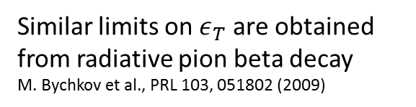
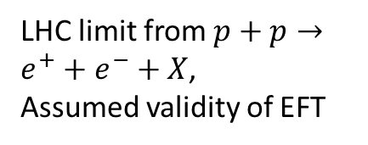
Future search for effective scalar (S) and tensor (T) interaction
Similar limits on $ε_{T}$ are obtained from radiative pion beta decay
M. Bychkov et al., PRL 103, 051802 (2009)
LHC limit from $p+p→e^{+}+e^{−}+X$,
Assumed validity of EFT
Fig. from V. Cirigliano, M. Gonzales Alonso, after PPNP 104, 165 (2019)
Search for BSM physics, may show as S,T interactions (fermions with “wrong” helicity) at low energies. Competitive if$Δb\left(n\right)∼{10}^{−3}$ or $Δb_{ν}\left(n\right)∼{10}^{−3}$
Alternatively, if we added a new measurement of the beta asymmetry $A$ with ${ΔA}/A=5⋅{10}^{−4}$ and ${Δτ}_{n}=0.13 s$ to the neutron and nuclear decay data set in the previous slide, we obtain $Δ\frac{C_{T}+C_{T}^{′}}{2C_{A}}=1.2⋅{10}^{−3}$ (90% CL), which translates to $Δε_{T}=3⋅{10}^{−4}$

Slide 8
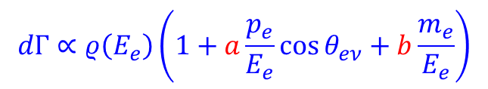

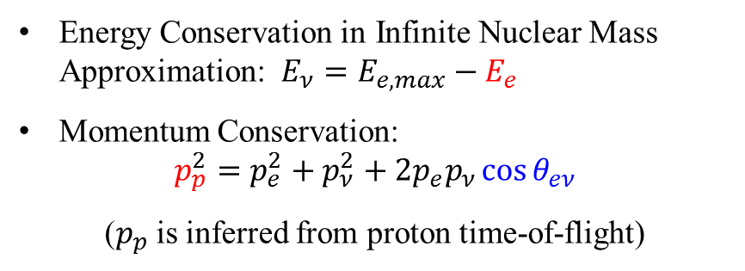
Idea of the cos θ_{eν} spectrometer Nab @ SNS
n
e⁻
Energy Conservation in Infinite Nuclear Mass Approximation: $E_{ν}=E_{e,max}−E_{e}$
Momentum Conservation:
$$p_{p}^{2}=p_{e}^{2}+p_{ν}^{2}+2p_{e}p_{ν}\cos{θ_{eν}}$$
($p_{p}$ is inferred from proton time-of-flight)
p
$$θ_{eν}$$
$$\overline{ν_{e}}$$
$$dΓ∝ρ\left(E_{e}\right)\left(1+a\frac{p_{e}}{E_{e}}\cos{θ_{eν}}+b\frac{m_{e}}{E_{e}}\right)$$
1.5
Proton phase space (Dalitz plot)
Probability (arb. units)
E_{e} =
1.25
700 keV
cos θ_{eν} = 1
236 keV
1
0.75
75 keV
p_{p}² [MeV²/c²]
0.5
cos θ_{eν} = 0
cos θ_{eν} = -1
450 keV
0.25
0
0
0.2
0.4
0.6
0.8
E_{e} [MeV]

Slide 9





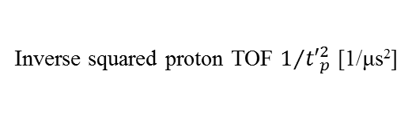

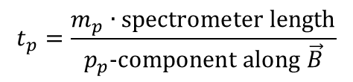



Nab data analysis
$$1+a\frac{p_{e}}{E_{e}}\cos{θ_{eν}\left({p_{p}}^{2}\right)}$$
Full GEANT4 spectrometer simulation:
p_{p}² distribution
$$\cos{θ_{eν}\left({p_{p}}^{2}\right)}=−1$$
$E_{e,kin}=150$ keV
$$\cos{θ_{eν}\left({p_{p}}^{2}\right)}=+1$$
$E_{e,kin}=300$ keV
12000
$E_{e,kin}=450$ keV
$E_{e,kin}=450$ keV
8000
Yield
0.0
0.5
1.0
1.5
4000
$E_{e,kin}=600$ keV
p_{p}² [MeV²/c²]
$E_{e,kin}=750$ keV
0
0
0.002
0.004
0.006
$$t_{p}=\frac{m_{p}∙\text{spectrometer} \text{length}}{p_{p}\text{−}\text{component} \text{along} \vec{B}}$$
Inverse squared proton TOF $1/{{t′}_{p}^{2}}$ [1/μs²]
Data analysis: Use edge to determine or verify the spectrometer TOF response function.
Then, use central part to determine slope and correlation coefficient a. Need agreement for all.

Slide 10
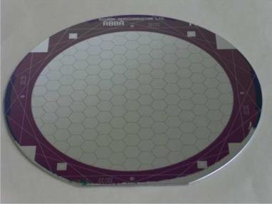
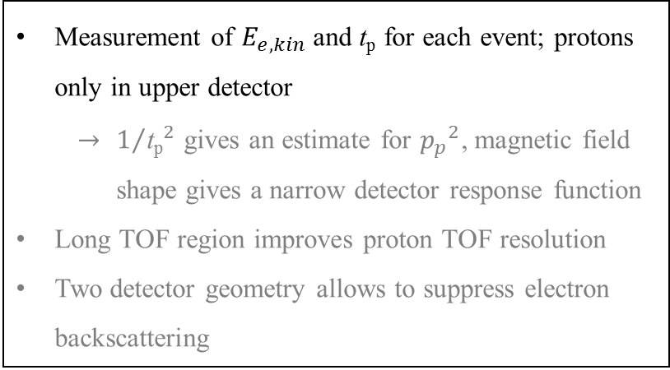
Nab spectrometer operation
- 30 kV
Segmented
Si detector
Ø 81 mm
TOF region
(low field)
4 m flight path skipped
magnetic filter
region (field maximum)
decay volume
0 kV
Measurement of $E_{e,kin}$ and $\text{t}\text{p}$ for each event; protons only in upper detector
    $1/{{\text{t}\text{p}}_{}^{2}}$ gives an estimate for ${p_{p}}^{2}$, magnetic field shape gives a narrow detector response function
Long TOF region improves proton TOF resolution
Two detector geometry allows to suppress electron backscattering
Neutron
beam
1 m flight path skipped
0-1 kV

Slide 11
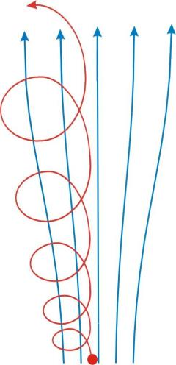

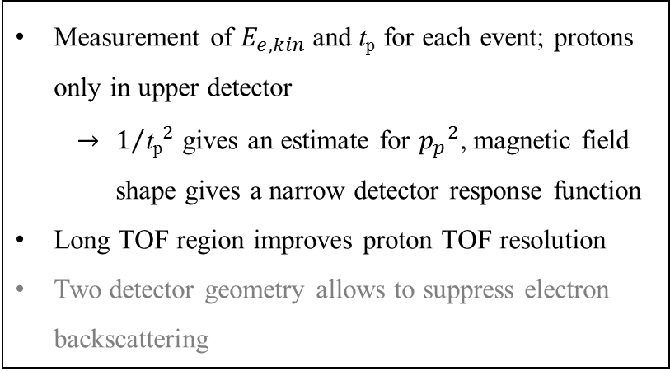



Nab spectrometer principle: measurement of E_{e} and t_{p}
- 30 kV
$$p_{∥}$$
$$p_{⊥}$$
Magnetic Field
TOF region
(low field)
Adiabatic conversion
4 m flight path skipped
magnetic filter
region (field maximum)
Proton Trajectory
$$p_{∥}$$
decay volume
$$p_{⊥}$$
0 kV
Measurement of $E_{e,kin}$ and $\text{t}\text{p}$ for each event; protons only in upper detector
    $1/{{\text{t}\text{p}}_{}^{2}}$ gives an estimate for ${p_{p}}^{2}$, magnetic field shape gives a narrow detector response function
Long TOF region improves proton TOF resolution
Two detector geometry allows to suppress electron backscattering
Neutron
beam
1 m flight path skipped
0-1 kV

Slide 12
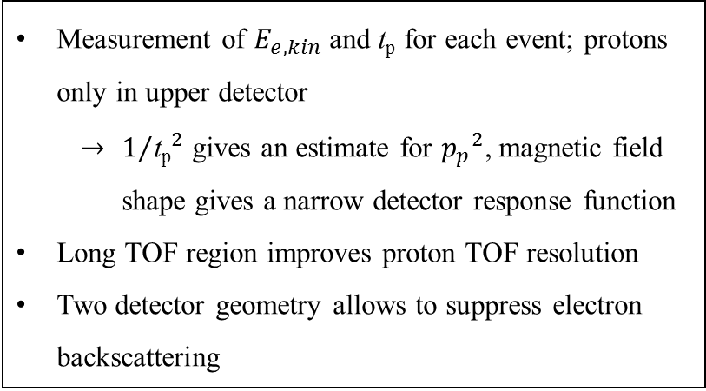
Electron energy measurement with backscattering suppression
5
- 30 kV
10
detected E_{e} for e⁻ in lower detector
4
detected E_{e} with only lower detector
10
Detector response for
incoming E_{e} = 300 keV
3
10
Yield
TOF region
(low field)
2
10
4 m flight path skipped
magnetic filter
region (field maximum)
1
10
1
decay volume
0
50
100
150
200
250
300
detected E_{e} [keV]
0 kV
Measurement of $E_{e,kin}$ and $\text{t}\text{p}$ for each event; protons only in upper detector
    $1/{{\text{t}\text{p}}_{}^{2}}$ gives an estimate for ${p_{p}}^{2}$, magnetic field shape gives a narrow detector response function
Long TOF region improves proton TOF resolution
Two detector geometry allows to suppress electron backscattering
Neutron
beam
1 m flight path skipped
0-1 kV

Slide 13
Measurement idea
Setup to measure Fierz term (Nab-b)
Lower detector detects all protons.
Upward-going protons are reflected by a 1 kV field above decay volume
- 30 kV
TOF region
(low field)
4 m flight path skipped
0 kV
magnetic filter
region (field maximum)
decay volume
TOF region
(low field)
4 m flight path skipped
0 kV
magnetic filter
region (field maximum)
Neutron
beam
1 m flight path skipped
decay volume
0-1 kV
+1 kV
Neutron
beam
Setup to measure proton asymmetry (Nab-a)
Only upper detector detects protons.
Downward-going protons are lost.
1 m flight path skipped
-30 kV

Slide 14
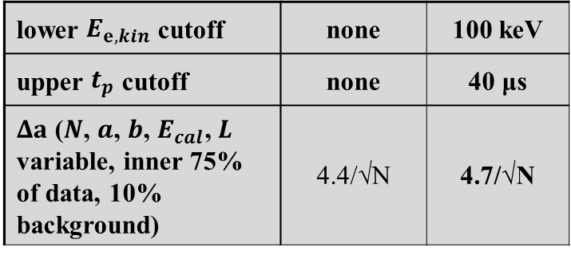
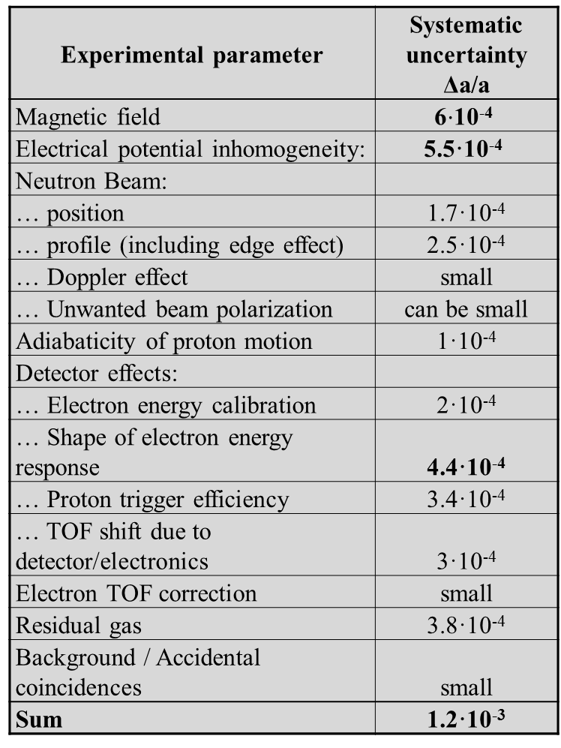
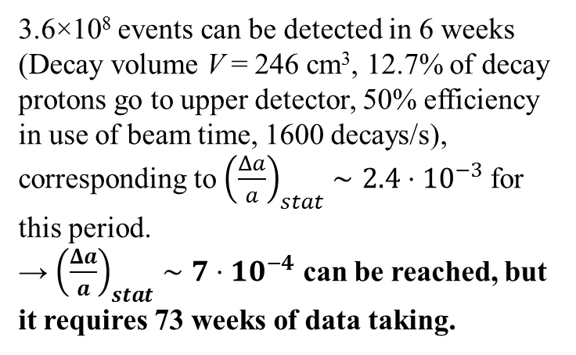
Nab goal for SNS run
Experimental parameter | Systematic uncertainty Δa/a
Magnetic field | 6$⋅$10⁻⁴
Electrical potential inhomogeneity: | 5.5·10⁻⁴
Neutron Beam:
… position | 1.7·10⁻⁴
… profile (including edge effect) | 2.5·10⁻⁴
… Doppler effect | small
… Unwanted beam polarization | can be small
Adiabaticity of proton motion | 1·10⁻⁴
Detector effects:
… Electron energy calibration | 2·10⁻⁴
… Shape of electron energy response | 4.4·10⁻⁴
… Proton trigger efficiency | 3.4·10⁻⁴
… TOF shift due to detector/electronics | 3·10⁻⁴
Electron TOF correction | small
Residual gas | 3.8·10⁻⁴
Background / Accidental coincidences | small
Sum | 1.2·10⁻³
lower $E_{e,kin}$ cutoff | none | 100 keV
upper $t_{p}$ cutoff | none | 40 μs
$Δa$ ($N$, $a$, $b$, $E_{cal}$, $L$ variable, inner 75% of data, 10% background) | 4.4/√N | 4.7/√N
3.6×10⁸ events can be detected in 6 weeks (Decay volume V = 246 cm³, 12.7% of decay protons go to upper detector, 50% efficiency in use of beam time, 1600 decays/s), corresponding to ${\left(\frac{Δa}{a}\right)}_{stat}∼2.4⋅10^{−3}$for this period.
→ ${\left(\frac{Δa}{a}\right)}_{stat}∼7⋅10^{−4}$ can be reached, but it requires 73 weeks of data taking.

Slide 15
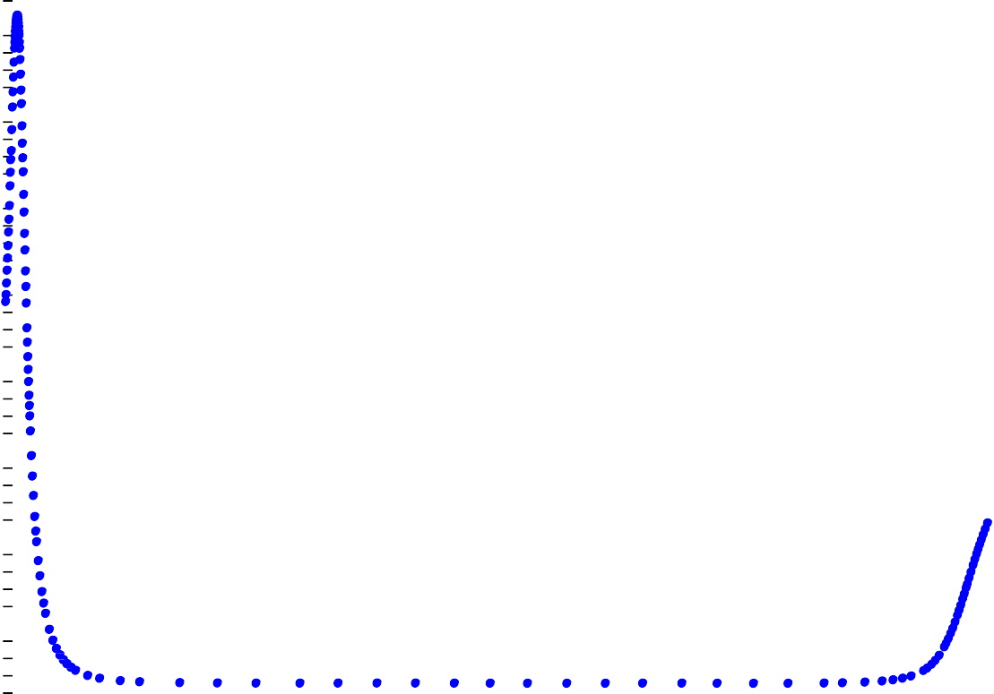
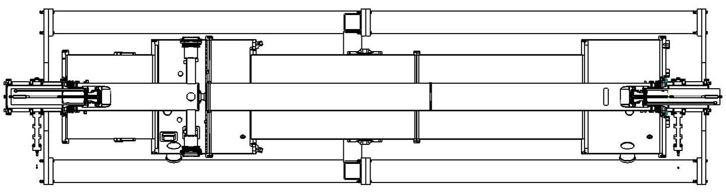












Status of Nab experiment: Magnetic field mapping
4
4
Run 484
Magnetic field on axis in filter and TOF region
3.5
3.5
Analytic Calculation
3
3
B_{z} [T]
2.5
2.5
2
B_{z} [T]
2
1.5
1.5
0.5
UPDATE
1
0
0
5
10
15
20
25
30
35
0.5
z (arb) [cm]
0
0
100
200
300
z (arb) [cm]
400
500

Slide 16
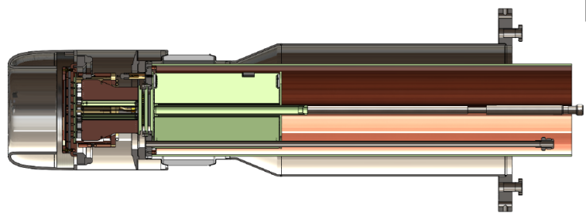
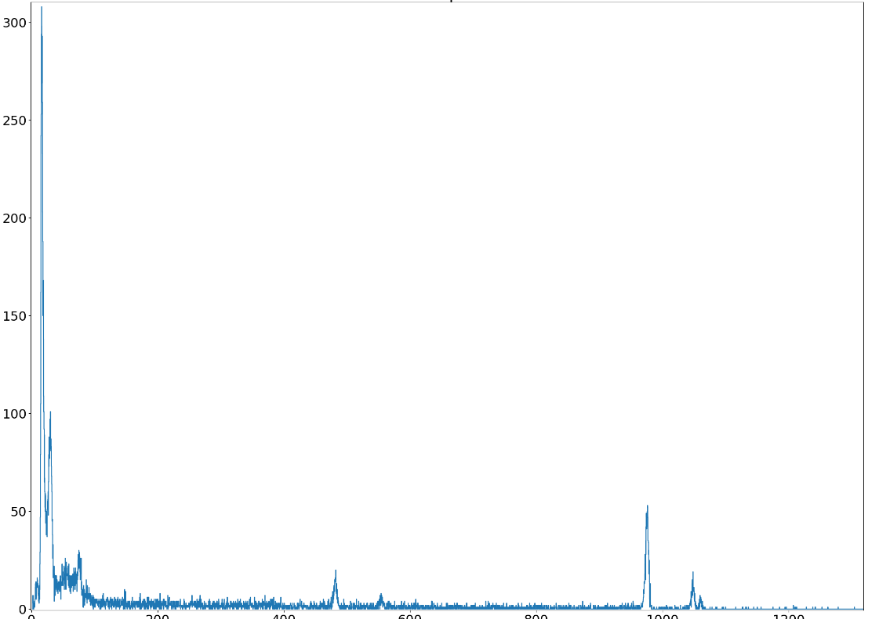
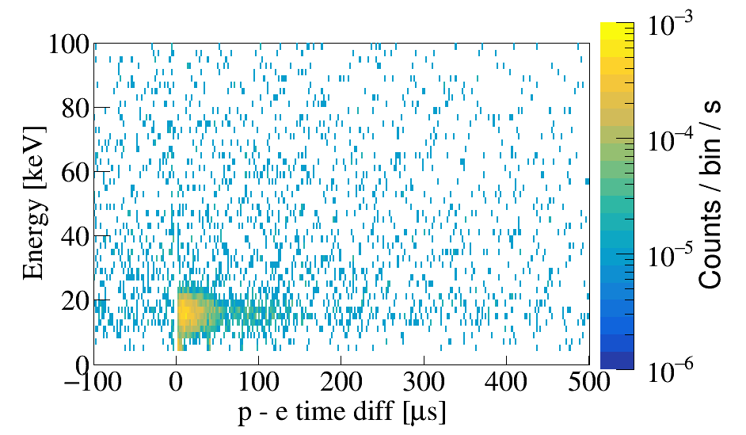

Status of Nab experiment: Detector development
Detector subsystem is primarily responsibility of LANL (M. Makela, E. Smith et al.):
Energy resolution a few keV
Lower (proton) detection threshold 10 keV
Detector transit time bias sub-ns
Silicon detector in mount
$e^{−}$, $p$
From UCNB @ LANL
Bi-207 source
protons
Yield
These are $∼10$ keV X-Rays, not noise
Signal: Electron, ~> 100 keV, followed by proton, ~18 keV, in neighboring pixel. Shown is the energy of the second signal, and its delay after the first.
200
400
Energy [keV]
1000

Slide 17




pNab: Measurement of correlation coefficients with polarized neutrons
$b$ or $b_{ν}$ may indicate S,T
$B_{0}≠B_{0}(λ)$ may indicate V+A
$$dΓ∝ρ\left(E_{e}\right)\left(1+a\frac{p_{e}}{E_{e}}\cos{({\vec{p}}_{ν},{\vec{p}}_{e})}+b\frac{m_{e}}{E_{e}}+A_{0}\frac{p_{e}}{E_{e}}\cos{({\vec{σ}}_{n},{\vec{p}}_{e})}+\left(B_{0}+b_{ν}\frac{m_{e}}{E_{e}}\right)\cos{({\vec{σ}}_{n},{\vec{p}}_{ν})}\right)$$
$$a_{0}=a_{0}\left(λ\right)$$
$$A_{0}=A_{0}\left(λ\right)$$
New addition:
Neutron beam polarizer

Slide 18
pNab: Measurement idea
Setup to measure electron asymmetry (as Nab-b):
Lower detector detects all protons.
Upward-going protons are reflected by a 1 kV field above decay volume
- 30 kV
0 kV
TOF region
(low field)
4 m flight path skipped
TOF region
(low field)
magnetic filter
region (field maximum)
4 m flight path skipped
magnetic filter
region (field maximum)
decay volume
polarizer
0 kV
decay volume
Neutron
beam
polarizer
Spin flipper
+1 kV
1 m flight path skipped
Neutron
beam
0-1 kV
Spin flipper
1 m flight path skipped
Setup to measure proton asymmetry (as Nab-a):
Only upper detector detects protons.
Downward-going protons are lost.
-30 kV

Slide 19
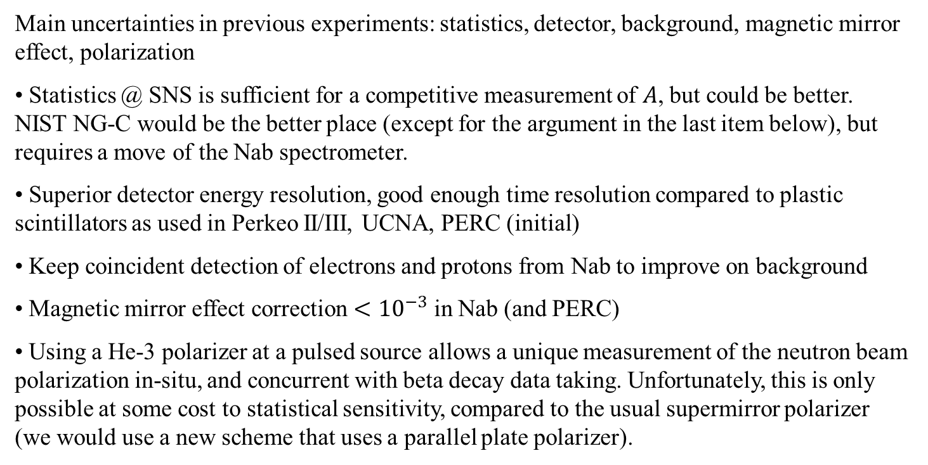
Features of measurement of beta asymmetry with pNab
Main uncertainties in previous experiments: statistics, detector, background, magnetic mirror effect, polarization
Statistics @ SNS is sufficient for a competitive measurement of $A$, but could be better. NIST NG-C would be the better place (except for the argument in the last item below), but requires a move of the Nab spectrometer.
Superior detector energy resolution, good enough time resolution compared to plastic scintillators as used in Perkeo II/III, UCNA, PERC (initial)
Keep coincident detection of electrons and protons from Nab to improve on background
Magnetic mirror effect correction $<{10}^{−3}$ in Nab (and PERC)
Using a He-3 polarizer at a pulsed source allows a unique measurement of the neutron beam polarization in-situ, and concurrent with beta decay data taking. Unfortunately, this is only possible at some cost to statistical sensitivity, compared to the usual supermirror polarizer (we would use a new scheme that uses a parallel plate polarizer).
See S. Baessler et al., JPG 41, 114003 (2014)

Slide 20
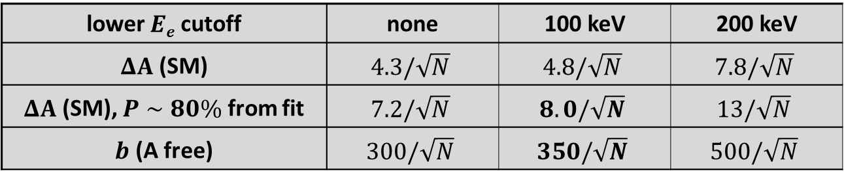
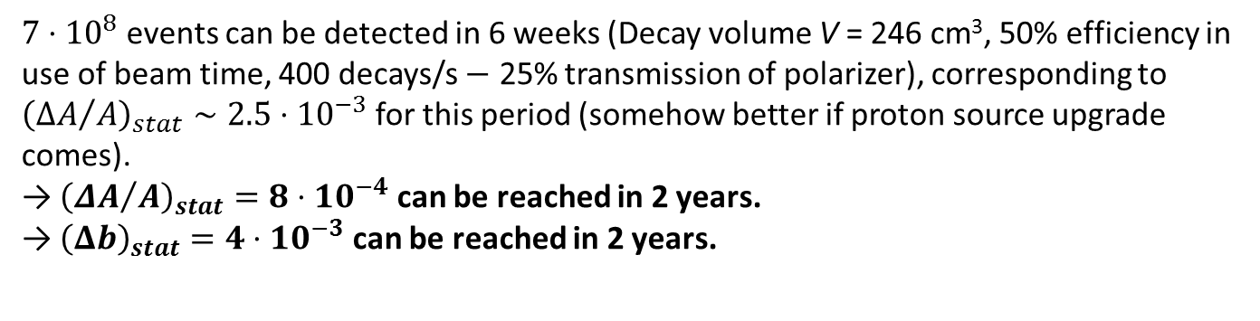
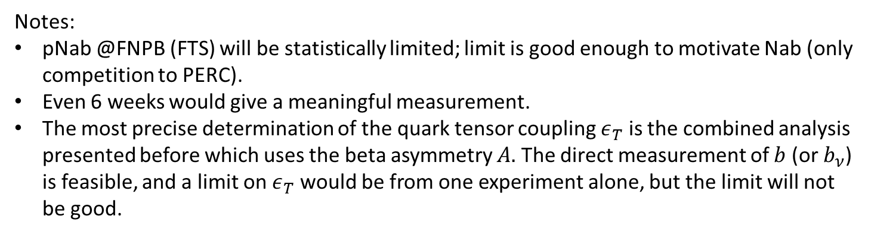
Statistical uncertainty for A and b from beta asymmetry
Statistical uncertainty budget:
lower $Ee$ cutoff | none | 100 keV | 200 keV
$ΔA$ (SM) | $$4.3/\sqrt{N}$$ | $$4.8/\sqrt{N}$$ | $$7.8/\sqrt{N}$$
$ΔA$ (SM), $P∼80\%$ from fit | $$7.2/\sqrt{N}$$ | $$8.0/\sqrt{N}$$ | $$13/\sqrt{N}$$
$b$ (A free) | $$300/\sqrt{N}$$ | $$350/\sqrt{N}$$ | $$500/\sqrt{N}$$
$7⋅{10}^{8}$ events can be detected in 6 weeks (Decay volume V = 246 cm³, 50% efficiency in use of beam time, 400 decays/s $−$ 25% transmission of polarizer), corresponding to ${\left({ΔA}/A\right)}_{stat}∼2.5⋅10^{−3}$for this period (somehow better if proton source upgrade comes).
→ ${\left({ΔA}/A\right)}_{stat}=8⋅{10}^{−4}$ can be reached in 2 years.
→ ${\left(Δb\right)}_{stat}=4⋅{10}^{−3}$ can be reached in 2 years.
Notes:
pNab @FNPB (FTS) will be statistically limited; limit is good enough to motivate Nab (only competition to PERC).
Even 6 weeks would give a meaningful measurement.
The most precise determination of the quark tensor coupling $ε_{T}$ is the combined analysis presented before which uses the beta asymmetry $A.$ The direct measurement of $b$ (or $b_{ν}$) is feasible, and a limit on $ε_{T}$ would be from one experiment alone, but the limit will not be good.

Slide 21


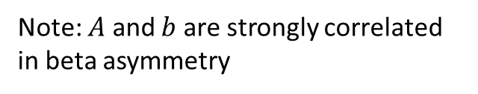


Beta spectroscopy in neutron decay
Beta asymmetry ($A_{exp}=\frac{N_{e}^{↑}\left(E_{e,kin}\right)−N_{e}^{↓}\left(E_{e,kin}\right)}{N_{e}^{↑}\left(E_{e,kin}\right)+N_{e}^{↓}\left(E_{e,kin}\right)}∝A$):
(unpolarized) beta spectrum:
]
Yield
Beta asymmetry $A_{exp}$
$$b=+0.1$$
$$b=−0.1$$
SM
SM
0
2
0
0
4
0
0
6
0
0
8
0
0
0
2
0
0
4
0
0
6
0
0
8
0
0
E
(
k
e
V
E
(
)
k
e
V
)
e
,
k
i
e
n
,
k
i
n
Note: $A$ and $b$ are strongly correlated in beta asymmetry

Slide 22

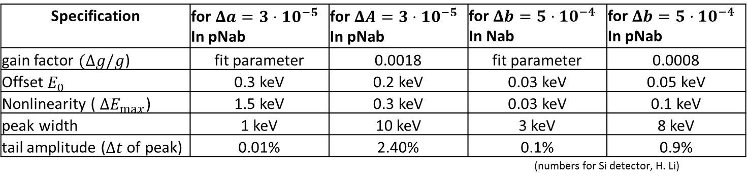



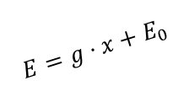

Detector systematics
Electron energy calibration
Detector response in Si detector for incoming E_{e} = 300 keV,
(Max. impact angle of electrons is ${12}^{∘}$, due to magnetic filter)
5
²⁰⁷Bi
10
detected E_{e} for e⁻ in lower detector
$$E=g⋅x+E_{0}$$
4
detected E_{e} with only lower detector
10
width
Reconstructed energy
¹⁰⁹Cd
²⁰⁷Bi
3
¹¹³Sn
10
¹³⁹Ce
Yield
2
Pulse height
10
(mostly)backscattering
1
Tail amplitude $t$
$$ΔE_{max}$$
10
$$0$$
Residual
(mostly) bremsstrahlung
$$ΔE_{max}$$
1
0
50
100
150
200
250
300
Pulse height
detected E_{e} [keV]
Specification | for $Δa=3⋅10^{−5}$ In pNab | for $ΔA=3⋅10^{−5}$ In pNab | for $Δb=5⋅10^{−4}$ In Nab | for $Δb=5⋅10^{−4}$ In pNab
gain factor $(Δg/g$) | fit parameter | 0.0018 | fit parameter | 0.0008
Offset $E_{0}$ | 0.3 keV | 0.2 keV | 0.03 keV | 0.05 keV
Nonlinearity ( $ΔE_{max}$) | 1.5 keV | 0.3 keV | 0.03 keV | 0.1 keV
peak width | 1 keV | 10 keV | 3 keV | 8 keV
tail amplitude ($Δt$ of peak) | 0.01% | 2.40% | 0.1% | 0.9%
 |  |  | (numbers for Si detector, H. Li)
Requirements in pNab equal or less than what Nab requires!

Slide 23

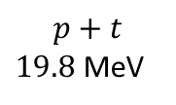






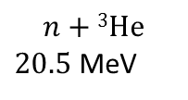
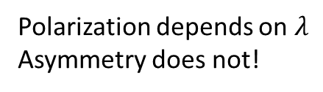
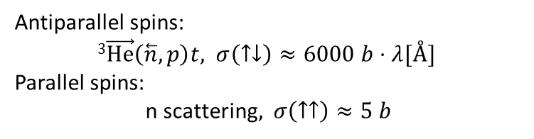
Neutron beam polarization
If pNab is operated at NIST, we would use a He3 polarizer, due to the feature to obtain an in-situ measurement of the polarization. No correction for Stern-Gerlach effects, no depolarization error, no time dependence.
This is at the cost of some stat. sensitivity (see before).
$$n+\text{3}\text{He}$$
$20.5$ MeV
$\text{4}\text{He}\text{*}$ ($J=0$)
$20.1$ MeV
$Γ=270$ keV
$$p+t$$
$19.8$ MeV
Neutron TOF $∝λ$
$\text{4}\text{He}$ ($J=0$)
Antiparallel spins:
$\text{3}\vec{\text{H}\text{e}}\left(\overset{⃖}{n}, p\right)t,$ $σ\left(↑↓\right)≈6000 b⋅λ[Å]$
Parallel spins:
n scattering$,$ $σ\left(↑↑\right)≈5 b$
Polarization depends on $λ$
Asymmetry does not!
3He cell
Unpolarized neutron
beam
Polarized neutron
beam
$$⇑⇓$$
$$⇑$$
$$⇑$$
$$P_{n}=\tanh\left(0.0733⋅p\left[atm\right]⋅l\left[cm\right]⋅λ\left[Å\right]⋅P_{He}\right)$$
Neutron TOF $∝λ$
See S. Penntila, D. Bowman, J Res. NIST 110, 309 (2005)

Slide 24
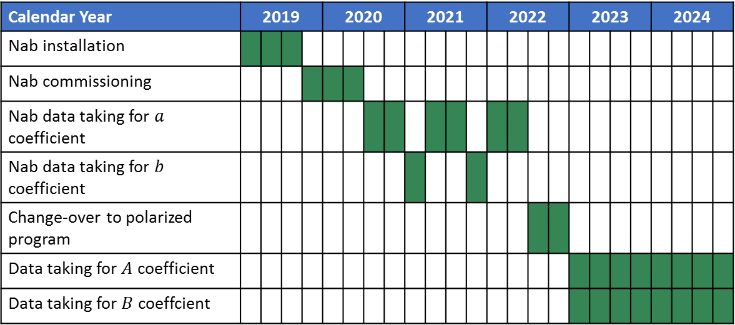
Nab schedule and potential pNab schedule
Calendar Year | 2019 |  |  |  | 2020 |  |  |  | 2021 |  |  |  | 2022 |  |  |  | 2023 |  |  |  | 2024
Nab installation
Nab commissioning
Nab data taking for $a$ coefficient
Nab data taking for $b$ coefficient
Change-over to polarized program
Data taking for $A$ coefficient
Data taking for $B$ coeffcient
At FNPB, or at new NG-C beamline at NIST
Somewhere here, we may have a 8 months shutdown
Problem: Schedule for pNab@FTS conflicts with EDM installation. Scenarios:
With an additional 12 weeks, we could do a measurement with accuracy like PERKEO III, statistically limited
nEDM moves elsewhere (e.g., STS)
pNab moves elsewhere

Slide 25



The Nab collaboration
Active and recent collaborators:
R. Alarconª, A. Atencio^{k}, S.Baeßler^{b,c} (Project Manager), S. Balascutaª, L. Barrón Palos^{n}, T.L. Bailey^{m}, K. Bass^{i}, N. Birge^{i}, A. Blose^{f}, D. Borissenko^{b}, J.D. Bowman^{c} (Co-Spokesperson), L. Broussard^{c}, A.T. Bryant^{b}, J. Byrne^{d}, J.R. Calarco^{c,i}, J. Caylor^{i}, K. Chang^{b}, T. Chuppº, T.V. Cianciolo^{c}, C. Crawford^{f}, M. Cruz^{i}, X. Ding^{b}, W. Fan^{b}, W. Farrar^{b}, N. Fomin^{i}, E. Frlež^{b}, J. Fry^{b}, M.T. Gericke^{g}, M. Gervais^{f}, F. Glück^{h}, G.L. Greene^{c,i}, R.K. Grzywacz^{i}, V. Gudkov^{j}, J. Hamblen^{e}, C. Hayes^{m}, C. Hendrusº, T. Ito^{k}, A. Jezghani^{f}, H. Li^{b}, M. Makela^{k}, N. Macsai^{g}, J. Mammei^{g}, R. Mammei^{l}, M. Martinezª, D.G. Matthews^{f}, M. McCrea^{f}, P. McGaughey^{k}, C.D. McLaughlin^{b}, P. Mueller^{c}, D. van Petten^{b}, S.I. Penttilä^{c} (On-site Manager), D.E. Perryman^{i}, R. Picker^{p}, J. Pierce^{c}, D. Počanić^{b} (Co-Spokesperson), H. Presley^{i} , Yu Qian^{b}, G. Randallª, G. Riley^{i}, K.P. Rykaczewski^{c}, A. Salas-Bacci^{b}, S. Samiei^{b}, E.M. Scott^{i}, T. Shelton^{f}, S.K. Sjue^{k}, A. Smith^{b}, E. Smith^{k}, E. Stevens^{b}, J.W. Wexler^{m}, R. Whitehead^{i}, W.S. Wilburn^{k}, A.R. Young^{m}, B.Zeck^{m}, M. Zemke^{i}
ª Department of Physics, Arizona State University, Tempe, AZ 85287-1504 ^{b} Department of Physics, University of Virginia, Charlottesville, VA 22904-4714 ^{c} Physics Division, Oak Ridge National Laboratory, Oak Ridge, TN 37831 ^{d} Department of Physics and Astronomy, University of Sussex, Brighton BN19RH, UK ^{e} Department of Chemistry and Physics, University of Tennessee at Chattanooga, Chattanooga, TN 37403 ^{f} Department of Physics and Astronomy, University of Kentucky, Lexington, KY 40506 ^{g} Department of Physics, University of Manitoba, Winnipeg, Manitoba, R3T 2N2, Canada ^{h} KIT, Universität Karlsruhe (TH), Kaiserstraße 12, 76131 Karlsruhe, Germany | ^{i} Department of Physics and Astronomy, University of Tennessee, Knoxville, TN 37996 ^{j} Department of Physics and Astronomy, University of South Carolina, Columbia, SC 29208 ^{k} Los Alamos National Laboratory, Los Alamos, NM 87545 ^{l} Department of Physics, University of Winnipeg, Winnipeg, Manitoba R3B2E9, Canada ^{m} Department of Physics, North Carolina State University, Raleigh, NC 27695-8202 ^{n} Universidad Nacional Autónoma de México, México, D.F. 04510, México º University of Michigan, Ann Arbor, MI 48109 ^{p} TRIUMF, Vancouver, Canada, V6T 2A3
Main project funding:

Slide 26
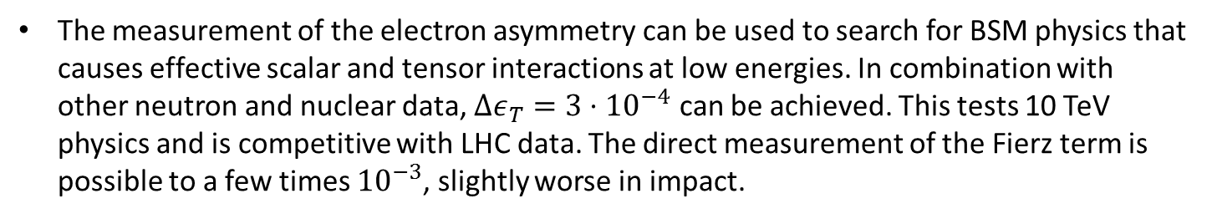
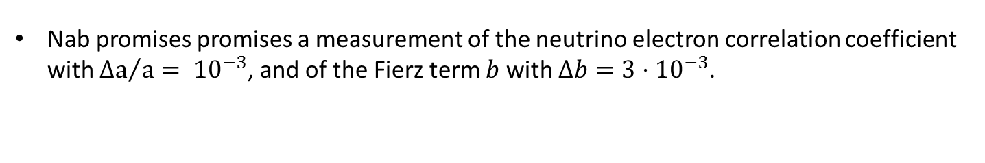



Summary
Nab promises promises a measurement of the neutrino electron correlation coefficient with ${Δa}/a= {10}^{−3}$, and of the Fierz term $b$ with $Δb=3⋅{10}^{−3}$.
pNab promises a measurement of the beta asymmetry to substantially better than ${ΔA}/A= {10}^{−3}$, competitive with other current experiments. If nothing else changes, pNab conflicts with EDM installation.
Nab and pNab measurements allow to study the Unitarity of the CKM matrix, which seems to be violated by about $3σ$ since a new calculation of the inner radiative correction. Is the Standard Model finally breaking?
pNab promises to measure the proton asymmetry, too, which has not been discussed. Of particular interest is the planned determination of $b_{ν}$ with $Δb_{ν}=3⋅{10}^{−3}$, probably through taking the systematically cleaner ratio of electron and proton asymmetry.
The measurement of the electron asymmetry can be used to search for BSM physics that causes effective scalar and tensor interactions at low energies. In combination with other neutron and nuclear data, $Δε_{T}=3⋅{10}^{−4}$ can be achieved. This tests 10 TeV physics and is competitive with LHC data. The direct measurement of the Fierz term is possible to a few times ${10}^{−3}$, slightly worse in impact.

Slide 28
Parallel plate polarizer
Goal: Achieve >99.5% polarization at maximum transmission
Proposed solution: Build short stack of thin substrates (quartz or sapphire) with double-sided SM coating. Neutrons go through substrate! Use perfect parallel plate polarizer, and select dimensions such that neutrons undergo two reflections. (A.K. Petukhov et al., arXiV:1906.04690)
SM is stack from sapphire plates:
Sapphire 180 um
Two stacks are needed for incoming beam with divergence, otherwise there would be neutrons parallel to the plates. Both stacks need to be in strong and uniform static magnetic field to avoid depolarization (see C. Klauser et al., NIM A840, 181 (2016) )

Slide 29


Parallel plate polarizer (2)
Present best geometry gives us $P=99.5\%$ and $T=25.6\%$ in our decay volume (Lingnan Shen, UVa). Length of each stack is about 3 cm, thickness of plates is 180 $μ$m, angle between two stacks is about 0.6 deg. Assume measured reflectivity curves and measured extinction curves from A. Pethoukov et al., NIM A 838, 33 (2016) and arXiV:1906.04690, neglect depolarization.
To put the in perspective: Typically, one can achieve
$P=98.5\%$ and $T=25\%$ with single SM
$P=99.7\%$ and $T=10\%$ with XSM (Kreuz et al, 2005)
He3 is preferred at SNS or systematic reasons. Seppo/David $P∼80\%$ and $T∼28\%$.
Polarized beam at output of polarizer is not bent, and has very little displacement. One can interchange between polarized and unpolarized beam.
We do not have to move the magnet to change from Nab to pNab.
Largest loss mechanism in conventional SM or XSM setup is that neutrons that hit the substrate are lost. Here, they are not, except for the manageable effect of absorption.
Status: ILL team verified properties with small stack and small beam. I have not seen the data. Full polarizer @ILL in production. FNPB beam has larger divergence than PF1B, and therefore our problem is a bit less favorable. We are in the design optimization stage. Expected costs: ~$100k, mostly for SM coatings.

