Slide 1



5d ions Revealed as Key Ingredient in Creating Record
Spin-phonon Coupling
Scientific Achievement
NaOsO₃ is found to host a spin-phonon transition with the largest ever measured phonon shift of 40cm⁻¹.
Significance and Impact
Enhanced coupling of material properties offers new fundamental insights and routes to multifunctional devices. In this context, 5d oxides provide new paradigms of cooperative interactions that drive novel emergent behavior. Using inelastic neutron scattering to access the collective excitations, we uncovered the largest ever recorded phonon shift at a spin-phonon transition. In combination with detailed theory the extended Os-O orbital overlap is found to be the mechanism driving the giant coupling. The results offer new routes to design materials with enhanced coupling, with 5d ions a key ingredient.
Research Details
  Record phonon shift measured with neutrons.
  Neutrons used to rule out a structural change.
  Theoretical calculations at ORNL uncovered the phonons and mechanism for enhanced magnitude.
a-b Inelastic neutron scattering reveals a record phonon shift of 40cm⁻¹ coupled to the magnetic and metal-insulator transition in NaOsO₃. c Density functional theory calculations reproduces the results and reveals the modes responsible as all involving Os-O distortions, shown in d. The intrinsically extended Os-O orbital overlap allows magnetism to couple to the modes on an unprecedented scale and results in the record phonon shift.
S. Calder, J. H. Lee, M. B. Stone, M. D. Lumsden, J. C. Lang, M. Feygenson, Z. Zhao, J.-Q. Yan, Y. G. Shi, Y. S. Sun, Y. Tsujimoto, K. Yamaura, A. D. Christianson, Nature Communications. 6 (2015): 8916.
  This work was performed at the ORNL Spallation Neutron Source’s NOMAD and ARCS instruments, a DOE User Facility.
Notes:
Calder S., Lee J.H., Stone M.B., Lumsden M.D., Lang J.C., Feygenson M., Zhao Z.Y., Yan J.Q., Shi Y.G., Sun Y.S., Tsujimoto Y., Yamaura K., Christianson A.D., "Enhanced spin-phonon-electronic coupling in a 5d oxide", Nature Communications, 6, 8916 (2015).
The research conducted at ORNL's Spallation Neutron Source was sponsored by the Scientific User Facilities Division, Office of Basic Energy Sciences, US Department of Energy. Part of the research at ORNL was sponsored by the Scientific User Facilities Division and Materials Sciences and Engineering Division. This work was performed at the ORNL Spallation Neutron Source’s NOMAD and ARCS instruments.

Slide 2
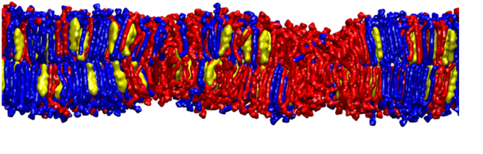
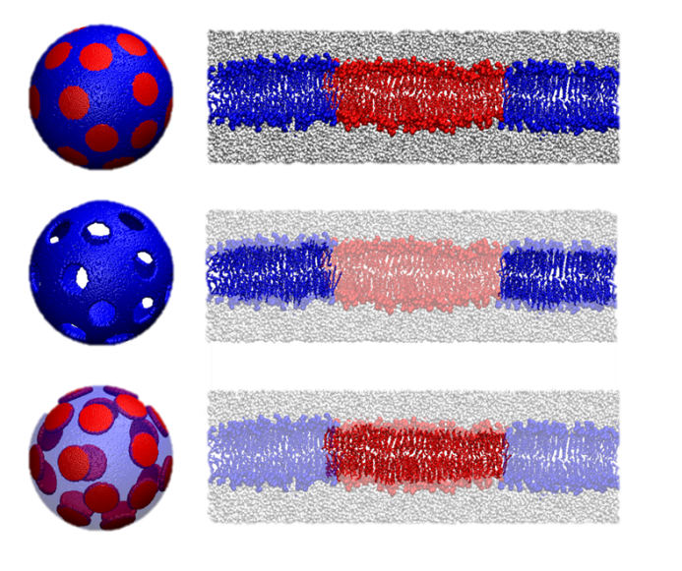
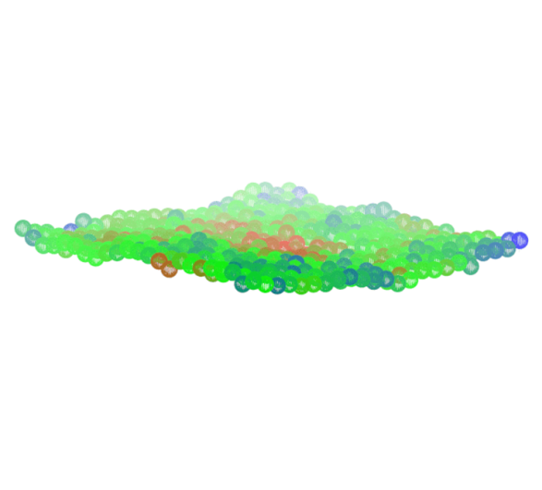

Neutrons Show Mechanical
Properties of Nanoscale Lipid Domains
Scientific Achievement
  Lipid domains are thought to play a major role in organizing biological membranes. Using small angle neutron scattering, neutron spin echo, and all-atom molecular dynamics (MD) simulations, the research team determined, for the first time, the structure and mechanical properties of approximately 13 nm domains populating 60 nm diameter vesicles.
Significance and Impact
  This work shows that the bending modulus of nanoscopic domains is not affected by the mechanical properties of the surrounding bilayer. This result informs new and existing models of lipid phase behavior and bilayer organization. Potential impacts of this research range from a better understanding of how cells regulate protein function to how viruses infiltrate healthy cells.
Research Details
Structural studies made use of both the Extended Q-range Small Angle Neutron Scattering (EQ-SANS) and Nanoscle-Ordered Materials Diffractometer (NOMAD) instruments.
Measurements used to determine the bending modulus of nanoscopic domains were carried out on the Neutron Spin Echo (NSE) instrument.
Atomistic MD simulations were performed on the Titan supercomputer.
Normal Bilayer Nanodomain Normal Bilayer
Schematic of a lipid bilayer containing a nanoscopic domain (lipid raft).
Schematic of neutron contrast achieved through specific deuteration of biomolecules. This scheme enables scattering only from the “contrast enhanced” bilayer regions.
The dynamics from the “contrast enhanced” bilayers reveal their local mechanical properties.
  J. D. Nickels, X. Cheng, B. Mostofian, C. Stanley, B. Lindner, F. A. Heberle, S. Perticaroli, M. Feygenson, T. Egami, R. Standaert, J. C. Smith, D. A. A. Myles, M. Ohl, and J. Katsaras, JACS. 137 (2015): 15772–15780.
This work was performed at both ORNL’s Spallation Neutron Source and the Oak Ridge Leadership Computing Facility, DOE User Facilities.
Notes:
J. D. Nickels, X. Cheng, B. Mostofian, C. Stanley, B. Lindner, F. A. Heberle, S. Perticaroli, M. Feygenson, T. Egami, R. Standaert, J. C. Smith, D. A. A. Myles, M. Ohl, J. Katsaras. “Mechanical Properties of Nanoscopic Lipid Domains.” JACS. (2015).
J. Am. Chem. Soc., 2015, 137 (50), pp 15772–15780
DOI: 10.1021/jacs.5b08894
http://pubs.acs.org/doi/10.1021/jacs.5b08894

Slide 3


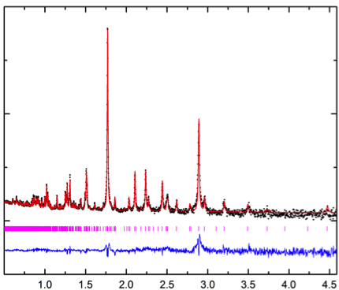


Neutrons at SNS Reveal the Specific Site That is the
Major Contributor to Conductivity in Ga₂In₆Sn₂O₁₆
Scientific Achievement
Neutron diffraction was used to determine the site-specific substitution in the Ga₂In₆Sn_{2-x}M_{x}O₁₆ (M = Ti, Zr, or Hf) solid solutions and correlate this site with trends in the desirable conductivity of the parent material.
Significance and Impact
The 7-coordinate site in Ga₂In₆Sn₂O₁₆ is the origin of the majority of its conductivity, unlike most n-type transparent conducting oxides (TCOs), which rely exclusively on 6-coordinate sites. This structure-property relationship has suggested a new direction for engineering new TCOs, which are used as transparent electrodes for renewable energy production, like in solar cells, and for advanced electronic devices, like flat panel displays and touch screens.
Research Details
Ga₂In₆Sn₂O₁₆ has a complex crystal structure with 4 different coordination environments.
The majority of sites are partially occupied by In, Sn, and Zr or Hf, which have extremely similar X-ray scattering powers.
Joint refinements of neutron and X-ray diffraction patterns demonstrated substitution prefers the 7-coordinate site and this finding was confirmed with DFT calculations.
1.0 1.5 2.0 2.5 3.0 3.5 4.0 4.5
Rietveld refinements of POWGEN neutron diffraction data of Ga₂In₆Sn_{2-x}M_{x}O₁₆ show that the 7-coordinate site is the preferred substitution site. The d⁰ orbitals of Ti, Zr, and Hf are able to form covalent “necks” on this site that Sn’s d¹⁰ orbitals cannot, which decreases the conductivity. The 7-coordinate site is occupied by Sn, In, and M (for x < 0.32), which means that neutron diffractions is the best choice for accurate site occupancy determination.
  Work was performed at the ORNL Spallation Neutron Source’s POWGEN, which is a DOE Office of Science User Facility.
K. Rickert, A. Huq, S.H. Lapidus, A. Wustrow, D.E. Ellis, and K.R. Poeppelmeier. Chem. Mater. 27 (2015) 8084-8093.
Notes:
Rickert, K.; Huq, A.; Lapidus, S. H.; Wustrow, A.; Ellis, D. E.; Poeppelmeier, K. R. Site Dependency of the High Conductivity of Ga₂In₆Sn₂O₁₆: The Role of the 7-Coordinate Site. Chem. Mater. 2015, 27, 8084-8093, DOI: 10.1021/acs.chemmater.5b03790
Work was performed at the ORNL Spallation Neutron Source’s POWGEN, which is a DOE Office of Science User Facility.

Slide 4



Neutrons Provide Insight into the Structure of
Cellulose Synthase Complex for Potential Biofuel Applications
Scientific Achievement
Researchers at ORNL have solved a low resolution structure of the CESA catalytic domain of the cellulose synthase complex (CSC), the enzyme responsible for synthesis of cellulose, a major structural component of plant cell walls. Neutron and X-ray scattering together with computational techniques provide the first experimental evidence to reveal self-assembly of CESA into a stable trimer in solution.
Significance and Impact
This study advances our knowledge of the structure and function of the plant CSC, and supports a ‘hexamer of trimers’ model of a CSC that synthesizes an 18-chain cellulose microfibril as its fundamental product, which could resolve long-standing debates over the definitive structure of cellulose in plant cell walls.
Research Details
  The conformations of monomeric and trimeric recombinant proteins (from the catalytic domain of Arabidopsis CESA1, CatD) were studied using small-angle neutron scattering (SANS) and X-ray scattering (SAXS).
  A series of CatD trimer computational models were compared with the SAXS trimer profile to explore possible arrangement of the monomers in the trimers.
  Candidate trimers were identified with monomers oriented such that the newly synthesized cellulose chains project towards the cell membrane.
Left: SANS and SAXS profiles of CatD monomers and trimers. Right: Plant Physiology cover art showing CSC. Ab initio models of catalytic domain of CESA calculated from scattering data are represented by semi-transparent grey surface envelopes, superimposed with the computational atomic models in orange.
This work was performed at the ORNL Spallation Neutron Source EQ-SANS and High Flux Isotope Reactor Bio-SANS instruments, and the Brookhaven National Lab NSLS X9 beam line, DOE User Facilities. Supported by the ORNL LDRD program and the Center for Lignocellulose Structure and Formation, a DOE BES EFRC.
  V.G. Vandavasi, D.K. Putnam, Q. Zhang, L. Petridis, W.T. Heller, B.T. Nixon, C.H. Haigler, U. Kalluri, L. Coates, P. Langan, J. Smith, J. Meiler, and H.M. O’Neill. Plant Physiology. 170.1 (2016): 123–135.
Notes:
Vandavasi V., Putnam D.K., Zhang Q., Petridis L., Heller W.T., Nixon B.T., Haigler C.H., Kalluri U., Coates L., Langan P., Smith J., Meiler J., O’Neill H.M., "A Structural Study of CESA1 Catalytic Domain of Arabidopsis Cellulose Synthesis Complex: Evidence for CESA Trimers", Plant Physiology, 170, 1, 123-135 (2016).
http://www.plantphysiol.org/content/170/1/123.full
This work was performed at the ORNL Spallation Neutron Source EQ-SANS and High Flux Isotope Reactor Bio-SANS instruments, and the Brookhaven National Lab NSLS X9 beam line, DOE User Facilities. Supported by the ORNL LDRD program and the Center for Lignocellulose Structure and Formation, a DOE BES EFRC.
Researchers at ORNL have solved the complex structure of cellulose, a great potential source of renewable energy, using neutron and X-ray scattering. This is the first experimental evidence showing how many proteins are in the cellulose complex, providing fundamental information needed to create better sources of biofuels.
Extended image caption: Cellulose is the major structural component of plant cell walls and has great potential as a renewable source of energy. The plant cellulose synthesis complex (CSC), also called a ‘rosette’ because of its hexameric appearance in transmission electron microscope (TEM) images, is a large multi-subunit transmembrane protein complex responsible for synthesis of cellulose chains and their assembly into microfibrils. Despite the importance of cellulose, fundamental properties of the CSC remain unclear. The number of cellulose synthase (CESA) proteins in the CSC and the number of cellulose chains in a microfibril have been debated for years. Vandavasi et al report a solution structure of the catalytic domain of CESA1 from Arabidopsis thaliana determined by small-angle scattering that provides experimental evidence for the self-assembly of CESA into a stable trimer. This study strongly supports the ‘hexamer of trimers’ model for the rosette CSC that synthesizes an 18-chain cellulose microfibril as its primary product. The cover shows ab initio structures of CESA trimers calculated from small-angle scattering data represented by semi-transparent grey surface envelopes, superposed with the computational atomic models in orange. The trimer models are arranged in a hexameric configuration consistent with the rosette shape observed in TEM images. The view is from the cytosolic side of the membrane. Cellulose microfibrils are visible in the apoplastic space.

Slide 5
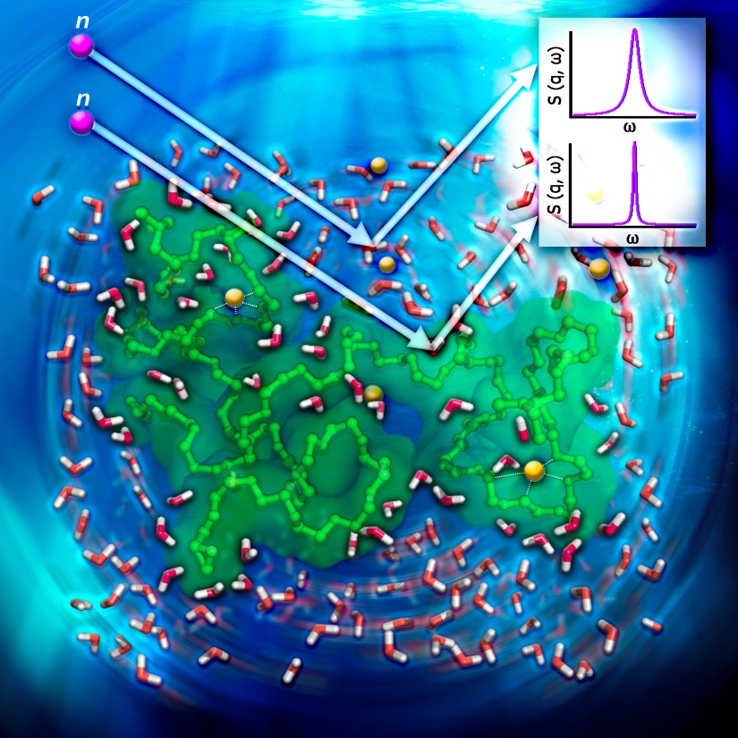
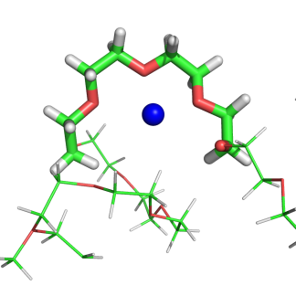
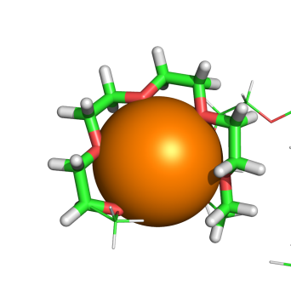
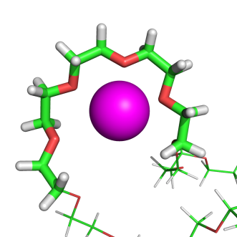

New Insight Into the Dynamics of Water: in Association with PEO Cages for Ions
Scientific Achievement
Two different dynamic scales of water diffusion representing interfacial water and bulk water dynamics have been experimentally identified. In addition, molecular dynamic (MD) simulations revealed that larger ions stay in the cages longer due to the limited space in the cage, preventing water to come in and break the interaction between the ion and polyethylene oxide (PEO).
Significance and Impact
The caging process is playing an important role in solid polymer electrolyte batteries. Therefore, understanding the correlation between the structure and dynamics of cages and the transportation of ions will provide transformative insights into designing next generation ion batteries.
Research Details
  The quasi-elastic neutron scattering (QENS) experiments were performed at T=300K. The instrument resolution was measured at T=28K. The energy transfer range was selected as ±115μeV. And the selected q range is from 0.3 to 1.1 Å⁻¹ with the interval of 0.2Å⁻¹.
  The molecular dynamics simulation was run at T = 300K for 5 ns. The dynamic factor was calculated with the same q range as in the experiments.
Li⁺
Na⁺
K⁺
A representative snapshot of PEO with various salts in aqueous solution, measuring dynamics of water molecules. MD simulation snapshots show cage formations around various ions.
  Work was performed using the ORNL Spallation Neutron Source’s BASIS instrument, which is a DOE Office of Science User Facility.
Z. Zhang, M. Ohl, S. Diallo, N. Jalarvo, K. Hong, Y. Han, G. Smith, and C. Do, Physical Review Letters. 115 (2015): 198301.
Notes:
Zhang Z, Ohl M, Diallo S, Jalarvo N, Hong K, Han Y, Smith G, Do C, “Dynamics of Water Associated with Lithium Ions Distributed in Polyethylene Oxide” Phys. Rev. Lett. 115, 198301 (2015)
http://journals.aps.org/prl/abstract/10.1103/PhysRevLett.115.198301
Work was performed using the ORNL Spallation Neutron Source’s BASIS instrument, which is a DOE Office of Science user facility.

Slide 6

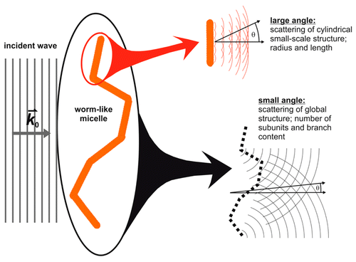
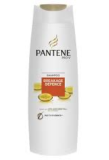
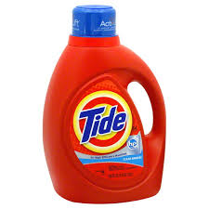


Understanding Branched Worm-like
Micelles Using Neutron Scattering
Scientific Achievement
A model to understand the structure of branched worm-like micelles has been developed.
Significance and Impact
Surfactant molecules, which are the major components for liquid soaps and shampoos, form branched worm-like micelles. The structure of this branched worm-like micelles determines the viscoelastic behavior of the product (how they feel, how they pour out of the bottle, how long they can be stored and etc.) and, therefore, are of tremendous commercial interest. The developed model will provide quantitative structural information that can be connected to these physical properties in future research.
Research Details
  Extracted quantified parameters are consistent with independent measures of viscosity on same system.
  A more detailed approach to account for more complex morphology of micelles is underway.
Complex micellar systems make up the chassis of many consumer products and affect many performance properties including consumer delight. A new SANS analysis model allows fitting SANS data to understand both branching structure (large length scale) and worm-like micelle structure (small length scale).
K. Vogtt; G. Beaucage, M. Weaver, and H. Jiang. Langmuir, 31 (2015) 8228-8234.
  This work was performed using the ORNL High Flux Isotope Reactor’s Bio-SANS instrument and the Spallation Neutron Source’s EQ-SANS instrument, DOE User Facilities.
Notes:
K. Vogtt; G. Beaucage, M. Weaver, and H. Jiang. “Scattering function for branched worm-like chains.” Langmuir, 31 (2015) 8228-8234.
http://pubs.acs.org/doi/abs/10.1021/acs.langmuir.5b01630
This work was performed using the ORNL High Flux Isotope Reactor’s Bio-SANS instrument and the Spallation Neutron Source’s EQ-SANS instrument, DOE User Facilities.

