Slide 1
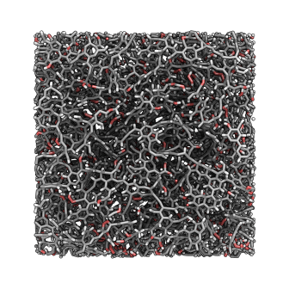



Neutrons, X-rays and Simulations Used in Combination for a Better Understanding of Shale Gas
a
c
Scientific Achievement
  Neutrons provided diffraction measurements over a large Q-range, enabling pair distribution functions (PDFs) to be used in a Hybrid Reverse Monte Carlo (HRMC) method to reconstruct realistic molecular models of mature and immature kerogen nanostructures. Research reveals kerogens’ maturation entails a crossover from plastic-to-brittle rupture mechanisms.
Significance and Impact
  Despite kerogen’s importance as the organic backbone for hydrocarbon production from source rocks like gas shale, the interplay between kerogens’ chemistry, morphology, and mechanics has gone largely unexplored until now. Validated models will offer a better understanding of kerogens’ microscopic behavior, providing a fundamental building block, unravelling the adsorption, mechanical, and transport properties of this complex organic matter.
Research Details
  Partial PDFs are used to constrain the reconstruction process, while vibrational densities of states, together with other non constraining parameters, are used to validate the chemistry of the produced models.
  These models are then used to draw a link between maturity, structure, mechanical properties and vibrational properties.
b
d
Illustration showing (a) partial PDFs for the four studied kerogens; (b) the organic matrix found in shale gas; and (c) the comparison between simulated and experimental vibrational densities of state, pore size distributions, and mechanical properties used to validate (d) the models obtained using the HRMC technique.
  Work was performed at SNS’s NOMAD and VISION instruments at ORNL, and at Argonne’s Advanced Photon Source, all of which are DOE Office of Science User Facilities.
C. Bousige, C. Matei Ghimbeu, C. Vix-Guterl, A.E. Pomerantz, A. Suleimenova, G. Vaughan, G. Garbarino, M. Feygenson, C. Wildgruber, F.-J. Ulm, R.J.-M. Pellenq, and B. Coasne. Nature Materials, 2016.
Notes:
Bousige C., Ghimbeu C.M., Vix-Guterl C., Pomerantz A.E., Suleimenova A., Vaughan G., Garbarino G., Feygenson M., Wildgruber C., Ulm F.J., Pellenq R.J., Coasne B., "Realistic molecular model of kerogen’s nanostructure", Nature Materials, (2016). doi:10.1038/NMAT4541.
http://www.nature.com/nmat/journal/vaop/ncurrent/full/nmat4541.html

Slide 2
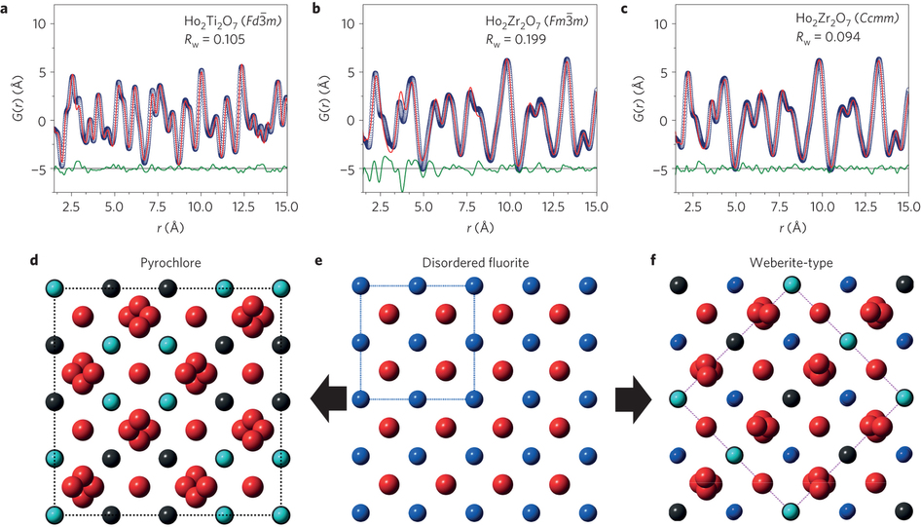




UT, ORNL Scientists Gain New Insights Into Atomic Disordering of Complex Metal Oxides
Scientific Achievement
Researchers have discovered a novel atomic disordering mechanism in complex metal oxides exposed to radiation. Neutron total scattering techniques revealed the cations and oxygens in the materials are not randomly arranged at the atomic level but only appear so when sampling over longer scales.
Significance and Impact
A better understanding of these and similar materials can help in the improvement and controllability of performance in important technologies such as fast ion conduction, thermal barrier coatings, and plutonium immobilization.
Research Details
Complex oxides with the pyrochlore composition (A₂B₂O₇) were disordered through 2.2 GeV Au irradiation, varying composition or altering stoichiometry.
The neutron pair distribution function analysis leads to the conclusion of a universal disordering mechanism.
Neutron PDFs and structural models for ordered (Ho₂Ti₂O₇) and disordered (Ho₂Zr₂O₇) pyrochlore.
Work was performed on the NOMAD instrument, beam line 1-B, at ORNL’s Spallation Neutron Source, a DOE Office of Science User Facility.
J. Shamblin, M. Feygenson, J. Neuefeind, C. Tracy, F. Zhang, S. Finkeldei, D. Bosabach, H. Zhou, R. Ewing, and M. Lang. Nature Materials, 2016.
Notes:
Shamblin J., Feygenson M., Neuefeind J., Tracy C.L., Zhang F., Finkeldei S., Bosbach D., Zhou H.D., Ewing R.C., Lang M., "Probing disorder in isometric pyrochlore and related complex oxides", Nature Materials, (2016). doi:10.1038/nmat4581.
http://www.nature.com/nmat/journal/vaop/ncurrent/full/nmat4581.html

Slide 3
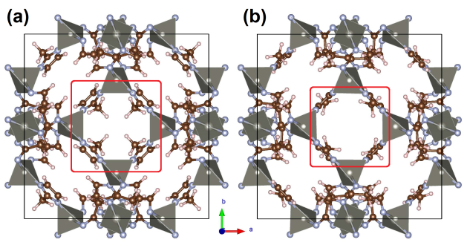
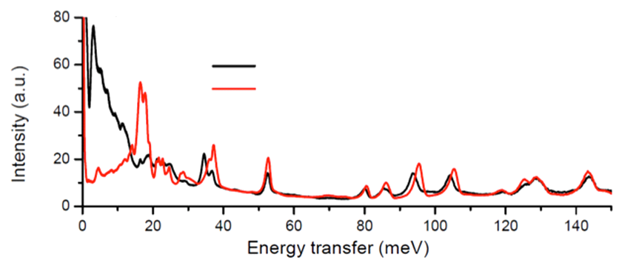


Watch the Gate Opening in a Metal-Organic Framework with Neutrons
Scientific Achievement
  Inelastic neutron scattering (INS) experiments provided unambiguous evidence for the gate-opening effect in ZIF-8, a Zeolitic Imidazolate Framework with potential applications in gas sequestration and separation. The atomistic processes associated with the gate-opening effect were described by integrating INS and computer simulation, revealing, in this case, gates open when exposed to pure nitrogen under a pressure of 0.8 bar.
  Significance and Impact
  Gate-opening is characteristic of inorganic solids with certain structural flexibility upon interaction with an external stimuli, e.g., pressure, temperature, light, electric or magnetic field. It provides unusual properties to the materials such as molecular selectivity and sensing ability.
Research Details
  Pure ZIF-8 and ZIF-8 on AC samples were prepared. The AC serves as a nanoconfinement to prohibit large framework expansion.
  Samples were measured before and after N2 dosing. Gas-induced structural deformation, as indicated by the changes in the INS spectra, was observed in all samples.
  By comparing with simulation, it is confirmed that the deformation involves the rotation of the methyl groups and the swinging of the imidazolate rings.
  The experiment also excluded the possibility of large framework expansion by comparing with samples under the confinement of amorphous carbon (AC).
Gate closed
Gate open
Gate closed w/o nitrogen
Gate open w/ nitrogen
The gate-opening effect revealed by inelastic neutron scattering and computer simulation. The rotation of the methyl groups and the swinging of the imidazolate rings associated with the gate opening can be seen by comparing the marked areas in (a) and (b).
Work was performed at ORNL’s SNS VISION spectrometer, a DOE Office of Science User Facility.
  M.E. Casco, Y.Q. Cheng, L.L. Daemen, D. Fairén-Jiménez, E.V. Ramos-Fernández, A.J. Ramirez-Cuesta, and J. Silvestre-Albero. ChemComm, 2016.
Notes:
Casco M.E., Cheng Y.Q., Daemen L.L., Fairen-Jimenez D., Ramos Fernandez E.V., Ramirez-Cuesta A.J., Silvestre-Albero J., "Gate-opening effect in ZIF-8: First experimental proof using inelastic neutron scattering", Chemical Communications, 2, 3639-3642 (2016). DOI: 10.1039/C5CC10222G.
http://pubs.rsc.org/en/Content/ArticleLanding/2016/CC/C5CC10222G#!divAbstract

Slide 4
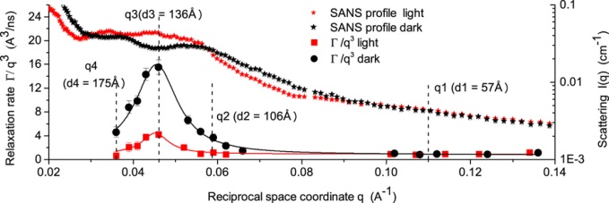
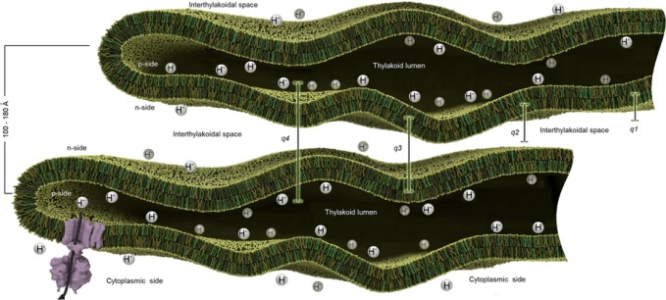



Neutron Spin-Echo Reveals the Dynamics of Thylakoid Membranes in Living Cyanobacterial Cells
Scientific Achievement
  Using neutron scattering, the mobility of intracellular photosynthetic membranes in living organisms was directly measured for the first time, revealing membrane motion is influenced by light intensity.
Significance and Impact
  The study sheds new light onto the potential role of lipid bilayer membrane dynamics in life-sustaining processes such as photosynthesis, opening up a new field of research for unique applications of the neutron-spin echo technique.
Research Details
  Thylakoid membranes in vivo show typical q³-dependent membrane undulation motion with 5% higher bending modulus in light relative to dark.
  Significant additional motion is observed on length scales of inter-membrane spacing, and this component of membrane dynamics is approximately 4 times faster in the dark than in light.
  Slower dynamics in light may arise from charge gradients across membranes related to photosynthetic activity.
Top: Thylakoid membranes show additional dynamics at length scales that correspond to distances between membrane pairs; this excess dynamics strongly depends on light intensity.
Bottom: Schematic thylakoid membrane morphology; indicated distances correspond to vertical dashed lines (q1-q4) in top figure.
Work was performed at ORNL’s SNS Neutron Spin Echo Spectrometer, beam line 15, and HFIR BIO-SANS instrument, CG-3, which are both DOE Office of Science User Facilities.
L.R. Stingaciu, H. O’Neill, M. Liberton, V.S. Urban, H.B. Pakrasi, and M. Ohl. Scientific Reports, 2016.
Notes:
Stingaciu L., O’Neill H.M., Liberton M., Urban V.S., Pakrasi H.B., Ohl M., "Revealing the Dynamics of Thylakoid Membranes in Living Cyanobacterial Cells", Scientific Reports, 6, 19627 (2016). DOI: 10.1038/srep19627.
http://www.nature.com/articles/srep19627
ABSTRACT
Cyanobacteria are photosynthetic prokaryotes that make major contributions to the production of the oxygen in the Earth atmosphere. The photosynthetic machinery in cyanobacterial cells is housed in flattened membrane structures called thylakoids. The structural organization of cyanobacterial cells and the arrangement of the thylakoid membranes in response to environmental conditions have been widely investigated. However, there is limited knowledge about the internal dynamics of these membranes in terms of their flexibility and motion during the photosynthetic process. We present a direct observation of thylakoid membrane undulatory motion in vivo and show a connection between membrane mobility and photosynthetic activity. High-resolution inelastic neutron scattering experiments on the cyanobacterium Synechocystis sp. PCC 6803 assessed the flexibility of cyanobacterial thylakoid membrane sheets and the dependence of the membranes on illumination conditions. We observed softer thylakoid membranes in the dark that have three-to four fold excess mobility compared to membranes under high light conditions. Our analysis indicates that electron transfer between photosynthetic reaction centers and the associated electrochemical proton gradient across the thylakoid membrane result in a significant driving force for excess membrane dynamics. These observations provide a deeper understanding of the relationship between photosynthesis and cellular architecture.

Slide 5
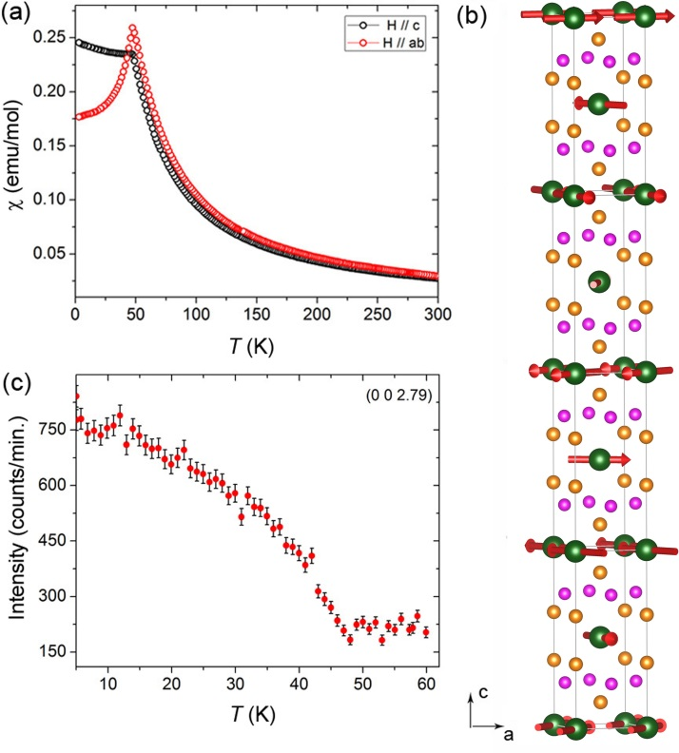



Localized to Strongly Correlated Electron Transition in EuCo₂As₂
Scientific Achievement
The mixed valence state of Eu has been induced by high-pressure in EuCo₂As₂ accompanied with a change of magnetic ordering. Neutron diffraction revealed an incommensurate magnetic order for the Eu sub-lattice and no magnetic order for Co sub-lattice at ambient pressure.
Significance and Impact
This work demonstrates the highly sensitive nature of itinerant magnetism in ACo₂As₂ (A = Eu, Ca) to electronic doping and physical/chemical pressure.
Research Details
EuCo₂As₂
The magnetic order was found for Eu sub-lattice but no magnetic order for Co sub-lattice. The Eu has a fully ordered moment at 7 μ_{B}.
Neutron diffraction was successful on a heavy neutron absorbing element (natural Eu) containing crystal with a size of 0.4 mm³.
EuCo₂As₂: (a) magnetic susceptibility vs. temperature under magnetic fields along the c-axis and ab-plane; (b) nuclear and magnetic structure determined by neutron diffraction; (c) temperature dependence of the magnetic peak intensity at (0, 0,2.79).
Work was performed at DOE Office of Science User Facilities: HB-2A and HB-3A, Neutron Powder Diffractometer and Four-Circle Diffractometer instruments, respectively, at ORNL’s HFIR; and beam line 4ID-D at Argonne’s Advanced Photon Source.
X. Tan, G. Fabbris, D. Haskel, A. A. Yaroslavtsev, H. Cao, C. M. Thompson, K. Kovnir, A. P. Menushenkov, R. V. Chernikov, V. O. Garlea, and M. Shatruk. Journal of the American Chemical Society, 2016.
Notes:
Tan X., Fabbris G., Haskel D., Yaroslavtsev A.A., Cao H.B., Thompson C.M., Kovnir K., Menushenkov A.P., Chernikov R.V., Garlea V.O., Shatruk M., "A Transition from Localized to Strongly Correlated Electron Behavior and Mixed Valence Driven by Physical or Chemical Pressure in ACo2As2 (A = Eu, Ca)", Journal of the American Chemical Society, (2016), 138 (8), pp 2724–2731. DOI: 10.1021/jacs.5b12659. http://pubs.acs.org/doi/abs/10.1021/jacs.5b12659.
http://pubs.acs.org/doi/abs/10.1021/jacs.5b12659

Slide 6



Neutron Vibrational Spectroscopy to Investigate Density of States in Thermal Expansion of Glass
Scientific Achievement
A 2012 National School on Neutron and X-Ray Scattering (NXS) graduate and current Corning Incorporated employee has returned to SNS to make fundamental measurements relating thermal and vibrational properties of silica glass. Details on his work as part of the collaboration with Corning is detailed below.
Significance and Impact
Using the VISION instrument, the user made broad frequency range observations, gleaning information on energy spectrum to better understand the vibrational dynamics of the silica glass sample at the molecular level. Understanding the fundamental thermal expansion behavior of this material will benefit the development of new products with better properties.
Research Details
  In addition to the good resolution for data analysis, the user noted that VISION also provides powerful data analysis software.
  The sample environment temperature ranged from 5K to 700K, which allowed the user to investigate vibrational changes as a function of temperature.
  Ling Cai is a 2012 graduate of the NXS and has returned as a user at SNS for experiments in 2014 and 2015. Here he prepares a sample for experiments conducted at VISION, SNS beam line 16B, in February 2016.
  This work was performed using the ORNL Spallation Neutron Source’s VISION instrument, which is a DOE User Facility.
© 2016 Corning Incorporated
Notes:
This work was performed using the ORNL Spallation Neutron Source’s VISION instrument, which is a DOE User Facility.

