Slide 1
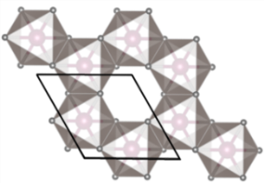



Neutrons expose Kitaev quantum spin liquid excitations in α-RuCl₃
10
5
0
Scientific Achievement
  Inelastic neutron scattering (INS) experiments on the layered honeycomb magnet α-RuCl₃ provide clear evidence for excitations related to a Kitaev quantum spin liquid (QSL). The measured response function cannot be explained by conventional spin waves but is consistent with scattering from itinerant Majorana fermions. Majorana fermions are their own antiparticles and are potential building blocks of future quantum computers.
  Significance and Impact
  Under appropriate circumstances, including strong spin-orbit coupling, S=1/2 spins on a honeycomb lattice can form a Kitaev QSL. INS measurements on graphene-like α-RuCl₃ yielded estimates of the magnetic interactions placing this material in proximity to the Kitaev QSL limit, and found evidence for an excitation continuum arising from Majorana fermions associated with the QSL state. This is a major step forward in identifying fractionalized excitations that someday could be useful for quantum information technology.
  Research Details
  α-RuCl₃ samples were purified to 99.9% purity at ORNL.
T < T_{N}
α-RuCl₃
M2
a
M1
Energy Transfer (meV)
10
5
0
T > T_{N}
M2
Ru
Cl
a
b
0 0.5 1 1.5 2
Q (Å⁻¹)
Magnetic excitations in α-RuCl₃ showing M1, the spin-wave mode from the ordered ground state, and thermally resilient M2 mode from itinerant Majorana fermions. The crystal structure of α-RuCl₃, bottom right, exhibits a layered honeycomb arrangement of S=1/2 magnetic moments.
A. Banerjee, C. Bridges, J. Yan, A. Aczel, L. Li, M. Stone, G. Granroth, M. Lumsden, Y. Yiu, J. Knolle, S. Bhattacharjee, D.. Kovrizhin, R. Moessner, D. Tennant, D. Mandrus, and S. Nagler, Nature Materials, 2016.
Work performed at ORNL’s SNS SEQUOIA instrument, BL-17 and HFIR instrument HB-1A, DOE Office of Science User Facilities.
Notes:
A. Banerjee, C. A. Bridges, J.-Q. Yan, A. A. Aczel, L. Li, M. B. Stone, G. E. Granroth, M. D. Lumsden, Y. Yiu, J. Knolle, S. Bhattacharjee, D. L. Kovrizhin, R. Moessner, D. A. Tennant, D. G. Mandrus, and S. E. Nagler, “Proximate Kitaev Quantum Spin Liquid Behaviour in a Honeycomb Magnet,” Nature Materials (2016). DOI: 10.1038/nmat4604.
http://www.nature.com/nmat/journal/vaop/ncurrent/abs/nmat4604.html
ABSTRACT
Quantum spin liquids (QSLs) are topological states of matter exhibiting remarkable properties such as the capacity to protect quantum information from decoherence. Whereas their featureless ground states have precluded their straightforward experimental identification, excited states are more revealing and particularly interesting owing to the emergence of fundamentally new excitations such as Majorana fermions. Ideal probes of these excitations are inelastic neutron scattering experiments. These we report here for a ruthenium-based material, α-RuCl₃, continuing a major search (so far concentrated on iridium materials) for realizations of the celebrated Kitaev honeycomb topological QSL. Our measurements confirm the requisite strong spin–orbit coupling and low-temperature magnetic order matching predictions proximate to the QSL. We find stacking faults, inherent to the highly two-dimensional nature of the material, resolve an outstanding puzzle. Crucially, dynamical response measurements above interlayer energy scales are naturally accounted for in terms of deconfinement physics expected for QSLs. Comparing these with recent dynamical calculations involving gauge flux excitations and Majorana fermions of the pure Kitaev model, we propose the excitation spectrum of α-RuCl₃ as a prime candidate for fractionalized Kitaev physics.

Slide 2
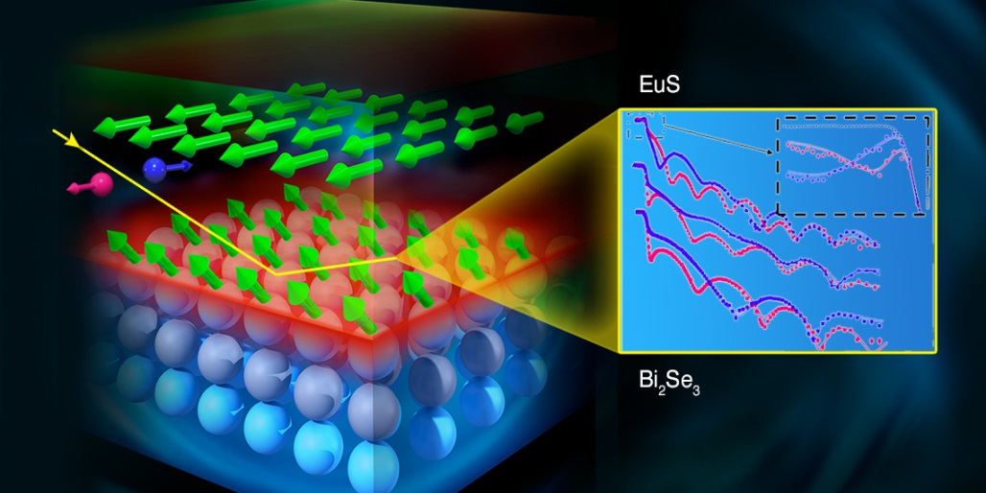







Achieving High-Temperature Ferromagnetic Topological Insulators by Proximity Coupling
Scientific Achievement
Using polarized neutron reflectometry (PNR), researchers have discovered magnetic moments in hybrid topological insulator (TI) materials at room temperature, hundreds of degrees warmer than the sub-zero temperature where the properties are expected to occur.
Significance and Impact
TIs are insulating materials in bulk and display conducting surface states protected by time-reversal symmetry, wherein electron spins are locked to their momentum. Inducing ferromagnetic surface states in TIs are thought to enable the emergence of exotic phenomena such as interfacial magneto-electric coupling, and Majorana fermions. This discovery promises new opportunities for next-generation electronic and spintronic devices such as improved transistors and quantum computing technologies.
Schematic of the PNR experimental set up for Bi₂Se₃-EuS bilayer films and measured and fitted (solid lines) reflectivity curves for two neutron spin-polarization. The inset is an expanded view of the reflectivity below its critical edge that is sensitive to the distribution of the Eu ions due to the absorption cross section and the magnetic moment.
Research Details
The ferromagnetic state was directly observed in the top two quintuple layers (QL, where 1 QL ≈ 0.96 nm) of Bi₂Se₃ near the TI-FMI interface up to temperatures higher than 300 kelvins.
F. Katmis, V. Lauter, F. Nogueira, B. Assaf, M. Jamer, P. Wei, B. Satpati, J. Freeland, I. Eremin, D. Heiman, P. Jarillo-Herrero, and J. Moodera, Nature, 2016.
PNR provides characterization of the depth profiles of the elemental nuclear density, the magnetization density, and is also particularly element-sensitive to Eu via the absorption density profile. This affords a very precise disentanglement of the intrinsic ferromagnetism of EuS, from its interfacial magnetism and the induced magnetization in Bi₂Se₃.
  Work was performed at ORNL’s SNS Magnetism Reflectometer instrument, BL-4A, a DOE Office of Science User Facility.
Notes:
Ferhat Katmis, Valeria Lauter, Flavio S. Nogueira, Badih A. Assaf, Michelle E. Jamer, Peng Wei, Biswarup Satpati, John W. Freeland, Ilya Eremin, Don Heiman, Pablo Jarillo-Herrero, and Jagadeesh S. Moodera, “A High-temperature Ferromagnetic Topological Insulating Phase by Proximity Coupling,” Nature, (2016). DOI: 10.1038/nature17635.
http://www.nature.com/nature/journal/vaop/ncurrent/full/nature17635.html
ABSTRACT
Topological insulators are insulating materials that display conducting surface states protected by time-reversal symmetry, wherein electron spins are locked to their momentum. This unique property opens up new opportunities for creating next-generation electronic, spintronic and quantum computation devices. Introducing ferromagnetic order into a topological insulator system without compromising its distinctive quantum coherent features could lead to the realization of several predicted physical phenomena. In particular, achieving robust long-range magnetic order at the surface of the topological insulator at specific locations without introducing spin-scattering centres could open up new possibilities for devices. Here we use spin-polarized neutron reflectivity experiments to demonstrate topologically enhanced interface magnetism by coupling a ferromagnetic insulator (EuS) to a topological insulator (Bi₂Se₃) in a bilayer system. This interfacial ferromagnetism persists up to room temperature, even though the ferromagnetic insulator is known to order ferromagnetically only at low temperatures (<17 K). The magnetism induced at the interface resulting from the large spin–orbit interaction and the spin–momentum locking of the topological insulator surface greatly enhances the magnetic ordering (Curie) temperature of this bilayer system. The ferromagnetism extends ~2 nm into the Bi₂Se₃ from the interface. Owing to the short-range nature of the ferromagnetic exchange interaction, the time-reversal symmetry is broken only near the surface of a topological insulator, while leaving its bulk states unaffected. The topological magneto-electric response originating in such an engineered topological insulator could allow efficient manipulation of the magnetization dynamics by an electric field, providing an energy-efficient topological control mechanism for future spin-based technologies.

Slide 3
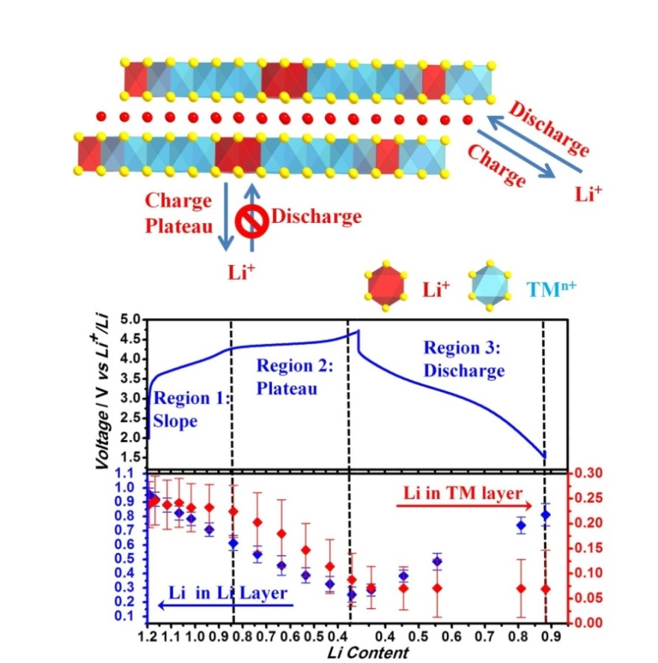


Operando Lithium Dynamics in the Li-rich Layered Oxide Cathode Material
(a)
Scientific Achievement
  The lithium and oxygen dynamics of Li-rich cathodes are investigated via neutron diffraction (ND) under operando battery cycling.
Significance and Impact
  This work provides new insights into the lithium migration behavior in lithium rich layered oxides and demonstrates the unique capabilities to observe light elements in the bulk under operando. Research revealed the path-dependent rate of lithium migration in the lithium layer and transition metal (TM) layer are asymmetric for charging and discharging which explains the origin of irreversible lithium loss.
Research Details
  Researchers designed the multi-layered pouch cell with amorphous silicon anode, which improved the quality of operando ND data.
  Evolution of the lattice parameters and oxygen position showed lattice contractions occuring for the Li-rich cathode at higher voltages.
(b)
Schematic plot of the path-specific lithium dynamics of Li-rich layered oxide cathode (a). Lithium occupancy at different states of delithiation/lithiation in high Li-rich cathode (b).
  Work was performed at ORNL’s SNS VULCAN instrument, BL-7, a DOE Office of Science User Facility.
  H. Liu, Y. Chen, S. Hy, K. An, S. Venkatachalam, D. Qian, M. Zhang, and Y. Meng, Advanced Energy Material, 2016.
Notes:
H. D. Liu, Y. Chen, S. Hy, K. An, S. Venkatachalam, D. Qian, M. Zhang, and Y. S. Meng, “Operando Lithium Dynamics in the Li-Rich Layered Oxide Cathode Material via Neutron Diffraction,” Advanced Energy Material, 6 (2016). DOI: 10.1002/aenm.201502143.
http://onlinelibrary.wiley.com/doi/10.1002/aenm.201502143/full
ABSTRACT
Neutron diffraction under operando battery cycling is used to study the lithium and oxygen dynamics of high Li-rich Li(Li_{x/3}Ni_{(3/8-3x/8)}Co_{(1/4-x/4)}Mn_{(3/8+7x/24)}O₂ (x = 0.6, HLR) and low Li-rich Li(Li_{x/3}Ni_{(1/3-x/3)}Co_{(1/3-x/3)}Mn_{(1/3+x/3)}O₂ (x = 0.24, LLR) compounds that exhibit different degrees of oxygen activation at high voltage. The measured lattice parameter changes and oxygen position show largely contrasting changes for the two cathodes where the LLR exhibits larger movement of oxygen and lattice contractions in comparison to the HLR that maintains relatively constant lattice parameters and oxygen position during the high voltage plateau until the end of charge. Density functional theory calculations show the presence of oxygen vacancy during the high voltage plateau; changes in the lattice parameters and oxygen position are consistent with experimental observations. Lithium migration kinetics for the Li-rich material is observed under operando conditions for the first time to reveal the rate of lithium extraction from the lithium layer, and transition metal layer is related to the different charge and discharge characteristics. At the beginning of charging, the lithium extraction predominately occurs within the lithium layer. Once the high voltage plateau is reached, the lithium extraction from the lithium layer slows down and extraction from the transition metal layer evolves at a faster rate.
Research is sponsored by the Battery Materials Research Program.

Slide 4




Neutron Crystallography Captures a Two-Proton Transfer in an Enzyme for the First Time
a)
Scientific Achievement
Proton transfer is a fundamental chemical reaction that is integral to many biochemical processes. Neutron crystallography was used to capture the locations of protons in HIV-1 protease catalytic site before and after a pH-induced two-proton transfer between aspartic acid residues and a hydroxyl group of bound clinical drug.
Significance and Impact
Direct observation of proton transfer in biological systems is of paramount importance to the understanding of enzymatic reactions and ion transfer through membranes. It has now been demonstrated that unequivocal description of proton transfer mechanisms is possible with macromolecular neutron crystallographic experiments.
Research Details
  This study focused on the HIV-1 protease, a key drug target in HIV/AIDS therapy.
  Two neutron structures were determined at different pH values in complex with a clinical drug Darunavir.
  The low-pH structure was obtained by lowering the pH in crystallo using acetic acid vapor, a new technique for pH studies in crystals.
  Quantum and molecular mechanics calculations revealed the low-pH proton arrangement is stable only when four surface residues are protonated in acidic conditions.
b)
a) A cartoon representation of the HIV-1 protease structure, showing the catalytic site, active site cavity and flexible flaps that open and close for substrate and drug entry. b) Visualizations of the protonation states in the catalytic site; black arrows reveal the two-proton transfer pathway (proton positions are shown by the magenta mesh).
  Work was performed using ORNL’s HFIR instrument CG-4D, IMAGINE, DOE Office of Science User Facilities.
O. Gerlits, T. Wymore, A. Das, C. Shen, J. Parks, J. Smith, K. Weiss, D. Keen, M. Blakeley, J. Louis, P. Langan, I. Weber, and A. Kovalevsky, Angewandte Chemie, 2016.
Notes:
O. Gerlits, T. Wymore, A. Das, C.-H. Shen, J. M. Parks, J. C. Smith, K. Weiss, D. A. Keen, M. P. Blakeley, J. M. Louis, P. Langan, I. Weber, A. Kovalevsky, “Long-range Electrostatics-induced Two-proton Transfer Captured by Neutron Crystallography in an Enzyme Catalytic Site,” Angewandte Chemie, (2016). DOI: 10.1002/anie.201509989.
http://onlinelibrary.wiley.com/doi/10.1002/anie.201509989/full
ABSTRACT
Neutron crystallography was used to directly locate two protons before and after a pH-induced two-proton transfer between catalytic aspartic acid residues and the hydroxy group of the bound clinical drug darunavir, located in the catalytic site of enzyme HIV-1 protease. The two-proton transfer is triggered by electrostatic effects arising from protonation state changes of surface residues far from the active site. The mechanism and pH effect are supported by quantum mechanics/molecular mechanics (QM/MM) calculations. The low-pH proton configuration in the catalytic site is deemed critical for the catalytic action of this enzyme and may apply more generally to other aspartic proteases. Neutrons therefore represent a superb probe to obtain structural details for proton transfer reactions in biological systems at a truly atomic level.

Slide 5


Influence of Surface Chemistry on Ion Dynamics and Capacitance in Carbon Electrodes
Scientific Achievement
Researchers investigated fundamental capacitive behaviors of electrolytes in carbon electrodes and demonstrated better charge storage and improved ion dynamics of ions on oxidized pore interfaces. Neutron scattering showed that surface functional groups affected charge filling densities and molecular configurations and enhanced charge transport. Molecular dynamics (MD) simulations correlated with electrochemical tests and neutron scattering and highlighted the influence of heterogeneous interfaces on ion orientations and charge densities.
Significance and Impact
Electrode-electrolyte interfaces influence capacitance and electrosorption dynamics. Researchers successfully correlated neutron scattering results with electrochemistry and MD to explain fundamental ion behavior. Optimized electrode surfaces may be integrated into novel supercapacitors with higher energy and power densities.
Ions demonstrate different arrangements and filling densities once confined in (a) defunctionalized and (b) oxidized carbon pores. (c) QENS measurements showed higher ionic mobilities in oxidized pores, which translated into (d) higher electrochemical capacitance and rate handling abilities of [EMIm⁺][TFSI⁻] electrolyte.
Research Details
Oxidized pores improved ion dynamics and capacitance.
Inelastic neutron scattering showed randomly aligned ions in oxidized pores.
Quasi-elastic neutron scattering demonstrated resulting higher mobilities.
MD simulations assessed ion densities.
B. Dyatkin, Y. Zhang, E. Mamontov, A. Kolesnikov, Y. Cheng, H. Meyer, P. Cummings, and Y. Gogotsi, The Journal of Physical Chemistry C, 2016.
Work was performed at ORNL’s SNS instruments BASIS, BL-2, and VISION, BL-16B, DOE Office of Science User Facilities.
Notes:
Boris Dyatkin, Yu Zhang, Eugene Mamontov, Alexander I. Kolesnikov, Yongqiang Cheng, Harry M. Meyer III, Peter T. Cummings, & Yuri Gogotsi, "Influence of Surface Oxidation on Ion Dynamics and Capacitance in Porous and Non-Porous Carbon Electrodes," The Journal of Physical Chemistry C, (2016). DOI: 10.1021/acs.jpcc.6b01204.
http://pubs.acs.org/doi/abs/10.1021/acs.jpcc.6b01204
ABSTRACT
We investigate the influence of surface chemistry and ion confinement on capacitance and electrosorption dynamics of room-temperature ionic liquids (RTILs) in supercapacitors. Using air oxidation and vacuum annealing, we produced defunctionalized and oxygen-rich surfaces of carbide-derived carbons (CDCs) and graphene nanoplatelets (GNPs). While oxidized surfaces of porous CDCs improve capacitance and rate handling abilities of ions, defunctionalized nonporous GNPs improve charge storage densities on planar electrodes. Quasi-elastic neutron scattering (QENS) and inelastic neutron scattering (INS) probed the structure, dynamics, and orientation of RTIL ions confined in divergently functionalized pores. Oxidized, ionophilic surfaces draw ions closer to pore surfaces and enhance potential-driven ion transport during electrosorption. Molecular dynamics (MD) simulations corroborated experimental data and demonstrated the significance of surface functional groups on ion orientations, accumulation densities, and capacitance.
Research funded by FIRST Energy Frontier Research Center at ORNL.

Slide 6
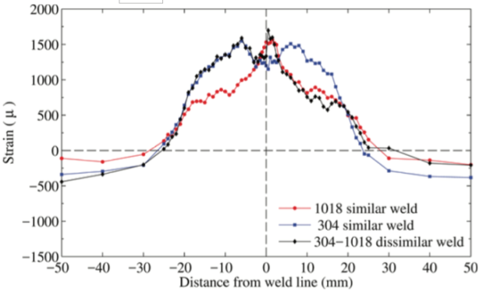

Measuring Stresses in Dissimilar Welds via Neutron Scattering
Scientific Achievement
  Neutron diffraction mapping revealed stress distributions from dissimilar metal (face-centered cubic, body-centered cubic (fcc-bcc)) welds are asymmetric due to phase transformation and materials properties.
Significance and Impact
  In addition to demonstrating neutron utility in real-world industrial processes, this work provides new insights into the nature and magnitude of stresses resulting from joining metals with different structures and physical properties. Data will be used to verify computational models of welding stresses.
Research Details
  Dissimilar welds manifest assymetric strain/stress distributions that cannot be thermally relieved by conventional procedures.
  Similar metal (bcc-bcc, and fcc-fcc) weldments were mapped and compared to dissimilar (fcc-bcc) weldments.
Chart shows distribution of longitudinal strain in 1018 (bcc, low carbon steel) similar weld, 304 (fcc, stainless steel) similar weld, and 304-­1018 dissimilar weld.
Work was performed at ORNL’s HFIR instrument HB-2B, DOE Office of Science User Facilities.
  H. Eisazadeh, J. Bunn, H. Coules, A. Achuthan, J. Goldak, and D. Aidun, Welding Journal, 2016.
Notes:
H. Eisazadeh, J. Bunn, H.E. Coules, A. Achuthan, J. Goldak, and D.K. Aidun, “A Residual Stress Study in Similar and Dissimilar Welds,” The Welding Journal, 95, 4, 111-s (2016).
https://s3.amazonaws.com/WJ-www.aws.org/supplement/WJ_2016_04_s111.pdf
ABSTRACT
Residual strain distributions in similar and dissimilar welds were measured using the neutron diffraction (ND) method. Then, using three strain components, three­-dimensional stress states were calculated. The results were used to determine the effect of the martensitic phase transformation and material properties on residual stress (RS) distribution. It was observed that smaller longitudinal RS was induced in the low­carbon steel side of the dissimilar weld when compared to its similar weld. Also, it was found that the transverse RS near and within the weld zone (WZ) in the dissimilar weld exhibited a distinctive trend, with tensile mode reaching the yield strength of the base metal (BM). In order to characterize the WZ in the dissimilar weld, optical microscopy, hardness tests, and energy dispersive X-­ray spectroscopy (EDAX) were employed. This study not only provides further insight into the RS state in similar and dissimilar welds, it also delivers important consequences of phase transformation in the latter case.

