Slide 1
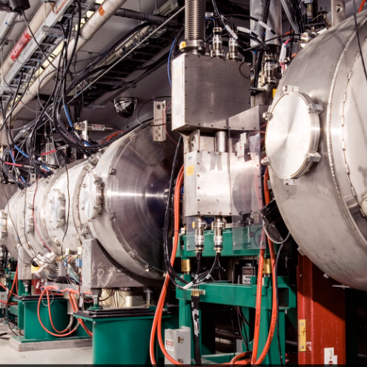
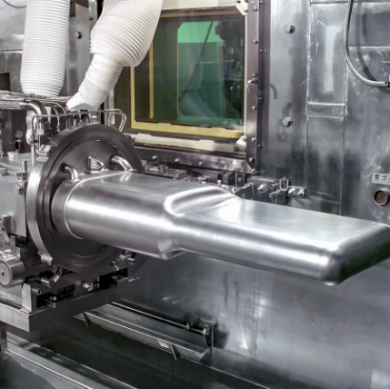
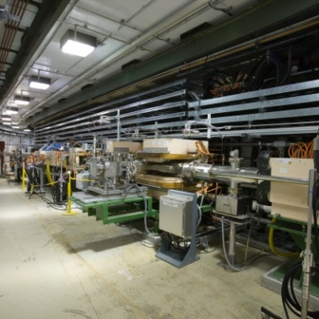
SNS Cryogenic Moderator System Operations to Support Reliability CMS Review
John Denison
Rocky Armstrong
January 22, 2020

Slide 2
Outline
System overview
Organization structure
Best Practices
Meeting the challenges of continuing operation
Spare inventory and management processes
Summary

Slide 3
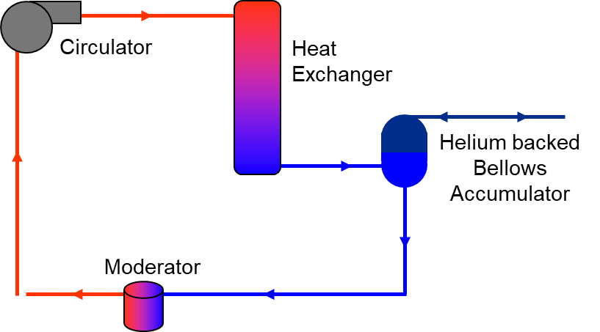
High-level CMS operational overview
The CMS consists of two closed loop systems
The helium refrigerator provides cooling to for 3 supercritical hydrogen loops
Hydrogen loops provide ~20 K H2 to neutron moderator vessels housed within the Inner Reflector Plug (IRP).
An independent He loop for the hydrogen system accumulator provides backing pressure to dampen pressure transients due to beam trips
Not discussed within this review content
High-level CMS flow schematic

Slide 4
Cryogenic Moderator System organizational structure
The Target Operations and Maintenance Team is responsible for maintenance and operation of the CMS, along with 29 other target systems
CMS engineering resides in the Neutron Technologies Division
Research Accelerator Division
Division Director
Mechanical Systems and Operations Group
Target Operations and Maintenance Team
Target Operations
Target Support and remote handling

Slide 5
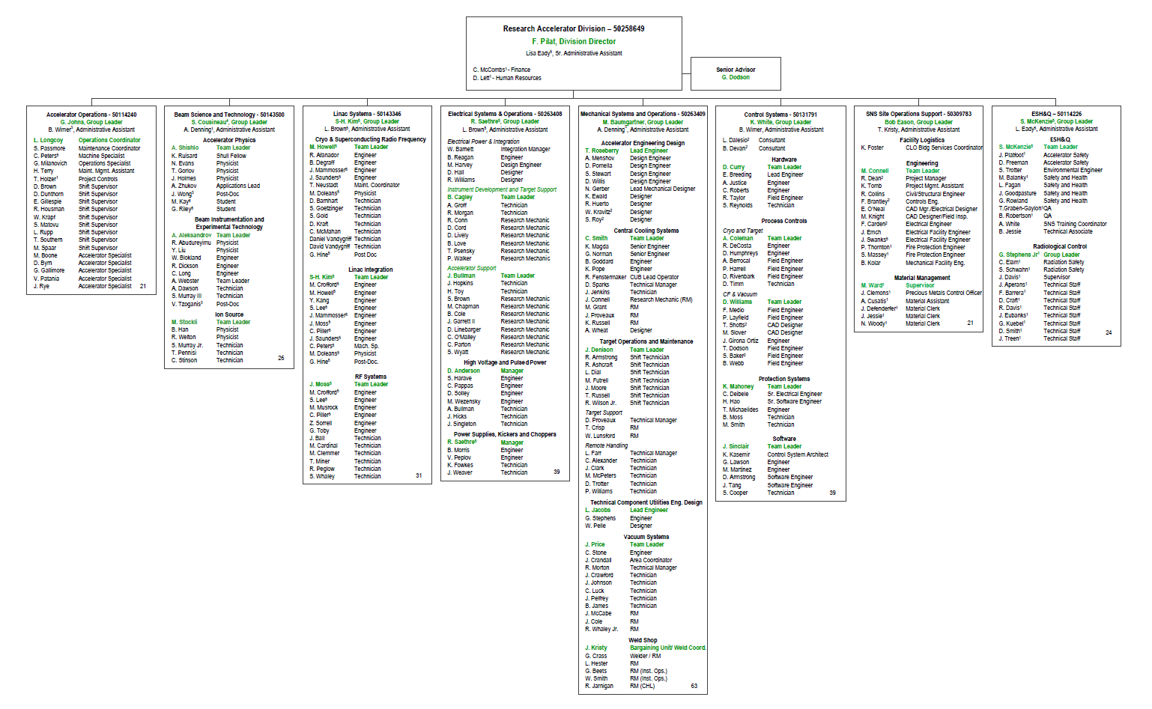
Target Operations and Maintenance Team members
J. Denison – Team Leader
R. Armstrong (Shift Tech., primary CMS OST SME)
R. Ashcraft (Shift Tech.)
L. Dial (Shift Tech.)
M. Futrell (Shift Tech.)
J. Moore (Shift Tech.)
T. Russell (Shift Tech.)
R. Wilson Jr. (Shift Tech.)
Target Support
D. Proveaux (Technical Manager)
T. Crisp (Research Mechanic)
W. Lunsford (Research Mechanic)
Remote Handling
L. Farr (Technical Manager)
C. Alexander (Tech.)
J. Clark (Tech.)
M. McPeters (Tech.)
D. Trotter (Tech.)
P. Williams (Tech.)
Additional matrixed support from NTD and CMSTF

Slide 6
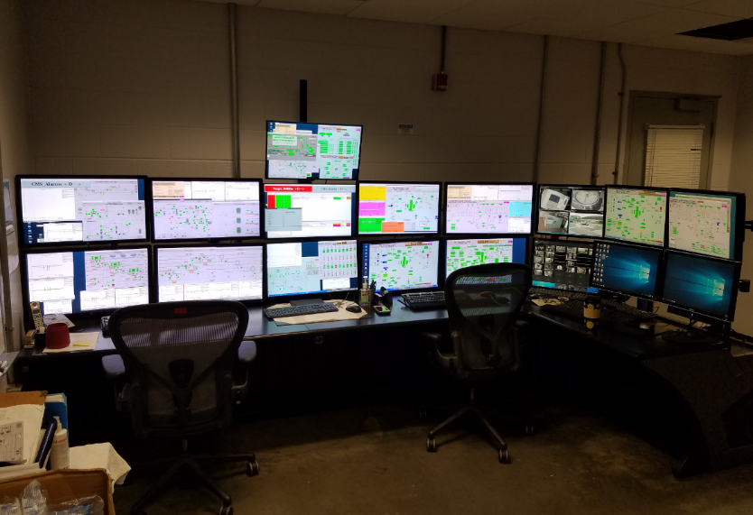
Operations Shift Technician (OST) Responsibilities
OST Responsibility:
Monitoring of 29 systems
Daily system walk-downs
Daily shift logs
CMS-SME OST Responsibility:
Maintain >80% focus (R. Armstrong)
Monitor system health (CSS and local)
Develop input for outage planning
Manage procurement of spares and PM materials
P&ID management
Procedure and training module updates
Provide OST training
Support other target work as directed
24/7 operational coverage from on-shift operation shift technicians as required by the Accelerator Safety Envelop (ASE)
Target Control Room (TCR)

Slide 7
Incorporating Best Practices
Reviewed existing maintenance and operating procedures for the system
Focused on how current practices might have contributed to CMS instability
Compared CMS and CHL procedures for similar activities and decided on “best practice”
Determined “best practice” methodology for specific iterations
Carbon bed processing
System clean up
Leak checking
Gas analyzer configuration
Process is ongoing
As “best practice” methodology is developed, training of personnel will follow

Slide 8
Procedures will be systematically evaluated and updated
Long-term goal is transition to one CMS maintenance outage per year
Reduce man-power footprint during facility outages
Improve hardware life – reduce thermal cycles
This requires standardization of all maintenance activities, hardware procurements, and observation of plant performance to implement industry best-practices

Slide 9
Best-practice development will improve reliability and repeatability
Identify critical maintenance and operation activities
Proceduralize activities and check-points
Update and reference accurate hardware IDs
Inclusion of valve-out configurations is critical
Modular documentation tree to ease configuration management
References to necessary sub-procedures
Maintain control copy and red-line procedures
Leverage internal expertise at the SNS CHL and HFIR Cold-source
Efforts to deploy this plan have been hindered by lack of dedicated resources
Notes:
Images?

Slide 10
CMS training modules will be updated to reflect proceduralized best-practices
Spread training module across wider period of time
Build in job-shadowing periods between classroom training modules
Require participation in critical system transitions
Cool-down, warm-up, anomaly states
Update to reflect current system configuration
Efforts to deploy this plan have been hindered by lack of dedicated resources

Slide 11
Dedicated resources are required to maintain system operation and deploy a procedural update
Procedural review requires time input from SMEs
CMSTF, CHL, HFIR, external expertise
Technical writing support
Review support and training
CMS technician SME is a single-point risk
Reliable operation is aided by procedural/training updates, but personnel availability remains a concern

Slide 12
Carbon loading and processing procedures were updated
Diagnostics are built into processes to best suit the current state of the system
Drying process now cycles between heated nitrogen flow, isolation, and cold-trapping exhaust to diagnose volume purity
Provides method of ensuring dryness and removing nitrogen from isolated CB volumes
Carbon addition technique was improved
Screened drum and vacuum assembly to remove particulate as carbon is added
Prevents migration of carbon particulate downstream
Prevents potential increase of DP and loss of capacity
Carbon sifting on screened-drum

Slide 13
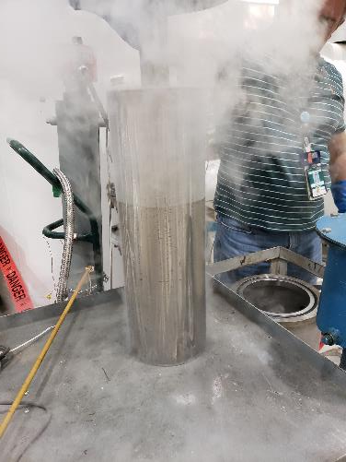
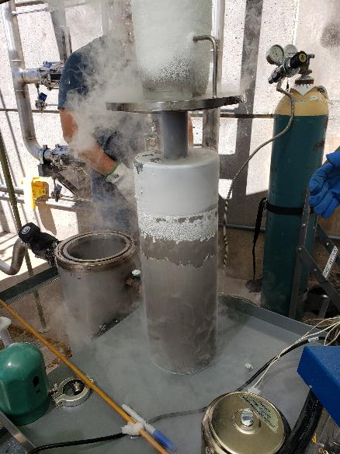
Purging routine has been enhanced
System recovery following exposure to atmosphere
Standardized methods
Leverage experience at CHL to improve repeatability
Isolate and vary heated N2 flow paths to remove moisture and limit effected volume
Deploy cryo-trapping in purge exhaust as diagnostic
He purge to pressure, 30-min hold period, cold-trap exhaust
Purge with He flow through the He purification system when possible
Minimize volume of system opened to atmosphere during maintenance activities
Increase number of purge/backfill cycles
Clean cryo trap from HX header
Cryo trap with moisture pumped from carbon vessel

Slide 14
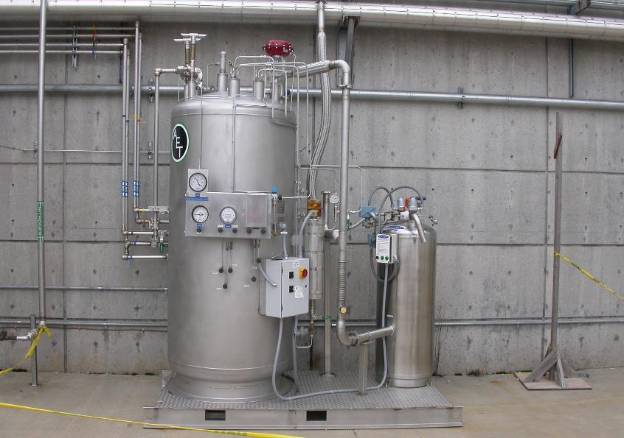
He purification capabilities returned to service
80 K liquid nitrogen purification system
60 g/s capacity, slip-stream function
Requires main compressor for motive force
Developed piping and valve lineups to permit purification of isolated system volumes
Permits purification of large portions of the system while invasive activities continue elsewhere
Identified and included provisions to ensure purifications of system dead-legs
Typical minimum system purification period of 4 days

Slide 15
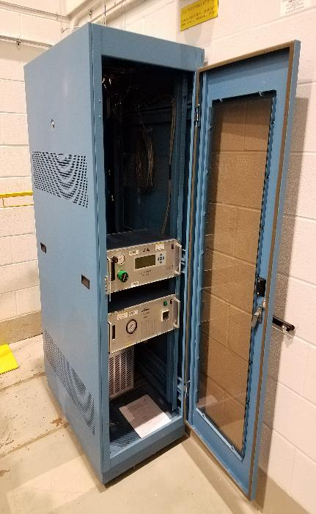
CMS He contamination monitoring improvements
Additional LGA sampling ports added to permit contamination monitoring elsewhere in the system
Investigation of individual component performance during summer 2019 transient behavior
Identified incorrect discharge conditions
Short-term solution is inefficient
He waste limits sampling to every other week
CHL collaboration has improved and standardized operational practices
Purge of pyrolizer conducted prior to powering on unit
Improves purity of sampling window
Routine calibration now standard
Dew-point readings included as standard procedure in purging operations
Linde picture and dew point meter picture picture

Slide 16
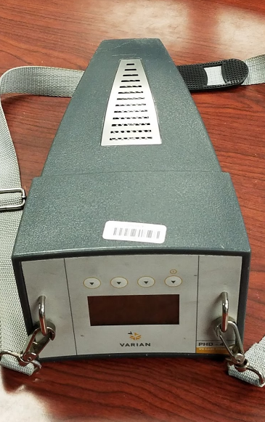
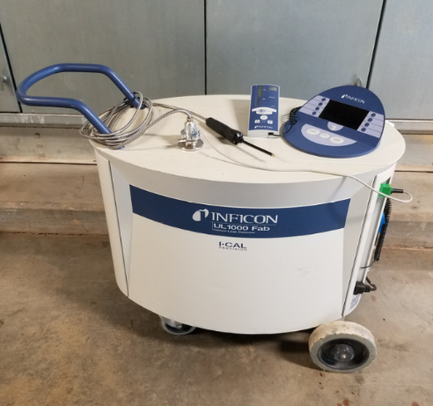
Leak checking processes have been standardized and widely deployed
Engage SNS vacuum group for support
Leverage expertise
Dedicated resource
Collaboration has improved OST leak checking skillset
Increased frequency of routine, blanket leak checks
Expanded scope of routine checks to include compressor building, ORS, cold box, and HUR

Slide 17
Meet the challenges that continue to arise
Beam Power
Heater Margin
Fuse Failure
Fuse Replacement
January 8, 2020
January 9, 2020
Failed heater fuse lead to development of a procedure to safely replace while running cold with beam on target

Slide 18
Spares inventory and management processes have improved
Aggressive outage schedules have forced improvements to this process
Consolidation of tracking to single system
Procurement process has been a bottleneck
Vendor performance remains an issue
Management consumes OST resource
Quick response to incoming data requires lean system

Slide 19
Summary of charges
Is the plan to return the CMS to reliable operation for 1.4 MW beam power by April 2020 reasonable? Are there additional considerations that need to be included?
Maintenance activities are being executed in compliance with industry best-practices to support reliable operation at 1.4 MW beam power. CMS operational performance in the Winter 2019-2020 SNS run-cycle is promising.
Is the plan to prepare the CMS for reliable operation for the beam power ramp up defined for the PPU culminating in 2.0 MW beam power in Q3 2024 reasonable? Are there additional considerations that need to be included?
The CMS is currently maintaining stable operation with enough capacity to support 2.0 MW beam on target. Additional gains in capacity and long-term delivery of reliable operation at both 1.4 MW and 2.0 MW beam power will be supported by the deployment of a plan to standardize CMS maintenance activities.
Are the allocated resources sufficient to execute the CMS plans? Is the organization structure for CMS resources reasonable to carry out the scope of work defined in the operations plans?
Added resources to support standardization and update of procedural documentation to reflect best-practices would be beneficial.

