Slide 1
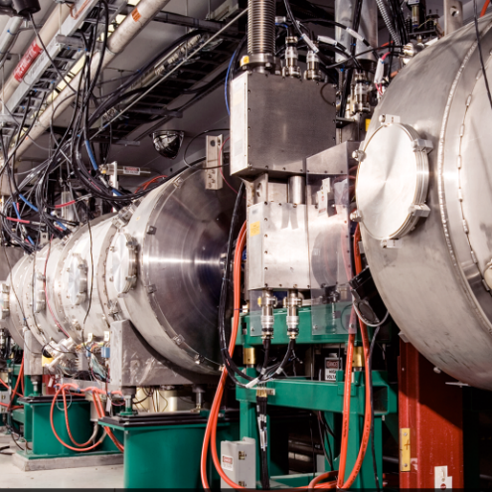
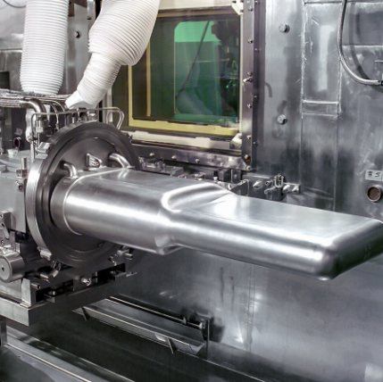
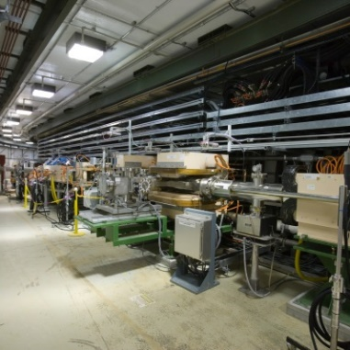

Plan to Reliable 1.4 MW Operation
Matt Williamson
Cryogenic Moderator System Engineer
January 22, 2020

Slide 2
Review charges
  Is the plan to return the CMS to reliable operation for 1.4 MW beam power by April 2020 reasonable? Are there additional considerations that need to be included?
  Is the plan to prepare the CMS for reliable operation for the beam power ramp up defined for the PPU culminating in 2.0 MW beam power in Q3 2024 reasonable? Are there additional considerations that need to be included?
  Are the allocated resources sufficient to execute the CMS plans? Is the organization structure for CMS resources reasonable to carry out the scope of work defined in the operations plans?

Slide 3
Outline of discussion
Overview of near-term reliability improvement projects
Status and schedule
Summary and discussion

Slide 4
Near-term reliability improvement projects seek to improve reliability at 1.4MW beam on target
Diagnostic Improvements
  Contamination monitoring
  Pressure/temperature indication
  Upgrade insulating vacuum
System Controls & Hardware Optimization
  Turbine, compressor, and flow control set points
  External consultations
Oil Removal System (ORS)
  Configuration changes
  Replace/repair critical components
  Carbon effectiveness study
He Compressor
  Upgrade problematic components
  Repair and preventative maintenance

Slide 5
CMS diagnostics were highlighted as a key weak point during the Summer 2019 SNS run-cycle
Contamination monitoring in the CMS He gas stream was erratic and unreliable
  Contradictory readings reported frequently
  Replaced CMS diagnostic with unit on loan from CHL early in the Summer 2019 operational upset
    Calibrated for CHL oil – qualitative value only
Pressure and temperature indication near the He/He heat exchanger modules can be improved
  Physical distance of instrumentation from HX
  Key instrumentation was not auto-archived
    Local gauge readings recorded manually
  Instrumentation is original in most cases, calibration confidence is an issue

Slide 6
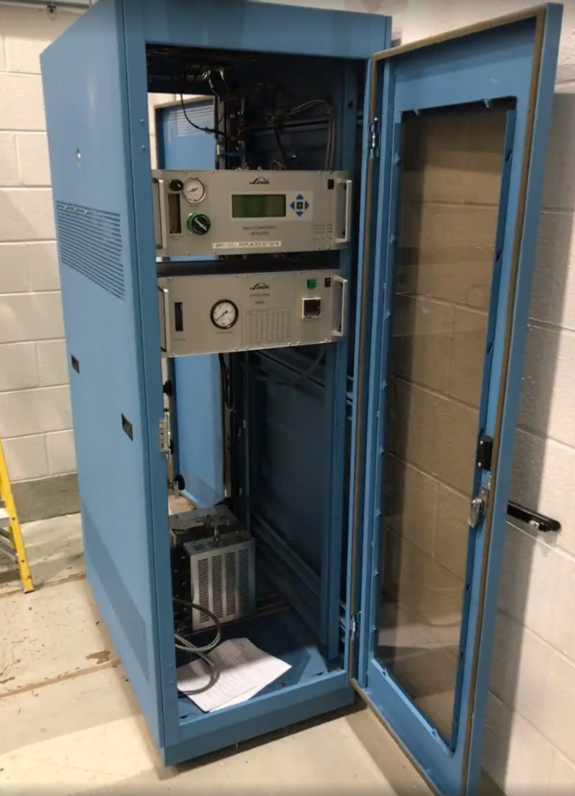
Current CMS contamination monitoring capabilities are limited and inefficient
Linde Gas Analyzer (LGA) provides primary contamination monitoring of CMS He
  The LGA configuration during Summer 2019 permitted sampling at a single location in the loop
    At high pressure supply between the ORS and He coldbox
    Short-term fix piping slows reliable sampling
  LGA unit configuration found to be discharging to pressure higher than mfg. recommendation
    Validity of instrument reporting called into question
  Short-term fix for this issue required He discharge to atmosphere
    20-minute LGA pyrolyzer sampling interval and lengthy time for stabilization after swapping sampling locations resulted in intolerable helium waste

Slide 7
Configuration changes will improve reliability of He contamination monitoring
Safe addition of He sample discharge volume at pressure recommended by mfg.
Provide motive force to return sample gas to helium compressor suction and stabilize sampler flow
Reduce helium consumption
FDR complete, procurement in progress

Slide 8
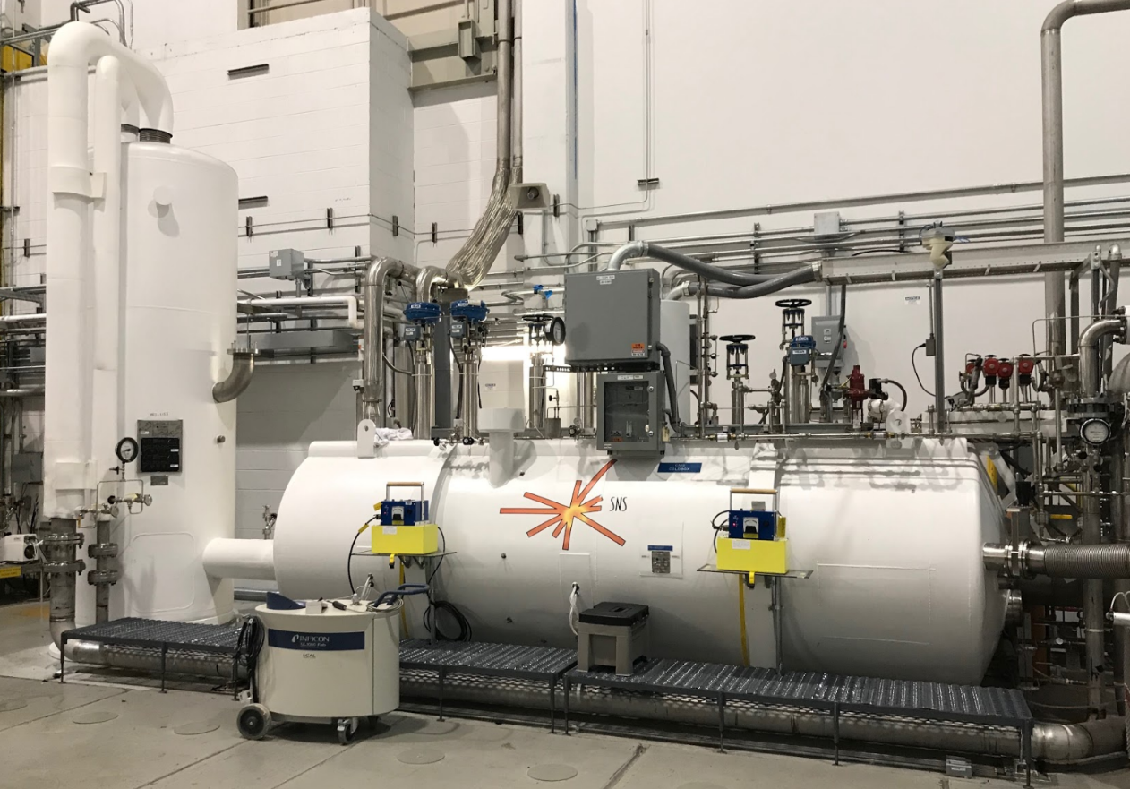
Modernization of existing P/T diagnostics and supporting utilities will improve quality of system health indicators
Several pressure and temperature diagnostics in the He coldbox were replaced and routed for auto-archival during the October 2019 outage
Additional P/T diagnostics will be added as opportunities arise during invasive maintenance activities
Upgrade of Coldbox insulating vacuum systems provide additional confidence in vacuum integrity
  He diffusion pump – no serious issues observed during 2019, but occasional irregular behavior

Slide 9
Near-term reliability improvement projects seek to improve reliability at 1.4 MW beam on target
Diagnostic Improvements
  Contamination monitoring
  Pressure/temperature indication
System Controls & Hardware Optimization
  Turbine, compressor, and flow control set points
  External consultations
Oil Removal System (ORS)
  Configuration changes
  Replace/repair critical components
  Carbon effectiveness study
He Compressor
  Upgrade problematic components
  Repair and preventative maintenance

Slide 10
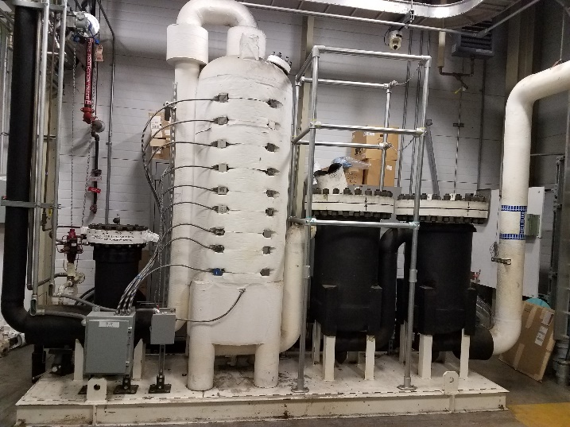
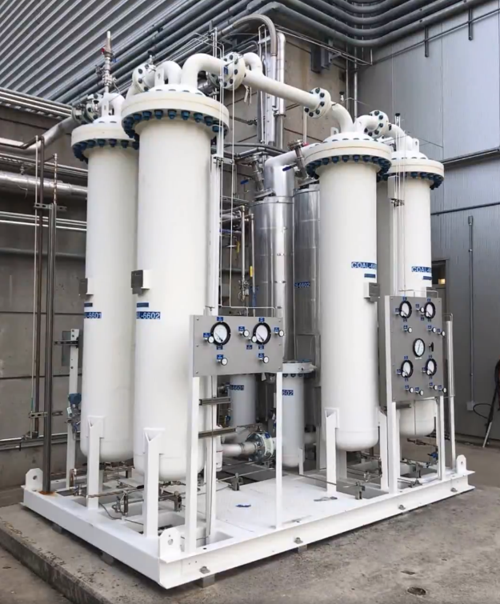
The CMS Oil Removal System was upgraded in 2018
Coal. 1
Coal. 2
CB 1
FF 1
From He Compressor
To Coldbox
Orig. CMS ORS
Allows for processing of one carbon bed with the other on-line
CB1
FF 1
Coal. 1
Coal. 2
Coal. 3
Coal. 4
CB 2
FF 2
Upgraded CMS ORS
Coal. – Coalescer
CB – Carbon Bed
FF – Final Filter

Slide 11
Migration of oil contamination to the refrigerator was suspected in Summer 2019
Elevated oil readings were observed downstream of the ORS during the Summer 2019 run-cycle
  Concern over misaligned Bulk Oil Separator (BOS) filters
  Initial efforts to identify an analytical instrument to measure oil levels in helium at BOS exit have been unsuccessful
Linde Gas Analyzer readings upstream of ORS carbon beds: ~30-100 ppb, downstream of carbon beds: ~2-5 ppb
  Effective carbon beds should provide 99.99% contamination capture
Sudden appearance of significant oil in ORS coalescer 4 sight-glass
  ~40 mL during 4-hour period
  No visible accumulation in coalescer 1-3 sight glasses during this period
  Oil return volume in effective series of coalescers should taper down significantly as flow proceeds downstream (rarely should see significant return from coal. 3 or 4)

Slide 12
Oil Removal Skid carbon beds were replaced with two different types of carbon
New CMS ORS includes two carbon beds (in parallel configuration)
  Carbon was replaced in both during October outage
    CHL variety carbon (coconut husk)
    CMS variety (Cabot Sorbonorit B 4, current flow path)
  Variation due to different oil types in CHL/CMS compressors
New configuration provides option of redirecting flow to alternate bed if oil contamination levels begin to read high downstream of the ORS carbon bed
CB1
(Coconut)
FF 1
Coal. 3
Coal. 4
Coal. 5
Coal. 6
CB 2
(Cabot)
FF 2
Coal. – Coalescer
CB – Carbon Bed
FF – Final Filter
New CMS ORS

Slide 13
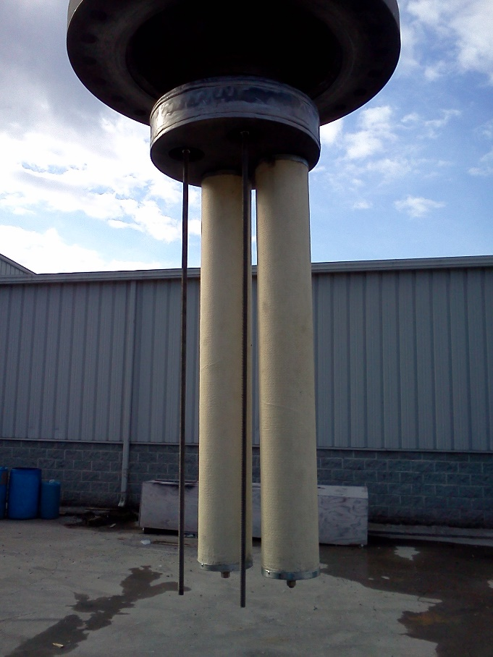
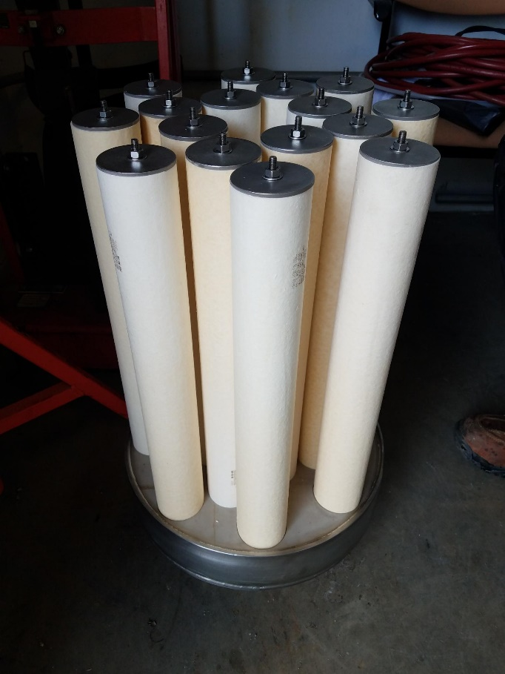
Oil Removal Skid coalescers were replaced with proven Balston coalescing elements
Installed adapter plates to improve coalescer performance in new ORS
  Quadrupled total element count
  Replaced with proven elements
Checked for coalescer seal, installation, or integrity issues in new ORS
  No observed issues
IES elements installed in new ORS during Summer 2019 run-cycle
Adapter with Balston elements - installed in original ORS coal. 1-2, new ORS coal. 3-6

Slide 14
Original CMS ORS coalescer vessels were installed in series
Original ORS Balston coalescer elements were replaced and returned to service upstream of the new ORS
  Carbon and FF were removed from original ORS
96 total coalescing element count
  No significant additional DP observed vs. previous run-cycles
  Prior to this change, inlet to CB reading: 30-100 ppb. Following change: ~9 ppb
From He Compressor
Coal. 1
Coal. 2
CB 1
(empty)
FF 1
(removed)
Coal. – Coalescer
CB – Carbon Bed
FF – Final Filter
Orig. CMS ORS
CB1
(Coconut)
FF 1
Coal. 3
Coal. 4
Coal. 5
Coal. 6
CB 2
(Cabot)
FF 2
To Coldbox
New CMS ORS

Slide 15
A study on carbon effectiveness and oil contamination is needed
Application is common, but documentation guiding carbon media selection is lacking
  CHL variety (coconut husk), historical CMS variety (Cabot Sorbonorit B 4)
Comparative analysis of effectiveness has not been performed
  Compressor oil type
  Pre-installation oil processing technique performed
  Carbon installation technique
  Post-installation processing/purging performed

Slide 16
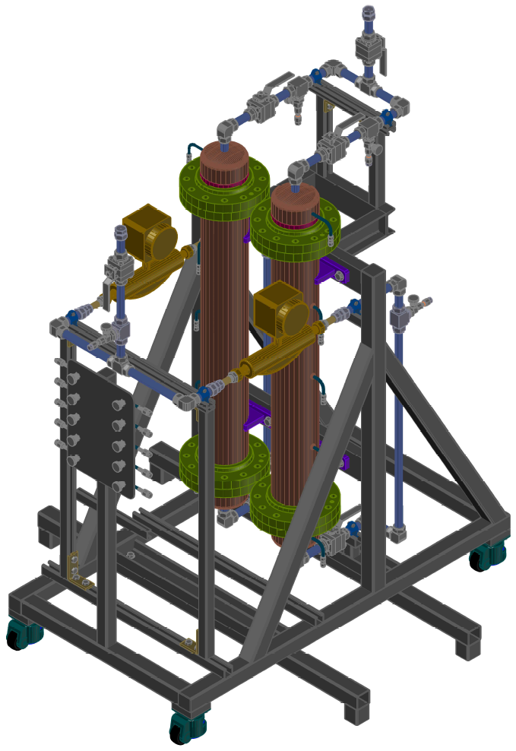
The carbon effectiveness test skid will utilize CTF equipment to simulate CMS flow conditions
Provide a simulation of flow characteristics and exposure time matching carbon beds installed in the CMS ORS
Design will support future work:
  additional contamination types, carbon processing, etc.
Common Exhaust
Common Inlet
Independent Coriolis Flowmeters
Multiple Contamination Sampling Ports
Dual Pressure Vessels
Mobile Support Frame
Image and tables courtesy of Brian Degraff
Removeable Tipping Outriggers

Slide 17
Near-term reliability improvement projects seek to improve reliability at 1.4 MW beam on target
Diagnostic Improvements
  Contamination monitoring
  Pressure/temperature indication
System Controls & Hardware Optimization
  Turbine, compressor, and flow control set points
  External consultations
Oil Removal System (ORS)
  Configuration changes
  Replace/repair critical components
  Carbon effectiveness study
He Compressor
  Upgrade problematic components
  Repair and preventative maintenance

Slide 18

External consultations are being pursued to evaluate controls set-points
Air Liquide consultation will provide an external evaluation of system historical performance, including Summer 2019 excursion
  Air Liquide originally managed the fabrication of the CMS coldbox
  Evaluation of system parameters during healthy and troubled run-cycles
  Report on recommended operational changes and action plan:
    Control set-points, turbine hardware, flow control valve configurations, etc.
  Phase 1 report deliverable expected in January 2020
Agreement includes exchange of internal heat exchanger geometry critical to completion of a CMS thermal-hydraulic model
  Delivery expected in January 2020

Slide 19
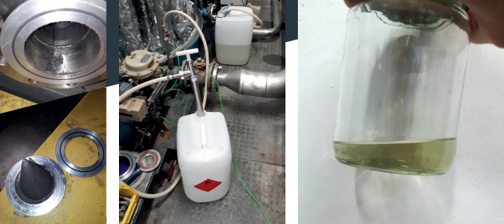
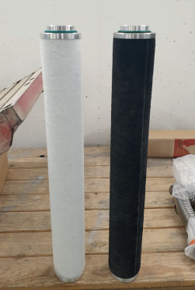
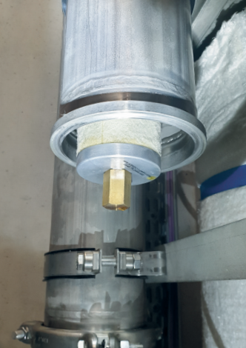

External consultations are being pursued to build internal expertise
RAK Industrial Consulting will provide an external evaluation of CMS operation
  Report will include recommend actions and procedural changes
  Initial SNS visit scheduled January 15 -16, 2020
  Experienced in recovery of problematic systems
Images: RAK Industrial Consulting

Slide 20
Near-term reliability improvement projects seek to improve reliability at 1.4 MW beam on target
Diagnostic Improvements
  Contamination monitoring
  Pressure/temperature indication
System Controls & Hardware Optimization
  Turbine, compressor, and flow control set points
  External consultations
Oil Removal System (ORS)
  Configuration changes
  Replace/repair critical components
  Carbon effectiveness study
He Compressor
  Upgrade problematic components
  Repair and preventative maintenance

Slide 21
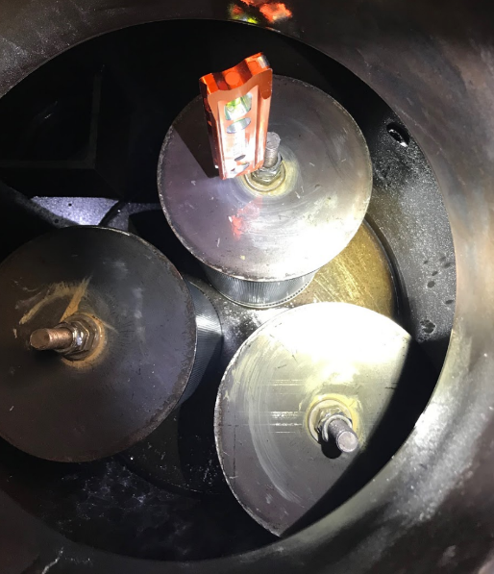
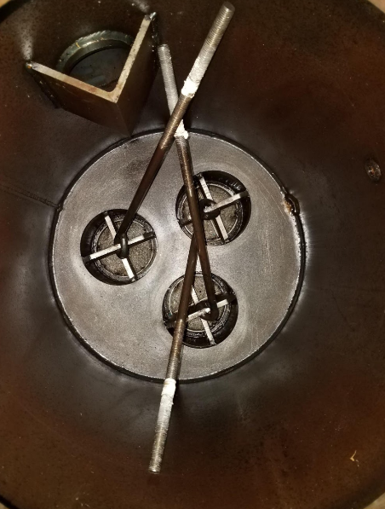
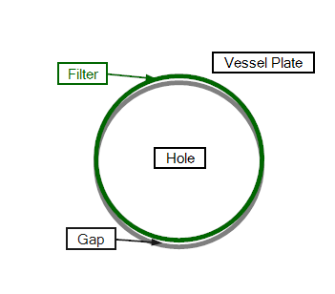
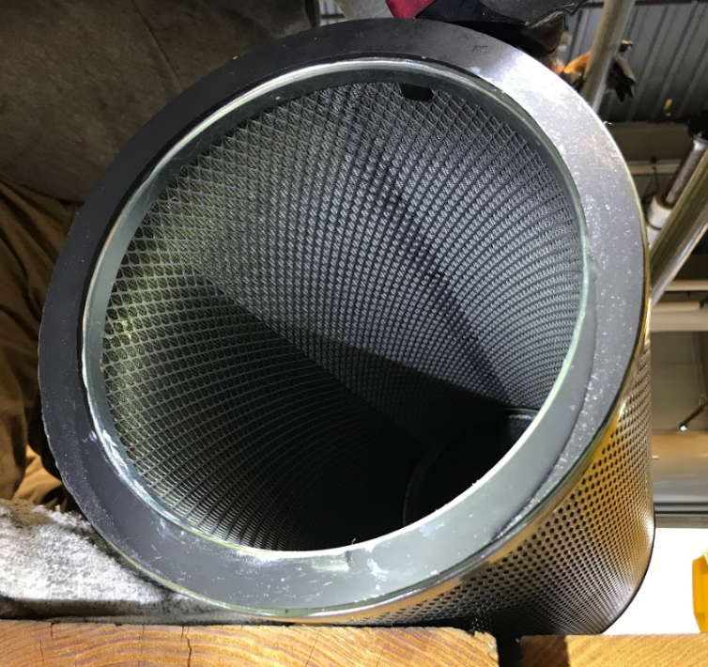
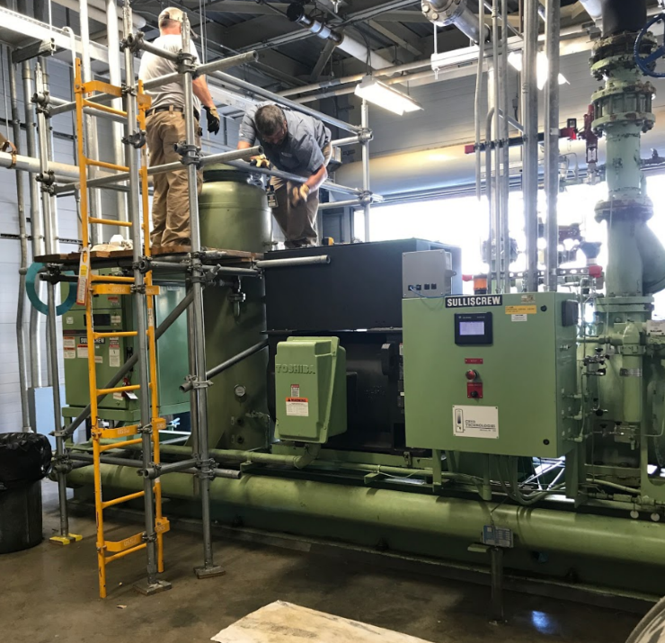
The first line of protection against oil contamination will be redesigned
Bulk oil separator mounting design makes for challenging installation
  Misalignment dramatically increases oil passage downstream to the ORS
  Difficult to verify alignment prior to system restart

Slide 22
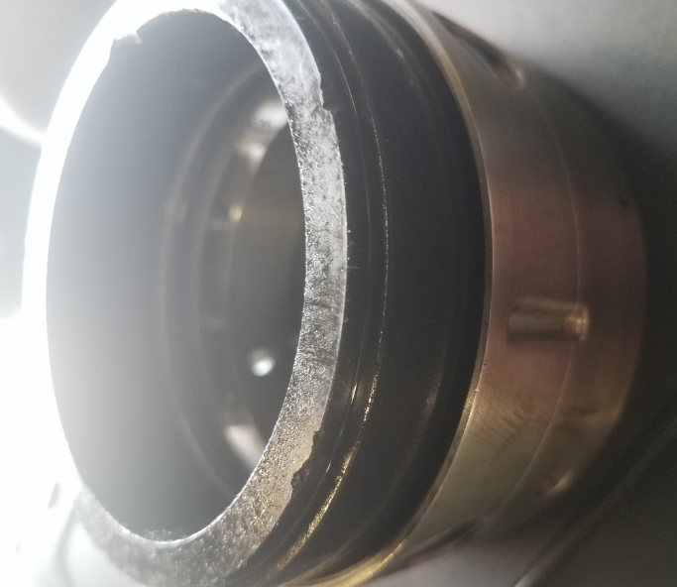
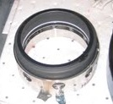
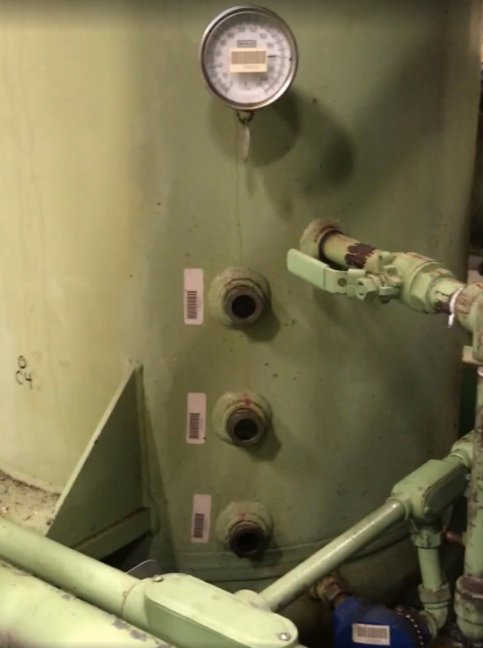
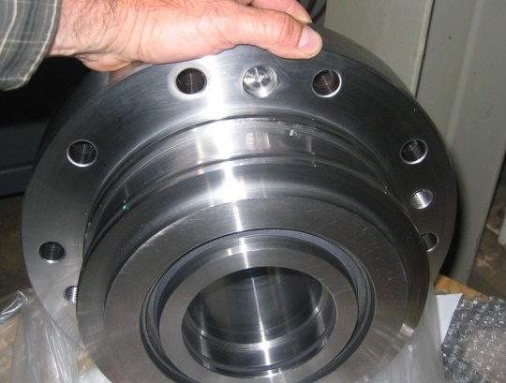
Problematic He compressor components will be upgraded
Repair of drain-back lines and internal compressor process lines
Upgrade leaking shaft seal
  Performed on CHL compressors
  Dual seal with SS bellows
Addition of a continuous oil level sight glass
Implementation of these improvements will consider long-term CMS goals and PPU upgrades

Slide 23
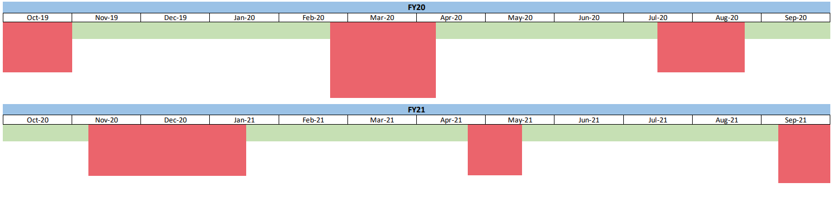
Sprint-planning for implementation of reliability improvements during SNS outages
Task Force Formed
Changed coal. Filters & changed carbon
Run System (exhibit extended run cycle)
Change Comp.
& Change oil, LGA Upgrade
Flush HX, comp annual & circulator maintenance, Ready for 1.55 MW
Run System (exhibit extended run cycle)
Utilize outages is Summer of 2020 and Winter of 2020-21 to implement 1.4 MW reliability upgrades

Slide 24
Current status and resource needs to accomplish these goals
Reliability improvement projects are staffed and supported by highly matrixed team
Diagnostic Improvements
  Contamination monitoring
  Pressure/temperature indication
  Upgrade insulating vacuum
System Controls & Hardware Optimization
  Turbine, compressor, and flow control set points
  External consultations
Oil Removal System (ORS)
  Configuration changes
  Replace/repair critical components
  Carbon effectiveness study
He Compressor
  Upgrade problematic components
  Repair and preventative maintenance

Slide 25
System controls and hardware optimization may be understaffed
Turbine/coldbox hardware changes will require extensive planning
  Currently lack FTE to manage this effort and interface with sub.
Impact on controls could be significant
  Lack dedicated controls FTE to manage SNS/AL interface
Scope of work to be determined following analysis of external consultation reports

Slide 26
Compressor system improvements and repairs require additional support
Compressor upgrades will require extensive planning
  Manage interfaces with long-term CMS upgrades and PPU impacts
  Currently lack FTE to manage this effort and interface with multiple subcontractors/vendors
  Progress has been stagnant

Slide 27
Summary of charges
  Is the plan to return the CMS to reliable operation for 1.4 MW beam power by April 2020 reasonable? Are there additional considerations that need to be included?
    Implementation of hardware configuration improvements to support the near-term plan for reliable operation at 1.4 MW is underway, and resulting operational performance in the Winter 2019-2020 SNS run-cycle is promising. This plan is designed to interface with plans for operational procedure development and long-term CMS hardware configuration goals that are occurring in parallel.
  Is the plan to prepare the CMS for reliable operation for the beam power ramp up defined for the PPU culminating in 2.0 MW beam power in Q3 2024 reasonable? Are there additional considerations that need to be included?
    The plan for reliable operation at 1.4 MW lays groundwork for reliable operation at 2.0 MW beam power. Elements of the plan to support 1.4 MW reliable operation have been deployed to provide maximum short-term impact while maintaining healthy interfaces with the long-term plan for reliable 2.0 MW operation.
  Are the allocated resources sufficient to execute the CMS plans? Is the organization structure for CMS resources reasonable to carry out the scope of work defined in the operations plans?
    The resources assigned to support these reliability improvement projects are limited and/or lacking in key areas. Where deployed, matrixed support has proved effective.

Slide 28
Thank you!
Further discussion, Q&A

Slide 29
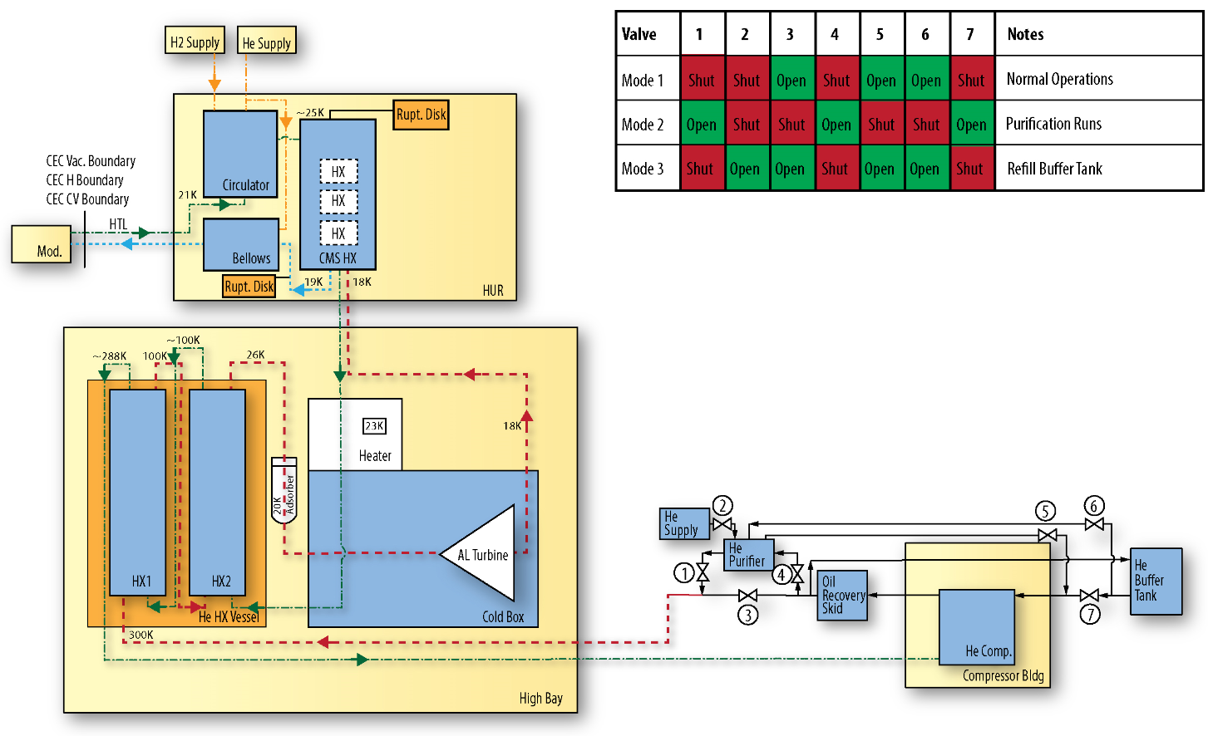
Reference
CMS Heat Exchanger Vessel
CMS “Coldbox”
CMS Helium Refrigerator
Notes:
Move to own slide

Slide 30
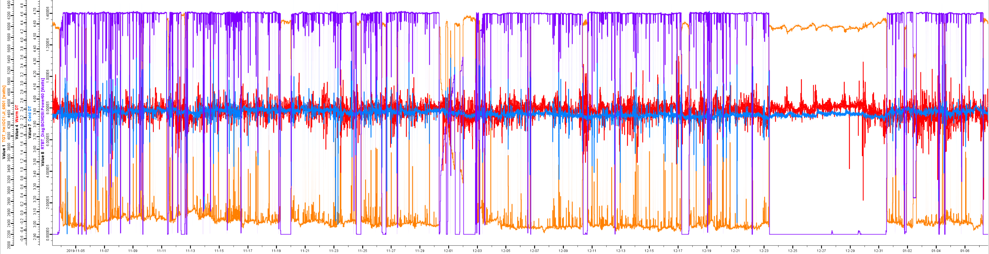
Performance to date, following completion of October SNS outage
Nov. 3, 2019
January 7, 2020
Refrigeration margin under load from 1.4MW beam on target: ~2500W
Observation continues
Heater Margin
HX Warm DT
Beam Power
HX Cold DT
Notes:
Update image with latest – delete after incorporation in ops presentation

Slide 31
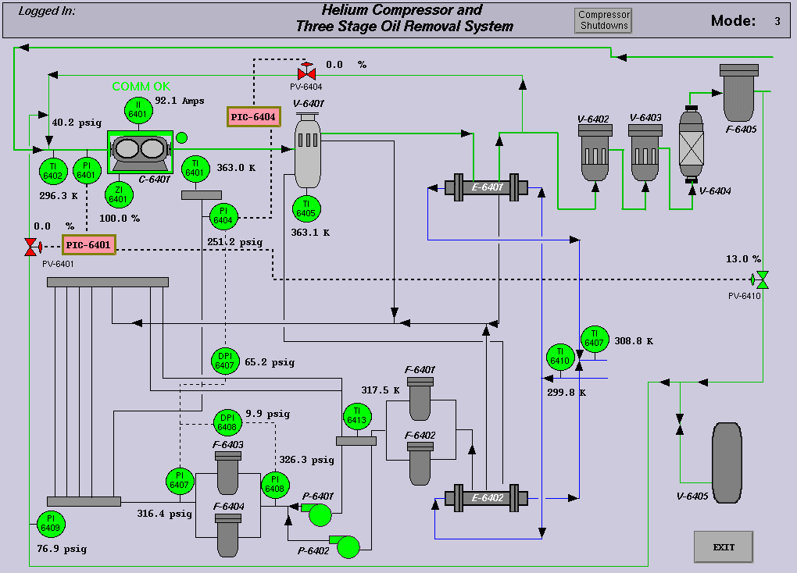

Slide 32
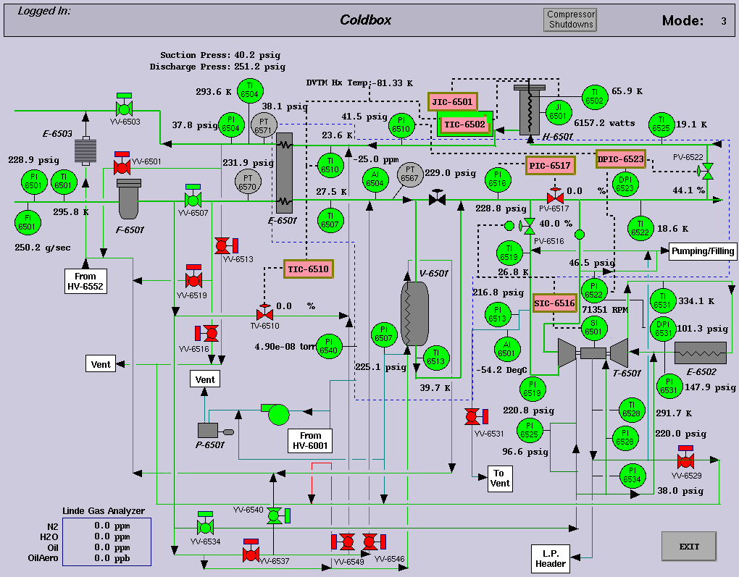

Slide 33
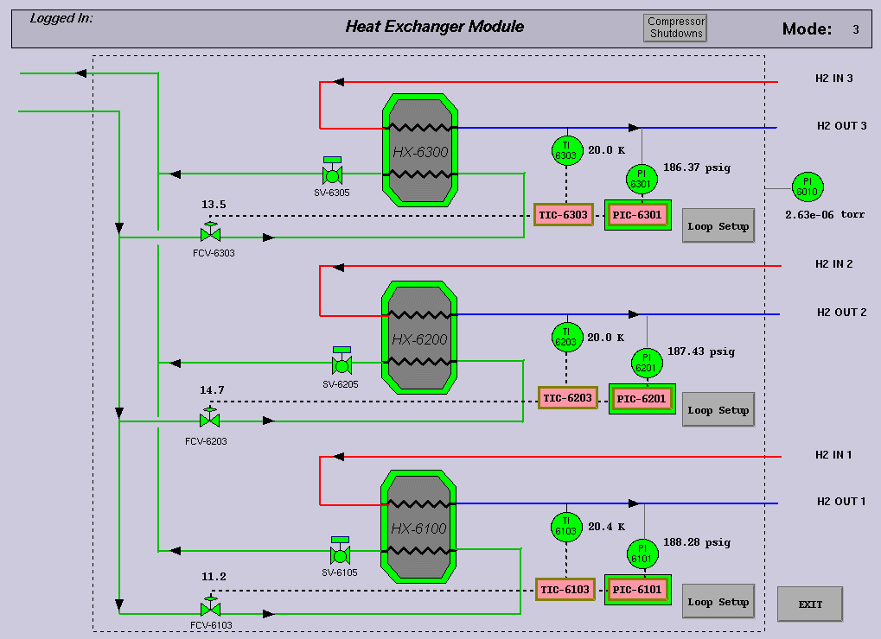

Slide 34
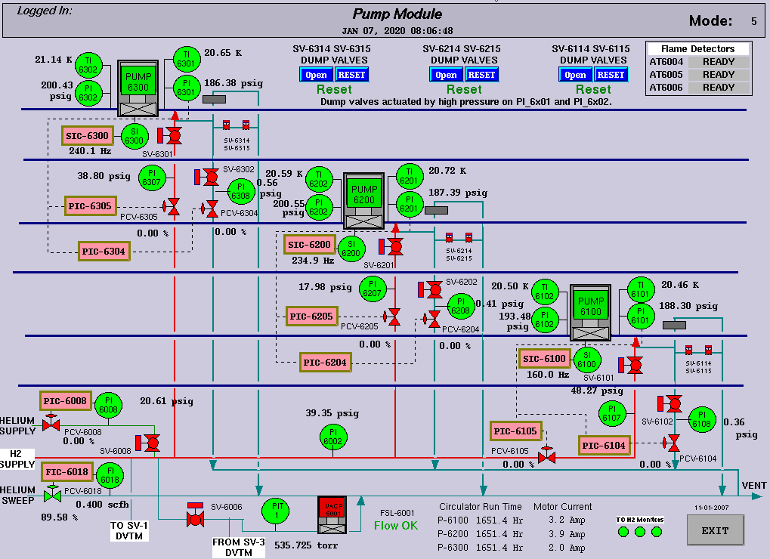

Slide 35
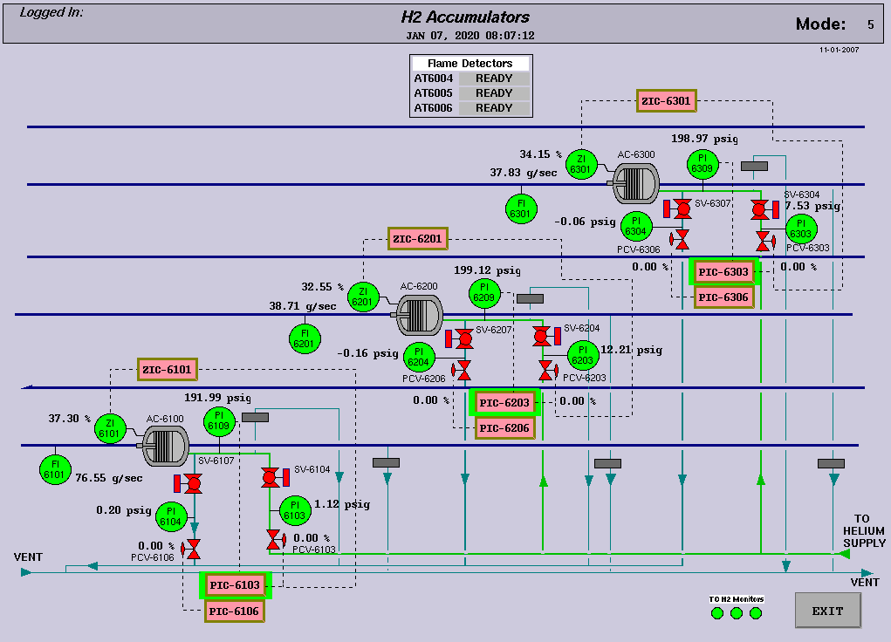

Slide 36
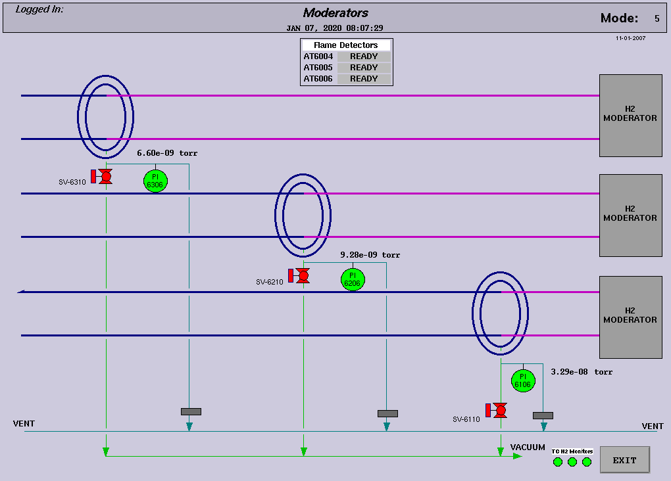

Slide 37
