Slide 1
Muon Spin Rotation/Relaxation as a Probe of Unconventional Superconductivity
Graeme Luke
McMaster University

Slide 2
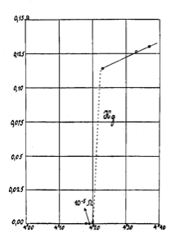
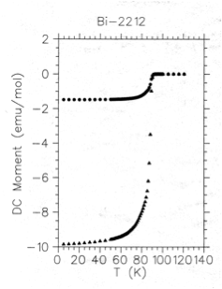
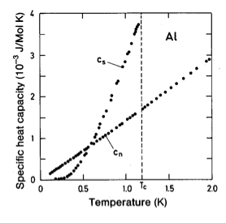
Superconductivity
𝛒=0, M=-1.0 (SI)
Thermodynamic phase transition (Cp)
2Δ= Energy to split Cooper pair
Order parameter for S.C.
Measure directly
Tunneling, ARPES
Indirectly via quasiparticles
specific heat
penetration depth

Slide 3
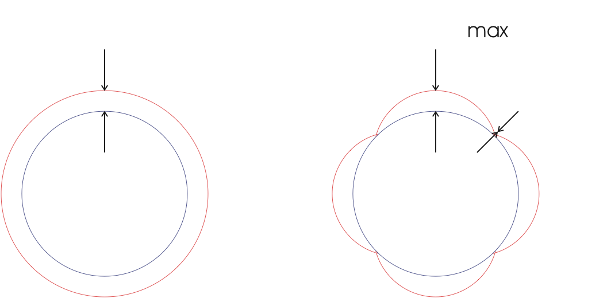
Unconventional Superconductivity
Δ=Δ
Δ
Conventional
Δ(k) has symmetry of crystal
Usually Δ(k)=Δ (s-wave)
Unconventional
Δ(k) has lower symmetry
Possible nodes in gap.
Other broken symmetries

Slide 4
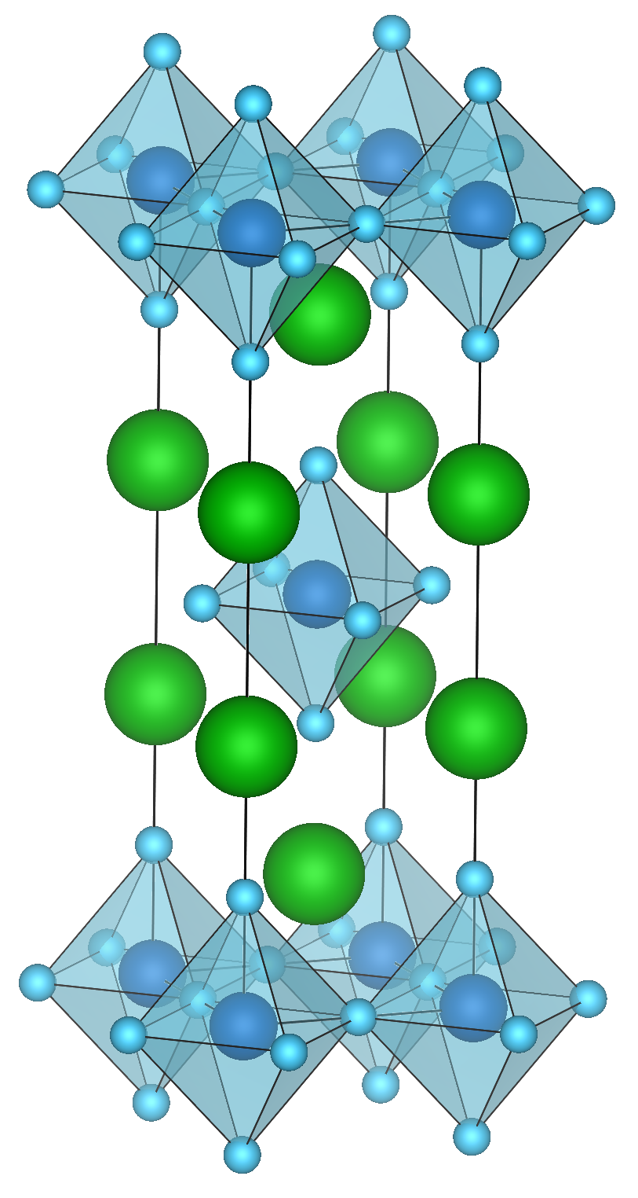
Sr2RuO4
1st superconducting layered perovskite w/o Cu.
Isostructural to La2CuO4
Stoichiometric Sr2RuO4: metallic and superconducting
Maeno et al., Nature 372, 532 (1994).

Slide 5
Sr2RuO4 Normal State
Anisotropic 3-D metal
T<25K: 𝛒~T² (Fermi liquid)
𝛒c/𝛒ab~1400
Hussey et al., Phys. Rev. B 57, 5505 (1998).
α
β
γ
Bergemann et al., Adv. Phys. 52, 639 (2003).
Damascelli et al., Phys. Rev. Lett. 85, 5196 (2000).
Mackenzie et al., Phys. Rev. Lett. 76, 3786 (1996).

Slide 6
Superconducting State
Dependence of Tc on 𝛒0
Extreme sensitivity to (non)-magnetic impurities
Mackenzie et al., Phys. Rev. Lett. 80, 161 (1998).

Slide 7
Anisotropic Pairing? - NMR
power law 1/T1, no Hebel-Slichter peak.
spin susceptibility unchanged below Tc.
Ishida et al., Phys. Rev. B 56, R505 (1997).
Ishida et al., Phys. Rev. Lett. 84, 5387 (2000).
Ishida et al., Nature 396, 658 (1998).

Slide 8
Anisotropic Pairing?
Induced moment form factor (Neutron)
No change of spin susceptibility below Tc.
consistent with spin triplet: kx±iky state.
Duffy et al., Phys. Rev. Lett. 85, 5412 (2000).

Slide 9
Muon Spin Rotation
π⁺ → µ⁺ + υ_{µ}. (26ns)
100% muon polarization
µ⁺ →e⁺ + 2 neutrinos
~1/3 polarization.

Slide 10
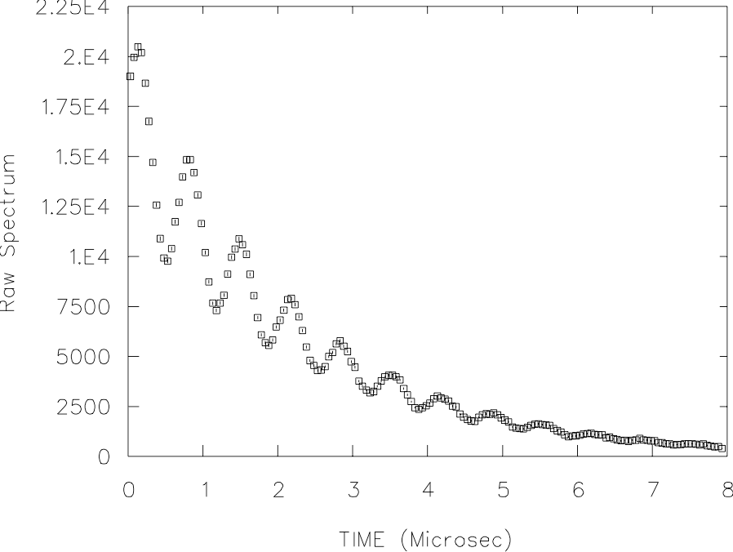
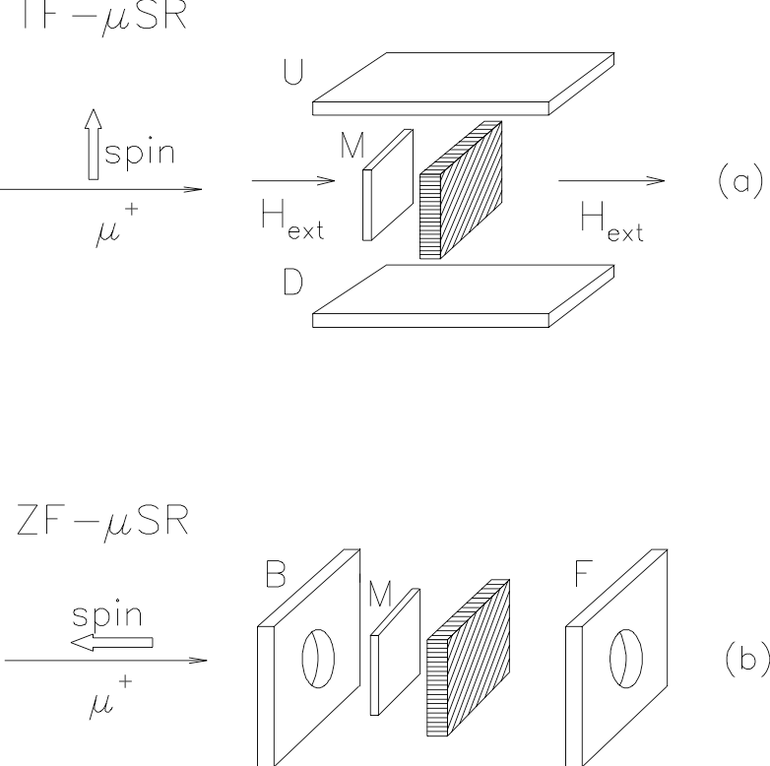
Experimental Geometry
τμ=2.2μs

Slide 11
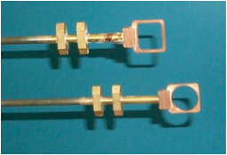
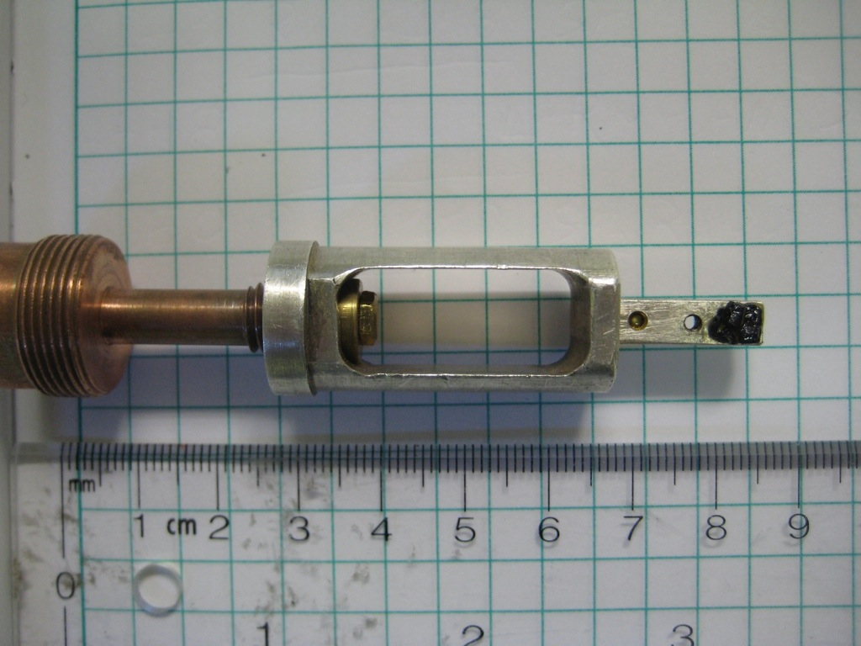
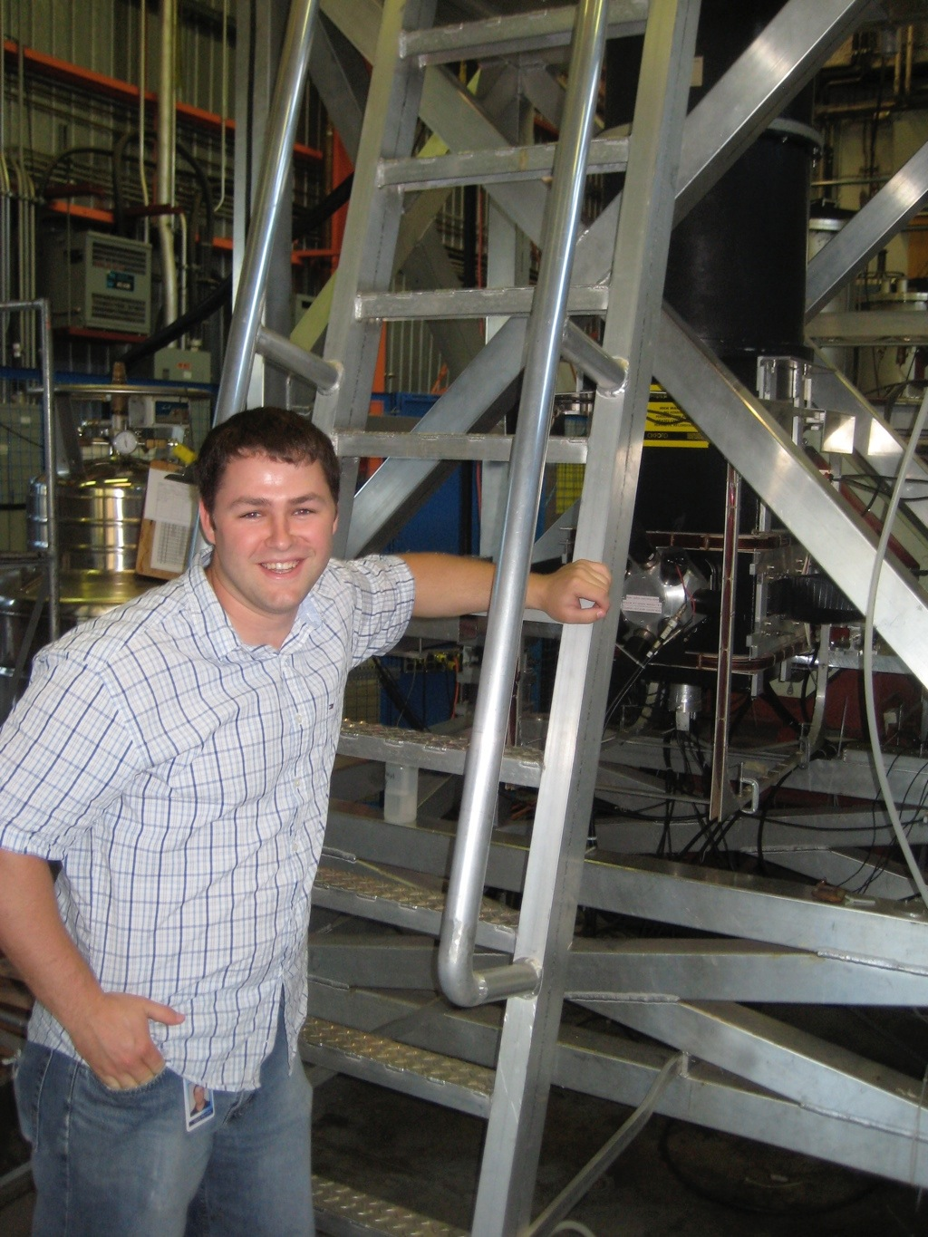
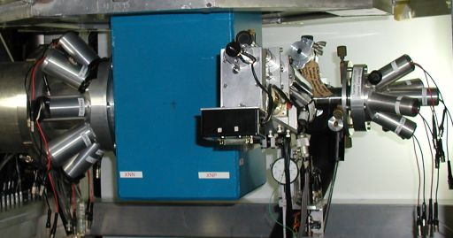
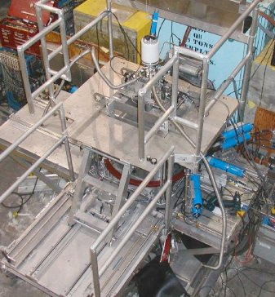
Capabilities at TCMMS
Low Background
DR: 20mK, 5T
HiTime: 7.5T, 1GHz, 2K
High Pressure:
22kbar, 2.5K, 55% sample

Slide 12
Zero Field ZF-μSR
Ordered state, ν∝ Moment ∝√IB
Random frozen spins give characteristic relaxation.
Carlo et al., Nat. Mat. 11, 323 (2012).

Slide 13
Broken Time Reversal Symmetry
Surfaces, domain walls, defects generate physical supercurrents and magnetic fields.
eg. kx+iky/kx-iky
B(x)
j(x)
Sigrist & Ueda, R.M.P. 63, 239 (1991).

Slide 14
Sr2RuO4: ZF-μSR
Luke et al., Nature 394, 156 (1998).
Luke and Sonier, Physics in Canada 67, 93 (2011).

Slide 15
Polar Kerr Effect
Kerr rotation in trained samples below Tc.
Xia et al., Phys. Rev. Lett. 97, 167002 (2006).

Slide 16
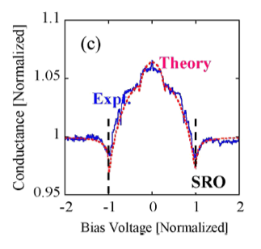
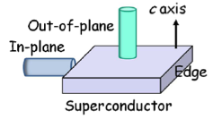
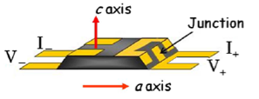
Surface Probes
No supercurrents detected at surfaces of Sr2RuO4.
Kirtley et al., Phys. Rev. B 76, 014526 (2007).
Hicks et al., Phys. Rev. B 81, 214501 (2010).
Tunneling detects edge states
Kashiwaya et al., Phys. Rev. Lett. 107, 077003 (2011).

Slide 17
PrOs4Sb12
ZF-μSR
Scanning SQUID - no evidence for surface currents.
Aoki et al., Phys. Rev. Lett. 91, 1067003 (2003).
Hicks et al., Phys. Rev. B 81, 214501 (2010).

Slide 18
UPt3
ZF-μSR
spontaneous local field below Tc-.
Not seen in Europe.
Kerr rotation
below Tc-.
Luke et al., Phys. Rev. Lett. 71, 1466 (1993).
Dalmas de Reotier et al., Phys. Lett. A 205, 239 (1995).
Schemm et al., Science 345, 190 (2014).

Slide 19
Non-Centrosymmetric Superconductors
SrPtAs
LaPt3Si
Biswas et al., Phys. Rev. B 87, 180503R (2013).
Kawasaki et al., JPSJ 82, 084713 (2013).

Slide 20
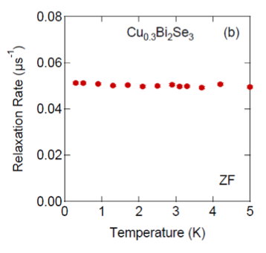
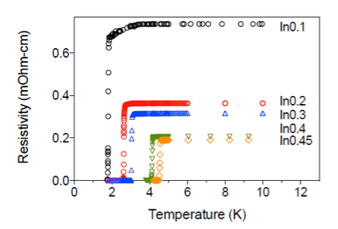
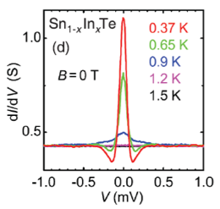
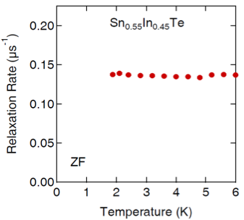
Topological Superconductors
CuxBi2Se3
Sn1-xInxTe
Sasaki et al., PRL 107, 217001 (2011).

Slide 21
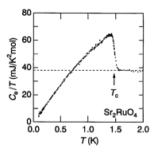
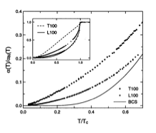
Sr2RuO4 Electrodynamics
ZF-μSR gives broken time reversal symmetry.
kx±iky most likely state.
state is nodeless (gap magnitude constant).
Evidence for gap nodes
Power laws in specific heat, ultrasound attenuation, thermal conductivity…
Nishizaki et al., JPSJ 69, 572 (2000).
Lupien et al., PRL 86, 5986 (2001).

Slide 22
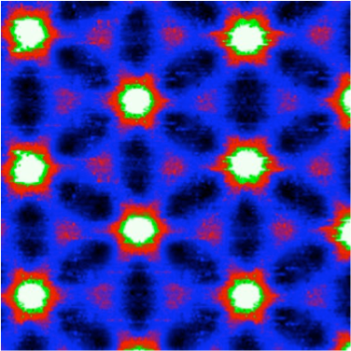
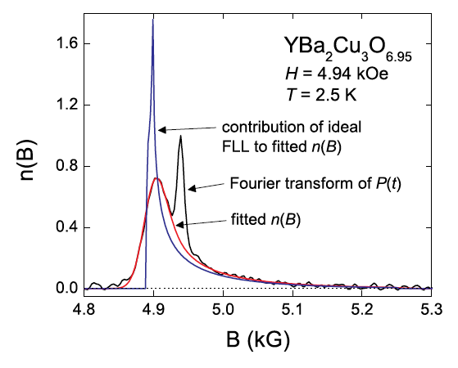
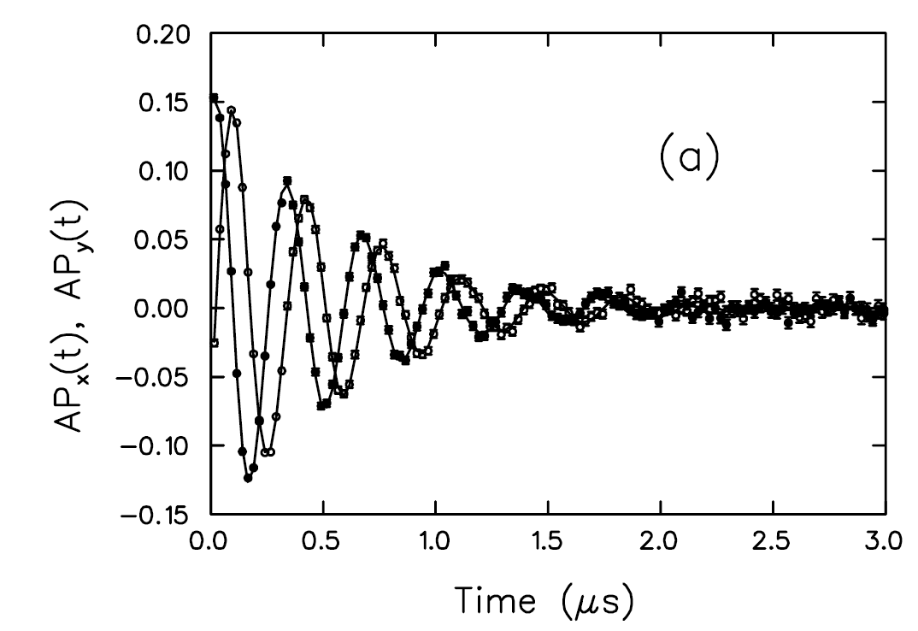
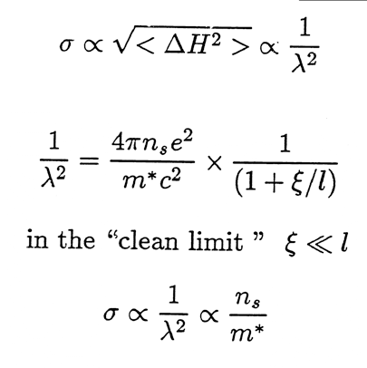
Vortex State
2 lengthscales: λ, ξ
Disorder: broadening of line shape features (convolute with Gaussian).
J.C. Davis website
Ceramics - Gaussian
Sonier, Rep. Prog. Phys. 70, 1717 (2007).

Slide 23
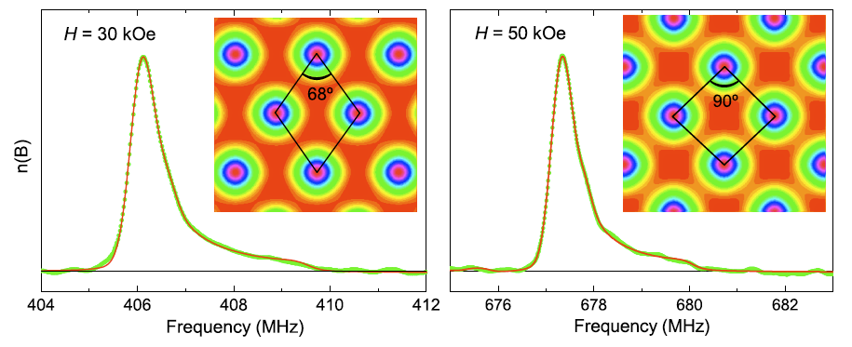
Vortex Lattice Field Distribution
Yaouanc et al., Phys. Rev. B 55, 11107 (1997).
V3Si

Slide 24
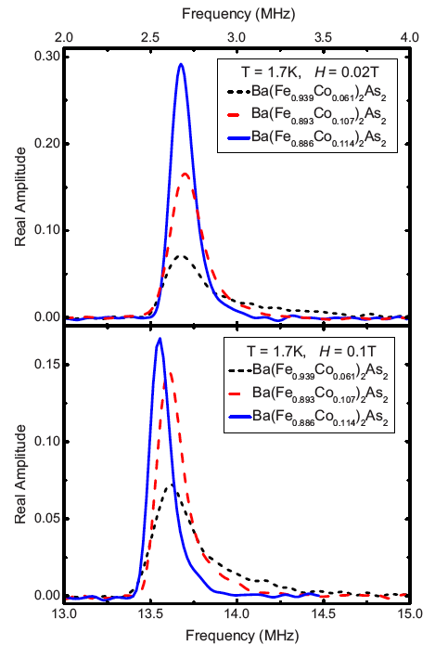
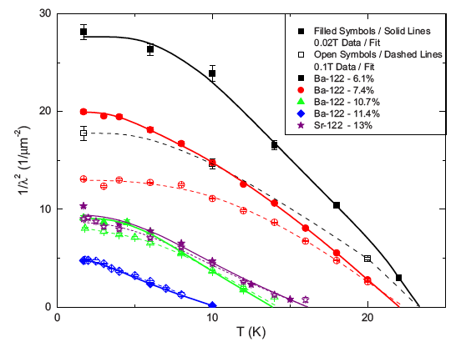
Ba(Fe1-xCox)2As2 Superfluid Properties
Text
Williams et al., PRB 82, 094512 (2010).
s±➞d gap
with Co doping ↑

Slide 25
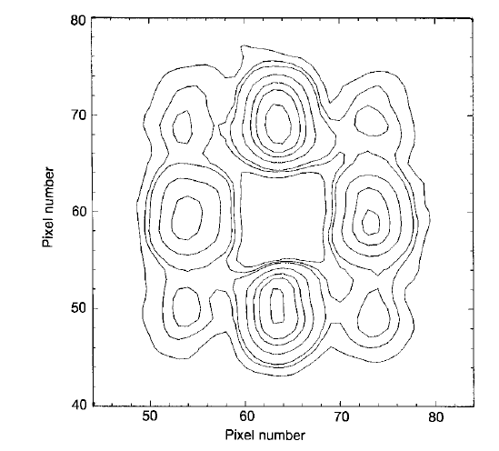
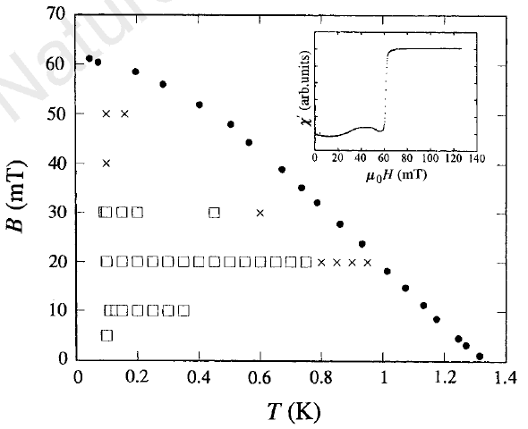
Sr2RuO4: Square Vortex Lattice - SANS
Riseman et al., Nature 396, 242 (1998).

Slide 26
Vortex Lattice - Agterberg
G.L. Theory for a 2-component order parameter with B//c.
Detailed comparison with small angle neutron scattering favours Agterberg model.
1Comp. G.L.
Agterberg ν=.2
Observed
Kealey et al., Phys. Rev. Lett. 84, 6094 (2000).

Slide 27
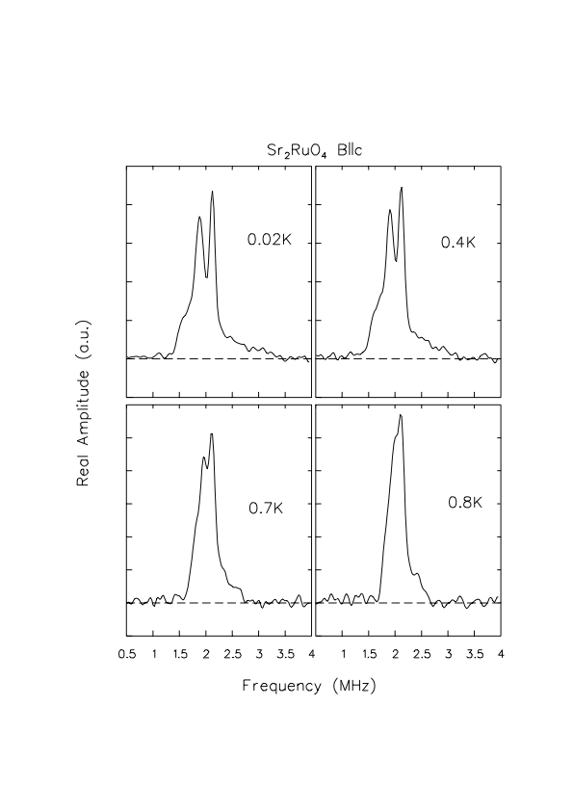
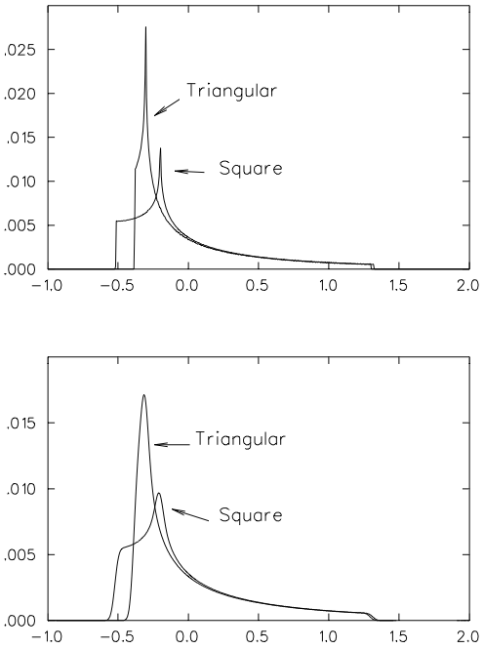
Sr2RuO4 Vortex Lattice Geometry
B.G.
broadened for 𝞃μ, disorder.

Slide 28
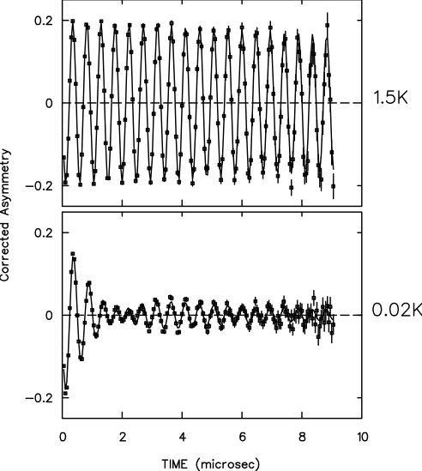
Sr2RuO4 TF-μSR Analysis
Square lattice data fit to microscopic Agterberg theory.
Triangular lattice fit to Ginzburg-Landau model.
Obtain κ for each field from global fit, then extract λ(Τ,Η).

Slide 29
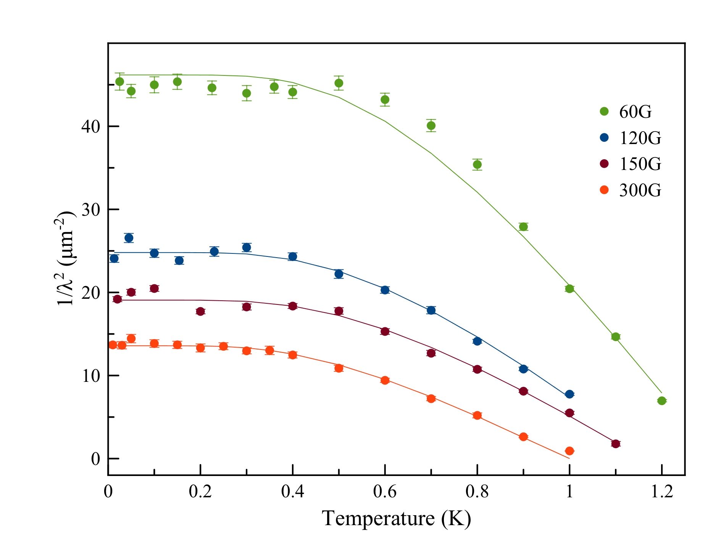
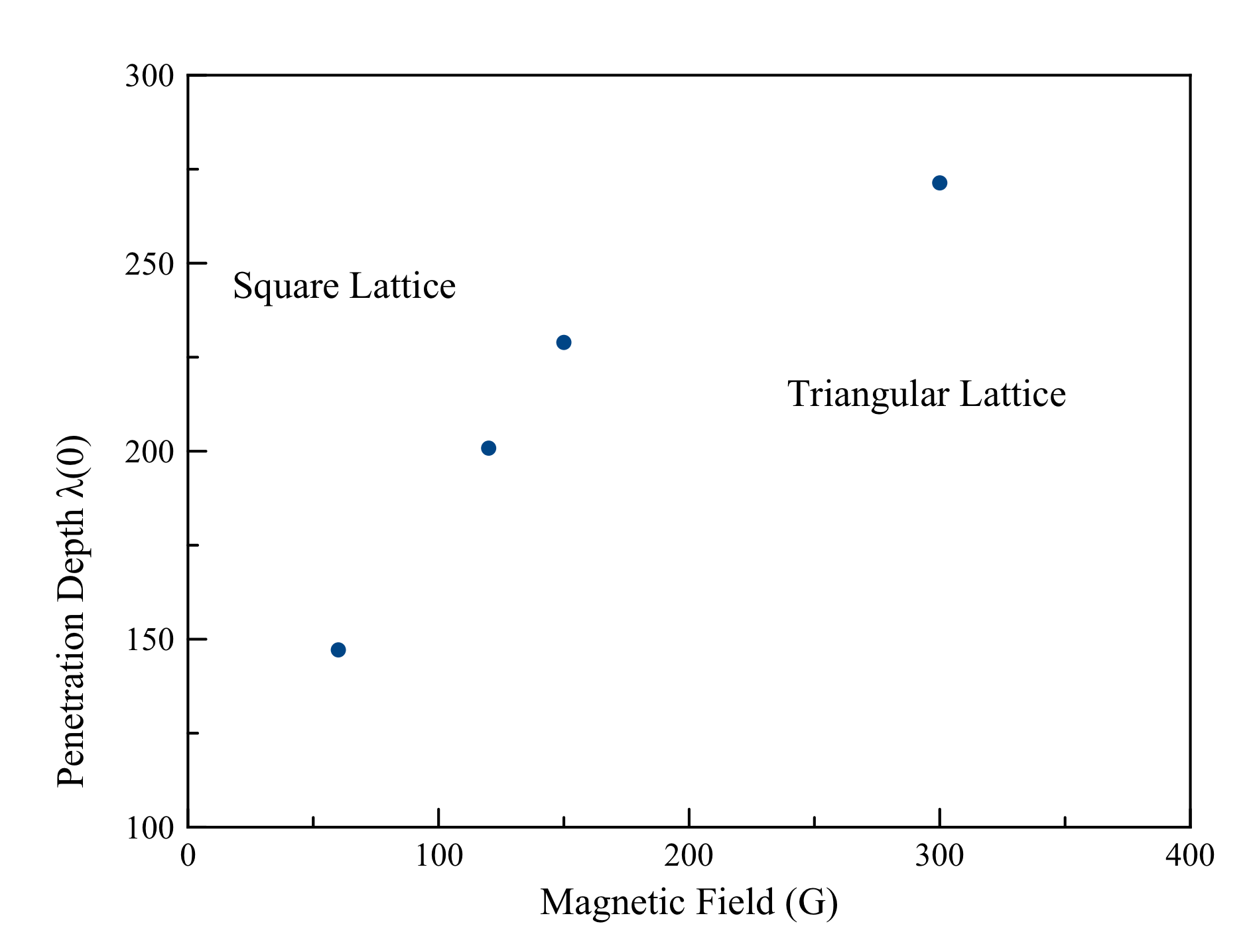
Superfluid Density
Fit to weak coupled BCS.
Neutrons give 194nm at 20mT
all bands give 100nm
γ alone gives 171nm.

Slide 30
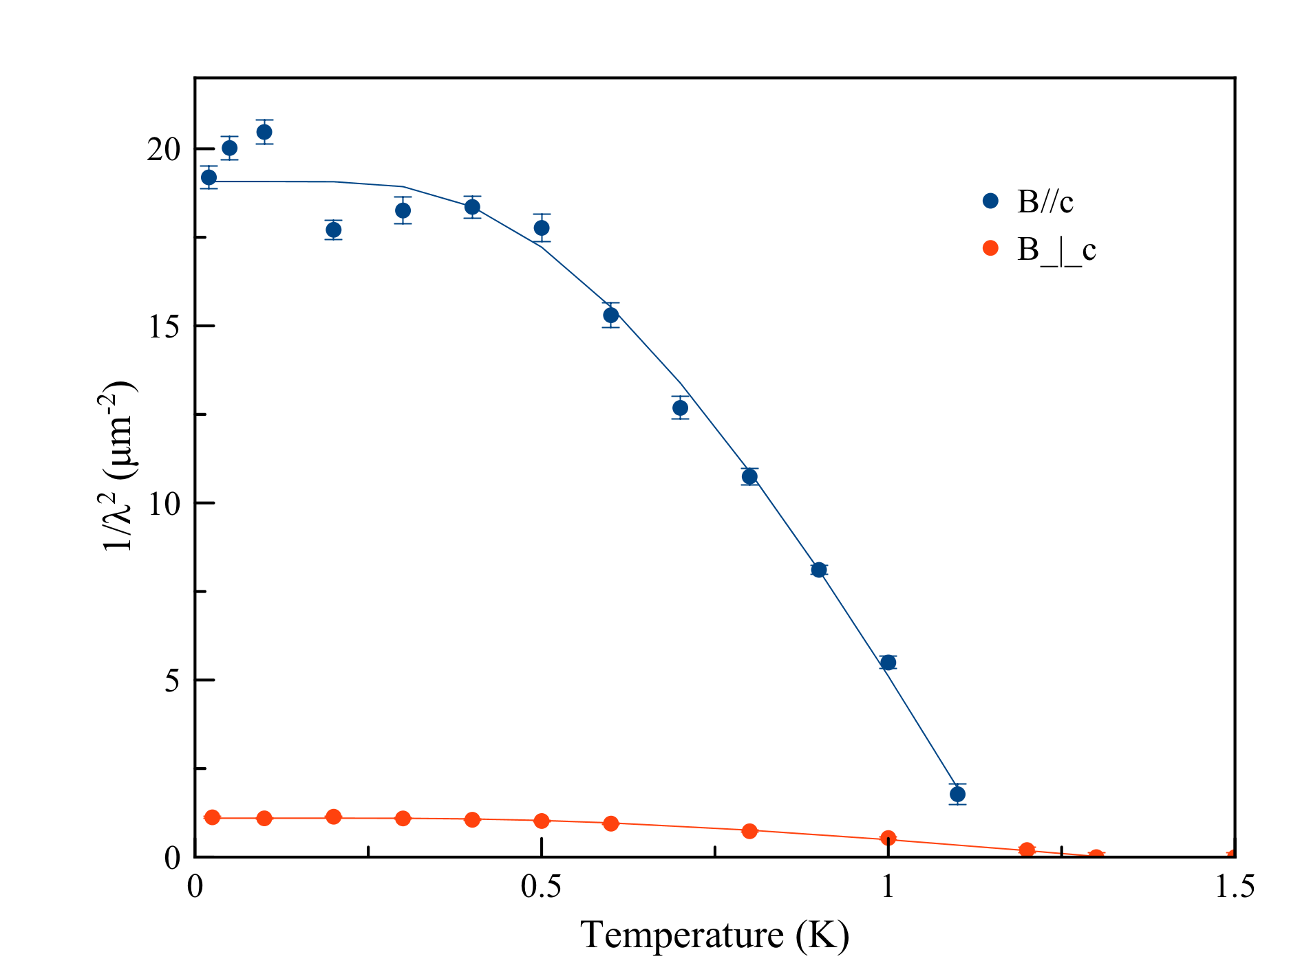
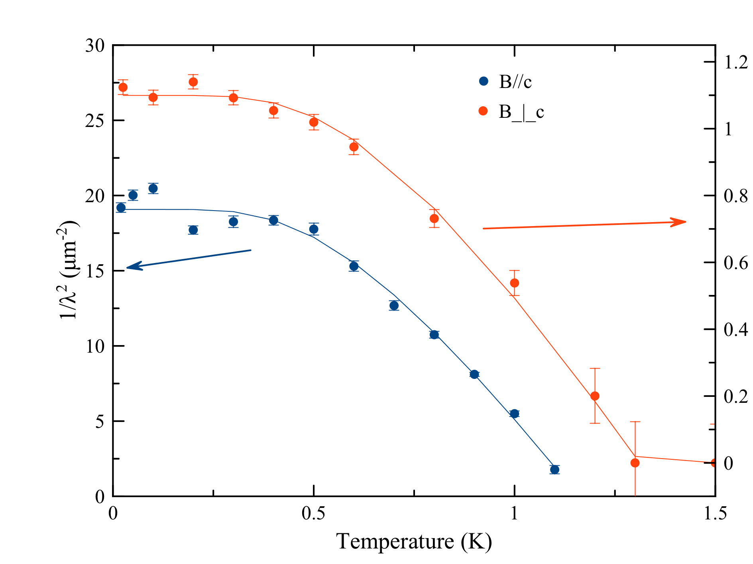
c-axis
λc(0)=4000nm.
No evidence for nodes.
1/λ²=1/λcλab

Slide 31
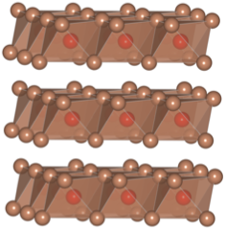
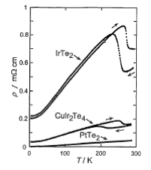
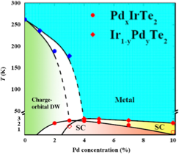
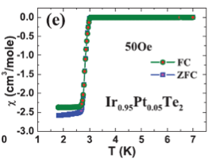
(Ir,Pt)Te2
Layered structure
High spin orbit coupling
Structural transition
Ir Te
Matsumoto et al., JLTP 1999
Yang et al., PRL 108 116402 (2012)
Feng et al., Sci. Rep. 3 1153 2013

Slide 32
(Ir,Pt)Te2 Superconducting Tc

Slide 33
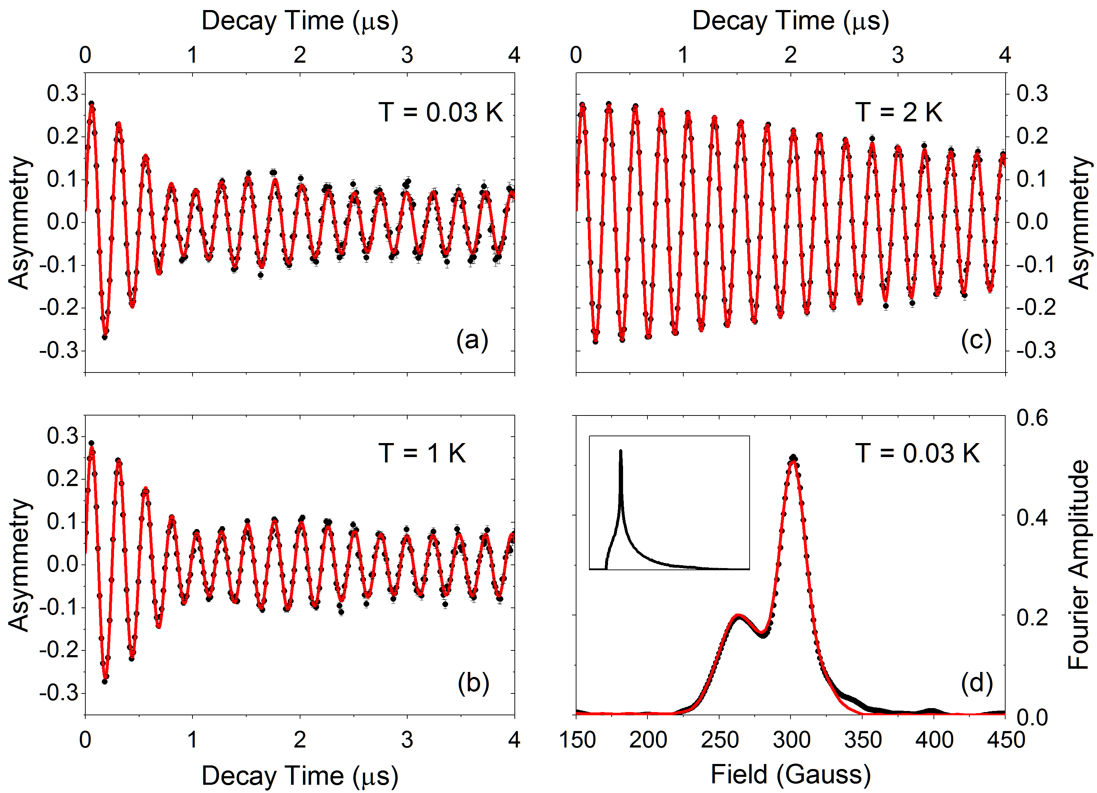
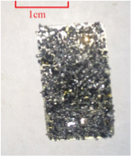
(Ir,Pt)Te2 TF-µSR

Slide 34
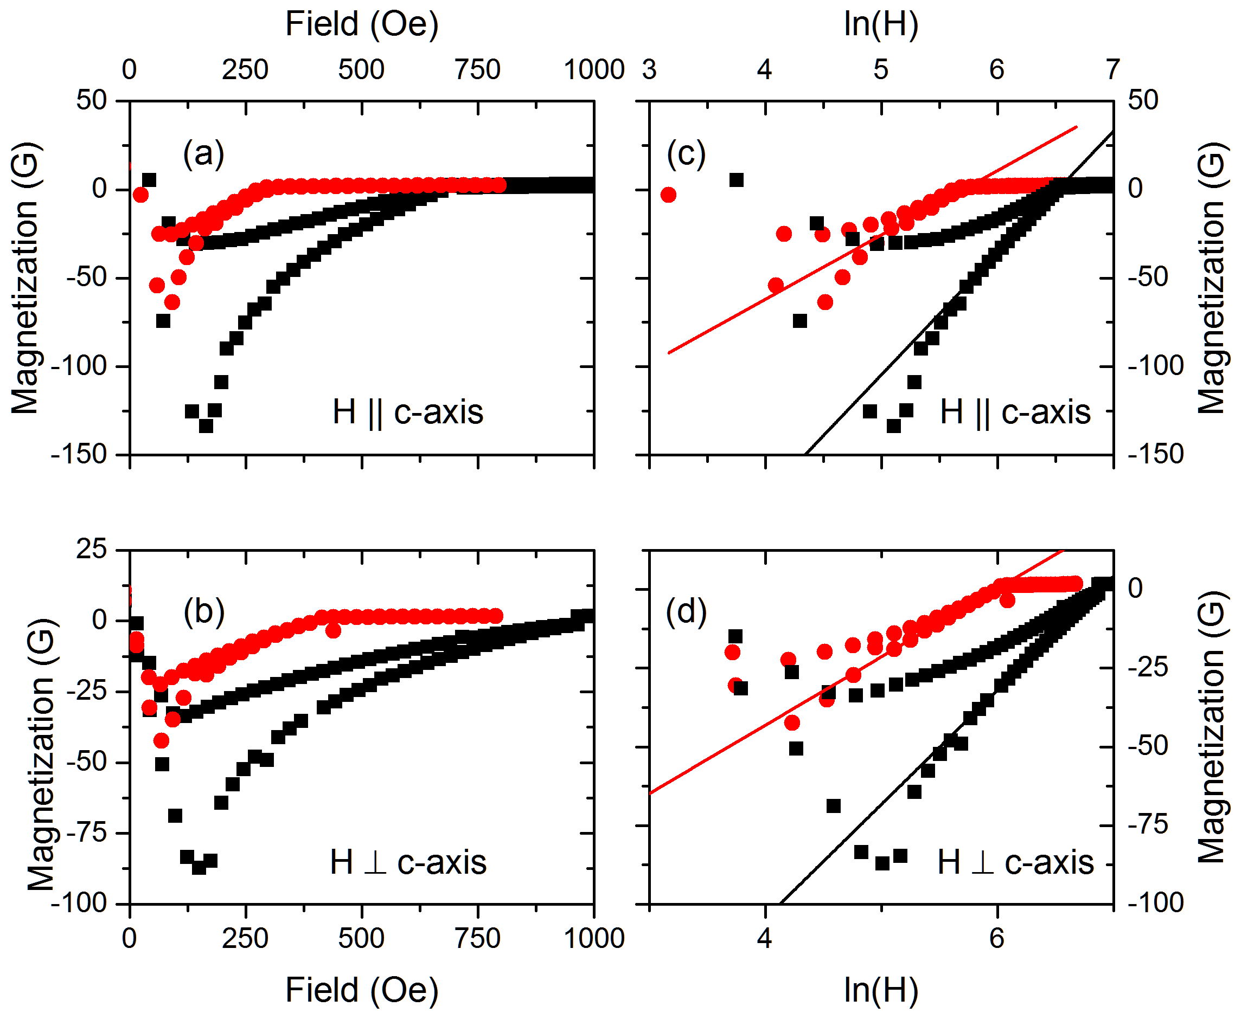
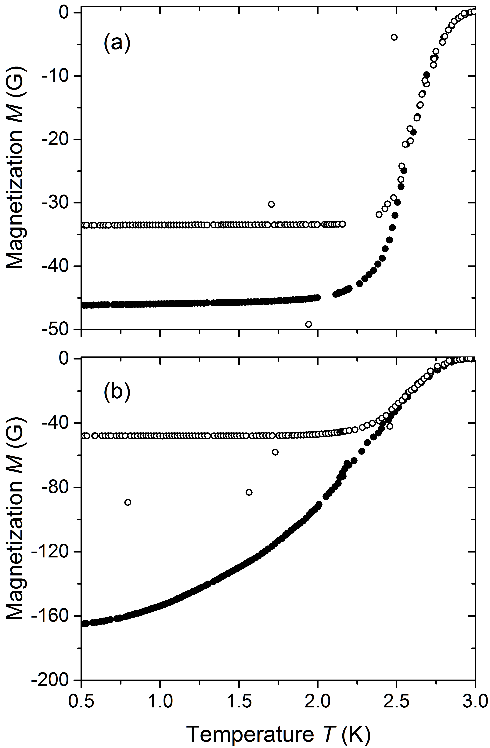
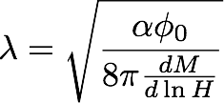
(Ir,Pt)Te2 Reversible Magnetization
Wilson et al., 1605.04296

Slide 35
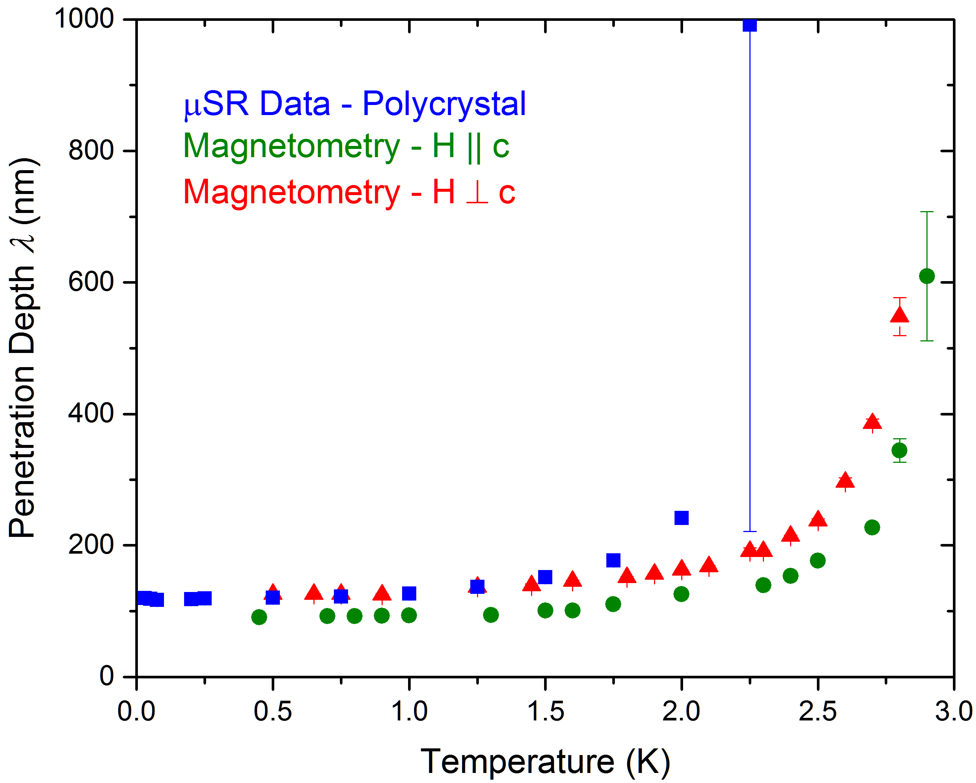
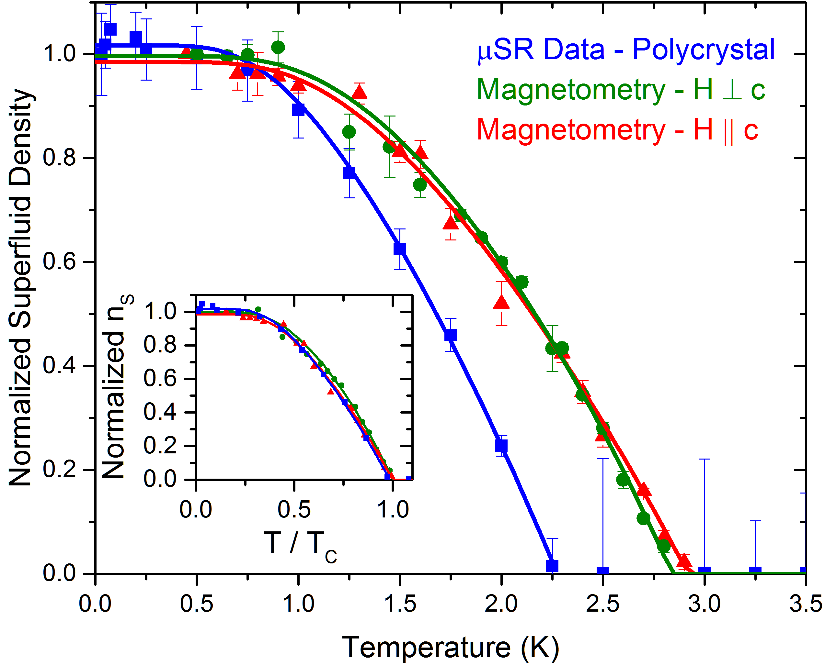
(Ir,Pt)Te2 Penetration Depth
Wilson et al., 1605.04296
Fits to ns(T) give

Slide 36
Conclusions
Broken time reversal in an expanding list of superconductors.
Sr2RuO4 likely chiral p-wave state (topological).
No obvious pattern for broken time-reversal, gap nodes.
µSR highly sensitive to magnetic field penetration depth in the intermediate state.

Slide 37
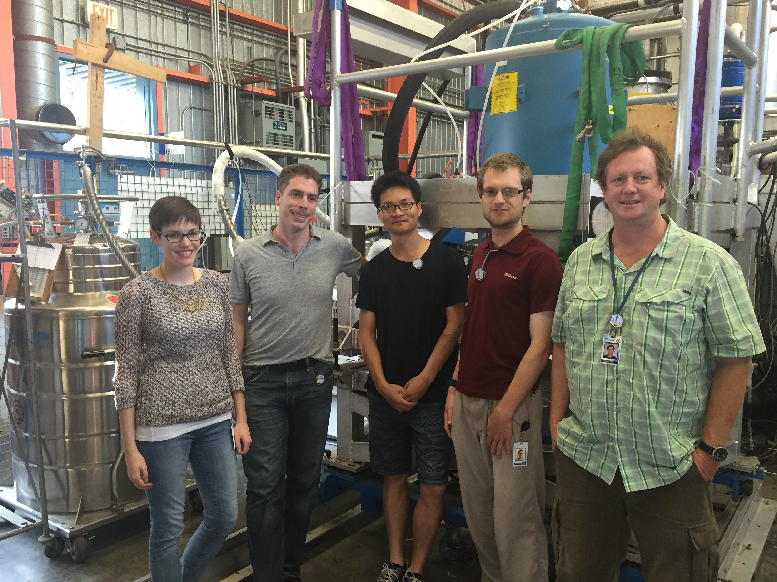
Collaborators (Partial)
McMaster: M. Wilson, T. Munsie, A. Hallas, Y. Cai
Columbia: Y.J. Uemura, T. Goko
SFU: S.A. Sabok-Sayr, J.E. Sonier
Kyoto: Y. Maeno, Z.Q. Mao, Y. Mori
Wisconsin: D.F. Agterberg
ORNL,Knoxville: J. Yan, D. Mandrus

