Slide 1
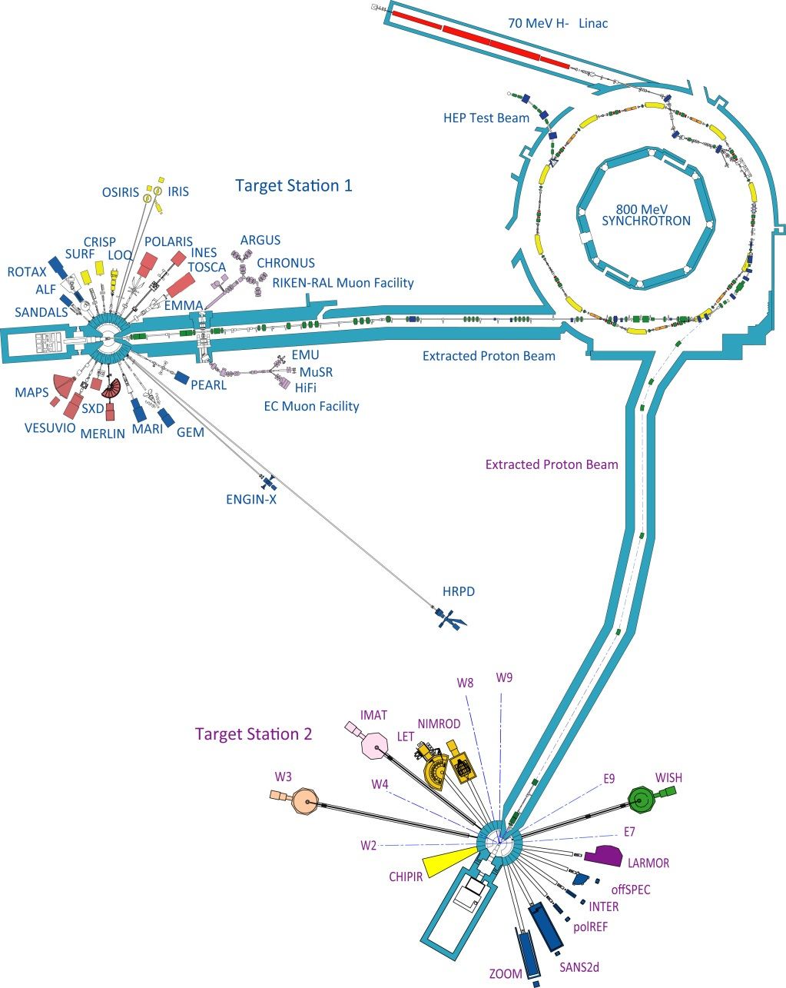
Muons at ISIS
Muons take about 4% of the proton beam
Proton Pulse FWHM ~70ns
EC muon facility:
Uses +ve muons
Three spectrometers for materials studies
RIKEN-RAL muon facility:
Uses +ve or –ve muons
Variable momentum
Two spectrometers for materials studies
Low energy muon development
Other fundamental muon physics experiments

Slide 2
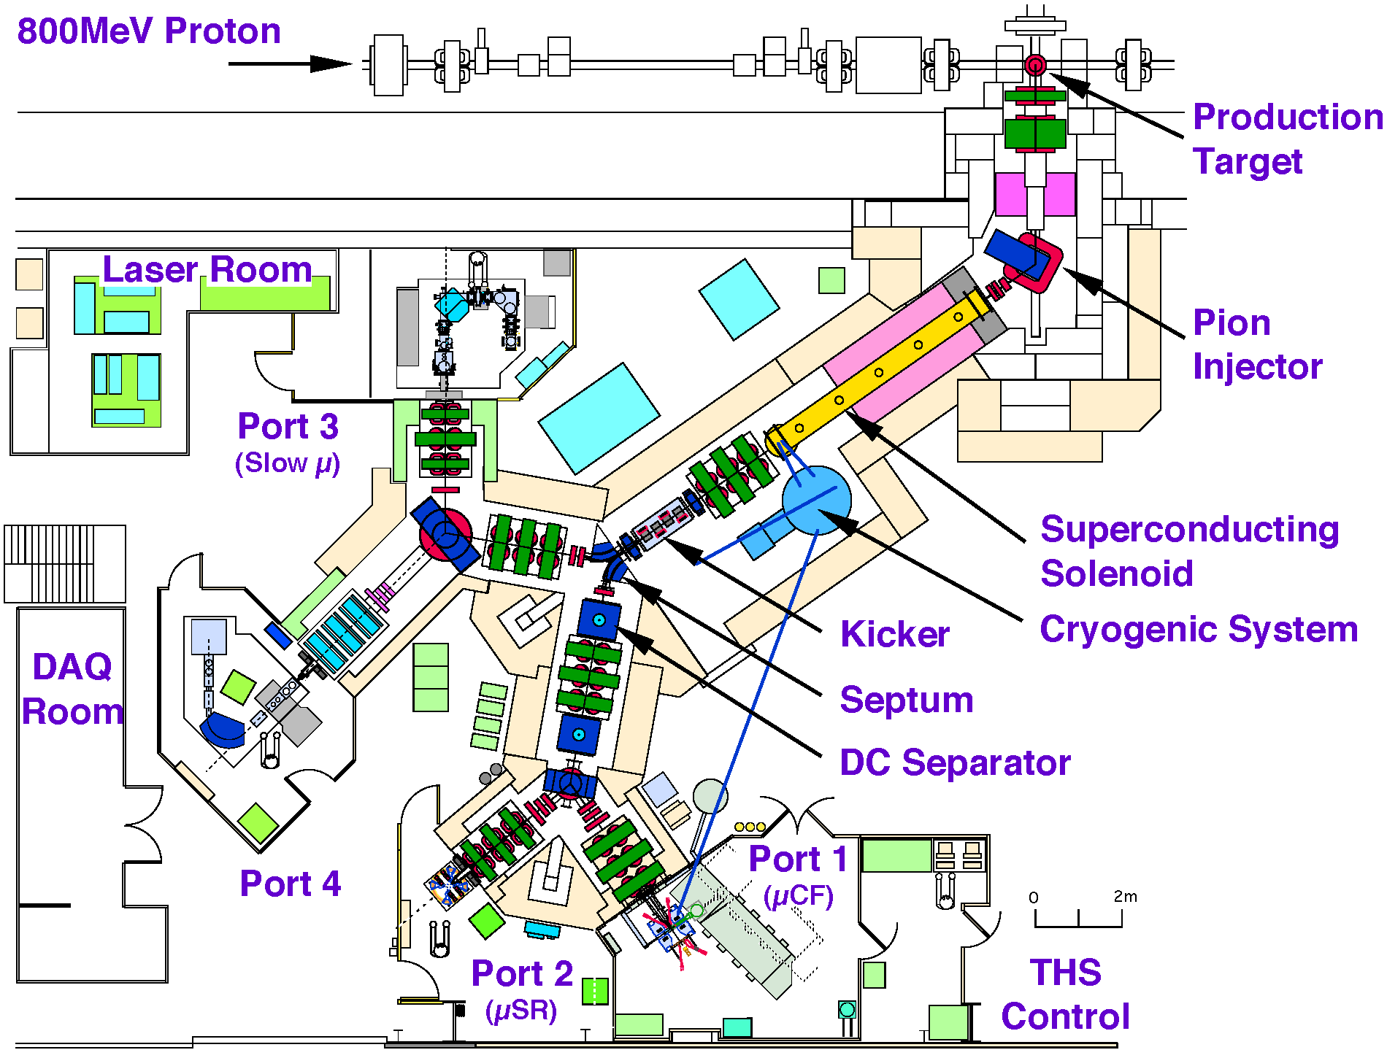
Muons at ISIS

Slide 3
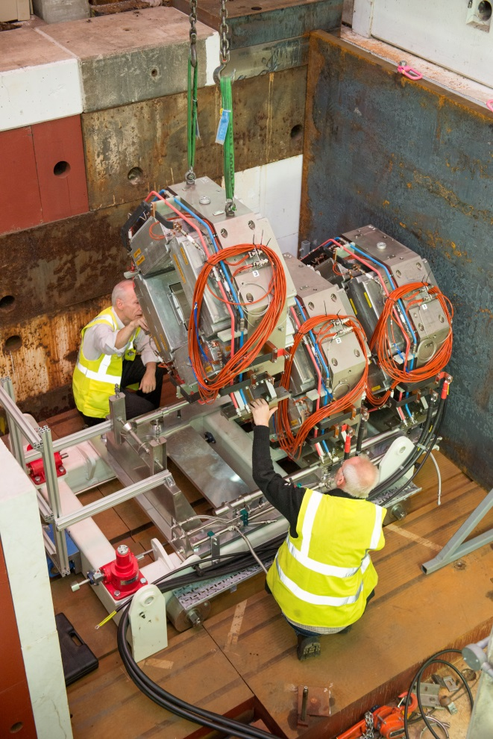
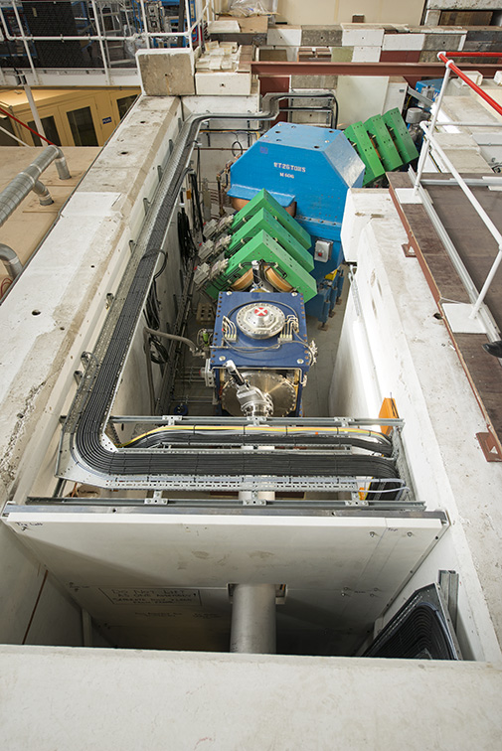
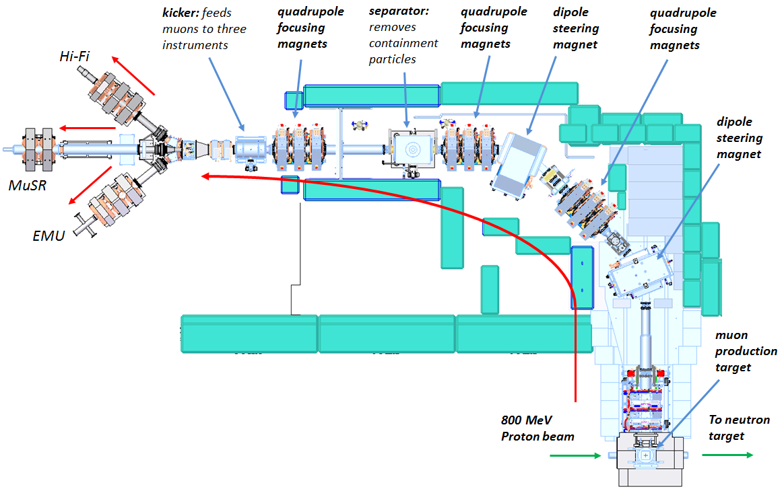
EC Muons at ISIS
After upgrade

Slide 4
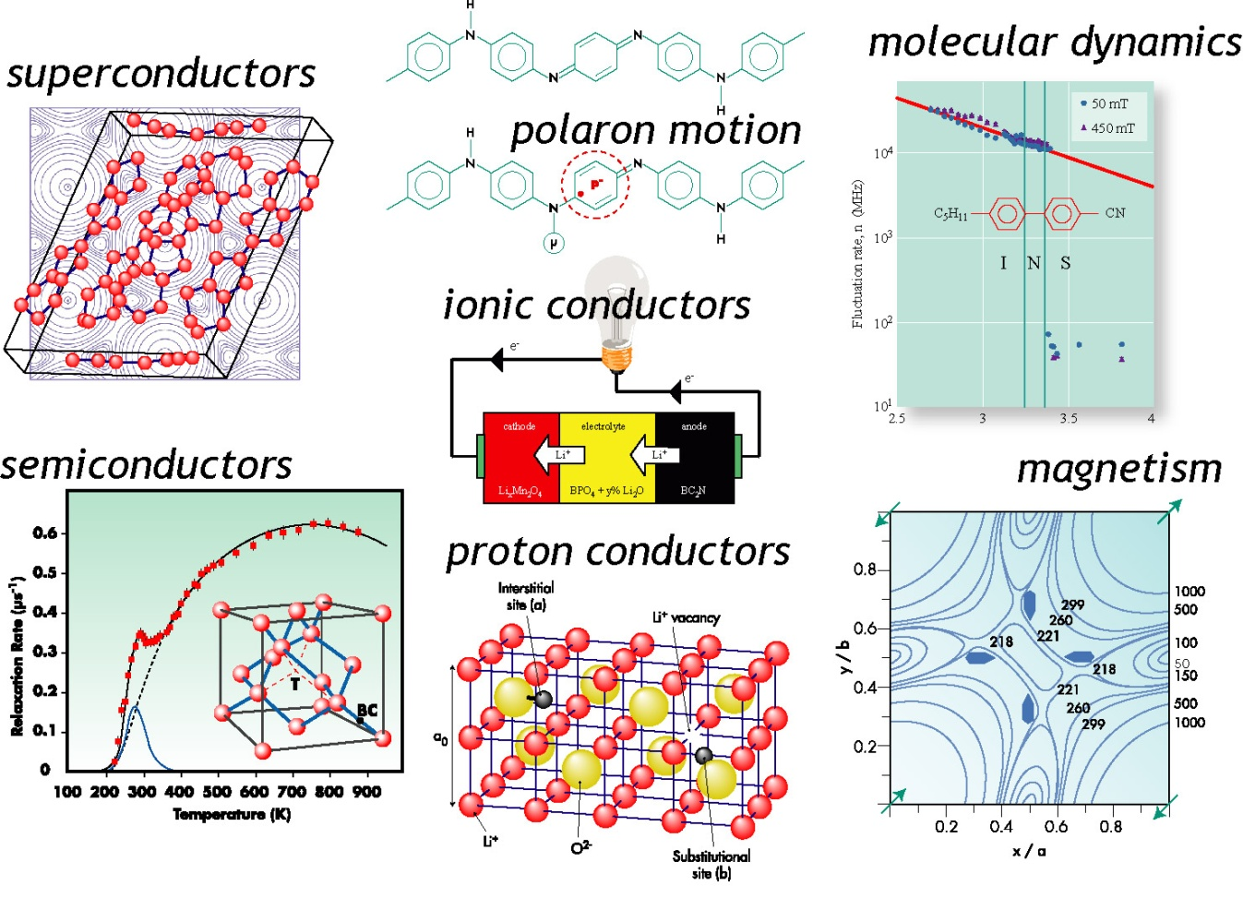
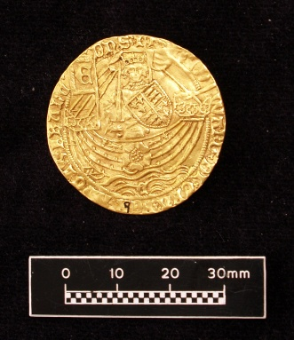
Muon science areas
Muons as passive probes in superconductivity, magnetism, molecular dynamics, charge transport.
Muons as active probes: proton analogues in semiconductors, proton conductors, light particle diffusion, etc.
Elemental Analysis
Electronics Irradiation

Slide 5
Muon science areas
MUONS:
Versatile probes of magnetic, superconducting, molecular systems
Complementary to other techniques ISIS / PSI / J-PARC all have n and μ facilities
Around 60 groups from 15 countries using ISIS muons
Further details:
http://www.isis.stfc.ac.uk/groups/muons/

Slide 6
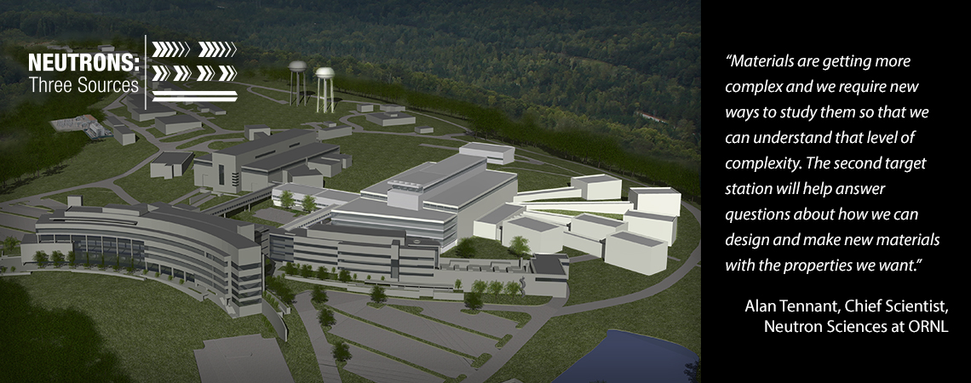
Muon @ SNS
Questions: What is the repetition rate? 10Hz?
What is the pulse width?
How thick a target can you insert?
Being parasitic you get muons almost for free?

Slide 7
Super MuSR
High resolution mode: 10x resolution at 2x current rate
High rate mode: 15-20x rate at current resolution
Quad
Doublet
Now:
Slits
MuSR
Spin Rotator
Quad
Triplet
Spin Rotator
Quad
Triplet
Super MuSR
Future:
Slits
Slicer

Slide 8
What does the science need?
Area | Requirements
Ionic diffusion (e.g. Li batteries) | Rate
Magnetism – oxides and intermetallics | Resolution
Magnetism – organic and weak | Rate
Muon chemistry – RF experiments | Rate, higher field, spin rotation
Semiconductors | Resolution, spin rotation
Skyrmions | Resolution, spin rotation
Superconductors – vortex lattices | Resolution, spin rotation
Superconductors – TRS-breaking | Rate
Superconductors – Topological | Rate, spin rotation

Slide 9
Pulse slicing on request

