Slide 1

Report of
Documentathon 2023

Slide 2
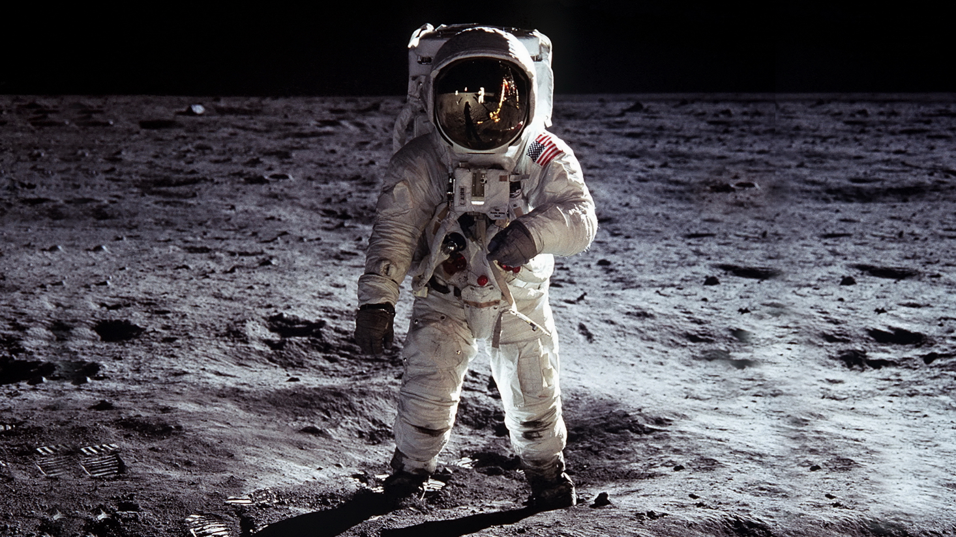


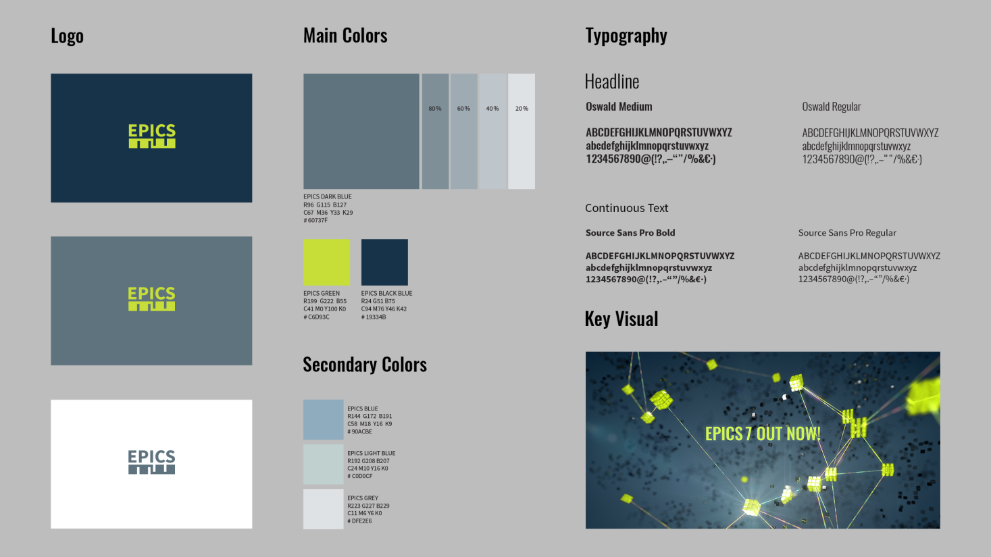
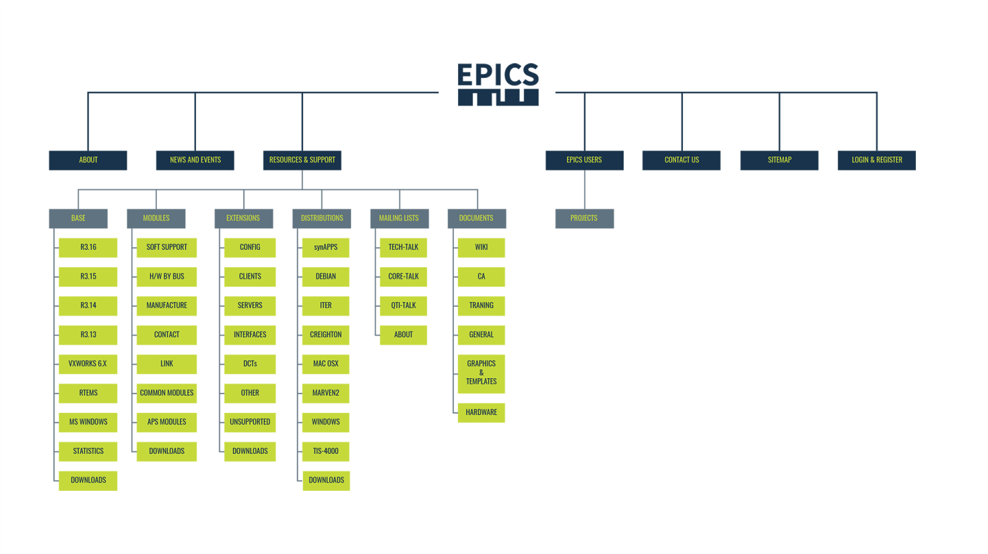
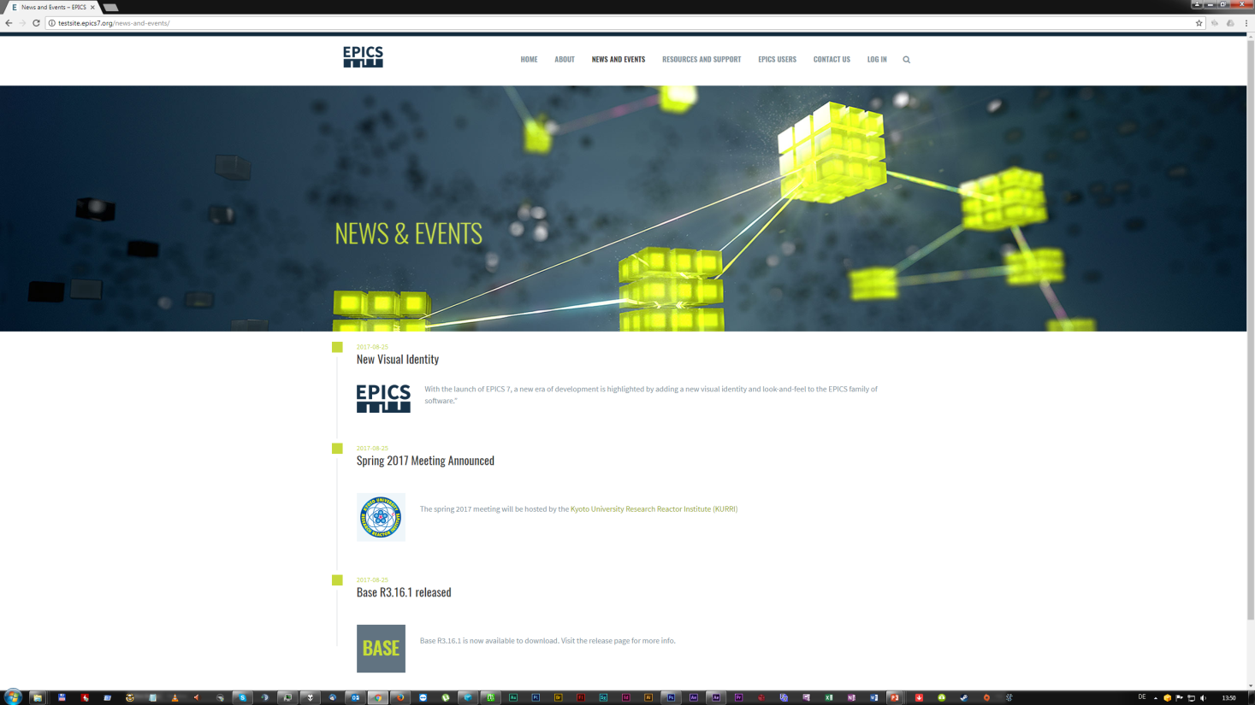
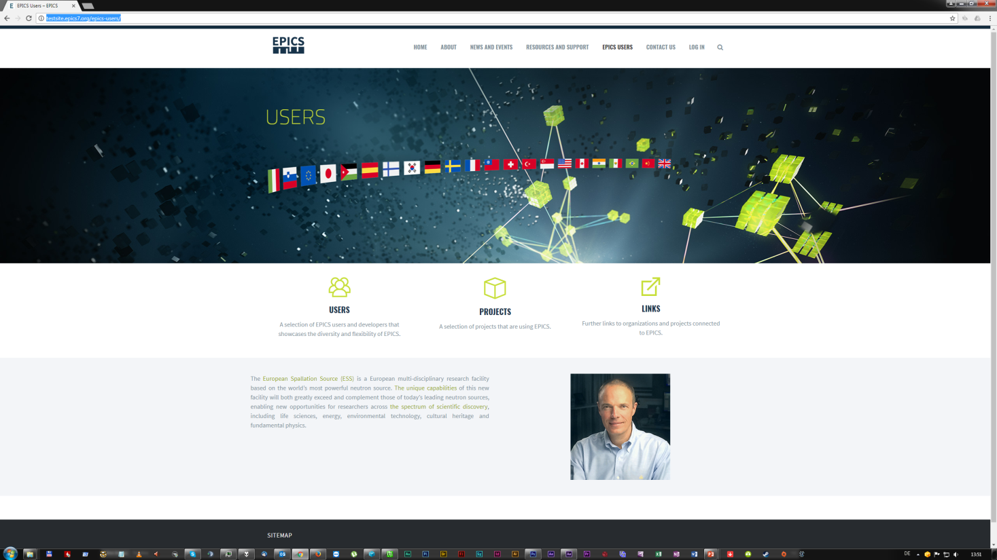
Many years ago, the new EPICS graphical identity and website were introduced at the Collaboration Meeting in Barcelona... (2017)

Slide 3
After that, a lot happened:
the Wordpress site (epics-controls.org) has been in operation, however with very few updates after launch.
docs.epics-controls.org sub-site was created using Readthedocs & Sphinx
Many improvements have been done in the EPICS documentation.
…but…
A lot did not happen (before the docuathon)
docs.epics-controls.org had not developed as it was foreseen
The WP site had a lot of documentation that has not been updated
EPICS 7 feature documentation was scattered or missing altogether
Still no (complete) Application Developer‘s Guide for EPICS 7
Number of contributors was low

Slide 4
Work plan for the docuathon:
Consolidate the content:
Consider and discuss what are the most important issues:
  AppDevGuide v7, PVA examples, RRM, specifications,…
  Look at results of Rémi Nicole’s documentation user survey
Improve integration of epics-controls and docs.epics-controls sites
  Clarify the navigation, and
  Agree on what documentation should go where.
Clarify the process to contribute:
  Hosting of the document sources, what goes where
  Use the readthedocs.org toolchain
  Consolidate the tools, document the documenting process

Slide 5

What we did:
Discussed and exchange opinions on what makes sense and is most needed
  AppDevGuide v7, PVA examples, RRM on docs.epics-controls,…
Reviewed content of epics-controls and docs.epics-controls sites
  Updated outdated and removed obsolete content from epics-controls.
  Most documentation was moved to docs.epics-controls
Developed and documented the process:
  General documentation hosted on docs, sources in github
  Documentation for modules and extensions should stay with sources
  Created a Documentation contribution Guide (https://docs.epics-controls.org/en/latest/CONTRIBUTING.html)

Slide 6
Short description of how to contribute
If you have noticed an issue or something missing…
Option 1: if you prefer that somebody else does it:
  Email tech-talk and describe the issue. Somebody from the community will (hopefully) pick it up and fix.
Option 2: Suggest a fix:
  head to Github epics-docs repository and create an issue
Option 3: You want to contribute by doing it yourself (preferred ☺ )
  Be prepared to write either Markdown (md) or ReStructuredText (rst)
  Fork the repository
  Write your contribution or fix an existing text
  Create a pull request.
  Pull request will eventually be merged by the repo maintainers and the document will appear on the docs website.

Slide 7
Some highlights – small selection of many
Created a classification to help users to find the right content
  Beginner, user, developer, advanced
Reworked the menu structure on docs site
  Getting started, Installation, Process Database, Related Software,…
Resqued and reworked the “related software” page from old site
  Had been sitting on epics-controls almost unnoticed
  First user contributions arrived within hours of creating the new page!
    Needs to be consolidated with the existing supported HW & SW lists
Application Developers Guide as well as Record Reference Manual (auto-generated) are on the way to the docs site (..coming soon…)
Many other contributions…

Slide 8
Summary
A very busy but also very exciting week
  The team was excellent and got an amazing amount of work done!
  The structure improved a lot, but there is still work remaining
The number of contributors increased a lot!
  Github site maintainers and contributors, WordPress contributors
We have a new structure and well-defined process to contribute
  If other related documentation would use the same tools and process, it would help in creating more consistent documentation that is easier to find and access.
But: this is just the beginning!
  A lot was achieved – more than I dared to hope – but there is still many things to improve
  But the excuse ”I do not know how to contribute” should not be an issue anymore.
Thank you to all who have contributed – and to all who will contribute in the future!

Slide 9
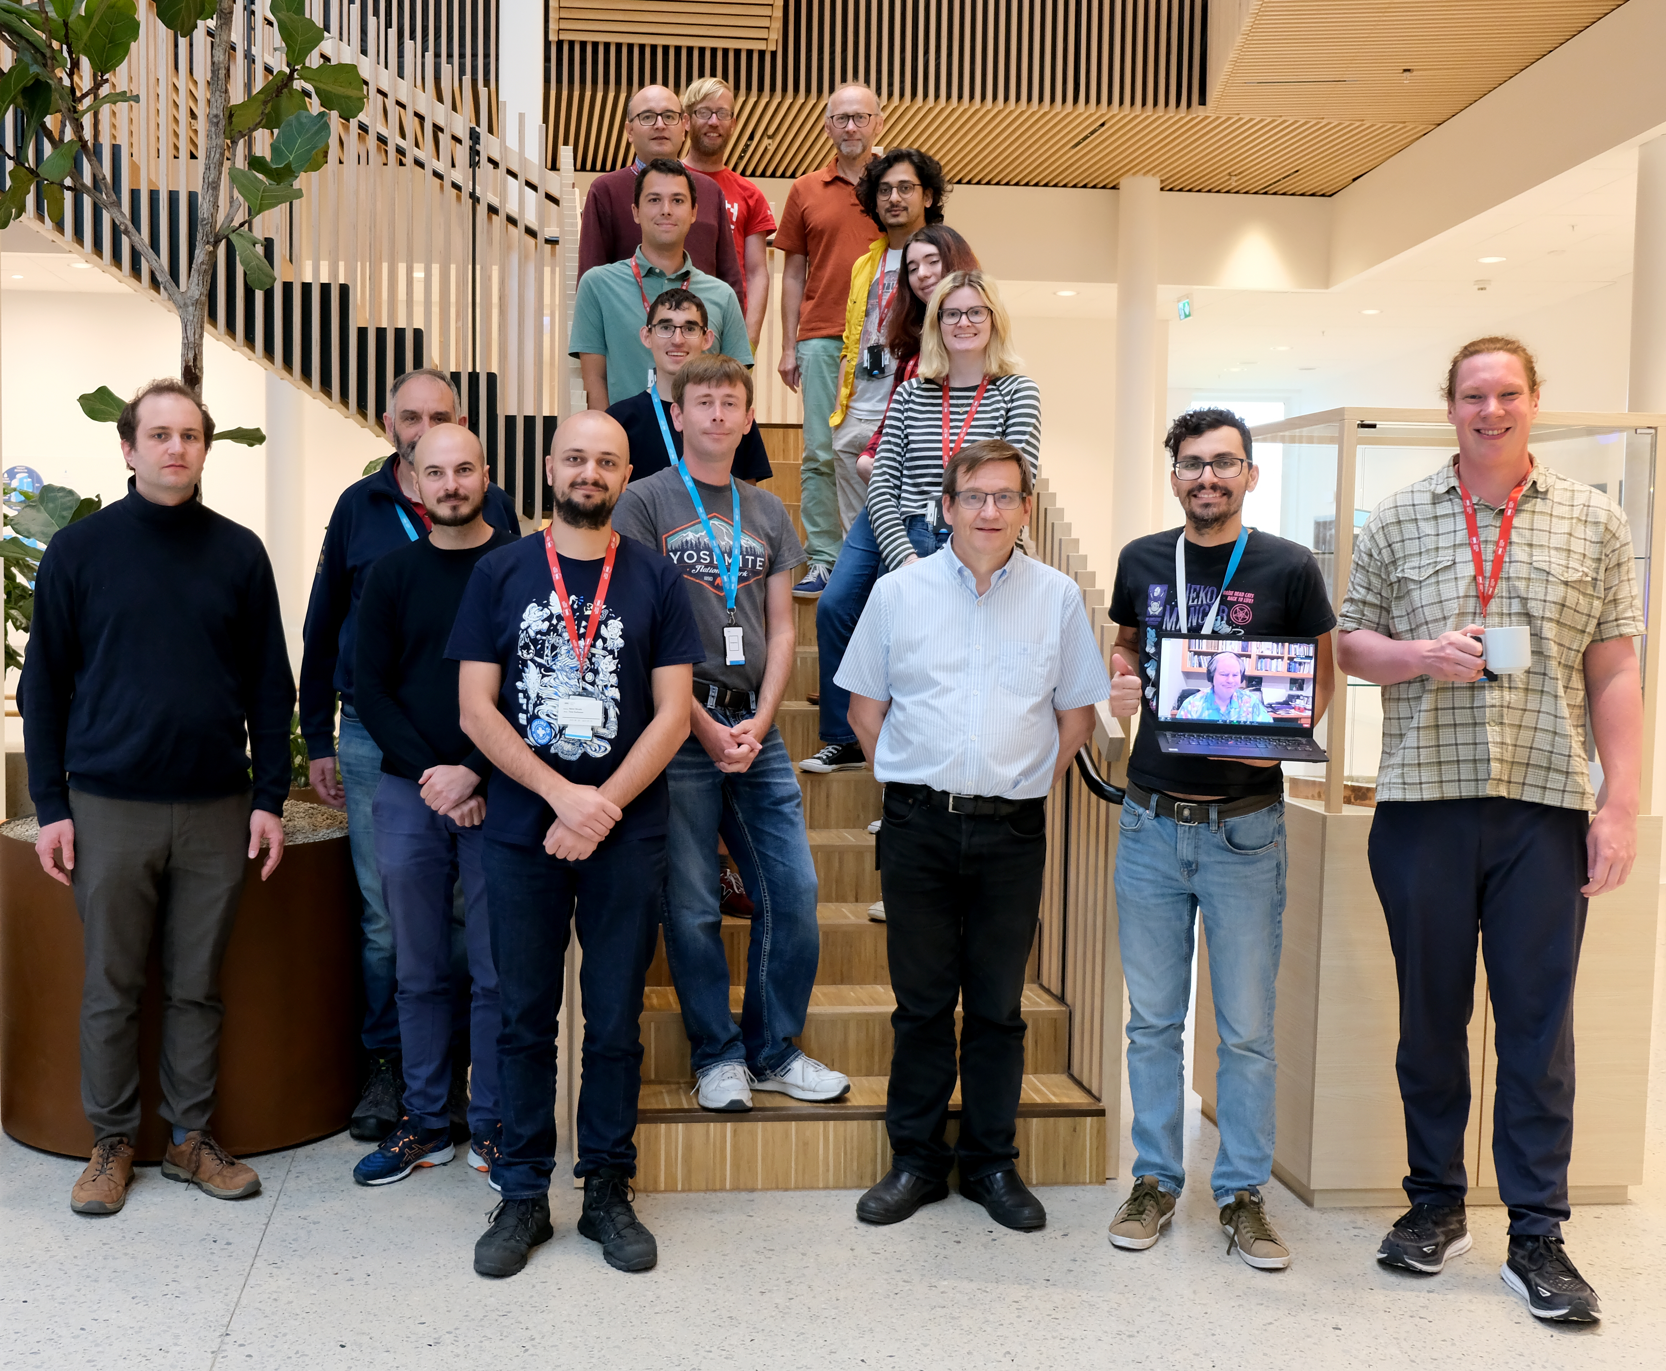
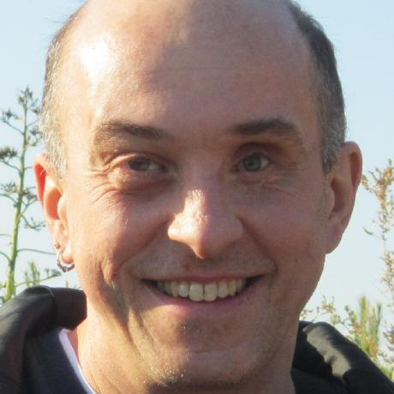
The team – thank you for the great work!
Plus Ralph who participated remotely,
As well as Doug – participating from US Pacific timezone!

Slide 10

Thank You for Your Attention!
See you in the next <docu/code>-athon…

