Slide 1
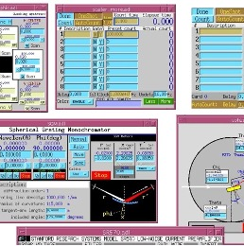
APS Beamline Controls Strategy
Joseph Sullivan
Group Leader
Beamline Controls Group
Argonne National Laboratory
BC Group
Tim Mooney
Pete Jemian
Kurt Goetze
Kevin Peterson
Jeff Kirchman
Tom Walsh
Mark Engbretson
Keenan Lang
Max Wyman
Bryan Monk
Fanny Rodolakis
Nick Marks
EPICS Collaboration Workshop, Cape Town,South Africa
October 8, 2023
Notes:
Univ of Chicago Review, Aug. 30, 2010
1

Slide 2
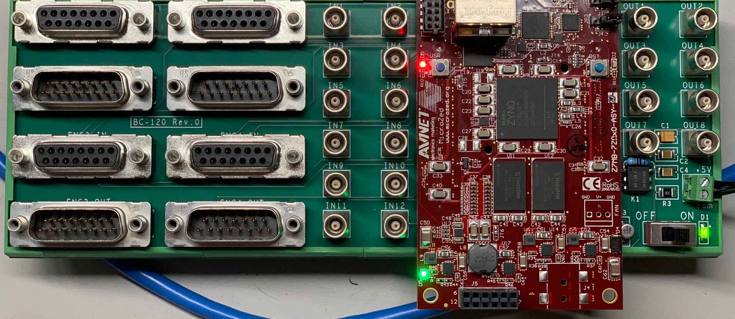
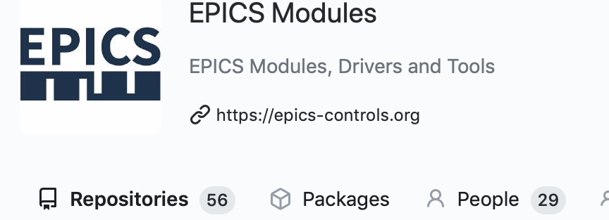
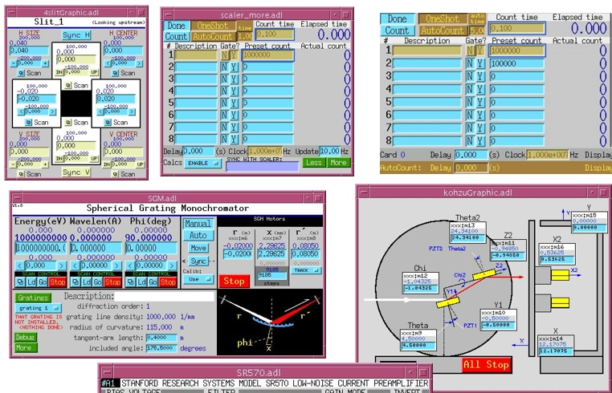
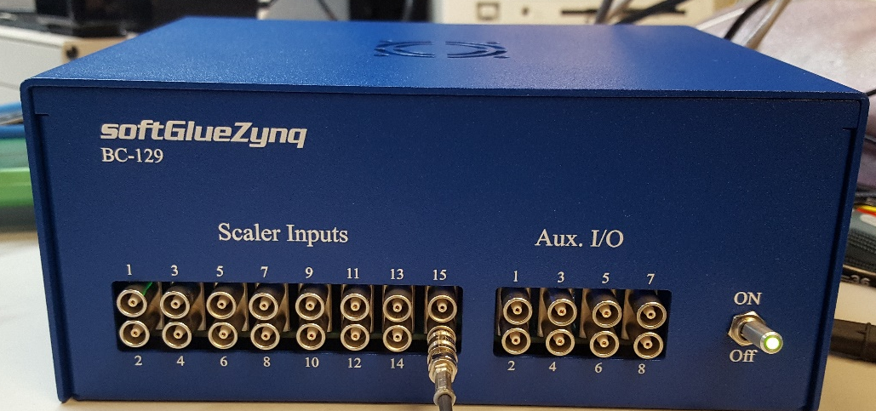
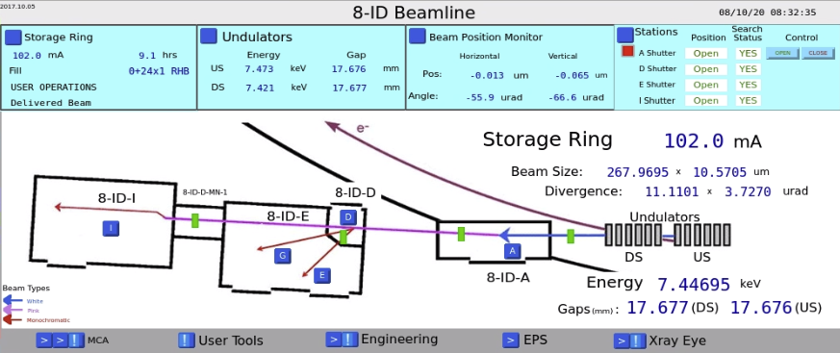
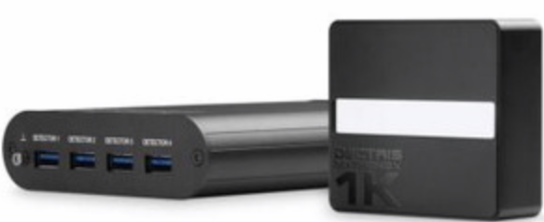
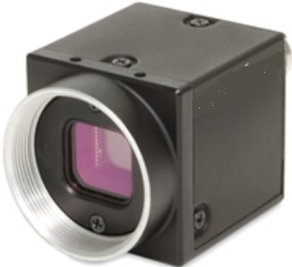
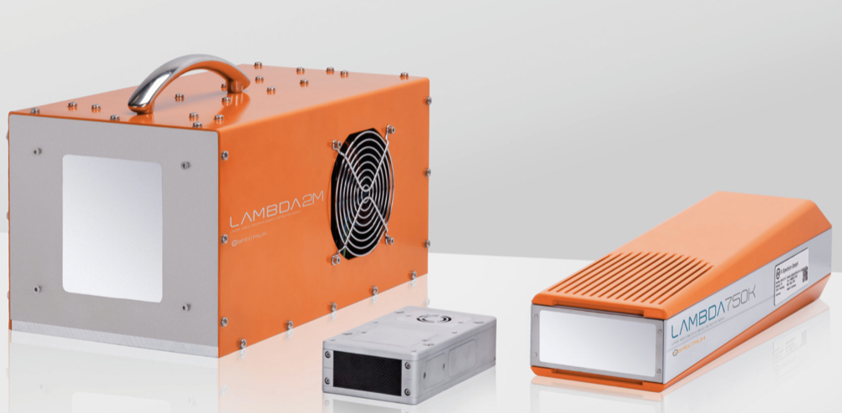
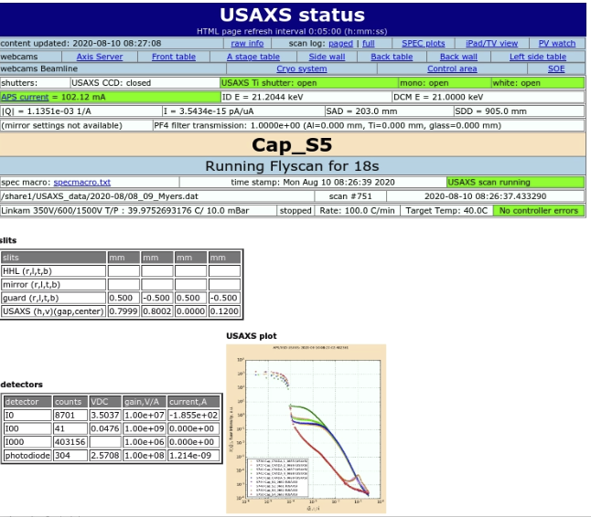
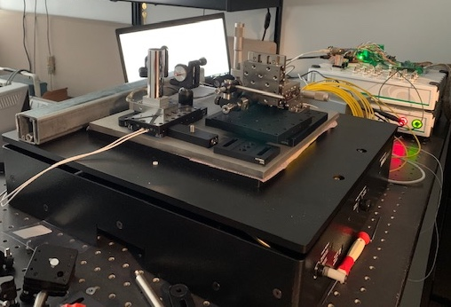

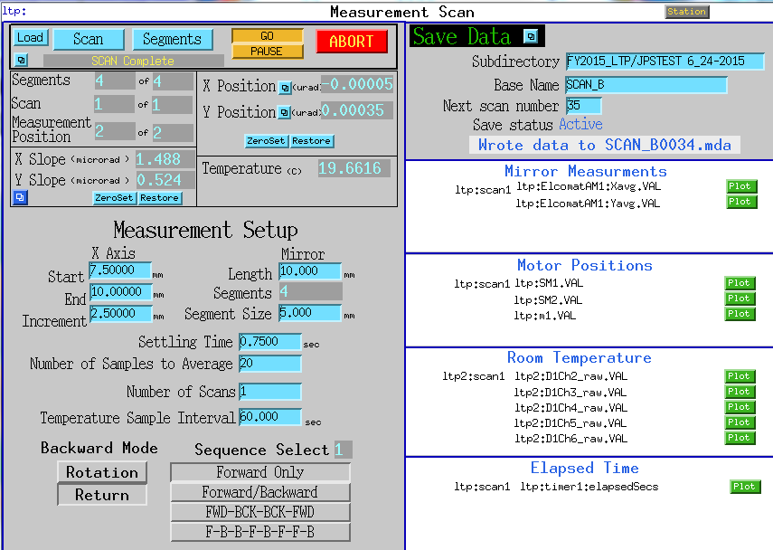
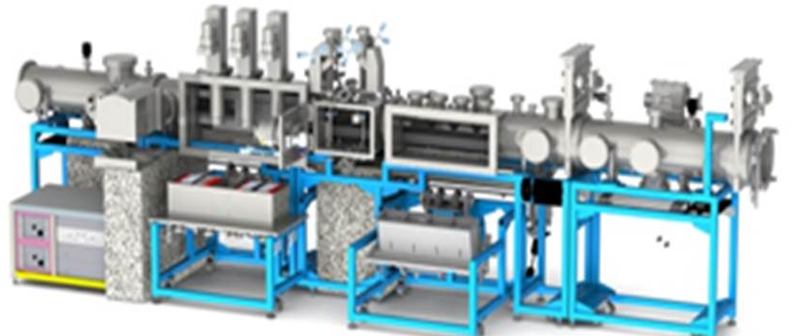
APS Beamline Controls Group
EPICS/synApps Development
Controls Scope
Custom controls electronics
(FPGA solutions , motor drives and interfaces, …)
X-ray Optics Control
Beamline Operations Support
EPICS areaDetector support
23 Sectors – 66 End Stations
Dectris Mythen2
Spectrum LAMBDA
Experimental Software
(Bluesky, Python, SPEC,…)
Prosilica
(X-ray eye)
Nano-resolution/Fast Scanning Controls
XSD-OPT Instrument Controls
(LTP and Deposition Labs)
Remote Operation Enhancements
(Robots,…)
The APS-U instrument metrology station

Slide 3
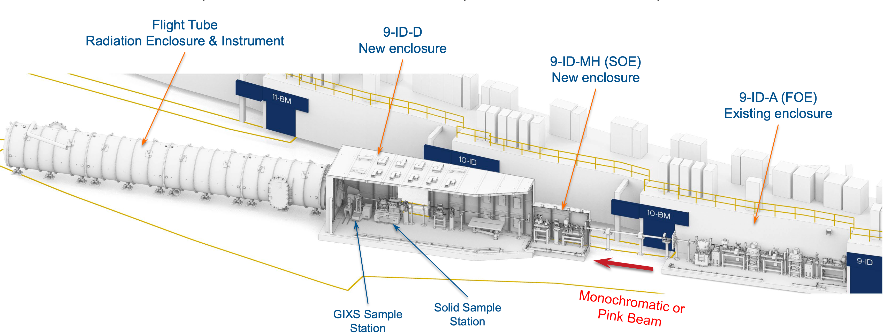
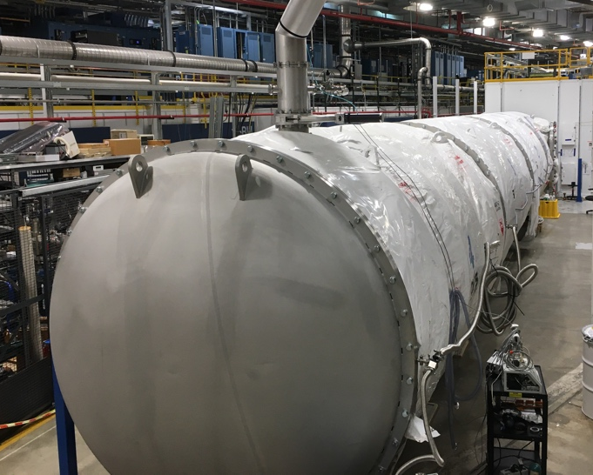
Beamline Controls at the APS
APS-U Beamline Scope
Coherent Surface-Scattering Imaging (CSSI) – 9ID

Slide 4
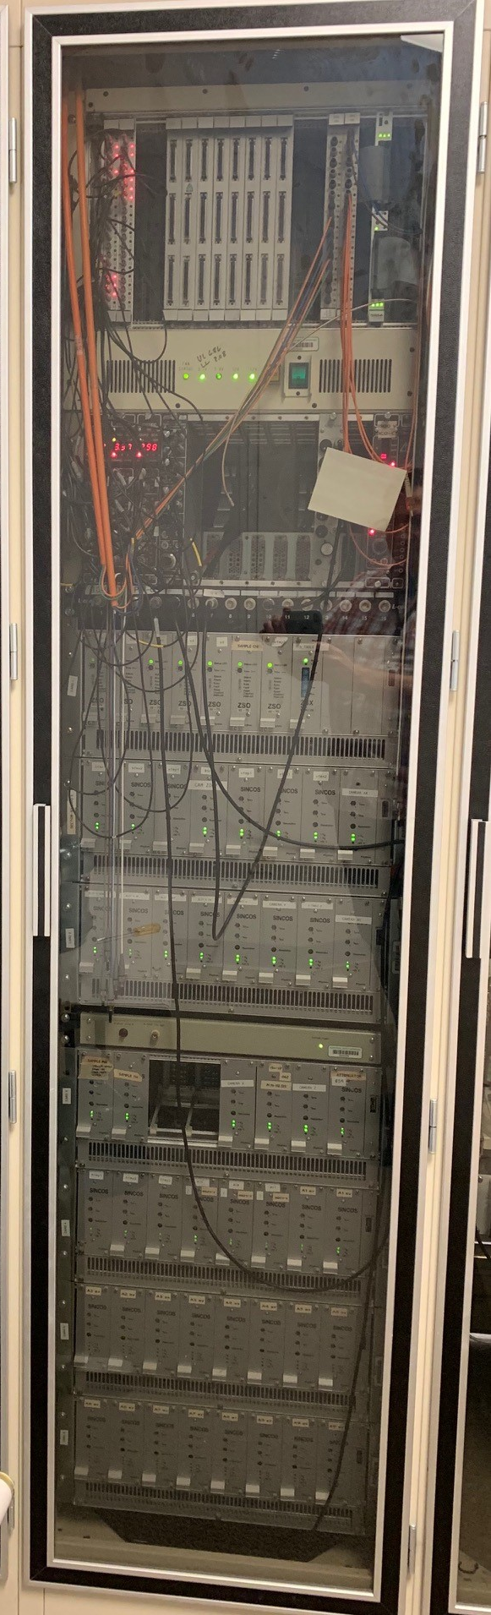
Beamline Controls at the APS
Key APS-U controls implementation decisions
Controls methods selected based on proven strategies (Maintainable, COTS, long life cycle, adaptable) and have an upgrade path for legacy software/hardware infrastructure.
Recommended transition from VME based controls to networked devices. This impacted network design, motion control and data acquisition/control hardware.
Recommending Bluesky for experimental processes to assure reusable and maintainable code and enable cutting-edge research and high-impact scientific output.
Select commercial FPGA platform for higher performance data acquisition needs to add I/O capability and reduce risk of obsolescence.

Slide 5
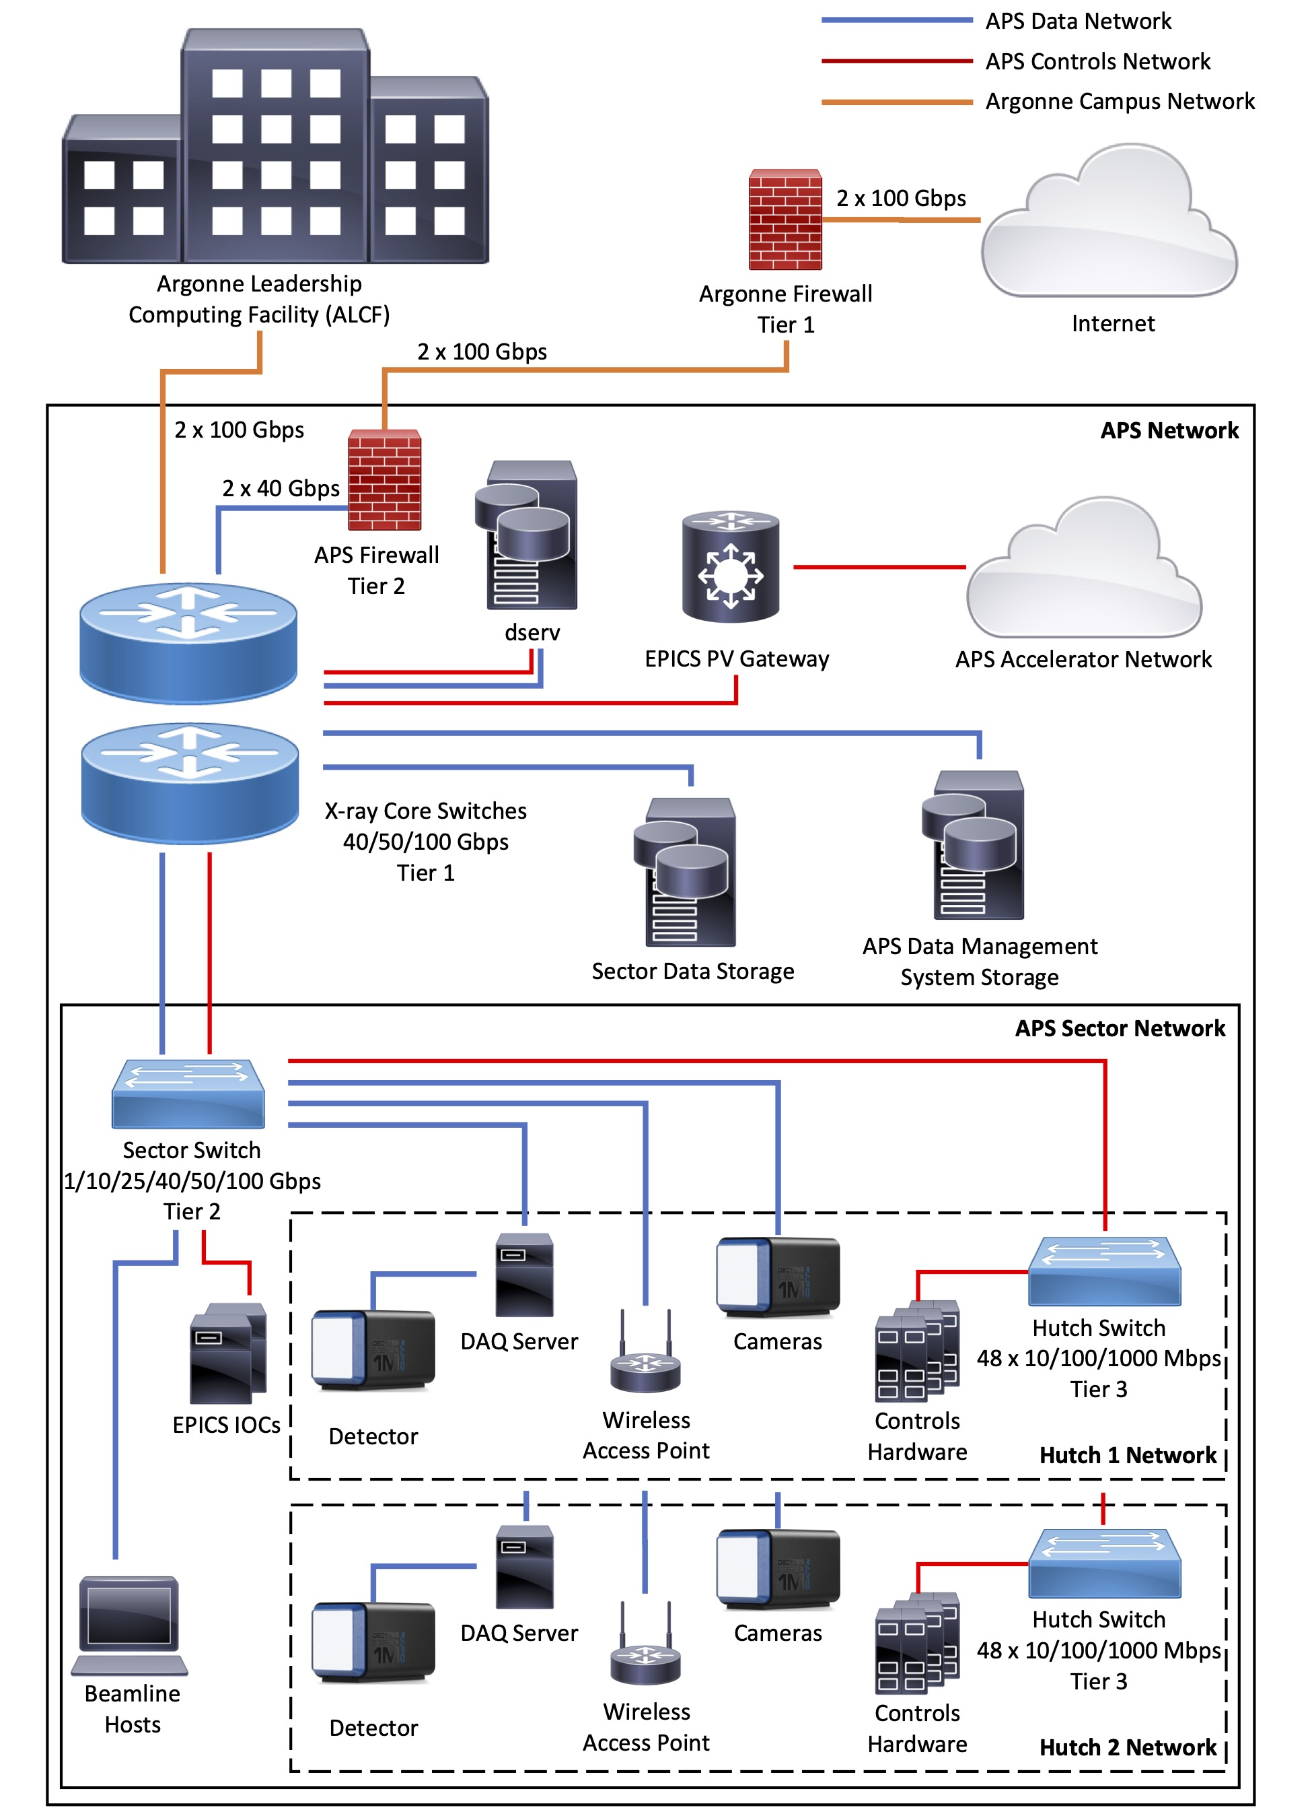
Beamline Network Architecture
Updated network to support APS-U Era data and control requirements
3-tier network infrastructure: facility, sector, hutch
Supervisory Control and Data Acquisition (SCADA) architecture to better support controls, data, and regular network traffic
Installing new fiber plant for all APS beamlines; 768 pairs of new single mode fiber from the APS computer room to beamline networks
Installed new core network switches capable of 100 Gbps links
APS sector capable of 100 Gbps links
Upgraded the APS <-> ALCF network connection to 200 Gbps; upgrade to a terabit/s network in the future
Adding wireless access points inside hutches and installing CAT 6A 10 Gbps copper cable at beamlines

Slide 6
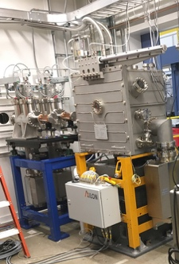
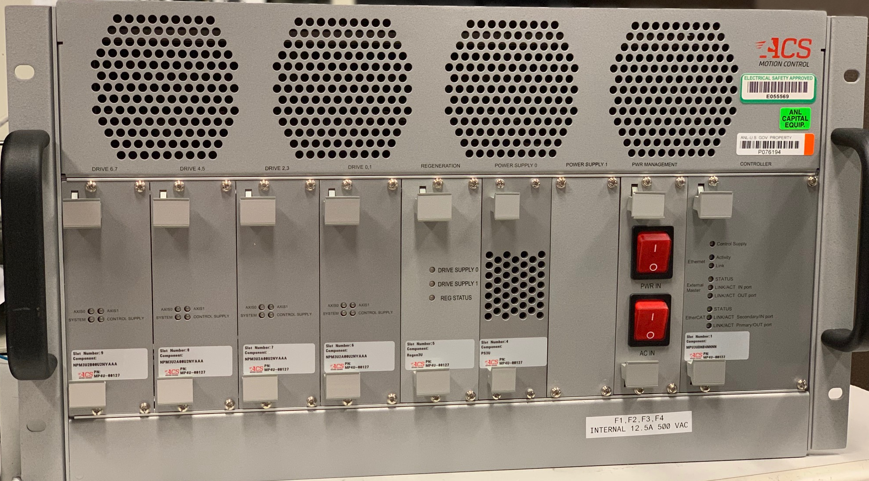
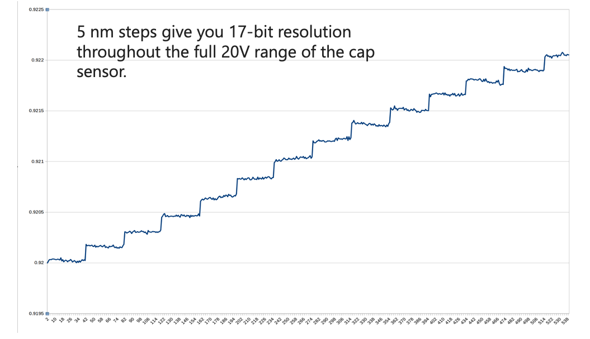
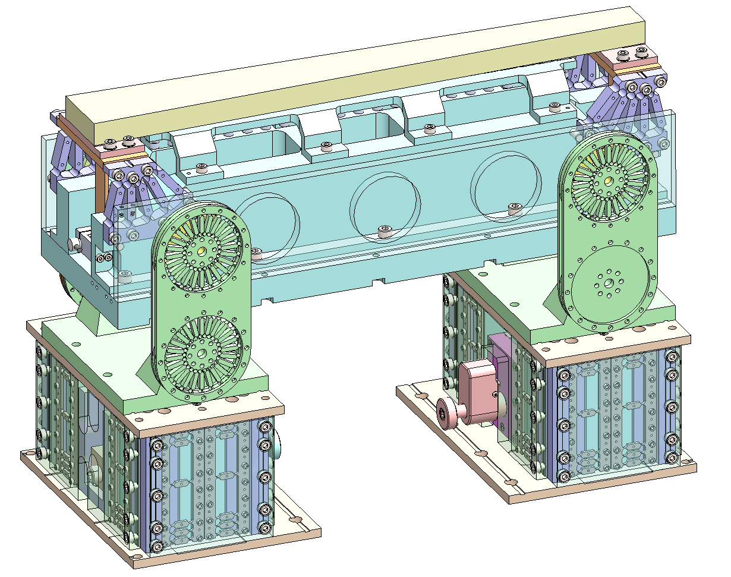
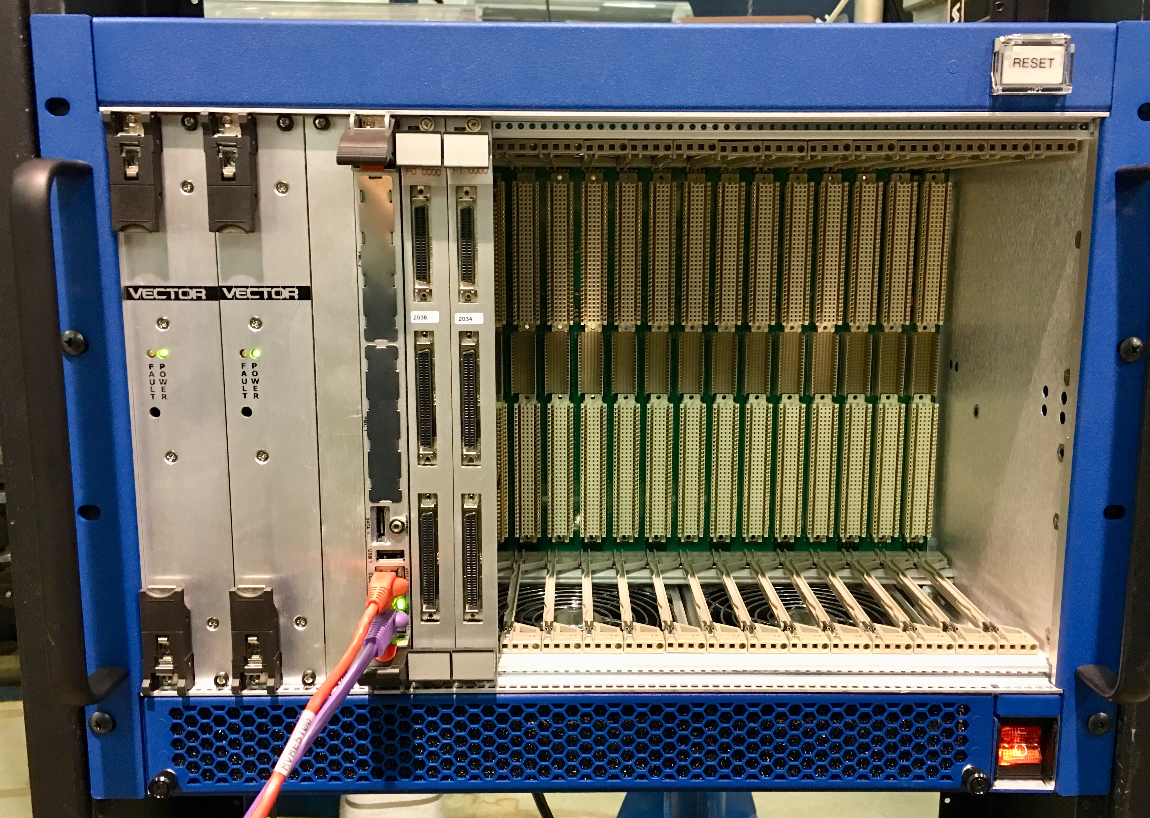
Beamline Motion Controls
Major Optical Components
General Motion Control
Precision Motion Control
High heat load mirrors, monochromators, transfocators
Slits, flags, etc.
Nano-positioning instruments, KB mirrors, benders, etc.
Standardizing on ACS and OMS motion control platforms
Full EPICS support (asynMotor, flyscanning)
Motion systems ordered in bulk
Standardizing on ACS motion control platform.
APS supported control hardware included with component with procurement packages
Precision stage positioning and scanning based around a piezo, pico, and stepper motion stack (APS flexure design)
High precision capacitive sensor feedback
Coarse/fine motion coordination
Networked Motion System (ACS/MP4U)
Step scan of piezo with 5 nm steps with 4 s dwell time
25-ID monochromator with controller
VME/OMS Motion System
KB mirror positioner

Slide 7
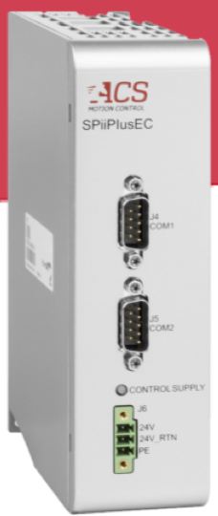
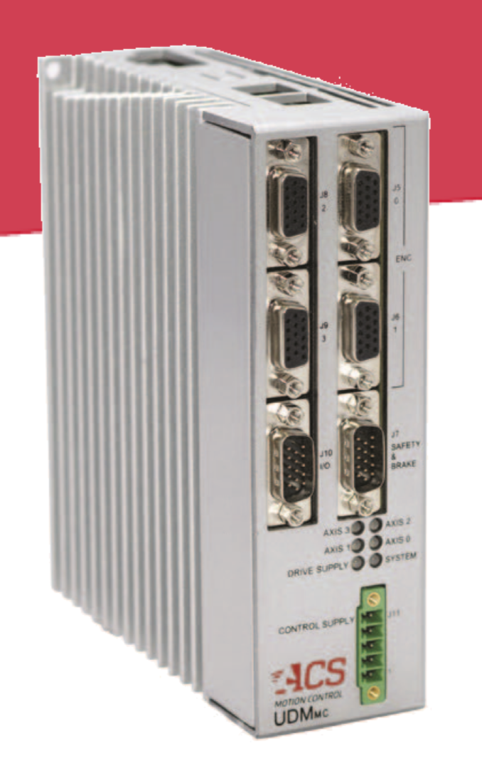
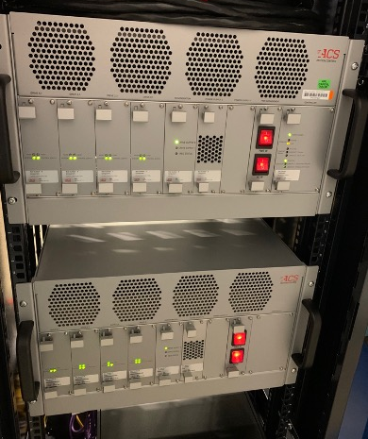

Beamline Motion System
Networked programmable motion system components
32 Axis Controller / EtherCAT
4-Axis Drive Module
(20 Amp)
2x Encoders per Axis
Programmable motion controller
  Advanced programming language (SPiiPlus)
  Servo loop runs at 20kHz
  Custom motion applications run embedded in the controller
Tailored motion solutions (pre-built chassis if needed)
  Motor: Servo, stepper and piezo
  Feedback: Quadrature, Absolute, Interferometer
Position/vector trigger (18MHz Quadrature/4kHz Absolute)
Axis synchronization and remote I/O over deterministic network
  2kHz updates (EtherCAT)
Local Distributor/Support (RSA)
  Motion integration expertise (high precision – chip fabrication)
Combined 8 axis drive/controller

Slide 8
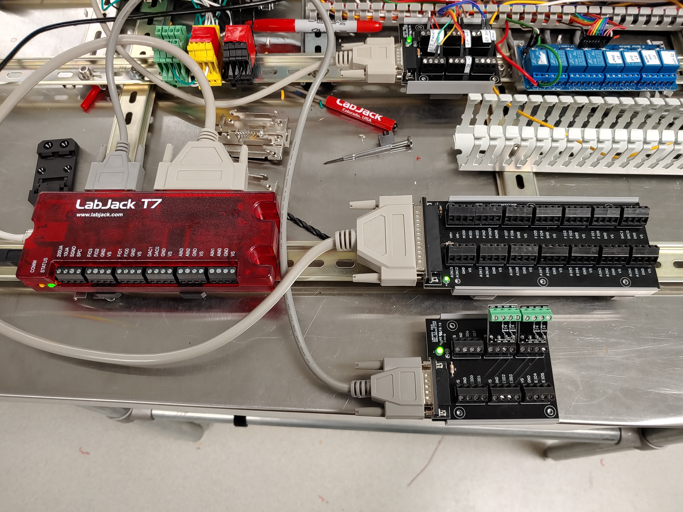
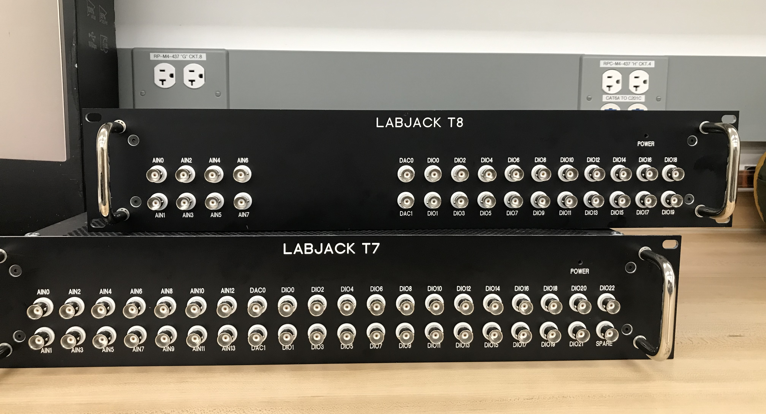
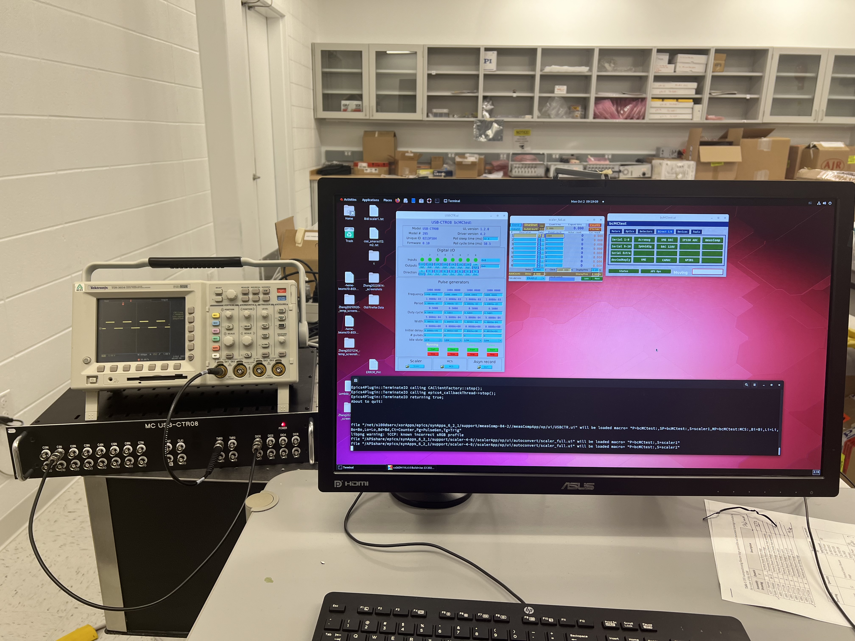
Beamline Controls DAQ Devices
Networked Scaler and I/O Solutions
Labjack I/O Solutions and Measurement Computing devices
Pulse counters, control and readback (sensors, actuators, RTDs, Tcouples . . .)
USB / Ethernet – ModbusTCP Interface
Flexible I/O adaptability (hardware and software)
EPICS Support : Full device functionality available via vendor API.
  Github: epics-module/LabJack, epics-module/measComp (Credit Mark Rivers)

Slide 9
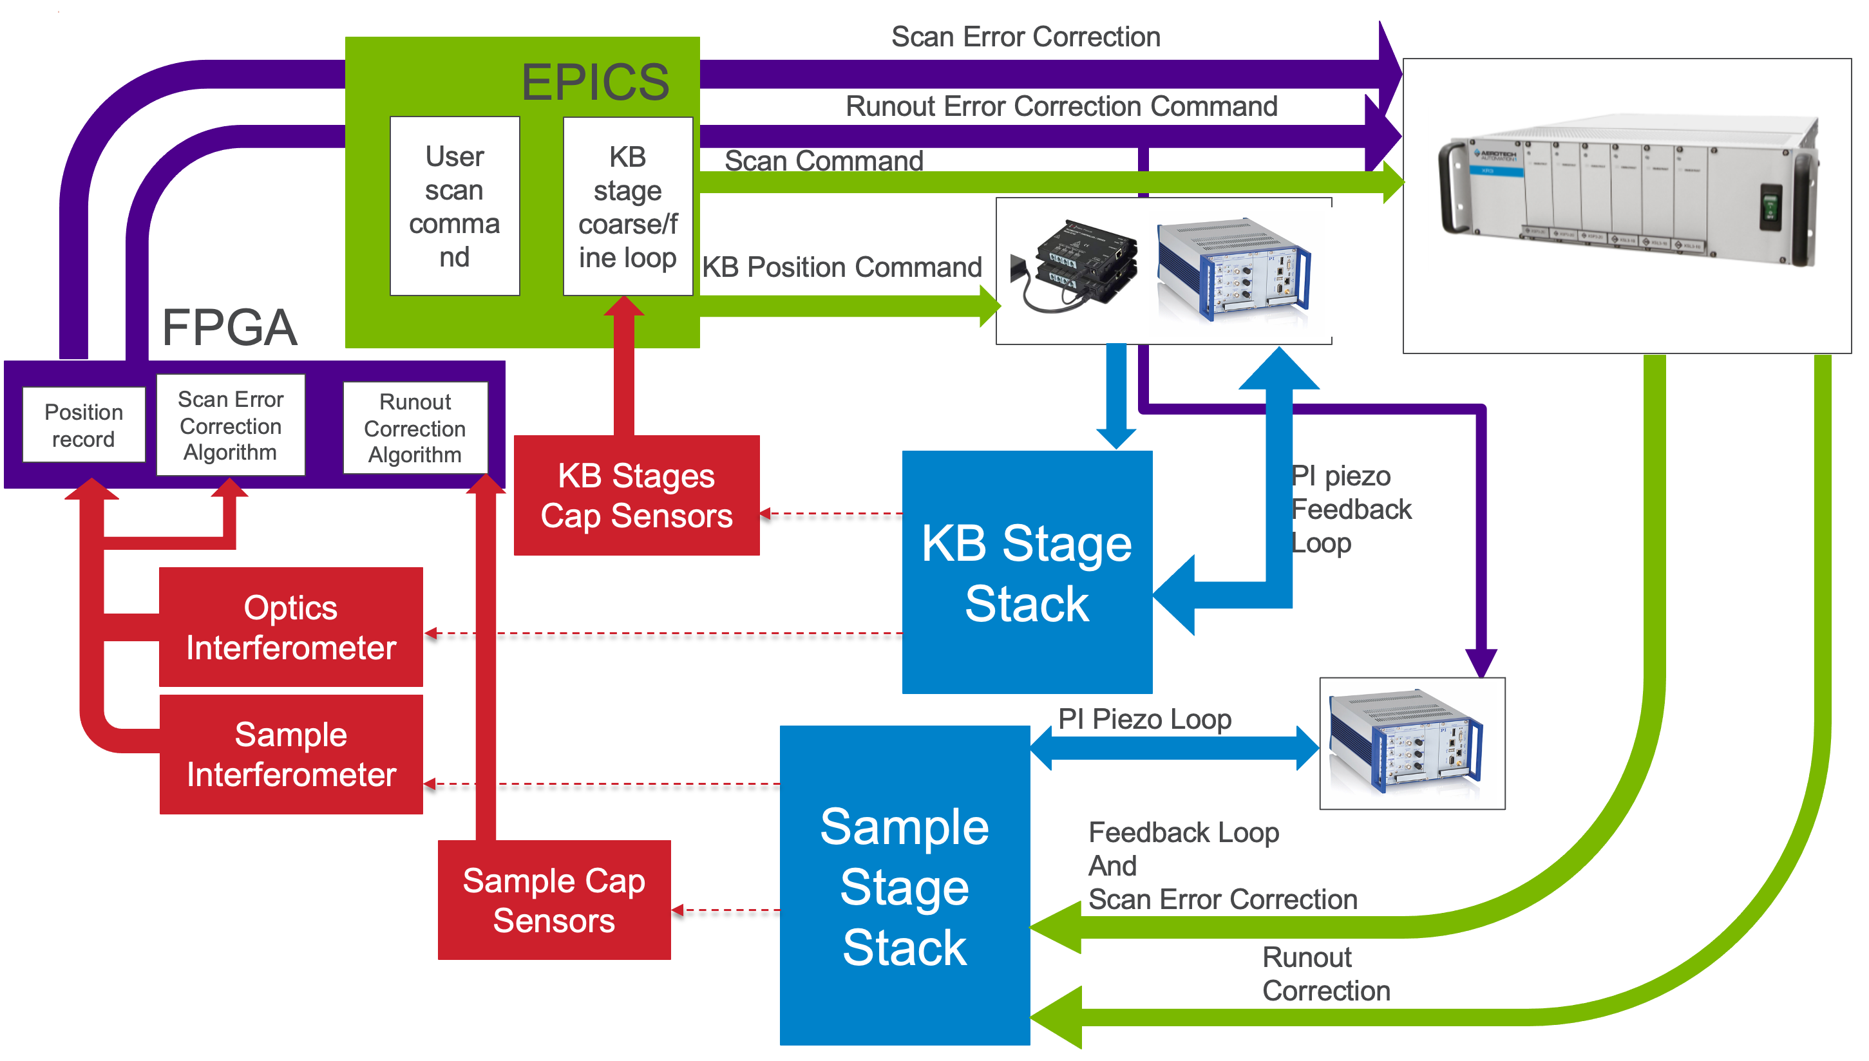
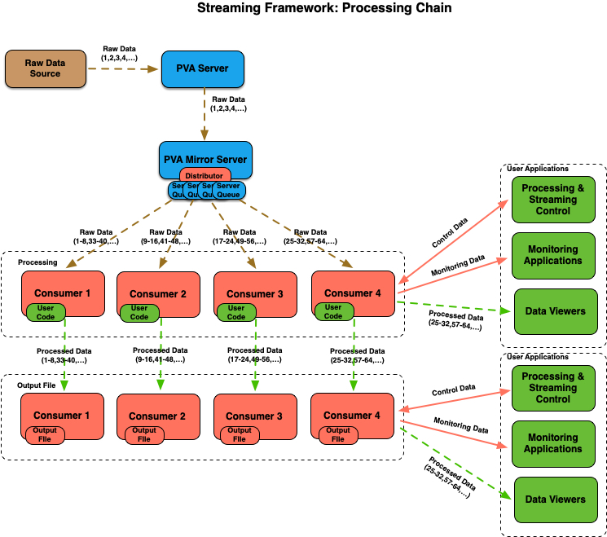
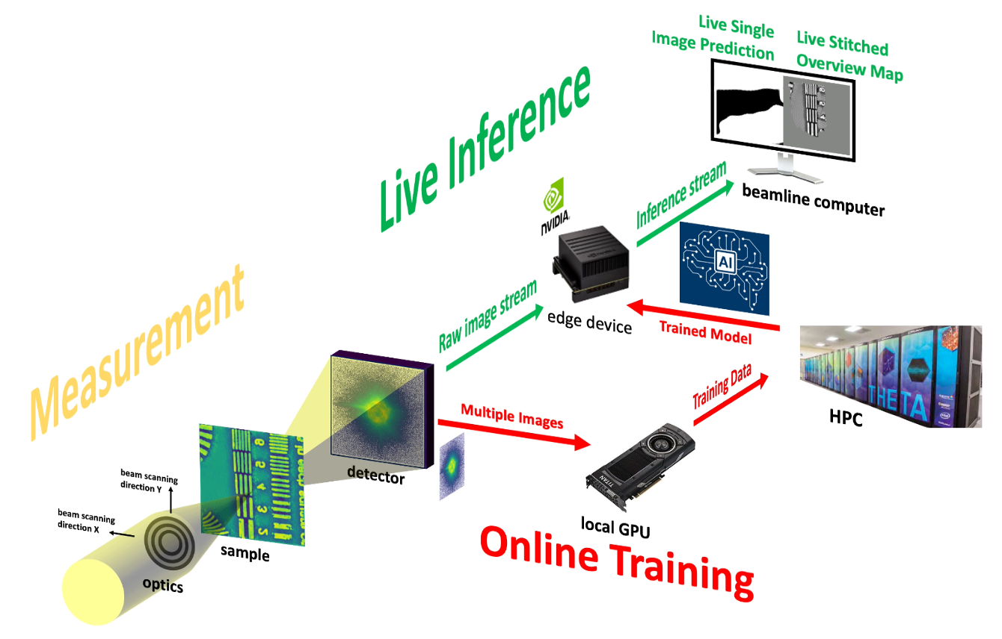
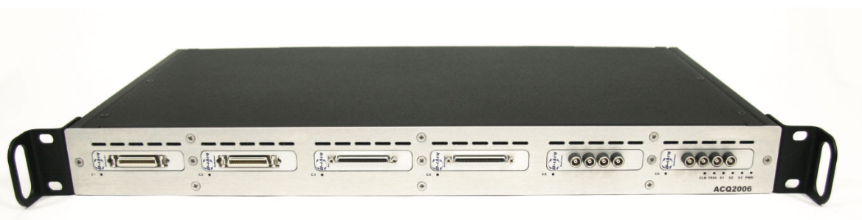
Instrument Control & Data Acquisition
Fast Scanning and Feedback
Fast Detector Data Handling
New instruments, especially the nano- and micro-probe scanning instruments, require fast scanning and feedback capabilities
APS developed softGlueZynq provides configurable FPGA capabilities for data acquisition and feedback
softGlueZynq framework being ported to D-TACQ FPGA platform
New high data-rate detectors can generate thousands of frames per second using tens of Gbps of bandwidth
EPICS V7, areaDetector, and newly developed pvaPy streaming data framework can process data at thousands of frames per second
Integration with the APS Data Management System and Globus infrastructure
Schematic of fast scanning and interferometry on the APS-U ISN Feature beamline
pvaPy streaming framework
Real-time AI-assisted ptychography reconstruction using the pvaPy framework
https://github.com/epics-base/pvaPy/blob/master/documentation/streamingFramework.md
APS Beamline Data Pipeline Project Team: Henke, S., Lang, K., Bicer, T., Guruswamy, T., Jemian, P., Leibfritz, D., Sersted, R., Babu, A., V., Veseli, S.
D-TACQ FPGA control platform

Slide 10


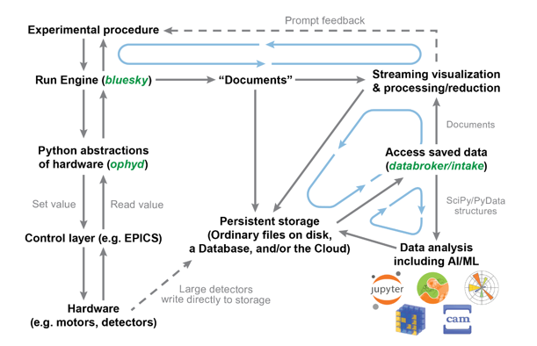
Experiment Process Control
Bluesky for data collection using EPICS (& other controls, too)
Based on well-known programming language: Python
Lots of prebuilt devices (MCA, diffractometer, slits, filters, amplifiers, …)
Integrates with automated workflows (data management, ESAF system)
Coordinates data collection and analysis with X-ray experiments
Works along with existing GUIs
Replaces what was used to run experiments
Delivers data and metadata for analysis processes from easily-discoverable data repositories.
Collaboration amongst the US-DOE user facilities (NSLS-II, APS, ALS, LCLS) and now Diamond.

Slide 11
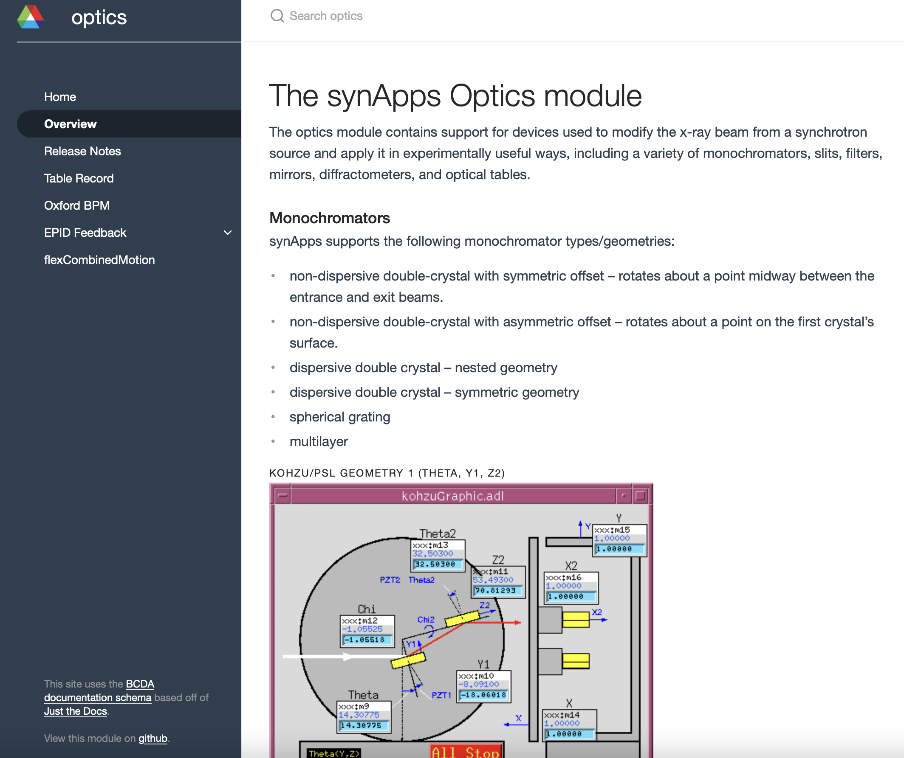
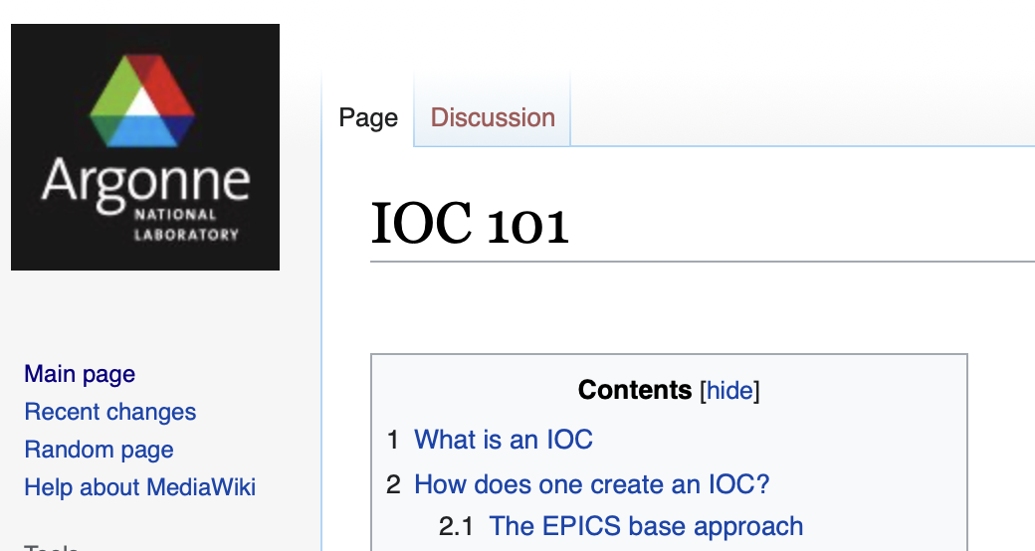
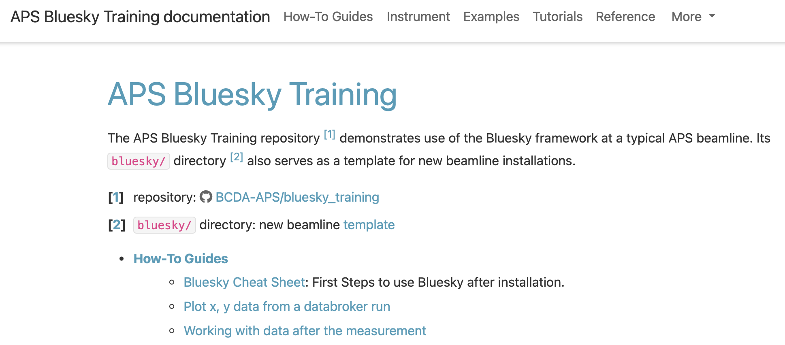
Beamline Controls Documentation
APS focused controls documentation and training
Github centric documentation for synApps module
  Common APS/BC schema based on Just-the-Docs technology
  Document process for generationing documentation.
APS IOC deployment and configuration training
  Beamline Controls Wiki
Bluesky training and instrument deployment how-to’s
  https://bcda-aps.github.io/bluesky_training/index.html

Slide 12
Acknowledgements
Nicholas Schwarz
Ken Sidorowicz
Mathew Cherukara
Alec Sandy

Slide 13
Thank You! Questions?

Slide 14
Additional material

Slide 15
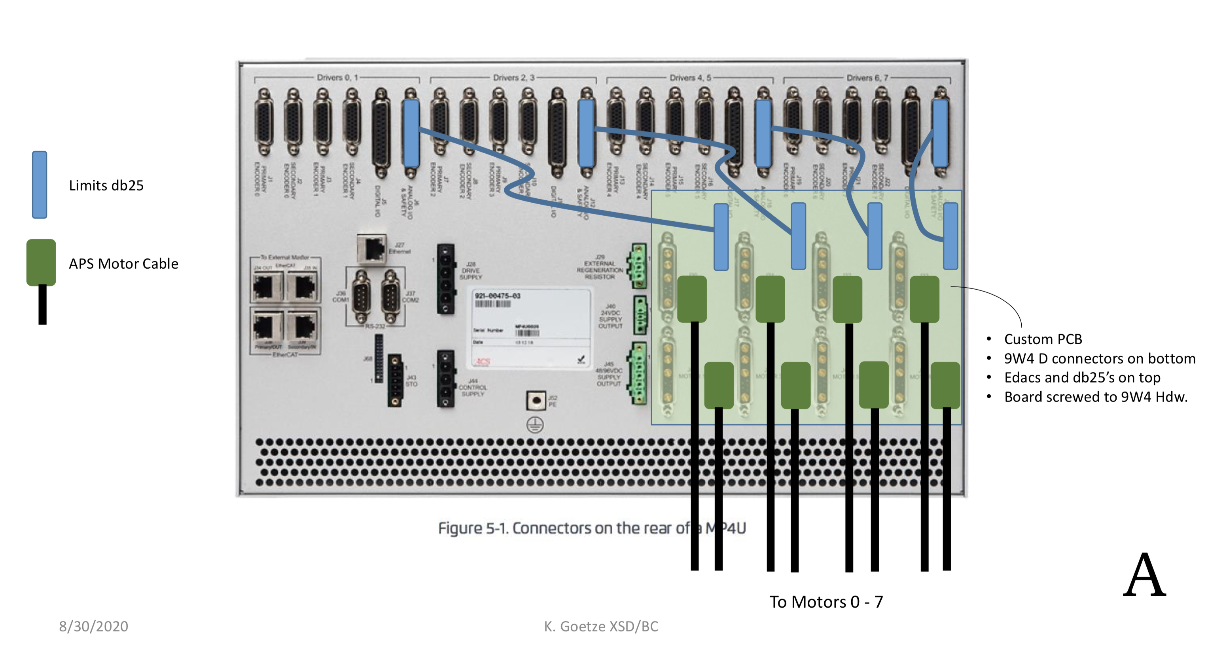
Motion control System (ACSMOTION)
MP4U to APS Motor Standard Transition

Slide 16
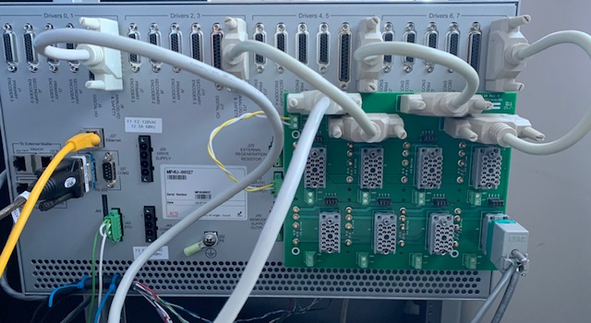
Motion control System (ACSMOTION)
MP4U to APS Motor Standard Transition

