Slide 1
The decade long transition from a custom control system to EPICS
Edmund Blomley on behalf of the KIT team
Copyright M. Breig

Slide 2
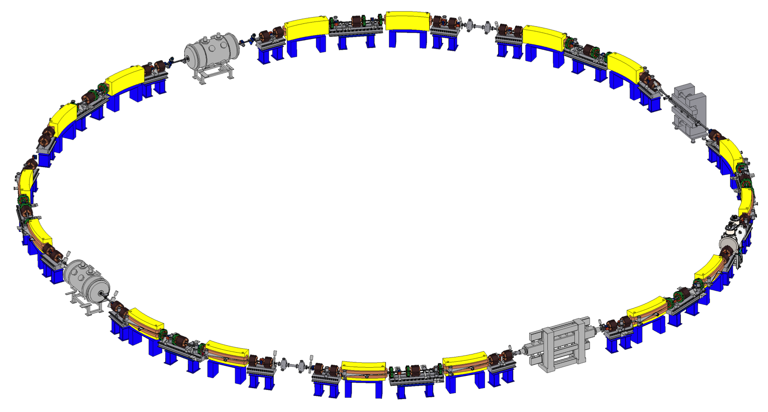
Karlsruhe Research Accelerator (KARA)
KIT synchrotron lightsource & accelerator test facility
until 2015 known as „ANKA“
Key parameters
Build 2001
Circumference: 110.4 m
Ramped storage ring: 0.5 - 2.5 GeV
1 Hz injection scheme at 0.5 GeV
accumulation for 30-45 minutes once per day
Image: U. Herberger

Slide 3
The Original Control System: ACS
ACS
ALMA common software (https://ascl.net/1302.003)
Advanced control system
Motivation
Object-oriented interface abstraction layer
Provide same interface for all power supplies independent of manufacturer
Custom extensions for ANKA
LonWorks bus (at that time, cheap and efficient for the amount of data)
Special hardware control cards
First Control System

Slide 4
ACS & LonWorks Layout
Server
LonWorks Bus
LonWorks PCI Card
Custom Interface Card
Custom Interface Card
Custom Interface Card
Custom Interface Card
Custom Interface Card
LonWorks bus system
Worked well for original setup
Over time maintenance more tricky
Challenge of adding any new device
Device
Device
Device
Device
Device
Device
Device
Device
Custom Interface Card
Custom Interface Card
Custom Interface Card

Slide 5
Migration to a new Control System?
Issues with ACS in regard to scale– and extendability
Around 2007 looking for an alternative control system
No dedicated controls group
“What is CERN doing?”
Decision was made to introduce to PVSS/WinCC
GUI(!)
support for PLCs
Integration of MRF timing system via UDP
By choice to avoid VME
Second Control System

Slide 6
EPICS: First Contact
3-4 years of investment into PVSS
Spoiler alert: PVSS didn’t get much traction on the accelerator side
Around 2010: Tango or EPICS?
New BPM electronics
Comparing Tango and EPICS implementation
Decision was made to switch to EPICS
Control System Studio (CSS) as the new GUI
Third Control System

Slide 7
Design Decisions
Ubuntu desktop and server as main OS
Use virtual machines as much as possible
Custom EPICS build toolchain creating Debian packages
Only build modules we need
Add local patches as needed
Cassandra database for archiving raw data
Naming conventions…
<accelerator>:<location>:<device group>:<device name/number>:<properties>
Avoid too many abbreviations
Local patch of EPICS base to allow PV length up to 255 characters

Slide 8
Migration Plan
Ethernet or serial communication directly possible?
Beam current DCCT: create IOC to read out serial interface
Possible to exchange hardware interface?
Storage ring quadrupole magnets: replaced controls interface
Exchange individual devices
Ideally commercially available (no custom power supplies)
TCP/UDP (or serial) interface mandatory
No migration of complex systems
Analog LLRF: replace whole system

Slide 9
Gateways
Implement gateways while “waiting“ for native implementation
At least basic access
Status, on, off, set value
Allow GUI control, alarming, archiving via EPICS/CSS
EPICS
CAS
OPC
ACS
PVSS

Slide 10
Migration Milestones
2012
2015
2018
2021
2023
First IOC
LLRF system
Shutdown of PVSS
First EPICS devices
First insertion device
Replacement of large power supplies
First family of power supplies
Second family of power supplies
Shutdown of ACS

Slide 11
Status
~700 IP devices
~80,000 PVs
~94 IOCs
~30 PLCs
TUPDP030
Recent focus on Python-based IOCs and AI integrations
Centralised IOC management via Salt
Next in line:
Migration to Phoebus
Fully transition to OPCUA (for PLCs)
Bluesky?
THPDP020
More accelerators!
FLUTE
cStart
Laser Wakefield Accelerator…

Slide 12
Community Contribution?
Working on new controls website
Open access to our internal EPICS repositories and/or build products
Lots of automated workflows (CI/CD using GitLab)
EPICS Debian tool chain
Python-to-Debian tool chain (pyepics, softIOC, caproto, etc…)
IOCs for commercial devices
Establish documentation workflow (GitLab -> Readthedocs)
Make our EPICS developments more visible
OPCUA, MRF, …
Execute Device Support

Slide 13
Not just changing Control Systems…
2001
2006
2012
2019
2023
Karlsruhe Research Center (FZK)
Karlsruhe Institute of Technology (KIT)
Institute for Synchrotron Radiation (ISS)
Institute for Beam Physics and Technology (IBPT)
Institute for Photon Science (IPS)
ANKA
KARA
ACS
PVSS
EPICS

