Slide 2
Running a major facility (almost exclusively) on pvAccess
European Spallation Source commissioning 2023
PRESENTED BY Simon Rose.

Slide 3
Agenda
1 Introduction
2 ESS commissioning 2023
3 Scope of PVA use
4 Substituting CA
5 Extending into structured data
6 Coming soon…
7 Conclusions and summary

Slide 4
Introduction
Goal setting…
In 2015 ICALEPCS 2015 contribution we wrote:
”Our goal is to build the system based on the EPICS Version 4. All our low-level controllers as well as software applications use the version 4 structured data and normative types at the application level and communicate using pvAccess. This enables us to simplify and improve the integration of different systems beyond the pure control capabilities of EPICS version 3.”
The parts of EPICS 4 related to structured data and pvAccess (PVA) were integrated in EPICS core which then was released as EPICS 7 in 2017.
Thus, EPICS 7 is:
EPICS 3 with latest bugfixes and features + QSRV serving data using pvAccess
Not very many changes if you do not use PVA
This enabled us to develop systems without waiting for completion of PVA features
Development was going on…

Slide 5
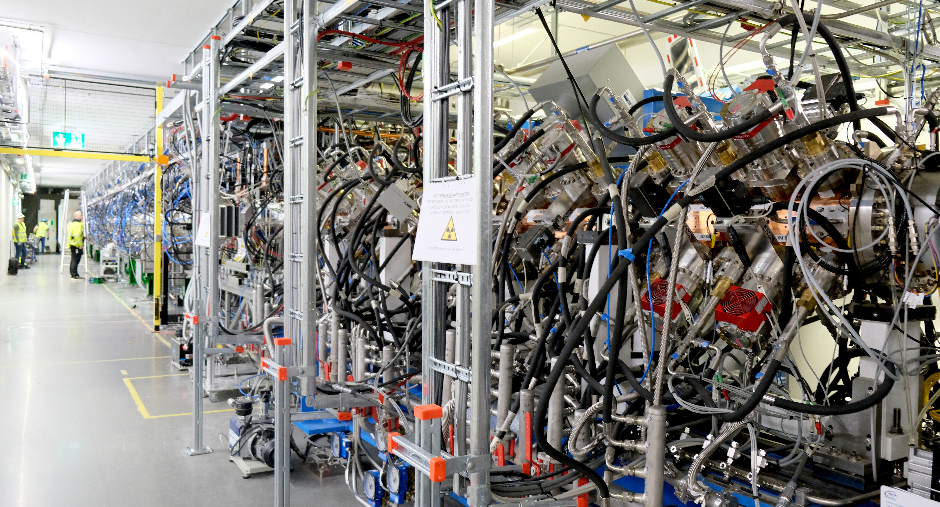
ESS Commissioning in 2023
The time to bite the bullet had come…
In Spring of 2023 the ESS Normal Conducting part of the accelerator (NCL) went into commissioning.
Compared to the final ESS machine, NCL is “simple”, but nevertheless
Contains most essential components except superconducting RF
RF systems, beam instrumentation, timing, machine protection,…
Large number of records (est. ~3 million) and big data volumes
Mostly running at low rep rates (1 Hz), but still.
All IOC were running EPICS 7 already before this year
Previous commissioning round was still done with CA as the default.
Preparations were done to check that e.g., all IOCs could serve PVA.
Finally, it looked like we were ready to take the dive…
NCL

Slide 6
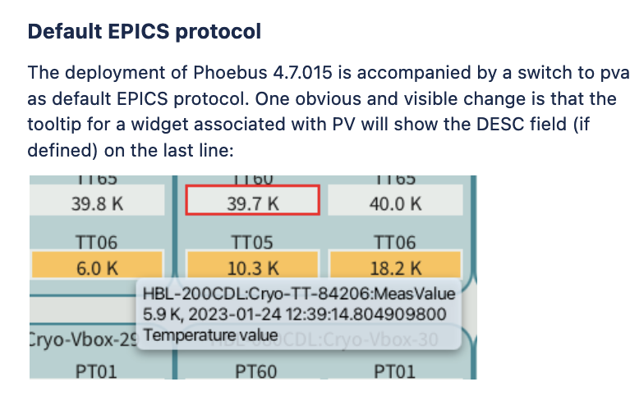
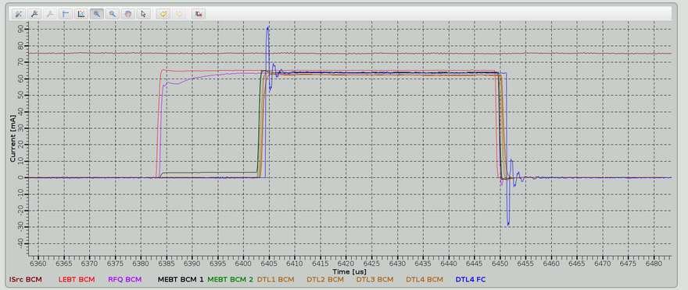
Scope of PVA use
Tools and goals
PVA set as default for CS-Studio (Phoebus)
All OPIs in (and outside) control room use PVA
Beam physics (OpenXAL) uses PVA
Custom applications (Python, Jupyter) use PVA
Archiver Appliance still mainly on CA
No method yet to change the default – coming in the next release.
In addition to the linac, many other activities going on in parallel
SRF preparation (testing, commissioning, preparation for installation)
Target systems development and testing
Neutron instruments development and testing
All of this uses PVA.
From ESS internal Phoebus release note, 13. January 2023
Beam pulse through the linac, displayed on Phoebus OPIS

Slide 7
Substituting CA with PVA
Sub-headline to strengthen the headline above
First stage has been using PVA as a substitute for CA
Scalars and simple arrays
Not a lot of structured data yet, but this is still an important step
Stability of the infrastructure
Check for the stack (IOC-Network-Clients)
Phoebus support
OPI widgets, Save&Restore
Services validation: alarms, CA Security
Use of PVA soon extended out from the control room to office.
CA gateways were problematic with a mixture of scalars and big arrays.
Big arrays in effect block scalars from going through. Delays are intolerable.
Trying to keep arrays separated was futile
P4P (PVA gateway) to the rescue!
Balanced throughput of scalars and arrays, minimal decline of scalar throughput even with heavy load (arrays up to 800000 points of doubles!)
Performance is outstanding

Slide 8
Going beyond CA
Starting to make use of structured data
Start has been slow
Understanding the concept
Communication: what is available, what are the structures good for?
Documentation missing and/or outdated, or too sparse (“expert-friendly”)
lack of (real world) examples
Use of ”group” PVs
Building structures out of data items in ”classic” records
Least invasive method. Existing databases do not need modification.
Records take care of their usual business
Templates, linking, conversions,…
QSRV routes and orchestrates data out and in – atomically
Pretty much “everything” can be done with group PVs
Without custom programming

Slide 9
Emerging applications
Structured data in atomic units as the key feature
Synchronous Data Service in “alpha”, first use in the field this spring
Collects data items from subsystems, organised by beam pulse (vs. time series)
Can handle large arrays gracefully, without hogging all network bandwidth
Can be triggered by subsystems on a predefined condition
Used for post-mortem and (user-defined) anomaly detection
Collects also key parameters continuously
Descriptive metadata combined with payload
Data will be saved as HDF5 files for subsequent analysis
Operational data in atomic units
Handling of beam parameters and timing patterns as structures
Suitable for things like timing tables (machine cycle sequences)
More to come…
Neutron instrument (aka beamline) experimental metadata

Slide 10
Future work and conclusions
Where do we stand now
One issue remaining: detection of duplicate PVs on the same network
Does not yet work with PVA. One of the few cases where resorting to CA is necessary. Rare, but annoying.
Fix is underway: QSRV2, a rewrite of the PVA server based on PVXS (Michael Davidsaver)
Eagerly waiting for official release
Was missing PVA link implementation, but is being worked on (ESS funding)
Use cases for structured data are emerging
As a conclusion, from our perspective:
pvAccess has reached stable state and is ready for use in a major facility
With many advantages and room for future expansion
We at ESS have reached the goal of running the facility on PVA – for all practical purposes
Even if a few corner cases still need(ed) CA

Slide 11
Finish presentation

