Slide 1
ICALEPCS 2023 EPICS Satellite Meeting
Diamond-II
Austen Rose
Head of Accelerator Controls

Slide 2
Synchrotron Light Source Evolution
Diamond is a modern 3rd generation synchrotron
4th generation synchrotron light source technology is now mature and a reality
Max-IV, ESRF, SIRIUS
4th generation technology is offers x100 in X-ray brightness.
Every generation of synchrotron light source has transformed our understanding of materials and systems in biology, physics, chemistry, engineering
Impacts all fields of natural sciences, from the atomic and molecular levels to macroscopic length scales, and dynamics
4th generation
e-
e-
3rd generation
e-
1st/2nd generation
Bending magnet

Slide 3
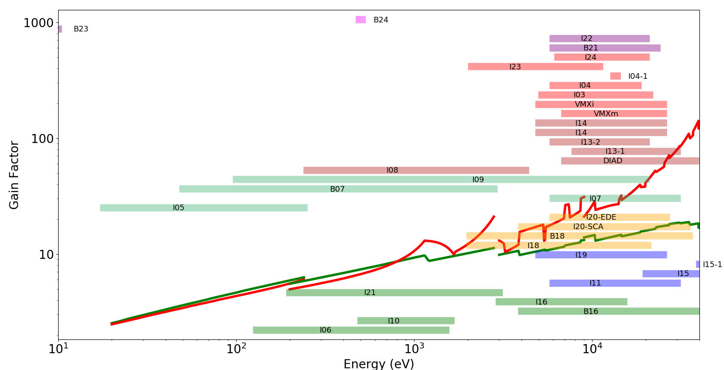
Diamond-II Brightness
3.5 GeV, 161 pm†
3.0 GeV
118 pm†
† bare lattices

Slide 4
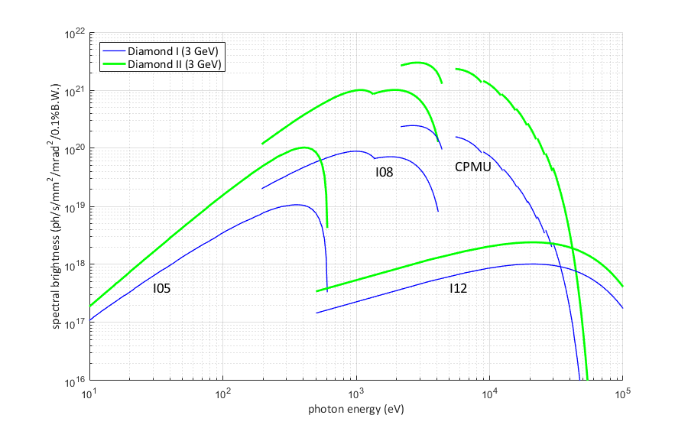
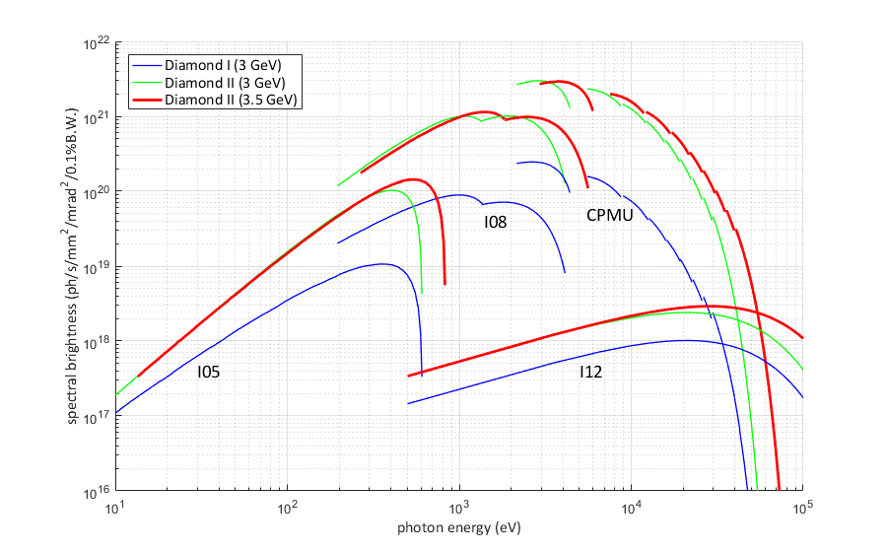
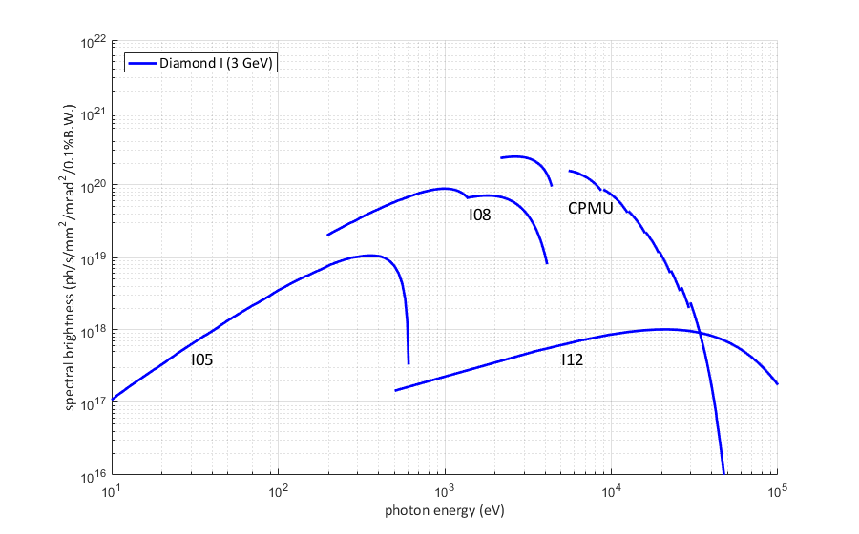
Diamond-II Brightness
3.0 GeV, 2.7 nm
3.0 GeV, 118 pm
3.5 GeV, 161 pm
UV
X-ray

Slide 5
Diamond-II Cell Design
Diamond-I
Diamond-II

Slide 6
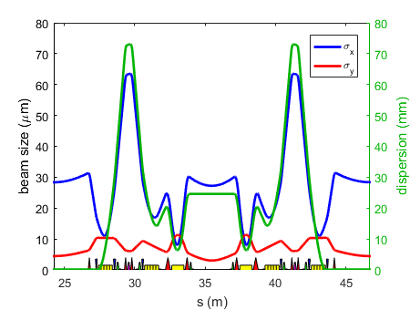
Diamond-II Lattice Cell Design
 | Diamond-I | Diamond-II
Lattice Type | DBA | M-H6BA
Circumference | 561.6 m | 560.561 m
Straight Sections | 24 | 48
Energy | 3 GeV | 3.5 GeV
Beam Current | 300 mA | 300 mA
Natural Emittance | 2.7 nm.rad | 161 pm.rad
Natural Energy Spread | 0.096 % | 0.094 %
Equilibrium Emittance | 3.1 nm.rad | 139 pm.rad
Equilibrium Energy Spread | 0.096 % | 0.109 %
Modified Hybrid 6 Bend Achromat

Slide 7
Project Timescales – Overall

Slide 8
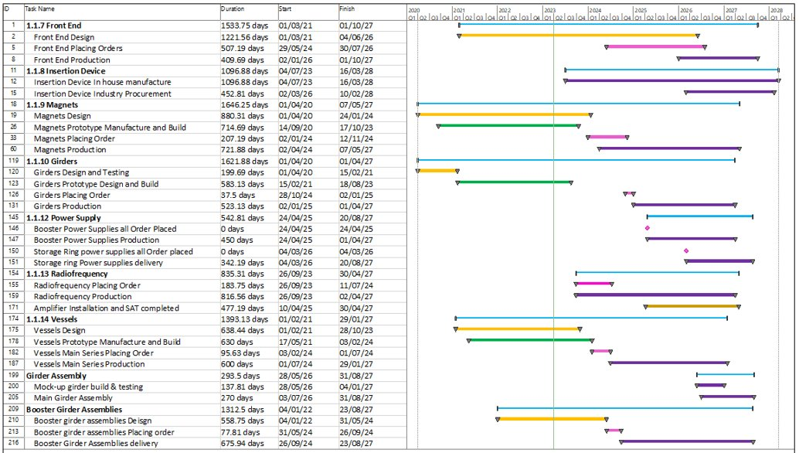
Project Timescales – Pre Dark Period

Slide 9
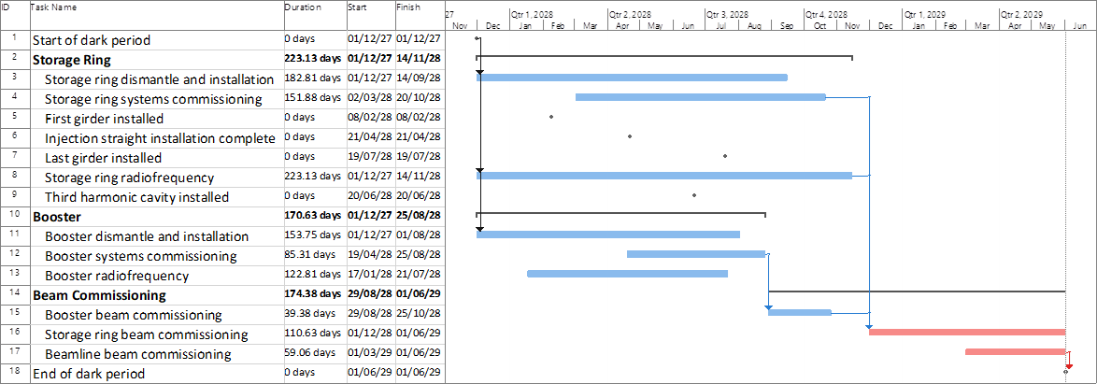
Project Timescales – Dark Period

Slide 10
Diamond II Programme
1.Diamond-II project
1.1 Machine
1.2 Beamlines
1.3 Software/Computing
1.4 Infrastructure
1.4.1 Girder assembly building.
1.4.2 Misc. Assembly / Storage building
1.4.3 Pipework and Cabling Storage Buildings
1.4.4 Contractors Cabins
1.2.1 Critical Beamline upgrades
1.2.2 New and rebuilt Beamlines
1.3.1 Data centre extension 2MW
1.3.3 Data analysis for high data rate applications
1.3.4 Common Instrumentation, Control, Acquisition and Detector Readout
1.1.1 Storage Ring
1.1.2 Injection System
1.4.5 Infrastructure
1.5.2 Finance
1.5 Programme Management
1.5.1 Planning/resource management
1.5.3 QA
1.1.3 Insertion Devices
1.3.2 IT infrastructure
1.2.3 Optics Simulations and R&D

Slide 11
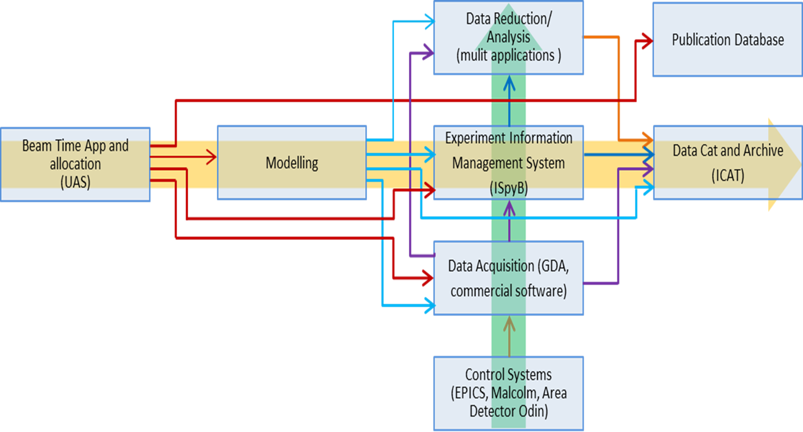
Software and Controls Developments
More holistic approach to software design and development
Greater functional integration
Richer metadata
Service orientated architecture
Substantial software developments in
Data to Knowledge
Realtime Data Management
Experiment Management
Information Management
Facilitate greater use of
ML/AI technologies
Post visit data analysis services
Open data management

Slide 12
Highlights of Controls activities
Try to spend the rest of this talk focusing on the EPICS layer (this might be difficult):
Accelerator systems
Enabling Activities
RTEMS
Engineering UI
Insertion Devices Controls
Rack upgrades
D-II deliverables
EPICS Interfaces
High Level Applications
EBPM Interface and Orbit Feedback
Beamline systems
Containers (Kubernetes)
Bluesky / Ophyd
Panda
FastCS
Electronic systems
MPS
PSS
Motion
There is a lot of sharing of tools and ideas across accelerator and beamline controls, so this split does not really hold true. The work done by one team will be utilised by the other, and we share resources to achieve the goals.

Slide 13
Enabling Activities Progress
RTEMS
To maintain our older VME systems we are replacing VxWorks OS with RTEMS
RTEMS is open-source and has been in use for many years by facilities using EPICS
It is being actively developed and supported
The latest version 5.3 runs on our existing hardware with the most recent version of EPICS, 7.0.7
Our elderly version of VxWorks will not support later versions of EPICS
Transition as many of our accelerator VME systems to RTEMS as possible over the next couple of years
Move to RTEMS6 for longer term support.
RTEMS 5 is dependent on NFS V2, which is not supported by later versions of RHEL. RTEMS 6 will have NFS V4 compatibility.
We have tried to run an NFS V2 service under Kubernetes in user space, but this did not work well as the library we found was unsupported and did not have write support.
A. Rose, Diamond-II MAC#5, Apr. 4th-5th 2023

Slide 14
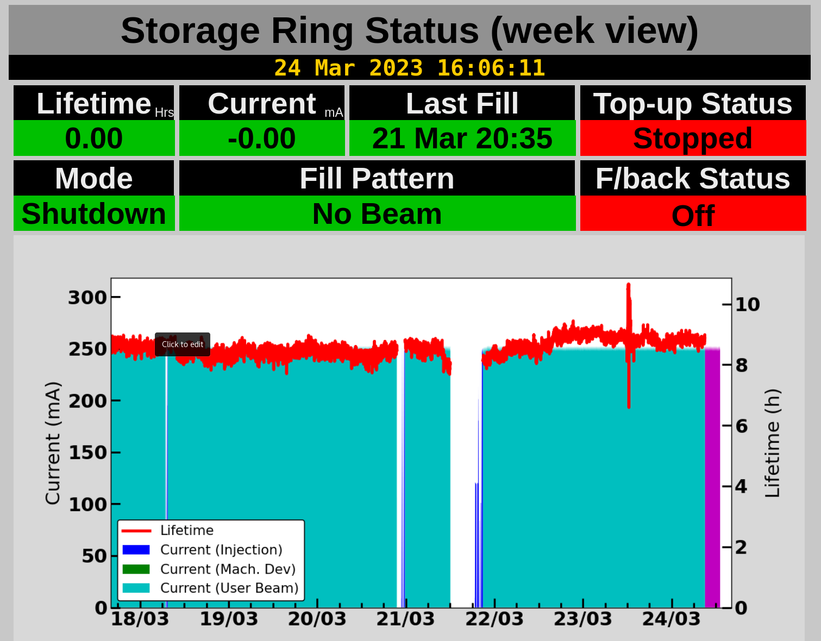
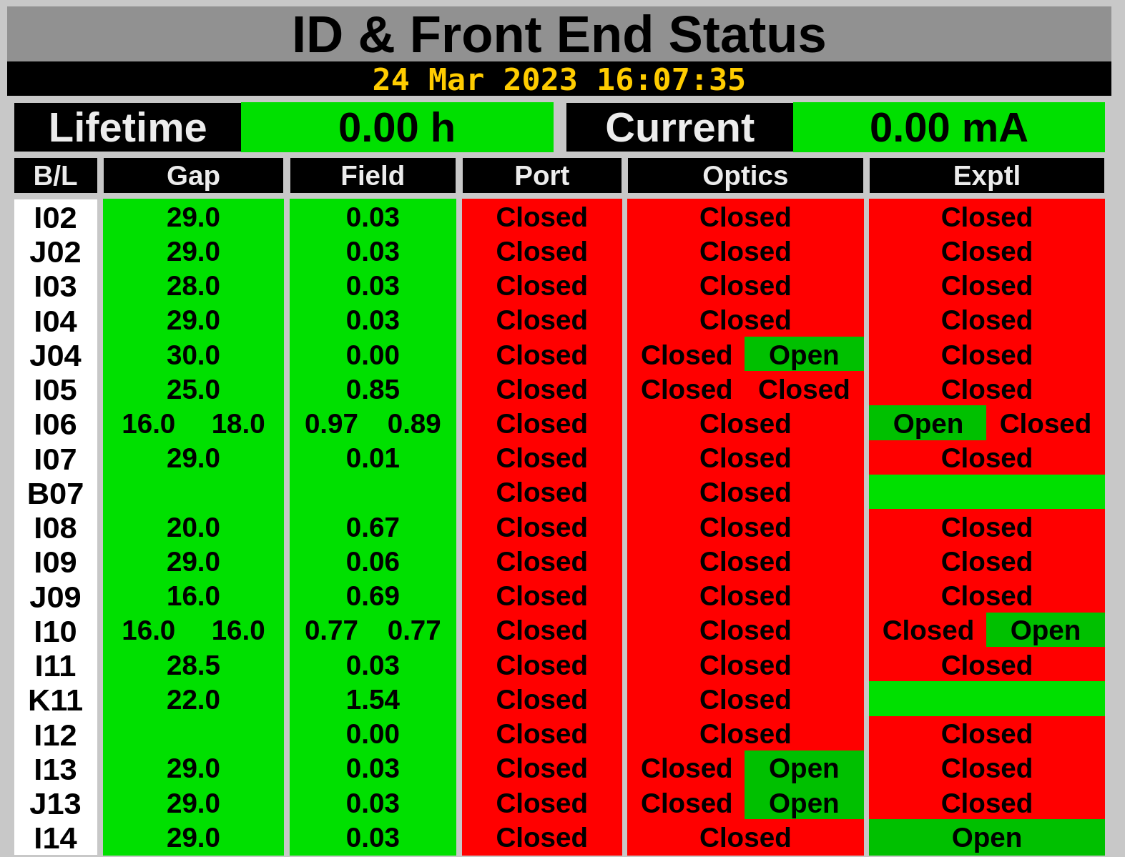
Enabling Activities Progress
Engineering UI
The architecture was reviewed by and external software house
We have 1 ½ FTEs working on the project and are shortly to add another ½.
We have budgeted for 2 further contract FTEs to commit a further 3 years of effort.
The prototype is currently deployed and delivering the machine status displays around Diamond.
Current activities include plotting widgets and video widgets.
We are doing backend and frontend performance testing.
We have a project plan in place – but will need continuous review.
Engineering UI Machine Status Display

Slide 15
D-II Specific Deliverables
Activity | Progress | Comments
Injector Technical Systems EPICS Interfaces | Good progress made and will make more progress in 2023 | The Linac and booster vacuum and MPS will be completed in 2023.
Storage Ring Technical Systems EPICS Interfaces | Broadly, little progress | We need to work through the requirements. For completion this year.
Storage Ring Girder Movers | Motion prototyping progressing | Actively being developed.
Power Supply Controller | Under development for prototype systems. Available for use. | Change in architecture where we will have one IOC per power supply. ~1200 PSU IOCS.
Front-ends | Scope of work “under discovery” | We thought three new front ends, but it seems more likely to be eight
Insertion Devices | Large program of work | Still uncertain as to scope
A. Rose, Diamond-II MAC#5, Apr. 4th-5th 2023

Slide 16
Containerisation
Applicable to accelerator controls, beamline controls, data acquisition & analysis, plus other services
Allows us to ‘divorce’ the operational OS that is deployed across workstations and servers from the OS used to deliver EPICS level interfaces.
Containers for development
Containers for deployment
Accelerator systems will have containers to support IOC deployment. It is planned that beamlines will have one cluster per beamline.

Slide 17
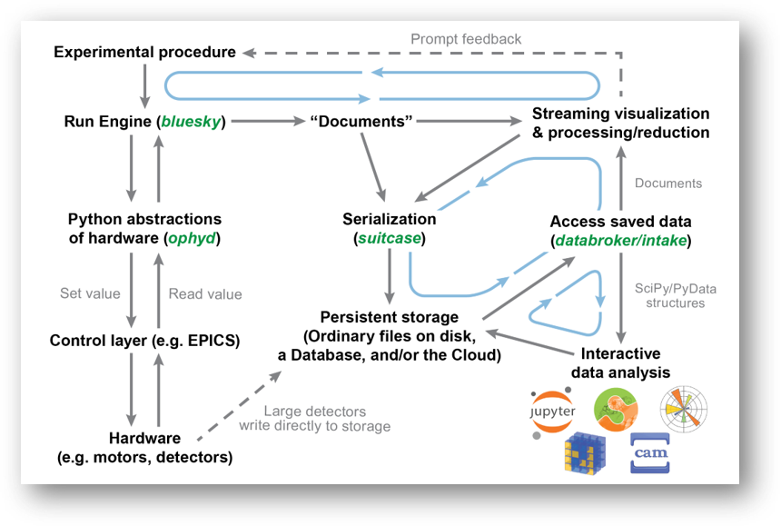
Beamline specific Deliverables
Bluesky / Ophyd
Lightweight clean architecture
Scanning features
Rapid Grid
Time resolved
Python3 based
Event model for data
Ecosystem of complementary modules
Proven at NSLS-II
Adopted by several other facilities
Our prototypes were leading to a similar architecture

Slide 18
PandA
Highly configurable timing unit that can be used on a beamline to sequence motion and data acquisition
Can have integrated EVR capability
Now possible to integrate the logic into a PowerBrick motion controller, reducing complex cabling and saving space
Developed in partnership with SOLIEL. A further development to use a larger FPGA is under active consideration and being driven forward under LEAPS

Slide 19
FastCS
FastCS: Why do we need it?
PandA is dynamic and introspectable, don't know PVs until you connect to hardware
This means you can't make screens until you connect to hardware
Or make the ophyd interface
So made a pythonSoftIOC that did all this
In the process realised that pythonSoftIOC is not type hint friendly
Now we need to write IOCs for Odin and ​TwinCAT​, needed to abstract to a library
Called it FastCS

Slide 20
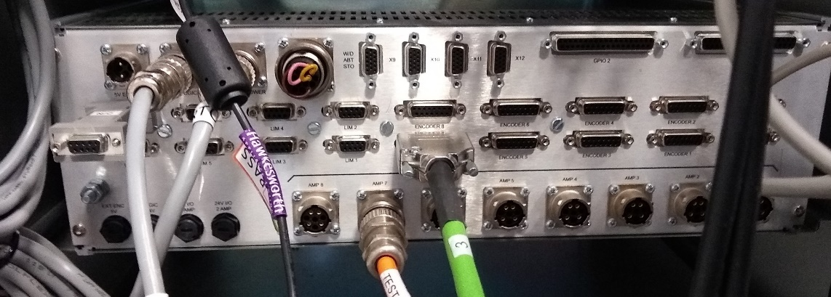
Motion Control - PowerBrick
Last year, after a tender process the Faraday Motion PowerBrick was chosen as Diamond’s next generation of motor controller, replacing the now obsolete GeoBrick
Many aspects of this controller are similar to a GeoBrick:
8 axes
Same physical size
A DeltaTau (Omron) product inside
PLCs, coordinate systems
etc
But there are still a lot of differences and new features which need to be addressed or taken advantage of

Slide 21
Motion Control - PowerBrick
Cool New Stuff
EtherCAT – means that we can link other systems (such as the MPS) with the controller directly, including being able to interrupt individual end-of-travel limits internally
EtherCAT/MACRO to control more axes
PowerBrick FPGA – all controllers will support the option of housing a Panda FPGA
More built-in functionality – e.g. encoder loss and e-brake
Differences
One of the biggest differences is that it is built around a Linux computer with a separation between its own file system, and a ‘live environment’
This adds complication to how we synchronise files and settings between the motion area and the controller
Still supports PLCs but the PMAC scripting language is more C like, and it is also possible to write PLCs in C
Still supports coordinate systems but they are structured differently, with the kinematics separated from the rest of the routine

Slide 22
Acknowledgements
With Thanks to:
Mark Heron,
Ian Martin,
Sky French,
Tom Cobb,
and ….
Accelerator controls group, Beamline controls and the SSCC Group more widely

Slide 23
Thank you

Slide 24
Extra Slides

Slide 25
Definitions
Ophyd is a hardware abstraction layer for Bluesky. It groups collections of EPICS PVs together into logical devices and provides logic to implement Bluesky verbs (like trigger, read, set). The original ophyd uses threads where it needs concurrency. The new ophyd-async uses asyncio to do concurrency, and supports not only CA, but PVA and soon will support Tango.
References:
Ophyd — ophyd documentation (blueskyproject.io)
Bluesky Data Collection Framework — bluesky 1.6.7.post2+g888716e documentation (nsls-ii.github.io)
asyncio — Asynchronous I/O — Python 3.11.6 documentation

Slide 26
Definitions
Diffraction limit can mean different things to different people, depending on context. In the present case of a diffraction limited storage ring, this is usually taken to be the point where the contribution to the total radiation beam size coming from the electron beam is equal to the natural size of the photons at a given wavelength. I.e., making the electron beam smaller (lower emittance) doesn’t help, as you start to become dominated by the size of the individual photons.
Roughly speaking, emittance needs to be <8 pm.rad to be diffraction limited for 10 keV photons, or <80 pm.rad for 1 keV photons.
Natural emittance is the emittance you get for the bare lattice (no IDs) and without considering any collective effects (impact of intra-beam scattering, interaction with wakefields, etc.)
Equilibrium emittance is the actual operating emittance once you take everything into account. We usually have to make some assumption on which IDs are operating at which gap here though. We usually say all IDs closed to minimum and 300 mA / 900 bunches, with harmonic cavity operating.

Slide 27
Diffraction-Limited Storage Rings
Goal for future storage rings is to approach ‘the diffraction limit’
i.e. reduce the electron beam size below the intrinsic size of the photons
Electron emittance, ε = 1 nm.rad
Beta, β = 1 m
Wavelength, λ = 1 nm
Undulator length, L = 2 m
Electron emittance, ε = 0.01 nm.rad
Beta, β = 1 m
Wavelength, λ = 1 nm
Undulator length, L = 2 m
Existing rings already operate close to the diffraction limit in the vertical plane
Challenge is to reduce the horizontal beam size / divergence

