Slide 1
Progress of the EPICS Transition at the ISIS Neutron and Muon Source
Ivan Finch
ICALEPCS’23 / EPICS Collaboration Meeting, Cape Town, South Africa
Sunday 8 October 2023

Slide 2
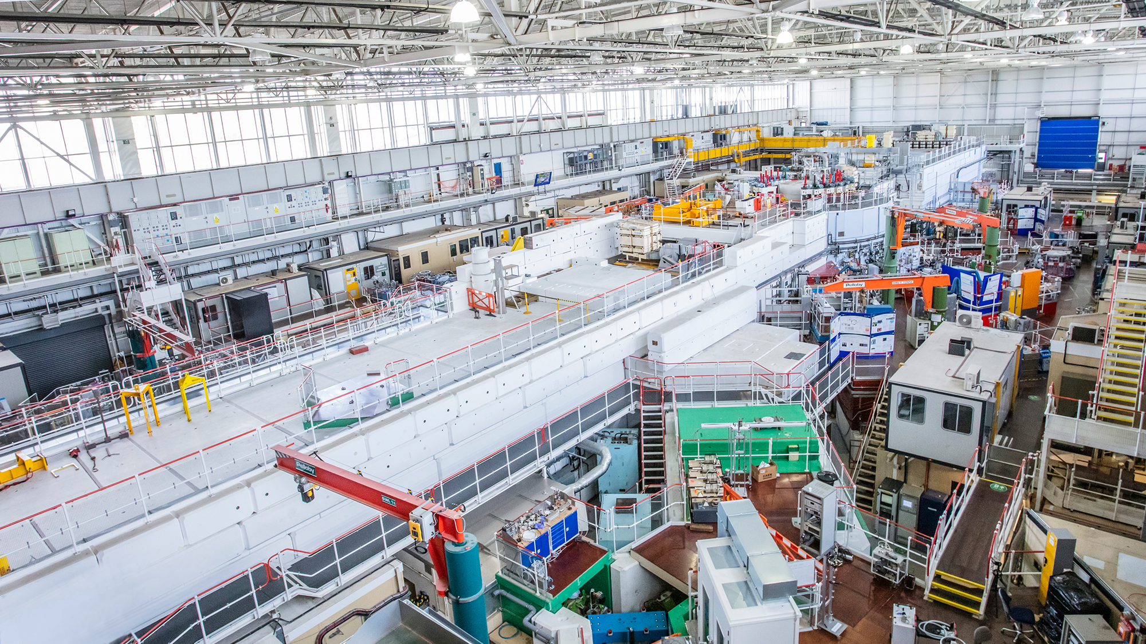

Transition Decisions
Slide from EPICS Collaboration Meeting Fall’22
Made
Phoebus for user interaction
favour PVAccess over Channel Access
prefer IOCs (or equivalents) in containers on centrally managed servers
Deferred
selection of technology for archiving of PVs
selection of alarm handler software
Opportunistic
Allow obsolescence to take care of old hardware
Fortunate
Already a dedicated controls network
Notes:
Somewhat deliberately we have modelled ourselves after how I understand ESS to work, and less deliberately like Diamond, and entirely accidentally very differently from ISIS Instrumentation.
Note that this is an old slide. Mihnea will be presenting on the topic of Archiving and using an alternate data source to the EPICS Archiver Appliance

Slide 3
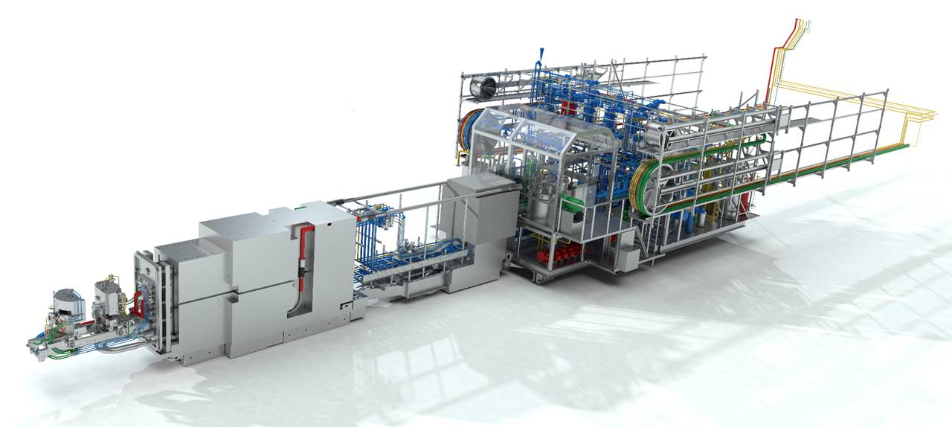
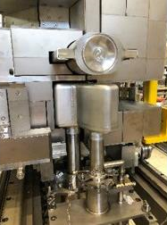
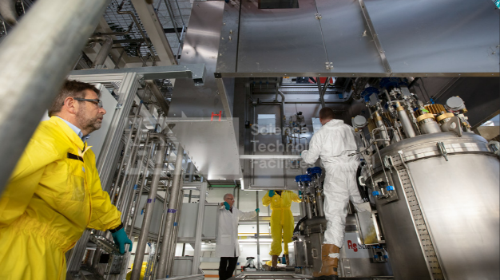
Target Station 1 Upgrade
Between Apr 2021 and Nov 2022 Target Station 1 (TS1) was closed for its first complete refurbishment since operations began in 1984.
This included changes to the design of the target and its cooling systems, the moderators, the reflector and all their associated services.
As part of the upgrade work most of the existing Omron CJ PLCs were replaced with three Omron NJ PLCs.
This was an opportunity for us to move these new systems to EPICS.
Target, Reflector and Modulator assembly with half the reflector removed
Fitting the ATEX area in the Target Service Area
Notes:
ISIS 40th anniversary next year.
The TS1 Upgrade was obviously affected by Covid-19
Pressure on the PLC team was particularly intense, but we had some of it as we worked to meet the deadline

Slide 4
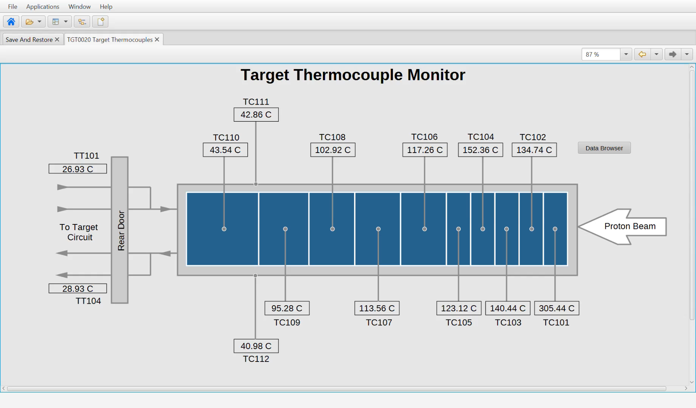
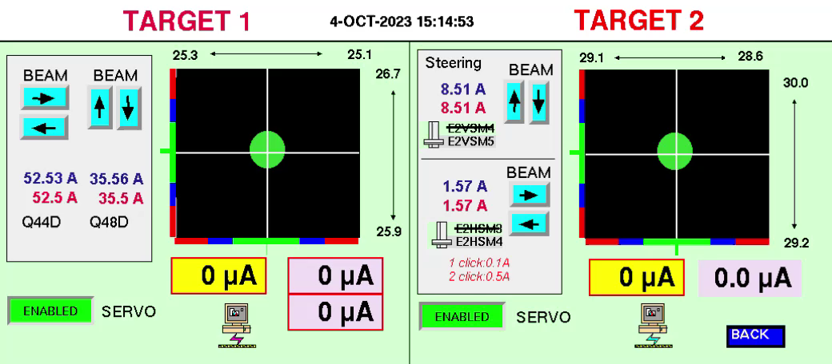
EPICS at ISIS Accelerators
Success!
We have our first end-to-end EPICS deployment – with caveats – and we are successfully running the EPICS and Vsystem control systems in parallel. PVEcho (WE2BCO04) in successful operation for almost a year.
TS1 HMI in Phoebus (top)
Halo steering in Vsystem, showing control loop using data from EPICS (bottom)
Notes:
Spoke last year about auto-generated screens, and one had been in use in the MCR since Feb 2022.
Caveats will be addressed in a later slide.
Note that PVEcho is the bridge between the two control systems and my colleague Kathryn Baker will be talking in more details about this software on Wednesday. Sufficiently reliable bridging for us to use it in a control loop!

Slide 5
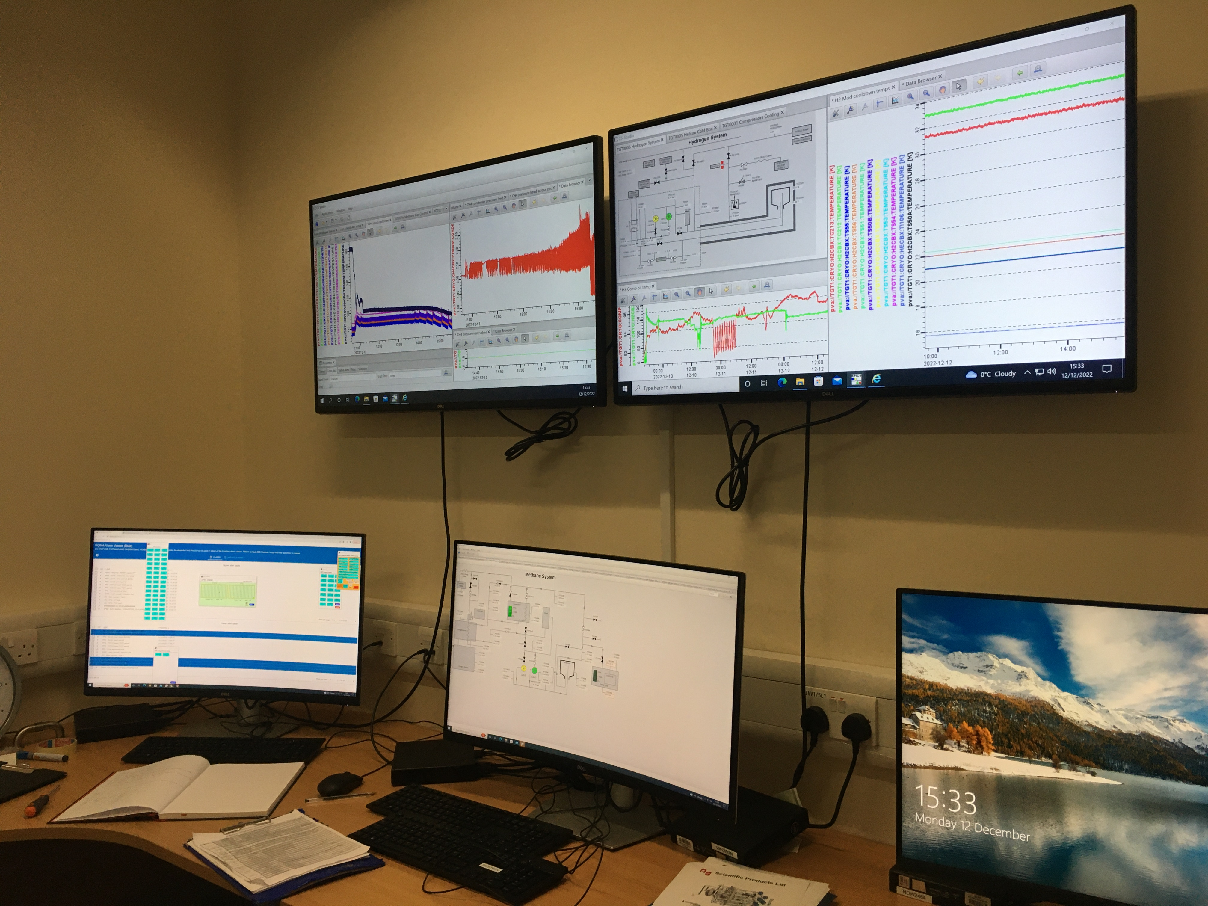

EPICS End-to-End
EPICS is now the primary system in use in the TS1 Control Room.
EPICS is in use in the Main Control Room, for TS1 screens.
As we are feeding all data to the EPICS Archiver Appliance the auto-converted screens have also been used by crew and accelerator physics for post-mortems, etc.

Slide 6
EPICS at ISIS Accelerators
Omron PLC
(CIP Protocol)
Talked about our CIP PVAServer at the previous EPICS Collaboration Meeting.
Our system is unusual – we have implemented our “IOC” in Python, which we run in a Docker Container. We read the configuration of the PVs (e.g. alarm settings) from the PLC.
It interfaces conventionally with Phoebus and the EPICS Archiver Appliance.
CIP PVAServer
(pvapy)
Phoebus
Notes:
Mention what makes us unusual

Slide 7
EPICS at ISIS Accelerators
Omron PLC
(CIP Protocol)
Deployment Servers
The implementation proved more complex in practice!
We still use Vsystem in two different ways:
A small number of values originating in Vsystem are written to the PLCs
We chose to have only one alarm interface in our Main Control Room (MCR). This is currently Valarm.
All values logged to EPICS Archiver Appliance and, through PVEcho & Vsystem, to InfluxDB.
Docker Swarm
CIP PVAServer
(pvapy)
Load-Balancers
Bare Metal
PVEcho
PVA Gateway
PVA Gateway
(Read-Only)
Docker Swarm
Mosquitto
(MQTT Broker)
Bare Metal
TCP Only
Vsystem
Valarm
(Alarm Display)
Phoebus
(On-site Operators)
Phoebus
(Off-site Operators)
Note: archiving and logging infrastructure not shown.

Slide 8
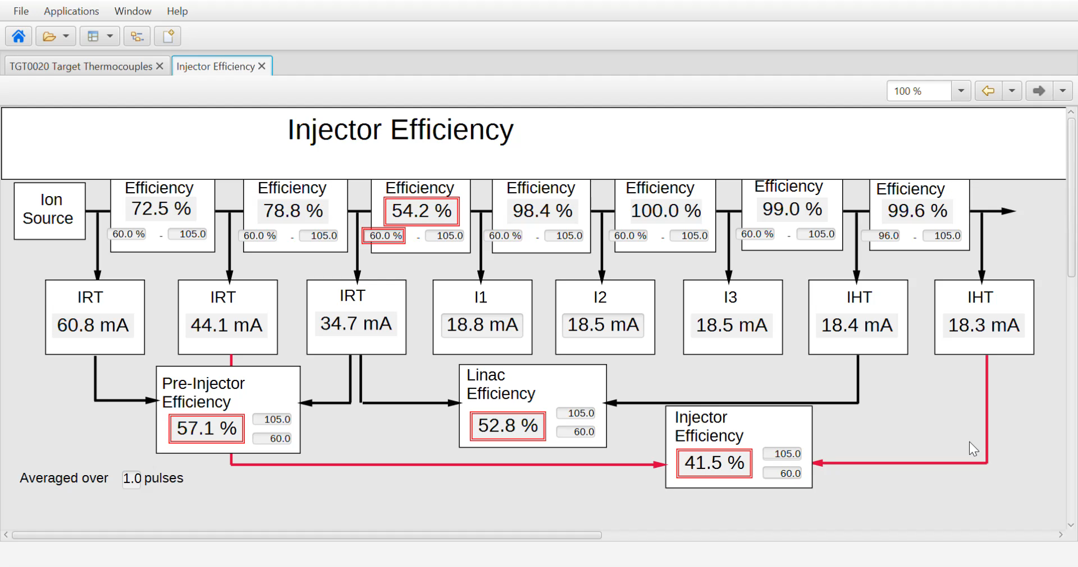
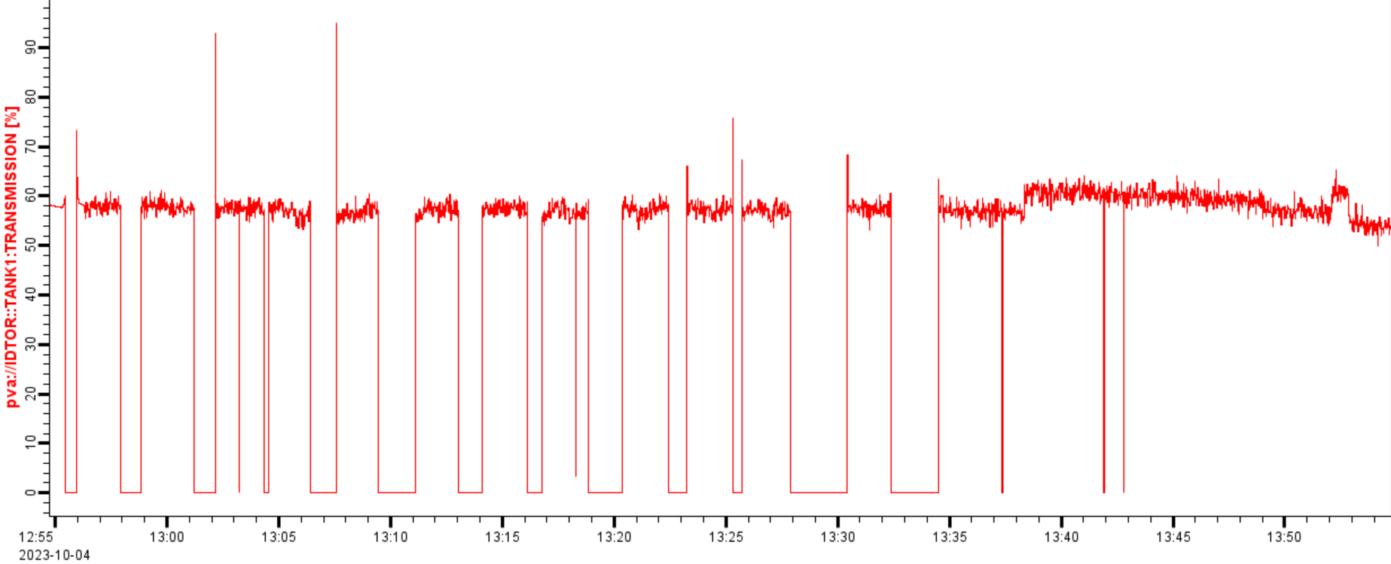
Lessons Learned – Easy Access to Archiving
Our operators were using the EPICS Archiver Appliance before we even deployed the new screens.
Operators and equipment owners have made it clear to us just how important for diagnosis (especially of new systems) they regard easy access to trend data.
Interface to our existing InfluxDB data, see TUMBCMO08
Notes:
Note that this also demonstrates an aspect of PVEcho operations including alarms propagating correctly.

Slide 9
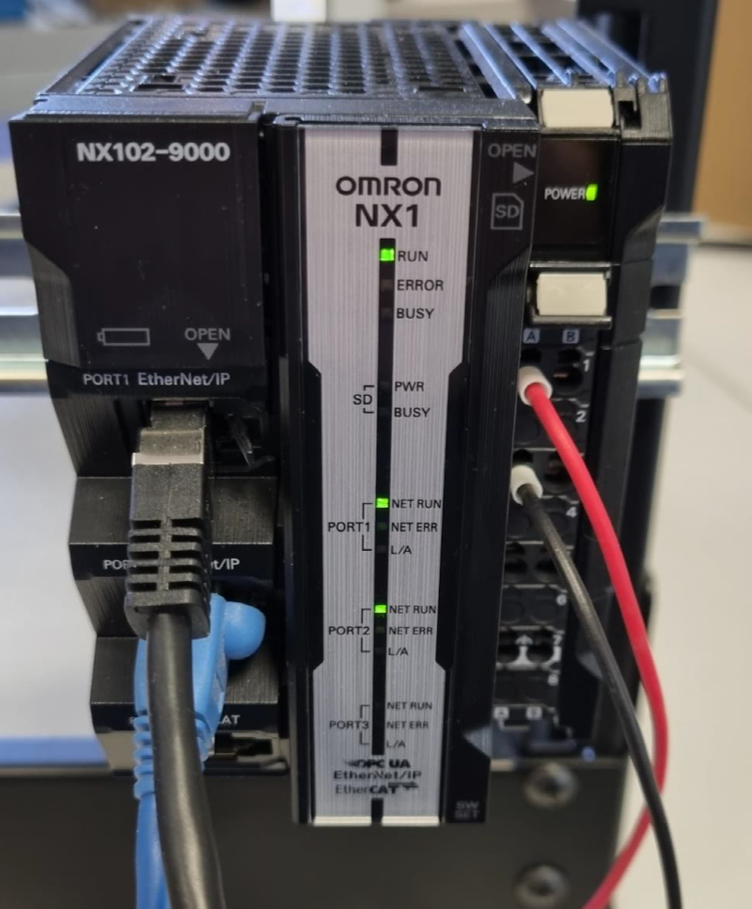
Lessons Learned – CIP PVAserver
Our unusual design, reading structured configuration data from the PLCs worked.
But it was not performant. The problem was the PLCs’ own CIP implementation.
Moving to an MQTT implementation for faster operation and p4p for future-proofing, see TUMBCMO26.
Notes:
Note that this also shows weaknesses in our testing environment. We do not have

Slide 10
Lessons Learned – Remote Access
Load-Balancers
The most urgent request we received from operators was for remote access (via VPN) to the new TS1 control screens.
We implemented this using a read-only PVA Gateway using EPICS_PVA_NAME_SERVERS (TCP only).
This is also how we support access to EPICS PVs in our Docker on Windows development systems.
Bare Metal
PVA Gateway
(Read-Only)
TCP Only
Phoebus
(Off-site Operators)
Notes:
Note that this was installed on the load-balancers because we didn’t want to interfere with our operations after we’d deployed working PVA Gateways on our deployment servers

Slide 11
EPICS at ISIS Accelerators
Omron PLC
(CIP Protocol)
How we hope to simplify our architecture in the next few months:
Bring the PVA Gateways into the Docker Swarm (fail-over)
Remove Vsystem by transferring more systems to EPICS (FINS and CPS are next)
Remove Valarm by migrating to Phoebus alarm management
Mosquitto
(MQTT Broker)
MQTT PVAServer
(p4p)
IOCs
PVA Gateway
PVA Gateway
(Read-Only)
Phoebus
(On-site Operators)
Phoebus
(Off-site Operators)
Notes:
Note that we’re not proposing to (ever!) bring all our Vsystem channels fully into EPICS
CPS / PXI will use a similar p4p model rather than a conventional IOC. FINS will use

Slide 12
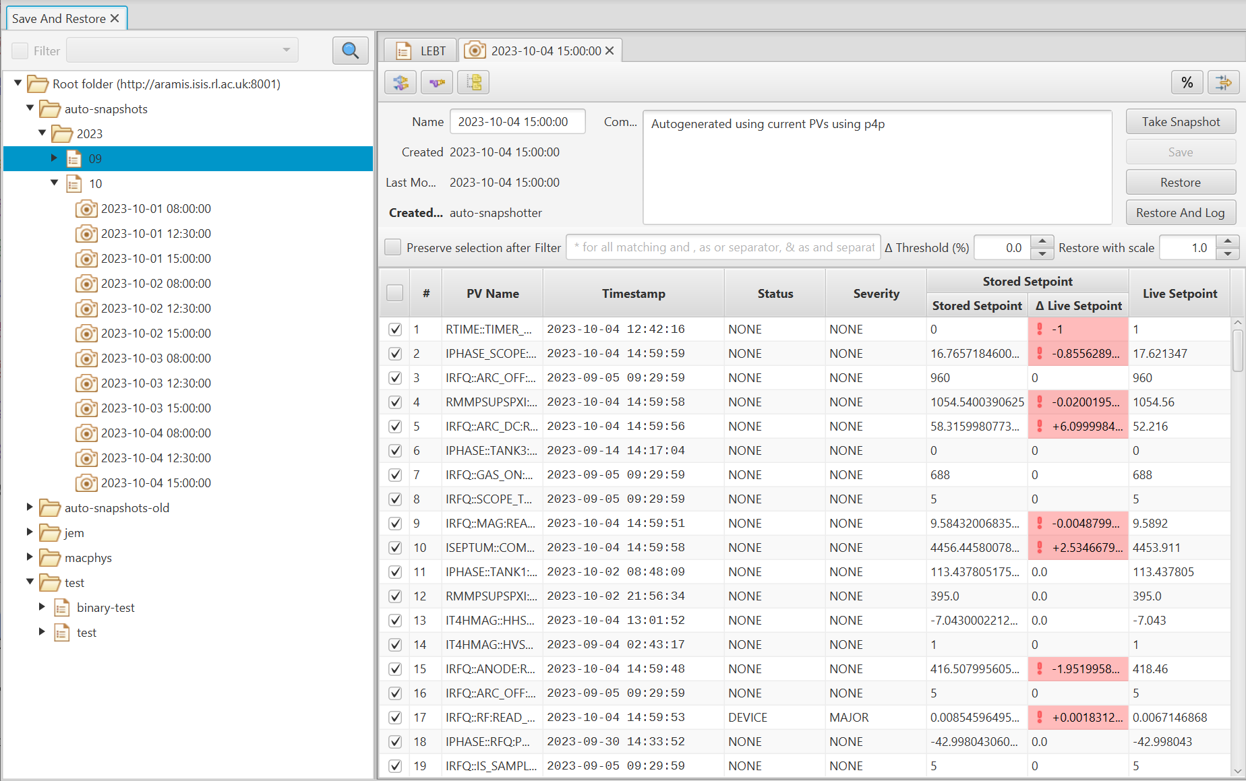
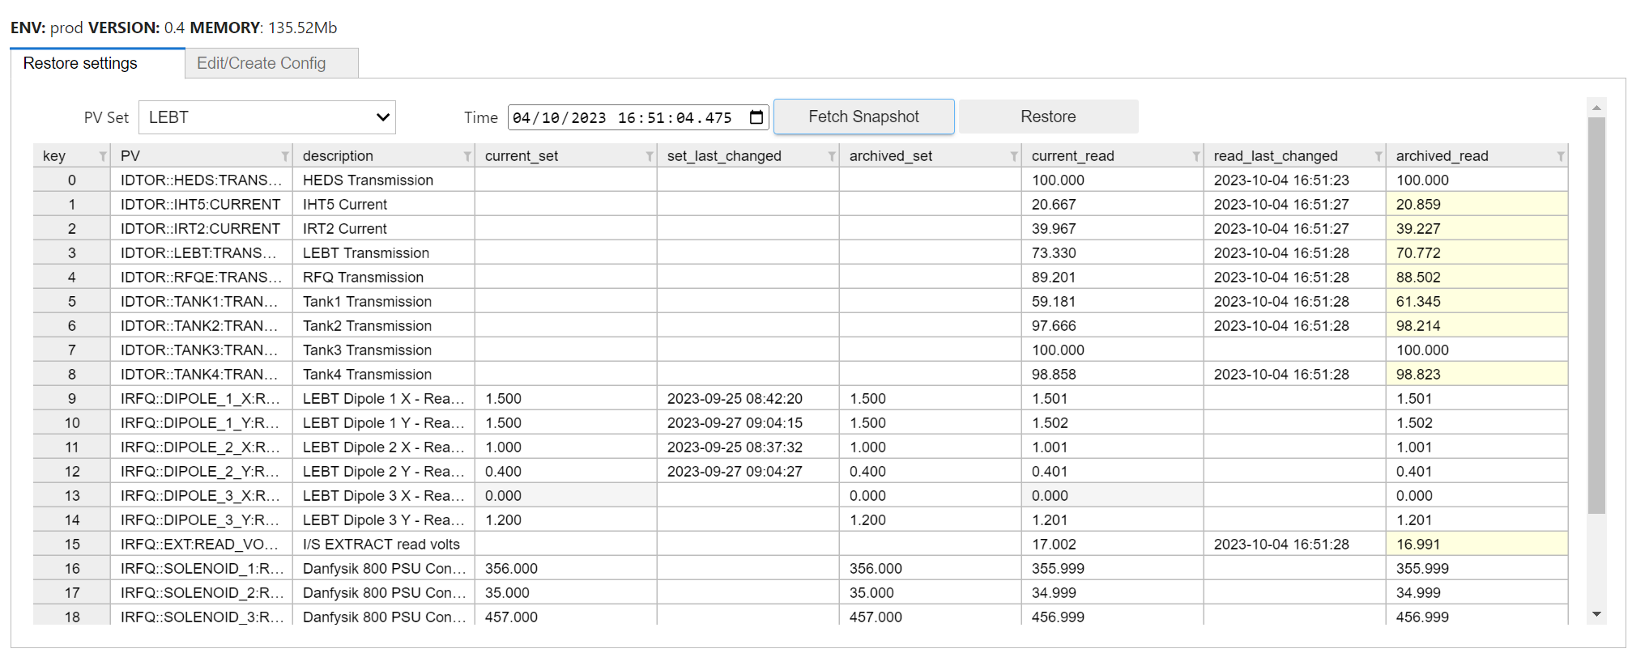
Save and Restore
A long-standing request from our machine physicists. The old system involves text files of values generated from Vsystem and manually restored.
We are currently trialling:
Phoebus save-and-restore, with automated snapshots
A web-based solution which integrates with the EPICS Archiver Appliance.
Notes:
Emphasise our alternate interface is experimental and primarily because we have a new starter who took an interest. (But it’s still odd that you can’t just dial up a time…)
However, it’s also secretly a source of concern. Our team doesn’t have much Java expertise but our experience is primarily in Python and secondarily in C/C++

Slide 13
Challenges
Loss of effort – particularly in infrastructure and liaison with users and operators
Delays in modification and acceptance testing of auto-converted screens
Naming convention – a success for new PVs from TS1, but delayed for application to those bridged from PVEcho.
Implementation of other EPICS IOCs – expect CPS/PXI and FINS soon (>50% of existing Vsystem channels). A mix of Python-based interfaces and conventional IOCs.
Technical issue with pvgets – unsure of cause (possible interaction between pvapy and PVA Gateway)
Notes:
Mention that in attempting

Slide 14
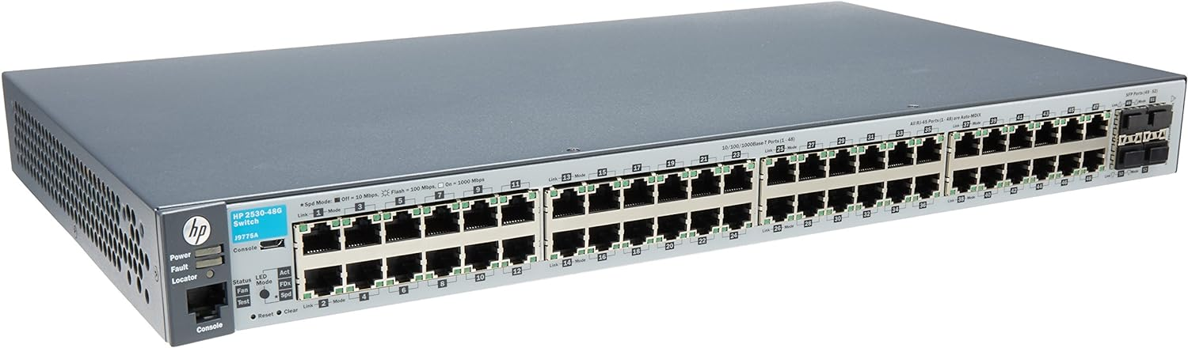

CyberSecurity
Our network is:
isolated from the public internet
not isolated from the site network
mixes all types of equipment (servers, desktops, PLCs, etc.)
not segmented by purpose (e.g. injector, targets)
No security beyond that provided by PVA Gateways. No pvAccess authentication and authorisation.
We have a Technical Advisory Panel on Cybersecurity in November. Please ask if you are interested in supplying expertise and advice!
Notes:
This represents worse security than Vsystem, which did at least need have server login required. Though it’s no change for the security at the PLC level!
This panel has been delayed by 6 months because we simply didn’t have the effort available to implement recommendations. Admit own lack of expertise in this area.

Slide 15




Notes:
The abstract pattern can be removed or repositioned if required. Be careful to ‘Send to Back’ so that it does not obscure any important information.

Slide 16





isis.stfc.ac.uk
@ISISNeutronMuon
STFC
Notes:
The abstract pattern can be removed or repositioned if required. Be careful to ‘Send to Back’ so that it does not obscure any important information.

