Slide 1
Review of the open source EtherCAT Motion Control Framework
Alvin Acerbo :: Controls Engineer :: Paul Scherrer Institute
EPICS Collaboration Meeting 2023, 8 October, Cape Town

Slide 2
EtherCAT: an Ethernet-based fieldbus
EtherCAT = Ethernet for Control Automation Technology
Open fieldbus standard originally developed by Beckhoff GmbH.
Maintained by EtherCAT Technology Group.
Hardware requirements:
Master: standard computer hardware (NIC)
Slaves: dedicated hardware, EtherCAT Slave Controller (ESC)
Masters: Commercial (e.g. Beckhoff TwinCAT) and open source masters available.
Slaves: Several 100 manufacturers of slaves (drives, I/O, sensors, robots).
Topologies: Line, Star, Ring.
Media: Cat 5 cable, plastic fiber, glass fiber.
Bandwidth utilization: 80%-97% (100 Mbit/s , Ethernet, Full-Duplex) .
Supports Distributed Clock (DC) in slaves with a max. of 100 ns synch error.
Cycle times > 50μs.
Applications: Motion, large or long distance systems, synchronized systems.

Slide 3
Previous work and status at SLS-2
Diamond Light source “dls-ethercat” driver:
Data acquisition and control
Paul Scherrer Institute “ecat2” driver:
Data acquisition and control
Other facilities are using EtherCAT as well but based on commercial software / hardware platforms.
At SLS-2.0:
Chosen as a medium performance platform for data acquisition and control.
Chosen for motion control in accelerator applications.
ECMC with EtherLab driver.

Slide 4
ECMC: EtherCAT Motion Control
ECMC is an open source motion control framework for EPICS environment.
Functionalities:
Motion (with EPICS Motor Record support):
Positioning (absolute, relative)
Constant speed
Referencing sequences
Motion (extension to Motor Record)
Motion interlocks
Triggering, latching positions
Synchronization axis to axis
Synchronization to external source (timing system,…)
General
Data acquisition (analogue <100 kHz, digital <1 MHz)
General I/O + low level control

Slide 5
Architecture
Linux Controller
Iocsh conf. cmd:
“ecmcConfigOrDie()”
EPICS motor records
EPICS records
EthercatMC
Motor model 3 drv.
asynPortDriver
Interfaces
asynoctet
asynint32
asynfloat64
asynarrayxxx
command parser
ECMC Core
Real Time Thread (1kHz)
Axis 1
Axis 2
Axis n
PLC 1
PLC n
EtherCAT process image
EtherCAT master / User space
Kernel

Slide 6
Real Time Thread Execution
Sleep (next ms)
EtherCAT
Read from EC
Axis PLC 1
Axis 1
Axis PLC 2
Motion
Axis 2
Axis PLC n
Axis n
PLC 1
PLC 2
General PLC
PLC n
EtherCAT
Write to EC

Slide 7
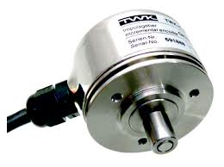
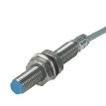
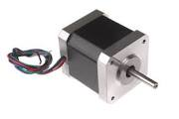
Axis class
“Cfg.CreateAxis(…)”
Axis
Types: Normal / Virtual
Encoder
Trajectory
PID-Control
Monitor
Drive
Normal, Virtual
Normal, Virtual
Normal
Normal, Virtual
Normal
Optional Axis PLC for synchronization / control (executed in sync with axis object)
ECPdoEntry
Axis object executes and links objects:
Encoder
Trajectory Generation
PID-Controller
Monitor
Drive
Sequences
Homing (different types)
ECPdoEntry
ECPdoEntry
ECPdoEntry
ECPdoEntry
ECPdoEntry
ECPdoEntry
ECPdoEntry
ECPdoEntry
EC master
EC master
EC master
14

Slide 8
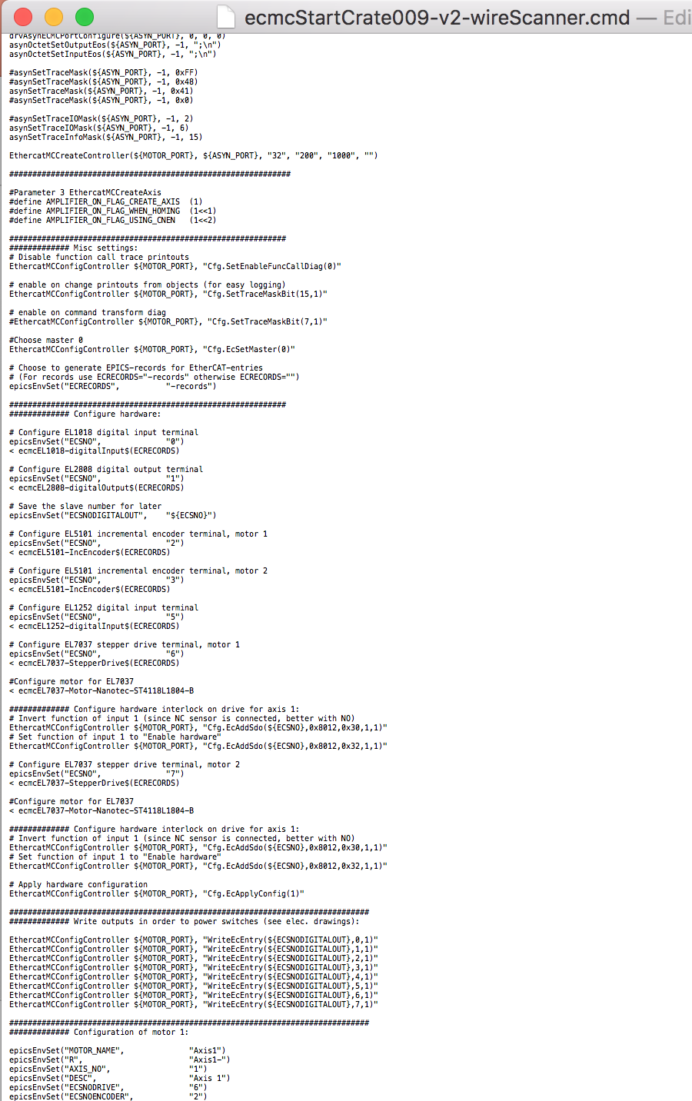
Configuration in EPICS
All configuration in EPICS startup file:
ECMC configurations
(speed, acceleration…..)
Terminal configurations
(Service Data Object access:
max current, mode…)

Slide 9
Configuration continued
Configuration iocsh command:
ecmcConfigOrDie “command” : Exits if return code !=0
ecmcConfig “command” : Accepts return codes !=0
Returns: 0 for success or otherwise error code.
Example 1: Create Axis 1 object:
ecmcConfigOrDie ”Cfg.CreateDefaultAxis(1)”
Example 2: Set position controller gain for axis 1 to 0.1
ecmcConfigOrDie ”Cfg.SetAxisCntrlKp(1,0.1)”
Example 3: Read max current of EL7041 drive at bus position 1:
ecmcConfig ”EcReadSdo(1,0x8010,0x1)”

Slide 10
Configuration with ecmccfg
Configuration is made by adding commands to the ioc startup file.
In order to simplify, a configuration framework called ecmccfg have been developed (originally at PSI):
Main repo: https://github.com/paulscherrerinstitute/ecmccfg
Local fork: https://github.com/icshwi/ecmccfg.
ecmccfg contains:
Hardware configuration files for:
EtherCAT slaves
Motors, encoders, and sensors
Default database files
Extensive set of examples for different hardware's and applications

Slide 11
Synchronization
Execution flow:
Synchronization of axes is handled by a axis synchronous PLC:
ax<id>.traj.setpos = Trajectory generated setpoint for axis <id>
ax<id>.enc.actpos = Actual position of axis <id>
ax<id>.drv.enable = Enable amplifier of axis <id>
ax<id>.mon.ilock = Motion interlock of axis <id> (allowed to move if 1)
ax<id>.mon.ilockfwd = Motion interlock of axis fwd <id> (allowed to move if 1)
ax<id>.mon.ilockfwd = Motion interlock of axis bwd <id> (allowed to move if 1)
….. Any plc expression can be entered.
Axis PLCs are recalculated / refreshed in 1kHz
Examples:
Slaving: ax2.traj.setpos := ax1.enc.actpos;
Synchronization: ax2.traj.setpos := ax1.traj.setpos;
Gearing: ax2.traj.setpos := 0.5 * ax1.traj.setpos;
Phasing: ax3.traj.setpos := ax1.traj.setpos + ax2.traj.setpos;
Advanced: ax1.traj.setpos := 10*sin(ax2.traj.setpos + ec0.s3.VALUE);
Timing system: ax1.traj.setpos := ec0.s3.VALUE * 0.5 + ec0.s4.AO_1;
Interlocks: ax1.mon.ilock := ax2.mon.ilock and ax5.mon.ilock and ax4.enc.actpos > ax3.enc.actpos;
Enable: ax2.drv.enable := ax1.drv.enable;
Enable alternative: mc_power(1,ax1.drv.enable);
Read from EC
Axis PLC 1
Axis 1
Axis PLC 2
Axis 2
Axis PLC n
Axis n
PLC 1
PLC 2
PLC n
Write to EC

Slide 12
ECMC data access over Asyn: EtherCAT
Record INP/OUTP field syntax:
"@asyn(<asynPort>,<address>,<timeout>)ecmcInfoStr)”
ecmcInfoStr:
CMD=<cmd>/T_SMP_MS=<sampletime>/TYPE=<type>/<parameter name><read/write>"
CMD (optional):
“UINT64TOFLOAT64”: Converts 64bit uint data to float64 before push to EPICS (64 bit positions and time)
“FLOAT64TOINT32”: Converts float 64 to int32 before push to epics (binary PLC values)
T_SMP_MS (optional): Record update rate in milliseconds
TYPE (mandatory): Type of data to transfer (asynInt32, asynFloat64, asynInt32ArrayIn..)
<parameter name> (mandatory):
Example for Ec data: “ec<master index>.s<slave index>.<data alias>”
Use “ecmcReport 3” to see available parameter names
<read/write> (mandatory)
read “?”
write “=”

Slide 13
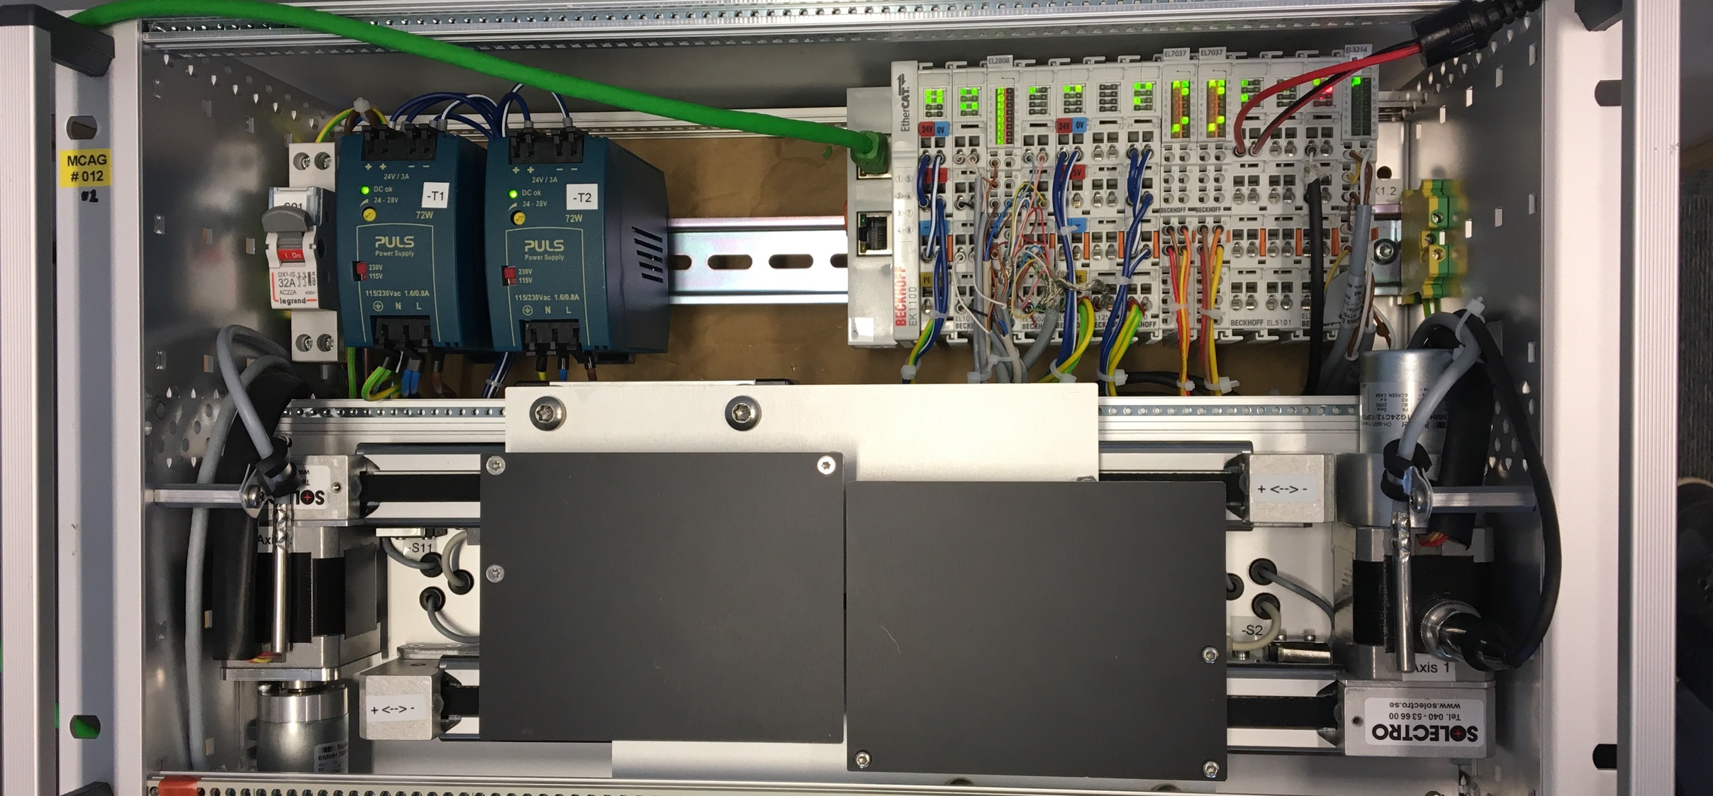
Example: 2-Axes slit
2 virtual axes
Slit center position
Slit gap/opening
2 normal axes (blade positions)
Axis 1 (Virt: Center position)
Forward Kinematics:
ax3.traj.setpos:=ax1.traj.setpos - ax2.traj.setpos/2;
ax4.traj.setpos:=ax1.traj.setpos + ax2.traj.setpos/2;
Inverse Kinematics:
ax1.enc.actpos:=(ax3.enc.actpos+ax4.enc.actpos )/2;
ax2.enc.actpos:=(ax4.enc.actpos – ax3.enc.actpos);
Amplifier enable:
ax3.drv.enable:=ax1.drv.enable or ax2.drv.enable;
ax4.drv.enable:=ax1.drv.enable or ax2.drv.enable;
Or:
mc_power(3, ax1.drv.enable or ax2.drv.enable);
mc_power(4, ax1.drv.enable or ax2.drv.enable);
Axis 2 (Virt: Gap)
Axis 3 (Normal: Blade position)
Axis 4 (Normal: Blade position)
Blade
Axis 3
Blade
Axis 4

Slide 14
Summary
EtherCAT:
Hardware portfolio supporting EtherCAT is large.
EMCC:
ECMC built on OS EtherLab driver.
ECMC has a well-developed interface to EPICS.
SLS-2.0:
ECMC is being adopted for motion, DAQ, I/O at SLS-2.0 beamlines girders, RF.
Served mid-tier performance applications, highly customizable.
Potential for more complex scenarios (i.e. complex kinematics, fly-scan)

Slide 15
Wir schaffen Wissen – heute für morgen
My thanks go to
ECMC developers
Anders Sandstrom
Igh open source EtherCAT master (www.etherlab.org)
Questions?

