Slide 1
Accelerator Systems Cyber Security Activities at SLAC.
Greg White, SLAC
At ICALEPCS 2023, Cape Town, South Africa, 10th October 2023.
Greg White for Auralee Edelen, Alberto Lutman, Chris Mayes, Murali Shankar, Erwin Lopez, Mark McCullough, Amedeo Perazzo, Ken Brobeck, Mark Foster, Daron Chabot, Mike Zelazny, Debbie Rogind, Lance Nakata, Matt Gibbs, Andrea Chan, Arash Alavi, Poonam Pandi, Lisa Christiansen, Uy Chu, Jacqueline Garrahan, Syed Hasan (SLAC), Bob Dalesio, Michael Davidsaver (Osprey DCS), George McIntyre (Level-N Ltd)
Many Thanks to Dale Dale Hugo Leschnitzer, Mark Hahnert (US Dept of Energy, Office of Science)
David Manz (PNNL), Jozsef Gacsal (SecurityLit), Jason Carter (ORNL), Ralph Lange (ITER)
EPICS 7 Development Team, and many others.

Slide 2
How Beam Tuning by ML, AI, and Big Data are Changing Accelerator Network Architecture and Cyber Security at SLAC
Greg White, Auralee Edelen, SLAC
At ICALEPCS 2023, Cape Town, South Africa, 10th October 2023.
Work of A. Edelen, R. Roussel, C. Mayes, D. Ratner, C. Emma, S. Miskovich, J. Garrahan, C. Xu, W. Neiswanger, H. Slepicka, J. Duris, A. Hanuka, N. Neveu, L. Gupta, E. Cropp, P. Musumeci, A. Mishra, Z. Zhang, J.P. Gonzalez-Aguilera, S. Kim, J. Power, E.Wisniewski, A. Lutman;
J. Garrahan, J. Bellister;
Amedeo Perazzo, Ken Brobeck, Mark Foster, Daron Chabot, Mike Zelazny, Debbie Rogind, Lance Nakata;
Erwin Lopez, Mark McCullough (SLAC IT Cyber)
B. Dalesio, M. Davidsaver, G. McIntyre (Osprey DCS), K. Kasemir (ORNL), M. Sekoranja (CosyLab).
Many Thanks to Dale Dale Hugo Leschnitzer, Mark Hahnert (US Dept of Energy, Office of Science)
David Manz (PNNL), Jozsef Gacsal (SecurityLit), Jason Carter (ORNL), Ralph Lange (ITER),
EPICS 7 Development Team, and many others.

Slide 3
Talk Outline. Accelerator Computing and Controls Revolution
Online Beam Tuning: Linear numerical methods, precomputed linear or 2nd order model
→ non-linear, multi-particle model based, ML and multiparametric methods.
⇒ 𝚫 Scope: Controls += Accelerator Optimization + Big Data
⇒ 𝚫 Network: Controls += High-Performance Computing
⇒ 𝚫 Security: EPICS += Transport Layer Security. Secure High-Performance Computing.

Slide 4
Talk Outline. Accelerator Computing and Controls Revolution
Online Beam Tuning: Linear numerical methods, precomputed linear or 2nd order model
→ non-linear, multi-particle model based, ML and multiparametric methods.
⇒ 𝚫 Scope: Controls += Accelerator Optimization + Big Data
⇒ 𝚫 Network: Controls += High-Performance Computing
⇒ 𝚫 Security: EPICS += Transport Layer Security. Secure High-Performance Computing.

Slide 5
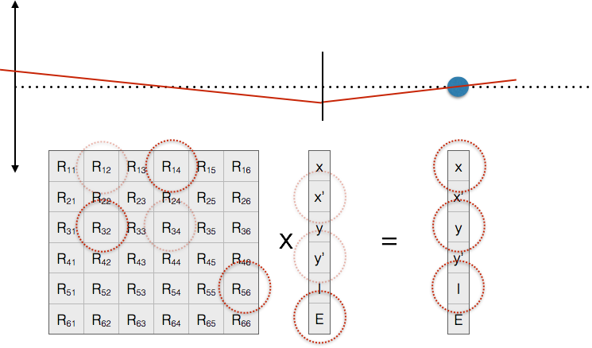
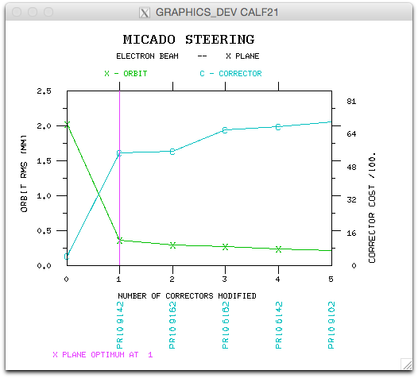
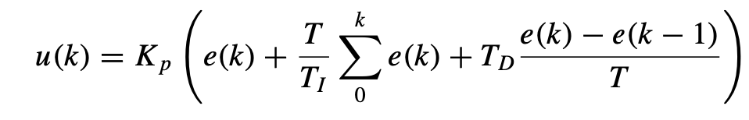

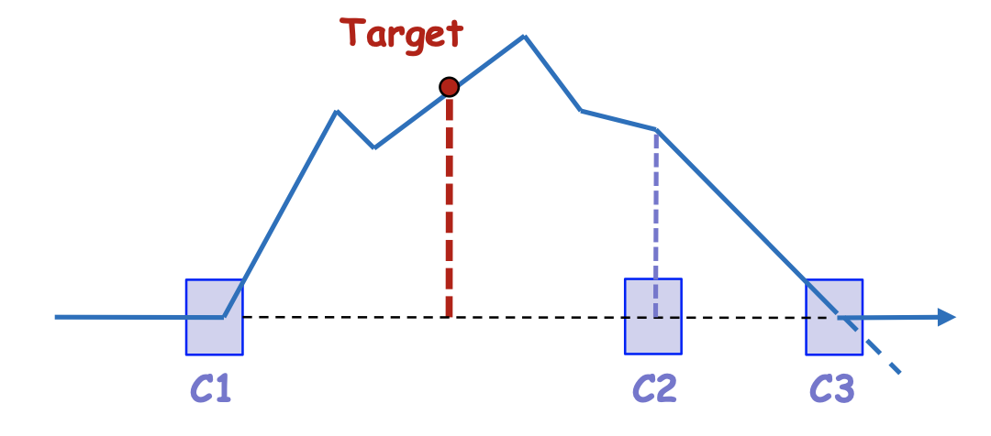
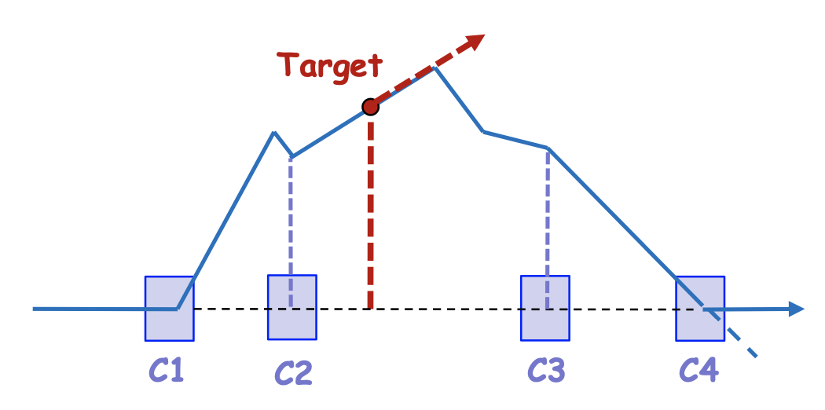
Classical Beam Tuning
“The orbit correction problem”
MICADO (90’s)
Feedbacks. PID Control
A corrector
x
b
A BPM
Transverse
beam offset
(x or y)
“Modern Control Theory”
Bumps (eg “3” and “4” bumps)
Micado, B. Autin and Y. Marti (CERN)
Singular Value Decomposition
SVD. E. Beltrami, C. Jordan. G. Gobub (computation)
Thank you J. Wenninger, CERN
Methods largely based on 3 assumptions 1) that you know a priori basically the relation between actuators and sensors – the linear (plus some 2nd order) online “model”, 2) That optimizing the orbit RMS, or timing, will optimize the true objective – minimize emittance or maximize luminosity, 3) Direct tuning 6D phase space was out of reach.
Notes:
All methods based on the assumption that you know a priori basically the relation between actuators and sensors – at least roghly. And that has been computed or verified by some model. The model may have been, occasionally, empirically verified- but not often because that’s usually invasive – done as a macine development rather than continuously, and by scanning actuators and taking measurements. Model computation is offline. Model use is online. Model verification is online and invasive.
Bumps can be used for local region orbit correction, small energy tunes (via dispersion), fix gradianet errors, cacelling dispersion in wakefiled, even tuning for polarization.

Slide 6
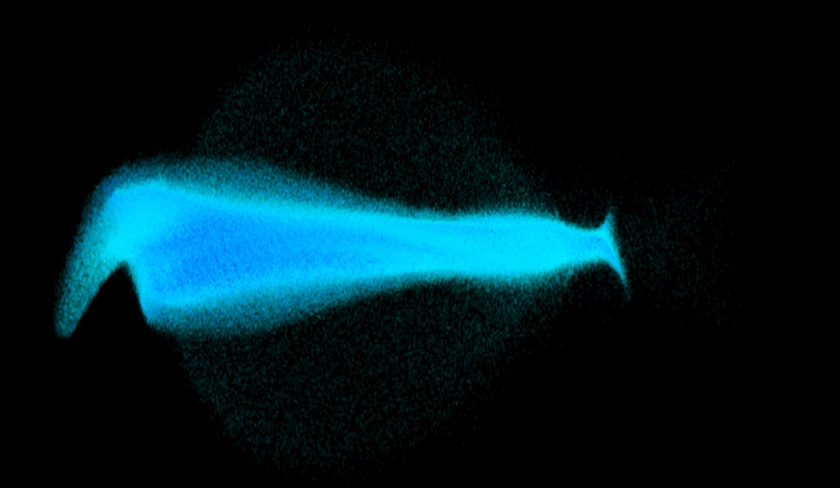
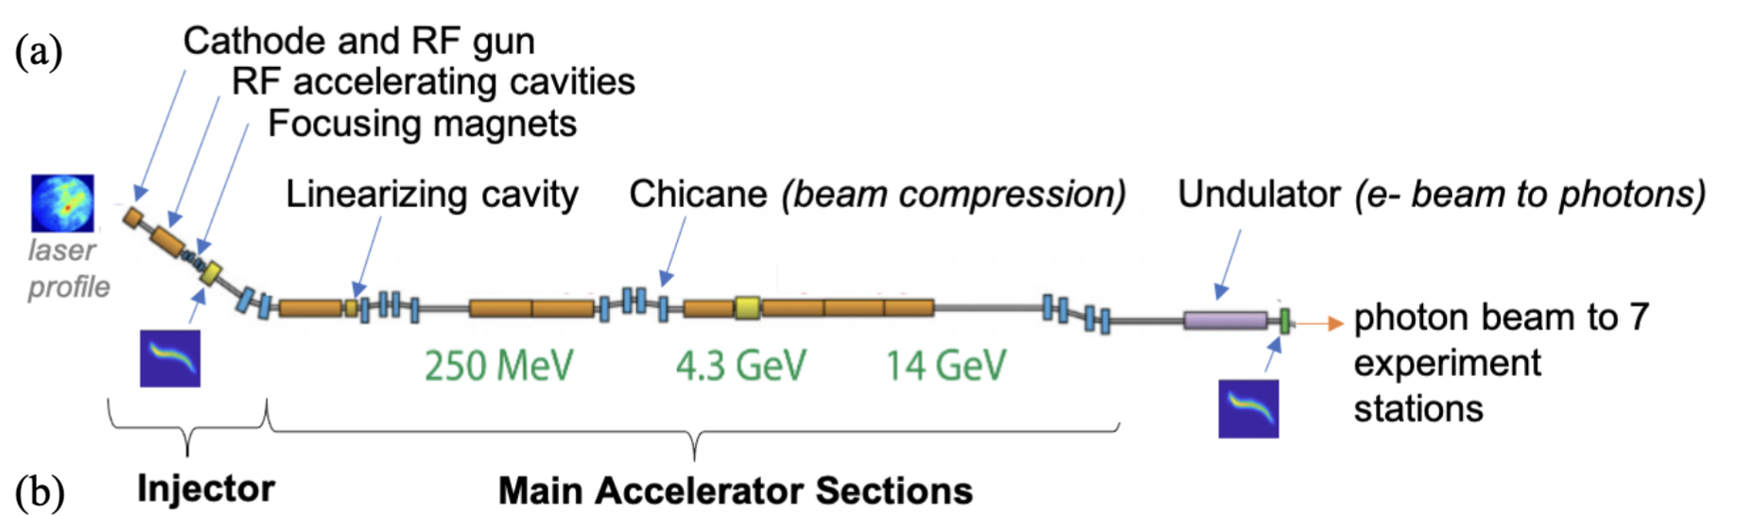
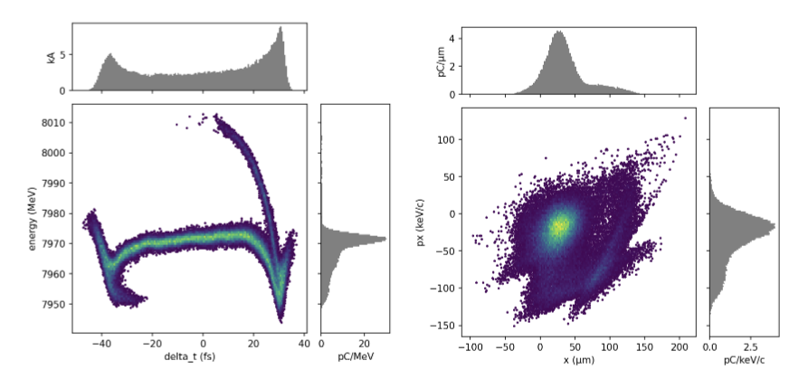
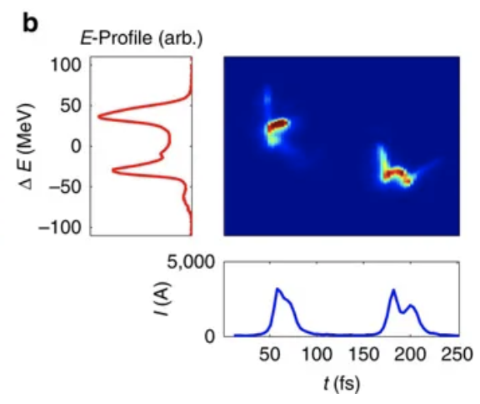
Many tuning problems at LCLS/LCLS-II and FACET-II at SLAC require detailed phase space customization for different experiments
Beam exists in 6-D position-momentum phase space
Have incomplete information: measure 2-D projections or reconstruct based on perturbations of upstream controls (e.g. tomography, quad scans)
Have dozens-to-hundreds of controllable variables and hundreds-of-thousands (up to millions for LCLS-II) to monitor
Energy (MeV)
Nonlinear, high-dimensional optimization problem
Time (fs)
A. Marinelli, et al., Nat. Commun. 6, 6369 (2015)
A. Marinelli, IPAC’18

Slide 7

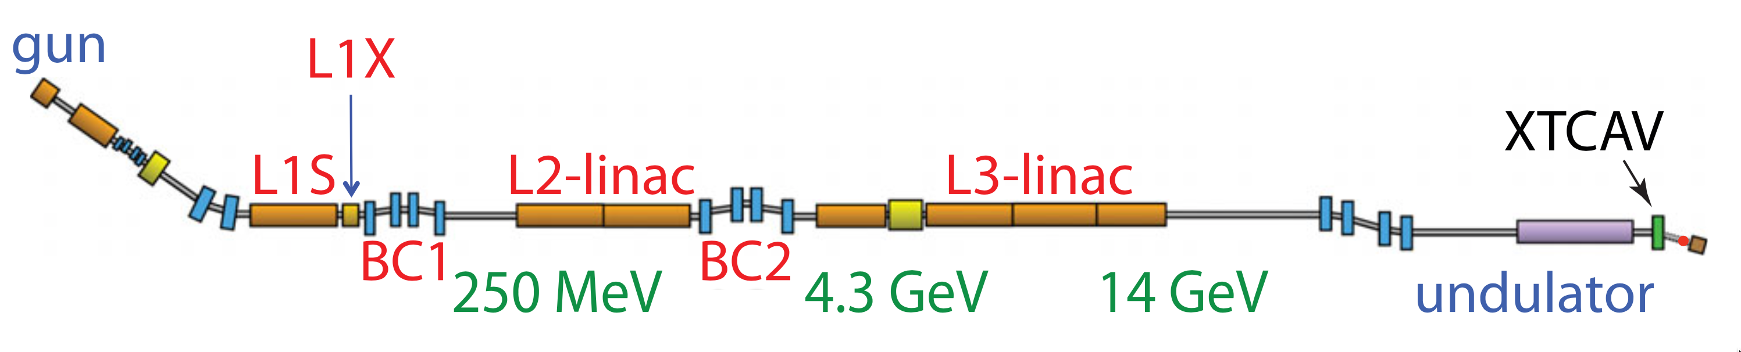
Wide spectrum of tuning needs
laser
profile
photon beam to 7 experiment stations
A. Marinelli, et al., Nat. Commun. 6, 6369 (2015)
A. Marinelli, IPAC’18
J. Qiang et al, PRAB (2017)
Energy (MeV)
Energy (MeV)
Time (fs)
Time (fs)
Achieve new configurations + unprecedented beam parameters
Fine control to maintain
stability within tolerances
Rapid FEL beam customization

Slide 8
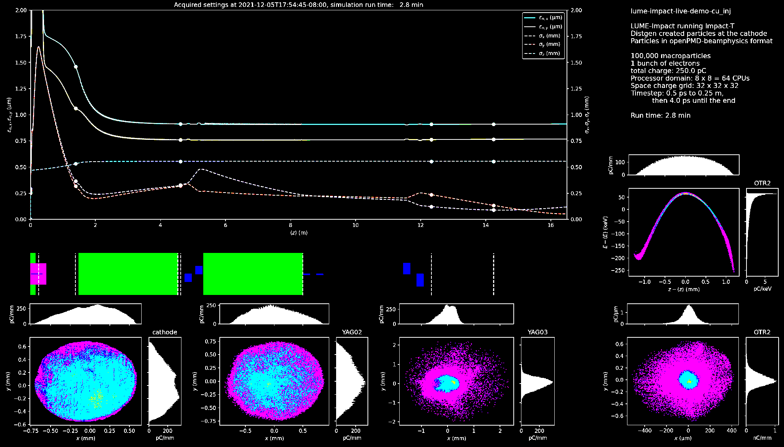
Spectrum of Tuning approaches leverage different amounts of data / previous knowledge
→ suitable under different circumstances
less
assumed knowledge of machine
more
Model-Free
Optimization
Model-guided Optimization
Global Modeling +
Feed-forward Corrections
J. Kirschner
Observe performance change after a setting adjustment
→ estimate direction or apply heuristics toward improvement
Update a model at each step
→ use model to help select the next point
Make fast system model
→ provide initial guess (i.e. warm start) for settings or fast compensation
gradient descent
simplex
ES
Bayesian optimization
reinforcement learning
ML system models +
inverse models
SLAC aims to combine the strengths of different approaches.
General strategy: start with sample-efficient methods that do well on new systems, then build up to more data-intensive and heavily model-informed approaches.

Slide 9
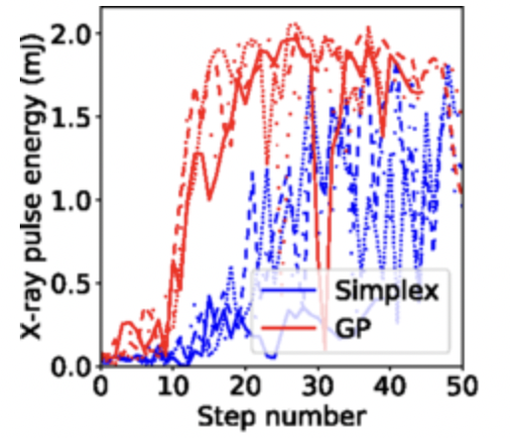
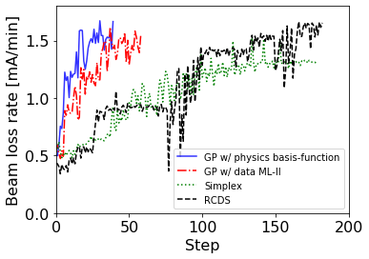
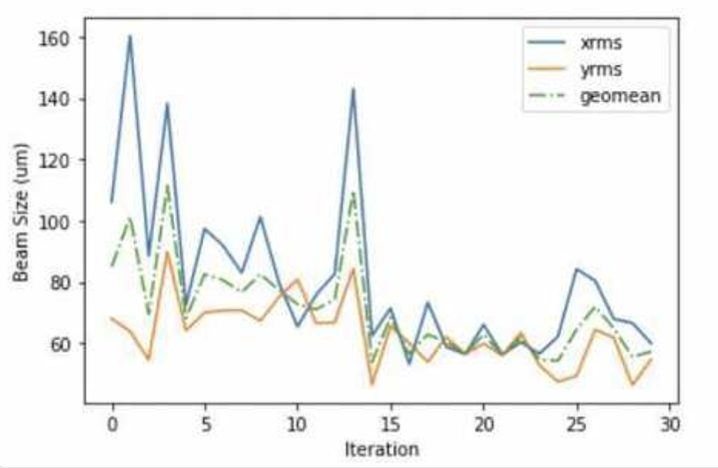
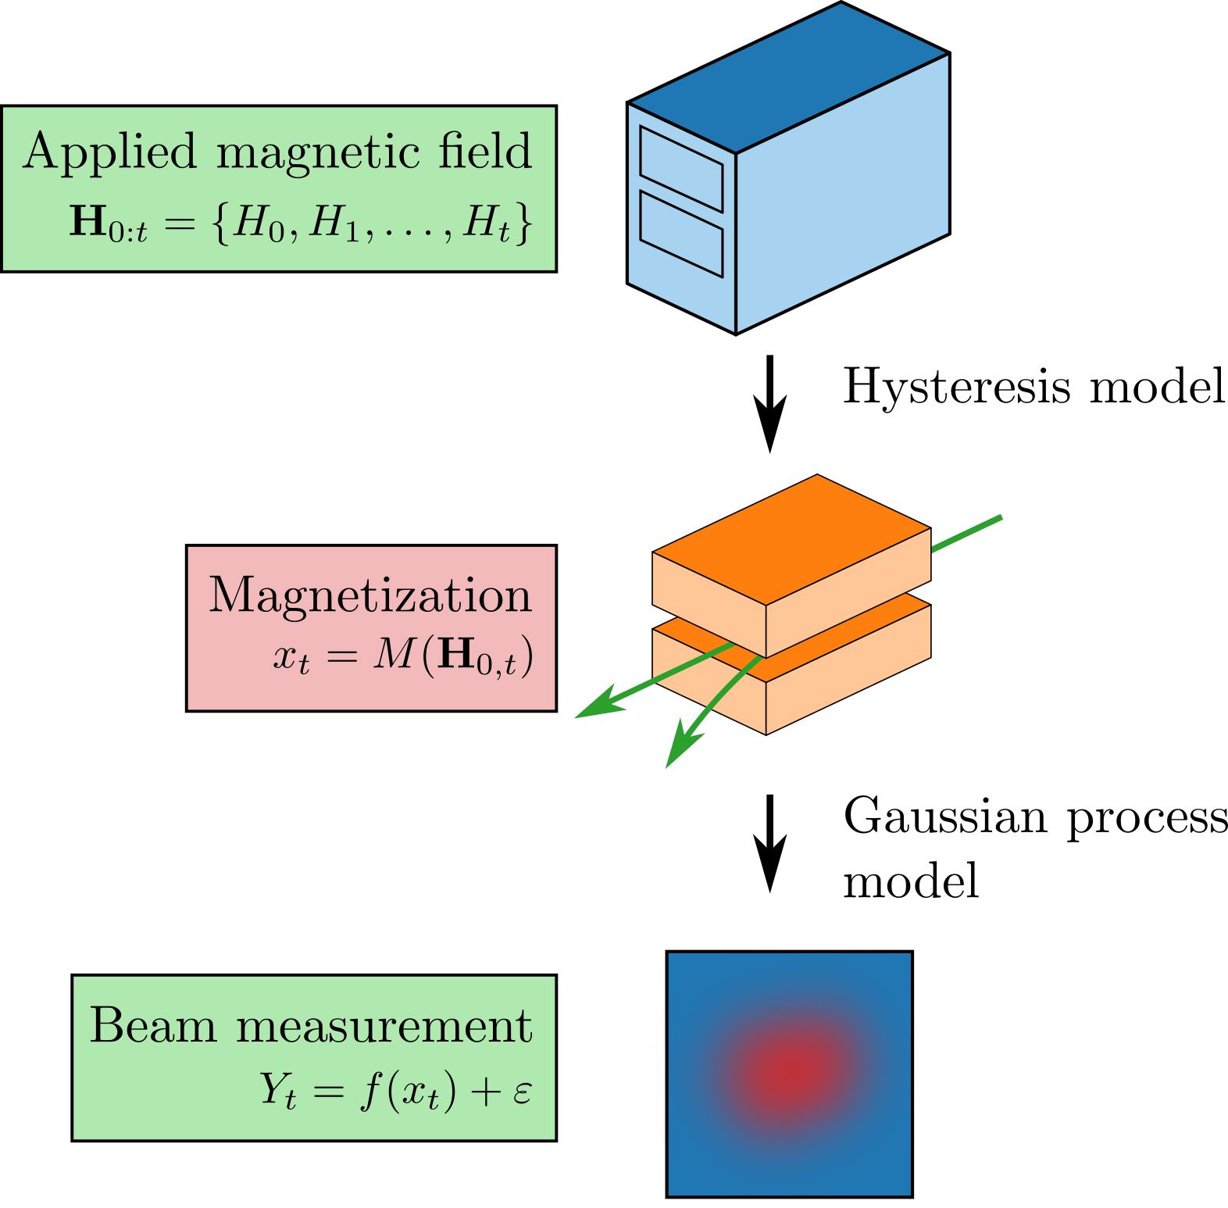
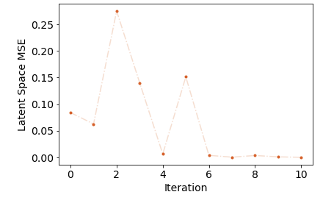
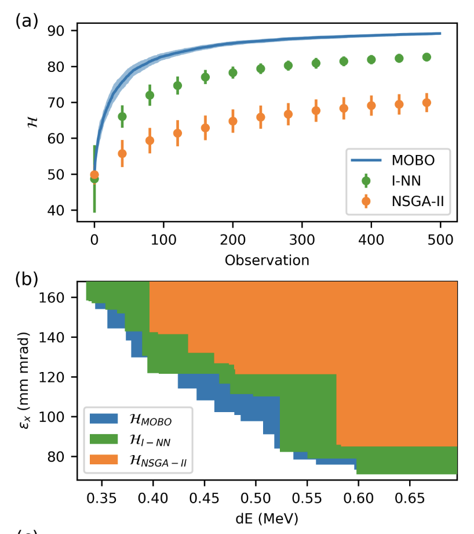
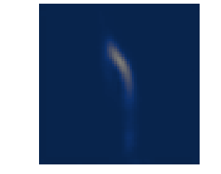
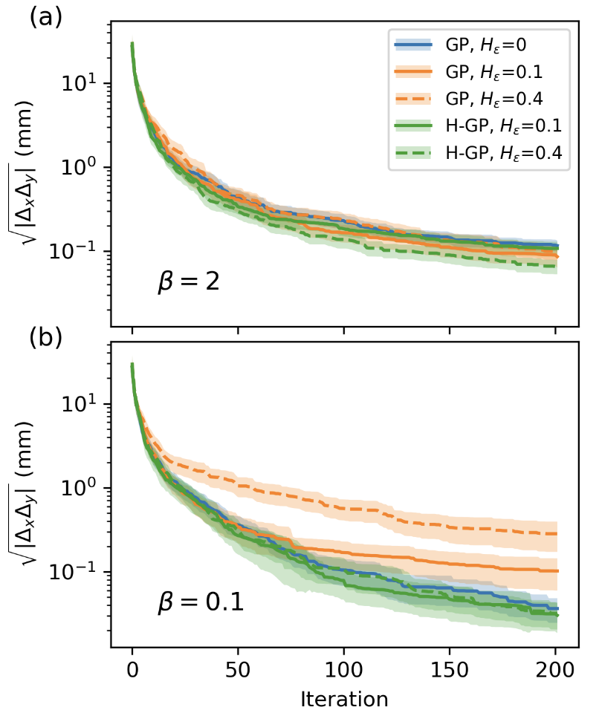

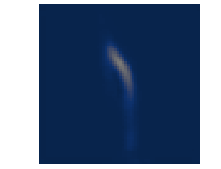

FEL pulse energy tuning at LCLS
Loss rate tuning at SPEAR3
Sextupole tuning for IP at FACET-II
Many successes with Bayesian Optimization
(+ improvements)
Duris et. al. PRL , 2020
Hanuka et. al. PRAB , 2021
Multi-objective
Bayesian Optimization
Longitudinal phase space tuning on LCLS
Higher-precision optimization possible when including hysteresis effects in model
BO on sys. with hysteresis
target
Hybrid BO on sys. with hysteresis
Roussel et. al. PRL , 2022
Roussel et. al. PRAB , 2021
Algorithms being implemented/distributed in Xopt: https://github.com/ChristopherMayes/Xopt

Slide 10
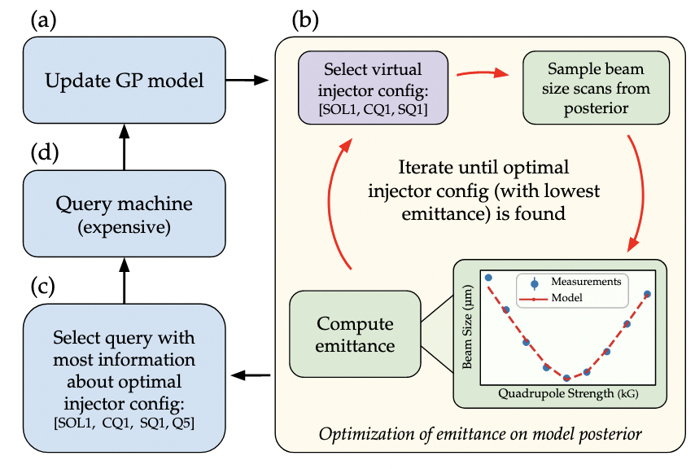
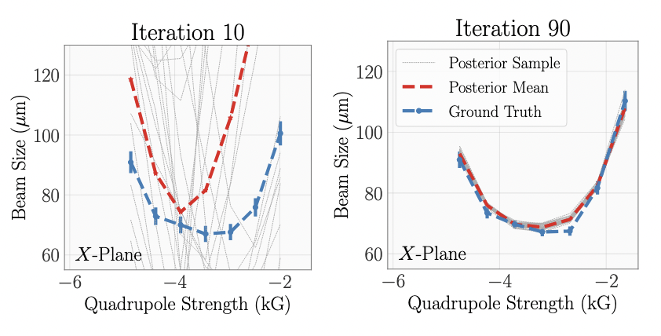
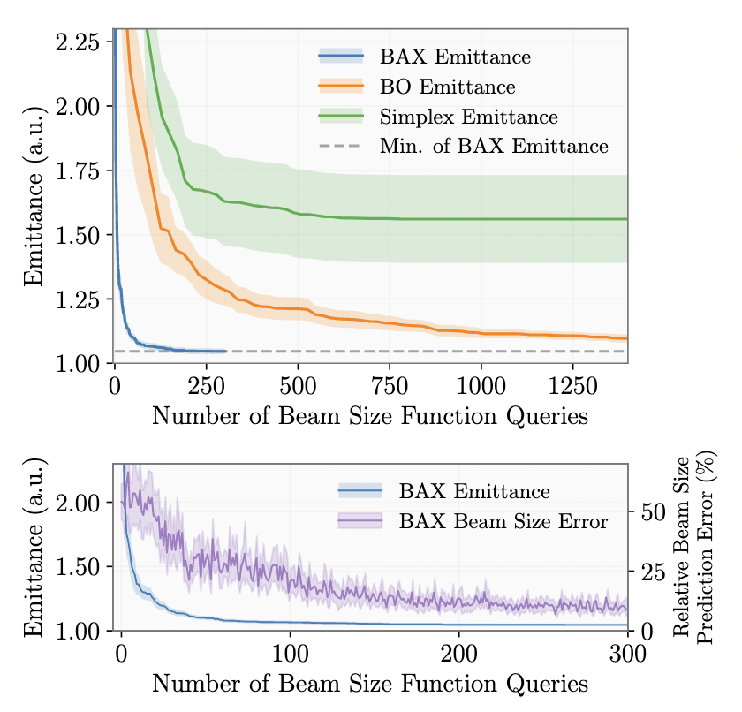
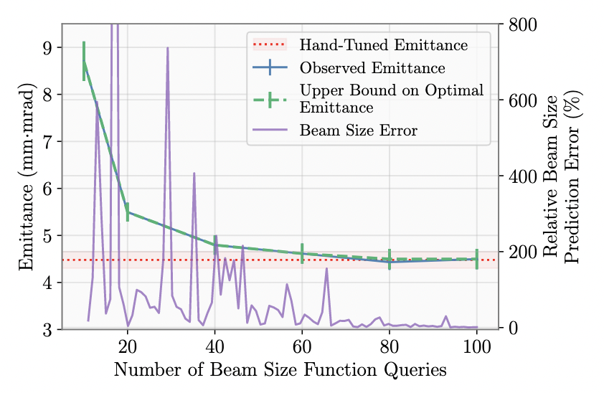
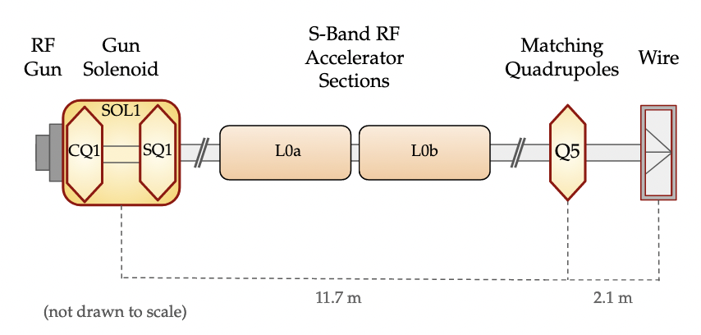
Efficient Emittance Optimization with Partial Measurements
Instead of tuning on costly emittance measurements directly: learn a fast-executing model online for beam size while optimizing → learn on direct observables (e.g. beam size); do inferred “measurements” (e.g. emittance)
New algorithmic paradigm leveraging “Bayesian Algorithm Execution” (BAX) for 20x speedup in tuning
simulation
Convergence of beam size prediction error gives practical indicator of optimization convergence (no need to do direct emittance measurement until the end)
model is learned
on-the-fly
Found equivalent quality to hand-tuning in about 70 iterations (estimate this would take a few minutes with computationally optimized routine)
experiment
https://arxiv.org/abs/2209.04587
Paradigm shift in how tuning on indirectly computed beam measurements (such as emittance) is done, with 20x improvement over standard method for emittance tuning. → Now working to integrate into operations.
Also now working to incorporate more informative global models /priors rather than learning the model from scratch each time.

Slide 11
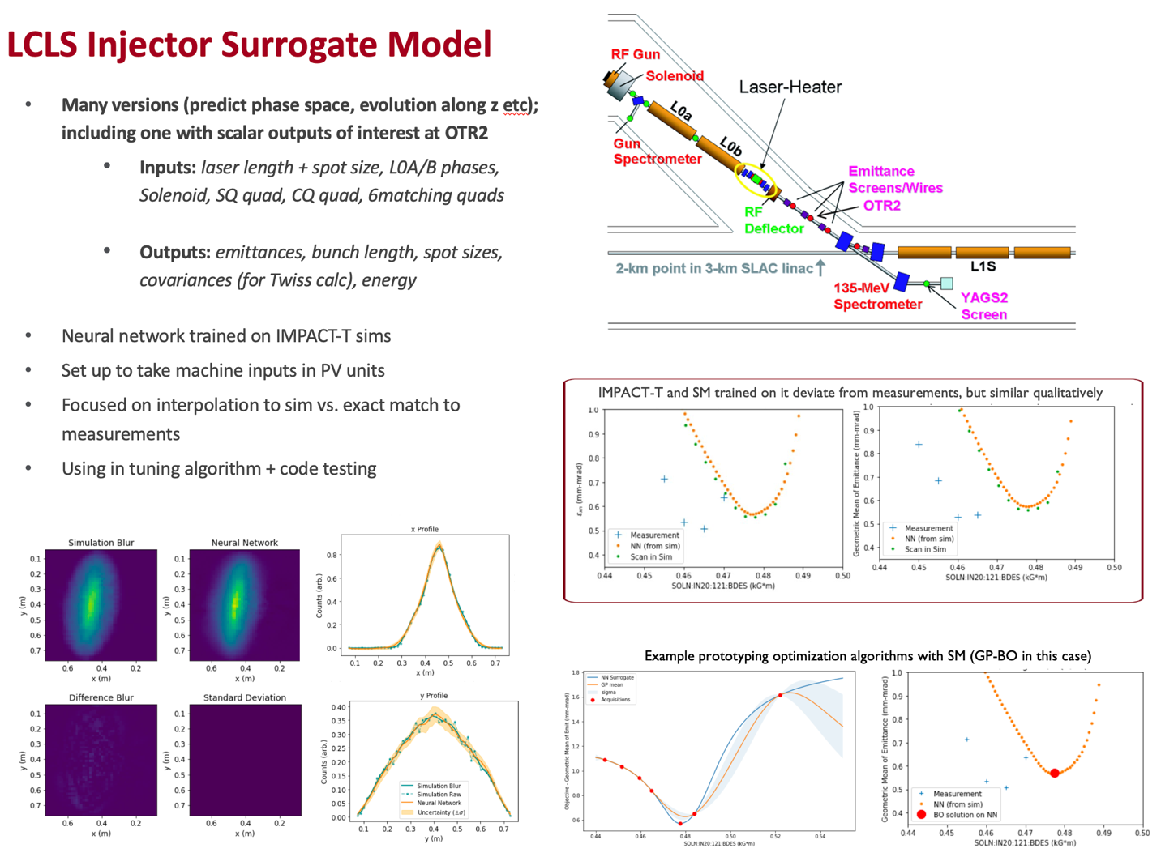
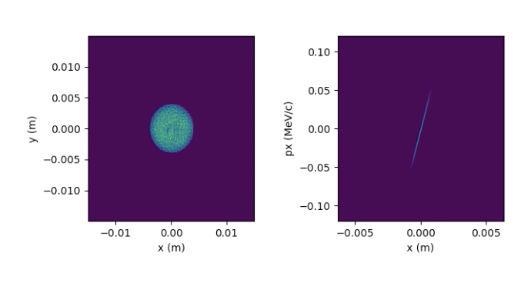
In Regular Use: Injector Surrogate Model at LCLS
ML models trained on detailed physics simulations with nonlinear collective effects
Accurate over a wide range of settings → calibrate to match machine measurements
Used to develop/prototype new algorithms before testing online
(e.g. BAX w/ 20x speedup in emittance tuning https://arxiv.org/abs/2209.04587)
Will provide initial Twiss parameters for downstream online model for optics matching
Working on integrating model information to further speed up optimization algorithms
prototyping optimization
algorithms
ML model matches simulation under interpolation
Simulation and ML model trained on it are qualitatively similar to measurements under interpolation (setting combinations reasonable distance from training set)
interactive model widget and visualization tools
  Automatic adaptation of models and identification of sources of deviation between simulations and as-built machine
ML models trained on simulations and measurements have enabled fast prototyping of new optimization algorithms, facilitated rapid model adaptation under new conditions, and can directly aid online tuning and operator decision making

Slide 12
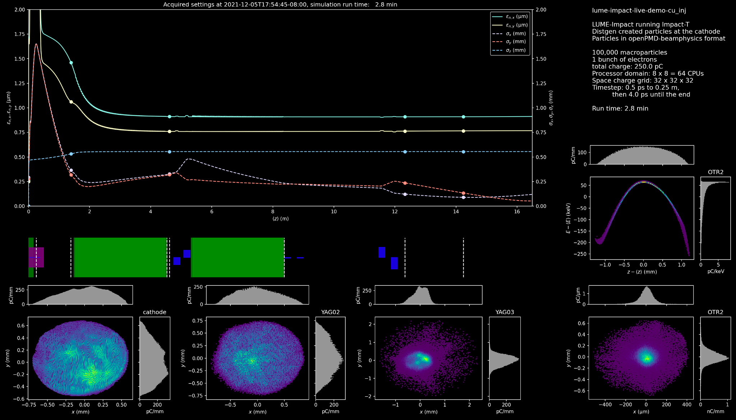
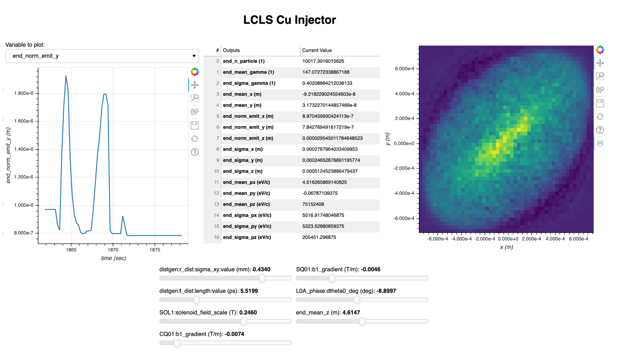
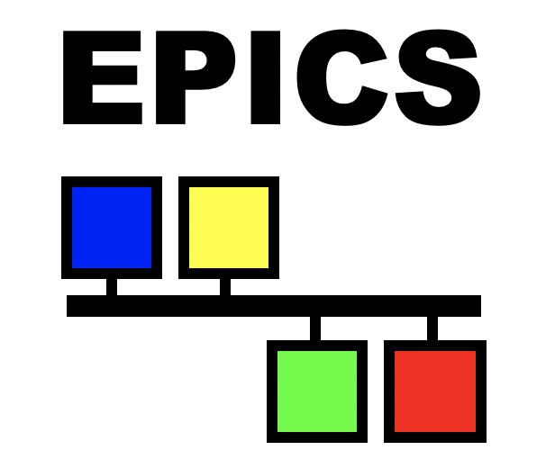
LUME-services: An online modeling service built on microservices
Provide continuously executing online models
  Slow-executing physics simulations
  Fast-executing ML surrogates
Generality of tooling
  Provide abstracted interfaces for model packaging
  Provide standardized set of services for composing applications
EPICS integration
  Collect PV values over EPICS and queue simulations
  Serve model output over EPICS using programmatic IOC
Impact Dashboard:
Example applications:
  Particle data or screen images (e.g. laser profile) as input (distgen → Impact)
  Advanced online visualization
  Optimization using online model information (e.g. prior mean for Bayes opt)
LCLS Injector UI w/ EPICS-based widgets (Using LUME-EPICS tools):
Online Modeling Service
Have used at LCLS for linac/injector, FACET-II injector, LCLS-II injector → now want to interface with tuning (e.g. model info → Xopt)

Slide 13
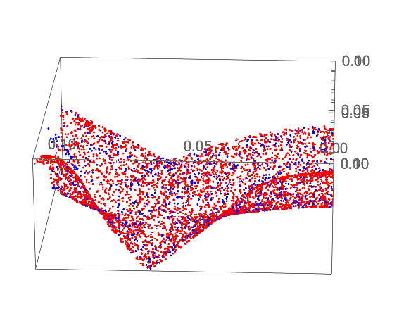
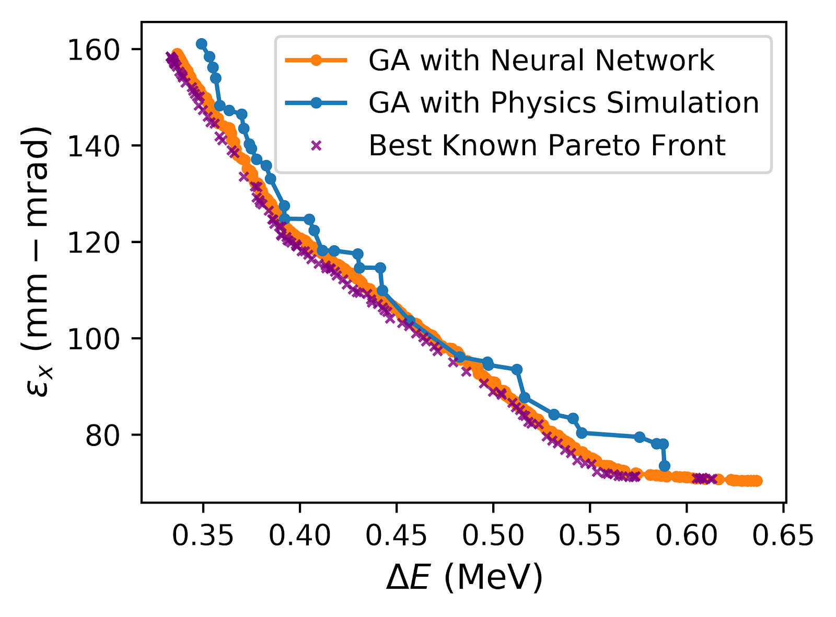

Smooth interpolation
Example $σ_{x}$ surface from 2D scan, LCLS-II Injector
Warm starts for optimization
A. Scheinker, A. Edelen,
et al, PRL, 2018
A. Edelen et al., NeurIPS 2019
Physics Sim:
~95k core hrs, 131k sims
2246 cores, 36 hours
Neural Network:
~2 mins on a laptop
(500 sims for training)
A. Edelen
et al., PRAB, 2020
Surrogate-boosted design optimization

Slide 14
Talk Outline. Accelerator Computing and Controls Revolution
Online Beam Tuning: Linear numerical methods, precomputed linear or 2nd order model
→ non-linear, multi-particle model based, ML and multiparametric methods.
⇒ 𝚫 Scope: Controls += Accelerator Optimization + Big Data
⇒ 𝚫 Network: Controls += High-Performance Computing
⇒ 𝚫 Security: EPICS += Transport Layer Security. Secure High-Performance Computing.

Slide 15
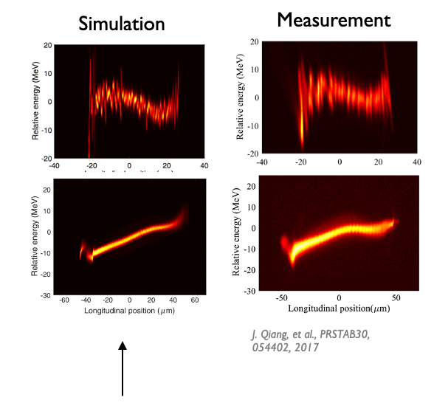
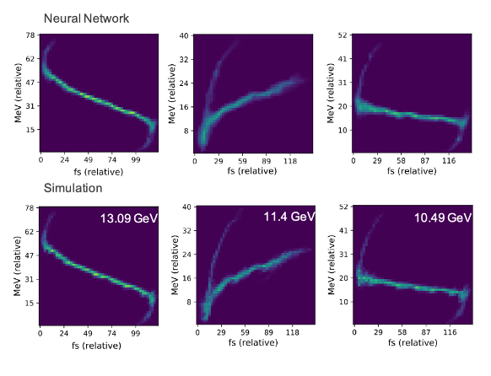
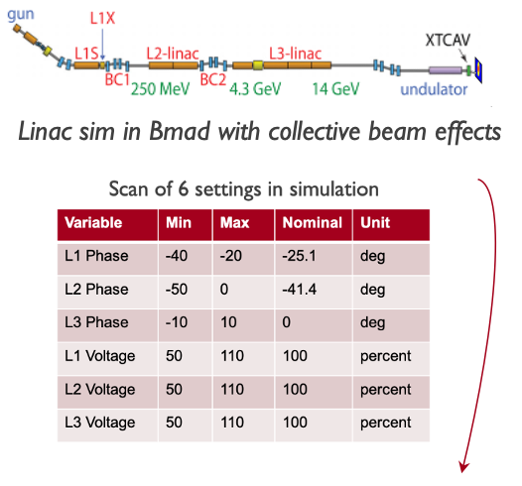
Need: Fast-Executing & Accurate System Models
Accelerator simulations that include nonlinear and collective effects are powerful tools, but they can be computationally expensive
ML models are able to provide fast approximations to simulations
(“surrogate models”)
10 hours on thousands of cores at NERSC!
< ms execution speed
10⁶ times speedup
Edelen et al., NeurIPS 2019
ML modeling enables accurate predictions of system responses with unprecedented speeds, opening up new avenues for high-fidelity online prediction, tracking of machine behavior, and model-based control

Slide 16
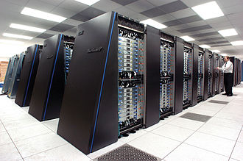

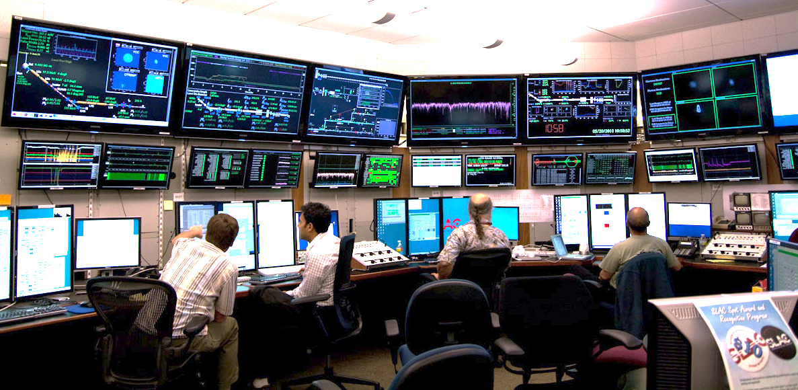
Fast-Executing, Accurate System Models
ML models are able to provide fast approximations to simulations
(“surrogate models”)
Bringing simulation tools from HPC systems to online/local compute
Control prototyping
Experiment planning
< ms execution speed
10⁶ times speedup
Online prediction
Model-based control
Edelen et al., NeurIPS 2019
ML modeling enables accurate predictions of system responses with unprecedented speeds, opening up new avenues for high-fidelity online prediction, tracking of machine behavior, and model-based control

Slide 17
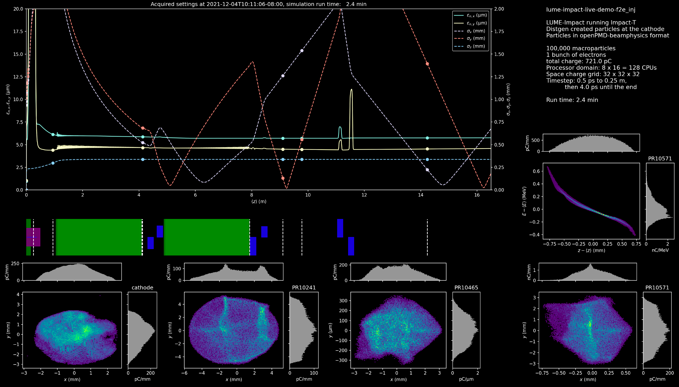
Goal: Multi-modal HPC Modeling Facility. Full Integration of AI/ML Optimization, Data-Driven Modeling, and Physics Simulations, working in a machine-agnostic ecosystem for online simulation, but delivering fast model RESULTS - PV settings - to running accelerators (!)
Cluster Compute
(CPU,GPU)
C. Mayes
Making good progress toward this vision with open-source, modular software tools

Slide 18
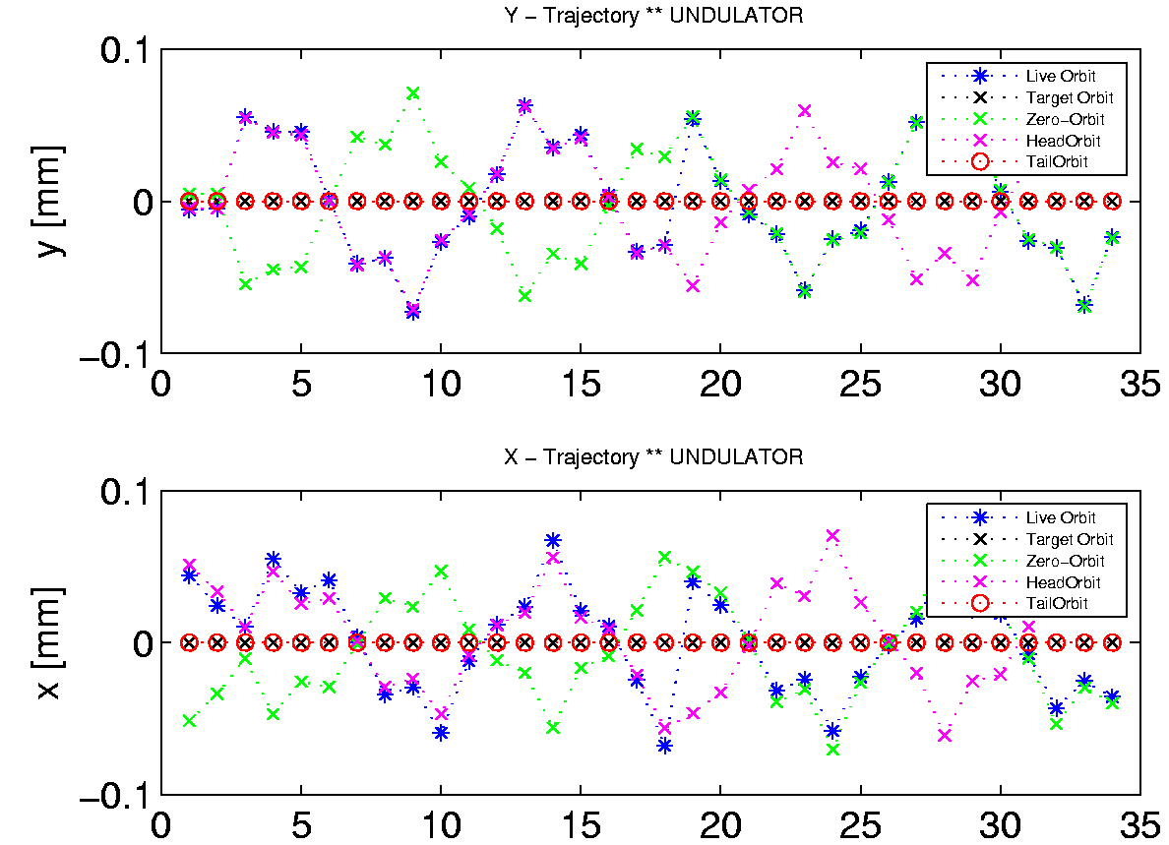
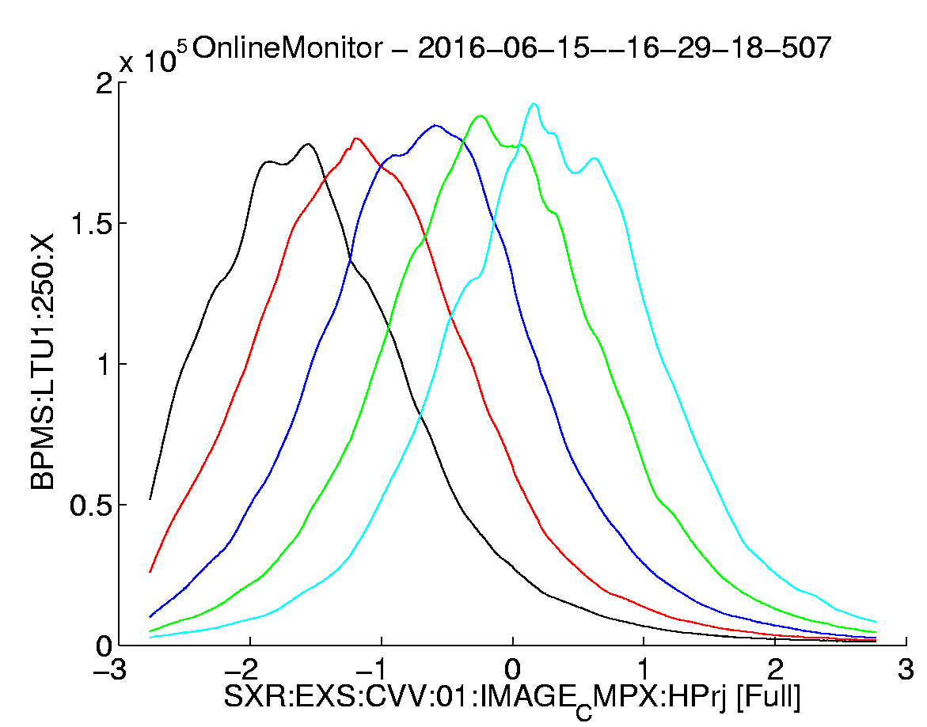
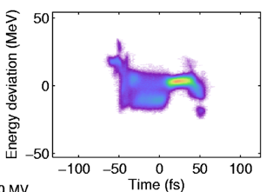
Beam Synchronous Data – and Event building
Alberto Lutman, SLAC
Objective: Build a model and inverse problem for energy spectra tuning. Support Regression Analysis and ML, and event build for FEL tuning
Problem: Assemble pulse synchronous data & machine meta data. Complex, incomplete.
  In Accelerator – Beam Synchronous Acquisition system (BSA).
  In Experimental support controls, Beam Line Data System (BLD).
Requirement: Save all Beam Synchronous Data (eg monitors), every pulse, all the time.
Controls and Data Systems Requirement: Fast transfer ALL pulse identified data, as atomic structures of the measured data and their “meta-data” for analysis, experiment tuning, and ML , accessible both immediately, and from archive (!)

Slide 19
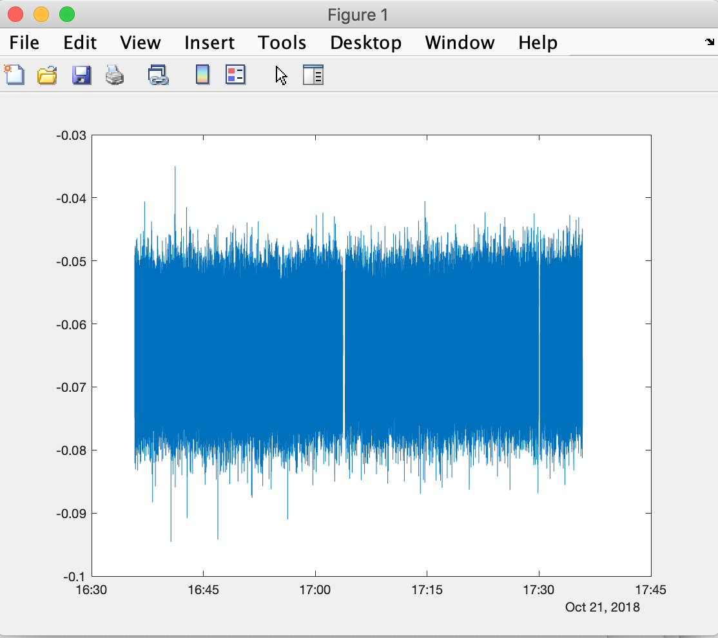
“All the [beam] data, all the time” at SLAC’s LCLS
Figure: Accelerator Event Building Service collects all bunch-by-bunch data, lines up by bunch ID, tags with accelerator meta data, stream to clients, and archives for Machine Learning and diagnostics. ~800 TB/yr
Physics Software Apps (HLAs)
Displays (pyDM)
SRF diagnostics
Regression Analysis & ML
1 EPICS 7 NTTable PV of all Beam Synchronous BSA PVs in beampath, for every pulse <= 1 kHz. Statistics for pulse rates > 1 kHz.
BSA Service listens to ALL Beam Synchronous PVs collates and publishes. Impl in p4p.
PVA
EPICS 7 p4p
EPICS 7 p4p
PVA
Pulse Synchronous Data Archive
BSA Event Building Service Collector
BSA Service PVA Writer
PVA
CA
All ~3000 PVs 1 kHz
single pulse data
1 MHz aggregate
LCLS-II SC
Beam Synchronous Acquisition
LCLS-I Cu
Beam Synchronous Acquisition (BSA)
(Complete)
All ~3000 PVs 120 Hz
single pulse data
EPICS 7 IOCs
EPICS 3 IOCs
>> load('~/Development/bsd/CU_HXR_20181022_003549.h5','-mat’);
>> % Make a single vector of real seconds POSIX time, and convert to local time
>> ts=double(secondsPastEpoch)+double(nanoseconds)*1e-9;
>> t=datetime(ts,'ConvertFrom','posixtime','TimeZone','America/Los_Angeles’);
>> % E.g. Plot every pulse at one BPM PV over the hour
>> plot(t,BPMS_IN20_525_X);
19
https://www.slac.stanford.edu/grp/ad/docs/model/matlab/bsd.html, M. Davidsaver, B. Martins, D. Murray, G. White

Slide 20
EPICS 7 network performance (pvAccess)
Performance and Reliability
Comparison of new data protocol included in EPICS 7 compared to EPICS 3
pvAccess is significantly faster than EPICS 3 at big data. CA is faster at many small ops in parallel.
Use Cases Indication: Use pvAccess for machine beam synchronous accelerator data, experimental data, camera data, structured data or data & metadata. Maybe use CA for very full synoptic displays and compatibility with legacy display mgr.
Matej Sekoranja, Cosylab
Notes:
So, as you can see, for many parallel gets, of small data object sizes (like scalar), CA is faster than PvAccess.
But for larger datasizes, like images, and modern beam data, PvAccess is faster. Much faster in the sequential case – eg camera acq, RPC.

Slide 21
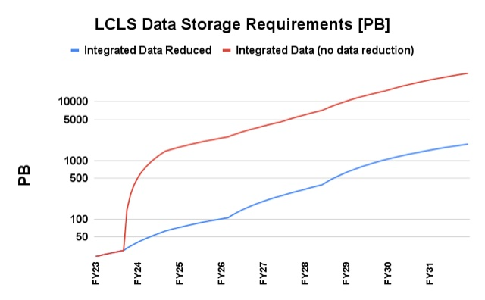
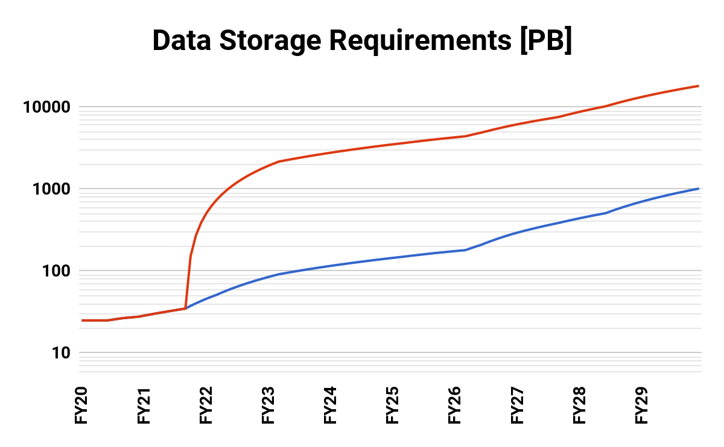
Data will drive analytics. Both data generated and storage requirement are set to grow enormously
1 TB/s
Detector Output
250 GB/s
Processed Data
LCLS Accelerator Data
LCLS Experiment Data
G. White, D. Murray
Jana Thayer, LCLS
Optimistic: Assumes continuous 24/7 data recording and file format does include data summary tuple for characterizing data >1 kHz. At end of years.
Data roll-up DOES NOT Include LCLS-HE assumed coming after 2026
Data roll-up DOES NOT include Camera image data
Accelerator data storage size will be large for us, but small compared to LCLS experiment (1 PB << 1000 PB)

Slide 22
EPICS Version 7 in a Nutshell
New Fast Protocol, “pvAccess” replaces CA
Structured data
Python and MATLAB APIs (and C++ and Java)
Data Services (Process variables with arguments)
Standardized Scientific Types
Dynamic typing
Introspection interface
New smart process database
$ pvget XCOR:LI24:900:TWISS
structure
double energy 5.00512
double psix 37.7625
double alphax 13.6562
double betax -2.78671
double etax -0.00698294
double etaxp 0.00107115
double psiy 31.9488
double alphay 116.762
double betay 5.2592
double etay 0
double etayp 0
Figure: pvAccess getting PV of a structure of
optics parameters. In this case a standard
“Normative Type” type was not used, so the raw
structure is displayed
Faster. Structured data. Metadata. RPC. Easier.

Slide 23
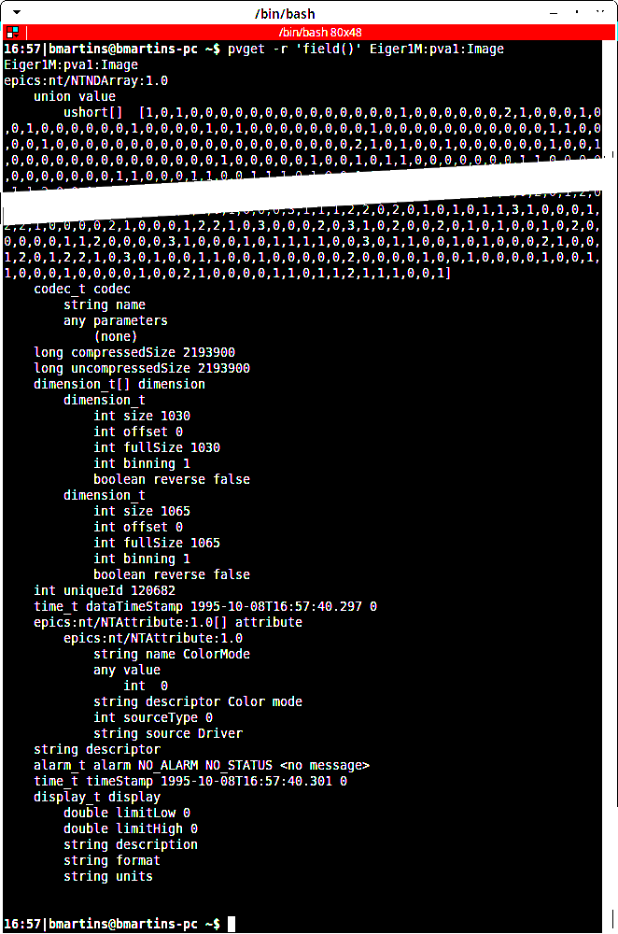
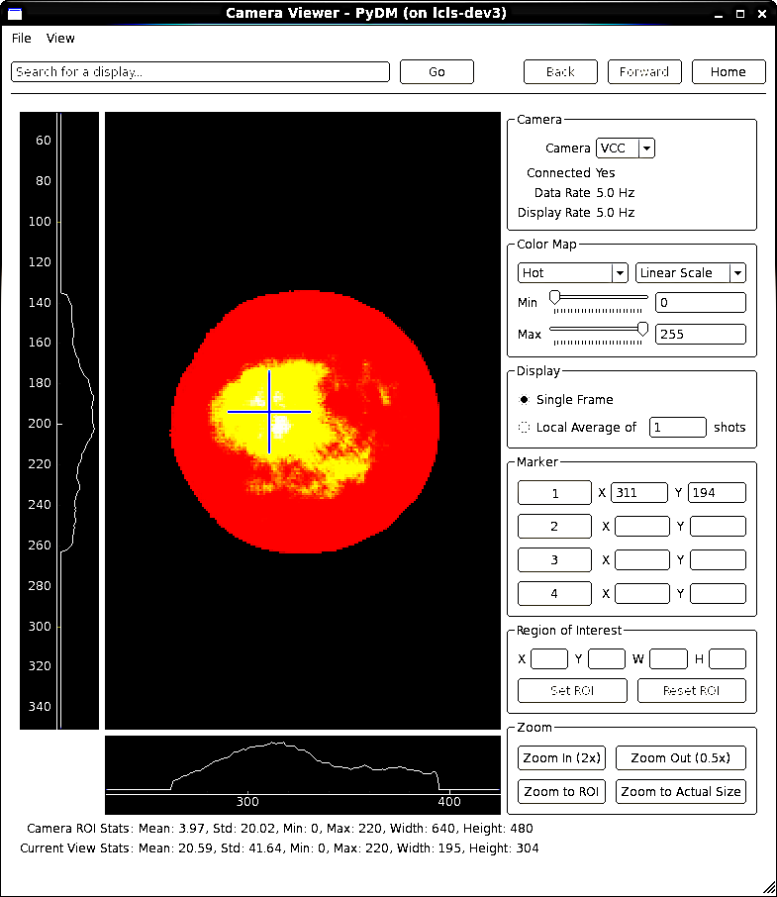
EPICS 7 Image Type (NTNDArray) Example
Helping ML answer e.g. – What does the cathode look like when the photon flux intensity is high
Command line request for a given image PV by name.
Data Type Identifier
A lot of data snipped
Raw image data.
Widget learns how to display image from metadata
The image meta data; giving parameters to interpret data in the value field, and other information.
Figure: A screenshot of the output of the EPICS 7 “pvget” command, for an image.
Figure: A screenshot of PyDM displaying a beam profile image.
B. Martins (now MS), M. Gibbs SLAC

Slide 24
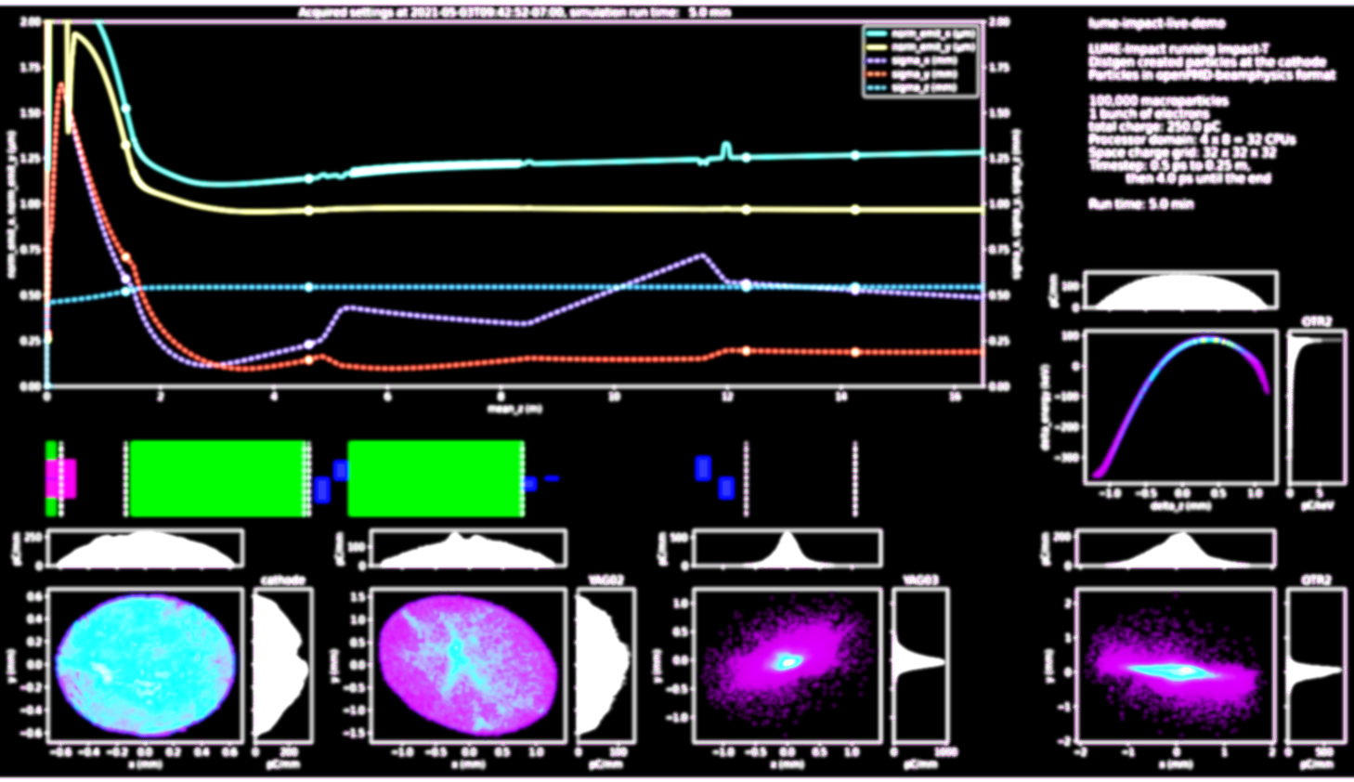
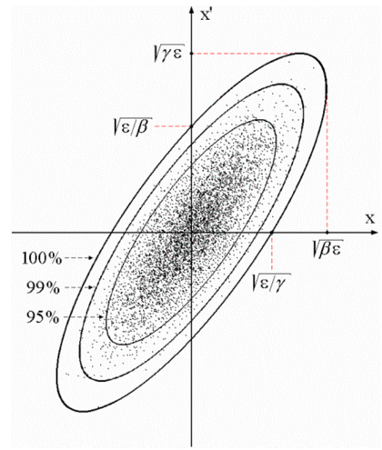
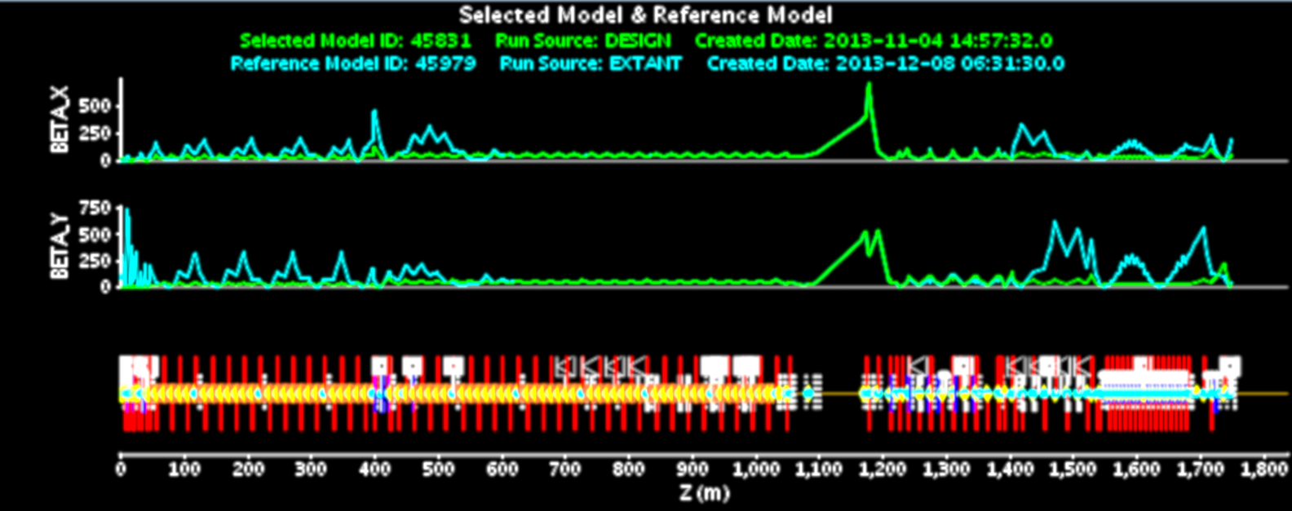
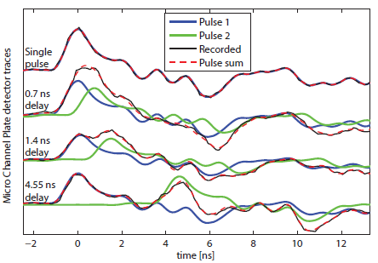
Emerging Control Ecosystem Roles in AI/ML & Physics Applications
Device Abstraction, Data Measurement & Transport | Online non-linear optimization | Collection & Event Building / Big Data | Online Linear Modeling | Big simulation, ML, LLM
 |  |  |  | Online Multi-particle simulation (Impact-T). ML real time optimization.
 |  |  | Online linear model of whole machine, from pulse sync data
 |  | Beamline - Accelerator Synchronous tuning
 |  | Bunch resolved mass data archived w/ meta data
 |  | Sync Camera data
 | Ad-hoc Bunch sync ML regression analysis / ML. Non-linear Model. Gaussian Process. Gradient decent
EPICS 7 Structured data. EPICS Security
EPICS 7 gateway. New network protocol. Process Variables of Structured data. EPICS Security
PV carries many signals/records. E.g. NTNDArray image | PVs carry physics measurements & tuning results | 1 PV carries whole synchronous orbit data etc. | 1 PV carries whole lattice, all Twiss etc. | PVs from High Performance Cluster carry tuning for immediate use online. Cyber?

Slide 25
Review - Physics Requirements of the Future Controls
Online Beam Optimization no longer just known a priori model. Not only ad-hoc “correlation plots”, Singular Value Decomposition, bumps, PID or Kalman – based. Rather continuous multi-parametric and NN online, and big-data offline, informing online in real time
Online Models no longer linear only. Space charge, RF kicks, magnet errors, dynamic initial conditions, must be included. That implies large HPC and ML, reading and writing to online PVs!
Tuning on Pulse identified data. Pulse Synchronous Archiving All pulses, (soft) Real time pulse synch accelerator-detector optimization, Continuous image acq/store, Pulse based Modeling
Control system Requirements (SLAC = EPICS). High Speed Data Services (PVA). Semi-structured science data (PVA)
  Big Data Storage (S3DF) – typically outside the control network (!)
  High Performance Computing – typically outside the control network (!)
CONCLUSION: Controls Architecture must adapt to support physics analysis on fast networks off production;
Control system moves into High Performance Compting (formery entirely offline, and outside the production secure network)
Controls can no longer rely on a secure perimeter cyber model.

Slide 26
Talk Outline. Accelerator Computing and Controls Revolution
Online Beam Tuning: Linear numerical methods, precomputed linear or 2nd order model
→ non-linear, multi-particle model based, ML and multiparametric methods.
⇒ 𝚫 Scope: Controls += Accelerator Optimization + Big Data
⇒ 𝚫 Network: Controls += High-Performance Computing
⇒ 𝚫 Security: EPICS += Transport Layer Security. Secure High-Performance Computing.

Slide 27


Our PRODUCTION Distributed Control System + EPICS Cyber Schematic
Classically, SLAC Policy = ALL machine settable process variables MUST ONLY be set from the production network – as an implementation of the cyber policy that only authorized personnel or authorized machines may write PVs. That is, accelerator cyber sec is implemented as a sequestered network.
Control Network. EPICS (CA and/or PVA) in most DOE labs. Others include ACNET, TANGO, SLCMSG etc. EPICS has Authorization but no intrinsic Authentication.
⇒ Server can’t be sure who made a control request. Client can’t be sure data came from a given device.
Field Buses;
Allen-Bradley, VME, CAMAC
Input Output Controllers (IOCs). Pseudo real-time dataflow databases and device drivers, maybe also real-time PLC or FPGA. Essentially no authentication nor authorization. No software signing.
⇒ Can’t be sure the computer code you think is running your accelerator is in fact running your accelerator.
Glossary. “AAA”:
Authentication: Establish you are who you say you are
Authorization: What set of things are you allowed to do once authenticated
Audit: Keeping track of what you did.
Borrowing from M. Thuot 1996.

Slide 28








Present Typical Accelerator Computing Architecture
(LCLS complex at SLAC)
Big Data stores
High Performance Computing Network
Experiment Data Analysis
Office Network
Science Data Facility
SLAC Network
SDF Disk
SDF Disk
Accelerator Physics Analysis
Documents, Engineering Drawings
Oracle, People-soft etc
Multi-particle Tracking (s-2-e)
Machine Learning Training
Data Systems Analysis Network
Experiment Network
Non-critical Data Services
Simulation
Software development
Controls Network
Production Services and Control Room Network
Control room displays
High Level Apps execution
Online modeling
Critical Data Services
Optimization, ML and slow feedback
EPICS Input Output Controllers (IOCs) - 100s
Accelerator devices - 1000s. Producing control and diagnostics signals (Process Variables) - > 8 million at LCLS

Slide 29
In progress Accelerator Computing Architecture
Multi-modal modelling systems added to High Performance Computing
Big Data stores
Experiment Data Analysis
Accelerator Physics Analysis
Multi-particle Tracking (s-2-e)
Machine Learning Training
Acting on s-2-e results -> PV write
Machine Learning Inference -> PV write (Hmmm, problematic!)
High Performance Computing Network
Office Network
Science Data Facility
SLAC Network
SDF Disk
SDF Disk
Documents, Engineering Drawings
Oracle, People-soft etc
Data Systems Analysis Network
Experiment Network
Non-critical Data Services
Simulation
Software development
Controls Network
Production Services and Control Room Network
Control room displays
High Level Apps execution
Online modeling
Critical Data Services
Optimization, ML and slow feedback
EPICS Input Output Controllers (IOCs) - 100s
Accelerator devices - 1000s. Producing control and diagnostics signals (Process Variables) - > 8 million at LCLS

Slide 30


SLAC Shared Science Data Facility (S3DF) and
Stanford Research Computing Facility (SRCF)
S3DF is a compute, storage and network architecture designed to support massive scale analytics required by all SLAC experimental facilities and programs, including LCLS/LCLS-II, UED, cryo-EM, the accelerator, and the Rubin observatory
Optimized for data analytics and characterized by large, massive throughput, high concurrency storage systems
Over the next decade will deploy 2+ and 20+ PFLOPS of CPU and GPU compute, 50 PB of flash-based storage, 500 PB of spindle-based storage and 2.5 exabytes of archiving capabilities
S3DF opened to Rubin and SuperCDMS users in the second half of 2022 and is now open to the entire SLAC community
Beneficial occupancy of the second module of the Stanford Research Computing Facility (SRCF-II) expected for late-Oct
Combined facility to offer 6 megawatts of power and host 360 racks
S3DF will eventually occupy roughly ⅓ of SRCF I + II
A. Perazzo*, A. (Yemi) Adesanya, L. Nakata, Y. L. Ting, https://s3df.slac.stanford.edu

Slide 31
Secure Model Tuning Solution (PVs values)
Implementation(*) Requirements
A secure online Optimal Control process (i.e. model) in a super-compute cluster:
MUST guarantee that the PV is not dangerous to the machine. (Or more likely collection of computed values.) E.g. large machine model making recommendation on large set of heterogenous PVs. At least minimize subject to constraints. Ideally, something like LCLS Guardian or SLC Paranoia also.
MUST be protocol secure. enable a computed recommendation for a machine PV value to be deployed into the accelerator without risk that PV’s value has been trivially hacked - compromised by a malign actor. E.g. someone on HPC just writes to an objective PV, that then is reflected into the accelerator
MUST/SHOULD guarantee code secure. That the PV processing itself has not been hacked (Model itself, hosted in HPC, maybe an EPICS IOC in HPC).
(*) By “value implementation” is meant, computed objective solution (recommended PV values) to be deployed into the running accelerator.

Slide 32


Requirement: ML / AI solution must include Machine Safety and Beam Operational Requirements!
SVD/LLS methods incorporate parameter constraints.
E.g. “Constrained SVD”
Emerging ML methods.
Set input bounds for settings that can't be violated
Use learned output constraints
Set a max step size if desired to avoid making large jumps
SVD. E. Beltrami, C. Jordan. G. Gobub (computation)
Weigh the acquisition function by the probability the constraint
Is satisfied.
R. Roussel
Bayesian optimization (e.g. GPs, but any with an uncertainty estimate) we can also model the probability of a constraint violation (such as losing the beam off a screen).
Constrained SVD, G. White, T. Himel, G. Golub
Notes:
set input bounds usually informed by ops or a reasonable historical range, rather than the EPICS max/mins.
(more detail below), learned output constraints so that the algorithm learns to avoid settings that lead to constraint violations
large jumps in settings; this can interfere with finding an optimum as efficiently, but it is a tradeoff

Slide 33
Talk Outline. Accelerator Computing and Controls Revolution
Online Beam Tuning: Linear numerical methods, precomputed linear or 2nd order model
→ non-linear, multi-particle model based, ML and multiparametric methods.
⇒ 𝚫 Scope: Controls += Accelerator Optimization + Big Data
⇒ 𝚫 Network: Controls += High-Performance Computing
⇒ 𝚫 Security: EPICS += Transport Layer Security. Secure High-Performance Computing.

Slide 34
Cyber Threat Statistics and Context
SLAC CYBER EVENT DATA | Q4 2022 | Q2 2023
Perimeter defenses stopped attempts. Scanning for known vulnerabilities. Like ssh user brute force attack, Apache path traversal, ZeroShell command execution, etc. Or actual exploits. Like Remote Code Execution (RCE), SQL injection, etc. | 33,149,555 | 509,750,086 (Yes, 509 M)
Endpoint protection events stopped: Crowdstrike. Malicious software detected. Successfully mitigated by Endpoint protection and response | 130 | 490
Control system intrusions known | 0 | 0
Front-end intrusions known | 0 | 0
  Context and thinking
  Historically, accelerator control systems have not included strong cyber security within the network
  We have relied on “secure–perimeter” (sometimes called sequestered network, or “walled garden”)
  The world is a different place
  Is secure-perimeter still advisable? Cf Executive Order (EO) 14028, Improving the Nation’s Cybersecurity and Zero Trust Architecture (ZTA) and DOE SC orders
  Is EPICS secure? See later in talk.

Slide 35
Requirement: Secure EPICS.
Present EPICS Security Vulnerabilities:
Passive Traffic Inspection
Passive attacker can observe and learn Process Variable and server names. Not considered serious.
⇒ Could Mitigate by TCP+TLS(*)
PV Denial of Service by search spam
Active attacker responds to PV search requests, directing to null server
PV Search Hijacking / Man in the Middle Attack
Active attacker responds quickly to all observed searches, redirect clients to rogue EPICS server. Returns fake data, or proxy forwards bad control data to a legitimate control system EPICS server. Very bad things.
⇒ Mitigate by adding Transport Layer Security (as long as attacker does not hold certificate)
Server impersonation / credential theft
Theft of server certificate used to maliciously impersonate PVs provided a legitimate server.
⇒ Mitigate by something like certificate “pinning.”
(*) Transport Layer Security (TLS); Encryption, certificate-based authentication, compression.
Work of Michael Davidsaver, Osprey DCS, under SLAC contract, 2021

Slide 36

EPICS Security Improvement:
PvAccess and Transport Layer Security (TLS)
PvAccess += Transport Layer Security.
First step to Zero Trust Architecture in EPICS Accelerator controls
Multi phase project:
  Server side authentication
  Client side
  Yr 2 / 3. Certificate server? Name Server? Pinning?
Transition phase: EPICS pvAaccess TLS fully backward compatible. TLS endpoints co-exist with non TLS.
GOAL: All endpoints use PvAccess + TLS.
NOTE security implies removal of Channel Access protocol from EPICS systems (!)
Very early Prototypes now available.
Figure: EPICS PVA negotiation with TLS proposal, showing:
TLS handshake after message validation, ”tls” message, cipher handshake, and certificate verification additions to EPICS PvAccess protocol.
Modification uses the “magic” byte in the pvAccess header, and existing protocols field in the search response.
Work of George McIntyre, Level-N Ltd, + Michael Davidsaver, Bob Dalesio, Osprey DCS, for SLAC. Kay Kasemir for ORNL.

Slide 37

EPICS Security Improvement 2:
US Dept of Energy sponsored project to add TLS to PvAccess for the EPICS community
$ 1.4 M over 2 years. SLAC leading, Osprey primary contractor (M. Davidsaver, G. McIntyre). Kay Kasemir (ORNL) adding for core-pva. Many, many thanks to Dale Dale Hugo Leschnitzer & Mark Hahnert (US Dept of Energy, Office of Science).
Year One
1. Technology analysis and selection
2. Implement a simple prototype containing TLS additions to the EPICS PV Access protocol
3. Design changes to EPICS
4. Implement prototype for PV Access Name Server changes
5. Implement prototype for client authorization via certificate
6. Integrate with site-specific authentication protocols
7. PVA Protocol Performance tests
8. PV Access Name Server Performance tests
9. Functional Verification Testing and Combined Report
Year Two
1. Implement Beta version of PVA TLS
2. Update Beta with performance and usability improvements
3. Update Beta with certificate management improvements -
4. Release Beta to SLAC and monitor
6. Release Beta to selected facilities and monitor results
Figure: The basic architecture of PVA+TLS in context of an EPICS installation, shoing integration with enterprise authentication, certificate validation and management, and integration with EPICS Access Control.

Slide 38
Possible Solution – Production Read Only EPICS Mailbox
High Performance Computing Network
Acting on s-2-e optimization results -> PV write
Machine Learning Inference -> PV write
Office Network
Science Data Facility
SLAC Network
SDF Disk
SDF Disk
EPICS-kafka gateway EPICS server
Documents, Engineering Drawings
Oracle, People-soft etc
Kafka or PVA
Model writes to kafka or direct to PVA Mailbox PV
Data Systems Analysis Network
Experiment Network
PVA R/O
Pros | Cons
Kubernetes friendly way to distribute computed results | Not secure in itself. Needs EPICS ACL, k8 and kafka process to be authenticated
Provides a location to implement a guardian | No simple PV write. No clear way to do an authenticated & authorized write. The kafka would have to carry the credentials for write to the EPICS-kafka gateway so it could use them to write.
 | Requires all machine tuning in HPC be in k8 & kafka
 | (For read) Kafka bus <-> accelerator network are different temporal structure.
Prod IOC/OPI/HLA reads from gateway EPICS mailbox PV
Controls Network
Production Services and Control Room Network
EPICS Input Output Controllers (IOCs) - 100s

Slide 39
Propose “Best” Solution – Direct read/write to/from Model process, over TLS secure (EPICS) PV.
High Performance Computing Network
Acting on s-2-e results -> PV write
Machine Learning Inference -> PV write
Office Network
Science Data Facility
SLAC Network
k8 LUME process’ EPICS server
SDF Disk
SDF Disk
Documents, Engineering Drawings
Oracle, People-soft etc
Model process reads or writes to ANY secure EPICS server. Initial prototypes of PVA+TLS now in pvxs and Phoebus*.
Data Systems Analysis Network
Experiment Network
PVA+TLS R/W
PVA+TLS R/W
Prod IOC/OPI/HLA read or even writes to HPC model process
Pros | Cons
Simple | No obvious location for a guardian process. But we can add that at the CS level.
Secure control system I/O R & W
Pattern for long term production network
Controls Network
Production Services and Control Room Network
EPICS Input Output Controllers (IOCs) - 100s

Slide 40
Propose “Best” Solution – Direct read/write to/from Model process, over TLS secure (EPICS) PV.
High Performance Computing Network
Acting on s-2-e results -> PV write
Machine Learning Inference -> PV write
Office Network
Science Data Facility
SLAC Network
k8 LUME process’ EPICS server
SDF Disk
SDF Disk
Documents, Engineering Drawings
Oracle, People-soft etc
Model process reads or writes to ANY secure EPICS server. Initial prototypes of PVA+TLS now in pvxs and Phoebus*.
Data Systems Analysis Network
Experiment Network
PVA+TLS R/W
PVA+TLS R/W
Prod IOC/OPI/HLA read or even writes to HPC model process
Pros | Cons
Simple | No obvious location for a guardian process. But we can add that at the CS level.
Secure control system I/O R & W
Pattern for long term production network
Controls Network
Production Services and Control Room Network
EPICS Input Output Controllers (IOCs) - 100s

Slide 41

The Control System Network is Defined As the network of endpoints that communicate over secure (TLS) PVA.
No more slow and clunky display over X11. Transport the control protocol, not the display protocol as now.
High Performance Computing Network
Office Network
Science Data Facility
SLAC Network
k8 LUME process’ EPICS server
SDF Disk
SDF Disk
Documents, Engineering Drawings
Oracle, People-soft etc
Data Systems Analysis Network
Experiment Network
PVA+TLS R/W
PVA+TLS R/W
Pros | Cons
Simple | No obvious location for a guardian process. But we can add that at the CS level.
Secure control system I/O R & W
Pattern for long term production network
Fast remote native displays. No more X11
Controls Network
Production Services and Control Room Network
EPICS Input Output Controllers (IOCs) - 100s

Slide 42
Summary: AI/ML/Multi-particle simulation will change how we do beam tuning, and in turn change computing infrastructure and Cyber Security design.
Beam Tuning Strategy : Machine Learning / AI / Multi-particle tracking:
  Improve global models (accuracy, expressivity, speed, uncertainty estimates, adaptability)
  Develop algorithms for exploration and optimization of new parameter spaces
  Incorporate physics with ML modeling wherever useful
  Set up algorithms and software tools that link each of the above
  Making lots of progress in these individual areas and increasingly using combinations of approaches
⇒ 𝚫 Scope: Controls += Physics
  Beam Tuning in High Performance Computing clusters, possibly even offsite, deploy into accel.
  Tuning changes will need peak amplitude validity checks (eg BMAX) – sometimes not easy to incorporate into optimizers
⇒ 𝚫 Network: Controls += ( High Performance Computing + Transport Layer Security)
  Accelerator network will include HPC – wherever it is
  PV writes may come from anywhere
  Classical “private network” is probably insufficient, at least for accelerators (not ITER, defense etc)
⇒ 𝚫 Security: Sequestered network replaced by authenticated endpoints (!)
The “Controls Network” will be defined as the system of computers interconnected by the secure controls protocol – PVA+TLS

Slide 43
Backups

Slide 44
Summary
General strategy for comprehensive tuning at SLAC:
Improve global models (accuracy, expressivity, speed, uncertainty estimates, adaptability)
Develop algorithms for exploration and optimization of new parameter spaces
Incorporate physics with ML modeling wherever useful
Set up algorithms and software tools that link each of the above
Making lots of progress in these individual areas and increasingly using combinations of approaches
Some tools are integrated into regular operations (e.g. Badger, Xopt), others are used regularly offline (e.g. Xopt, LUME), others need substantial investment / work (e.g. LUME-services)
Have been placing much emphasis on modular, interoperable software tools / standards → tools have been used now for a variety of tasks at SLAC and AWA

Slide 45





Thanks to the team!

Slide 46


(1) Developing new approaches for accelerator optimization/characterization and faster higher-fidelity system modeling,
(2) developing portable software tools to support AI/ML, (3) integrating these into regular use
  Efficient optimization and characterization (useful also for simulation exploration/design, data generation)
integrated development cycle
  Online prediction with physics sims and fast/accurate ML models
Fundamental AI/ML Research
Software
Tools
ground truth
validity probability
Testing/Deployment
(offline and online)
Roussel et. al. Nat. Comm. 2021
Output constraints learned on-the-fly
Hanuka et. al. PRAB , 2021
  Representation learning
  (e.g. better ways of modeling beams)
  Adaptation of models and identification of sources of deviation between simulations and as-built machine
  Techniques for combining
  physics and ML (more reliable/transferrable, require less data, more interpretable), including differentiable simulators
  Software packages and standards for data generation, modeling, and optimization (LUME, xopt, Badger)
Roussel et. al. PRL. 2022

Slide 47





Neural Network System Models + Bayesian Optimization
Combine expressive models with BO. important for scaling up to higher-dimensional tuning problems (more variables)
Good first step from previous work: use neural network system model to provide a prior mean for a GP
Used the LCLS injector surrogate model for prototyping
variables: solenoid, 2 corrector quads, 6 matching quads
objective: minimize emittance and matching parameter
Summer ’22 undergrad intern
Connie Xu
Correlations Between
Predictions and Ground Truth
prior mean from
models with different fidelity
Ground Truth
regular Bayesian
optimization
Model 2
Even prior mean models with substantial inaccuracies provide a boost in initial convergence
→ now testing on machine and refining approach
NeurIPS proceeding: https://arxiv.org/abs/2211.09028

Slide 48





Modular, Open-Source
Software Development
LCLS
Community development of re-usable, reliable, flexible software tools for AI/ML workflows has been essential to maximize return on investment and ensure transferability between systems
Modularity has been key: separating different parts of the workflow + using shared standards
Different software for different tasks:
Optimization algorithm driver (e.g. Xopt)
Visual control room interface (e.g. Badger)
Simulation drivers (e.g. LUME)
Standards model descriptions, data formats, and software interfaces (e.g. openPMD)
Online model deployment (LUME-services)
FACET-II
Optimizer
standard
data
format
LUME
Simulation
Online Impact-T simulation and live display; trivial to get running on FACET-II using same software tools as the LCLS injector
More details at https://www.lume.science/
Modular open-source software has been essential for our work. We welcome new users and contributors.

Slide 49
EPICS 2023 ML intro talk ends.

Slide 50
Talk Outline
Beam Modelling and Tuning
  Optimization techniques. Past and Present. How they compare and demands of control
  Start to end simulation – “Digital Twins”
  Data Storage usage and demand
  Machine integrity when ML makes automatic PV value choices
Control System Architecture changes implied by above
Cyber Security changes implied by above.

Slide 51
Data will drive analytics. Both data generated and storage requirement are set to grow enormously
1 TB/s
Detector Output
250 GB/s
Processed Data
LCLS Accelerator Data
LCLS Experiment Data
G. White, AD
Jana Thayer, LCLS
Optimistic: Assumes continuous 24/7 data recording and file format does include data summary tuple for characterizing data >1 kHz. At end of years.
Data roll-up DOES NOT Include LCLS-HE assumed coming after 2026
Data roll-up DOES NOT include Camera image data
Accelerator data storage size will be large for us, but small compared to LCLS experiment (1 PB << 1000 PB)

Slide 52
New Data Sizes, ML and Online Multi-particle Model, their Implications and Requirements on Architecture
1 TB/s
Detector Output
250 GB/s
Processed Data
Premise: Future accelerator will be optimized by Data Systems,
ML and HPC Model Systems
Implications
Data Science driven accelerator tuning.
BSA Data store, ML on SDF. ML on prod -> network, Physics Analysis Env & documentation
Complicates requirement to produce quick ”feedback” to experiment
Many controls and physics processes, not just IOCs --> PVA gateways, EPICS 7 IOCs, production HLAs online
Production at >1 network. Dev and SDF now incl.
Development in DMZ and SDF networks, not prod
New maths and algorithms to be prototyped
-> Matlab from home, PVA matlab, python env
Data access across networks (prod, dev/AFS, SDF)
Large amount of data to be stored, managed, understood
Fast and easy to use.
Consequent Requirements
Production architecture that includes S3DF.
Simple, fast, automated Workflows and Data Flows

Slide 53



Variety of Successes with Online Modeling and Optimization Tools So Far
10 variables
Digital twins: Online simulation and modeling with LUME infrastructure + adaptive ML models have been used with LCLS, LCLS-II, and FACET-II
Data collection/characterization: Smart sampling for efficient characterization successfully/robustly used online
→ data used directly to create ML model
ML-enhanced optimization: numerous successes with new algorithms for safe, efficient online tuning (e.g. injector emittance tuning, FEL pulse energy tuning, longitudinal phase space tuning, sextupole tuning for beam size)
Software transferability: have shown easy transfer of modeling and tuning software between LCLS/LCLS-II/FACET-II accelerators and to other labs (e.g. AWA at Argonne); now working integrate between accelerator/photon side at LCLS/LCLS-II
8x faster characterization than by hand
LCLS-II live simulation of injector (with nonlinear collective effects included) and online re-calibration to match measurements
Used combination of online physics simulation and custom Bayesian tuning algorithms in LCLS-II injector commissioning
→ achieved best emittance to date
Critical steps toward having an adaptive digital twin system and model-guided, ML-enhanced optimization have been demonstrated → now need infrastructure investment + more incorporation into regular operations

Slide 54

Example: Differentiable Physics + ML Modeling of Hysteresis
Regular GP
Model
Hysteresis + GP
Model
Magnetic hysteresis has been a major impediment to high-precision tuning → historically required standardization of magnets
New modeling approach combining classical Preisach model and a Gaussian Process
Joint modeling of hysteresis and beam propagation is more accurate and enables in-situ hysteresis characterization
BO on sys.
with hysteresis
Hybrid BO on sys.
with hysteresis
R. Roussel, et al., PRL, 2022
Higher-precision optimization possible when including hysteresis effects in model
Promising example showing the power of differentiable physics and ML models to enable high-precision characterization and control with minimal data.

Slide 55


Example: Multi-Objective Bayesian Optimization (MOBO)
Multi-objective optimization (MOO) in accelerators is traditionally done offline with high performance computing and simulations, or online at individual working points only
MOBO enables full characterization of optimal beam parameter tradeoffs (i.e. the Pareto front) online with high sample-efficiency
Has now been used experimentally at AWA, FACET-II, LCLS and SLAC UED
Can enforce smooth exploration
(no wild changes in input settings)
R. Roussel, et al.,
PRAB (2021)
Unprecedented ability to fully characterize tradeoffs between beam parameters in real accelerator systems.

Slide 56


Broad Set of Areas for ML to Impact Operation
Data reduction/rejection (kHz/MHz data streams)
Event triggering
automated control
+ optimization
ML-enhanced
diagnostics
(provide insight at faster rate,
at higher resolution,
non-invasively)
J. Duris et al., PRL, 2020
C. Emma et al., PRAB, 2018
algorithm transfer between systems
anomaly detection
failure prediction
(plan maintenance;
alert to changes in machine;
alert to interesting science)
extract unknown
relationships + correlations
(feed into future control / design)
R. Shaloo et al.
arXiv:2007.14340
digital twins + online modeling
(fast sims, differentiable sims, model calibration, model adaptation)
+ need uncertainty quantification for all
+ can incorporate physics information in all

Slide 57

Virtual Diagnostics
Provide information about parts of the system that are typically inaccessible
(destructive, too slow, not directly measurable)

Slide 58




Example: Physics-Informed Bayesian Optimization
J. Duris et al., PRL, 2020
A. Hanuka, et al., PRAB, 2021
→ design Gaussian Process kernel from expected correlations between inputs (e.g. quads)
FEL tuning @LCLS
→ take the Hessian of model at expected optimum to get the correlations
vertical emittance
tuning @SPEAR3
No measured data needed ahead of time, just a physics model
Including correlation between inputs enables increased sample-efficiency and results in faster optimization
→ kernel-from-Hessian enables easy computation of correlations even in high dimension

Slide 59

Accelerator Infrastructure data through EPICS
Examples
Data Services now trivial to implement in EPICS. In Python, Java, C++, even MATLAB
# Regular expression (restrict to sectors LI25-LI29)
$ eget -s ds -a regex='XCOR:LI2[5-9]:.*:BDES’
…
# Device names of the instruments in the laser heater region
$ eget -s ds -a etype INST -a tag LSRHTR -a show dname
…
# A recent search for invalid data in corrector PVs
$ eget -tTs ds -a name %COR:LTU%:%:%DES | \
eget -p ca -f - | grep nan
XCOR:LTU1:558:BDES nan
XCOR:LTU1:558:IDES nan
…
Directory Services
# The names of PVs, by device name pattern:
$ eget -s ds -a name=XCOR:LI21:135:%
name
XCOR:LI21:135:ABORT
XCOR:LI21:135:ACCESS
XCOR:LI21:135:ALLFUNCGO
XCOR:LI21:135:BACT
XCOR:LI21:135:BACTFO
… (many rows snipped)
Oracle Database accessed through Control System:
Figure: Access to Oracle gives device infrastructure, magnet calibrations, drawing names, etc.
Will be used in LCLS-II for such things as cryogenic plant system hierarchy etc.
Greg White, Murali Shankar SLAC
Notes:
SLAC and ESS are collaborating on a system of EPICS Version 4 services that help accelerator physicists write commissioning applications.
The two examples in this slide show use of an EPICS service to compute the optics of accelerator lattice elements.
The Left Hand Side shows the response matrix computed between a corrector and a BPM. Two things to note:
1. The use of RPC style argument – the name of the second device – given as an argument to the first.
2. That the response matrix self identified as the Normative Type NTMatrix, so eget (and any other client) knows to display it as a matrix
The Right Hand Side shows the acquisition of the Twiss – aka Courant-Snyder – parameters of a corrector.
Other PVs can also return the optics of the whole accelerator, returned as a very large table – in an NTTable.

Slide 60
Accelerator Computing Architecture Early 2023
Big Data stores
High Performance Computing Network
Experiment Data Analysis
Office Network
Science Data Facility
SLAC Network
SDF Disk
SDF Disk
Accelerator Physics Analysis
Documents, Engineering Drawings
Oracle, People-soft etc
Multi-particle Tracking (s-2-e)
Machine Learning Training
Data Systems Analysis Network
Experiment Network
Non-critical Data Services
Simulation
Software development
Controls Network
Production Services and Control Room Network
Control room displays
High Level Apps execution
Online modeling
Critical Data Services
Optimization, ML and slow feedback
EPICS Input Output Controllers (IOCs) - 100s
At SLAC, legacy AFS computing system (Accelerator Data Systems) being phased out, and being replaced by Stanford SLAC Science Data Facility (S3DF).
Accelerator devices

Slide 61
Accelerator Computing Architecture Late 2023
Big Data stores
High Performance Computing Network
Experiment Data Analysis
Office Network
Science Data Facility
SLAC Network
SDF Disk
SDF Disk
Accelerator Physics Analysis
Documents, Engineering Drawings
Oracle, People-soft etc
Multi-particle Tracking (s-2-e)
Machine Learning Training
Non-critical Data Services
Data Systems Analysis Network
Simulation
Experiment Network
Software development
Controls Network
Production Services and Control Room Network
Control room displays
High Level Apps execution
Online modeling
Critical Data Services
Optimization, ML and slow feedback
EPICS Input Output Controllers (IOCs) - 100s
Note how far EPICS physics is from the traditionally sequestered control system
Accelerator devices

Slide 62
Possible Solution 2 – DMZ Mailbox EPICS Service.
High Performance Computing Network
Acting on s-2-e results -> PV write
Machine Learning Inference -> PV write
Office Network
Science Data Facility
SLAC Network
SDF Disk
SDF Disk
Documents, Engineering Drawings
Oracle, People-soft etc
Data Systems Analysis Network
Model writes to EPICS server mailbox PV
Experiment Network
MCCAS0
LUME PV receiver mailbox EPICS service
(IOC or pyepics)
Prod IOC/OPI/HLA reads from mailbox PV
Controls Network
Production Services and Control Room Network
Pros | Cons
Simple way to deploy k8 computed results | Not secure in itself. Needs EPICS ACL and k8 process to be authenticated
Provides a location to implement a guardian | Bypasses the idea of security by sequestered network.
EPICS Input Output Controllers (IOCs) - 100s

Slide 63
Possible Solution 3 – Authenticated PVA Mailbox EPICS Service.
High Performance Computing Network
Acting on s-2-e results -> PV write
Machine Learning Inference -> PV write
Office Network
Science Data Facility
SLAC Network
SDF Disk
SDF Disk
Documents, Engineering Drawings
Oracle, People-soft etc
Data Systems Analysis Network
Model writes to EPICS server mailbox PV
Experiment Network
MCCAS0
LUME PV receiver mailbox EPICS service
(IOC or pyepics)
Prod IOC/OPI/HLA reads from mailbox PV
Controls Network
Production Services and Control Room Network
PVA+TLS R/W
Pros | Cons
Simple way to deploy k8 computed results | Not kafka/singularity /Kerberos ready
Secure read/write | Not terribly scalable
Provides a location to implement a guardian
EPICS Input Output Controllers (IOCs) - 100s

