Slide 1
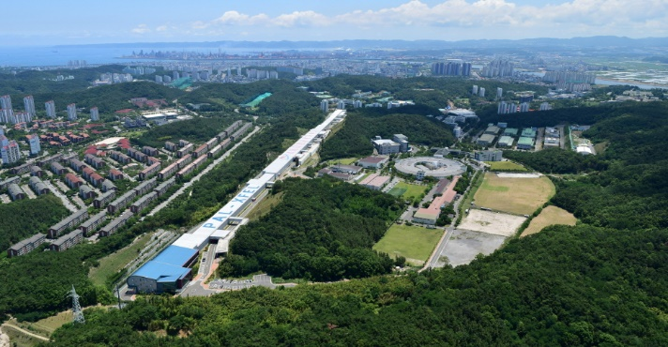
2024 EPICS Collaboration Meeting
October 5, 2023
Changbum Kim
Pohang Accelerator Laboratory

Slide 2
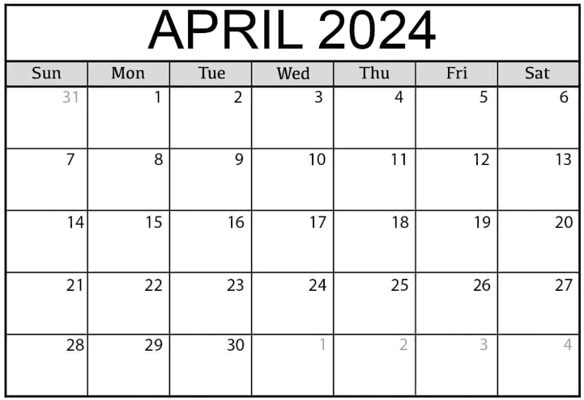
Dates
2024 EPICS Collaboration Meeting: April 15 ~ 18, 2024

Slide 3
Important Dates
Webpage Open: 2023. 10. 30
Official Announcement: 2023. 11. 1
Abstract Submission & Registration Open: 2023. 11. 1 ~ 2024. 2. 29
Abstract Submission & Registration Close: 2024. 2. 29
Timetable Defined: 2024. 3. 15
EPICS Collaboration Meeting: 2024. 4. 15 ~ 4. 18

Slide 4
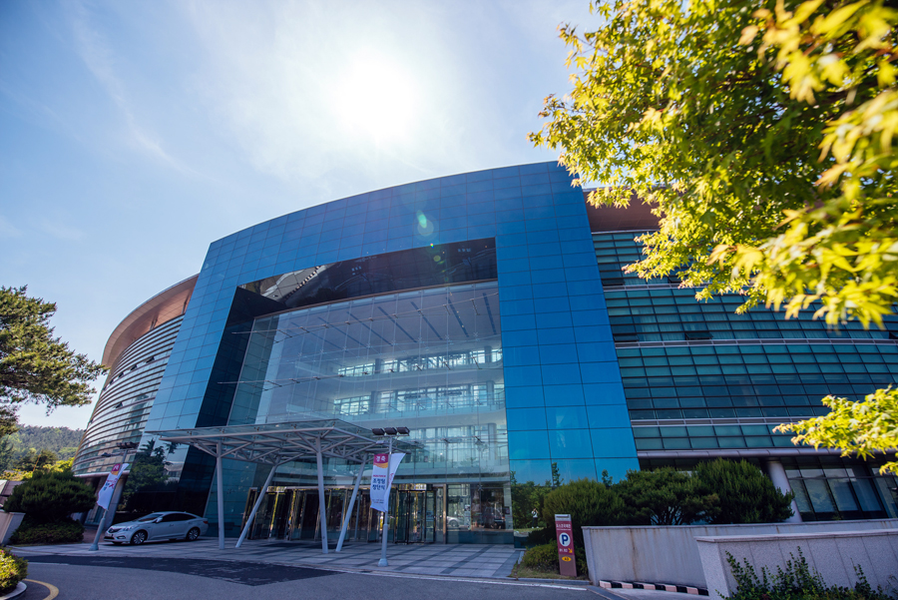
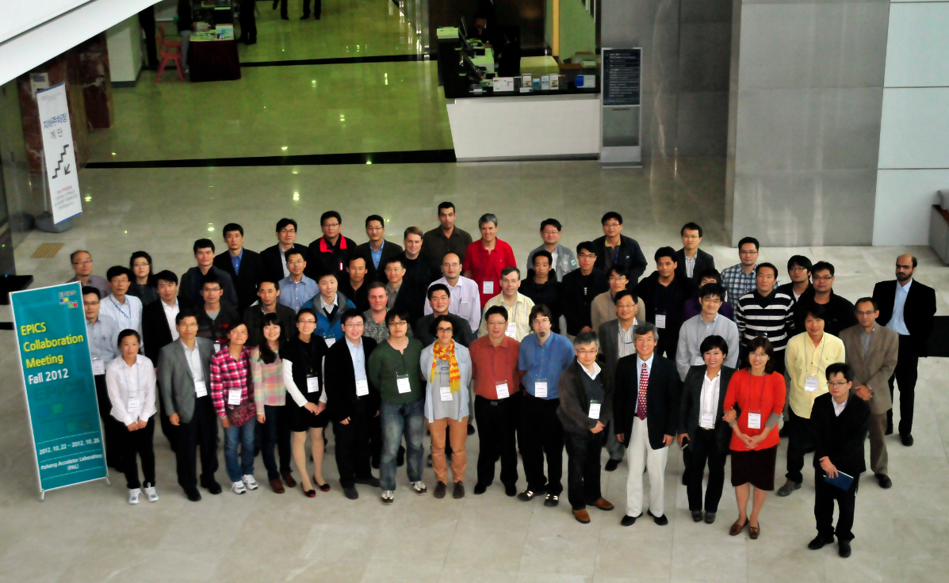
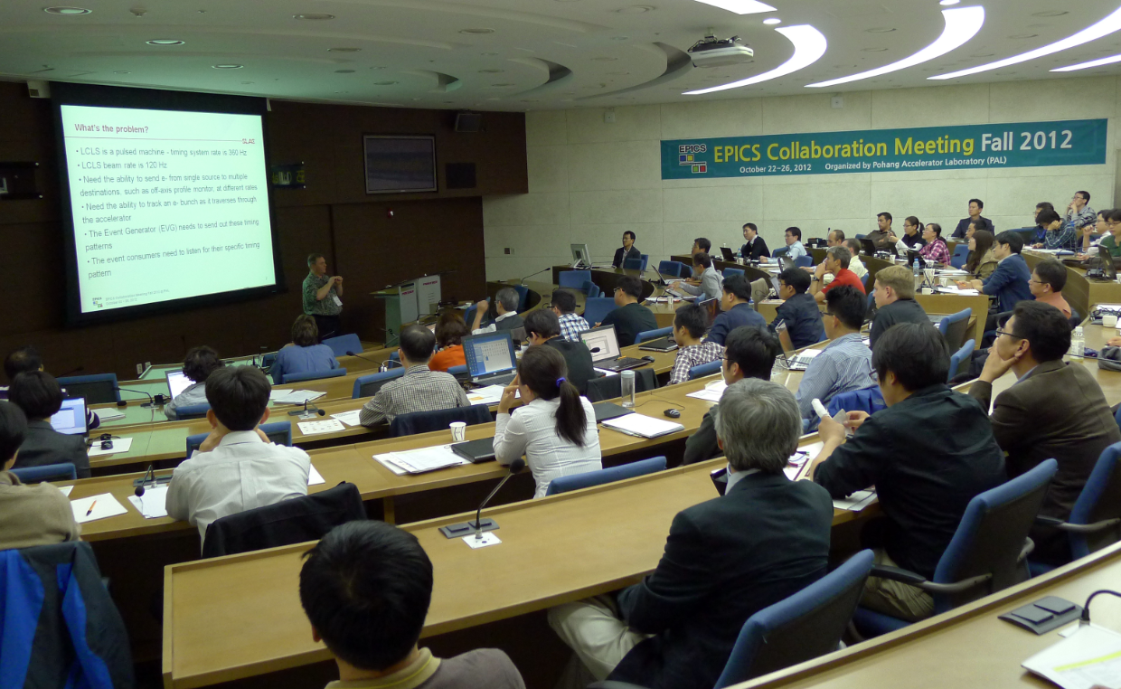
Venue
POSCO International Center in POSTECH, Pohang, Korea
The same place as the 2012 EPICS Collaboration Meeting

Slide 5
Scientific Program
Status Reports
EPICS Core & Applications
Low Level Controls
High Level Applications
Experimental Controls & Data Acquisition
Services
Miscellaneous

Slide 6
Training (Under Consideration)
EPICS 7 (Base + PVA)
Archive Appliance
Phoebus
BlueSky
Motion Control
areaDetector

Slide 7
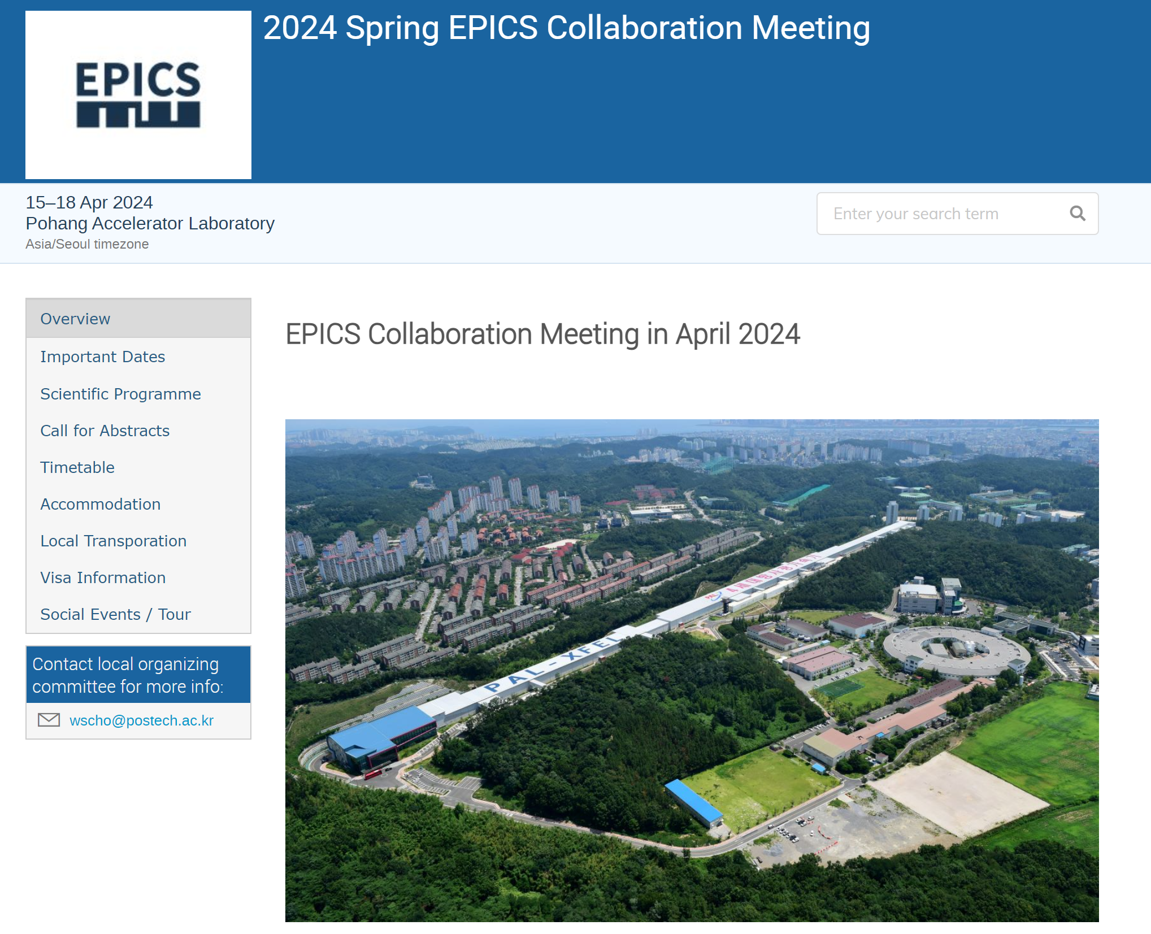
Homepage
https://www.indico.kr/event/51/
Under Construction

Slide 8
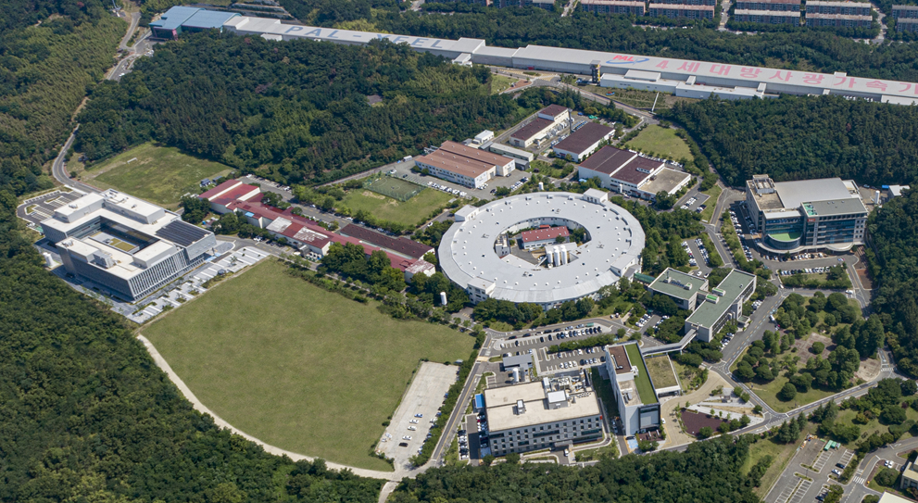
PLS-II 가속장치
See you in Korea!

