Slide 1
EPICS Collaboration Meeting Welcome
October 8, 2023

Slide 2
Welcome to Cape Town

Slide 3
Thanks
To ICALEPCS for providing meeting space, coffee, tea and food
iThemba labs for serving as local meeting host – Justin Abraham
Session chairs and speakers
This is a shorter meeting with opportunities for sharing developments and collaborating

Slide 4
We are collaborating more in person again
After a break from in person meetings due to COVID, it is fantastic to see people attending EPICS meetings in person again
Collaboration meetings
Cosylab in Ljubljana September 2022 – hybrid, first meeting with in-person participation since the pandemic began - ~100 participants
Fermilab April 2023, hybrid but more in person - 182 participants
Cape Town with ICALEPCS 2023 – in person ~?? Participants ??
Code-a-thons
Diamond Light Source – March 2023 – 32 participants
SLAC – May 2022 – 53 participants

Slide 5
We are collaborating more in person again
Other meetings
European Spallation Source – Code and Document-a-thon 8/28 – 9/1/23 - 21 participants
Diamond Light Source – Code-a-thon 3/7-10/2023 – 32 participants
Stanford Linear Accelerator – Code-a-thon 5/19-13/2022 – 53 participants

Slide 6
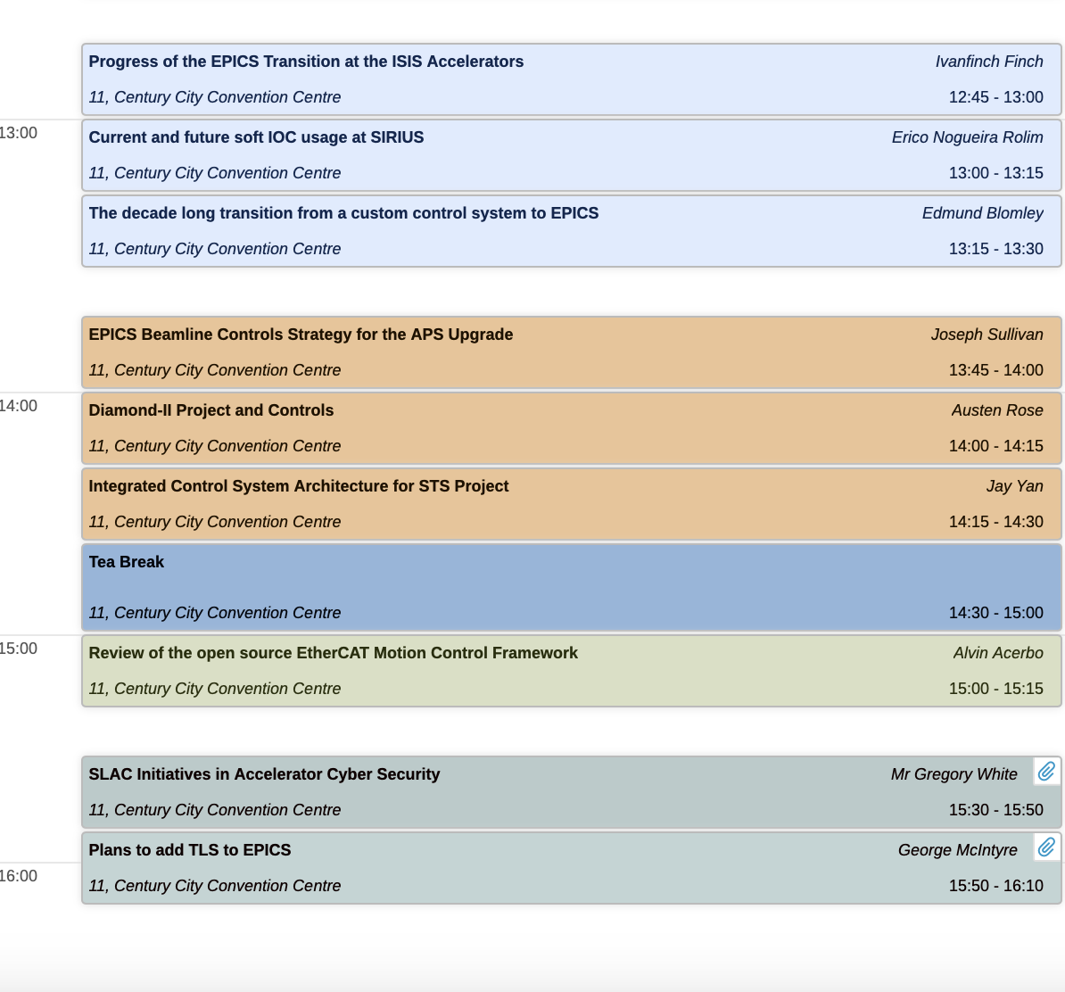
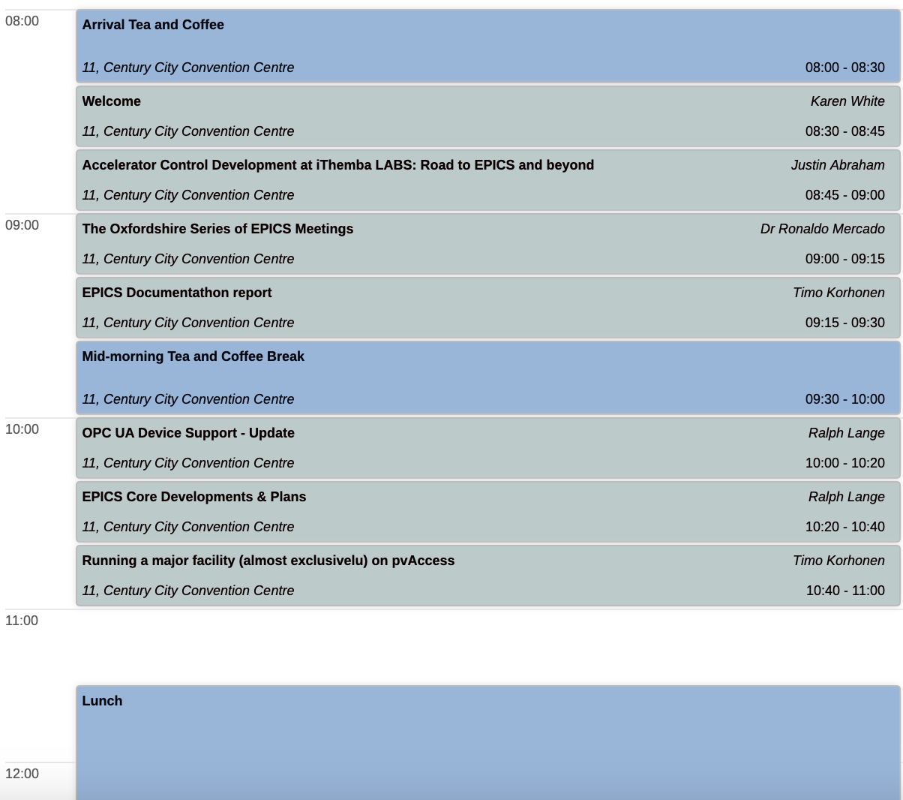
Agenda

Slide 7
Some highlights from EPICS Collaboration Meeting at FNAL
FNAL will use EPICS for PIP-II, considering options for legacy system upgrades funded by the ACORN project
BNL will use EPICS for the EIC, some hybrid for legacy RHIC system
Very successful meeting, largest in person EPICS meeting post COVID
Emerging themes (topics we have not discussed too much before)
ML/AI, ipv6, cyber security
Upgrades due hardware/software obsolescence, performance
VME, VxWorks
Eclipse -> Phoebus
Legacy systems look to EPICS for modernization

Slide 8
EPICS continues to grow
ICALEPCS 2023 abstract submission reflects the widespread impact of EPICS on accelerator and experiment controls
111 (of 413) abstracts mention EPICS in the title
Word Cloud of ICALEPCS abstracts, thanks Gary Croke

Slide 9
And now a word from our sponsor

Slide 10
How do we pay for EPICS?
There is no sponsor to support EPICS
EPICS is open source but not free, but also not funded
The EPICS Collaboration does not receive any specific funding to maintain and improve the software, but this work is essential to ensure future viability (one exception, discussed later in this meeting)
The collaboration relies on donated labor from a small percentage of organizations using EPICS software
The collaboration provides an incredible community of support (free)

Slide 11
You and your organization can should help
If your organization benefits from EPICS, consider how you can help
New projects are well positioned to fund new capabilities but not for support and maintenance
Tell your boss EPICS needs your organization to donate time/money to help with maintenance, testing, support, development or documentation
You can donate labor or fund a contract developer

Slide 12
How can you get involved?
Opportunities to join working groups such as EPICS core, CS-Studio,
Send someone to a code-a-thon or document-a-thon
Talks today may mention opportunities to contribute:
You can work with international experts => develop more advanced skills that benefit your professional development and your effectiveness for your home organization
“Win-win-win: Good for you, good for your lab, good for EPICS”
– Ralph Lange

Slide 13
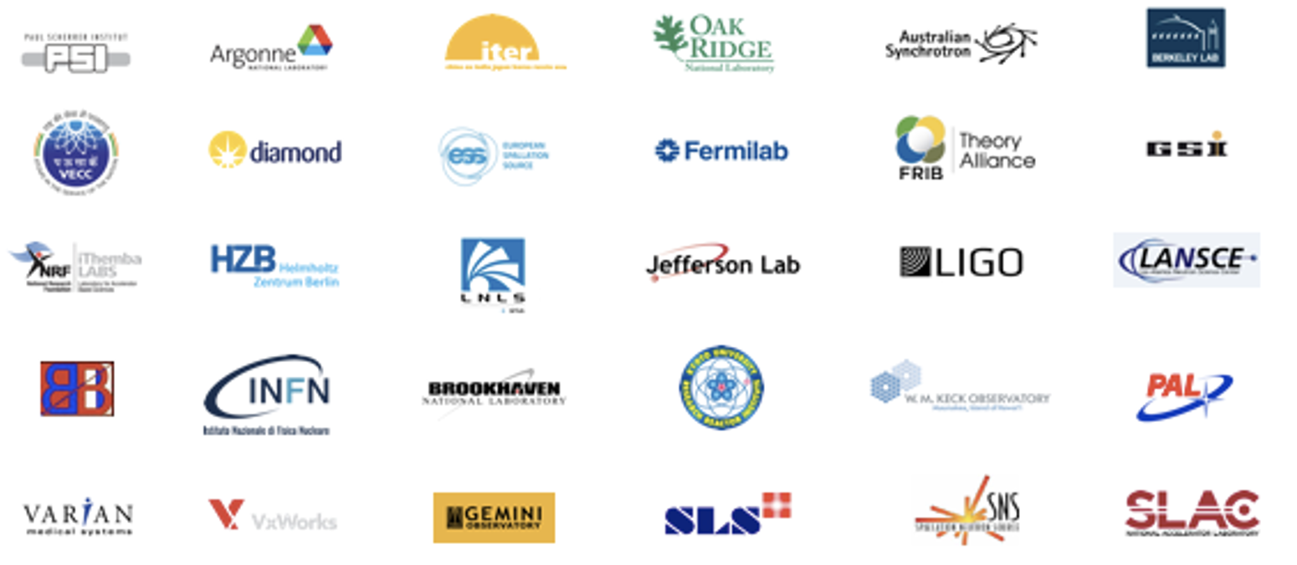
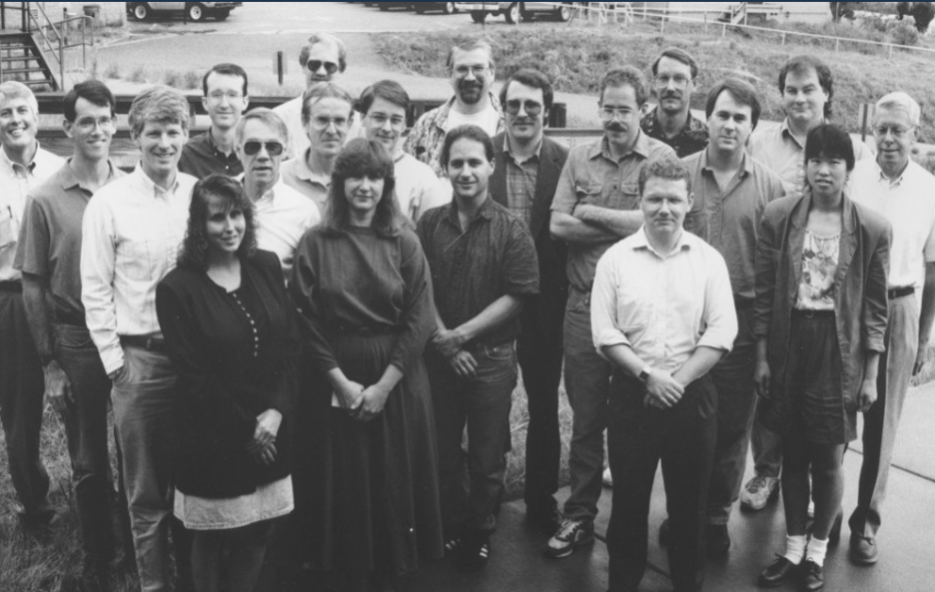
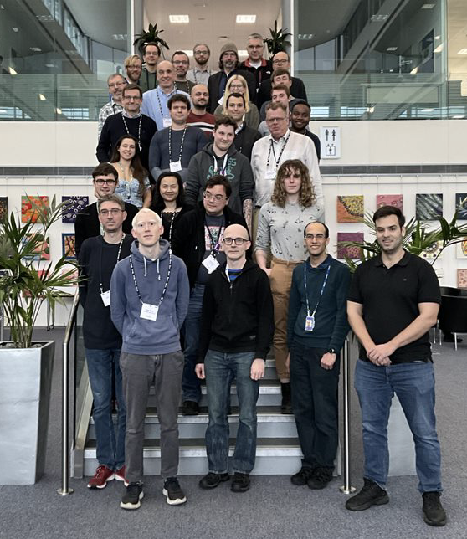
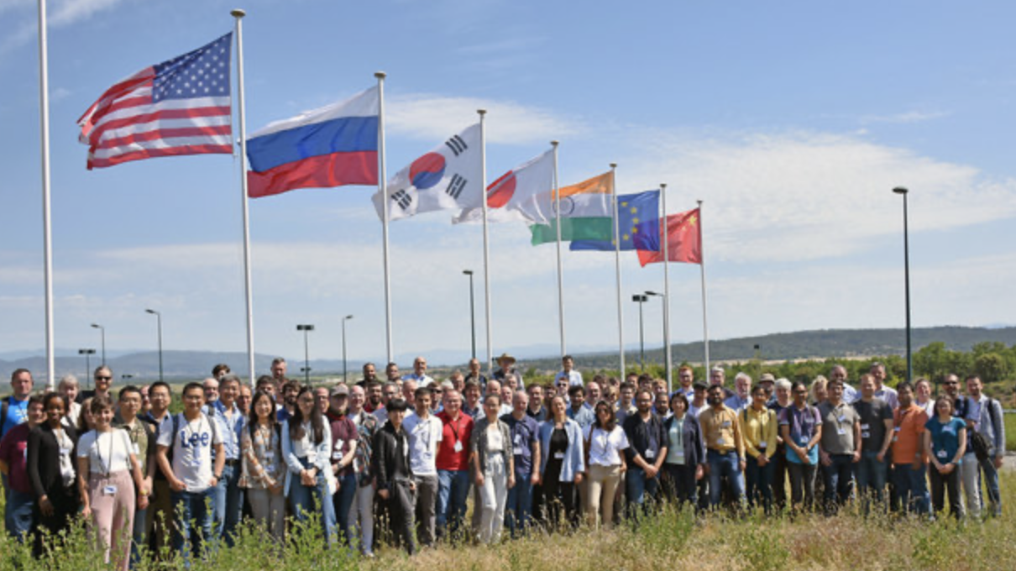
VOLUNTEERS

Slide 14
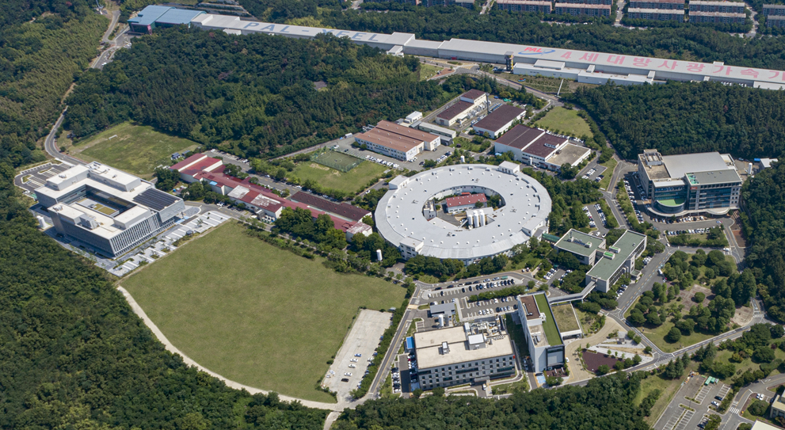
Next EPICS Collaboration Meeting April XX, 2024 Hosted by
Next EPICS Collaboration Meeting will be hosted by POSTECH, Pohang, South Korea
April 15-18, 2024

