Slide 1
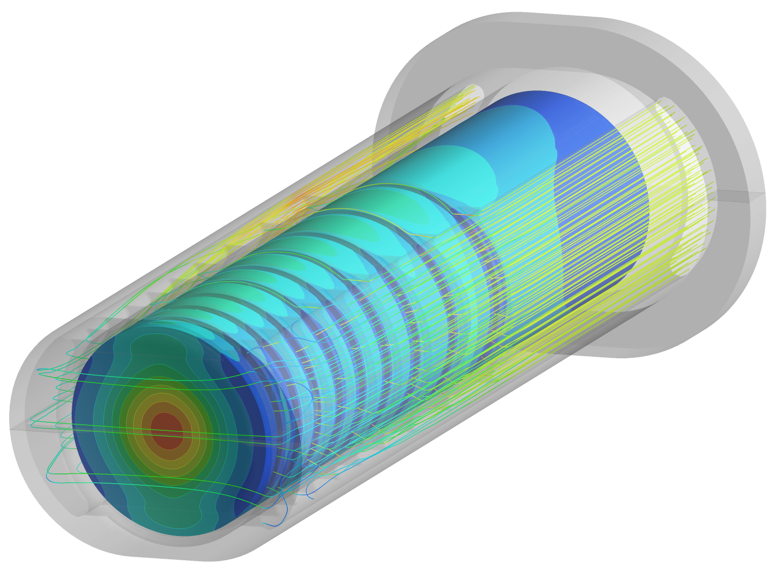
ISIS Target Modelling
Dan Wilcox
(STFC Rutherford Appleton Laboratory)
SNS Target Simulation Workshop 6th April 2021

Slide 2
Acknowledgements
High Power Targets Group:
Chris Densham, Tristan Davenne, Mike Fitton, Peter Loveridge, Nathan O’Donoghue, Mike Parkin
ISIS Target Design Group:
Dan Blanco-Lopez, Dan Coates, Stephen Gallimore, David Jenkins, Leslie Jones
ISIS Neutronics Group:
Steven Lilley, Lina Quintieri, Goran Skoro
ISIS Target Manufacturing:
Jeremy Moor, Maxwell Rowland, Peter Webb

Slide 3
Outline
Overview of ISIS Facility
Recent Simulation Projects
Improving lifetime of TS2 target
TS1 target redesign
Simulation Challenges
Irradiated material properties
Pre-stress analysis
Decay heat and LOCA conditions
Validation
Summary

Slide 4
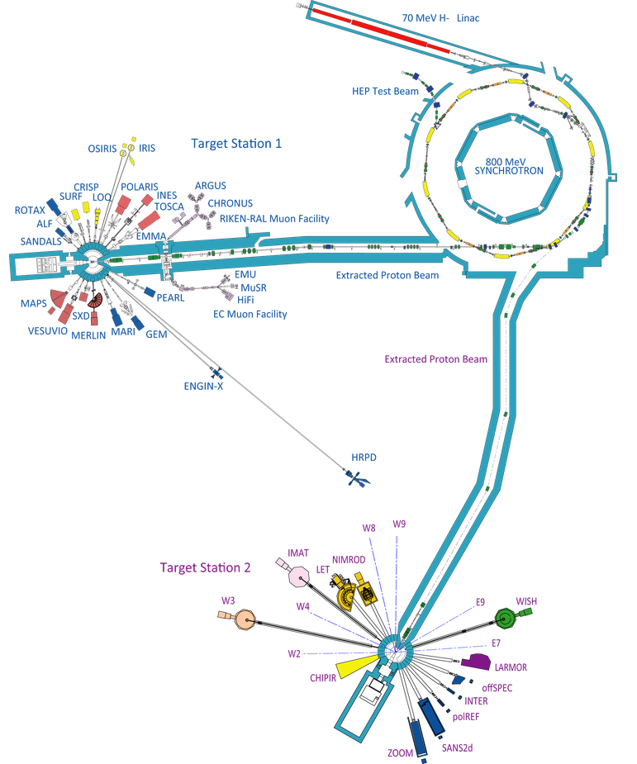
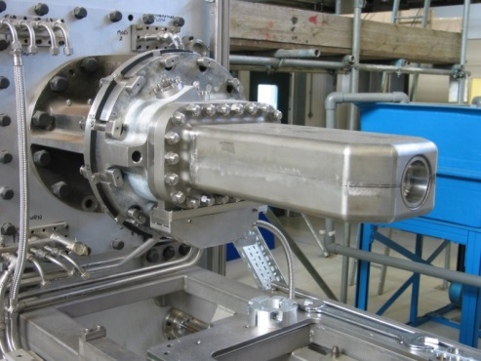
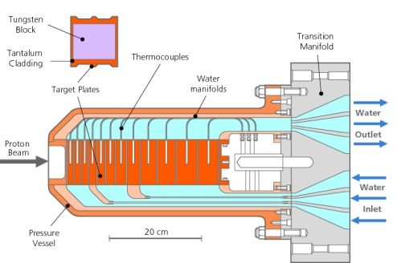
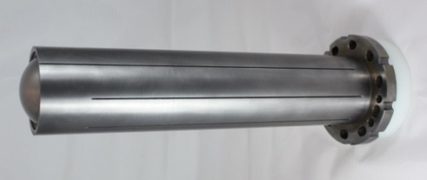
ISIS Facility Overview
Synchrotron
192kW, pulsed at 50Hz
Target Station 1
Receives 4/5 beam pulses (160kW)
Ta-clad W target, 12 plates
Proven reliability over many years
New design of target, moderator and reflector to be installed 2021-2022
Target Station 2
Receives 1/5 beam pulses (32kW)
Ta-clad W target, solid rod
High neutronic efficiency, short target lifetimes
ISIS-II construction starting in 2030s?

Slide 5
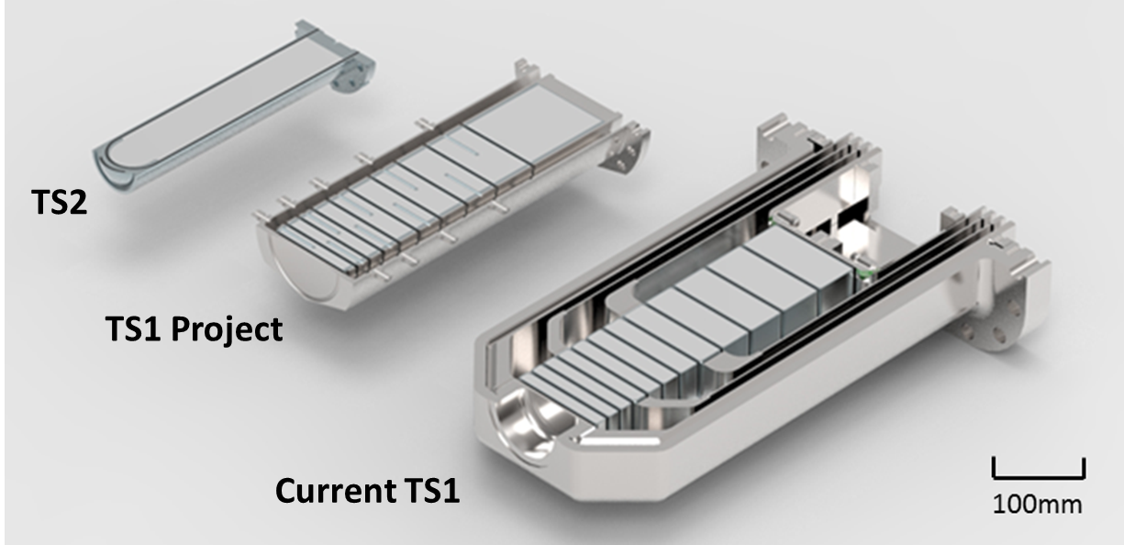
ISIS Target Simulation Goals
Develop an improved target for TS1
Done, awaiting installation
Improve lifetime of TS2 targets
Making progress, more to do
Design new targets for a future ISIS-II
Not yet started, but will build on previous research
Common ground: understanding target conditions, predicting effects of off-normal conditions
Challenges: pre-stress, radiation damage, fatigue, decay heat prediction…

Slide 6
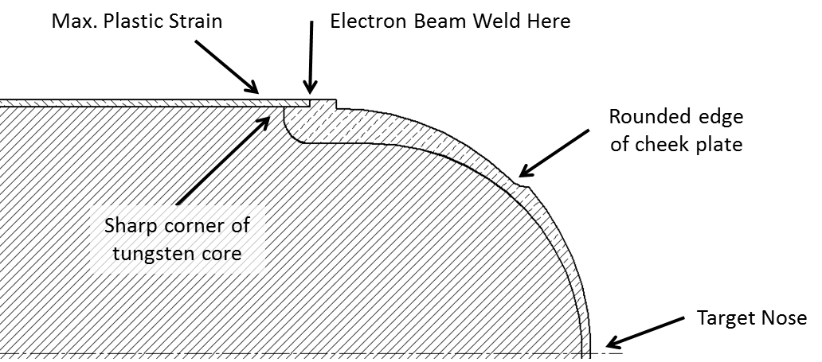
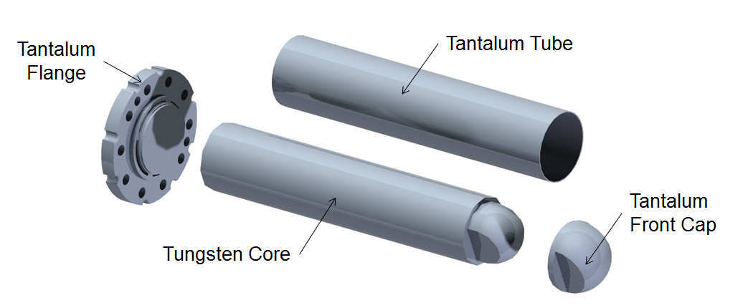
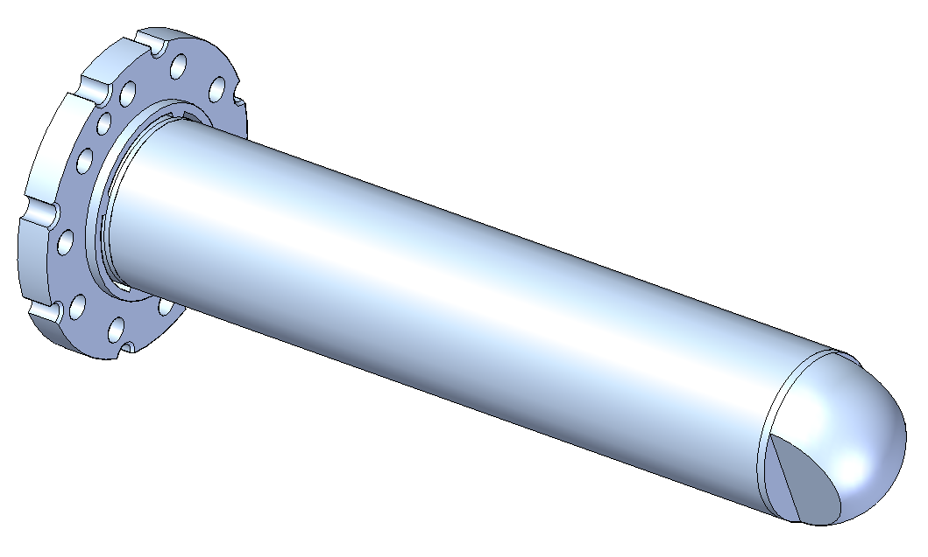
TS2 Target Lifetime Improvement
TS2 targets should last 5 years, but typically fail after ~1.5 years
Cause of failure is activation of the water circuit, preventing hand-on maintenance of pumps and filters. Isotope analysis indicates tungsten.
Our original simulations did not find any reason why this should be the case
Possible causes:
Residual manufacturing stress
Radiation damage + fatigue
Water hammer due to beam heating
Weld failure / intergranular corrosion
Contamination in water circuit

Slide 7
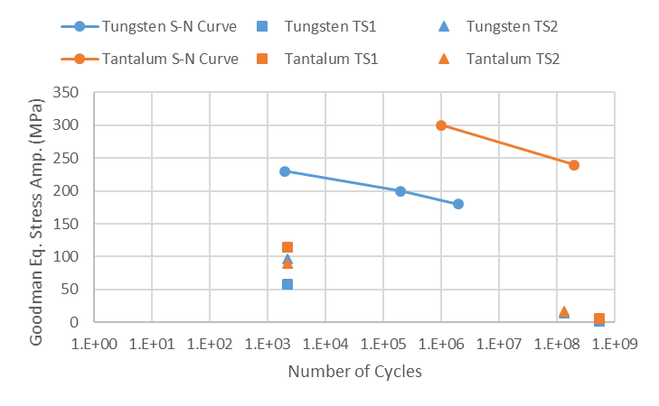
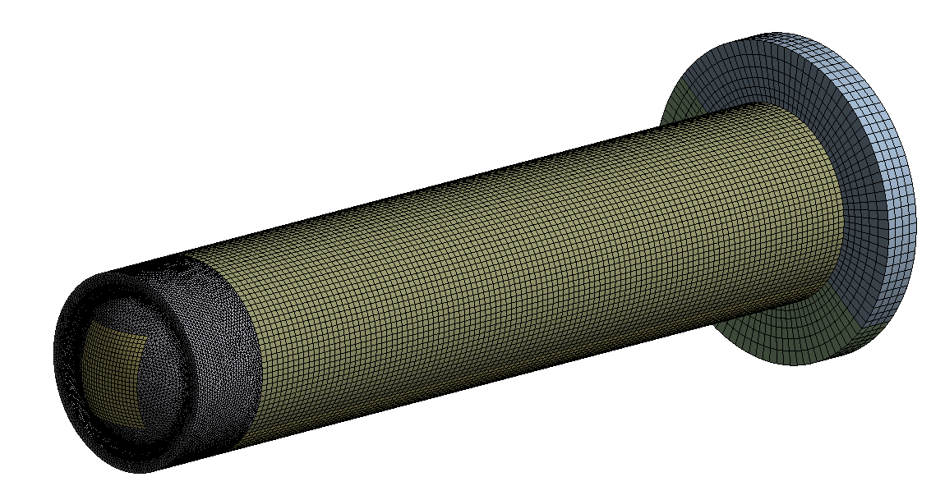
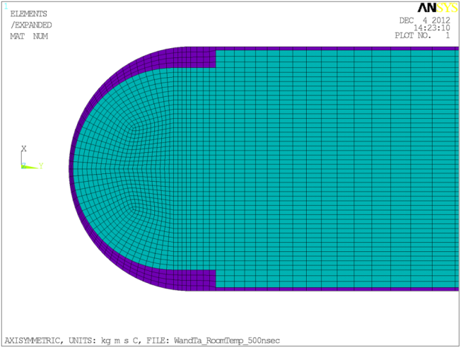
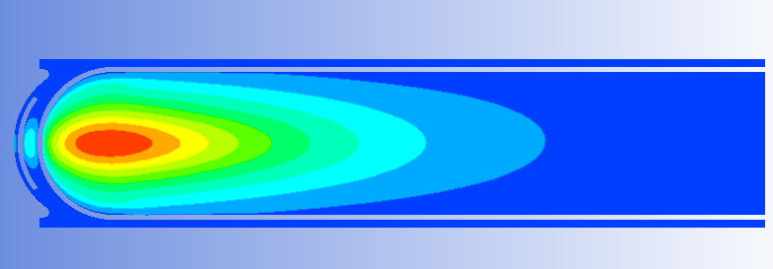
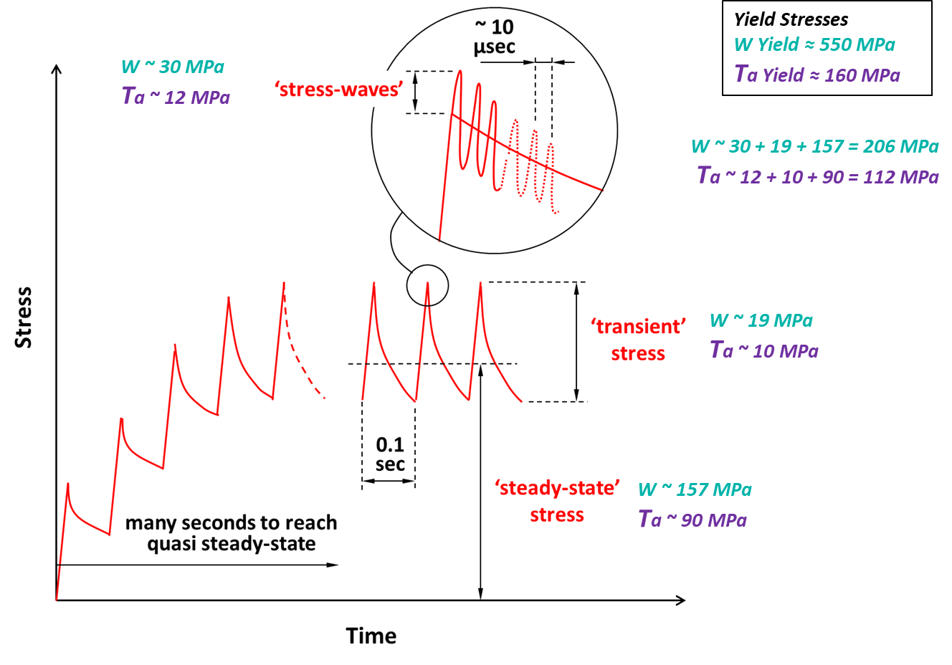
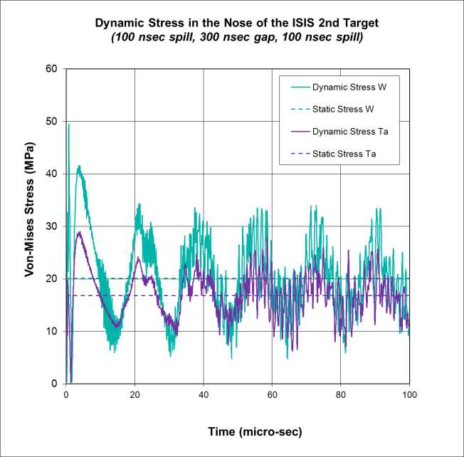
TS2 Target Simulations
3D fluid, thermal and structural simulations in ANSYS, including fatigue
2D approximation for stress waves

Slide 8
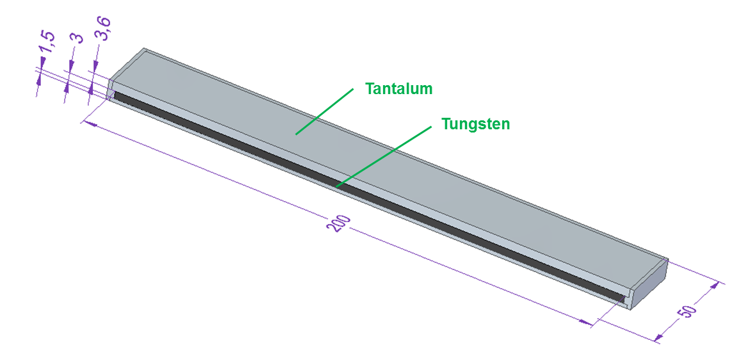
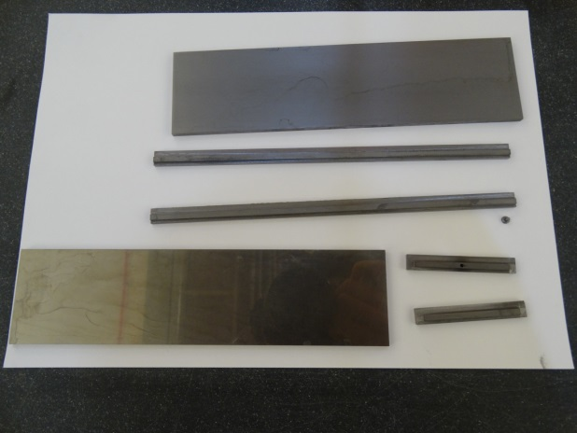
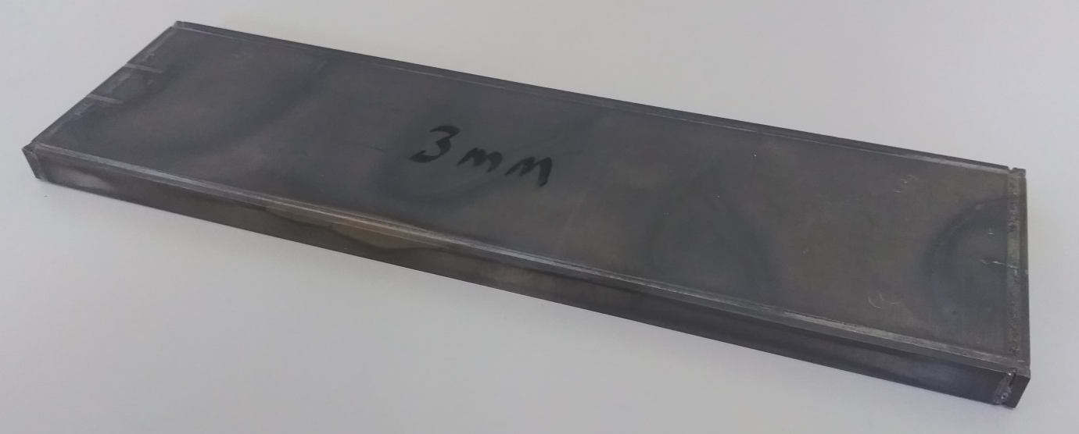
Residual Manufacturing Stress
TS1 and TS2 targets both use Hot Isostatic Pressing (HIPing) to attach the tantalum cladding to the tungsten core
Strong diffusion bond, good thermal contact, but potentially causes large residual stresses
An “asymmetrically-clad strip” experiment was designed to measure this
Same manufacture as ISIS targets, but with thicker cladding on one side
Photos courtesy of Jeremy Moor

Slide 9
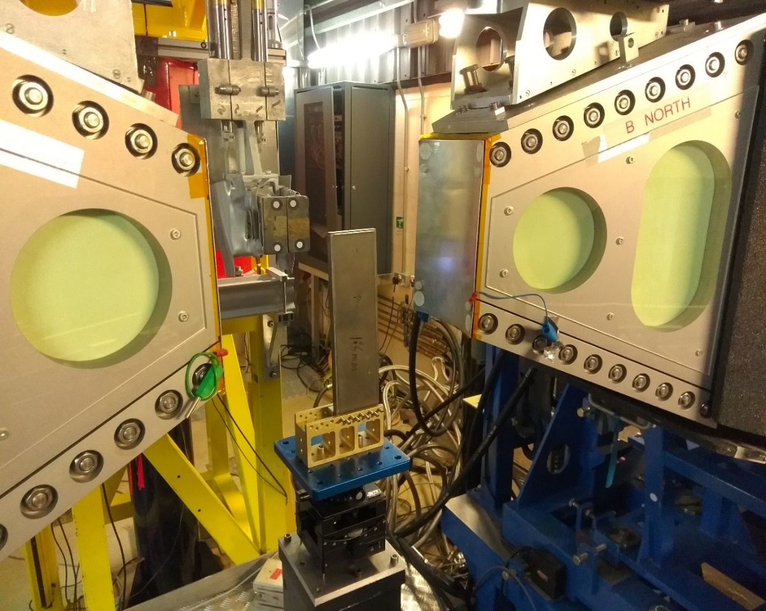
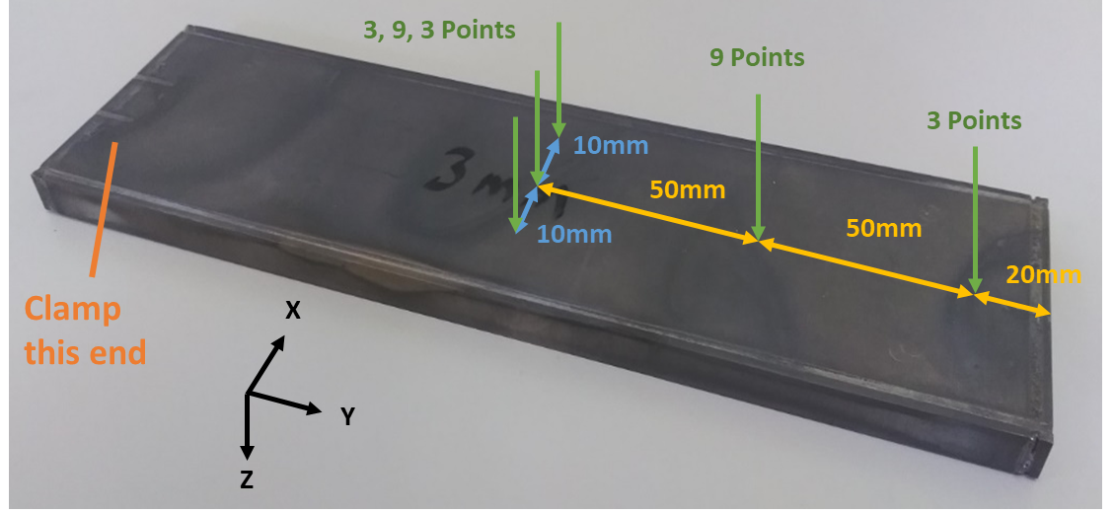
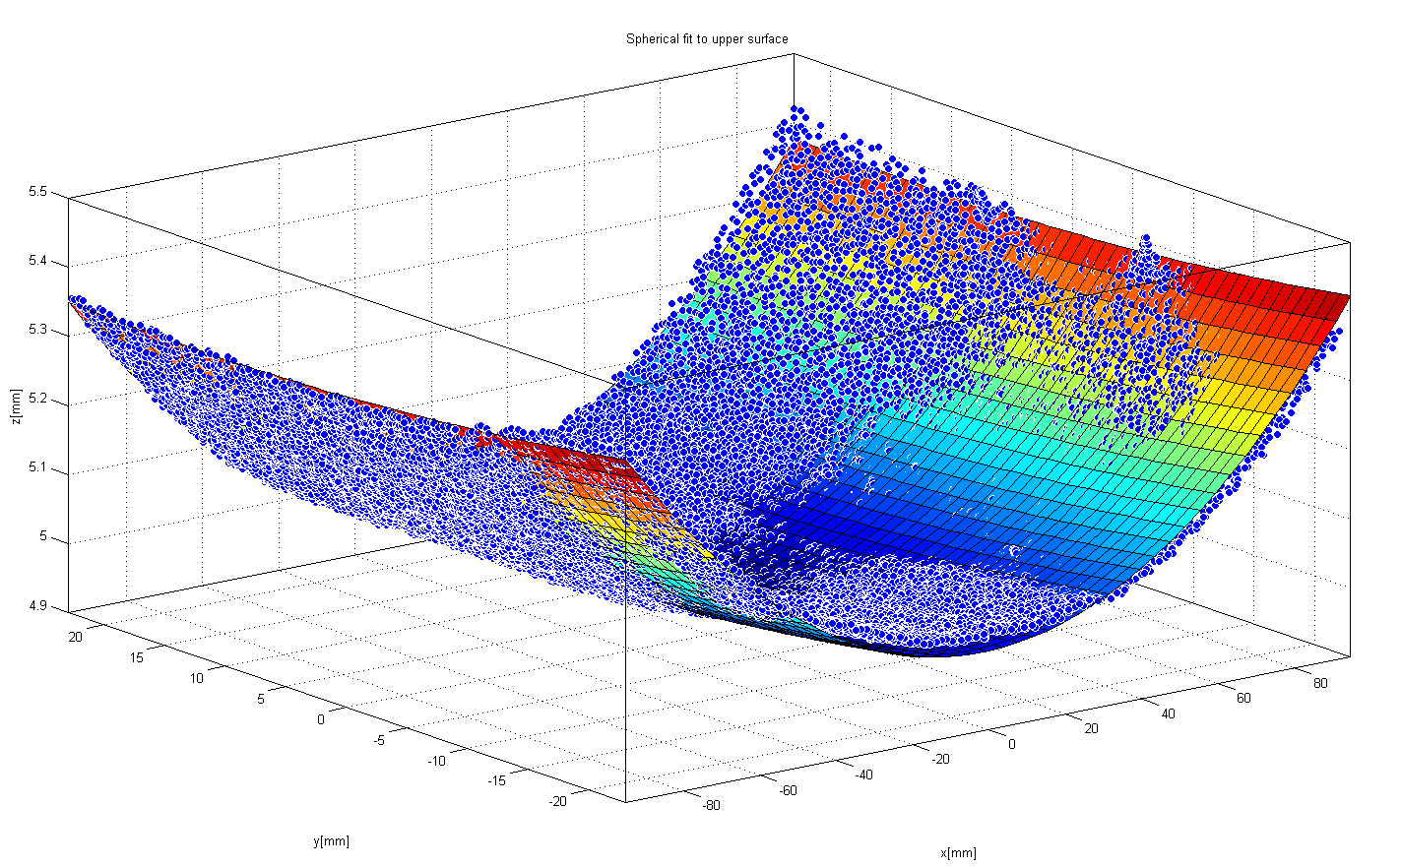
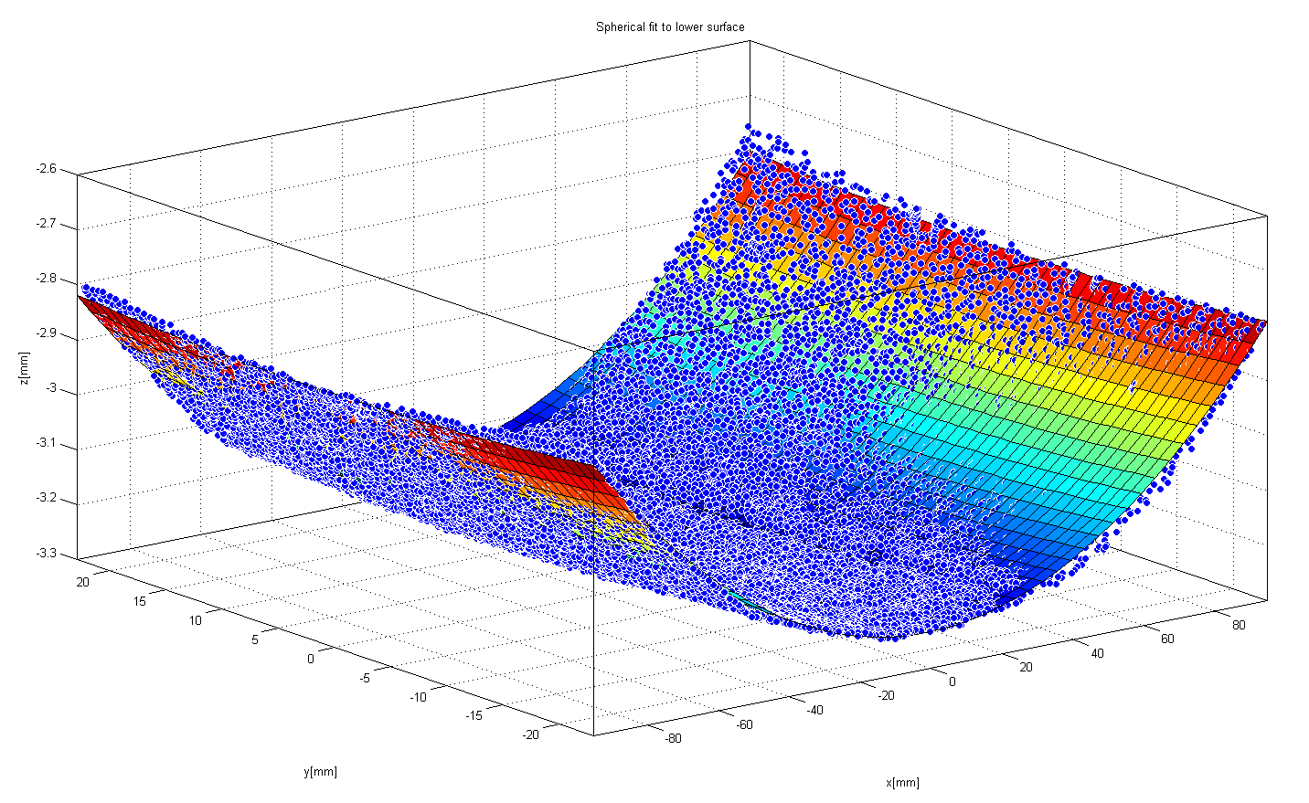
Asymmetrically-Clad Strip Experiment
Deflected surfaces measured by CMM; agreed well with simplified simulations
Neutron diffraction on ISIS ENGIN-X confirmed large residual strains
Some unexplained features, perhaps impurity pickup or microstructure changes during HIP
Conclusion: significant residual stress is present, as predicted by simulation
This causes plastic deformation of the tantalum, but is not expected to cause target failure
Latest information suggests pre-stress could be annealed by ~1dpa radiation
Spherical fits to CMM measurement of deflected surfaces
Upper
Lower
Diffraction measurement locations
Sample on ENGIN-X

Slide 10
Radiation Damage
Tantalum: high ductility can be retained after 11dpa, however there is a lot of scatter in the (limited) available data
Tantalum impurities and gas production in the irradiation environment may explain this
Currently not included in analysis. Target expected to survive as long as some ductility remains.
Tungsten: significant new information available from ESS (Habainy et al.)
At 1.3dpa tungsten UTS falls from 560 to 300MPa
Tungsten thermal conductivity drops rapidly from 175 to 88W/m.K at 2dpa, then appears to saturate at higher doses
Tungsten elastic modulus increases from 398 to 477GPa after irradiation to ~2dpa
For TS2, IFN estimates 15dpa/yr, SNS estimates 14dpa/5000hr

Slide 11
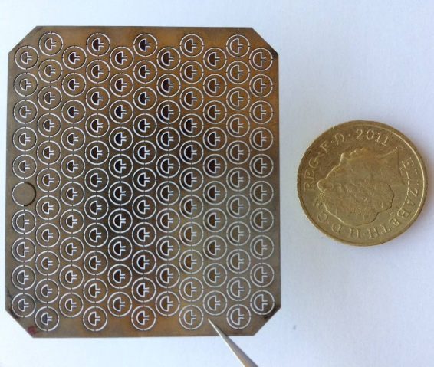
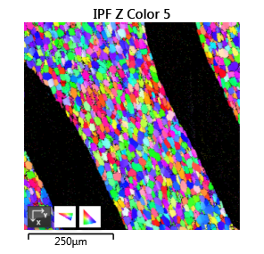
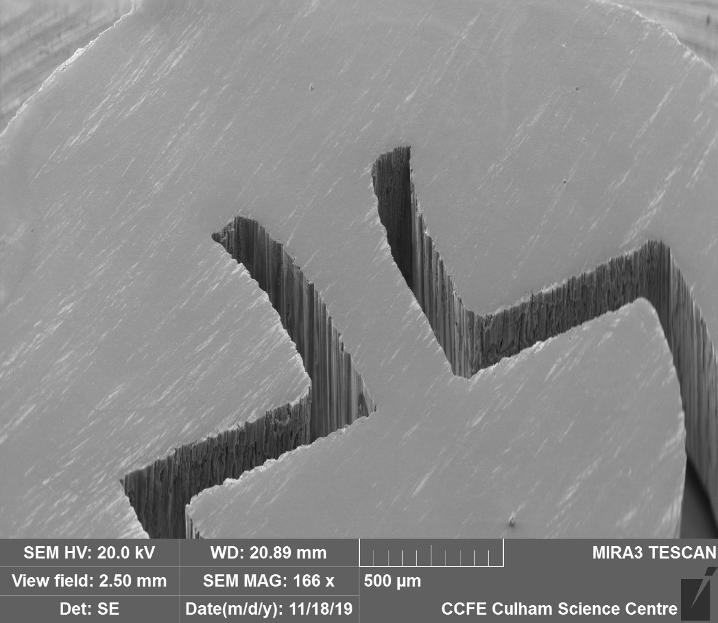
Radiation Damage
Opportunities for meso-fatigue testing of irradiated tungsten/tantalum
Dia. 3.4mm, thickness 100-150um
Irradiation at BLIP (Brookhaven), University of Birmingham’s cyclotron, etc.
Fatigue testing at Culham MRF. 20kHz test = 1E9 cycles in 14 hours
Already in use for T2K neutrino targets: titanium samples were irradiated as part of the RaDIATE collaboration and will be shipped from BLIP to MRF soon
Pictures courtesy of Phil Earp, Dr Jicheng Gong, Prof. Angus Wulkinson, Dr Slava Kuksenko

Slide 12
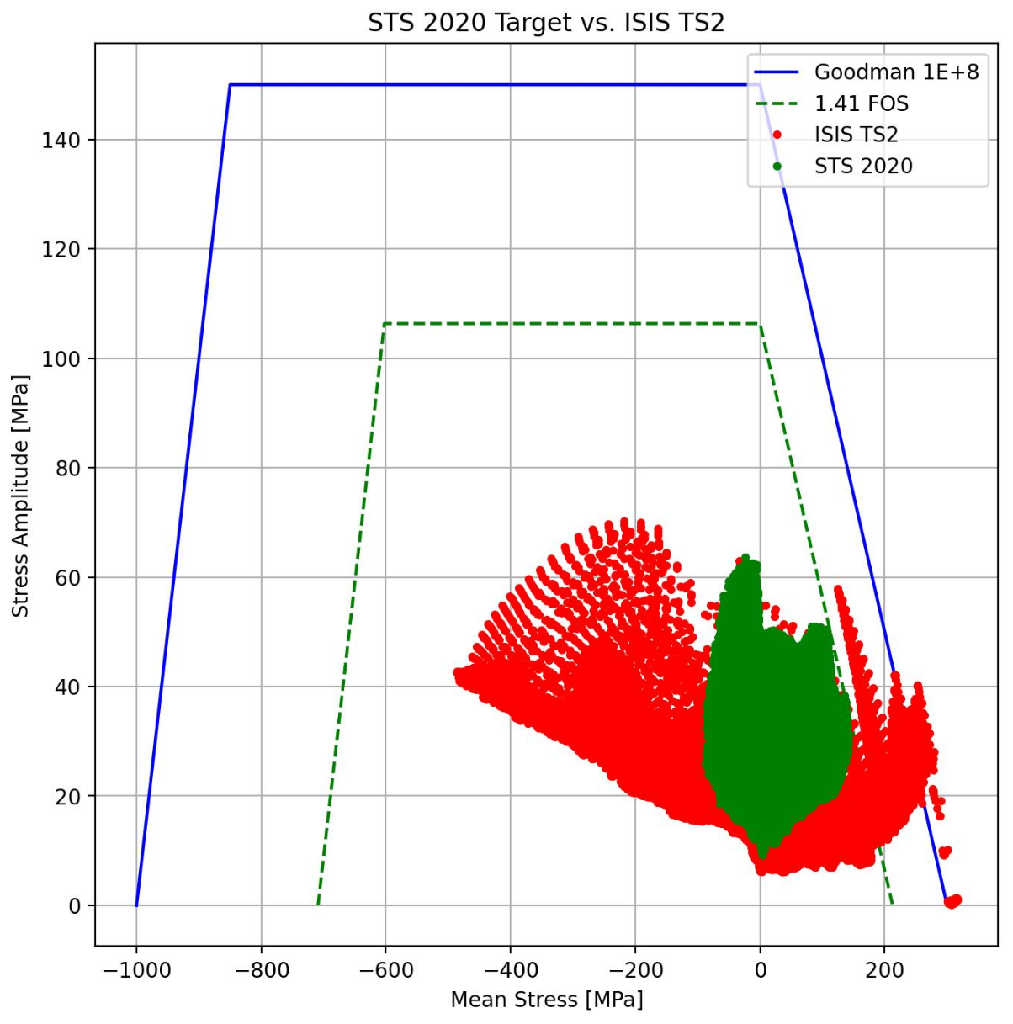
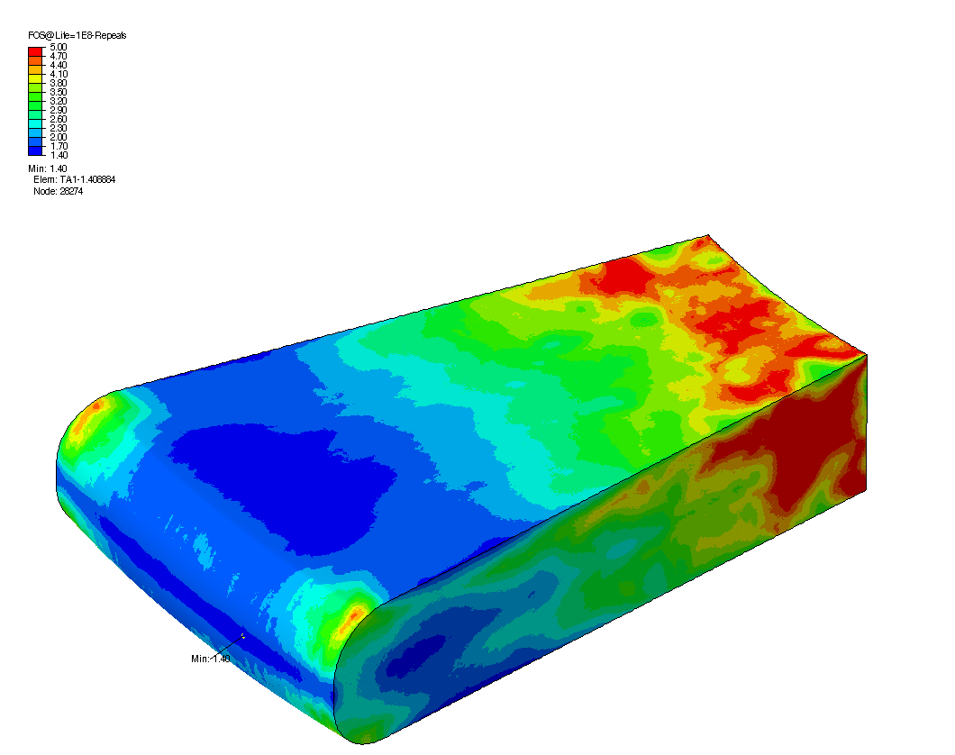
Fatigue + Irradiation
3D stress wave and fatigue analysis from SNS, using the latest irradiated tungsten properties from ESS
Many thanks to Tom McManamy, Aron Jacques, Joseph Tipton Jr, Peter Rosenblad, et al.
Cracking of tungsten predicted once the target exceeds ~2dpa (~50 days operating)
Targets last ~1.5 years. Is the difference due to the time taken to propagate a crack through the tantalum?
SNS STS Target Segment
ISIS TS2 Target
Figure courtesy of SNS

Slide 13
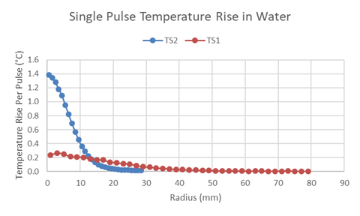
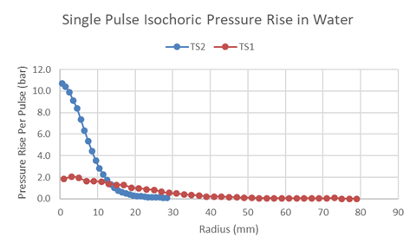
Water Hammer
Short beam pulse produces an almost instantaneous pressure rise in the water
Much more severe on TS2 than TS1, due to the small beam spot
Should be included in future dynamic simulations

Slide 14
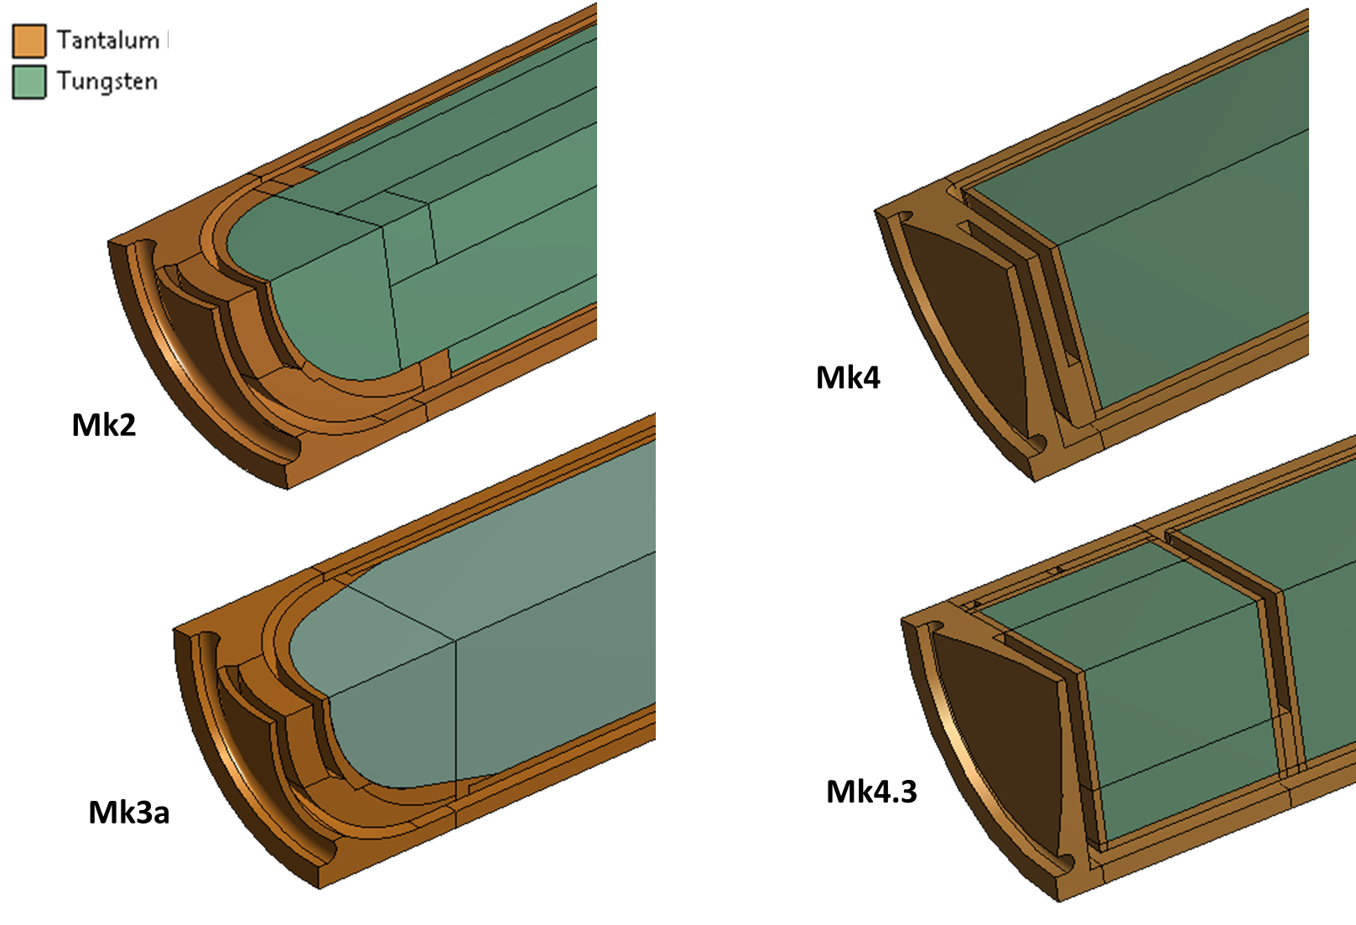
TS2 Target Development
Mk2: Currently installed. Weld penetration improved since early Mk2s
Mk3: Tapered core removes stress conc. and improves welding. To be installed next.
Mk4: Flat fronted target reduces weld stress. Currently under review for future use.
 | TS1 |  | TS2
 | Current | Project Mk8 | Mk2 | Mk3a | Mk4 | Mk4.3
Peak Von Mises stress at weld (MPa) | 53 | 38 | 73 | 72 | 43 | 37
Peak stress normal to weld plane (MPa) | 16 | 4.4 | 78 | 75 | 0.2 | 14

Slide 15
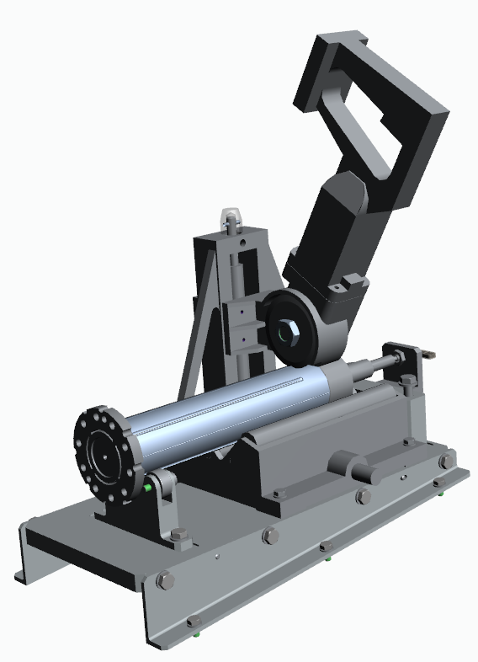
Conclusions on TS2 Target Lifetime
Initial failure thought to be due to incomplete weld penetration
Contaminated water circuit may have sped up subsequent failures
Redesigned versions will reduce weld stress
The next failure mode may be cracking of the tungsten core due to a combination of radiation damage and stress-wave induced fatigue
Future analysis will include this failure mode in more detail
PIE planned which will hopefully confirm the failure location on spent targets
TS2 PIE Rig: Picture courtesy of Leslie Jones

Slide 16
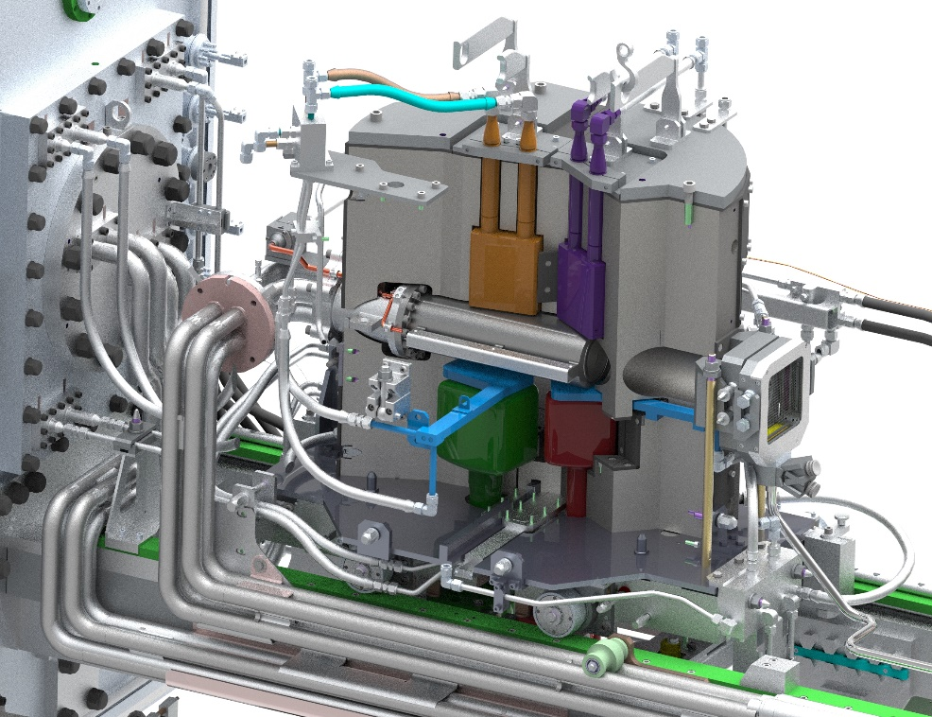
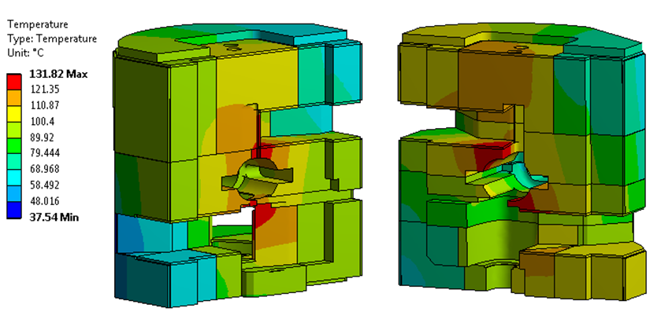
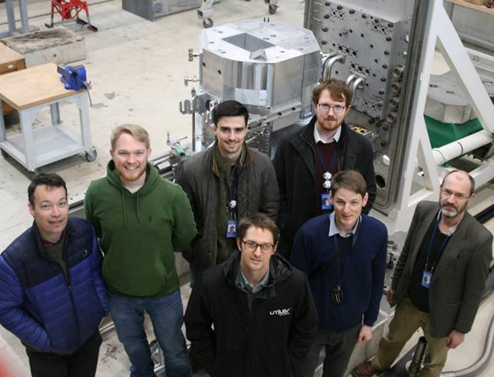
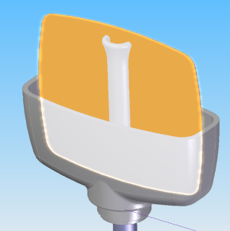
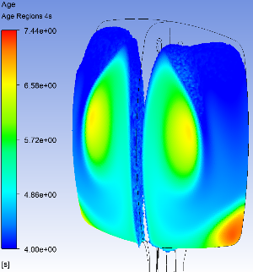
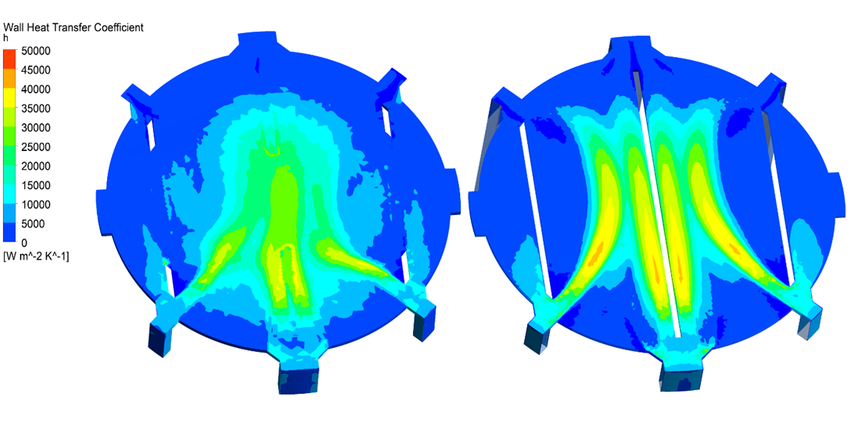
Analysis for ISIS TS1 Project
Target Redesign
Reflector Analysis
Moderator Development
Beam Window Design Assurance

Slide 17
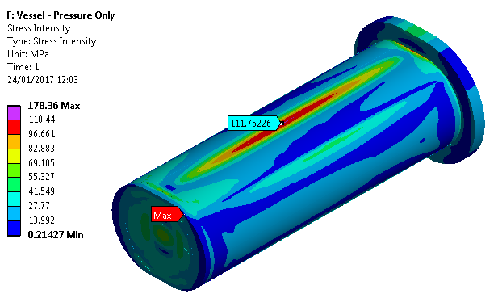
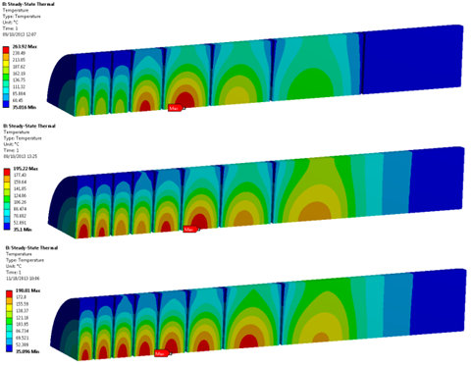
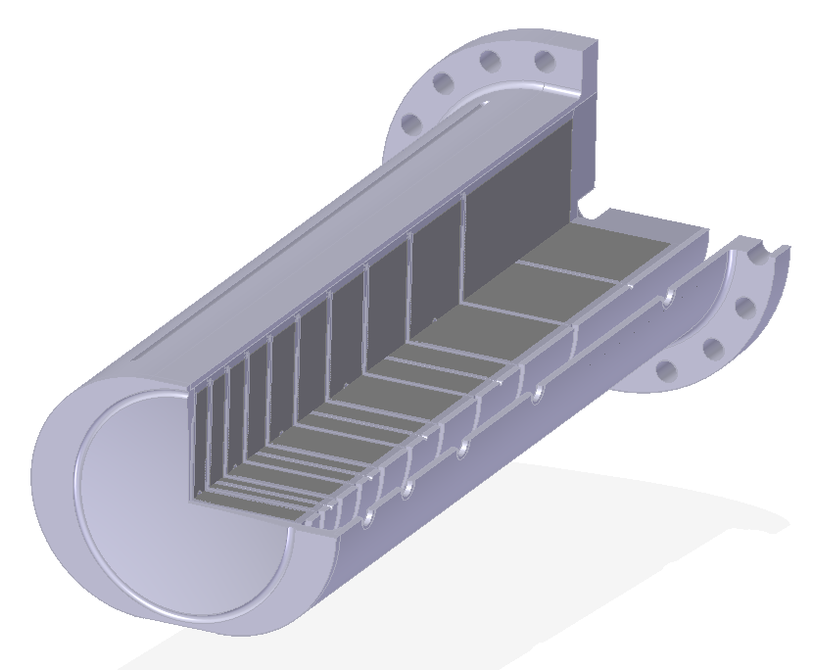
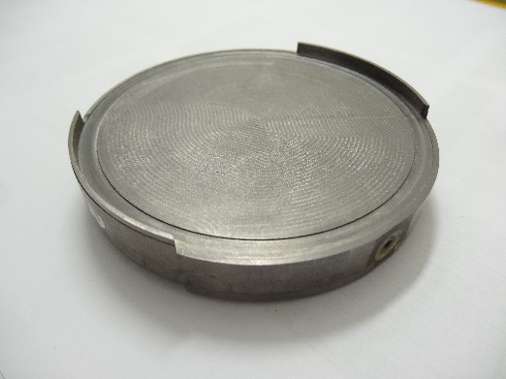
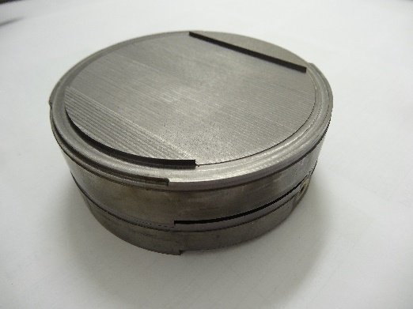
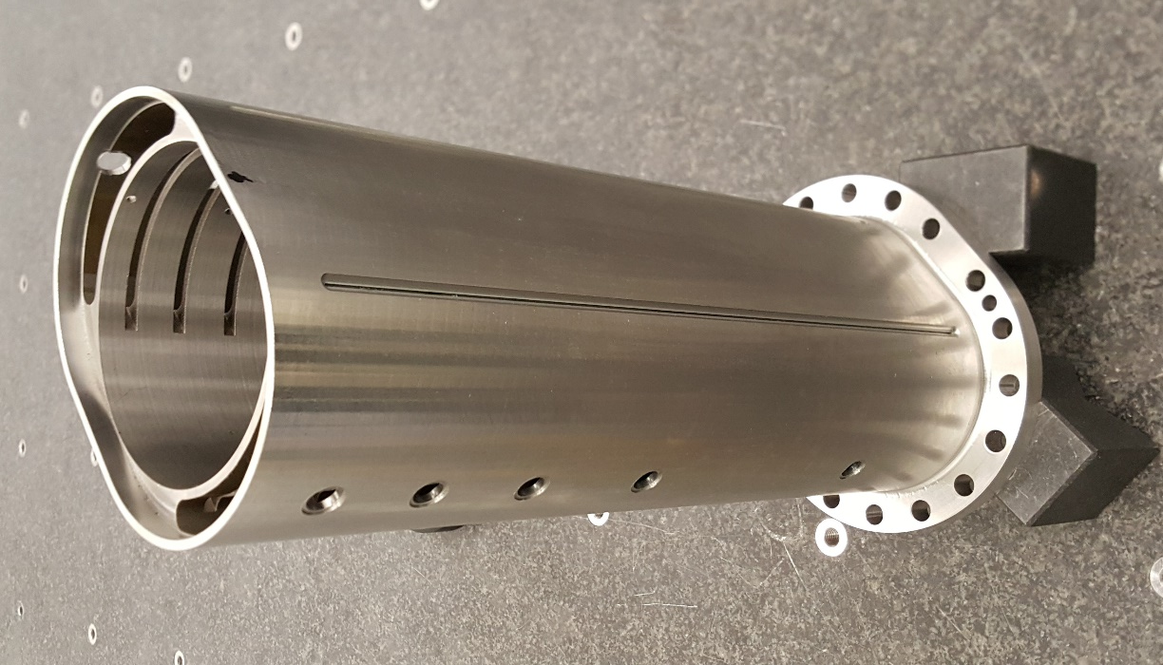
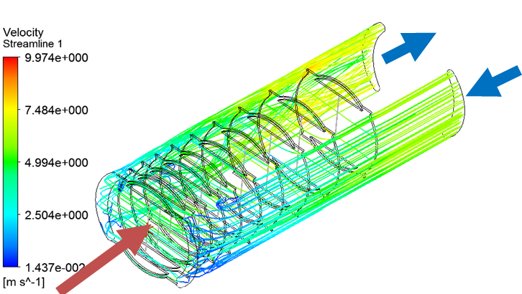
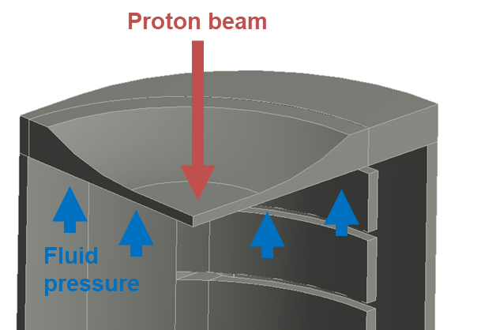
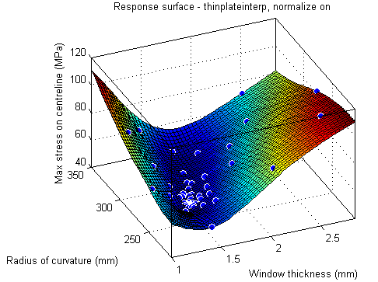
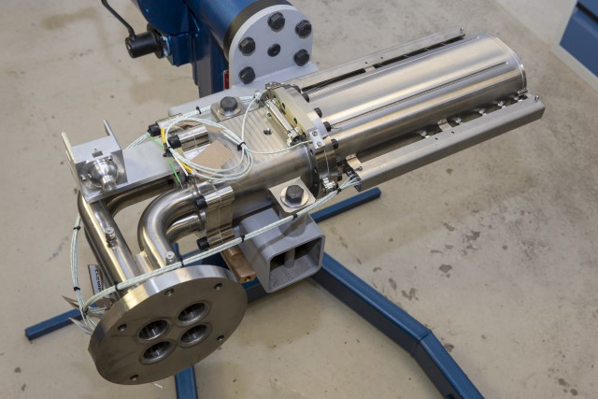
TS1 Project Target Optimisation
Pressure vessel design assurance to PD5500
Minimising number of plates
Design for manufacture
Beam window optimisation
Fluid flow in parallel channels
Photos courtesy of Leslie Jones and Jeremy Moor

Slide 18
Accident Case Simulations
For TS1 Project target, look at possible off-normal proton beam conditions
No case expected to cause a target failure
Max over-focus case is the largest cause for concern; but should be detected by target thermocouples
Parameter | Design Limit | Current TS1 | Standard (MCNPX Mk8) | Slight Overfocus (12.7mm) | Max Overfocus (7.5mm) | High beam current (250uA) | Off axis horizontal (5mm) | Off axis vertical (5mm) | Off axis diagonal (5mm, 5mm) | Hydrogen bubble
Core Temperature (°C) | N/A | 184 | 176 | 259 | 454 | 213 | 185 | 183 | 195 | 176
Surface Temperature (°C) | 100 | 35 | 85 | 82 | 79 | 97 | 90 | 109 | 125 | 89
Heat Flux (MW/m^2) | 3 | 2 | 1.9 | 3.1 | 5.8 | 2.4 | 2.0 | 1.9 | 2.1 | 1.9
Tungsten Stress (MPa) | 275 | 89 | 86 | 169 | 362 | 110 | 85 | 94 | 96 | 86
Tantalum Stress (MPa) | 116 | 116 | 101 | 165 | 209 | 123 | 103 | 102 | 106 | 101
PD5500 Safety Factor | 1 | ? | 2 | 2 | 1.2 | 2 | 2 | 1.9 | 1.8 | 2
Key
Within limit
<50% over limit
>50% over limit
Target failure risk

Slide 19
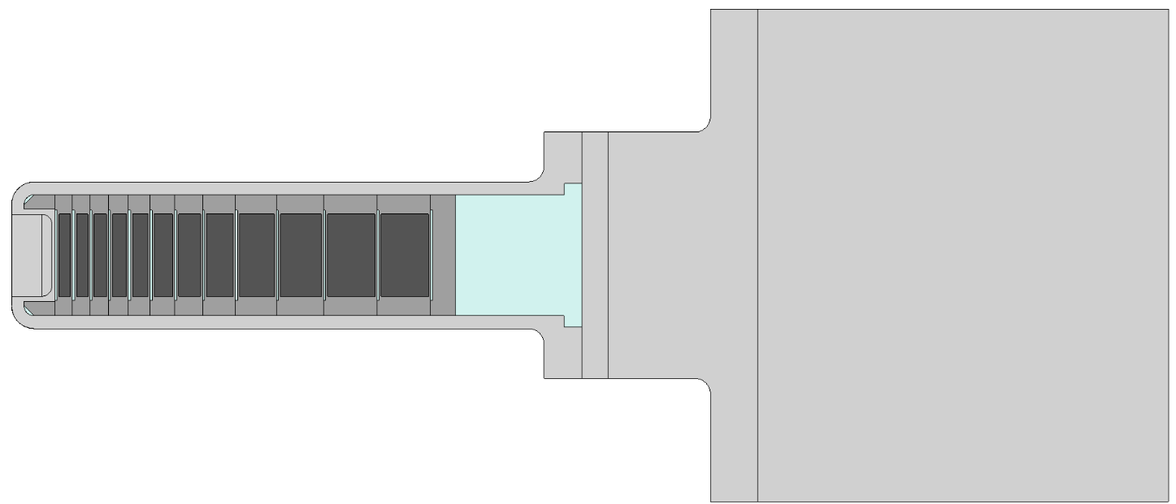
Decay Heat Simulation
Must manage decay heat in a loss-of-coolant accident (LOCA) scenario
Can we accurately predict the decay heat and simulate heat dissipation?
Switch off pumps on TS1 and record temperature rise on core thermocouples
Repeated at times from 1 minute to 14 days after beam off
Decay heat simulated using MCNPX and FLUKA, including detailed target station geometry and real irradiation history. Heat transfer simulated in CFX.

Slide 20
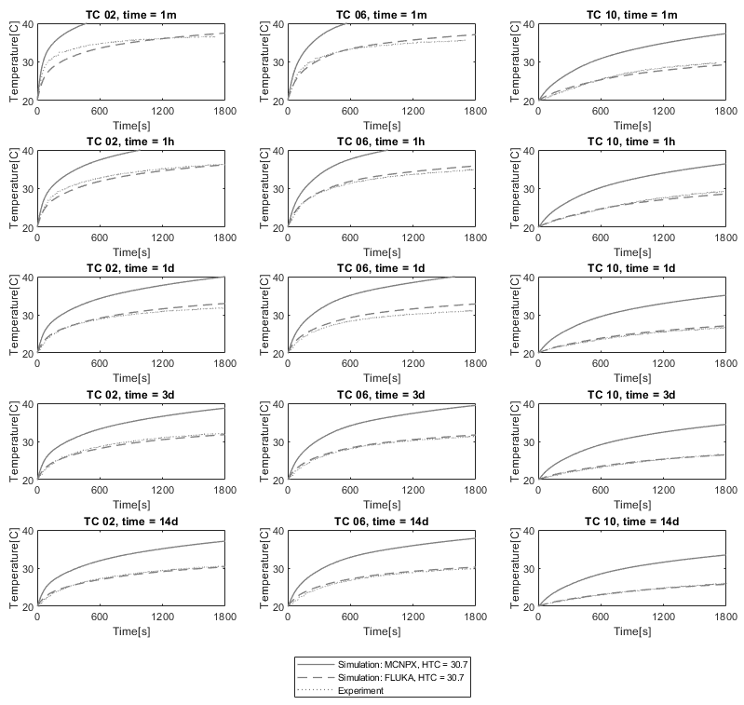
Decay Heat Simulation
FLUKA agrees well for all plate numbers and at all cooling times (1 minute to 14 days)
MCNPX predicts ~2x higher heat in all cases
Free convection in the water helps dissipate heat

Slide 21
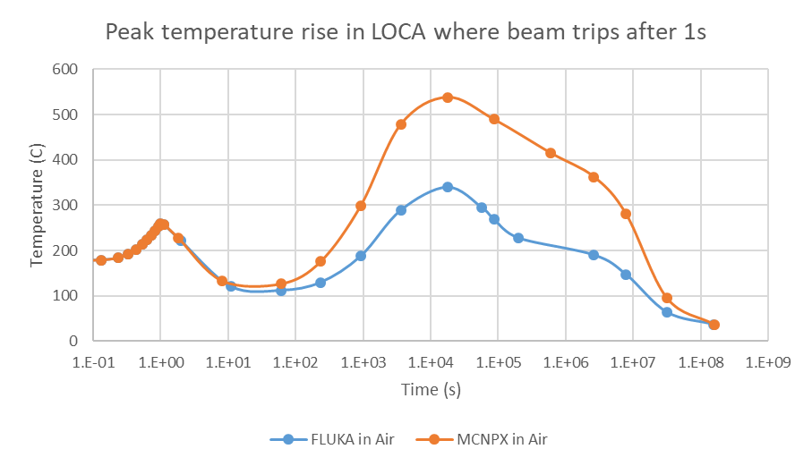
Decay Heat Simulation
Apply the same methods to a total loss of coolant on TS1 Project target
Worst case: all coolant lost, beam trips 1s late, void vessel helium replaced by air
Peak temperature at t = ~5hrs
Well below tungsten oxidation temperature (800°C in steam), even with conservative MCNPX heat load

Slide 22
Monte Carlo Code Comparison
FLUKA predicts ~15% higher for beam on heating, but ~50% lower for decay heat
Currently limited diagnostics to validate beam heating
Temperature rise in water is too small to accurately calculate target heat (~2.1°C on TS1)
Initial work on current TS1 suggests FLUKA is more accurate for decay heat
Target | Case | MCNPX | FLUKA | Measured Range
TS1 Current | Beam on (200uA) integrated heat dep (kW) | 89 | 104 | 90-120, based on temperature rise in water circuit
 | Decay heat after 1 hour (kW) | 0.91 | 0.49 | FLUKA looks much closer based on measured plate temperature increases
TS1 Project | Beam on (200uA) integrated heat dep (kW) | 91 | 105 | N/A
 | Decay heat after 1 hour (kW) | 1.10 | 0.54 | N/A

Slide 23
Validation
TS1 core thermocouples eventually become damaged by radiation. No core thermocouples on TS2.

Slide 24
Future Work
Stress wave plus radiation damage simulations for TS2 Mk4 and TS1 Project targets
Data from TS1 Project target: validate simulations, look for conductivity loss
Repeat stopped flow decay heat measurements
Continue fatigue testing, possibly start irradiated fatigue testing. Further investigation of microstructure and property changes after HIPing?
Design of targets for ISIS-II, building on our understanding of current targets
A new MW class short-pulse target station, likely to be a rotating or flowing target
Increased power to an upgraded TS2, pushing the limits for a stationary target

Slide 25
Summary
Detailed analysis of normal and off-normal conditions in ISIS targets
A combination of simulations and experiments is improving our understanding of operating conditions in ISIS targets
Current challenges:
Understanding effects of microstructure and manufacturing processes
Predicting irradiated material properties
Validating engineering and physics simulations
Further R+D required to enable ISIS-II target design; see our SnowMass LoI

Slide 26
References
[1] J. W. G. Thomason, “The ISIS Spallation Neutron and Muon Source—The first thirty-three years,” Nucl. Instr. Meth. A, vol. 917, pp. 61-67, 2019.
[2] D. Wilcox, P. Loveridge, T. Davenne, L. Jones and D. Jenkins, "Stress levels and failure modes of tantalum-clad tungsten targets at ISIS," Journal of Nuclear Materials, vol. 506, pp. 76-82, 2018.
[3] A. Dey and L. Jones, “Strategies to improve ISIS TS2 target life,” Journal of Nuclear Materials, vol. 506, pp. 63-70, 2018.
[4] R. McGreevy, "ISIS - from TS1 to TS2 to ISIS-II," Presentation at ICANS XXIII, 2019. [Online]. Available: https://conference.sns.gov/event/138/contributions/273/.
[5] C. Nelson, "Material Properties of Tantalum including High Cycle Fatigue," Proceedings of IWSMT 14, JPS Conf. Proc. 28, 081005, 2020.
[6] J. Chen et al., “Mechanical properties of pure tantalum after 800 MeV proton irradiation,” Journal of Nuclear Materials, vol. 298, no. 3, pp. 248-254, 2001.
[7] J. Chen et al., “Summary of the results from post-irradiation examination of spent targets at the FZ-Juelich,” Journal of Nuclear Materials, no. 318, pp. 56-69, 2003.
[8] D. Wilcox et al., "Measurement of residual strain in tantalum-clad tungsten after hot isostatic pressing," Journal of Neutron Research, vol. 22, no. 2-3, pp. 287-297, 2020.
[9] D. Wilcox and L. G. Jones, "Design and optimisation of the ISIS TS1 Project target," Journal of Physics: Conference Series, vol. 1021, p. 12-58, 2018.
[10] D. J. S. Findlay, G. P. Skoro, G. J. Burns and S. Ansell, "Experimental verification of spallation inventory calculations," Applied Radiation and Isotopes, vol. 125, 2017.
[11] D.J.S. Findlay et al., "Measurement and calculation of decay heat in ISIS spallation neutron target," Nucl. Instr. Meth. A, vol. 908, pp. 91-96, 2018.
[12] G.M. Allen et al., "Decay heat in ISIS spallation neutron target as function of cooling time," Nucl. Instr. Meth. A, vol. 933, pp. 8-11, 2019.
[13] D. Wilcox et al., "Simulation of decay heat induced temperature rise in the ISIS TS-1 spallation target," Nucl. Instr. Meth. A, [In Press].
[14] T.R. Davenne et al., “SnowMass 2021 LOI: ISIS Target Development”, 2020. [Online]. Available: https://www.snowmass21.org/docs/files/summaries/AF/SNOWMASS21-AF7_AF0_Dan_Wilcox-082.pdf.

