Slide 1
Structural Analysis of Mercury Targets
Target Simulations Workshop
4/6/2021
Drew Winder
SNS First Station
Target Engineering Group

Slide 2
Outline
Brief review of SNS mercury targets
Current modeling methods and challenges
Long-term challenges
Questions and discussion

Slide 3
Outline
Brief review of SNS mercury targets
Current modeling methods and challenges
Long-term challenges
Questions and discussion

Slide 4
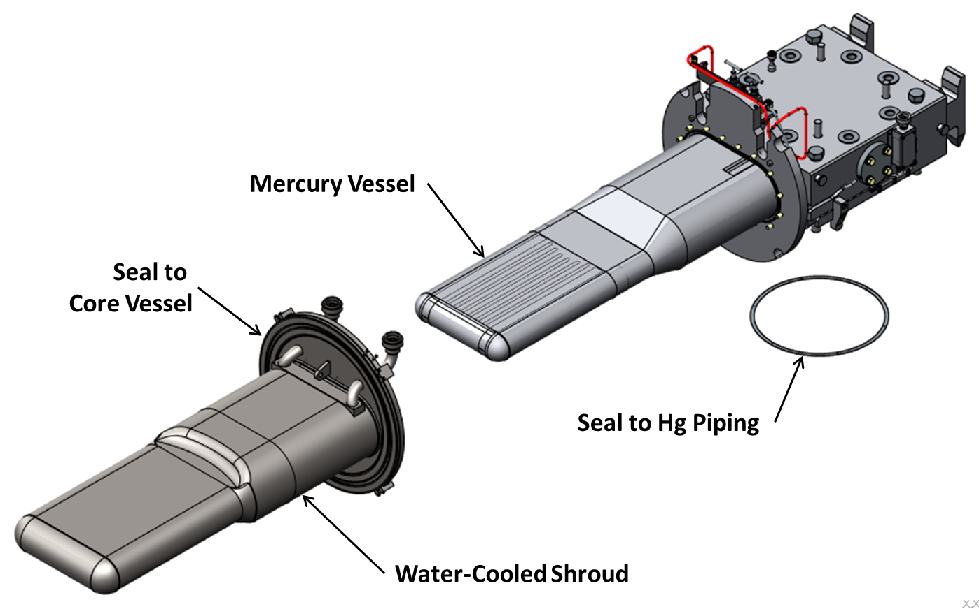
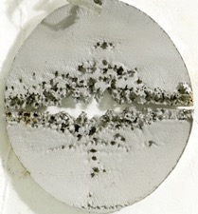
Goals are long, reliable lifetime of target modules
SNS target is not safety credited
Targets are expensive to build, exchange, and throw away
  Exchanges take ~ 1-2 weeks, during which no neutrons are produced
End of target life is caused by
  Fatigue cracks
  Cavitation damage
  Irradiation embrittlement of outer layer
Image Credit: David McClintock, Oak Ridge National Laboratory

Slide 5
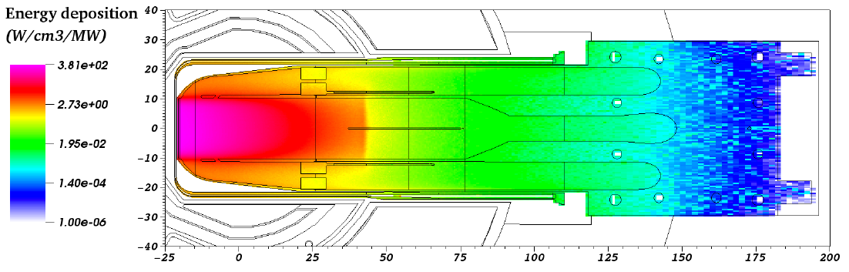
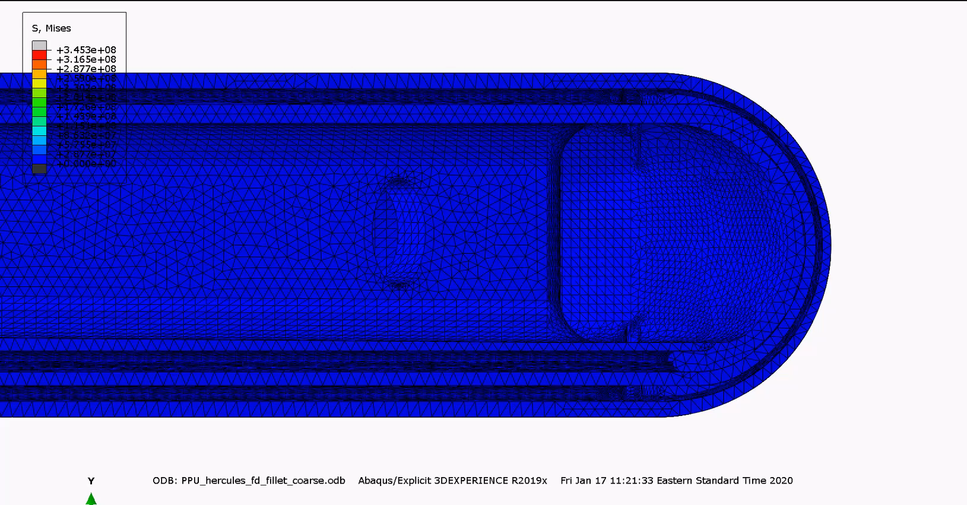
Targets receive 60, 23.3 kJ, 0.7-μs long pulses per second
Liquid mercury is target material and coolant
60% of energy deposited as heat
Pressure waves in the mercury lead to strain and cavitation damage to the stainless-steel shell
Plan to increase power to 33.3 kJ, and potentially to 46.7 kJ
Small helium bubbles are used to soften the response
Image Credit: Wei Lu, Oak Ridge National Laboratory
Deformations scaled 75X
Video Credit: Kevin Johns, Oak Ridge National Laboratory

Slide 6
Outline
Brief review of SNS mercury targets
Current modeling methods and challenges
Long-term challenges
Questions and discussion

Slide 7
Targets involve multiple time scales and phenomena
μs
Energy deposition from the beam
Neutronics analysis provides multiple, bounding energy deposition patterns
ms
Structural response to a single pulse
Explicit simulations using custom material models^{1,2,3}
seconds
Thermal stress from repeated beam strikes
Thermal-hydraulic modeling + implicit structural stress analysis
months
Accumulated fatigue, cavitation, and radiation damage
Fatigue analysis tools (FE-Safe), cavitation progression modeling, post-irradiation examination
Longer times
¹ Riemer, B. 10.1016/j.jnucmat.2005.01.026, 2005.
² Okita, K. et al., “Multi-scale analysis on cavitation damage and its mitigation for the spallation neutron source,” Proceedings of Coupled Problems, 2011.
³ Lin, L. et al., "Tunable EOS Material Model in the Simulation of Pulsed Mercury Spallation Target Vessel." Pressure Vessels and Piping Conference, 2019.

Slide 8
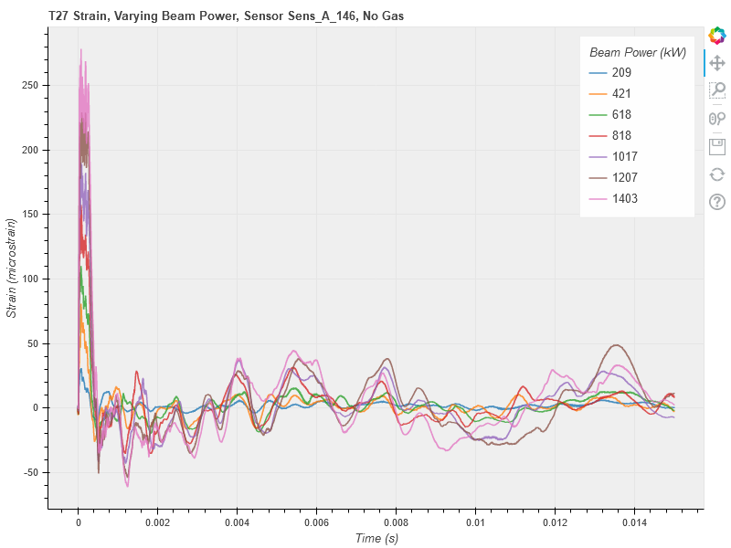
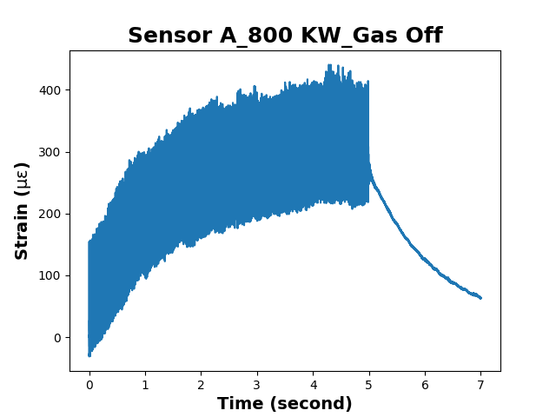
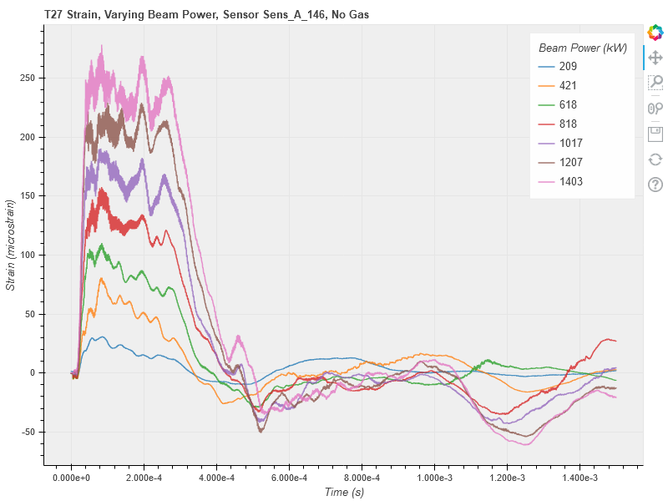
Cycles
0.015 seconds
5 seconds of beam, 7 seconds total
0.0015 seconds

Slide 9
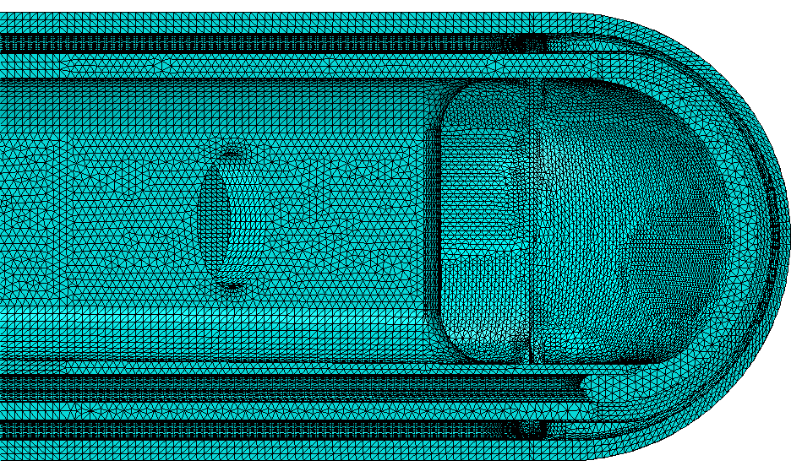
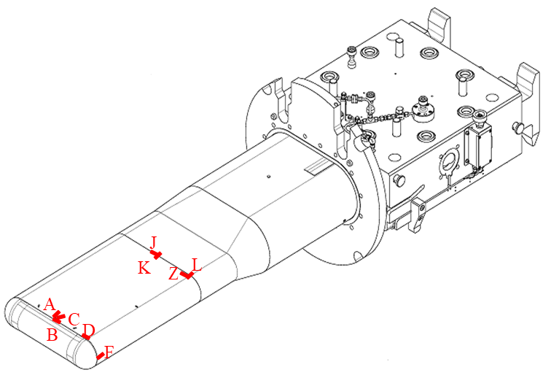
Response to a single pulse
Classic Methods
Current Work and Data
Remaining Challenges
Explicit FEA using commercial software
  Mercury material model incorporates tensile failure to replicate cavitation threshold
  Gas injection effects incorporated by measuring strain reductions in actual targets and scaling simulations
Mercury flow not considered
Each simulation takes hours to days on cluster
Strain and other data
  Historical experiments
  Operational targets under different conditions
  Can allow validation of new simulation models
  Could also allow for tuning of models or new approaches
Current simulations are relatively expensive, and CPU intensive
  Investigating government codes such as Sierra to allow more simulations
Developing candidate models with balance of
  Computational cost
  Potential accuracy
Verifying or tuning simulation models or approaches
Using the new models to direct changes in design and operation
Image Credit: Kevin Johns, Oak Ridge National Laboratory

Slide 10
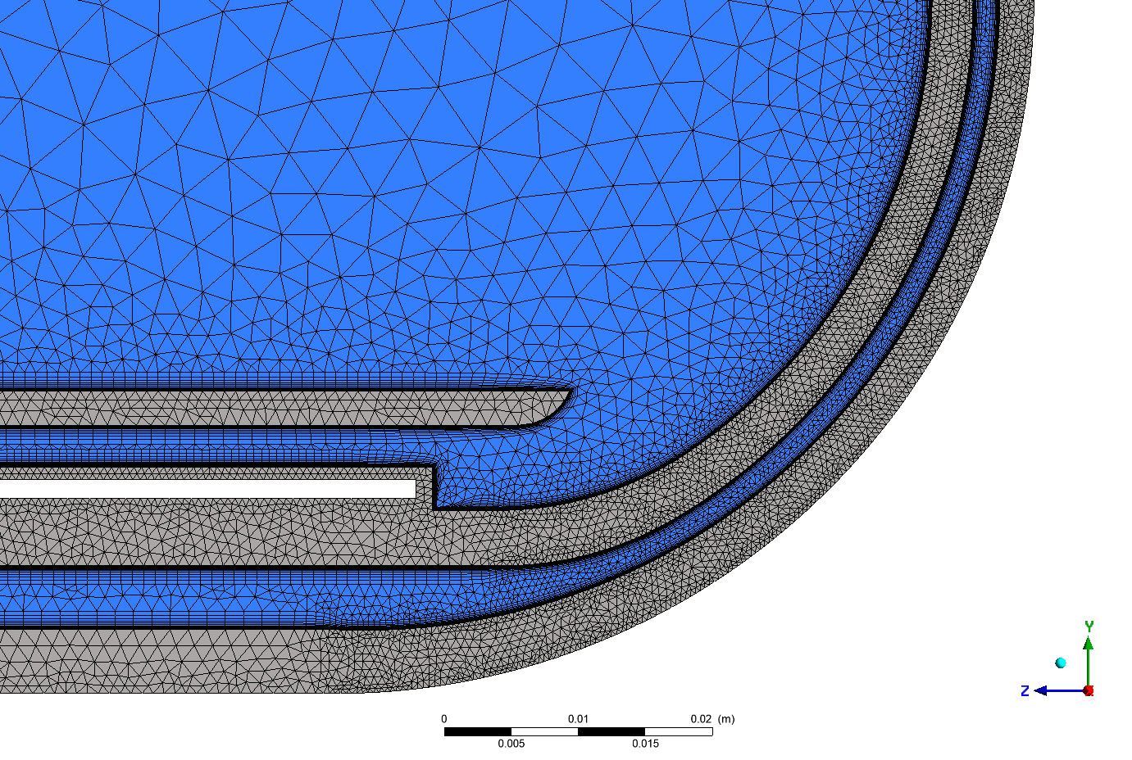
Fluids - Thermal stress from repeated beam pulses, gas distribution
Current Methods
Supporting Information
Current Challenges
CFD methods using commercial software to predict flow and resultant temperatures
Commercial software to convert temperature field to thermal stress
Correlations to predict bubble distributions
Measurements of bubble distributions and gas accumulation in test loops
  CFD predictions remain questionable
Computationally expensive simulations of single bubbles in flow
Historical liquid metal testing
  Heat transfer, flow
Operational measurements
Full size mercury test loop at SNS
  Supplementary smaller mercury experiments
Water test loops
How best to convert gas into longer target life
Quantifying conditions in operations targets including
  Bubble size distributions from generators
  Coalescence in target and piping
Secondary effects of gas
  Reduced heat transfer
Image Credit: Charlotte Barbier, Oak Ridge National Laboratory

Slide 11
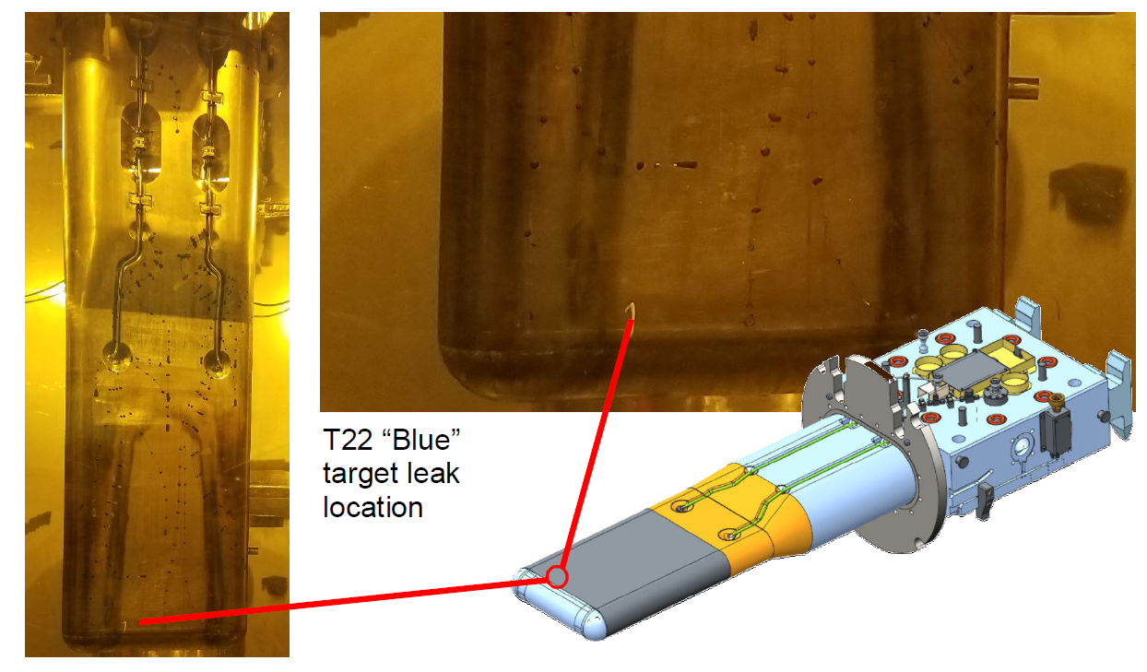
Accumulated damage
Current Methods
Supporting Information
Current Challenges
Fatigue life prediction from simulations
Commercial software used to combine thermal and pulse stress cycles and predict lifetime or needed strain reduction from gas
  Historically, life has been greater than predicted by simulations in many locations
  Multiple times we have found areas where we did not model in sufficient detail after a target failure
  Does not include cavitation damage effects
Cavitation damage scaled from experience
Post-irradiation examination of failed and successful targets
  Measurements of erosion depth
  Photographs of target interiors
  Failed target investigations
J-PARC cavitation progression experiments
Balancing maximizing utility from each target with risk of failure
  Recent results are positive
  Challenge in projecting reliability at higher power and lifetime
Lack of high-cycle fatigue data for our weld types and environment

Slide 12
Outline
Brief review of SNS mercury targets
Current modeling methods and challenges
Long-term challenges
Questions and discussion

Slide 13
Challenges in pulse simulations and experiments
More Complexity
Less Complexity
Potentially more accurate
Higher computational costs
Difficulty validating or using operationally
More divergence from reality
Less computational costs
Potential for overfitting and overconfidence
Conditions for each pulse
  Statistical bubble and cavitation seed distribution
  Complex initial conditions from flow and turbulence
Phase changes and interactions
  Cavitation formation and collapse
  Bubble-bubble interactions
  Flow-bubble interactions
Leveraging machine learning
  Building trust can be difficult

Slide 14
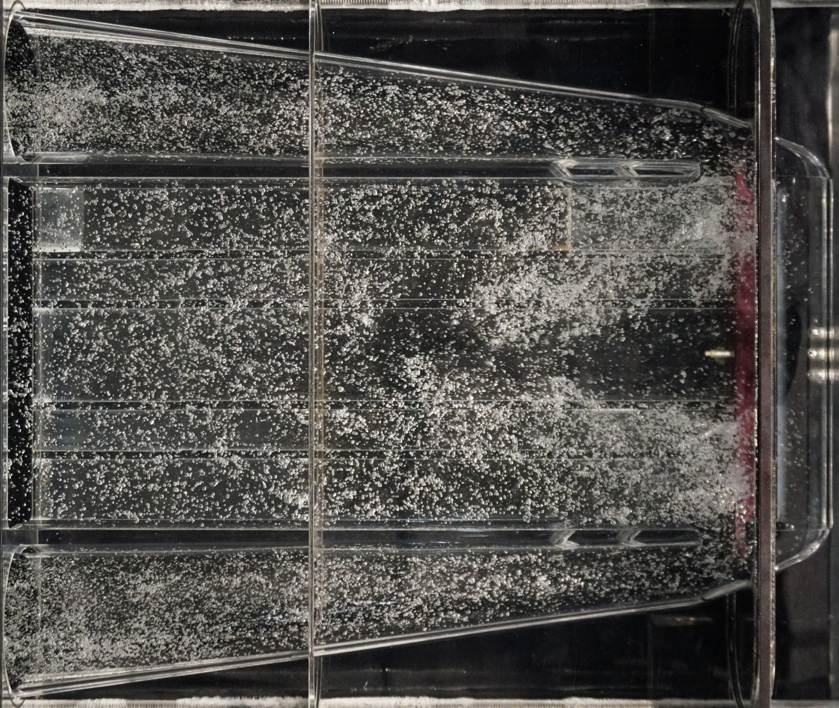
Challenges in fluids simulations and experiments
Gas optimization
  How best to generate and use gas in the target
  Quantifying the bubble distributions in a target module at different operating conditions
  How does the gas accumulate in the entire mercury loop
All difficult to simulate well or measure experimentally in mercury
  Water experiments are very helpful, but raise questions on conversion to mercury
  Multiphase simulations have proven difficult or unreliable
Image Credit: Justin Weinmeister,
Oak Ridge National Laboratory

Slide 15
Interactive effects are important
Operational Parameters and Design
Individual pulse response
Thermal and quasi-static loadings
Accumulated damage
Pulse simulations and fluids simulations are currently performed separately
Flow affects each pulse (ms) and long-term behavior (months)
  Disruption of cavitation bubble growth and collapse
  Removal of cavitation seeds from surfaces
  Changing cavitation progression patterns
Cavitation and fatigue affects target response
Target reliability and lifetime

Slide 16
Improving operation
Reactive
Measure effects of changes
Proactive
Predict future problems
Address found flaws
Quantify risk
Improve utility
How to make best use of limited chances for information
  Strain measurements, post-irradiation examination, changing operational set-points
How to account for combining multiple effects during the long life of targets
  Radiation effects, cavitation damage, fatigue damage, liquid metal embrittlement

Slide 17
Other long-term challenges
1.4 MW, 2.5 targets per year
2 MW, 3 targets per year
2 MW, ≤1 target per year
Geometry complicates all analysis steps
Reducing long-term costs
  Target life-cycle costs, reliability costs
Changes in mercury properties
  Mercury is reused continuously
  Properties appear to be changing over time (difficult to test)
Balancing reliable operation with improvements and cost savings
Sensor reliability and system upkeep

Slide 18
Summary
Despite 15 years of production use, liquid metal targets remain an area of continued development
Simulations are still a challenge in multiple areas
  Single pulse response
  Gas distribution and accumulation
  Cumulative damage and erosion
Challenges remain to prove reliable operation at maximum facility power levels
  Long planned lifetime of facilities (60 years), and impact to facility user program provide incentive for continued improvements

Slide 19
Outline
Thank you for
your attention
Brief review of SNS mercury targets
Current modeling methods and challenges
Long-term challenges
Questions and discussion

