Slide 1
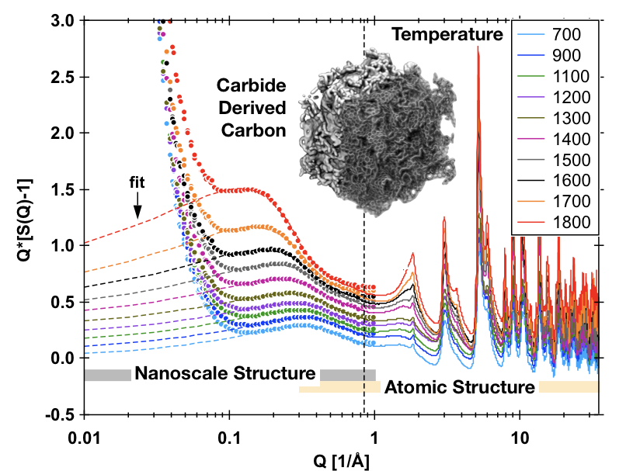
Complex materials away from equilibrium
It is incredibly hard to study how hierarchical structures arise in complex materials and respond to changing conditions
The relevant length and time scales span several decades
Local structures give rise to the nanoscale features and bulk material properties
Polymer complex coacervates
(Srivastava et al., 2017. image courtesy of Peter Allen, Institute for Molecular Engineering, The University of Chicago)
Carbide-derived carbon
(Data from H.-W. Wang, personal communication; inset image: Zhan et al. 2017)
STS tools will allow researchers to study sub-minute processes in complex materials

Slide 2
Complex materials away from equilibrium
Opportunity
STS Tools Required
Understanding the formation and evolution of complex hierarchical structures during self-assembly and their duty cycle provide avenues for developing new materials to meet desired performance characteristics.
Beamlines must provide high flux and the ability to measure a wide range of length scales at the same time. Instruments must also allow for the use of a very diverse range of sample environments to enable scientists to reproduce real-world processing and usage conditions for the materials to be studied.
Importance of STS
Broader Scientific Impact
The high peak brightness and potential for measurements over a wide dynamic range at the STS due to the source frequency enables time-resolved studies of out-of-equilibrium structures that span decades in length scales with sub-minute resolution.
Self-assembly of hierarchical structures and their response to external forces remain two of the most challenging problems in materials science. Revealing how to control structure formation and predict how it will respond during real-world applications has the potential to revolutionize many aspects of our daily lives.
References:
[Srivastava et al., 2017] “Gel phase formation in dilute triblock copolyeletrolyte complexes, Nat. Commun. 8: 14131.
[Zhan et al., 2017] Computational insights into materials and interfaces for capacitive energy storage, Adv. Sci. 4, 1700059.

Slide 3
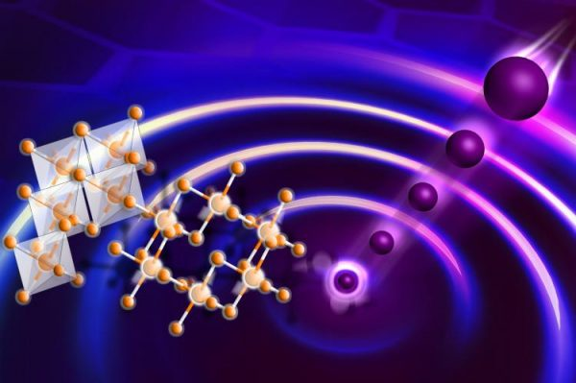
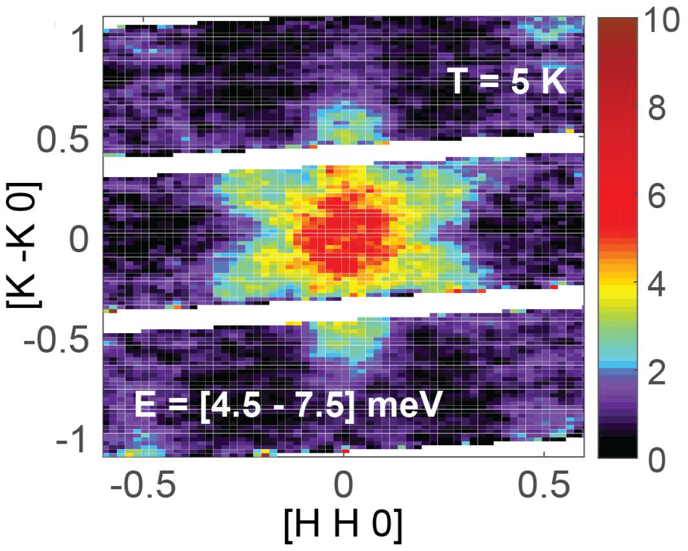
Fundamental Properties of Quantum Disordered Materials
“Neutron scattering experiments have long been a crucial tool in establishing the basics of quantum spin liquid behaviors: the absence of long-range order, the presence of fractionalized excitations, and the onset of the magnetic gap.”
  Basic Research Needs Workshop on Quantum Materials for Energy Relevant Technology, 2016
Inelastic neutron scattering has shown the presence of fractionalized excitations in the candidate Kitaev Quantum Spin Liquid, α-RuCl₃
STS will provide new tools allowing researchers to understand the fundamental magnetic properties and interactions in candidate quantum disordered materials earlier in the discovery cycle.

Slide 4
Fundamental Properties of Quantum Disordered Materials
Opportunity
STS Tools Required
Understanding the fundamental magnetic interactions which drive quantum disordered ground states, such as the quantum spin liquid, is critical to identify new materials whose properties are driven by quantum fluctuations, coherence and entanglement.
Neutron diffraction instruments to search for weak magnetic order. Inelastic neutron scattering instruments capable of measuring smaller samples to enable measurements earlier in the materials discovery cycle. Spectroscopy combined with high magnetic fields can reveal the fundamental magnetic interactions.
Importance of STS
Broader Scientific Impact
Quantum ground states are characterized by intrinsically low energies and must be explored at very low temperatures. As such, cold neutrons are at a premium and the high peak brightness of STS will enable the development of new tools capable of providing unique insight into a variety of quantum materials.
Quantum materials may hold the key to future technologies such as energy generation, transmission and storage, sensing, memory and data storage devices, and quantum computing. Materials discovery and characterization of exotic quantum ground states is critical to pursuing this agenda.

Slide 5
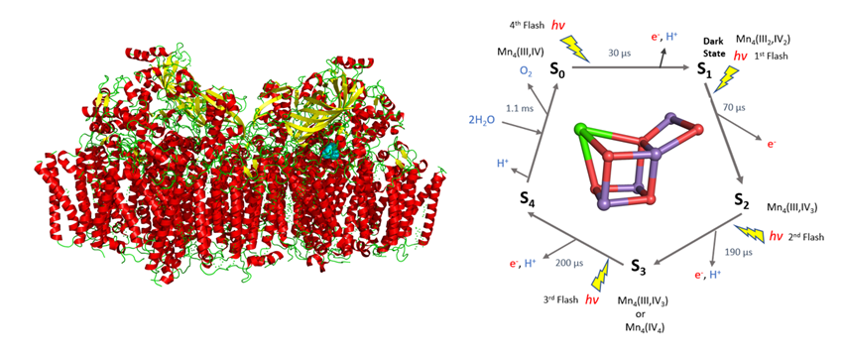
Proton Transfer in Biology
Most life processes depend on proteins that gather light and then convert it into signals or energy that regulate or enable biochemical processes that are catalyzed by enzymes. One common mechanism that drives these processes is the coupled motion or transfer of electrons and protons between different states. Photo-induced oxidation of water to oxygen gas is an example such a process.
The oxidation of water is catalyzed via a series of light induced transitions between the five kinetic states (S₀ to S₄) of the Kok cycle shown on the right while the structure of the multi subunit photosystem II complex is shown on the left.
STS tools will allow researchers to study in situ proton transfer in protein crystals
Notes:
Proton transfer reactions play key roles in energy conversion processes in biological systems, including photosynthesis and respiration.
S0 and S1 are stable states. S2 and S3 are stable for minutes / hours. S4 is metastable.

Slide 6
Proton Transfer in Biology
Opportunity
STS Tools Required
Neutrons can directly visualize protons in biological systems at physiological temperatures and without causing radiation damage or altering the electronic configuration of catalytic metals centers. Neutrons can help provide a detailed picture of the water environment of the catalytic site and reveal the role of light induced changes in the hydrogen bonding network around the active site.
Neutron instrumentation capable of collecting diffraction data from small protein crystals with large unit cell dimensions. To survey large volumes of reciprocal space within one crystal setting a large neutron bandwidth and large detector coverage is required.
Importance of STS
Broader Scientific Impact
The STS wavelength bandwidth will allow a large volume of reciprocal space to be simultaneously surveyed at one crystal orientation. Unprecedented peak brightness of cold neutrons reduces data collection times (required for pump probe methods) and crystal size requirements.
This first experiment illustrates a new neutron crystallography measurement approach which has the potential to transform studies of proton transfer processes in biology. Proton transfer reactions are critical steps most chemical reactions catalyzed by enzymes. Obtaining mechanistic insights into proton-transfer reactions is of central importance to understanding and mimicking enzyme function
Reference:
Kern, J. et al. Structures of the intermediates of Kok's photosynthetic
water oxidation clock. Nature 563, 421-425, doi:10.1038/s41586-018-0681-2 (2018).

Slide 7
Understanding how to overcome the strength-ductility tradeoff
High-density ductile multicomponent ordered intermetallic nanoparticles (MCINPs) were introduced in complex alloy systems. This results in superior strengths of 1.5 gigapascals and ductility as high as 50%. [Yang, Science, 2018].
STS instruments will enable probing and unraveling the formation and strengthening mechanisms during synthesis and deformation
Notes:
Materials are either strong or ductile, but rarely both at the same time

Slide 8
Understanding how to overcome the strength-ductility tradeoff
Opportunity
STS Tools Required
The next generation of advanced alloys will be increasingly complex and even hierarchically structured materials. For maximized strength and ductility, new alloys are being developed to achieve a high density of coherent ordered precipitates in a metastable matrix designed to enable twinning and/or phase transformation under applied stress.
The macroscopic properties of advanced alloys result from multiscale interactions among features from the atomic scale to the microscale. Multimodal beamline with diffraction, SANS and imaging enables real-time studies of multi-directional microstructure changes in lattice strain, phase transformation, precipitation, and texture to understand the strength-ductility tradeoff.
Importance of STS
Broader Scientific Impact
High neutron flux at longer wavelengths enables rapid collection of data to explore complex and low-symmetry structural evolution during deformation and provide simultaneous characterization of microstructural and crystallographic features across multiple length scales.
Structural materials are, and will remain, critical to broad swaths of the economy, from energy, transportation, security, aerospace, and health, to manufacturing and infrastructure. The knowledge gained by using STS will be critical to developing broad scientific guidelines for the design of next-generation structural materials.
References:
Li, Z. et al. Metastable high-entropy dual-phase alloys overcome the strength-ductility trade-off. Nature 534, 227-230 (2016).
Lei, Z.F. et al. Enhanced strength and ductility in a high-entropy alloy via ordered oxygen complexes. Nature 563, 546-550 (2018).
Yang, T. et al. Multicomponent intermetallic nanoparticles and superb mechanical behaviors of complex alloys. Science 362, 4. (2018)

