Slide 1
Radiation Safety at SNS
Presented to the
Accelerator Safety Review Committee
Donald C. Gregory, PhD, CHP
Neutron Sciences Facilities
July 26, 2016

Slide 2
SNS Radiation Doses 2008 - 2016
Calendar Year | # of workers > 100 mrem/y | Max Individual TLD Dose (mrem/y) | Collective Dose of Record (mrem/y)
2016 (to date) | 5 | 275 | ~2100
2015 | 2 | 187 | 1670
2014 | 1 | 102 | 837
2013 | 3 | 222 | 1670
2012* | 6 | 303 | 2680
2011 | 0 | 96 | 1000
2010 | 1 | 138 | 1124
2009 | 4 | 157 | 1681
2008 | 0 | 94 | 1100
* There were extra maintenance periods in 2012, resulting in higher personnel doses.

Slide 3
Rad Protection Staff at SNS are prepared to meet the challenges
NRPD Management Interface (George Stephens)
Radiation Safety Officer (Don Gregory, then ??)
Program Health Physicist (Scott Schwahn)
RCT Supervisor (Pedro Gonzalez/Nate Foster)
8 RCTs (24/7 coverage, up to 5 on day shift)
(Gregory and Gonzalez have announced retirements at the end of 2016)

Slide 4
Personnel radiation doses are low and controlled
Outside users receive Zero measurable dose
SNS workers receive Zero neutron dose
Almost all SNS dose comes from working on or near activated components
80% of the dose this year comes from: general tunnel maintenance (40%); vacuum (20%); and foil work (20%)
Contamination jobs are rare
Transfer Bay entries, Waste Loadouts, Stripper Foil changes, in-tunnel water skids
Dispersible samples are dealt with in categories and as exceptions

Slide 5
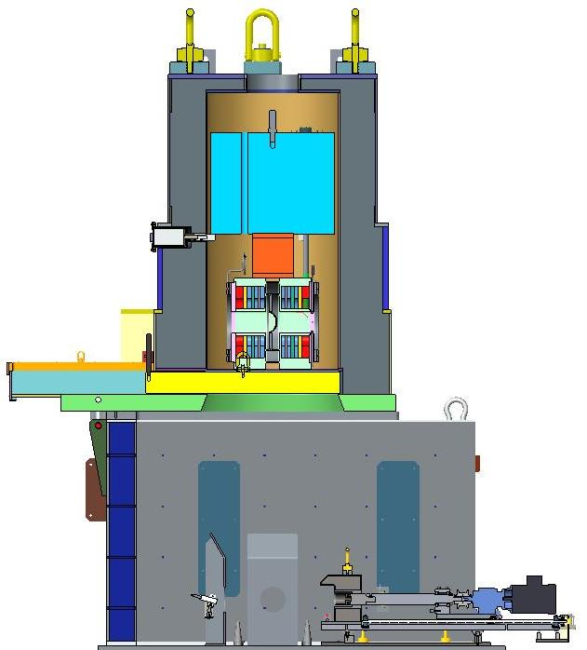
A Recent ALARA Success Story
The Proton Beam Window (PBW) (made from Inconel) separates target-area vacuum from accelerator-tunnel vacuum
Objective is to cut 4 coupons
PBW read up to 500 R/h
Some challenges
Unexpected airborne material
One coupon dropped
118 mrem collective dose
No personnel intake/cont.

Slide 6
SNS Continues to Grow and Mature
Second Target Station under development
Power Upgrade Project may go to 2.8 MW
1.4 MW sustained operation already proven
Target life at high power is a concern
Beam Test Facility (located in RFTF Annex) nears approval
2.5 MeV accelerator (initially a source, RFQ, beamstop)
Several levels of additional test capabilities planned

Slide 7
The Next Challenges
3-D scan of coupons cut from the target nose
Rad Protection involved from initial concept
Initial samples from target areas not directly in the beam
15 R/h coupons will be scanned with a hand-held probe
Predicted dose less than 20 mrem per scan
Hotter samples will likely follow; toys get played with
D₂O will be loaded into inner reflector cooling loop
Tritium inventory will grow rapidly
Air-supplied suit capability being explored
Future Service Bay entry possible?

Slide 8
We Remain Optimistic and Alert
SNS is still relatively youthful and operating within the original design envelope
Doses and operations indicators are positive
Safety is integrated into work planning and execution; cooperation all around
The User population grows steadily
Sample handling provides our greatest opportunities to adapt

