Slide 1
Safety Documentation Status and Updates
Presented to the
Accelerator Safety Review Committee
D. Freeman, SNS Safety Specialist
SNS ESH&Q
July 26, 2016

Slide 2


Safety Documentation Overview
Two Final Safety Assessment Documents (FSADs):
  FSAD-Proton Facilities (FSAD-PF)
  FSAD-Neutron Facilities (FSAD-NF)
Single Comprehensive ASE addresses entire complex
Unreviewed Safety Issue Evaluations serve as addendums to safety assessments
FSADs/ASE comply with O 420.2C and ORNL SBMS

Slide 3
FSADs/ASE Present Status
Continue to be Order 420.2C compliant
Identified updates are minor
Minor corrections, some administrative titles, division names outdated
USI Evaluations – fold in minor revisions associated with 10 USIEs

Slide 4
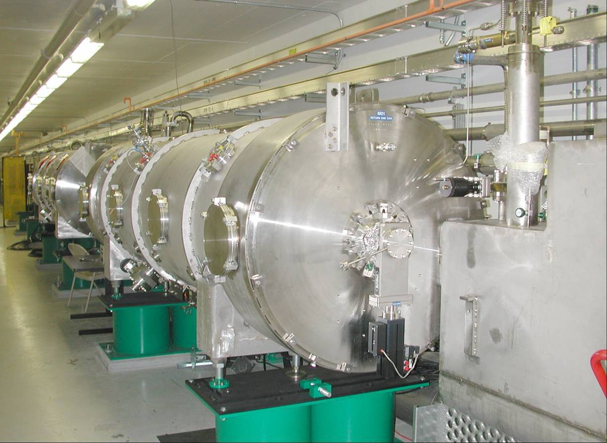
FSAD-PF – Traditional Community Approach
  Address hazards associated w/ proton accelerator
  Addresses common site-wide hazards
  Defers to ORNL Standards Based Management System (SBMS) for standard industrial and laboratory hazards
  FSAD + SBMS = all hazards addressed; safely managed
  Final SAD (2005) →Rev. 1 (2007) →Rev. 2 (2010) →Rev. 4 (2017)

Slide 5
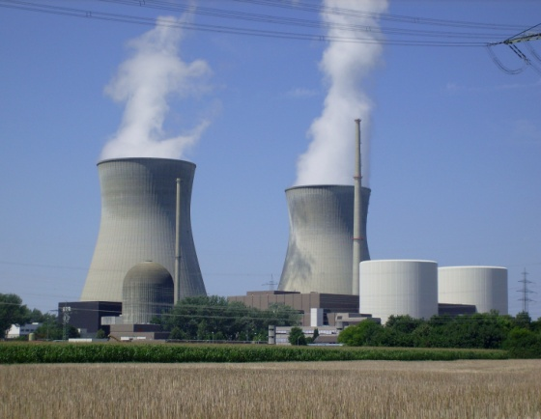

  FSAD-NF: Initially Developed for
  Nuclear Facility
  FSAD-NF –Addresses “neutron facility” hazards (target systems and instruments)
  Defers to the FSAD-PF with regard to common site-wide issues
  Defers to SBMS for standard industrial and laboratory hazards
  PSAR (2000 & 2003) developed per DOE-STD-3009
  FSAD (2005)→ Rev. 1 (2006)→Rev. 2 (2007) →Rev. 3 (2011) →Rev. 4 (2017)

Slide 6
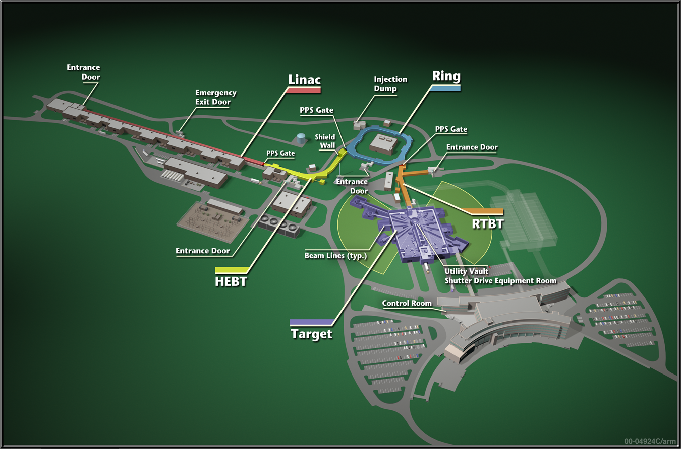
SNS PF and NF Boundaries/Interface
Proton Facilities
Neutron Facilities

Slide 7
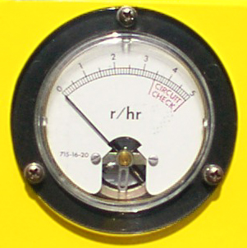


SNS Primary Hazards Summary
Prompt radiation associated with proton beam
  Massive passive shielding and access control
  Addressed primarily in FSAD-PF
Exposure to target mercury (highly radioactive and chemically toxic)
  Primarily passive design features for confinement of Hg
  Some active and administrative controls required
  Addressed in FSAD-NF
Oxygen deficiency associated with Helium for superconducting LINAC
  Passive and Active Controls
  See and flee training
  Addressed in FSAD-PF
Electrical Safety (Standard industrial, ORNL SBMS)
  Addressed in FSAD-PF

Slide 8


FSADs – Format and Content
Chapter 1, Introduction
Chapter 2, Summary and Conclusions
Chapter 3, Site, Facility, and Operations
Chapter 4, Hazard/Accident Analysis (onsite/offsite)
Chapter 5, Basis of the ASE
Chapter 6, Proton-Neutron Facility Interfaces
Chapter 7, Instrument Systems Hazards
Chapter 8, QA
Chapter 9, Post Operations Planning

Slide 9
Credited Control Selection Criteria
Potential Unmitigated Offsite Impacts:
Dose > 25 rem - two levels of control required
5 rem < Dose < 25 rem and (f > 10⁻⁴/year) - level of control required
[Hg] > ERPG-2 (2 mg/m³ ) - level of control required
Potential Unmitigated Worker Impacts:
Dose > 25 rem or [Hg] > EPRG-3 (4 mg/m³) - level of control required
Dose outside building > 25 rem (and f > 10⁻⁴/year) – two levels of control required
Worker exposure to [O₂] < 12.5 % (unless SBMS provides adequate protection) - level of control required

Slide 10
Credited Control Selection Philosophy
Passive Features preferred to Active Control
Engineered Controls preferred to Administrative Controls
Preventative Controls preferred to Mitigative Controls
When multiple Controls required – must be independent

Slide 11

Credited Engineered Controls (CEC)
CMS Hydrogen and Vacuum Boundaries
Target Service Bay and Monolith - Confinement of Hg
Service Bay/Core Vessel Fire Barrier
Core Vessel - Confinement Function
High Bay Crane Design per ASME NOG-1
High Bay Floor Design
Robust Mercury Heat Exchanger Design
Mercury Pump Tank Exhaust Line Loop Seal
Target Protection System
FSS Inside the Service Bay
FSS Outside the Service Bay
Service Bay Differential Pressure Monitoring System
Primary Confinement Exhaust System
Transfer Bay Access Control System
Personnel Protection System
Oxygen Deficiency Hazard System
Emergency Ventilation System for Accelerator Tunnel
Central Helium Liquefier Bldg- Passive Ventilation Features

Slide 12

Credited Administrative Controls (CAC)
ORNL SBMS - Radiological Protection Program
ORNL SBMS - Chemical Safety Program (no longer required)
ORNL SBMS - Ignition Control Program
ORNL SBMS - Hoisting and Rigging Program
Combustible Materials Control Program
Specific Procedures and training

Slide 13
SNS Accelerator Safety Envelope
ASE establishes bounding conditions and limits essential for safety
Single Document addresses Proton Facilities and Neutron Facilities
1st facility-wide ASE issued for Low Power (100kW) (April, 2006) in conjunction with ARR
ASE Updated May 31, 2007 for High Power (2 MW) Operations in conjunction with ARR
2017 ASE Update (in progress)

Slide 14

SNS ASE Format and Content
Introduction
Definitions
Limitation on Operating Parameters (beam power limits)
Shielding
Active Credited Engineered Controls
  Operability, Compensatory Measures, Surveillances
Credited Administrative Controls
Monitoring and Effluent Release
Administrative Controls (includes standard DOE dose limits)
Staffing
Procedures addressing ASE Requirements
Appendix A. Passive CECs

Slide 15
Unreviewed Safety Issue (USI) Process
Present Status – 420.2C compliant, functions effectively
Implemented by SNS Procedure OPM 2.B-10 Unreviewed Safety Issue Process
Ensures proper level of approvals (DOE vs SNS line mngt.)
Important part of configuration control
Helps maintain safety documentation current – USI Evaluations considered “addendum” to FSAD
Work Control/Configuration Control triggers USIE for modifications to Credited Engineered Controls

Slide 16


OPM 2.B-10 Unreviewed Safety Issue Process
USI Evaluation conducted if reasonable chance proposed activity (or previously unevaluated hazard) could:
  Affect probability/consequence of accident or equipment malfunction evaluated in FSAD
  Introduce new accident or malfunction not evaluated in FSAD
SNS uses “6 Question Approach”
System Engineers have completed Safety Basis Training
Training for USIE preparation/review developed and implemented

Slide 17


OPM 2.B-10 USI Process (cont.)
USIDs posted in SNS document control (ProjectWise)
USIDs posted on the SNS Webpage for wide access/dissemination
Jake will discuss USI Evaluations since last ASRC review

Slide 18

FSAD/ASE Update Process – Objectives
Ensure continued compliance w/ Order 420.2C and consistency w/ Guide
Ensure SMEs/operations staff/line management engaged through out process
Ensure material from USI Evaluations folded into FSADs as appropriate
Ensure reference documents captured as controlled documents
Improve presentation – streamline, clarify, clean up some language, consolidate topical material
Address desired improvements and upcoming initiatives (e.g. gas injection, water mist, etc.) as appropriate

Slide 19

FSAD/ASE Revision Process
Identify needed revisions and issues
  SME Review
    Identify SMEs for each FSAD section
    Initiate SME review and comment of assigned Sections (see spreadsheet)
    Collect SME input
  Accelerator Safety Expert Reviews (Freeman, Harrington, McManamy, Platfoot)
  ASRC 2013 - 2016 FSAD/ASE recommendations
  USI Evaluations – identify material that needs to be integrated
Address/Incorporate identified revisions and issues
  Capture all revisions with redlines, identify substantive changes for USI Evaluation

Slide 20
FSAD/ASE Revision Process (continued)
  Issue successive drafts, achieve SME and management concurrence
  Socialize proposed revisions w/DOE, ensure concerns addressed
  Issue support documentation (Design Analysis Calcs, etc.) as needed
  Complete USI Evaluations for proposed FSAD-PF and FSAD-NF revisions
  Obtain SNS management approval for FSADs/ASE
  Obtain DOE approval for ASE

Slide 21


Tentative Schedule Milestones
SME Review and Comment (Nov 2015 – Feb 2016)
ASRC-2016 Input (July 2016)
Issue Draft FSAD-PF/NF for review and comment (Nov/Dec 2016)
Issue Draft ASE for review and comment (Dec/Jan 2016)
Revised FSAD-PF/NF finalized with USI Evaluation (Jan thru Mar/April 2017
ASE submitted to DOE (~ March 2017)
ASE approved by DOE (~ April 2017)

Slide 22


Questions?

Slide 23
Safety Analysis Evaluate Impacts to 4 Receptors
Building
Site Boundary
Hazard
Second
Receptor
Third
Receptor
First
Receptor
Site Workers
(Exposure to
significant material
release)
Public
Facility Worker
(Significant Exposure – direct exposure or material release)
Notes:
The workers in the facility were assessed for control needs as two distinct receptors, but reported as a single in facility receptor. This was due to most events not having a 1st Receptor.

Slide 24
 | Milestone | Tenative Dates
a. | Identify Needed Revisions and Issues | (Dec 15, 2015 to March 17, 2015)
i. | Identify SMEs with line management input and concurrence (Dec 11, 2015) | (Dec 11, 2015)
ii. | Initiate SME review | (Dec 18, 2015)
iii. | SME FSAD/ASE review complete | (Feb 25, 2016)
iv. | Prioritize 1st round comments and issues to be resolved
b. | Revise Schedule milestones, if necessary, based on extent of issues identified | (March 31, 2016)
c. | Issue Rev 0 Draft FSAD-PF for review and comment | (June 30, 2016)
d. | Issue Rev 0 Draft FSAD-NF for review and comment | (July 31, 2016)
e. | Solicit ASRC-2016 Input | (August 2016)
f. | Issue Rev 1 Draft FSAD-PF for review and comment | (Oct 2016)
g. | Issue Rev 1 Draft FSAD-NF for review and comment | (Nov 2016)
h. | Issue Draft ASE for review and comment | (Nov 2016)
i. | Revised FSAD-PF finalized with USI Evaluation | (Jan 2017)
j. | Revised FSAD-NF finalized with USI Evaluation | (April 2017)
k. | ASE submitted to DOE | (April 2017)

