Slide 1
SNS Overview and Update
Presented to the
Accelerator Safety Review Committee
Kevin W. Jones
Research Accelerator Division Director
July 26, 2016

Slide 2
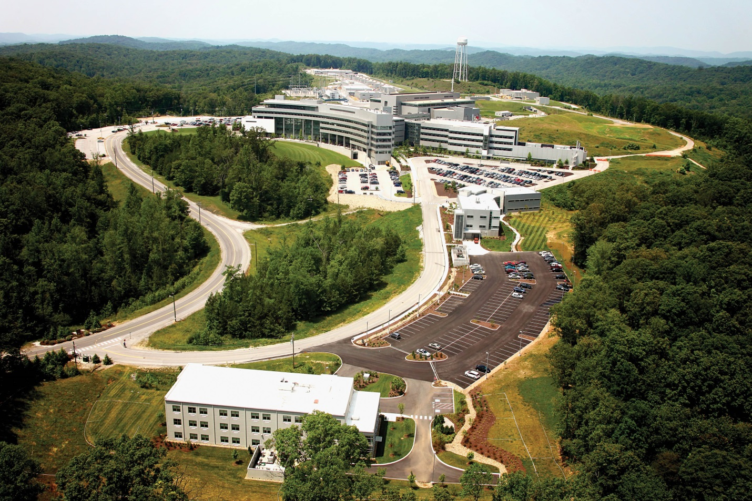
The Spallation Neutron Source (SNS) is a federally-sponsored national user facility

Slide 3
The attributes of Office of Science national user facilities are well-defined
The facility is open to all interested potential users without regard to nationality or institutional affiliation
Allocation of facility resources is determined by merit review of the proposed work
User fees are not charged for non-proprietary work if the user intends to publish the research results in the open literature – full cost recovery is required for proprietary work
The facility provides resources sufficient for users to conduct work safely and efficiently
The facility supports a formal user organization to represent the users and facilitate sharing of information, forming collaborations, and organizing research efforts among users
The facility capability does not compete with an available private sector capability

Slide 4
The Neutron Science organization has evolved since your last visit in 2010 (1)
Via Ron Crone for 2014
ALD
Ian Anderson
ALD
Kelly Beierschmitt
ALD
Paul Langan
October 2011
January 2015
Research
Reactors
Research
Reactors
Research
Reactors
Quantum
Condensed Matter
Quantum
Condensed Matter
Biology and
Soft Matter
Biology and
Soft Matter
Neutron Scattering Sciences Division
Chemical and
Engineering Materials
Chemical and
Engineering Materials
Neutron Data Analysis
and Visualization
Neutron Data Analysis
and Visualization
Research Accelerator Division
Research
Accelerator
Research
Accelerator
Neutron Facilities Development Division
Instrument and
Source Design
Instrument and
Source Design
SNS Operations
Frank Kornegay
Directorate Operations
Crystal Schrof
Directorate Operations
Hans Vogel
User Programs and Outreach
Judy Trimble
User Programs and Outreach
Laura Morris Edwards
Scientific and Program Service Office – Crystal Schrof

Slide 5
The Neutron Science organization has evolved since your last visit in 2010 (2)
Associate Laboratory Director
Paul Langan
Alan Tennant, Chief Scientist
Herb Mook, Senior Corporate Fellow Emeritus
Jeanine Evans, Executive Secretary
Shull Wollan Center
Alan Tennant
Second Target Station
Project Office
John Galambos
Scientific and Program Services Office
Crystal Schrof
Directorate
Operations
Hans Vogel
Quantum
Condensed Matter
Stephen Nagler
Biology and
Soft Matter
Volker Urban (Acting)
Chemical and
Engineering Materials
Richard Ibberson
Neutron Data Analysis
and Visualization
Thomas Proffen
Research
Reactors
Tim Powers
Instrument
and Source
Don Abercrombie
Research
Accelerator
Kevin Jones
Matrix Support
Bonnie Hébert, HR Manager
Lorie Hickey, Business Manager

Slide 6
The Research Accelerator has returned to focusing on accelerators and instrument data acquisition (in synergy with control systems) while providing essential support to instrument upgrades and operation
Research Accelerator Division
Kevin Jones, Director
Accelerator Operations
Glen Johns
Accelerator
Physics, Beam Instrumentation
and Ion Source
Sarah Cousineau
Control
Systems
Karen White
Electrical
and RF Systems
Mark Champion
Instrument Data Acquisition
and Controls
Steven Hartman
Mechanical Systems and Operations
Mike Baumgartner
Superconducting Linac Systems
Sang-Ho Kim

Slide 7
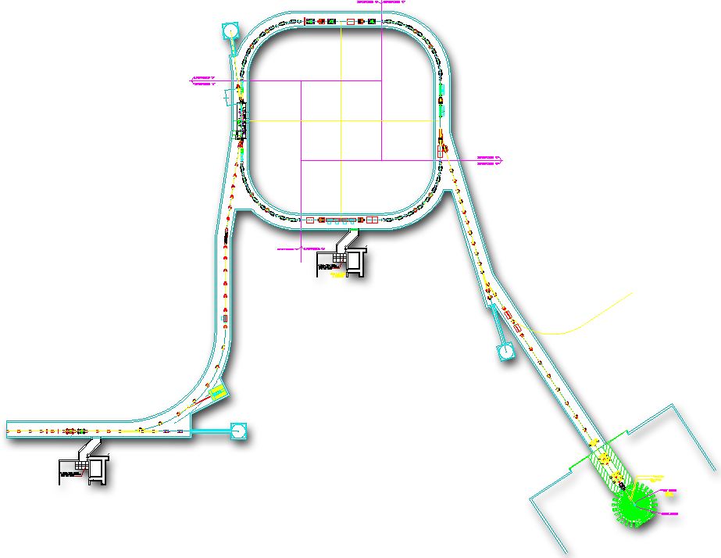


The SNS is a complex machine that performs well – overall system reliabilities (excluding targets) > 90%
The SNS machine has over 100,000 control points and cycles ~5.2 million times a day
Power (and base neutron flux) is the product of:
Accumulator Ring: Compress ~1 msec pulse to 700 nsec
Collimators
  Peak Current
  Chopping Fraction
  Beam Energy
  Pulse Length
  Repetition Rate
Injection
Extraction
RF
~700 nsec
RTBT
2.5 MeV
186 MeV
~957 MeV
HEBT
Front-End
Warm Linac
Superconducting LINAC
Liquid Hg Target
LEBT chopper system makes gaps between mini-pulses
Mini-pulses contain RF micro-pulses
945 ns
Current
Current
1 ms macropulse
1ms
~1 ms macro-pulse
The front end produces a 60 Hz, ~1 ms long chopped H- beam
~1 ms

Slide 8
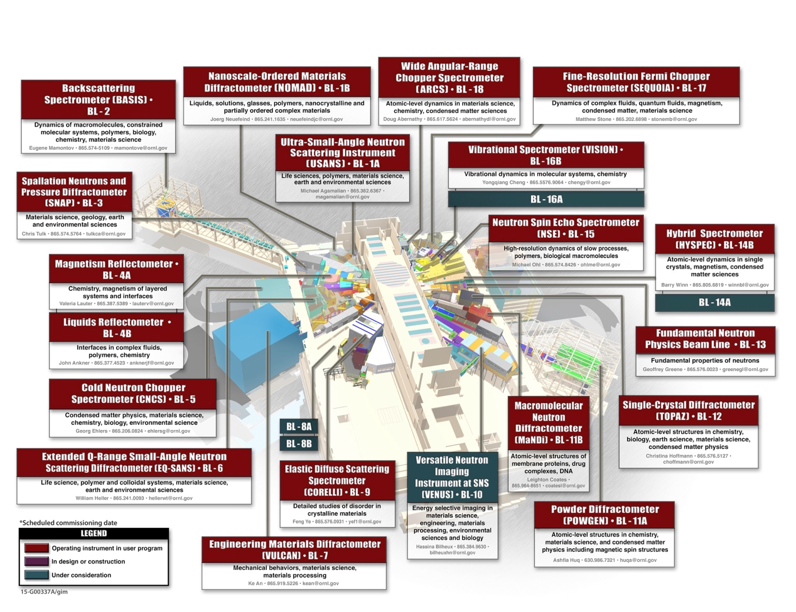
There are now 18 instruments in the user program along with one operated by Office of Nuclear Physics

Slide 9
The SNS is an accelerator facility as defined by DOE Order O420.2C
Requirement flow-down through SBMS Management System: Nuclear and Facility Safety

Slide 10
The required safety assessment documents and safety envelope govern operation

Slide 11
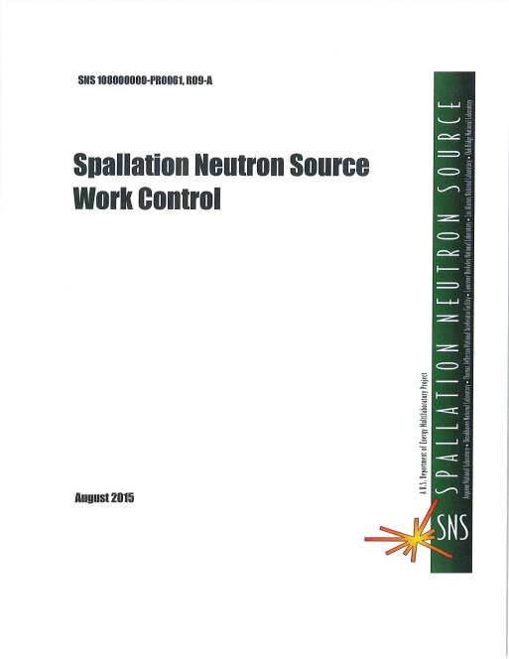
Implementation is through effective work control including Research Safety Summary (RSS), Job Hazard Analysis (JHA) and Experiment Safety Summary (ESS)

Slide 12
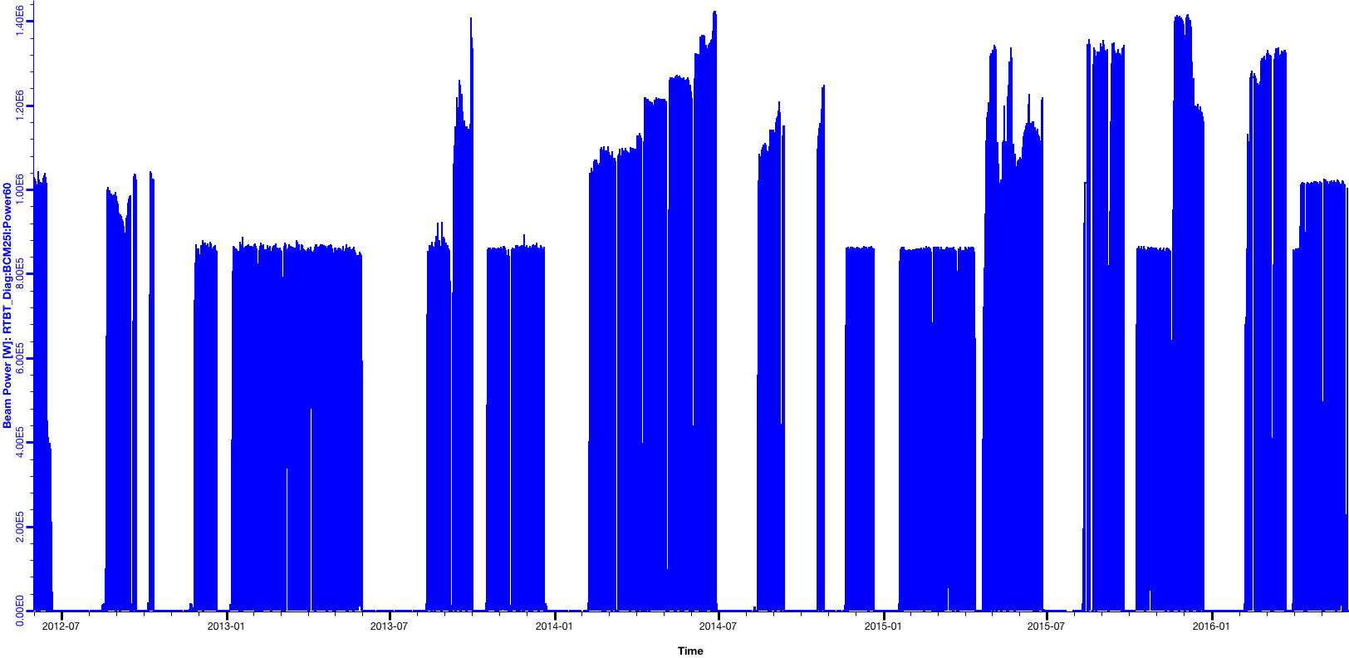
The SNS four-year beam power history illustrates both successes and challenges
1.4 MW for ~24 hrs
OE limit restriction
Ion source Edump
Planned power ramp up
Damaged DTL5 ceramic RF window
1 MW Target Experiment
Damaged RFQ RF couplers
Damaged RFQ RF couplers
1.4 MW
1.2 MW
1.4 MW 1st time
Sustained 1.4 MW
1.0 MW
0.85 MW*
Beam power on target
Unplanned Target replacement
Unplanned Target replacement and MEBT water leak
Unplanned Target replacement
Unplanned Target replacement
Unplanned Target replacement
Unplanned Target replacement
*0.85 MW is target conservation
Jun. 1, 2012 to May 31, 2016
Notes:
Fall 2013 the RFQ couplers were damaged after a long period of abuse (vacuum event during a power outage, high hydrogen flow). They showed multipacting signatures and high temperature.
Spring 2014 had good RFQ couplers and ion source performance which allowed power increase to 1.4 MW.
July 2014 there were two vacuum events that released water vapor into the RFQ. RFQ couplers showed multipacting signatures and heating after those events. Increased heat load required reducing the field to allow for stable RFQ operation.
Fall 2014 there were two target failures and the MEBT water leak.
April 2015 DTL5 window failed during RF conditioning, and the replacement window had a leak that prohibited running above 1.3 MW.
Fall 2015 the OE limit restricted running below 1.4 MW. There were ion source edump issues with voltage decay and bad insulators before the target failure in September 2015. The ion source edump insulator issues continued throughout the fall. The voltage decay issue was resolved by increasing the cesium collar temperature before the target failure in September 2015. The ion source edump issues also degraded the RFQ performance by increasing beam loss and using up cooling capacity for the RFQ.

Slide 13
The SNS neutron source is now capable of reliable operation at 1.4 MW and we are working to increase operating margin

Slide 14
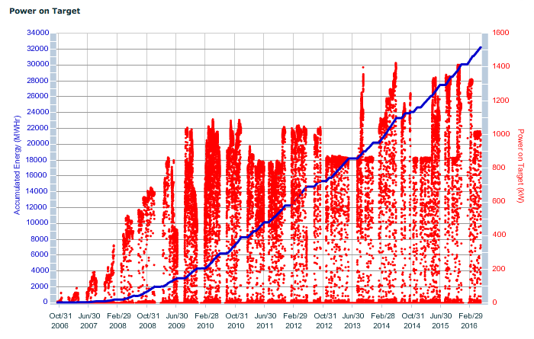
Energy and power on target from October 2006

Slide 15
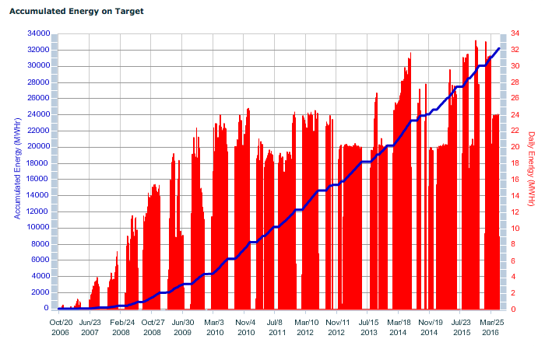
Accumulated energy on target from October 2006

Slide 16
SNS has identified and is addressing barriers to operation at 1.4 MW with margin
402.5 MHz
805 MHz
Foil limitation:
Survivability and damage rates at high power
RFQ
MEBT
DTL
CCL
SCL β=0.61
SCL β=0.81
To
Ring
Source and LEBT
2.5 MeV
86.8 MeV
186 MeV
387 MeV
957 MeV
New foils, new brackets, electron catcher, laser stripping
Chopper improvements:
Rise/fall time improvements, longer minipulse length, smart chopping help overcome power limitations
Peak current limitation:
Poor beam transmission through RFQ
60 – 75%
Energy limitation:
SCL cavity gradients (notably high beta) limit max beam energy to ~957 MeV
Plan to install new RFQ April-June 2017
Plasma processing increases high beta SCL cavity gradients
Accelerated peak current and beam energy limitations have been offset by LEBT chopper improvements, but we need more margin

Slide 17
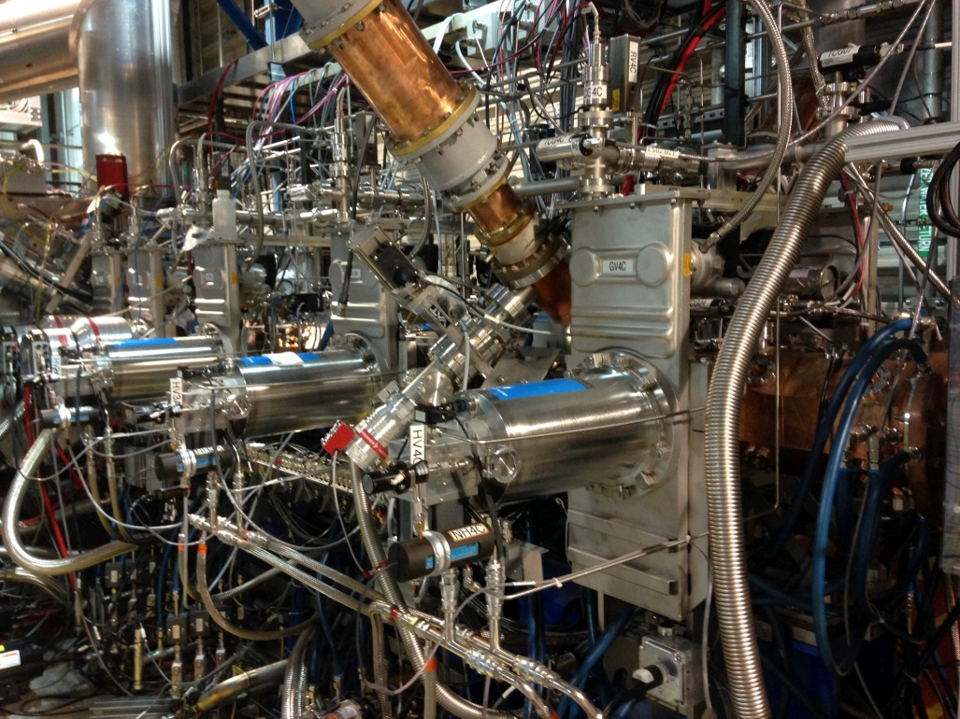
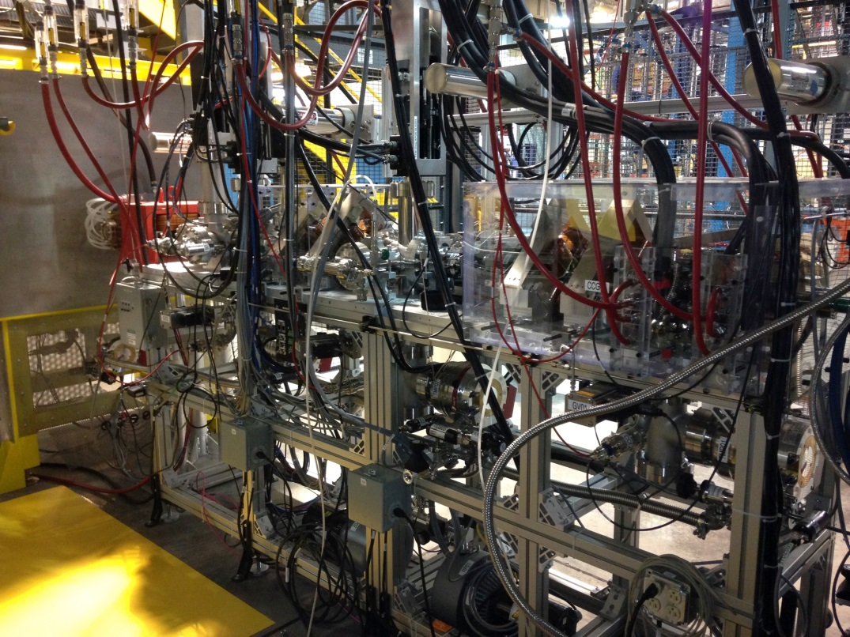
The new Beam Test Facility is awaiting DOE authorization for an exemption from 420.2C to demonstrate that the spare RFQ functions as designed
Medium Energy Beam Transport toward 7.5 kW Beam Stop
View from RFQ high energy end toward ion source showing vacuum and RF services

Slide 18
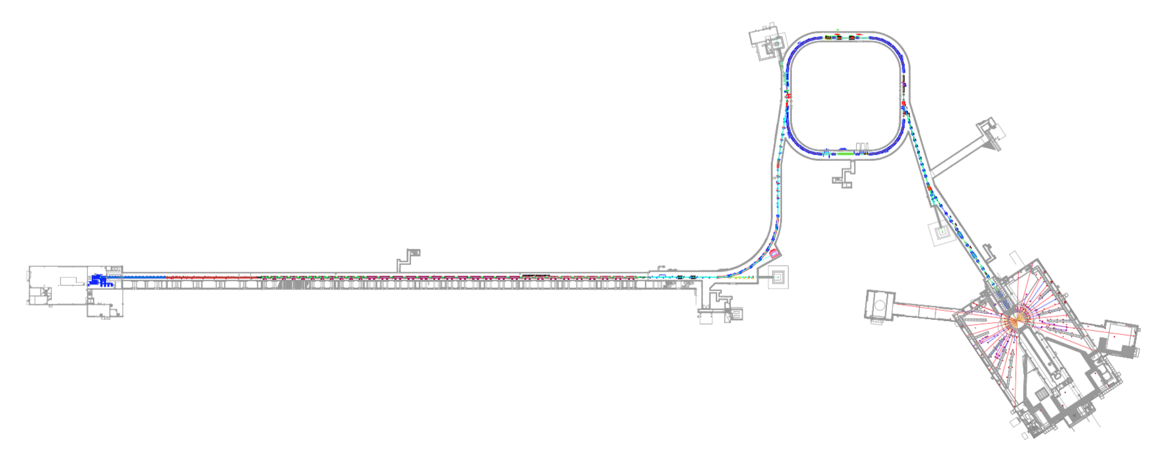
Residual activation levels in the machine must be managed for sustainable high-power operation
1.3 MW until 3 to 5 hours before survey
Sept. 22, 2015
All numbers are mrem/h at 30 cm
100 mrem/h = 1 mSv/h
90
coll. straight
1000
inj kicker
80
Extr Sptm
1000
strip foil
50*
DH13
90
DH25
DTL
2 – 30
CCL
8 – 60
SCL mb
5 – 40
SCL hb
5 – 45
Ring
5 – 40
150*
QH26
5 – 35
HEBT
<5**
RTBT
5 – 25*
70
Slot 32
90
LEDP
50
After SCL-1
Except for a few hot spots, the dose rates are relatively low but improvements are needed
* 3 days after 1.3 MW
** No survey near this time,
indicated does rates are typical

Slide 19
SNS will operate Target 14 at 1.0 MW until October 1, 2016
Schedule is now official through September 30, 2016, for beam accounting purposes
Notes:
RAD

Slide 20
After a planned target change in early October 2016, SNS will operate Target 15 at 1.2 MW through March 2017 before the first facility extended outage for RFQ/IRP replacement
This strategy will permit us to obtain quantifiable erosion data from two different power levels for approximately equivalent numbers of beam pulses.
Notes:
RAD

Slide 21
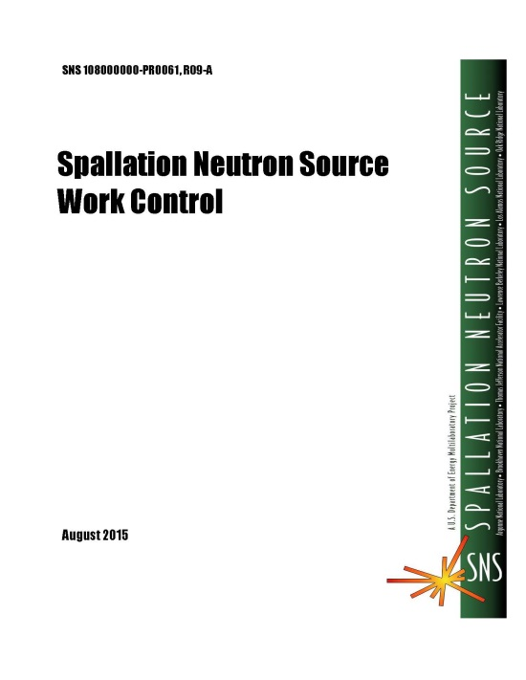
SNS Work Control improvement is underway
The active involvement of SNS staff is essential for success
The work control improvement team is having SNS staff review and improve all phases of its work. To date, staff reviews have included:
  The work control process map
  Work control needs and requirements
SNS work control functional and operational requirements for procedures and tools have been developed (June deliverable)
Tools
Roles
Training
Update & Integrate
V
Next Generation
SNS Work Control
June 2017
Notes:
RAD

Slide 22

The SNS Work Control improvement project is progressing well
Other Operations, Maintenance, & Services work control processes in use at ORNL were evaluated using the SNS work control process functional & operational requirements:
  ORNL Standards-Based Management System (SBMS)
  Nonreactor Nuclear Facilities (NNFD)
  High Flux Isotope Reactor (HFIR)
During August, the software tools used by these processes and those used by SNS will be evaluated against the SNS work control tool functional & operational requirements
Tools
Roles
Training
Update & Integrate
V
Next Generation
SNS Work Control
June 2017

Slide 23


Recordable and DART cases within NScD are consistent with laboratory averages
NSD at SNS - Total Injuries per FY
 | NC | FA | TRC | DART | Total injuries
FY12 | 4 | 4 | 4 | 0 | 12
FY13 | 6 | 5 | 2 | 0 | 13
FY14 | 7 | 4 | 3 | 0 | 14
FY15 | 3 | 2 | 2 | 0 | 7
FY16* | 1 | 1 | 3 | 2 | 5
ORNL Rate: TRC= 0.75; DART= 0.28
NSD @ SNS: TRC= 0.77; DART= 0.26

Slide 24
SNS has seen an increase in both TRC and DART in 2016 principally due to two events
Employee struck on head by falling object during elevated work in the klystron gallery – in depth investigation and change to work practices
Employee injured knee when stepping on a roof to inspect a job
NSD at SNS - Total Recordables per FY
 | TRC | DART | Hours worked
FY12 | 4 | 0 | 1,022,867
FY13 | 2 | 0 | 949,474
FY14 | 3 | 0 | 993,070
FY15 | 2 | 0 | 1,035,779
FY16 | 3 | 2 | 775,914
Notes:
Updated 5/18/16

Slide 25
ORNL recordable cases in 2015 were dominated by slips and falls during ice events – overall trends are generally constant

Slide 26
ORNL overall rates compare favorably with other DOE laboratories
July 2016
TRC - Total Recordable Case. the total number of work related injuries or illnesses that resulted in death, days away from work, job transfer or restriction or other recordable case.
DART - (Days Away, Restricted or on Job Transfer), the number of days away from work plus the number of days on restricted work activity or job transfer.

Slide 27
From June 2013 to June 2016 SNS reported 12 Occurrences and experienced 29 other significant* events (1)
H Gas Cabinet Burst Disk Rupture 7/26
Elevated Airborne Activity during Transfer Bay Entry 10/9
Cooling Loop Valve Line-up Error 9/30
Stopper Ejection in Lab C-261 1/23
Damaged BL-11A Collimator 7/1
Cut into Live Circuit at CUB 7/30
Dropped Tank 8/25
Incorrect IPPS Software Version BL-7 11/10
PPS Certification Failure 7/31
Sample Can Failure 12/4
Jun
2013
2013
2014
Dec 2014
PPS Operational issue at BL-1A and BL-11A 6/3
Unexpected Discharge of Cryogenic Liquid He 6/21
Hand Contam. after handling samples 8/7
Pump Failures Sensible DI Water 11/26
Vacuum Event BL-18 8/14
Klystron Gallery Shock 9/16
PPS Key Exchange Failure 1/15
Target Failure 10/26
Warm Compressor Started without Interlocks 7/23
Unlabeled chemicals in BSM Labs 8/9
Target Failure 9/11
Water Leak to computer lab 6/18
Discovery of Exposed contacts on receptacles 11/5
*NScD/SNS has a strong commitment to learning from off-normal events by conducting fact-finding to determine opportunities for improvement
Legend: ORPS Events Non-ORPS Events

Slide 28
From June 2013 to June 2016 SNS reported 12 occurrences and experienced 29 other significant events (2)
Tunnel Entry w/out sign-in 7/14/15
Mild Shock at Chopper cage 11/5
Servo-manipulator hoist Trapped by X-fer Bay Shield Door 5/19
User brought unauthorized sample 2/25
User vented sample outside propped door 8/29
Head Trauma – falling tool 10/2
Crane Interference 1/8
User took non-released sample 4/27
Target Failure 3/22
Jan
2015
2015
2016
June2016
Unexpected shutter opening BL-4A 2/4
RFTF Evacuation due to Vent of Liquid He 8/31
Research Mechanic receives oil spray 3/29
Inaccurate Sample Shipping Document 5/20
Powder transfer at beamline 6/15
Loss of Feeder power 8/18
2 events – User took samples 2/9 and 2/16
Work Control – check valve maintenance 8/18
Personnel Contamination – Transfer Bay exit 4/8
Sample handling has received significant attention
Legend: ORPS Events Non-ORPS Events

Slide 29
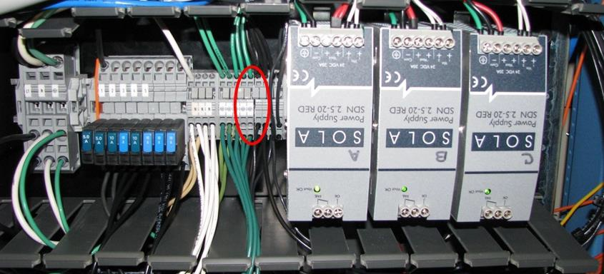
July 31, 2013 – Personnel Protection System (PPS) discovered to be non-operable
The PPS is a segmented, PLC-based Safety Interlock Level 2 (SIL-2) system that accepts inputs from sub-systems, applies control logic and provides state outputs to control machine configuration for safe operations
  A key design feature is redundant, independent legs (designated A and B)
  Inter-segment communication occurs in configuration-controlled equipment racks in the SNS Central Control Room
  A key design feature is redundant, independent legs (designated A and B)
Causal Factors: Multiple errors led to a system modification that resulted in a common mode failure
  Design error
  Screen out of USI process
  Procedural deficiency
  Implementation error
  Installation error
  Testing error

Slide 30
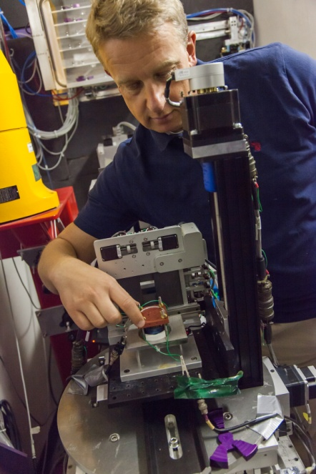
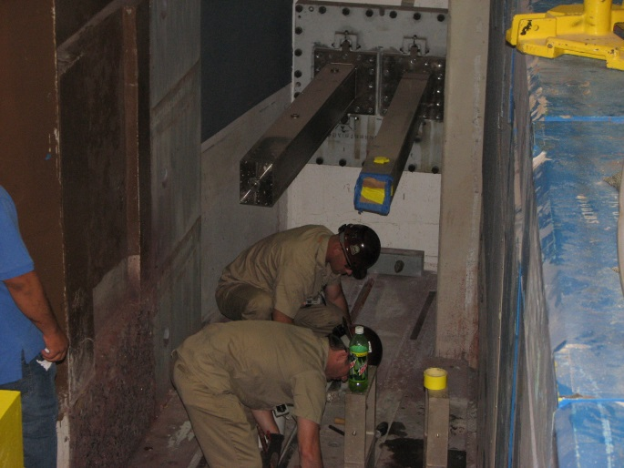
User safety is critical, and we have sound processes to facilitate success (1)
Every beam line must complete two Instrument Readiness Reviews before user operation can begin
  Commissioning review
  User Operation review
All proposals are reviewed by a team of safety professionals to ensure that the experiment can be performed safely
The recognized, best practice of developing Quick Start Guides for laboratory operations continues
We manage over 7000 user samples annually (almost 8700 since last July); samples are tracked from “cradle to grave” to prevent potential safety or legacy issues
Beamline training has been improved for consistent content and delivery across all beamlines
Notes:
-~1200-1500 Proposals allocated beam time.
e.g.NSSAC
Literally thousands of samples….hundreds of shipments

Slide 31
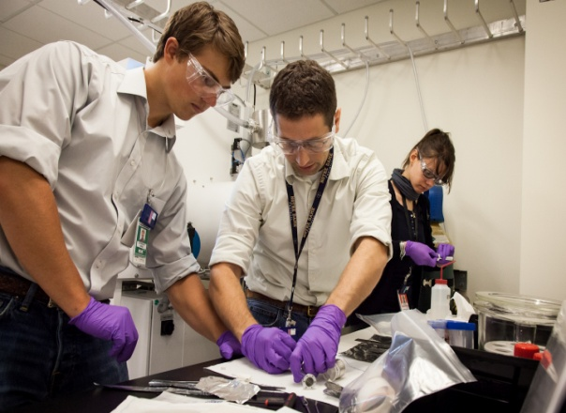
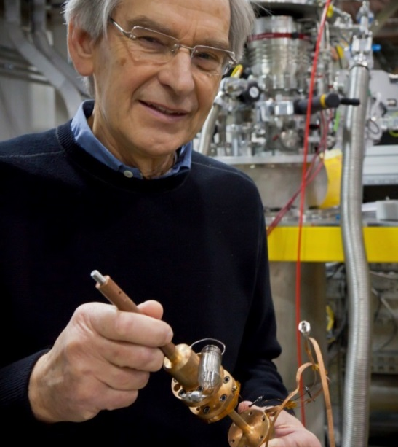
User safety is critical, and we have sound processes to facilitate success (2)
Thousands of general user beamline proposals have been reviewed, approved and experiments performed with no user illness or injuries
Lessons Learned from users, other user facilities and our advisory groups have been implemented (e.g., subject matter expert notification, pressure hazards, chemical hazards)
Additional emphasis on users “checking-in” their samples and equipment - proper management and disposition of samples and equipment is reviewed and users acknowledge with sample management acknowledgement (SMA)
The Experiment Safety Summary (ESS) is used to bridge applicable Instrument Research Safety Summary (RSS) hazards for each experiment – the ESS is reviewed with staff and signed by the users prior to beginning their experiment
Notes:
-~1200-1500 Proposals allocated beam time.
e.g.NSSAC
Literally thousands of samples….hundreds of shipments

Slide 32
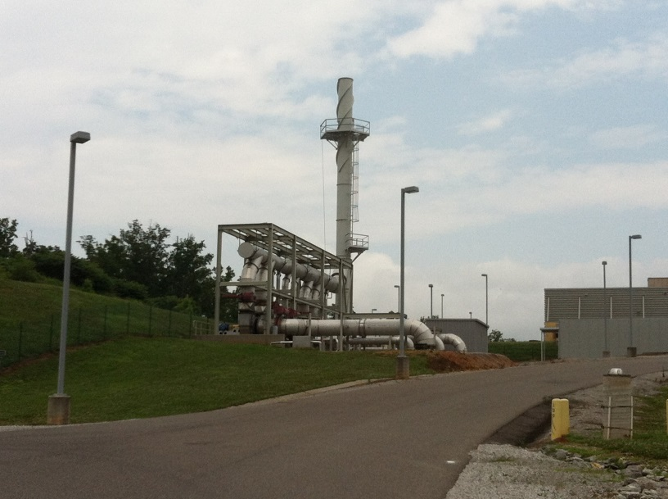
Our environmental monitoring programs support compliance with federal and state requirements
Rad NESHAPs Program
Groundwater monitoring program was implemented in 2004
  Low concentrations of radionuclides detected during baseline and subsequent operations
  Results remain consistent and significantly below Drinking Water Standards and Derived Concentration Standards
Year | Dose (mrem)
2010 | 0.051
2011 | 0.073
2012 | 0.110
2013 | 0.180
2014 | 0.400
2015 | 0.106

Slide 33
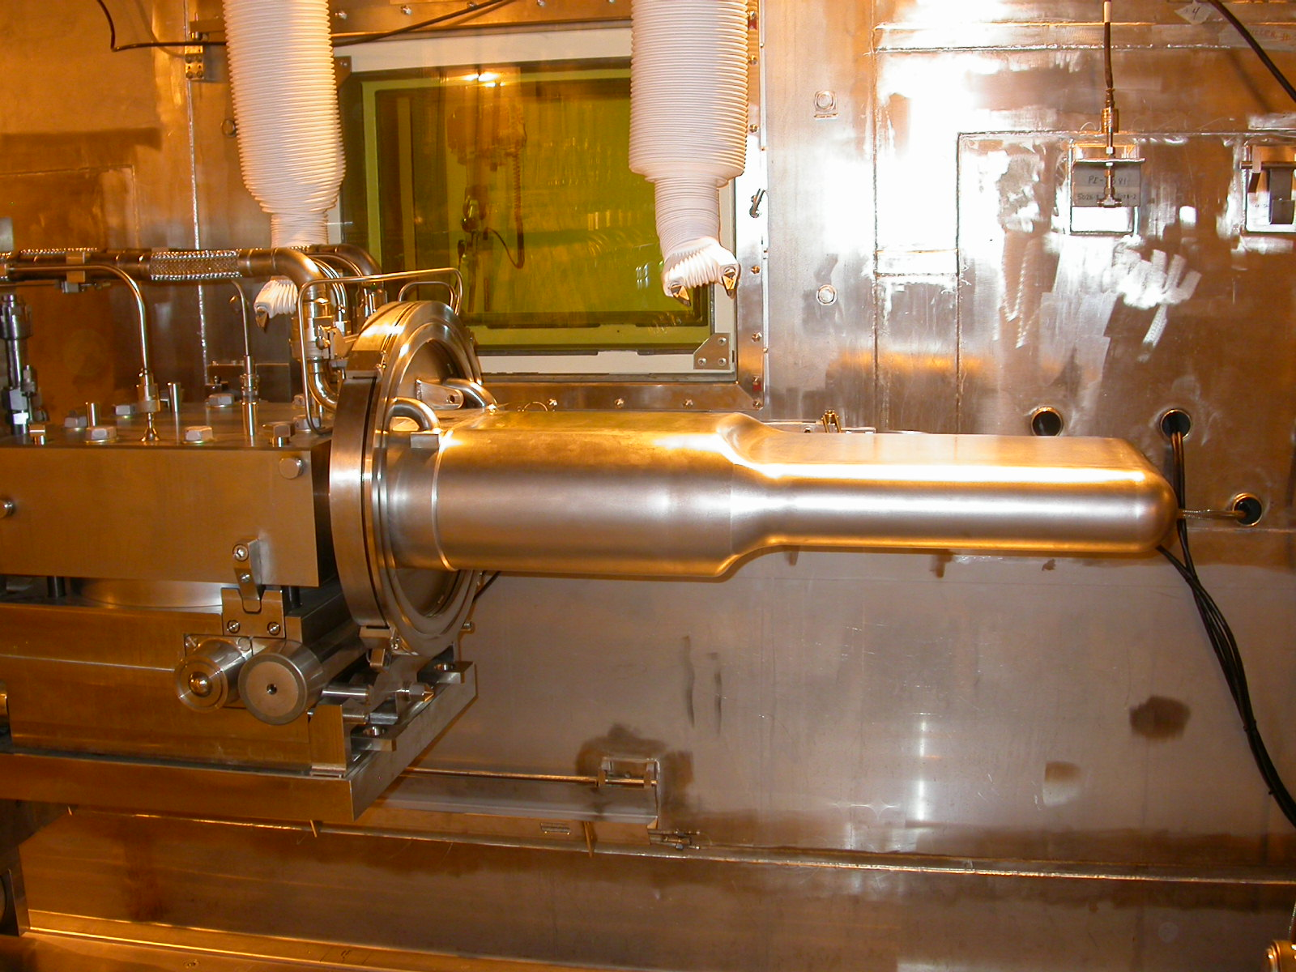
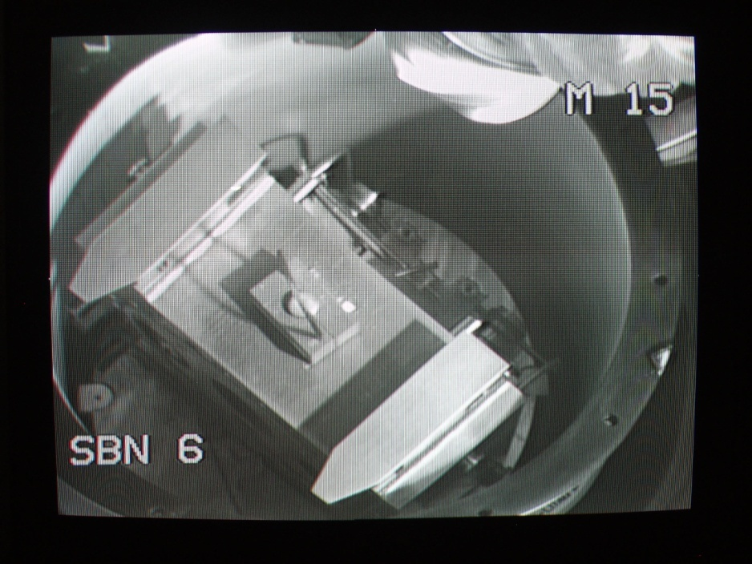
SNS aggressively manages disposition of waste to prevent accumulation
Solid wastes generated at SNS fall into four major categories. All categories have pathways to disposition:
  Sanitary/Industrial Waste (ORR Landfill)
  Low Level Waste (Clive, Utah; Nevada National Security Site [NNSS])
  Mixed Low Level Waste (Clive, Utah)
  Hazardous (no rad added) (Commercial Vendors)

Slide 34
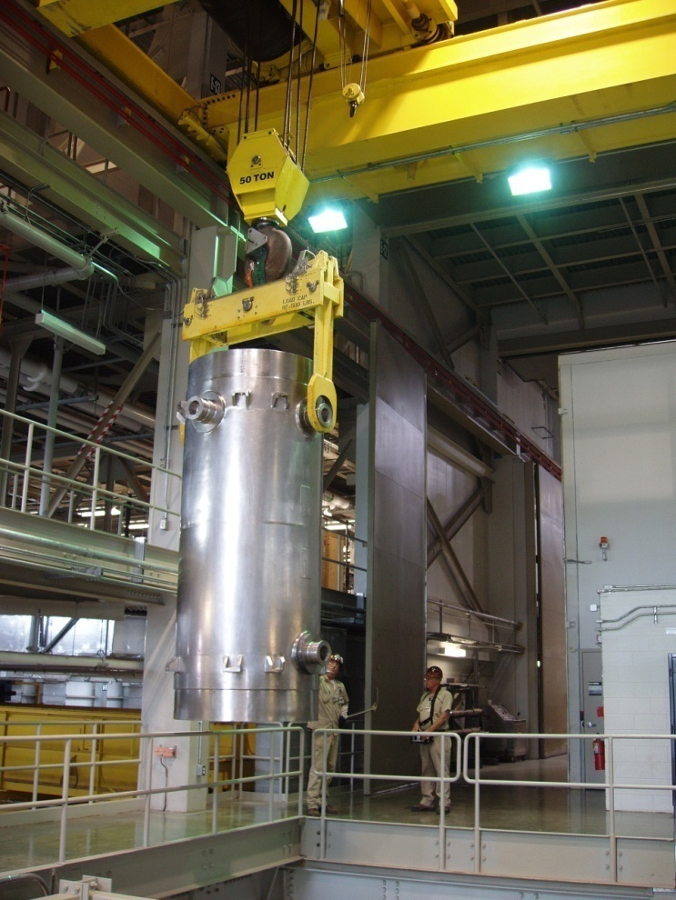
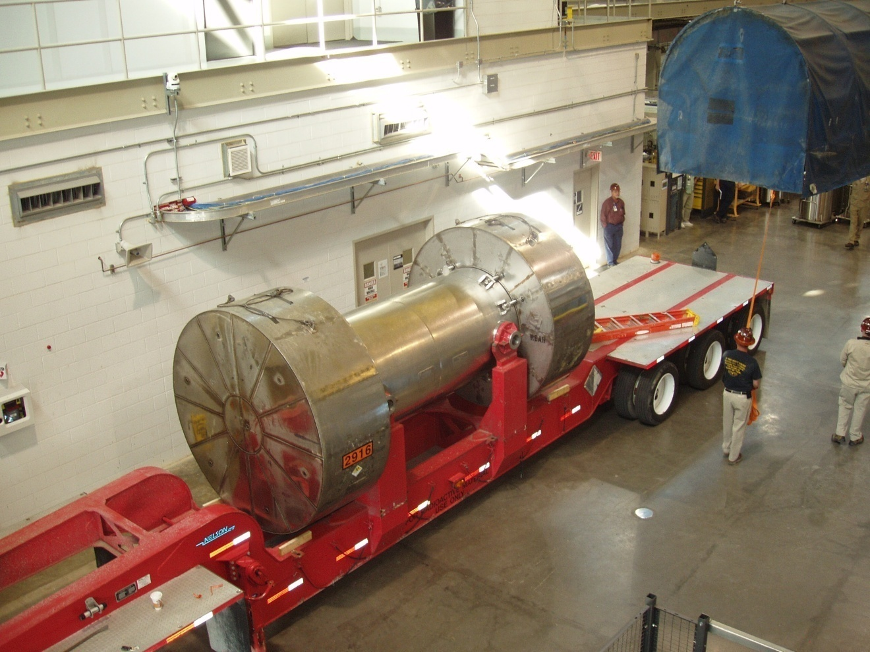
Target and proton beam window disposition is done at NNSS using a certified shipping cask

Slide 35
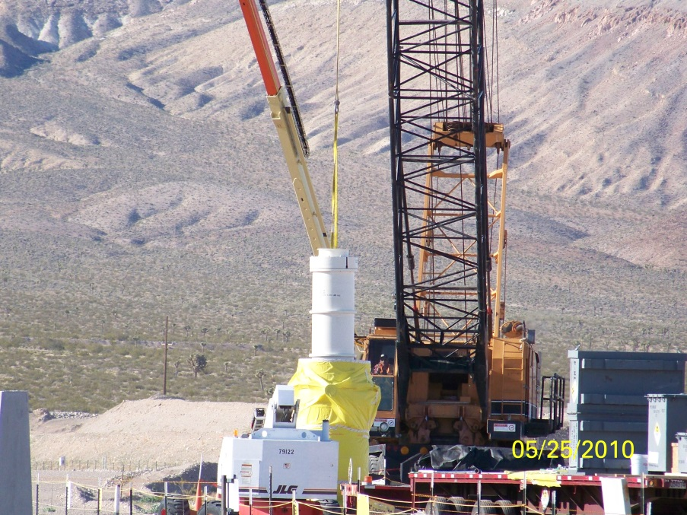
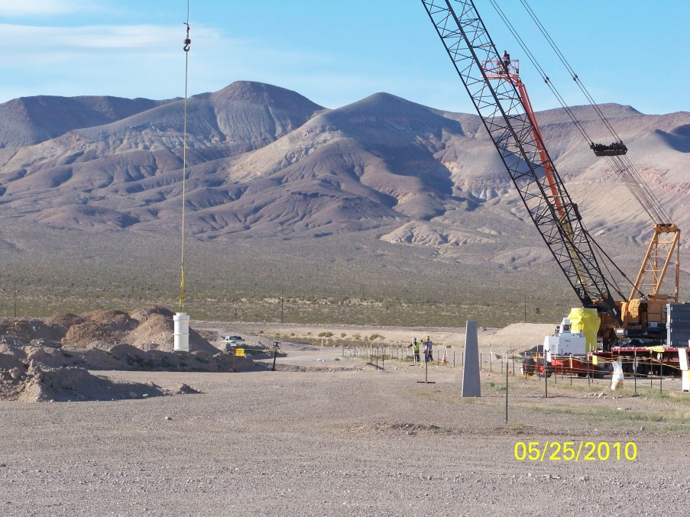
Liners containing the waste are buried at NNSS
SNS has shipped twelve target modules and four proton beam windows to NNSS
The shipments of target modules 13-14 and proton beam window 5 are currently scheduled for FY17

Slide 36
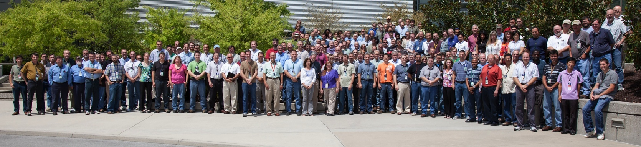
Summary
We have a strong safety, environmental compliance and waste management record
We can operate reproducibly with beam power up to 1.4 MW and reliability ~ 90%
While we meet or exceed operating commitments many significant challenges remain
Our immediate focus is predictable and reliable operation at powers above 1 MW (subject to target limitations)
Our medium term effort will achieve reliable 1.4 MW operation by 2018 with adequate operating margin
The hard work, dedication and talent of the SNS staff, coupled with a commitment to safe operation, enable these achievements

