Slide 1
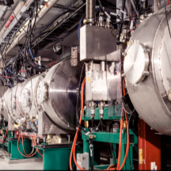
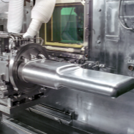
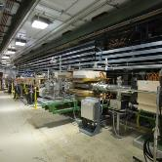
Jefferson Lab Perspective
Director’s Review of the Proton Power Upgrade Project
Stuart Henderson for the JLab Team
Director, Jefferson Lab
August 3 - 5, 2021

Slide 2
My Perspective
We have an excellent team in place to ensure successful execution of SNS-PPU
Jefferson Lab is committed to the success of SNS-PPU
PPU Team has support of Jefferson Lab
Assurance process in place and working
Excellent progress is being made and remaining challenges -- principally clean assembly to avoid field emission -- are being met
We are enthusiastic partners
Eager to see nearly two decades of improvements in technology and processes reflected in SNS-PPU performance

Slide 3
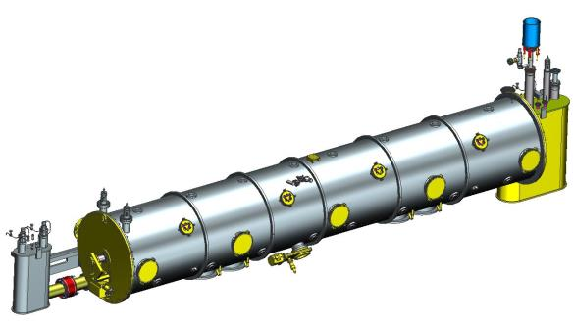
Excellent progress is being made
Excellent collaboration with ORNL colleagues since September 2018
Jefferson Lab SNS-PPU Scope:
Designing, procuring, assembling, low-power testing/shipping of 8 PPU High Beta CMs
Added 8th CM to overall scope in April 2021
Design efforts completed on schedule in 2019
Shipping tests completed successfully in 2021
Procurement activities are progressing very well
Procurements are nearly complete for first 7 CMs
Production has ramped up
Qualified 17 of 30 cavities with excellent results
Particular attention to clean assembly to avoid field emission
On track to deliver first CM in FEB-2022 (~60% complete)
A big year ahead (FY22): on-track to receive/test remaining cavities, build 8 cavity strings and deliver 4 cryomodules
More details on CM Production Progress in the Break Out Talk
B1-3 Daly

Slide 4
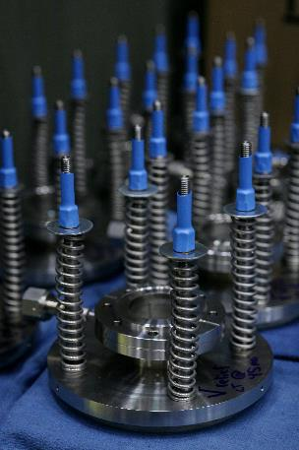
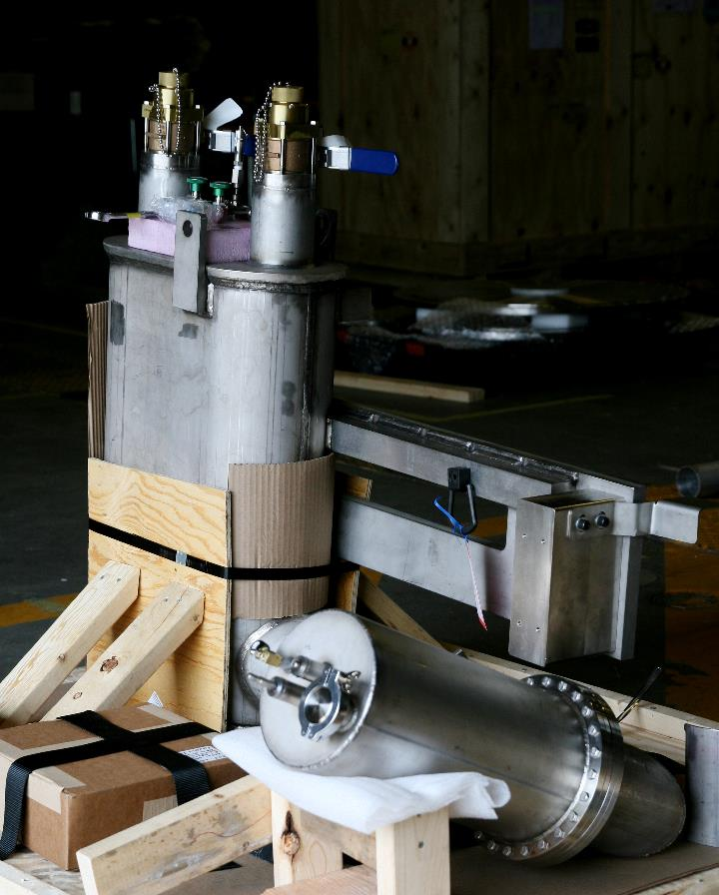
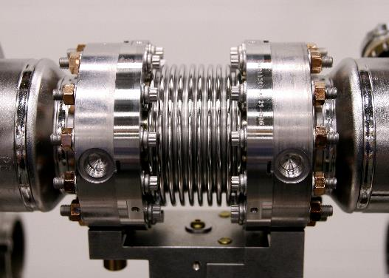
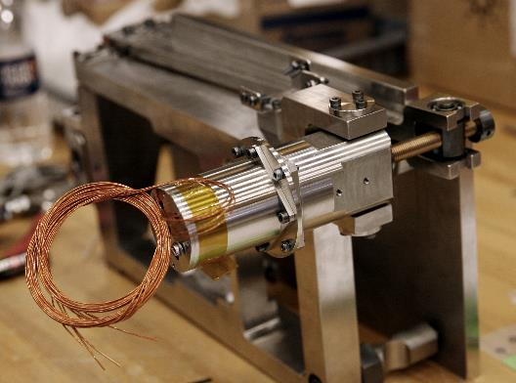
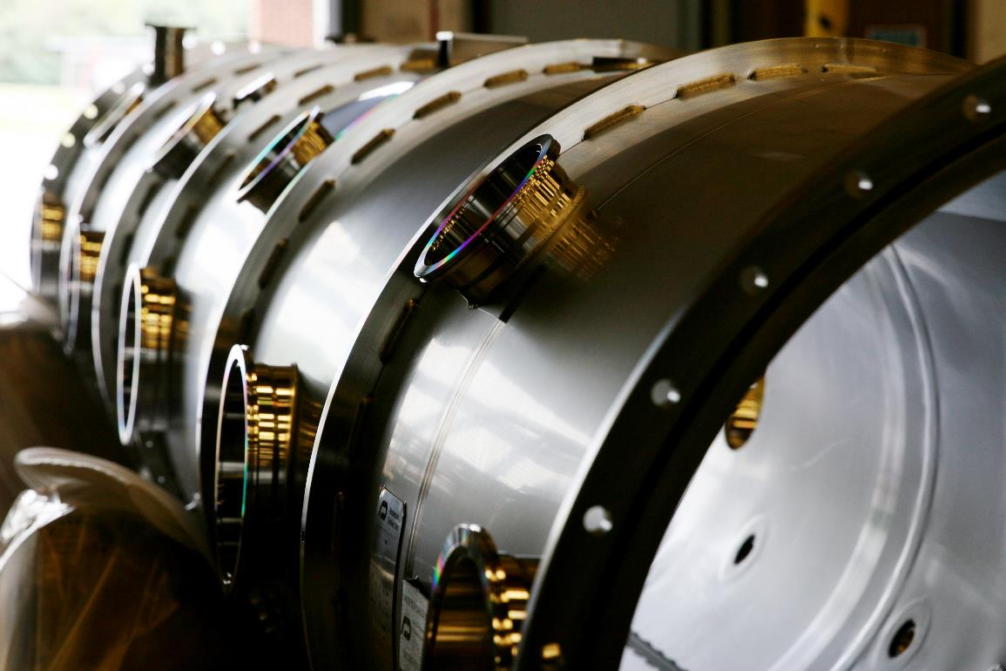
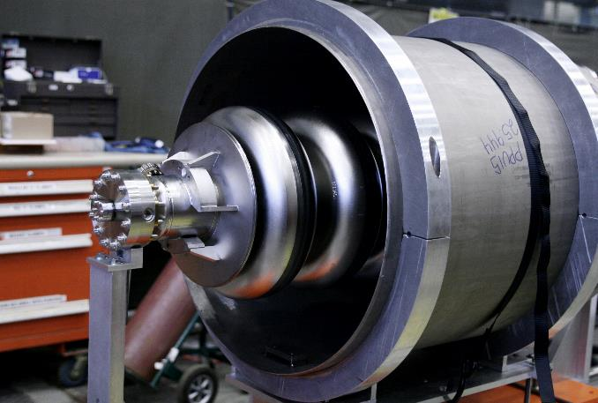
Procurement Progress
Clockwise from right: lift plate reliefs; supply end can; cavity inside helium vessel; vacuum vessel; tuner motor and frame; beamline bellows

Slide 5
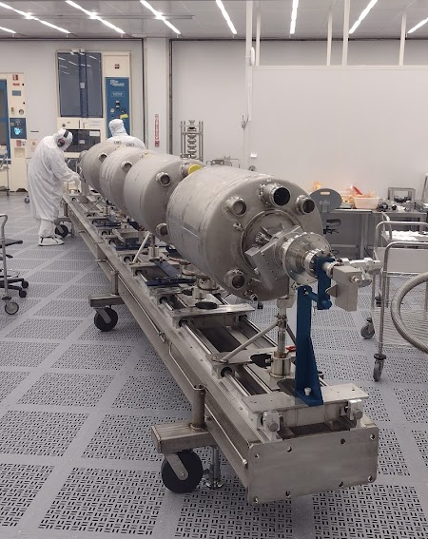
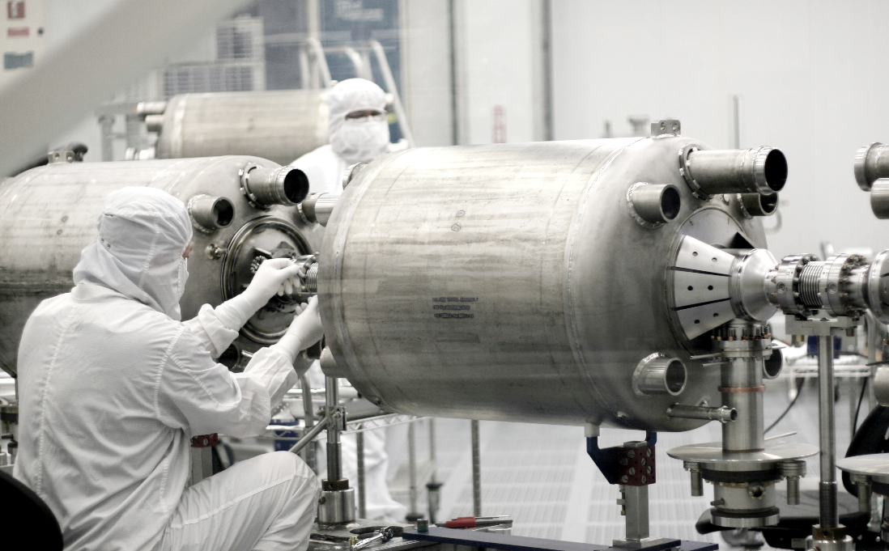
String Assembly
Cavity string assembly: String #1 (bottom) and String #2 (right)

Slide 6
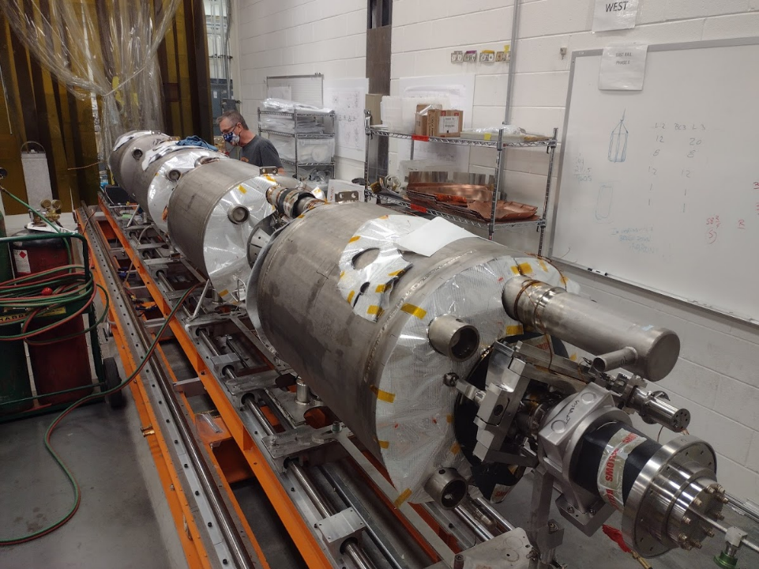
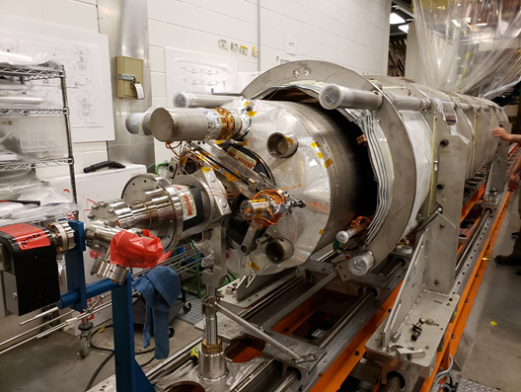
CM Production
CM-01 Cold Mass Assembly in Progress
CM-01 Space Frame Assembly Test-Fit

Slide 7
Questions?

