Slide 1
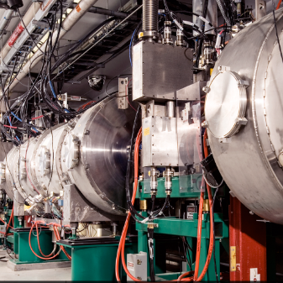
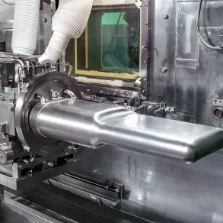
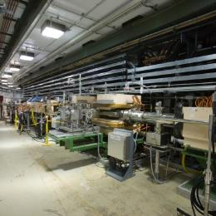

Project Management
DOE/SC Independent Project Review of the Proton Power Upgrade Project
Mark Champion
Project Manager
Level 2 Manager for P.1 Project Management
September 14–17, 2021

Slide 2
Outline
Organization
Staffing
Cost and schedule
Contingency spend plan
Final design status
Storage
Risk register
Responses to recommendations
Summary

Slide 3
Integrated Project Team
Charge: 5
Harriet Kung
Linda Horton
Kurt Fisher
Linda Horton
Underlined team members meet regularly
Transition to new program manager and federal project director in April 2021
Hannibal Joma
(Ed Stevens previously)
Johnny Moore
Wendy Cain
(James Barnard previously)
Thomas Zacharia
John Galambos
Mark Champion
Sang-Ho Kim
Wayne Steffey

Slide 4
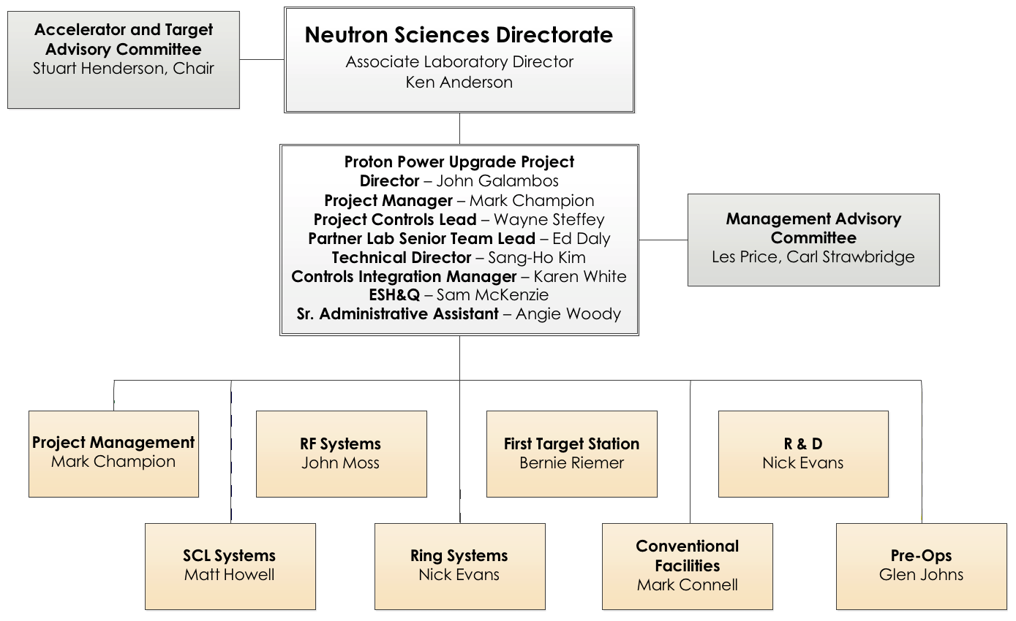
PPU Project Organization
Charge: 5
Talented, experienced team
Many team members participated in the SNS construction project and have extensive operations experience
(Not a PPU-only committee)

Slide 5
Organization
Details
Charge: 5
Accelerator and Target Advisory Committee
Stuart Henderson, Chair
Neutron Sciences Directorate
Associate Laboratory Director Ken Andersen
Proton Power Upgrade Project
Director – John Galambos
Project Manager – Mark Champion Project Controls Lead – Wayne Steffey Partner Lab Senior Team Lead – Ed Daly Technical Director – Sang-Ho Kim
Controls Integration Manager – Karen White
ESH&Q – Sam McKenzie
Sr. Administrative Assistant – Angie Woody
Stable experienced team with a few changes since last year
  Retirements, departures, and reassignments
Management Advisory Committee
Les Price, Carl Strawbridge
Project Management Mark Champion
SCL Systems
Matt Howell
RF Systems
John Moss
Ring Systems
Nick Evans
First Target Station
Bernie Riemer
Conventional Facilities Mark Connell
R & D
Nick Evans
Pre-Ops
Glen Johns
Project Support Wayne Steffey ESH& Q
Sam McKenzie
Cavities
John Mammosser
Cryomodules Ed Daly Cryogenics Brian Degraff Utility Systems Chris Stone
System Integration John Mammosser SCL Controls Karen White
SCL HPRF
John Moss
NCL HPRF
John Moss
LLRF
Mark Crofford Existing Linac Modulators Chris Pappas
New Linac Modulators David E. Anderson Utilities
Greg Norman RF Controls Karen White Global Controls
Karen White
Injection Region Robert Saethre Injection Dump Charlotte Barbier Extraction Region Robert Saethre Utilities
Greg Norman
Ring Control Systems
Karen White RTBT Stub Nick Evans
Accelerator Physics
Nick Evans
Neutronics Franz Gallmeier Mercury Process Makayla Edwards
Moderator Cryogenic Systems
Bernie Riemer(Interim) Vessel and Shielding Systems
Oscar Martinez
Target Utility Erica Ahlschwede Instrument Systems
Oscar Martinez
MOTS
Greg Stephens 2 MW Target Kevin Johns
Safety, Controls and Operations
Charlotte Barbier Gas Injection Development Charlotte Barbier
Building Modifications
Mark Connell
Gas Injection Development Charlotte Barbier Foil Development Nick Evans
Commissioning Glen Johns Regulatory Compliance Glen Johns
Changes since the CD-2/3 IPR

Slide 6
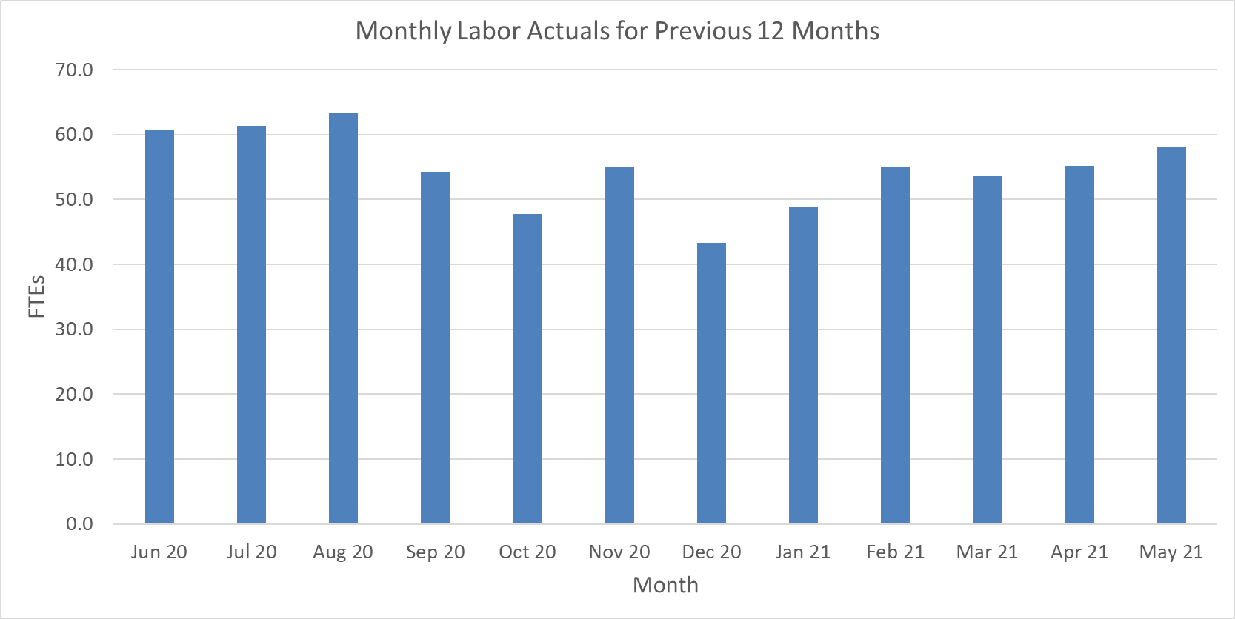
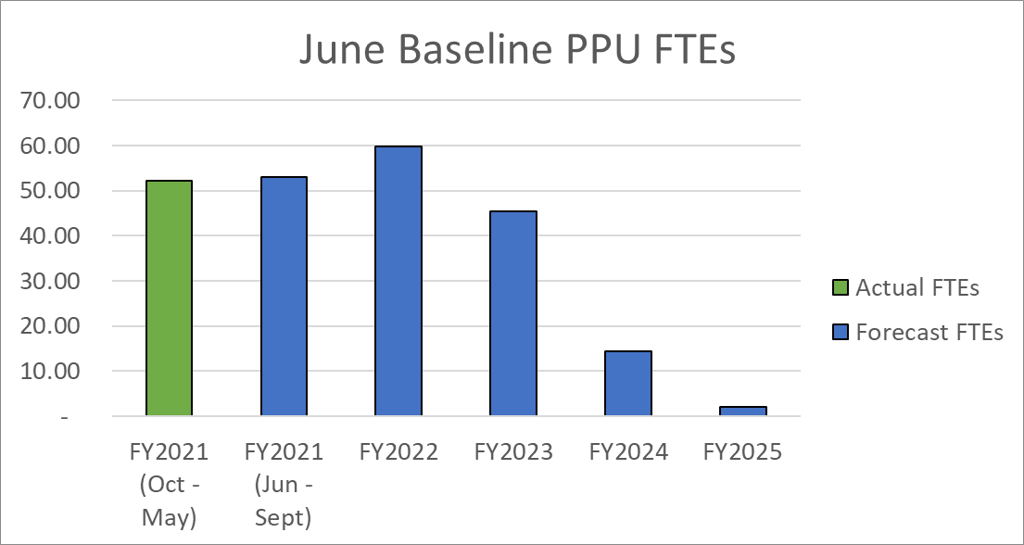
Matrixed work force is meeting project needs
Charge: 5
May data indicated 70 FTEs needed for remainder of FY21 (not feasible)
Project change request in June reduced this to 53 FTEs, which is in line with actuals over last year
RF system installation effort spread out over a longer period – no impact on early finish milestone
Average is 55 FTEs
Entire project team is matrixed. Most people have operations responsibilities in addition to PPU
Staffing peaks in FY22
(does not include partner lab labor)

Slide 7
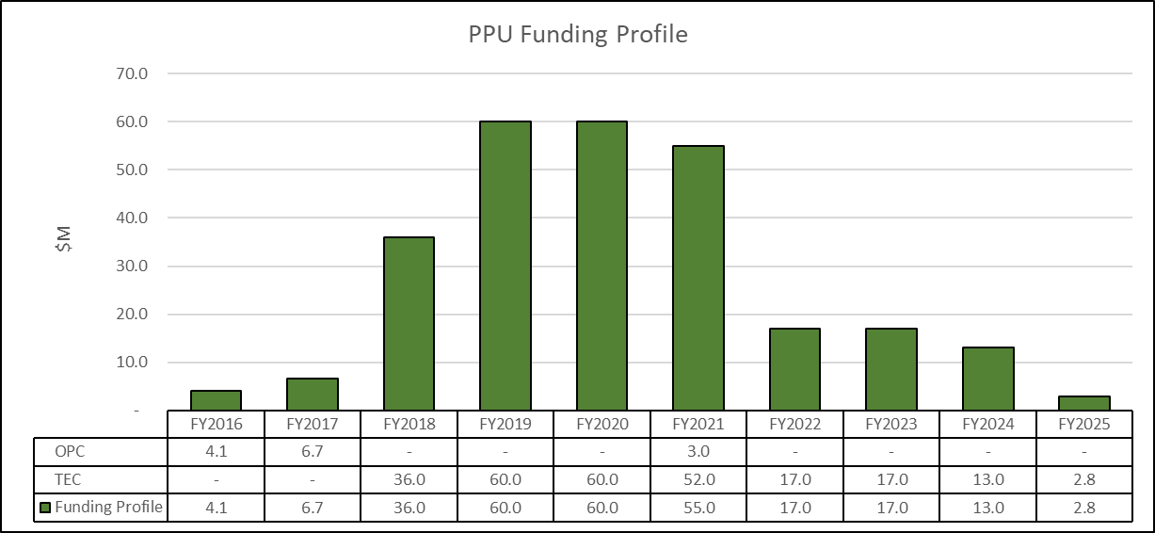
Project has received 82% of TPC through FY21
- $50M to go on total project cost of $271.6M
Charge: 4
Level 1 Milestone
s
Schedule
CD
-
0, Approve Mission Need
Jan 2009 (A)
CD
-
1, Approve Alternative Selection and Cost Range
Apr 2018 (A)
CD
-
3A, Approve Long Lead Procurement
Oct 2018 (A)
CD
-
3B, Approve Long Lead Procurement
Sep
2019
(A)
CD
-
2, Approve Performance Baseline
Oct
202
0 (A)
CD
-
3, Approve Start of Construction
Oct
2020
(A)
CD
-
4, Approve Project Completion
(Level 0 Milestone)
Q
4
FY202
8

Slide 8
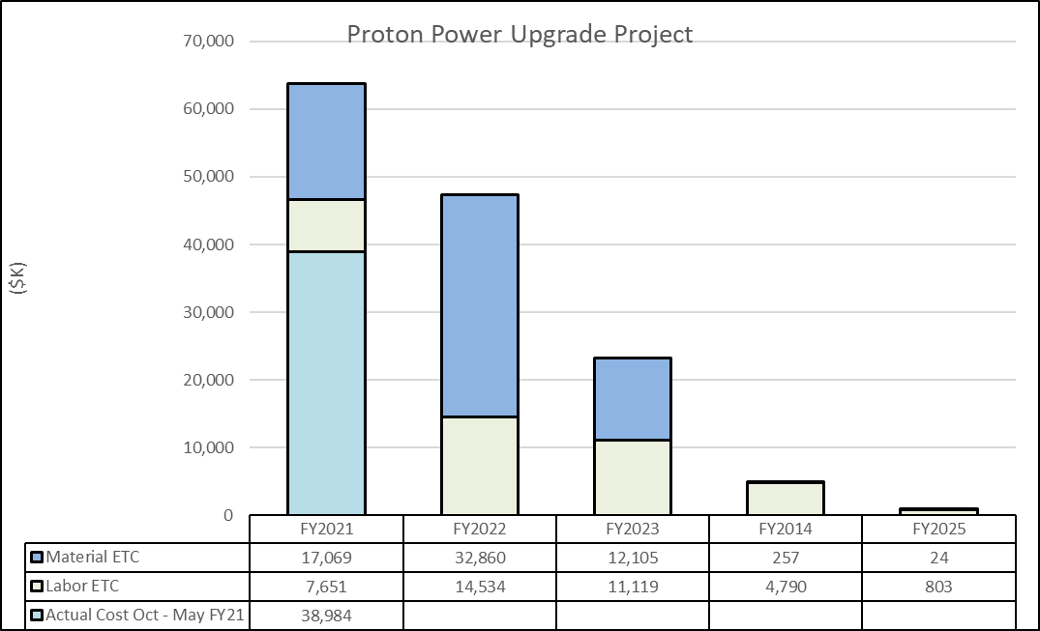
Cost estimate by fiscal year is supported by funding profile
Charge: 4
Decrease from FY21 to FY22 is driven by completion of CD-3B long lead procurements
FY21 bar shows plan forward plus actuals to date

Slide 9
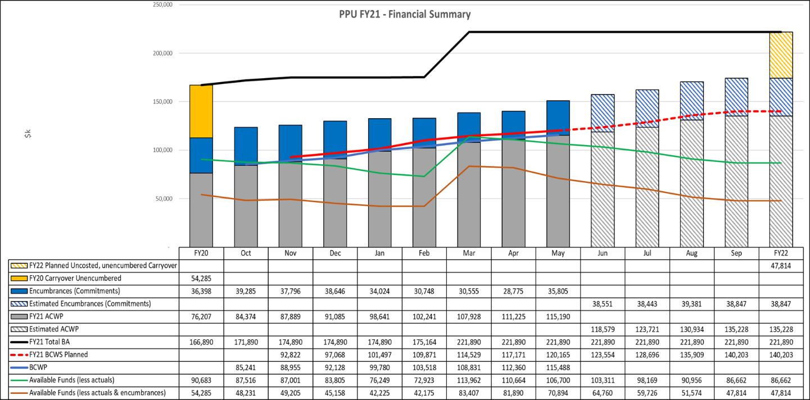
Fiscal year 2021 financial summary
Charge: 4
Carryover of $47.8M planned at end of FY21

Slide 10
Progress since CD-2/3
Charge: 4
Project advanced to 53% complete by cost (was 25% at CD-2/3)

Slide 11
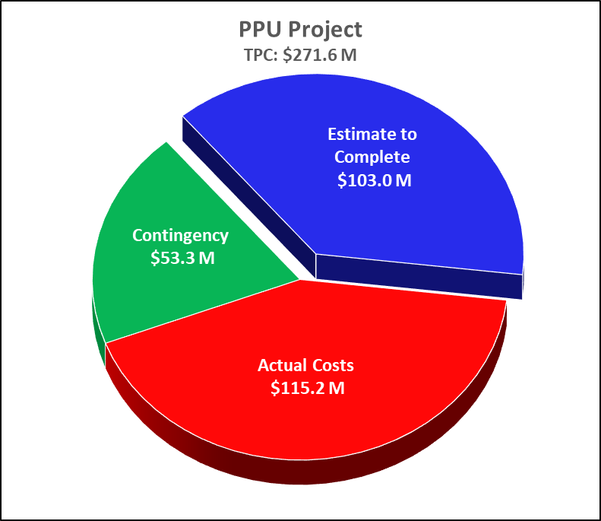
Summary Performance
Charge: 4
Actual Costs

Slide 12
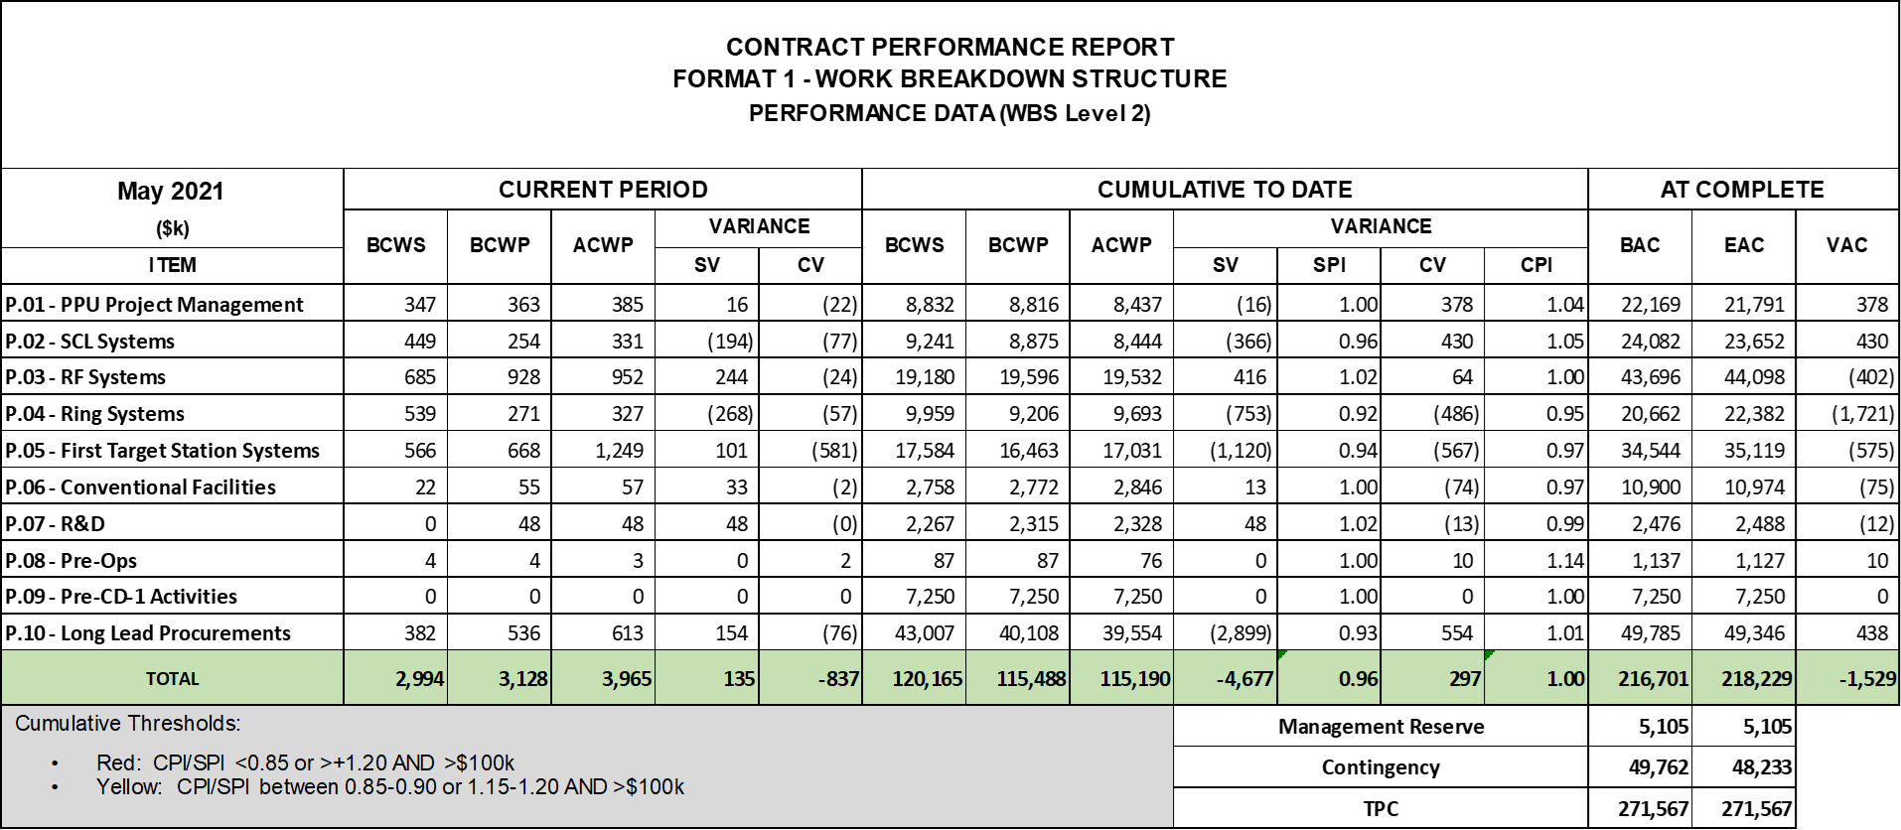
Project Performance by WBS Level 2: SPI=0.96, CPI=1.00
Charge: 4

Slide 13
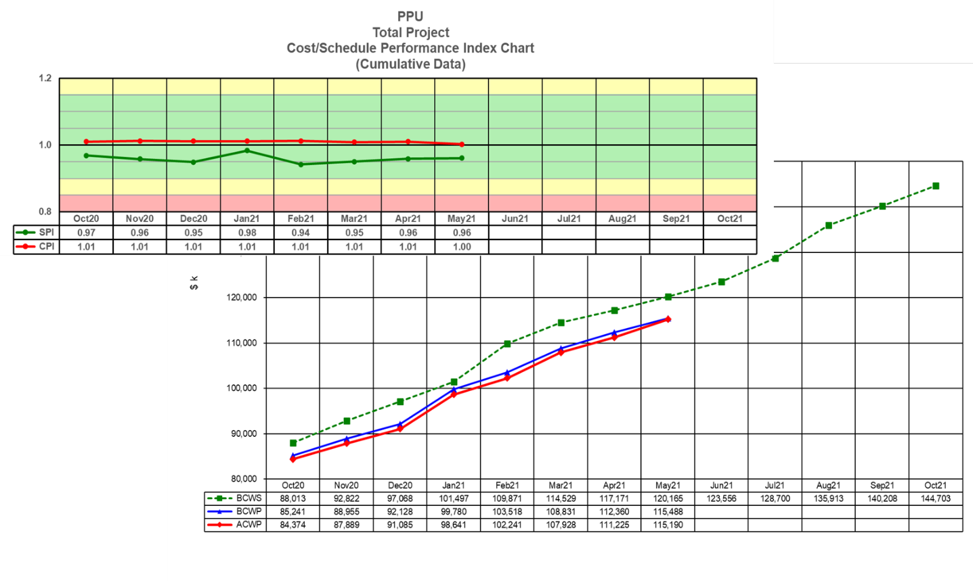
Fiscal year 2021 earned value performance is stable
Charge: 4

Slide 14
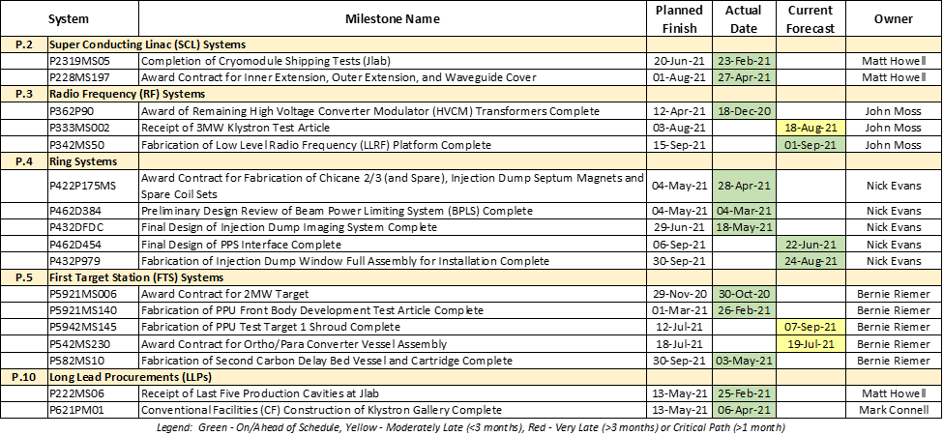
Annual DOE milestones are on track with a few minor delays
Charge: 5
3MW klystron schedule delays are caused by bottle-necking at the CPI cold test facility, a dynamic fabrication load at the factory, and a leak found in the vacuum oven at the start of the klystron processing. CPI has installed parallel cold testing lines to alleviate the bottleneck and has repaired the vacuum leak. The PPU RF team is actively working with CPI to recover the lost time and will be making a factory visit at the end of July during the 3MW factory acceptance testing.
Weld defects in the final electron beam weld of the PPU Test TT#1 water-cooled shroud were found by ORNL inspectors. After repair and reinspection, delivery of TT#1 is now anticipated at the end of August or beginning of September.
The solicitation for the Ortho/Para Converter Vessel Assembly was not issued in May. Issues with the procurement package documents
were resolved and the solicitation was issued in early June.

Slide 15
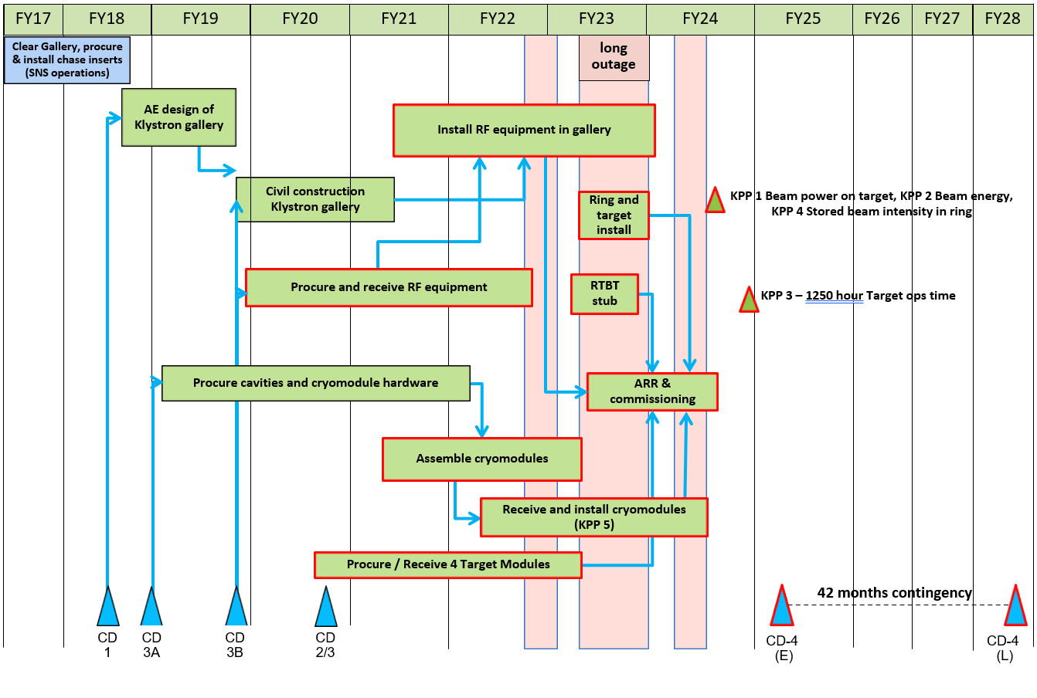
PPU May 2021 Status Summary Schedule
Charge: 5
Many parallel items are on or near the critical path
Long outage readiness is a key milestone supporting achievement of the project early finish in February 2025
B8-2 Steffey
Now
Must be performed during outage

Slide 16
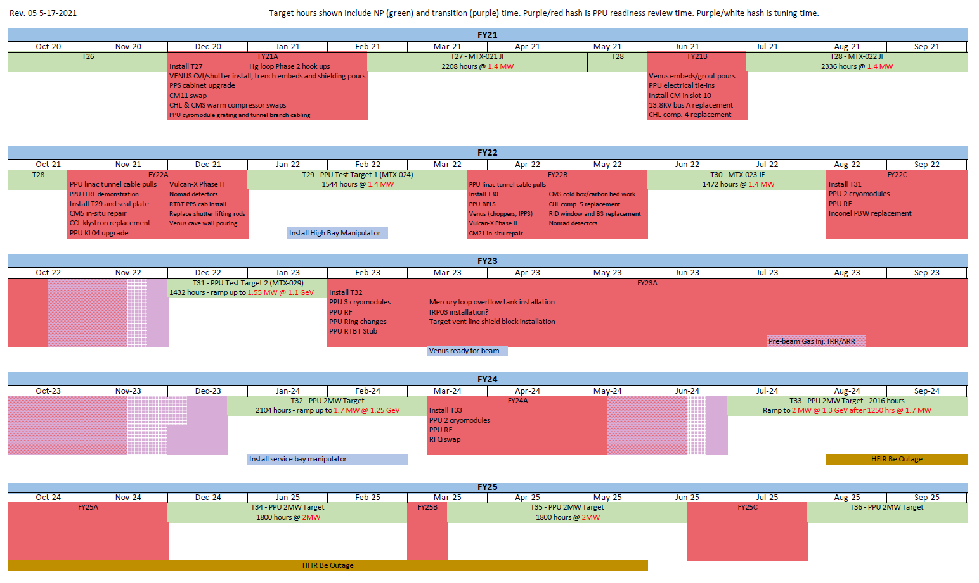
SNS operations and PPU schedules are synchronized
Charge: 5
Directorate level negotiation with input from BES
PPU early finish prioritized
Project change request processed in May
Early finish slipped 3 weeks relative to CD-2/3 baseline
  $280k cost increase
B8-7 Champion, B8-8 Johns

Slide 17
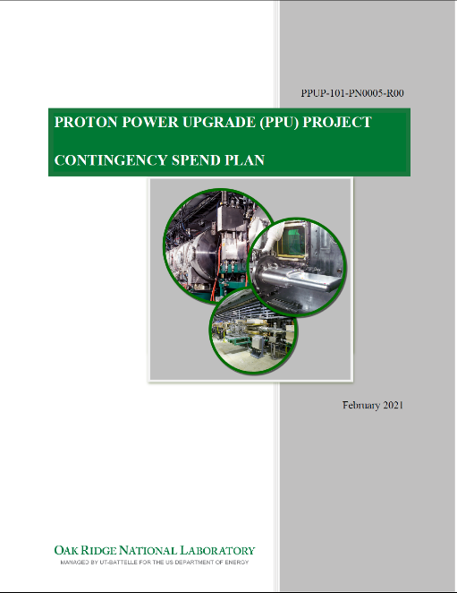
Contingency spend plan developed to effectively utilize funds as risks are retired
Charge: 5
As defined in the Project Execution Plan (PEP):
  Contingency may be used “to optimize the scientific capability or substantially improve the performance, reliability, or functionality within the overall facility design and mission need including spares acquisition.”
  Requires federal project director approval
Project management team determines scope and timeline of contingency spending as risks are retired
Contingency use committee (project and directorate management teams) evaluates proposals
Spending decisions are communicated to BES
Spreadsheet of spares and other potential improvements exists and offers a menu of spending opportunities
  Critical and Operational/Economic spares total $42M

Slide 18
Contingency is adequate to cover remaining risks based on risk analysis
Charge: 5
Greenwood: B8-3

Slide 19
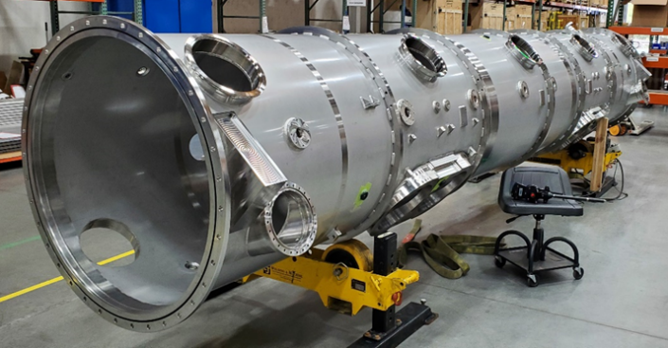
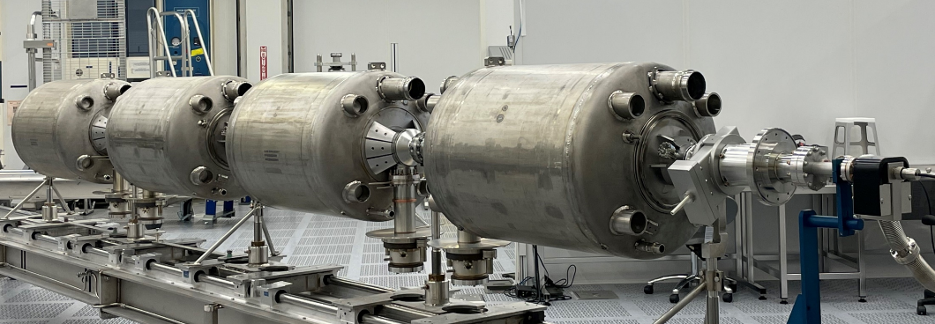
Spare Cryomodule has been added to project scope
Charge: 5
First major use of contingency in category of spares, optimization, or improvement as defined in the Project Execution Plan (PEP)
Project change request processed in April
  $2.95M
  Extends Jefferson Lab schedule by 30 days
Cryomodule vacuum vessel
Cryomodule cavity string

Slide 20
Final design reviews were completed for RF, Ring, and FTS systems
Final design reviews
  Injection dump quadrupole and power supply, Jul. 20………………………………………2020
  Target safety, controls, and operations – part 1, Sep. 4
  Low-level radio-frequency control system, Sep. 16-17
  Injection dump septum magnet, Sep. 18
  Moderator cryogenic system, Sep. 17-18
  Existing high-voltage converter modulator upgrade, Sep. 22
  Target safety, controls, and operations – part 2, Oct. 30
  Mercury off-gas treatment system cold trap and crane, Jan. 15…………………………...2021
  Target utility systems basement electrical upgrades, Mar. 18
  Target gas panel 10, May 13
  Target in-cell gas supply hardware, May 26
  Ring personnel protection system, Jun. 10
Other notable reviews
  Preliminary design review for Beam Power Limit System, Mar. 2-4
  Independent review of decision to remove the gas liquid separator
  from project scope, Apr. 21

Slide 21
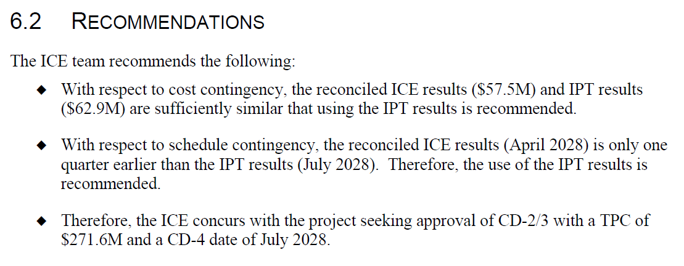
Independent cost estimate (ICE) review successfully completed following the CD-2/3 IPR
ICE Review, July 21-24, 2020
Positive final report received in October supported CD-2/3 approval

Slide 22
Final design is 98% complete (was 92% at CD-2/3)
Remaining design work in
  P.4 Ring Systems
  P.5 First Target Station Systems
Technical risk and cost for these items is low
Production procurements are authorized only after achieving final design
Readiness is confirmed via:
  Completion of final design review and recommendations addressed
  Completion of procurement readiness review where applicable
  Approval of federal project director, as stated in the Project Execution Plan
B4-1 Evans, B2-1 Riemer
Final design reviews completed since the CD-2/3 IPR

Slide 23
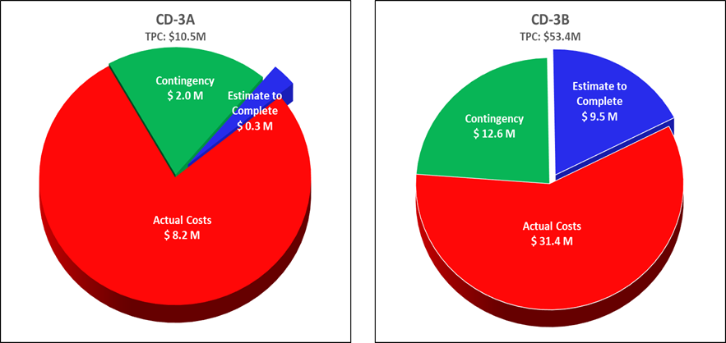
Procurements are progressing according to plan with some vendor delays
Project early finish is planned for February 2025
  So far, vendor performance supports the early finish
CD-3A long lead procurements
  Cavities, couplers, supporting hardware
CD-3B long lead procurements
  Klystron gallery construction
  RF system procurements
  Cryomodule production
SNS procurements to date total $106M
(63% complete)
JLab procurements to date total $9.85M
(98% complete, excluding spare cryomodule)
B8-5 Camfield

Slide 24
PPU has secured all needed storage space on the SNS site
Charge: 5
Previously, it was planned to utilize conditioned storage space in the 7000 area of the main campus at a budgeted cost of $400k
Negotiations with NScD management resulted in a commitment of 9000 sq ft of conditioned storage space at SNS in exchange for PPU‑supported addition of air conditioning to the RATS-II building
  HVAC upgrade work was completed in June
This reduced PPU storage costs,
improved the RATS-II building, and
simplified on-site transportation of
PPU equipment
The RATS-II building utilization has
been optimized, and some
Operations equipment was
moved to the 7000 area

Slide 25
Risk register is reviewed and updated regularly
Charge: 5
Forty-nine risks
  80 Threats and 16 Opportunities have been retired. 6 Threats and 3 Opportunities have been realized.
  Pre-Mitigated Ranking: 11 Low, 34 Medium, 4 High
  Post-Mitigated Ranking: 24 Low, 23 Medium, 2 High
High Risks
  COVID-19 Impacts Project Cost or Schedule
    Mitigation: Frequent vendor communication, use of alternate vendors if needed, vendor oversight by local experts, vaccinations, masking, social distancing, and work-from-home.
  Fermilab has competing projects or resource issues
    Mitigation: Maintain good communication between PPU and Fermilab so that schedule challenges can be discovered early and mitigated. Engage project management and Fermilab management as needed to ensure this work receives adequate priority. Perform periodic visits to Fermilab to assess progress
Key risk categories analyzed
  Vendor delivery delays
  Budget cycle
  Resource availability
B8-3 Greenwood

Slide 26
Top-10 Risk Summary
Charge: 5
B8-3 Greenwood

Slide 27
Top-10 Risk Summary
Charge: 5
B8-3 Greenwood

Slide 28
Responses to Recommendations
Charge: 6
CD-2/3 Independent Project Review (IPR)
  Five recommendations have been addressed and closed
  One recommendation is being addressed in this review
CD-2/3 Director’s Review
  Eight recommendations have been addressed and closed
Prior Reviews
  All recommendations from prior IPRs and Director’s reviews have been addressed and closed
B8-4 - McKenzie

Slide 29
12-Month Look-Ahead at CD-2/3 IPR
Charges: 1, 5
Receive CD-2/3 approval Yes
Long lead procurements nearly complete Yes
Complete klystron gallery construction; begin installation of technical equipment Yes
First cryomodules in production Yes
Complete final designs and initiate related production procurements
Much progress, but a few items have not achieved final design
Manage the project for success; adapt as needed to meet challenges and risks Yes

Slide 30
Current 12-month look-ahead
Charges: 1, 5
Four cryomodules received and tested at SNS
  Two cryomodules ready for installation in the tunnel in August 2022
Completed installation of all phase-1 RF equipment
  High power testing of transmitters 30 and 31 scheduled for late summer 2022
Nearly all RF system components received
Completed remaining Ring and FTS design work and issue procurements
Injection dump imaging system installed
Installed and operated PPU Test Target #1
Engaged with construction contractors for RTBT stub

Slide 31
Summary
The project team is fully staffed and successfully executing project responsibilities
Management systems and processes are in place
Procurements are progressing according to plan
Risks and action items are tracked and updated appropriately
The project is baselined, and construction is underway
ES&H performance is good
Project cost and schedule metrics are good
  Need to maintain cost and schedule performance without sacrificing safety or quality

