Slide 1
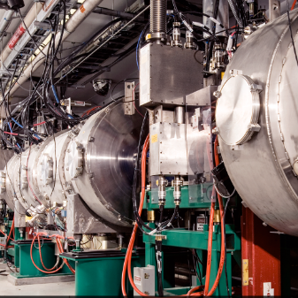
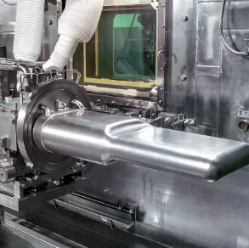
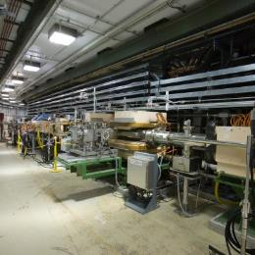

P.02.06. System Integration
DOE/SC Independent Project Review of the Proton Power Upgrade Project
John Mammosser
Level 3 Manager for Systems Integration
September 14-17, 2021

Slide 2
Outline
Scope
Organization
Progress since CD 2/3
Challenges
Final design status
Installation plans
Cost and schedule
Labor profile
Risk register
Responses to recommendations
ESH&Q and COVID-19 impacts
12-month look-ahead
Summary

Slide 3
Scope
Charge: 1
P.02.06.02 Completed Cryomodule Testing
  Perform incoming inspection of the PPU cryomodules
  Manage the 2K test cycle for each of the 8 cryomodules in the test cave
P.02.06.03 Cryomodule in Tunnel
  Procure cryomodule stands and saddles (CD 3b scope)
  Install stands in tunnel (CD 3b scope)
  Procure coupler cooling hardware for each cryomodule
  Install cryomodules (2-3-2) scheme
    Labor for installation of cryomodules in the tunnel

Slide 4
Scope Cont’d
Charge: 1
P.02.06.04 Cryomodules Testing in Tunnel
  Conditioning cryomodules for service
P.02.06.05 Plasma Process MB Cryomodule in Tunnel
  Procure RF and Vacuum Hardware (CD 3b scope)
  Develop Processing Procedure
  Implement Plasma Processing on 2 MB cryomodules

Slide 5
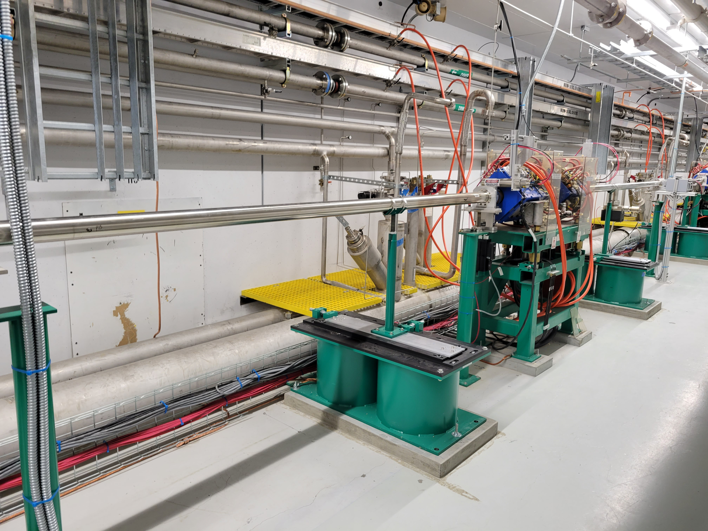
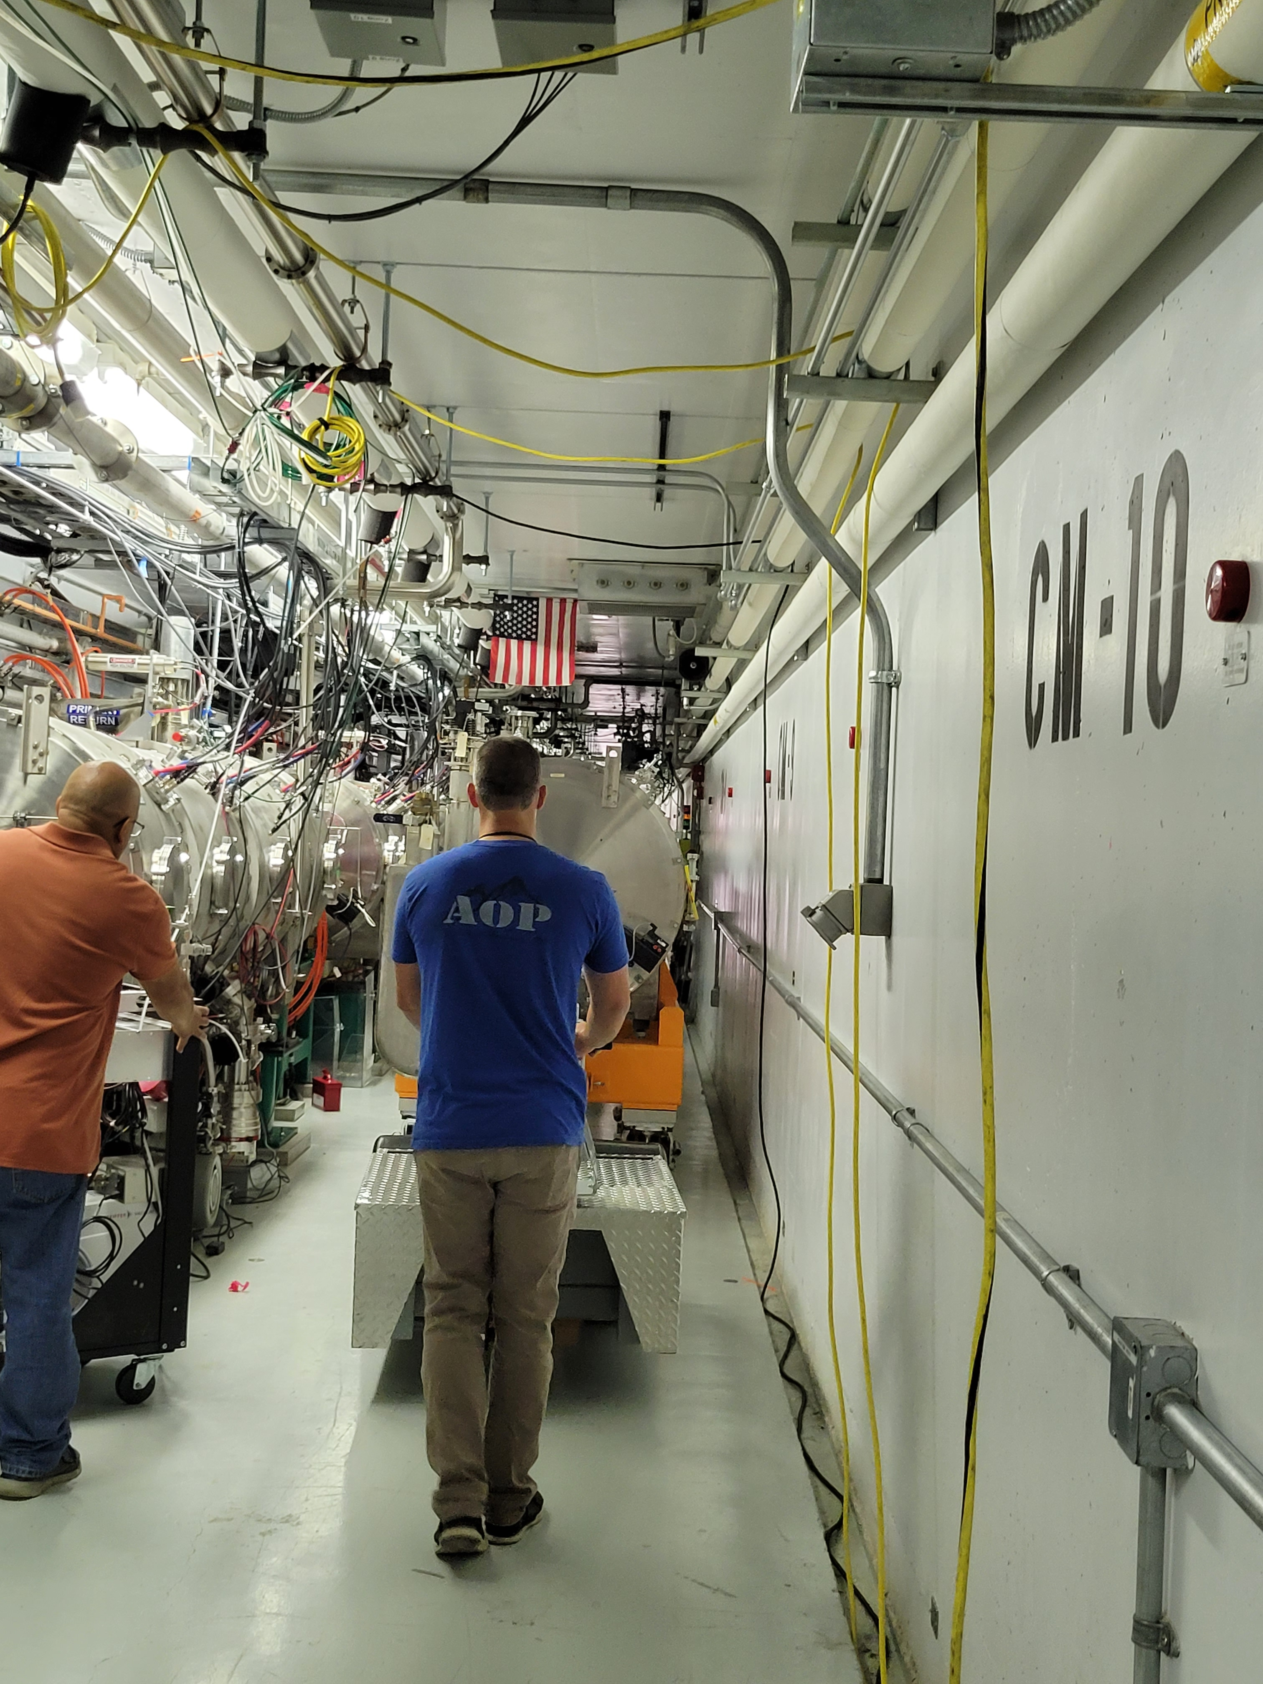
Hardware – Tunnel Installation
Tunnel cryomodule stands were installed in linac
Cryomodule stands installed in tunnel slots for PPU cryomodules
This is how PPU cryomodules will be moved in place

Slide 6
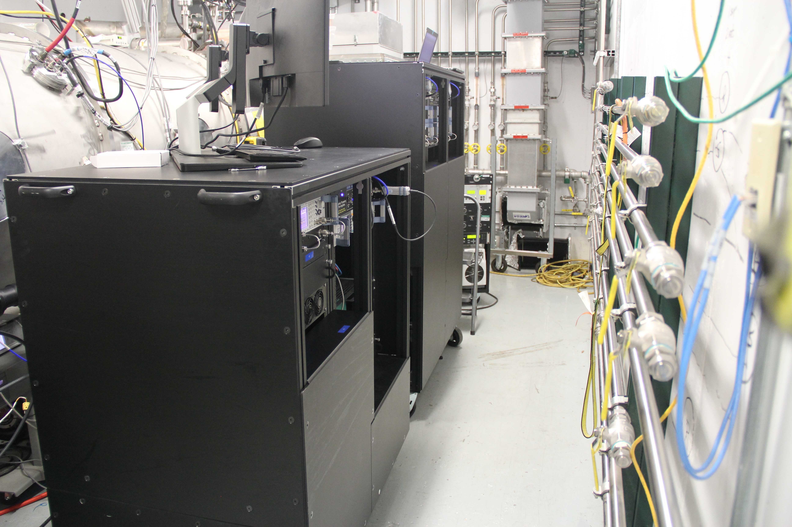
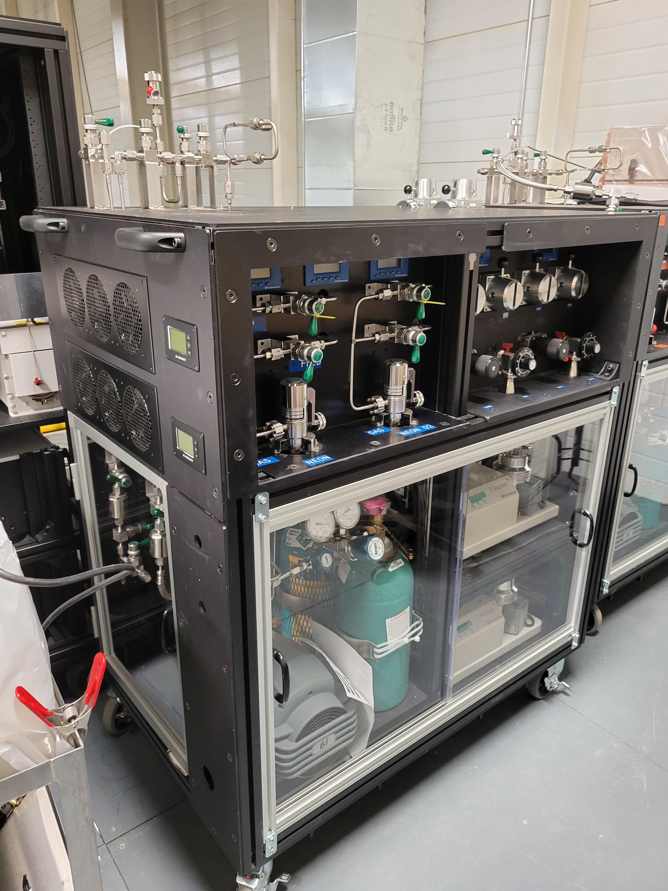
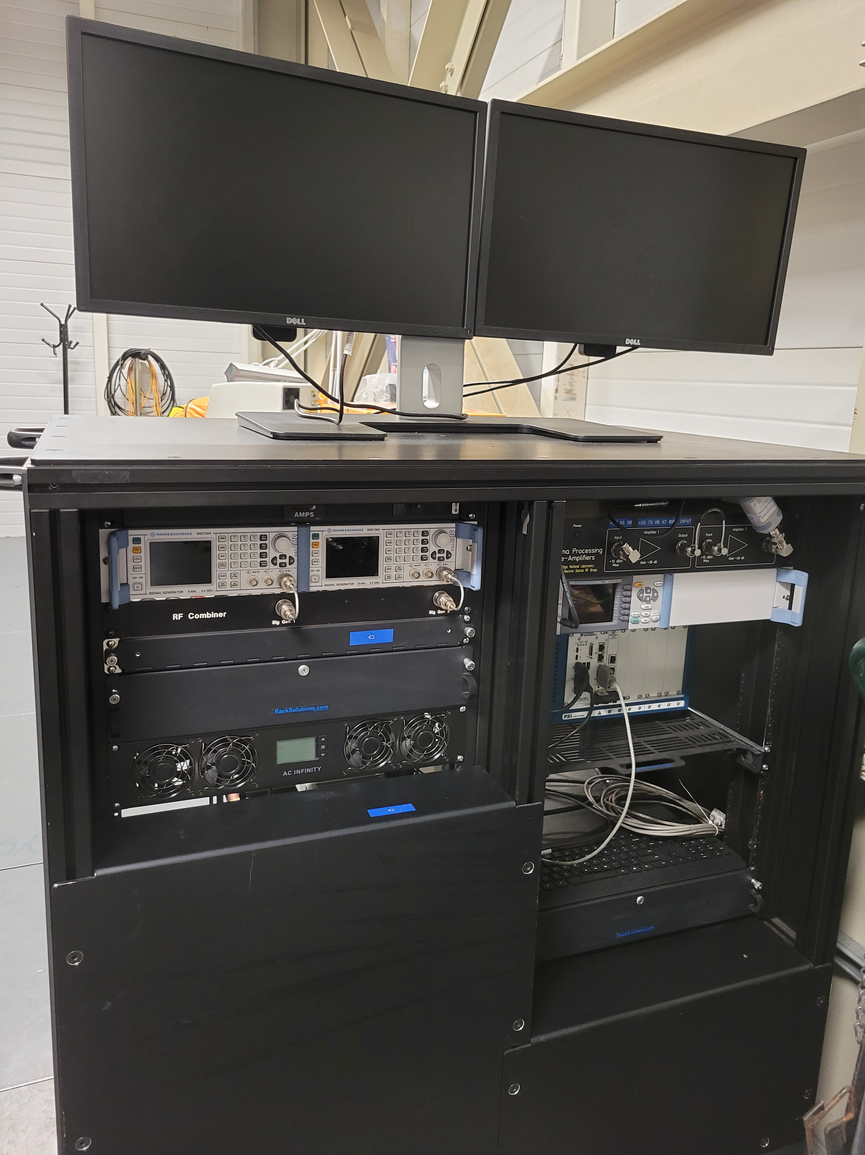
Hardware – Plasma Processing
Gas Cabinet
Plasma Processing of cryomodules in the test cave
RF Cabinet

Slide 7




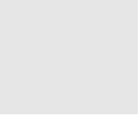
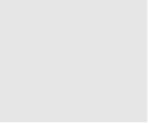


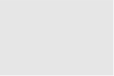
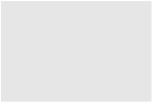


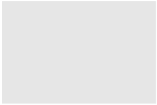

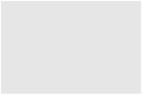
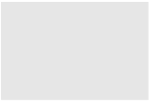











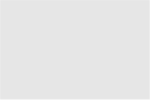




Organization
P.2 – SCL
Matt Howell
P.2.1
Management and System Integration Matt Howell
P.2.2 Cavities
John Mammosser
P.2.3
Cryomodules Integration Ed Daly
P.2.4
Cryogenics
Brian DeGraff
P.2.5 Utility Systems Chris Stone
P.2.6 System Integration
John Mammosser
P.2.7 SCL Controls Karen White
P.2.1.1
Management and System Integration
Matt Howell
P.2.2.1
Management and System Integration
John Mammosser
Partner Lab
P.2.4.1
Management and System Integration
Brian Degraff
P.2.5.1
Management and System Integration
Chris Stone
P.2.6.1
Management and System Integration
John Mammosser
P.2.7.1
Management and System Integration
Aaron Coleman
P.2.2.2 Cavity Procurement
John Mammosser
P.2.4.2 Cryogenic Components Brian Degraff
P.2.5.2 Beamline Vacuum
Chris Stone
P.2.6.2 Completed Cryomodule
Testing
John Mammosser
P.2.7.2 Linac Beamline Vacuum
Controls
Derrick Williams
P.2.2.4 Cavity Reprocessing
John Mammosser
P.2.4.3 Cryogenics System Testing
Brian Degraff
P.2.5.3 Insulating Vacuum System
Chris Stone
P.2.6.3
Cryomodule in Tunnel
John Mammosser
P.2.7.3 Linac Insulating Vacuum System Controls
Derrick Williams
P.2.2.5 Coupler Acquisition Yoon Kang
P.2.5.4 Water Systems Klent Pope
P.2.6.4
Cryomodule Testing in Tunnel John Mammosser
P.2.7.4
Cryomodule Controls Aaron Coleman
P.2.2.7 HTA Testing
Brian Degraff
P.2.6.5 Plasma Process MB Cryo. John Mammosser
P.2.2.8 Coupler Waveguide Transition Yoon Kang

Slide 8
Progress since CD 2/3
Charge: 1, 2
All cryomodule stands were procured and installed in the tunnel
All saddles were procured and shipped to Jefferson lab
Plasma processing hardware was procured
Plasma processing procedure was developed
Plasma processing was applied to two MB cryomodules CM01, CM10, gradient performance was improved as expected
  Both cryomodules are installed in the linac

Slide 9
Challenges
Main challenge is if cryomodules performance does not meet specifications, then additional repairs or testing may become necessary, and this can impact installation schedule for PPU

Slide 10
Final Design Status
Charge: 1
  Final design is complete for this WBS

Slide 11
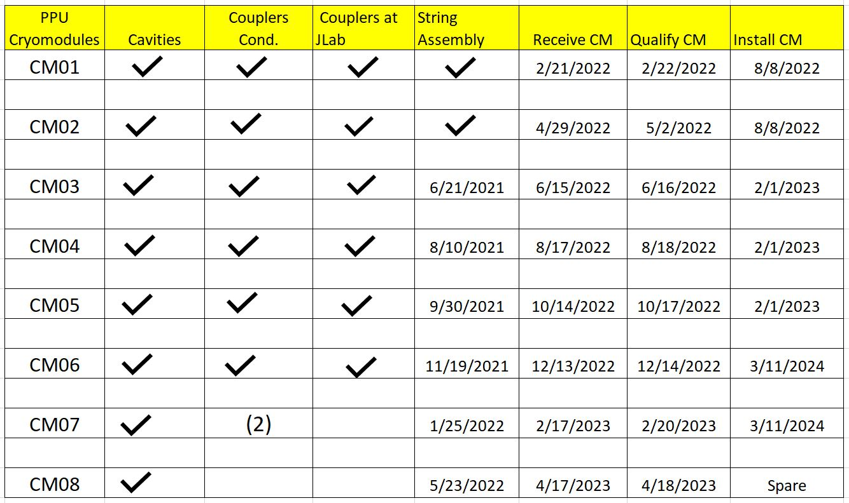

Slide 12
PPU Changes since CD 2/3
Charge: 4
In early phase of this WBS

Slide 13
Budget and Estimate to Complete
Charge: 4
Break down of P.02.06

Slide 14
Estimate to Complete by FY
Charge: 4
FY21 and FY22 scope completed early resulting in FY21 negative ETC

Slide 15
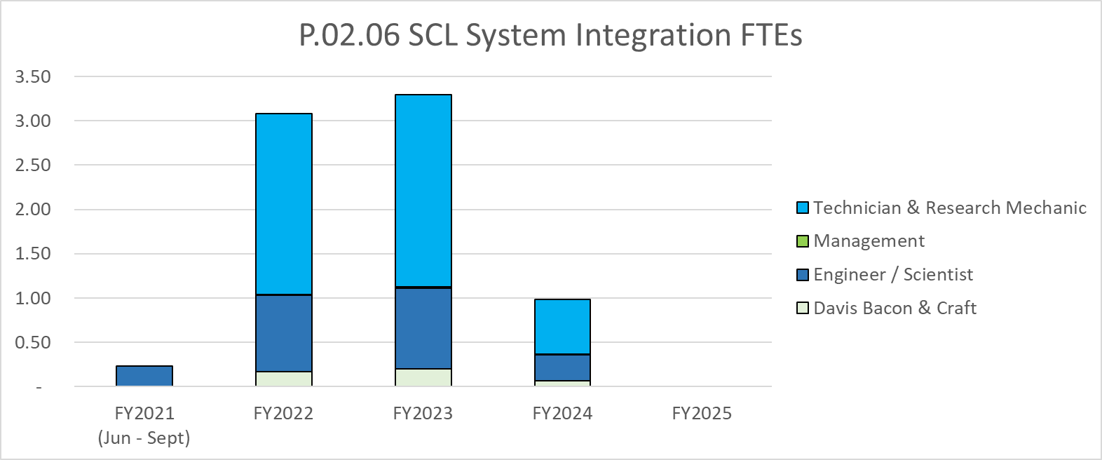
Labor Profile
Charge: 4
Labor increases during cryomodule receipt, test, and install

Slide 16
P.02.06 System Integration Risk Register
Charge: 1, 4
Risk ID | L3 WBS | Risk Title | Expiration Date | Mitigation | Pre-Mitigation Rank | Post Mitigation Rank
T-P.2-043 | P.02.06 | Cryomodule vacuum loss during testing or commissioning | 4/1/2024 | Install high beta spare CM in PPU CM slot and run at a limited gradient if needed | 4 | 4
T-P.2-028 | P.02.06 | Installation of Cryomodules | 12/1/2022 | Add overtime and add multiple shifts for installation tasks, as needed. | 3 | 2
T-P.2-041 | P.02.06 | CM is damaged during movement or testing | 4/1/2024 | Carefully plan and document the procedures for moving and testing of cryomodules. Ensure personnel are qualified to perform these activities. Ensure adequate front-line supervision. An eighth cryomodule was added as a spare to the plan to mitigate potential performances issues with CMs 1-7. | 2 | 2
T-P.2-026 | P.02.06 | Cryomodule Performance | 3/31/2023 | Plasma process and/or rework selected PPU cavities | 2 | 2
Four active risks identified
  One retired
  Pre-mitigated ranking: 4 Low
  Post-mitigated ranking: 4 Low
High Risks
  No high risks identified
Key risk categories analyzed
  Performance of cryomodules
  Damage from installation, testing or movement of equipment
Risks are reviewed on a regular basis

Slide 17
Responses to Recommendations
Charge: 6
No outstanding recommendations to address

Slide 18
ESH&Q and COVID-19 Impacts
Charge: 3
  ESH&Q
    SNS work control and planning will be incorporated in completing this effort
    Acceptance Criteria Listings (ACLs) have been generated for cryomodule receipt and test cave testing
      Any exceptions to these listings will be cause for an NCR as called out in the QAP
  No COVID impacts were encountered

Slide 19
12-Month Look-Ahead
Charge: 1
In the next year we will have received and tested the first four PPU cryomodules
In the next year we will have installed the first two PPU cryomodules in the linac

Slide 20
Summary
All cryomodule stands have been installed in the tunnel
All cryomodule saddles were received and shipped to Jefferson Lab
Plasma processing for MB cryomodules was developed and successfully implemented
We are ready for receiving, installing and qualifying new PPU cryomodules!!

