Slide 1




P.05 First Target Station Systems
DOE/SC Independent Project Review of the Proton Power Upgrade Project
Bernie Riemer
Level 2 Manager for FTS Systems
September 14-17, 2021

Slide 2
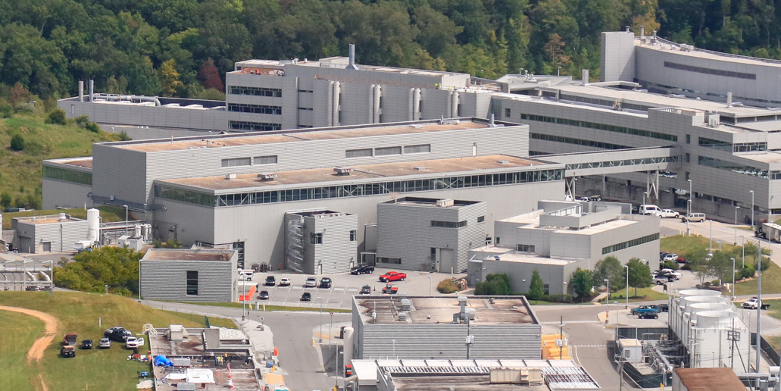
Outline
Scope
Organization
Progress since CD-2/3
Challenges
Final design status
Installation plans
Cost and schedule
Labor profile
Risk register
Responses to recommendations
ESH&Q and COVID-19 impacts
12-month look-ahead
Summary

Slide 3
PPU FTS Systems high-level requirements
Reliably operate the First Target Station at 2.0 MW with 1.3 GeV proton pulses delivered at 60 Hz
Assure consistent neutron pulses with LH₂ moderator catalysts and diagnostics
Confirm FTS facility lifetime extension from 40 to 60 years
– DONE ✓

Slide 4
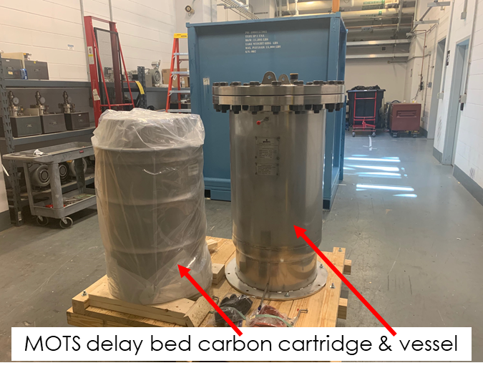
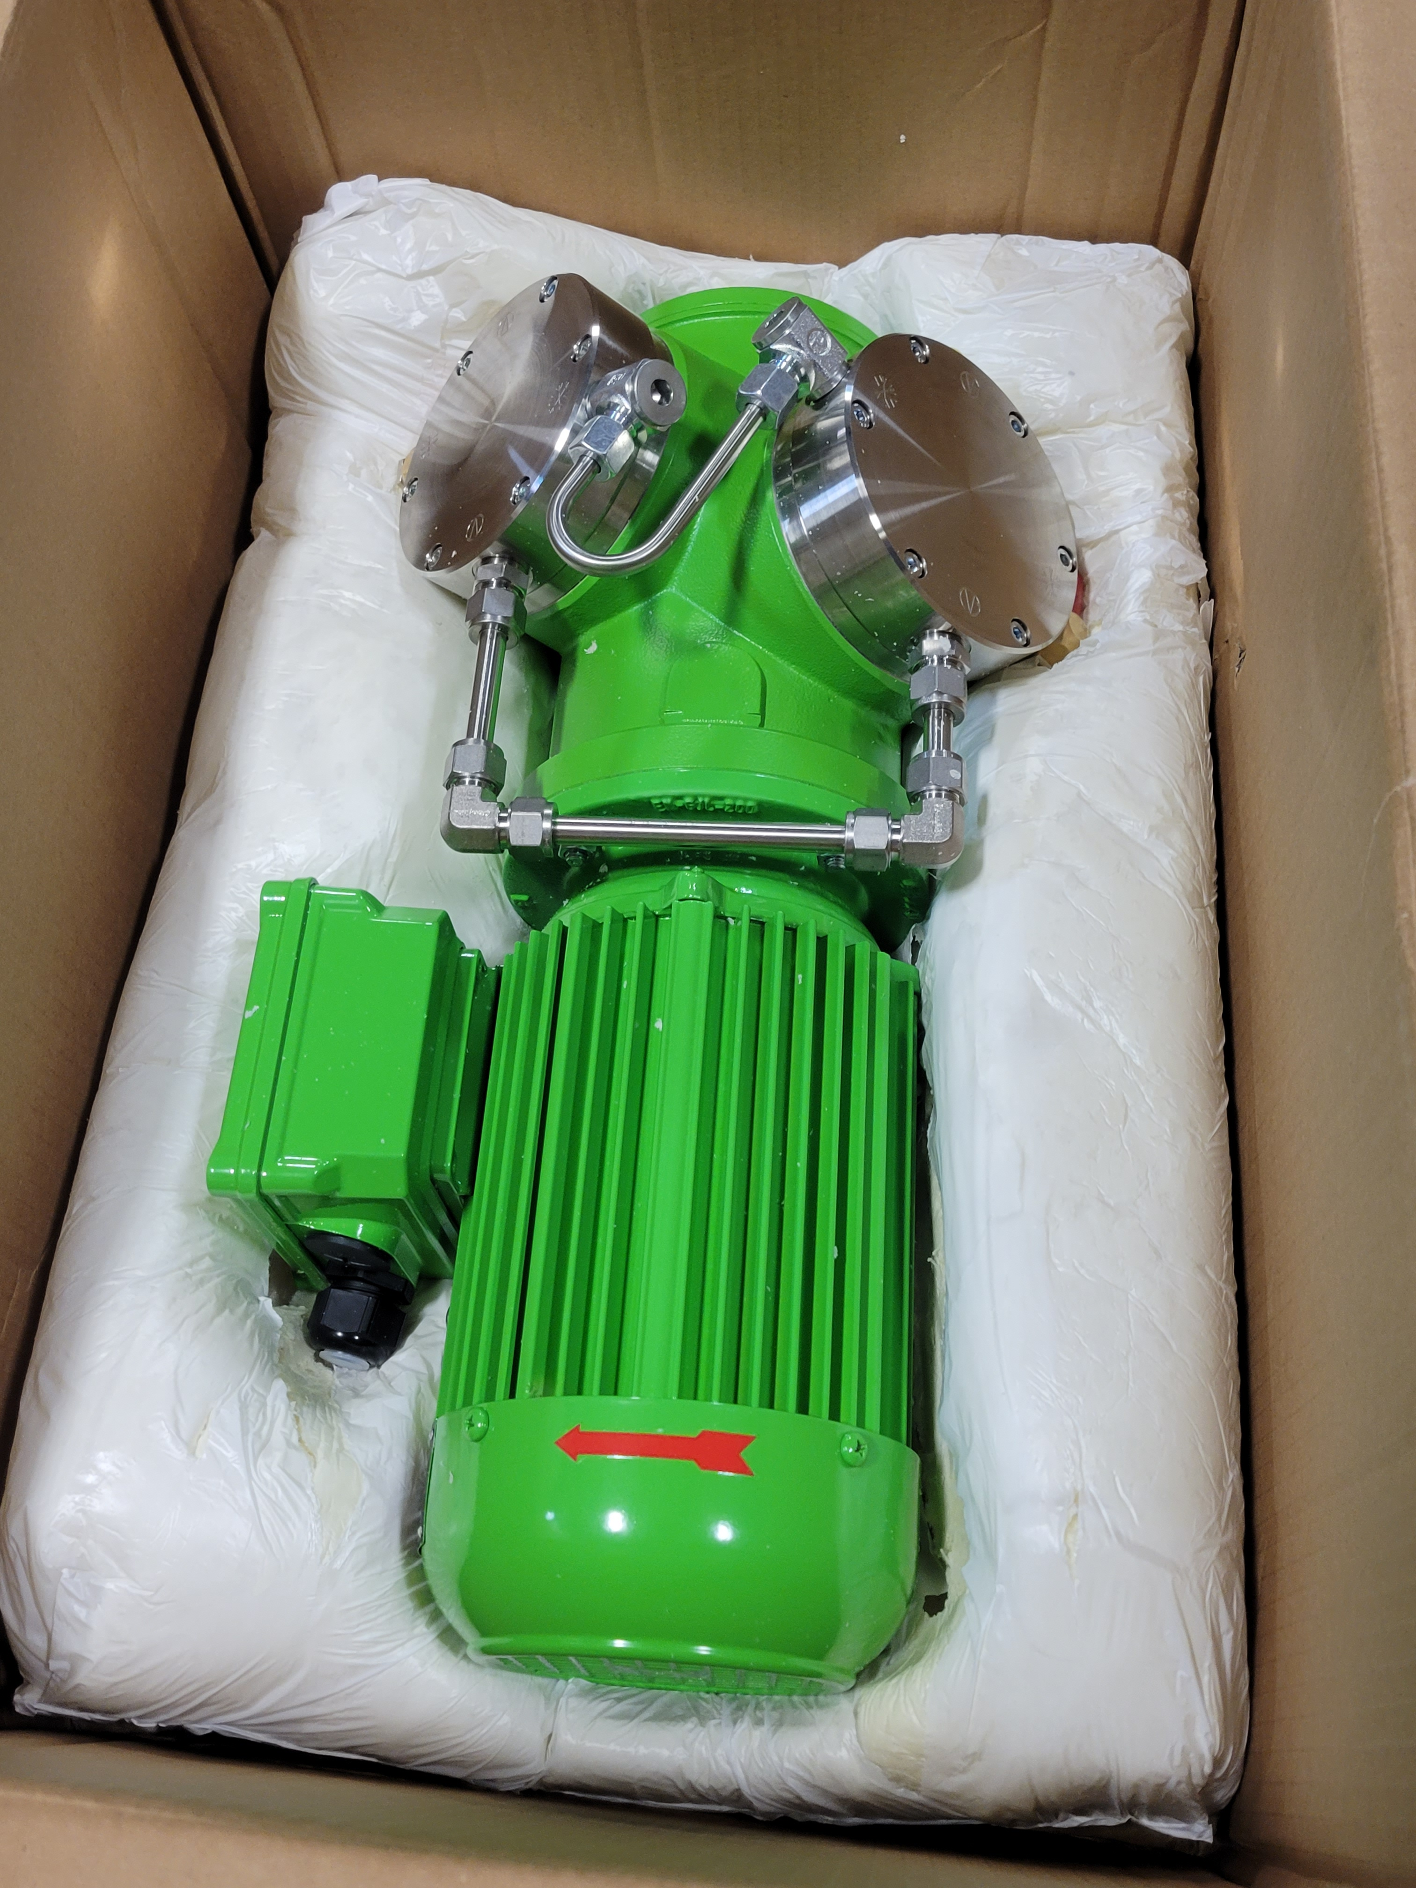
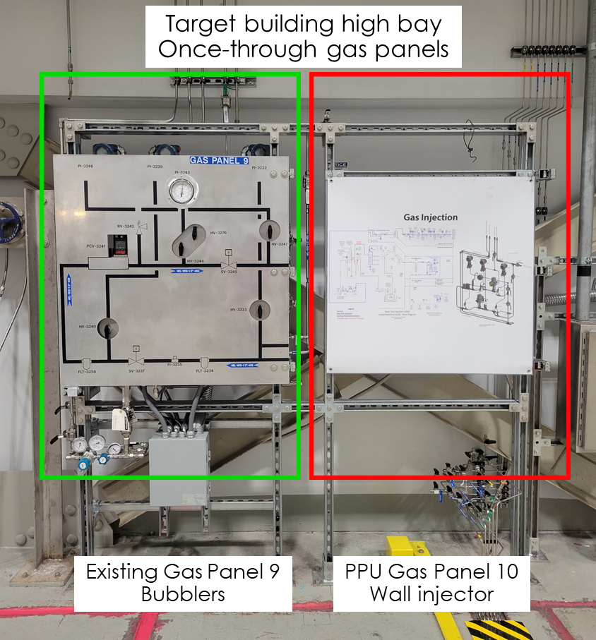
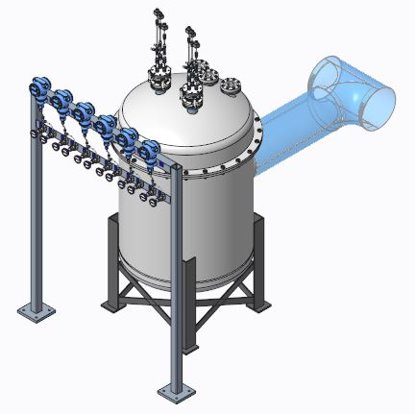
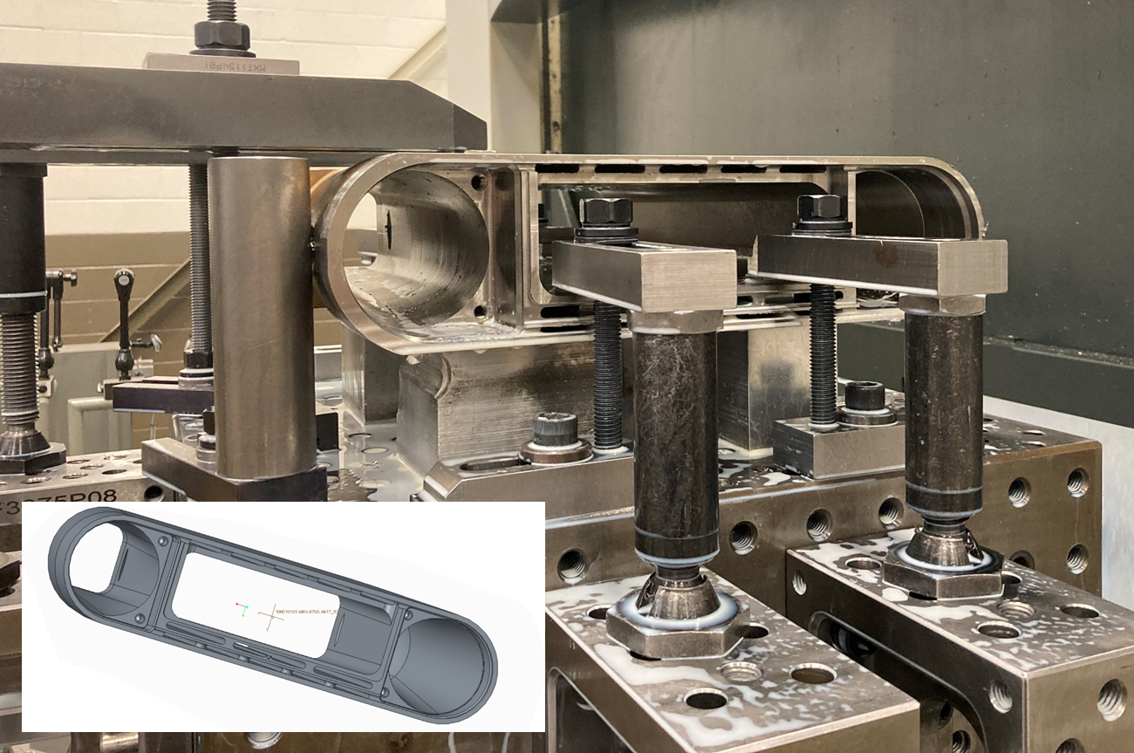
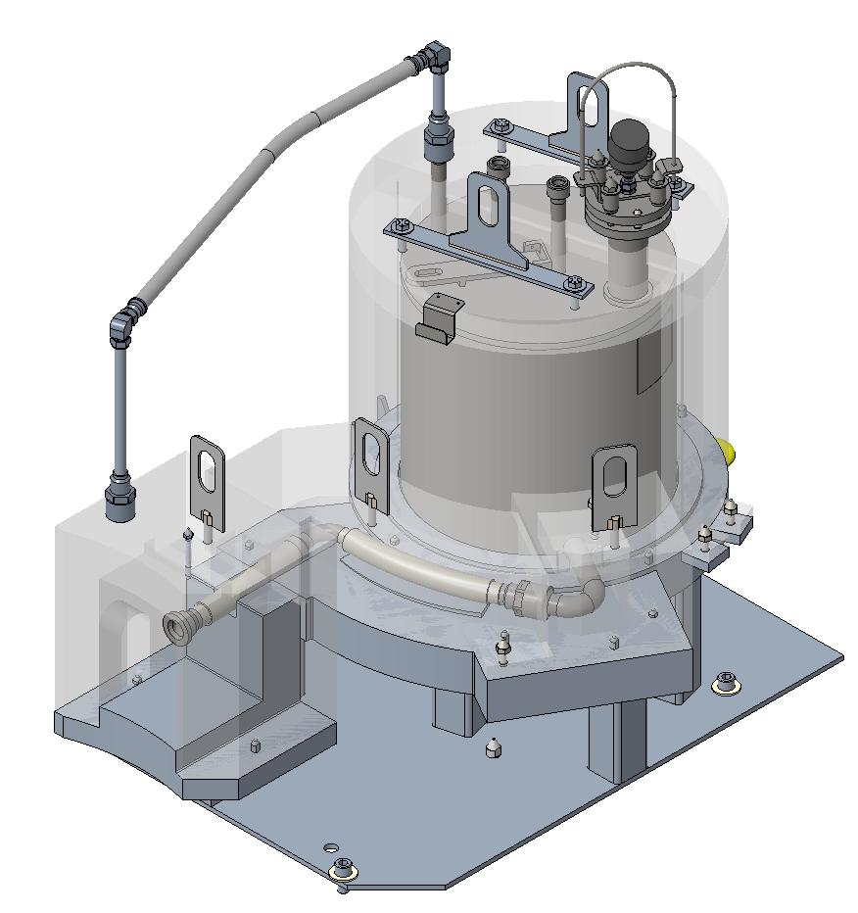
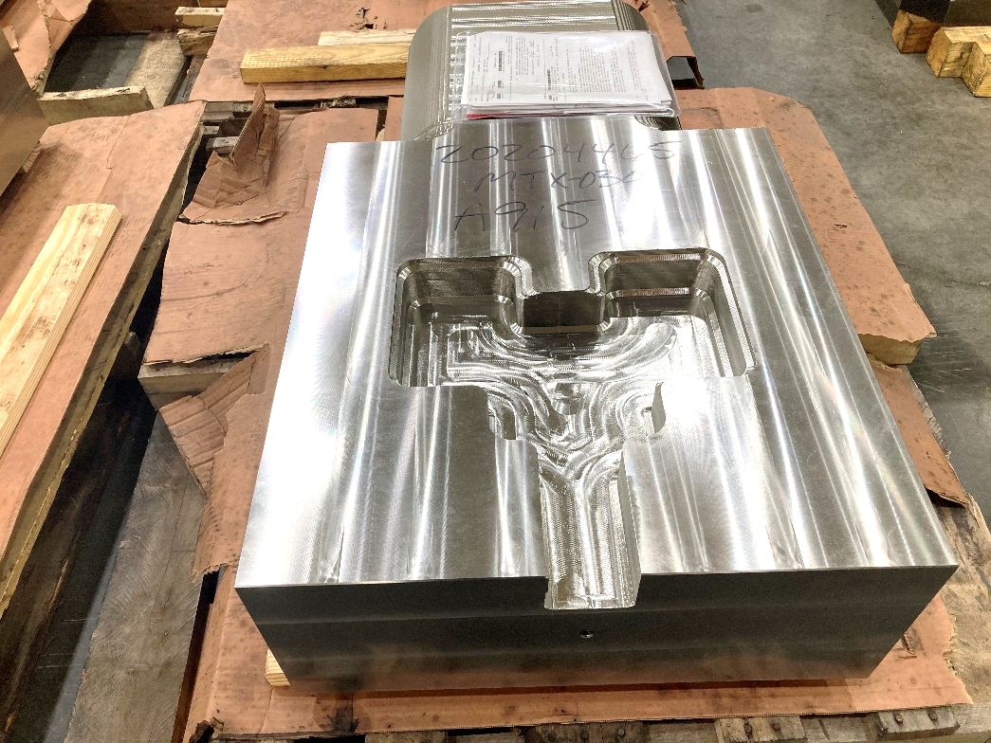
Scope
Compressor for gas recirculation
Ortho/parahydrogen
converter assembly
P.5.1 | System Management | Bernie Riemer
P.5.2 | Neutronics | Franz Gallmeier
P.5.3 | Mercury Process Systems | Makayla Edwards
P.5.4 | Moderator Cryogenic Systems | Bernie Riemer (interim)
P.5.5 | Vessel & Shielding Systems | Oscar Martinez
P.5.6 | Target Utility Systems | Erica Ahlschwede
P.5.7 | Instrument Systems | Oscar Martinez
P.5.8 | Mercury Off-gas Treatment Sys | Greg Stephens
P.5.9 | 2 MW Target | Kevin Johns
P.5.10 | Safety, Controls & Operations | Charlotte Barbier
P.5.11 | Gas Injection Development | Charlotte Barbier
Hg vessel front body machining
Hg pump OFT
41gal.
Test Tgt. #2 manifold block
Scope Completed
Notes:
Some remaining Neutronics scope to conduct measurements under PPU operation was transferred to P.08.01 Commissioning.

Slide 5
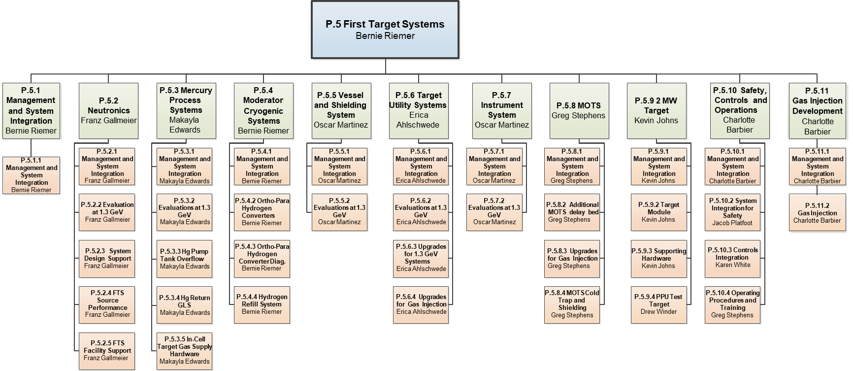
Organization chart
Completed
Notes:
Changes in L3 CAMS in P.3, P.4, P.5.9
Changes in L4 CAMS in P.5.10.n
Remaining Neutronics scope was transferred to P.08.01 Commissioning.

Slide 6
Progress since CD-2/3
12-Month Look-Ahead – from CD-2/3 July 2020
Place order for PPU Test Target #2 – DONE ✓
Place order for three production targets – DONE ✓
Complete the off-normal hazard analysis for gas injection – DONE ✓
Conduct installation mockup testing for GLS and OFT – DONE ✓
Mature remaining P.5.n upgrade designs to final status
  Done: Moderator LH₂ Converter; MOTS Cold Trap
  Nearly done: Mercury Overflow Tank (OFT)
  Challenges: Molecular sieve beds; hydrogen refill system; controls
Revisit P.5 risks – Regularly ✓
Improve resolution of installation activities, outage planning coordination and required resources – Alignment w/ 5-yr plan; progress at L3 to ramp up after reviews
Continue to monitor good operations-supported progress on CMS and gas injection – Executing
Notes:
Some action items from HAZOP are still “In-Progress”.
Review risks REGULARLY

Slide 7
Challenges to FTS Systems –
Personnel/resources, design and scope changes
Loss of Moderator Cryogenic Sys CAM and key subcontractor
  Hydrogen refill system design progress stalled
    Gas panel procurement on hold – was to be placed in March
    Outdoor installation fire safety constraints only recently clarified
Molecular sieve bed (MSB) design restarted after Oct. 2020 PDR
  Issues not flagged at PDR caused redesign starting in Jan. 2021
  Final design review delayed to October 2021
Controls scope growth and delay for design completion
  Overburdened controls staff now augmented with subcontractors
  Second MSB installation (GAR) added more I/Os that were not included in controls scope at CD-2/3
  Controls designs require near-final detail from other L3 systems
Notes:
Also dealt with Charlotte taking new group lead role, getting people into P.5.10.n L4 roles

Slide 8
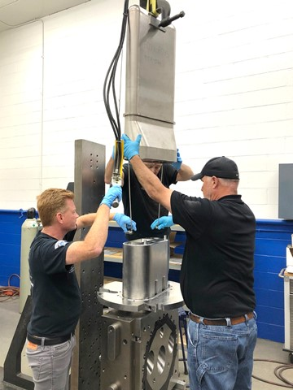
PPU Targets are in fabrication
Actual prices came in lower than estimated
Charges: 1-3
B2-3 Johns
B2-2 Winder
1.4 MW target gas injection experience v-good
Test Target #1 delivery delayed from July
  Problems with water-cooled shroud welding
  Delivery expected now
  Operation to begin CY2022 ✓
Test Target #2 fabrication is progressing
  This is identical to production target design
  Delivery in March 2022; operation slated for Aug. 2022
Fabrication of (3) production targets is underway
Oversight travel to vendor less than planned due to COVID
TT#1 mercury vessel
Notes:
TT#1 should be delivered by time of IPR

Slide 9
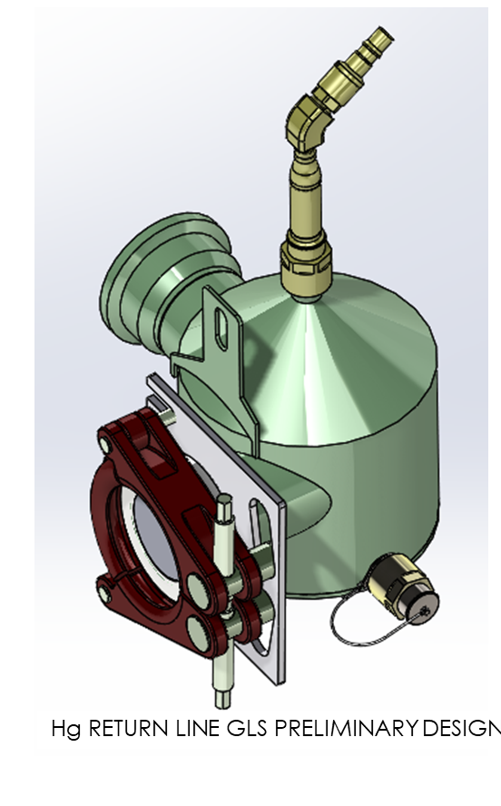
Decision was made to not proceed further with mercury return line gas-liquid separator (GLS)
B2-5 Edwards
Charge: 1
Satisfactory gas removal efficiency was achieved via development efforts
Design effort to reduce installation risks and operational challenges made progress, but
  Best options were less than satisfying
The balance of pros and cons tipped the decision
External review concurred with decision
B2-4 Barbier
https://conference.sns.gov/event/292/
Outlook for achieving project goal of 20 SLPM gas injection capability remains good without the GLS
GLS was never credited in hazard analysis approach

Slide 10
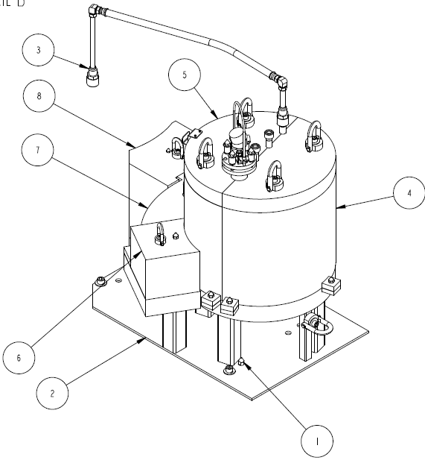
Mercury overflow tank (OFT) design awaits confirmation from mockup testing on remote installation and handling
B2-5 Edwards
Charge: 1
OFT design is close to final
Mockup testing in August is driving some design adjustments
FDR scheduled for September 2021

Slide 11
Moderator Cryogenic Systems upgrades –
Progress
Charges: 1, 3
B2-6 Riemer
RFP issued for catalyst / converter assembly
  Award will slip into September (from July)
    Installation should not be impacted
Catalyst retention elements are a credited control
Catalyst vessels (3)
B2-10 Platfoot
Converter vacuum vessel

Slide 12
Testing confirmed sapphire windows are suitable for LH₂ spin state measurement via Raman spectroscopy
Charge: 1
B2-6 Riemer
Cyclic testing (30) of sapphire windows with cryogenic helium successfully demonstrated leak integrity
First cycle
Last cycle
PPUP-500-TR0003-R00, Feb. 2021

Slide 13
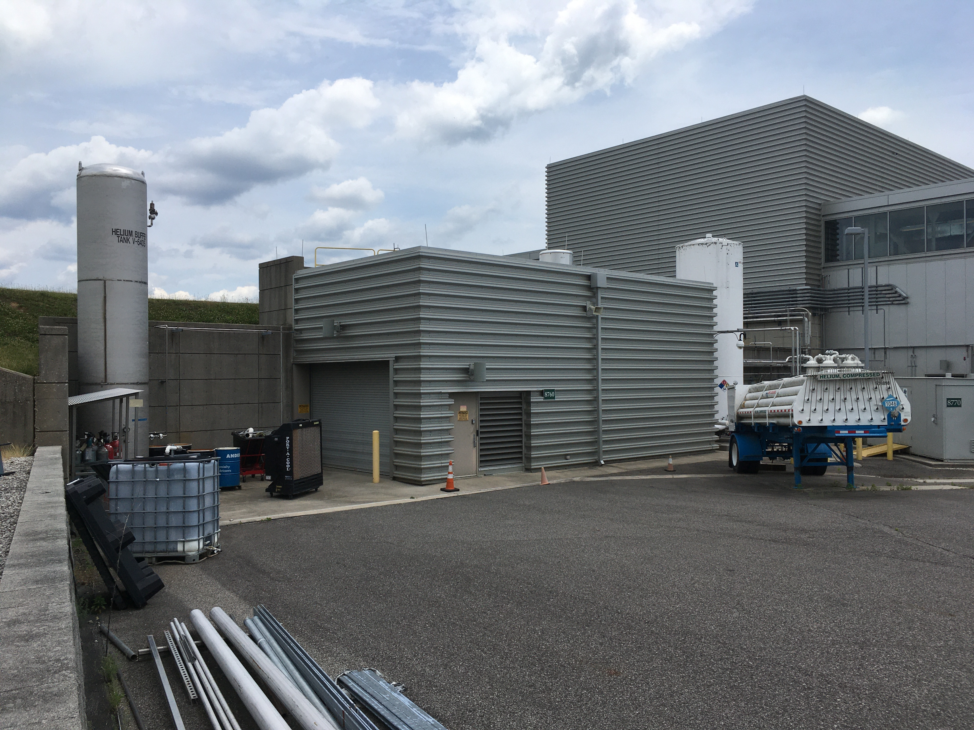
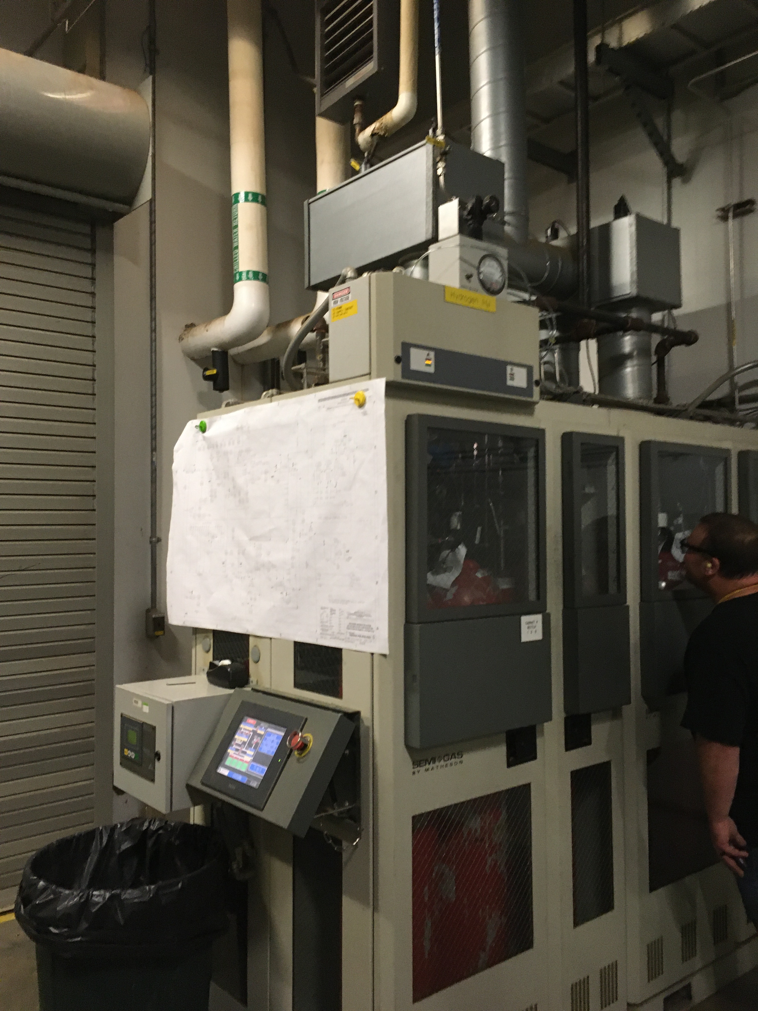
Moderator Cryogenic Systems upgrades –
Challenges
Charges: 1-5
B2-6 Riemer
Hydrogen Refill System upgrade is most impacted by loss of P.5.4 L3
  Gas panel award is late
  HRS can still be operational when needed in the extended outage
HRS equipment. now 8760 will
Be moved outside
Have larger H₂ capacity
Use standard H₂ bottles
8760
Existing hydrogen cabinet in 8760
Design of in situ diagnostics for ortho/parahydrogen fraction is stalled due to COVID and staff issues
  A few tasks remain on laser optics, fiber probe

Slide 14
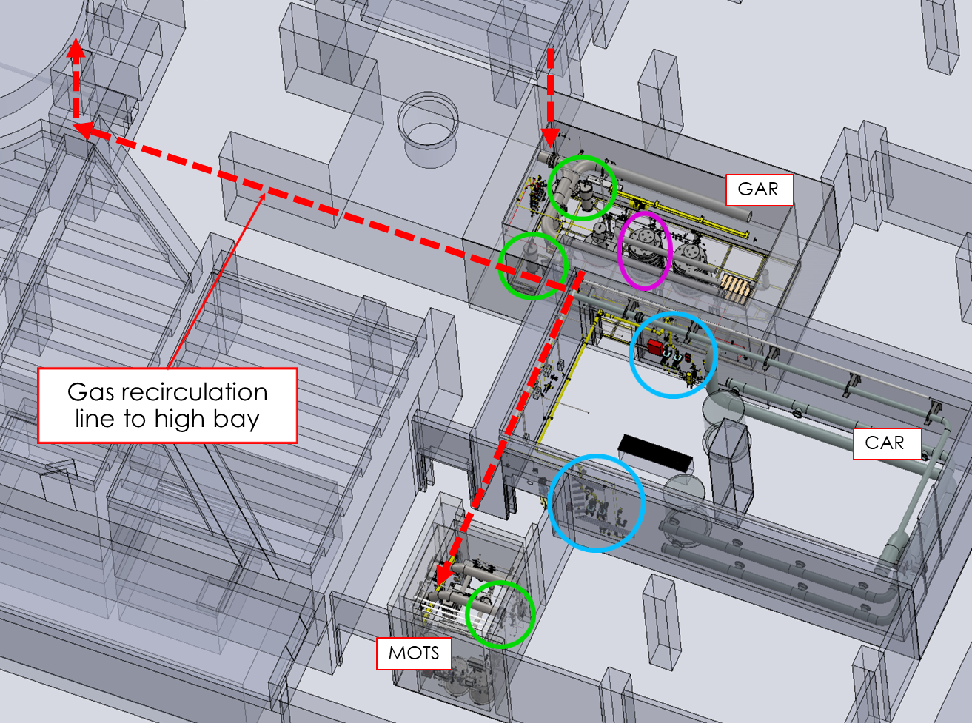
Progress for target gas injection utility upgrades
Charge: 1
B2-7 Ahlschwede
Gas panel #10
once-through – nose injector
PPU will provide separate gas supplies for
  Target bubblers ( ≤ 10 SLPM)
  Target nose injector ( ≤ 10 SLPM)
Both have recirculation and once-through modes
Gas panel 10 design is complete
All recirculating compressors (4) were received
Basement target gas utilities layout
KNF gas compressor (4)

Slide 15
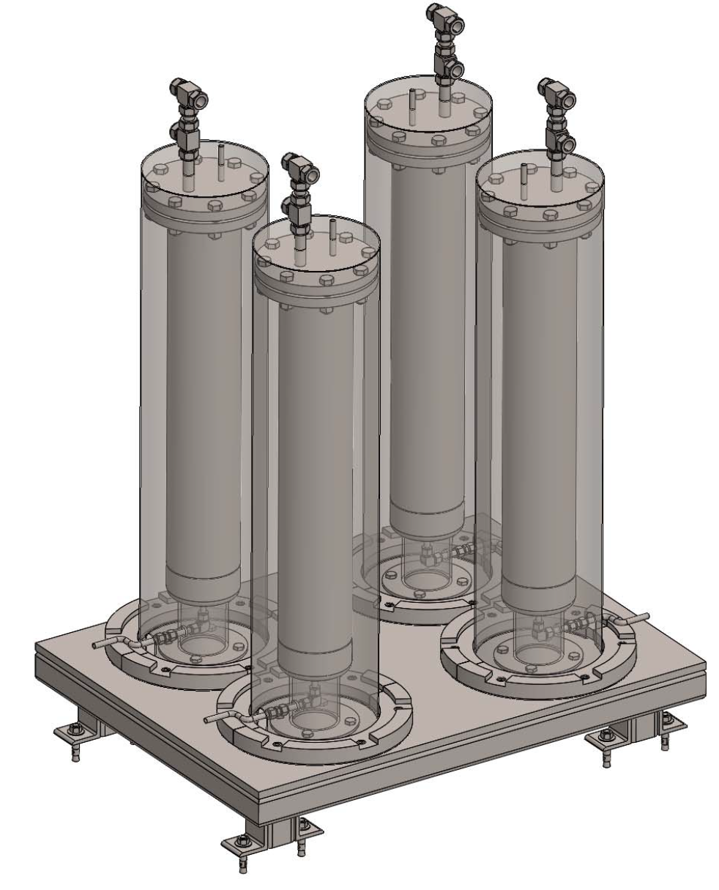
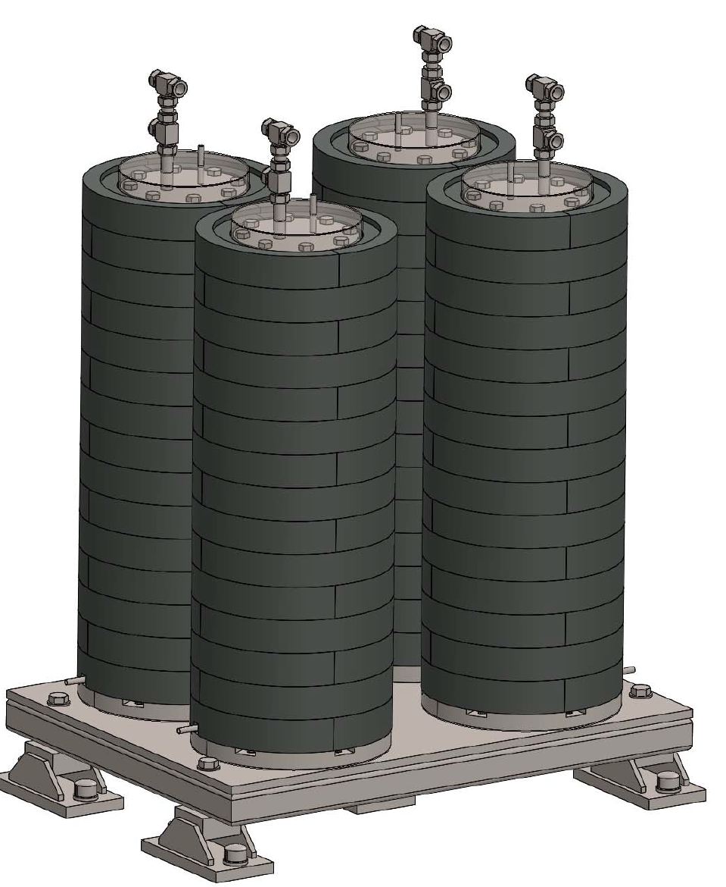
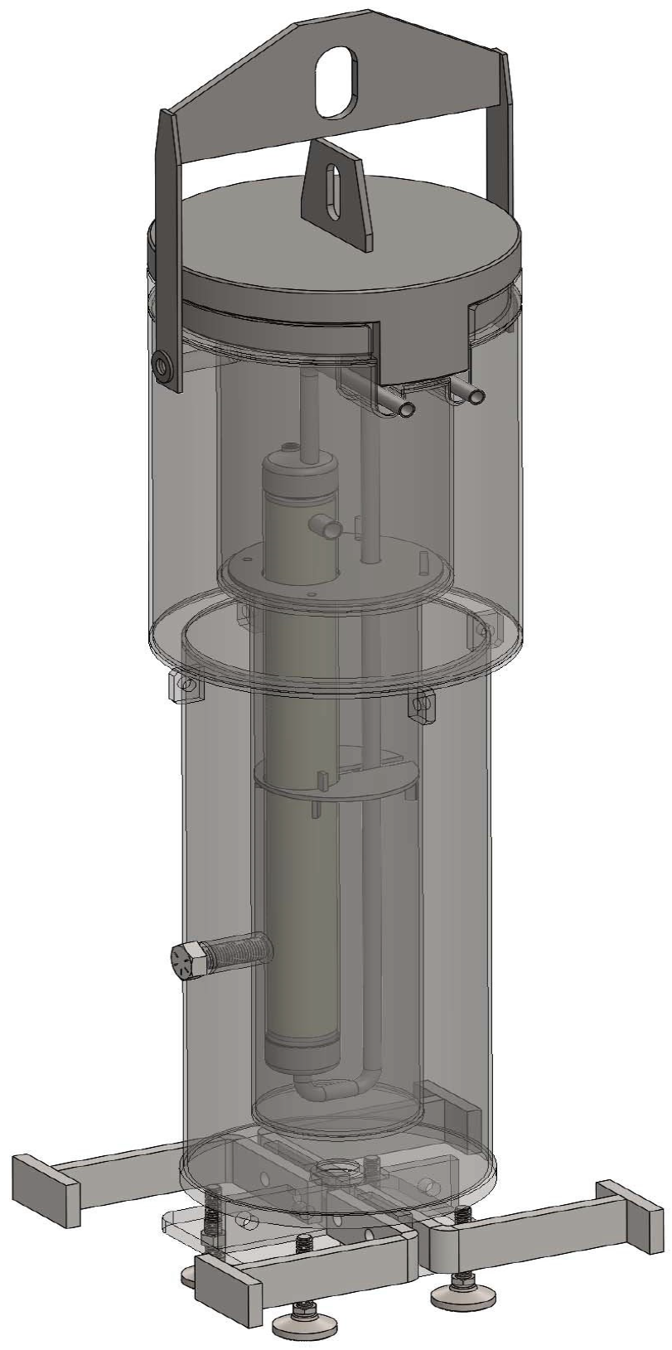
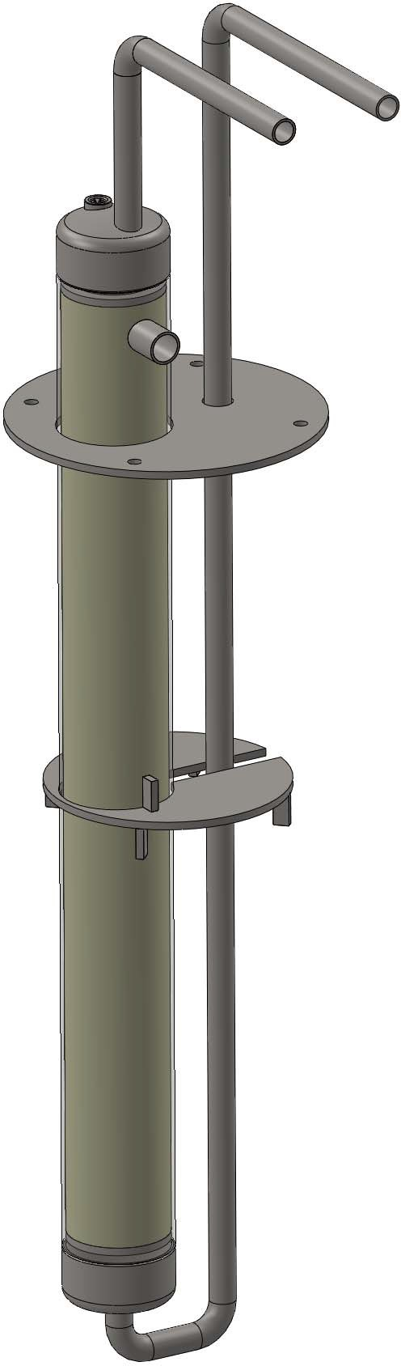
Challenges for gas injection upgrades
Charge: 1
Two installations of molecular sieve beds (MSB) planned
  MOTS equipment room and GAR
  Same design for both locations
  Each has four vessels
Design was restarted after the Oct. 2020 PDR
  Issues with paint on shield blocks and high source term
  Redesign progress has been slower than desired
  FDR has slipped to October
    Combined with gas recirculation FDR
  Schedule delay has eliminated float to the installation schedules
October 2020 PDR
6” OD vessel, clam shell shielding
B2-7 Ahlschwede
B2-8 Stephens
B2-9 Berrocal
Current design
3” OD vessel, lead poured in casing shielding
Notes:
Overburdened and less experienced staff.
Heavy reliance on subcontractors
Slow feedback from RSC.

Slide 16
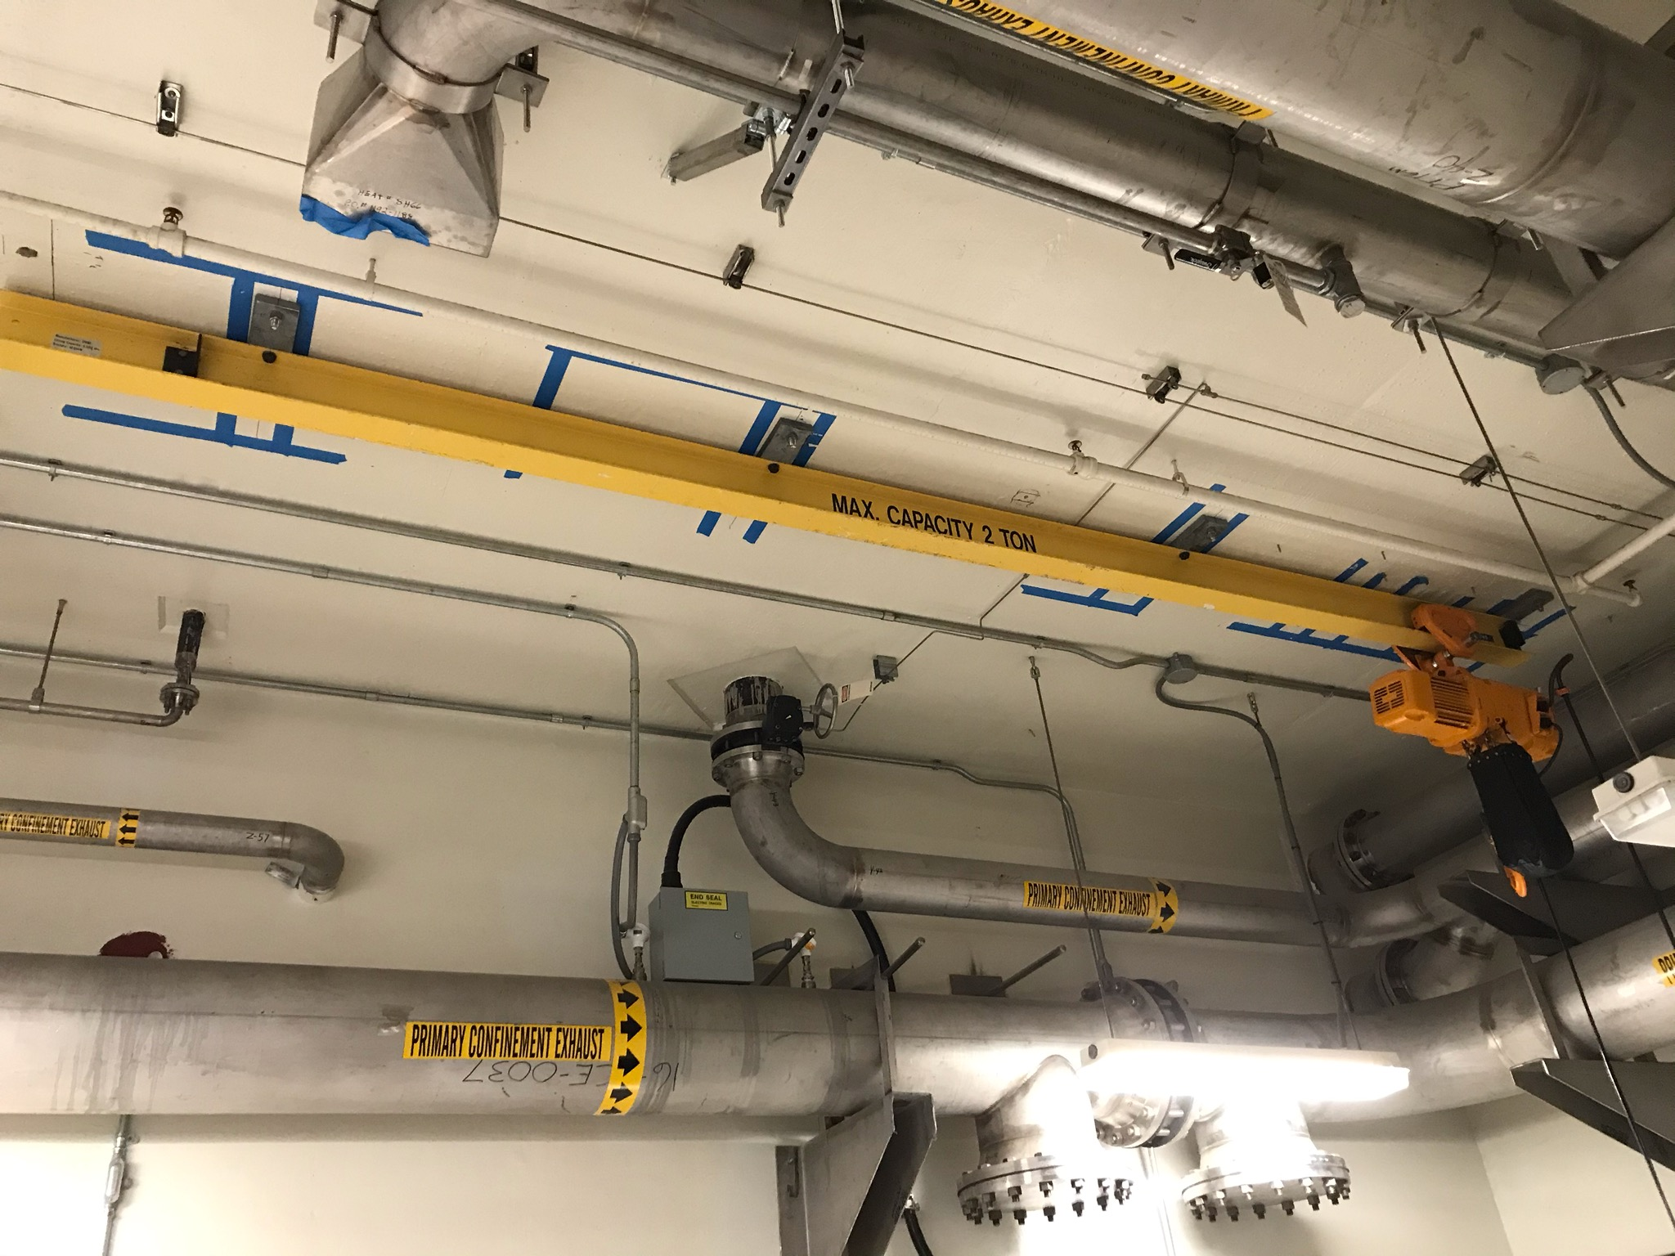
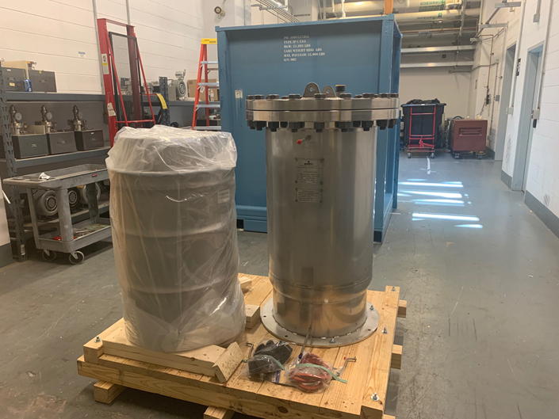
MOTS upgrades: generally good progress
Challenge with MSB
Charges: 1-3
B2-8 Stephens
MOTS and GAR overhead cranes installed
Delay bed installation completed (early)
CuO bed shielding fabrication complete
Fabrications of new cold trap & shielding are underway
  New primary unit sized for 25 SLPM gas flow
  Existing cold trap will get upgraded cold head and become a back-up unit
MSB design delay has reduced float for timely installation
GAR Crane
Delay Bed Vessel and Cartridge

Slide 17
Controls designs are making progress
Scope grew notably, and schedule has challenges
Charges: 1-5
2021 scope growth partly due to late incorporation of second MSB into controls project plans
PCR was processed in March 2021
  P.5.10.3 cost grew by $720k
  Schedule slip on controls design completion is as much as 318 days
Delays in completing other P.5 L3 designs are affecting completion of controls designs
  MSB, gas recirculation, HRS
Resource challenges with controls designs have been relieved with subcontractor engineer and designer
B2-9 Berrocal
Notes:
Scope growth in 2021 also due to lack of controls design attention last year. Resource issues. Too much waiting for L3 designs to be final.
318 days: PCR - Controls design slipped 75 days in gas recirculation and 318 days in MOTS.

Slide 18
All P.5 analyses for facility safety issues are complete and documentation updates are underway
Charge: 3
B2-10 Platfoot
Documentation updates for FSAD-NF and ASE are in progress
  Effects of 2 MW/1.3 GeV & 60-y life on credited monolith boundaries
  Changes in mercury spallation product inventory from PPU operation and FTS life extension
  High-flow gas injection
  Increase in CMS hydrogen inventory
  Migration of catalyst in CMS
Beam Power Limiting System is assigned to P.4 Ring Systems
  FTS System requirements document was provided
Notes:
Credit to Charlotte Barbier for supporting analyses on high-flow gas injection

Slide 19
Installation Plans – high-level
These WBS elements have equipment and controls installations
  P.5.3 Mercury Process Systems: OFT, in-cell gas hardware*
  P.5.4 Moderator Cryogenic Systems: Converter, HRS, O/P diagnostics
  P.5.6 Target Utilities: Gas Panel 10, gas recirculation, MSB-GAR
  P.5.8 MOTS: Delay bed, cold traps**, CuO bed, MSB-MOTS
  P.5.9 2 MW Target: Target module, jumper hardware
  P.5.10.3 Controls for above system installations
All except P.5.4 are essential for Target power-lifetime KPP
  These need to be installed, tested and ready by the middle of the extended outage
  Mini-ARR will be conducted to authorize integrated testing / commissioning of target / mercury / gas systems without beam
*in-cell gas hardware requires that vent line shield block be installed – ops responsibility
**backup cold trap will wait until last PPU outage
Notes:
P.5.3

Slide 20
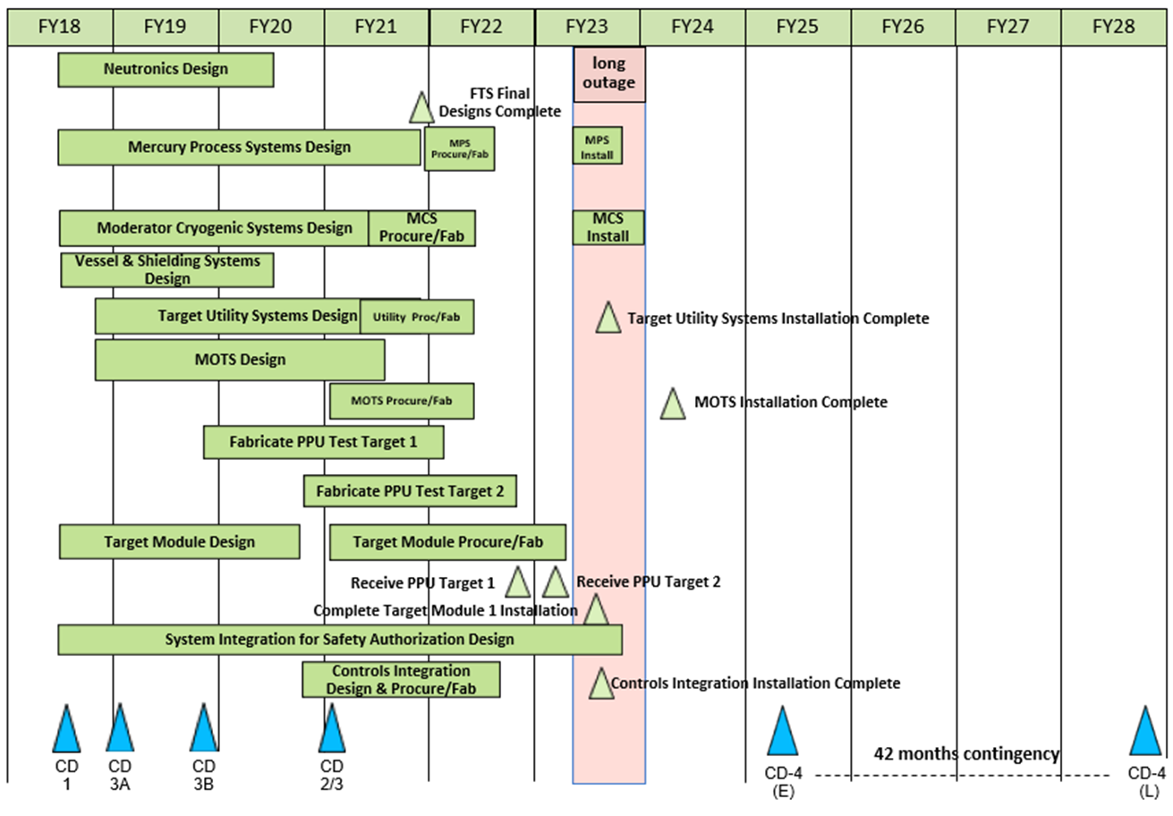
P.5 – Status Summary Schedule
Installation scope
Notes:
FTS May 2021. The MOTS completion milestone is in mid-FY24 because of the later completion of the 2nd cold-trap modification. That work is not essential for integrated system testing of gas injection / mercury system upgrades. It is purposefully delayed to maximum decay time to the existing old trap before it is upgraded to PPU specifications. It is a backup unit.

Slide 21
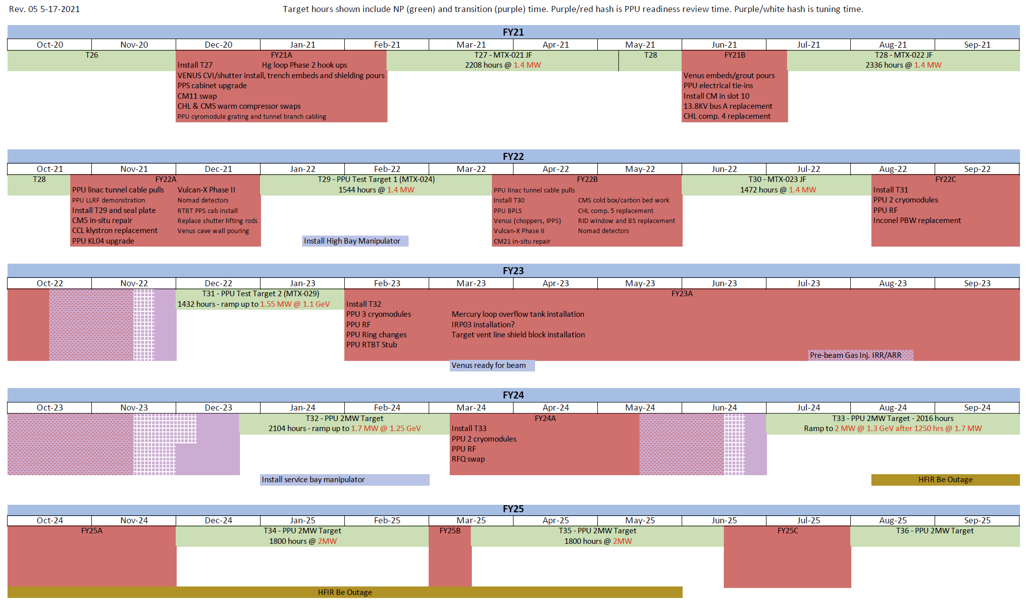
P.5 Installation plan alignment with ops 5-yr schedule
Essential P.5 installations complete, tested and results documented.
Procedures updated.
Training complete.

Slide 22
Budget and Estimate to Complete
Charge: 4
FTS Systems spending is close to half of BAC

Slide 23
Progress since CD-2/3
Charge: 4
Remaining neutronics scope transferred to P.8.1 and P.5.1
Hg Systems cost went up after CD-2/3
  then down some with GLS removal
Savings in 2 MW Target due to lower actual costs and less oversight travel
Controls cost up mostly due to 2nd MSB
Notes:
Neutronics down because of xfer of scope to P.8.1.
Any remaining P.5.2 support time was added to P.5.1. Same for Oscars (P.5.5, P.5.7) ARR time
MPS went up even though GLS was deleted. Why / what happened? :
We increased the P.05.03 budget after CD2/3 (when we were re-baselining). We added 3D modeling hours for the GLS, increased the cost of the overflow, and added FDRs at a L3. The total increase was 517K. Then we removed the GLS scope (277K).
Big jump in P.5.6 – mainly due to MSB saga
Target decrease because Tgts and bubblers all came in less that budgeted. Also, we have undercharged in oversight (Covid travel restrictions)
Big jump is in controls scope. Added MSB skid is main reason.
Development is essentially done.

Slide 24
SPI and CPI
Schedule and cost are on track in recent months
Low SPI in Jan-Feb were largely due to target PO milestones
Notes:
If CPI is less than 1 then project is over budget.
If SPI is less than 1 then project is behind schedule.

Slide 25
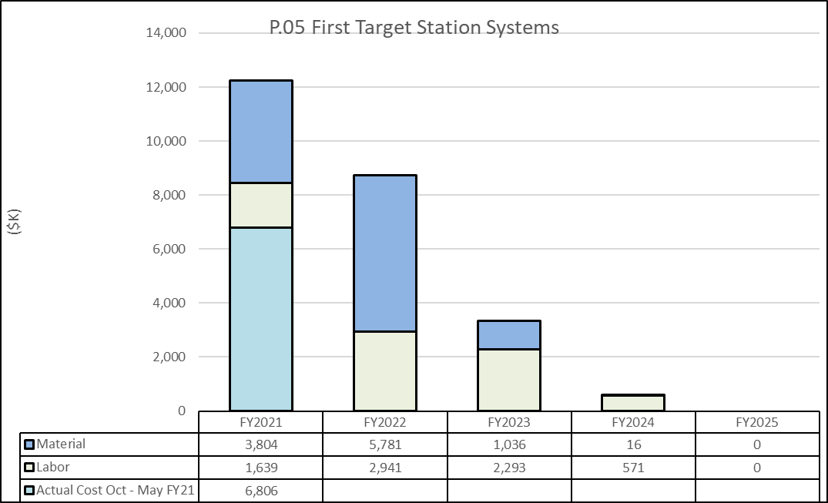
Cost Estimate by FY
Includes FY21 Actual Costs Oct – May
Charge: 4
The end of PPU is in sight for FTS Systems spending
Notes:
ETC for FY21 is from June forward

Slide 26
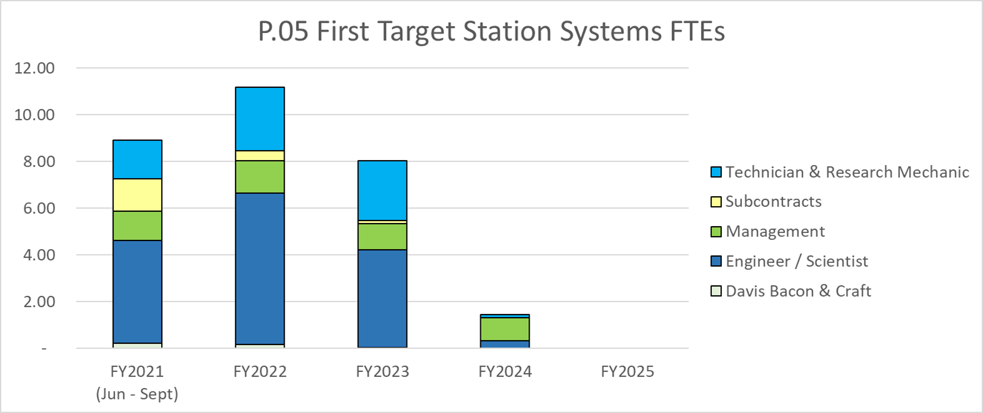
Labor Profile
The end of PPU is in sight for FTS Systems labor

Slide 27
Risk Register
Charge: 4
Eight risks
  Pre-Mitigated Ranking: 3 Low, 4 Medium, 1 High
  Pre-Mitigated Ranking: 4 Low, 4 Medium
High risk items
  None
We will soon re-activate T-P.5-003
Aluminum Proton Beam window assumption

Slide 28
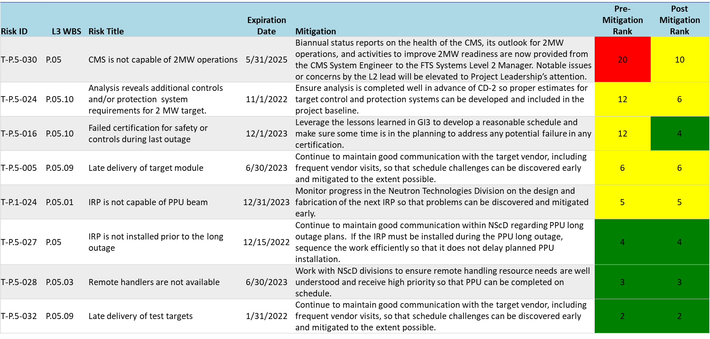
Risks are Identified and Monitored
Charges: 3-4
Operations responsibilities; sustained communication is mitigation
Notes:
Note that the CMS and (2) IRP risks are SNS operations responsibilities.
We keep on top of status and communicate concerns.
T-P.5-024 has been realized; we will retire it after the IPR.
We will also re-activate T-P.5-003 Aluminum PBW due to trouble with both fabrications (ops)

Slide 29
Responses to Recommendations
Charge: 6
CD-2/3 – July 2020
  There were no recommendations for FTS Systems
All recommendations from prior DOE reviews are closed

Slide 30
ESH&Q and COVID-19 Impacts
Charge: 3
USIs related to FTS Systems have all been analyzed and have a clear path in documentation updates to the FSAD-NF and ASE
COVID-19 impacts
  Vendor delays in delivering hardware have been minimal
    Some deliveries have been early
  Fabrication oversight travel to vendors has been curtailed
    Target, MOTS
    Business travel remains constrained
Delays in parts of P.5 scope driven by factors other than COVID
B2-10 Platfoot

Slide 31
12-Month Look-Ahead
Charges: 1-2, 4-5
Replace P.5.4 L3 CAM
Complete all outstanding designs
  Mercury Overflow Tank
  Target utilities – molecular sieve bed and gas recirculation
  Hydrogen refill system
  Ortho/para hydrogen diagnostic
  Controls
Place orders for remaining equipment
Focus more on installation plans
  Add resolution to tasks, with resource types identified
  Coordinate with operations groups, project office
Operate and learn from Test Target #1
Identify operating procedures needing updates for PPU
  Prepare associated list of staff training needs for ARRs

Slide 32
Summary
Charges: 1-5
Excellent progress in target fabrications is being realized
Decision on GLS made after benefits judged not worth risks
Preparations for FTS facility safety are in good shape
Remaining designs to finalize are getting maximum attention
  Matrixed staff is stretched thin, doing best as possible
  Use of subcontractors is helping, but not most efficient
Schedule float to key installation dates has eroded on utilities, MOTS, and controls
  Early project completion is still possible
Personnel changes have had effects but are being dealt with
Focus to shift from design to procurement, fabrication, installation and commission over the coming year

Slide 33
P.5.1 Changes since CD-2/3
P.5.1 Estimate at Complete
Notes:
P.5 1 - Management & System Integration

Slide 34
P.5.1 Cost Estimate by FY
Notes:
P.5 1 - Management & System Integration

