Slide 1
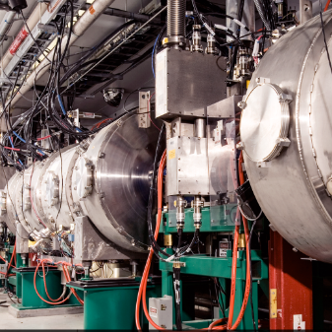
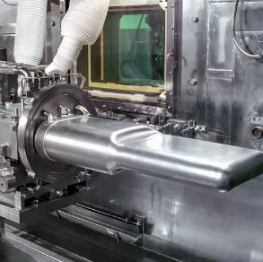
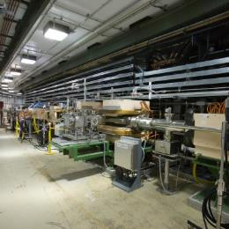

P.05.3 Mercury Process Systems
DOE/SC Independent Project Review of the Proton Power Upgrade Project
Makayla Edwards
Level 3 Manager for Mercury Process Systems
September 14-17, 2021

Slide 2
Outline
Scope
Organization
Progress since CD-2/3
Challenges
Final design status
Installation plans
Cost and schedule
Labor profile
Risk register
Responses to recommendations
12-month look-ahead
Summary

Slide 3
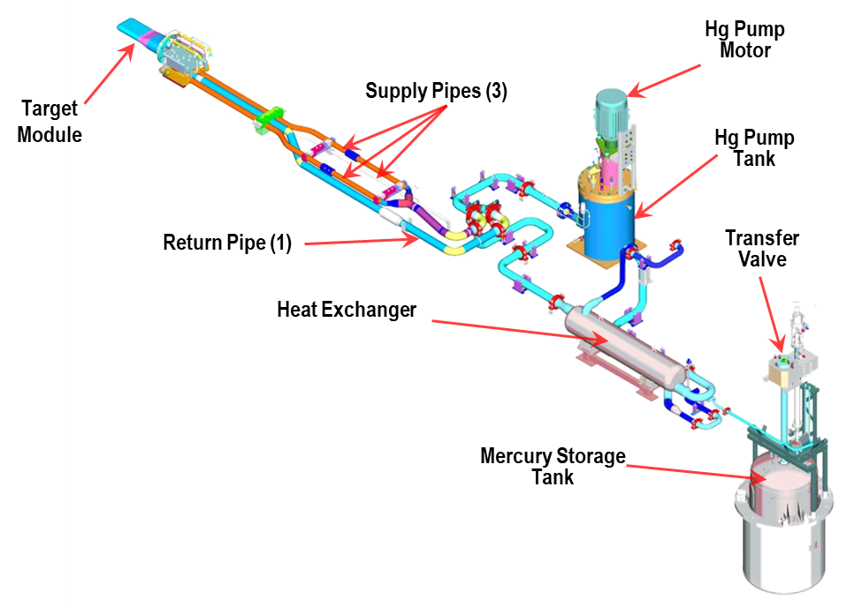
Scope
Higher power levels for the Proton Power Upgrade requires a higher helium gas injection flow-rate for the mercury target to mitigate target damage and fatigue.
  The higher gas flow rate could accumulate gas within the mercury loop, potentially displacing mercury from the piping into the mercury pump tank and MOTS.
  Pressure drop could increase in the loop and reduce mercury flow.
Modifications to the mercury process loop are needed to mitigate the potential of liquid mercury escaping the service bay under a hypothesized accident scenario

Slide 4
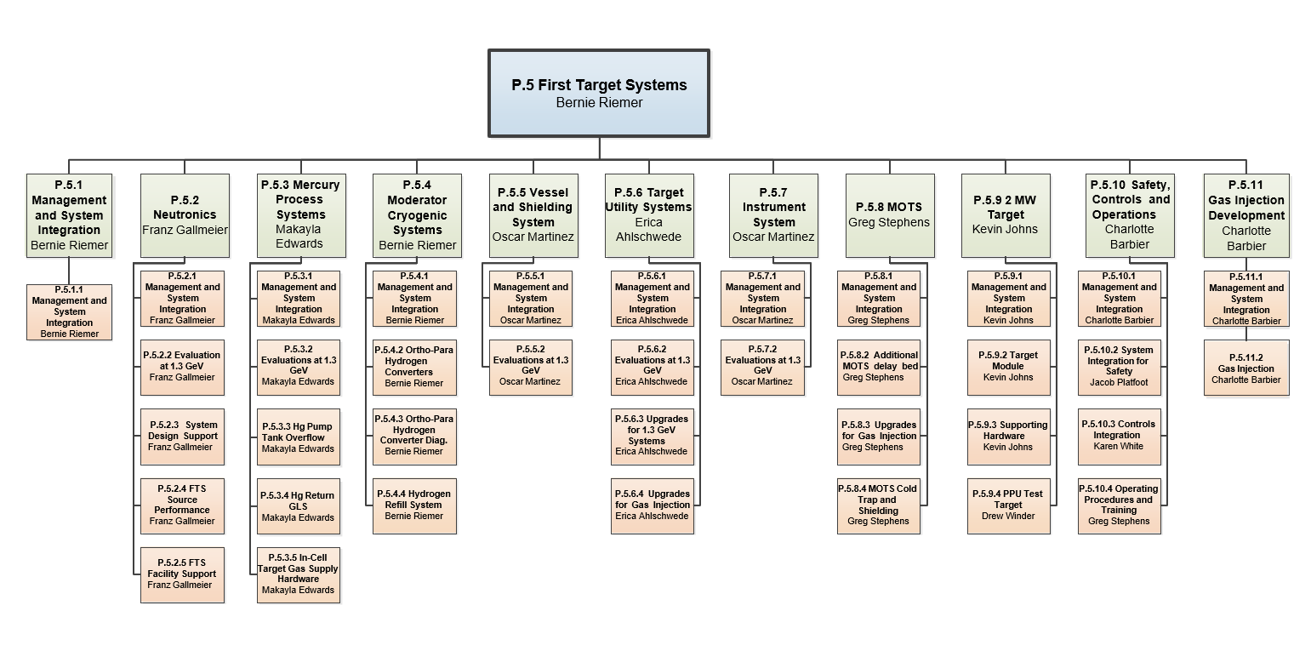
Organization
Charge: 5

Slide 5
CD-2/3 12-Month Look-Ahead Summary
Charge: 1, 2
Task | Status
Complete detail design for the Hg Pump Overflow Tank | Complete
Complete testing of the OFT first article level sensor | Complete
Begin procurement and fabrication of Hg Pump OFT | Awaiting FDR
Complete detail design for the Hg Return GLS equipment | Archived
Begin procurement and fabrication of Hg Return GLS | Removed
Complete detail design of OFT and GLS Installation Mockups | Complete
Complete procurement and fabrication of OFT and GLS Installation Mockups | Complete
Complete detail design of In-Cell Gas Supply Equipment | Complete
Begin procurement and fabrication of In-Cell Gas Supply Equipment | In Progress

Slide 6
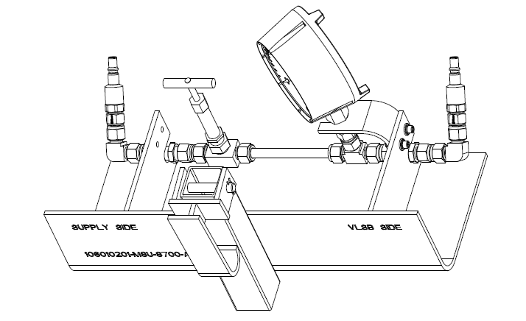
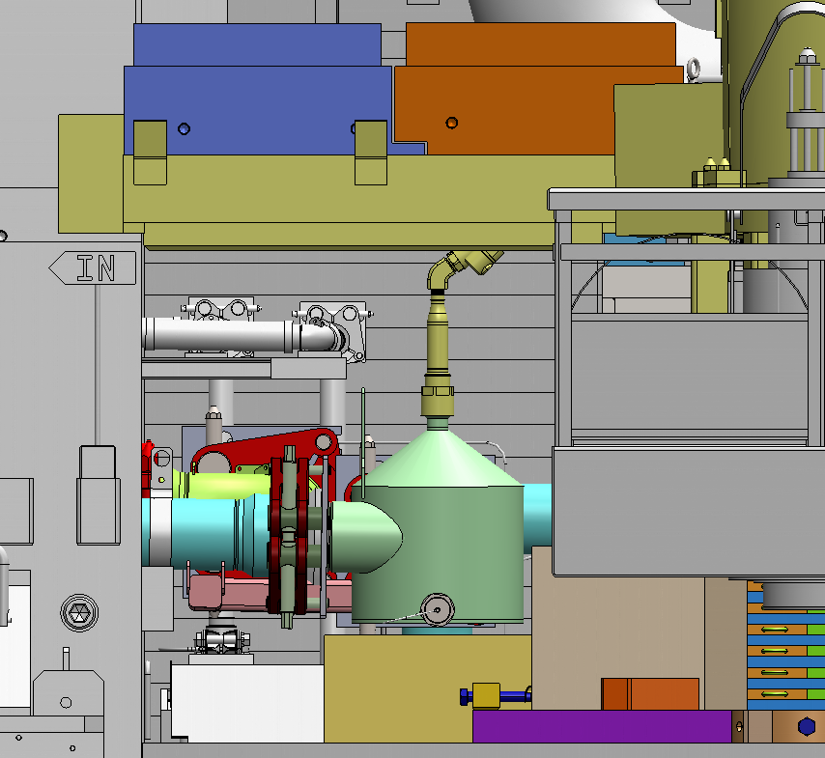
Progress since CD-2/3 – Target gas supply hardware design complete and GLS archived
Target in-cell gas supply hardware design complete
  Final design review approved design for fabrication
  Fabrication solicitation in progress
Gas liquid separator design removed from project scope
  GLS deployment review held on April 21st, 2021
  GLS documents archived

Slide 7
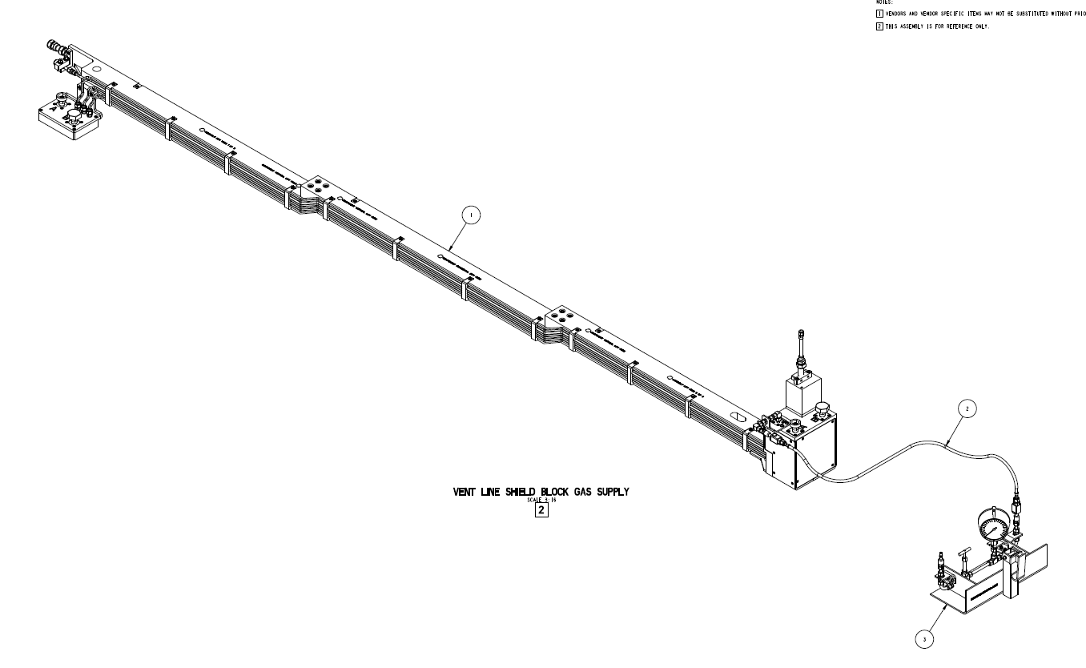
Vent Line Shield Block Design Complete – not project scope
The vent line shield block is complete
  Fabrication in progress
  Install during PPU FY23 outage
Provides new gas injection supply for PPU target

Slide 8
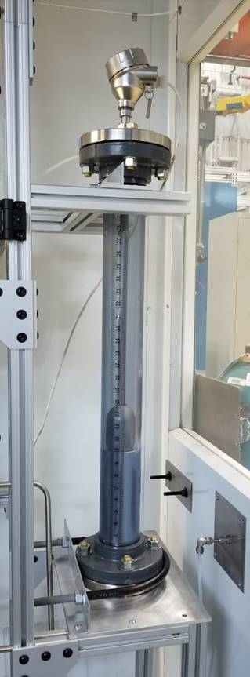
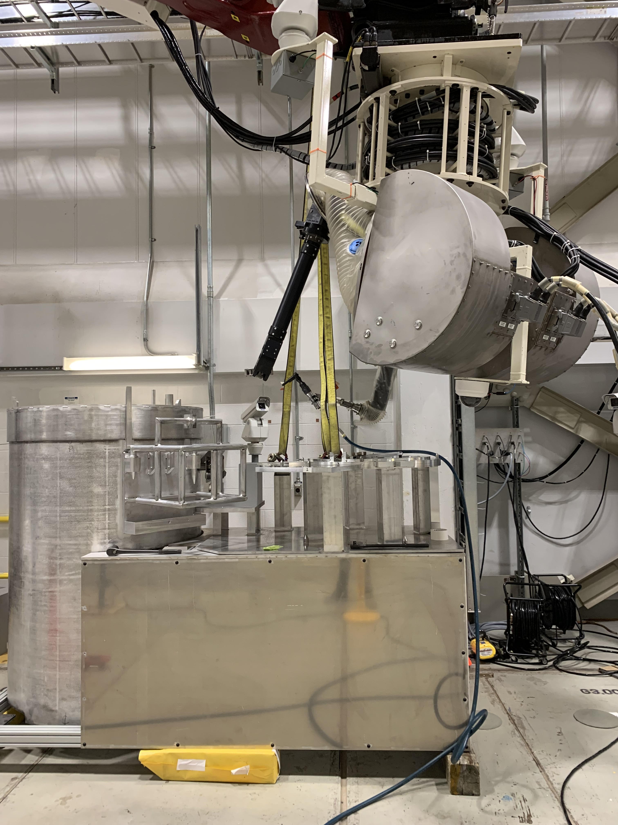
Progress since CD-2/3 – Mercury Pump OFT level sensor testing and mockup design complete
Charge: 1
OFT Khrone level sensor testing
  Test report states sensor performs adequately
  Working with controls to get it programmed and installed in the Service Bay
OFT mockup testing complete
  Fabrication completed on schedule
  Testing completed August 10th, 2021
  OFT FDR September
  OFT install: PPU outage
B2-9 - Berrocal

Slide 9




Challenges
Personnel turnover
  Craig Bradley (CAM) Craig Bradley (Design Engineer) Mike Costa (Designer)
  Makayla Edwards Jeremy Slade Ryan Mangus/Mark Phillips
Document organization/coherence
Resource availability

Slide 10
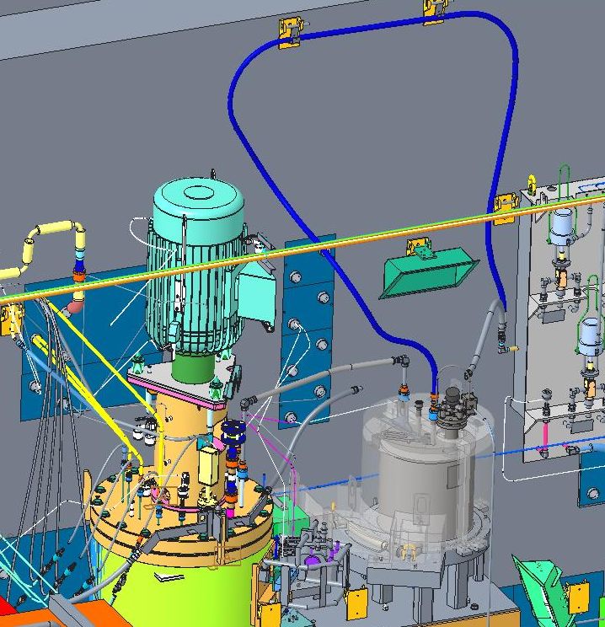
Final Design Status
Charge: 1
Target in-cell gas supply hardware design is complete
Mercury pump overflow tank is in final design
  Mockup testing results brought minor design revisions

Slide 11
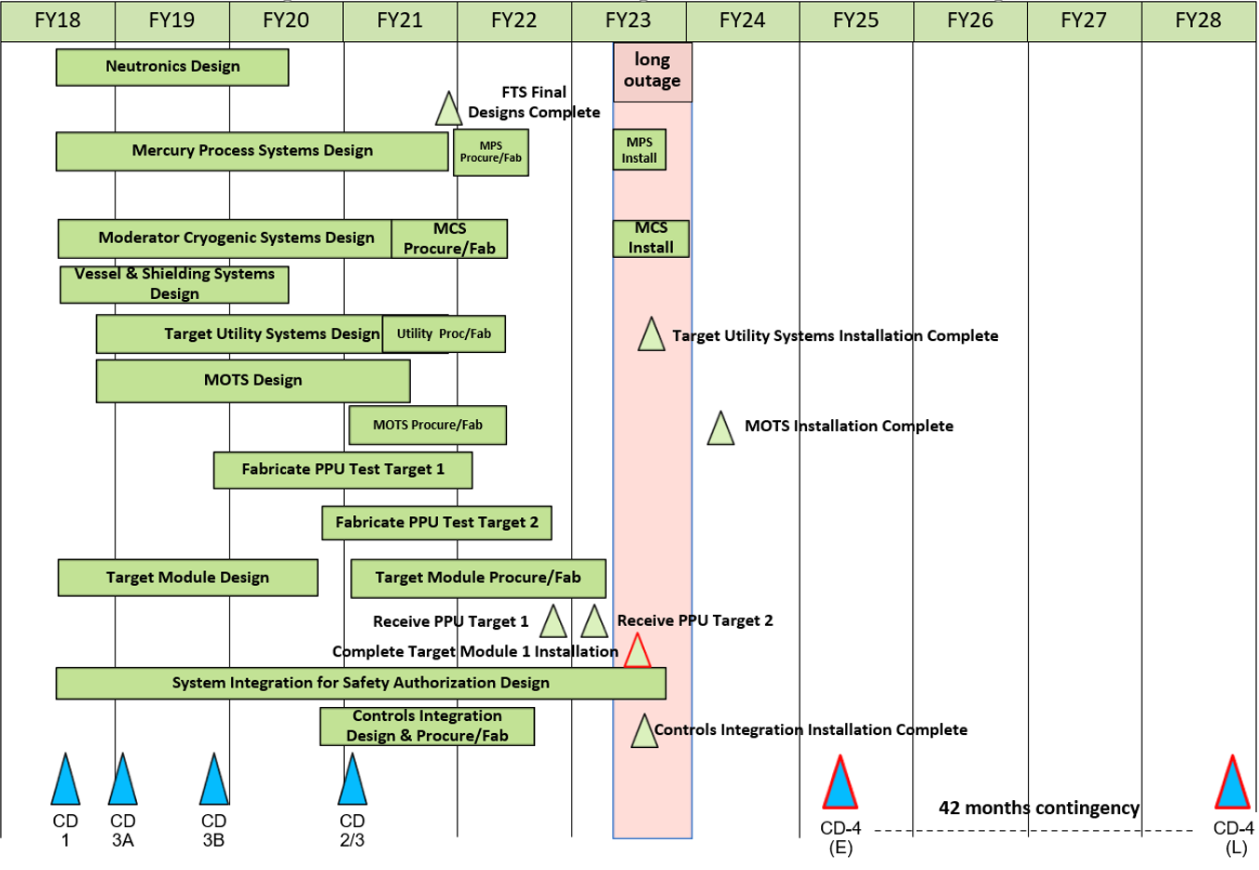
FTS May 2021 Status Summary Schedule

Slide 12
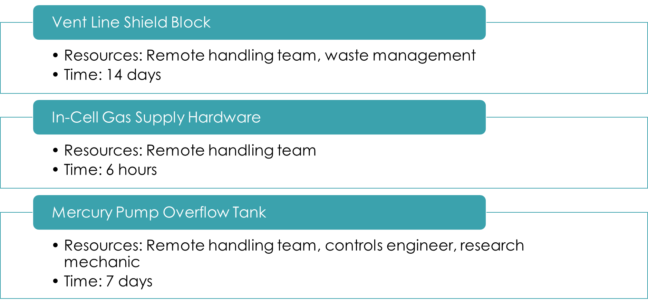
Installation Plans – PPU Outage
B2-9 - Berrocal

Slide 13
PPU Changes since CD-2/3
Charge: 4

Slide 14
Budget and Estimate to Complete
Charge: 4

Slide 15
Cost Estimate by FY
Charge: 4

Slide 16
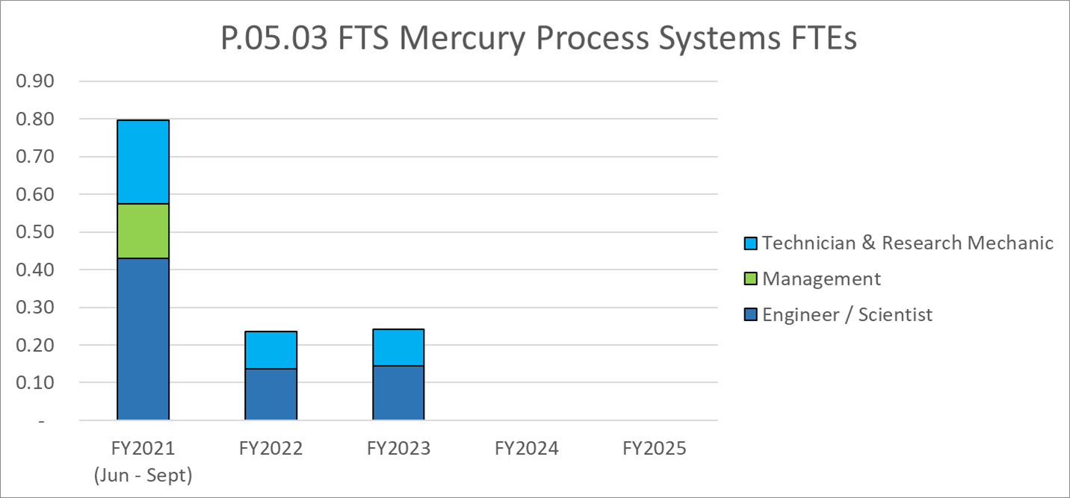
Labor Profile
Charge: 4

Slide 17
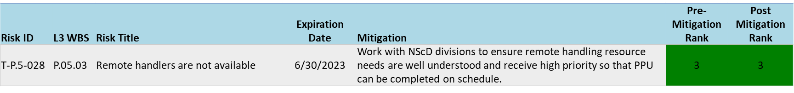
P.05.03 Mercury Process Systems Risk Register
Charge: 4
One active risk identified
  Nine risks retired
  Pre-mitigated ranking: 1 Low
  Post-mitigated ranking: 1 Low
High Risks
  No high risks identified
Key risk categories analyzed
  Remote handling
  Component Requirements
Risks are reviewed on a regular basis

Slide 18
Responses to Recommendations
Charge: 6
No recommendations from the CD-2/3 review
Recommendations from prior DOE reviews are closed

Slide 19
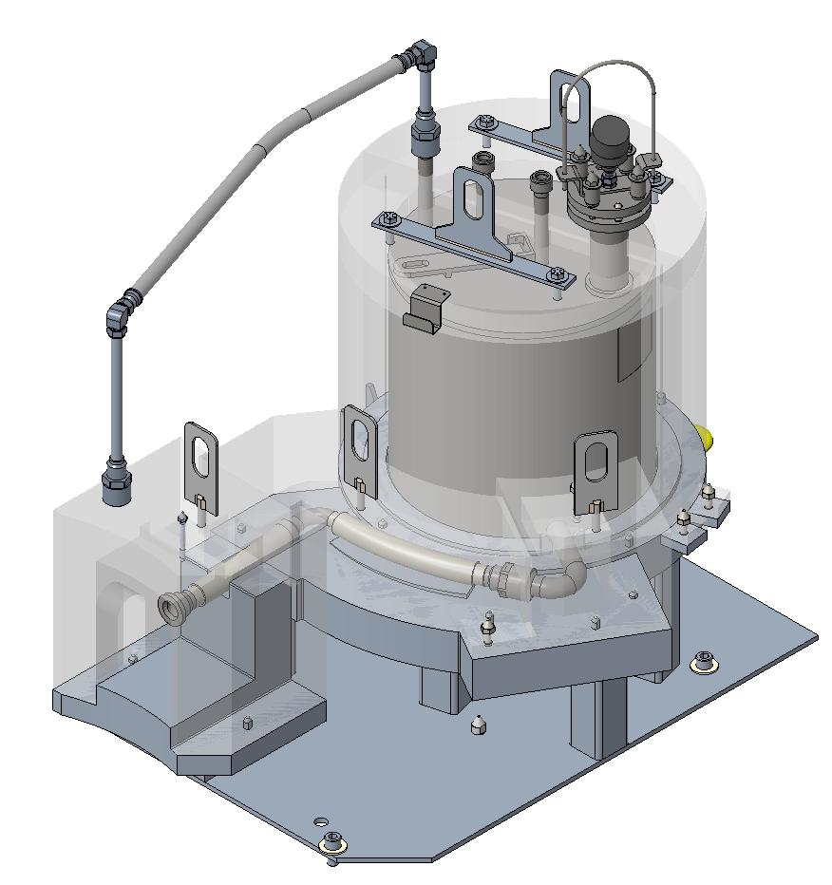
12-Month Look-Ahead
Charge: 1, 2
Mercury pump OFT Final Design Review
Start procurement/fabrication of the OFT equipment
Receive and inspect the in-cell gas supply hardware
Monitor fabrication efforts for the OFT and VLSB

Slide 20
Summary
The gas liquid separator was removed from project scope
The overflow tank is in final design
  Mockup testing completed August 10th – minor revisions to current design
  Level sensor testing is complete
In-cell gas supply hardware final design is complete
Vent line shield block is in fabrication
Thank you for your time!
Questions?

