Slide 1




P.05.04
Moderator Cryogenic Systems
DOE/SC Independent Project Review of the Proton Power Upgrade Project
Bernie Riemer (interim L3 P.5.4)
Level 2 Manager for FTS Systems
August 3 – 5, 2021

Slide 2
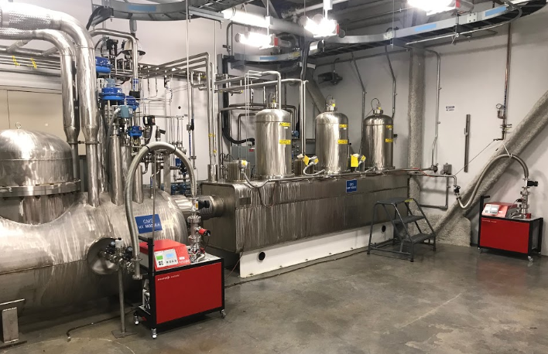
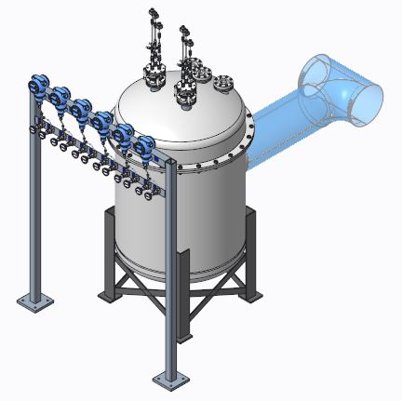
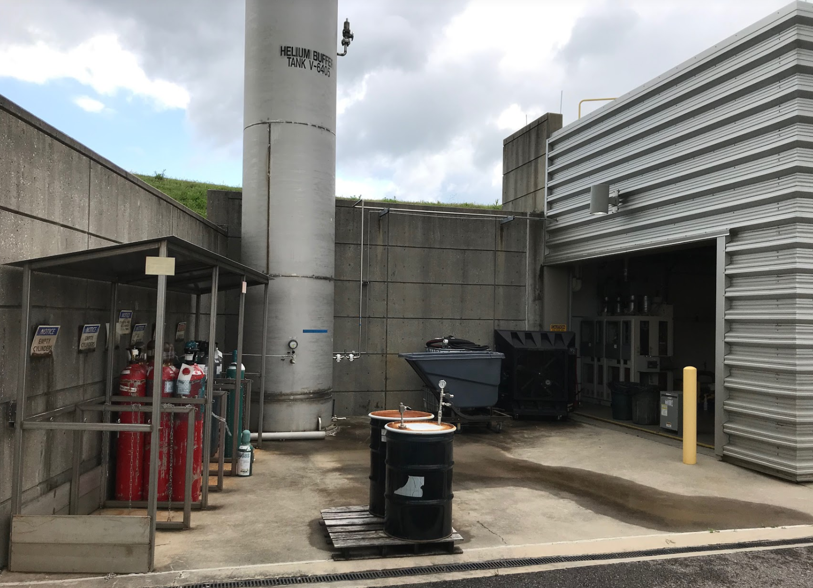
Outline
Ortho/parahydrogen
converter assembly
Scope
Organization
Progress since CD-2/3
Challenges
Final design status
Installation plans
Cost and schedule
Labor profile
Risk register
Responses to recommendations
ESH&Q and COVID-19 impacts
12-month look-ahead
Summary
CMS Hydrogen Utility Room
(Cryogenic Moderator System)
New HRS inventory location
Current HRS location (at capacity)
8760
Notes:
Before getting too far: CMS vs. MCS – the existing operating system vs. project upgrade scope.

Slide 3
Moderator Cryogenic Systems (MCS) upgrades will assure consistent cold neutron pulses regardless of beam power or time since H₂ loading
Charge: 1
Para-hydrogen fraction will be maintained above 99% with addition of ferrous oxide catalyst beds
  Converter assembly with 3 beds will integrate into CMS
  Catalyst bed design is based on JParc
Hydrogen Refill System upgrade is needed because of increase in H₂ loop volumes
In-situ monitoring of ortho/para-hydrogen (o/p) fraction will be accomplished by Raman spectroscopy
  Online feedback of o/p state at discharge of beds
  Direct laser viewing into H₂ through sapphire windows
Notes:
Scope

Slide 4
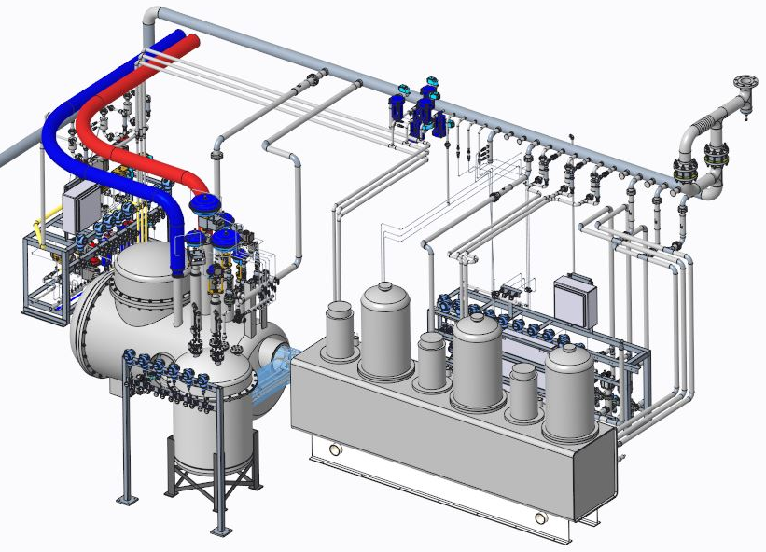
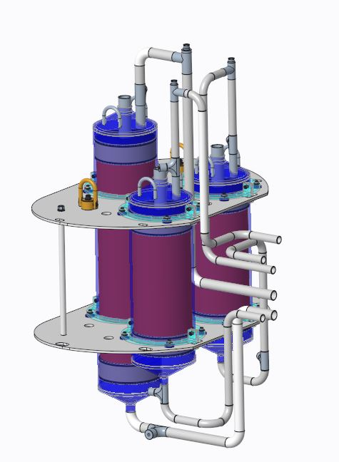
Converter assembly installs into CMS in the Hydrogen Utility Room
Charge: 1
10L Catalyst Module
Internal sapphire viewports (3x)
Heat Exchanger Module (exist.)
New H₂ loop piping
Pump Module (exist.)
5L Catalyst Module
Clamps and G10 spacers
Convertor Assembly
(P.5.4 Scope)
Notes:
Catalyst bed design is largely based upon JParc design

Slide 5
Vessel and piping are designed to ASME
Charge: 1
B31.3 for piping and catalyst bed vessels
Section VIII, Division 2 for vacuum vessel
ASME scope stops at the pipe/flange interfaces
  Sapphire windows are proprietary devices – owner has responsibility for safe operation
  In-house testing has provided confidence
  Internal windows are welded to pipes
  Vacuum vessel windows use CF flange mount
Internal sapphire viewports (3x)
Notes:
Scope

Slide 6
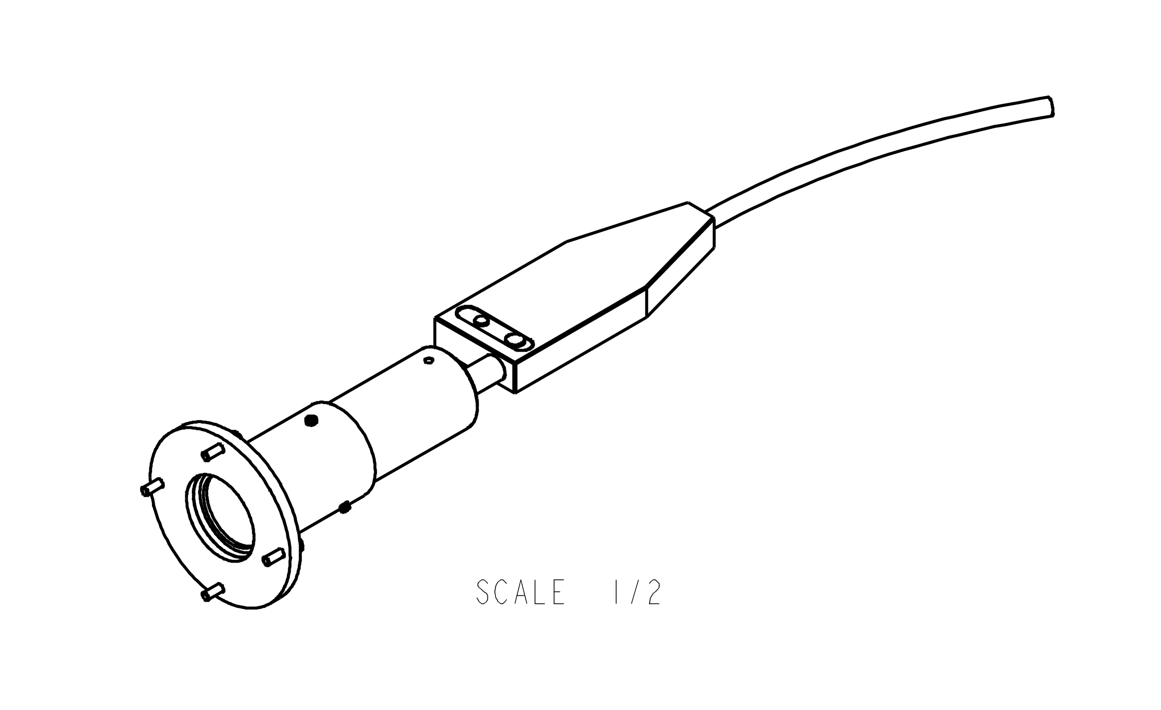
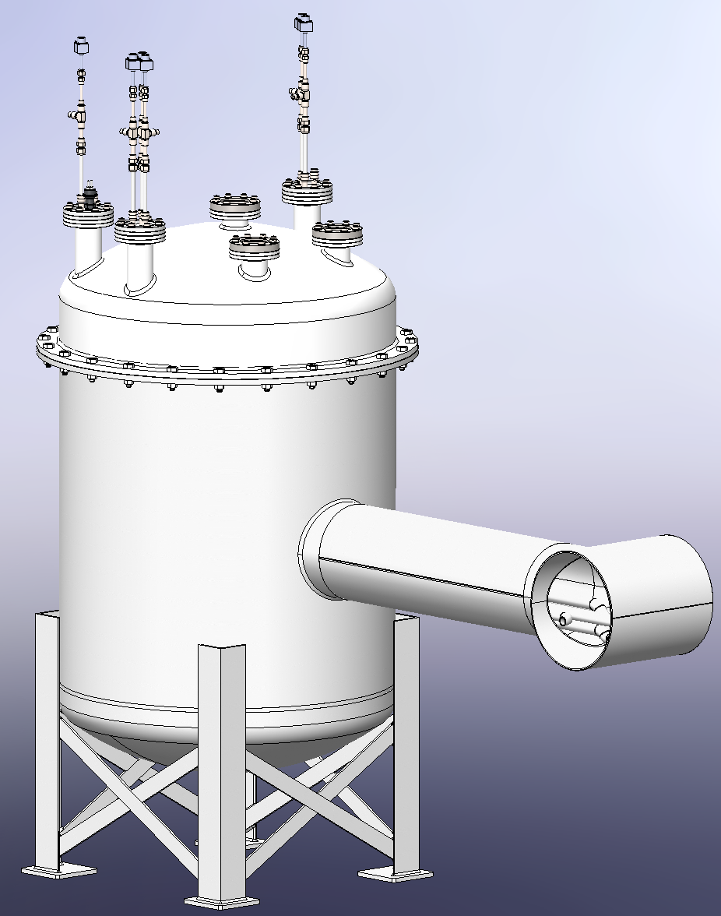
Raman laser diagnostic for o/p fractions
Charge: 1
Each Raman laser passes through 2 sapphire windows
  Vacuum boundary
  Liquid H₂ boundary
Raman head mounting (one per channel)
Mounting locations on converter module
Off-the-shelf laser and spectrometer; all electronics and computers, except for low-voltage spectrometer, will be outside the hydrogen utility room
Notes:
Scope

Slide 7
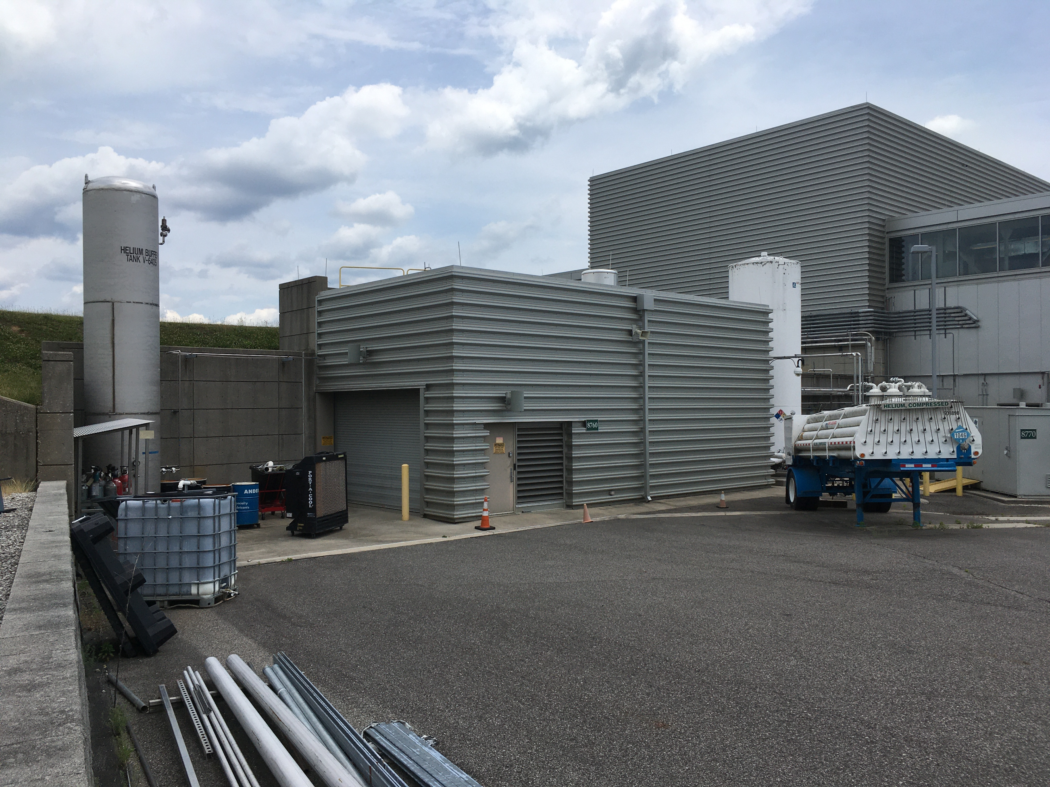
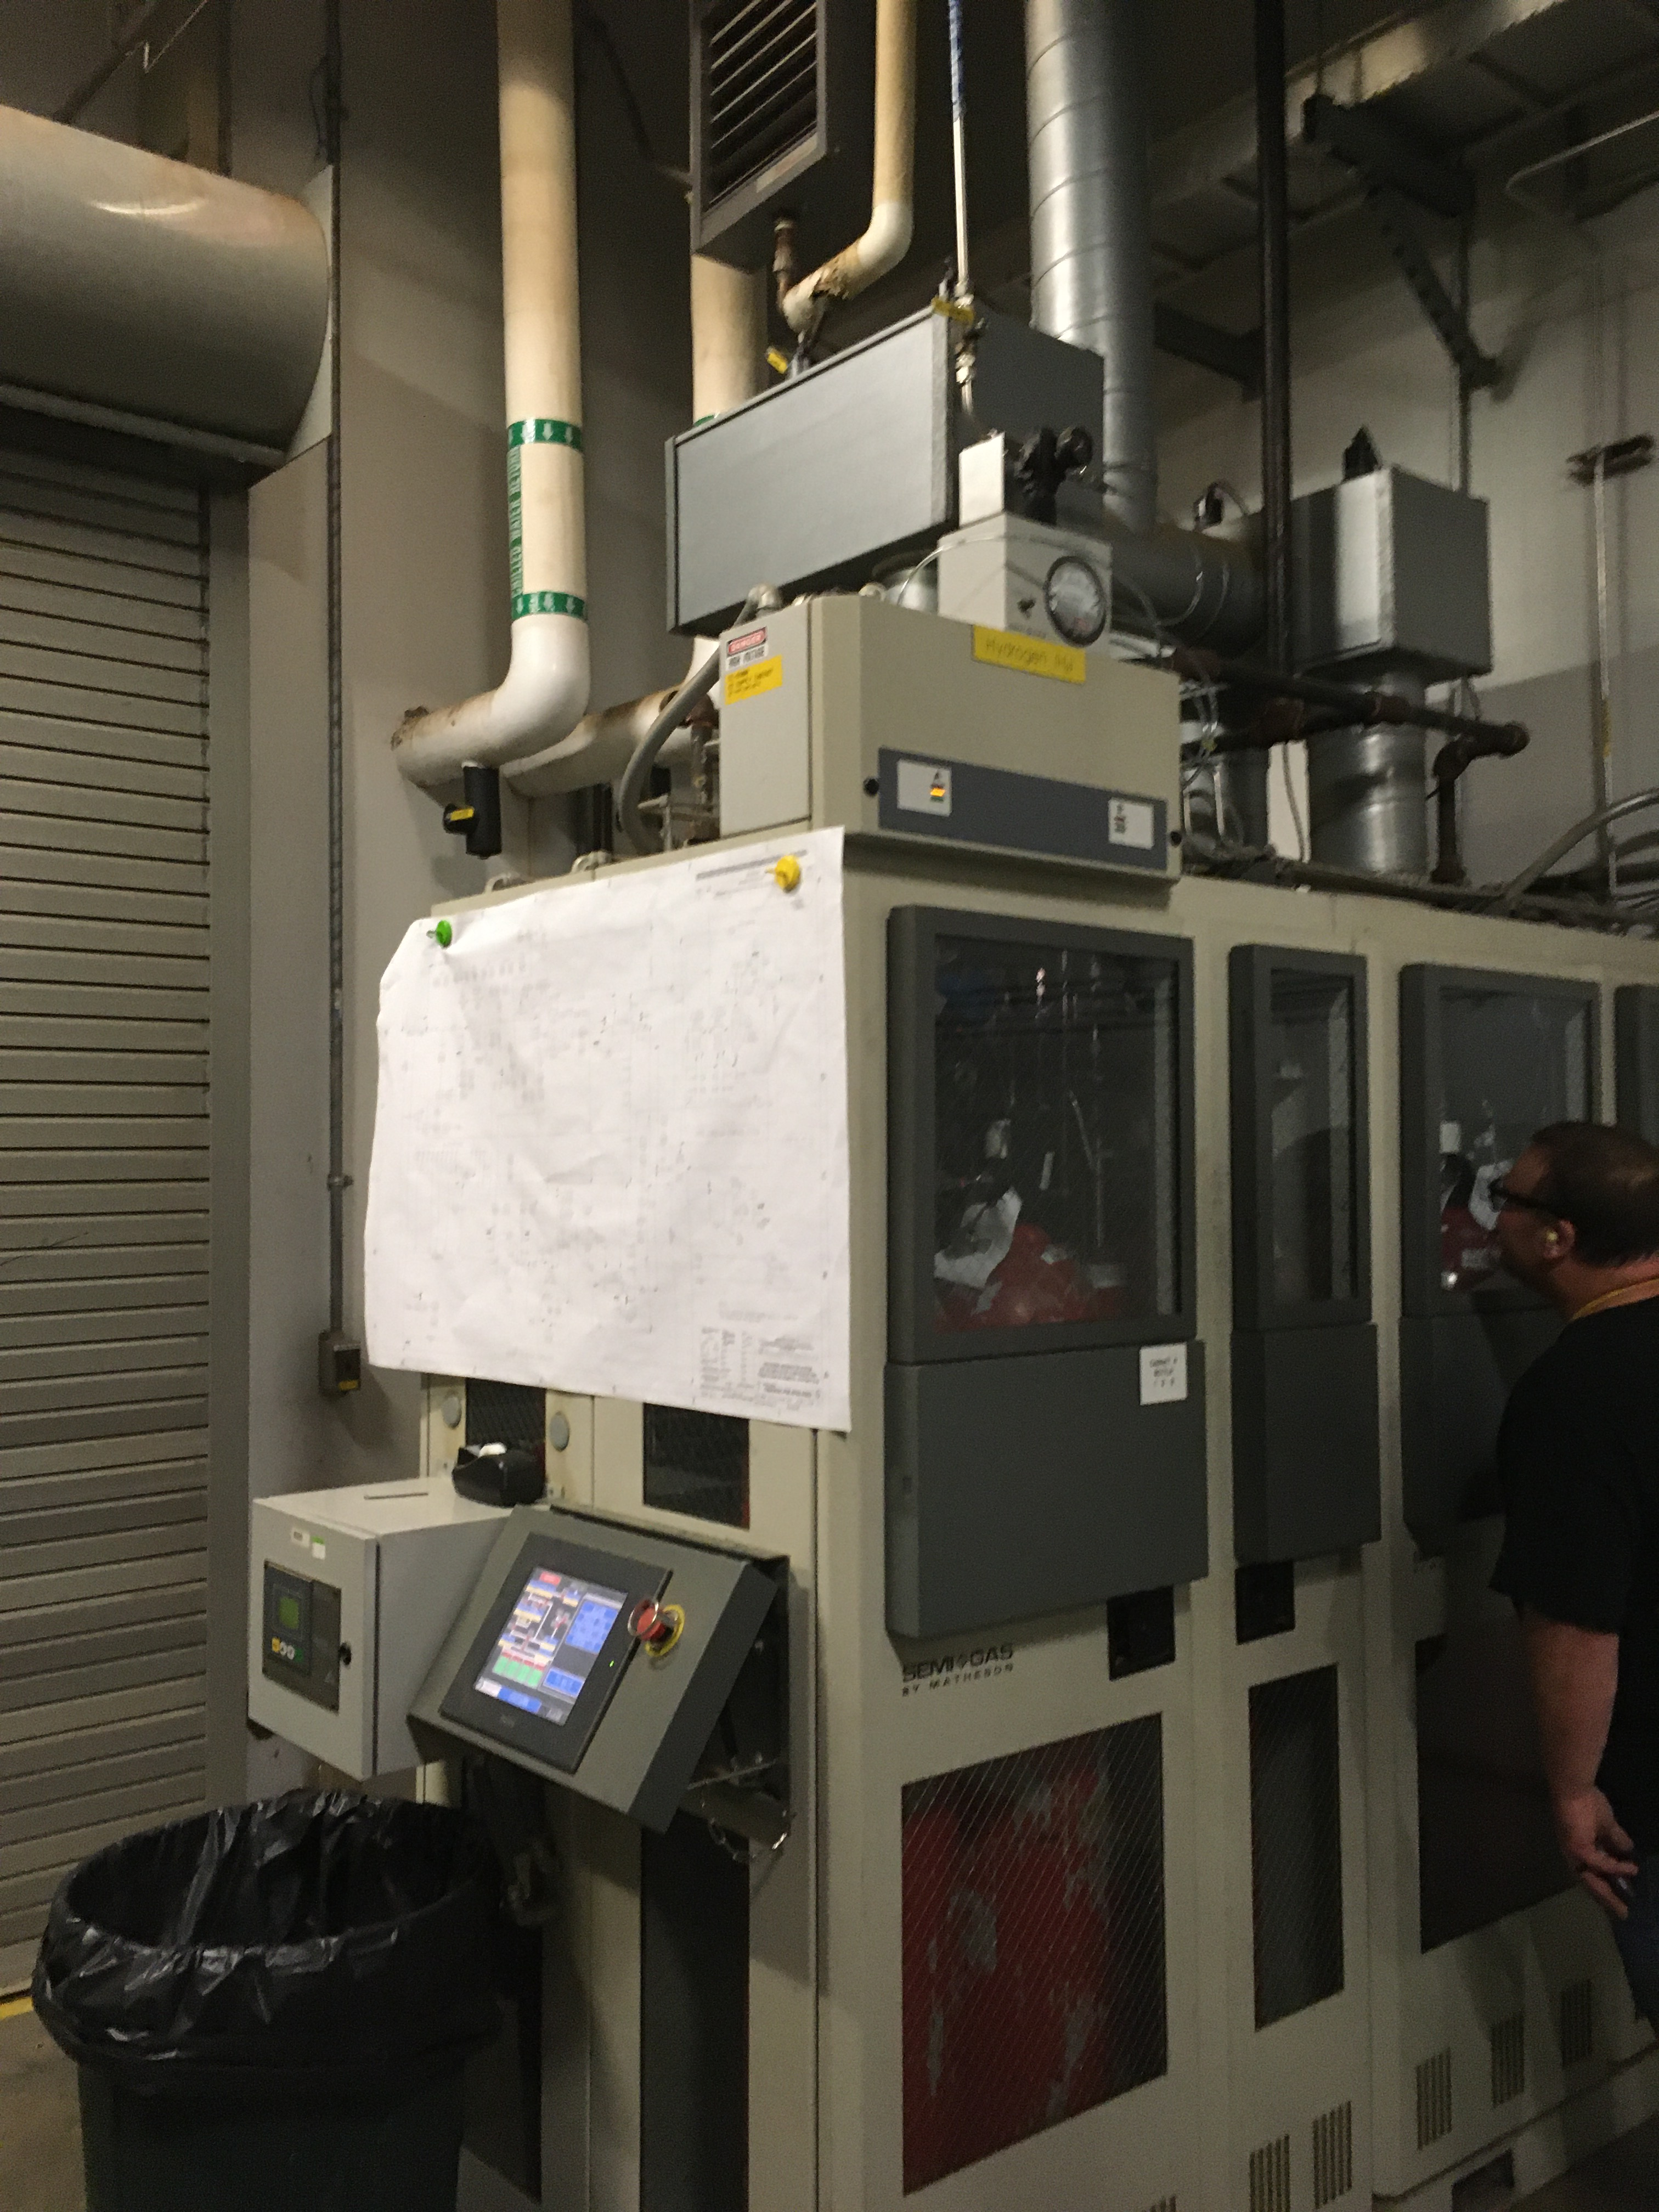
Hydrogen Refill System upgrade adds H₂ capacity for larger loop volumes
Charge: 1
HRS equipment now in 8760 will be moved outside and use standard bottles
New HRS inventory location
Current HRS location (at capacity)
8760
8760
Existing hydrogen cabinet in 8760
Notes:
Scope

Slide 8
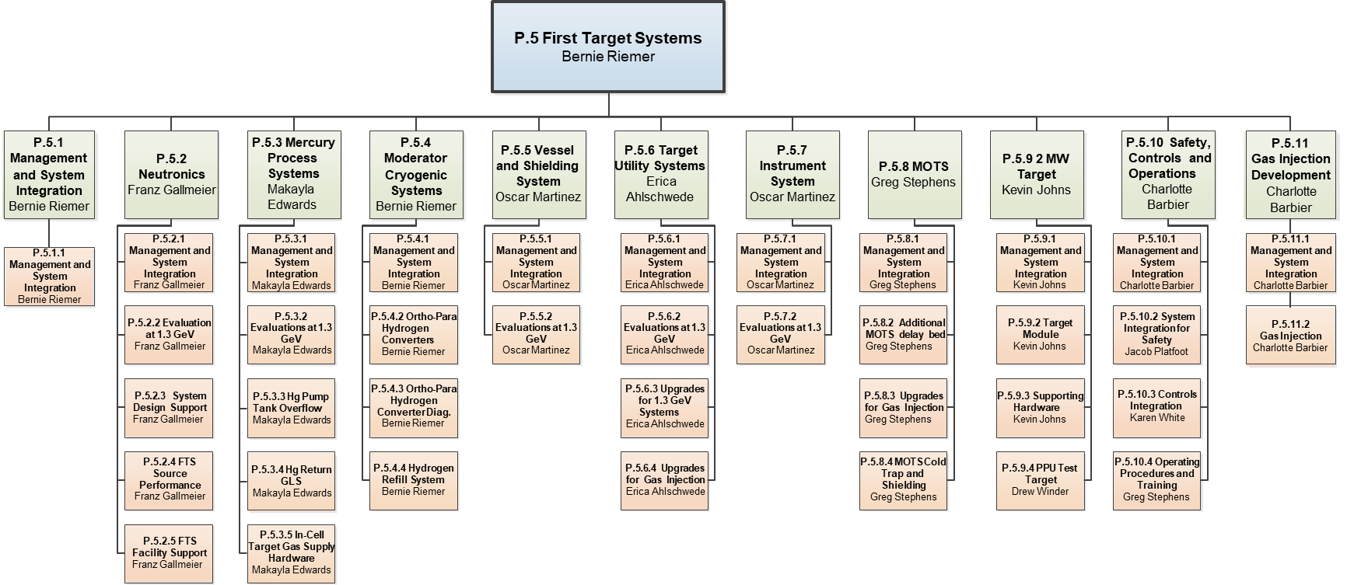
Organization
Charge: 5
Bernie Riemer is interim L3 CAM
RAD Cryogenics group is now responsible for CMS engineering
This group is hiring and will fill vacant CMS systems engineer position
P.5.4 CAM will come from this group

Slide 9
Progress since CD-2/3
Charges: 1-5
Integrity of sapphire optical windows under CMS operating temperature and pressure was confirmed in tests
  30 cycles (vs. typical 1 cycle per year in operations )
  As “proprietary devices”, windows are not addressed by ASME
    Owner’s responsibility
Credited control for catalyst migrated implemented
FDR conducted September 2020
PRR conducted March 2021
RFP issued for Converter Assembly in June
  Award by end of September
B2-10 Platfoot

Slide 10
Challenges since CD-2/3
Charge: 1-2, 4-5
L3 CAM left ORNL
  Engineer subcontractor also retired
HRS gas panel PO award delayed – was scheduled for March
  Design from sole source vendor not fully consistent with Eq. Spec.
    Equipment spec based all welded design approach
    Vendor proposal uses vacuum and compression fittings
    Acceptable, but Eq. Spec needs update
  Device compliance with fire safety has been slow to confirm
Status of HRS outdoor design is found to be less than final
  Fire safety requirements for outdoor installation are clear now
Finishing remaining tasks for diagnostic optics approach stalled
  COVID – key person has returned to site part of the time

Slide 11
Testing confirmed sapphire windows are suitable for LH₂ spin state measurement via Raman spectroscopy
Charge: 1
Cyclic testing (30) of sapphire windows with cryogenic helium successfully demonstrated leak integrity
  Test pressure and temperature bounded CMS conditions
First cycle
Last cycle
PPUP-500-TR0003-R00, Feb. 2021
Notes:
First & last test cycles show no loss of pressure – no leaks
These flanged windows from the vendor.
Glass is brazed to flange.
Same technique for windows with pipe weld stub.

Slide 12
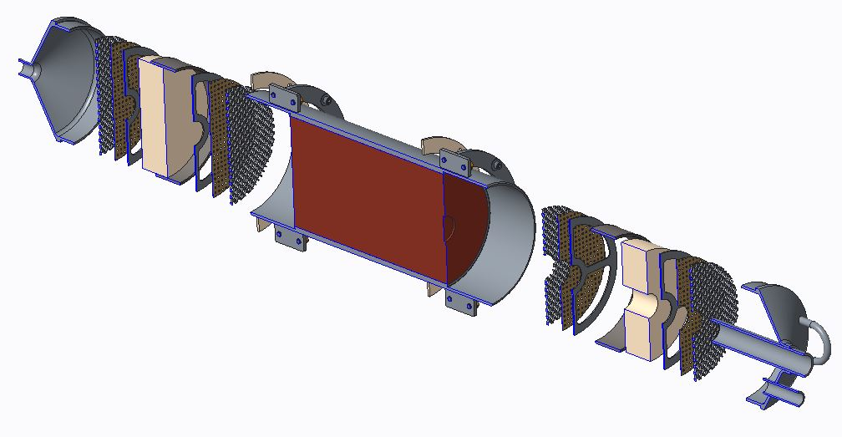


Catalyst retention elements are a credited control
Hypothesized hazard that catalyst migrates to moderators, get irradiated, then migrates back to the Hydrogen Utility Room
Control approach combines
  60 mesh screen per ASTM E11
  Media sifted to 30x50 per ASTM D2862
Compliance to be captured via oversight, Acceptance Criteria List
Charges: 1, 3
B2-10 Platfoot
Ionex ${{Fe}_{2}O}_{3}$ o/p catalyst media
Cerafelt filter media (2x)
Catalyst fill port
Perforated sheet (4x)
$H_{2}$ inlet
5L Catalyst Module
60x60 woven mesh(4x)
Notes:
The stack of elements at each end includes more than the credited items.
Only the woven mesh is credited, along with sifting applied to catalyst material by the vendor.

Slide 13
Installation Plans – Moderator Cryogenic Systems
Charge: 4
Moderator catalyst/converter can be physically placed in the Hydrogen Utility Room independently of operations
The connection to the CMS will be done in the extended outage – requires beam be off
  HRS upgrade must be operational once converter is connected to CMS
The HRS upgrade can have some hardware installed during operations
  Intention was to have it operational prior to extended outage
These upgrades are not essential for meeting project KPPs

Slide 14
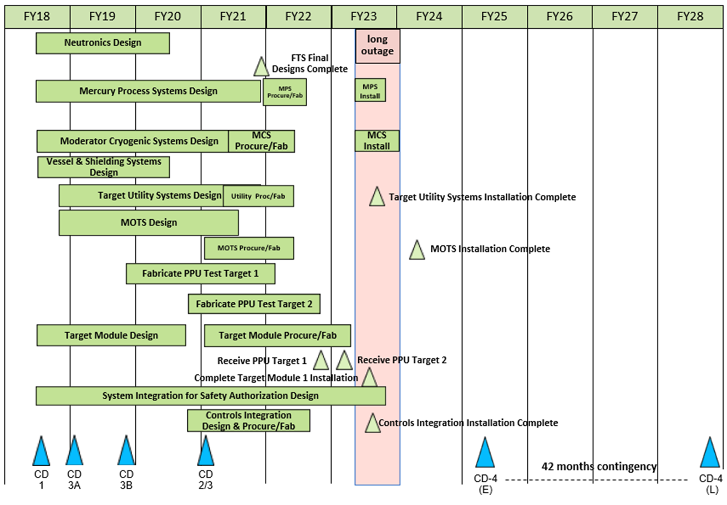
P.5 – FTS May 2021 Status Summary Schedule
Charge: 4
Notes:
The MOTS completion milestone is in mid-FY24 because of later completion of the 2nd cold-trap modification. That work is not essential for integrated system testing of gas injection / mercury system upgrades. It is purposefully delayed to maximum decay time to the existing old trap before it is upgraded to PPU specifications. It is a backup unit.

Slide 15
P.5.4 Progress since CD-2/3
Charge: 4
P.5.4 is more than half complete

Slide 16
P.5.4 Estimate to Complete
Charge: 4
P.5.4 is more than half complete

Slide 17
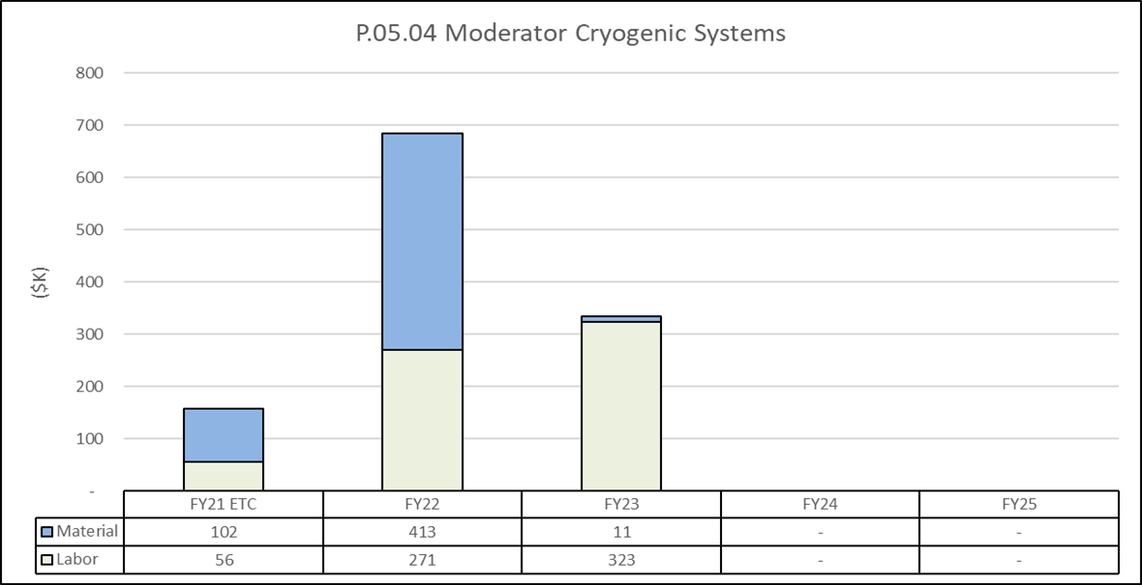
Estimate to Complete by FY
Charge: 4
Procurements and installation in FY22

Slide 18
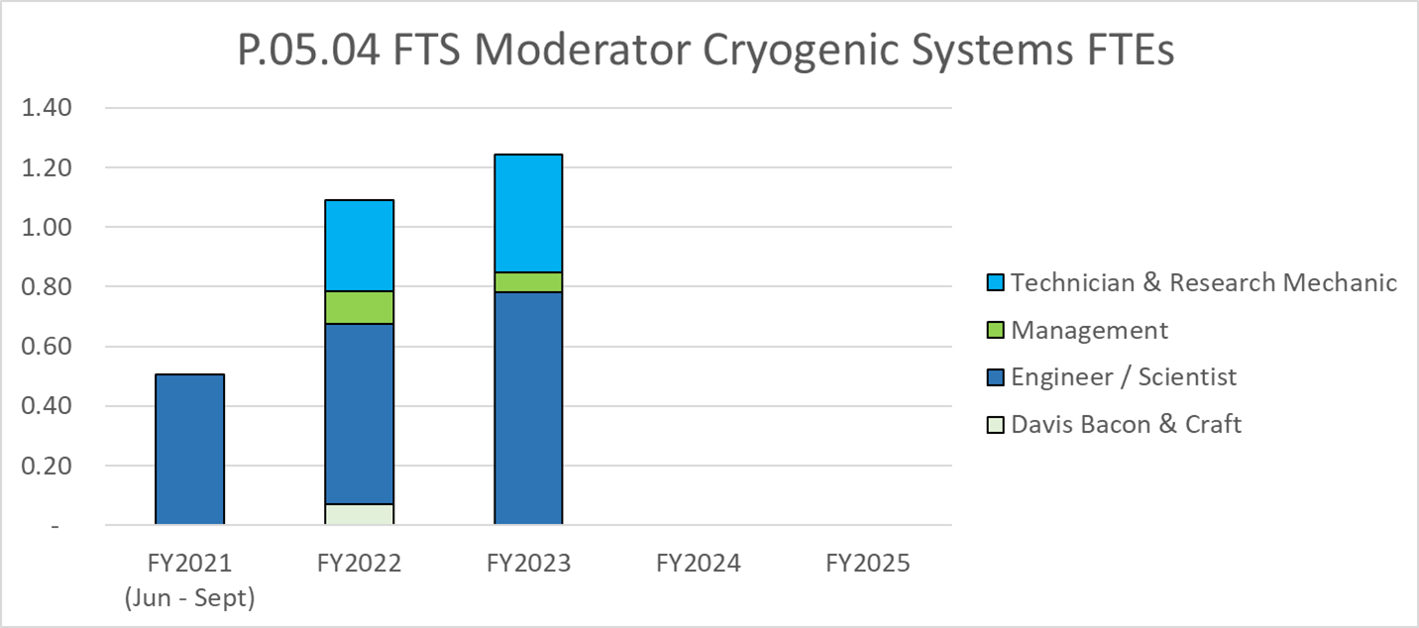
Labor Profile
Charge: 4
Installation and commissioning labor FY22-23

Slide 19
P.05.04 Moderator Cryogenic Systems Risk Register
Charge: 4
No active risks identified
  One risk retired
High Risks
  No high risks identified
Key risk categories analyzed
  Vendor availability
Risks are reviewed on a regular basis

Slide 20
Responses to Recommendations
Charge: 6
There were no recommendations to P.5.4 from earlier DOE reviews

Slide 21
ESH&Q and COVID-19 Impacts
Charge: 3
Facility hazards associated with P.5.4 have been analyzed and solutions found
  Increase in H₂ inventory
  Migration of catalyst
COVID-19 impacts in P.5.4
  Work at home inhibited completion of tasks for o/p diagnostic
    Testing / verification to be done in LH₂ lab that was recently moved to high-bay
    Optics of direct Raman laser
    Testing of updated fiber probe
  Employee has started back on site – tasks should get underway soon
  Minor impact potential on installation schedule for diagnostic
B2-10 Platfoot

Slide 22
12-Month Look-Ahead
Charge: 5
Award converter vessel PO
Purchase catalyst media (GFE), Raman diagnostics h/w
Identify replacement for P.5.4 L3 CAM
Resolve issues with HRS installation and gas panel
Award gas panel PO
Purchase H₂ bottles: 3 skids -16 bottles each
Complete HRS installation design and plans

Slide 23
CMS Readiness for 2 MW Beam Power
Charge: 5
CMS review help in December of 2019:
  The plan presented by the CMS Task Force to support 2.0 MW beam power included a number of longer-term projects and activities
    Flushing helium heat exchanger
    Procuring, installing, and commissioning a new oil processor
    Implementing a dual compressor system
    Evaluating and resolving the flow distribution issue to the three helium/hydrogen heat exchangers
    Implementing best practices to consistently provide greater than 6.5 kW refrigeration capacity, and
    Installing a smaller compressor to the purifier
  “In order to support PPU, the CMS Task Force established an aggressive schedule to complete these activities by the end of the long outages in 2023 . . .”
M. Howell – GL RAD Cryogenics
Notes:
From the CD-2/3 12-month outlook:
“Continue to monitor good operations-supported progress on CMS and gas injection”

Slide 24
CMS Readiness for 2 MW Beam Power Cont’d
Charge: 5
Good progress has been made on these items
  Flushing helium heat exchanger
    Contract with expert vendor. Materials on hand.
  Procuring, installing, and commissioning a new oil processor
    New processor procured. It was used to process oil currently in compressor.
  Implementing a dual compressor system
    Multi-year project in progress.
  Evaluating and resolving the flow distribution issue to the three helium/hydrogen heat exchangers
    Study recently conducted is a cause for concern
  Implementing best practices to consistently provide greater than 6.5 kW refrigeration capacity, and
    Initial results of preparation procedure authored by DeGraff yielded good results
  Installing a smaller compressor to the purifier
    Lower priority project that can coincide with HFIR refrigerator replacement
M. Howell – GL RAD Cryogenics

Slide 25
Committee Advised on 2 MW Beam Power
Charge: 5
Additional Considerations
  “The review committee recommends elevating the importance of the distribution analysis in the hydrogen/helium heat exchangers to ensure 2.0 MW beam power can be accommodated across all three cryogenic moderators.”
M. Howell – GL RAD Cryogenics

Slide 26
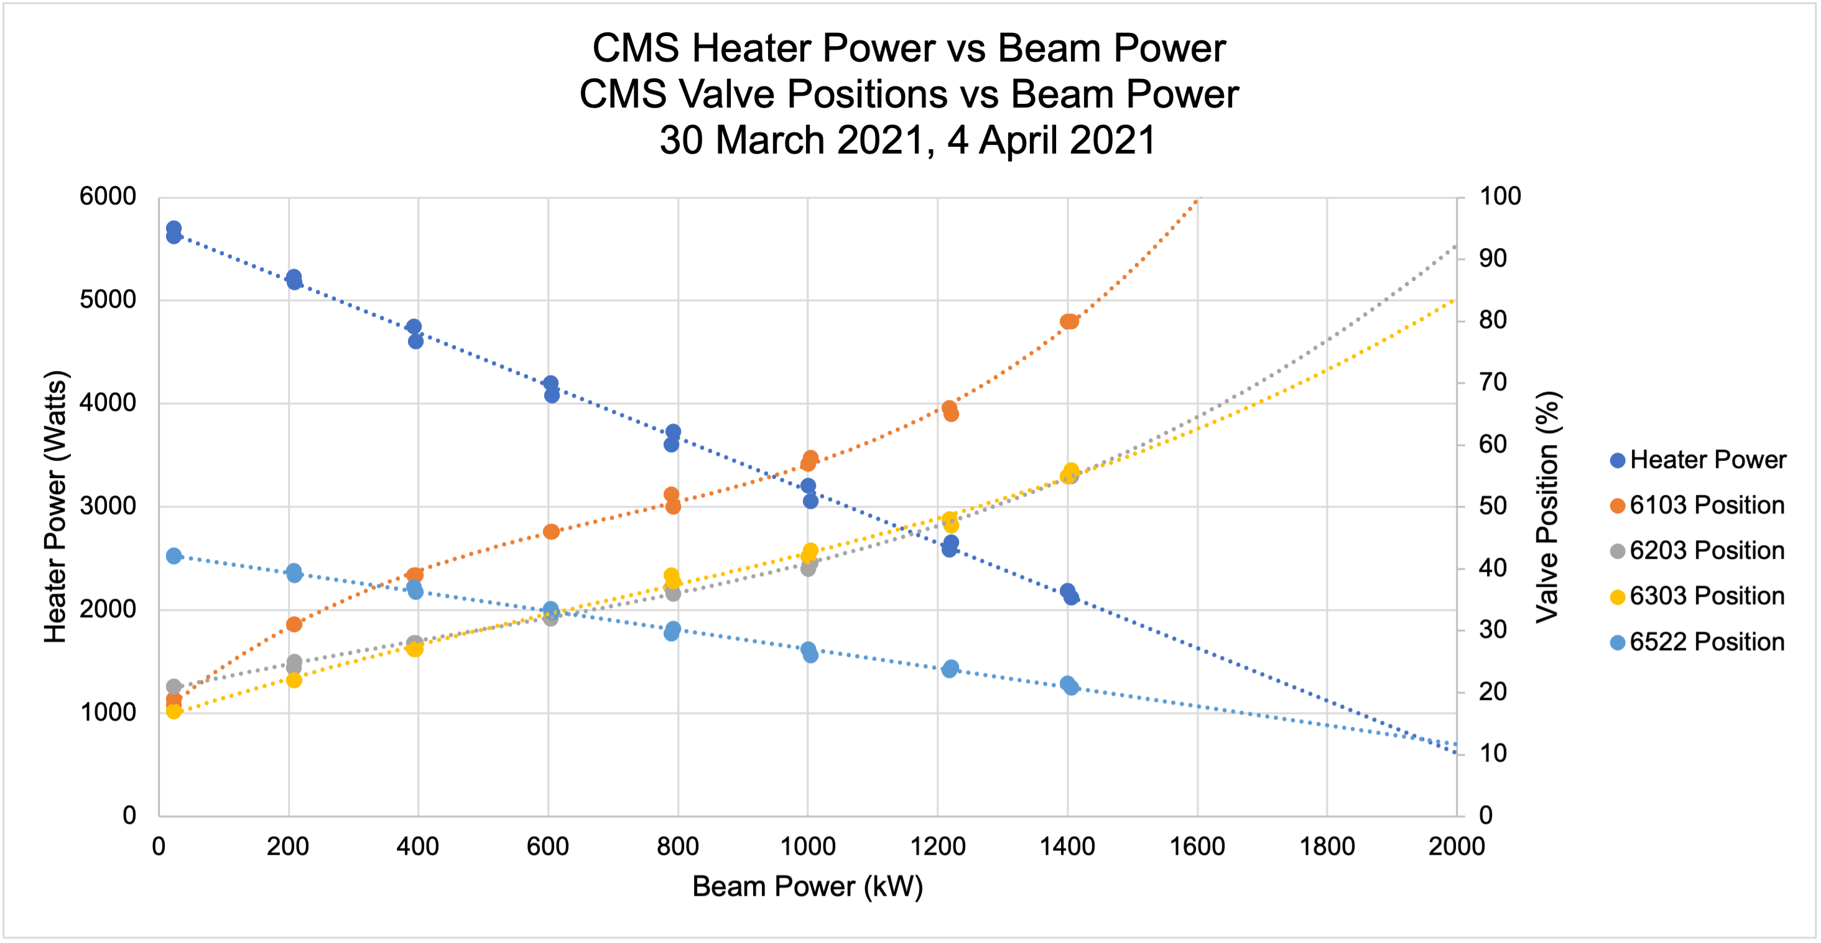
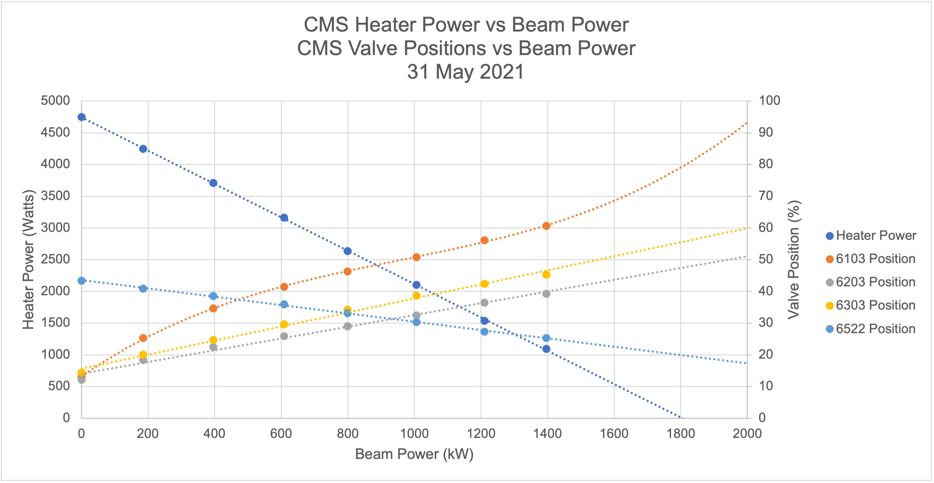
Flow distribution to Helium/Hydrogen Heat Exchangers
Charge: 5
Tests run at 18.8K turbine outlet temperature
  Indicates a larger heat exchanger is needed in Loop 1
  Cold box has adequate capacity
Tests run at 17.5K turbine outlet temperature
  Indicates a heat exchanger sizing is adequate for Loop 1
  Cold box has capacity issue for this condition
The desired path is to boost system capacity to run at colder temperature
  More desirable for neutron science
  Less capital cost
M. Howell – GL RAD Cryogenics
Notes:
Solvent flush of entire helium system will help.
A couple of other knobs to explore – plot on the right is kind of worse case scenario.
Maybe another 300-400 W. Etc. Key decisions in July.
As of today can make system work at 1.7 MW. Better than a few months ago. With more work 2MW

Slide 27
Summary
Good progress made since CD-2/3 in P.5.4 despite COVID and sudden departure of L3 CAM
Converter assembly RFP issued
Sapphire window pressure – temperature testing provides confidence in their integrity for use in converter
O/P diagnostic approach is mostly settled
  Remaining tasks will not take long once lab work restarts
HRS has been most impacted by loss of L3
  Details of design approach not as well understood by interim
  Resolution of installation and controls question has been slow but impact to schedule is manageable
  RAD Cryogenics group is hiring staff

