Slide 1
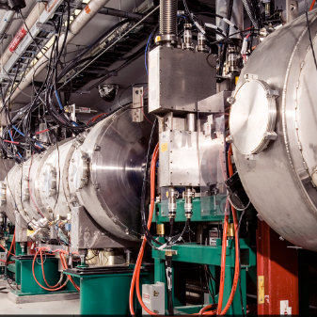
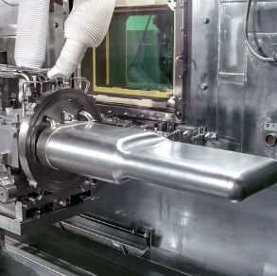
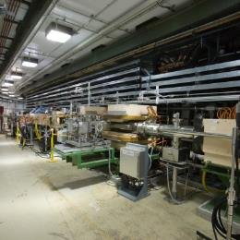
P.5.6 Target Utility Systems
DOE/SC Independent Project Review of the Proton Power Upgrade Project
Erica Ahlschwede
Level 3 Manager for Target Utility Systems
September 14-17, 2021

Slide 2
Outline
Scope
Organization
Progress since CD-2/3
Challenges
Final design status
Installation plans
Cost and schedule
Labor profile
Risk register
Responses to recommendations
ESH&Q and COVID-19 impacts
12-month look-ahead
Summary

Slide 3
Scope
Charge: 1
P.5.6.1: Management & System Integration
P.5.6.2/.3: Evaluations/Upgrades for increased beam energy from 1.0 to 1.3 GeV @ 2MW – Complete prior to CD-2/3
4 Primary Target Cooling Water Loops
4 Secondary Cooling Water Loops
3 Tertiary Cooling Water Loops
Nitrogen and Helium Gas Distribution
P.5.6.4: PPU Upgrades for Gas Injection for 1.3 GeV @ 2MW
Electrical Upgrade in target building basement
Recirculating gas injection systems
Target bubblers (up to10 slpm; PPU)
Target wall (up to 10 slpm; PPU)
“Once-through” helium (as backup to recirculating system)
Target bubblers (up to10 slpm via Gas Panel 9 provided by Operational Upgrades/Not PPU)
Target wall (up to 10 slpm via Gas Panel 10; PPU)
Molecular sieve system

Slide 4
Organization
Charge: 5

Slide 5
Progress since CD-2/3
Charge: 1
12-month look-ahead from CD-2/3
Complete supporting analyses and design on outstanding gas injection upgrades (equipment, molecular sieve systems and electrical upgrades)
Start procurement of components
Off-normal Analysis for FTS system upgrades
May 2021 – Final Electrical Design review

Slide 6
Progress since CD-2/3
Charge: 1
Off-normal Analysis for FTS system upgrades
Complete Oct 2020
Molecular Sieve PDR (P.5.6 and P.5.8)
Complete Oct 2020
Design continues to progress
Basement electrical upgrade FDR
Complete Feb 2021
Temperature control valve TCV-1061 received
March 2021
Gas Panel 10 FDR
Complete May 2021
Compressors for gas recirculation received
June 2021
B2-8 Stephens, B2-10 Platfoot, B2-5 Edwards
B2-8 Stephens

Slide 7
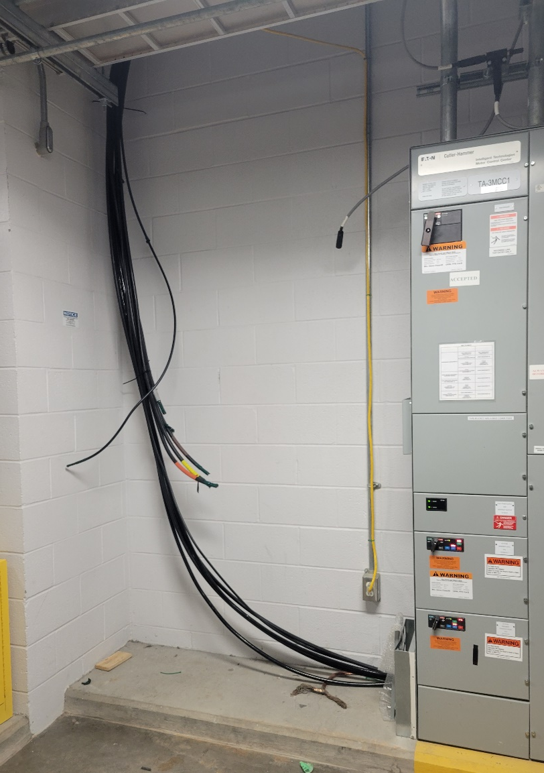
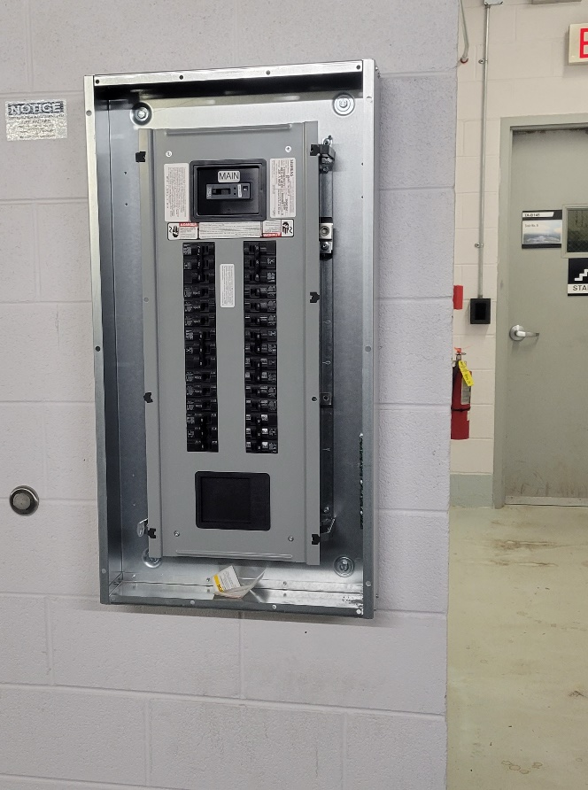
Progress since CD-2/3
New electrical cables from floor above
Charge: 1, 2
Off-normal Analysis for FTS system upgrades
9 action items
6 closed
Basement Electrical Upgrade
Procurement started April 2021
Installation began June 2021
Building 8700 power outage to allow for electrical tie into transformer occurred June 2021
Installation expected to be complete fall 2021
New electrical panel in 8700 Basement

Slide 8
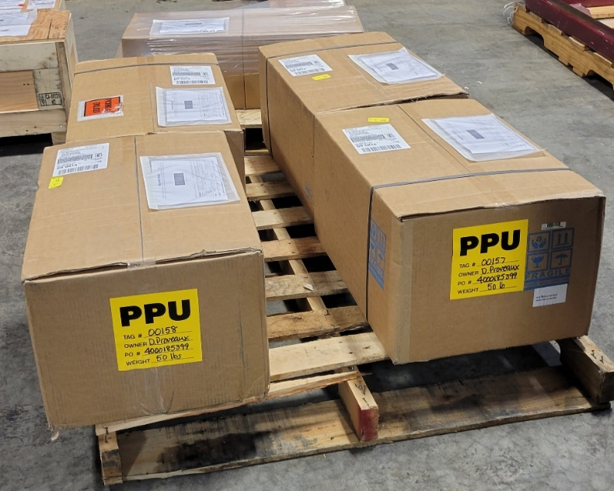
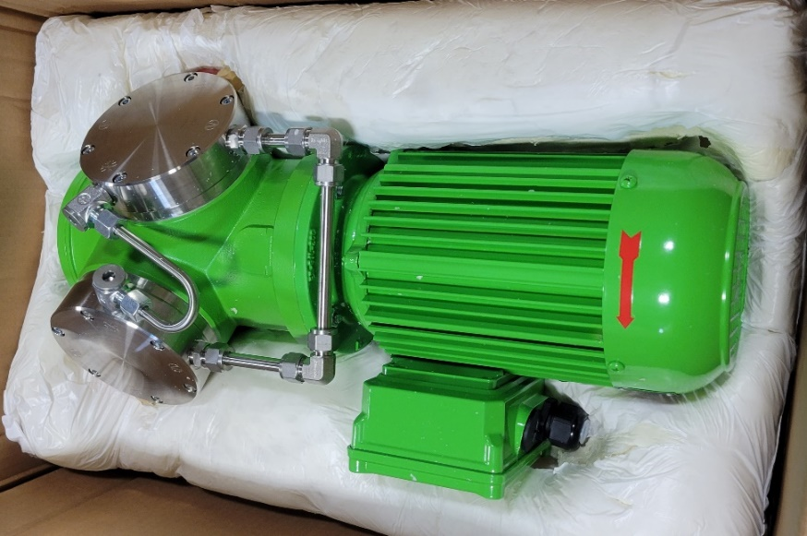
Progress since CD-2/3
Charge: 1, 2
Gas Recirculation
Received 4 Compressors
Long lead item from Germany
Received June 2021
Created hydraulic model of Hg loop, to help identify pressure drop concerns and issues
Identified the need for make up He to compressor suction during start-up
HVAC engineering design for ‘snorkel’ to capture potential He leaks from compressor diaphragm

Slide 9
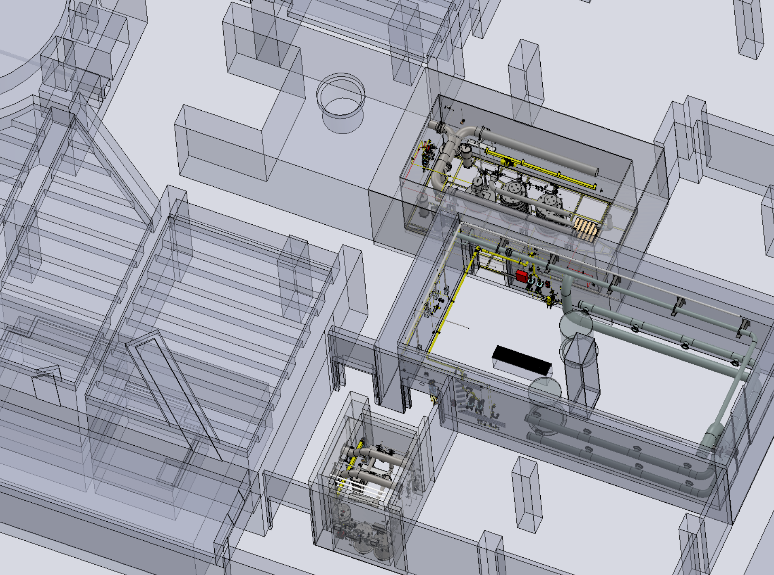
Overview of Gas Flow Path
Charge: 1
Green: Mol Sieves
Magenta: PPU Delay Bed
Blue: Gas recirculation compressors
Red: Transfer lines run through GAR, CAR, and MOTS
Gas travels through CuO reactor, MOTS Mol Sieve, and finally the cold trap
GAR
Gas recirculation line to high bay
CAR
MOTS

Slide 10
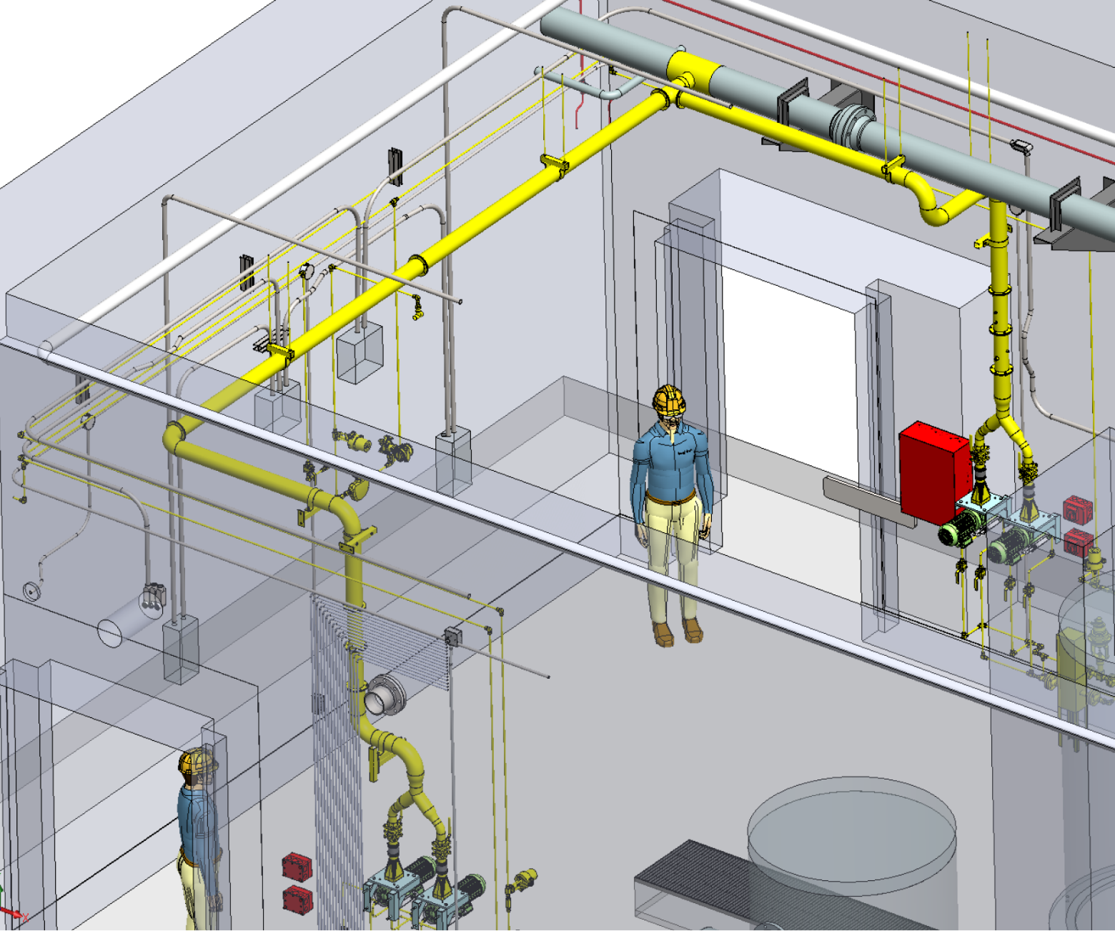
Progress since CD-2/3
Charge: 1
Gas Recirculation equipment layout
Red: compressors
Yellow pipe: snorkel system
Target wall train

Slide 11
Progress since CD-2/3
Charge: 1
Molecular Sieve Design (P.5.6 & P.5.8)
Tritium samples of existing mol sieves were taken in Nov 2020
Quantify tritium production and document findings
Sample results received week of August 13th
Met with radiation safety committee in Jan 2021, with RSC concerns around the high dose rates in the GAR
Team tasked to identify solutions to help remediate
Discovered the clam shell style shielding design concept was not viable
Unable to find a high temperature (600 F) and high radiation paint application
Team transitioned to a steel lined shielding design currently in use on the gold bed
Design team underwent the task of re-evaluating the vessel size, to reduce source term values
Received Ops management buy in for smaller vessel size
Determined that a 5th vessel for regeneration is not required
B2-8 Stephens

Slide 12
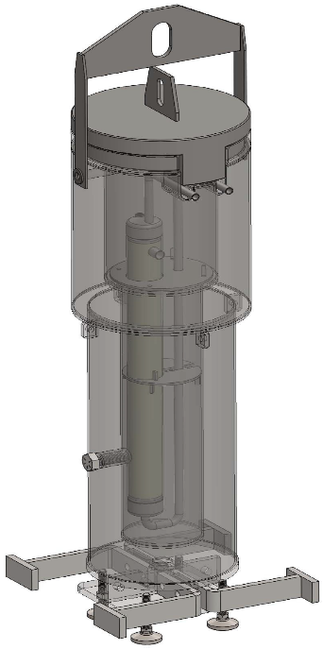
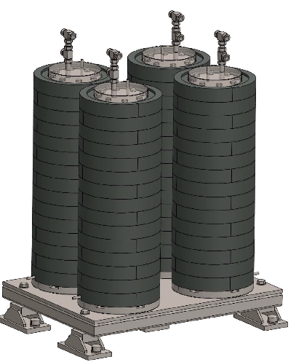
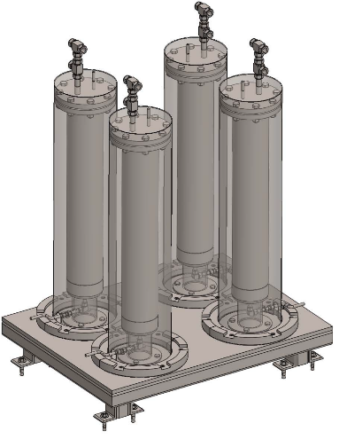
Progress since CD-2/3
Charge: 1
Molecular Sieve Design
Comparison “old” vs “new”
Old: 6” diameter vessel with clam shell style lead brick shielding
New: 3” diameter vessel with SS lined, poured lead design shielding
Smaller vessels reduce source term by ~50% with the same shielding thickness
B2-8 Stephens
6” diameter with lead brick shielding
3” diameter with SS lined, poured lead shielding

Slide 13
Progress since CD-2/3
Charge: 1
Molecular Sieve Design (P.5.6 & P.5.8)
Detailed discussions held with mol sieve vendors to communicate complexity of project
3 potential vendors are engaged, and feel comfortable with the project
Source term DAC revision
To address design progression and correct delay time
On / off valve selection complete
He leak tight, high temperature and high radiation application, need to fit into a small space
Met with RSC to present new source term findings (June 2021)
RSC recommends approval of new shielding design
B2-8 Stephens

Slide 14
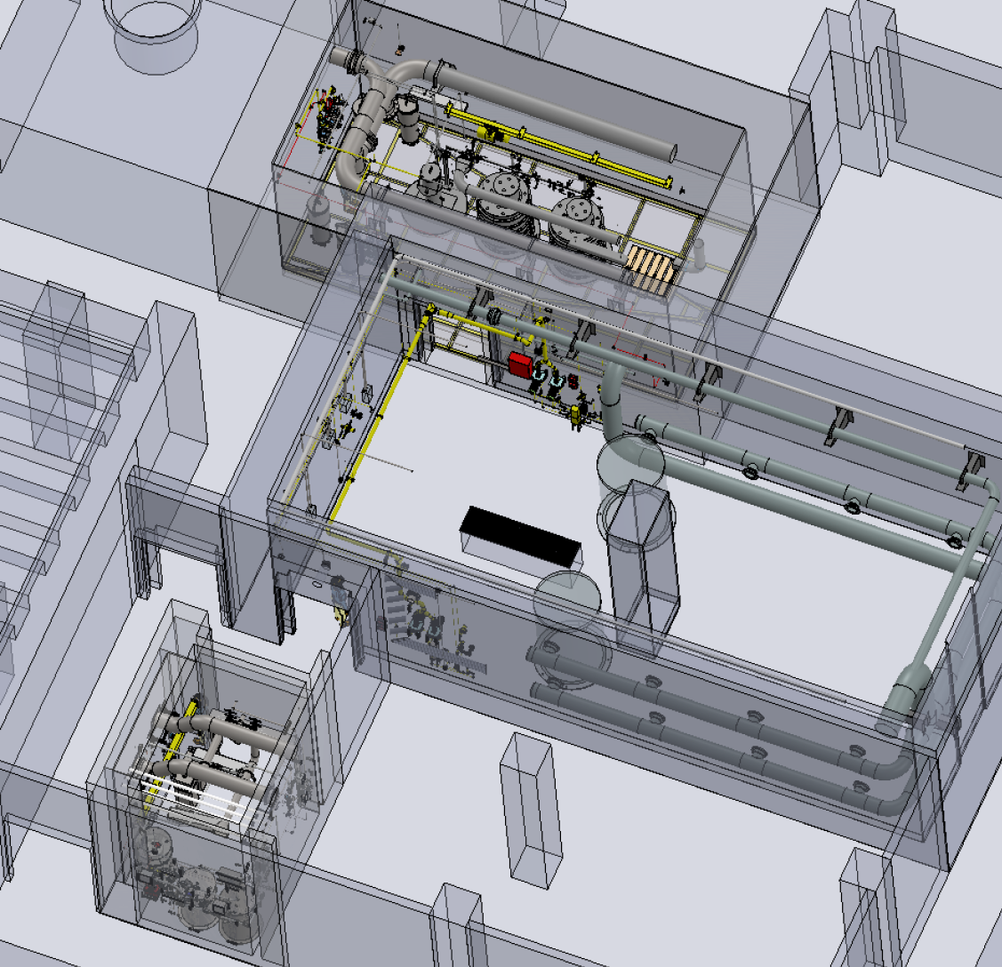
Progress since CD-2/3
Charge: 1
Mol sieve equipment layouts
Red: system in GAR
Green: system in MOTS
Gold Amalgamation Room (GAR)
B2-8 Stephens
MOTS

Slide 15
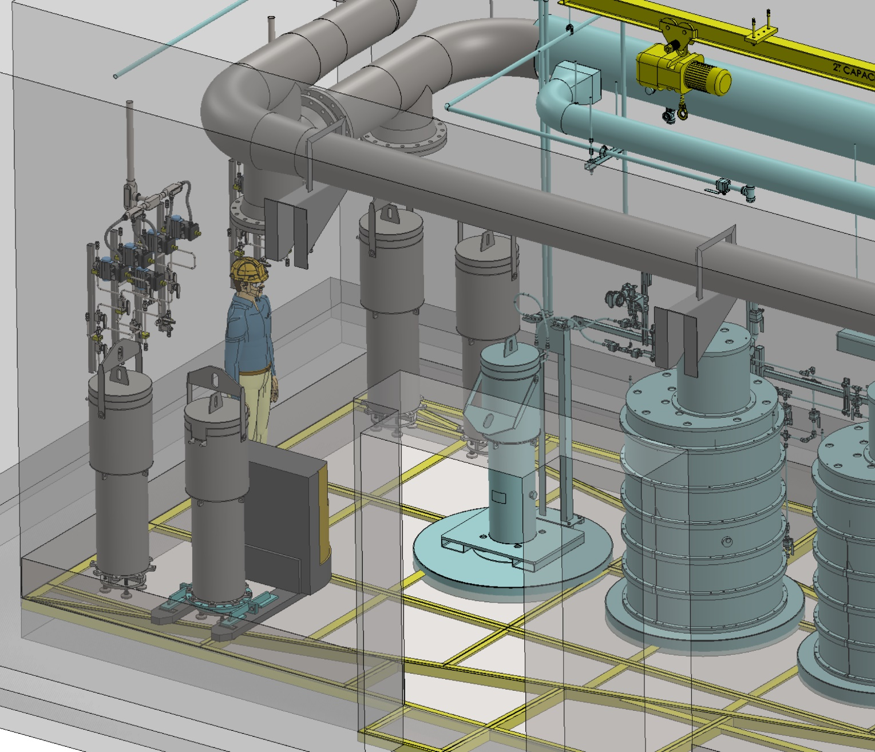
Progress since CD-2/3
Charge: 1
Mol sieve equipment layouts - GAR

Slide 16
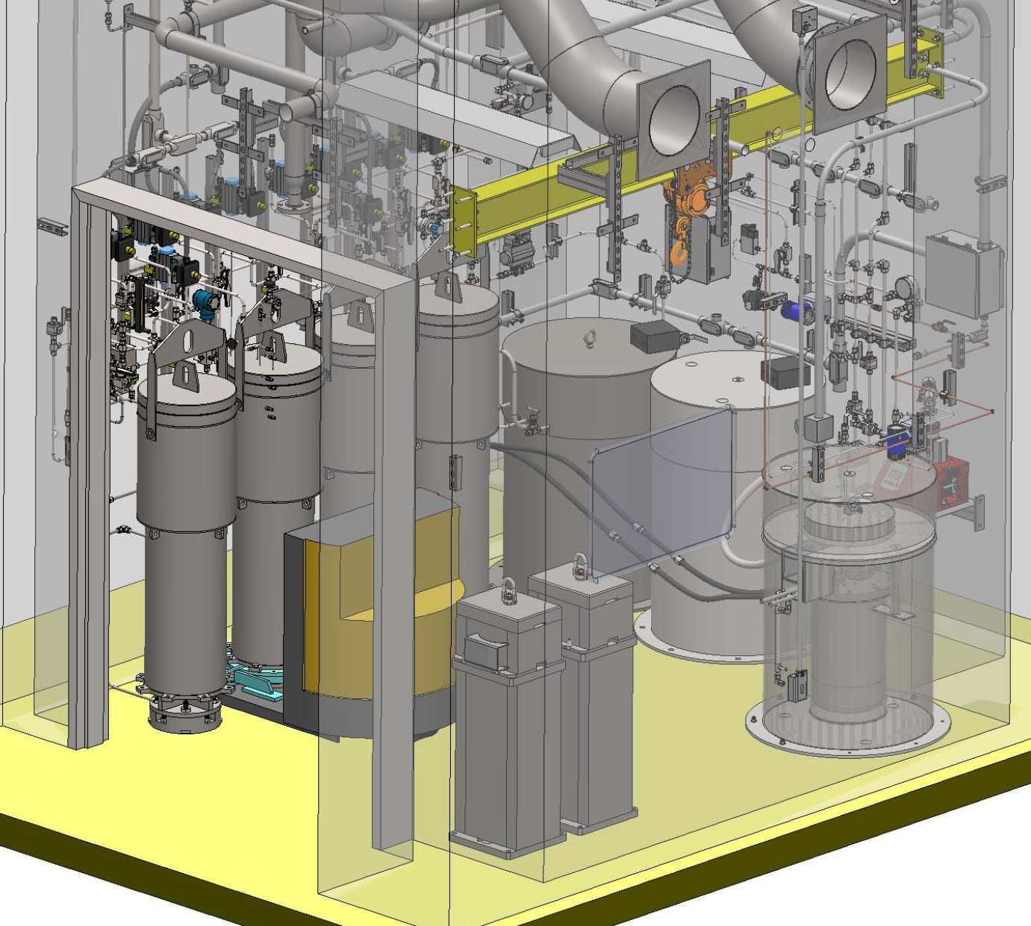
Progress since CD-2/3
Charge: 1
Mol sieve equipment layouts - MOTS
B2-8 Stephens

Slide 17
Challenges
Charge: 1
Technical
Mercury Loop Recovery Event (MLR)
Event occurred March 2019, project completed Dec 2020
Source term generation
Evaluated for each piece of equipment, under different flow rates and different flow configurations
RSC request to mitigate high source term values
Gas recirculation flow configurations
Once through, two different options to ‘recycle’
Hydraulic model identified need for helium introduction into compressor suction for pressure profile and to maintain helium purity
Mol sieve design complexity
600 F temps, high radiation, He service, small installation footprint, low dewpoint required, little to no pressure drop required
On / Off Valve selection
Process instrumentation must survive the same environment
Shielding design
B2-8 Stephens, B2-10 Platfoot, B2-5 Edwards

Slide 18
Challenges
Charge: 1
Technical
Internal Resources moved to STS
Process design engineer
3D designer
Coordination of Subcontract Support
Process engineering - flow sheet development and hydraulic modeling (was part time; now full time)
Nuclear HVAC engineering design (part time)
3D modeling and designer (was part time; now full time)
Seismic/Structural engineering design (part time)
Process Controls engineering design – instrumentation selection (part time)
FTS Operations Support
Ion exchange column deuteration
Procurement of heavy water
RID water chemistry support
Recombination & Recycle
Beamline support

Slide 19
Challenges
Charge: 1, 4
Schedule
Nature of the technical challenges negatively impacted design schedule
At CD-2/3, Mol Sieve FDR was projected to occur in March 2021
FDR will occur later than schedule shows, in the fall of 2021
Mol Sieve mechanical installation projected to occur during the long outage in FY23
Procurement
Mol sieve equipment specification
Will be tricky to write
Accurate communication of the technical challenges is key to success

Slide 20
Final Design Status
Charge: 1
Two areas are not yet at final design
Gas Recirculation: 90%
Molecular Sieves: 90%
Technical issues have been addressed
Supporting documentation and drawing packages need to be completed
FDR anticipated Fall 2021
Gas recirc install expected to begin winter 2021
No risks anticipated with completing final design
Mol sieve install expected in the extended outage in FY23
Ensuring accurate equipment specification

Slide 21
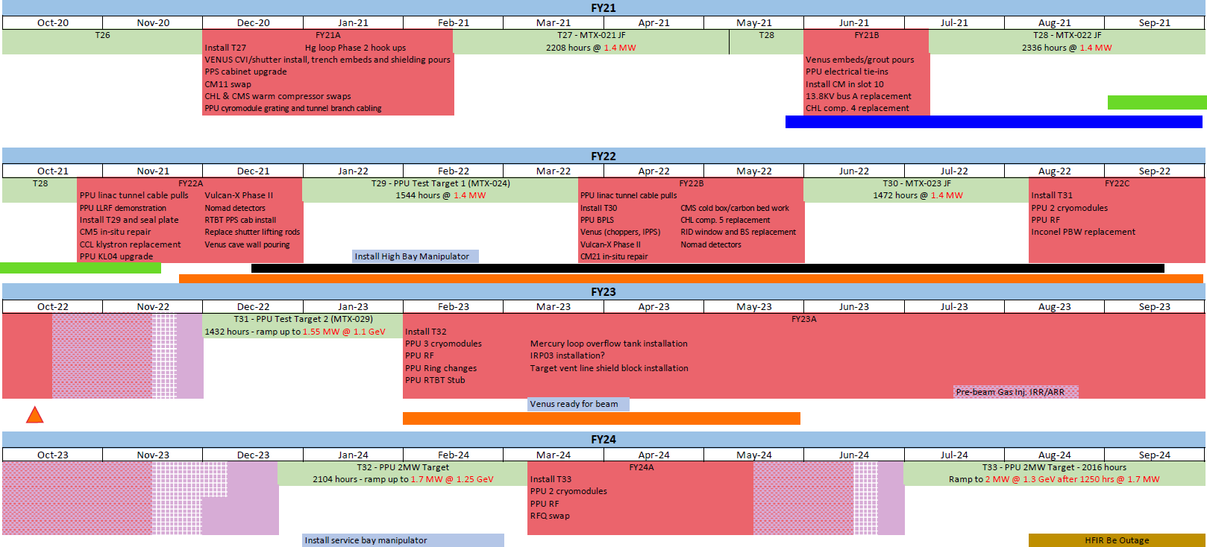
Installation Plans
Charge: 4
Electrical Upgrade: May 2021 – Fall 2021 Gas Panel 10: Sept 2021 – Nov 2021
Gas Recirculation: Dec 2021 – Sept 2022 Mol Sieve: Feb 2023 – May 2023

Slide 22
Cost and Schedule
Charge: 4

Slide 23
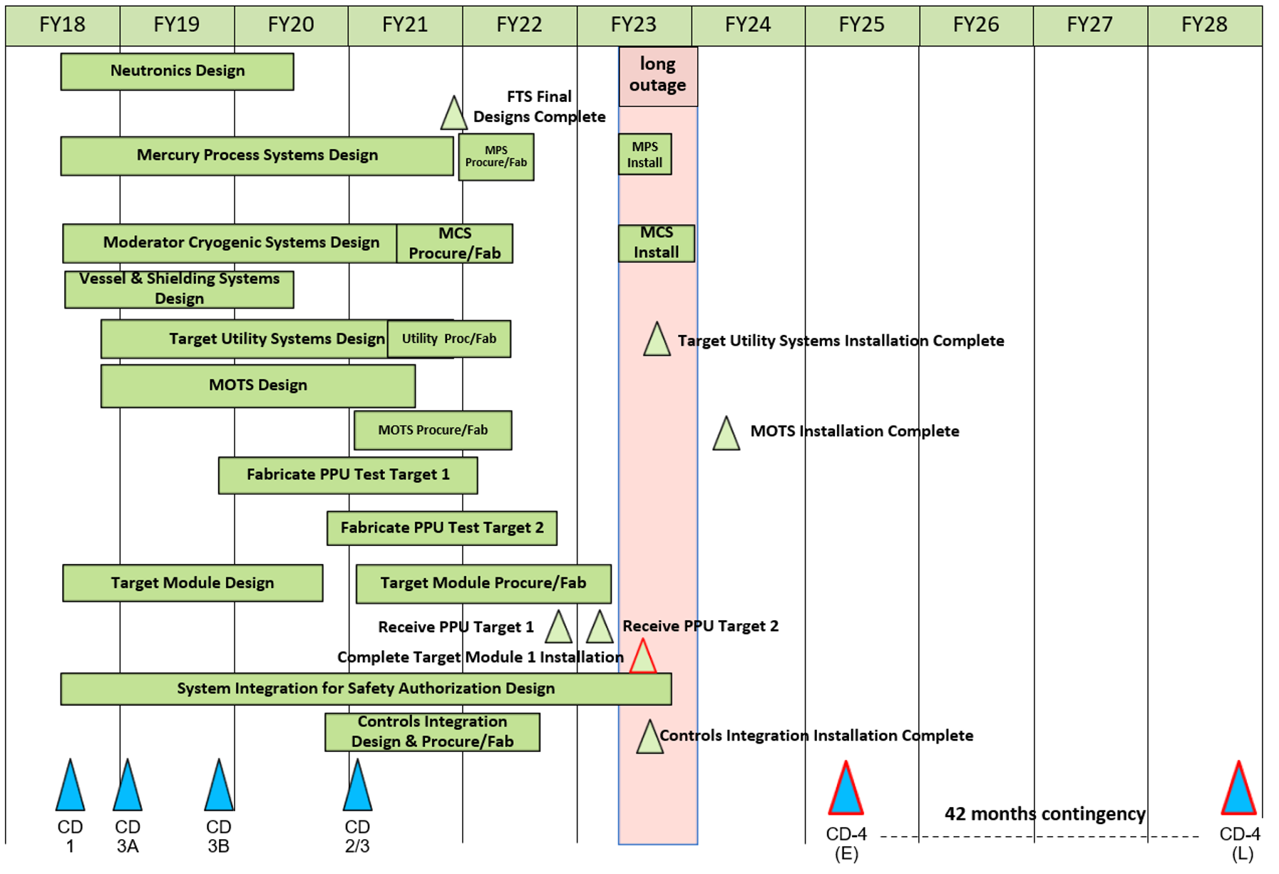
Cost and Schedule
Charge: 4

Slide 24
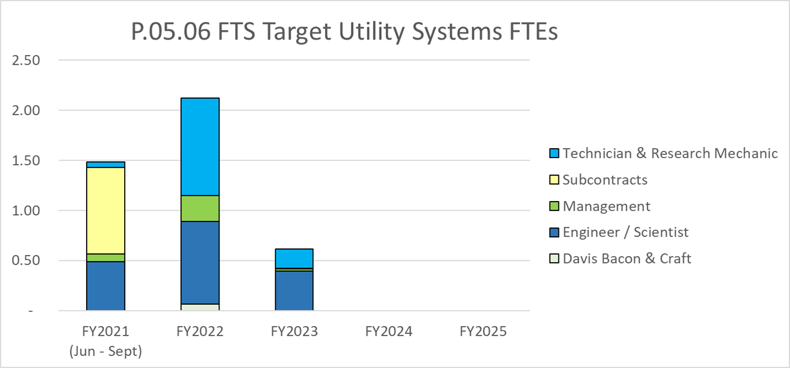
Labor Profile
Charge: 4, 5

Slide 25
P.05.06 Risk Register
Charge: 1
No active risks identified
Two risks retired
High Risks
No high risks identified
Key risk categories analyzed
Scope uncertainty
Risks are reviewed on a regular basis

Slide 26
Responses to Recommendations
Charge: 6
No recommendations from the CD-2/3 review
Recommendations from prior DOE reviews are closed

Slide 27
ESH&Q and COVID-19 Impacts
Charge: 3
ESH&Q Impacts
None
COVID-19 Impacts
Difficulty with technical reviews (Off Normal and Mol Sieve PDR)
Keeping folks engaged for the duration of the technical meeting
KNF Compressors for Gas Recirculation
Encountered a 2-month delay
Expected arrival in 4 months, received after 6 months
No impact to installation schedule

Slide 28
12-Month Look-Ahead
Charge: 1, 4
Complete mol sieve and gas recirculation final designs
Host FDR
Electrical upgrade installation complete
Gas Panel 10 mechanical installation complete
Gas Recirculation mechanical installation near completion
Mol sieve procurement process near completion

Slide 29
Summary
Charge: 1
Completed HAZOP
Molecular Sieve Design Progress (P.5.6 and P.5.8)
Addressed numerous technical challenges
FDR expected Fall 2021
Basement electrical upgrade installation
Gas Panel 10 installation
Gas Recirculation design progress
FDR expected Fall 2021
Project Team has overcome multiple challenges and has completed a substantial amount of work
Thank you for your time!

