Slide 1




P.03 RF Systems Overview
DOE/SC Independent Project Review of the Proton Power Upgrade Project
John Moss
Level 2 Manager for P.3 RF Systems
September 14-17, 2021

Slide 2
Outline
Scope
Organization
Progress since CD-2/3
Challenges
Final design status
Installation plans
Cost and schedule
Labor profile
Risk register
Responses to recommendations
ESH&Q and COVID-19 impacts
12-month look-ahead
Summary

Slide 3
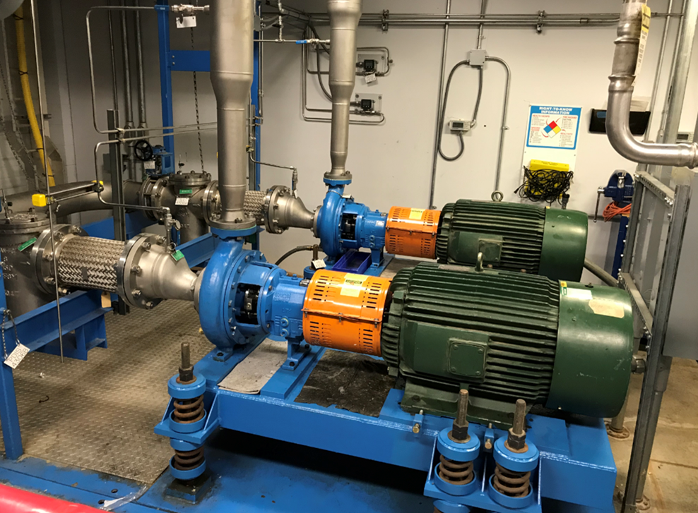
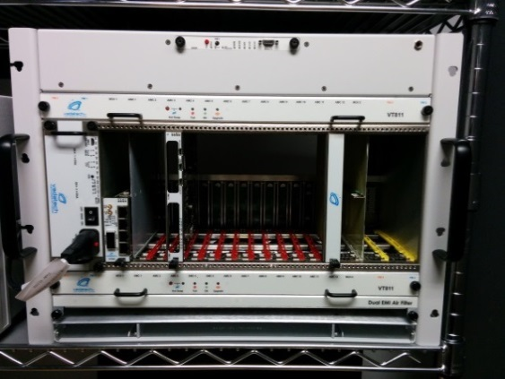
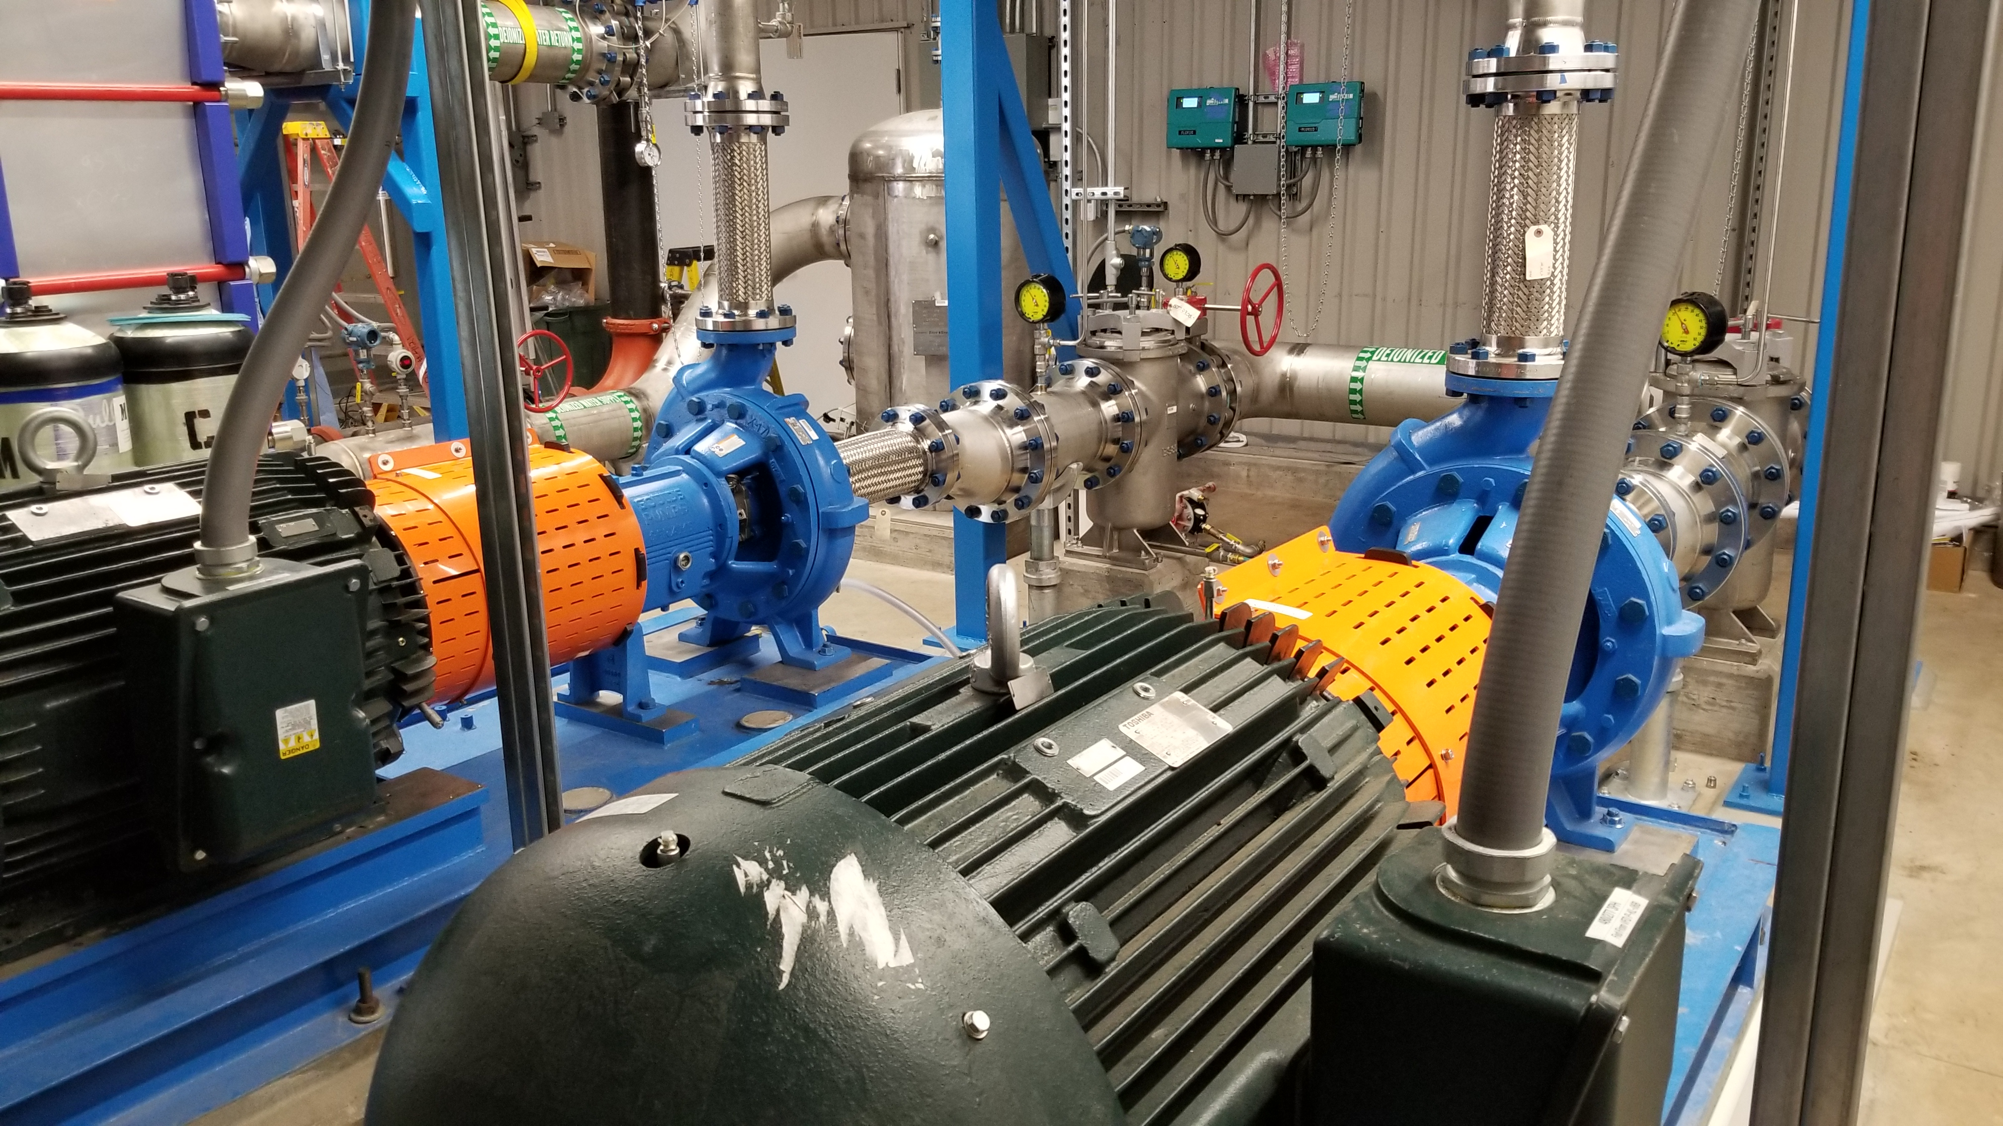
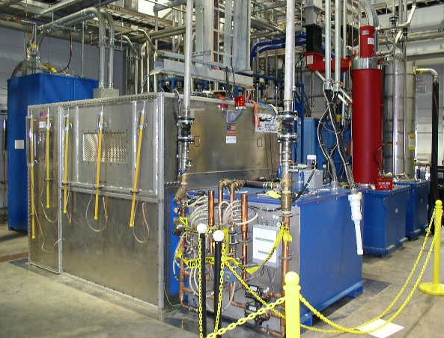
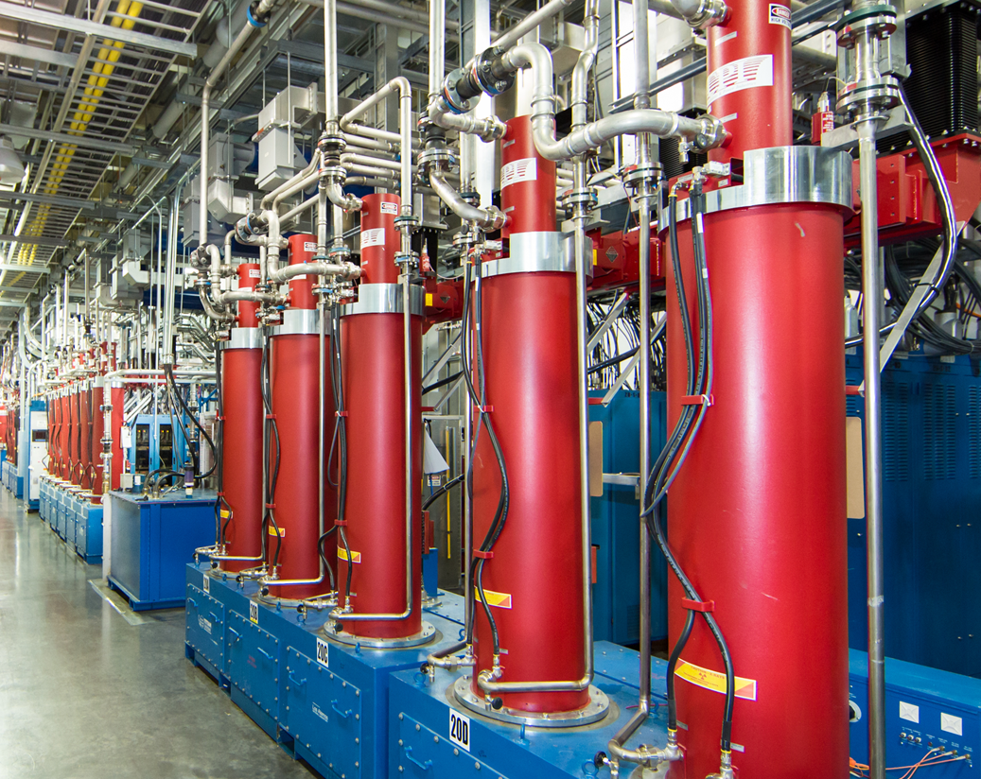
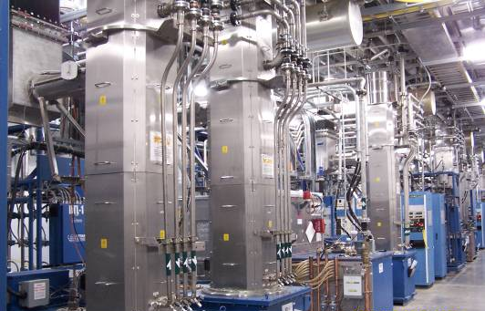
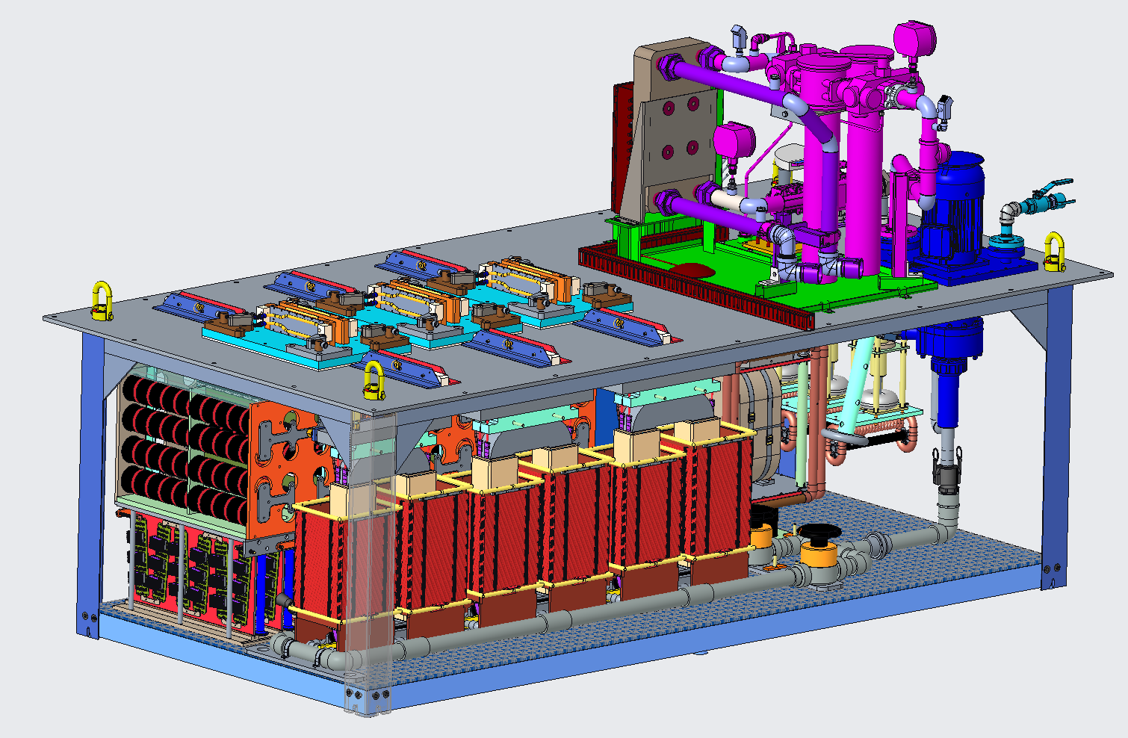
Scope
Charge: 1
RF Systems scope has two parts:
  Upgrade DTL-3, 4, and 5
  Install 28 additional SCL RF stations
KL-4 Pump Upgrade
LLRF
New KL-06 DI System
AT-HVCM
SCL HPRF x 28
DTL-3, 4, and 5
RFQ/DTL HVCM

Slide 4
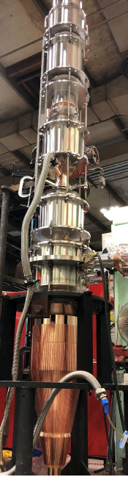
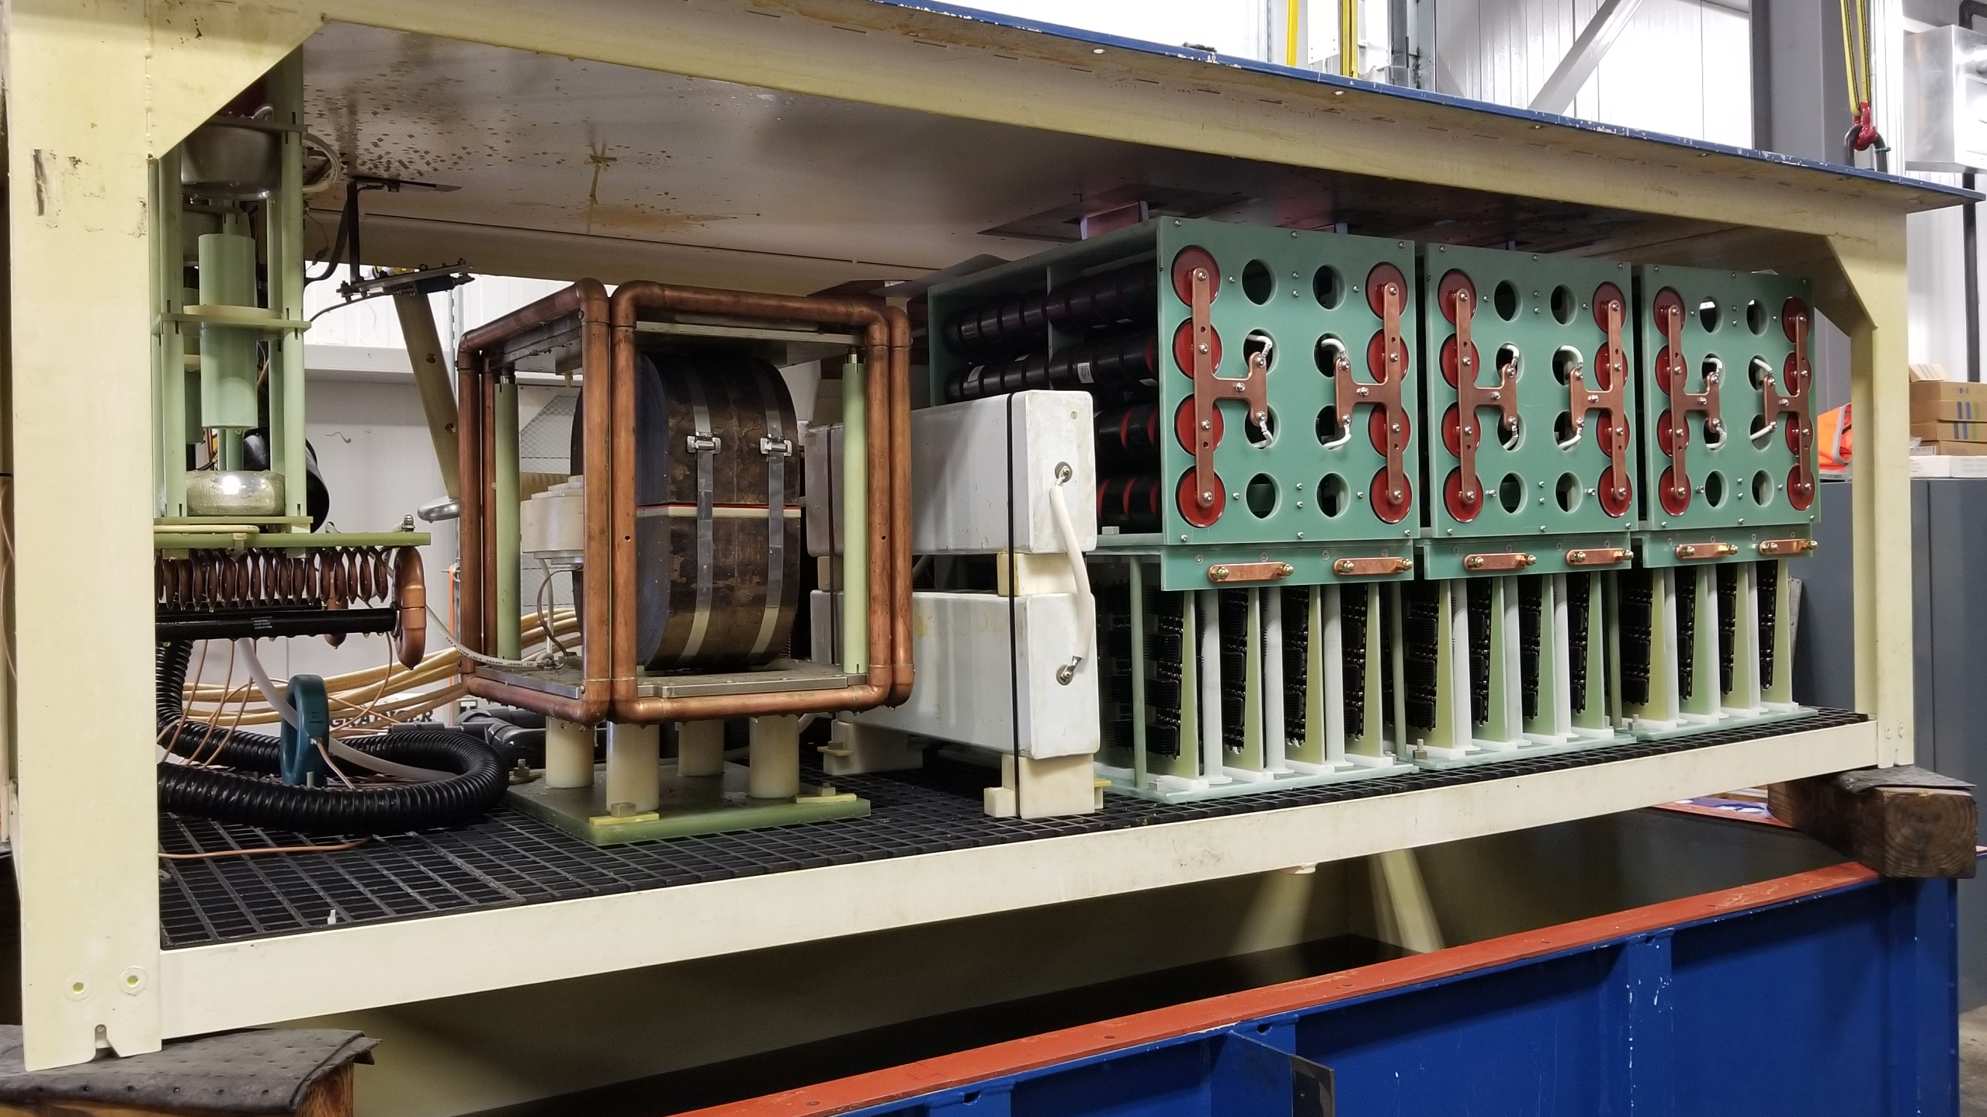
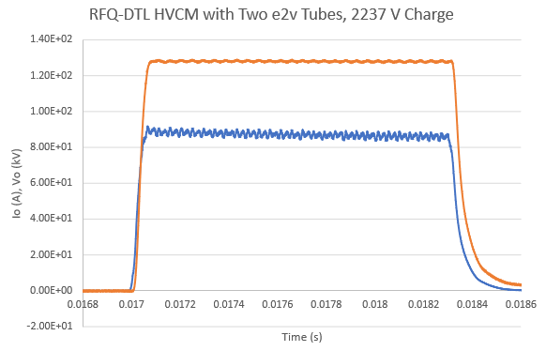
Scope Details – Normal Conducting Systems
Charge: 1
DTL-3, 4, and 5 upgraded to 3.0 MW peak
  Upgrading solenoid power supply
Upgrading DI system
  Re-working hard-piped connections
Redesign of HVCM to support new klystrons
  Common tank for RFQ and DTL
B3-2 Moss
B3-6 Norman
B3-5 Pappas
New CPI VKP-8354A, 402.5 MHz, 3 MW peak klystron
RFQ/DTL prototype HVCM tank and output waveforms

Slide 5
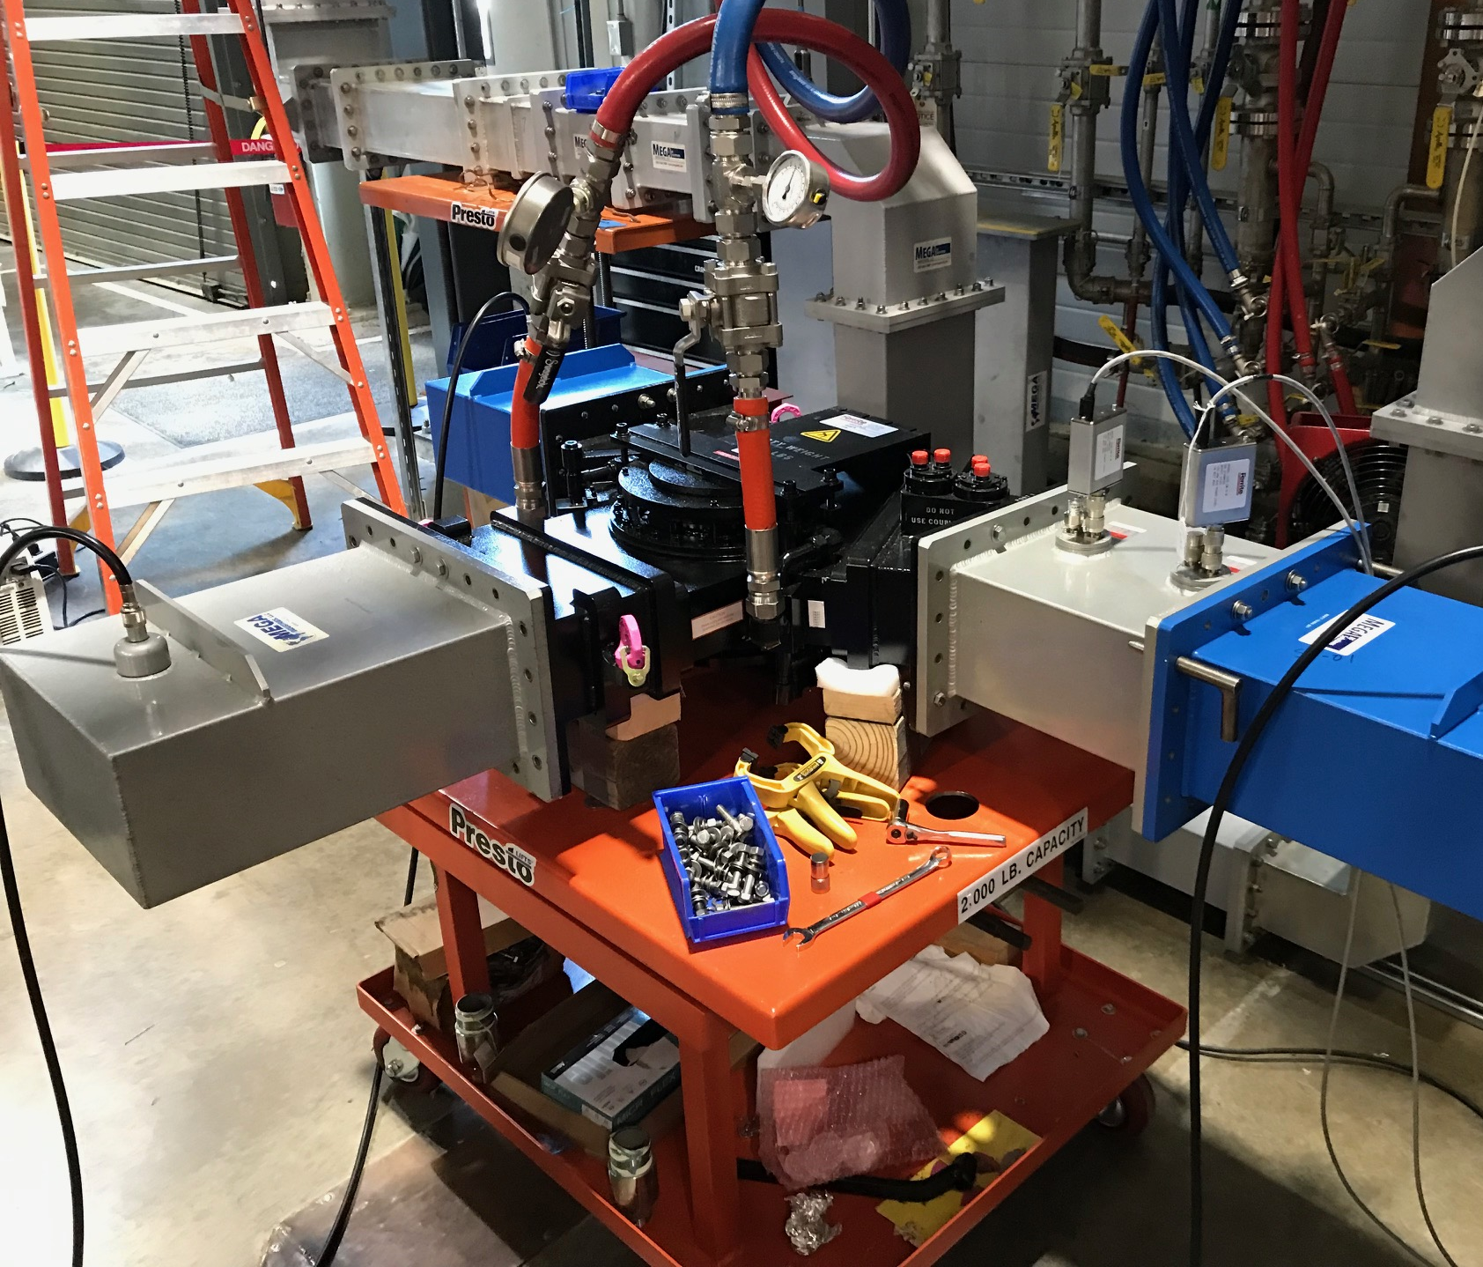
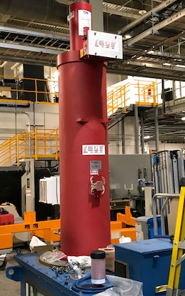
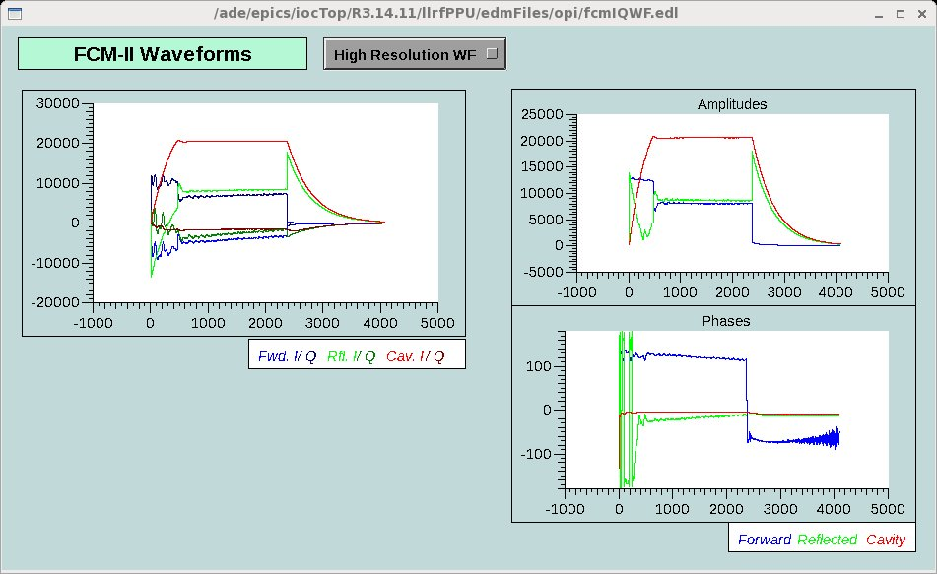
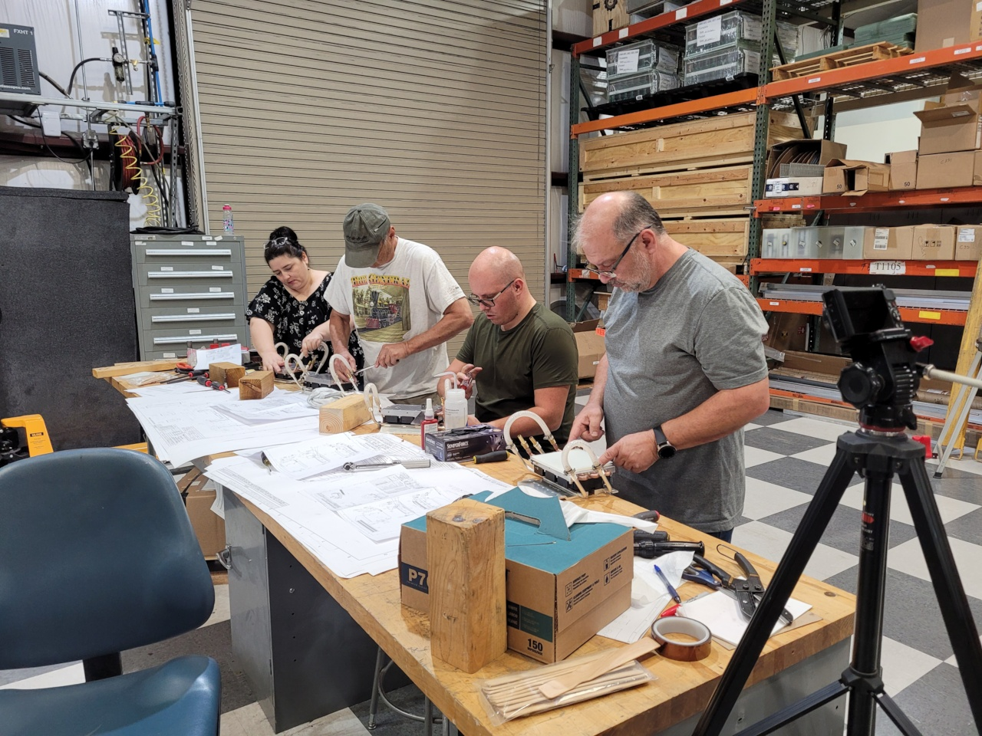
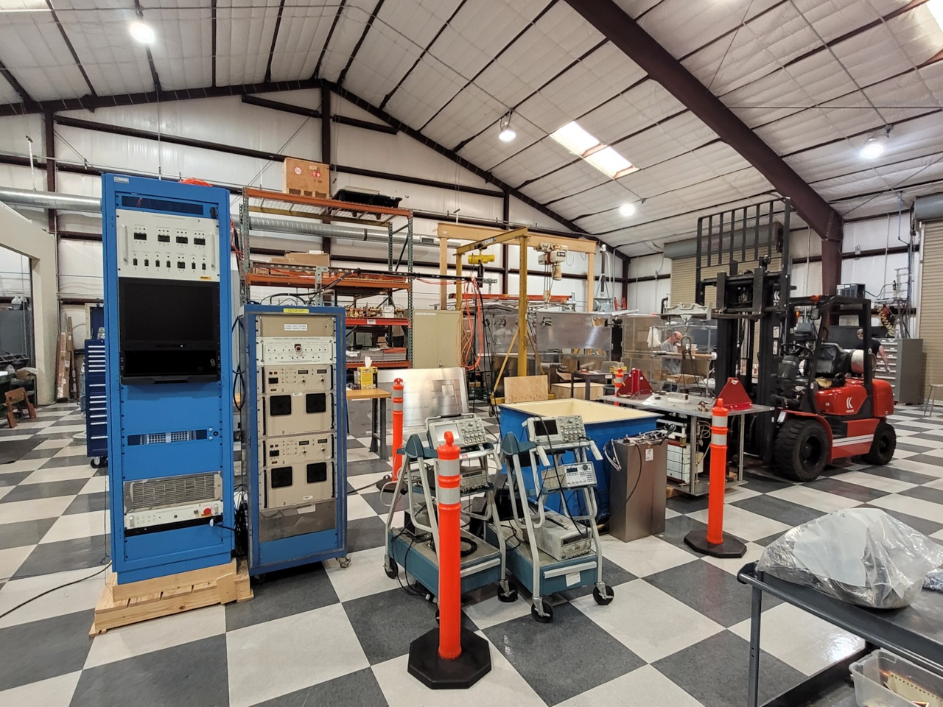
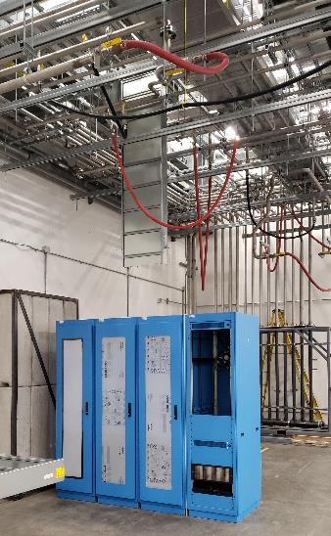
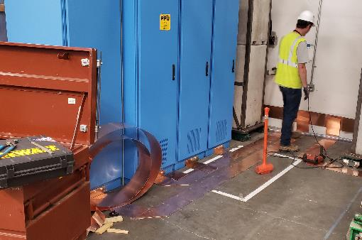
Scope Details – Superconducting RF Systems
Charge: 1
28 new 700 kW peak RF stations
  HPRF transmitters, klystrons, and waveguide
28 new LLRF systems
  Closed loop with beam operation in 23D
3 new AT-HVCM units (AT-HVCM)
  Redesigned tank layout
Equipment Installation
  Electrical and mechanical utilities
RF and Global controls
  Software and network extension
B3-2 Moss
B3-3 Crofford
B3-4 Anderson
B3-6 Norman
B3-7 Justice
Row 1: SCL transmitter, klystron, and first article circulator
Row 2: LLRF operating SCL-23D
Row 3: AT-HVCM fabrication and testing
Row 4: Equipment Installation

Slide 6
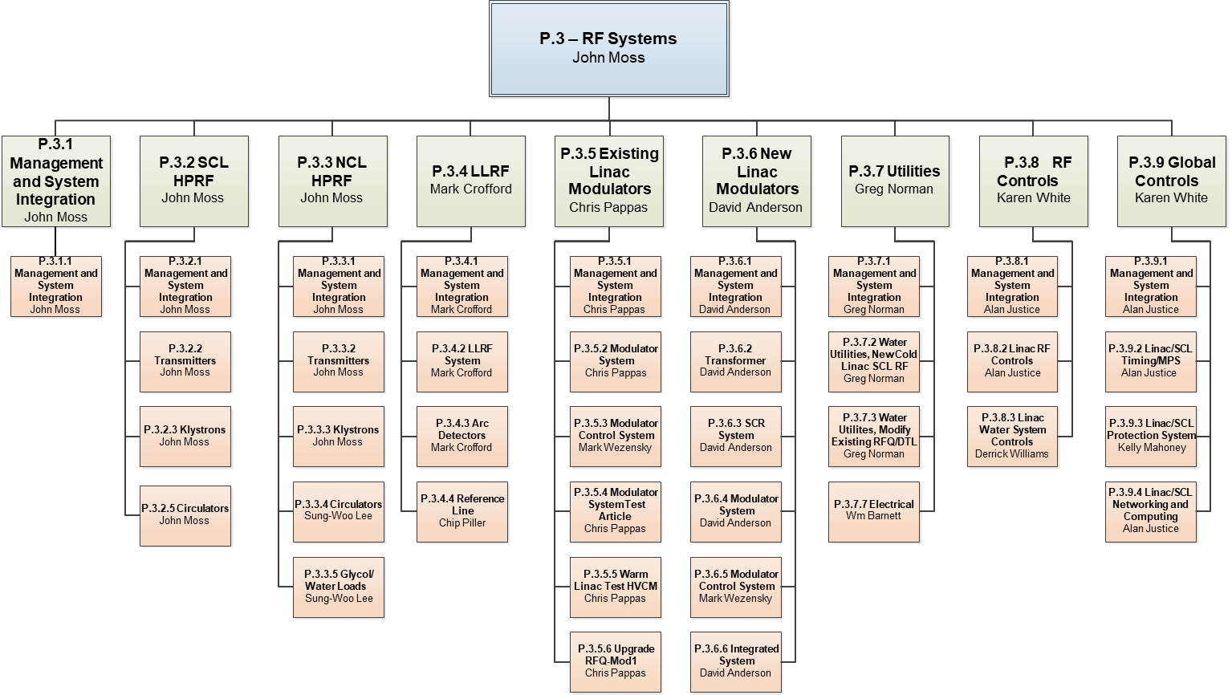
Organization
Charge: 5

Slide 7
Progress since CD-2/3 – A Look Back
Charge: 1, 2, 4
Final Design Reviews:
  HPRF Transmitter (Vendor) Final Design Review – Fall 2020
  RFQ/DTL HVCM Final Design Review – Summer/Fall 2020
  LLRF Final Design Review – Summer/Fall 2020
    23D SCL Cavity control test in early summer 2020
Receipt of major components:
  Receive transmitters 30 and 31 – Summer 2021
  Receive first 12 SCL klystrons – Summer 2021
  Receive SCL-MOD-30 – Summer 2021
Start installation of Transmitter 30 and 31 Equipment – Summer 2021
B3-2 Moss
COMPLETE
COMPLETE
COMPLETE
B3-5 Pappas
B3-3 Crofford
Fall 2021
B3-2 Moss
Received 4 of 12
Fall 2021
B3-4 Anderson
Started Infrastructure Work
B3-6 Norman

Slide 8
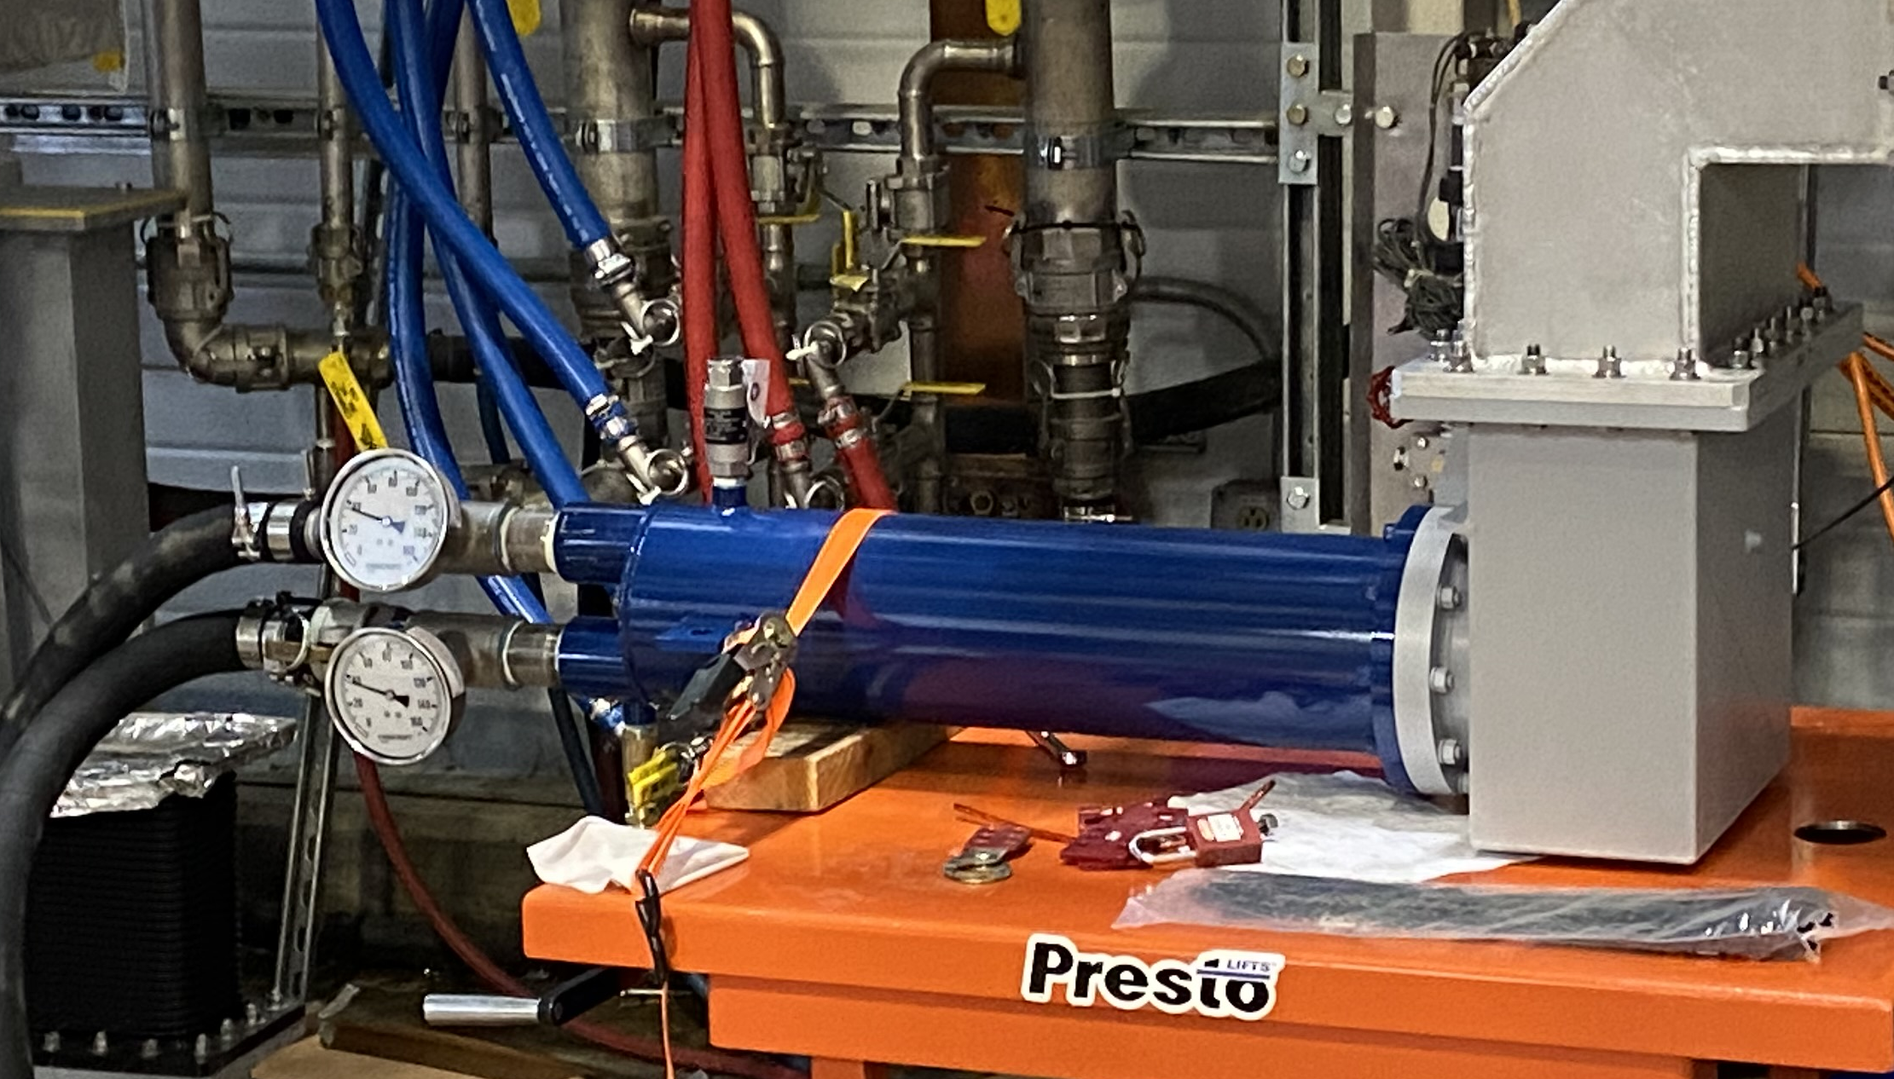
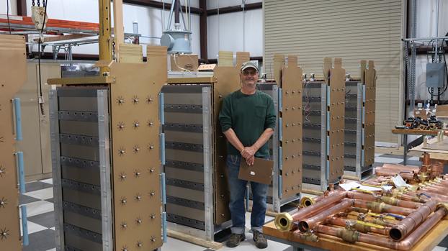
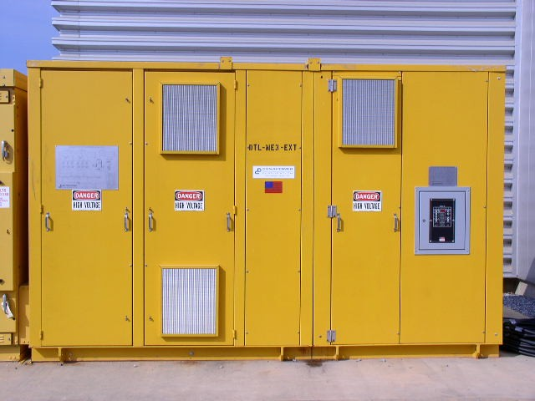
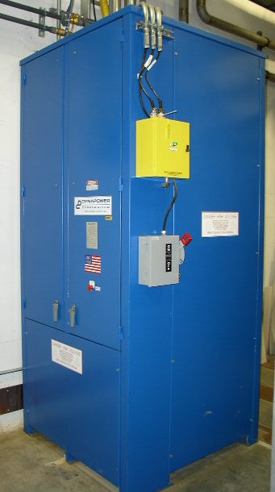
Progress since CD-2/3
Charge: 1, 2, 4
Fabrication started on all HPRF equipment
  Received 4 of 12 SCL klystrons
    Exercised option for remaining 16
  First article DTL klystron in processing
  Transmitter systems in fabrication
  Received first article waveguide circulator
  Waveguide load fabrication completed
RFQ/DTL HVCM prototype completed and tested
  Test results indicate the need for some redesign
AT-HVCM fabrication underway
  Transformer, switchgear and SCR FAT imminent
  First article switch-plate fabrication and testing complete
Row 1: Waveguide load under test
Row 2: AT-HVCM fab at AOPT
Row 3: HVCM transformer and SCR

Slide 9
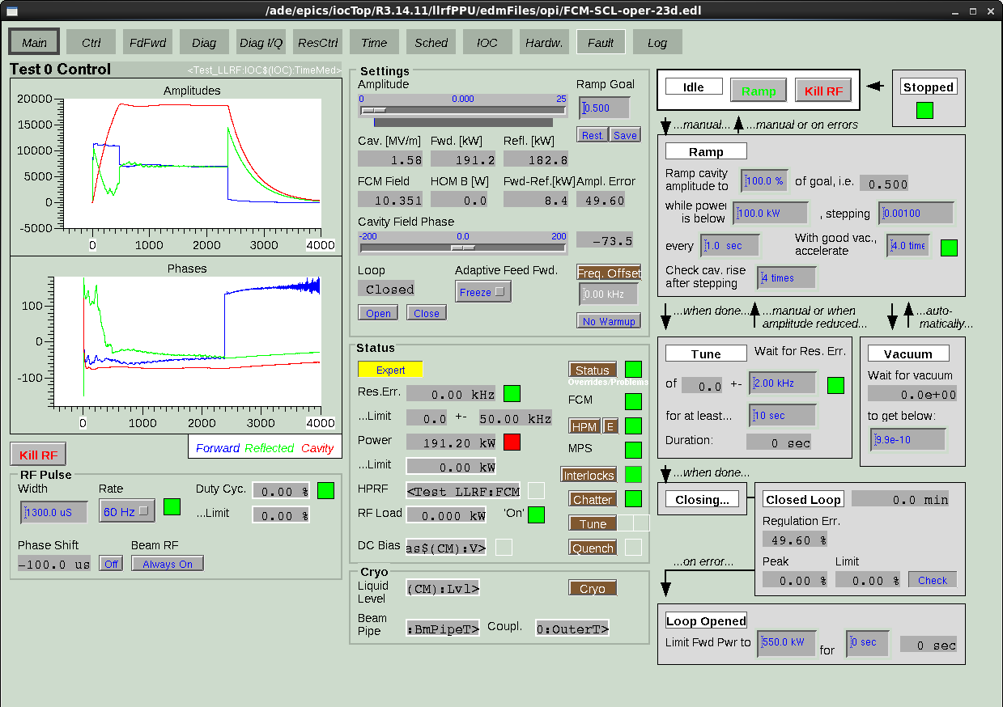
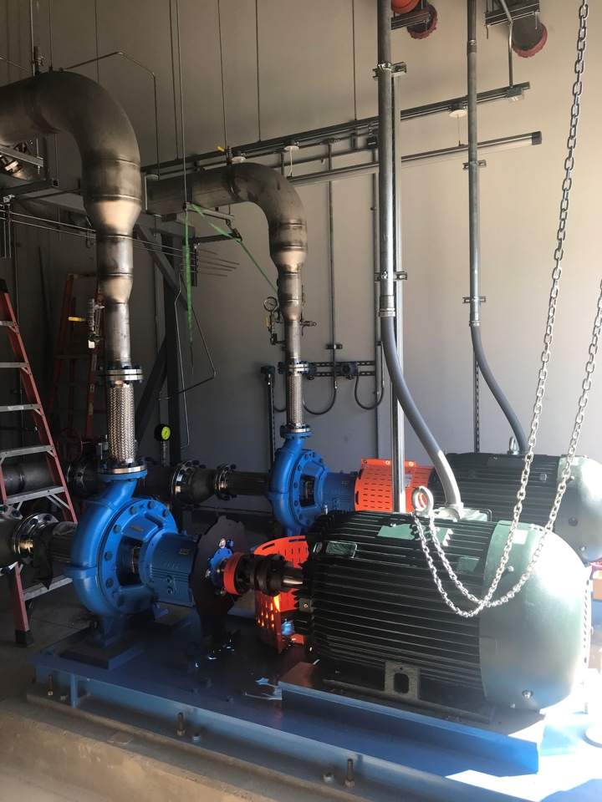
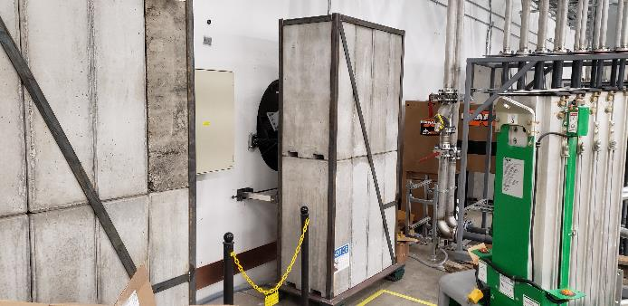
Progress since CD-2/3
Charge: 1, 2, 4
LLRF design completed
  Issued procurements for all subcomponents
  New LLRF system controlled 23D
KL-06 cooling system installed and tested
  Connections to equipment pending
Technical equipment installation underway
  Equipment racks have arrived and are being placed
  Electrical infrastructure installation is ongoing
Row 1: LLRF operating 23D
Row 2: KL-06 DI pumps
Row 3: Moveable shield block installation

Slide 10
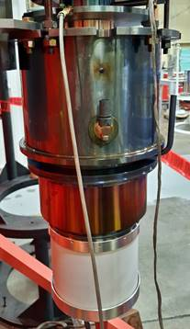
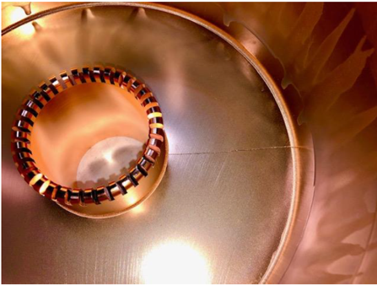
Challenges
Charge: 1, 4
Waveguide circulator and load procurement
  Company merger and component quality caused delays
Klystron procurement
  First article 3 MW 5th cavity crack after brazing and vacuum leak in first cavity
  Cold test “bottleneck”
  Three 700 kW klystrons failed during testing – open filament, cracked output window, and bent drift tube
Transmitter procurement delays
  Lagging sub-supplier COVID delays
AT-HVCM tank fabrication
  COVID related sub-supplier delays
B3-2 Moss
B3-4 Anderson
Top to bottom: 3MW klystron leak check; Crack in 5th cavity after first braze

Slide 11
Challenges
Charge: 1, 4
RFQ/DTL HVCM prototype test results indicated need for some redesign
  Output transformer inductance was low
LLRF fabrication and final testing
  COVID related sub-supplier delays
  Limited software resources
Craft shortage
  Delay in the ramp-up of technical equipment installation
B3-5 Pappas
B3-3 Crofford
B3-6 Norman

Slide 12
Final Design Status
Charge: 1
All RF design is complete
  Software for the Machine Protection System Upgrade still in design
    Separate Accelerator Improvement Project, but needed for PPU
B3-7 Justice

Slide 13
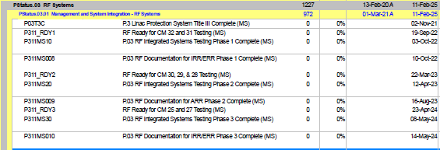
Installation Plans
Charge: 5
Following phased approach that is largely independent of machine outages
  Supports the installation and testing of the cryomodules
Overall plan follows the 5-year plan developed by the Neutron Sciences directorate

Slide 14
Installation Plans
Charge: 5
RF ready for CM 31 and 32
RF ready for CM 28, 29, 30
RF ready for CM 25, 27

Slide 15
Progress since CD-2/3
Charge: 4
~64 percent complete on long lead procurements
~45 percent complete on CD-3 scope

Slide 16
Project Change Requests since CD-2/3
Charge: 4
~$3M change to baseline

Slide 17
Estimate to Complete
Charge: 4
~ $8M ETC for long lead procurement scope
~ $24M ETC for P.03 scope

Slide 18
SPI and CPI – P.03
P.03 is tracking well against budget and schedule

Slide 19
SPI and CPI – P.10.03
P.10.03 is a little under cost and slightly behind schedule – all attributed to vendor delays

Slide 20
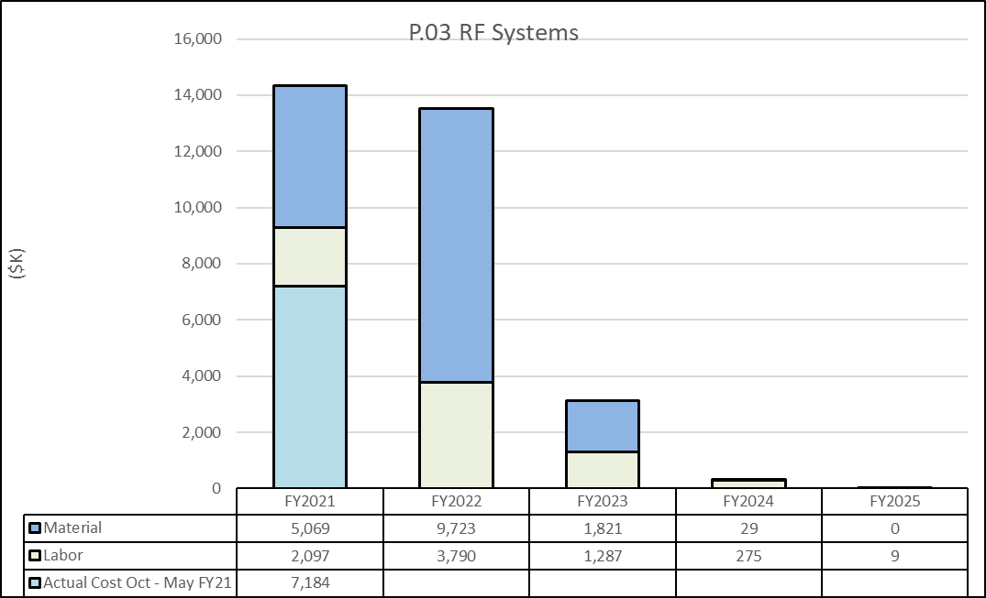
P.03 Material/Labor Charts with FY21 Actual Cost Oct – May
Charge: 4
Majority of the RF scope will be complete at the end of FY23

Slide 21
Cost Estimate by FY – RF Long Lead Procurements
Long lead procurements completed in FY22
Charge: 4

Slide 22
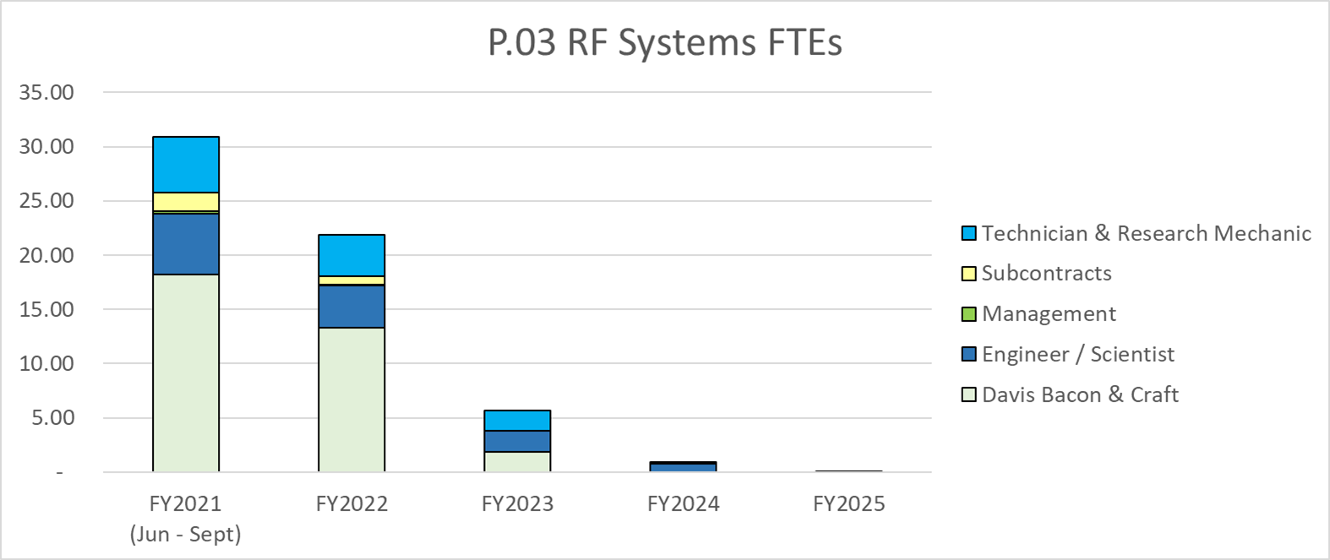
Labor Profile – P.03 RF
Charge: 5
Installation labor increases in FY21. Overall effort decreases over the next two FYs

Slide 23
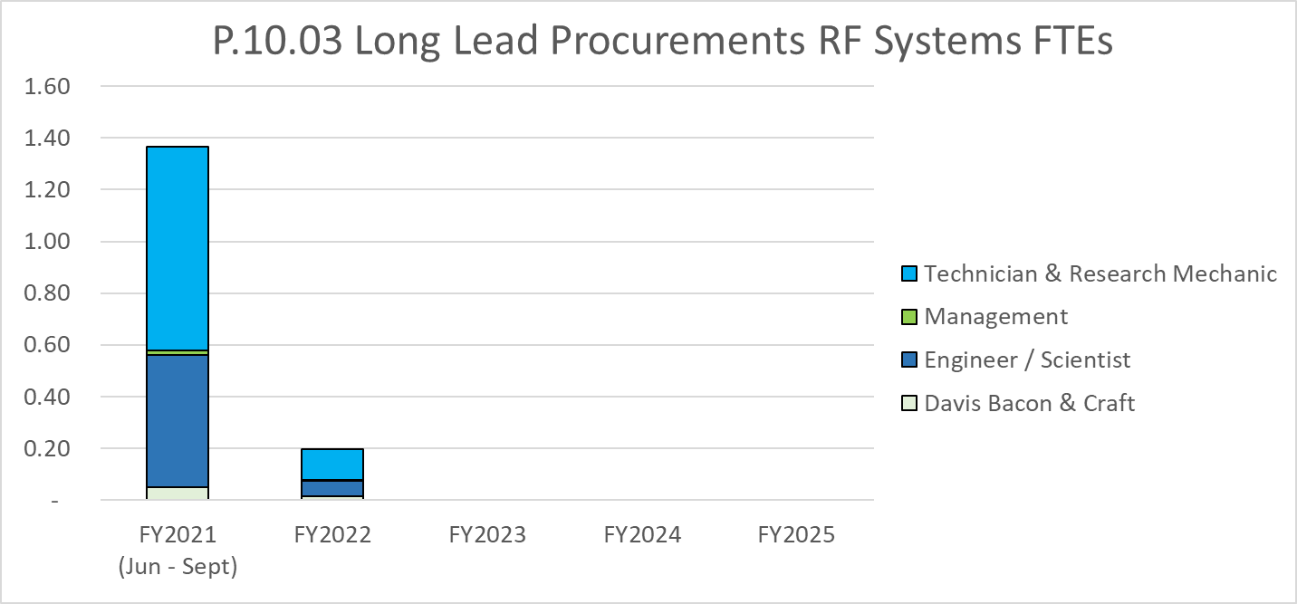
Labor Profile – RF Long Lead Procurements
Charge: 5
Long lead procurement FTEs drop off as scope is completed

Slide 24
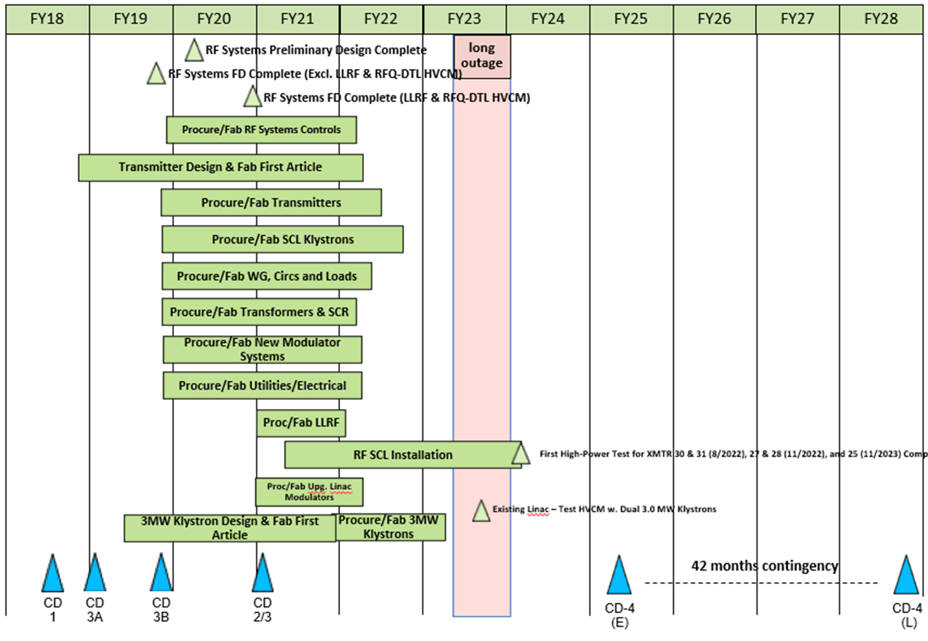
P.03 & P.10.03 RF May 2021 Status Summary Schedule
Charge: 4

Slide 25
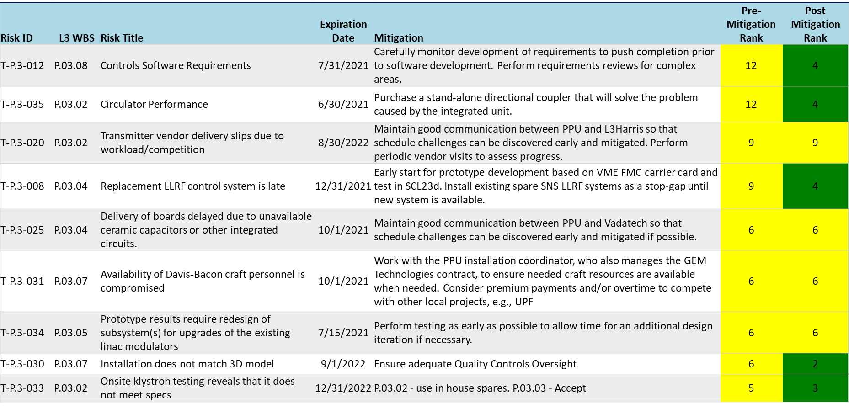
Risks are Identified and Monitored
Charge: 4

Slide 26
Risk Register
Charge: 4
Nine risks
  Pre-mitigated ranking: 9 medium
  Post-mitigate ranking: 5 medium, 4 low
No high risk items

Slide 27
Responses to Recommendations
Charge: 6
All recommendations from prior Director’s Reviews are closed
Single recommendation from CD2/3 IPR to “tabulate SCL power requirements by the next DOE IPR”
  Added table to PPU-P03-TR001, Proton Power Upgrade (PPU) Project Linac RF Power Margin
  Closed in August 2020

Slide 28
ESH&Q and COVID-19 Impacts
Charge: 2, 3, 4, 5
Vendor quality and non-conformances
  Waveguide circulator and load coolant leaks
  Three 700 kW klystrons failed during fabrication
  First article 3 MW klystron 5th cavity crack and vacuum leak
COVID-19 impacts
  Vendor delays – lagging in many cases
  Travel restrictions
  Quarantines – LLRF team hit especially hard
  Installation impacted with delays in equipment delivery and lack of available skilled labor pool
  Have been able to minimize the impact through routine vendor communication and revisions to our schedule logic

Slide 29
12-Month Look-Ahead
Charge: 1, 4
Receive all 28 700 kW klystrons and 3 MW first article
Receive all five high power transmitter systems
Complete prototyping of RFQ/DTL HVCM and fabricate production units
Complete FAT of all AT-HVCMs
Receive all LLRF subassemblies
Complete installation of ALL phase 1 RF equipment
  High power testing of transmitters 30 and 31 scheduled for late summer 2022

Slide 30
Summary
Significant percentage of work completed
  60 percent complete on long lead procurements
  45 percent complete on CD-3 project scope
CAMs are actively managing their scope
  Continue to work through COVID-19 and other challenges
  Risks are actively updated
Plan for remaining work meshes with the directorate 5-year plan

