Slide 1




P.3.1, P.3.2, and P.3.3 SCL and NCL HPRF
DOE/SC Independent Project Review of the Proton Power Upgrade Project
John Moss
Level 3 Manager for HPRF
September 14-17, 2021

Slide 2
Outline
Scope
Organization
Progress since CD-2/3
Challenges
Final design status
Installation plans
Cost and schedule
Labor profile
Risk register
Responses to recommendations
ESH&Q and COVID-19 impacts
12-month look-ahead
Summary

Slide 3
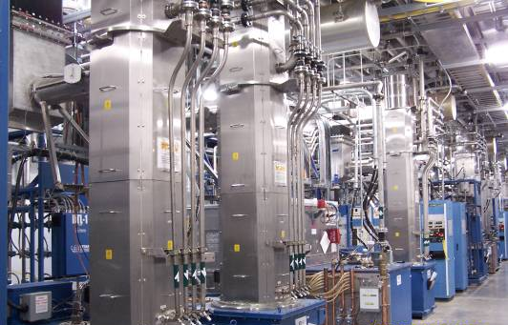
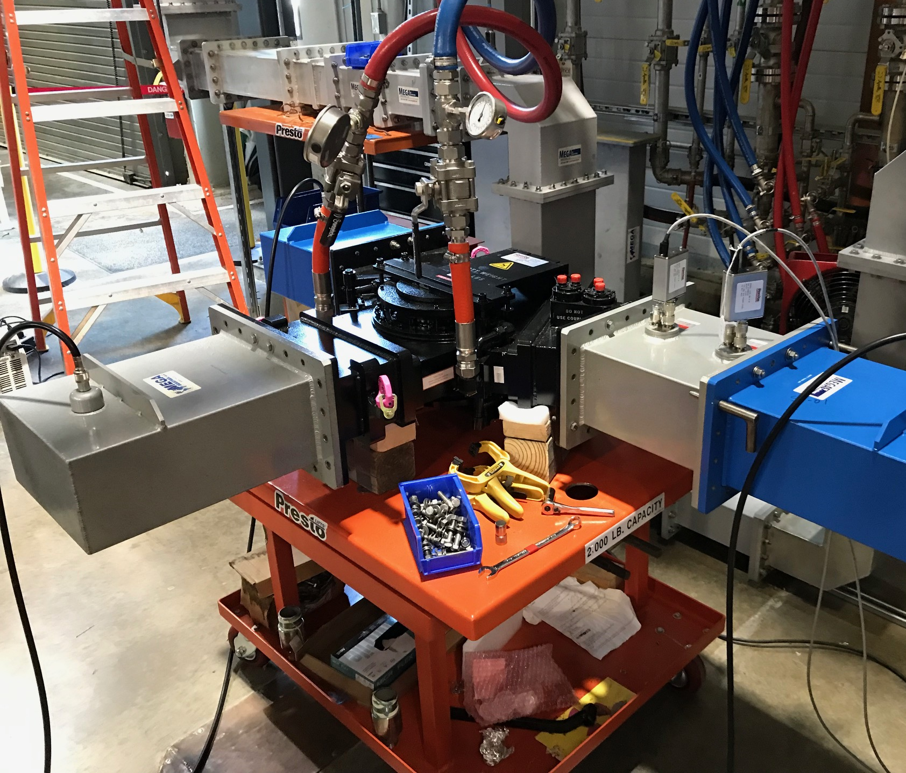
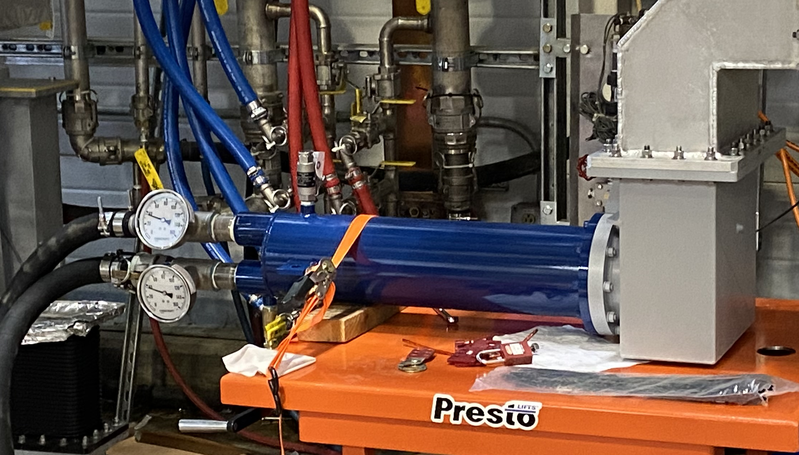
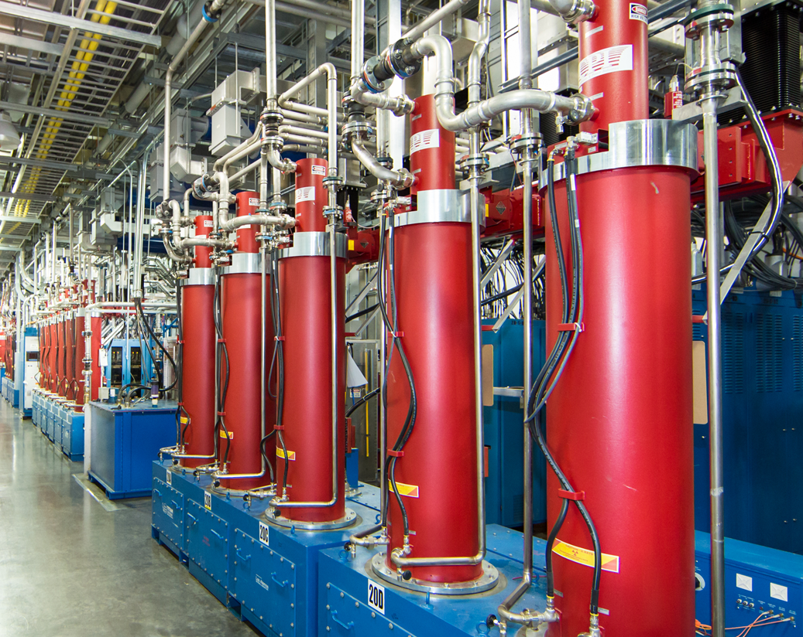
Scope
Charge: 1
P.3.2 SCL HPRF – Install five transmitters, 28 klystrons, and the associated waveguide and waveguide components
P.3.3 NCL HPRF – Upgrade DTLs 3, 4,and 5 to 3MW peak

Slide 4
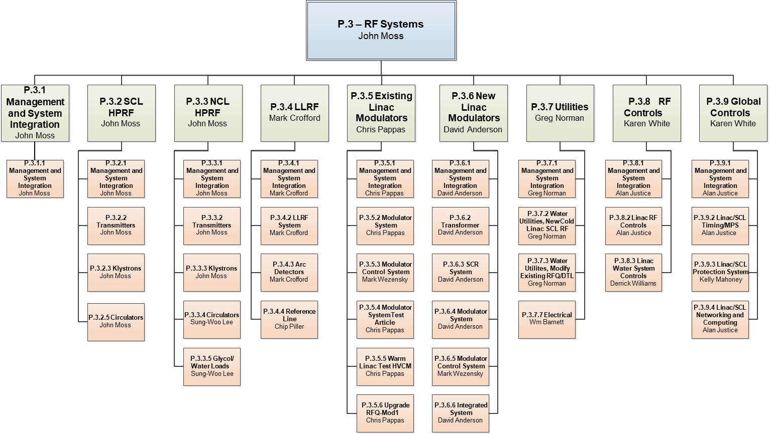
Organization
Charge: 5
HPRF Team
John Moss – work package manager, lead engineer
George Toby – RF engineer/Modeler
Sung-Woo Lee –RF engineer/modeler
Tim Miner – RF technician
Mark Cardinal – HPRF technician

Slide 5
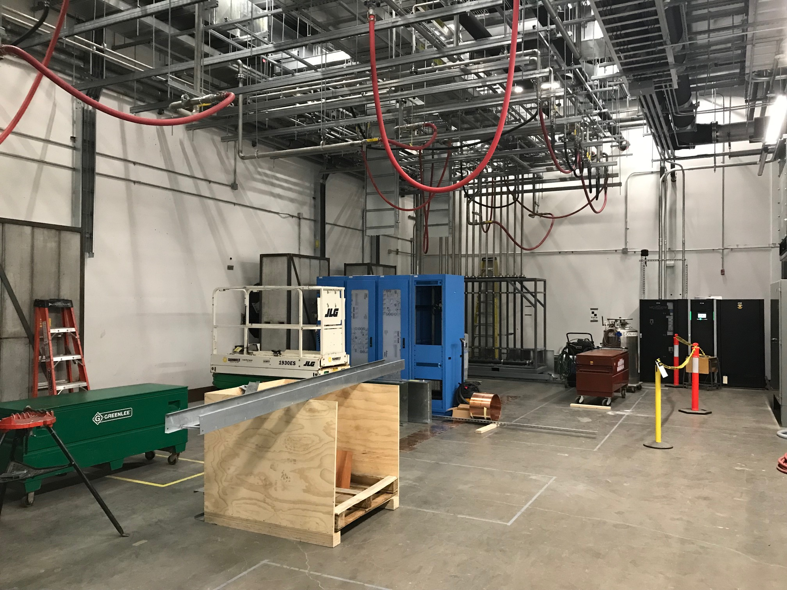
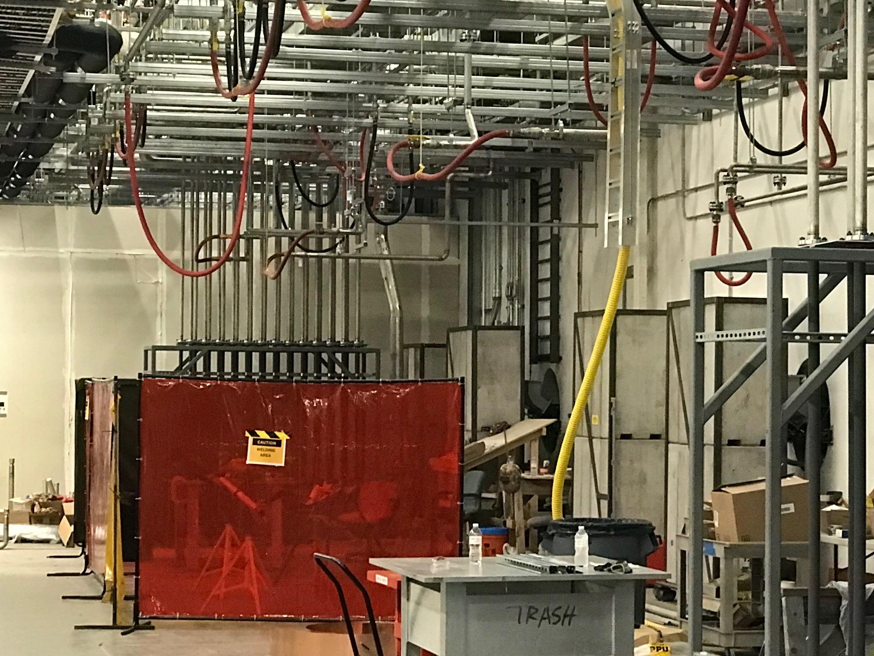
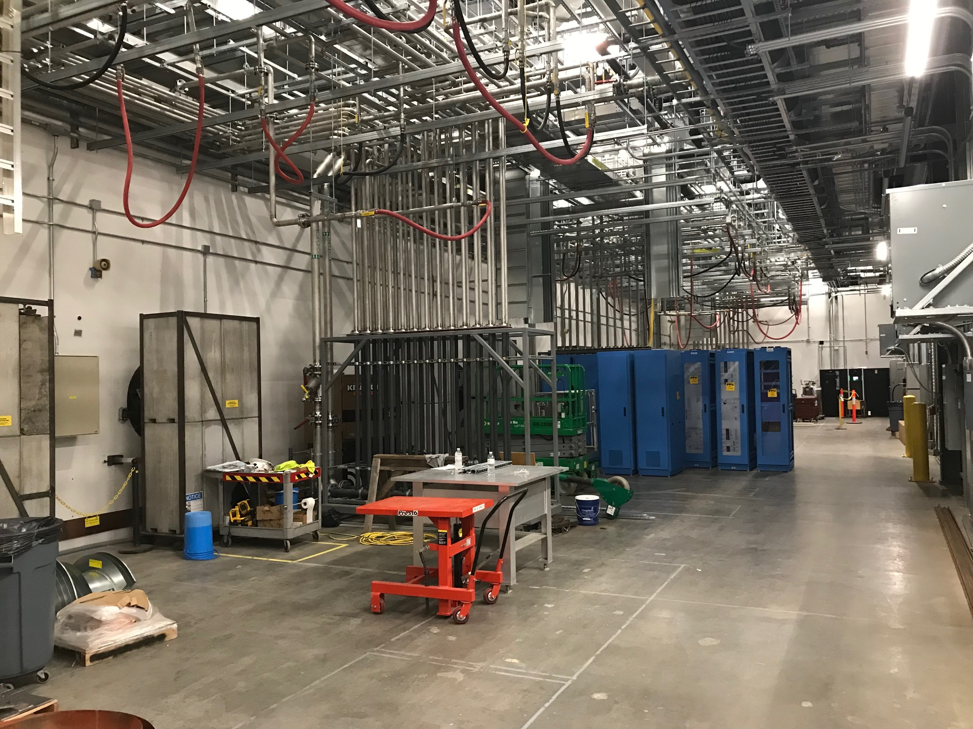
Progress since CD-2/3 – A look back
Charge: 1, 2, 4
From the 12 month look-ahead presented at the CD-2/3 IPR:
  Final Design Reviews:
    HPRF Transmitter (Vendor) Final Design Review – Fall 2020
  Receipt of major components:
    Receive circulators and loads – Summer 2020
    Receive transmitters 30 and 31 – Summer 2021
    Receive first 12 SCL klystrons – Summer 2021
  Start installation of Transmitter 30 and 31 Equipment – Summer 2021
COMPLETE – Fab underway
First articles tested
Fall 2021
Received 4 of 12
Started Infrastructure
Ongoing technical equipment installation in the klystron gallery

Slide 6
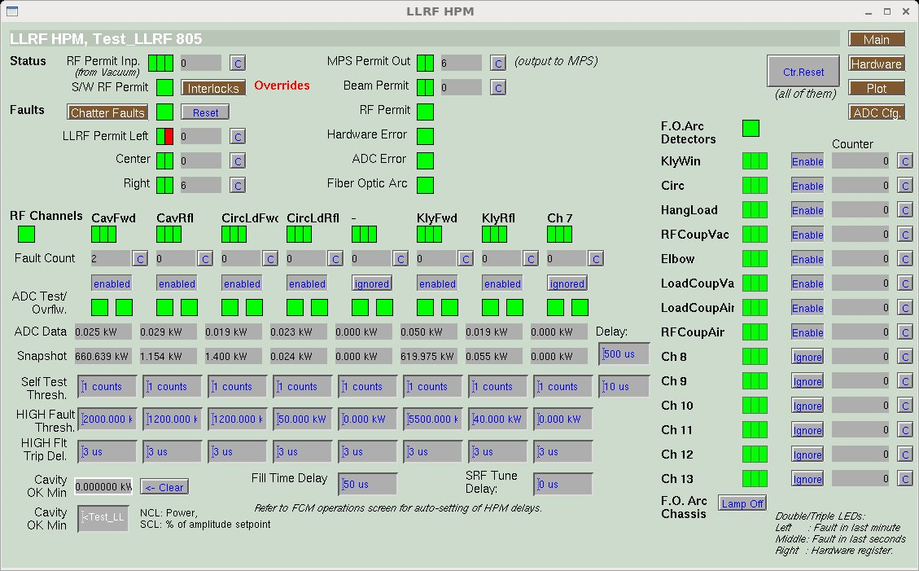
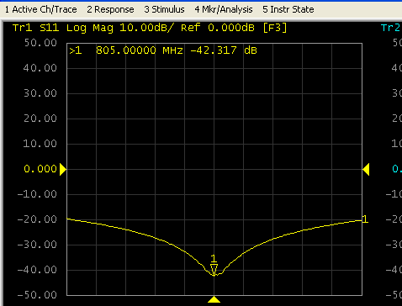
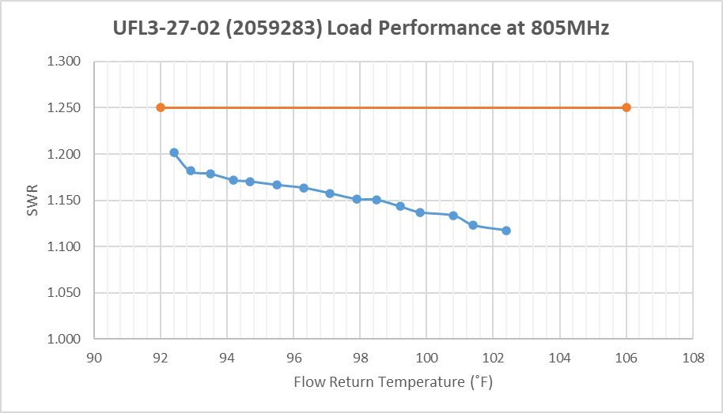
Progress since CD-2/3
Charge: 1, 2, 4
Tested first SCL klystron to 660 kW
First article 3 MW klystron dressed for FAT
Tested first article waveguide circulator and loads
  Circulator and load exceeded spec
    High power test of circulator pending
660 kW
SCL klystron test results; Waveguide circulator under low power test; Waveguide load test results

Slide 7
Progress since CD-2/3
Charge: 1, 2, 4
Fabrication of all HPRF transmitters underway
Transmitter components in fabrication

Slide 8
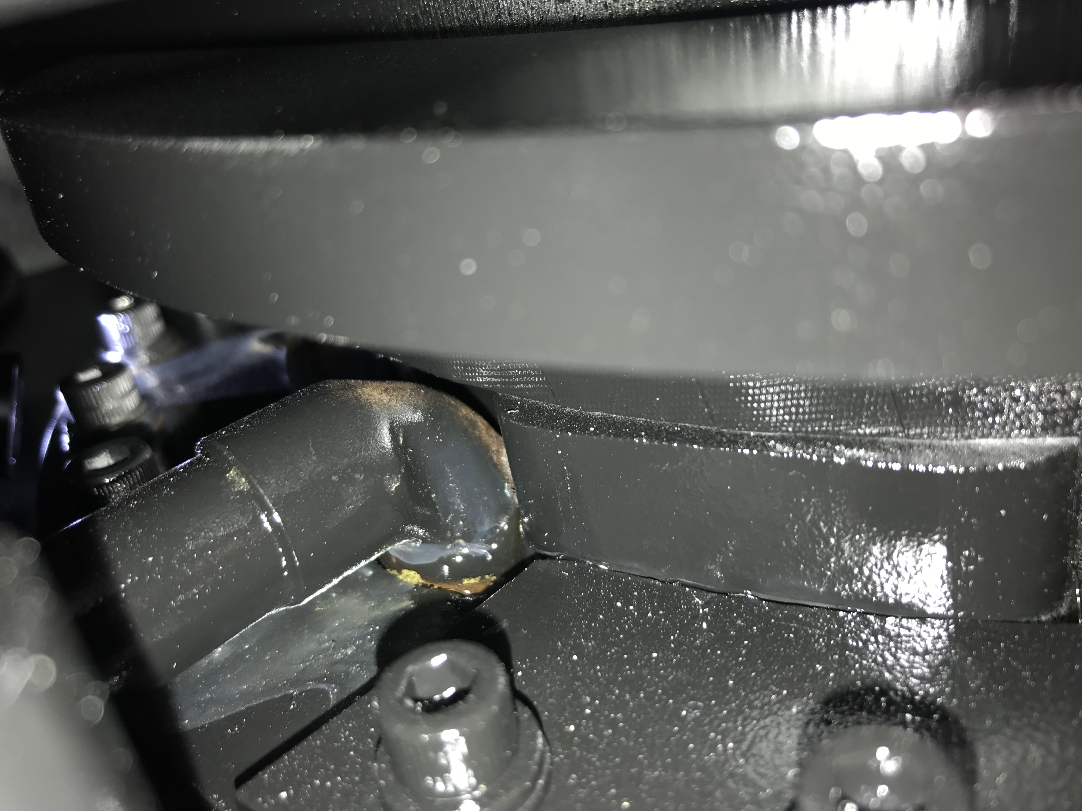
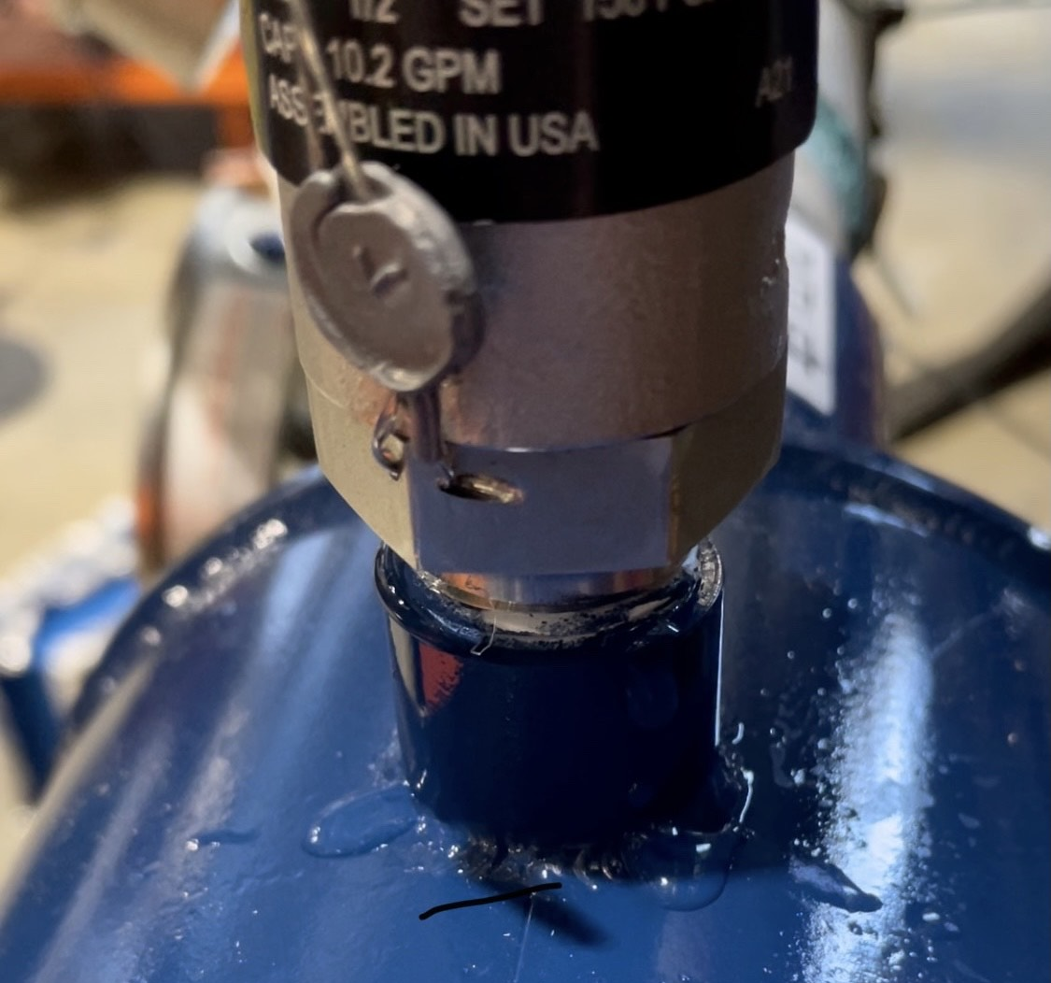
Challenges
Waveguide component quality
  Company merger induced design delays
  First article circulator leaked from brazed cap
    Returned to SNS - high power test pending
  All waveguide loads returned for re-work of relief valves
    First batch of six shipping on July 16th
SCL klystron fabrication (three damaged tubes)
  Bent drift tube
  Opened filament
  Cracked output window
First article 3 MW klystron fabrication
  5th cavity cracked during brazing
  Vacuum leak through wall of first cavity
Top to bottom: Water leaking from dome of first article circulator; Water leaking from around threads of load relief valve

Slide 9
Final Design Status
Charge: 1
Final design is complete

Slide 10
Installation Plans
SCL HPRF installation is independent of the outages
NCL HPRF installation will take place during the “long” outage
All installation activities – and PPU activities in general – follow the 5-year plan developed by the Neutron Sciences directorate
Key dates:
  XMTR 30 and 31 high power test – Summer 2022
  XMTR 27 and 28 high power test – Winter 2022
  XMTR 25 high power test – Fall 2023
  Finish installation of 3MW klystrons – Spring 2023

Slide 11
Installation Plans
XMTR 30 and 31 testing
XMTR 27 and 28 testing
3MW klystrons
XMTR 25 testing

Slide 12
PPU Changes since CD-2/3

Slide 13
Project Change Requests since CD-2/3
Charge: 4
~$707k change to baseline from HPRF

Slide 14
P.3.1 and P.3.2 Estimate to Complete

Slide 15
P.3.3 and P.10.3 Estimate to Complete

Slide 16
Cost Estimate by FY – P.03.01
RF management effort peaked in FY2021

Slide 17
Cost Estimate by FY – P.03.02
~ $8M remaining, mostly material (transmitter and klystron milestone payments)

Slide 18
Cost Estimate by FY – P.03.03
~ $4M remaining, mostly material costs for 3MW klystrons

Slide 19
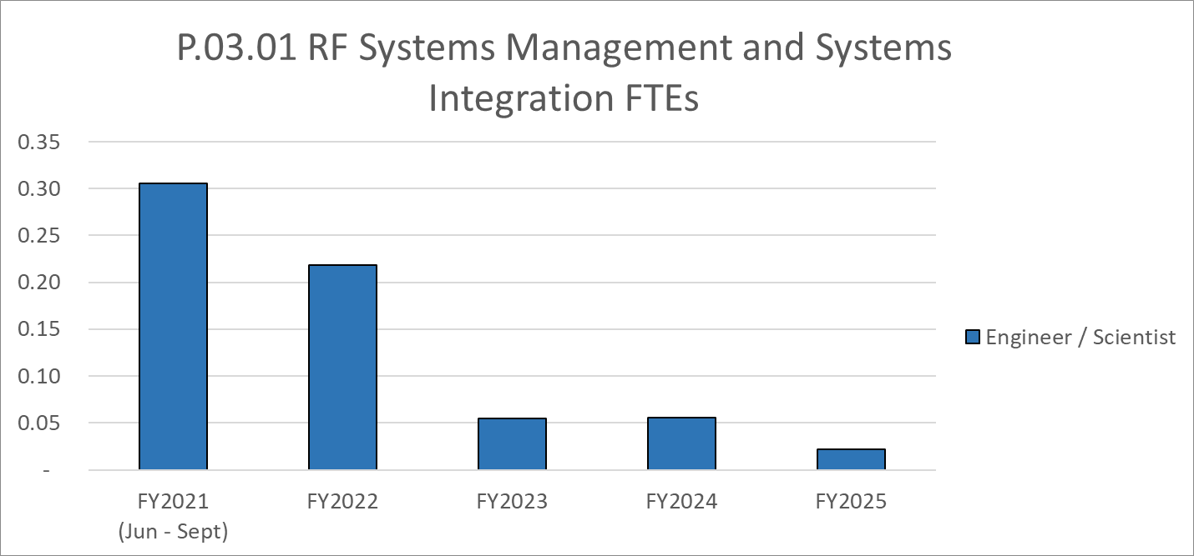
Labor Profile
Management effort begins to taper off as material arrives and installation activities start

Slide 20
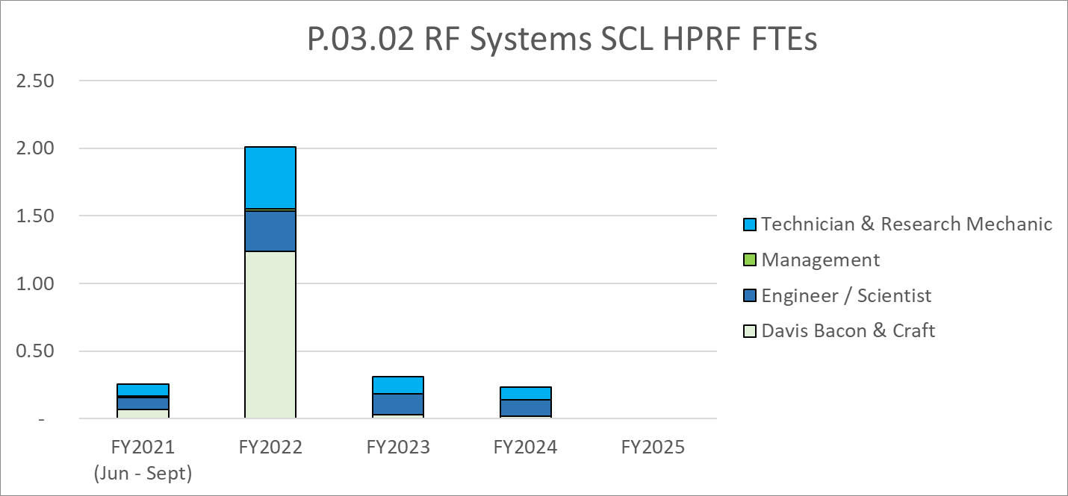
Labor Profile
Increase in DB resource associated with delivery and installation of HPRF components

Slide 21
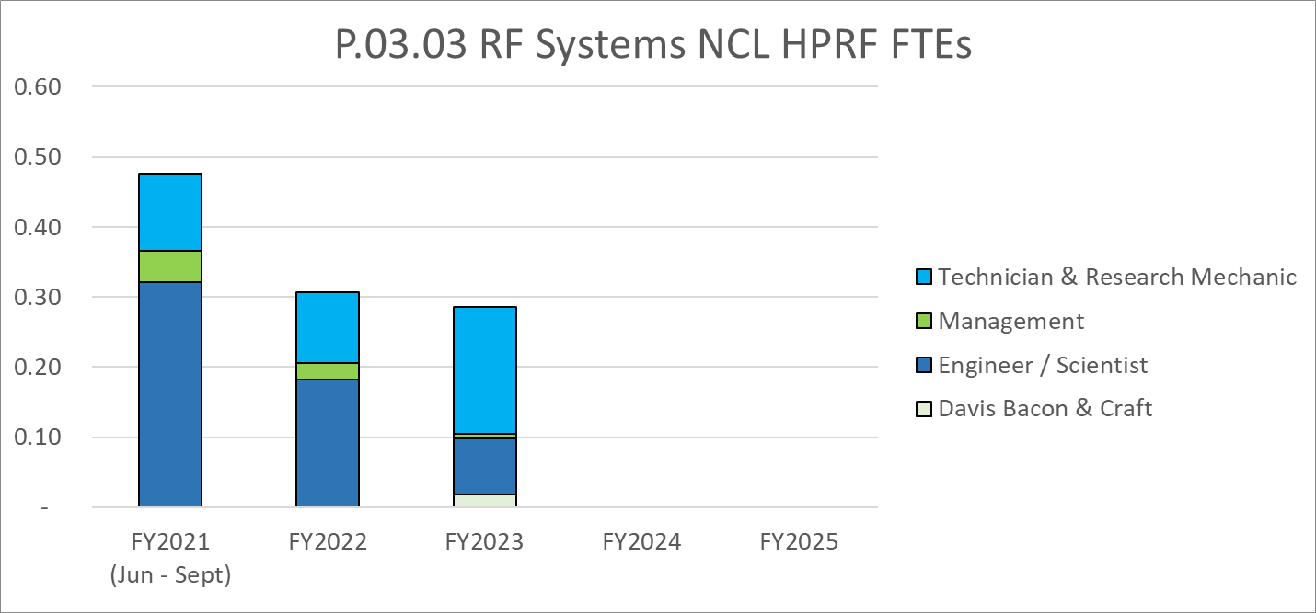
Labor Profile
Engineering effort decreases after the testing and acceptance of the 3MW first article

Slide 22
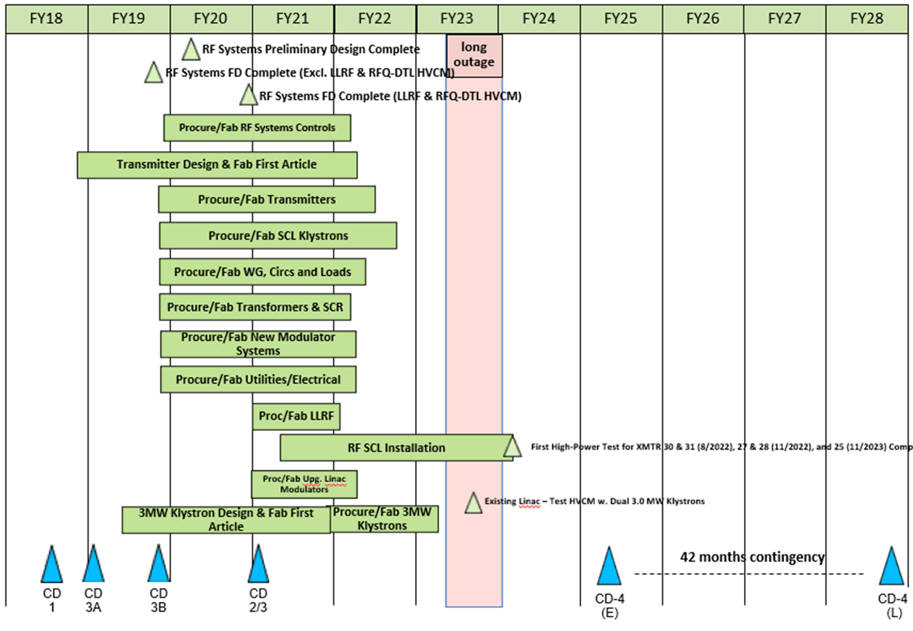
P.03 & P.10.03 – RF May 2021 Status Summary Schedule

Slide 23
P.03.02 SCL HPRF & P.03.03 NCL HPRF Risk Register
Charge: 4
Risk ID | L3 WBS | Risk Title | Expiration Date | Mitigation | Pre-Mitigation Rank | Post Mitigation Rank
T-P.3-035 | P.03.02 | Circulator Performance | 6/30/2021 | Purchase a stand-alone directional coupler that will solve the problem caused by the integrated unit. | 12 | 4
T-P.3-020 | P.03.02 | Transmitter vendor delivery slips due to workload/competition | 8/30/2022 | Maintain good communication between PPU and L3Harris so that schedule challenges can be discovered early and mitigated. Perform periodic vendor visits to assess progress. | 9 | 9
T-P.3-033 | P.03.02 | Onsite klystron testing reveals that it does not meet specs | 12/31/2022 | P.03.02 - use in house spares. P.03.03 - Accept | 5 | 3
Three active risks identified
  Ten risks retired
  Pre-mitigated ranking: 3 Medium
  Post-mitigated ranking: 2 Low, 1 Medium
High Risks
  No high risks identified
Key risk categories analyzed
  Vendor risks
  Equipment vulnerabilities
Risks are reviewed on a regular basis

Slide 24
Responses to Recommendations
Charge: 6
Single recommendation from CD 2/3 IPR to “tabulate SCL power requirements by the next DOE IPR”
  Added table to PPU-P03-TR001, Proton Power Upgrade (PPU) Project Linac RF Power Margin
  Closed in August 2020

Slide 25
ESH&Q and COVID-19 Impacts
Charge: 2, 3, 4, 5
Vendor quality and non-conformances
  Waveguide circulator and load coolant leaks
  Three 700 kW klystrons failed during fabrication
  First article 3 MW klystron 5th cavity crack and vacuum leak
Describe the COVID-19 impacts in your scope
  Lagging transmitter delays
    Sub-suppliers unable to keep schedules made last year
    Quarantine of design personnel
  Klystron material delays
  Shifted the finish date by several months, but no impact to milestones at this time
  Have been able to minimize the effect through routine meetings and schedule revision

Slide 26
12-Month Look-Ahead
Charge: 1, 4
Complete high-power test of first article circulator
Receive all klystrons needed for phase 1 and phase 2 (19 of 28)
Receive 3 MW first article and test
Receive all five high power transmitter systems
Complete the installation of ALL phase 1 HPRF equipment
  High power testing of transmitters 30 and 31 scheduled for late summer 2022
Start installation of phase 2 HPRF equipment

Slide 27
Summary
Fabrication of HPRF equipment is well underway
  Mitigating challenges through good vendor interaction
Still on schedule to meet high-level PPU milestones
Near-term focus on receipt and testing of equipment needed for phase 1 installation
Good progress made over the last 12 months

