Slide 1




P.03.6 New Linac Modulators
DOE/SC Independent Project Review of the Proton Power Upgrade Project
David E. Anderson
Level 3 Manager
September 14-17, 2021

Slide 2
Outline
Scope
Organization
Progress since CD-2/3
Challenges
Final design status
Installation plans
Cost and schedule
Labor profile
Risk register
Responses to recommendations
ESH&Q and COVID-19 impacts
12-month look-ahead
Summary

Slide 3
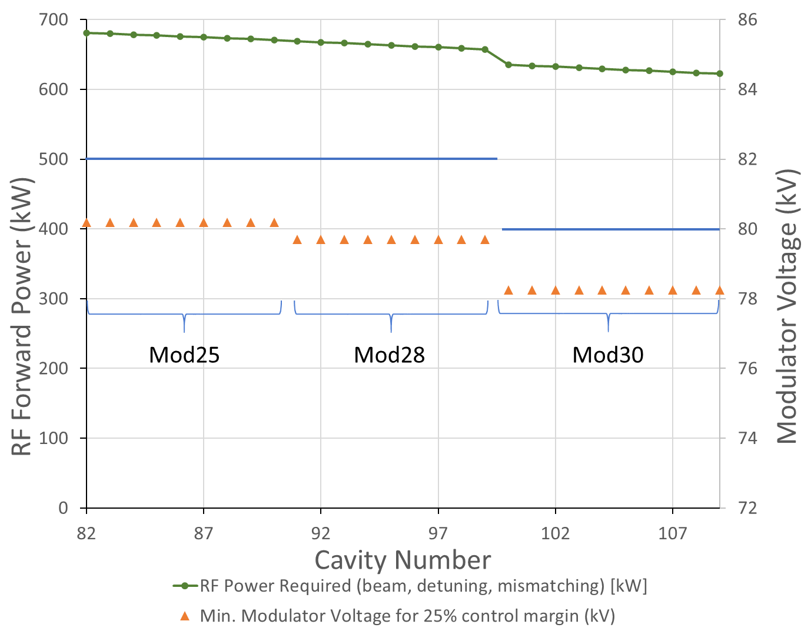
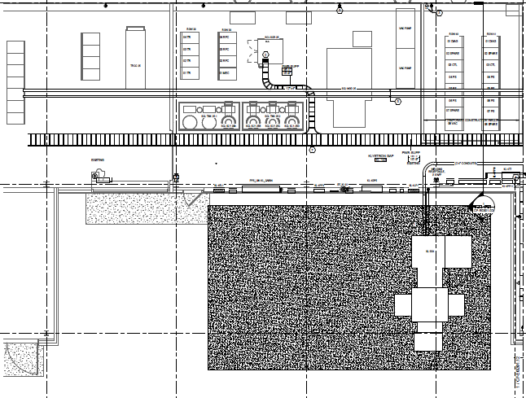
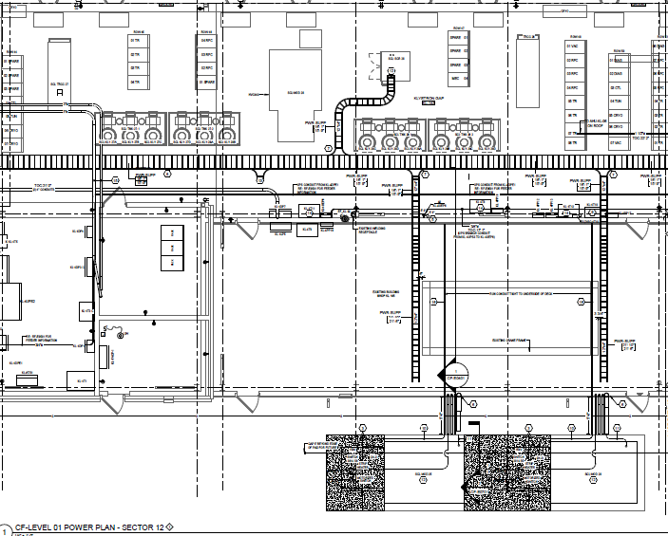
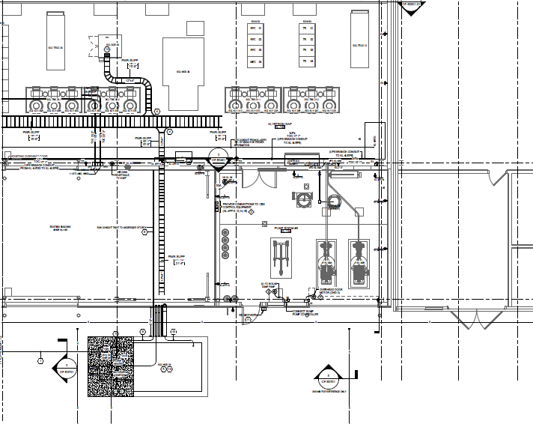
Scope P.3.6 – New Linac Modulators
Charge: 1
Final design of, procure, install, test and commission three new Alternative Topology High Voltage Converter Modulators (AT-HVCM) to power twenty-eight 700 kW klystrons
  Procure modulators under P.10.3.6
  Procure modulator spares to support operation of new AT-HVCM modulators
  Procure transformer and SCR Controller
  Upgrade & procure controller to address obsolescence issues
SCL-Mod25
SCR and modulator (9)
SCL-Mod28
SCR and modulator (9)
SCL-Mod30
SCR and modulator (10)
SCL-Mod25
transformer
SCL-Mod28
transformer
SCL-Mod30
transformer

Slide 4
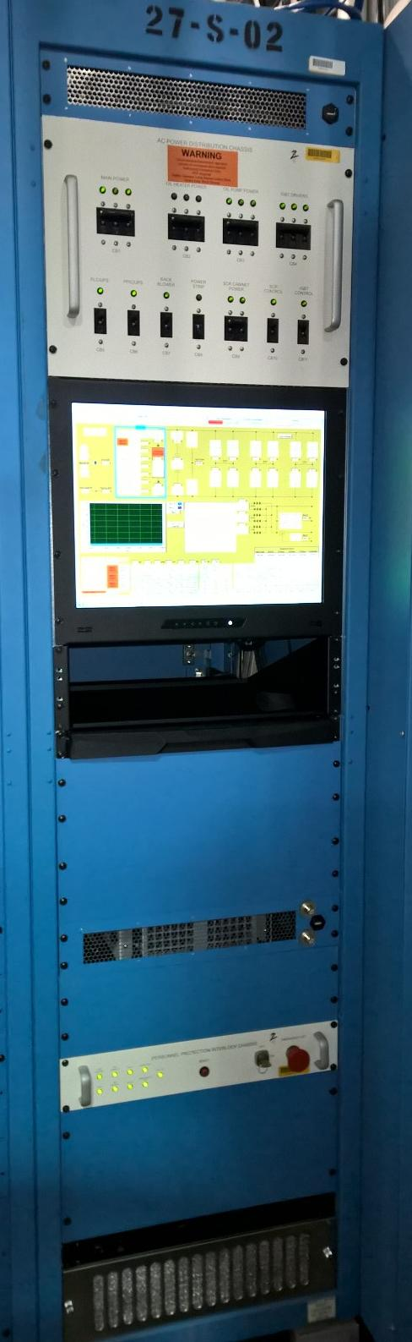
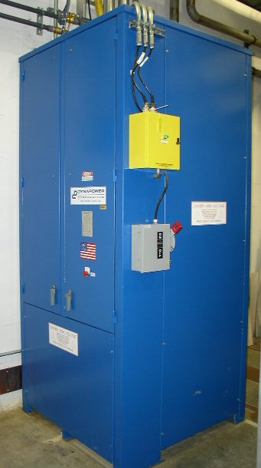
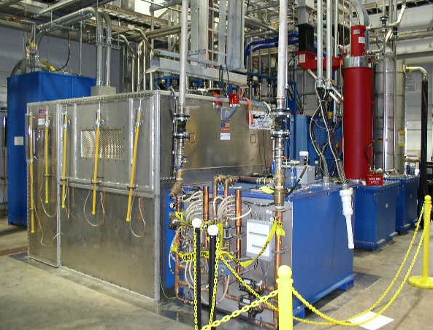
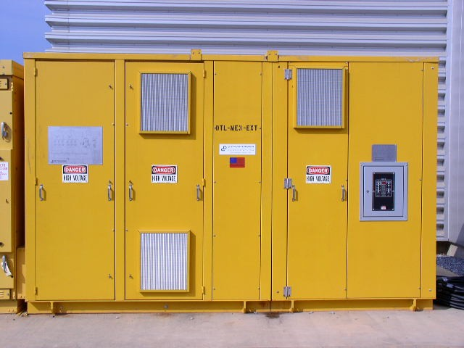
Procurement Strategy
Charge: 2
Step-down AC transformer¹
SCR Controller
AC-DC Conversion¹
Modulator System²
Modulator Controller
SCL-Mod25 | Sole source DPI | Sole source DPI | Build-to-print AOPT | Rack/chassis DCS³ Remainder ORNL
SCL-Mod28 | Sole source DPI | Sole source DPI | Build-to-print AOPT | Rack/chassis DCS³ Remainder ORNL
SCL-Mod30 | Sole source DPI^{3,4} | Sole source DPI⁴ | Build-to-print AOPT | Rack/chassis DCS^{3,4} Remainder ORNL
Spare | N/A | N/A | Build-to-print AOPT | N/A
¹identical to existing equipment
²excludes ORNL-provided CO₂, temp. monitor, oil circulation systems and oil
³currently at ORNL
⁴ship to AOPT as GFE for vendor FAT
Long lead CD-3B procurement (P.10.3.6)
Standard CD-3 procurement

Slide 5
















































Organization
Charge: 5
P.3 – RF Systems
John Moss
P.3.1
Management and System Integration John Moss
P.3.2 SCL HPRF
John Moss
P.3.3 NCL HPRF
John Moss
P.3.5 Existing Linac
Modulators
Chris Pappas
P.3.6 New Linac
Modulators
David Anderson
P.3.8 RF Controls Karen White
P.3.9 Global Controls Karen White
P.3.4 LLRF
Mark Crofford
P.3.7 Utilities
Greg Norman
P.3.6 Team
David E. Anderson – work package manager, lead engineer
Mark Wezensky – controls engineer
Kerry Ewald –mechanical designer
Jim Hicks – electrical technician
Joshua Singleton – electrical technician
Austin Bullman – electrical technician
P.3.1.1
Management and System Integration
John Moss
P.3.2.1
Management and System Integration
John Moss
P.3.3.1
Management and System Integration
John Moss
P.3.4.1
Management and System Integration
Mark Crofford
P.3.5.1
Management and System Integration
David Anderson
P.3.6.1
Management and System Integration
David Anderson
P.3.7.1
Management and System Integration
Greg Norman
P.3.8.1
Management and System Integration
Doug Curry
P.3.9.1
Management and System Integration
Doug Curry
P.3.2.2
Transmitters
John Moss
P.3.3.2
Transmitters
John Moss
P.3.4.2 LLRF System
Mark Crofford
P.3.5.2 Modulator System
Chris Pappas
P.3.6.2
Transformer
David Anderson
P.3.7.2 Water Utilities, New Cold
Linac SCL RF
Greg Norman
P.3.8.2 Linac RF Controls Doug Curry
P.3.9.2 Linac/SCL Timing/MPS Doug Curry
P.3.2.3 Klystrons
John Moss
P.3.3.3 Klystrons
John Moss
P.3.4.3 Arc Detectors
Mark Crofford
P.3.5.3 Modulator Control System Mark Wezensky
P.3.6.3 SCR System
David Anderson
P.3.7.3 Water Utilites, Modify
Existing RFQ/DTL
Greg Norman
P.3.8.3 Linac Water System
Controls
Derrick Williams
P.3.9.3 Linac/SCL Protection System
Kelly Mahoney
P.3.2.5 Circulators
John Moss
P.3.3.4 Circulators
Sung-Woo Lee
P.3.4.4 Reference Line
Chip Piller
P.3.5.4 Modulator SystemTest
Article
David Anderson
P.3.6.4 Modulator System
David Anderson
P.3.7.7 Electrical
Wm Barnett
P.3.9.4 Linac/SCL Networking and
Computing
Doug Curry
P.3.2.6 Water Loads
John Moss
P.3.3.5 Glycol/ Water Loads Sung-Woo Lee
P.3.5.5 Warm Linac Test HVCM David Anderson
P.3.6.5 Modulator Control System Mark Wezensky
P.3.5.6 Upgrade RFQ-Mod1 Chris Pappas
P.3.6.6 Integrated System
David Anderson

Slide 6
Progress since CD-2/3
Charges: 1,2,4
At CD-2/3, the following items were proposed for the previous year
  Execute build-to-print contract and perform 1st article FAT and SAT
  Award optional spares for build-to-print contract
  Procure 2 additional power transformers and SCR units
  Finalize modulator control system design

Slide 7
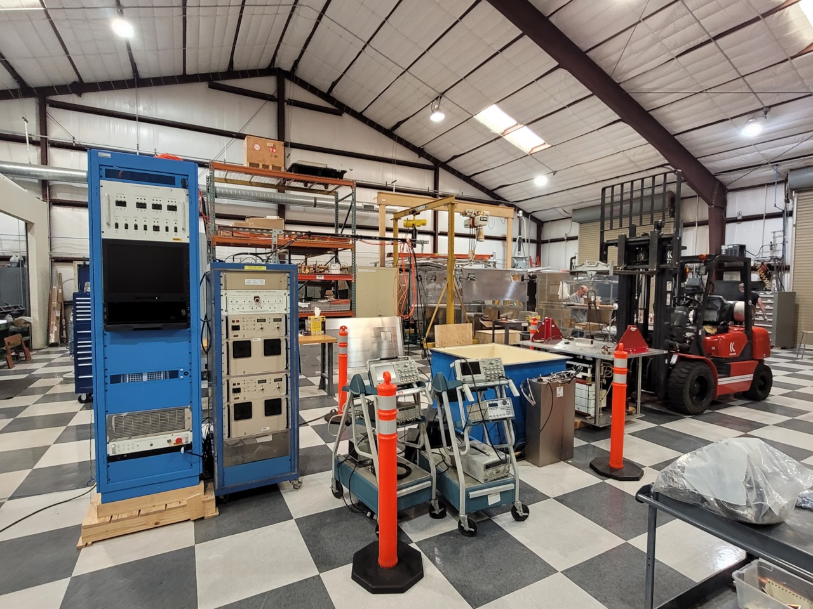
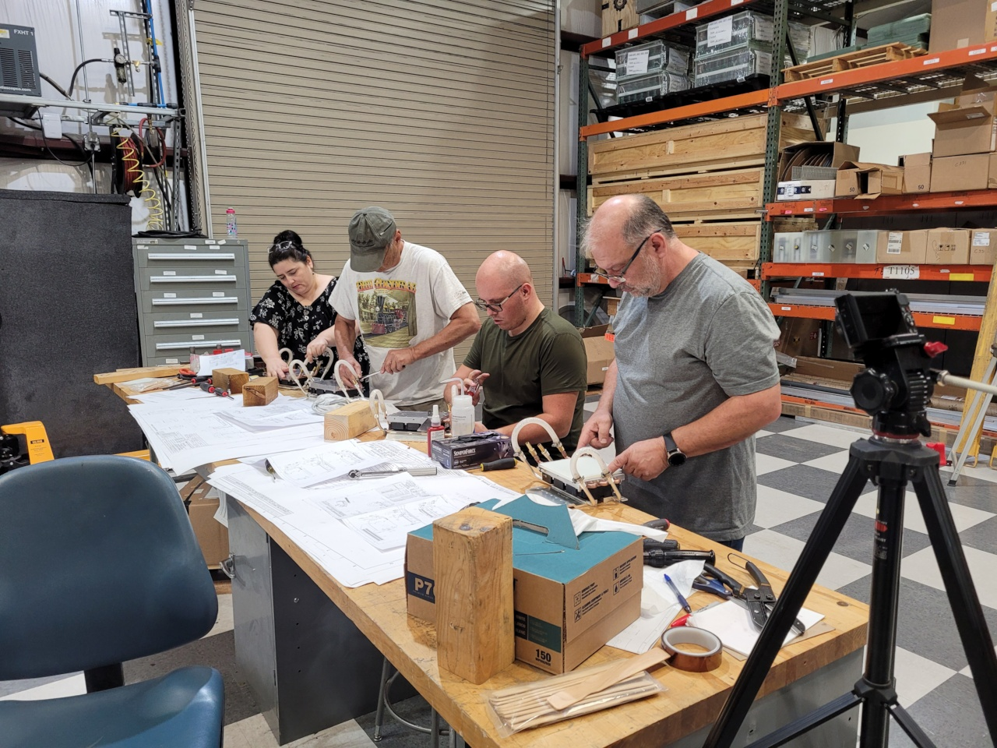
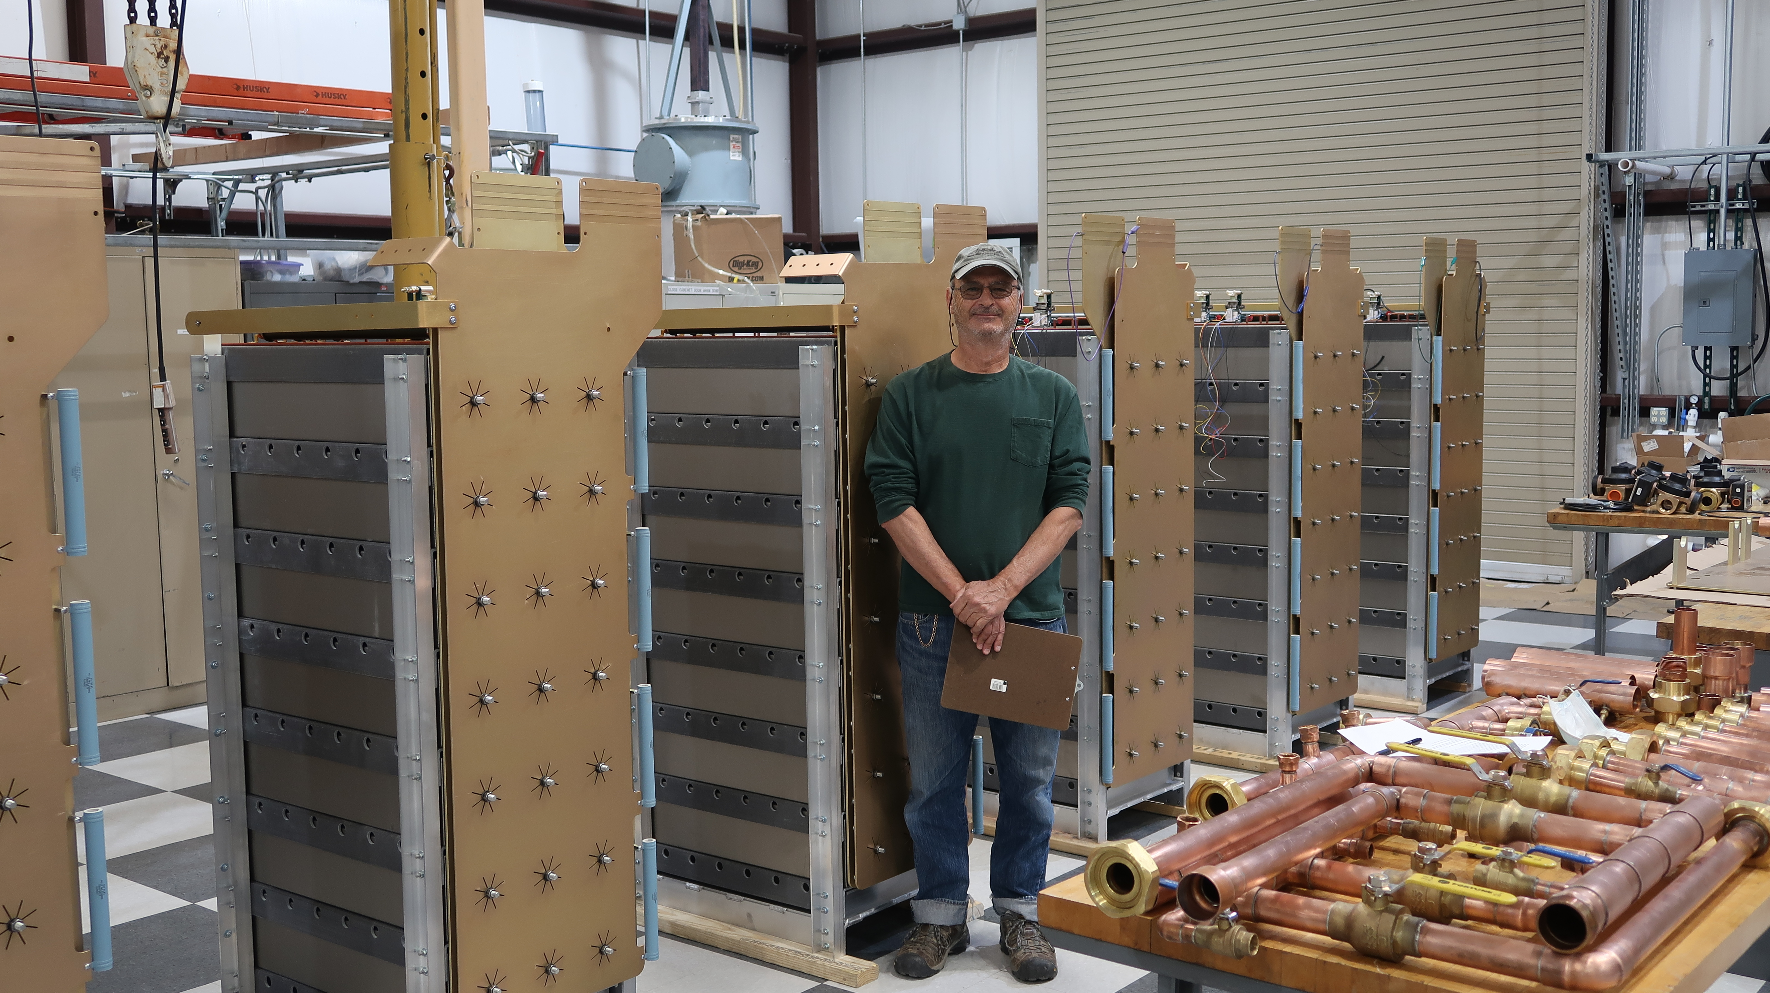
Progress since CD-2/3
Execute build-to-print contract and perform 1st article FAT and SAT and award spares
  Awarded to Alpha Omega Power Technologies (AOPT) in April 2020 with option for spares exercised after CD2/3 approval
  1st article FAT scheduled for September 2021; SAT will be eliminated since vendor is capable of full average power testing at FAT
  Supported vendor on assembly and switch plate testing
Single phase test stand set up at vendor for switch plate qualification
ORNL personnel training AOPT personnel on switch plate assembly
Capacitor rack assemblies at AOPT

Slide 8
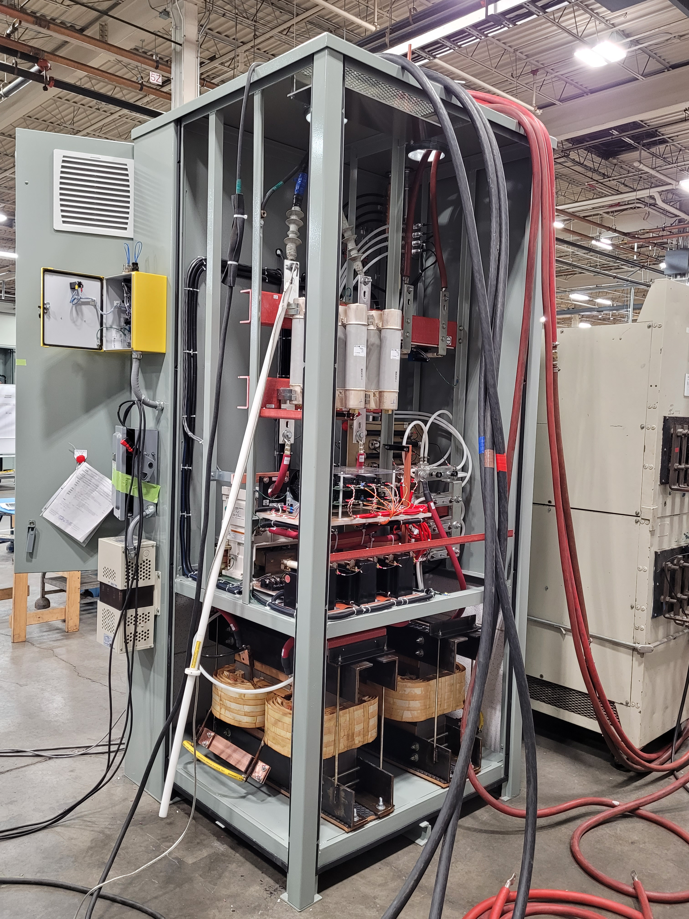
Progress since CD-2/3
Procure 2 additional power transformers and SCR units
  Awarded to Dynapower to insure interchangeability with existing equipment in December 2020
  Deliver SCR units by September 2021, transformers by September 2021
    2nd unit presently at AOPT for modulator FAT
    Minor delay due to regulator circuit configuration issue
SCR unit under factory acceptance testing at DPI, July 15, 2021

Slide 9
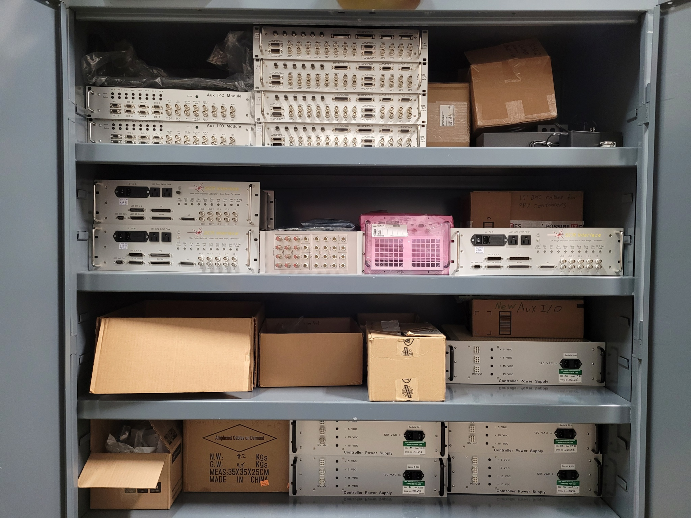
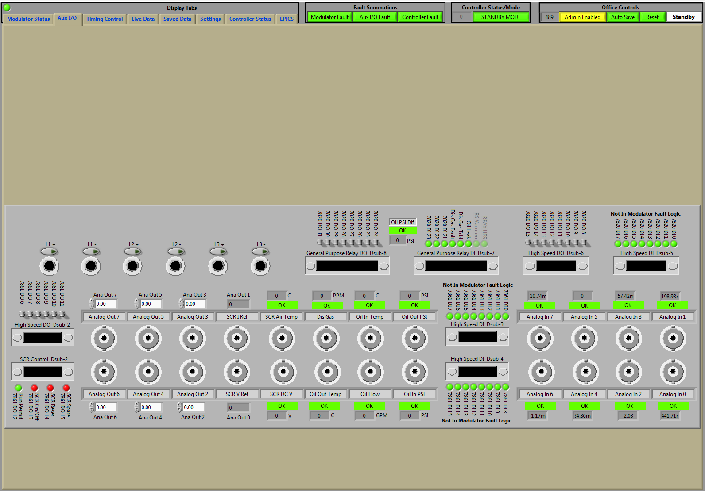
Progress since CD-2/3
Finalize modulator control system design
  Custom hardware, new PXI equipment and controller programming complete and mostly tested
  90+% of equipment in house and assembled/tested
  First article PPU controller rack at AOPT to be used for FAT
Custom chassis and modules for PPU new modulator controllers
Updated controller HMI with new Aux I/O screen

Slide 10
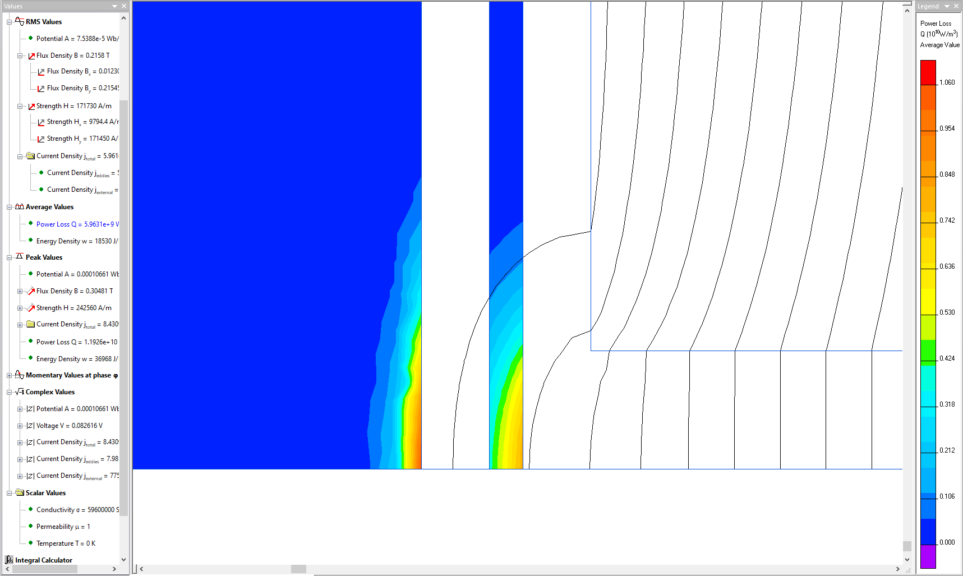
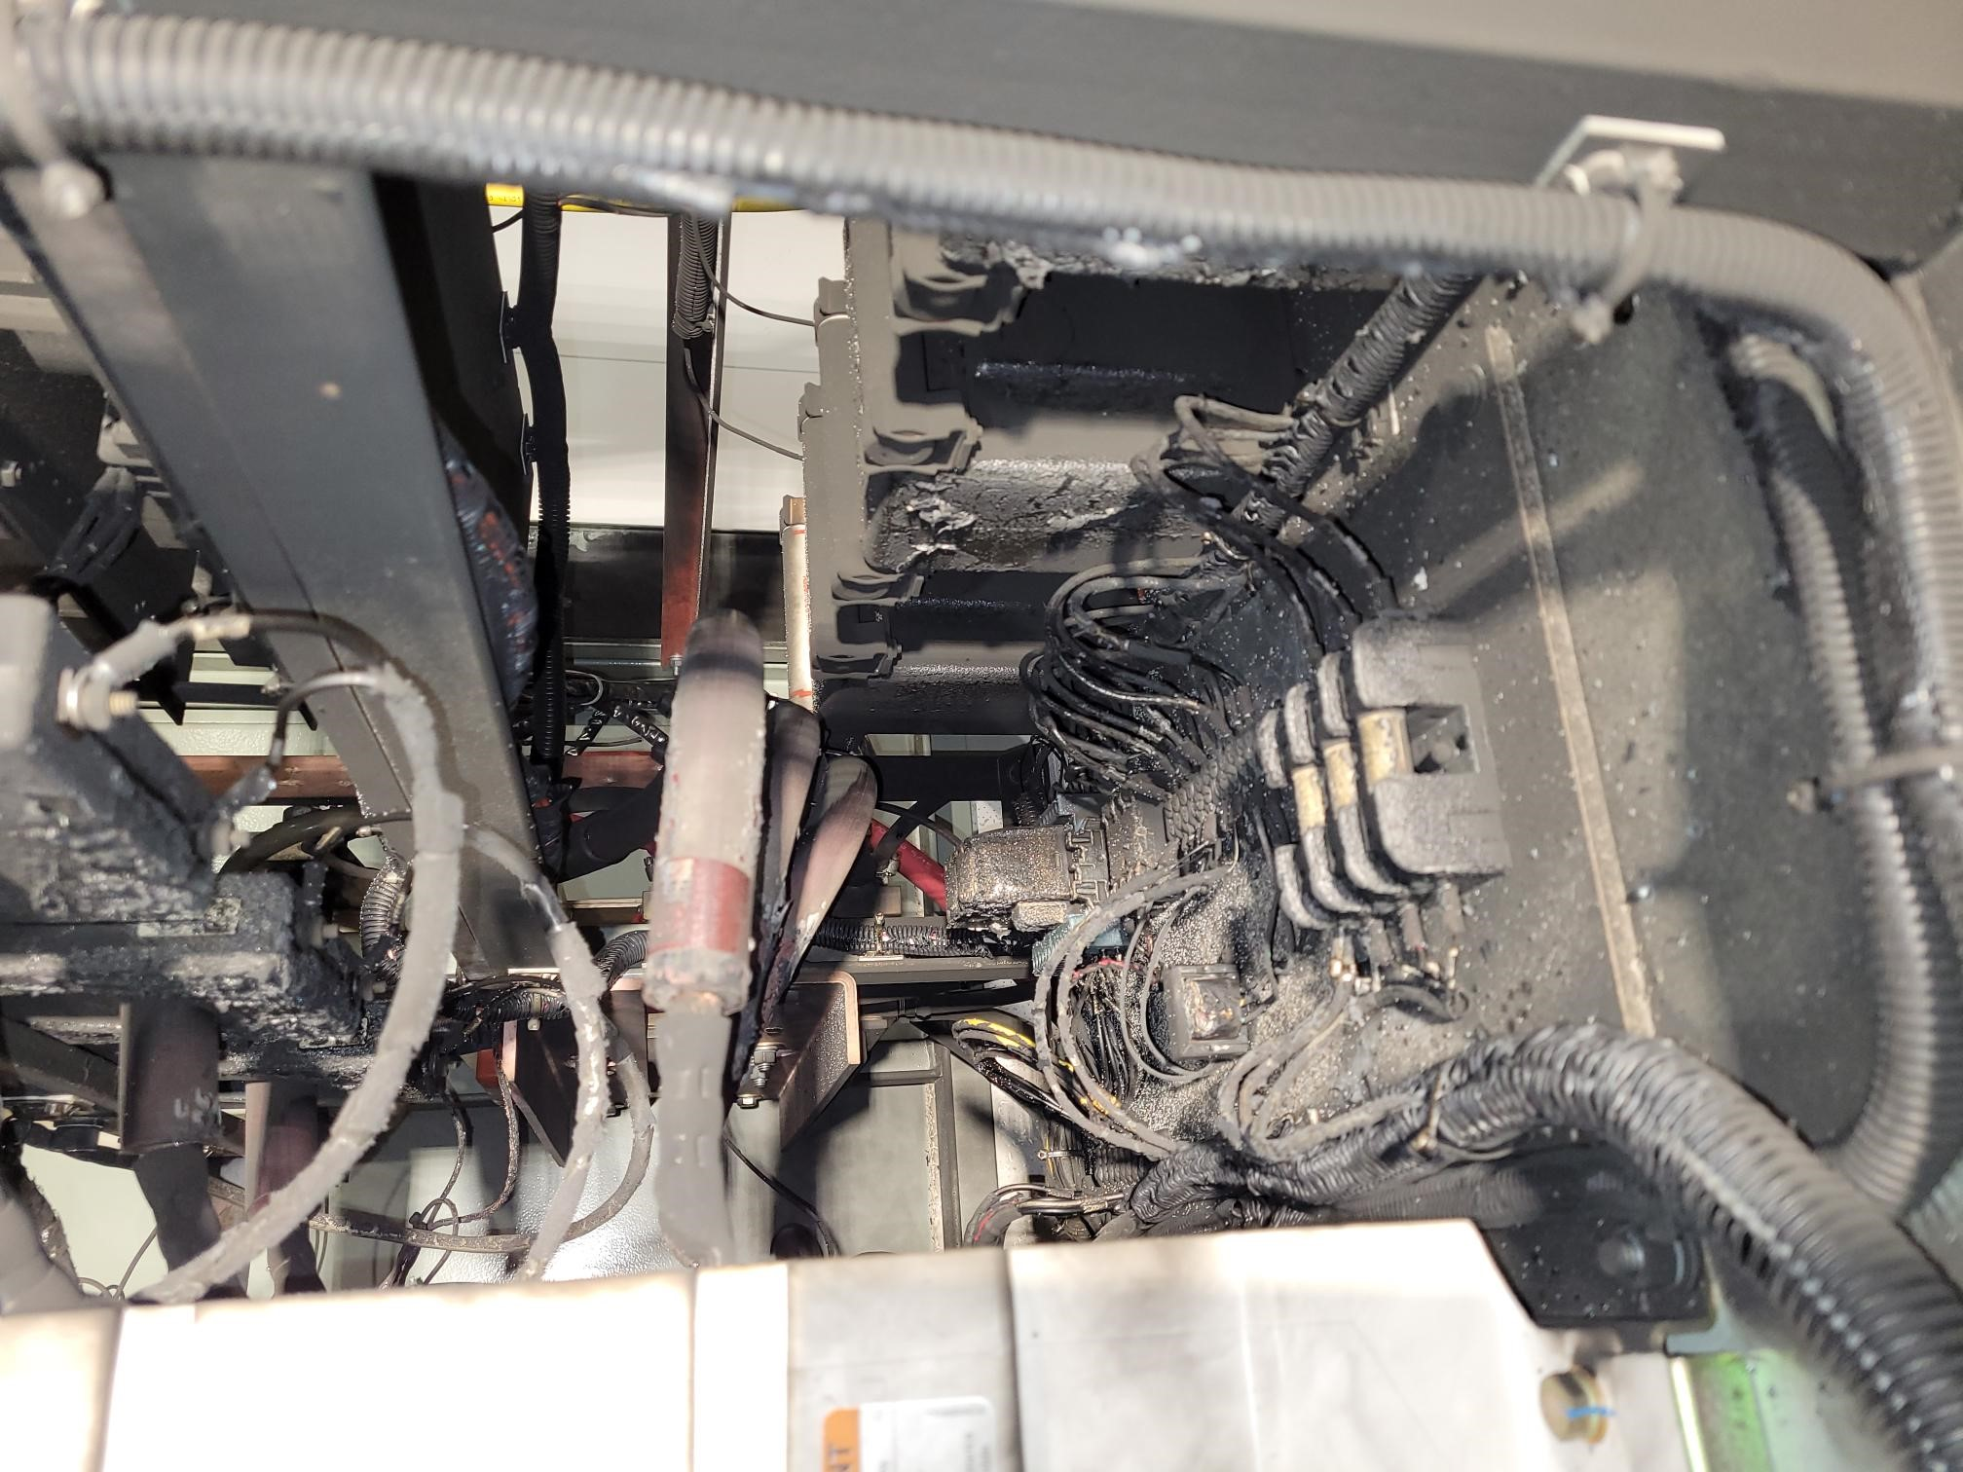
Challenges
Charges: 1,4
Discovery of heating on boost transformer gap components
  Redesigned to reduce losses to 5.2%, ΔT to 11.2% of original value
Manufacturing delays, primarily due to component suppliers
  Worked with vendor to optimize schedule, captured unrecoverable delays with project PCRs
Failure of SCR unit on RFAX modulator
  Sent to DPI to determine root cause (SCR failure and vacuum contactor failure, improper protection circuit configuration)
  PCR to procure additional unit from contingency
FEA of boost capacitor pole face redesign to minimize losses
Damage in HV section to SCR enclosure

Slide 11
Final Design Status
Charge: 6
Final Design Review held on May 26, 2019
Recommendations addressed
  Vendor test plan & QA plan with RFQ
  ORNL on-site presence during critical manufacturing stages
  ORNL procure long-lead items for build-to-print

Slide 12
Installation Plans
Charges: 4,5
Transformers installed on pads upon arrival starting Sept. 2021
  Switch gear and cabling already in place
SCRs installed according to installation schedule, except 1st unit which ships to AOPT for modulator FAT, starting Sept. 2021
Modulators and control racks installed according to installation schedule starting September 2021
  CO₂ system provided by external vendor due to certification requirements
  Oil circulation and temperature monitoring system installed by ORNL after equipment arrival
Integrated testing readiness dates¹:
SCL-Mod30: Mar. 2022
SCL-Mod28: Jul. 2022
SCL-Mod25: May 2023
¹latest dates based on approved June PCR

Slide 13
Schedule
Charge: 4
Fabrication on schedule with installation to begin late FY21
FY18
FY19
FY20
FY21
FY22
FY23
FY24
FY25
FY26
FY27
FY28
RF Systems Preliminary Design Complete
long outage
RF Systems FD (Excl. LLRF & RFQ-DTL HVCM)
RF Systems FD Complete (LLRF & RFQ-DTL HVCM)
Procure/Fab RF Systems Controls
Transmitter Design & Fab First Article
Procure/Fab Transmitters
Procure/Fab SCL Klystrons
Procure/Fab WG, Circs and Loads
Procure/Fab Transformers & SCR
Procure/Fab New Modulator Systems
Procure/Fab Utilities/Electrical
Proc/Fab LLRF
RF SCL Installation
First High-Power Test for XMTR 30 & 31 (8/2022), 27 & 28 (11/2022), and 25 (11/2023) Complete
Proc/Fab Upg. Linac Modulators
3MW Klystron Design & Fab First Article
Procure/Fab 3MW Klystrons
Existing Linac – Test HVCM w. Dual 3.0 MW Klystrons
42 months contingency
CD
1
CD
3A
CD
3B
CD
2/3
CD-4
(E)
CD-4
(L)

Slide 14
PPU Changes since CD-2/3
Charge: 4
Major increases
  Additional SCR unit and temperature monitoring $300k
  ORNL-provided cooling system with other modulators’ AIP-36 upgrades $227k
  AT-HVCM GFE shipping/preparation for vendor FAT $54k

Slide 15
Estimate to Complete
Charge: 4
P.03.06.02 (SCR System) merged into P.03.06.02 (Transformer) in FY21
P.03.06.02 and P.03.06.04 primarily vendor subcontracts

Slide 16
Estimate to complete
Charge: 4
Completion of manufacturing subcontracts main contributor to materials costs in FY21 and FY22
Labor primarily to support system installation and testing through FY23

Slide 17
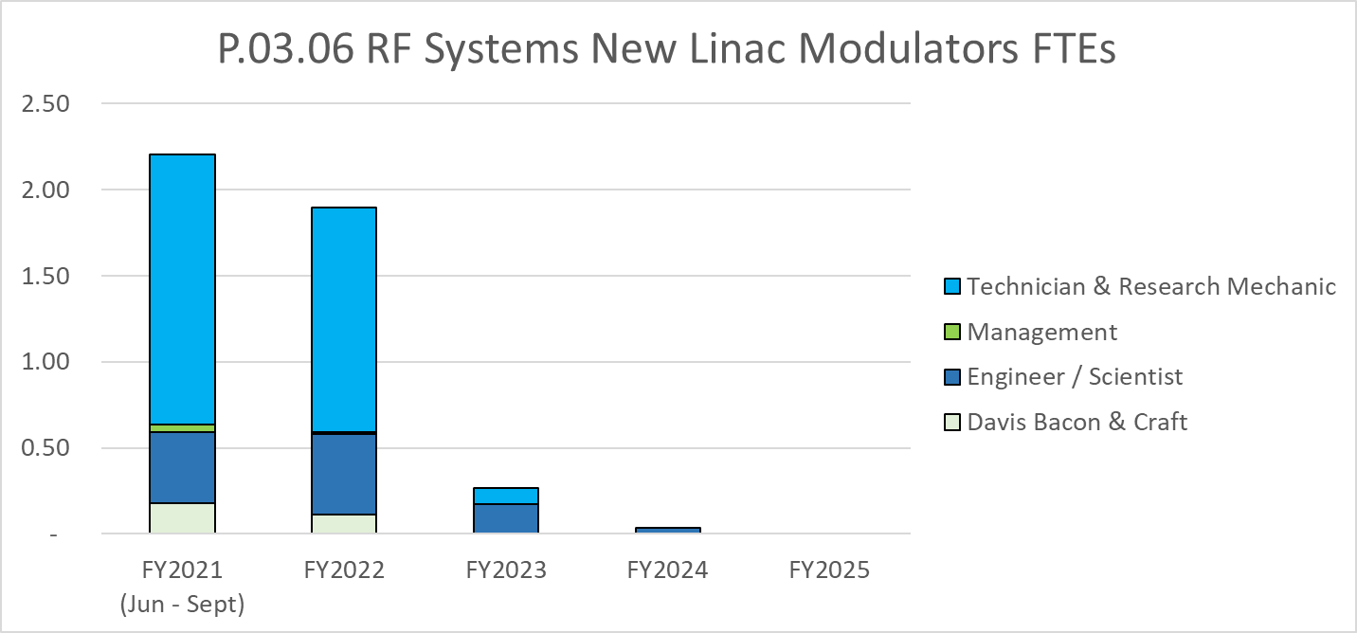
Labor Profile
Charge: 4
Heavy technician / RM labor remaining in FY21/FY22 to support installation
Labor ramps down quickly after installation complete
Heavy technician labor support is a challenge for new Electrical Power Conversion Group

Slide 18
Project Change Requests post CD-2/3
Charge: 4
PCR # | Title | Impact (k$) | Motivation
LL-2020-42 | Awarded AT-HVCMs & Error Corrections | 472 | Correct error for historical actuals, incorporate vendor costs and impacts
LL-2020-50 | AT-HVCM Vendor Inspection Consultant | 14 | Consultant for vendor oversight during COVID
LL-2020-53 | AT-HVCM Vendor Testing GFE | 54 | Prep and ship ORNL equipment to vendor for full power testing
RF-2021-01 | AT-HVCM Oil Cooling System | 227 | Provide ORNL-furnished oil cooling systems compatible with AIP-36
RF-2021-03 | Award of Remaining Transformers and SCRs | 11 | Cost increase to incorporate new design features
RF-2021-07 | Award of AT-HVCM Spare Parts | (37) | Vendor schedule improvements and removal of vendor oversight
RF-2021-12 | Added SCR Unit and Associated Hardware | 228 | Added SCR after failure of RFAX SCR unit
RF-2021-13 | AT-HVCM Temperature Monitoring and Other Diagnostics | 79 | Added temp. monitoring so modulator consistent with others
LL-2021-02 | AT-HVCM Vendor Schedule Update | 4 | Capture vendor schedule slippages
LL-2021-15 | Modulator Oil Award and de-scope test equipment | (24) | Reduced cost of modulator oil

Slide 19
Risk Register
Charge: 5
No active risks identified
  Three risks retired
High Risks
  No high risks identified
Key risk categories analyzed
  Equipment requirements
Risks are reviewed on a regular basis

Slide 20
Responses to Recommendations
Charge: 6
No recommendations from CD-2/3 DOE review
Recommendations from prior reviews are closed

Slide 21
ESH&Q and COVID-19 Impacts
Charge: 3,5
SCR vendor non-conformance to ORNL implemented changes
  Vendor improved internal QA procedures to address
  ORNL to perform more thorough incoming inspections
Modulator vendor has done a good job capturing ECOs with ORNL approval
COVID-19 has impacted manufacturing
  Vendor supply chain delays impacting manufacturing by ≤3 months
  Inability to travel required ORNL to hire local NM consultant to monitor modulator fabrication and assembly
  Overall, vendors and ORNL personnel have done an outstanding job responding to COVID-19 issues

Slide 22
12-Month Look-Ahead
Charge: 4,5
Complete FAT of modulator systems
  SCL-Mod30: Sept. 2021
  SCL-Mod28: Sept. 2021
  SCL-Mod25: Nov. 2021
Complete delivery of power transformers and SCR units by end of FY2021
Installation of first two systems initiated by summer of 2022

Slide 23
Summary
Technical challenges mostly in the past
Project is on schedule
  Vendor subcontracts are on track with deliveries on schedule
  Installation scheduled to begin late FY21
Using PCRs, costs have been well managed
Labor ramp-up for installation will tax EPC group resources

