Slide 1




P.02.4 Cryogenics
DOE/SC Independent Project Review of the Proton Power Upgrade Project
Brian DeGraff
Level 3 Manager for Cryogenics
September 14-17, 2021

Slide 2
Outline
Scope
Organization
Progress since CD-2/3
Challenges
Final design status
Installation plans
Cost and schedule
Labor profile
Risk register
Responses to recommendations
ESH&Q and COVID-19 impacts
12-month look-ahead
Summary

Slide 3
Scope
Charge: 1
P.2.4 Cryogenics scope is responsible for ensuring reliable and efficient operation of the 7 new PPU cryomodules with the current CHL infrastructure
Manage the additional cryogenic heat loads produced from operation of the new CMs
  Current CHL hardware is adequate
Connect the new CMs to the existing tunnel infrastructure
Control the various modes of CHL operation (2K versus 4K)
P.2.4 Cryogenics scope involves the re-use and modification of existing hardware and techniques
No new R&D required
No new hardware designs required

Slide 4
Scope
Charge: 1
As listed in the SCL Final Design Report (FDR), P.2.4 Cryogenics has three requirements:
Category | Requirement | Description | FDR Section
CHL Primary Helium Circuit | > 105 g/s | Existing CHL hardware shall provide cryogenic cooling for cavities at 2 K with adequate margin | 3.3.1 & 3.4
CHL Secondary Helium Circuit | > 15 g/s | Existing CHL hardware shall provide cryogenic cooling for couplers at 4 K with adequate margin | 3.3.1 & 3.4
CHL Shield Helium Circuit | > 8300 W | Existing CHL hardware shall provide cryogenic cooling for shields at 35 K with adequate margin | 3.3.1 & 3.4

Slide 5
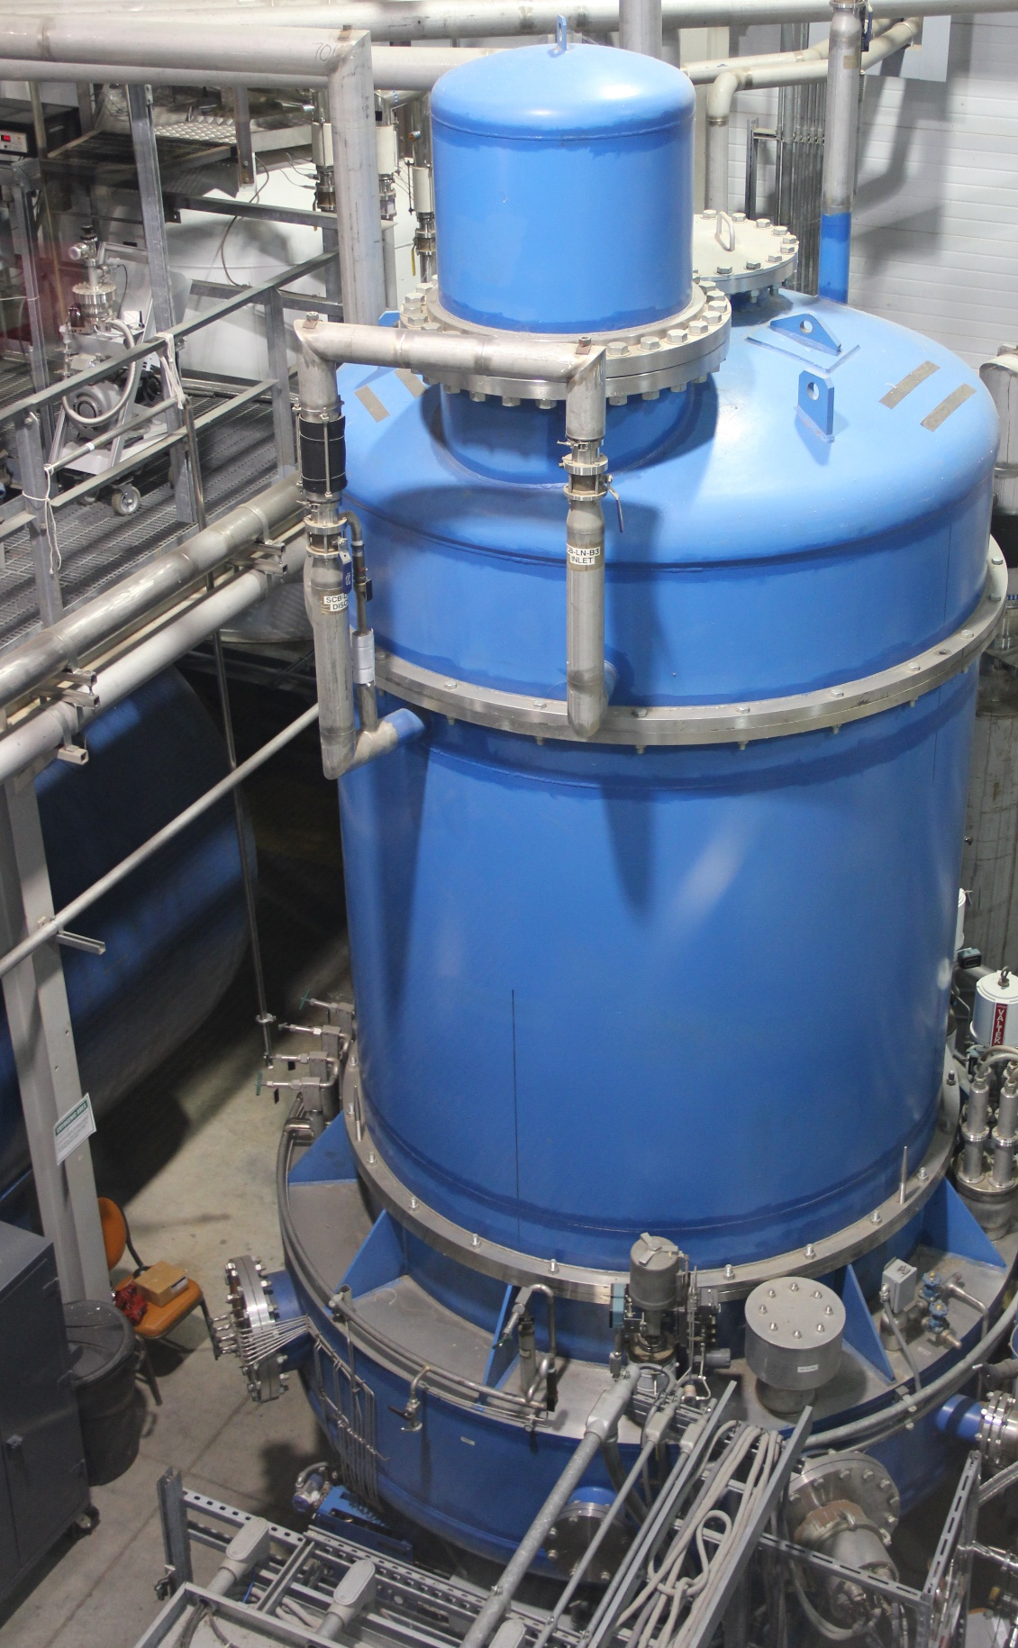
Scope
Charge: 1
No hardware changes are necessary to the primary 4K & 2K boxes
  2K cold box design capacity is 125 g/s
  New total static heat load expected ~700 W
  New total dynamic load ~700 W
  New margin of 40% at low flow (105 g/s)
No changes are necessary to shield 35 K supply
  Based on original SNS design values, new static heat load expected ~6.0 kW
  Based on current 4KCB readings values, new static heat load expected ~8.3 kW
    Matches box design capacity
    Mitigation strategy in place
CHL 2K Cold Box

Slide 6
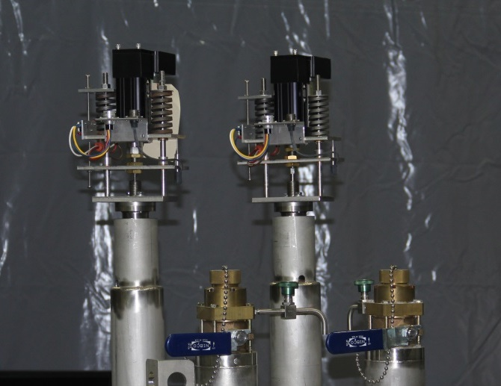
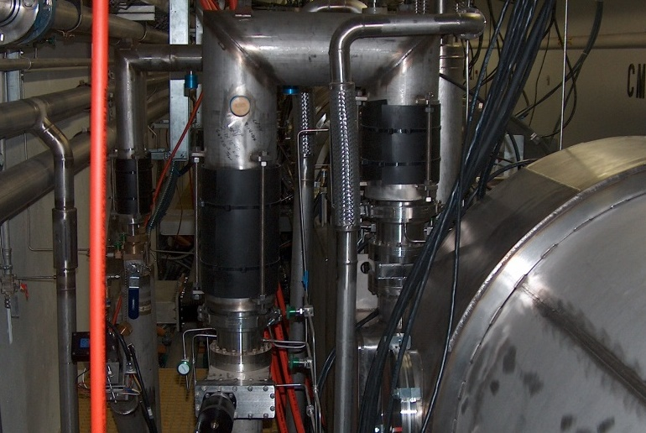
Scope
Charge: 1
New cryomodules actuators are copies of existing design operating in the SNS LINAC
New grating behind cryomodules copies of existing design
New set of 4 u-tubes for cryomodules (28 in total) identical in design to current tunnel u-tubes
  Quote for u-tubes provided by vendor that recently supplied an operational spare set of u-tubes for SNS and recently did extensive work for LCLS-II
Valve Actuator
Cryomodule U-Tube

Slide 7
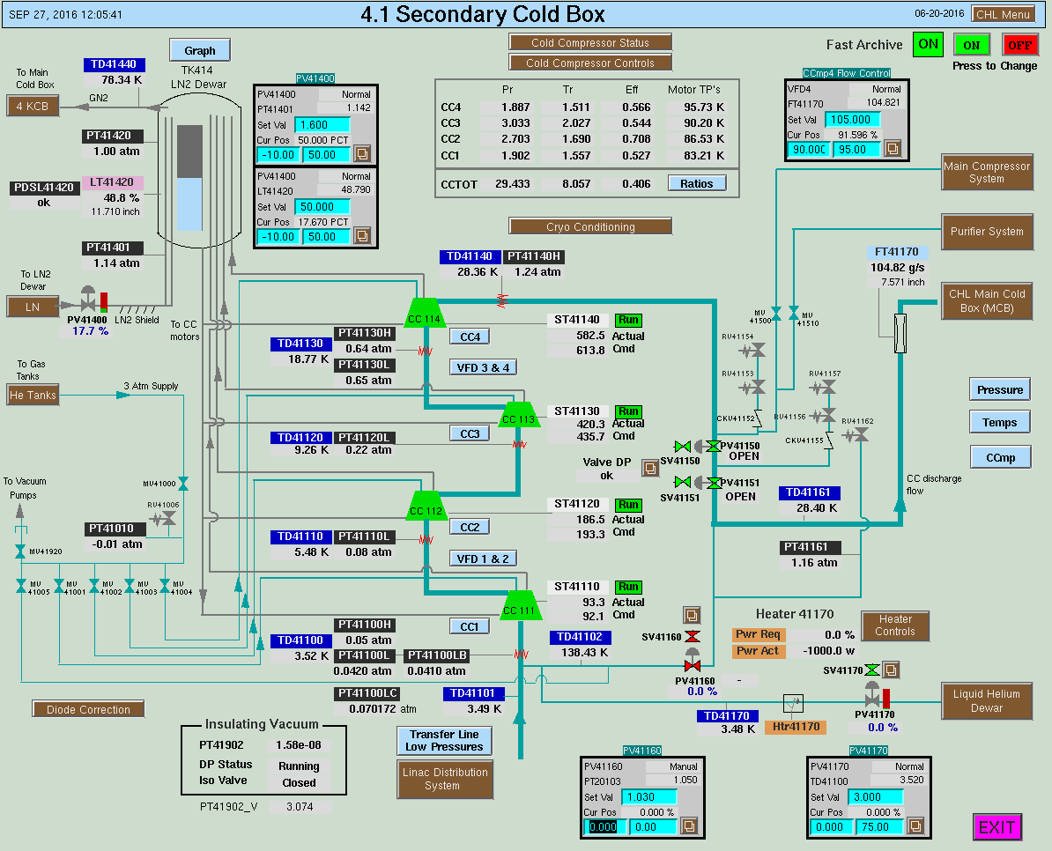
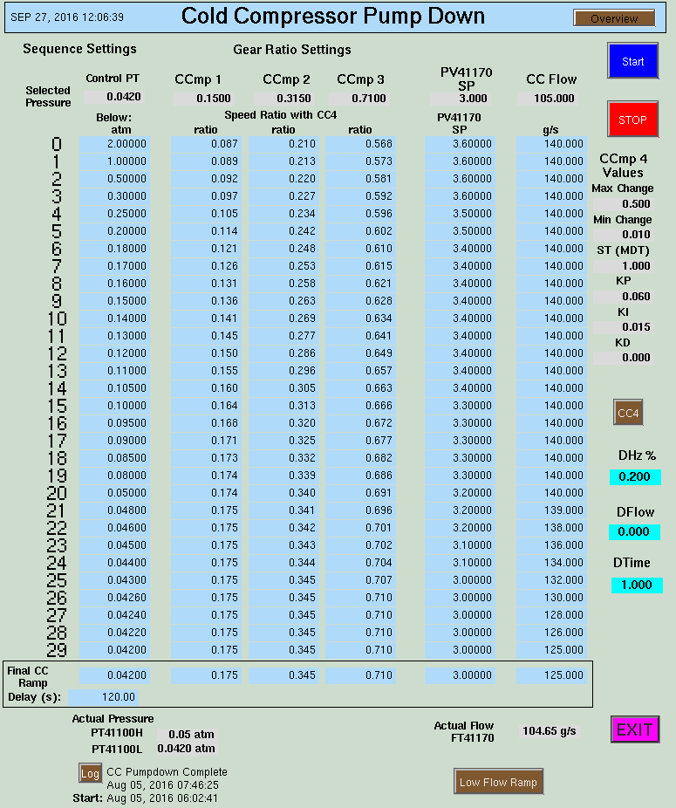
Scope
Charge: 1
Current 2K cold compressor hardware configuration will supply sufficient pumping capacity at 105 g/s to operate the LINAC with additional cryomodules at 2.1 K
Possible change in temperature profile of 2K system
  Either warmer or colder (testing required)
  Could require changes to the gear ratio pump down sequence
  Modifications carried out in WBS – 2.4.3
B1-7 Coleman
CHL EPICS Screens

Slide 8


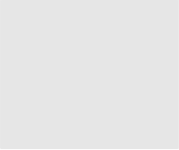


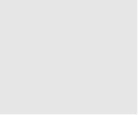


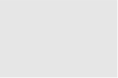
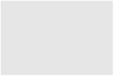


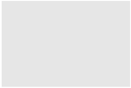

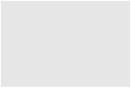
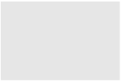











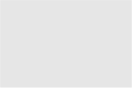




Organization
P.2 – SCL
Matt Howell
Charge: 5
P.2.1
Management and System Integration Matt Howell
P.2.2 Cavities
John Mammosser
P.2.3
Cryomodules Integration Ed Daly
P.2.4
Cryogenics
Brian DeGraff
P.2.5 Utility Systems Chris Stone
P.2.6 System Integration
John Mammosser
P.2.7 SCL Controls Karen White
P.2.1.1
Management and System Integration
Matt Howell
P.2.2.1
Management and System Integration
John Mammosser
Partner Lab
P.2.4.1
Management and System Integration
Brian Degraff
P.2.5.1
Management and System Integration
Chris Stone
P.2.6.1
Management and System Integration
John Mammosser
P.2.7.1
Management and System Integration
Aaron Coleman
P.2.2.2 Cavity Procurement
John Mammosser
P.2.4.2 Cryogenic Components Brian Degraff
P.2.5.2 Beamline Vacuum
Chris Stone
P.2.6.2 Completed Cryomodule
Testing
John Mammosser
P.2.7.2 Linac Beamline Vacuum
Controls
Derrick Williams
P.2.2.4 Cavity Reprocessing
John Mammosser
P.2.4.3 Cryogenics System Testing
Brian Degraff
P.2.5.3 Insulating Vacuum System
Chris Stone
P.2.6.3
Cryomodule in Tunnel
John Mammosser
P.2.7.3 Linac Insulating Vacuum System Controls
Derrick Williams
P.2.2.5 Coupler Acquisition Yoon Kang
P.2.5.4 Water Systems Klent Pope
P.2.6.4
Cryomodule Testing in Tunnel John Mammosser
P.2.7.4
Cryomodule Controls Aaron Coleman
P.2.2.7 HTA Testing
Brian Degraff
P.2.6.5 Plasma Process MB Cryo. John Mammosser
P.2.2.8 Coupler Waveguide Transition Yoon Kang
Work force supplied from three groups/teams
Executed by nine different people

Slide 9
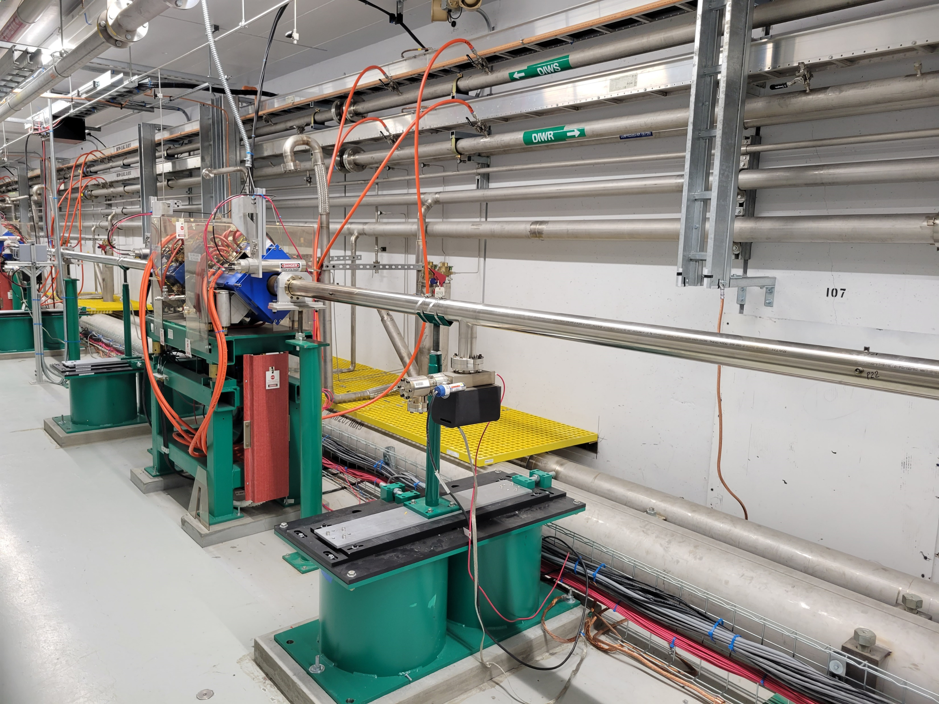
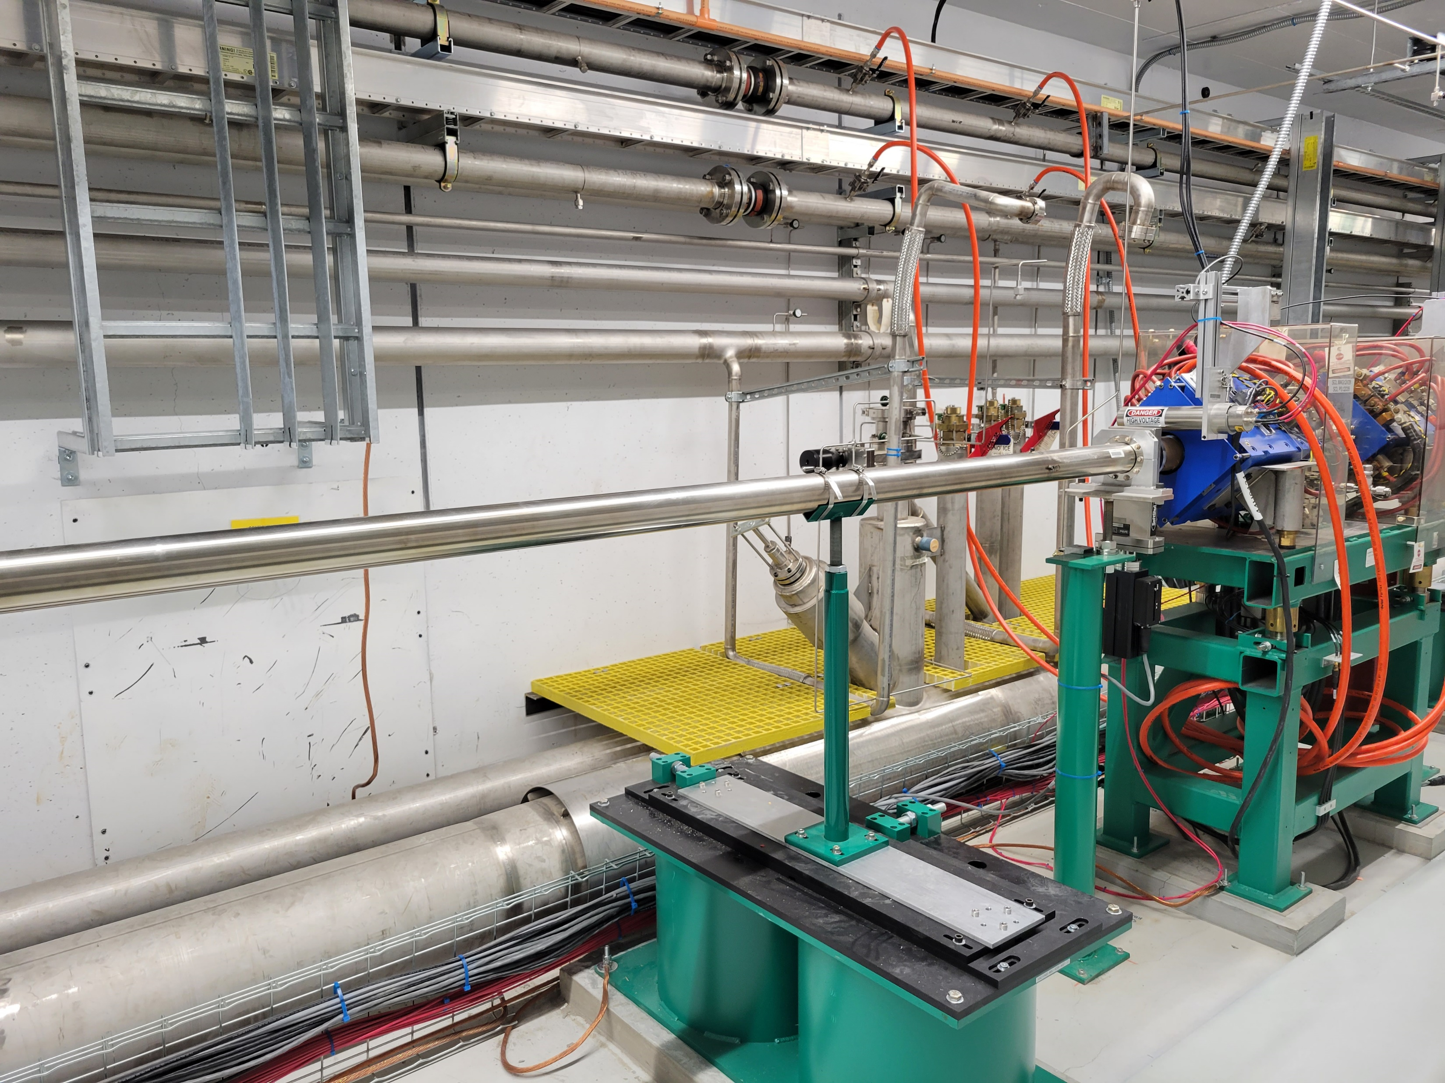
Progress since CD-2/3
Charge: 2
Most of the P.2.4 scope is remaining as it applies to after the PPU CMs have been installed in the LINAC
However, the personnel grating in the PPU CM slots has already been installed:
Grating Behind CMs

Slide 10
Challenges
Charge: 1
No challenges experience so far in P.2.4

Slide 11
Final Design Status
Charge: 1
P.2.4 final designs are complete

Slide 12
Installation Plans
Charge: 1
The scope of P.2.4 supports the installation and operation of PPU CMs at the end of each maintenance outage

Slide 13
Cost and Schedule
Charge: 4
P.2.4 is 8% complete and costs are being tracked

Slide 14
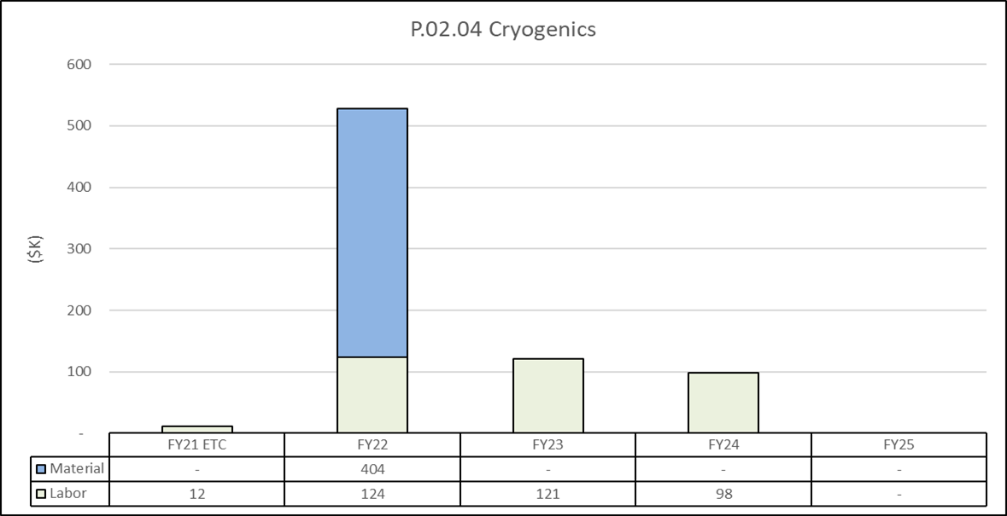
Cost and Schedule
Charge: 4
P.2.4 cost is dominated in FY22 with the procurement of U-tubes

Slide 15
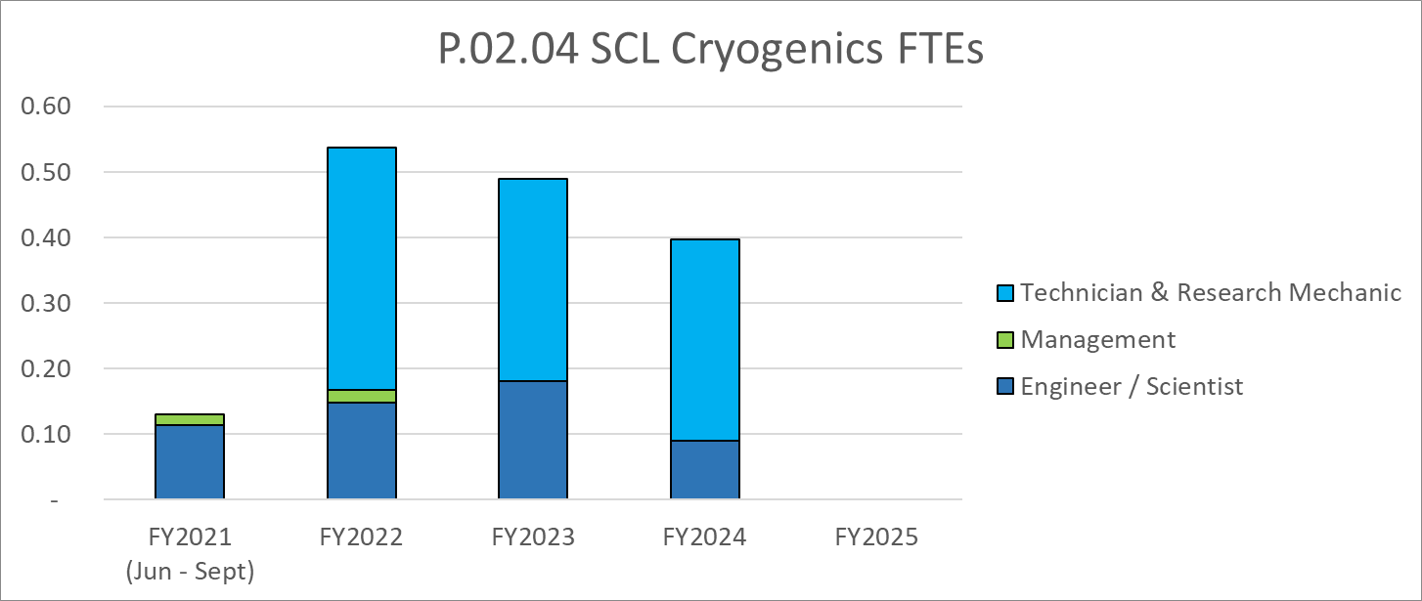
Labor Profile
Charge: 4
P.2.4 labor needs are low
  maximum of 0.55 FTE in FY22

Slide 16
Risk Register
Charge: 1, 4
Risk ID | L3 WBS | Risk Title | Expiration Date | Mitigation | Pre-Mitigation Rank | Post Mitigation Rank
T-P.2-022 | P.02.04 | Cryogenic Sequence Development | 12/1/2022 | Conduct work in advance, to the extent possible, so that the work can be efficiently executed during the outage. | 6 | 6
One active risk identified for Cryogenics
  One retired
  Pre-mitigated ranking: 1 Medium
  Post-mitigated ranking: 1 Medium
High Risks
  No high risks identified
Key risk categories analyzed
  Outage schedule issue
  Overcoming technical issues previously experienced at SNS
Risks are reviewed on a regular basis

Slide 17
Responses to Recommendations
Charge: 6
No P.2.4 CD-2/3 DOE review recommendations

Slide 18
ESH&Q and COVID-19 Impacts
Charge: 3
No ESH&Q considerations or impacts on P.2.4
No COVID-19 impacts on P.2.4

Slide 19
12-Month Look-Ahead
Charge: 2
Procurement of all PPU CM U-tubes will begin in September
Fabrication and delivery of all U-tubes by the end of FY22

Slide 20
Summary
The status for P.2.4 Cryogenics is commensurate with the project schedule:
The design is complete, and documentation is in place
The risks are well understood and documented
The past recommendation has been closed
The cost & labor needs are well defined
Early activities have been completed
Planning for near-term activities is underway
P.2.4 Cryogenics is executing effectively

